Slide 1
Transaction Ppt

Slide 2
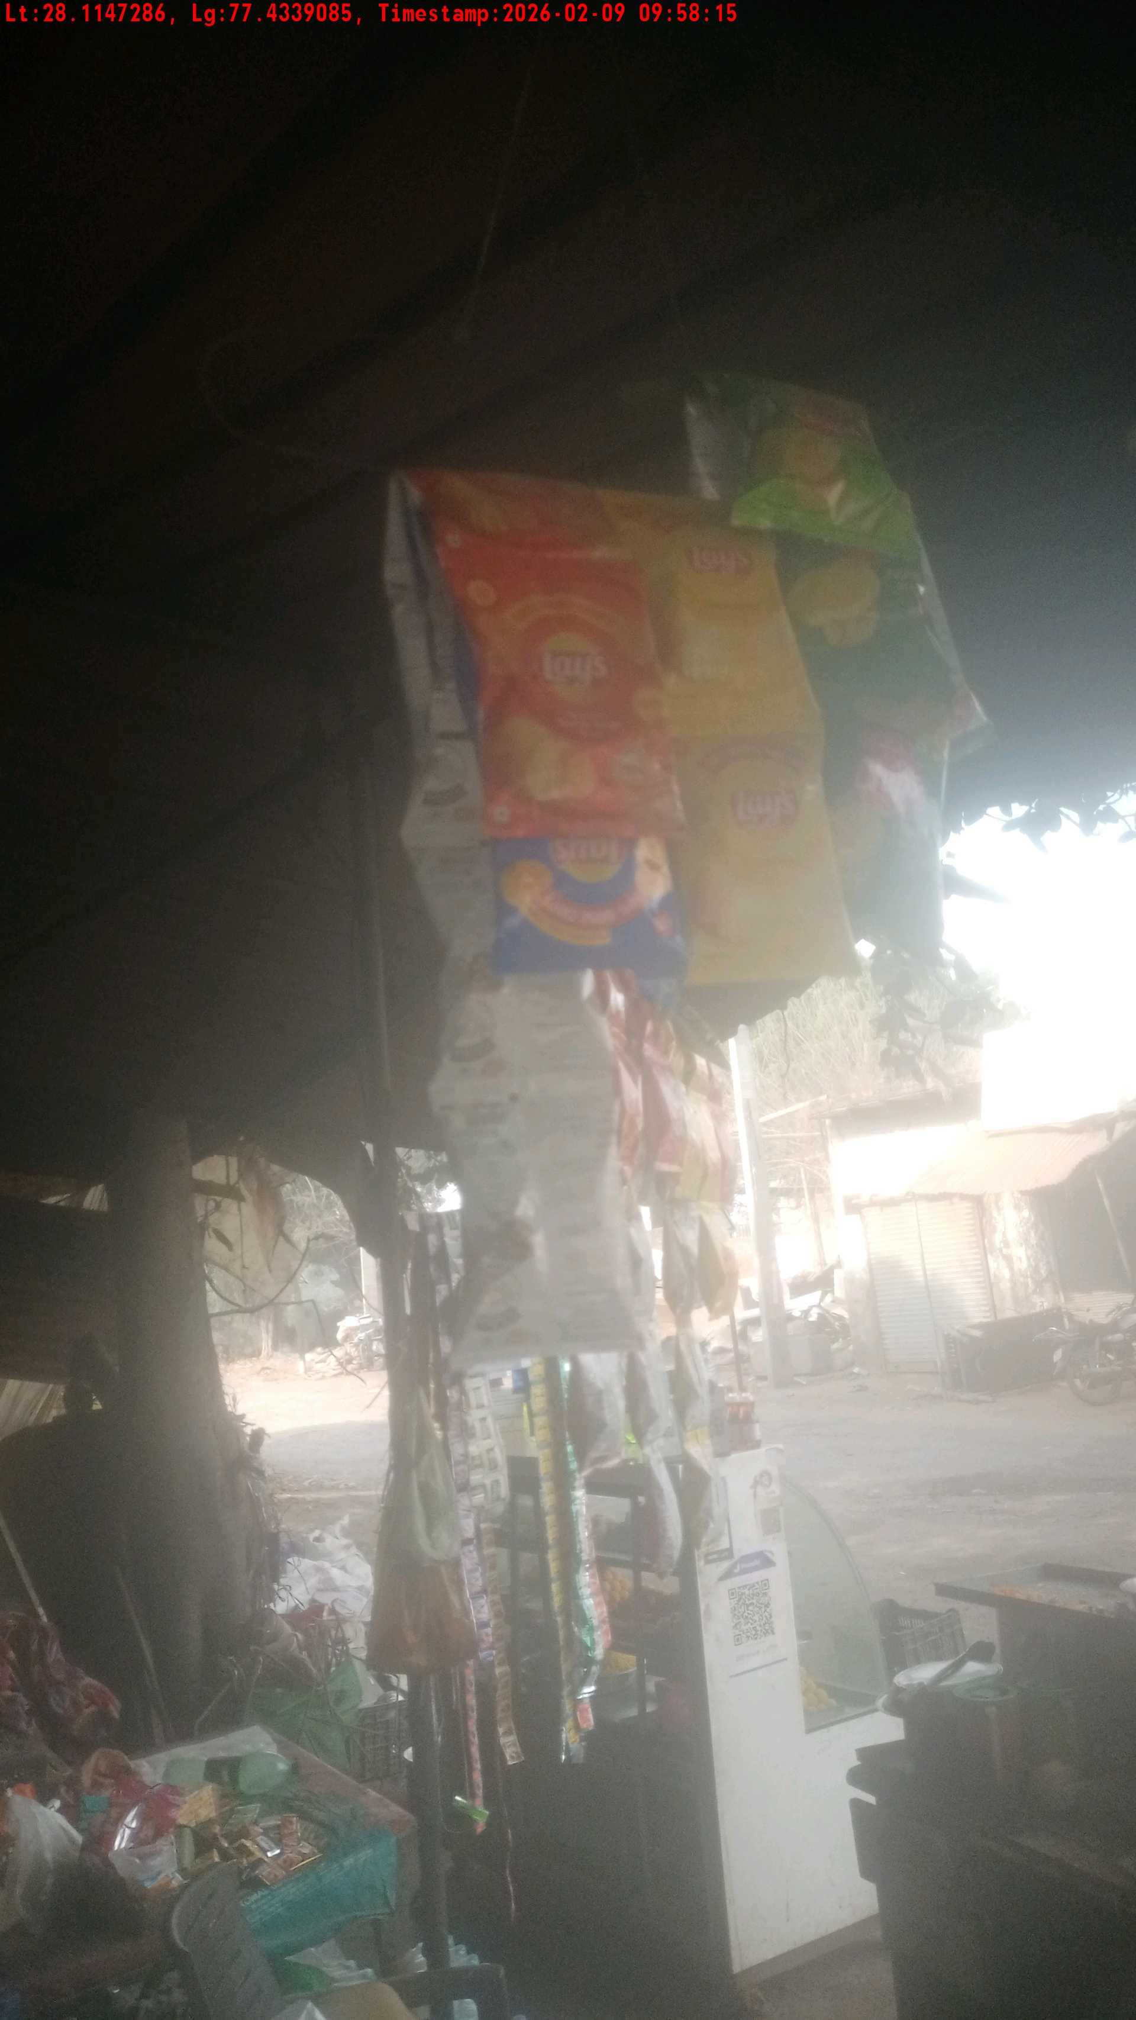
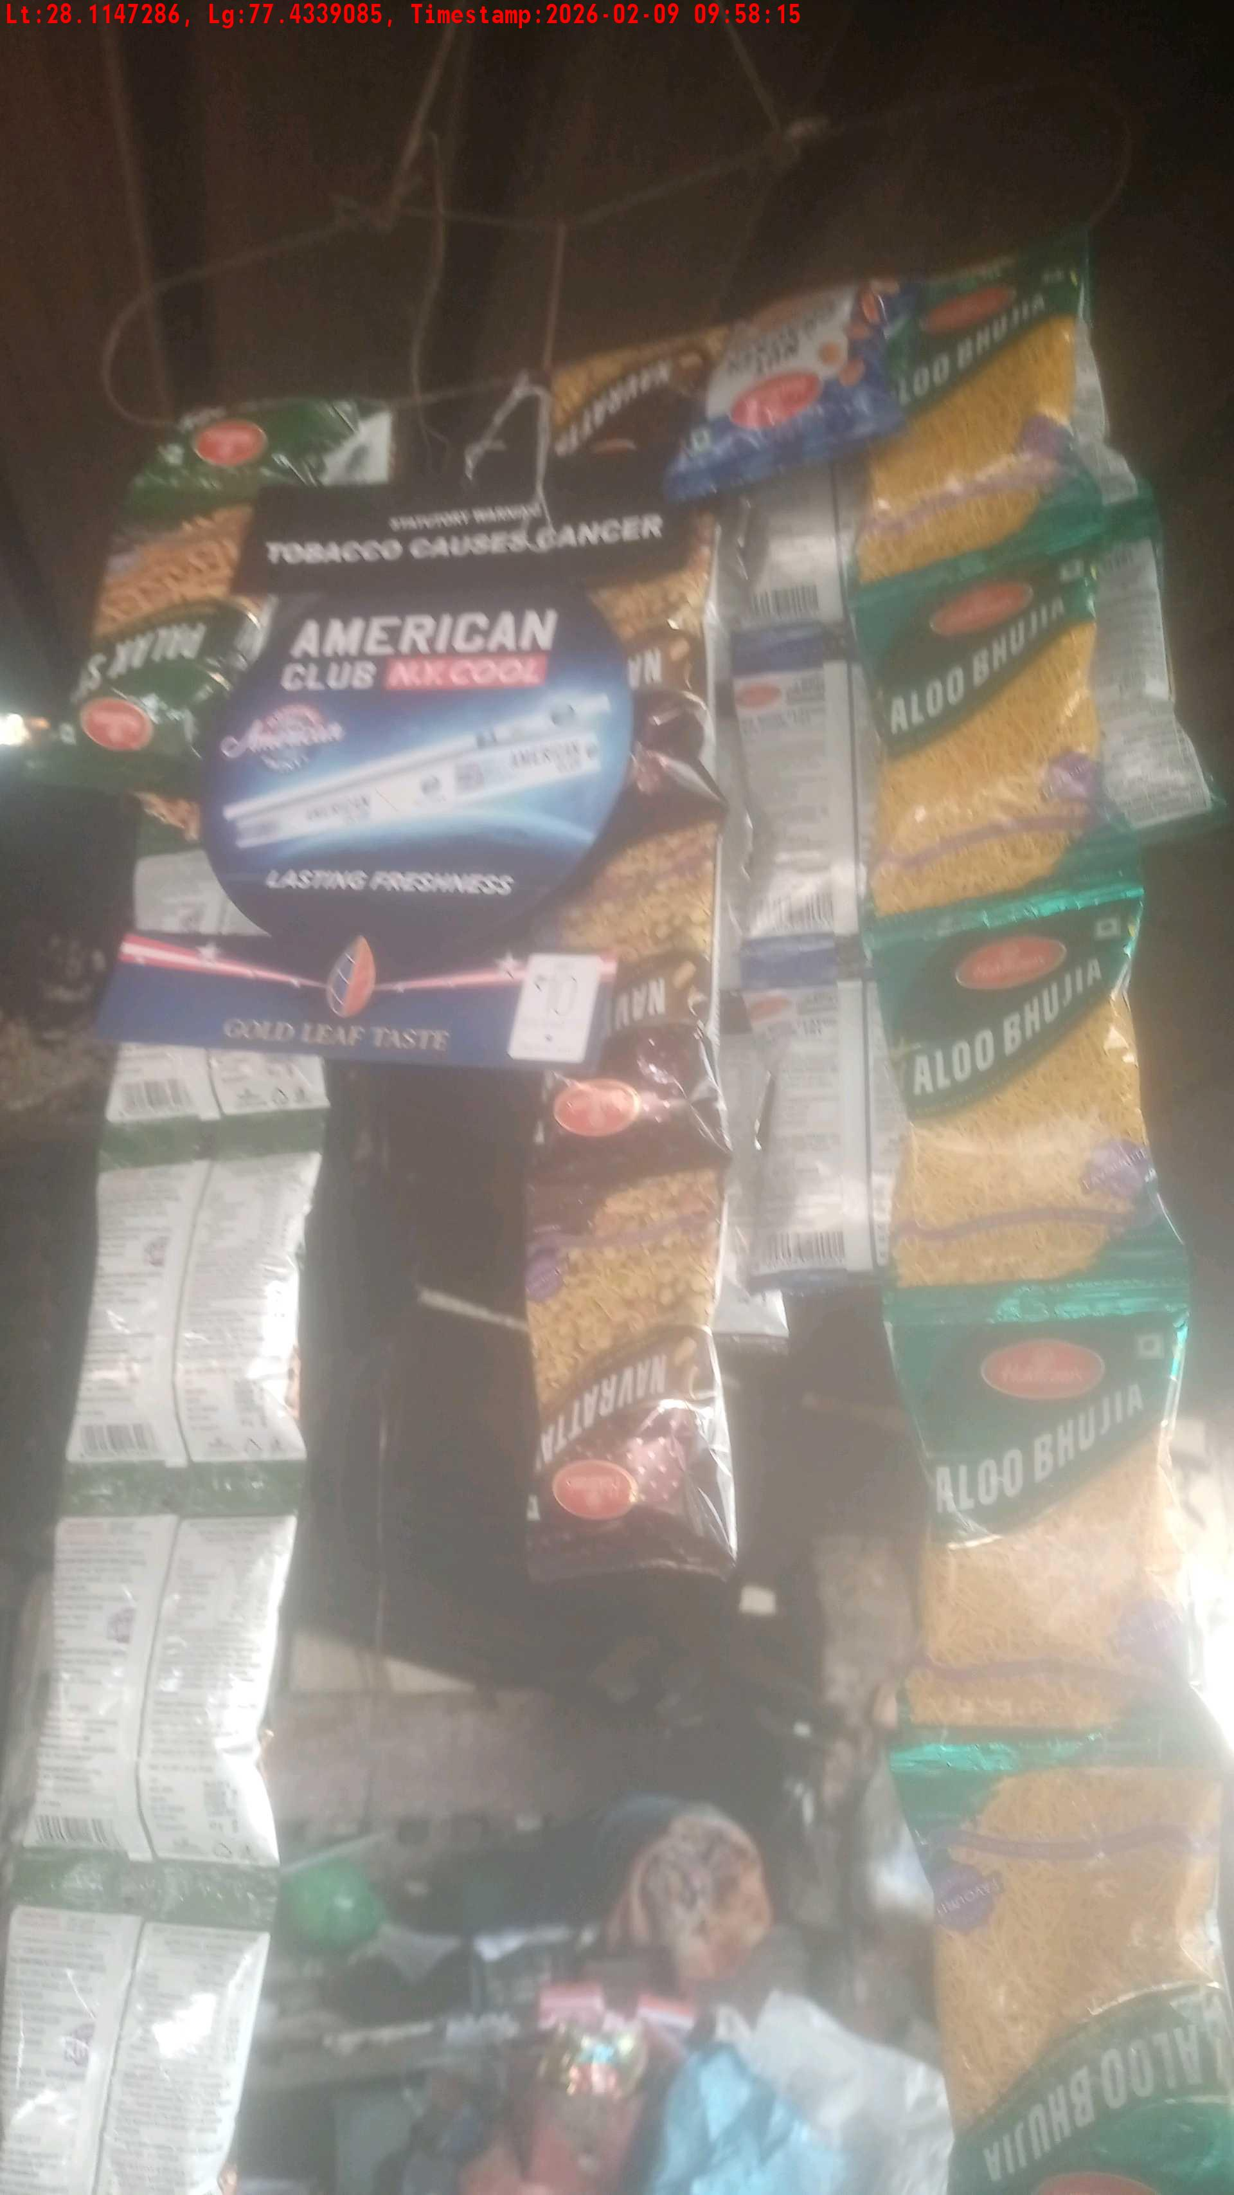
WD Code | Team Id | Team | Shop Name | Owner Mobile Number | Shop Address | Brand | Date Time
DE529610 | 3306 | Prem Pal | sushil kumar | 9991332679 |  | American Club | 09-02-2026 09:58:15 AM
Pre Shop Photo
Post Shop Photo

Slide 3
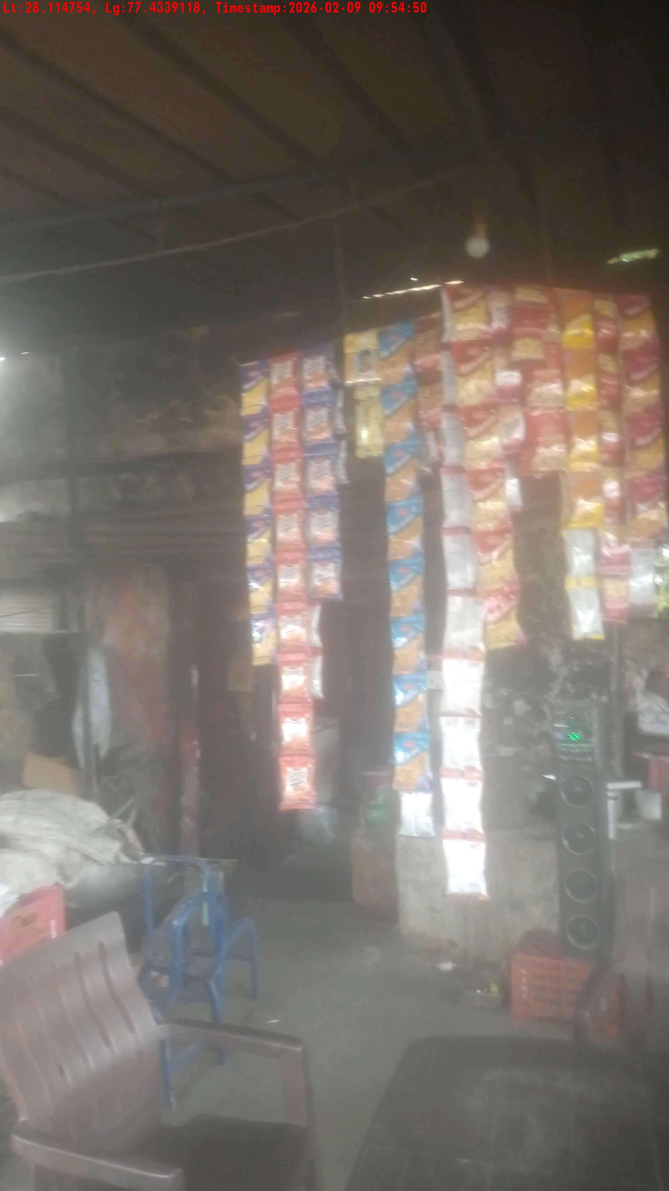
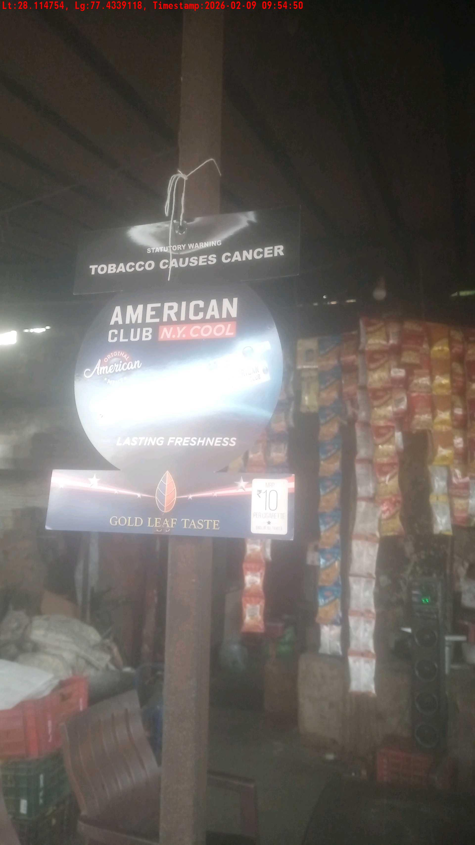
WD Code | Team Id | Team | Shop Name | Owner Mobile Number | Shop Address | Brand | Date Time
DE529610 | 3306 | Prem Pal | Omi pyare | 7015632497 |  | American Club | 09-02-2026 09:54:50 AM
Pre Shop Photo
Post Shop Photo

Slide 4
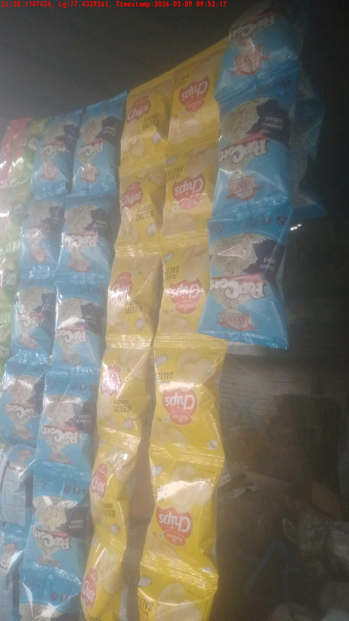
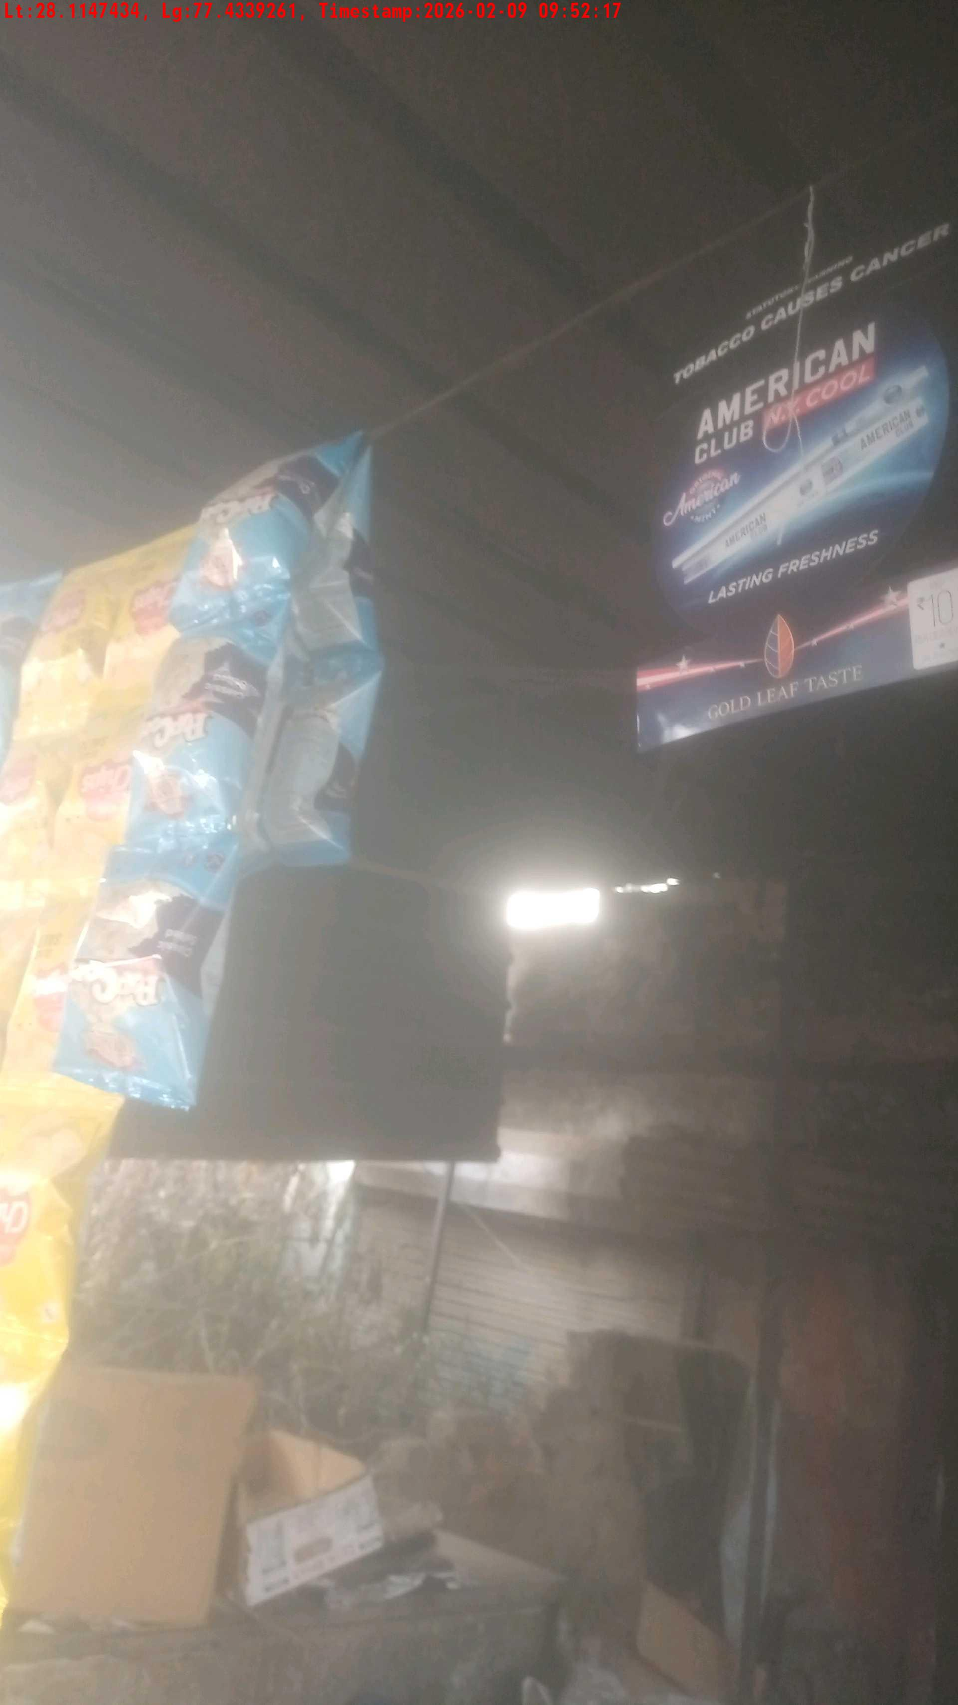
WD Code | Team Id | Team | Shop Name | Owner Mobile Number | Shop Address | Brand | Date Time
DE529610 | 3306 | Prem Pal | Ashok misthan | 8816997824 |  | American Club | 09-02-2026 09:52:17 AM
Pre Shop Photo
Post Shop Photo

Slide 5
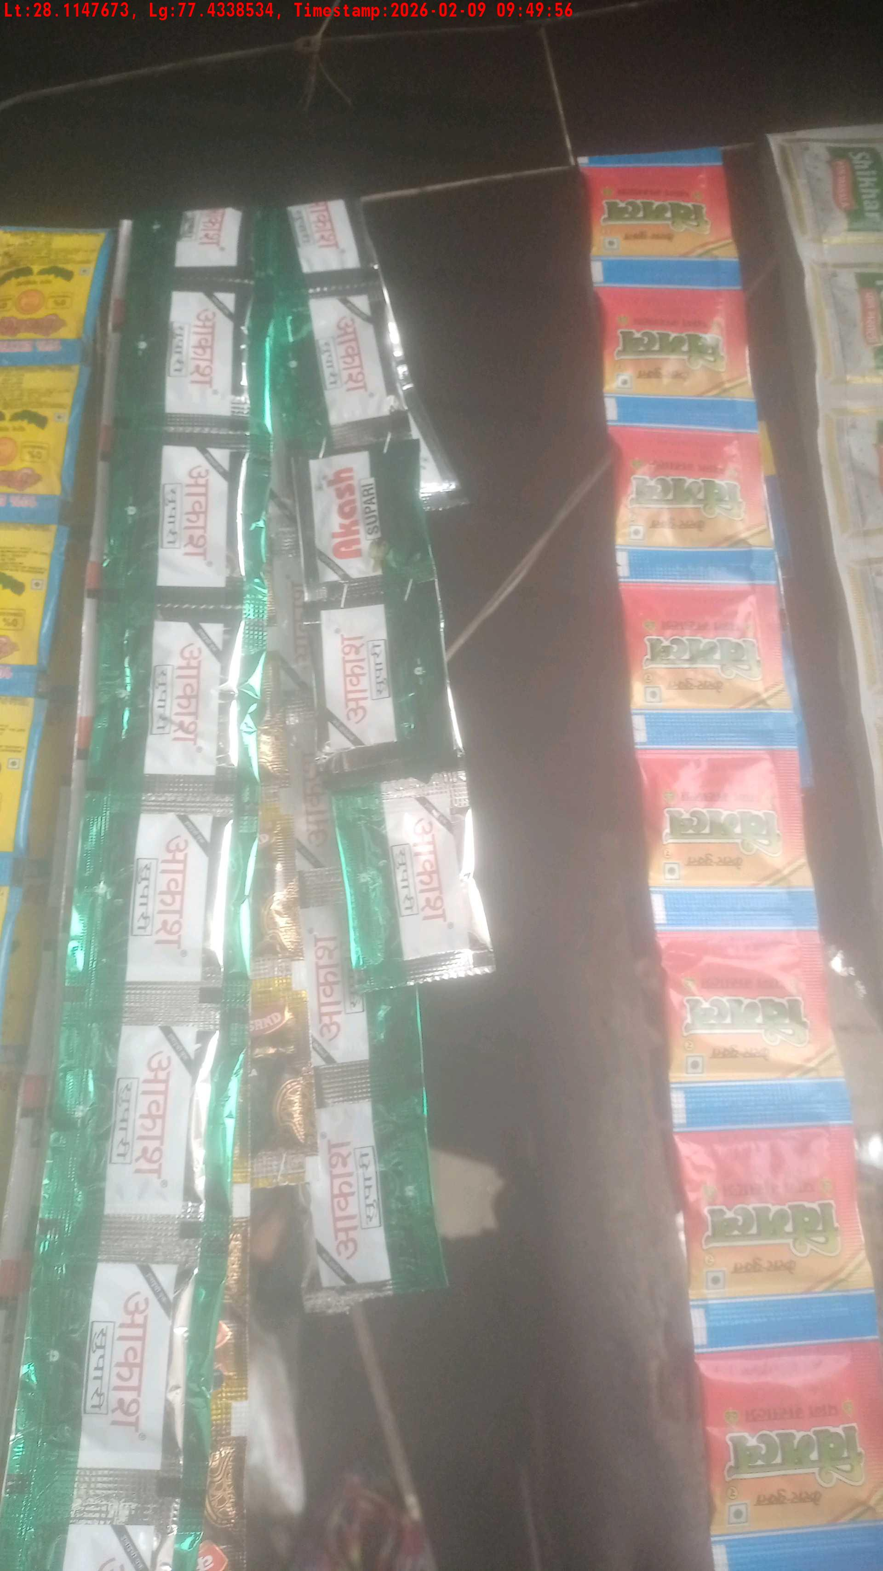
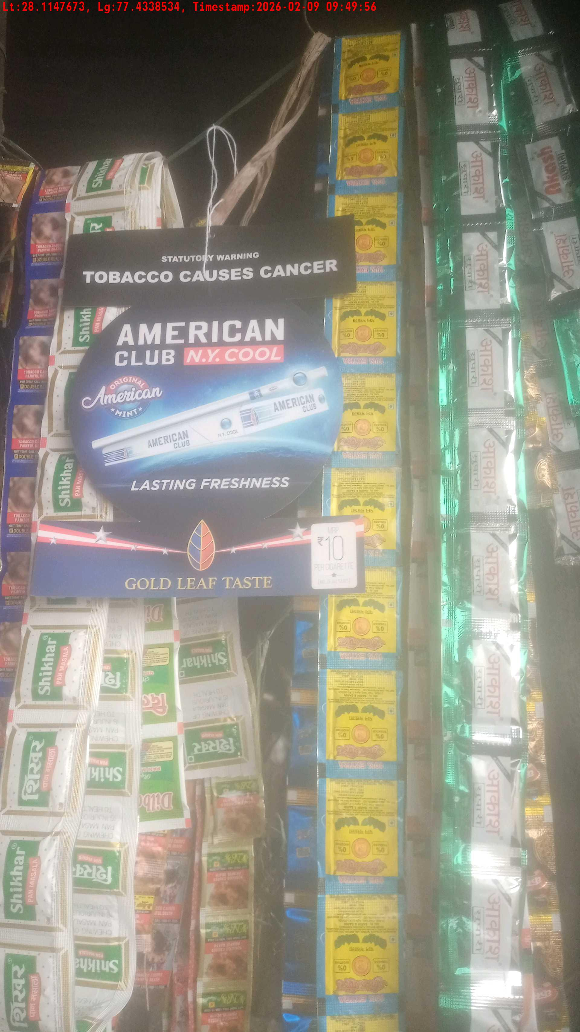
WD Code | Team Id | Team | Shop Name | Owner Mobile Number | Shop Address | Brand | Date Time
DE529610 | 3306 | Prem Pal | rupchand sweet | 8750984642 |  | American Club | 09-02-2026 09:49:56 AM
Pre Shop Photo
Post Shop Photo

Slide 6
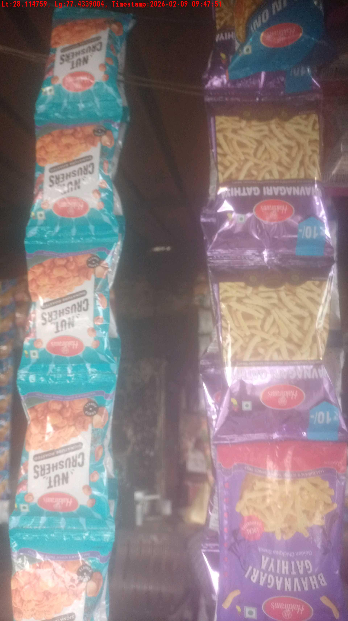
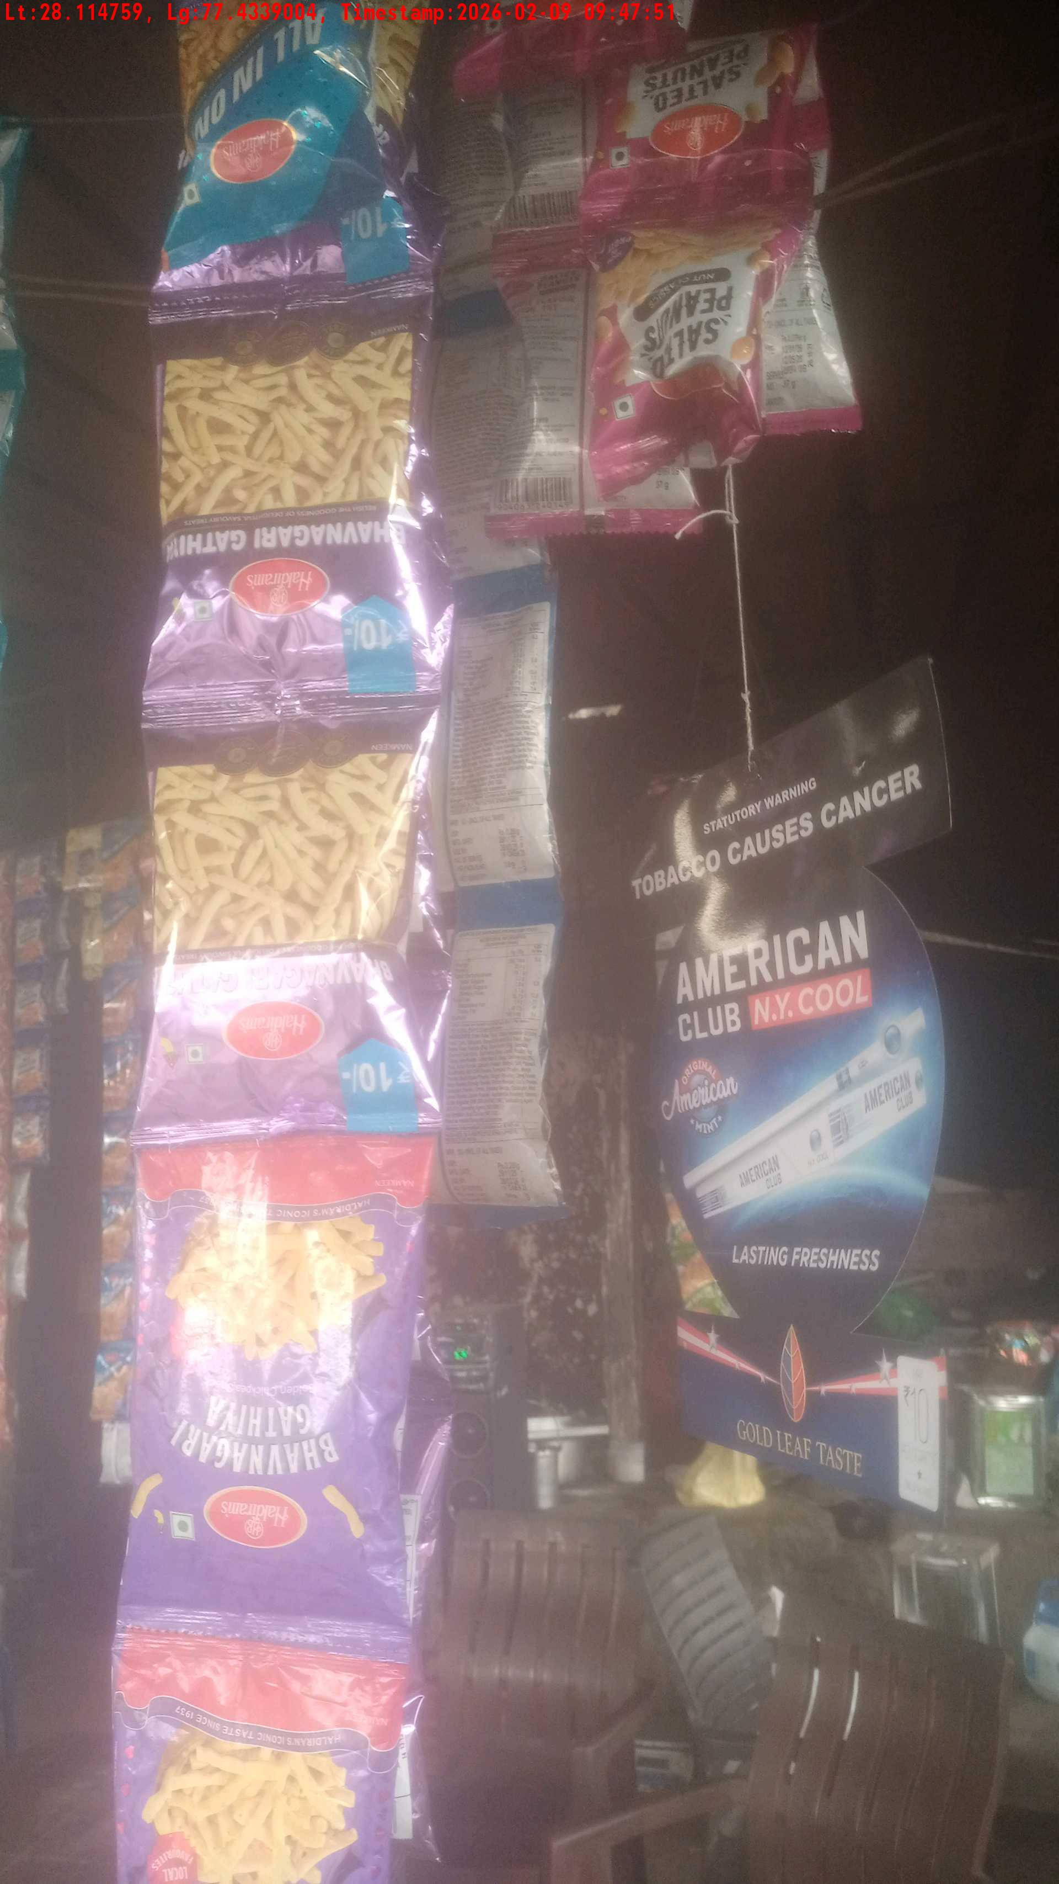
WD Code | Team Id | Team | Shop Name | Owner Mobile Number | Shop Address | Brand | Date Time
DE529610 | 3306 | Prem Pal | chhote Lal juice | 8814655573 |  | American Club | 09-02-2026 09:47:51 AM
Pre Shop Photo
Post Shop Photo

Slide 7
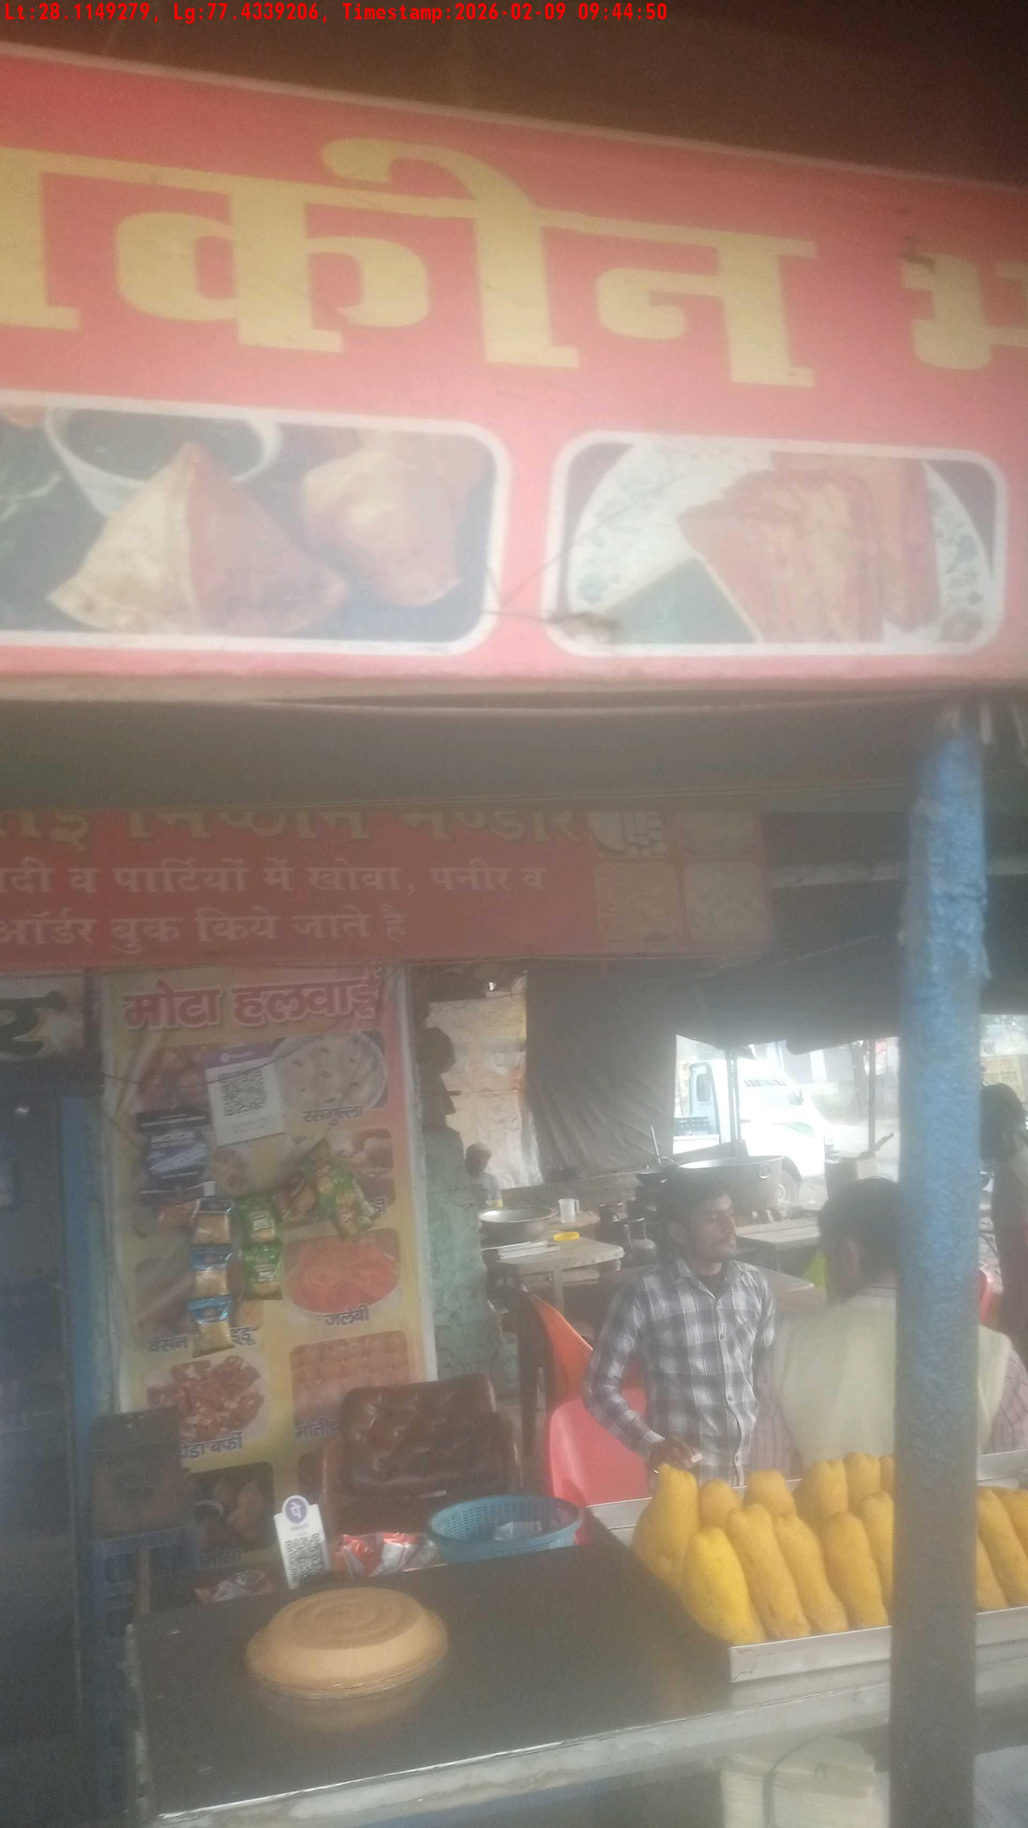
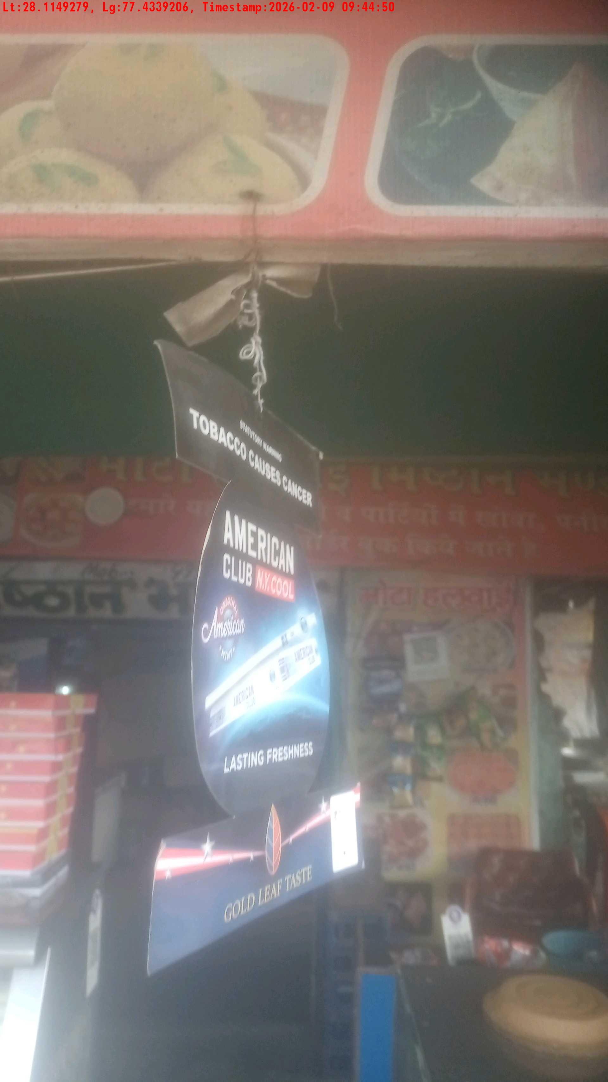
WD Code | Team Id | Team | Shop Name | Owner Mobile Number | Shop Address | Brand | Date Time
DE529610 | 3306 | Prem Pal | rajbir singh namkeen | 8930897645 |  | American Club | 09-02-2026 09:44:50 AM
Pre Shop Photo
Post Shop Photo

Slide 8
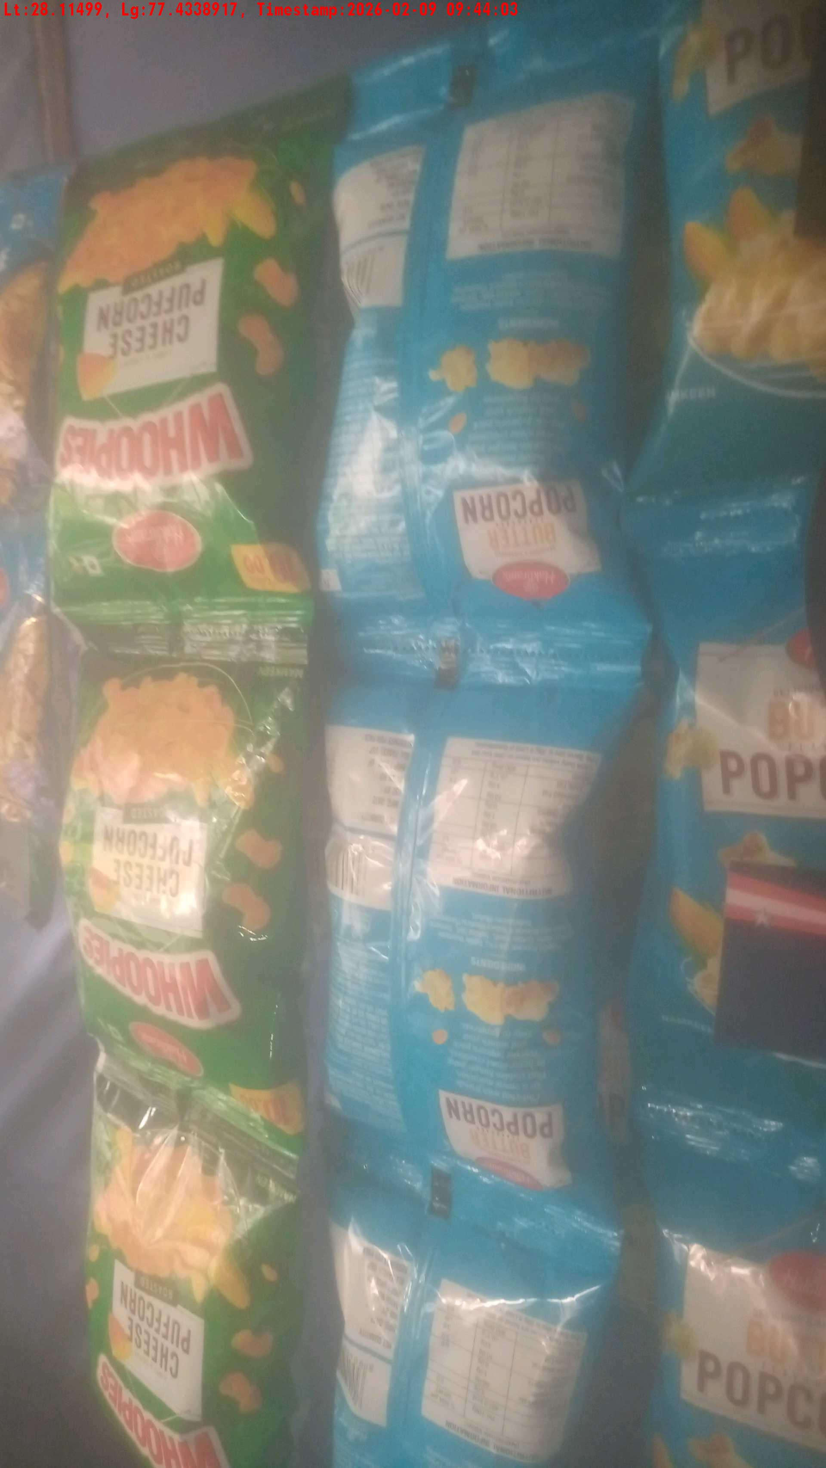
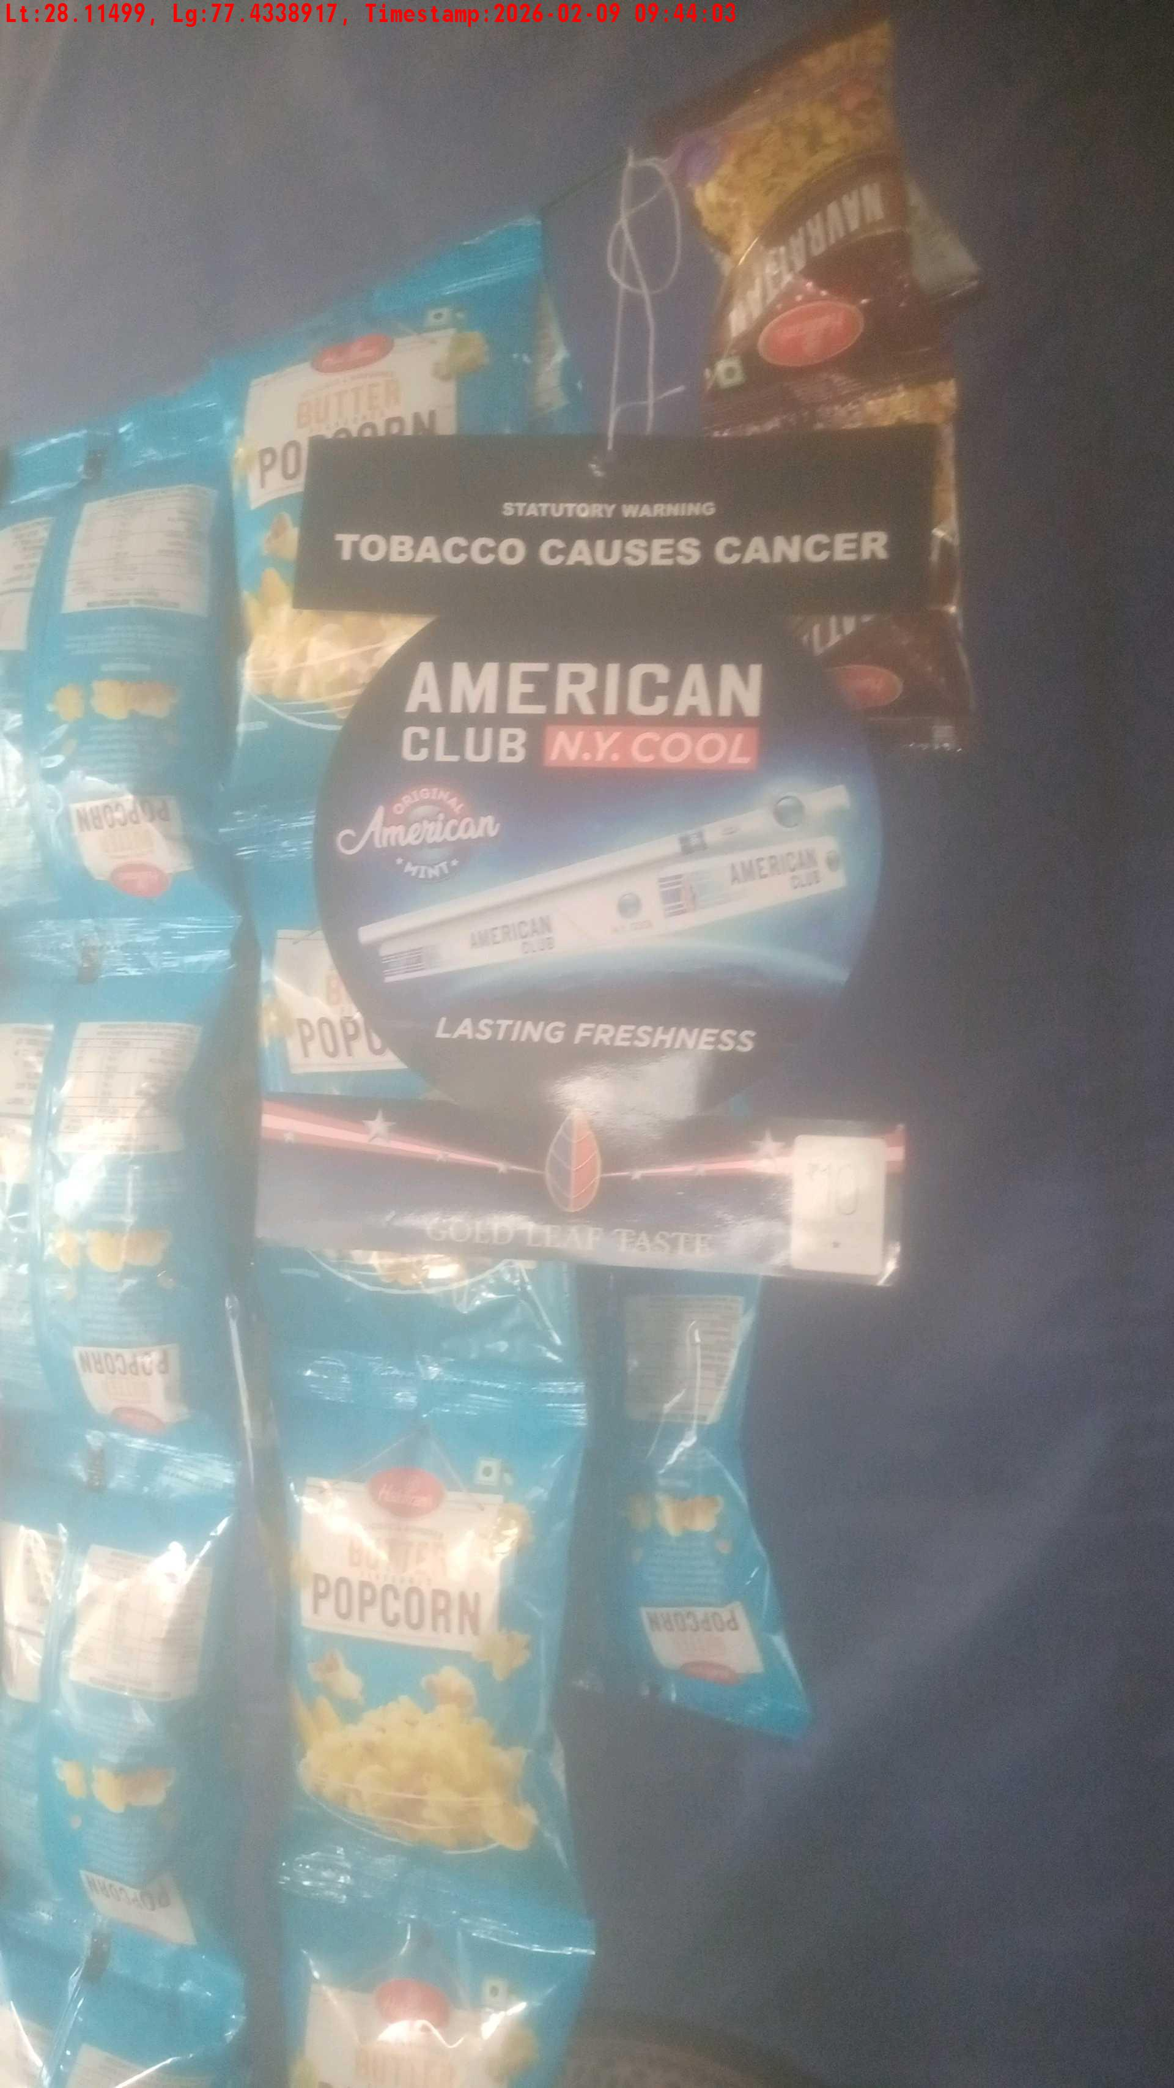
WD Code | Team Id | Team | Shop Name | Owner Mobile Number | Shop Address | Brand | Date Time
DE529610 | 3306 | Prem Pal | kashish chakhna Shop | 9466123657 |  | American Club | 09-02-2026 09:44:03 AM
Pre Shop Photo
Post Shop Photo

Slide 9
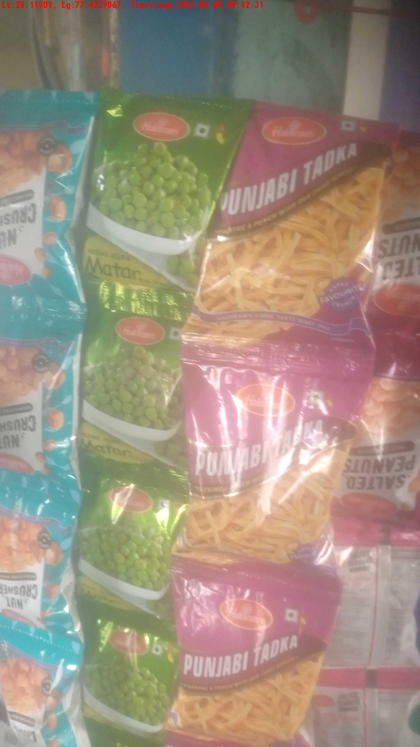
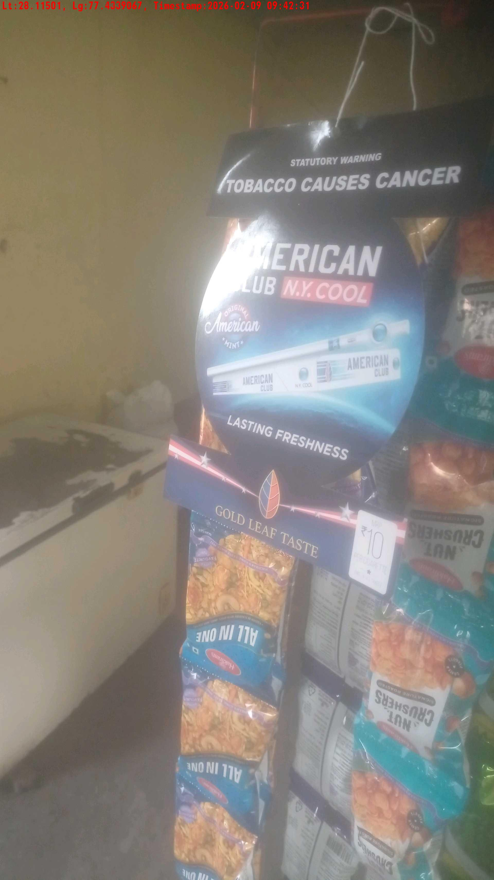
WD Code | Team Id | Team | Shop Name | Owner Mobile Number | Shop Address | Brand | Date Time
DE529610 | 3306 | Prem Pal | Shyam Lal | 7404553129 |  | American Club | 09-02-2026 09:42:31 AM
Pre Shop Photo
Post Shop Photo

Slide 10
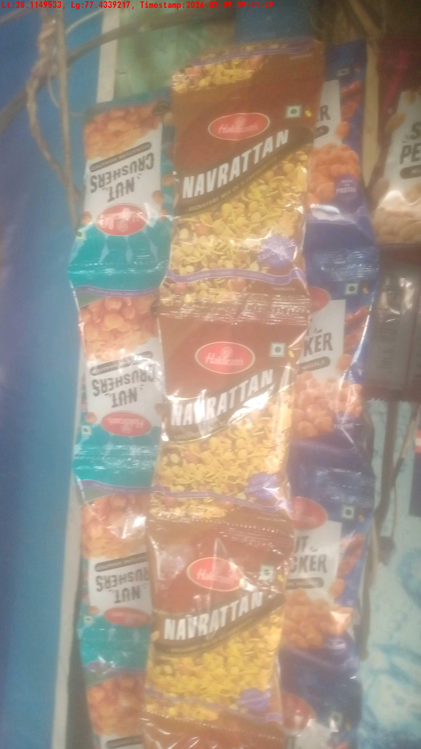
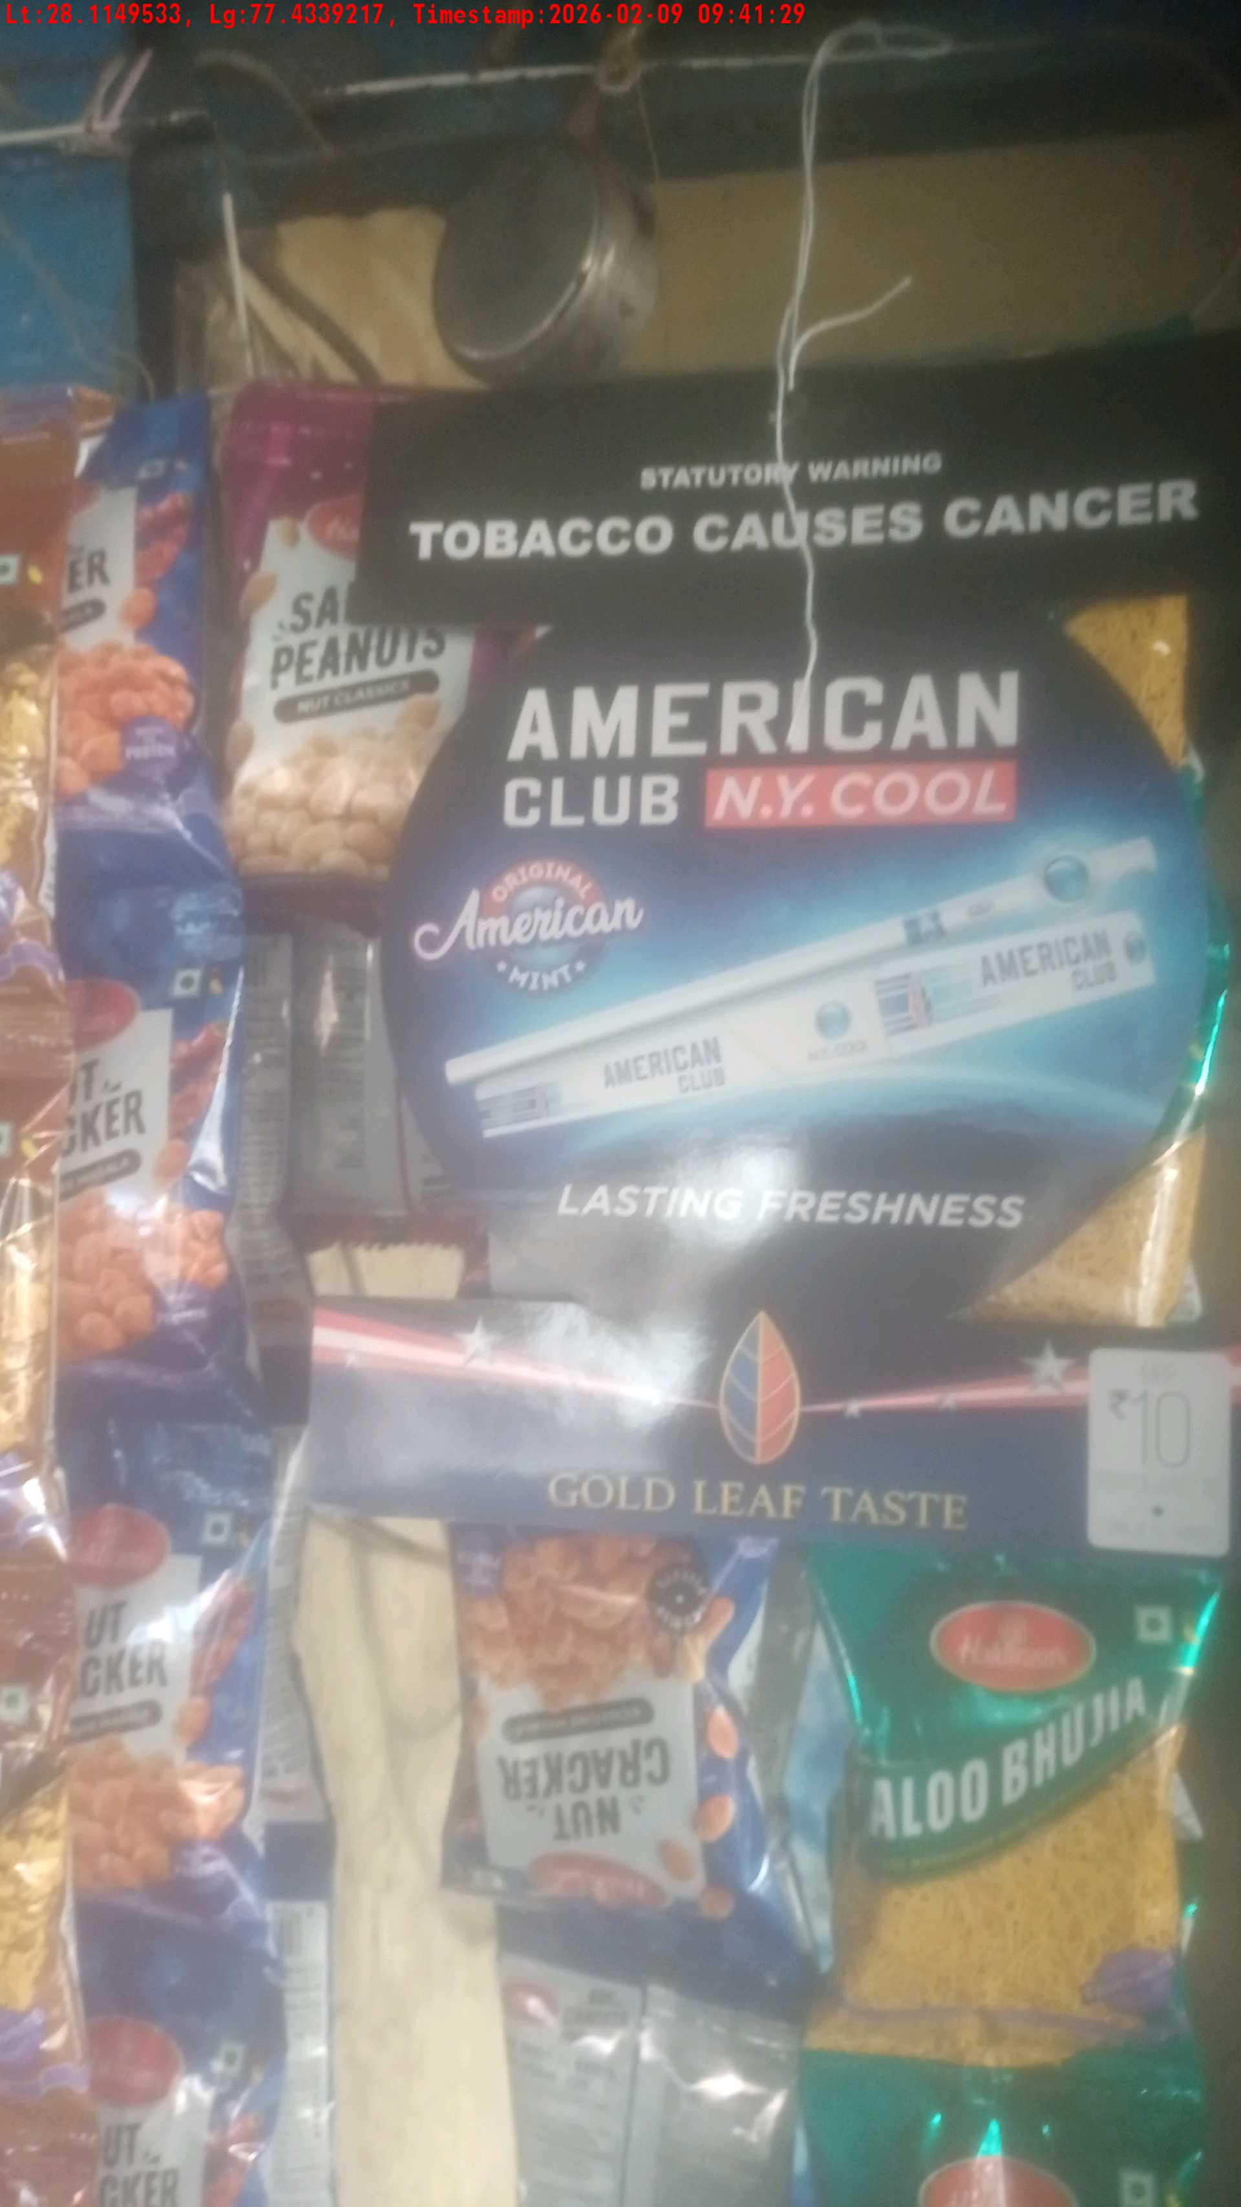
WD Code | Team Id | Team | Shop Name | Owner Mobile Number | Shop Address | Brand | Date Time
DE529610 | 3306 | Prem Pal | sanwariya tea stall | 9729463212 |  | American Club | 09-02-2026 09:41:29 AM
Pre Shop Photo
Post Shop Photo

Slide 11
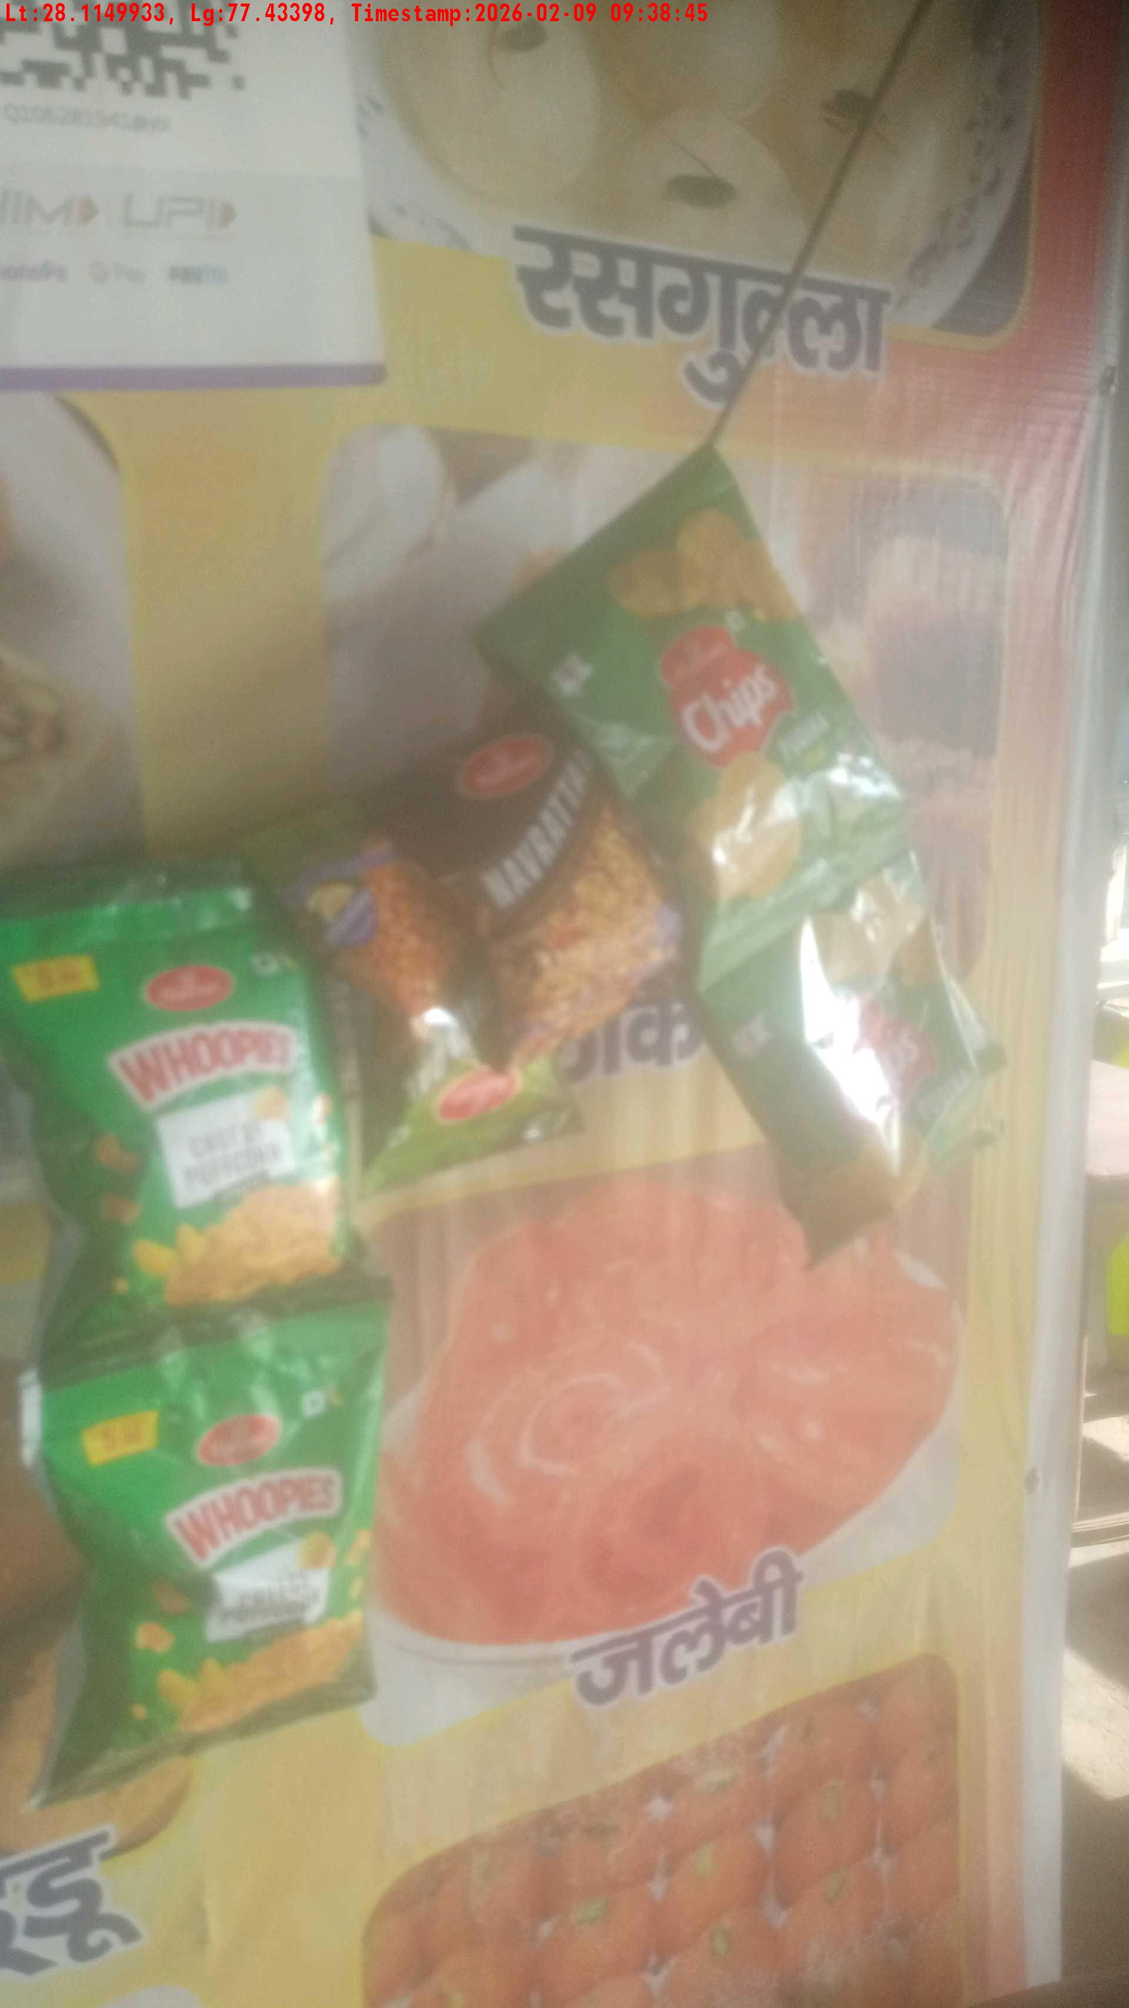
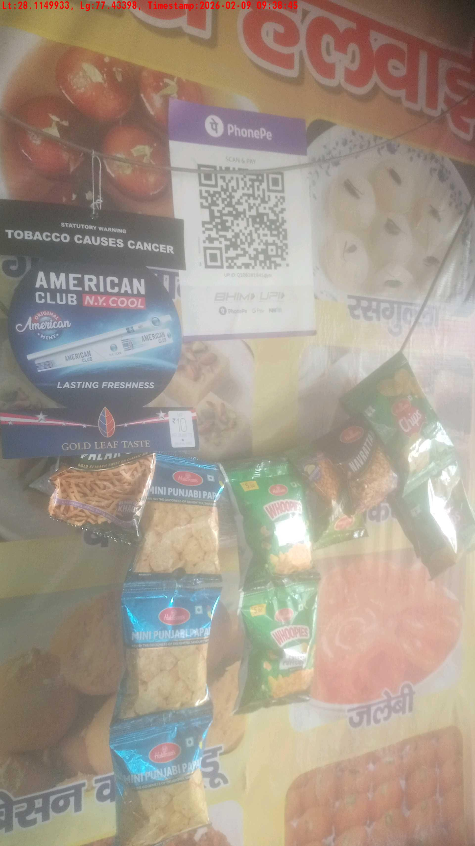
WD Code | Team Id | Team | Shop Name | Owner Mobile Number | Shop Address | Brand | Date Time
DE529610 | 3306 | Prem Pal | Hari Mohan | 9812366451 |  | American Club | 09-02-2026 09:38:45 AM
Pre Shop Photo
Post Shop Photo

Slide 12
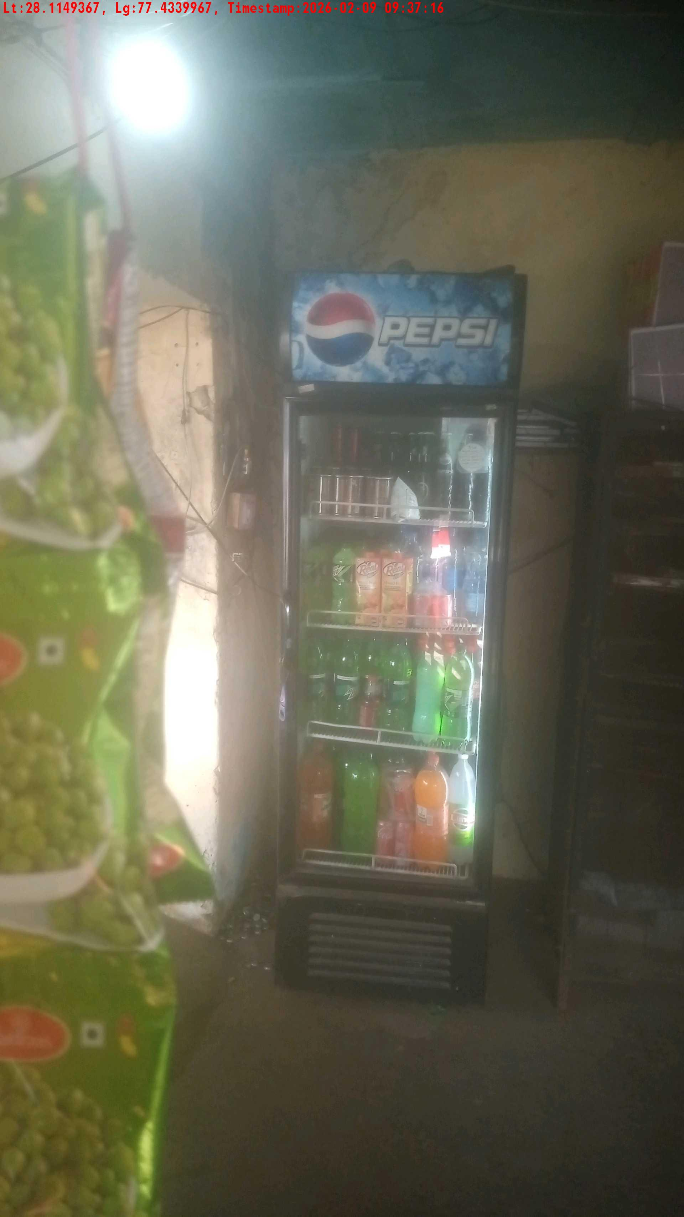
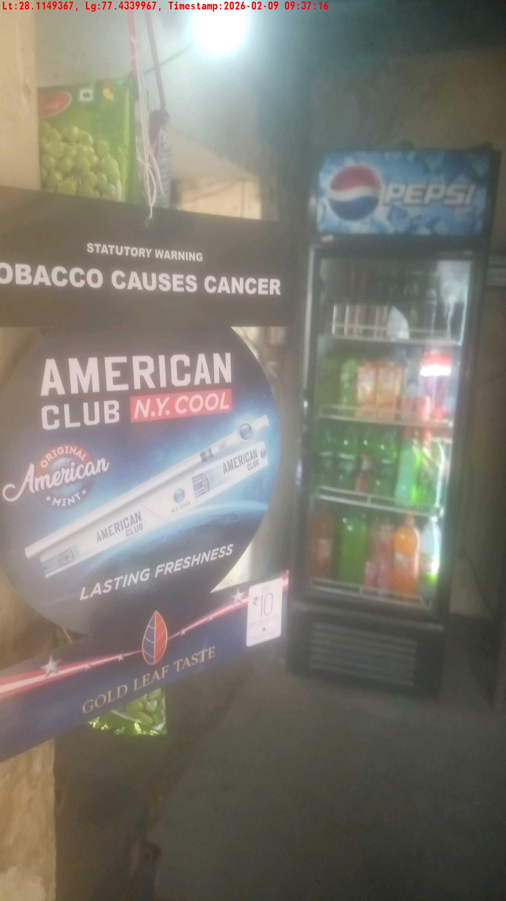
WD Code | Team Id | Team | Shop Name | Owner Mobile Number | Shop Address | Brand | Date Time
DE529610 | 3306 | Prem Pal | ramvtar cold drink | 9728635514 |  | American Club | 09-02-2026 09:37:16 AM
Pre Shop Photo
Post Shop Photo

Slide 13
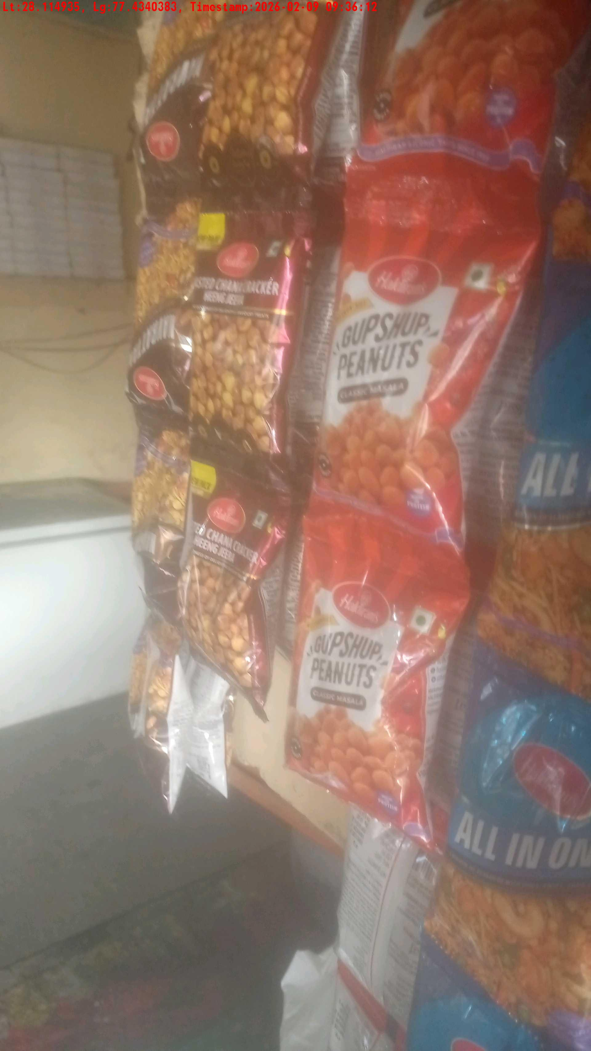
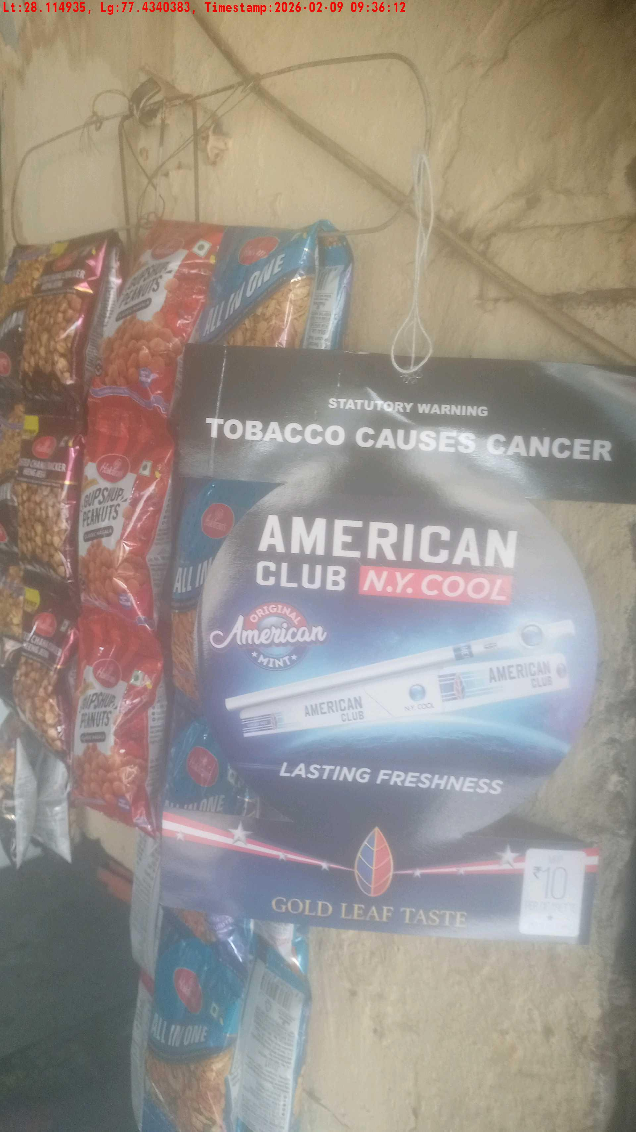
WD Code | Team Id | Team | Shop Name | Owner Mobile Number | Shop Address | Brand | Date Time
DE529610 | 3306 | Prem Pal | Sanju Bhai tea stall | 8053962177 |  | American Club | 09-02-2026 09:36:12 AM
Pre Shop Photo
Post Shop Photo

Slide 14
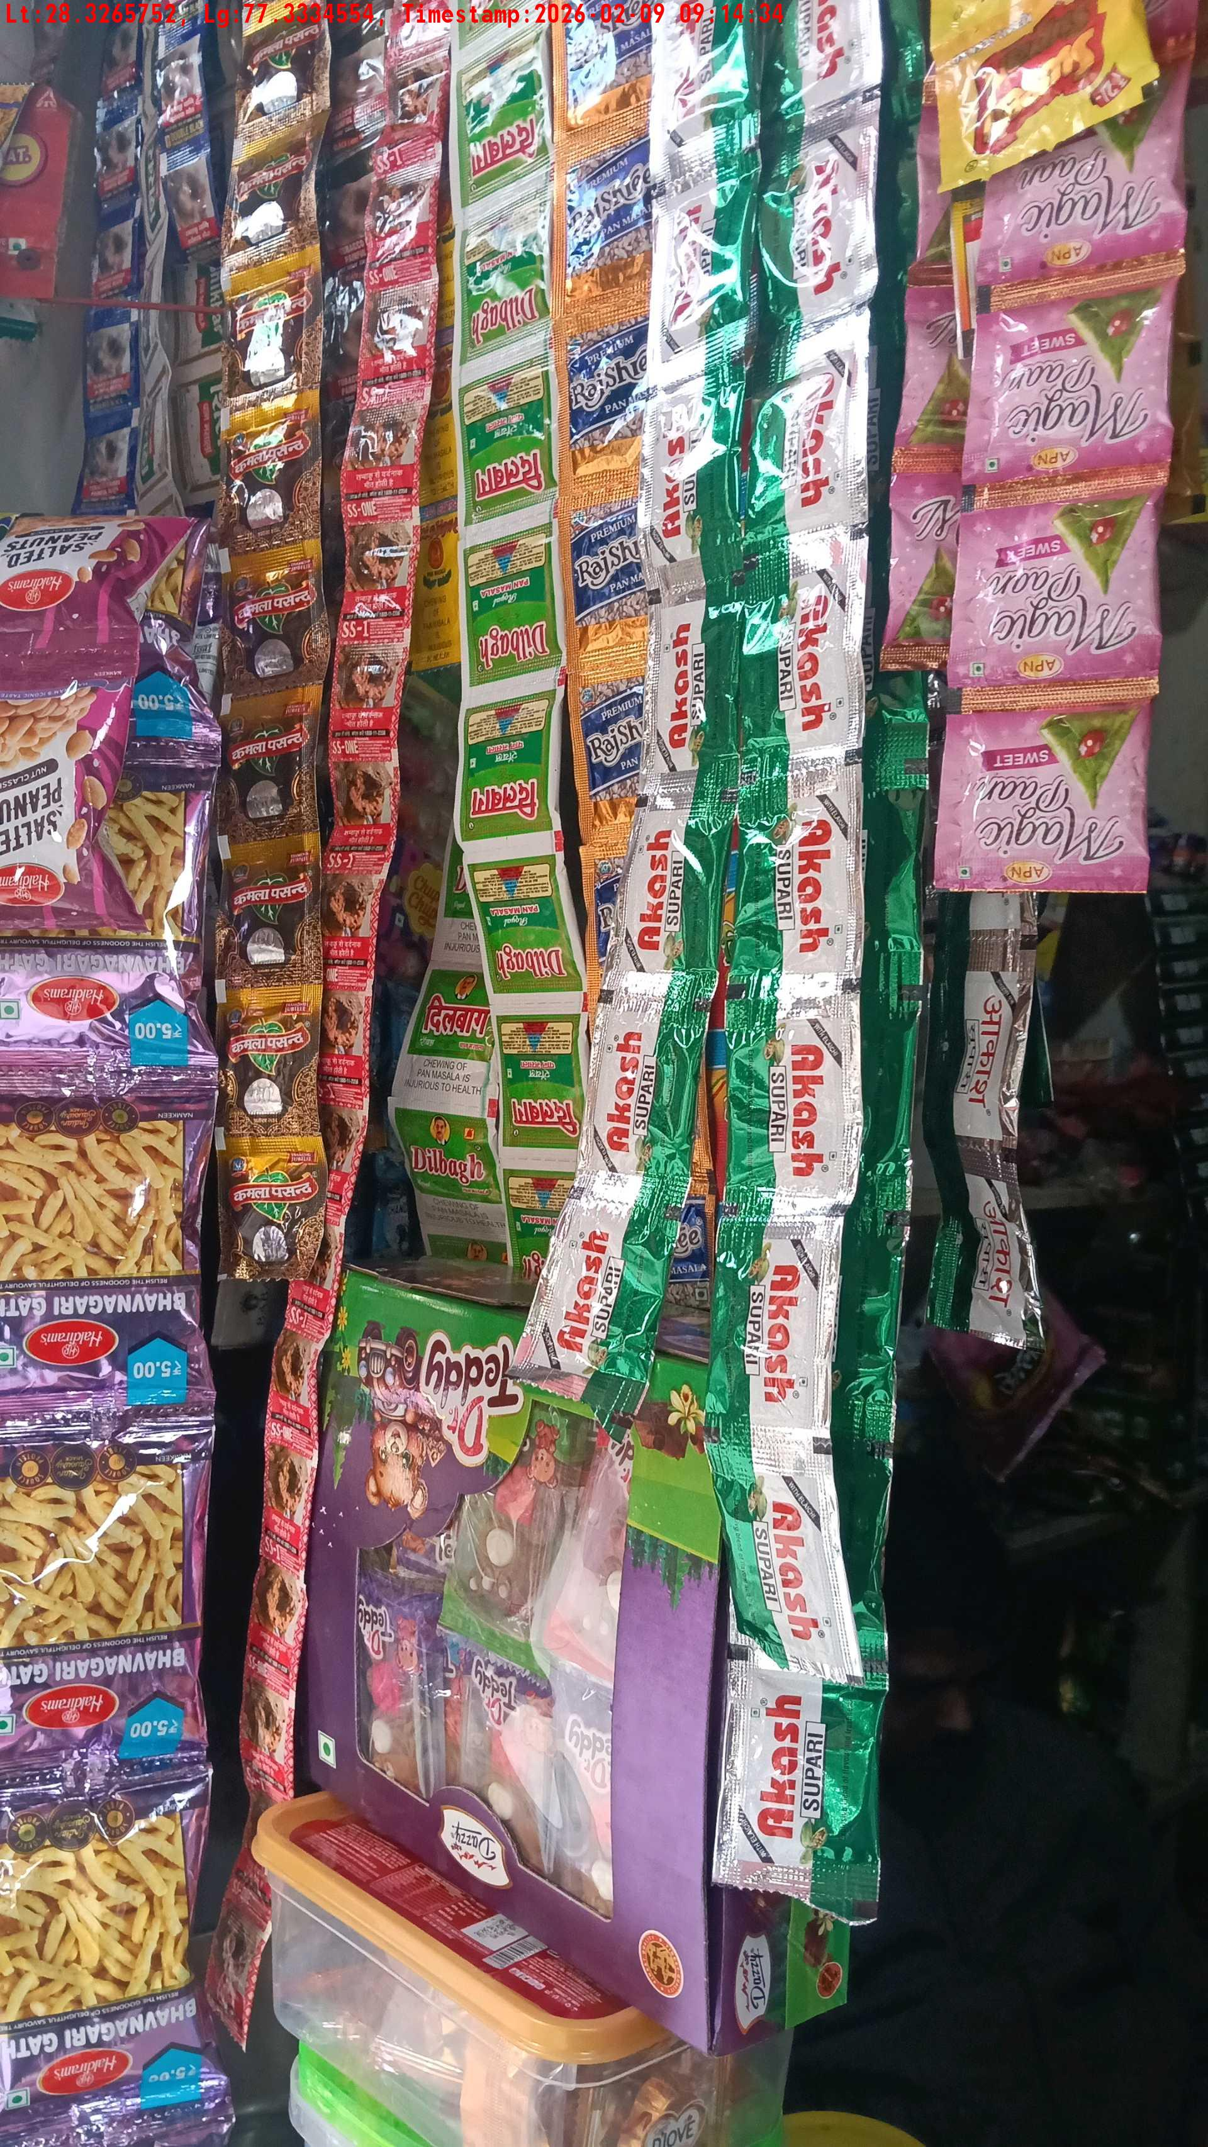
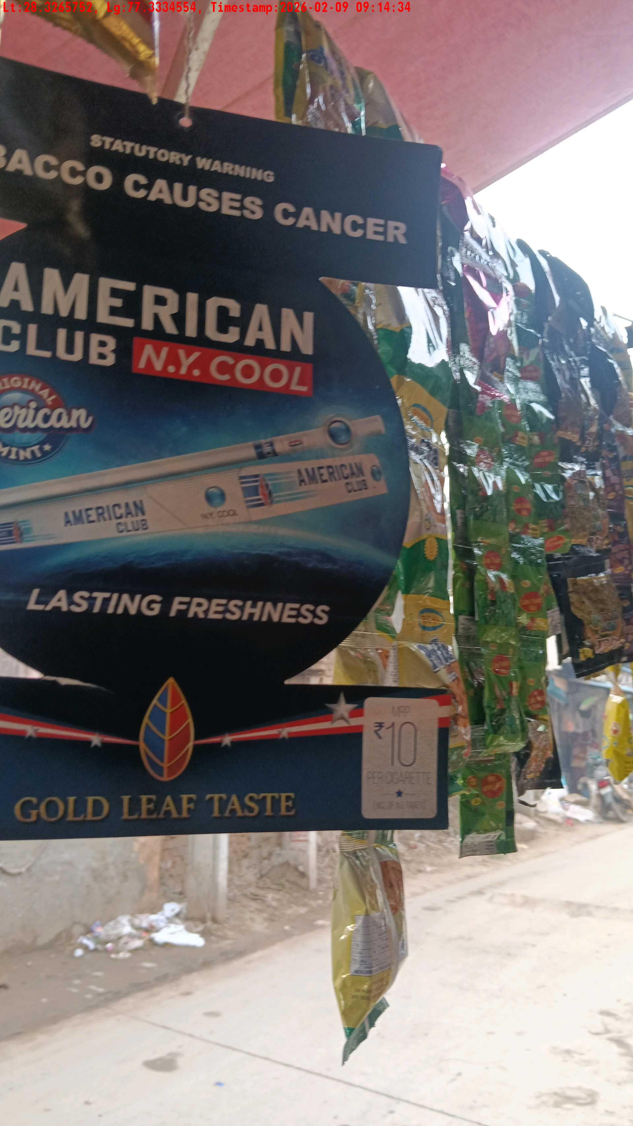
WD Code | Team Id | Team | Shop Name | Owner Mobile Number | Shop Address | Brand | Date Time
DE5457 | 3325 | Harkesh | ram | 7250784439 |  | American Club | 09-02-2026 09:35:26 AM
Pre Shop Photo
Post Shop Photo

Slide 15
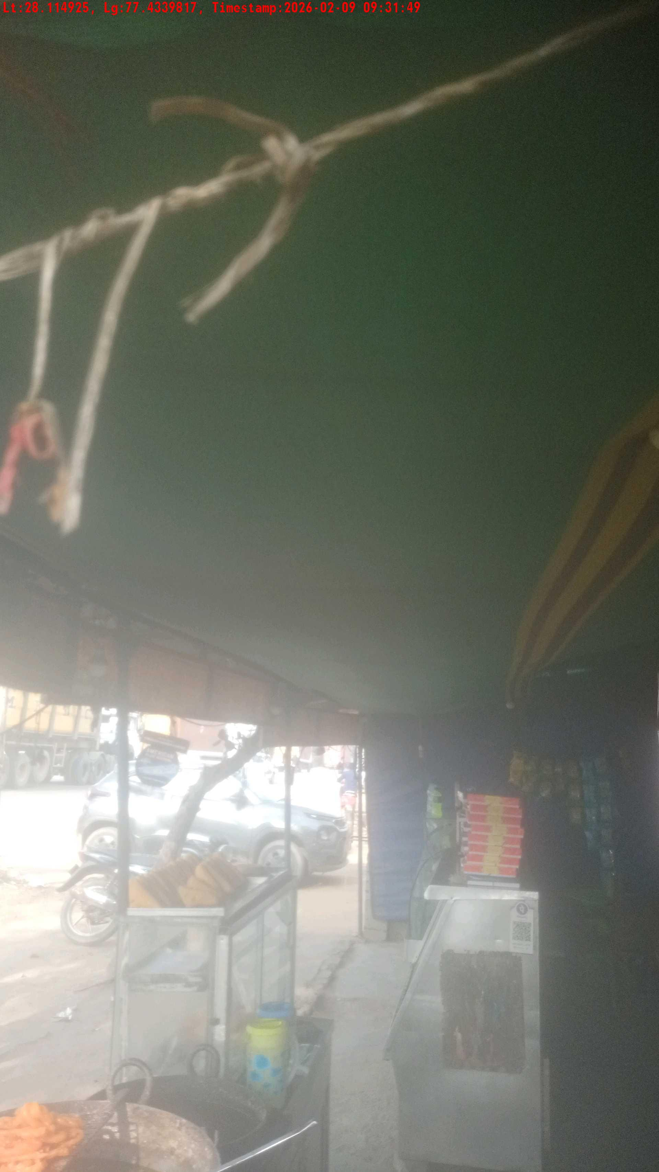
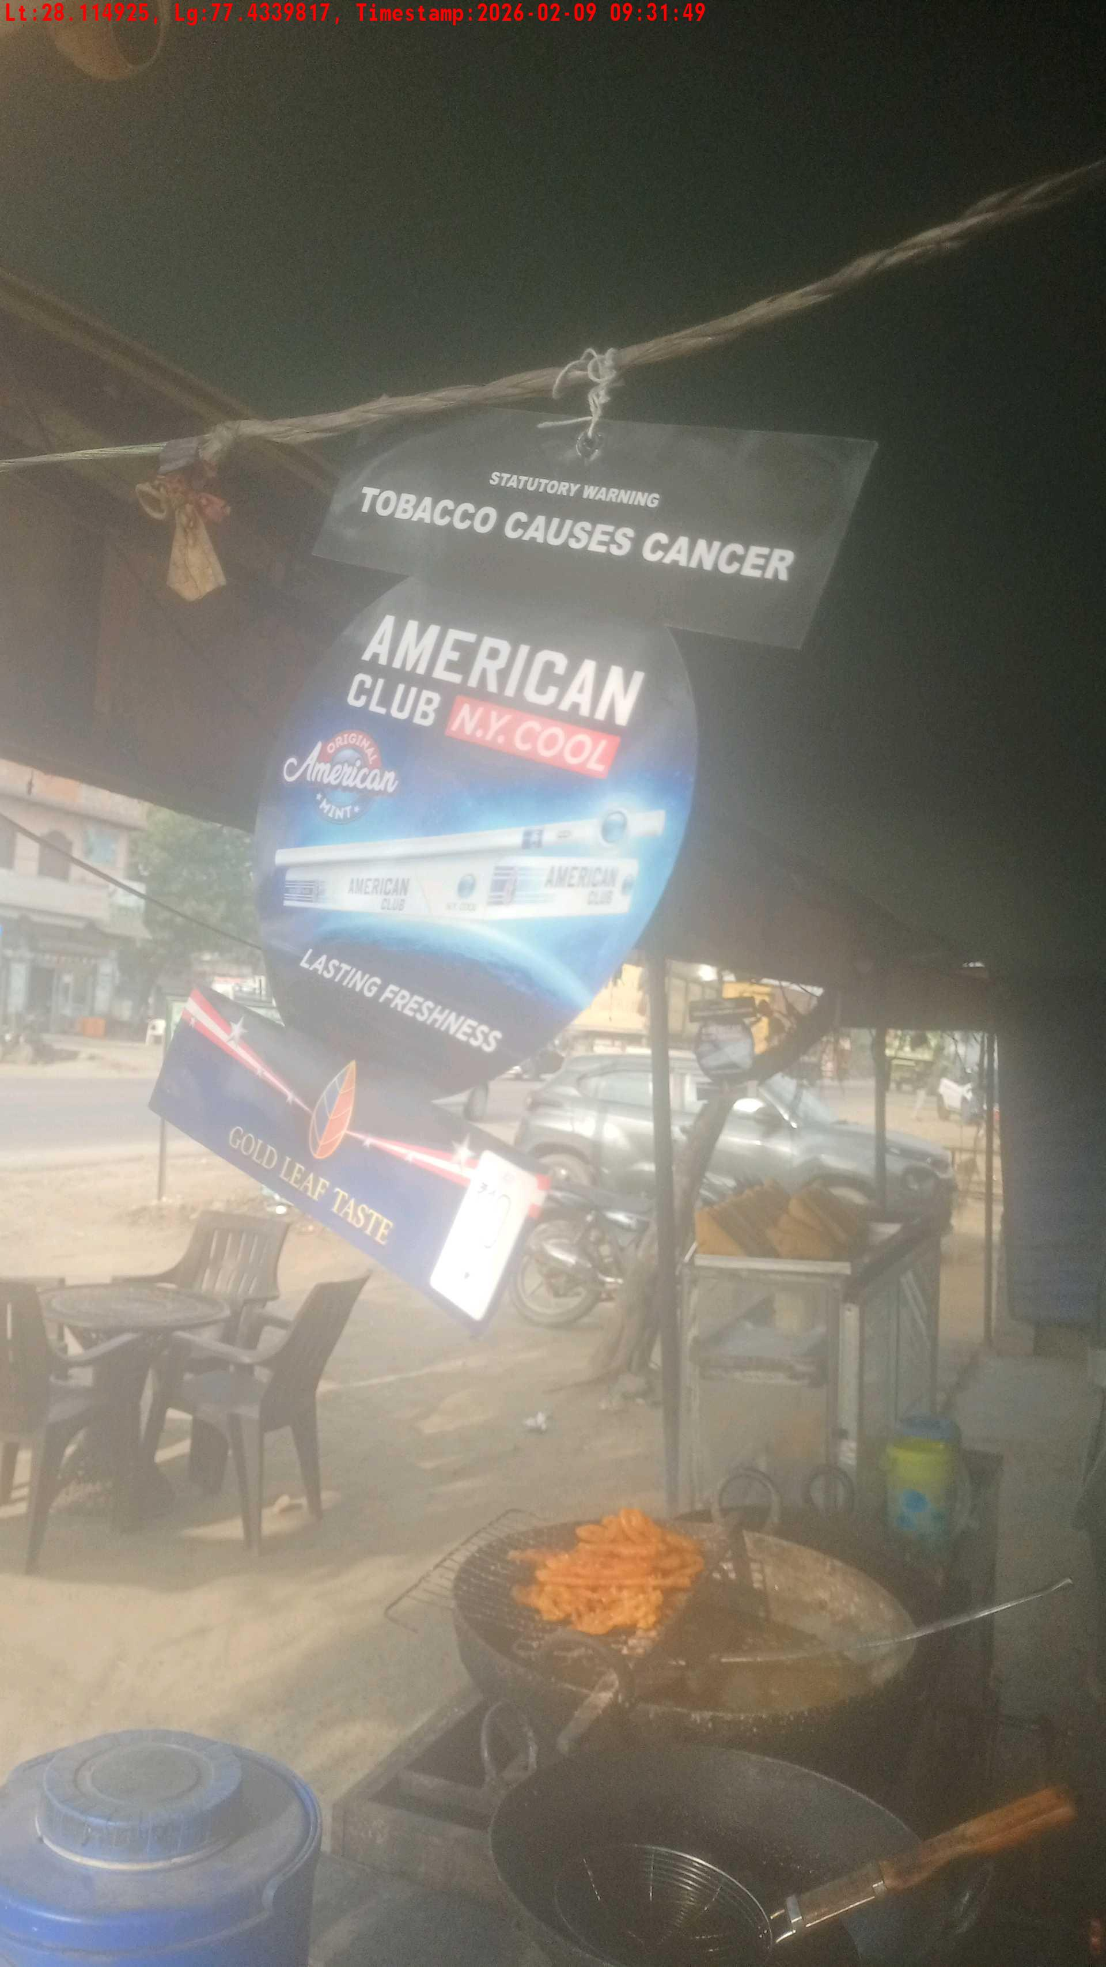
WD Code | Team Id | Team | Shop Name | Owner Mobile Number | Shop Address | Brand | Date Time
DE529610 | 3306 | Prem Pal | Sagar Halwai | 9996395412 |  | American Club | 09-02-2026 09:31:49 AM
Pre Shop Photo
Post Shop Photo

Slide 16
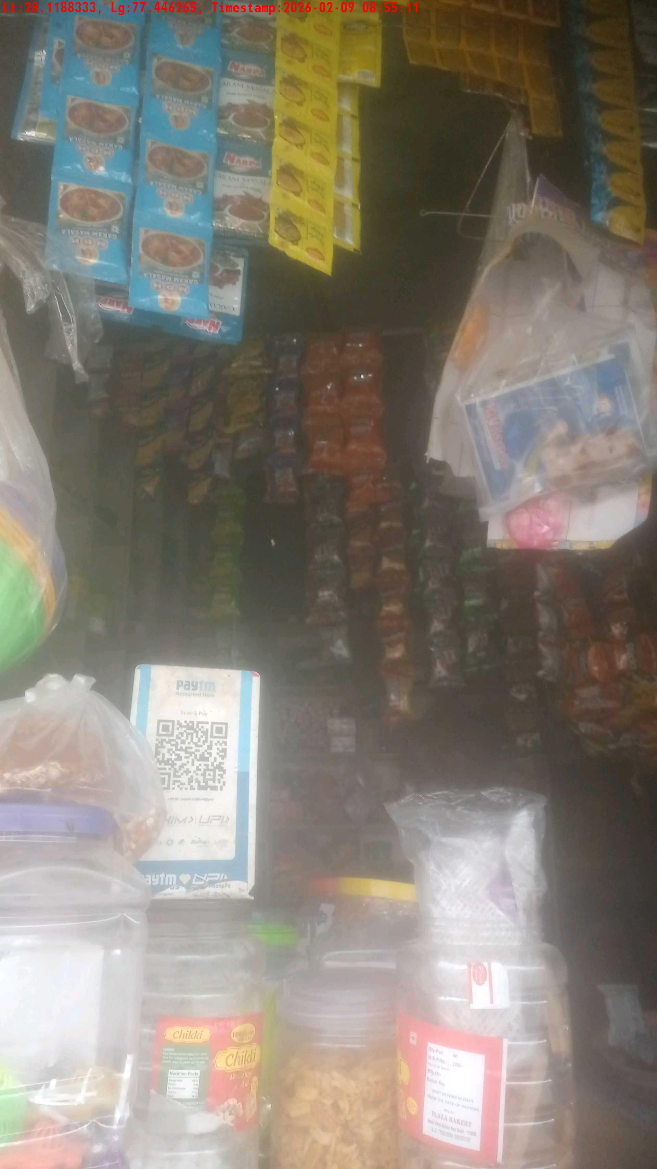
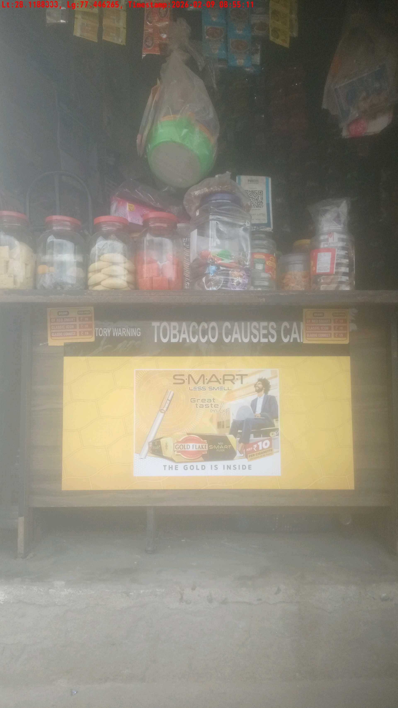
WD Code | Team Id | Team | Shop Name | Owner Mobile Number | Shop Address | Brand | Date Time
DE529610 | 3306 | Prem Pal | harkesh jogi k Store | 9050763541 |  | Gold Flake Neo Smart | 09-02-2026 09:29:07 AM
Pre Shop Photo
Post Shop Photo

Slide 17
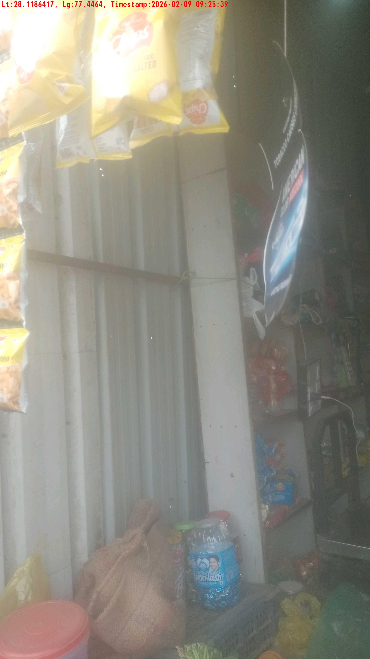
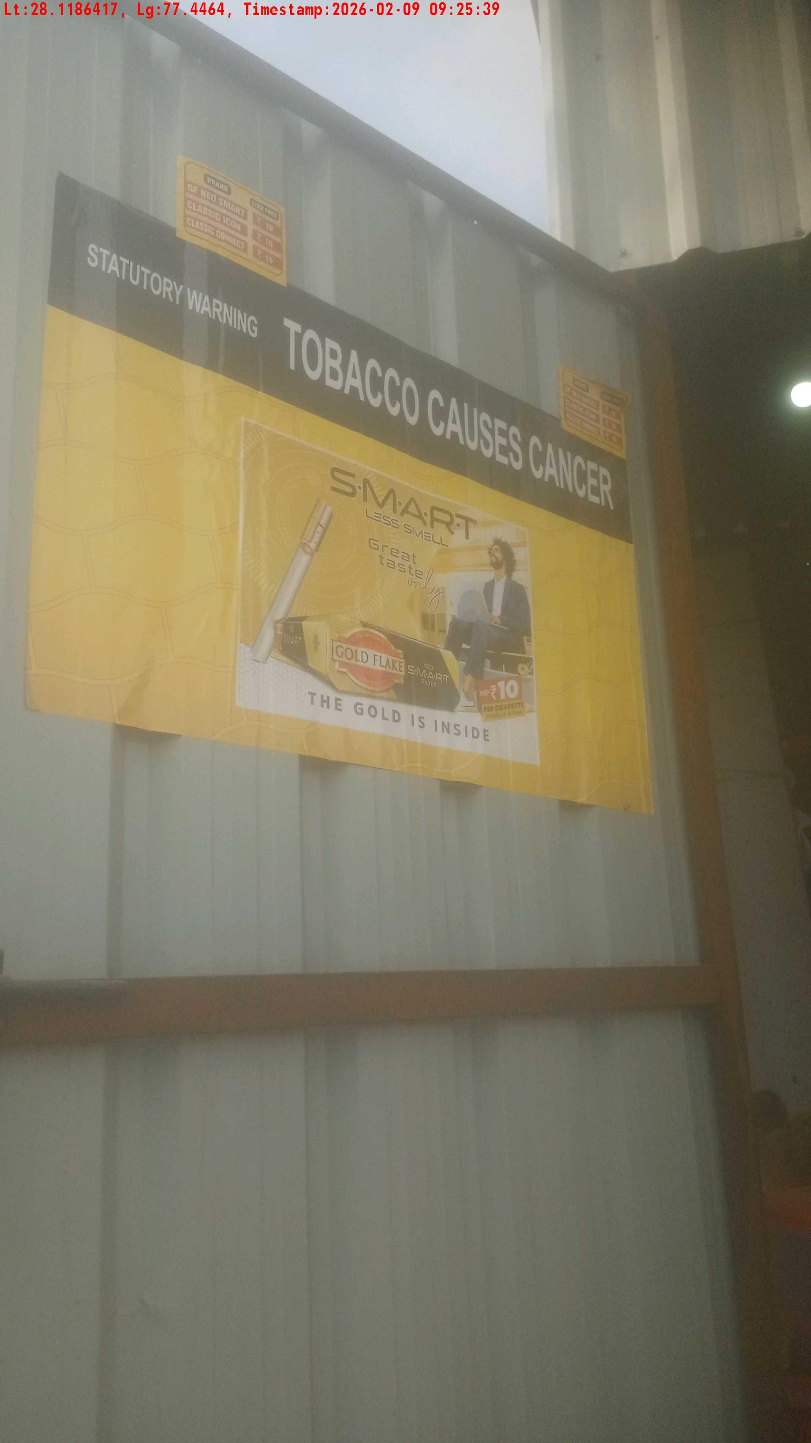
WD Code | Team Id | Team | Shop Name | Owner Mobile Number | Shop Address | Brand | Date Time
DE529610 | 3306 | Prem Pal | Kishan Lal | 9588632987 |  | Gold Flake Neo Smart | 09-02-2026 09:25:39 AM
Pre Shop Photo
Post Shop Photo

Slide 18
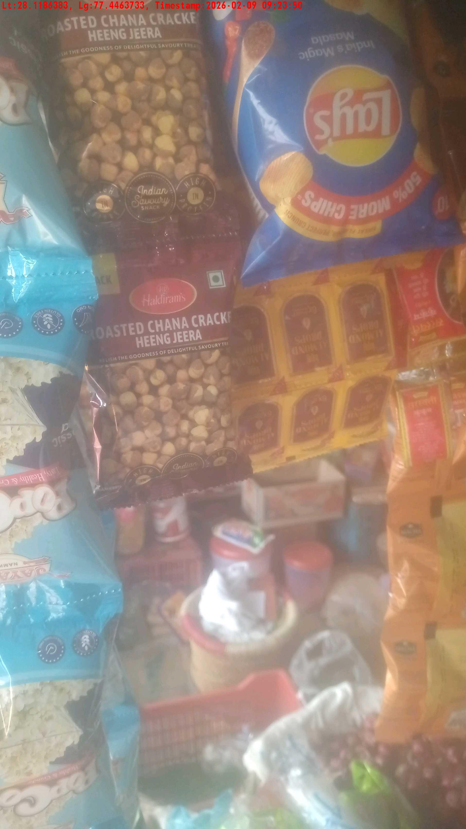
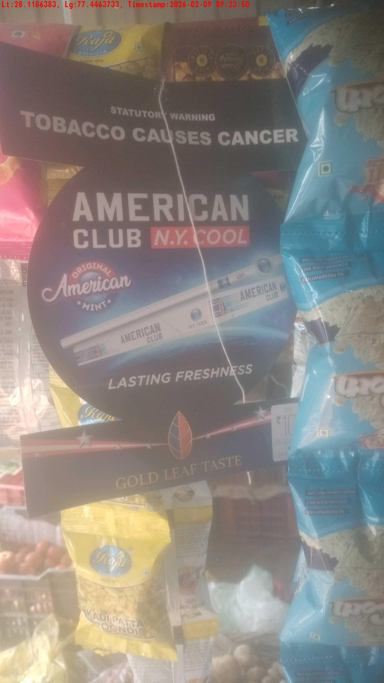
WD Code | Team Id | Team | Shop Name | Owner Mobile Number | Shop Address | Brand | Date Time
DE529610 | 3306 | Prem Pal | inder bhagat k Store | 9034967856 |  | American Club | 09-02-2026 09:23:50 AM
Pre Shop Photo
Post Shop Photo

Slide 19
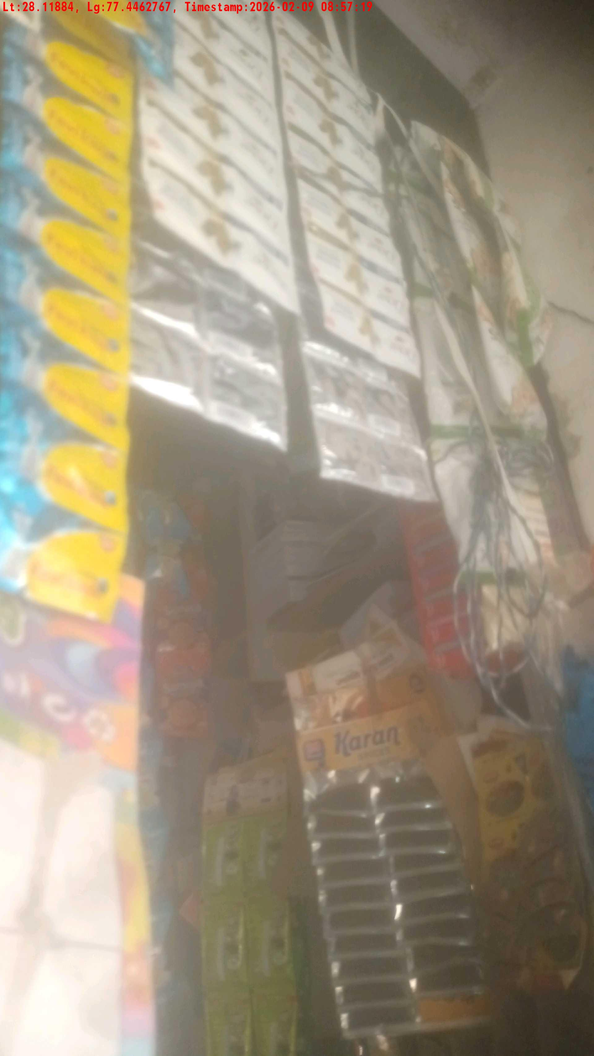
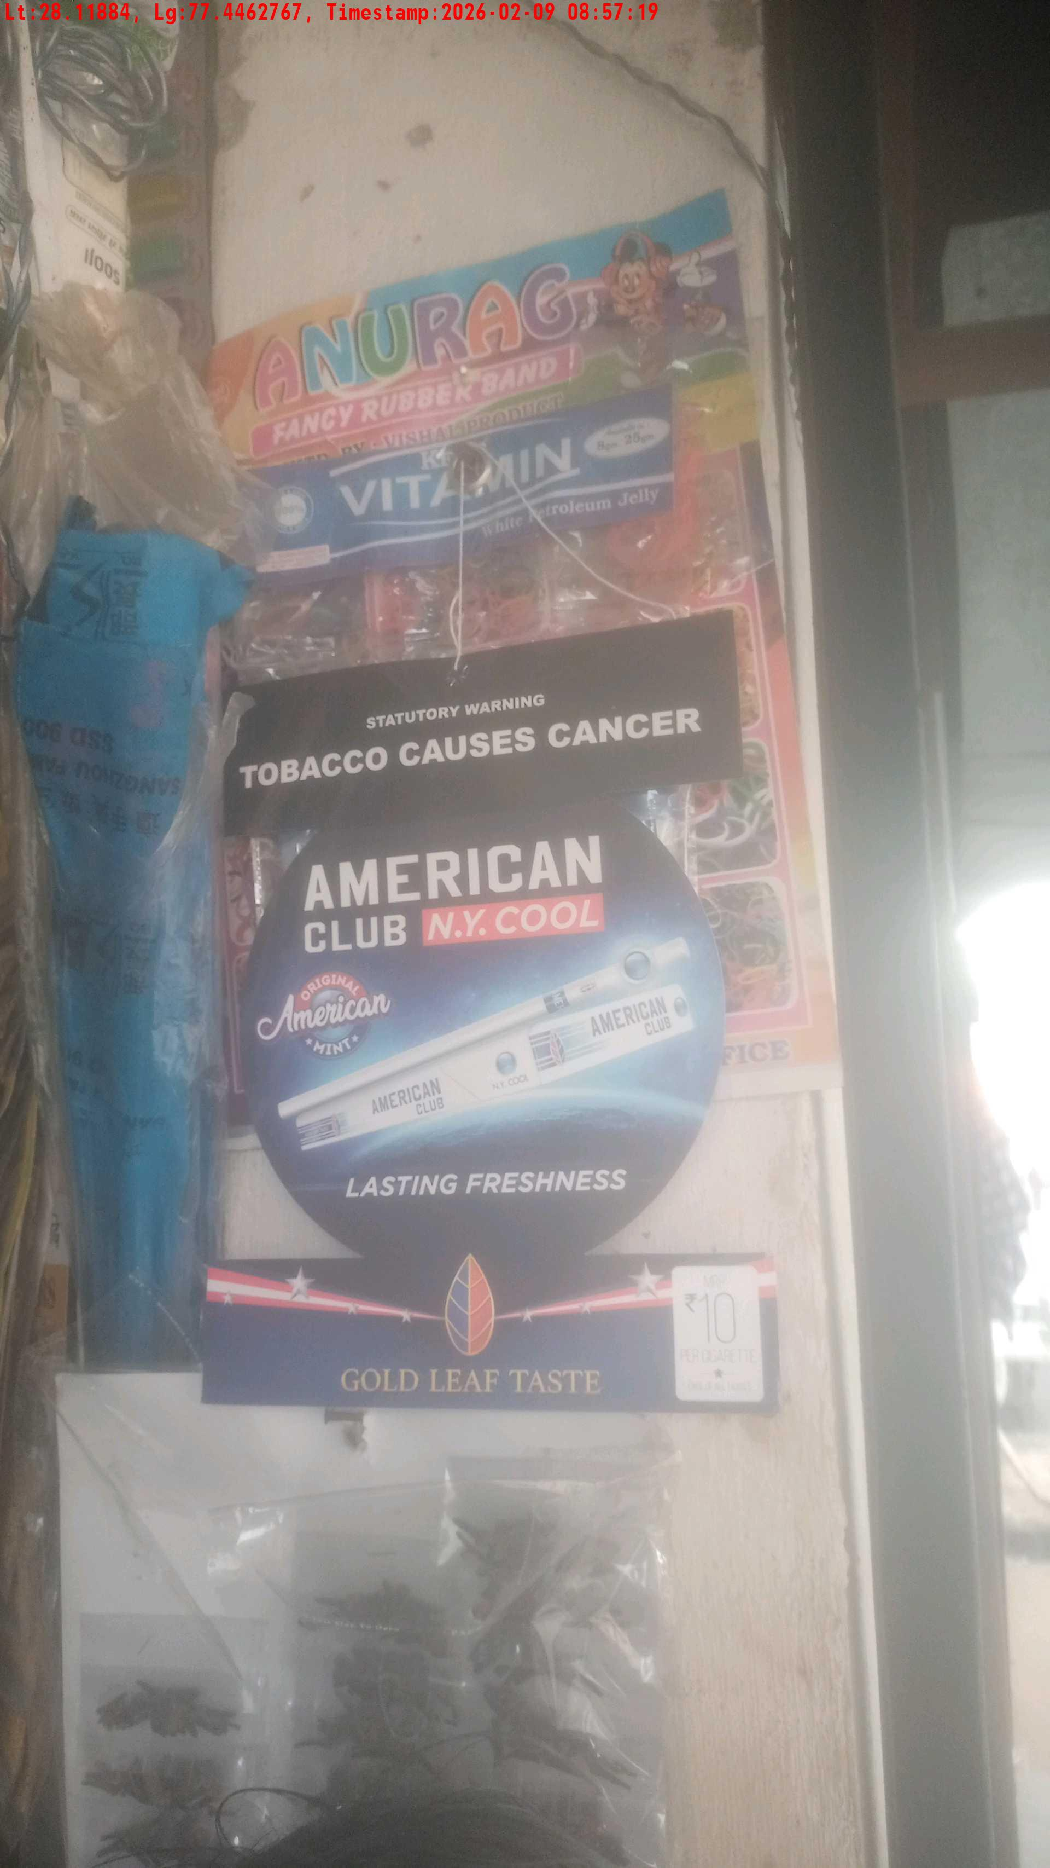
WD Code | Team Id | Team | Shop Name | Owner Mobile Number | Shop Address | Brand | Date Time
DE529610 | 3306 | Prem Pal | sanjeev kumar | 9416323557 |  | American Club | 09-02-2026 08:57:19 AM
Pre Shop Photo
Post Shop Photo

