Slide 1
Transaction Ppt

Slide 2
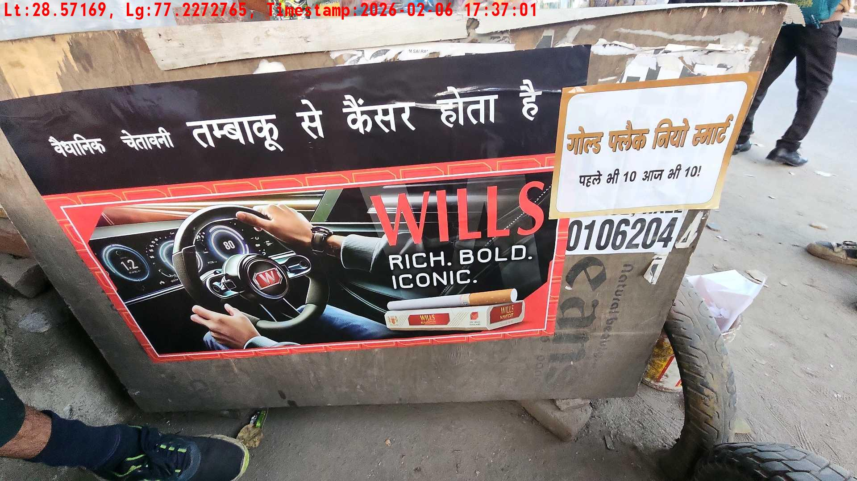
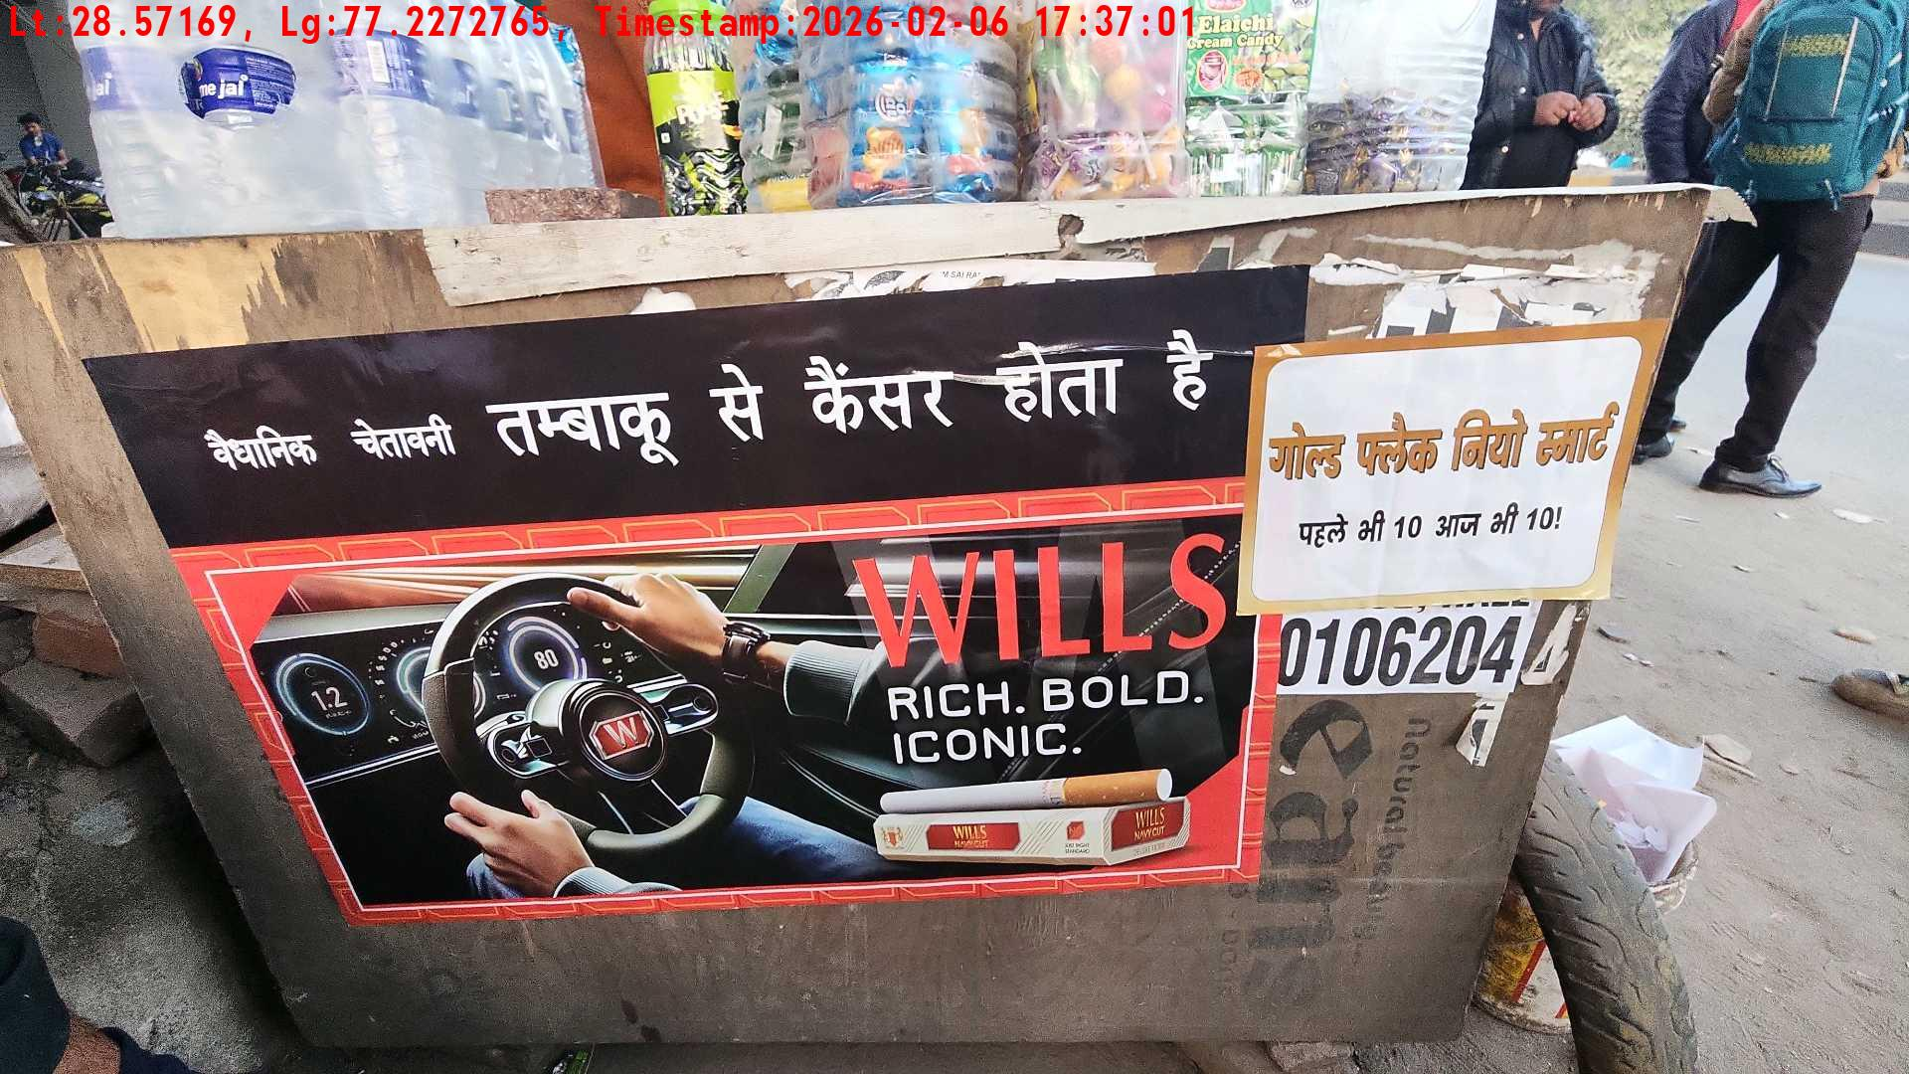
WD Code | Team Id | Team | Shop Name | Owner Mobile Number | Shop Address | Brand | Date Time
abc | 4601 | Bhagwat | nanu |  |  | Navy Cut | 06-02-2026 05:37:01 PM
Pre Shop Photo
Post Shop Photo

Slide 3
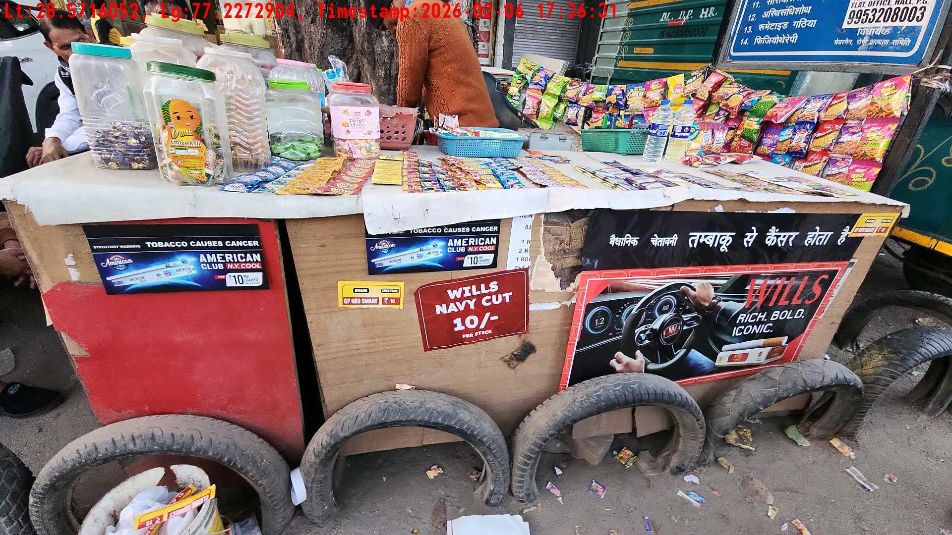
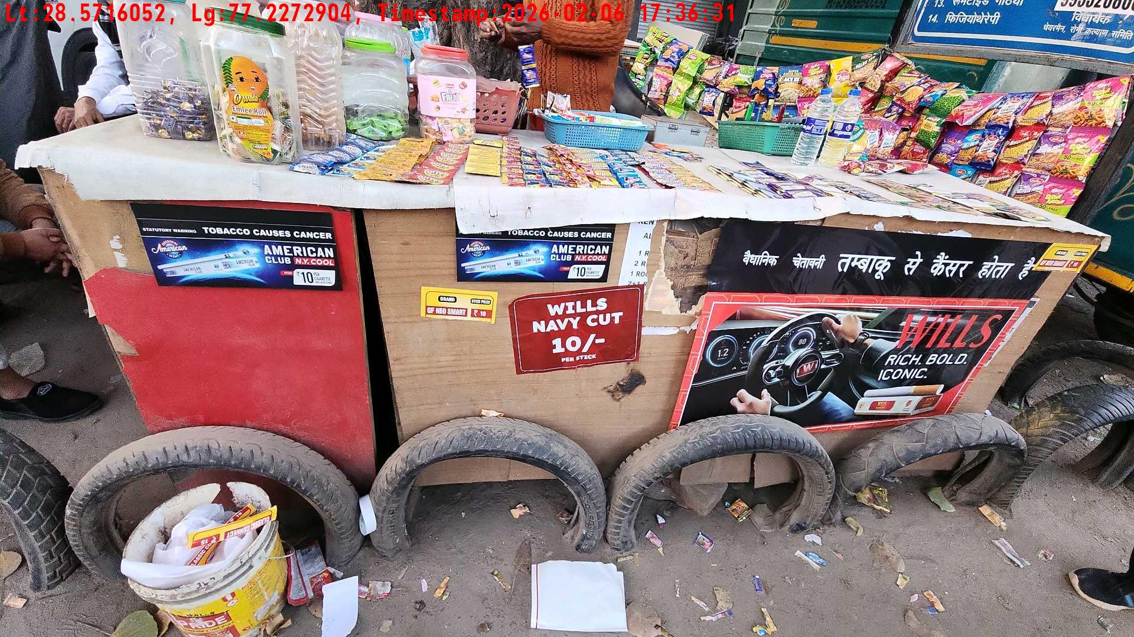
WD Code | Team Id | Team | Shop Name | Owner Mobile Number | Shop Address | Brand | Date Time
abc | 4601 | Bhagwat | khairati laal |  |  | Navy Cut | 06-02-2026 05:36:31 PM
Pre Shop Photo
Post Shop Photo

Slide 4
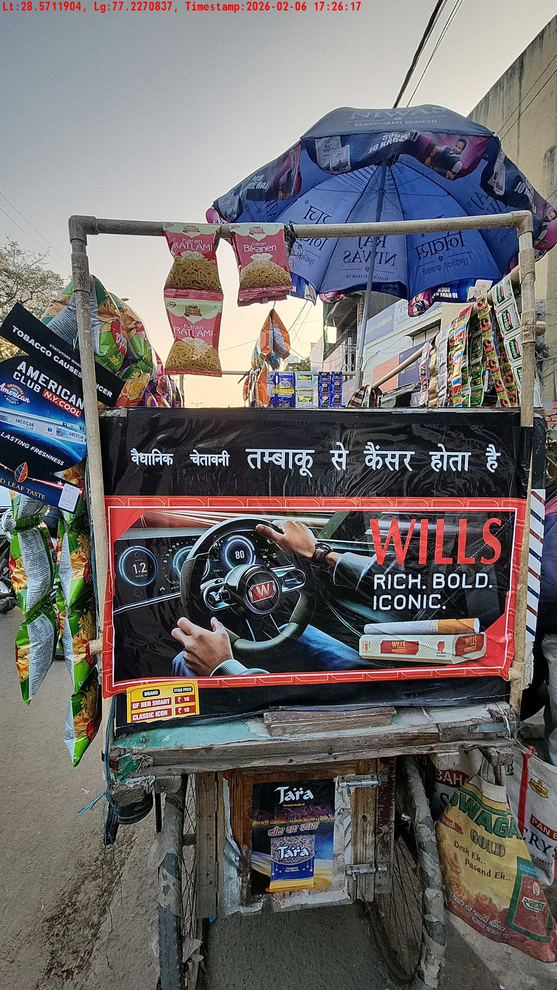
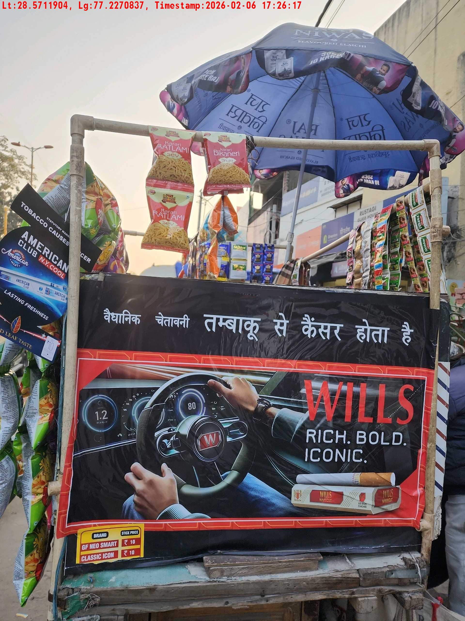
WD Code | Team Id | Team | Shop Name | Owner Mobile Number | Shop Address | Brand | Date Time
abc | 4601 | Bhagwat | chaubey |  |  | Navy Cut | 06-02-2026 05:26:17 PM
Pre Shop Photo
Post Shop Photo

Slide 5
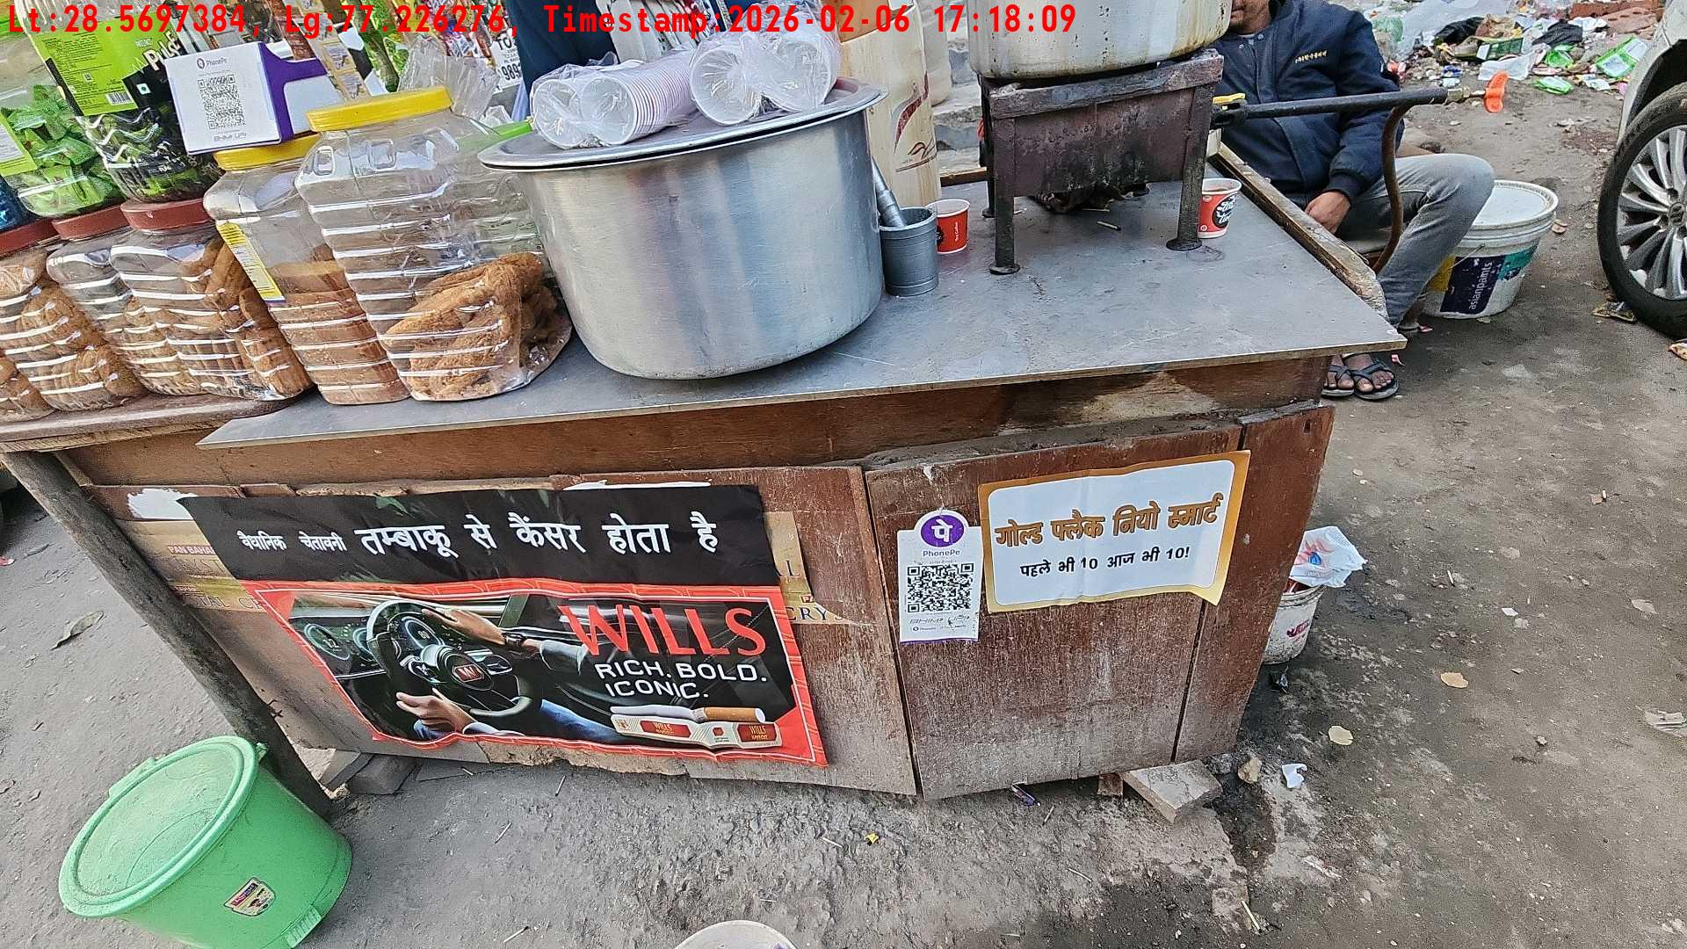
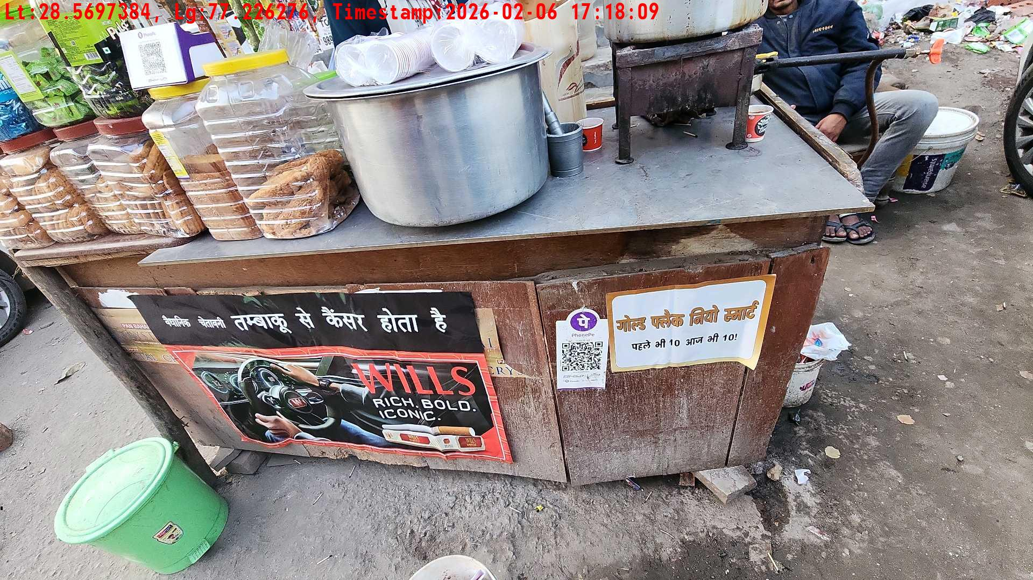
WD Code | Team Id | Team | Shop Name | Owner Mobile Number | Shop Address | Brand | Date Time
abc | 4601 | Bhagwat | harsh |  |  | Navy Cut | 06-02-2026 05:18:09 PM
Pre Shop Photo
Post Shop Photo

Slide 6
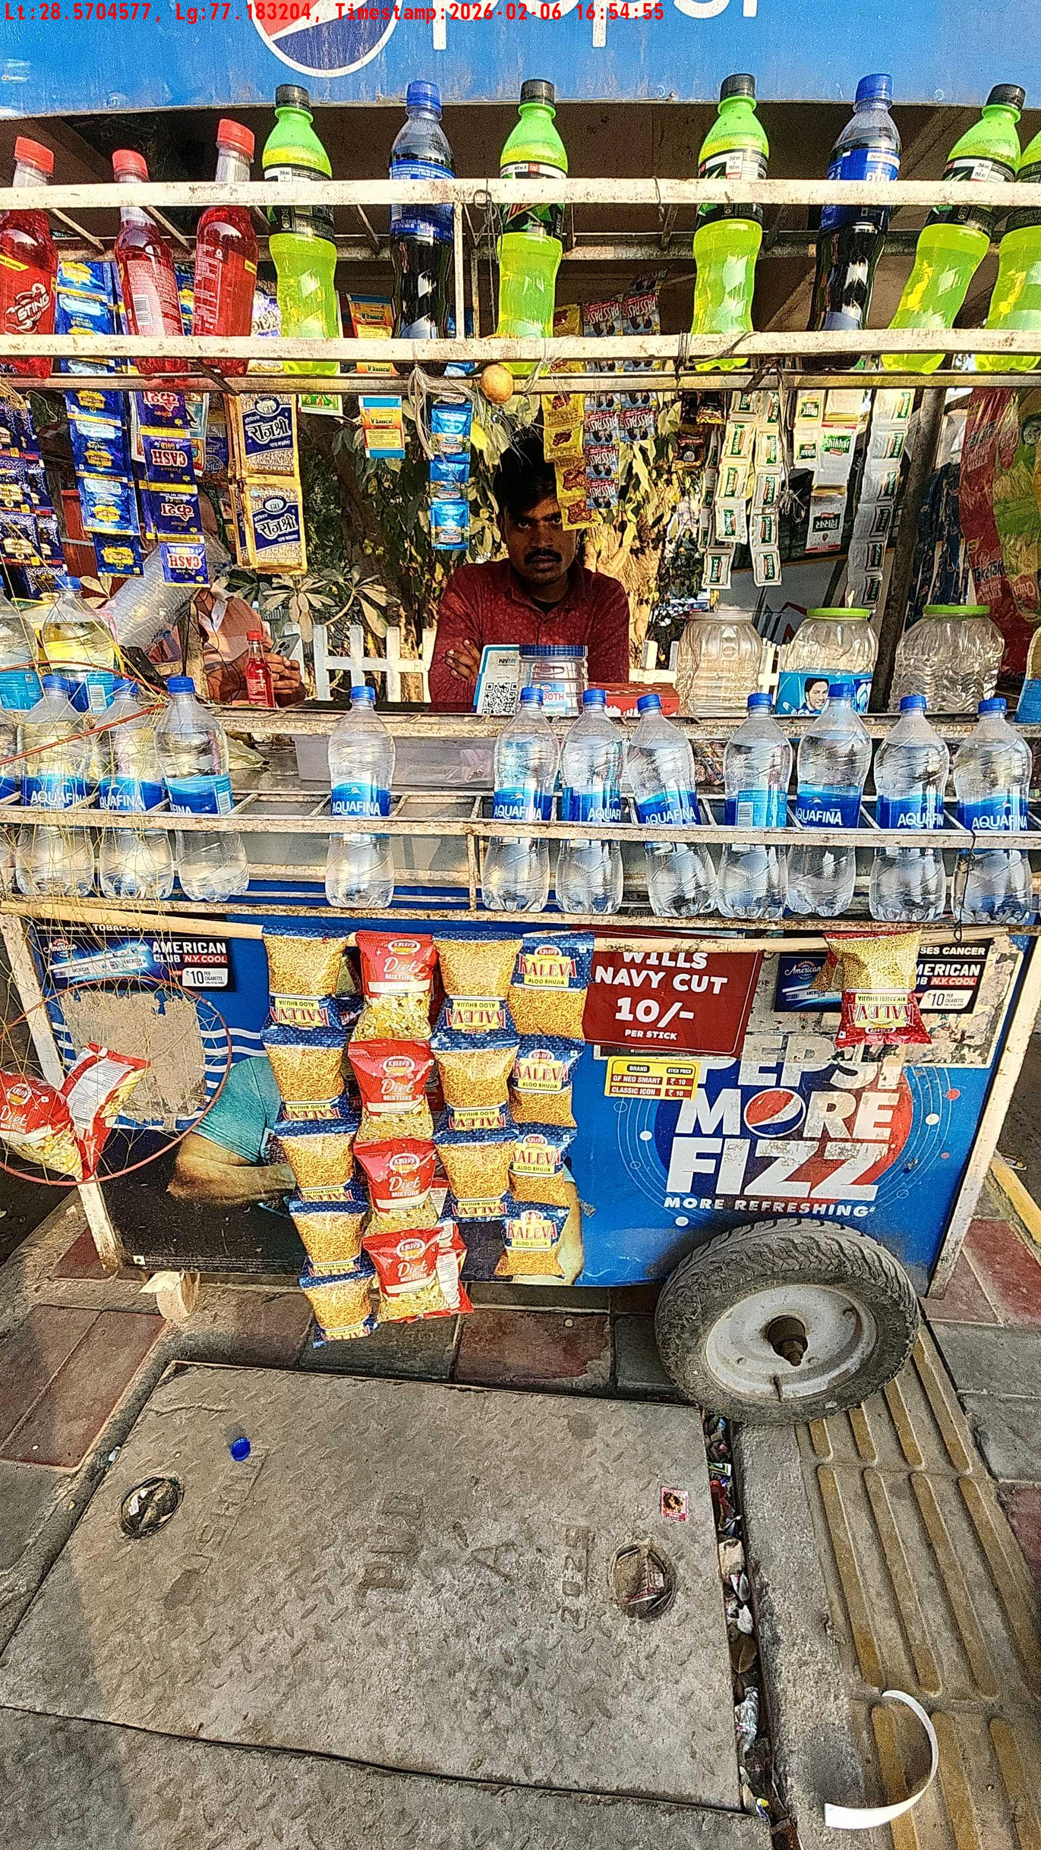
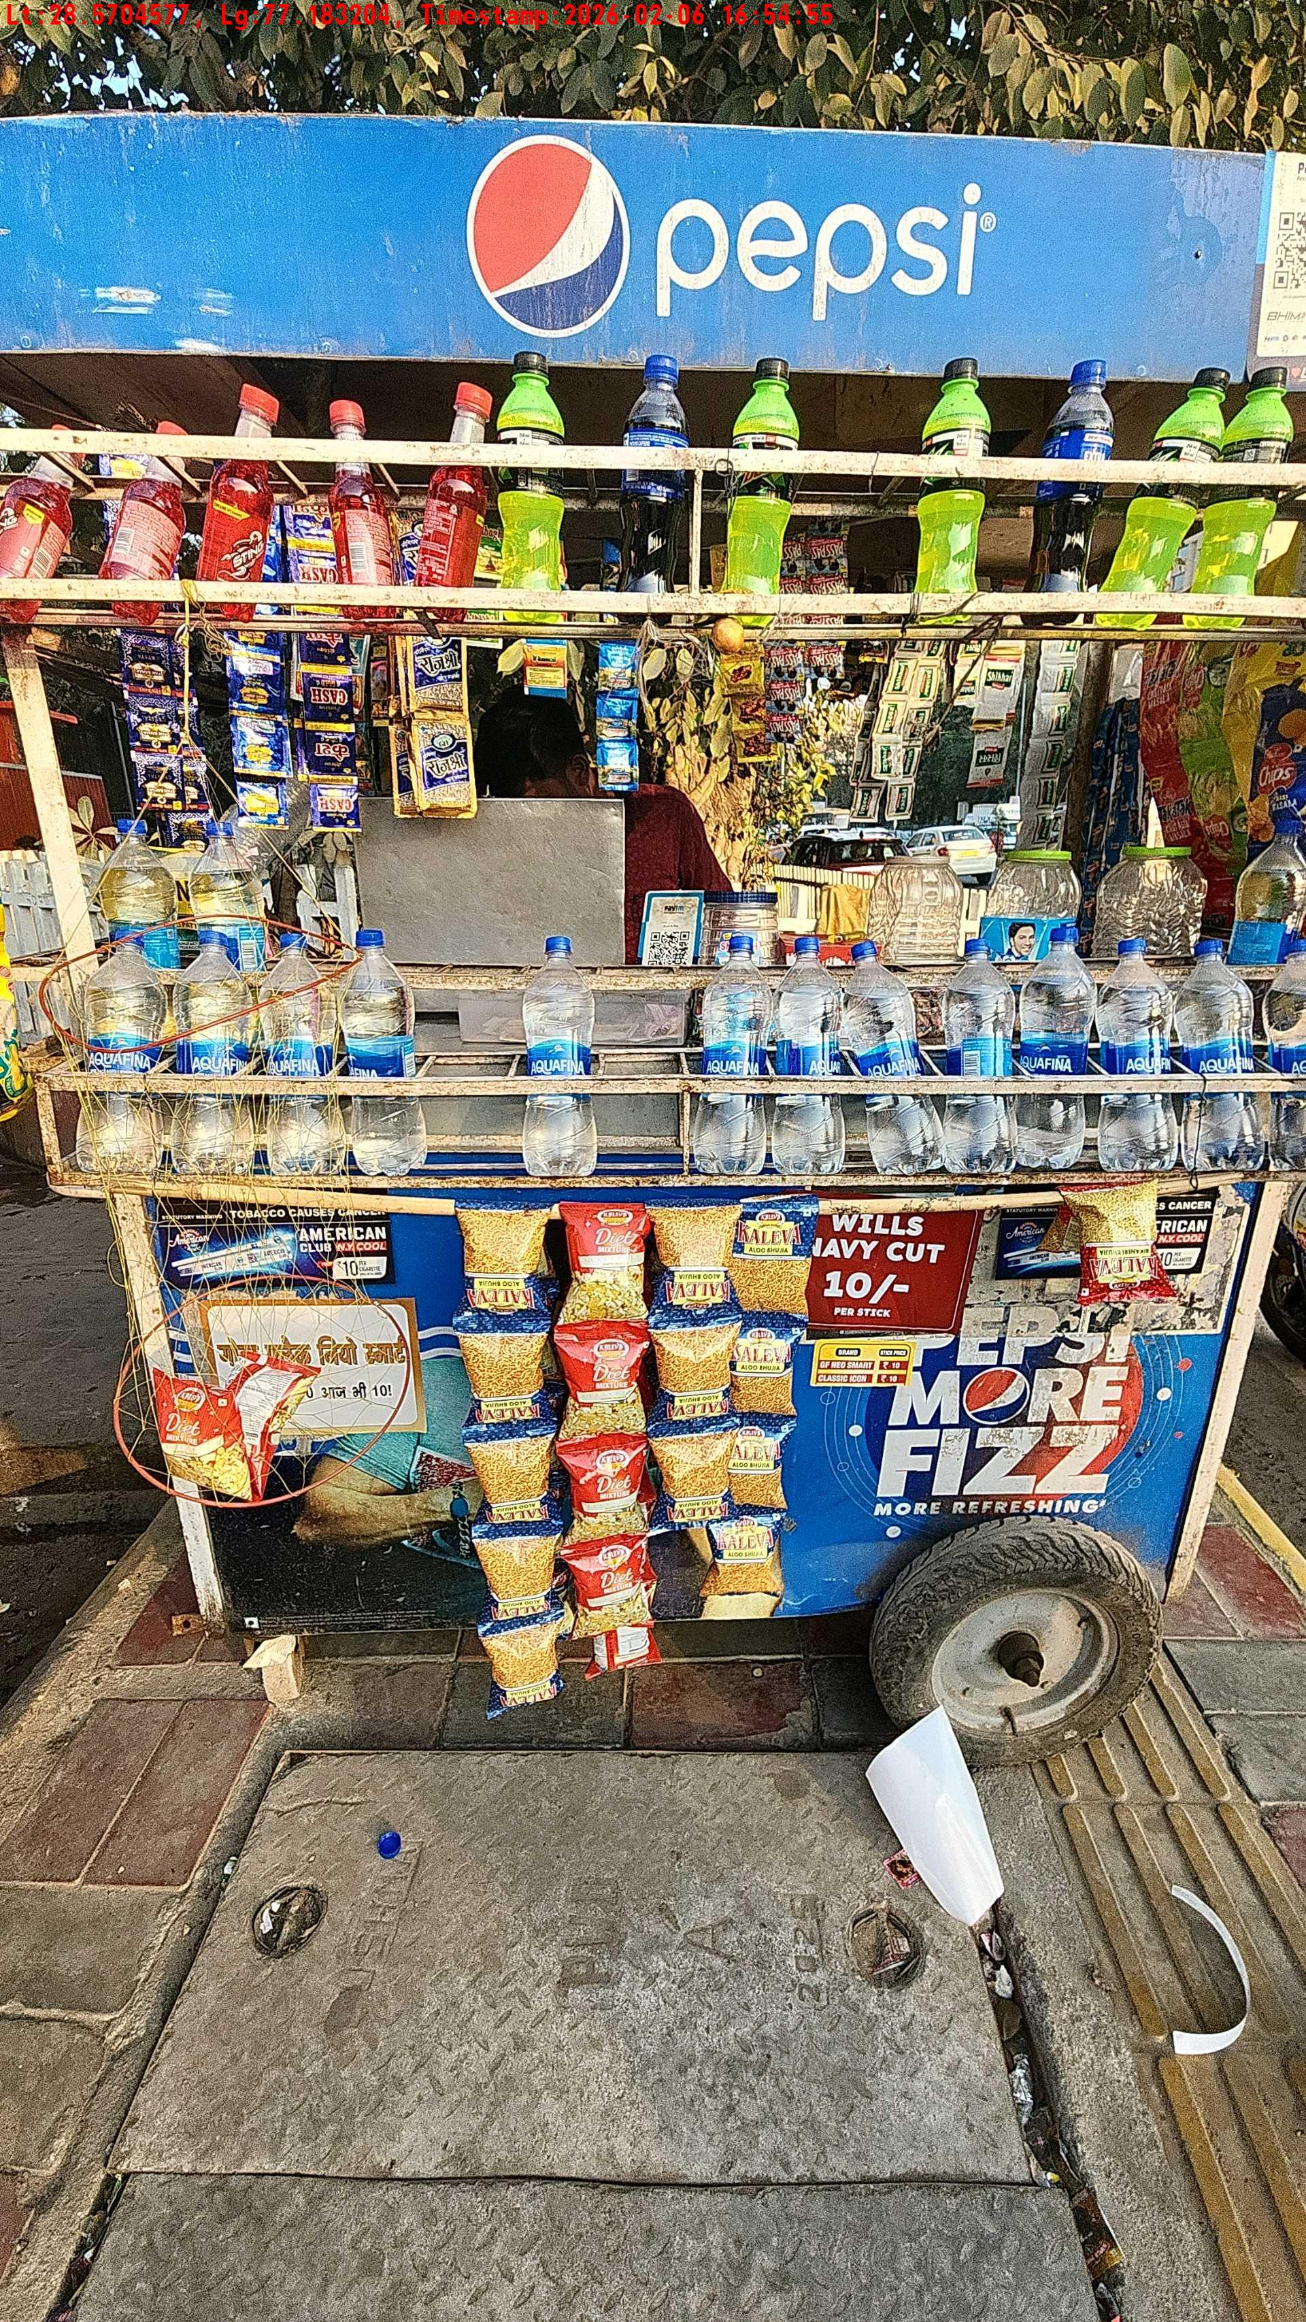
WD Code | Team Id | Team | Shop Name | Owner Mobile Number | Shop Address | Brand | Date Time
abc | 4601 | Bhagwat | brijesh |  |  | Price Sticker | 06-02-2026 04:54:55 PM
Pre Shop Photo
Post Shop Photo

Slide 7
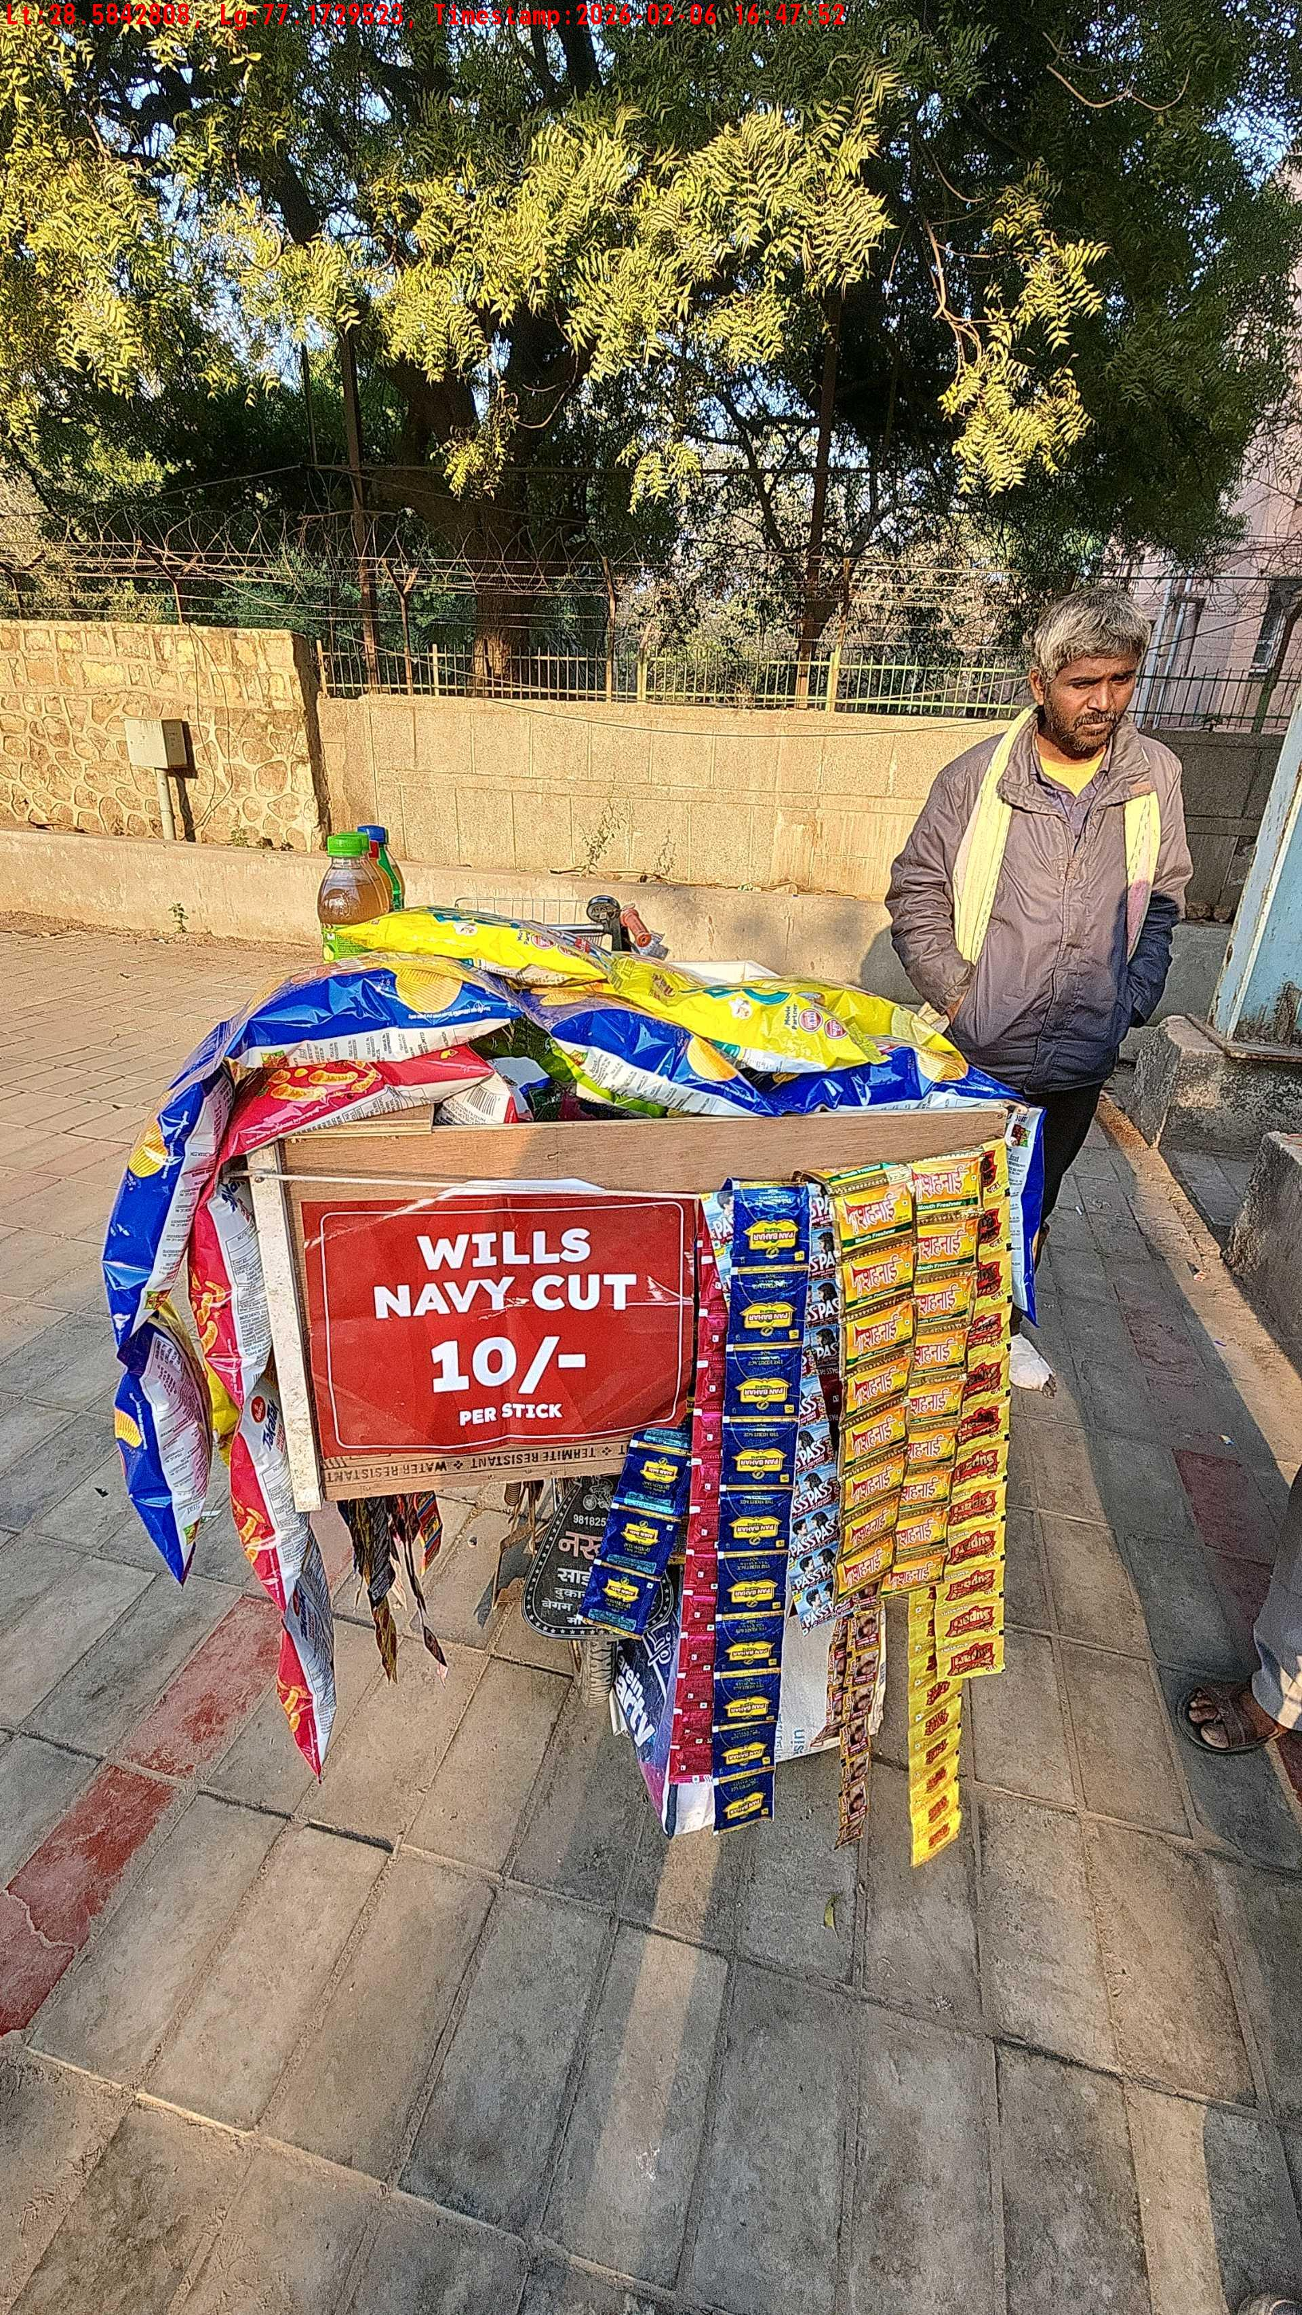
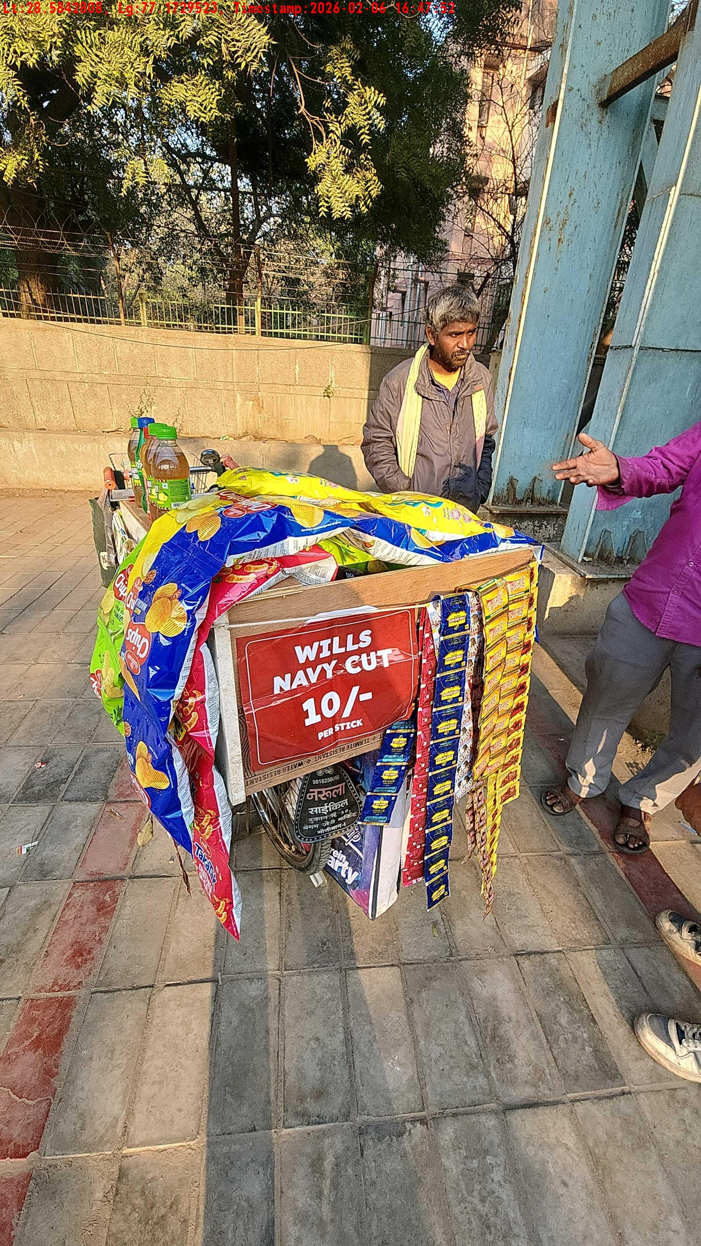
WD Code | Team Id | Team | Shop Name | Owner Mobile Number | Shop Address | Brand | Date Time
abc | 4601 | Bhagwat | khan sahab |  |  | Price Sticker | 06-02-2026 04:47:52 PM
Pre Shop Photo
Post Shop Photo

Slide 8
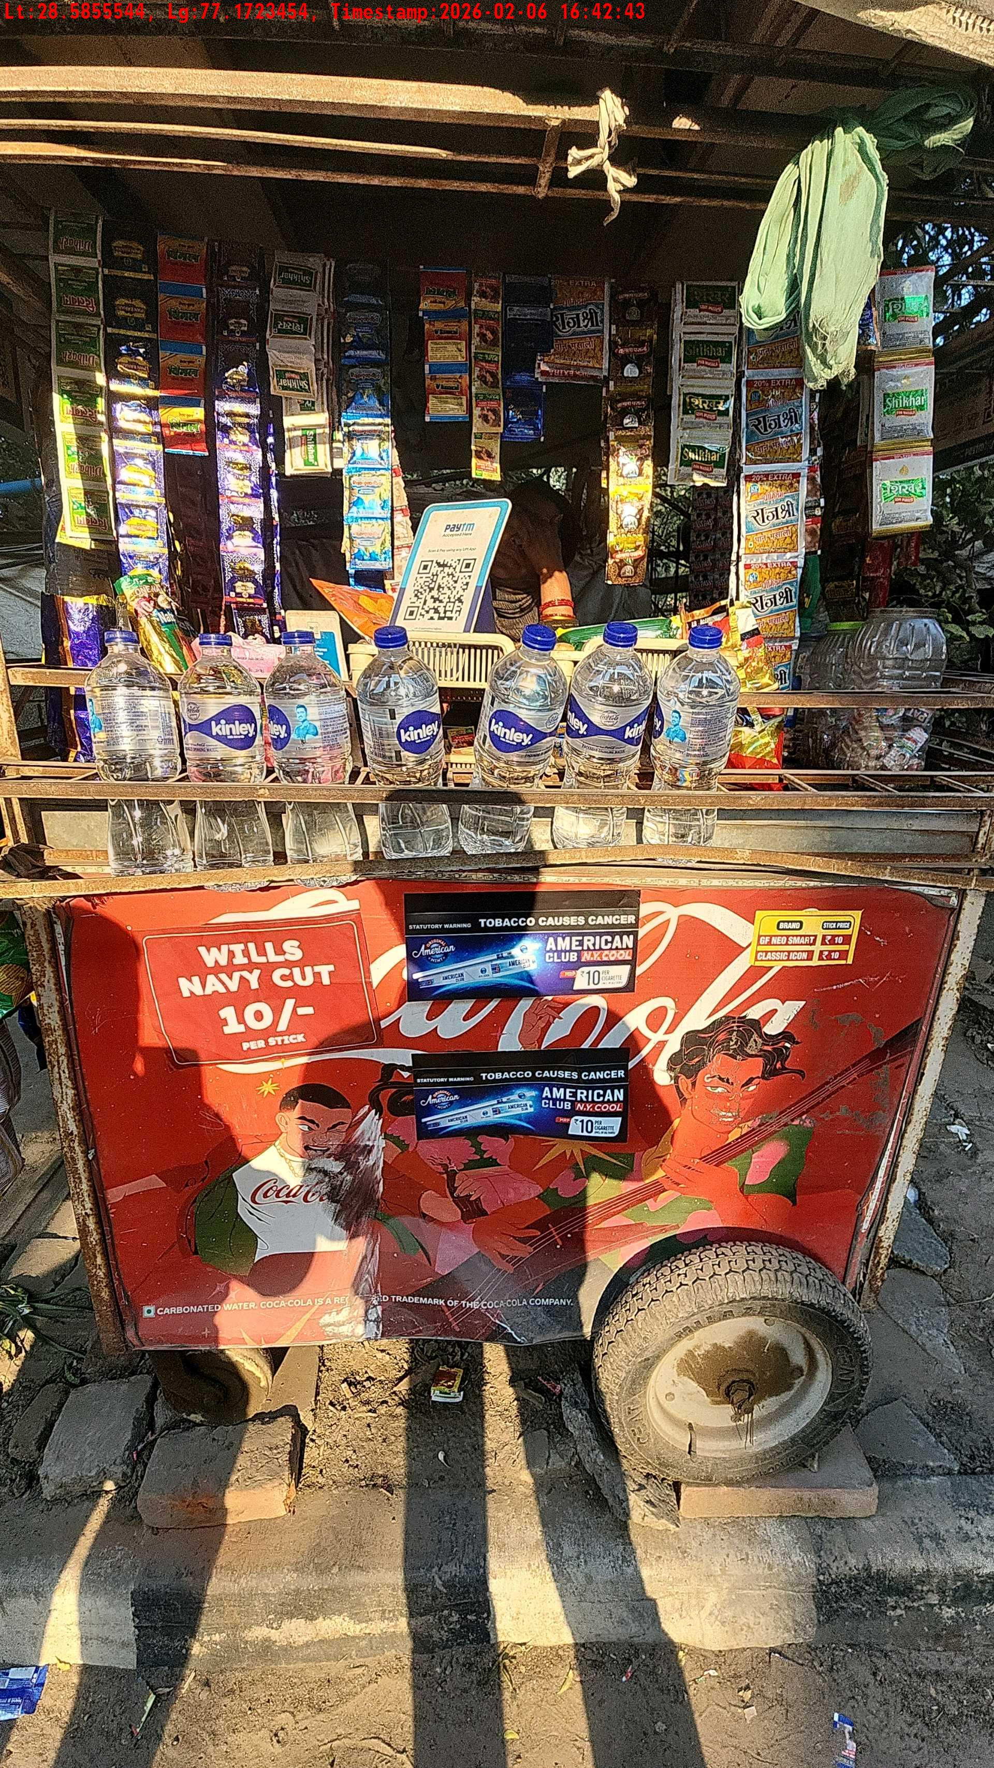
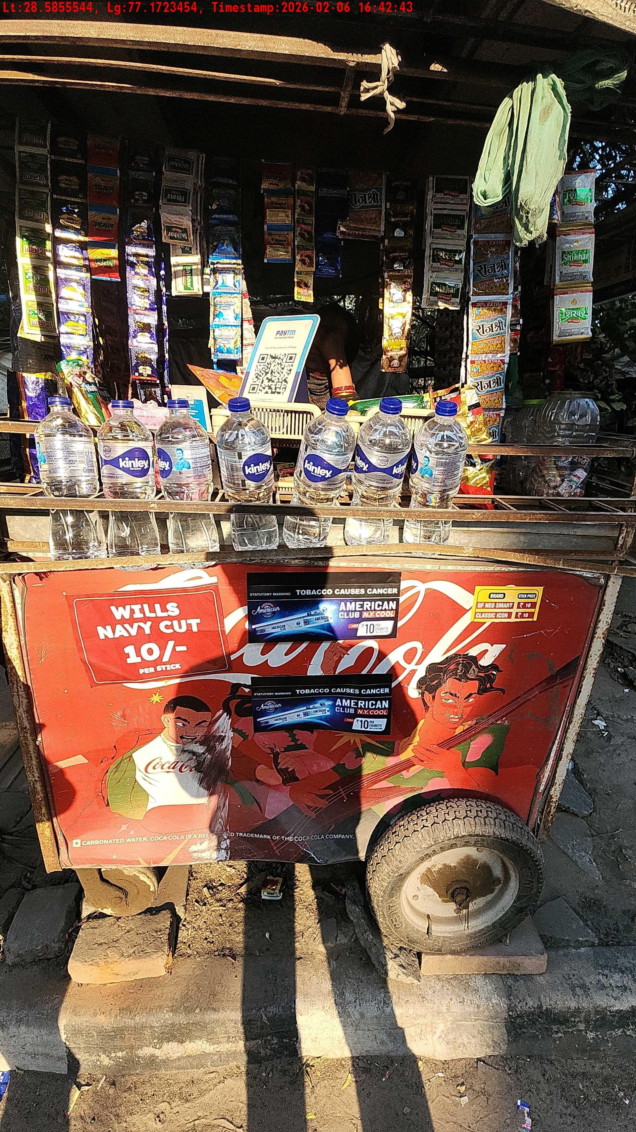
WD Code | Team Id | Team | Shop Name | Owner Mobile Number | Shop Address | Brand | Date Time
abc | 4601 | Bhagwat | Sandee |  |  | Price Sticker | 06-02-2026 04:42:43 PM
Pre Shop Photo
Post Shop Photo

Slide 9
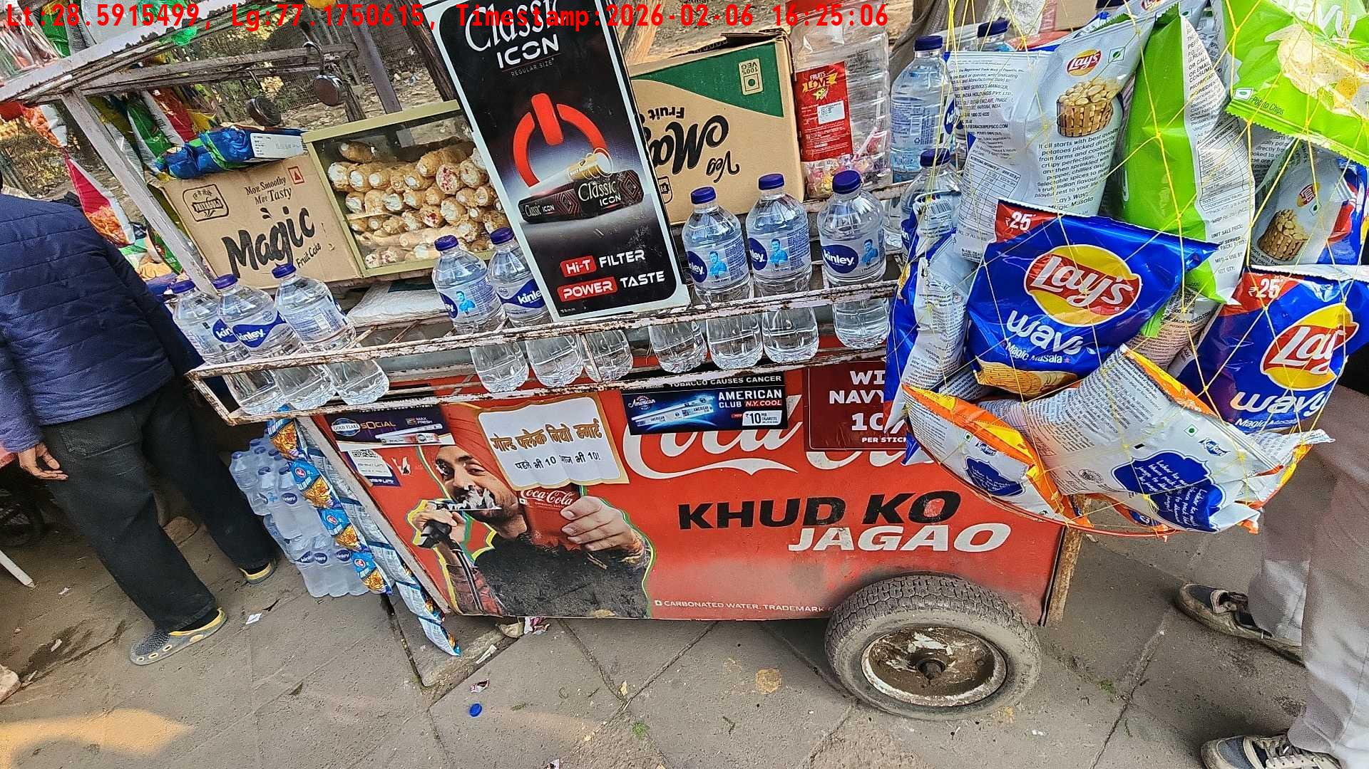
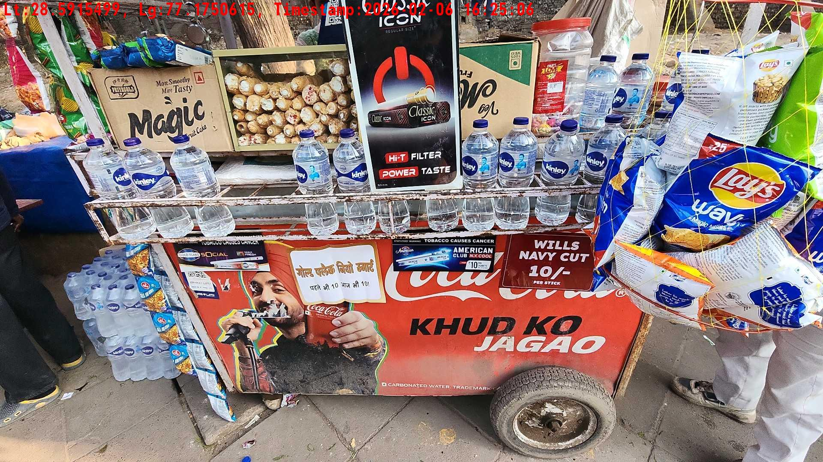
WD Code | Team Id | Team | Shop Name | Owner Mobile Number | Shop Address | Brand | Date Time
abc | 4601 | Bhagwat | deepak |  |  | Price Sticker | 06-02-2026 04:25:06 PM
Pre Shop Photo
Post Shop Photo

Slide 10
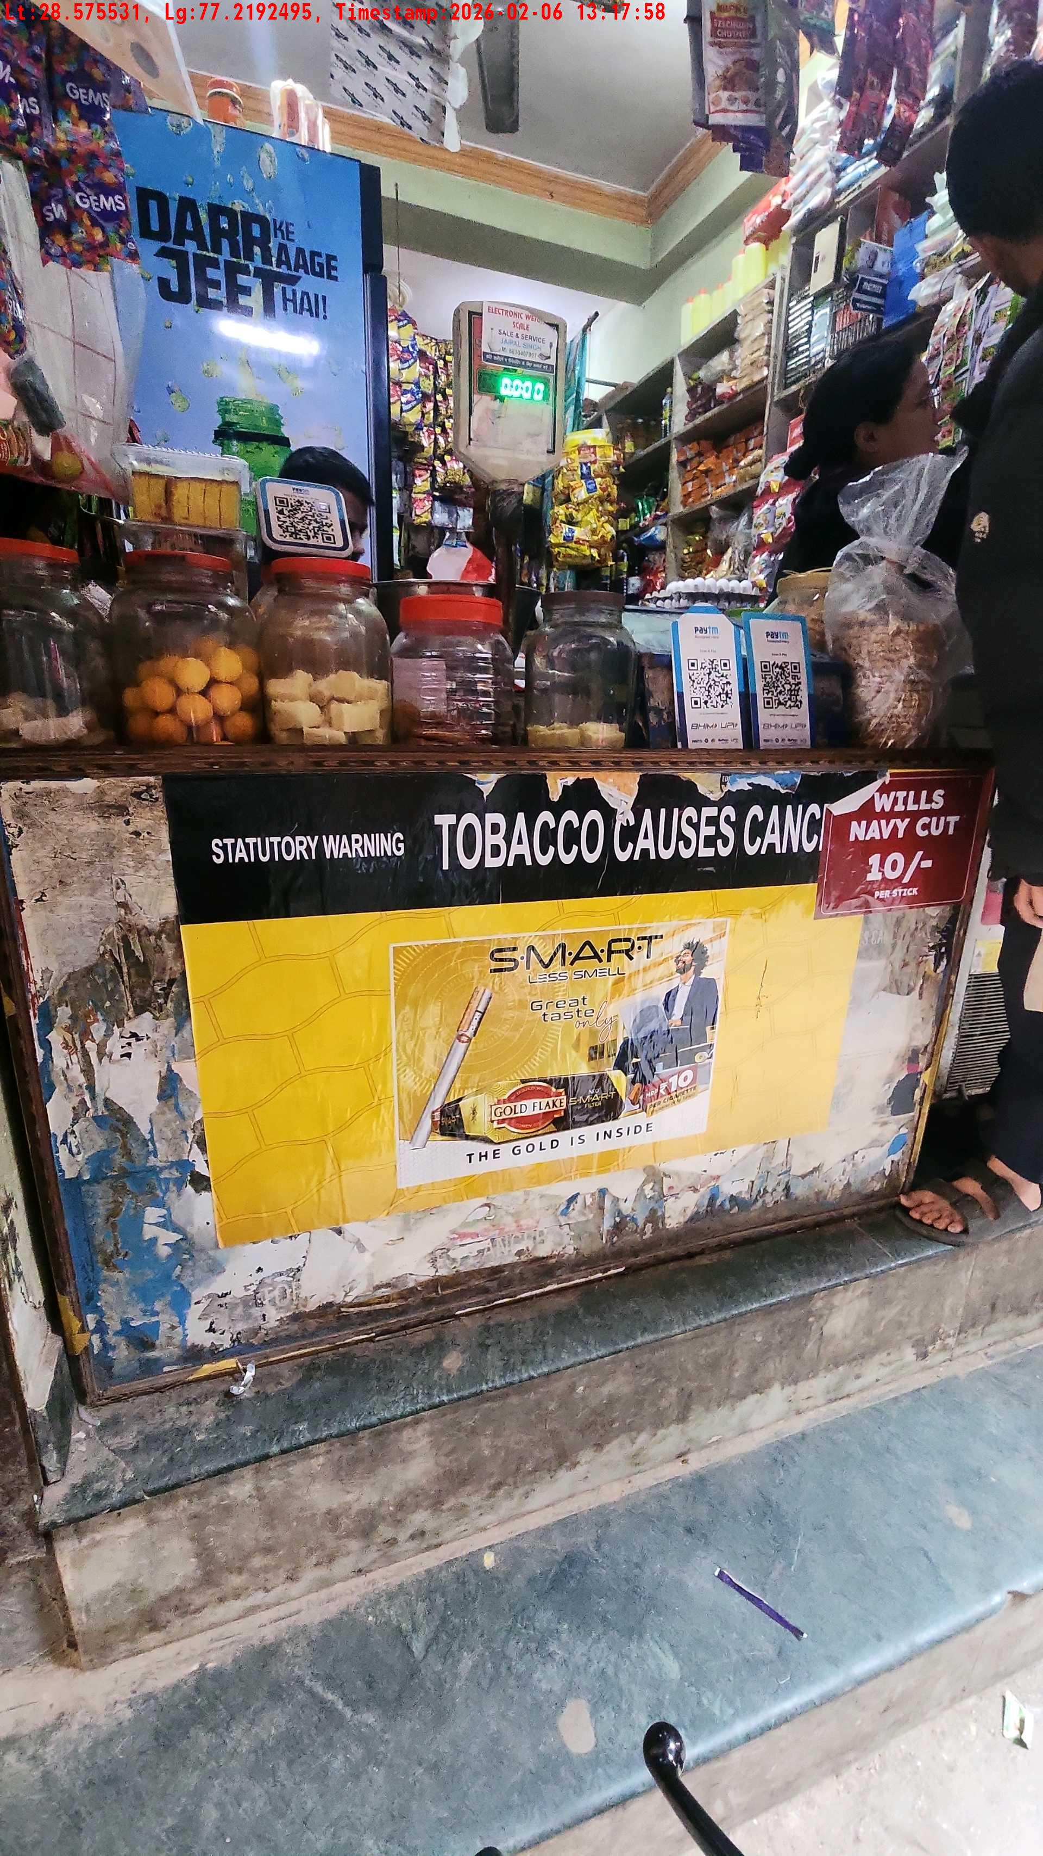
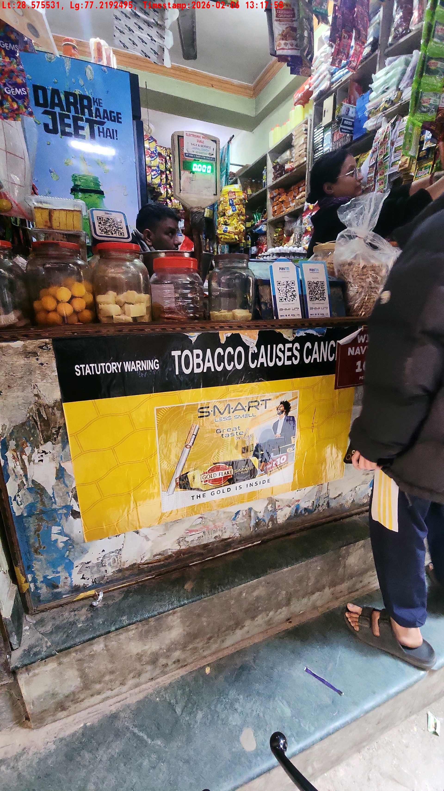
WD Code | Team Id | Team | Shop Name | Owner Mobile Number | Shop Address | Brand | Date Time
abc | 4601 | Bhagwat | deepak |  |  | Gold Flake Neo Smart | 06-02-2026 01:17:58 PM
Pre Shop Photo
Post Shop Photo

Slide 11
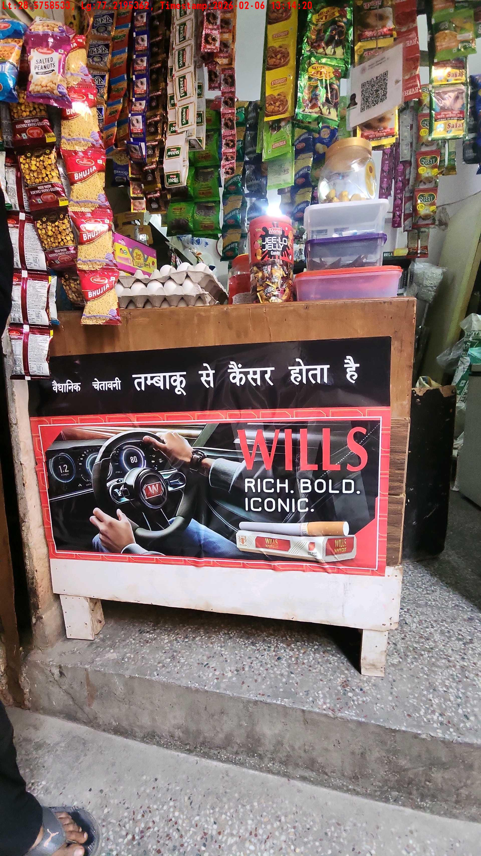
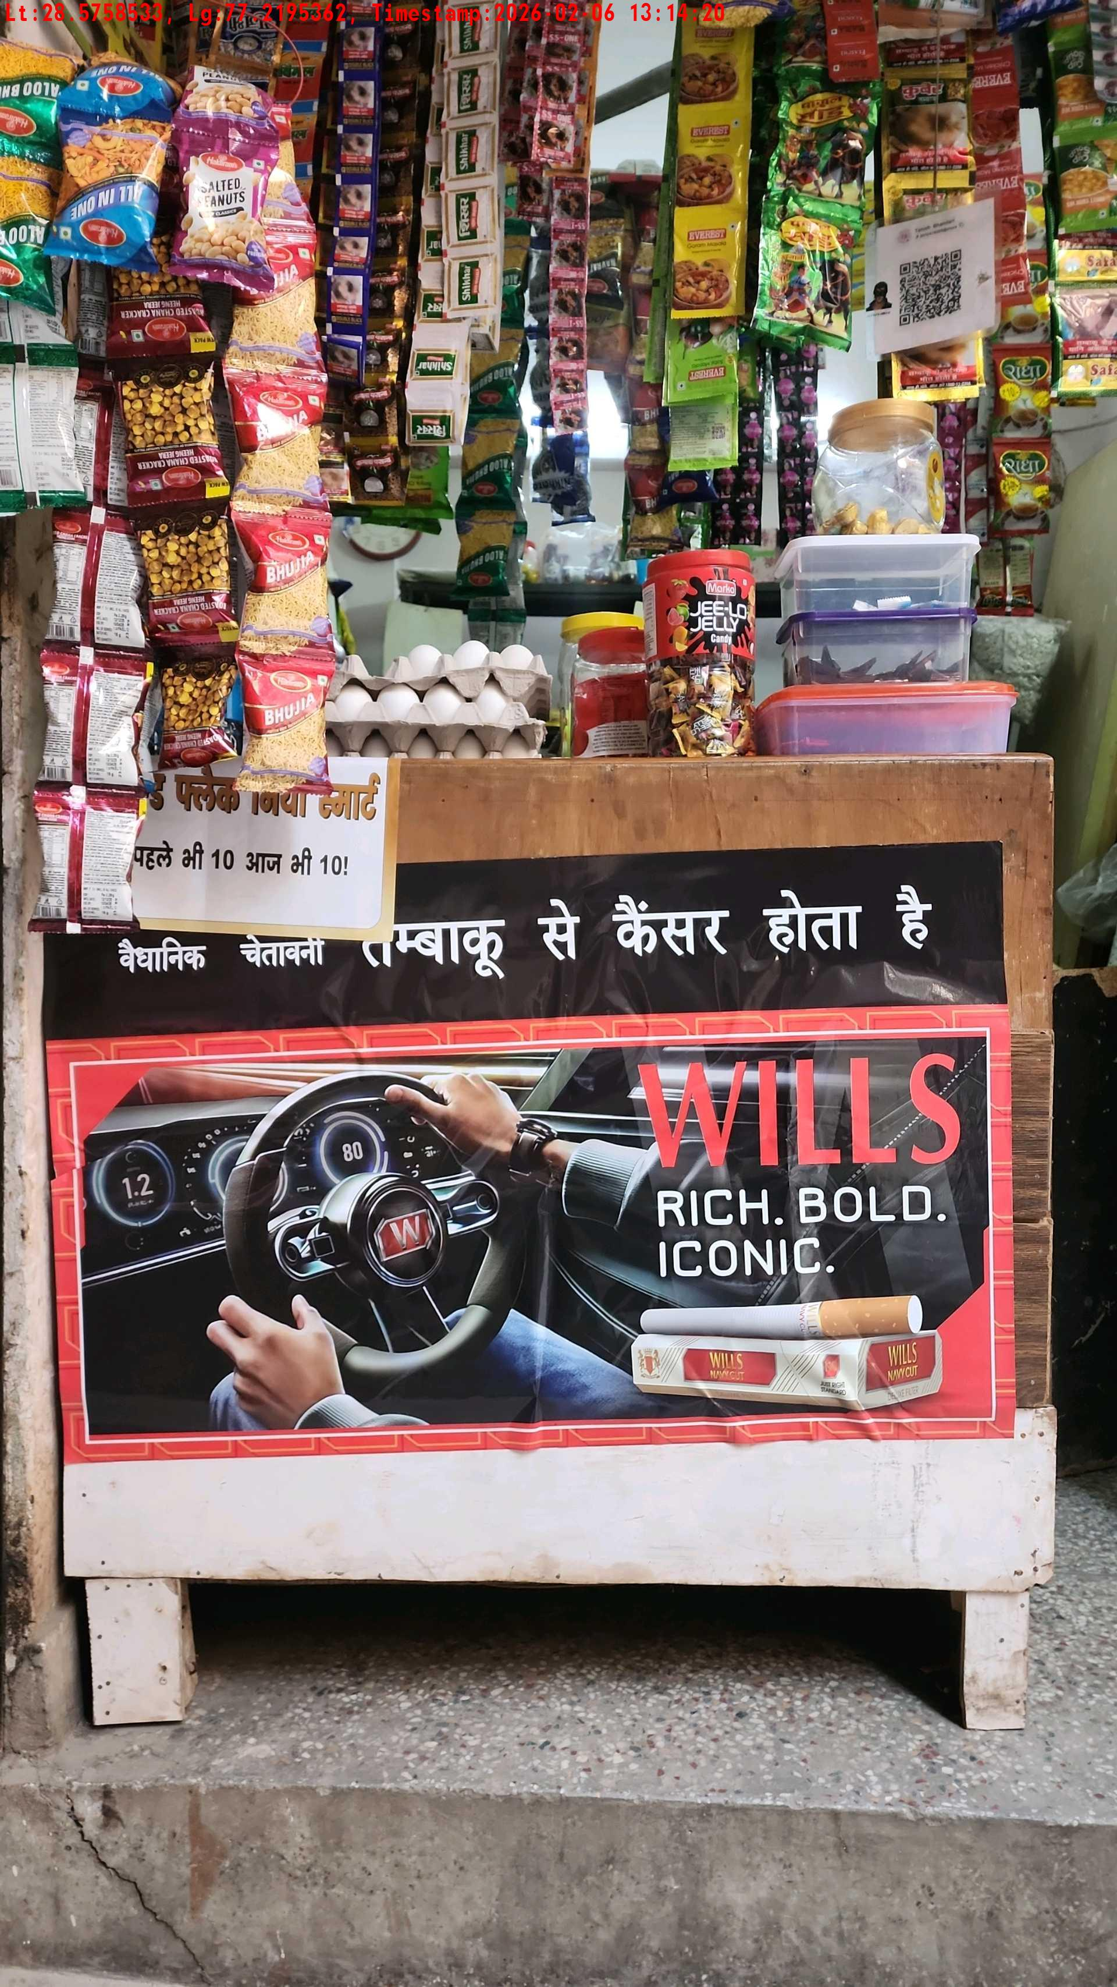
WD Code | Team Id | Team | Shop Name | Owner Mobile Number | Shop Address | Brand | Date Time
abc | 4601 | Bhagwat | bharat |  |  | Navy Cut | 06-02-2026 01:14:20 PM
Pre Shop Photo
Post Shop Photo

Slide 12
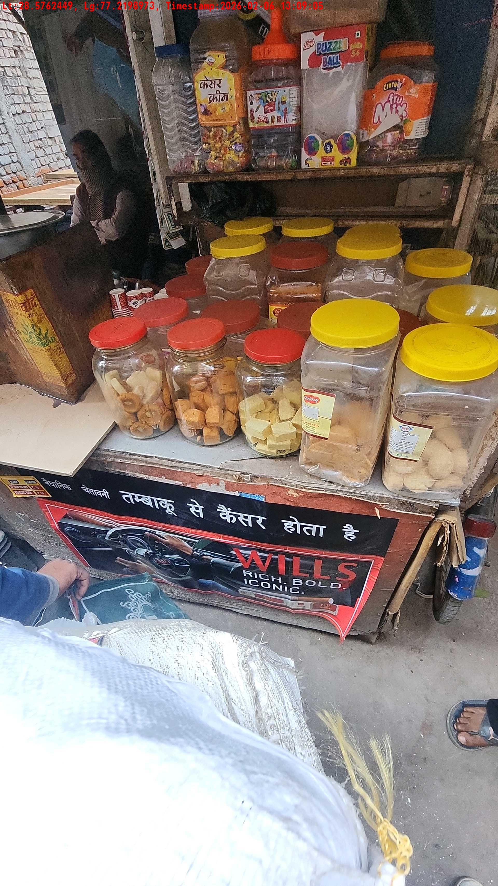
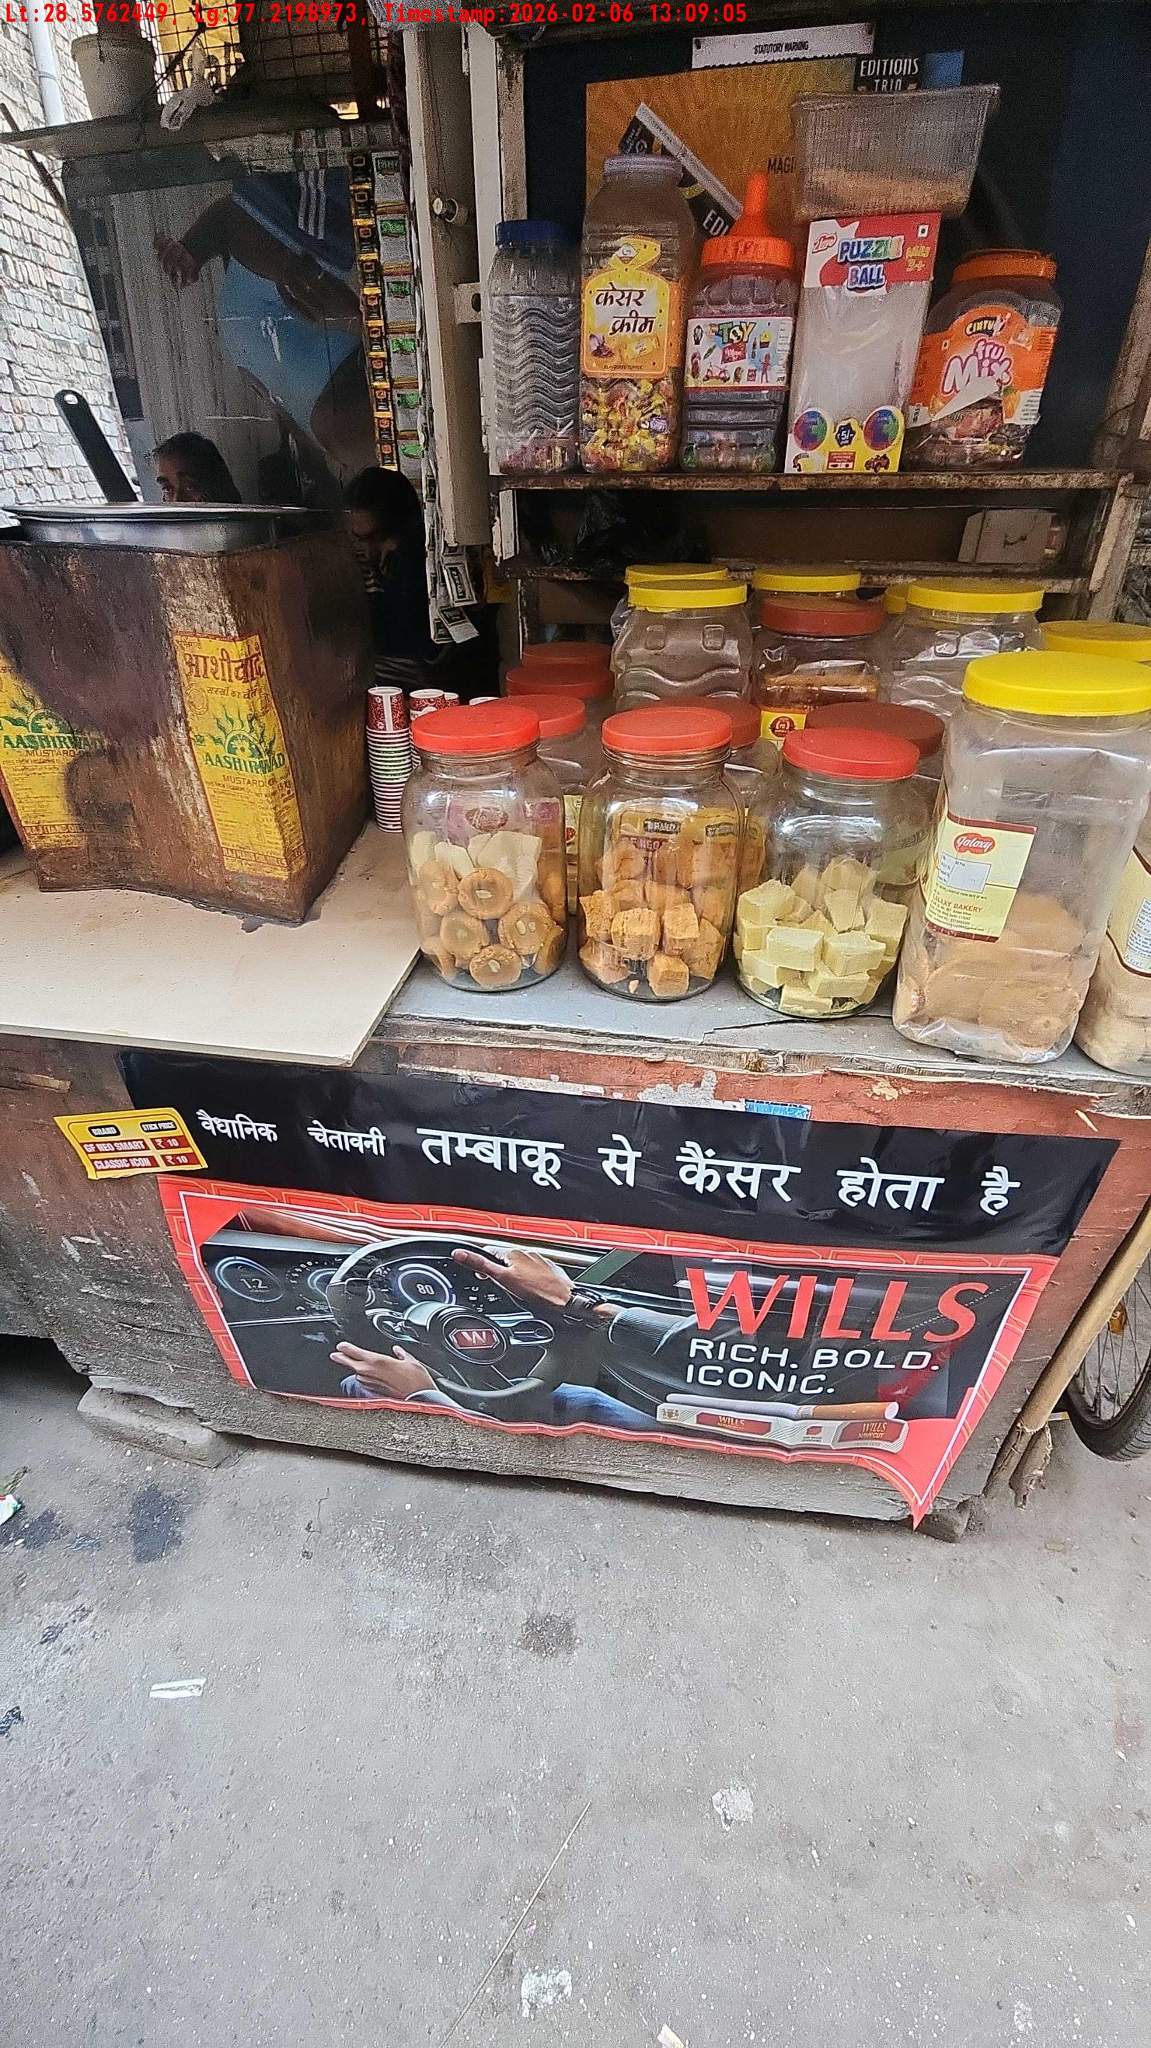
WD Code | Team Id | Team | Shop Name | Owner Mobile Number | Shop Address | Brand | Date Time
abc | 4601 | Bhagwat | Rohit Sharma |  |  | Navy Cut | 06-02-2026 01:09:05 PM
Pre Shop Photo
Post Shop Photo

Slide 13
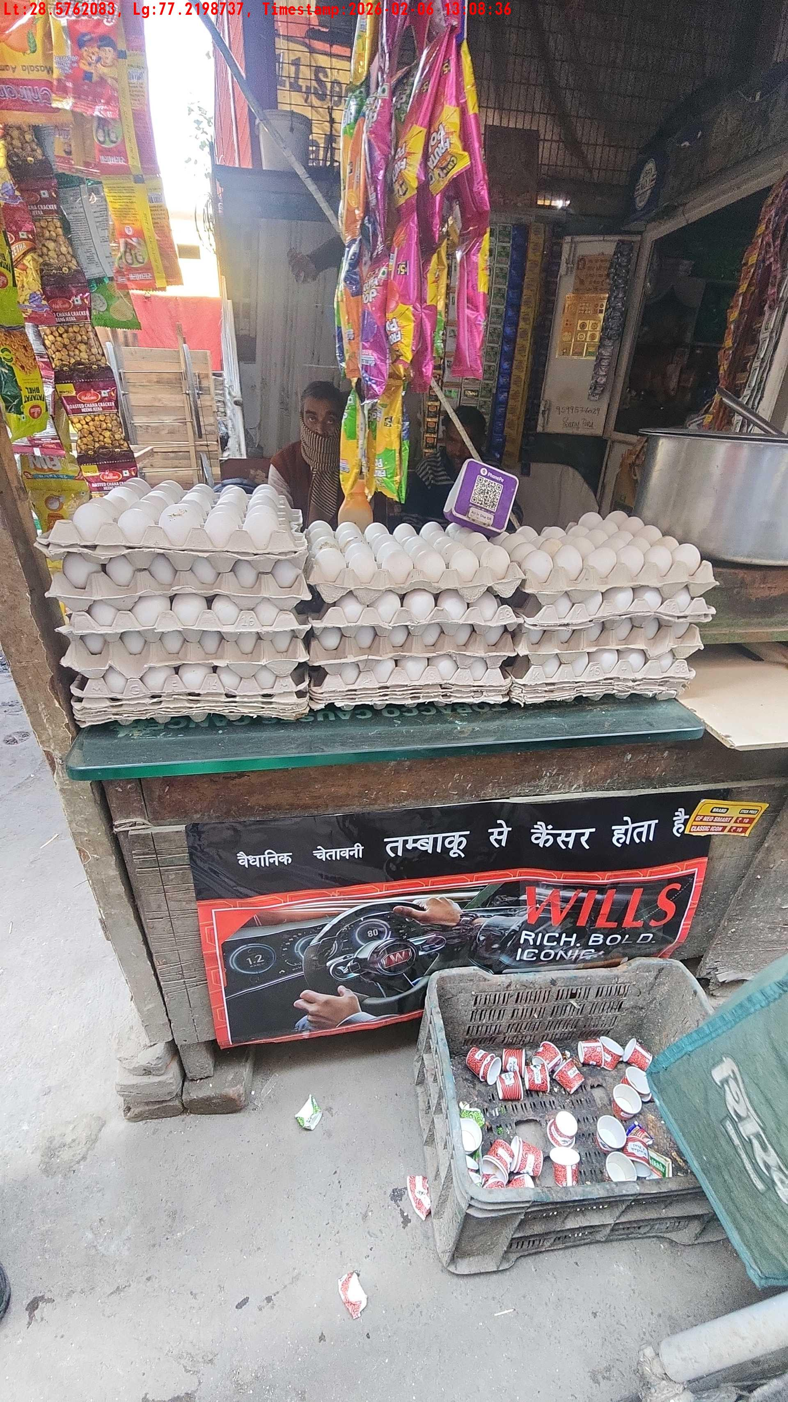
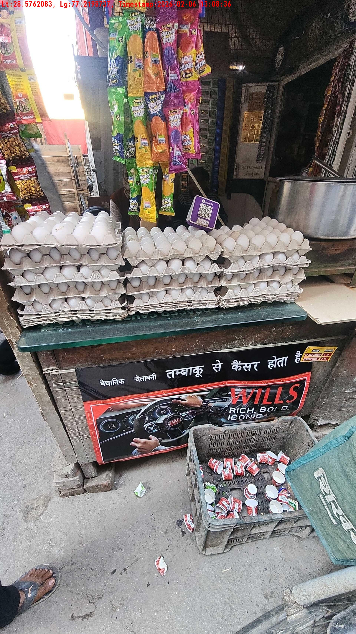
WD Code | Team Id | Team | Shop Name | Owner Mobile Number | Shop Address | Brand | Date Time
abc | 4601 | Bhagwat | Mohit baisla |  |  | Navy Cut | 06-02-2026 01:08:36 PM
Pre Shop Photo
Post Shop Photo

Slide 14
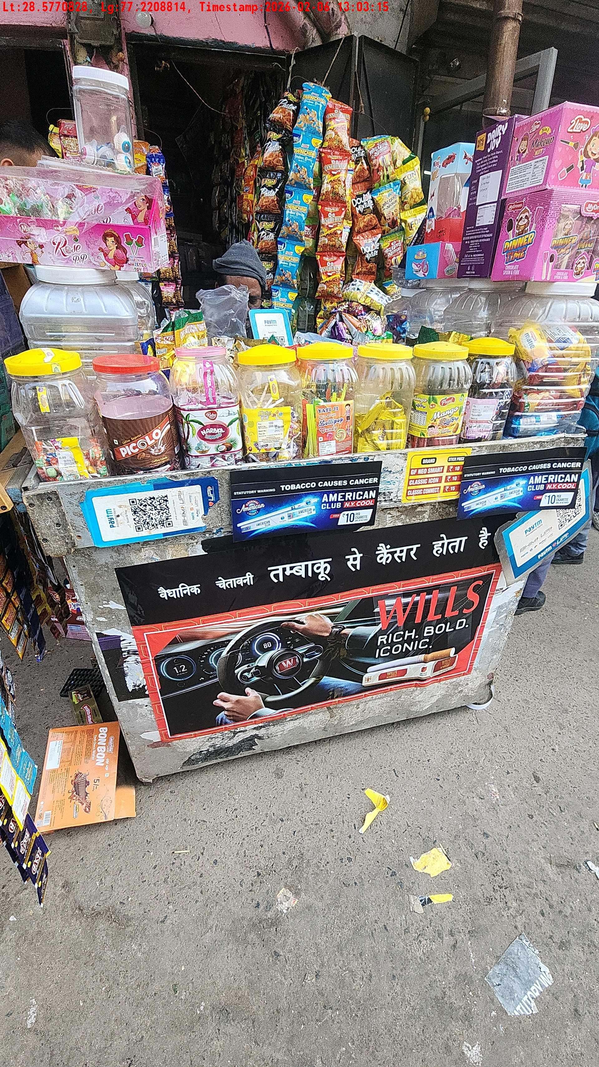
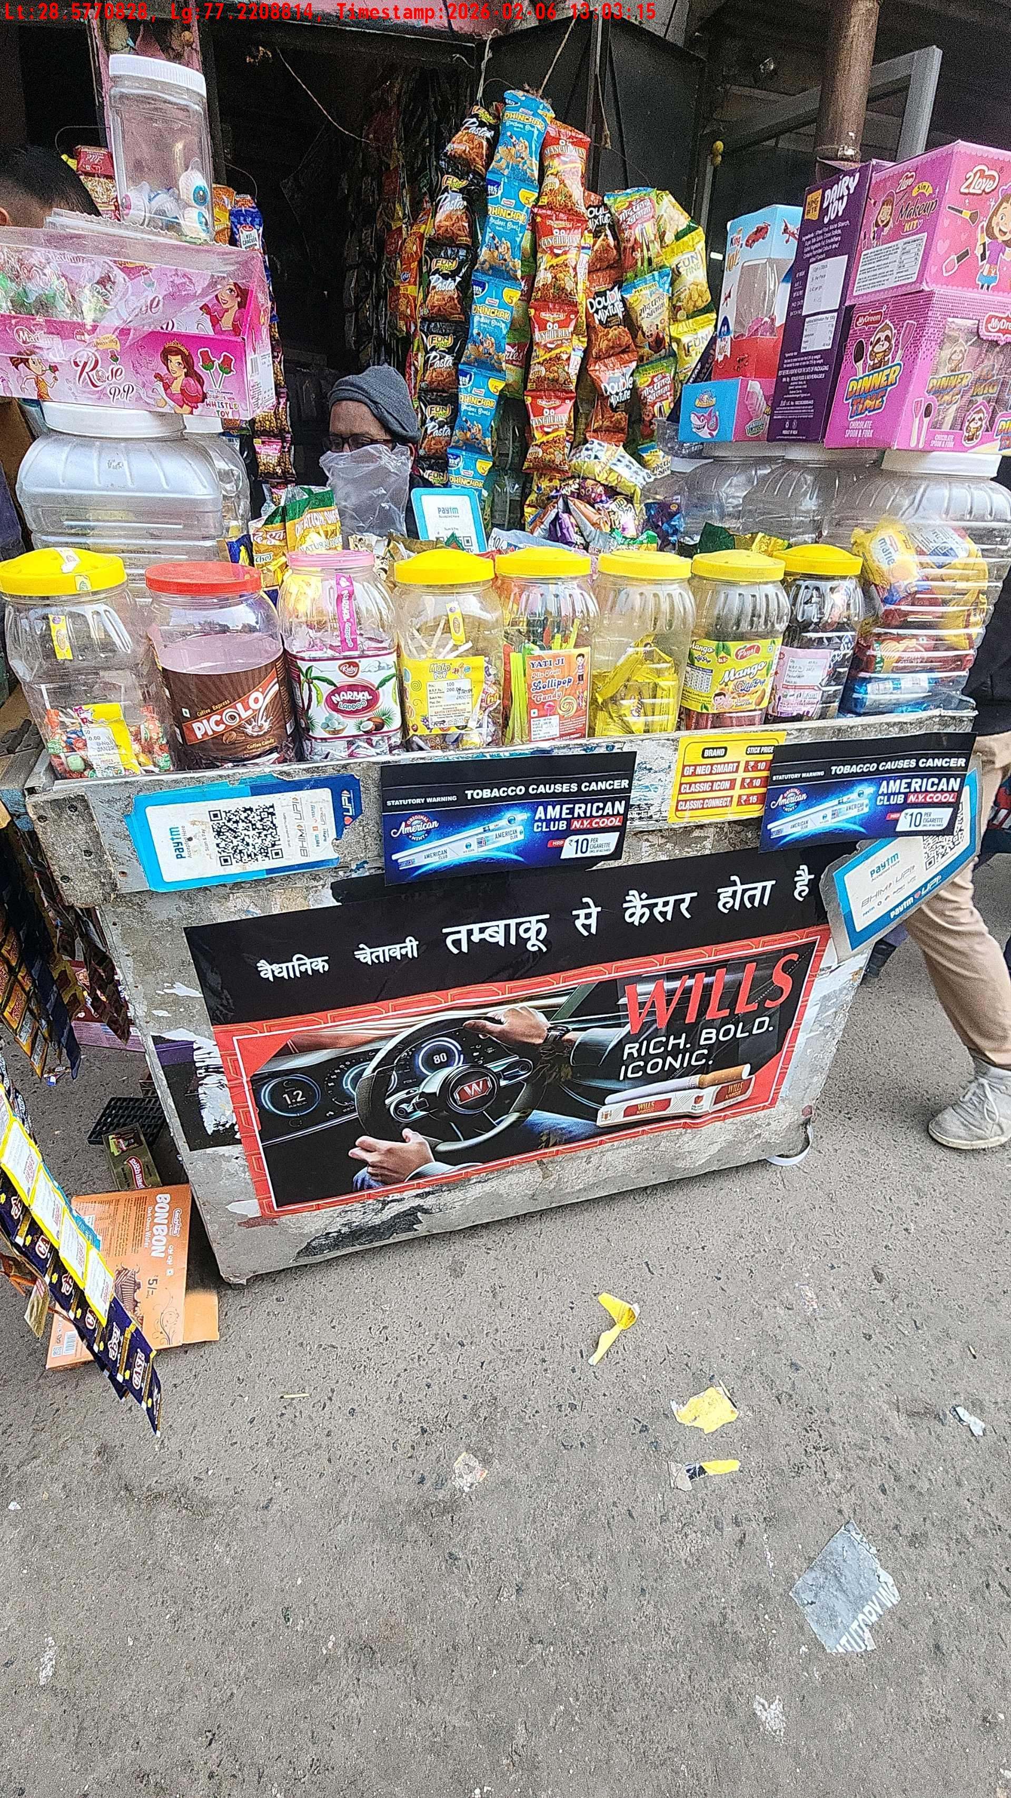
WD Code | Team Id | Team | Shop Name | Owner Mobile Number | Shop Address | Brand | Date Time
abc | 4601 | Bhagwat | pandit ji |  |  | Navy Cut | 06-02-2026 01:03:15 PM
Pre Shop Photo
Post Shop Photo

Slide 15
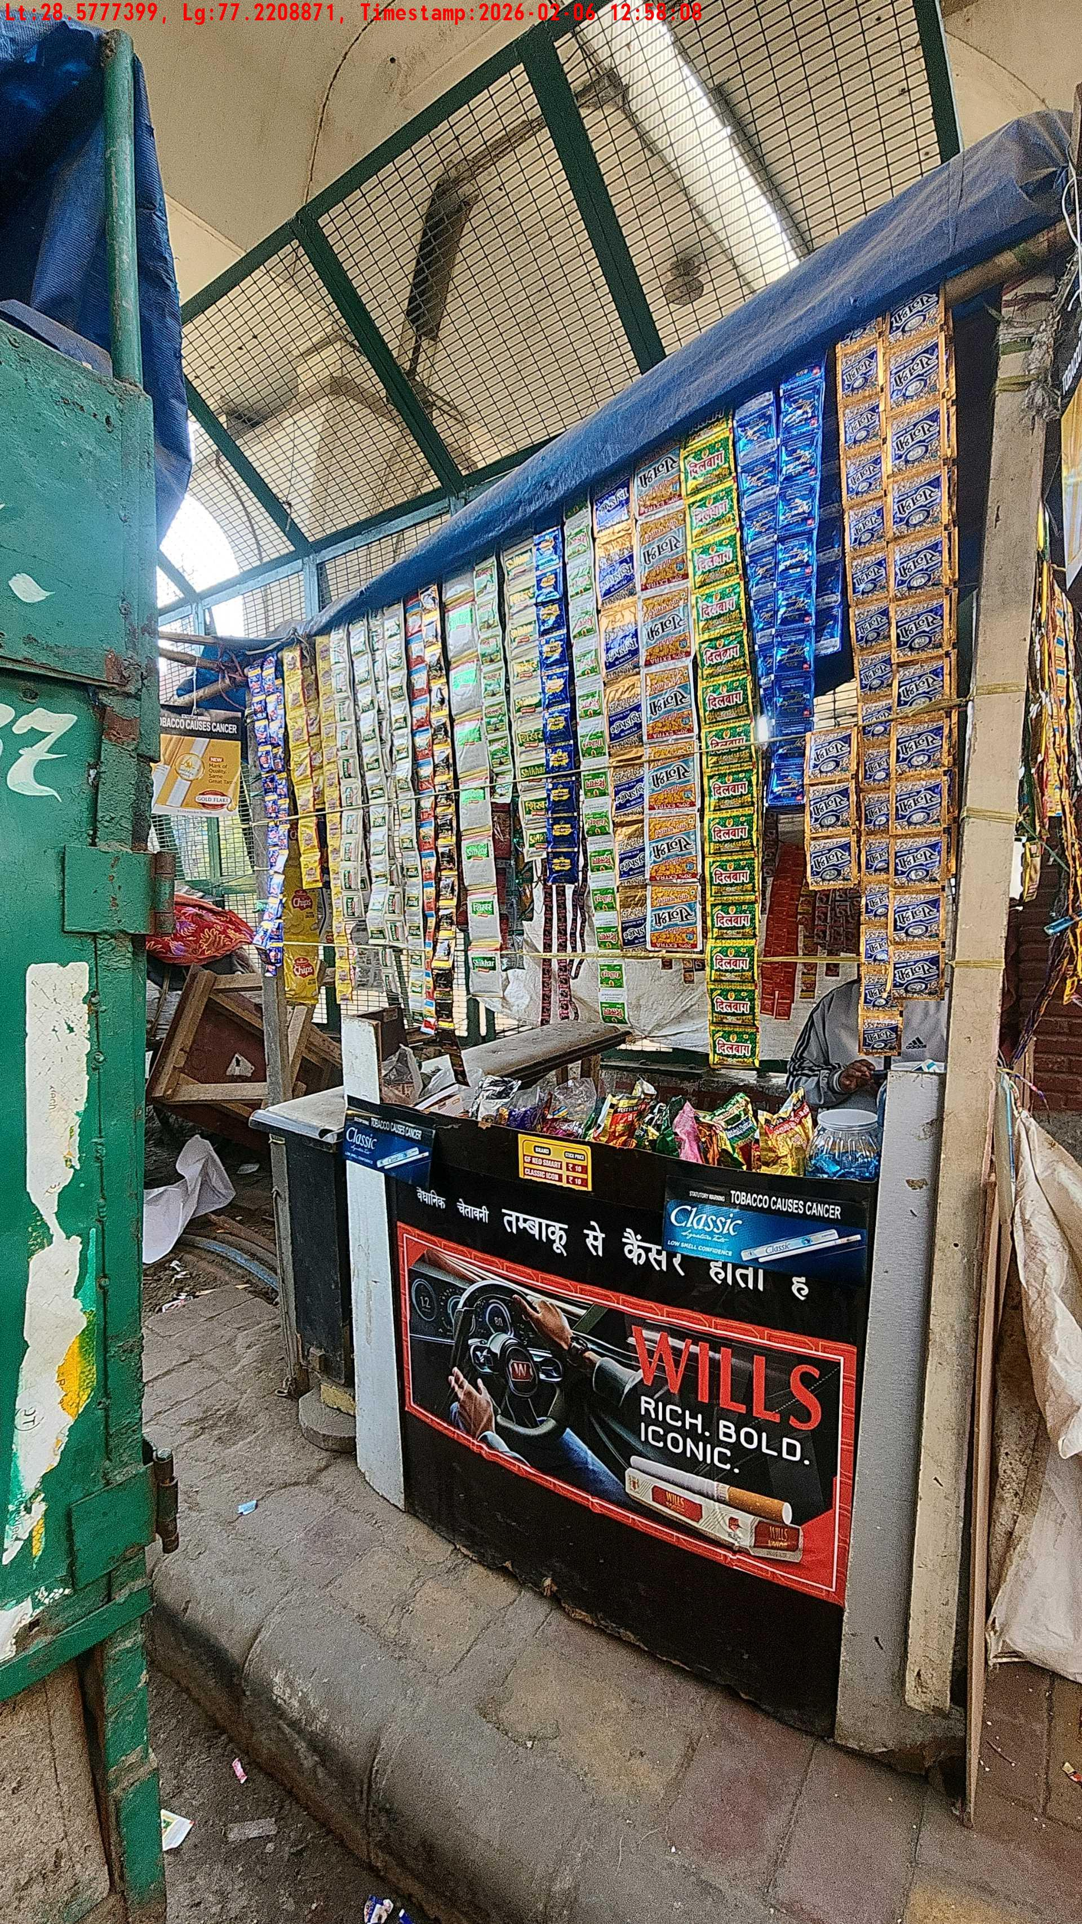
WD Code | Team Id | Team | Shop Name | Owner Mobile Number | Shop Address | Brand | Date Time
abc | 4601 | Bhagwat | harsh dev |  |  | Navy Cut | 06-02-2026 12:58:08 PM
Post Shop Photo

Slide 16
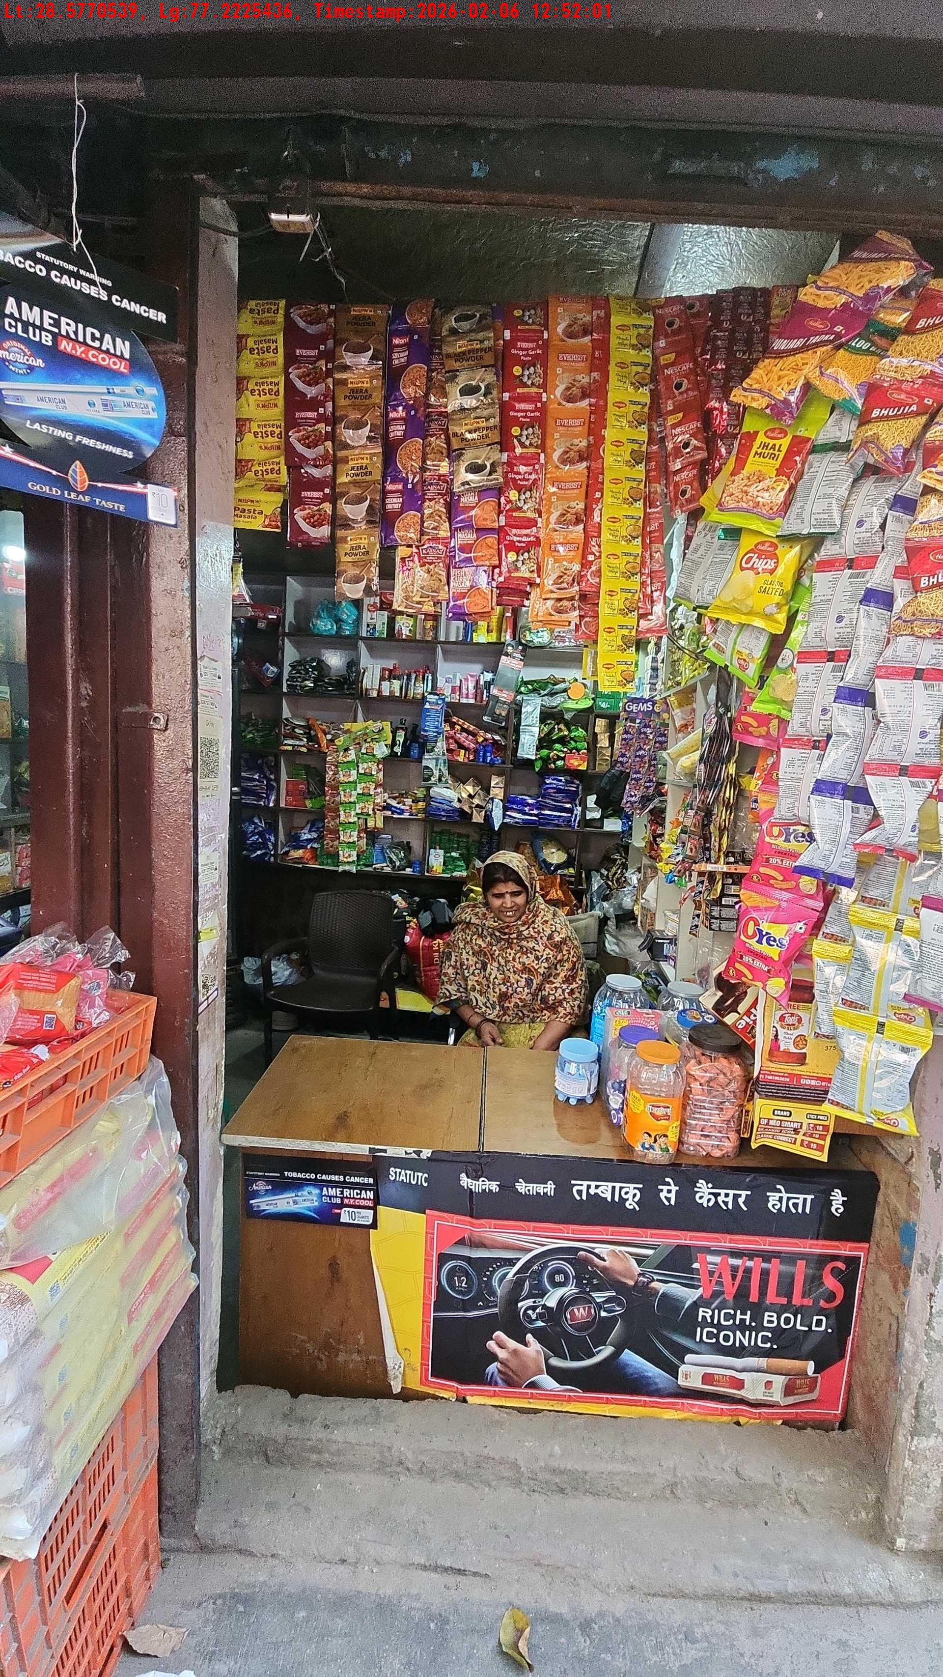
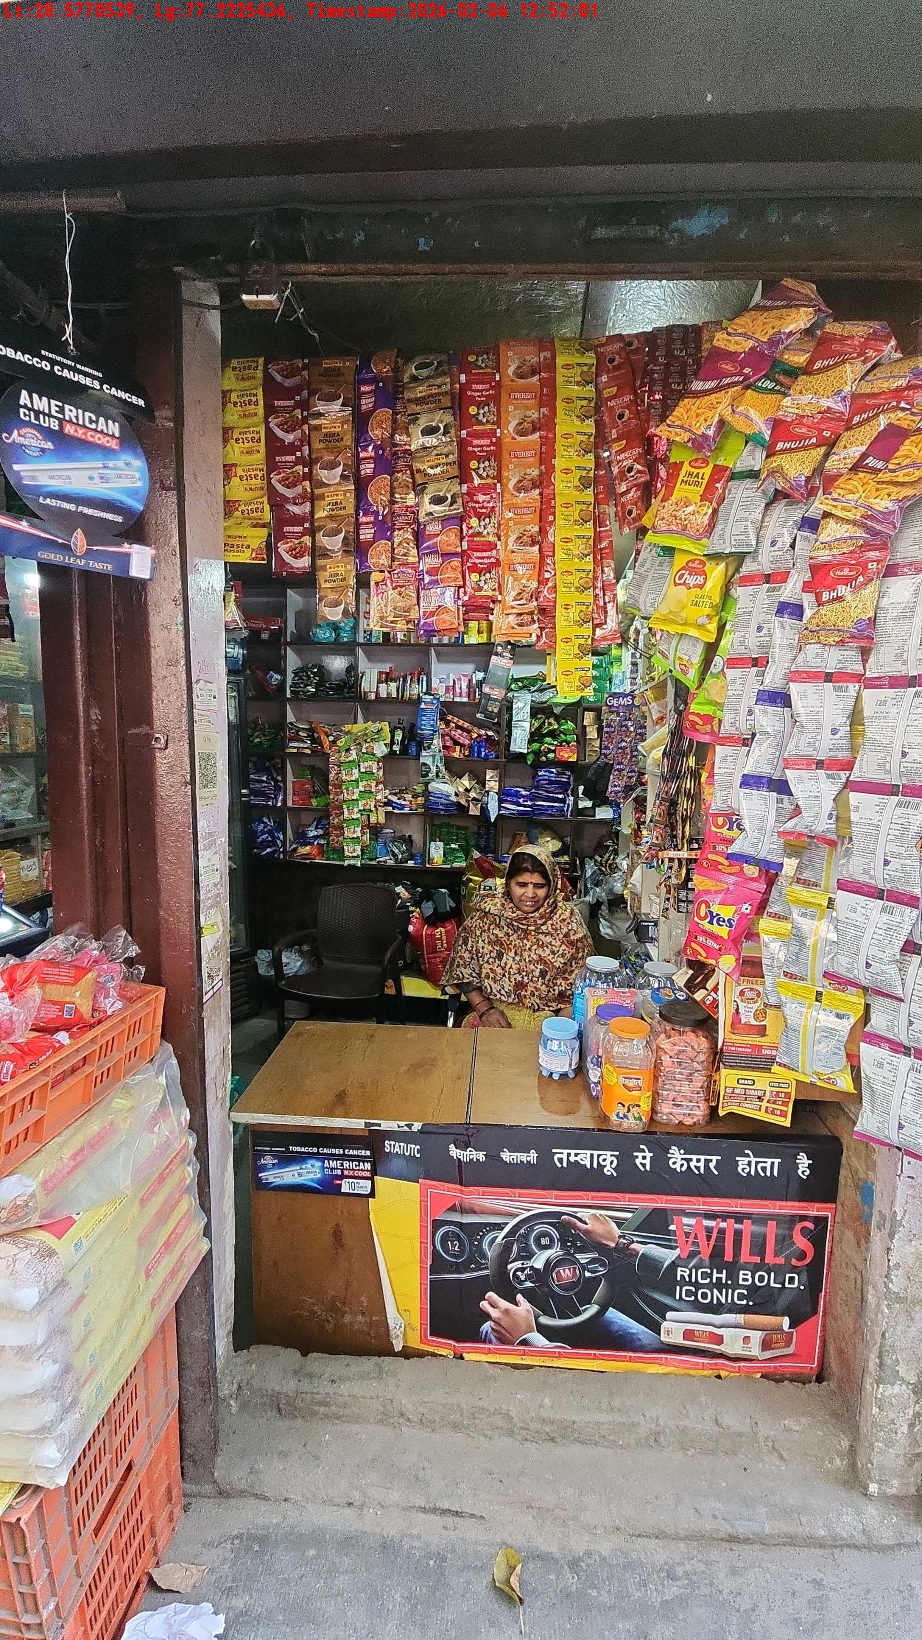
WD Code | Team Id | Team | Shop Name | Owner Mobile Number | Shop Address | Brand | Date Time
abc | 4601 | Bhagwat | Rohit |  |  | Navy Cut | 06-02-2026 12:52:01 PM
Pre Shop Photo
Post Shop Photo

Slide 17
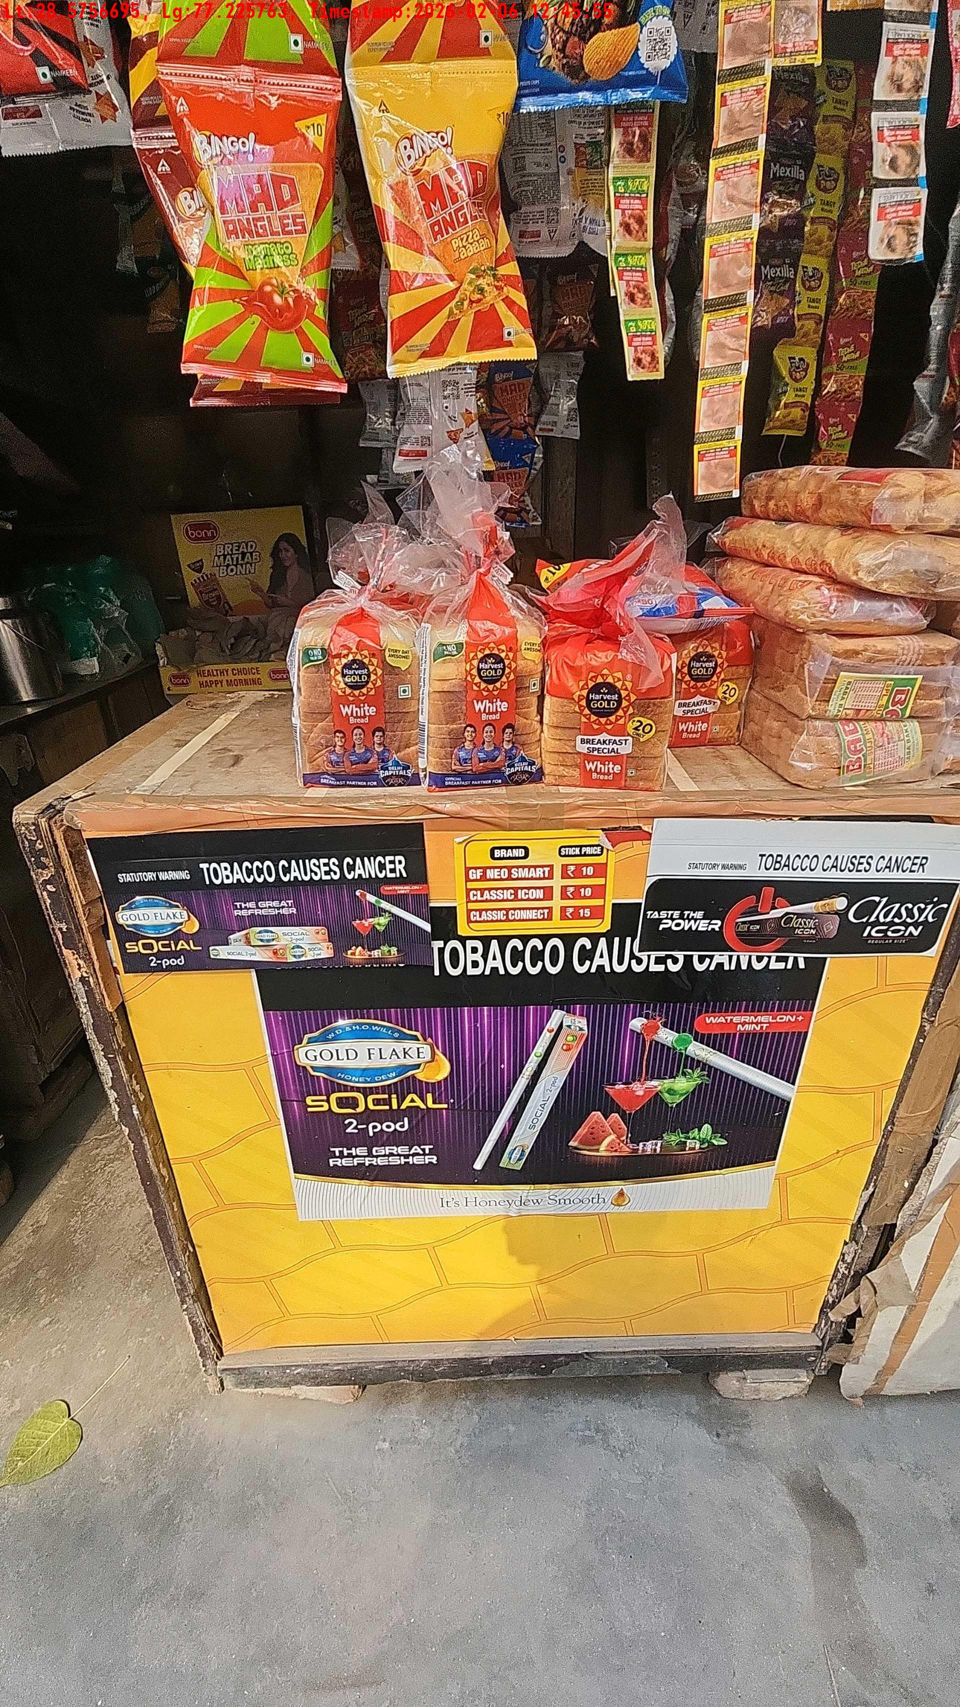
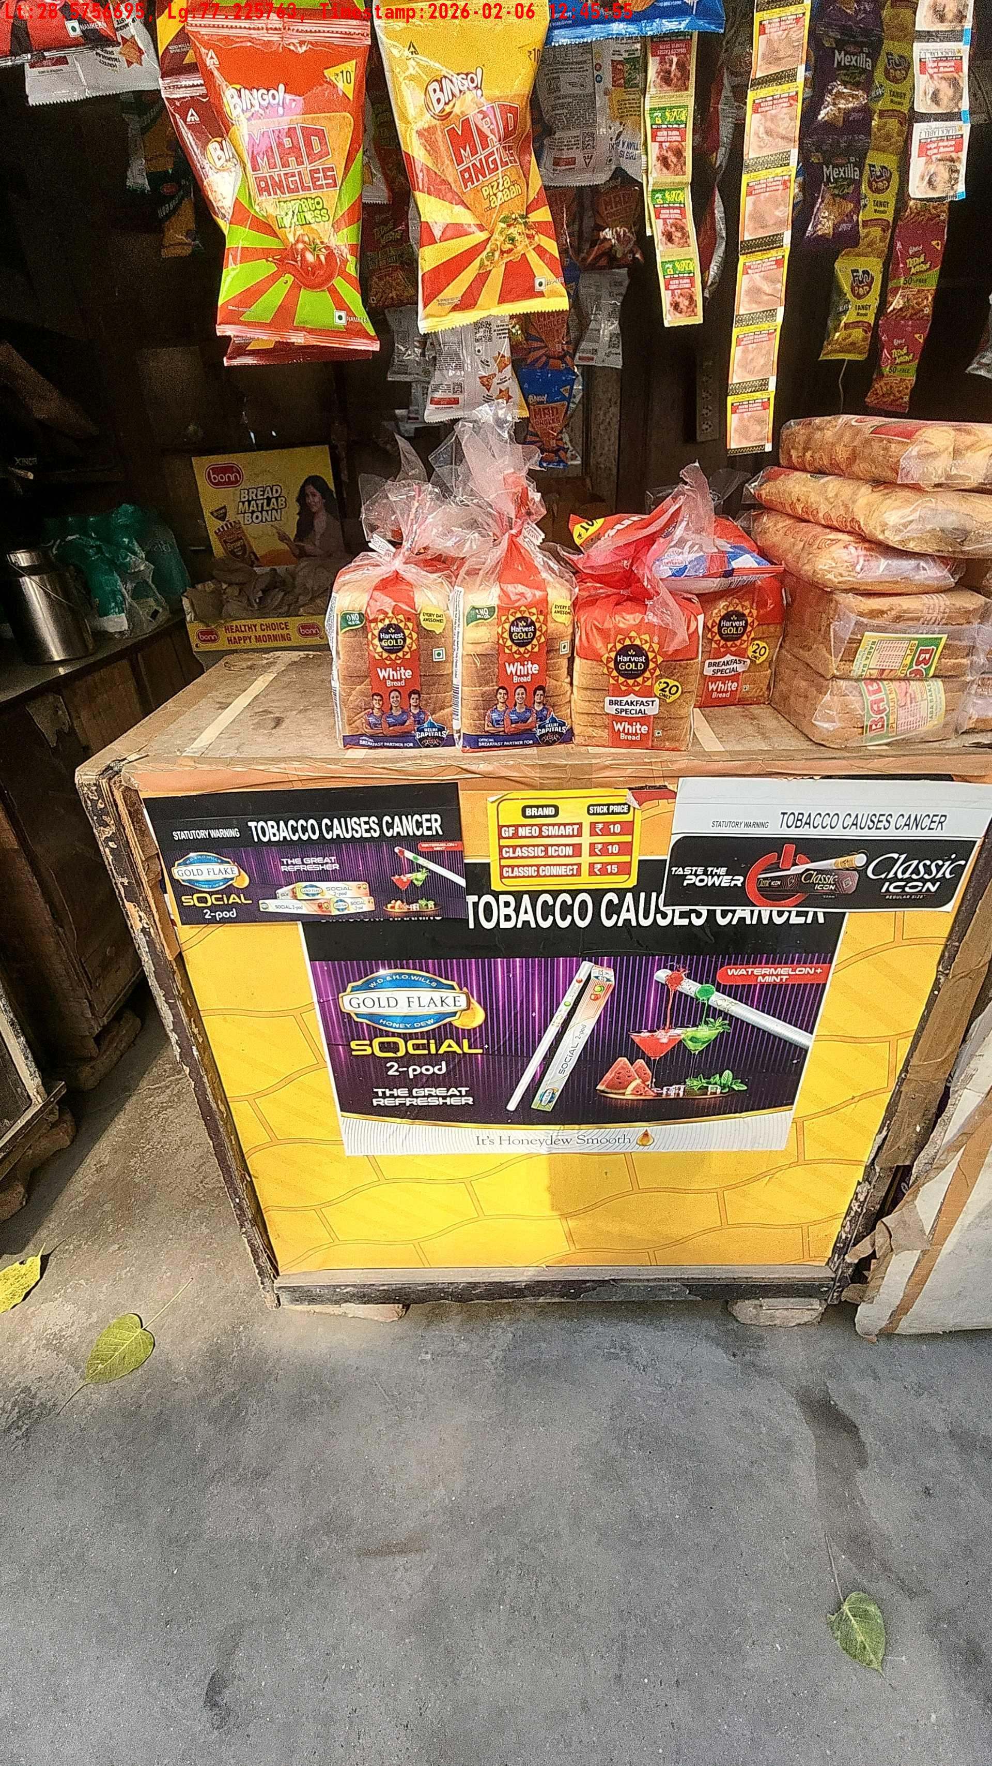
WD Code | Team Id | Team | Shop Name | Owner Mobile Number | Shop Address | Brand | Date Time
abc | 4601 | Bhagwat | rohan |  |  | Price Sticker | 06-02-2026 12:45:55 PM
Pre Shop Photo
Post Shop Photo

Slide 18
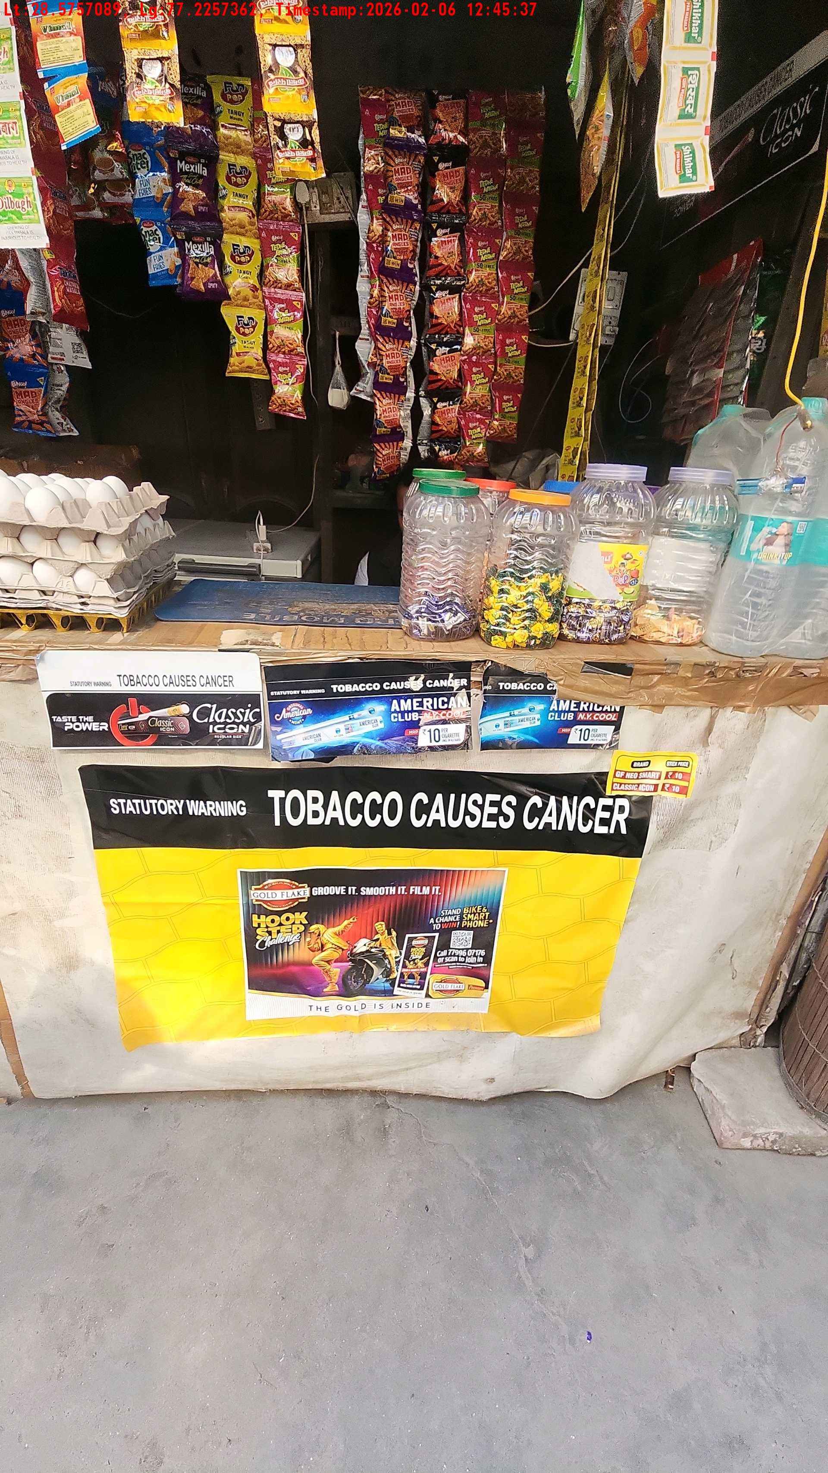
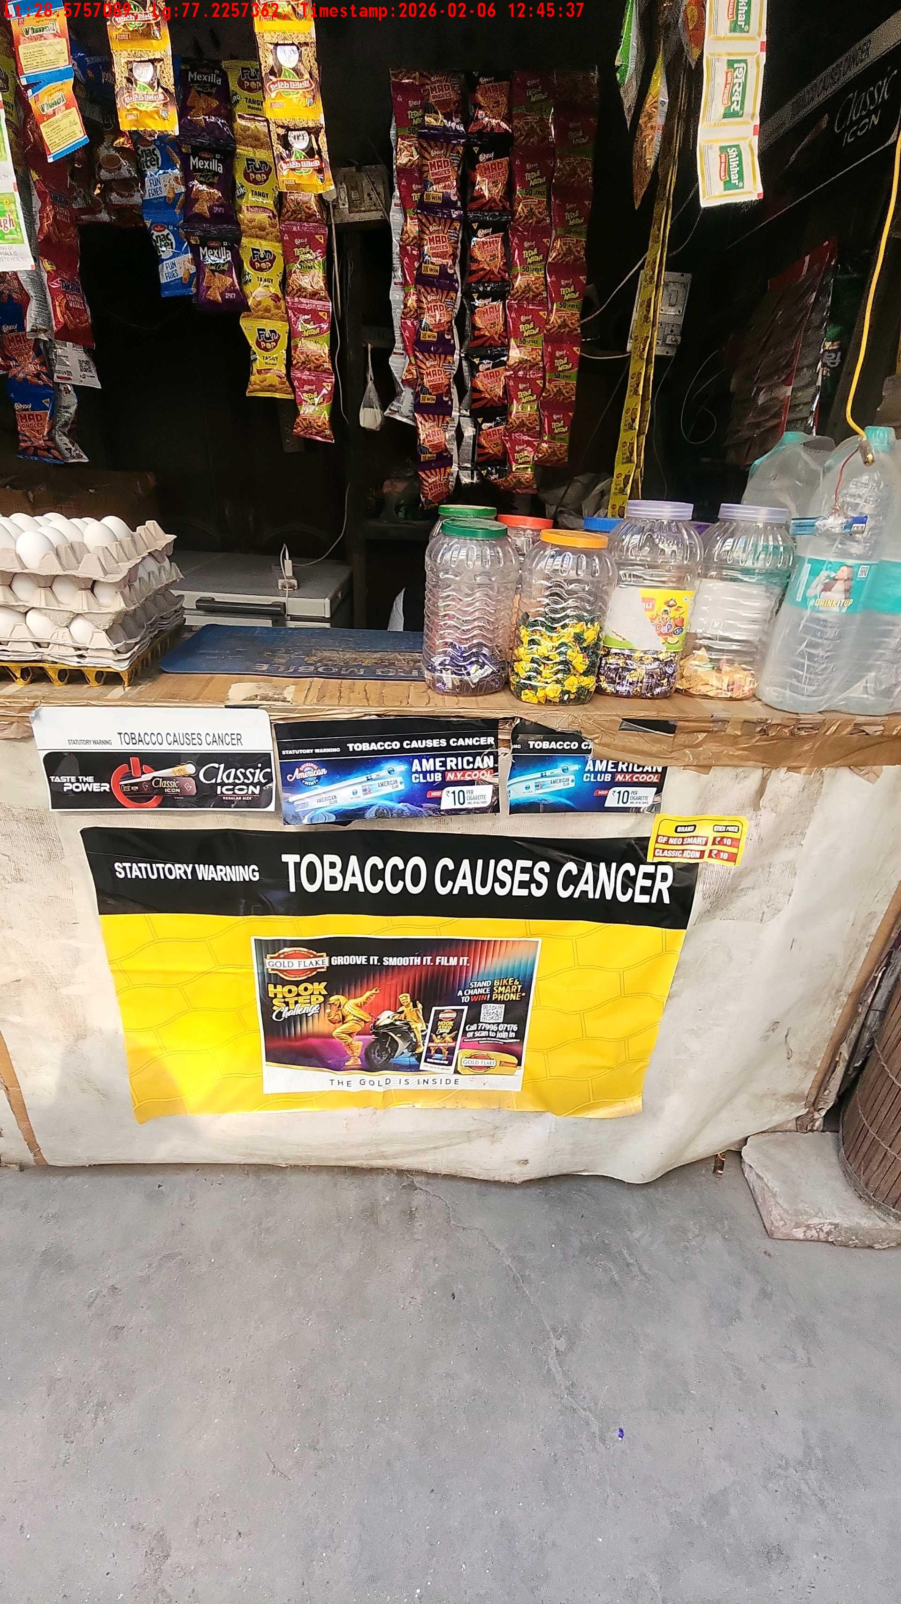
WD Code | Team Id | Team | Shop Name | Owner Mobile Number | Shop Address | Brand | Date Time
abc | 4601 | Bhagwat | sahil |  |  | Gold Flake Neo Smart | 06-02-2026 12:45:37 PM
Pre Shop Photo
Post Shop Photo

Slide 19
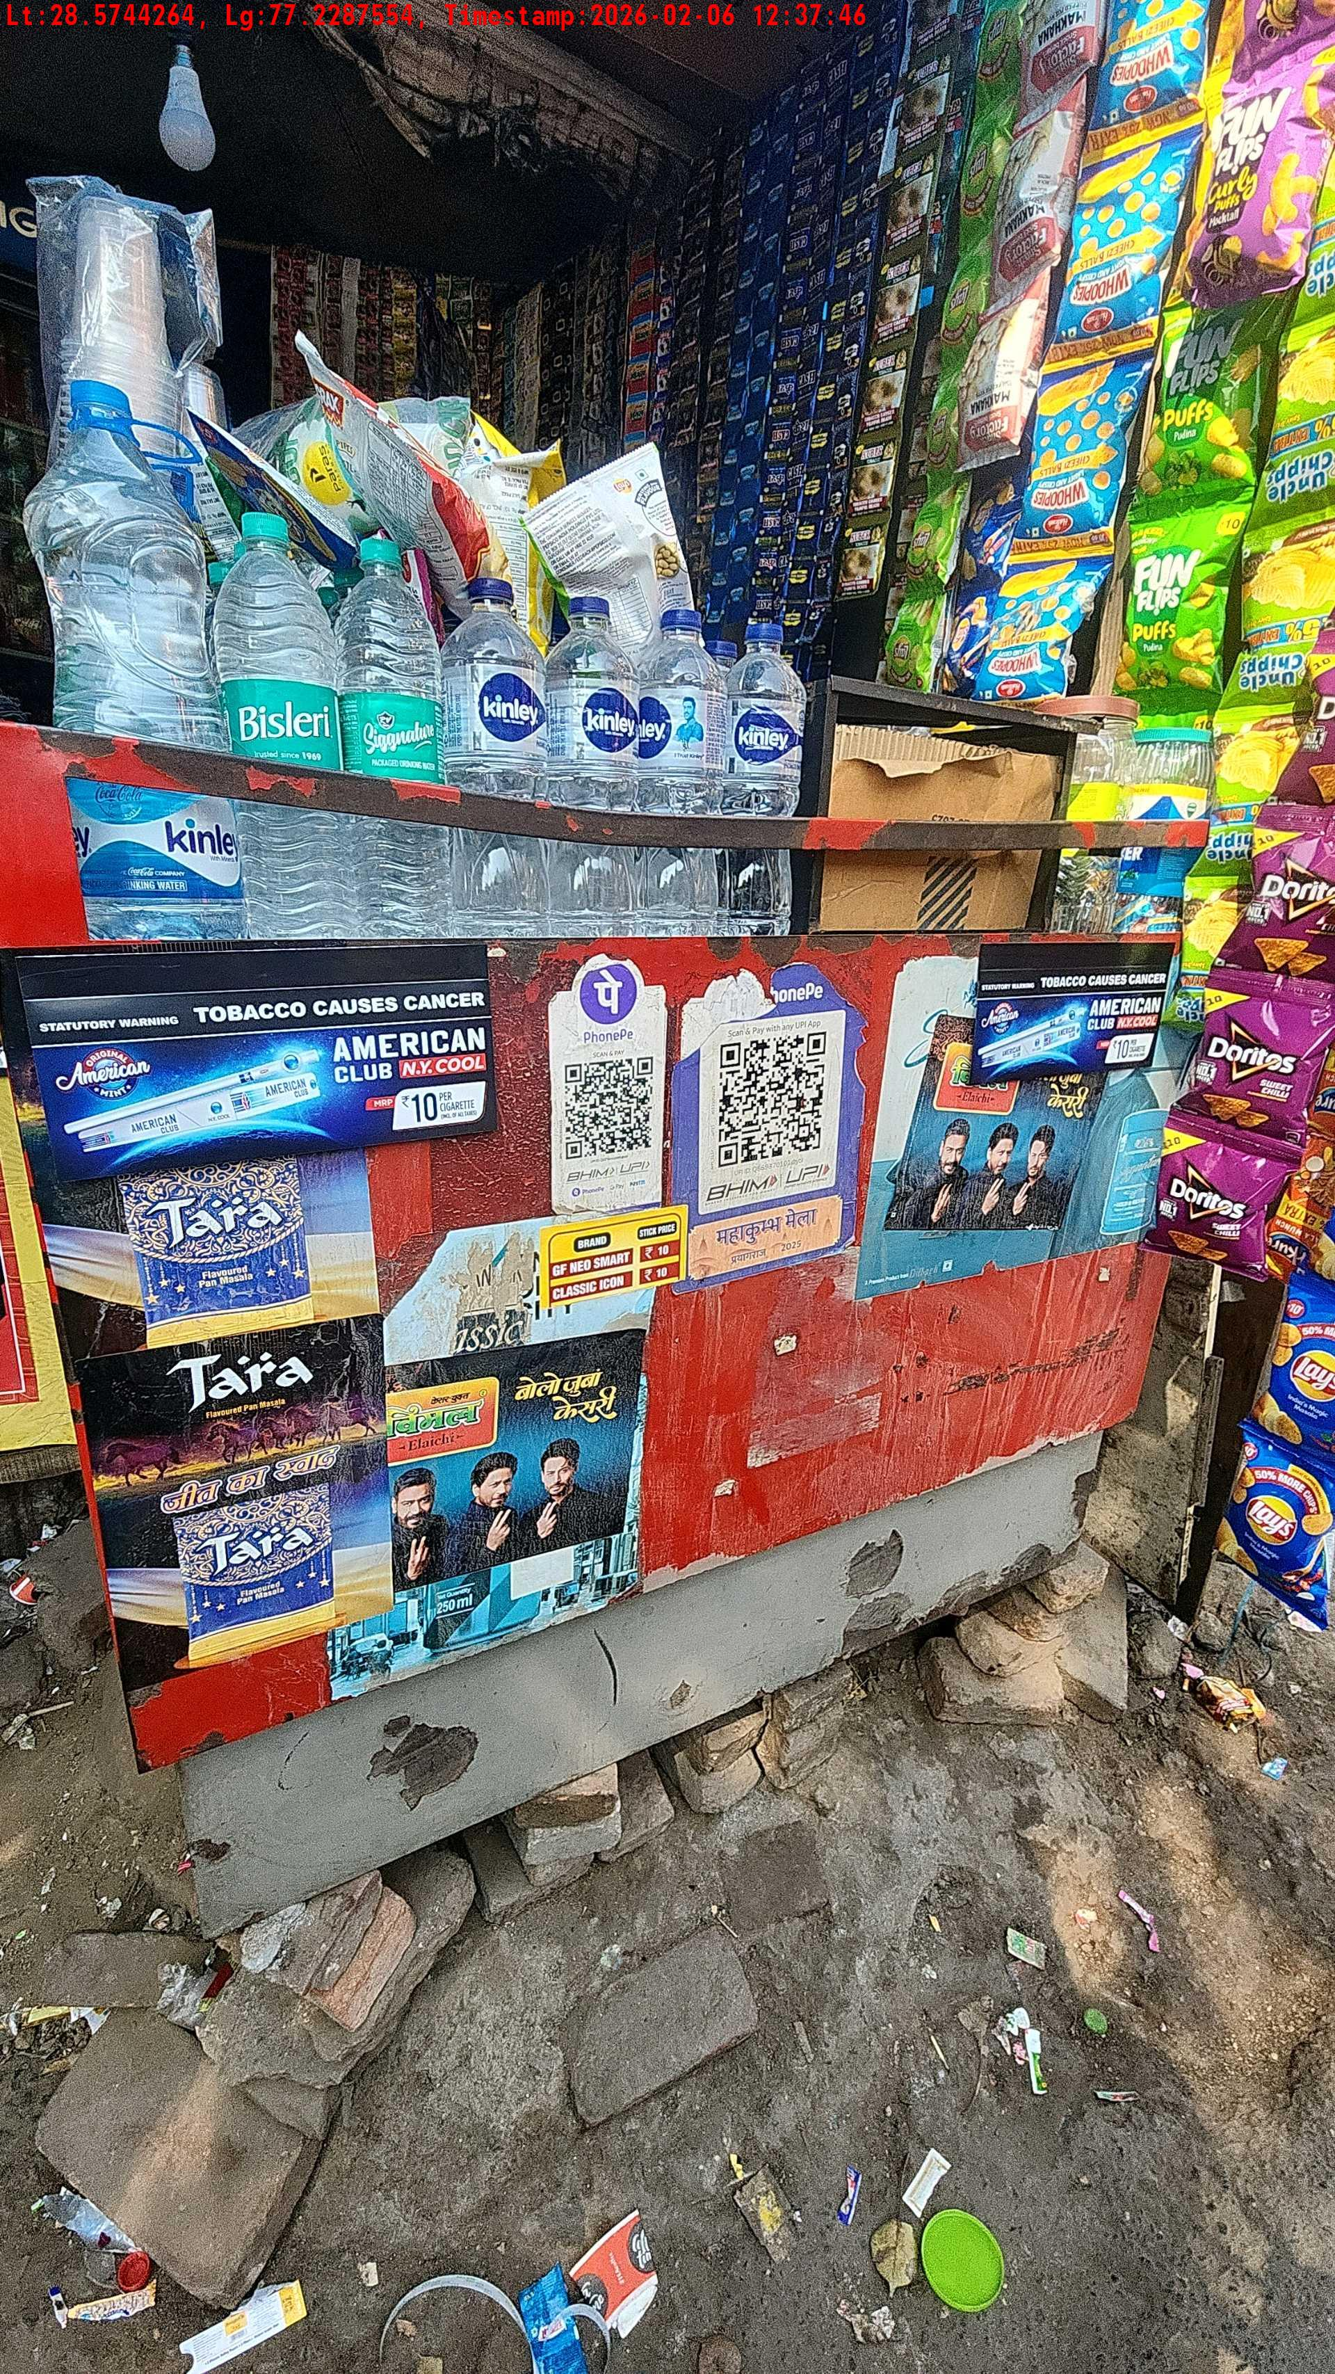
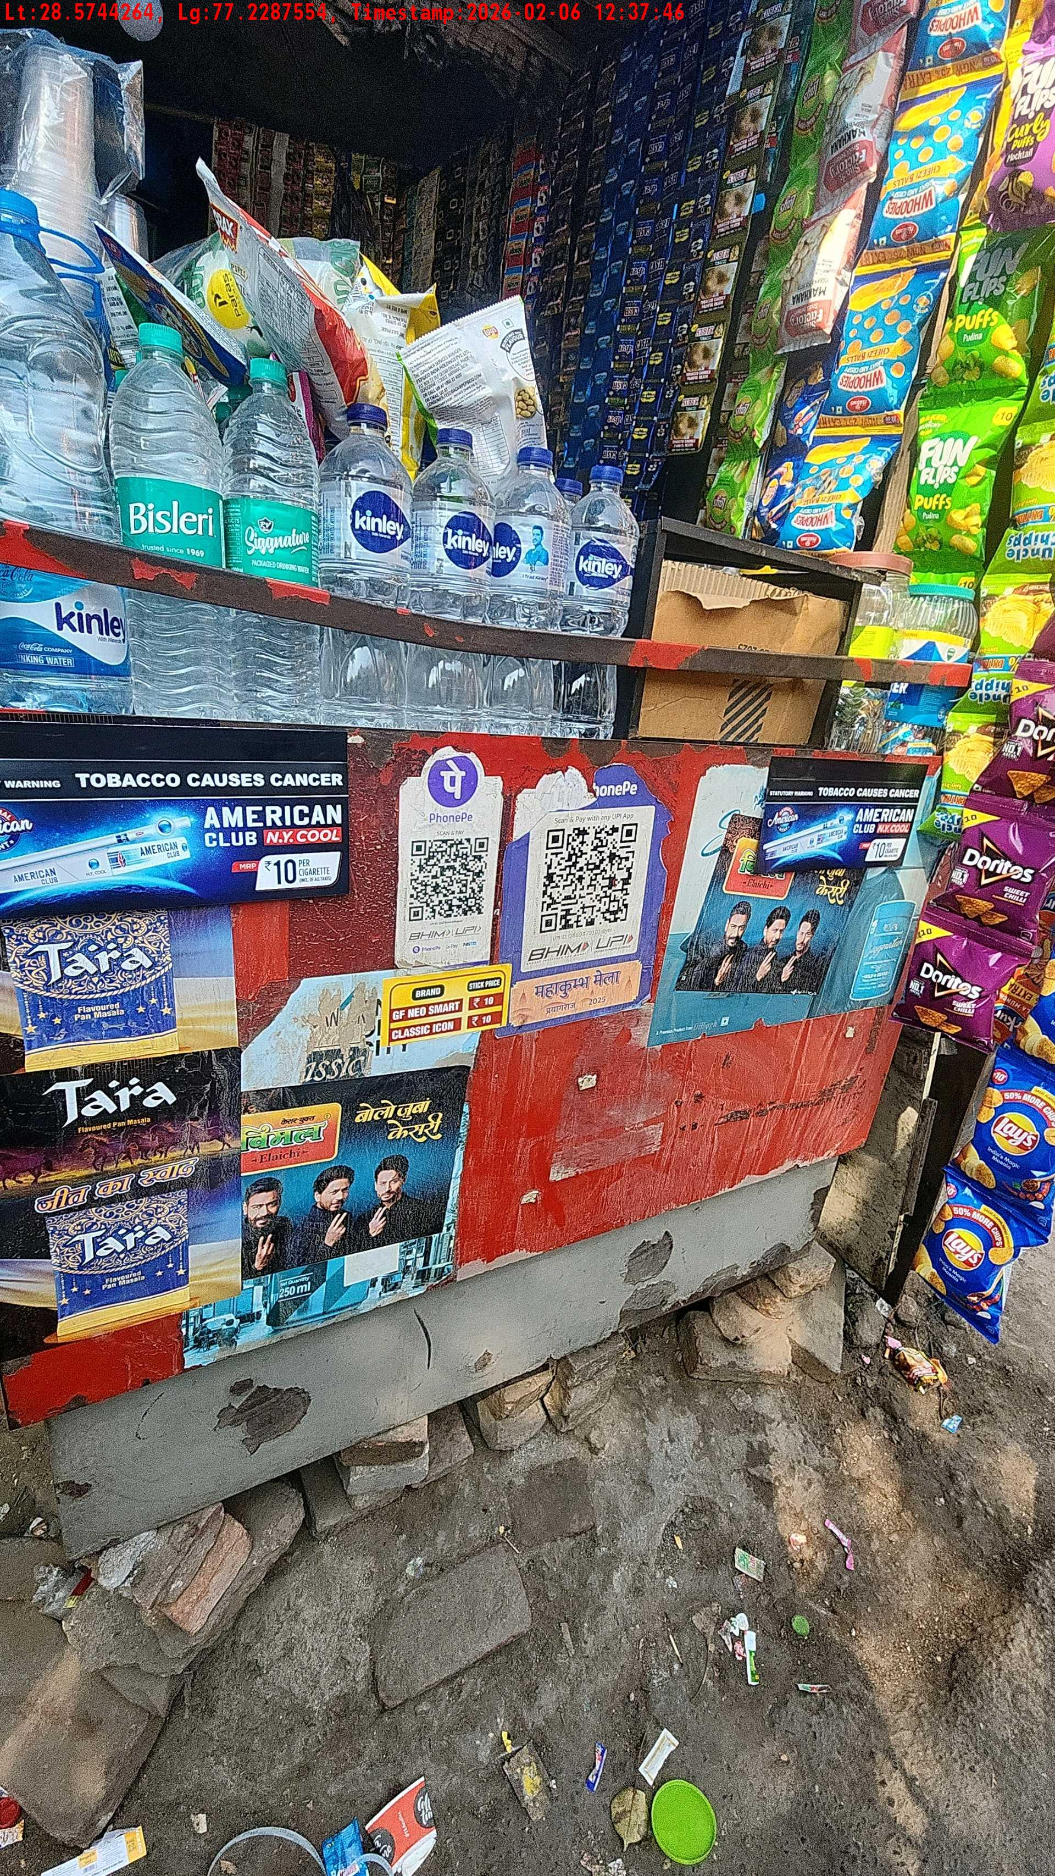
WD Code | Team Id | Team | Shop Name | Owner Mobile Number | Shop Address | Brand | Date Time
abc | 4601 | Bhagwat | virendra |  |  | Price Sticker | 06-02-2026 12:37:46 PM
Pre Shop Photo
Post Shop Photo

Slide 20
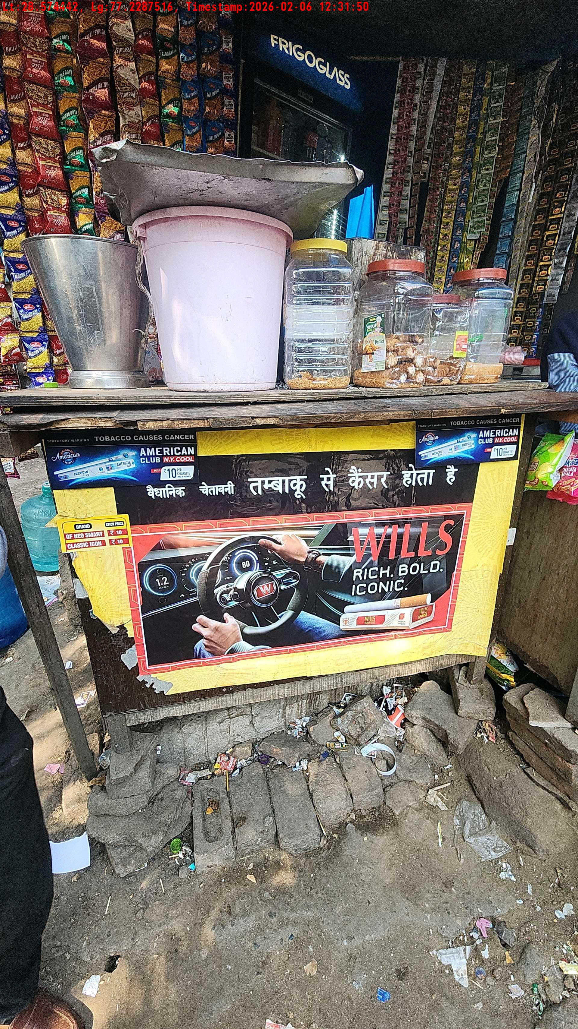
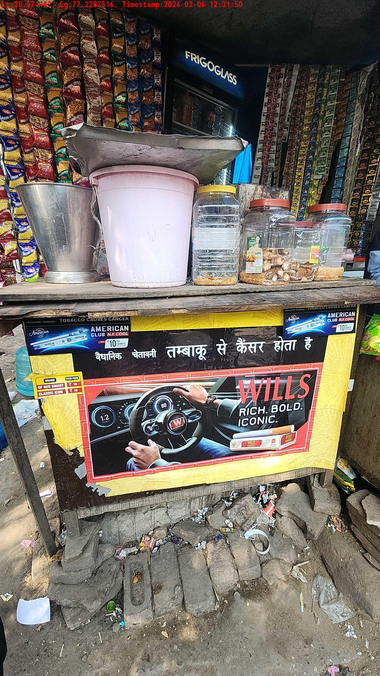
WD Code | Team Id | Team | Shop Name | Owner Mobile Number | Shop Address | Brand | Date Time
abc | 4601 | Bhagwat | biswas |  |  | Navy Cut | 06-02-2026 12:31:50 PM
Pre Shop Photo
Post Shop Photo

Slide 21
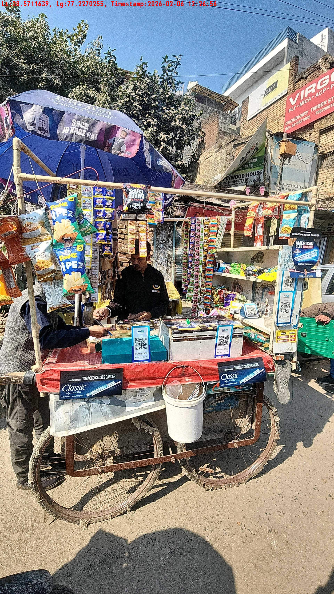
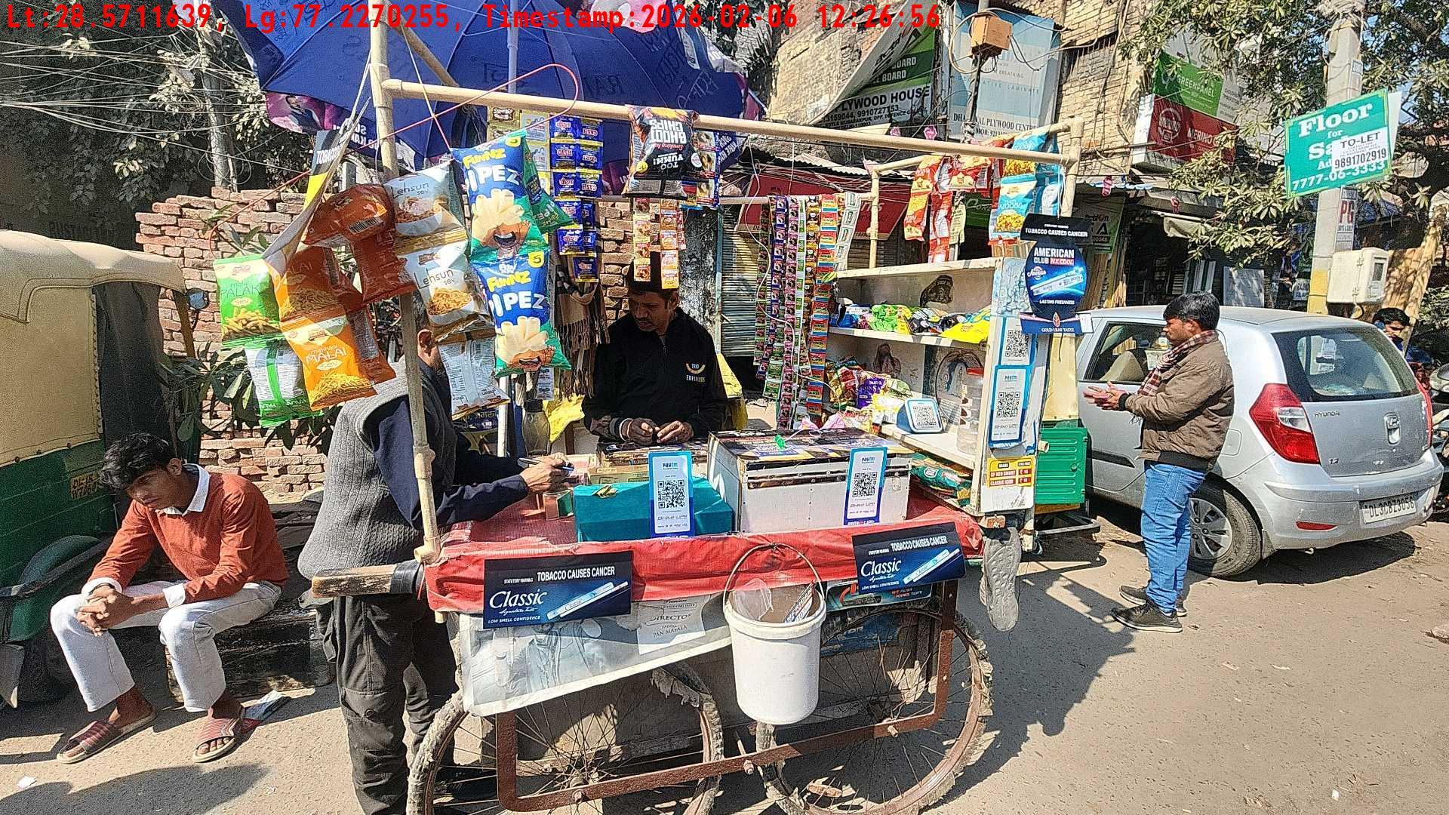
WD Code | Team Id | Team | Shop Name | Owner Mobile Number | Shop Address | Brand | Date Time
abc | 4601 | Bhagwat | rahul |  |  | Price Sticker | 06-02-2026 10:43:35 AM
Pre Shop Photo
Post Shop Photo

