Slide 1
Transaction Ppt

Slide 2
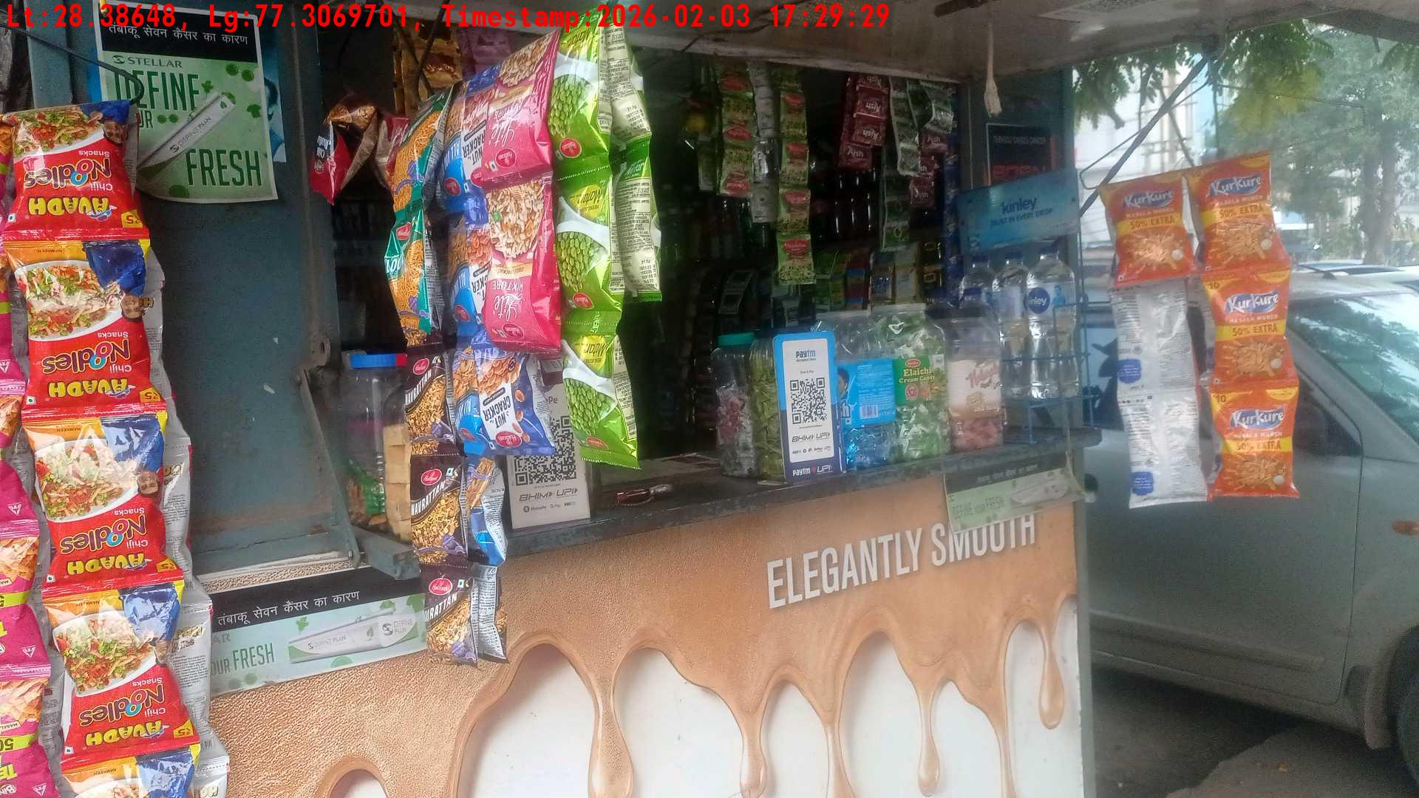
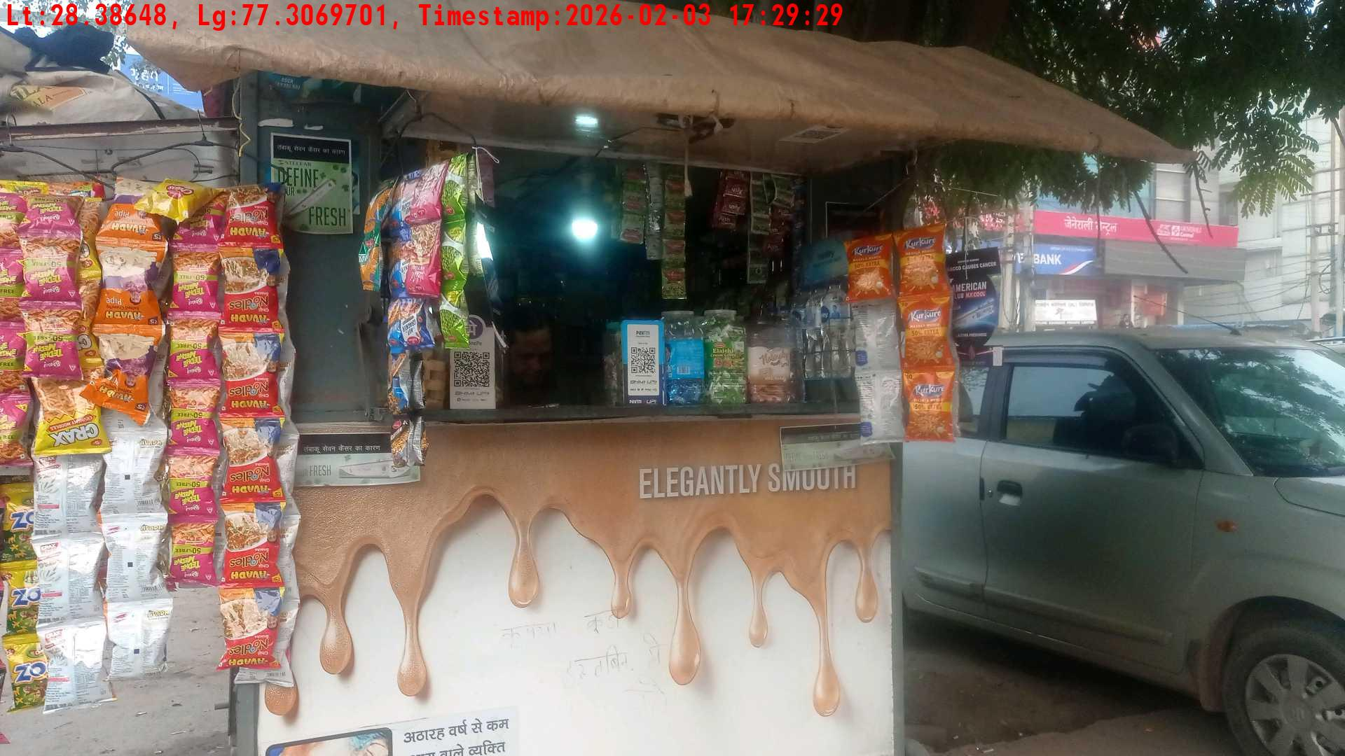
WD Code | Team Id | Team | Shop Name | Owner Mobile Number | Shop Address | Brand | Date Time
DE5493 | 3335 | Dilip | Ramesh | 9835949798 |  | Gold Flake Neo Smart | 03-02-2026 05:29:29 PM
Pre Shop Photo
Post Shop Photo

Slide 3
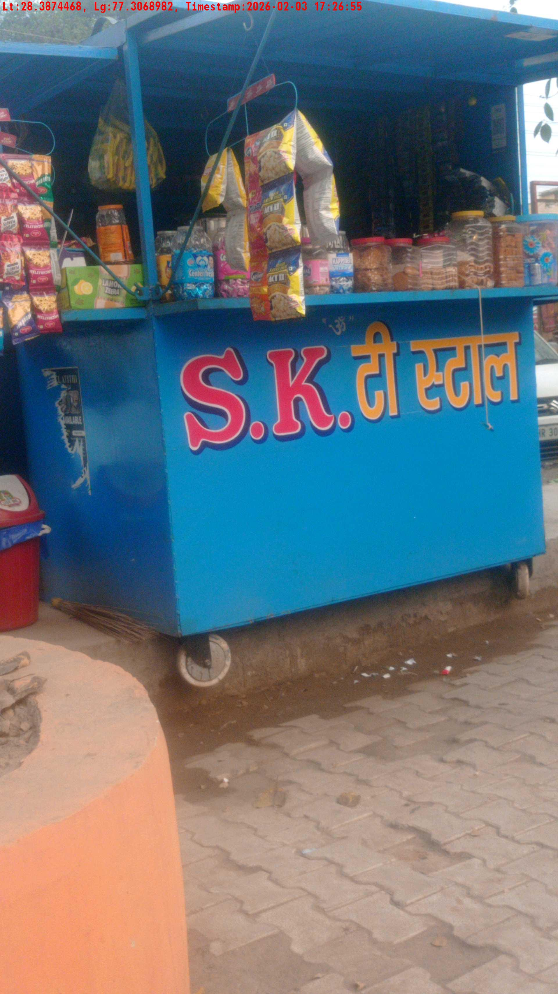
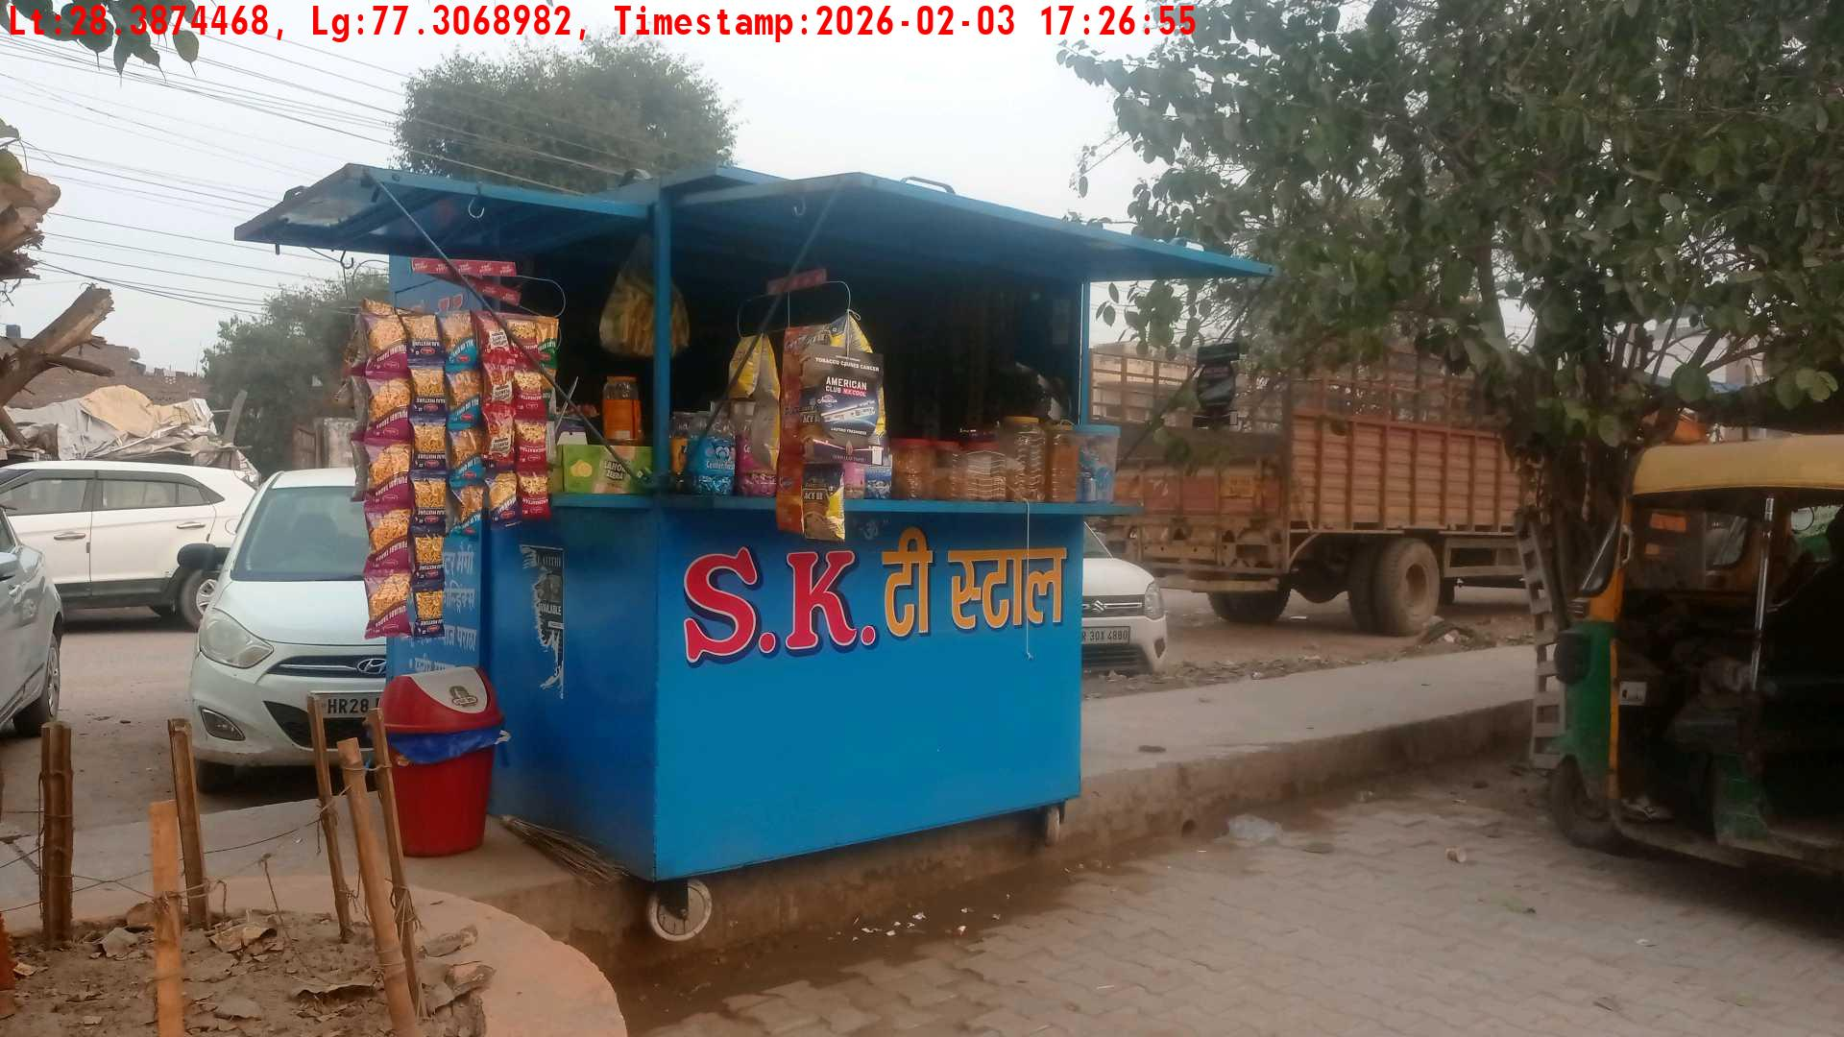
WD Code | Team Id | Team | Shop Name | Owner Mobile Number | Shop Address | Brand | Date Time
DE5493 | 3335 | Dilip | Ramesh | 9534656656 |  | Gold Flake Super Star | 03-02-2026 05:26:55 PM
Pre Shop Photo
Post Shop Photo

Slide 4
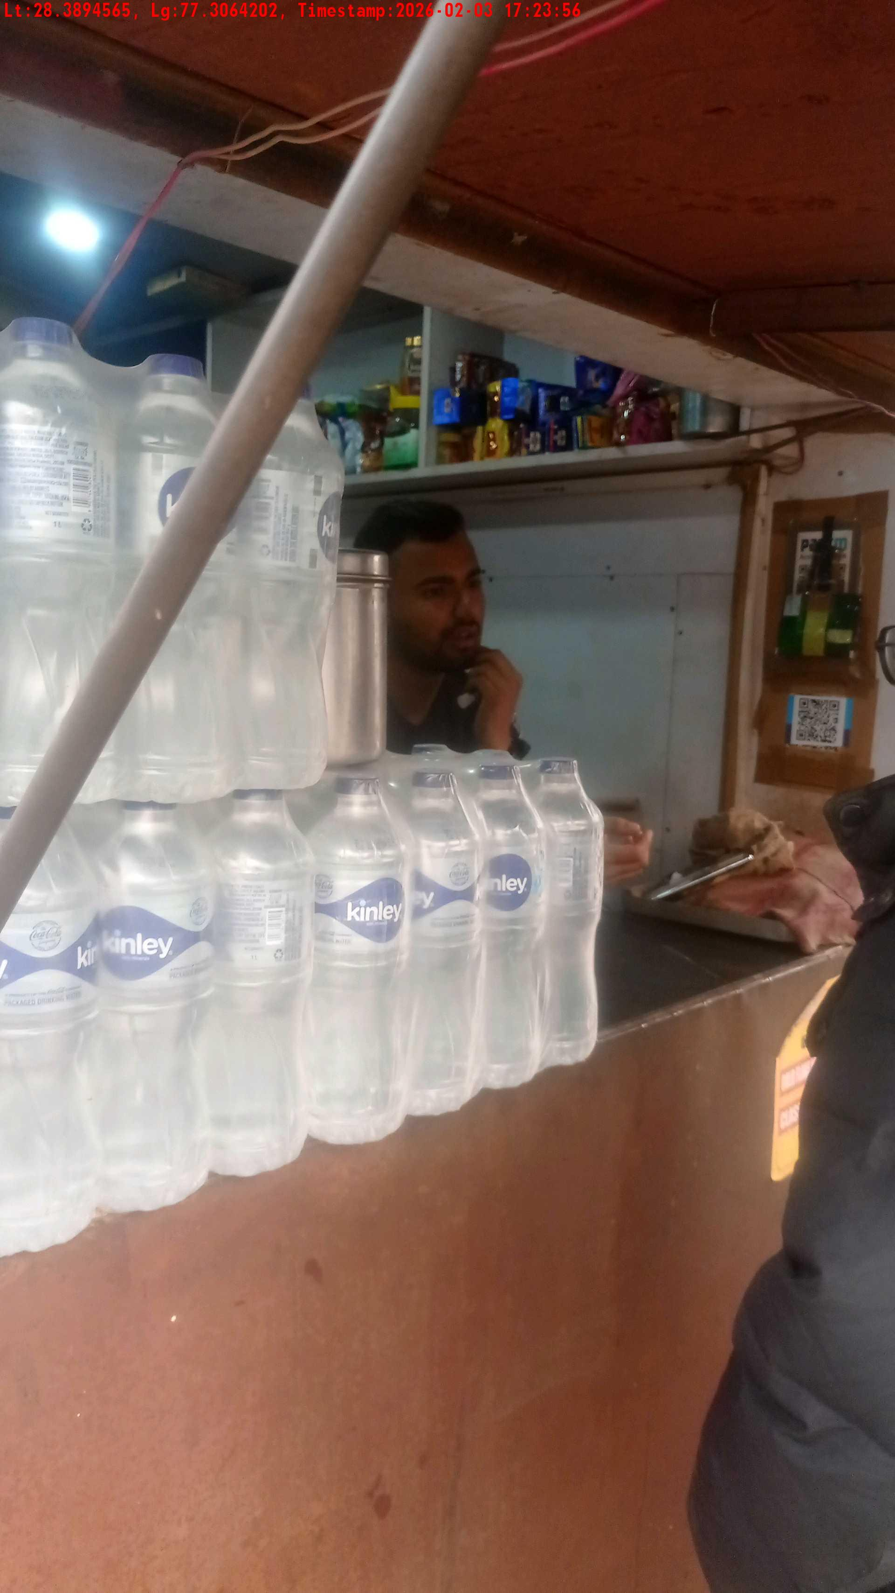
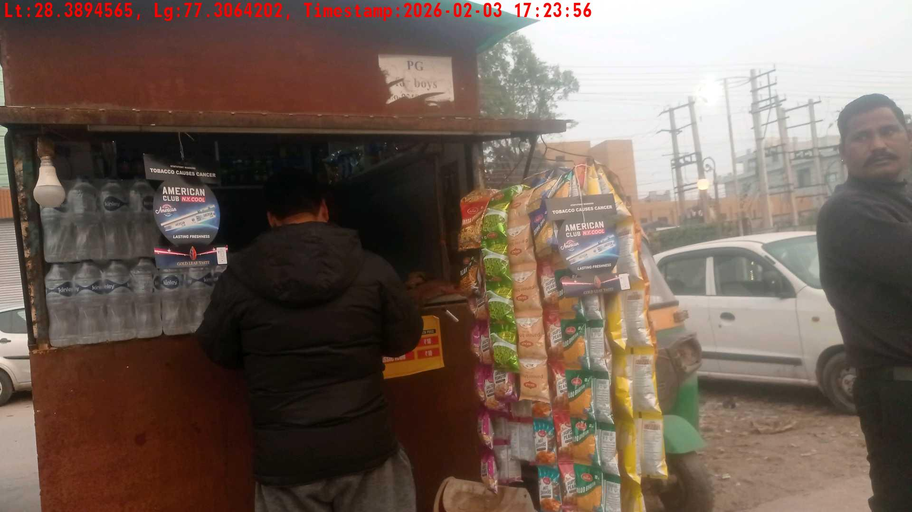
WD Code | Team Id | Team | Shop Name | Owner Mobile Number | Shop Address | Brand | Date Time
DE5493 | 3335 | Dilip | Ramesh | 9769464964 |  | Gold Flake Neo Smart | 03-02-2026 05:23:56 PM
Pre Shop Photo
Post Shop Photo

Slide 5
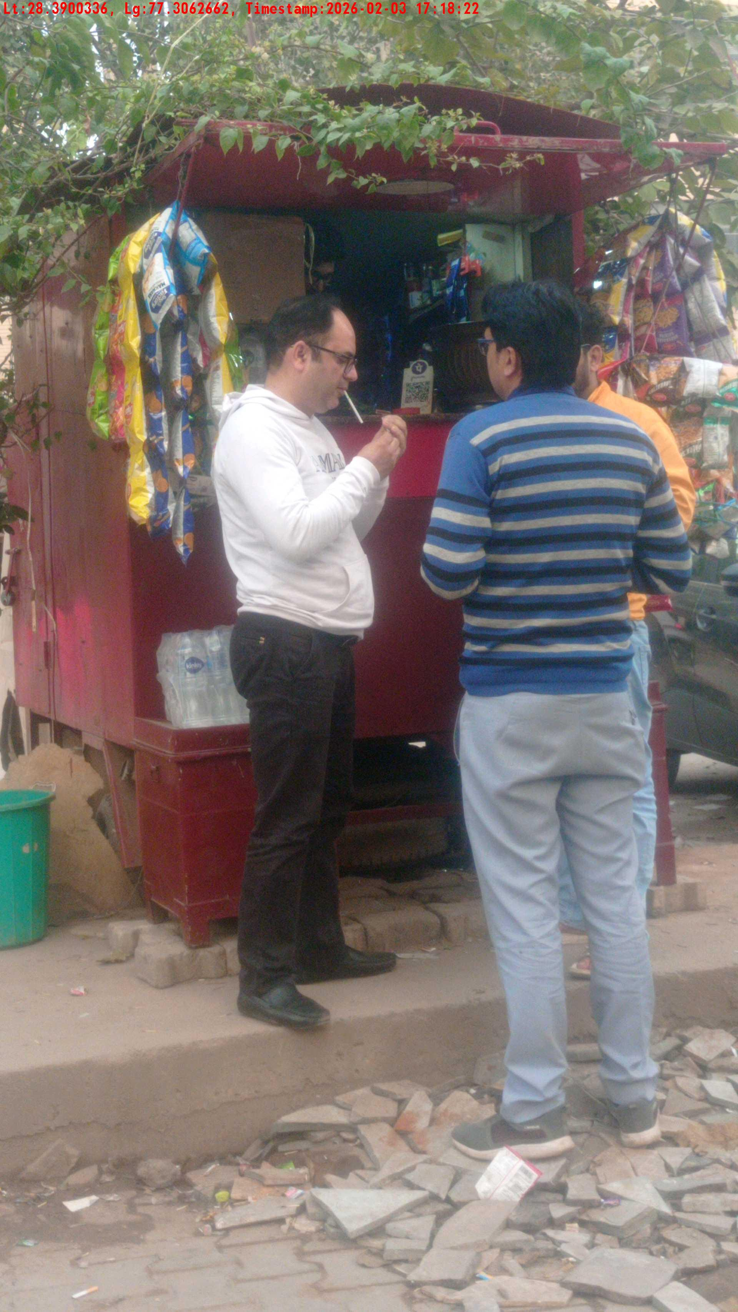
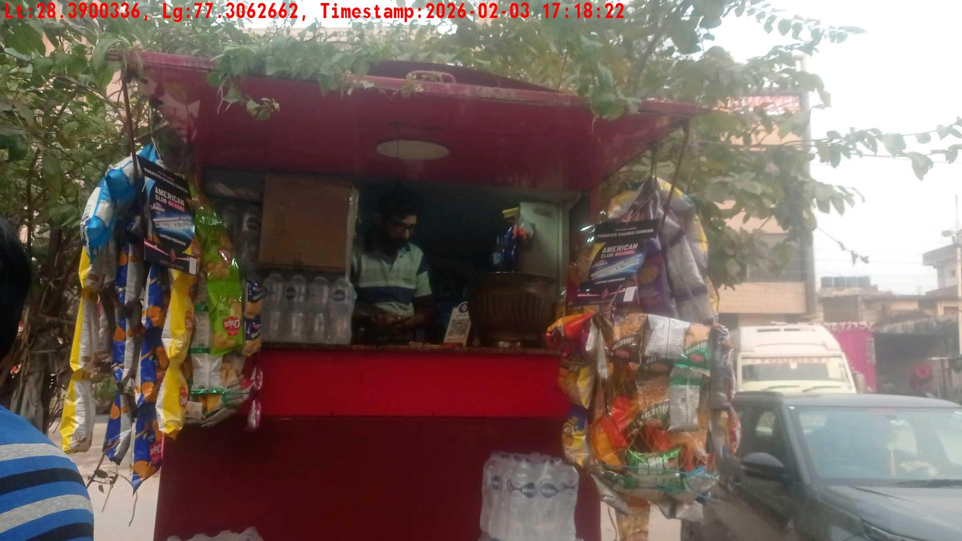
WD Code | Team Id | Team | Shop Name | Owner Mobile Number | Shop Address | Brand | Date Time
DE5493 | 3335 | Dilip | Ramesh | 9595659186 |  | Gold Flake Super Star | 03-02-2026 05:18:22 PM
Pre Shop Photo
Post Shop Photo

Slide 6
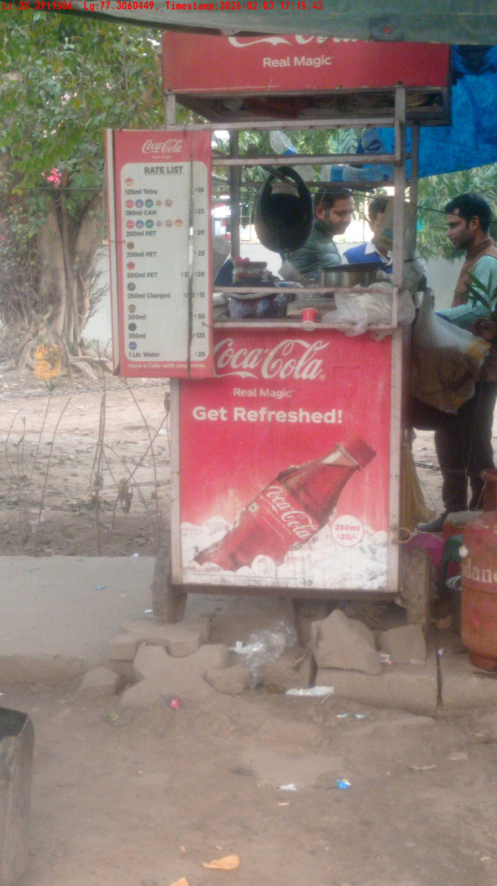
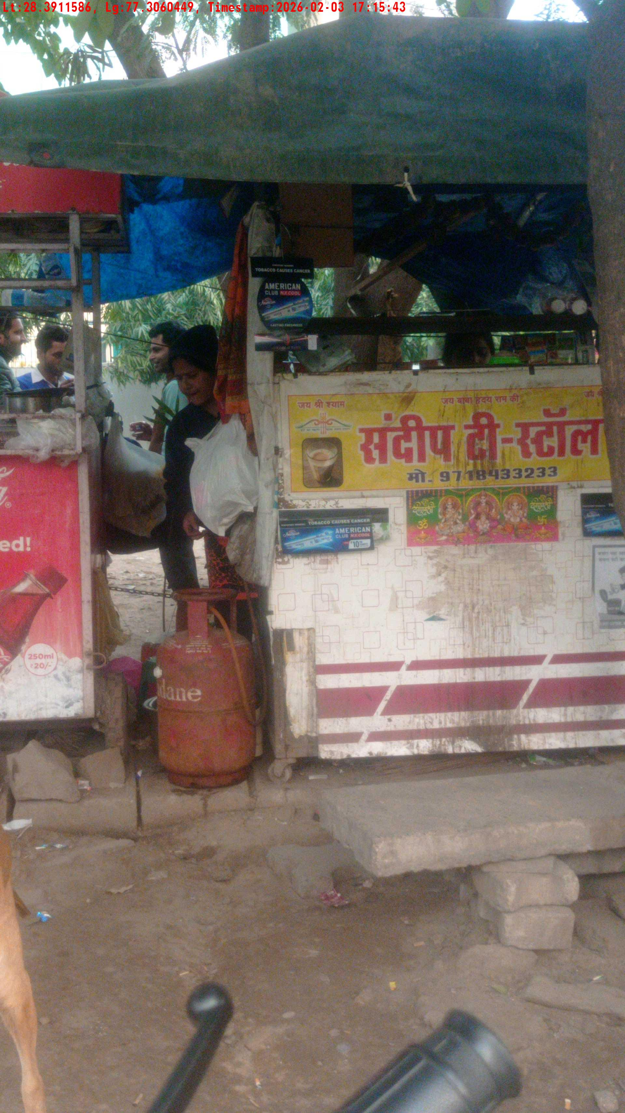
WD Code | Team Id | Team | Shop Name | Owner Mobile Number | Shop Address | Brand | Date Time
DE5493 | 3335 | Dilip | Ramesh | 8448206806 |  | Gold Flake Neo Smart | 03-02-2026 05:15:43 PM
Pre Shop Photo
Post Shop Photo

Slide 7
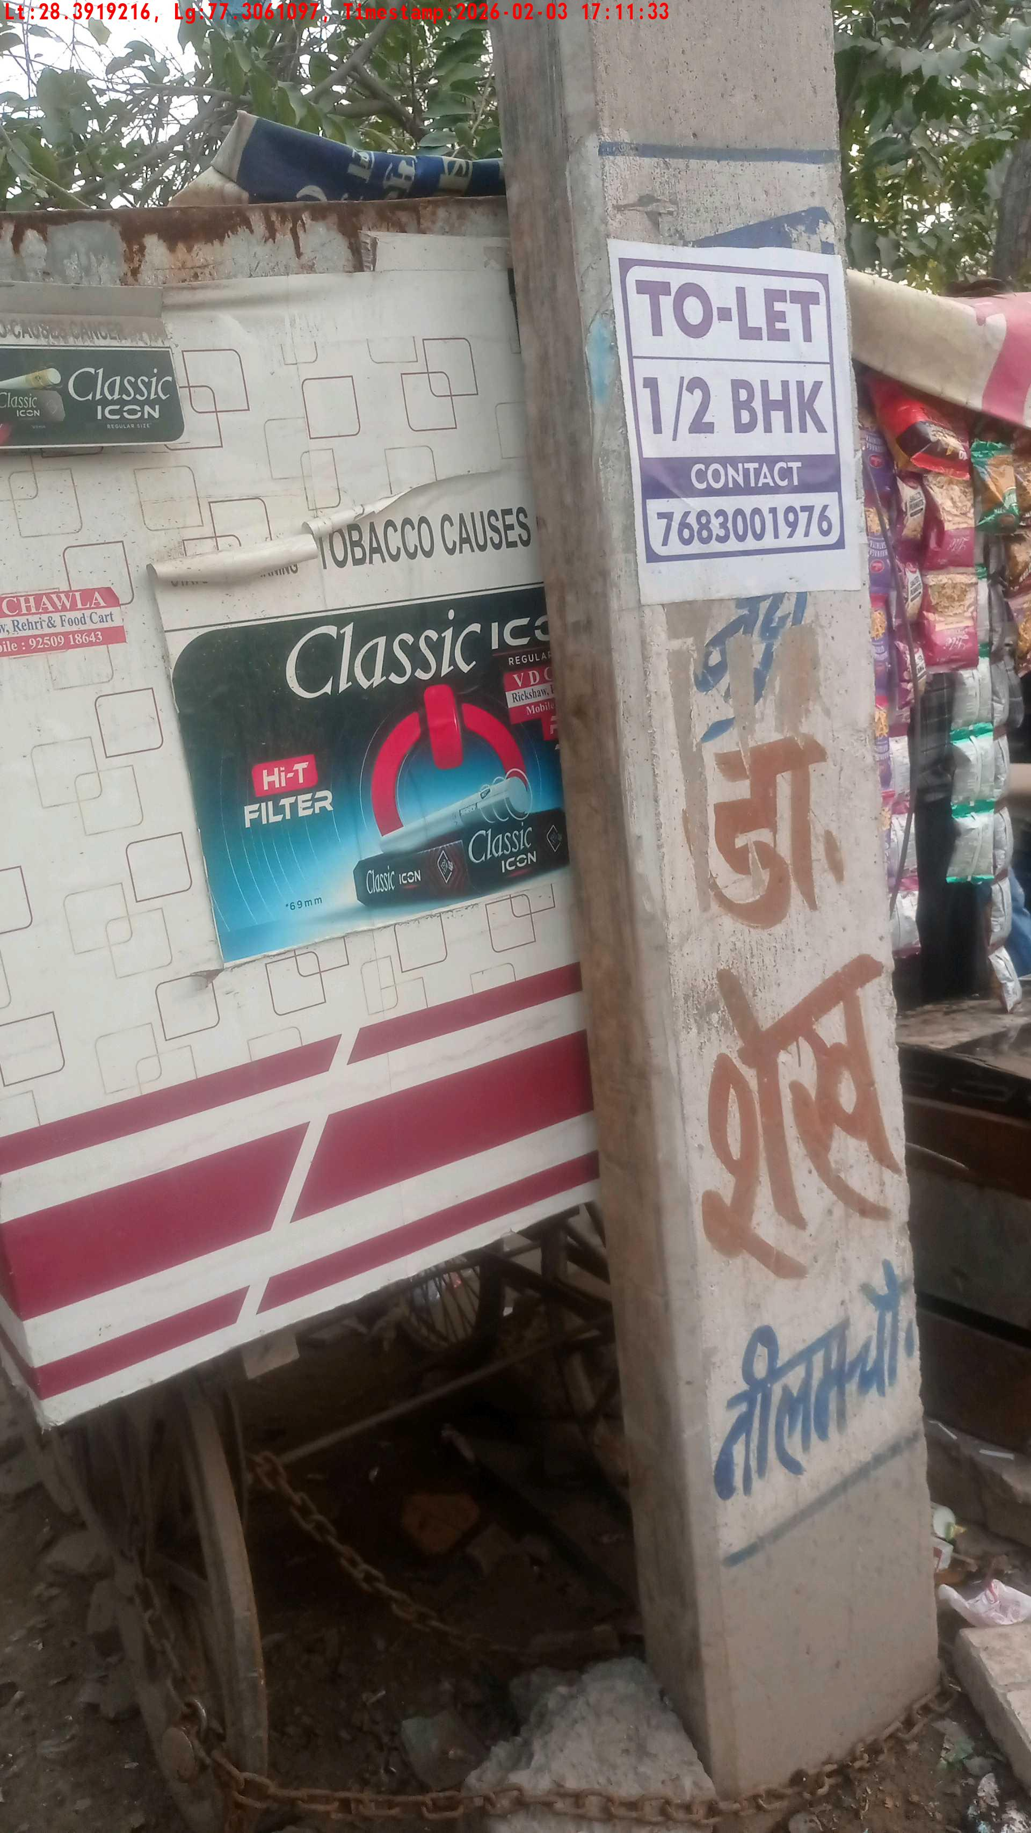
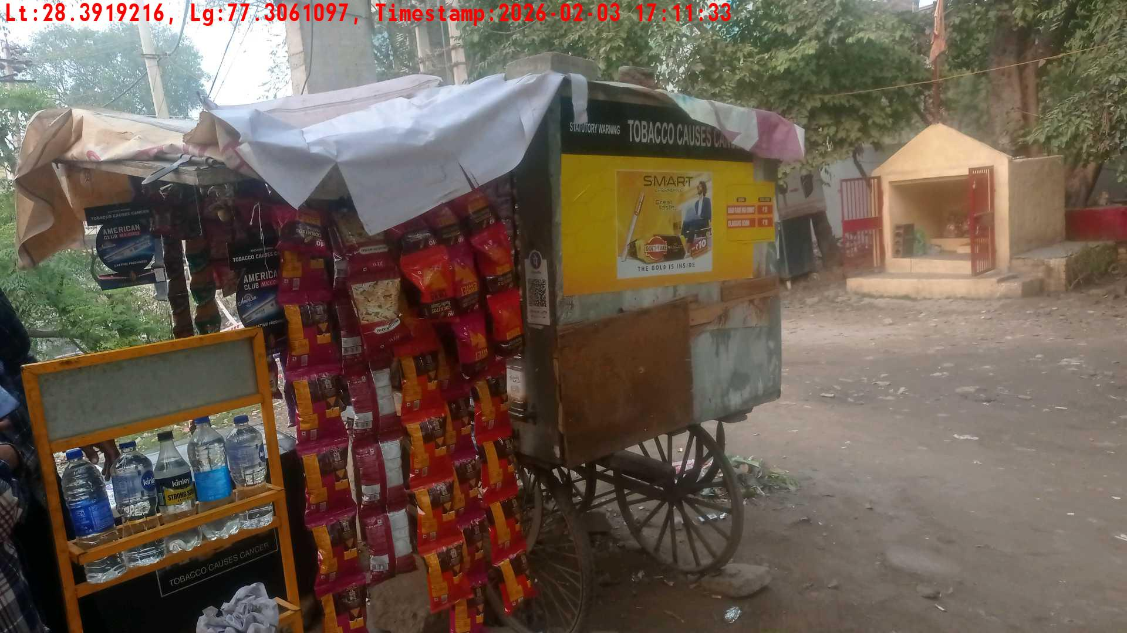
WD Code | Team Id | Team | Shop Name | Owner Mobile Number | Shop Address | Brand | Date Time
DE5493 | 3335 | Dilip | Ramesh | 9565664646 |  | Gold Flake Neo Smart | 03-02-2026 05:11:33 PM
Pre Shop Photo
Post Shop Photo

Slide 8
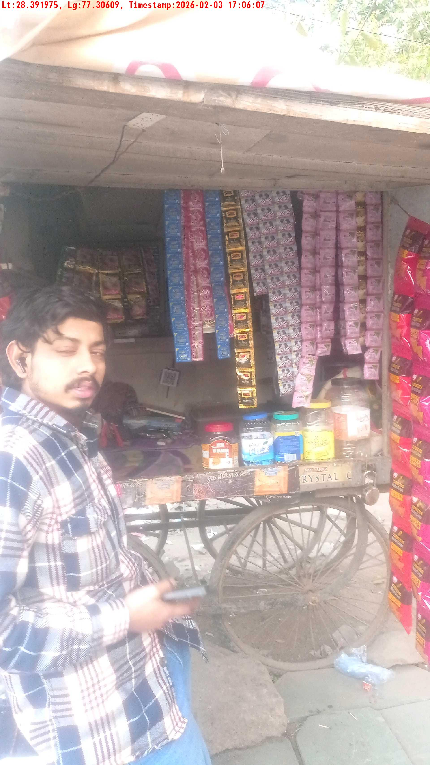
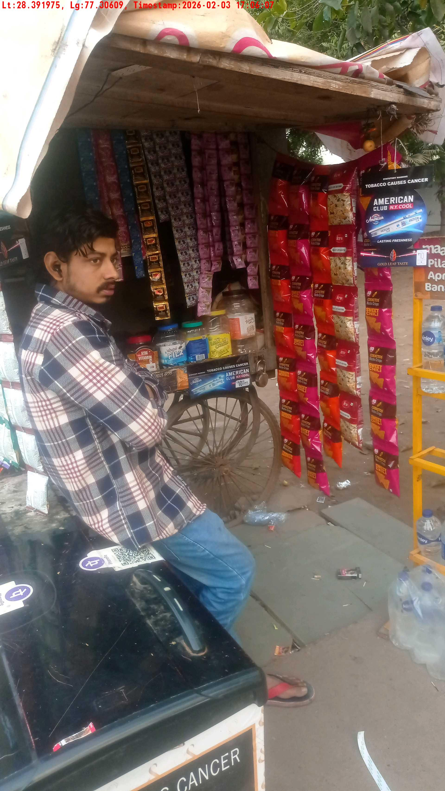
WD Code | Team Id | Team | Shop Name | Owner Mobile Number | Shop Address | Brand | Date Time
DE5493 | 3335 | Dilip | Ramesh | 9357664446 |  | Gold Flake Neo Smart | 03-02-2026 05:06:07 PM
Pre Shop Photo
Post Shop Photo

Slide 9
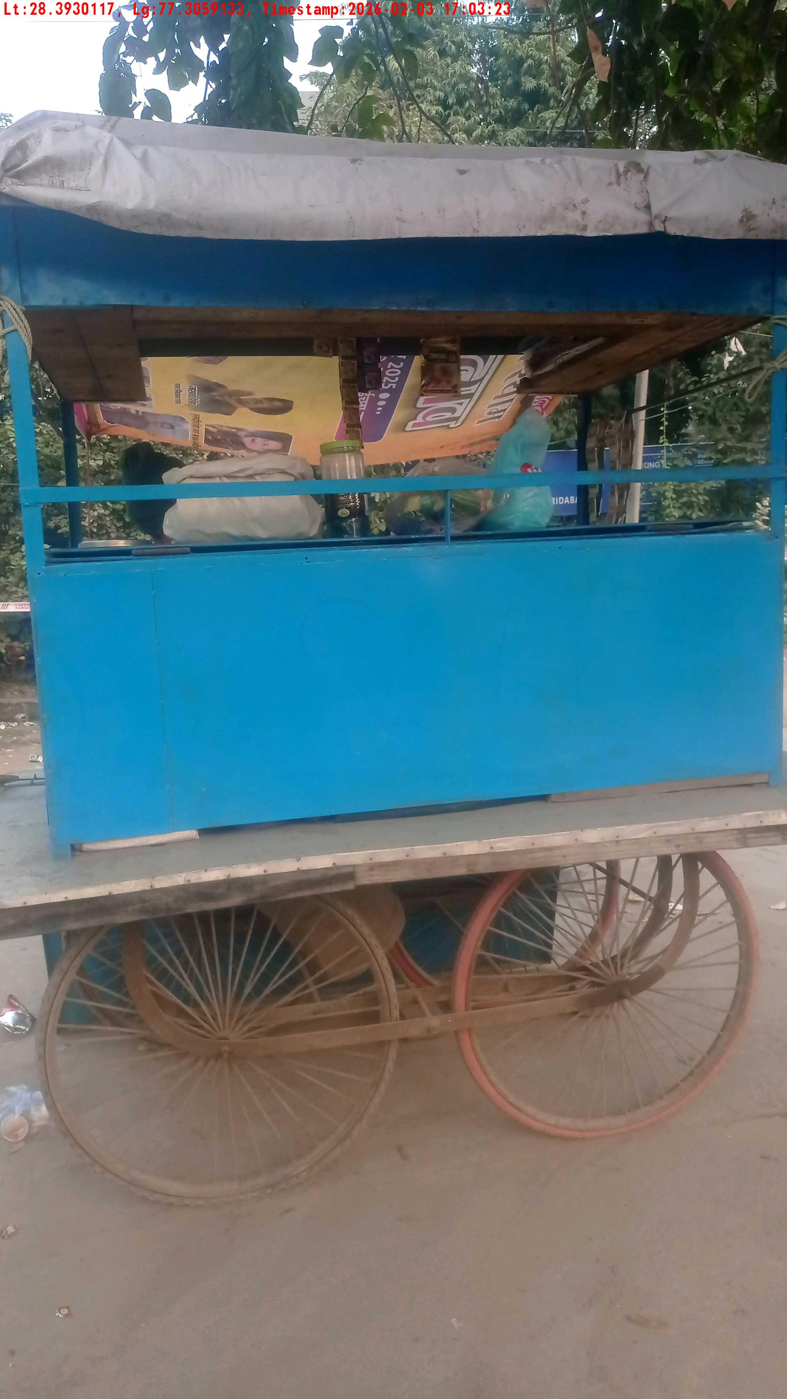
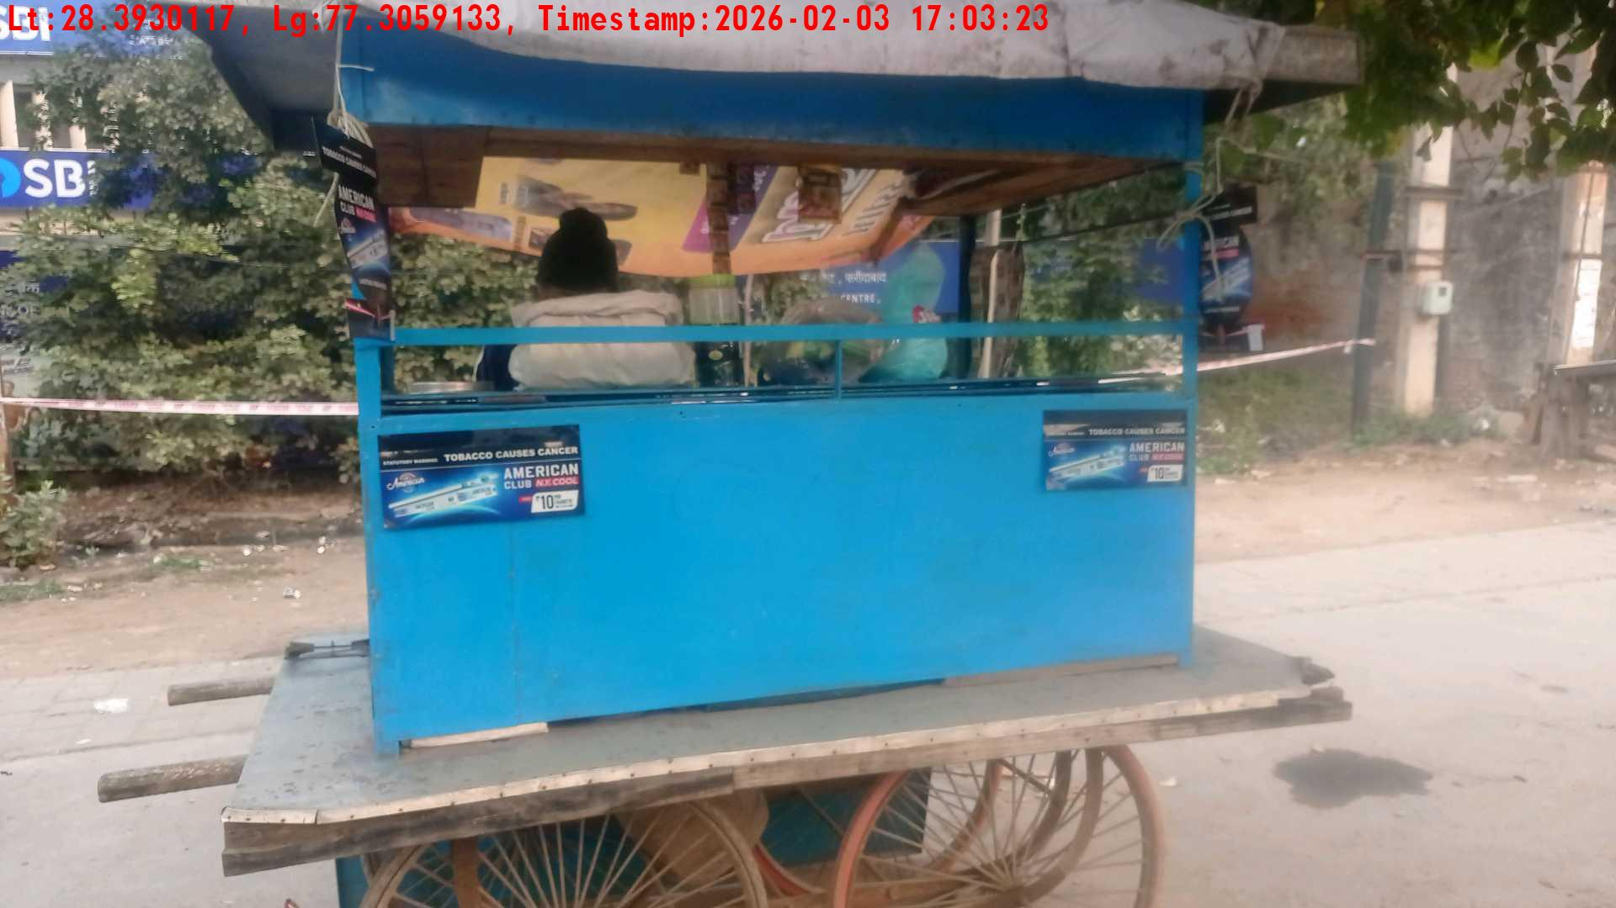
WD Code | Team Id | Team | Shop Name | Owner Mobile Number | Shop Address | Brand | Date Time
DE5493 | 3335 | Dilip | Ramesh | 8448206806 |  | Gold Flake Neo Smart | 03-02-2026 05:03:23 PM
Pre Shop Photo
Post Shop Photo

Slide 10
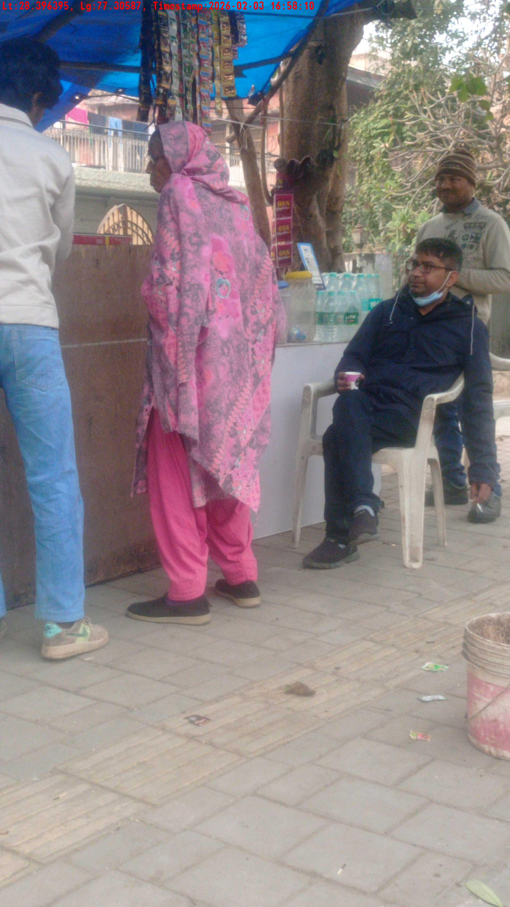
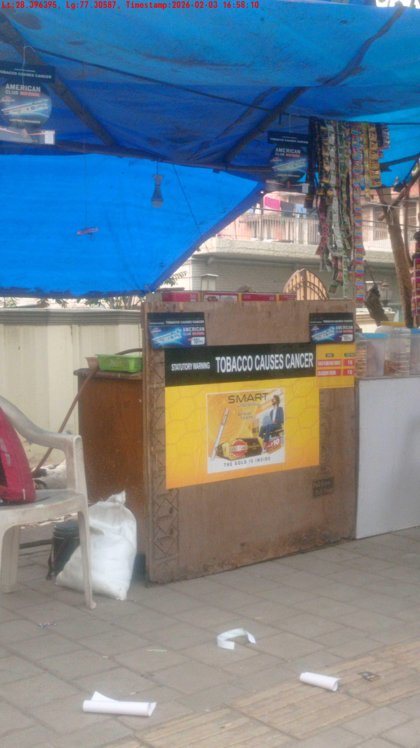
WD Code | Team Id | Team | Shop Name | Owner Mobile Number | Shop Address | Brand | Date Time
DE5493 | 3335 | Dilip | Ramesh | 8448206806 |  | Gold Flake Neo Smart | 03-02-2026 04:58:10 PM
Pre Shop Photo
Post Shop Photo

Slide 11
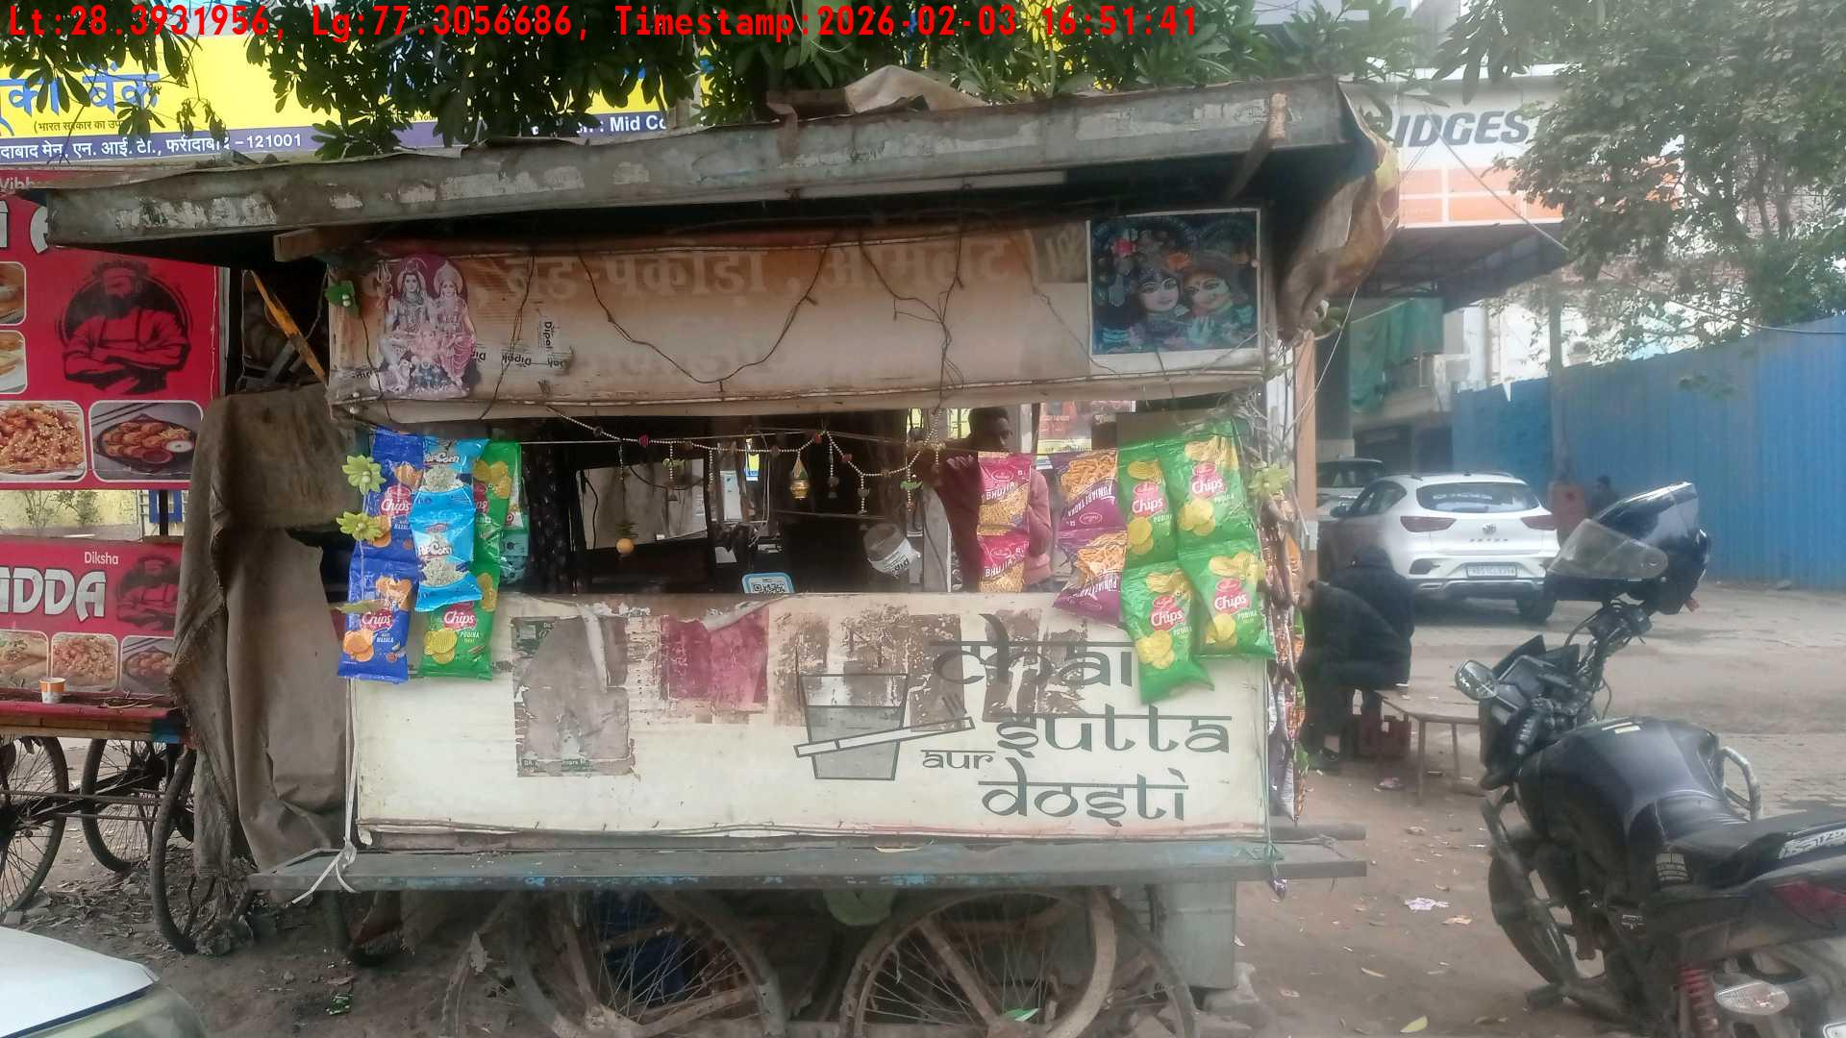
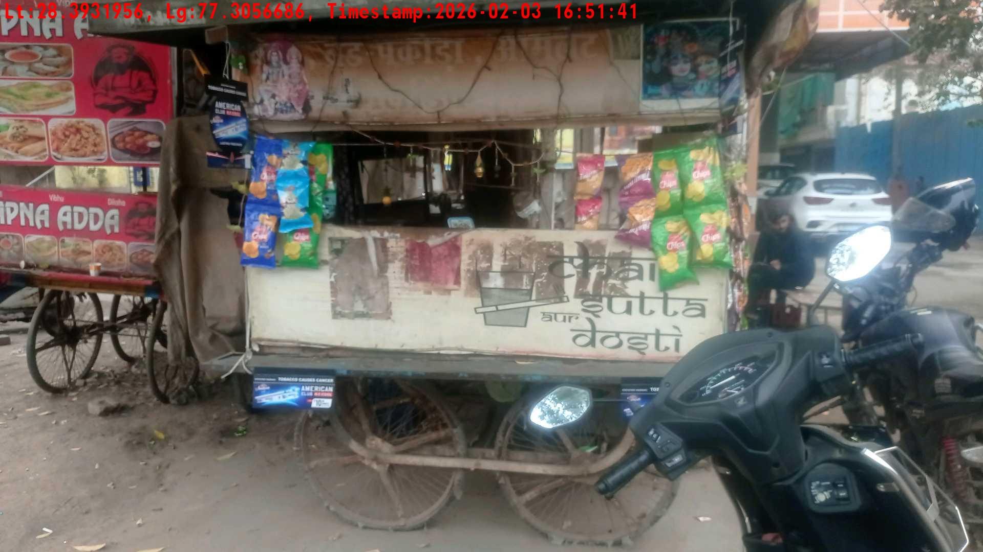
WD Code | Team Id | Team | Shop Name | Owner Mobile Number | Shop Address | Brand | Date Time
DE5493 | 3335 | Dilip | Ramesh | 8313266864 |  | Gold Flake Neo Smart | 03-02-2026 04:51:41 PM
Pre Shop Photo
Post Shop Photo

Slide 12
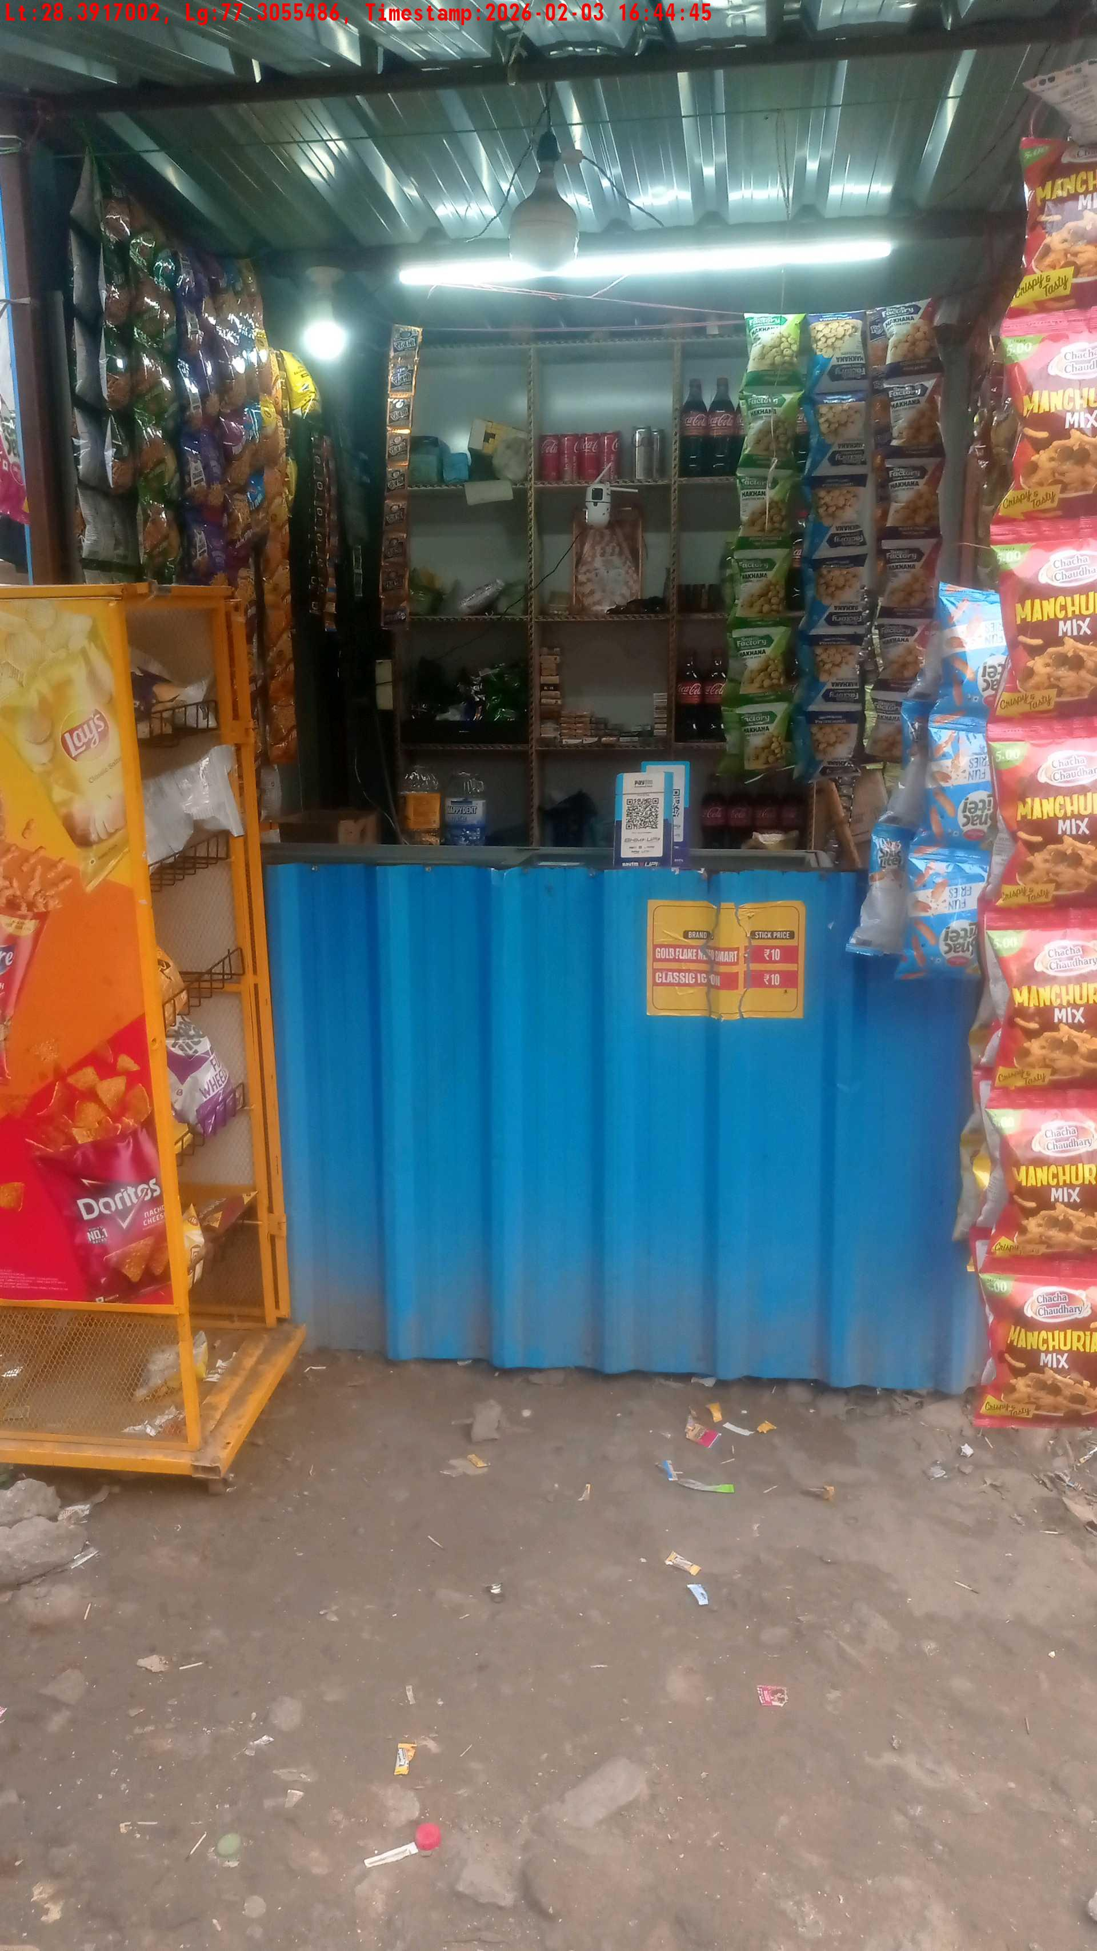
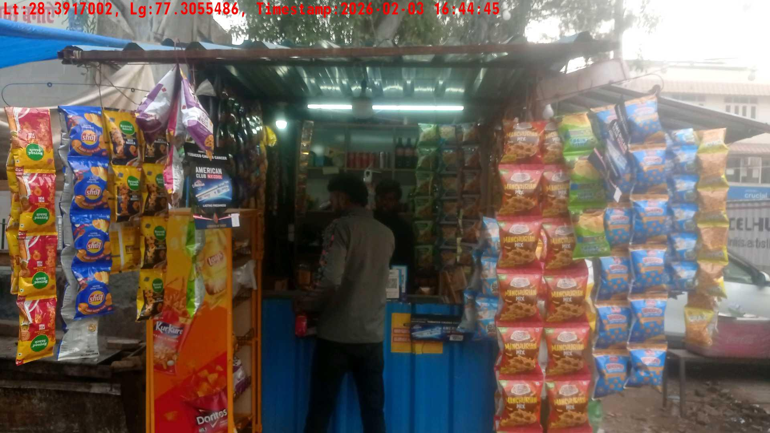
WD Code | Team Id | Team | Shop Name | Owner Mobile Number | Shop Address | Brand | Date Time
DE5493 | 3335 | Dilip | Ramesh | 8448206806 |  | Gold Flake Neo Smart | 03-02-2026 04:44:45 PM
Pre Shop Photo
Post Shop Photo

Slide 13
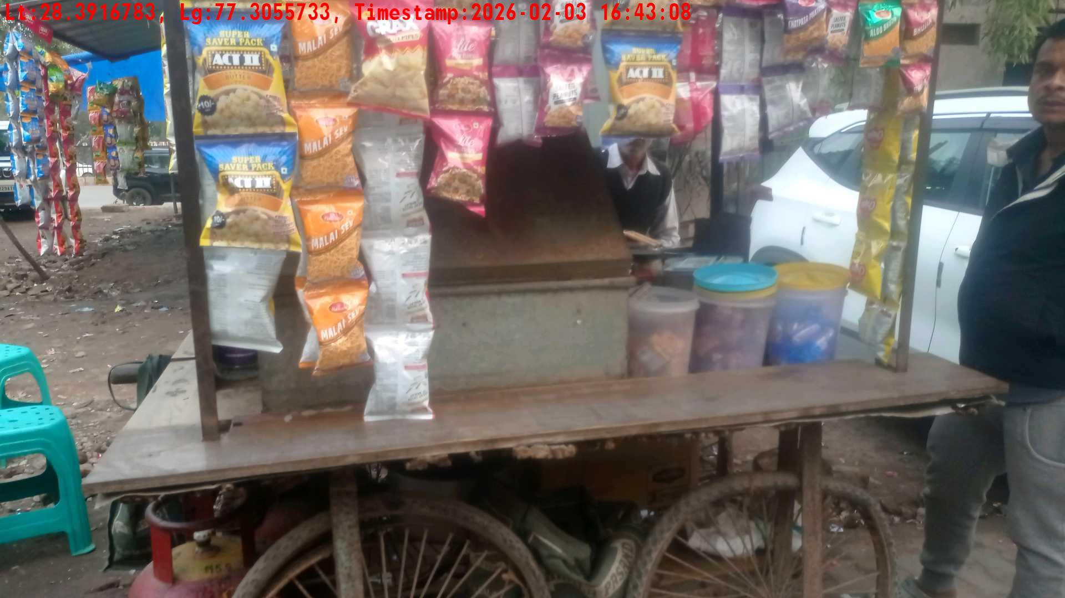
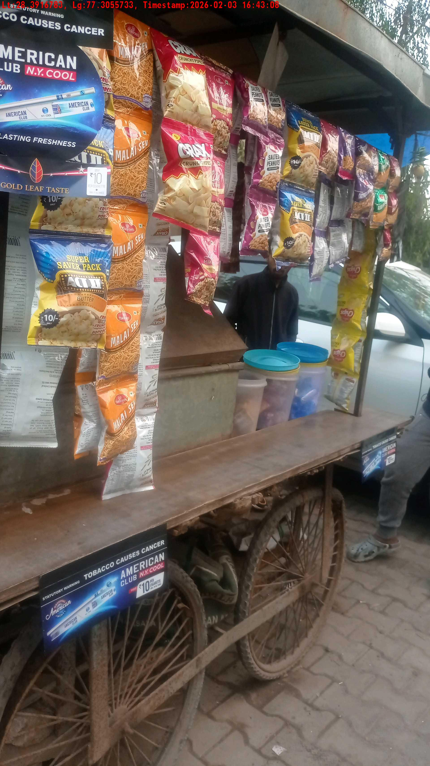
WD Code | Team Id | Team | Shop Name | Owner Mobile Number | Shop Address | Brand | Date Time
DE5493 | 3335 | Dilip | Ramesh | 9565866346 |  | Gold Flake Neo Smart | 03-02-2026 04:43:08 PM
Pre Shop Photo
Post Shop Photo

Slide 14
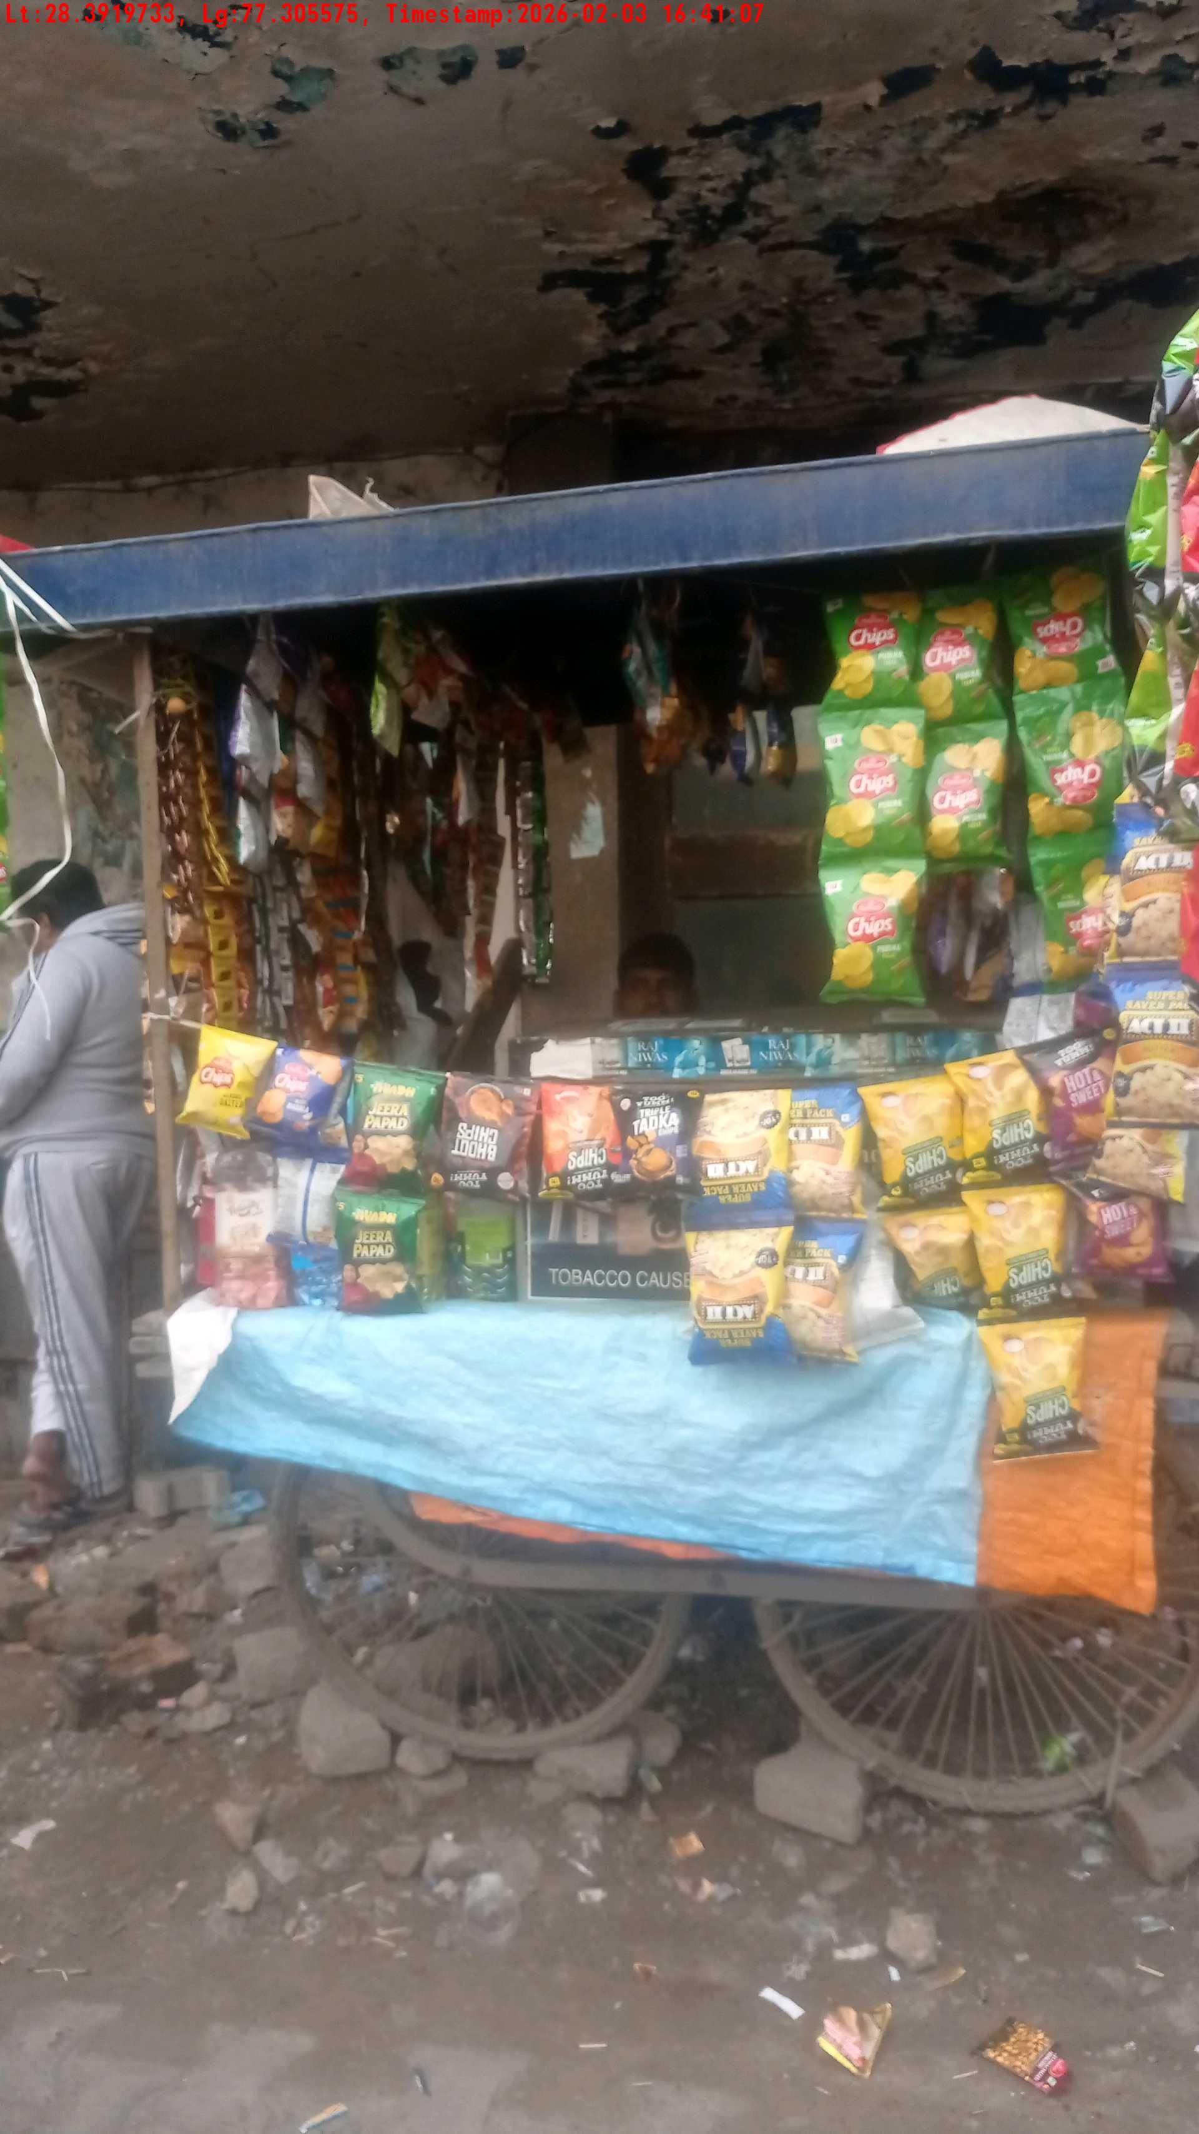
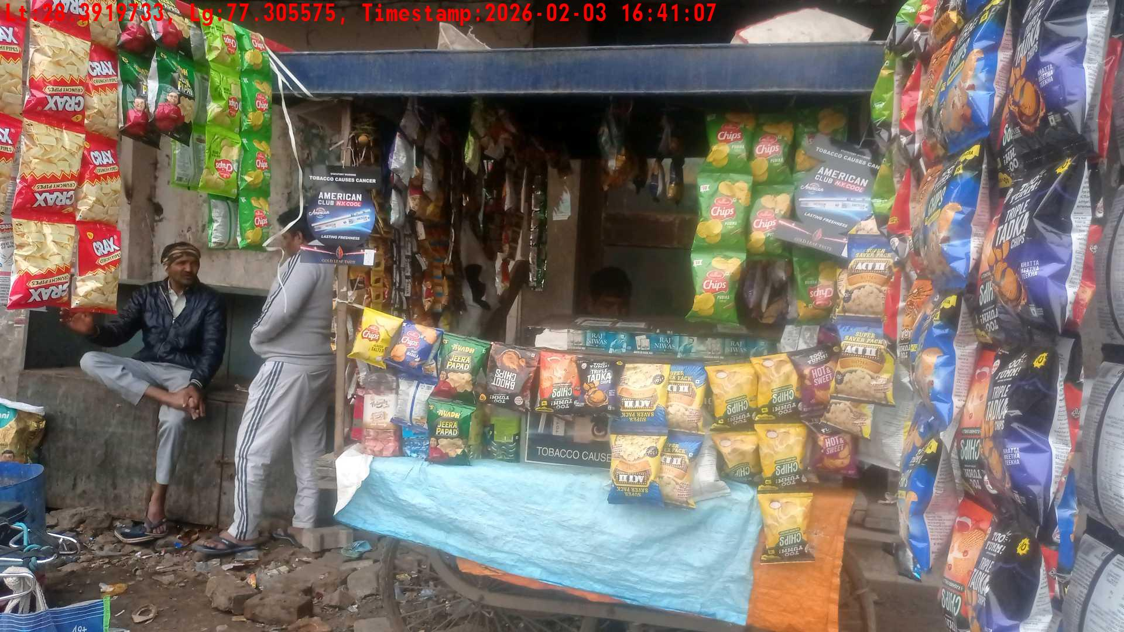
WD Code | Team Id | Team | Shop Name | Owner Mobile Number | Shop Address | Brand | Date Time
DE5493 | 3335 | Dilip | Ramesh | 8448206806 |  | Gold Flake Neo Smart | 03-02-2026 04:41:07 PM
Pre Shop Photo
Post Shop Photo

Slide 15
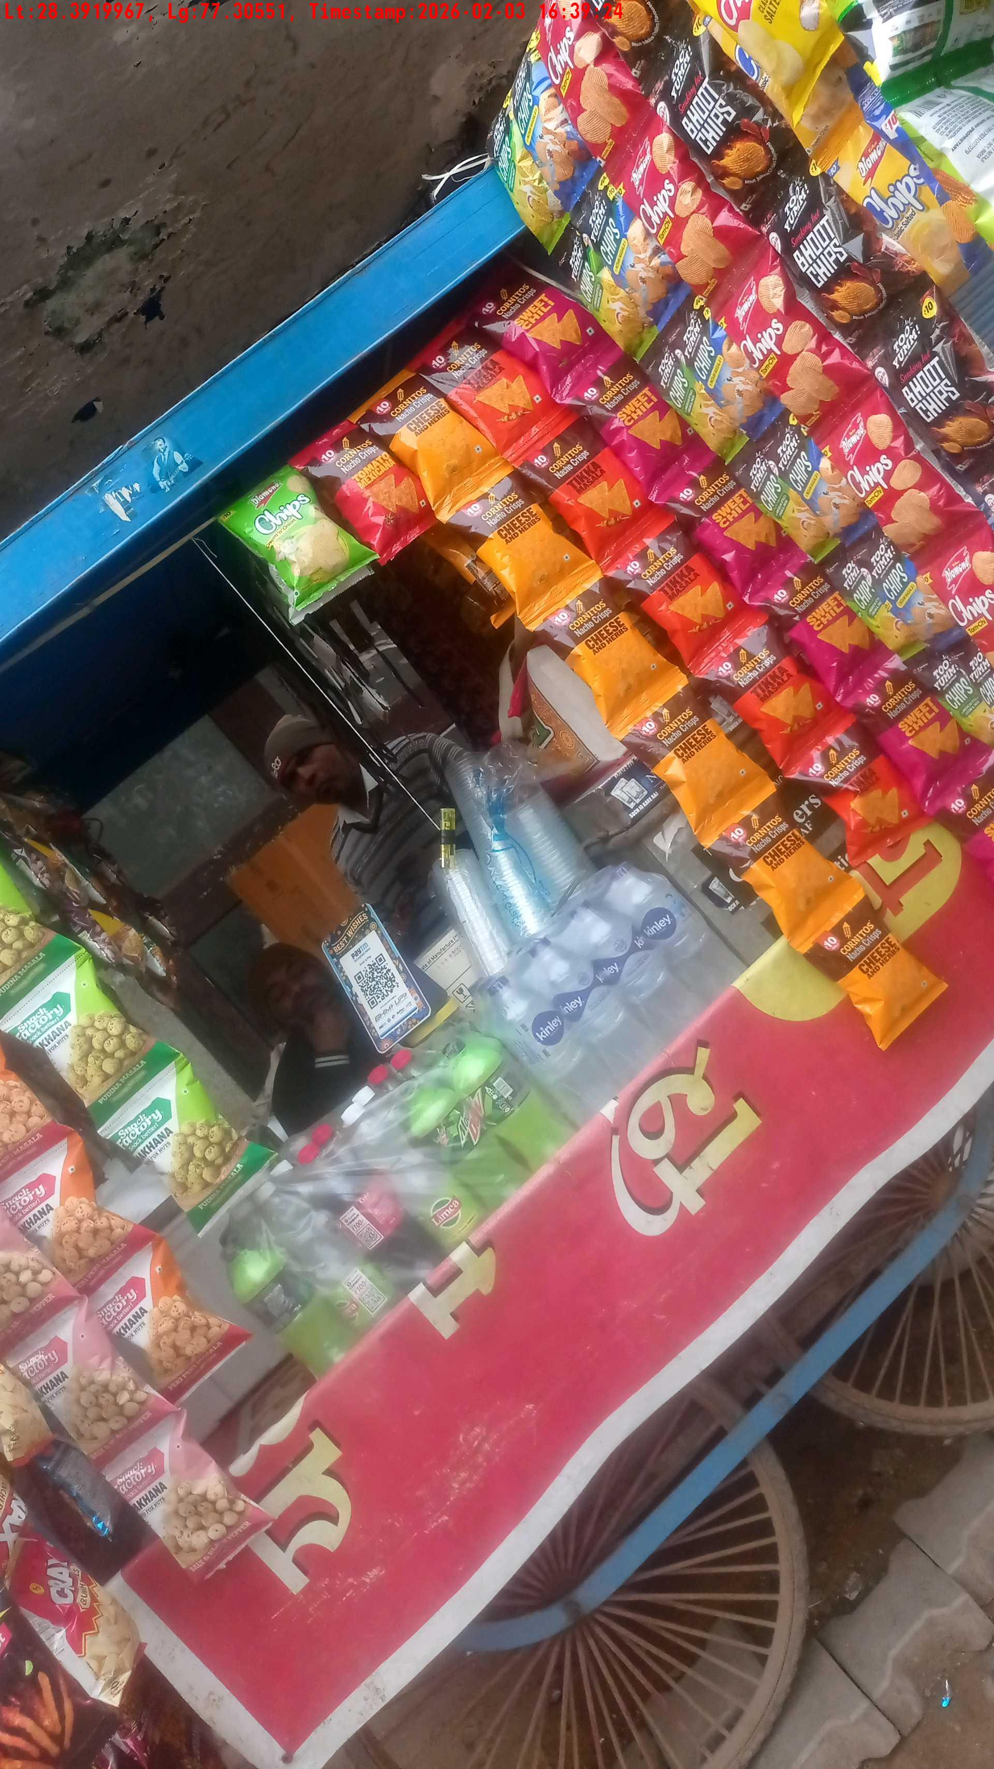
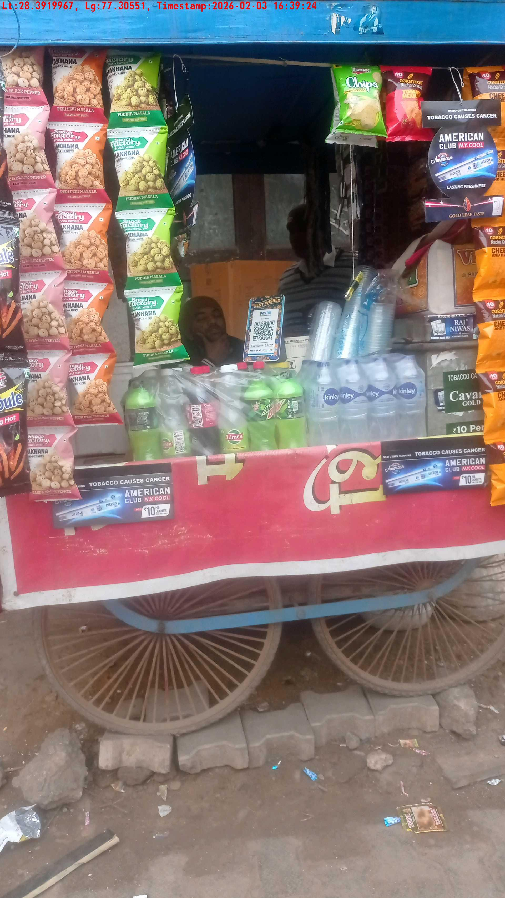
WD Code | Team Id | Team | Shop Name | Owner Mobile Number | Shop Address | Brand | Date Time
DE5493 | 3335 | Dilip | Ramesh | 9739434956 |  | Gold Flake Super Star | 03-02-2026 04:39:24 PM
Pre Shop Photo
Post Shop Photo

Slide 16
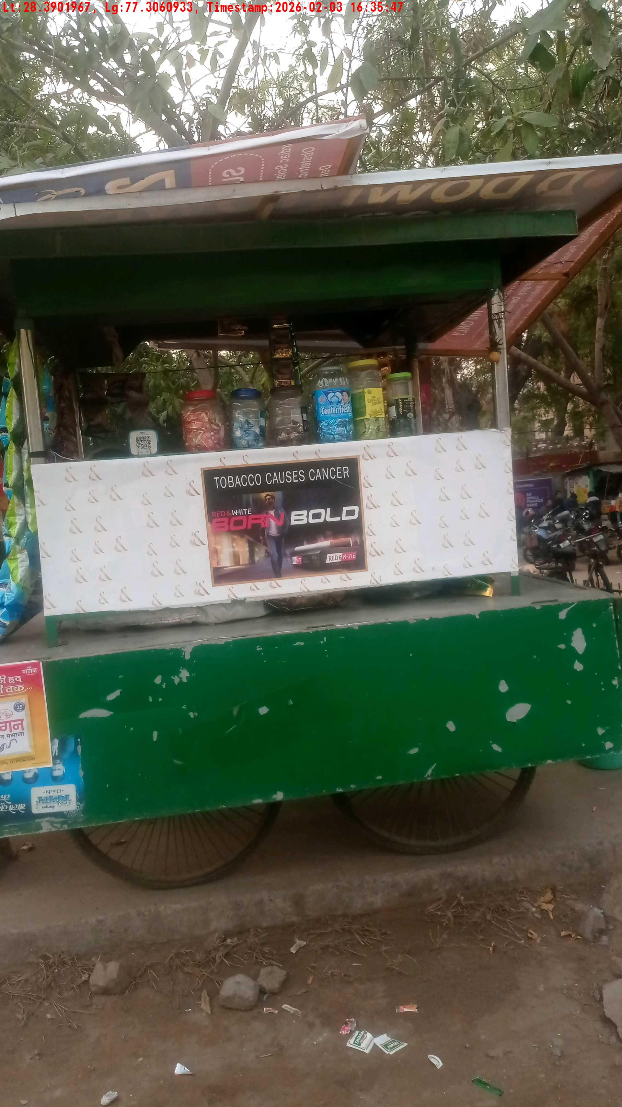
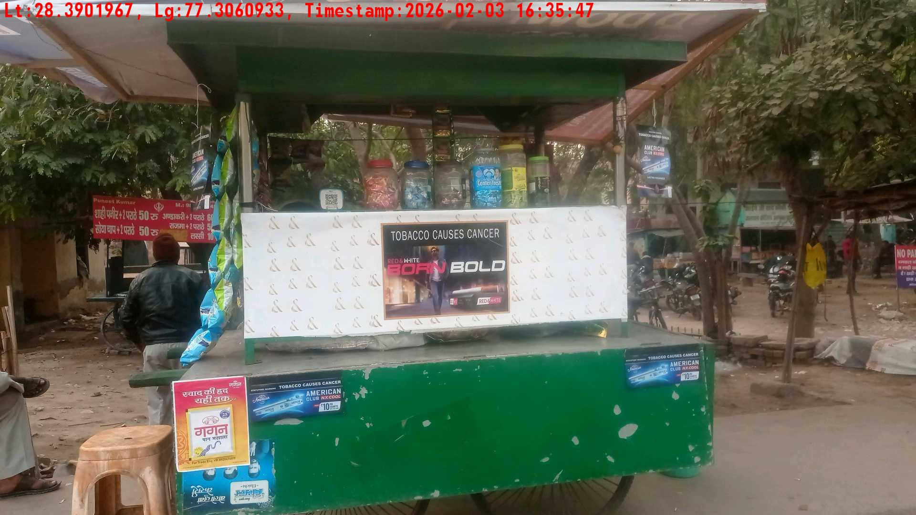
WD Code | Team Id | Team | Shop Name | Owner Mobile Number | Shop Address | Brand | Date Time
DE5493 | 3335 | Dilip | Ramesh | 7653168943 |  | Gold Flake Neo Smart | 03-02-2026 04:35:47 PM
Pre Shop Photo
Post Shop Photo

Slide 17
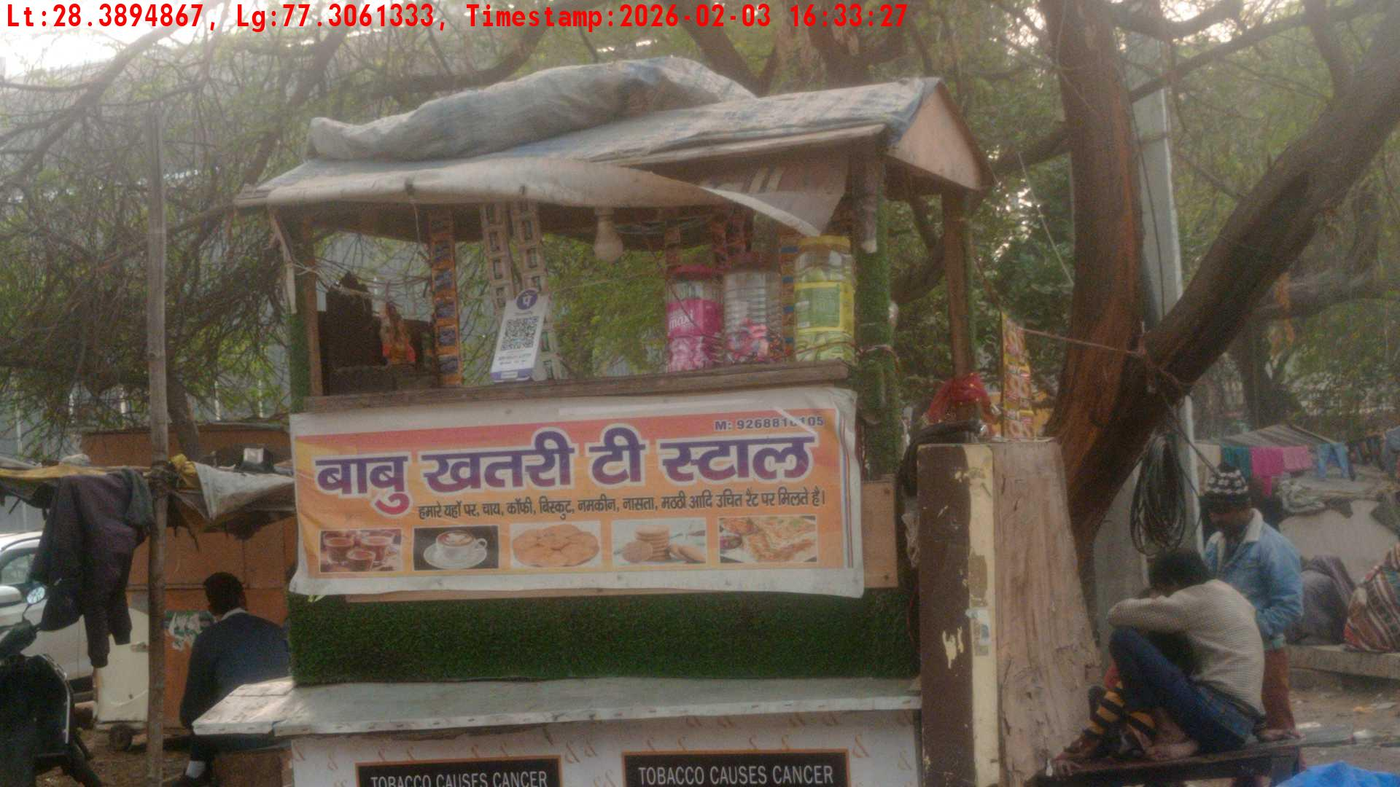
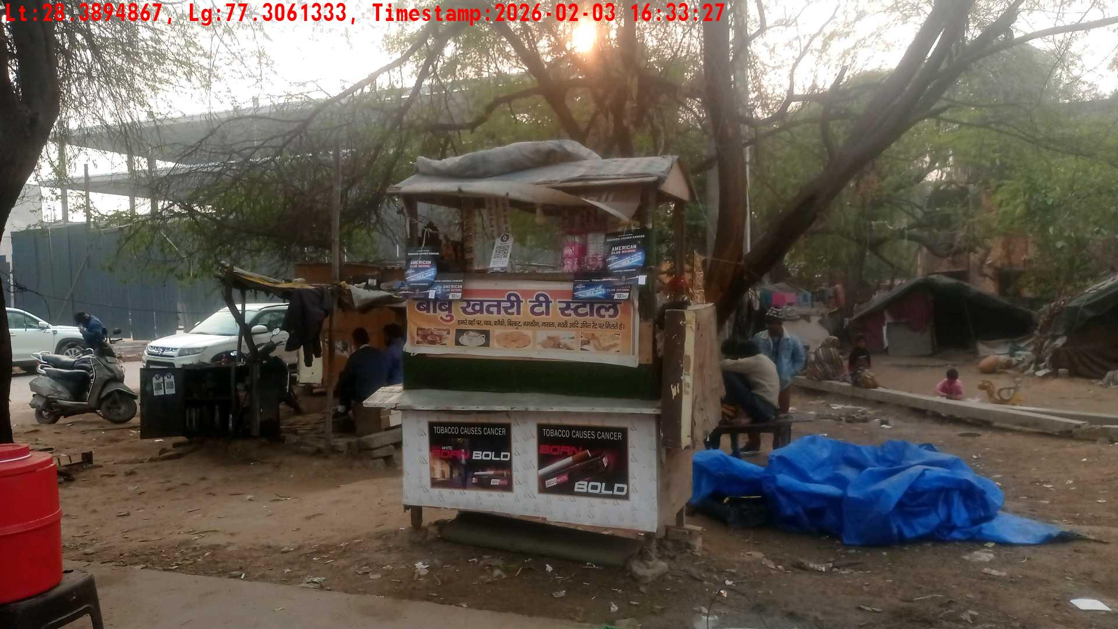
WD Code | Team Id | Team | Shop Name | Owner Mobile Number | Shop Address | Brand | Date Time
DE5493 | 3335 | Dilip | Ramesh | 8946956565 |  | Gold Flake Neo Smart | 03-02-2026 04:33:27 PM
Pre Shop Photo
Post Shop Photo

Slide 18
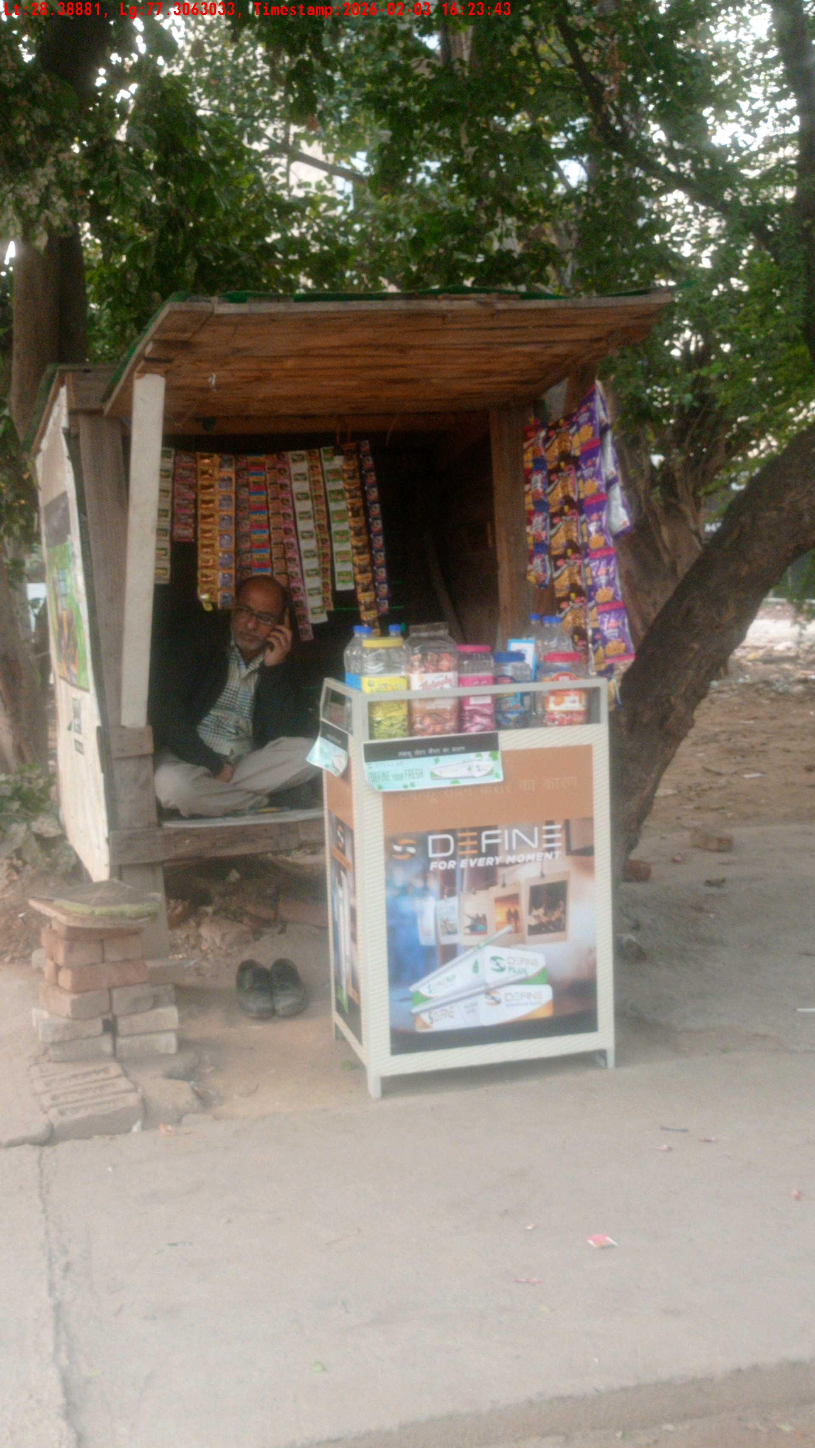
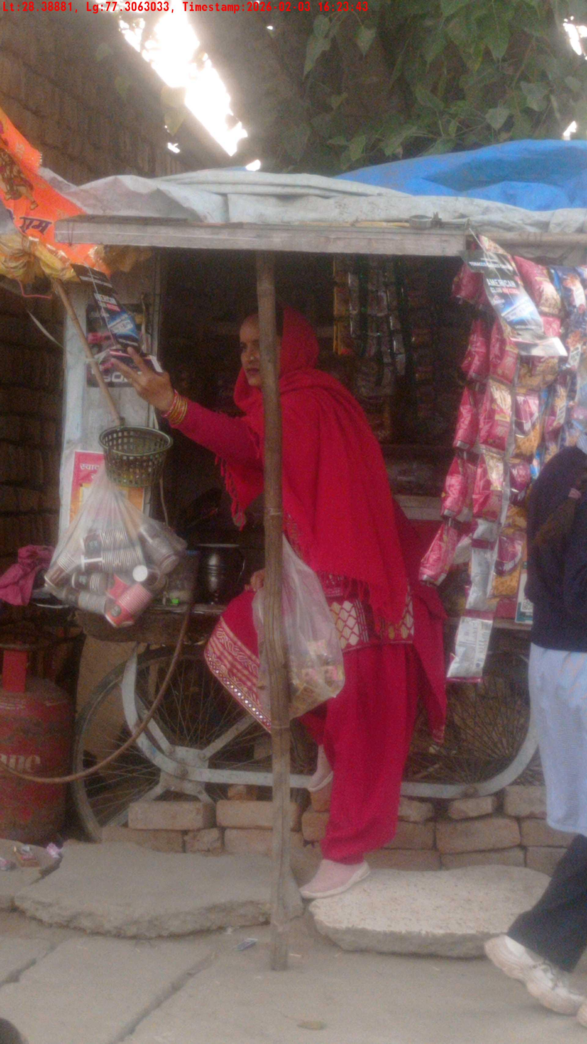
WD Code | Team Id | Team | Shop Name | Owner Mobile Number | Shop Address | Brand | Date Time
DE5493 | 3335 | Dilip | Ramesh | 8448206806 |  | Gold Flake Super Star | 03-02-2026 04:23:43 PM
Pre Shop Photo
Post Shop Photo

Slide 19
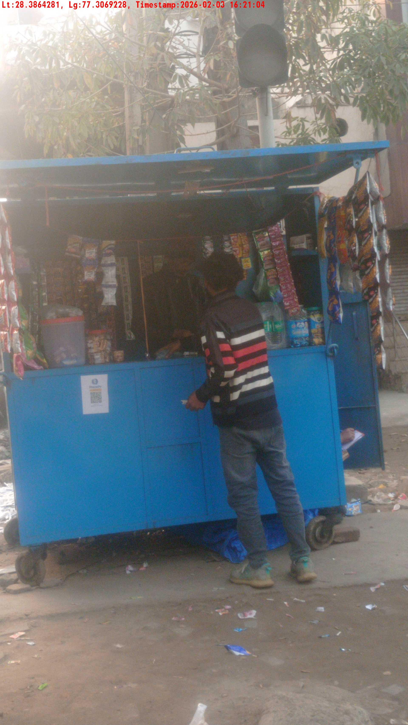
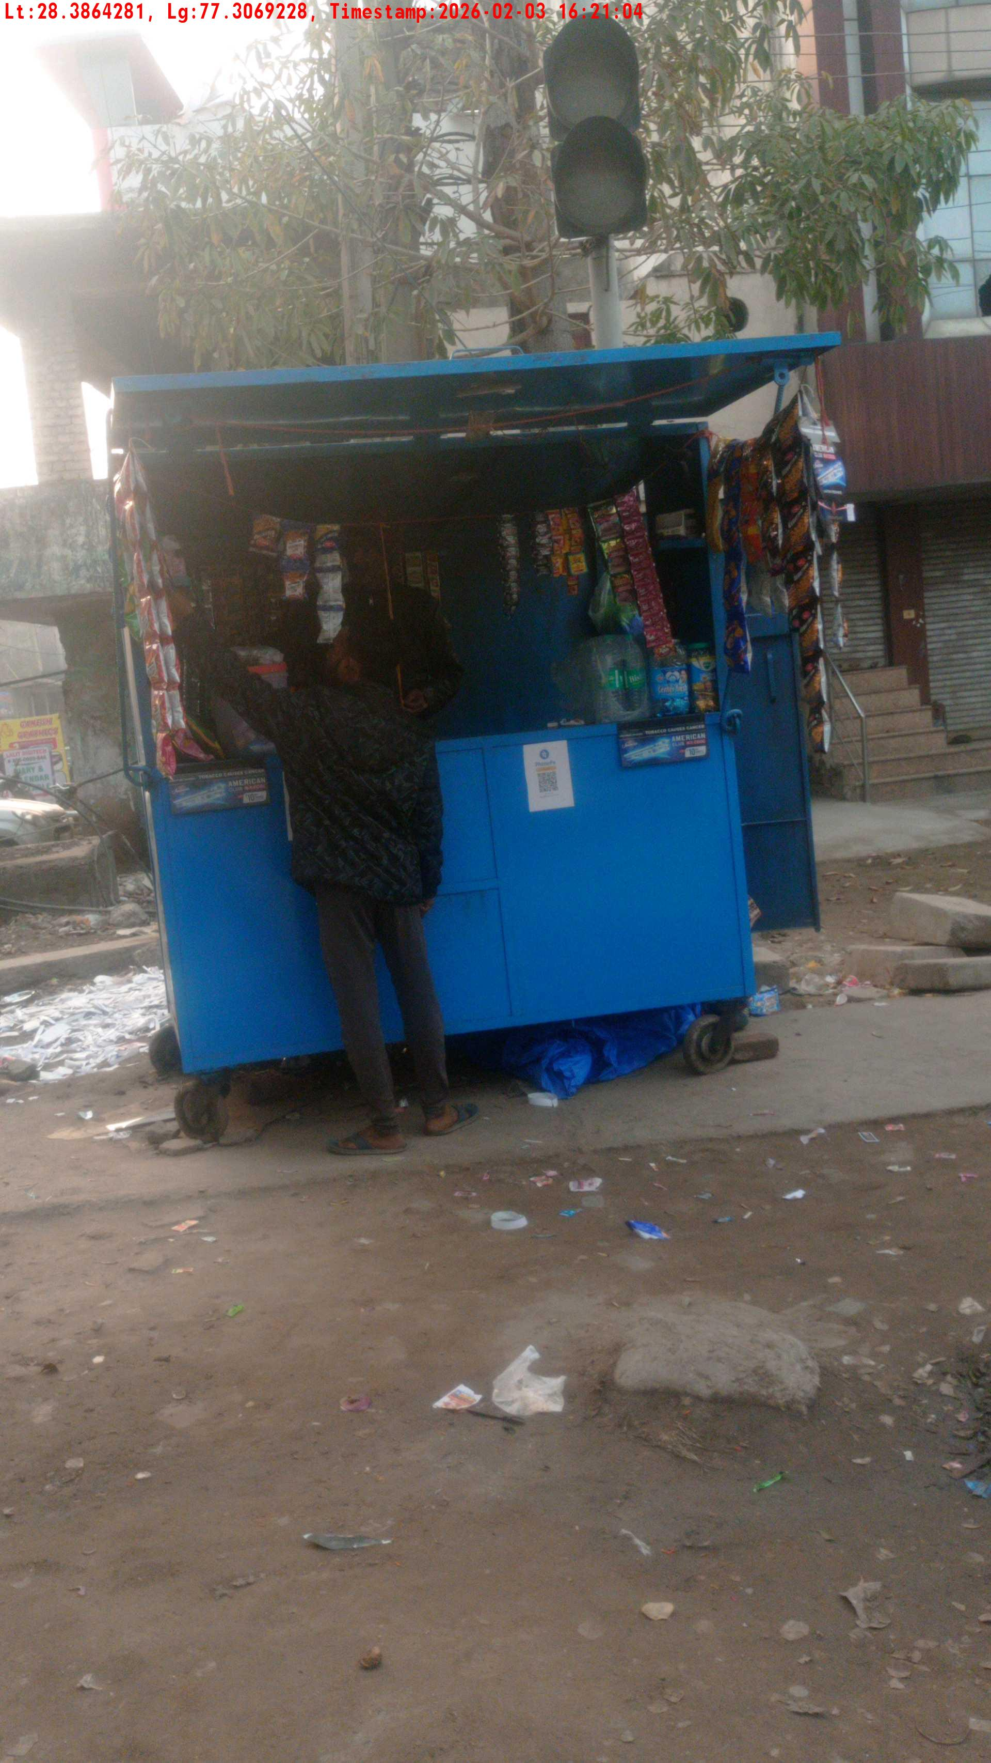
WD Code | Team Id | Team | Shop Name | Owner Mobile Number | Shop Address | Brand | Date Time
DE5493 | 3335 | Dilip | Ramesh | 8448206806 |  | Gold Flake Super Star | 03-02-2026 04:21:04 PM
Pre Shop Photo
Post Shop Photo

Slide 20
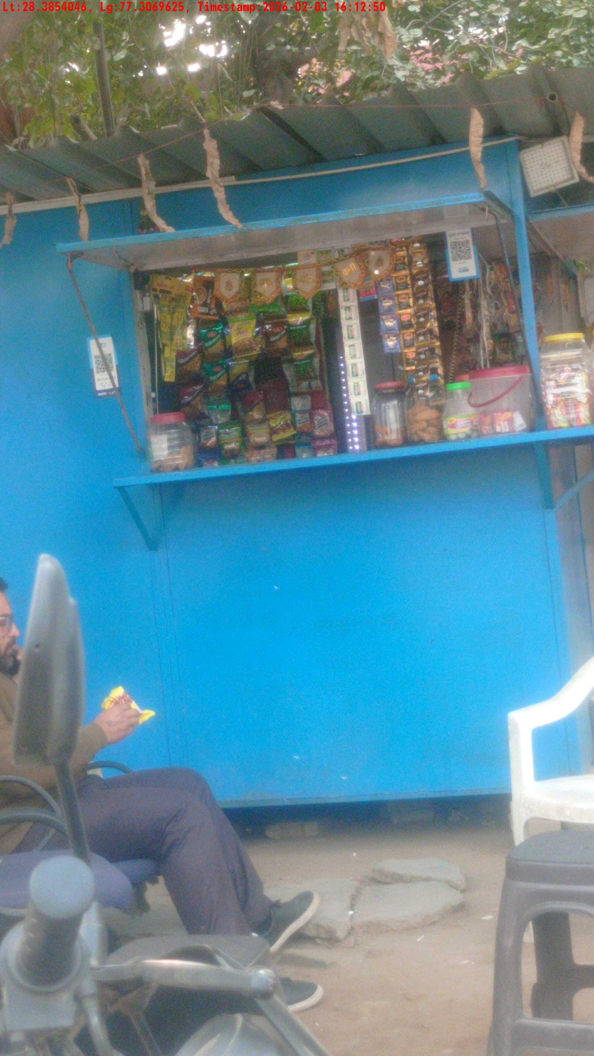
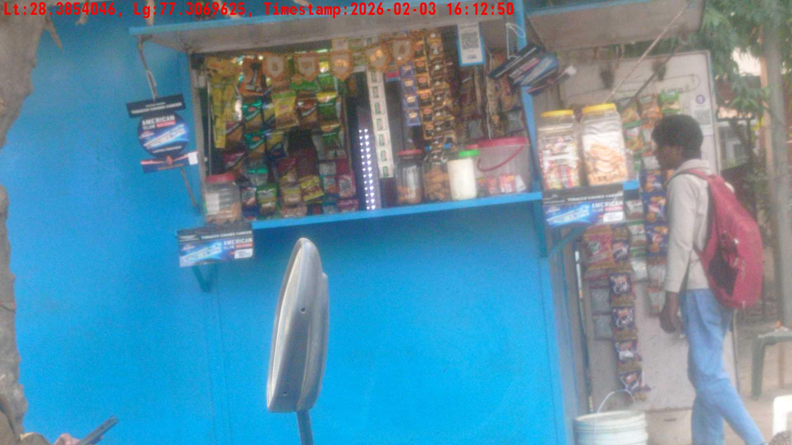
WD Code | Team Id | Team | Shop Name | Owner Mobile Number | Shop Address | Brand | Date Time
DE5493 | 3335 | Dilip | Ramesh | 8448206806 |  | Gold Flake Neo Smart | 03-02-2026 04:12:50 PM
Pre Shop Photo
Post Shop Photo

Slide 21
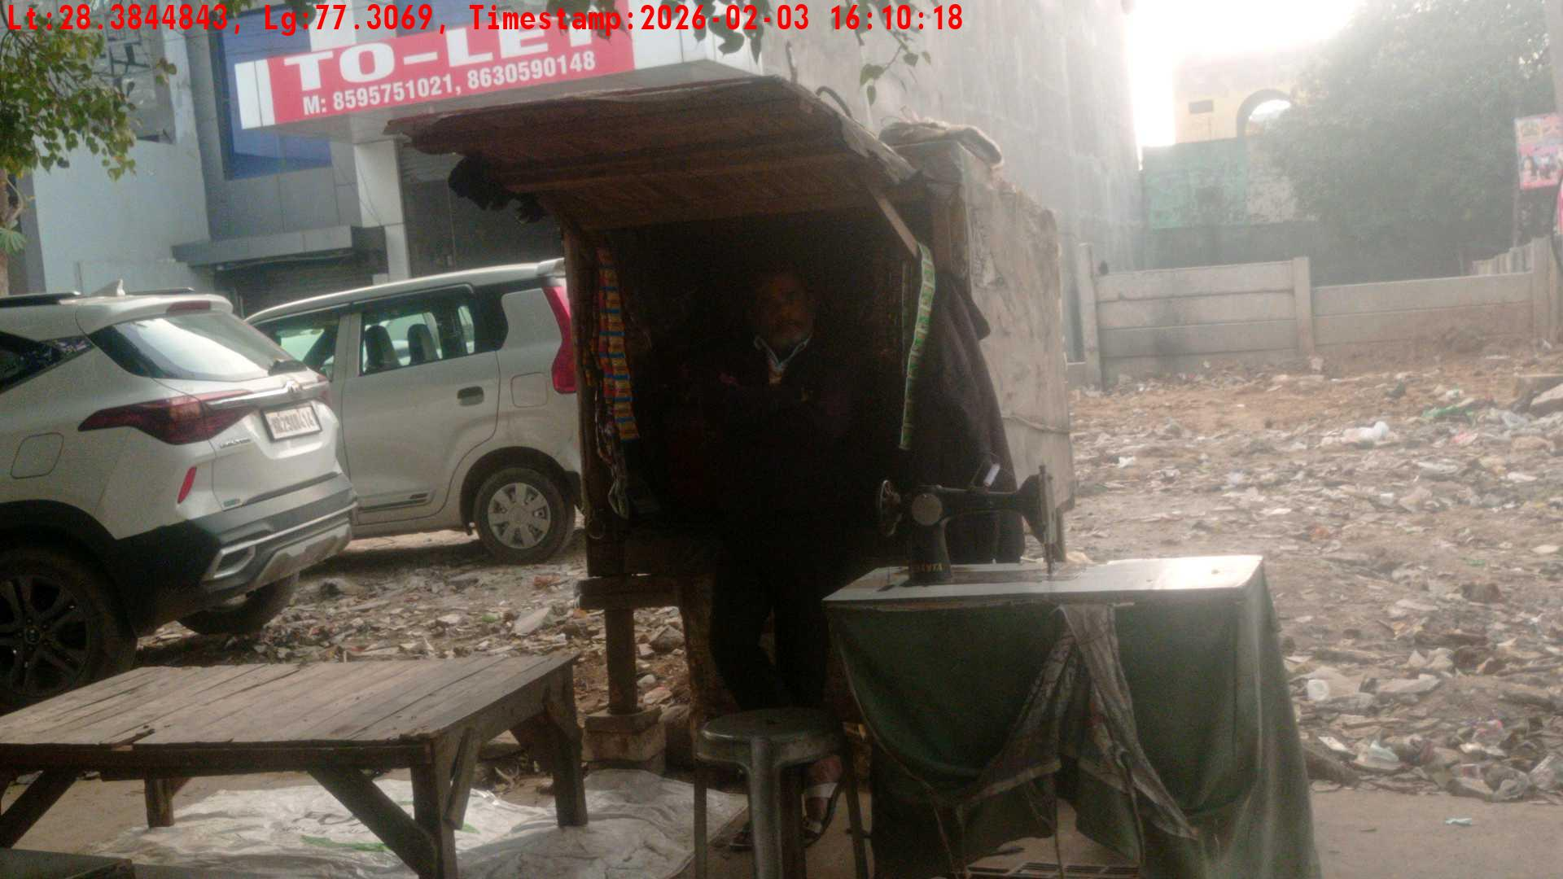
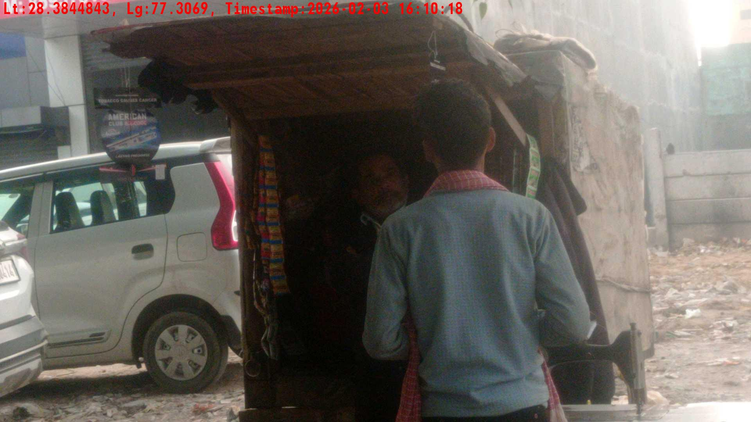
WD Code | Team Id | Team | Shop Name | Owner Mobile Number | Shop Address | Brand | Date Time
DE5493 | 3335 | Dilip | Ramesh | 9765946494 |  | Gold Flake Super Star | 03-02-2026 04:10:18 PM
Pre Shop Photo
Post Shop Photo

Slide 22
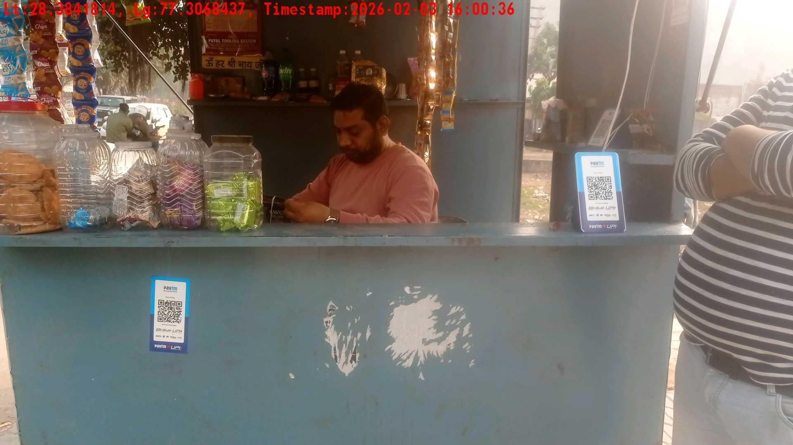
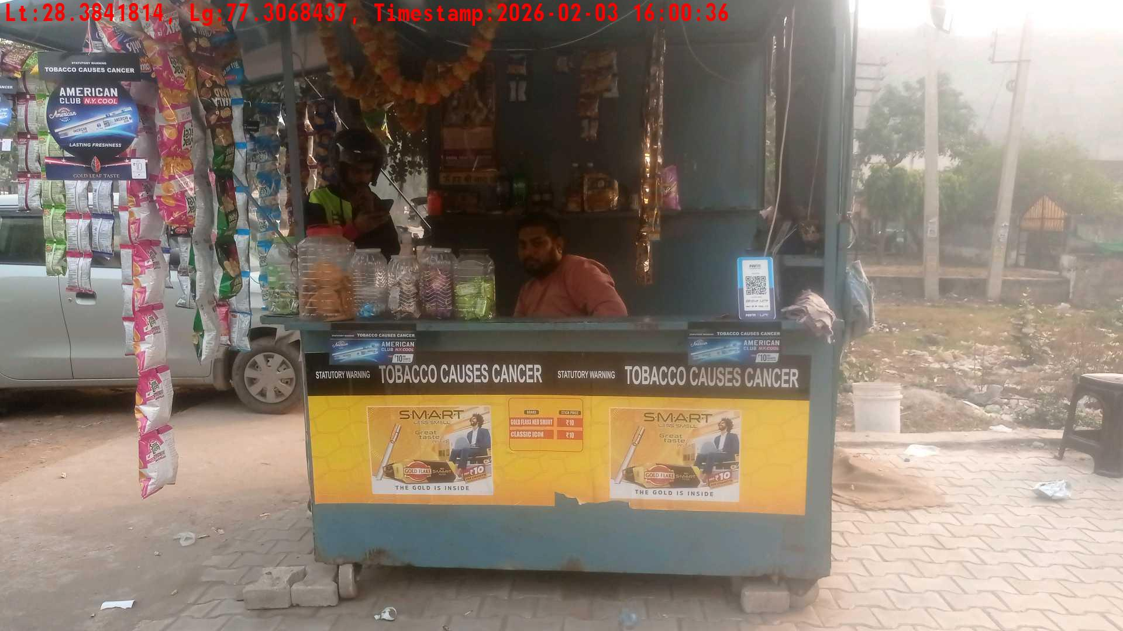
WD Code | Team Id | Team | Shop Name | Owner Mobile Number | Shop Address | Brand | Date Time
DE5493 | 3335 | Dilip | Ramesh | 9835934916 |  | Gold Flake Super Star | 03-02-2026 04:00:36 PM
Pre Shop Photo
Post Shop Photo

Slide 23
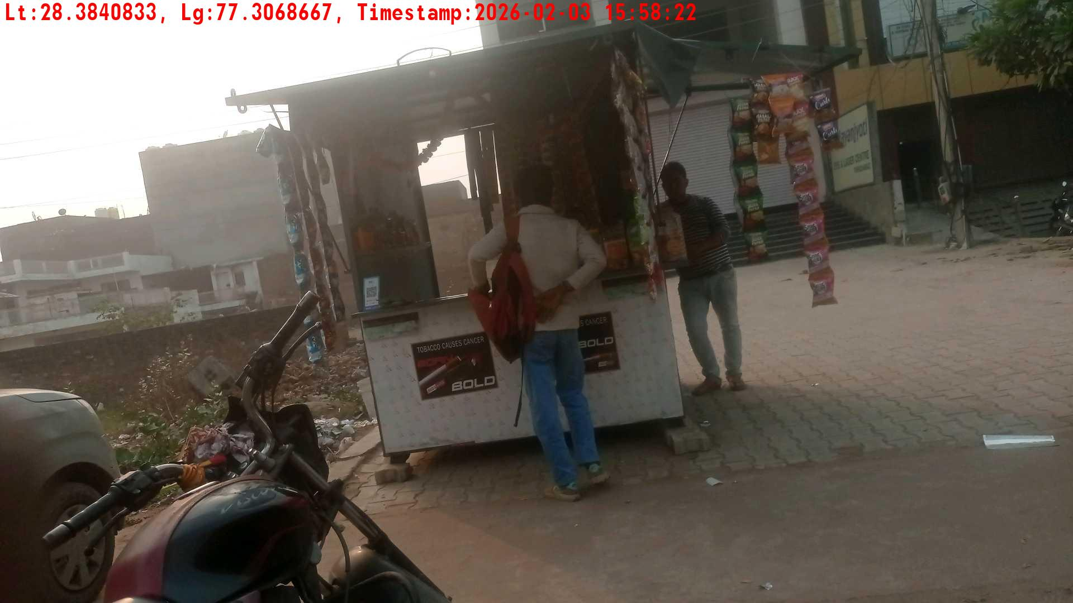
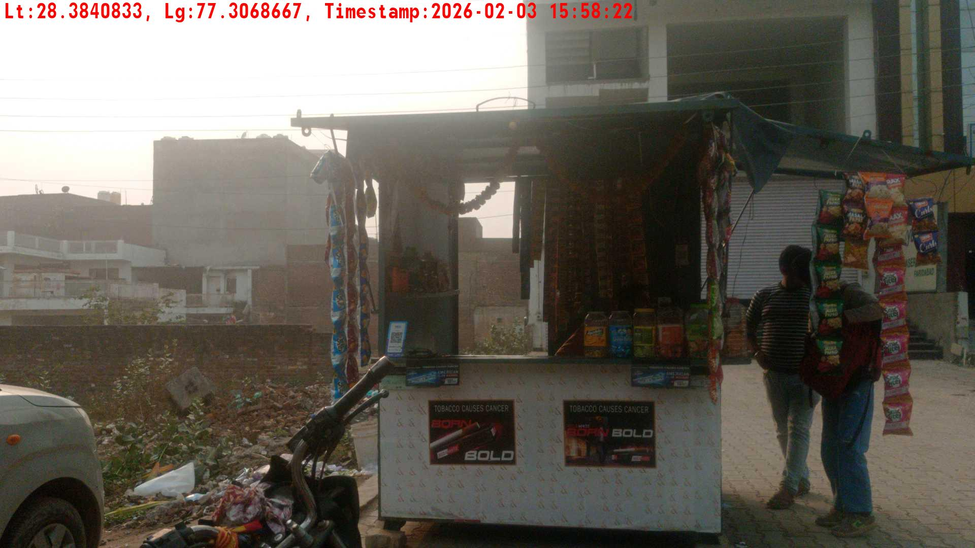
WD Code | Team Id | Team | Shop Name | Owner Mobile Number | Shop Address | Brand | Date Time
DE5493 | 3335 | Dilip | Ramesh | 9531664694 |  | Gold Flake Neo Smart | 03-02-2026 03:58:22 PM
Pre Shop Photo
Post Shop Photo

Slide 24
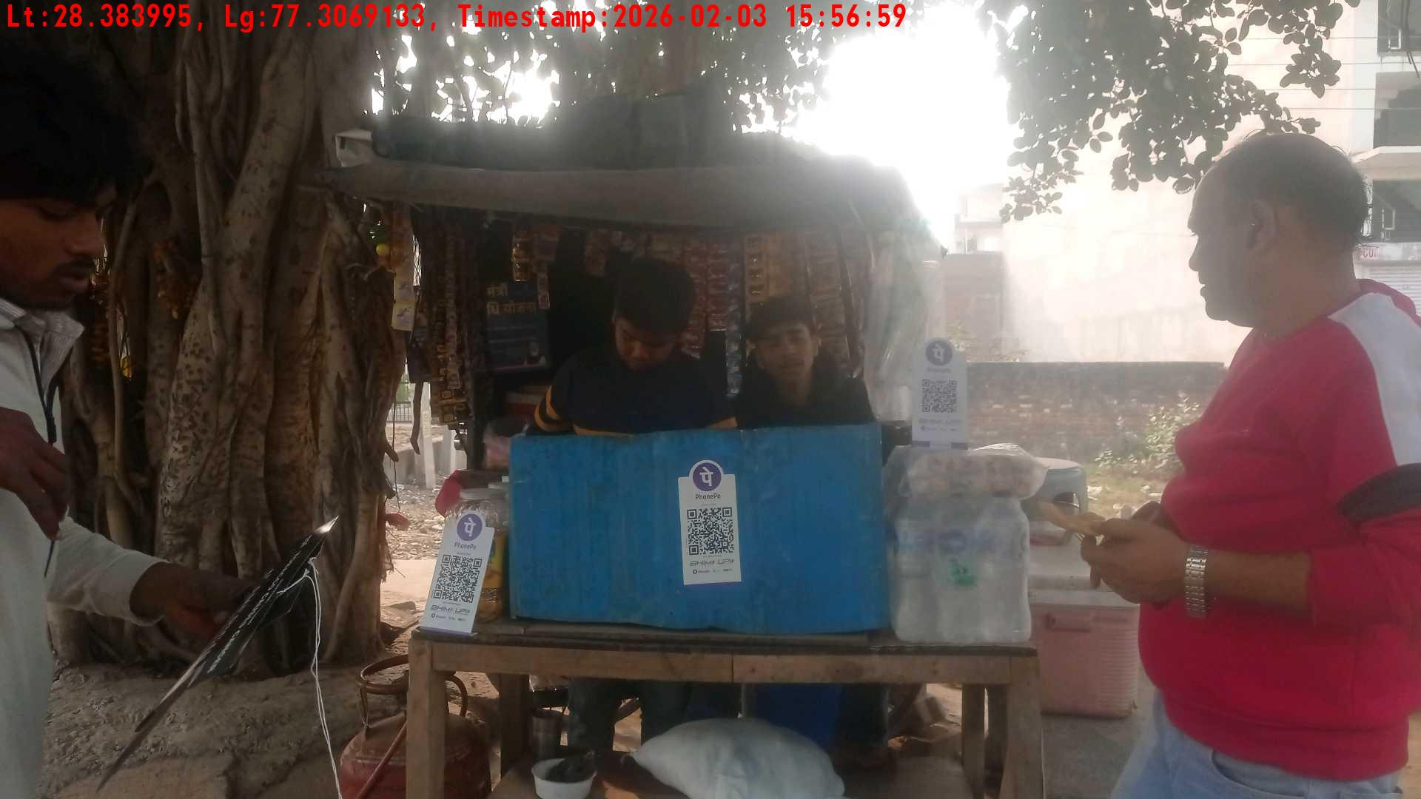
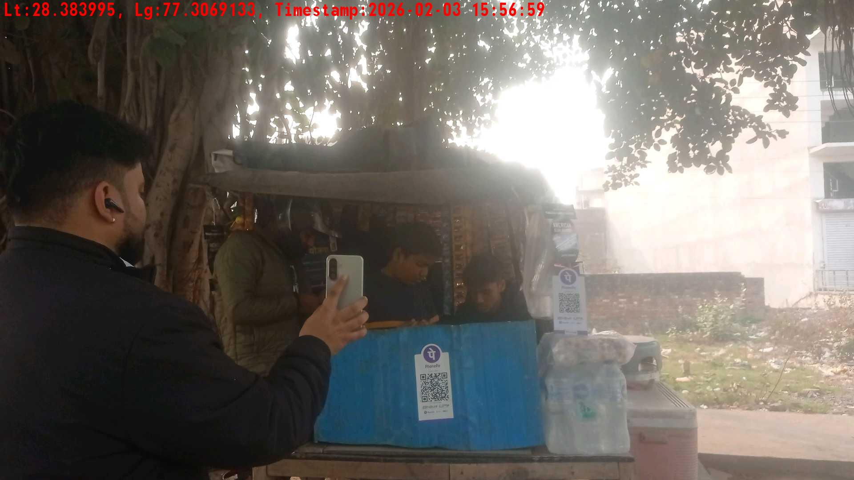
WD Code | Team Id | Team | Shop Name | Owner Mobile Number | Shop Address | Brand | Date Time
DE5493 | 3335 | Dilip | Princy | 9864946676 |  | Gold Flake Super Star | 03-02-2026 03:56:59 PM
Pre Shop Photo
Post Shop Photo

Slide 25
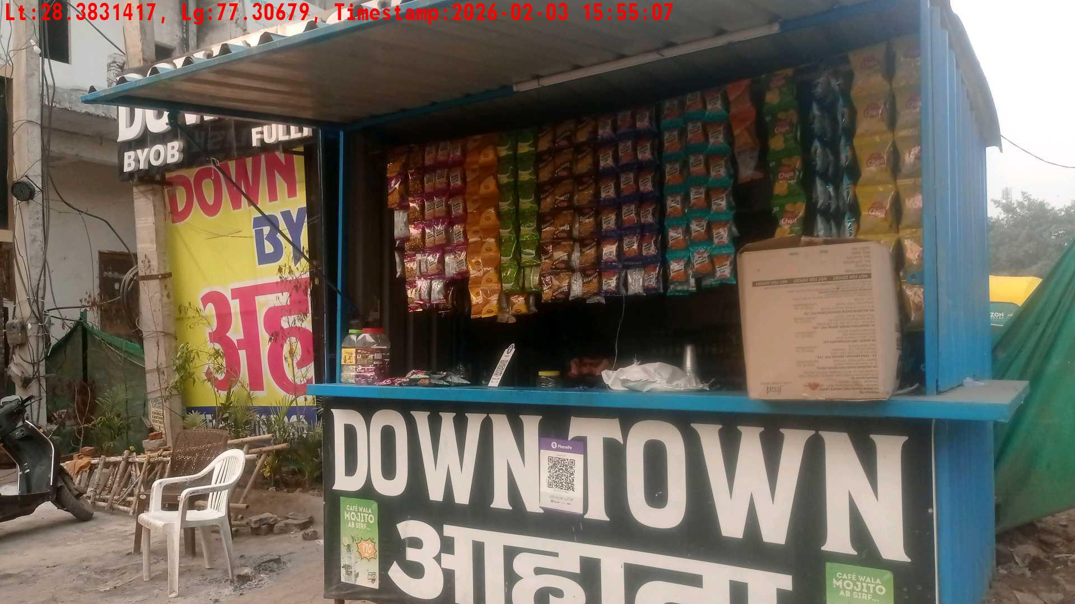
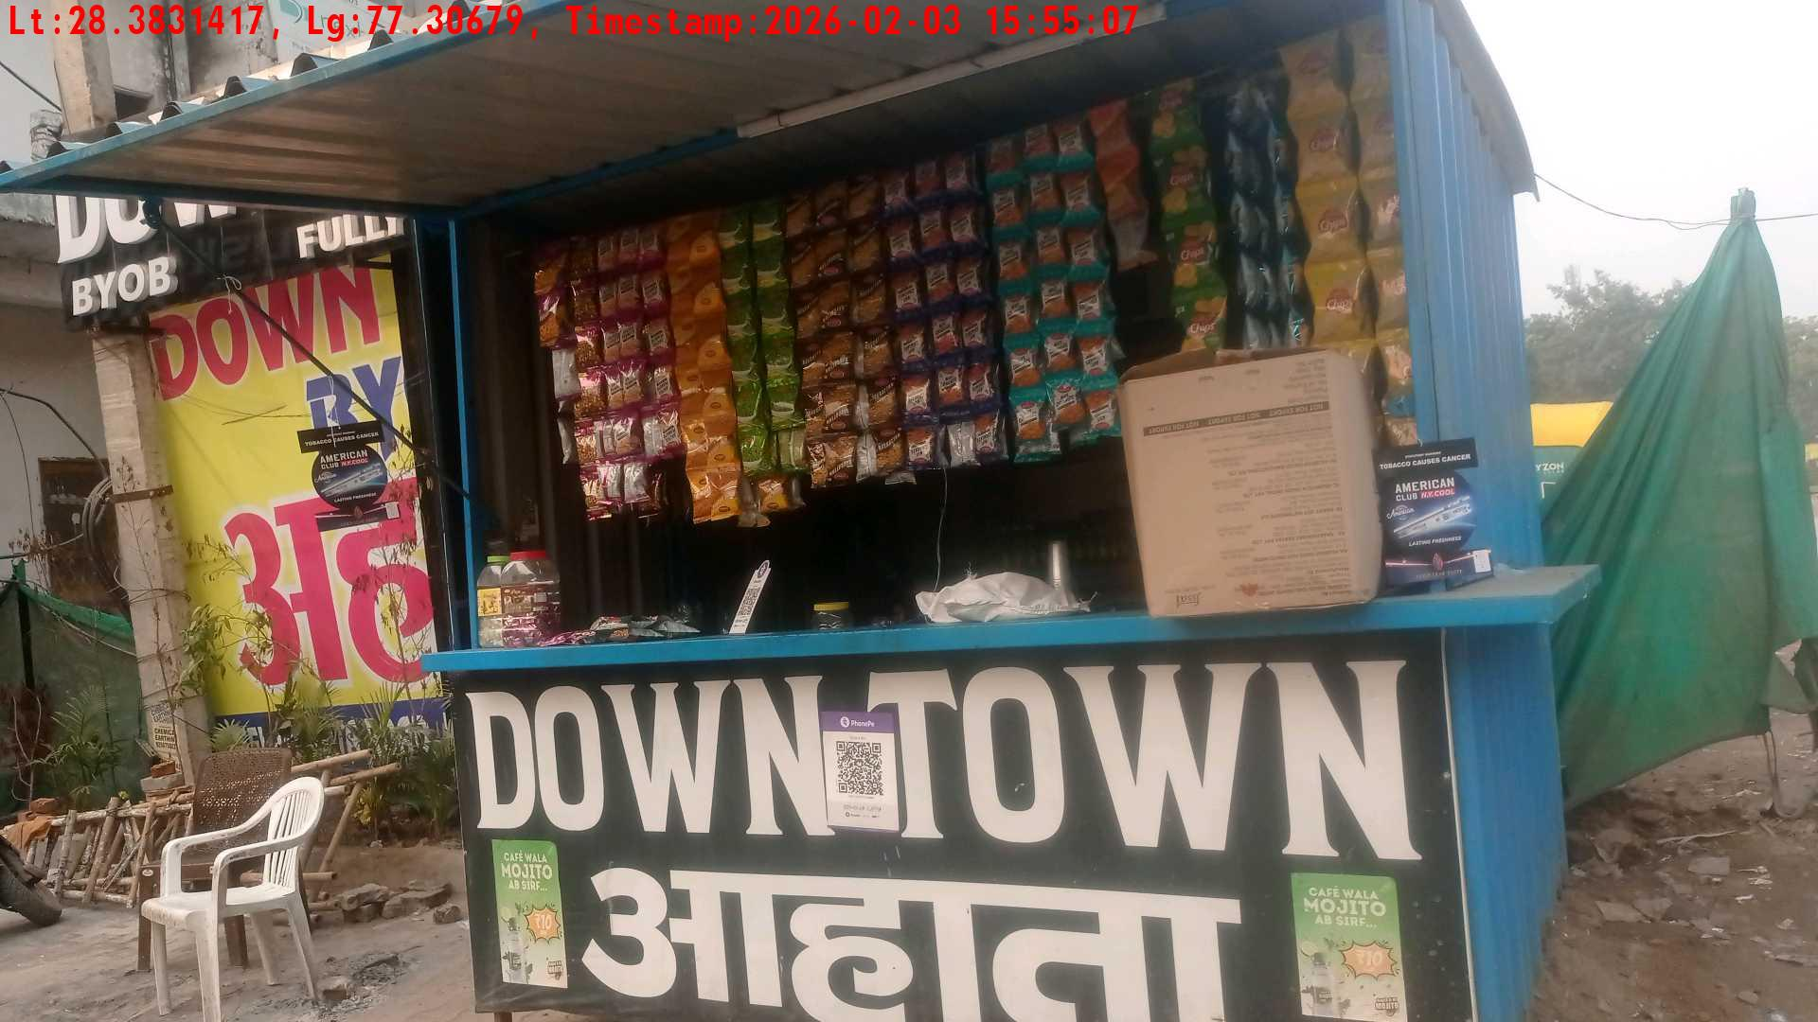
WD Code | Team Id | Team | Shop Name | Owner Mobile Number | Shop Address | Brand | Date Time
DE5493 | 3335 | Dilip | Princy | 8943598394 |  | Gold Flake Neo Smart | 03-02-2026 03:55:07 PM
Pre Shop Photo
Post Shop Photo

Slide 26
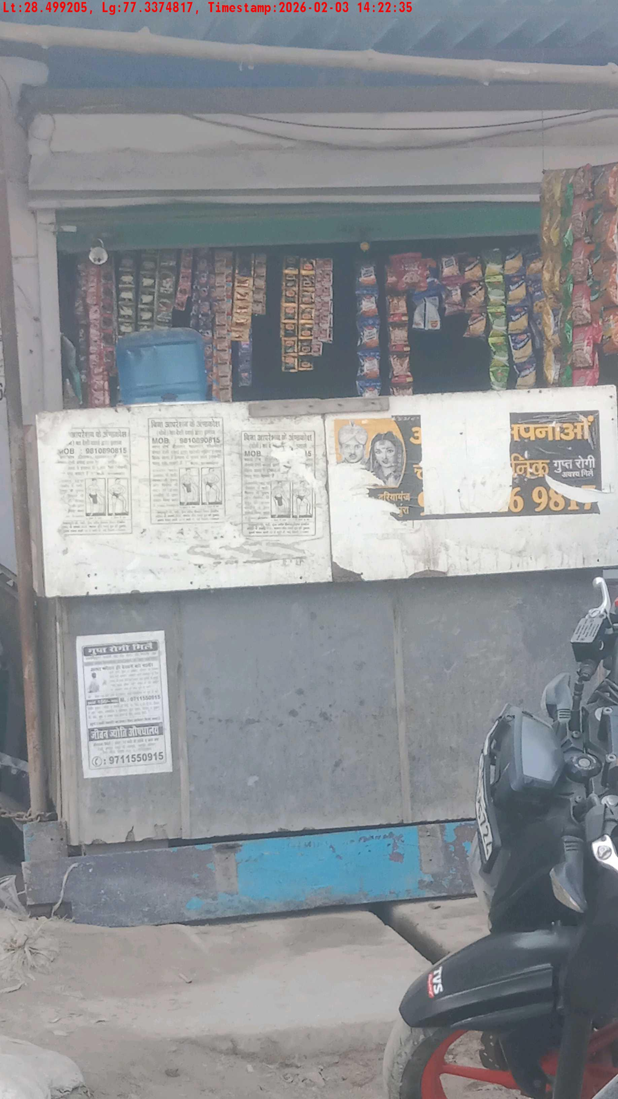
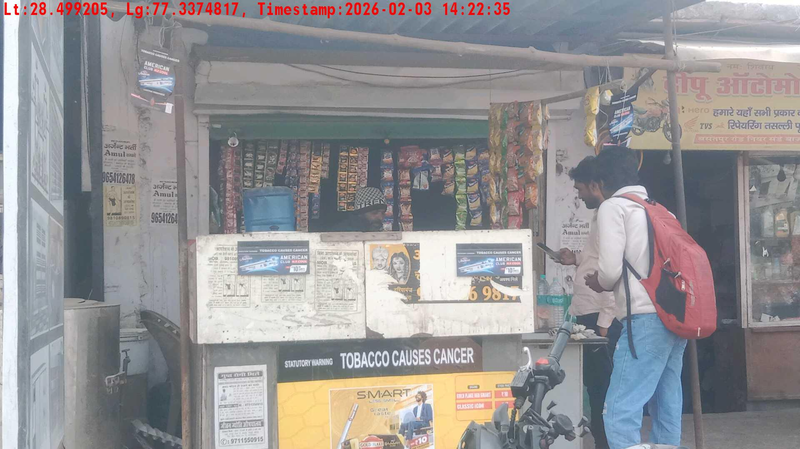
WD Code | Team Id | Team | Shop Name | Owner Mobile Number | Shop Address | Brand | Date Time
DE5493 | 3310 | Keshav Diwaker | Vinay Kanojia | 9349646467 |  | Gold Flake Super Star | 03-02-2026 02:22:35 PM
Pre Shop Photo
Post Shop Photo

Slide 27


WD Code | Team Id | Team | Shop Name | Owner Mobile Number | Shop Address | Brand | Date Time
DE5493 | 3310 | Keshav Diwaker | Vinita | 9735643919 |  | Gold Flake Super Star | 03-02-2026 02:19:49 PM
Pre Shop Photo
Post Shop Photo

Slide 28


WD Code | Team Id | Team | Shop Name | Owner Mobile Number | Shop Address | Brand | Date Time
DE5493 | 3310 | Keshav Diwaker | Mohanlal | 8793494649 |  | Gold Flake Super Star | 03-02-2026 02:15:47 PM
Pre Shop Photo
Post Shop Photo

Slide 29
WD Code | Team Id | Team | Shop Name | Owner Mobile Number | Shop Address | Brand | Date Time
DE5493 | 3310 | Keshav Diwaker | Mohanlal | 8793494649 |  | Gold Flake Super Star | 03-02-2026 02:15:47 PM
Pre Shop Photo
Post Shop Photo

Slide 30
WD Code | Team Id | Team | Shop Name | Owner Mobile Number | Shop Address | Brand | Date Time
DE5493 | 3310 | Keshav Diwaker | Mohanlal | 8793494649 |  | Gold Flake Super Star | 03-02-2026 02:15:47 PM
Pre Shop Photo
Post Shop Photo

Slide 31
WD Code | Team Id | Team | Shop Name | Owner Mobile Number | Shop Address | Brand | Date Time
DE5493 | 3310 | Keshav Diwaker | Mohanlal | 8793494649 |  | Gold Flake Super Star | 03-02-2026 02:15:47 PM
Pre Shop Photo
Post Shop Photo

Slide 32


WD Code | Team Id | Team | Shop Name | Owner Mobile Number | Shop Address | Brand | Date Time
DE5493 | 3310 | Keshav Diwaker | Mohanlal | 9345527564 |  | Gold Flake Super Star | 03-02-2026 02:12:03 PM
Pre Shop Photo
Post Shop Photo

Slide 33


WD Code | Team Id | Team | Shop Name | Owner Mobile Number | Shop Address | Brand | Date Time
DE5493 | 3310 | Keshav Diwaker | Mohanlal | 8359464661 |  | Gold Flake Super Star | 03-02-2026 02:10:52 PM
Pre Shop Photo
Post Shop Photo

Slide 34


WD Code | Team Id | Team | Shop Name | Owner Mobile Number | Shop Address | Brand | Date Time
DE5493 | 3310 | Keshav Diwaker | Mohanlal | 8349649467 |  | Gold Flake Super Star | 03-02-2026 02:04:40 PM
Pre Shop Photo
Post Shop Photo

Slide 35


WD Code | Team Id | Team | Shop Name | Owner Mobile Number | Shop Address | Brand | Date Time
DE5493 | 3310 | Keshav Diwaker | Mohanlal | 8736165949 |  | Gold Flake Super Star | 03-02-2026 02:02:20 PM
Pre Shop Photo
Post Shop Photo

Slide 36


WD Code | Team Id | Team | Shop Name | Owner Mobile Number | Shop Address | Brand | Date Time
DE5493 | 3310 | Keshav Diwaker | Mohanlal | 8943616461 |  | Gold Flake Super Star | 03-02-2026 01:57:31 PM
Pre Shop Photo
Post Shop Photo

Slide 37


WD Code | Team Id | Team | Shop Name | Owner Mobile Number | Shop Address | Brand | Date Time
DE5493 | 3310 | Keshav Diwaker | Kanhaiya Lal | 9759469538 |  | Gold Flake Super Star | 03-02-2026 01:51:56 PM
Pre Shop Photo
Post Shop Photo

Slide 38


WD Code | Team Id | Team | Shop Name | Owner Mobile Number | Shop Address | Brand | Date Time
DE5493 | 3310 | Keshav Diwaker | Kanhaiya Lal | 8961646496 |  | Gold Flake Super Star | 03-02-2026 01:40:22 PM
Pre Shop Photo
Post Shop Photo

Slide 39


WD Code | Team Id | Team | Shop Name | Owner Mobile Number | Shop Address | Brand | Date Time
DE5493 | 3310 | Keshav Diwaker | Kanhaiya Lal | 9836461615 |  | Gold Flake Super Star | 03-02-2026 01:37:10 PM
Pre Shop Photo
Post Shop Photo

Slide 40


WD Code | Team Id | Team | Shop Name | Owner Mobile Number | Shop Address | Brand | Date Time
DE5493 | 3310 | Keshav Diwaker | Prince pan | 8313835622 |  | Gold Flake Super Star | 03-02-2026 01:25:17 PM
Pre Shop Photo
Post Shop Photo

Slide 41


WD Code | Team Id | Team | Shop Name | Owner Mobile Number | Shop Address | Brand | Date Time
DE5493 | 3310 | Keshav Diwaker | Prince pan | 8943616464 |  | Gold Flake Super Star | 03-02-2026 01:23:49 PM
Pre Shop Photo
Post Shop Photo

Slide 42


WD Code | Team Id | Team | Shop Name | Owner Mobile Number | Shop Address | Brand | Date Time
DE5493 | 3310 | Keshav Diwaker | Prince pan | 8679134994 |  | Gold Flake Super Star | 03-02-2026 01:16:42 PM
Pre Shop Photo
Post Shop Photo

Slide 43


WD Code | Team Id | Team | Shop Name | Owner Mobile Number | Shop Address | Brand | Date Time
DE5493 | 3310 | Keshav Diwaker | Prince pan | 9761956946 |  | Gold Flake Super Star | 03-02-2026 01:14:23 PM
Pre Shop Photo
Post Shop Photo

Slide 44


WD Code | Team Id | Team | Shop Name | Owner Mobile Number | Shop Address | Brand | Date Time
DE5493 | 3310 | Keshav Diwaker | Prince pan | 8643464664 |  | Gold Flake Super Star | 03-02-2026 01:11:11 PM
Pre Shop Photo
Post Shop Photo

Slide 45


WD Code | Team Id | Team | Shop Name | Owner Mobile Number | Shop Address | Brand | Date Time
DE5493 | 3310 | Keshav Diwaker | Prince pan | 9536161659 |  | Gold Flake Super Star | 03-02-2026 01:06:43 PM
Pre Shop Photo
Post Shop Photo

Slide 46


WD Code | Team Id | Team | Shop Name | Owner Mobile Number | Shop Address | Brand | Date Time
DE5493 | 3310 | Keshav Diwaker | Prince pan | 9536161659 |  | Gold Flake Super Star | 03-02-2026 01:01:30 PM
Pre Shop Photo
Post Shop Photo

Slide 47


WD Code | Team Id | Team | Shop Name | Owner Mobile Number | Shop Address | Brand | Date Time
DE5493 | 3310 | Keshav Diwaker | Prince pan | 9536161659 |  | Gold Flake Super Star | 03-02-2026 12:56:29 PM
Pre Shop Photo
Post Shop Photo

Slide 48


WD Code | Team Id | Team | Shop Name | Owner Mobile Number | Shop Address | Brand | Date Time
DE5493 | 3310 | Keshav Diwaker | Prince pan | 8766464656 |  | Gold Flake Super Star | 03-02-2026 12:52:42 PM
Pre Shop Photo
Post Shop Photo

Slide 49


WD Code | Team Id | Team | Shop Name | Owner Mobile Number | Shop Address | Brand | Date Time
DE5493 | 3310 | Keshav Diwaker | Prince pan | 9359531946 |  | Gold Flake Super Star | 03-02-2026 12:49:05 PM
Pre Shop Photo
Post Shop Photo

Slide 50


WD Code | Team Id | Team | Shop Name | Owner Mobile Number | Shop Address | Brand | Date Time
DE5493 | 3335 | Dilip | Princy | 9434946654 |  | Gold Flake Neo Smart | 03-02-2026 10:59:43 AM
Pre Shop Photo
Post Shop Photo

Slide 51


WD Code | Team Id | Team | Shop Name | Owner Mobile Number | Shop Address | Brand | Date Time
DE5493 | 3310 | Keshav Diwaker | Prince pan | 9359531946 |  | Gold Flake Super Star | 03-02-2026 10:31:37 AM
Pre Shop Photo
Post Shop Photo

Slide 52


WD Code | Team Id | Team | Shop Name | Owner Mobile Number | Shop Address | Brand | Date Time
DE5493 | 3335 | Dilip | shiva pan | 9764964964 |  | Gold Flake Neo Smart | 02-02-2026 04:15:53 PM
Pre Shop Photo
Post Shop Photo

Slide 53


WD Code | Team Id | Team | Shop Name | Owner Mobile Number | Shop Address | Brand | Date Time
DE5493 | 3335 | Dilip | shiva pan | 9769464634 |  | Gold Flake Neo Smart | 02-02-2026 04:11:37 PM
Pre Shop Photo
Post Shop Photo

Slide 54


WD Code | Team Id | Team | Shop Name | Owner Mobile Number | Shop Address | Brand | Date Time
DE5493 | 3335 | Dilip | shiva an | 9764934534 |  | Gold Flake Neo Smart | 02-02-2026 04:09:20 PM
Pre Shop Photo
Post Shop Photo

Slide 55


WD Code | Team Id | Team | Shop Name | Owner Mobile Number | Shop Address | Brand | Date Time
DE5493 | 3335 | Dilip | kuldeep pan | 9769434934 |  | Gold Flake Neo Smart | 02-02-2026 03:48:14 PM
Pre Shop Photo
Post Shop Photo

Slide 56


WD Code | Team Id | Team | Shop Name | Owner Mobile Number | Shop Address | Brand | Date Time
DE5493 | 3335 | Dilip | kuldeep pan | 9764934634 |  | Gold Flake Neo Smart | 02-02-2026 03:31:17 PM
Pre Shop Photo
Post Shop Photo

Slide 57


WD Code | Team Id | Team | Shop Name | Owner Mobile Number | Shop Address | Brand | Date Time
DE5493 | 3335 | Dilip | kuldeep pan | 9768431834 |  | Gold Flake Neo Smart | 02-02-2026 03:27:47 PM
Pre Shop Photo
Post Shop Photo

Slide 58


WD Code | Team Id | Team | Shop Name | Owner Mobile Number | Shop Address | Brand | Date Time
DE5493 | 3335 | Dilip | sandeep pan | 9764834934 |  | Gold Flake Neo Smart | 02-02-2026 03:24:25 PM
Pre Shop Photo
Post Shop Photo

Slide 59


WD Code | Team Id | Team | Shop Name | Owner Mobile Number | Shop Address | Brand | Date Time
DE5493 | 3335 | Dilip | sandeep pan | 9839434934 |  | Gold Flake Neo Smart | 02-02-2026 03:20:32 PM
Pre Shop Photo
Post Shop Photo

Slide 60


WD Code | Team Id | Team | Shop Name | Owner Mobile Number | Shop Address | Brand | Date Time
DE5493 | 3335 | Dilip | sandeep pan | 9469434934 |  | Gold Flake Neo Smart | 02-02-2026 03:16:16 PM
Pre Shop Photo
Post Shop Photo

Slide 61


WD Code | Team Id | Team | Shop Name | Owner Mobile Number | Shop Address | Brand | Date Time
DE5493 | 3310 | Keshav Diwaker | DK Pan Bhandar | 9438676149 |  | Gold Flake Super Star | 02-02-2026 03:14:33 PM
Pre Shop Photo
Post Shop Photo

Slide 62


WD Code | Team Id | Team | Shop Name | Owner Mobile Number | Shop Address | Brand | Date Time
DE5493 | 3335 | Dilip | sandeep pan | 9761634631 |  | Gold Flake Neo Smart | 02-02-2026 03:13:11 PM
Pre Shop Photo
Post Shop Photo

Slide 63


WD Code | Team Id | Team | Shop Name | Owner Mobile Number | Shop Address | Brand | Date Time
DE5493 | 3310 | Keshav Diwaker | Vinay pal | 8564319828 |  | Gold Flake Super Star | 02-02-2026 03:11:32 PM
Pre Shop Photo
Post Shop Photo

Slide 64


WD Code | Team Id | Team | Shop Name | Owner Mobile Number | Shop Address | Brand | Date Time
DE5493 | 3335 | Dilip | sandeep pan | 9764834964 |  | Gold Flake Super Star | 02-02-2026 03:11:27 PM
Pre Shop Photo
Post Shop Photo

Slide 65


WD Code | Team Id | Team | Shop Name | Owner Mobile Number | Shop Address | Brand | Date Time
DE5493 | 3310 | Keshav Diwaker | Chandan Pandit | 9346434913 |  | Gold Flake Super Star | 02-02-2026 02:55:45 PM
Pre Shop Photo
Post Shop Photo

Slide 66


WD Code | Team Id | Team | Shop Name | Owner Mobile Number | Shop Address | Brand | Date Time
DE5493 | 3310 | Keshav Diwaker | Prem | 9355135946 |  | Gold Flake Super Star | 02-02-2026 02:53:15 PM
Pre Shop Photo
Post Shop Photo

Slide 67


WD Code | Team Id | Team | Shop Name | Owner Mobile Number | Shop Address | Brand | Date Time
DE5493 | 3310 | Keshav Diwaker | Prem | 9364649564 |  | Gold Flake Super Star | 02-02-2026 02:51:38 PM
Pre Shop Photo
Post Shop Photo

Slide 68


WD Code | Team Id | Team | Shop Name | Owner Mobile Number | Shop Address | Brand | Date Time
DE5493 | 3310 | Keshav Diwaker | chotu | 9359534813 |  | Gold Flake Super Star | 02-02-2026 02:36:38 PM
Pre Shop Photo
Post Shop Photo

Slide 69


WD Code | Team Id | Team | Shop Name | Owner Mobile Number | Shop Address | Brand | Date Time
DE5493 | 3310 | Keshav Diwaker | Sunil | 9546946594 |  | Gold Flake Super Star | 02-02-2026 02:31:20 PM
Pre Shop Photo
Post Shop Photo

Slide 70


WD Code | Team Id | Team | Shop Name | Owner Mobile Number | Shop Address | Brand | Date Time
DE5493 | 3310 | Keshav Diwaker | Sunil | 8631616597 |  | Gold Flake Super Star | 02-02-2026 02:26:08 PM
Pre Shop Photo
Post Shop Photo

Slide 71


WD Code | Team Id | Team | Shop Name | Owner Mobile Number | Shop Address | Brand | Date Time
DE5493 | 3335 | Dilip | sandeep pan | 9769464834 |  | Gold Flake Neo Smart | 02-02-2026 02:24:12 PM
Pre Shop Photo
Post Shop Photo

Slide 72


WD Code | Team Id | Team | Shop Name | Owner Mobile Number | Shop Address | Brand | Date Time
DE5493 | 3310 | Keshav Diwaker | Sunil | 9439231913 |  | Gold Flake Super Star | 02-02-2026 02:23:22 PM
Pre Shop Photo
Post Shop Photo

Slide 73


WD Code | Team Id | Team | Shop Name | Owner Mobile Number | Shop Address | Brand | Date Time
DE5493 | 3335 | Dilip | sandeep pan | 9769464964 |  | Gold Flake Neo Smart | 02-02-2026 02:21:56 PM
Pre Shop Photo
Post Shop Photo

Slide 74


WD Code | Team Id | Team | Shop Name | Owner Mobile Number | Shop Address | Brand | Date Time
DE5493 | 3310 | Keshav Diwaker | Shila Devi | 9345769464 |  | Gold Flake Super Star | 02-02-2026 02:21:34 PM
Pre Shop Photo
Post Shop Photo

Slide 75


WD Code | Team Id | Team | Shop Name | Owner Mobile Number | Shop Address | Brand | Date Time
DE5493 | 3335 | Dilip | kamal pan | 9734964934 |  | Gold Flake Neo Smart | 02-02-2026 02:18:03 PM
Pre Shop Photo
Post Shop Photo

Slide 76
WD Code | Team Id | Team | Shop Name | Owner Mobile Number | Shop Address | Brand | Date Time
DE5493 | 3335 | Dilip | kamal pan | 9734964934 |  | Gold Flake Neo Smart | 02-02-2026 02:18:03 PM
Pre Shop Photo
Post Shop Photo

Slide 77


WD Code | Team Id | Team | Shop Name | Owner Mobile Number | Shop Address | Brand | Date Time
DE5493 | 3335 | Dilip | kamal pan | 9764934934 |  | Gold Flake Neo Smart | 02-02-2026 02:11:09 PM
Pre Shop Photo
Post Shop Photo

Slide 78


WD Code | Team Id | Team | Shop Name | Owner Mobile Number | Shop Address | Brand | Date Time
DE5493 | 3335 | Dilip | raju pan | 9649649349 |  | Gold Flake Neo Smart | 02-02-2026 02:03:45 PM
Pre Shop Photo
Post Shop Photo

Slide 79


WD Code | Team Id | Team | Shop Name | Owner Mobile Number | Shop Address | Brand | Date Time
DE5493 | 3335 | Dilip | raju pan | 9769434964 |  | Gold Flake Neo Smart | 02-02-2026 02:02:04 PM
Pre Shop Photo
Post Shop Photo

Slide 80


WD Code | Team Id | Team | Shop Name | Owner Mobile Number | Shop Address | Brand | Date Time
DE5493 | 3335 | Dilip | raju pan | 9769464934 |  | Gold Flake Neo Smart | 02-02-2026 01:58:13 PM
Pre Shop Photo
Post Shop Photo

Slide 81


WD Code | Team Id | Team | Shop Name | Owner Mobile Number | Shop Address | Brand | Date Time
DE5493 | 3310 | Keshav Diwaker | Shila Devi | 8965471354 |  | Gold Flake Super Star | 02-02-2026 01:47:38 PM
Pre Shop Photo
Post Shop Photo

Slide 82


WD Code | Team Id | Team | Shop Name | Owner Mobile Number | Shop Address | Brand | Date Time
DE5493 | 3310 | Keshav Diwaker | Shila Devi | 9263458271 |  | Gold Flake Super Star | 02-02-2026 01:44:59 PM
Pre Shop Photo
Post Shop Photo

Slide 83


WD Code | Team Id | Team | Shop Name | Owner Mobile Number | Shop Address | Brand | Date Time
DE5493 | 3310 | Keshav Diwaker | Sandeep chandela | 9349469434 |  | Gold Flake Super Star | 02-02-2026 01:37:09 PM
Pre Shop Photo
Post Shop Photo

Slide 84


WD Code | Team Id | Team | Shop Name | Owner Mobile Number | Shop Address | Brand | Date Time
DE5493 | 3310 | Keshav Diwaker | Sandeep chandela | 8694649496 |  | Gold Flake Super Star | 02-02-2026 01:35:10 PM
Pre Shop Photo
Post Shop Photo

Slide 85


WD Code | Team Id | Team | Shop Name | Owner Mobile Number | Shop Address | Brand | Date Time
DE5493 | 3310 | Keshav Diwaker | Sandeep chandela | 9349564949 |  | Gold Flake Super Star | 02-02-2026 01:32:03 PM
Pre Shop Photo
Post Shop Photo

Slide 86


WD Code | Team Id | Team | Shop Name | Owner Mobile Number | Shop Address | Brand | Date Time
DE5493 | 3310 | Keshav Diwaker | Sandeep chandela | 8316439134 |  | Gold Flake Super Star | 02-02-2026 01:25:57 PM
Pre Shop Photo
Post Shop Photo

Slide 87


WD Code | Team Id | Team | Shop Name | Owner Mobile Number | Shop Address | Brand | Date Time
DE5493 | 3310 | Keshav Diwaker | Lucky Singh | 9359536166 |  | Gold Flake Super Star | 02-02-2026 01:11:22 PM
Pre Shop Photo
Post Shop Photo

Slide 88


WD Code | Team Id | Team | Shop Name | Owner Mobile Number | Shop Address | Brand | Date Time
DE5493 | 3310 | Keshav Diwaker | Lucky Singh | 8949649534 |  | Gold Flake Super Star | 02-02-2026 12:46:17 PM
Pre Shop Photo
Post Shop Photo

Slide 89


WD Code | Team Id | Team | Shop Name | Owner Mobile Number | Shop Address | Brand | Date Time
DE5493 | 3335 | Dilip | raju pan | 9769464934 |  | Gold Flake Neo Smart | 02-02-2026 12:44:41 PM
Pre Shop Photo
Post Shop Photo

Slide 90


WD Code | Team Id | Team | Shop Name | Owner Mobile Number | Shop Address | Brand | Date Time
DE5493 | 3310 | Keshav Diwaker | Lucky Singh | 8661349435 |  | Gold Flake Super Star | 02-02-2026 12:44:34 PM
Pre Shop Photo
Post Shop Photo

Slide 91


WD Code | Team Id | Team | Shop Name | Owner Mobile Number | Shop Address | Brand | Date Time
DE5493 | 3310 | Keshav Diwaker | Lucky Singh | 8932246649 |  | Gold Flake Super Star | 02-02-2026 12:42:08 PM
Pre Shop Photo
Post Shop Photo

Slide 92


WD Code | Team Id | Team | Shop Name | Owner Mobile Number | Shop Address | Brand | Date Time
DE5493 | 3310 | Keshav Diwaker | Lucky Singh | 8649469464 |  | Gold Flake Super Star | 02-02-2026 12:40:06 PM
Pre Shop Photo
Post Shop Photo

Slide 93


WD Code | Team Id | Team | Shop Name | Owner Mobile Number | Shop Address | Brand | Date Time
DE5493 | 3310 | Keshav Diwaker | Shankar | 9469464949 |  | Gold Flake Neo Smart | 02-02-2026 12:38:18 PM
Pre Shop Photo
Post Shop Photo

Slide 94


WD Code | Team Id | Team | Shop Name | Owner Mobile Number | Shop Address | Brand | Date Time
DE5493 | 3335 | Dilip | ram pan | 9863486635 |  | Gold Flake Neo Smart | 02-02-2026 12:37:23 PM
Pre Shop Photo
Post Shop Photo

Slide 95


WD Code | Team Id | Team | Shop Name | Owner Mobile Number | Shop Address | Brand | Date Time
DE5493 | 3335 | Dilip | ram pan | 9464964834 |  | Gold Flake Neo Smart | 02-02-2026 12:33:24 PM
Pre Shop Photo
Post Shop Photo

Slide 96


WD Code | Team Id | Team | Shop Name | Owner Mobile Number | Shop Address | Brand | Date Time
DE5493 | 3310 | Keshav Diwaker | Shankar | 9349464946 |  | Gold Flake Super Star | 02-02-2026 12:33:04 PM
Pre Shop Photo
Post Shop Photo

Slide 97


WD Code | Team Id | Team | Shop Name | Owner Mobile Number | Shop Address | Brand | Date Time
DE5493 | 3335 | Dilip | ram pan | 9864964646 |  | Gold Flake Neo Smart | 02-02-2026 12:29:39 PM
Pre Shop Photo
Post Shop Photo

Slide 98


WD Code | Team Id | Team | Shop Name | Owner Mobile Number | Shop Address | Brand | Date Time
DE5493 | 3310 | Keshav Diwaker | Shankar | 8613494694 |  | Gold Flake Super Star | 02-02-2026 12:26:10 PM
Pre Shop Photo
Post Shop Photo

Slide 99


WD Code | Team Id | Team | Shop Name | Owner Mobile Number | Shop Address | Brand | Date Time
DE5493 | 3335 | Dilip | Rajesh Pan | 9764964964 |  | Gold Flake Neo Smart | 02-02-2026 12:25:21 PM
Pre Shop Photo
Post Shop Photo

Slide 100


WD Code | Team Id | Team | Shop Name | Owner Mobile Number | Shop Address | Brand | Date Time
DE5493 | 3335 | Dilip | Rajesh Pan | 9734931934 |  | Gold Flake Neo Smart | 02-02-2026 11:17:24 AM
Pre Shop Photo
Post Shop Photo

Slide 101


WD Code | Team Id | Team | Shop Name | Owner Mobile Number | Shop Address | Brand | Date Time
DE5493 | 3310 | Keshav Diwaker | Shankar | 9345561815 |  | Gold Flake Super Star | 02-02-2026 10:49:20 AM
Pre Shop Photo
Post Shop Photo

