Slide 1
Transaction Ppt

Slide 2


WD Code | DS Id | DS Name | Route Name | Shop Name | Date Time
DE5458 | 779 | Niche-DS4 | Wed-Sat | Ramesh gen store | 11-03-2026 04:13:53 PM
Shop Inside Picture
Shop Front Picture

Slide 3
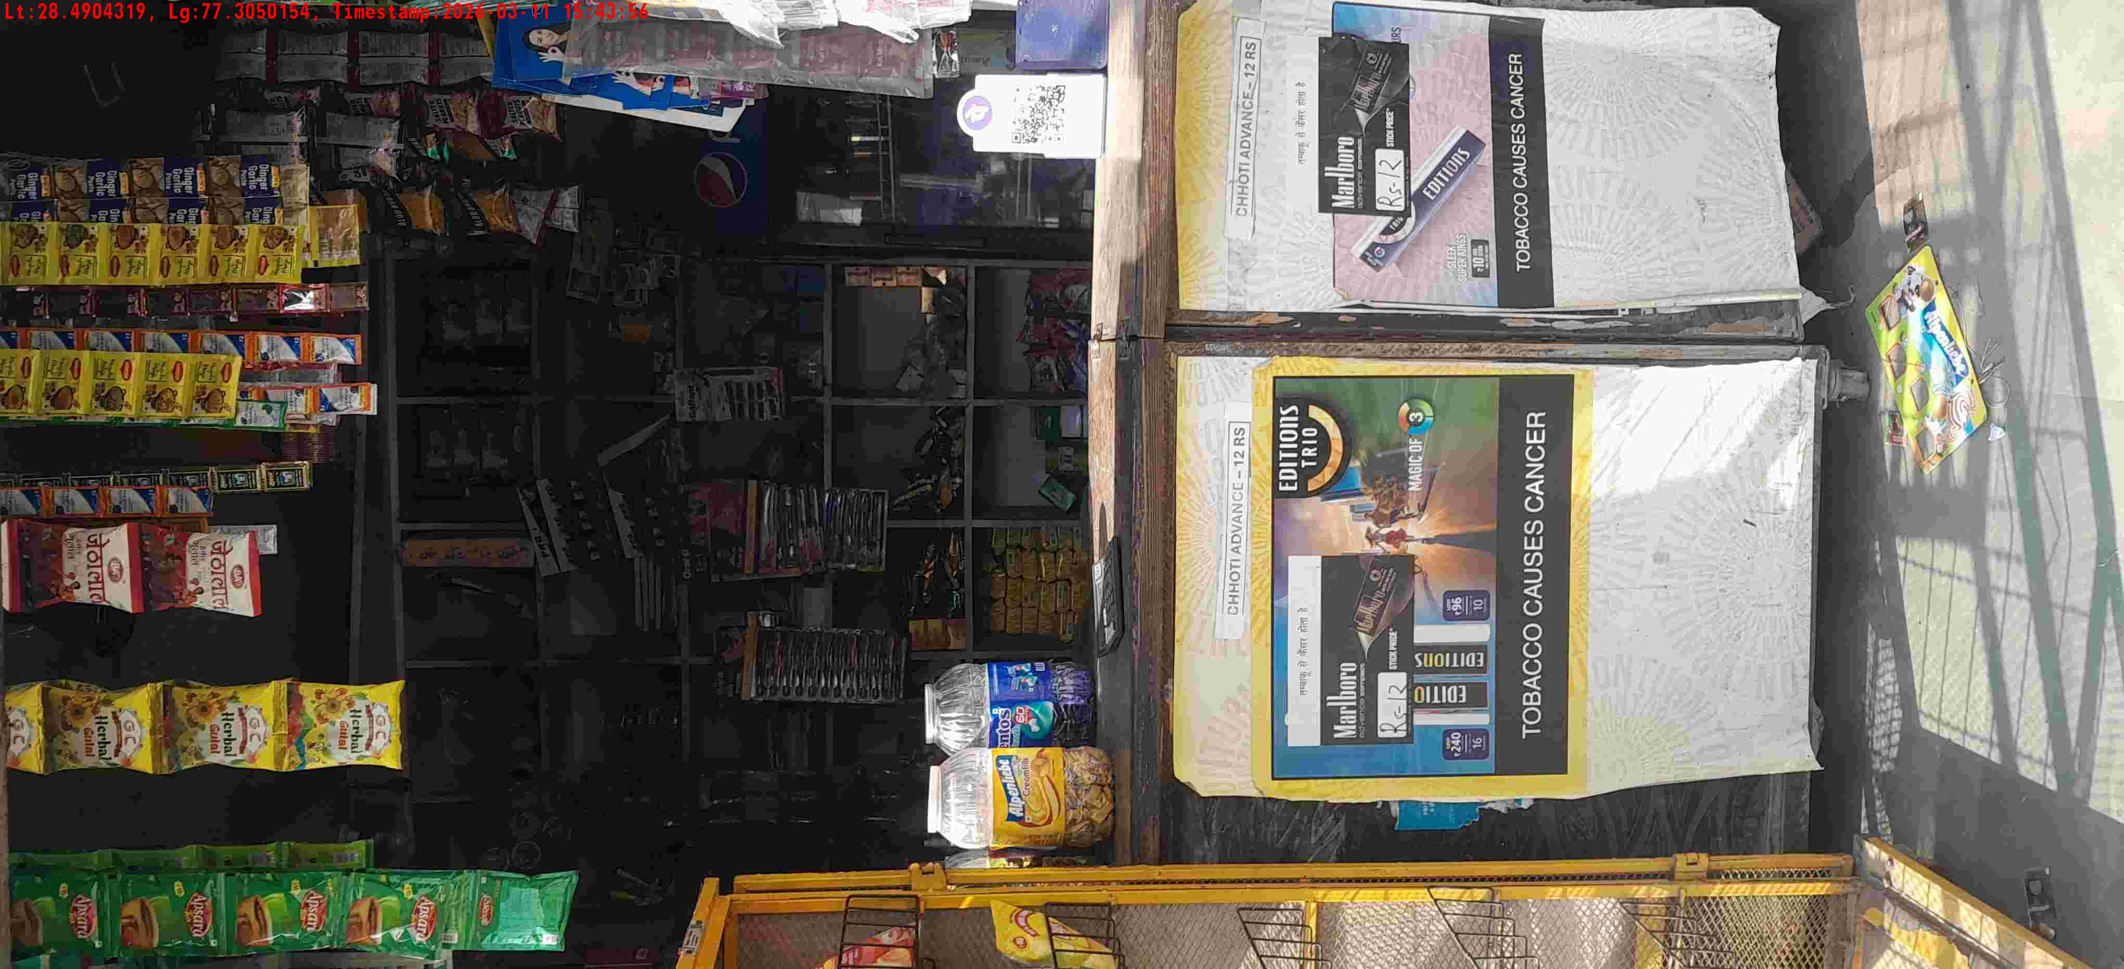
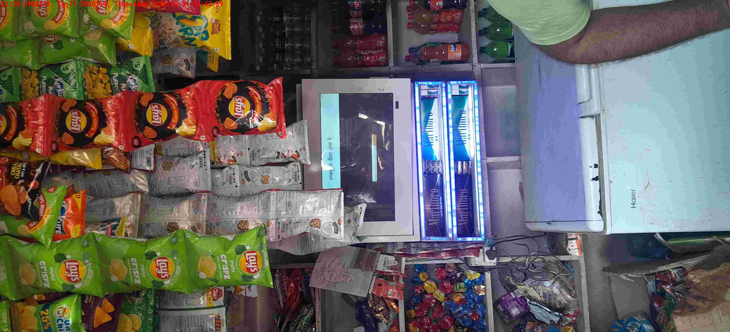
WD Code | DS Id | DS Name | Route Name | Shop Name | Date Time
DE5458 | 779 | Niche-DS4 | Wed-Sat | Tiwari Pan | 11-03-2026 03:43:52 PM
Shop Inside Picture
Shop Front Picture

Slide 4
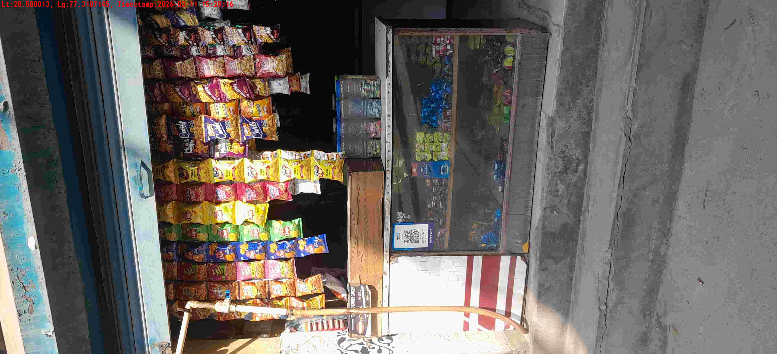
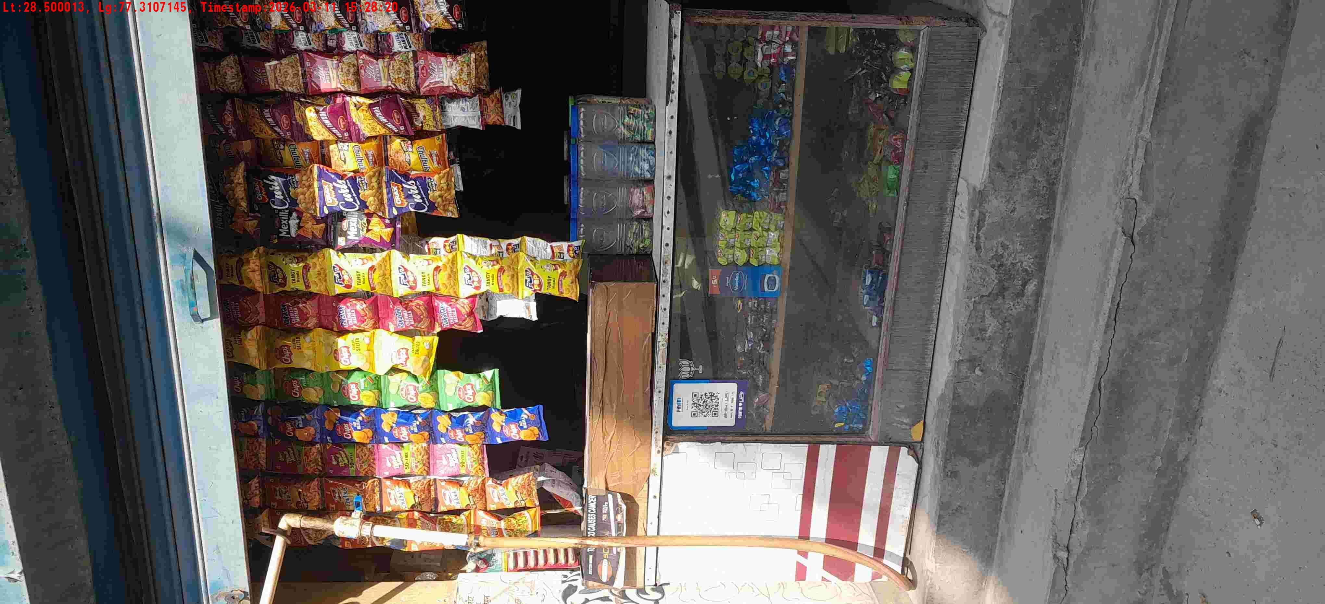
WD Code | DS Id | DS Name | Route Name | Shop Name | Date Time
DE5458 | 779 | Niche-DS4 | Wed-Sat | Yadav general store | 11-03-2026 03:28:11 PM
Shop Inside Picture
Shop Front Picture

Slide 5
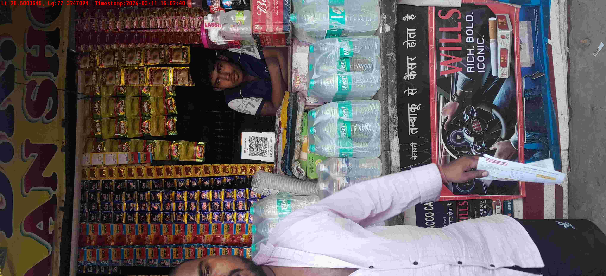
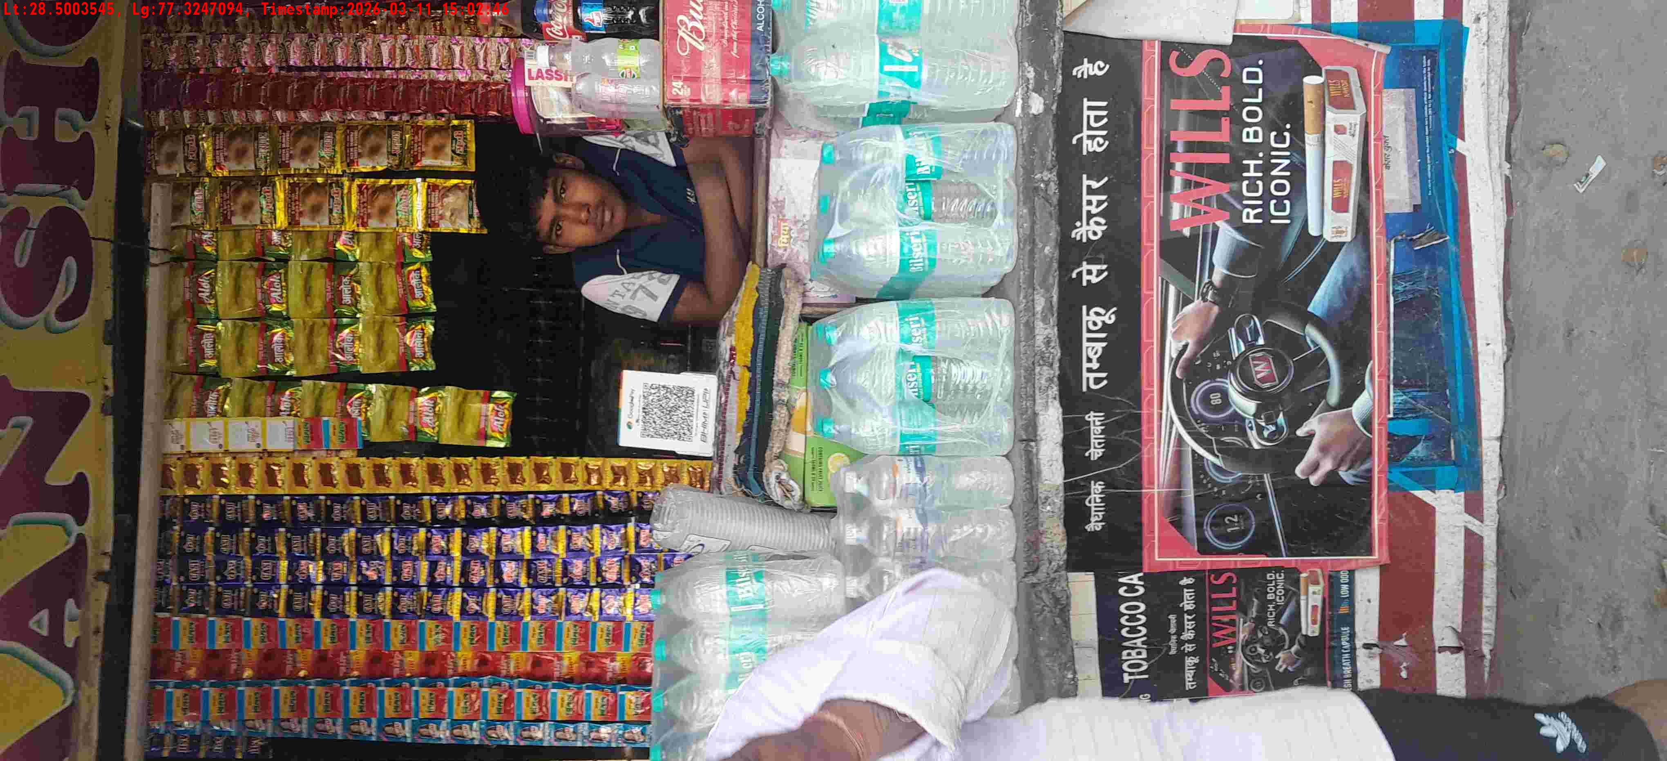
WD Code | DS Id | DS Name | Route Name | Shop Name | Date Time
DE5458 | 779 | Niche-DS4 | Wed-Sat | Mandal store | 11-03-2026 03:02:34 PM
Shop Inside Picture
Shop Front Picture

Slide 6
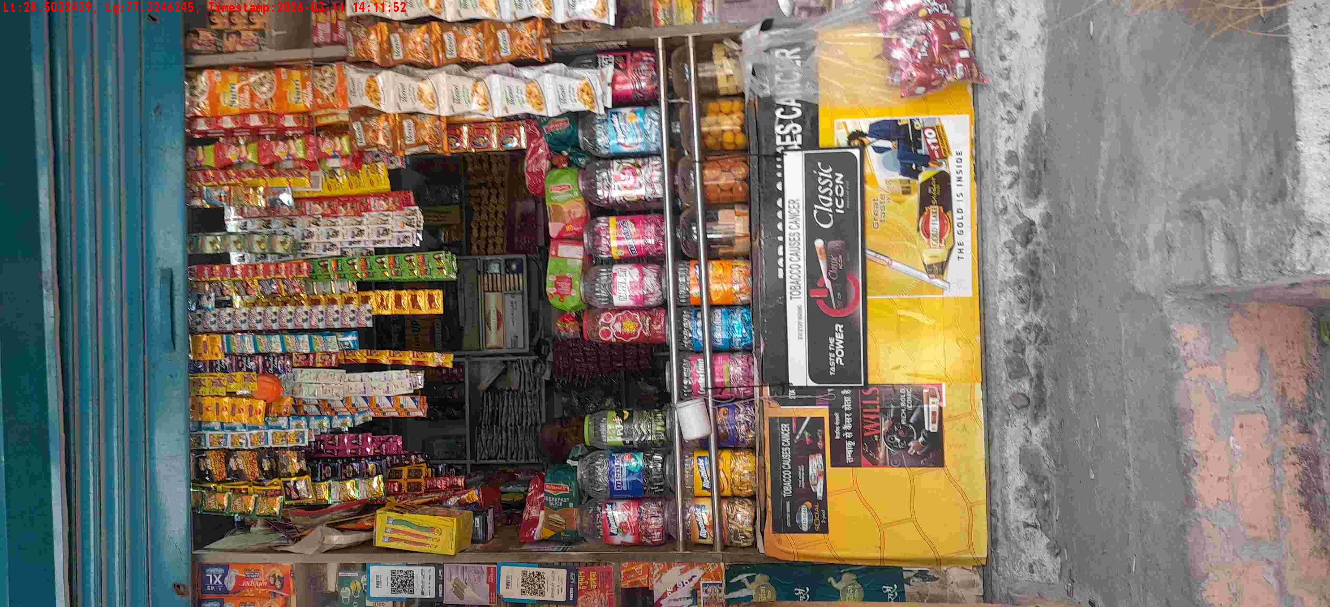
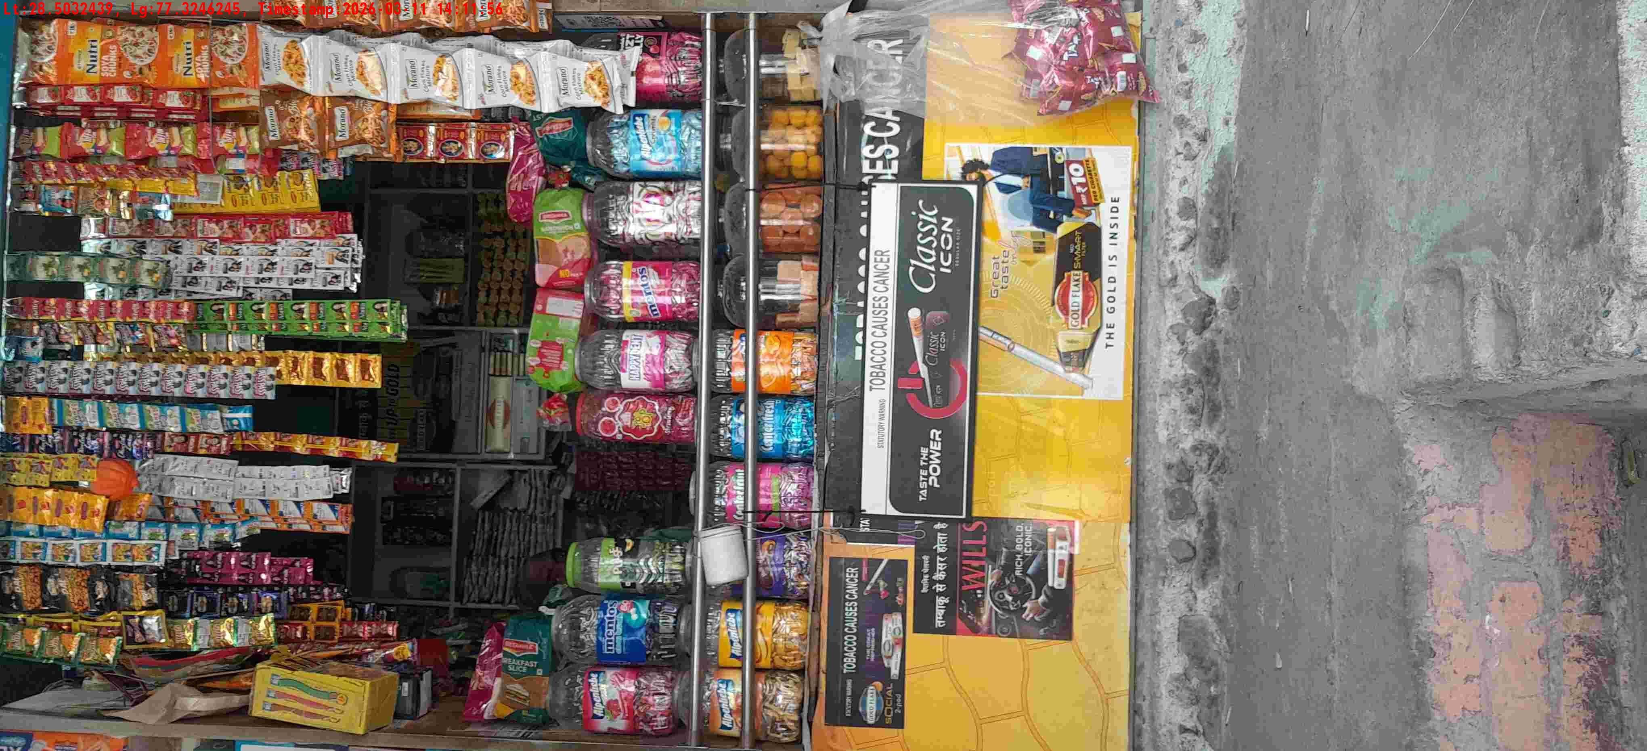
WD Code | DS Id | DS Name | Route Name | Shop Name | Date Time
DE5458 | 779 | Niche-DS4 | Wed-Sat | Satya gen store | 11-03-2026 02:11:49 PM
Shop Inside Picture
Shop Front Picture

Slide 7
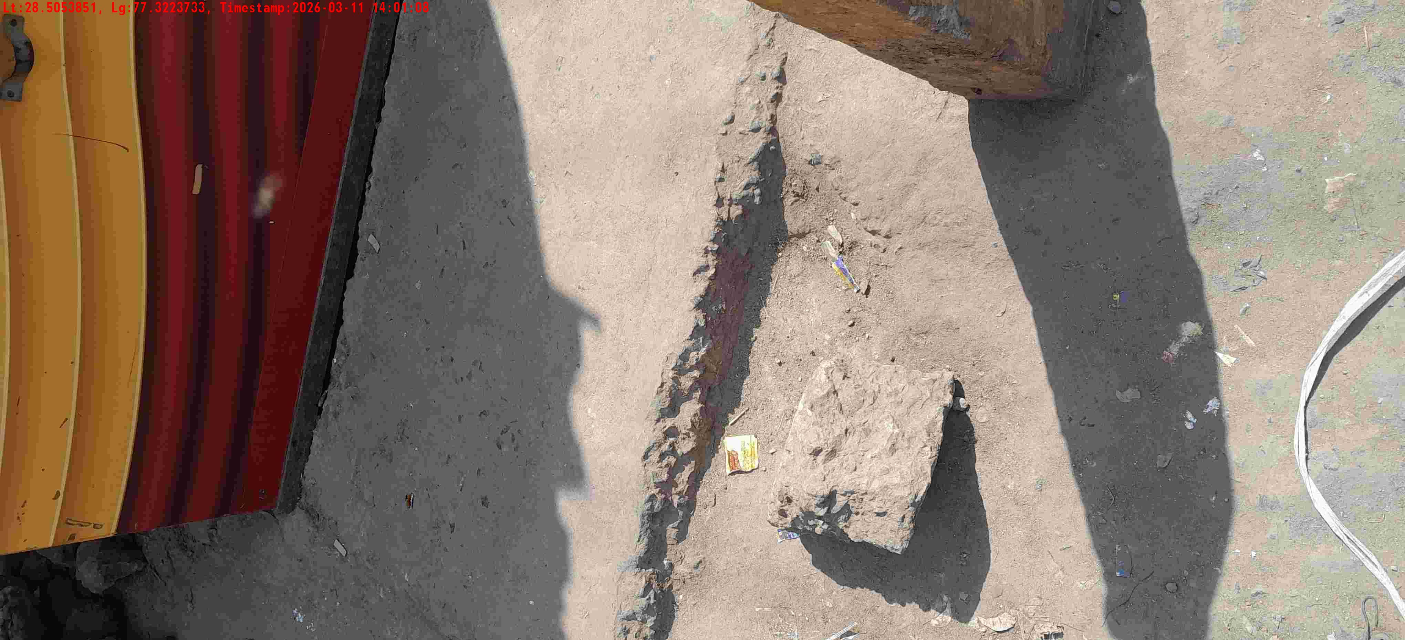
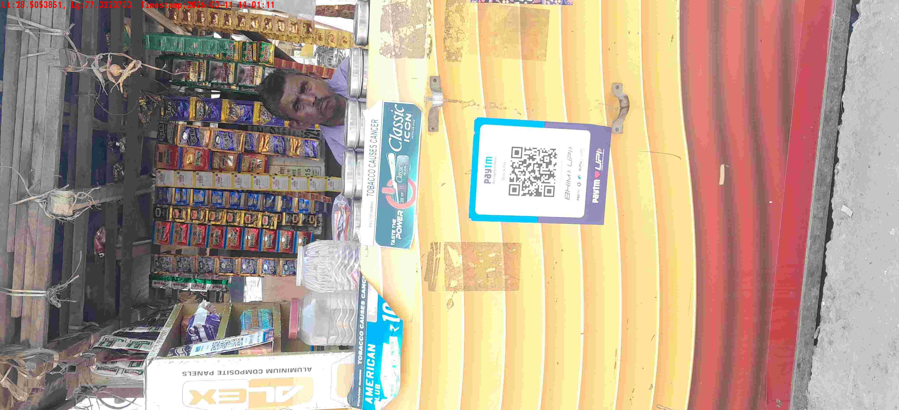
WD Code | DS Id | DS Name | Route Name | Shop Name | Date Time
DE5458 | 779 | Niche-DS4 | Wed-Sat | Vijay pan | 11-03-2026 02:01:03 PM
Shop Inside Picture
Shop Front Picture

Slide 8
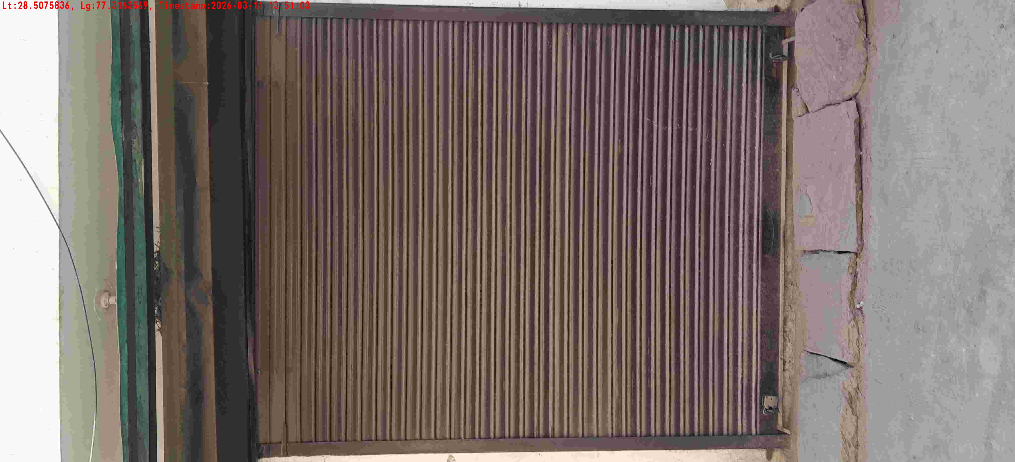
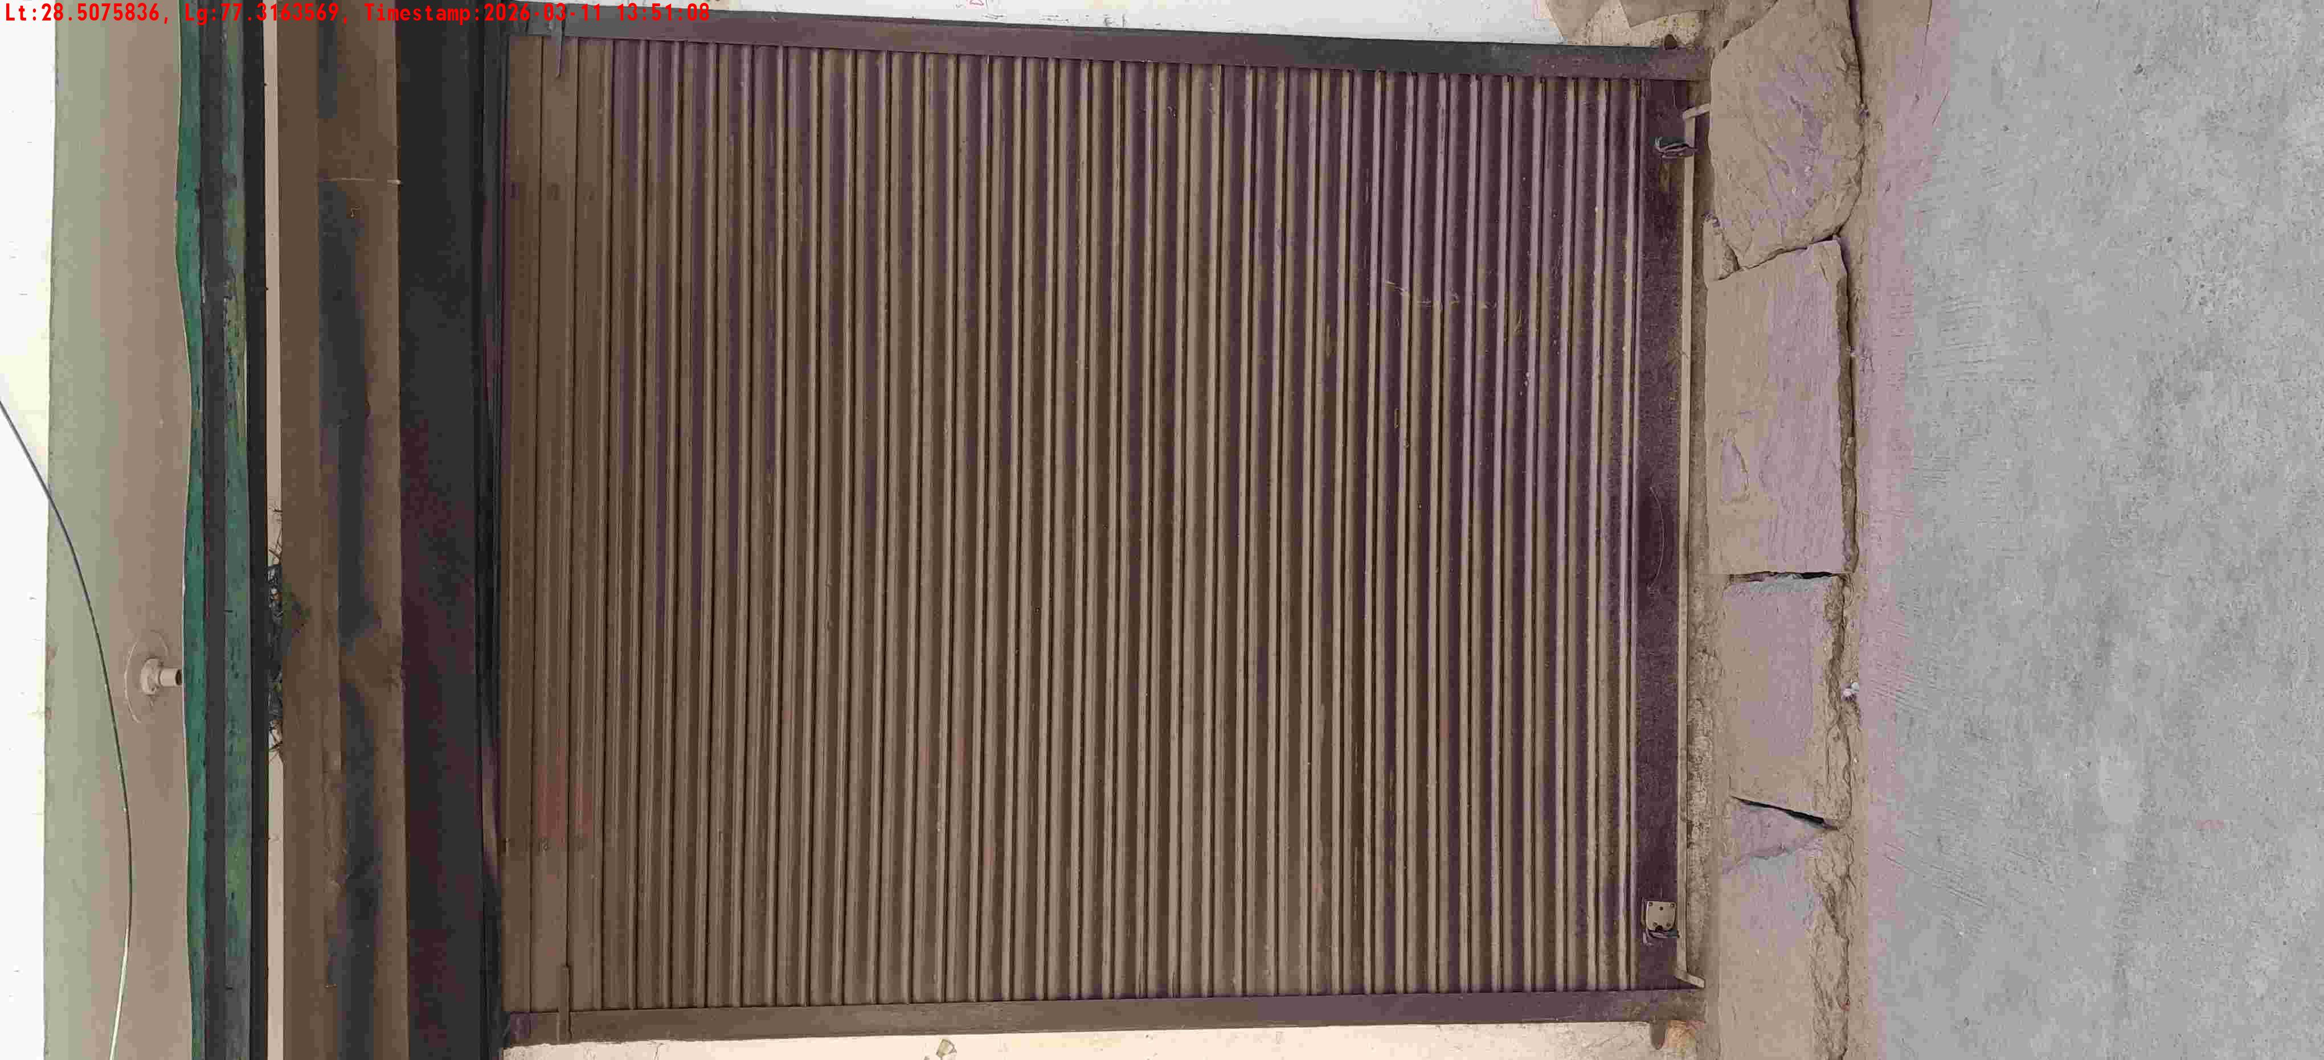
WD Code | DS Id | DS Name | Route Name | Shop Name | Date Time
DE5458 | 779 | Niche-DS4 | Wed-Sat | Rana store | 11-03-2026 01:51:00 PM
Shop Inside Picture
Shop Front Picture

Slide 9
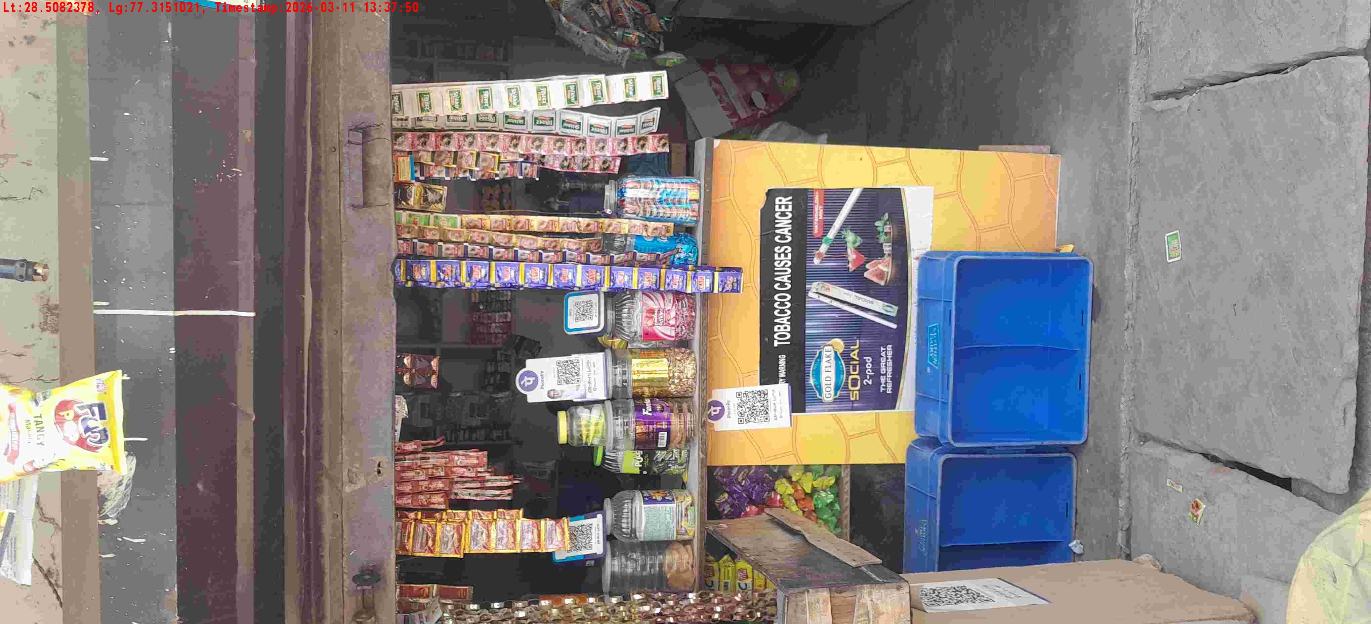
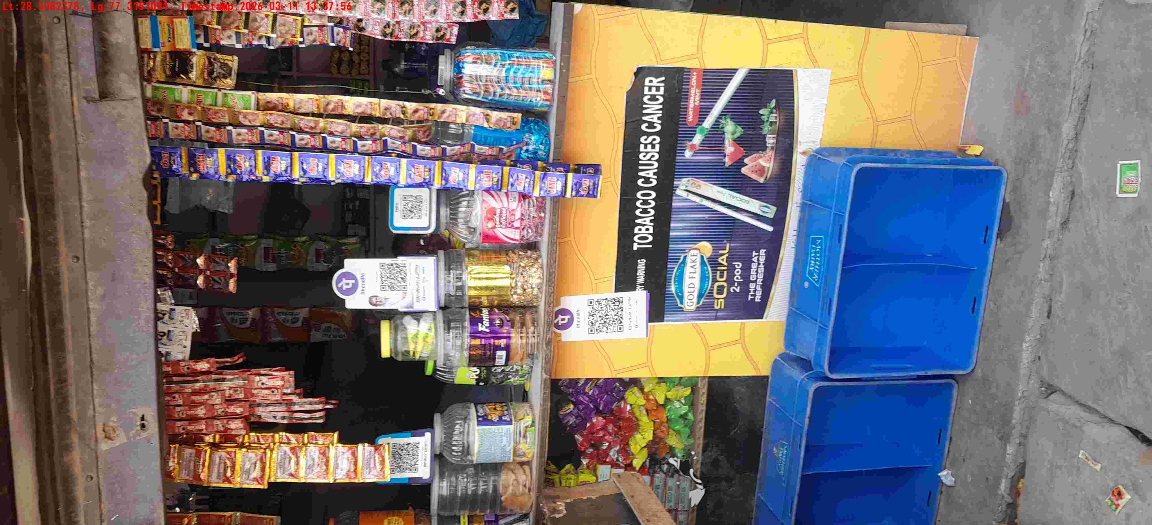
WD Code | DS Id | DS Name | Route Name | Shop Name | Date Time
DE5458 | 779 | Niche-DS4 | Wed-Sat | Ma kalika Interprises | 11-03-2026 01:37:45 PM
Shop Inside Picture
Shop Front Picture

Slide 10
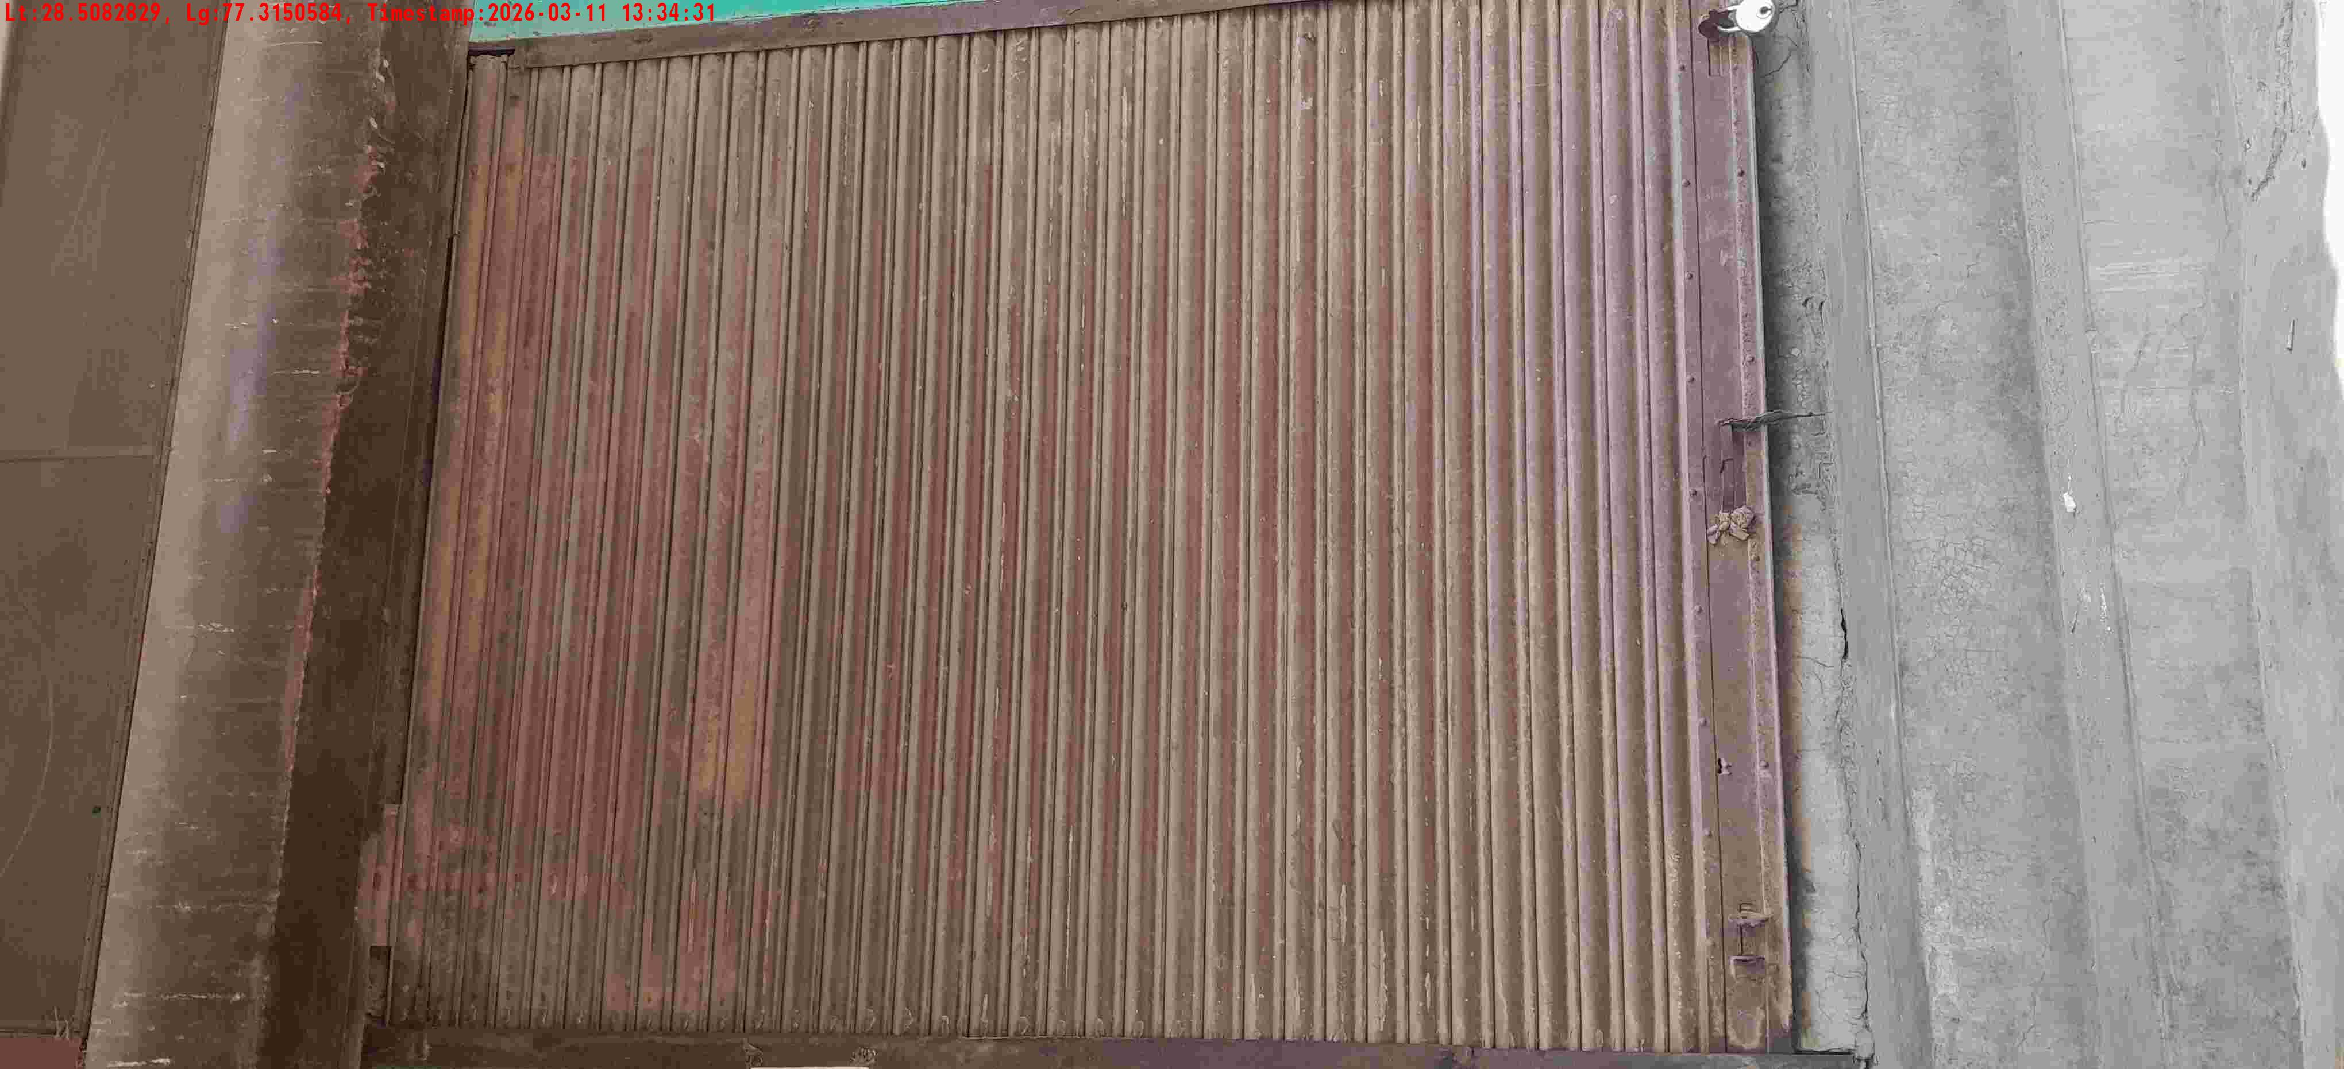
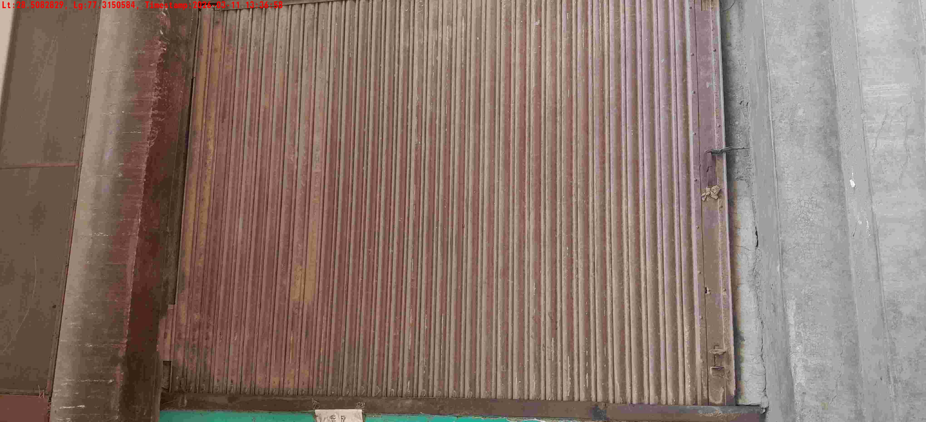
WD Code | DS Id | DS Name | Route Name | Shop Name | Date Time
DE5458 | 779 | Niche-DS4 | Wed-Sat | Chanchal store | 11-03-2026 01:34:28 PM
Shop Inside Picture
Shop Front Picture

Slide 11
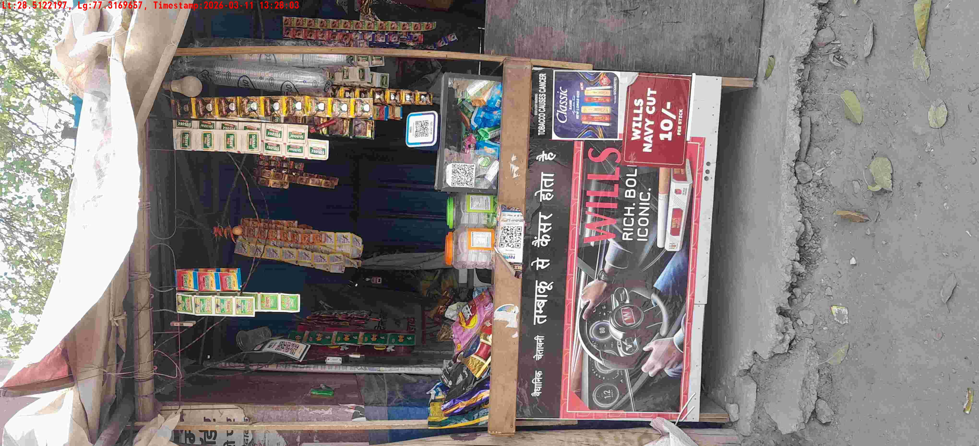
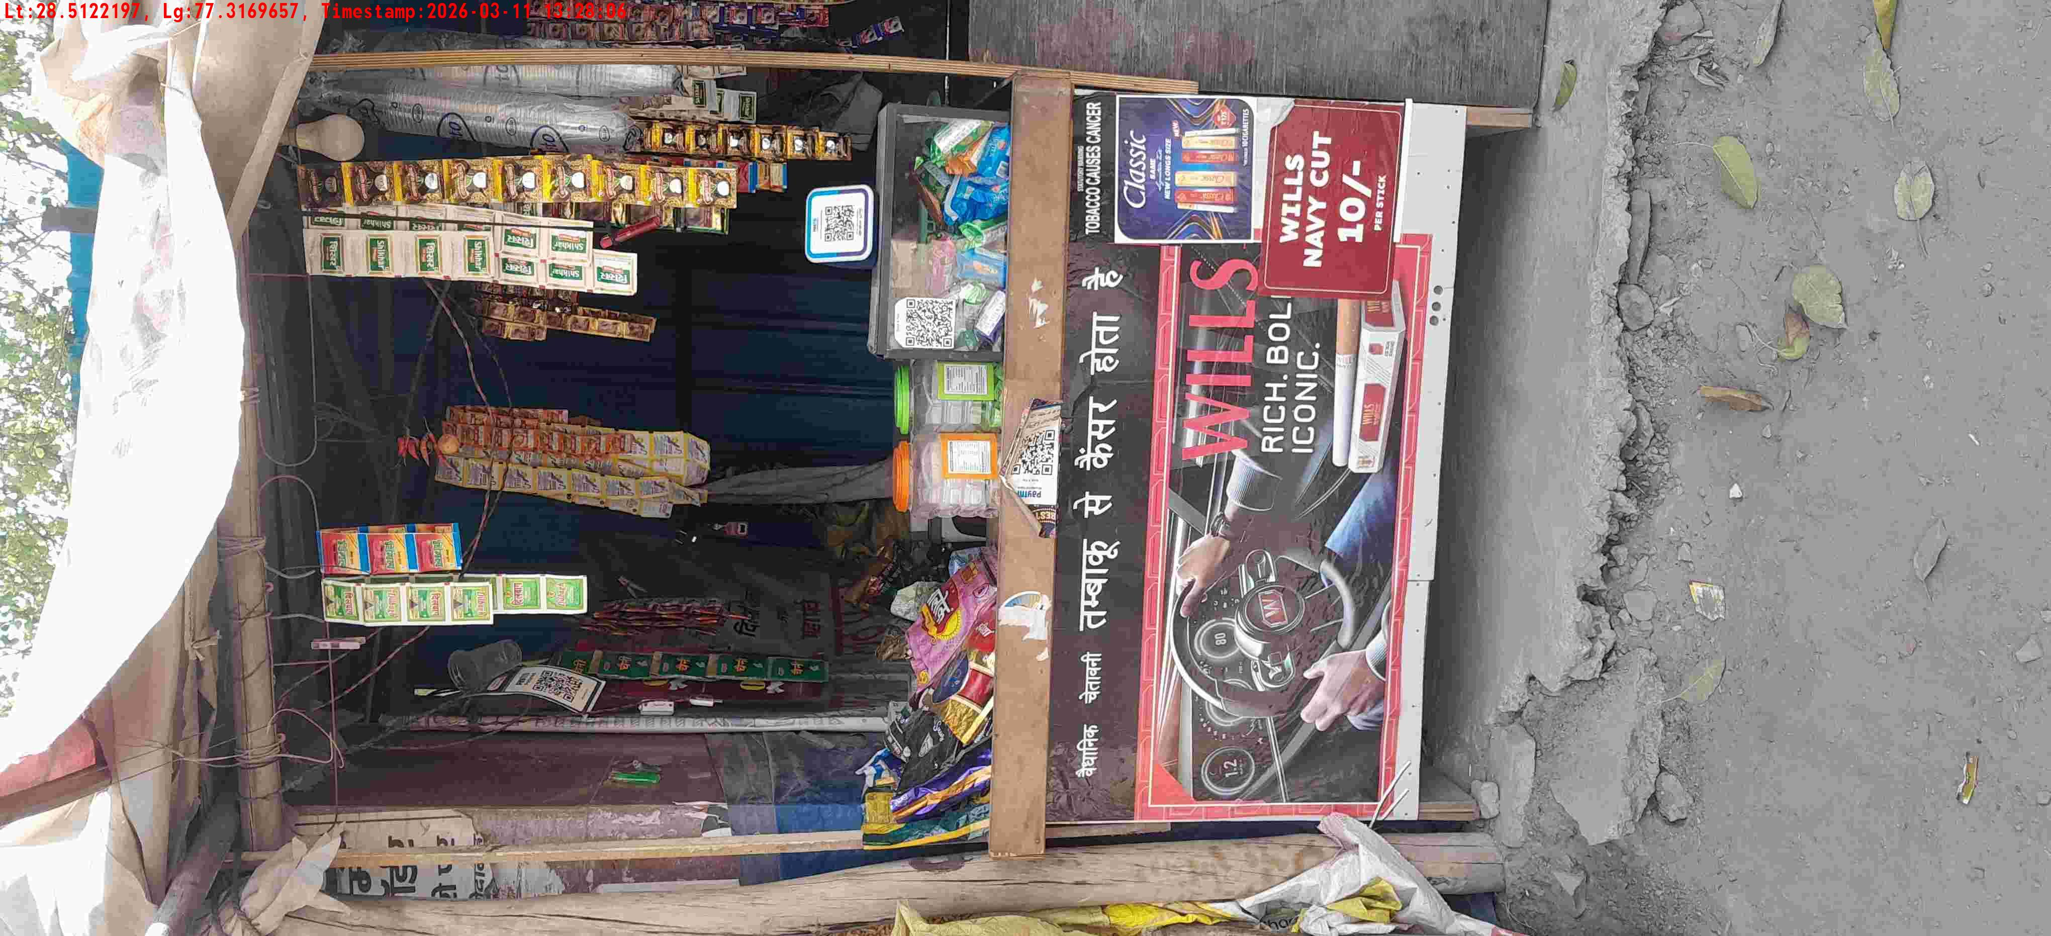
WD Code | DS Id | DS Name | Route Name | Shop Name | Date Time
DE5458 | 779 | Niche-DS4 | Wed-Sat | Monu paan | 11-03-2026 01:27:59 PM
Shop Inside Picture
Shop Front Picture

Slide 12
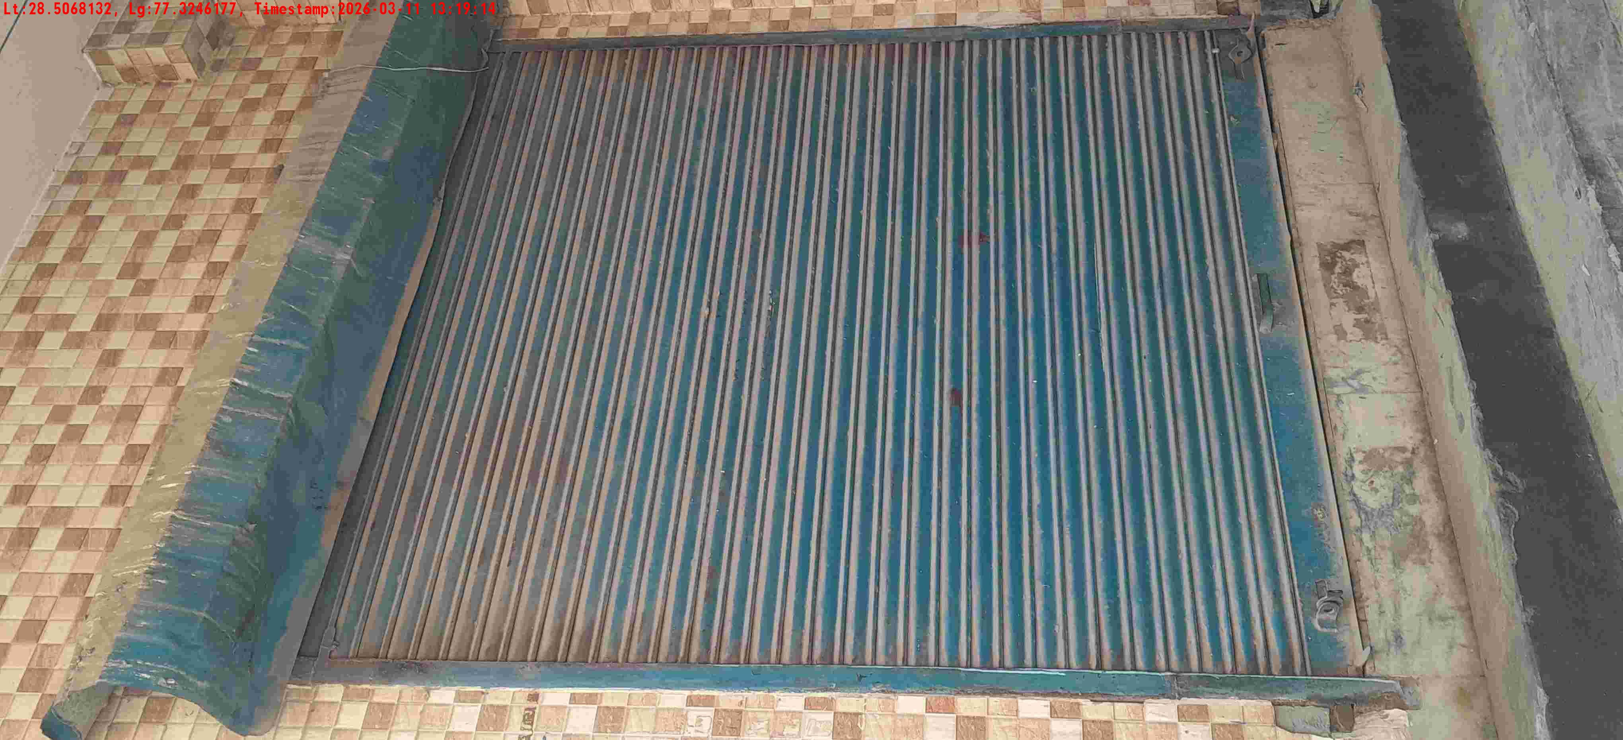
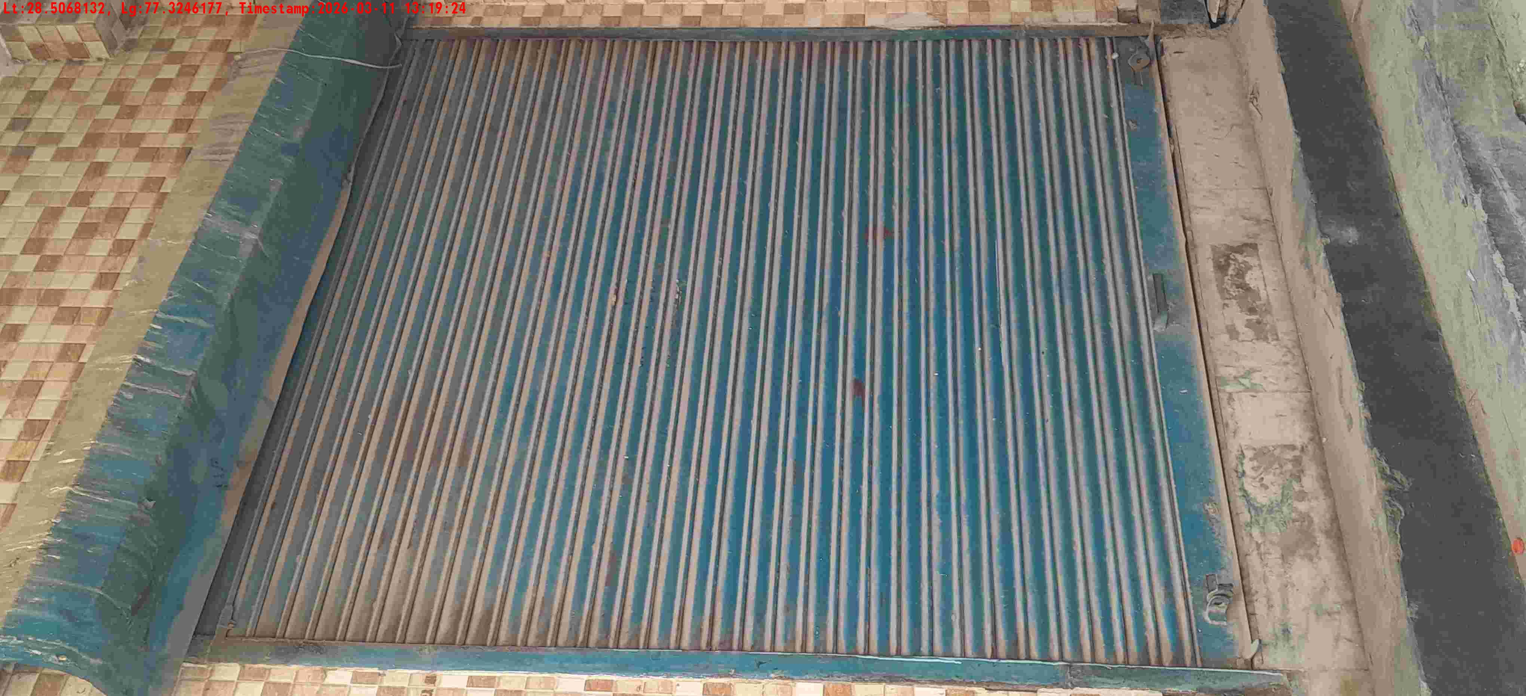
WD Code | DS Id | DS Name | Route Name | Shop Name | Date Time
DE5458 | 779 | Niche-DS4 | Wed-Sat | Kanak gen store | 11-03-2026 01:19:10 PM
Shop Inside Picture
Shop Front Picture

Slide 13
WD Code | DS Id | DS Name | Route Name | Shop Name | Date Time
DE5458 | 779 | Niche-DS4 | Wed-Sat | Kanak gen store | 11-03-2026 01:19:10 PM
Shop Inside Picture
Shop Front Picture

Slide 14
WD Code | DS Id | DS Name | Route Name | Shop Name | Date Time
DE5458 | 779 | Niche-DS4 | Wed-Sat | Kanak gen store | 11-03-2026 01:19:10 PM
Shop Inside Picture
Shop Front Picture

Slide 15
WD Code | DS Id | DS Name | Route Name | Shop Name | Date Time
DE5458 | 779 | Niche-DS4 | Wed-Sat | Kanak gen store | 11-03-2026 01:19:10 PM
Shop Inside Picture
Shop Front Picture

Slide 16
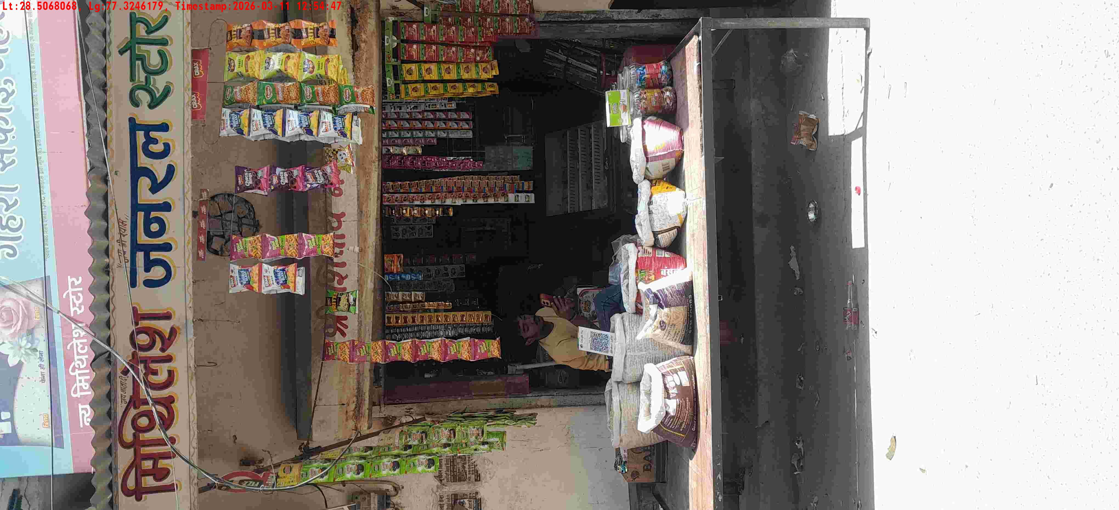
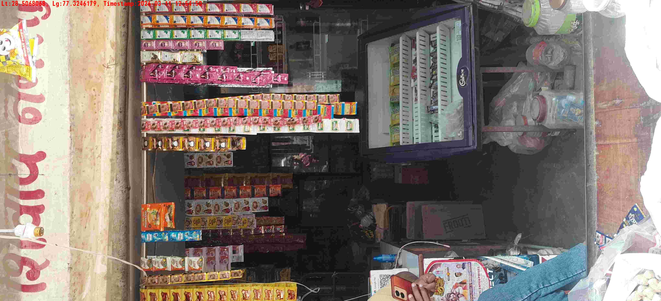
WD Code | DS Id | DS Name | Route Name | Shop Name | Date Time
DE5458 | 779 | Niche-DS4 | Wed-Sat | Mithlesh gen store | 11-03-2026 12:54:44 PM
Shop Inside Picture
Shop Front Picture

Slide 17
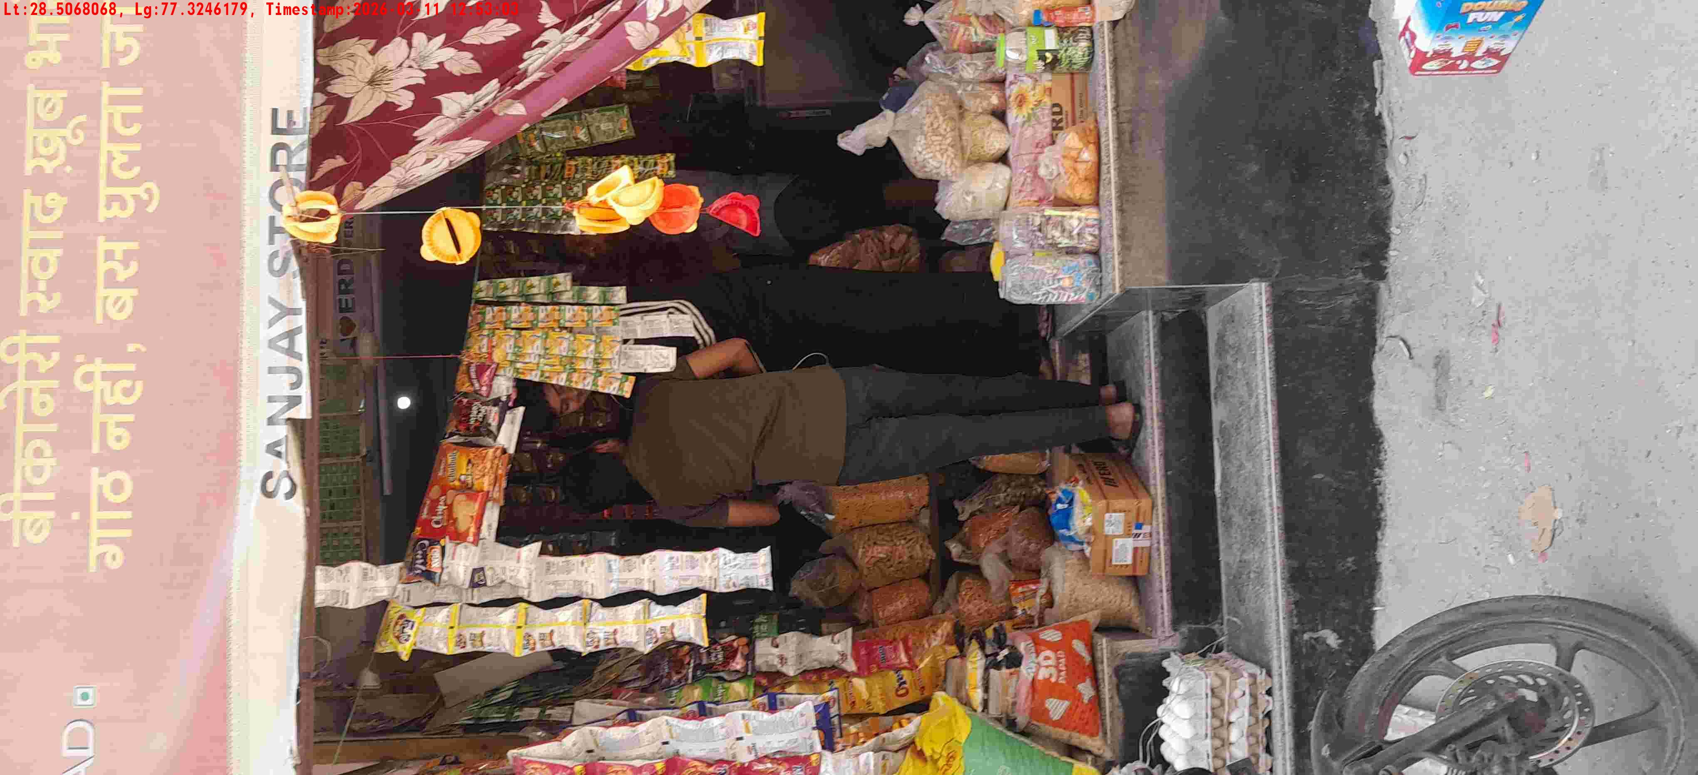
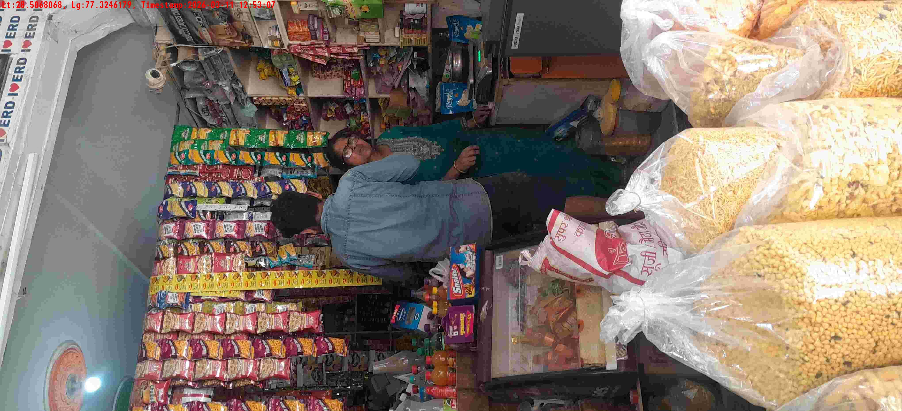
WD Code | DS Id | DS Name | Route Name | Shop Name | Date Time
DE5458 | 779 | Niche-DS4 | Wed-Sat | Sanjay store | 11-03-2026 12:53:00 PM
Shop Inside Picture
Shop Front Picture

Slide 18
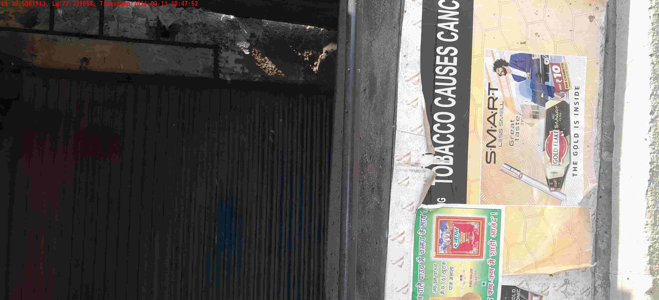
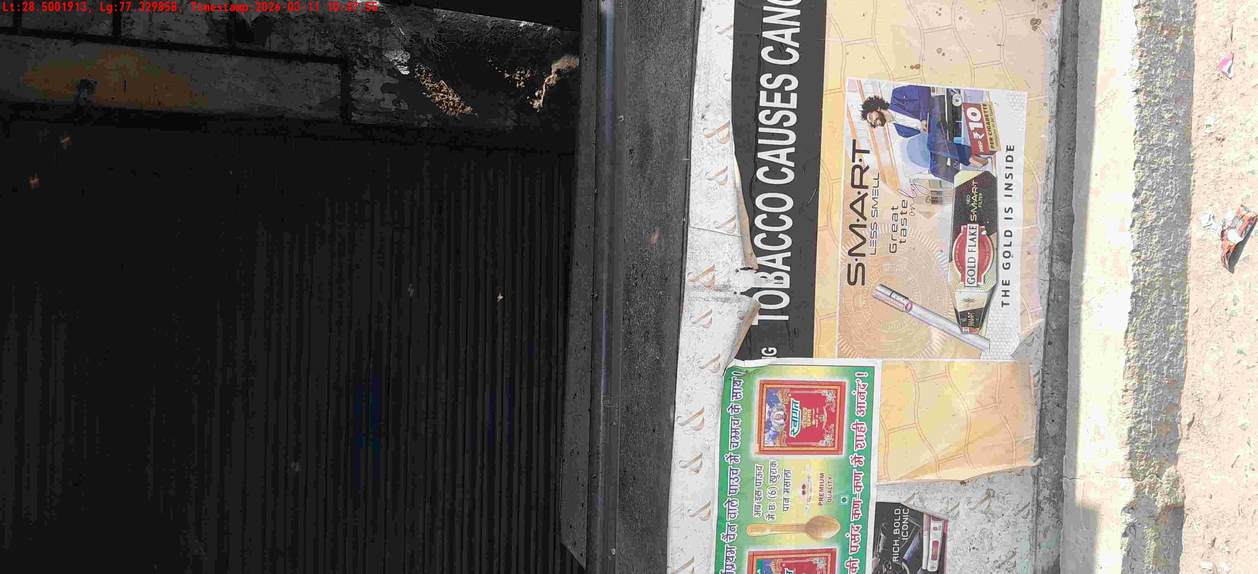
WD Code | DS Id | DS Name | Route Name | Shop Name | Date Time
DE5458 | 779 | Niche-DS4 | Wed-Sat | Pandey Pan | 11-03-2026 10:47:48 AM
Shop Inside Picture
Shop Front Picture

Slide 19
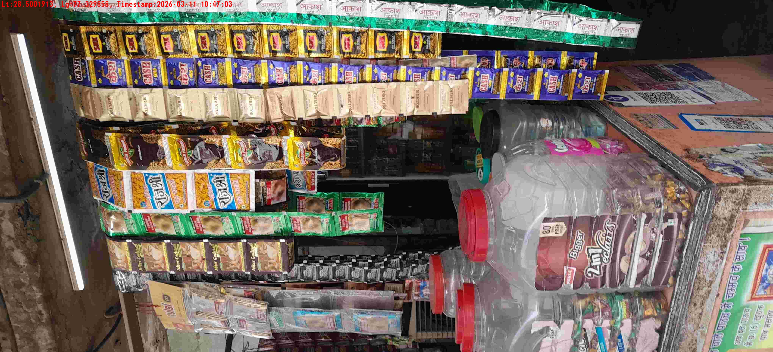
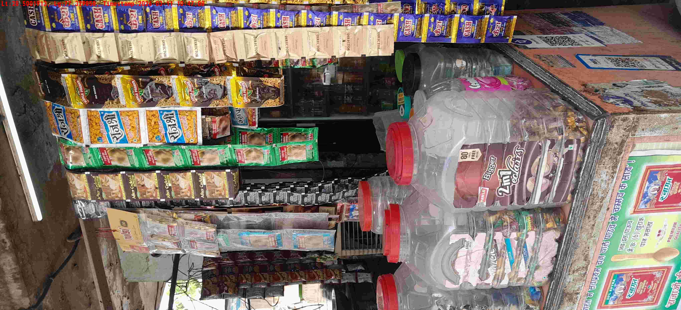
WD Code | DS Id | DS Name | Route Name | Shop Name | Date Time
DE5458 | 779 | Niche-DS4 | Wed-Sat | Ramesh gen store | 11-03-2026 10:47:01 AM
Shop Inside Picture
Shop Front Picture

Slide 20
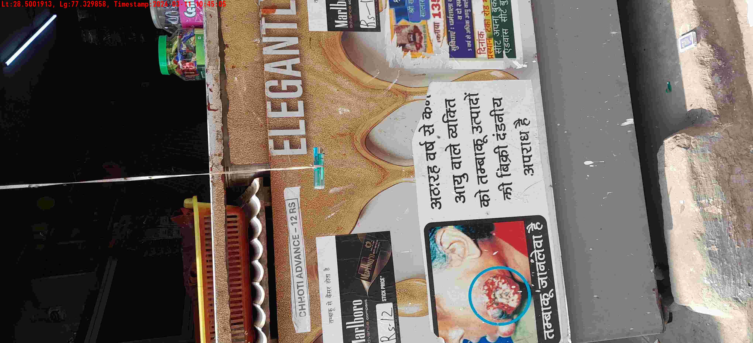
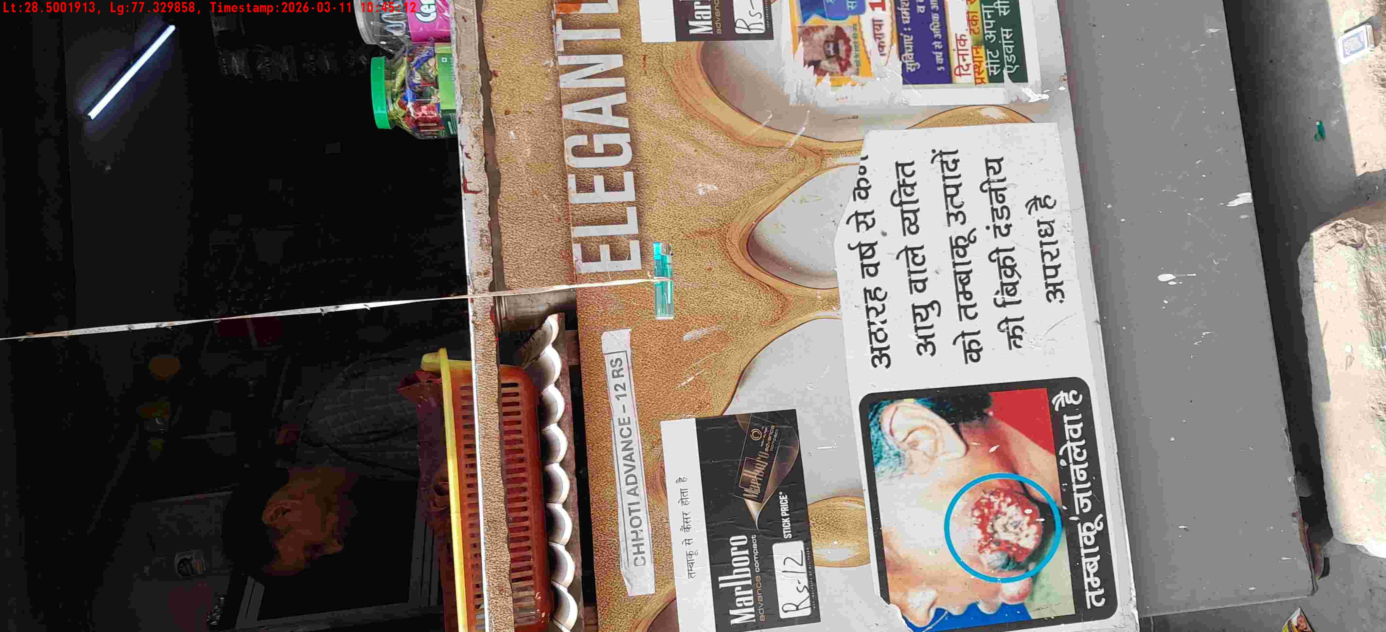
WD Code | DS Id | DS Name | Route Name | Shop Name | Date Time
DE5458 | 779 | Niche-DS4 | Wed-Sat | Rana store | 11-03-2026 10:44:56 AM
Shop Inside Picture
Shop Front Picture

Slide 21

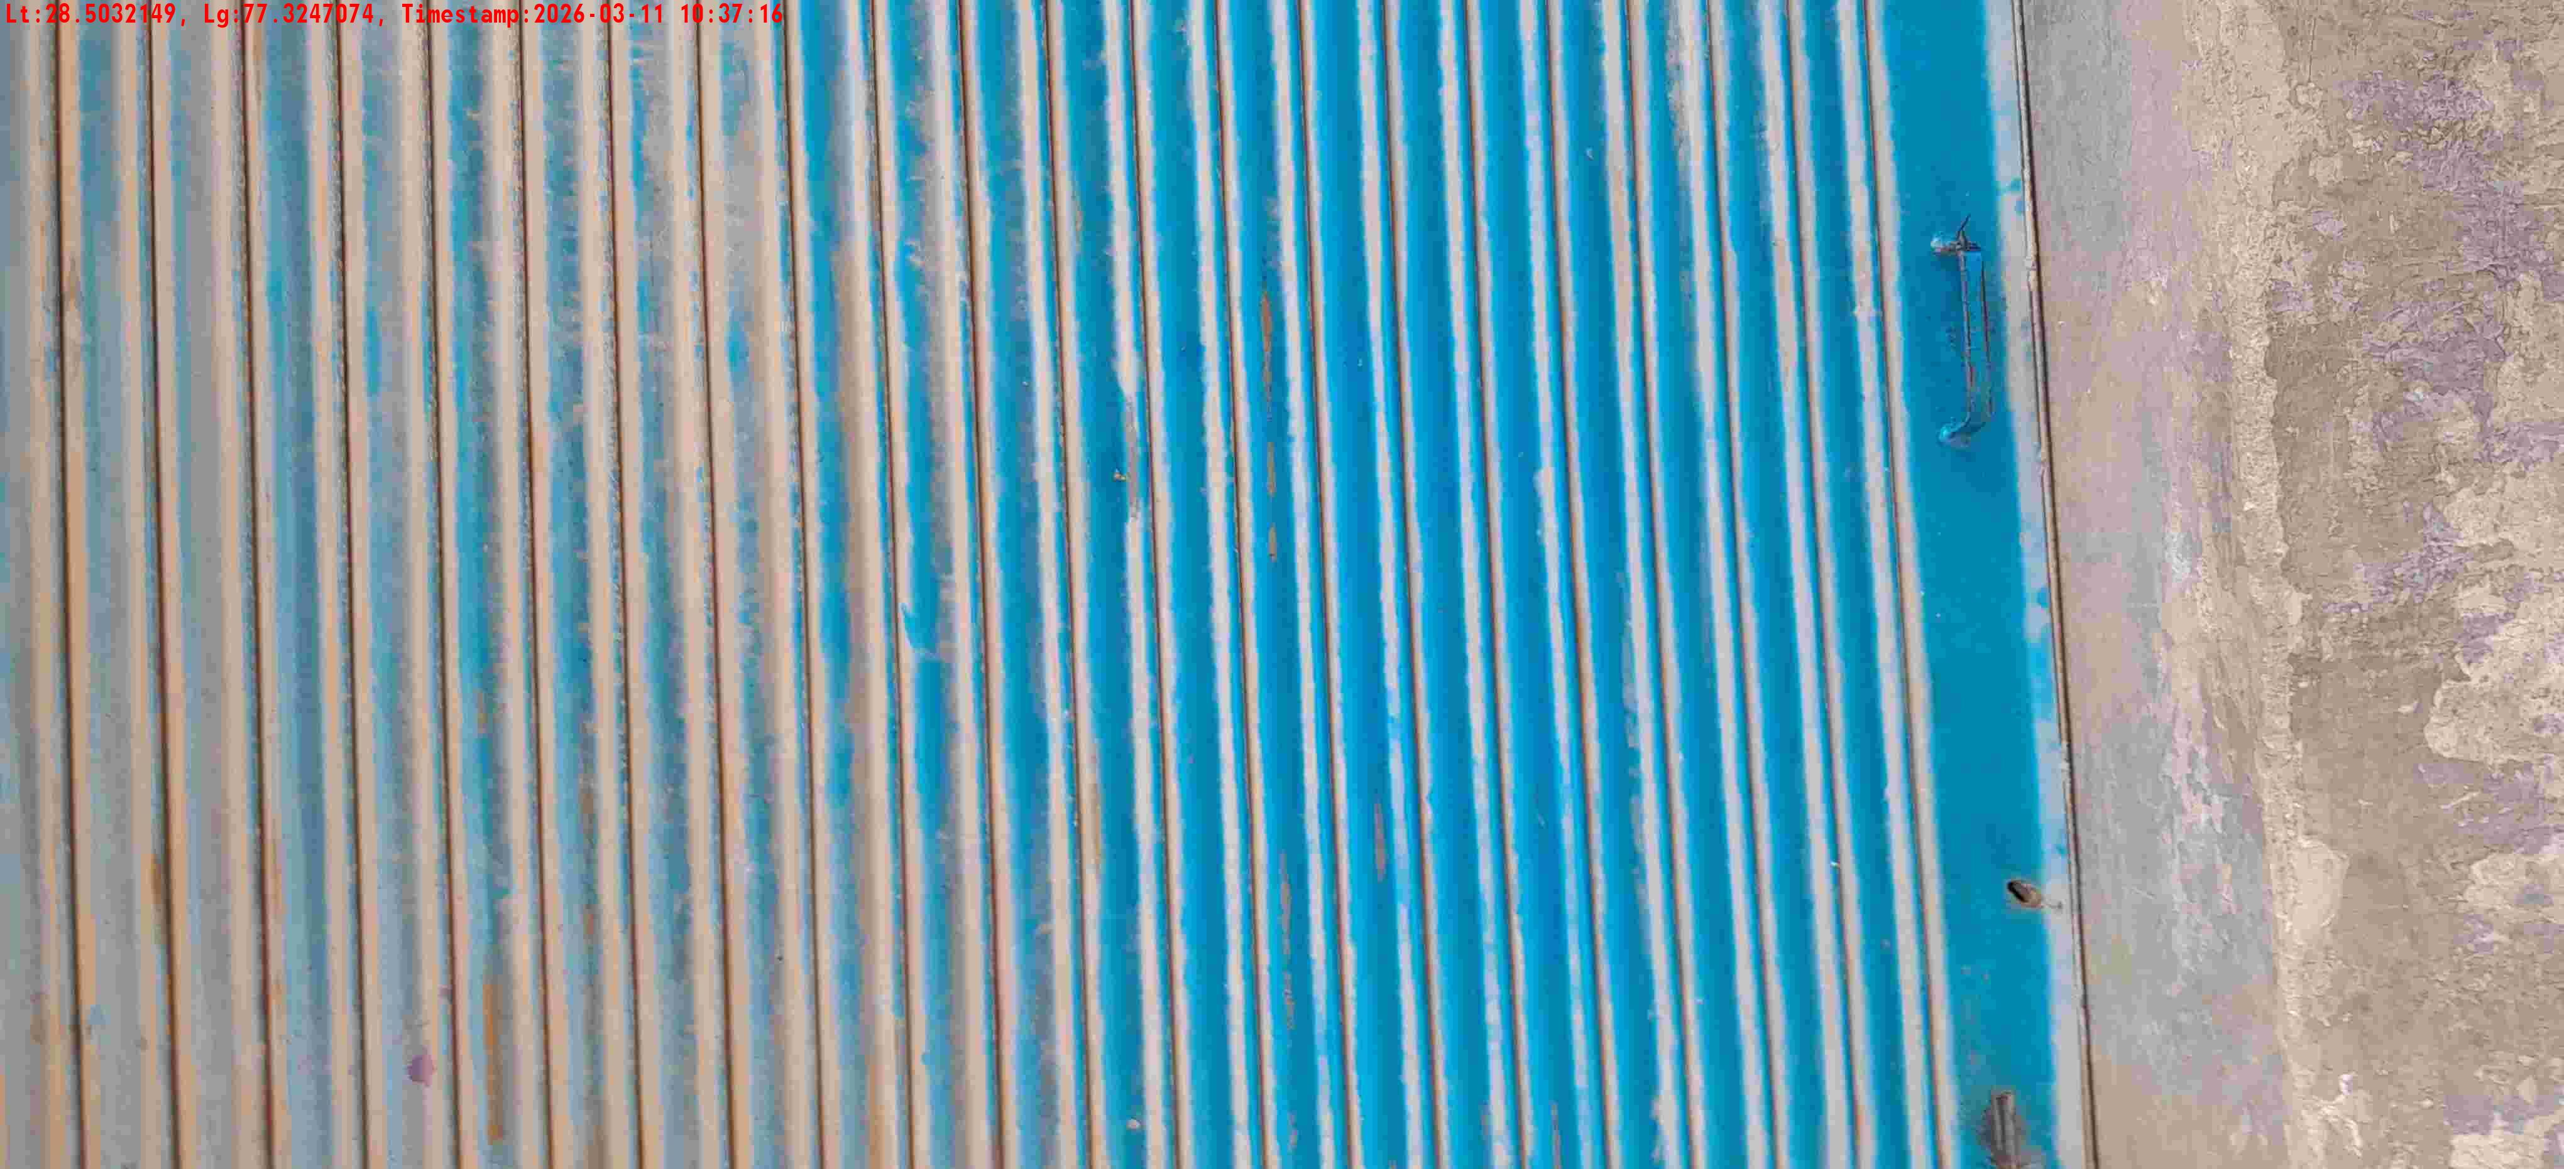
WD Code | DS Id | DS Name | Route Name | Shop Name | Date Time
DE5458 | 779 | Niche-DS4 | Wed-Sat | Saini pan bhandar | 11-03-2026 10:37:11 AM
Shop Inside Picture
Shop Front Picture

Slide 22
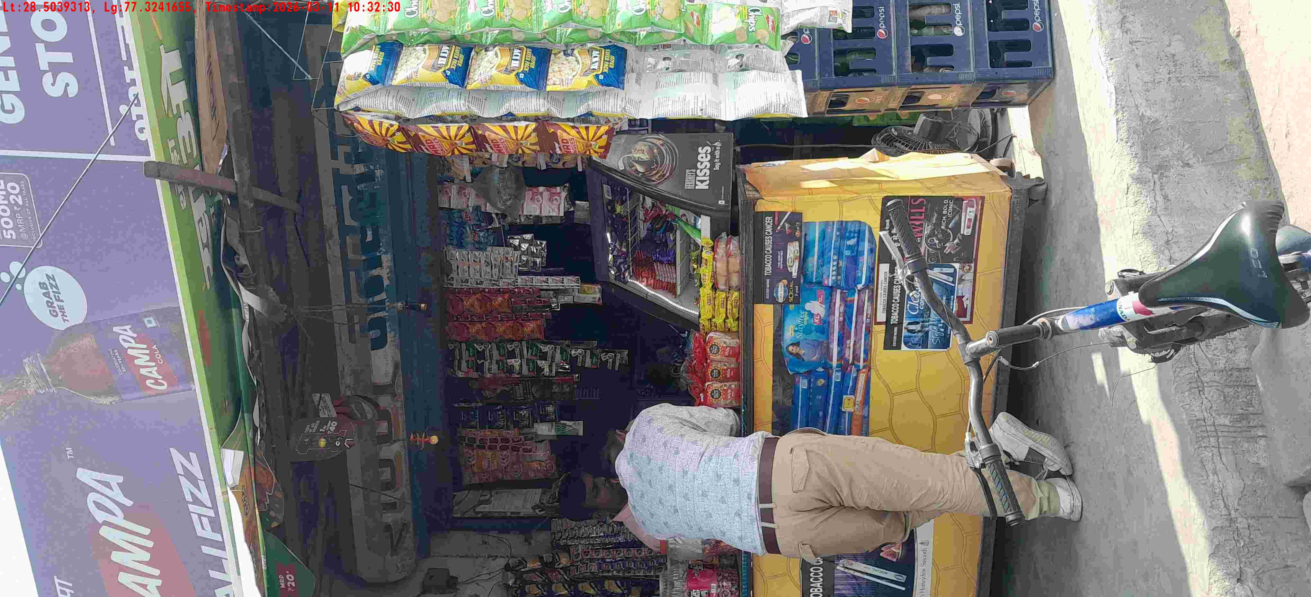
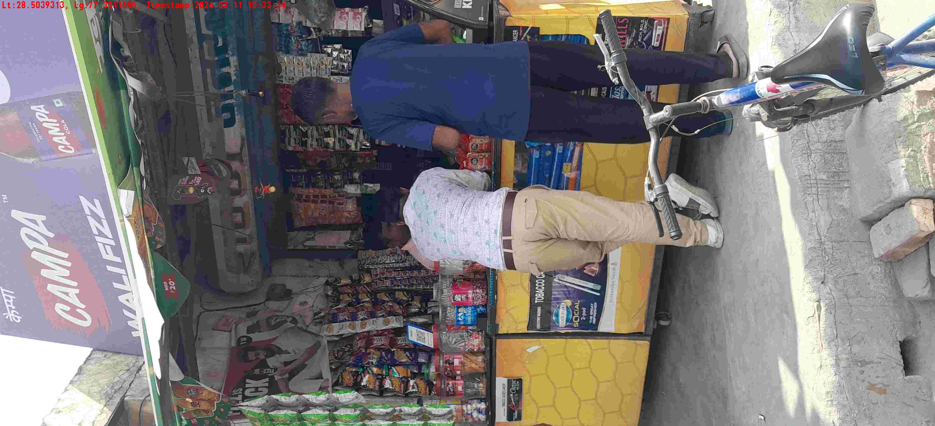
WD Code | DS Id | DS Name | Route Name | Shop Name | Date Time
DE5458 | 779 | Niche-DS4 | Wed-Sat | Saini pan bhandar | 11-03-2026 10:32:27 AM
Shop Inside Picture
Shop Front Picture

Slide 23
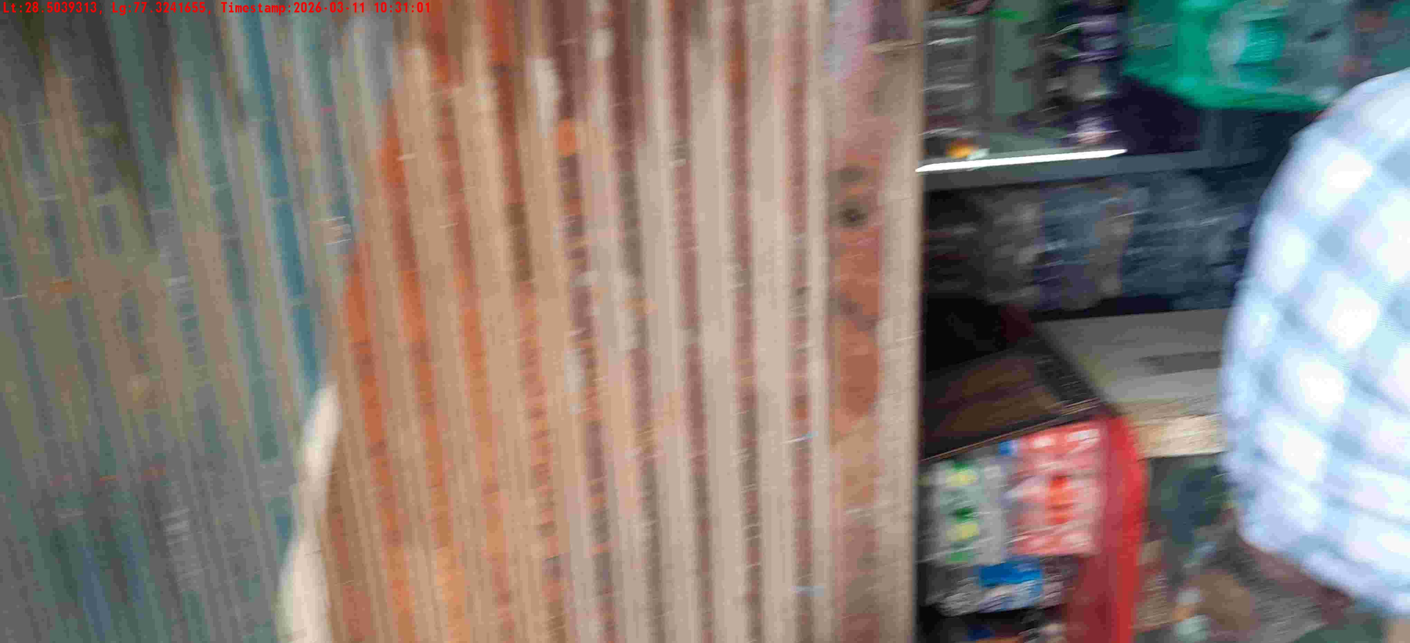
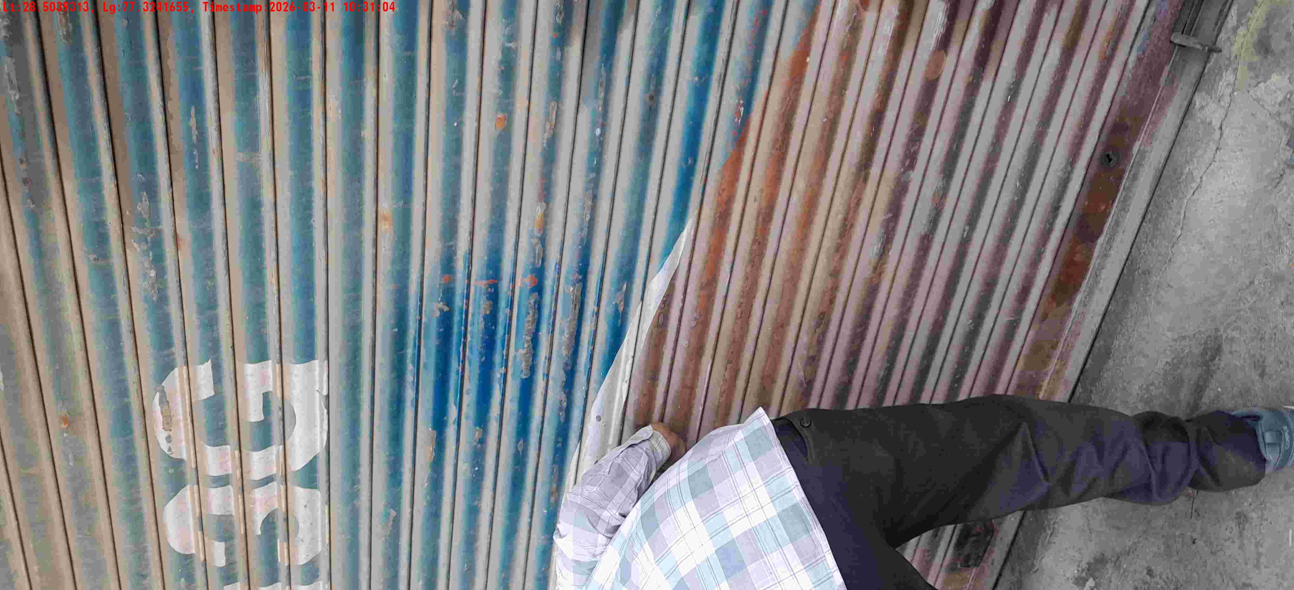
WD Code | DS Id | DS Name | Route Name | Shop Name | Date Time
DE5458 | 779 | Niche-DS4 | Wed-Sat | Sanjay store | 11-03-2026 10:30:59 AM
Shop Inside Picture
Shop Front Picture

Slide 24
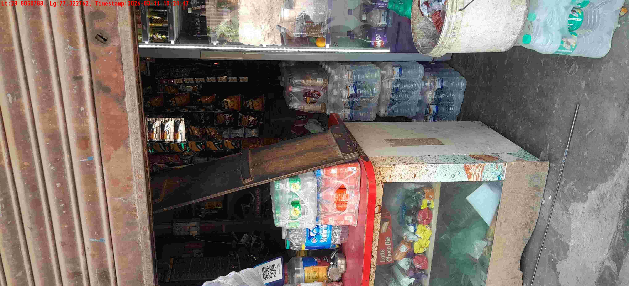
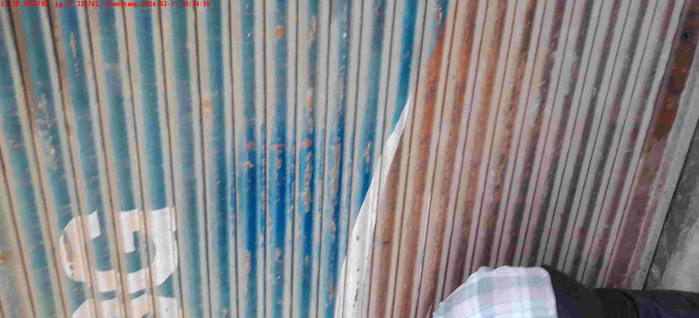
WD Code | DS Id | DS Name | Route Name | Shop Name | Date Time
DE5458 | 779 | Niche-DS4 | Wed-Sat | Sanjay store | 11-03-2026 10:24:45 AM
Shop Inside Picture
Shop Front Picture

Slide 25
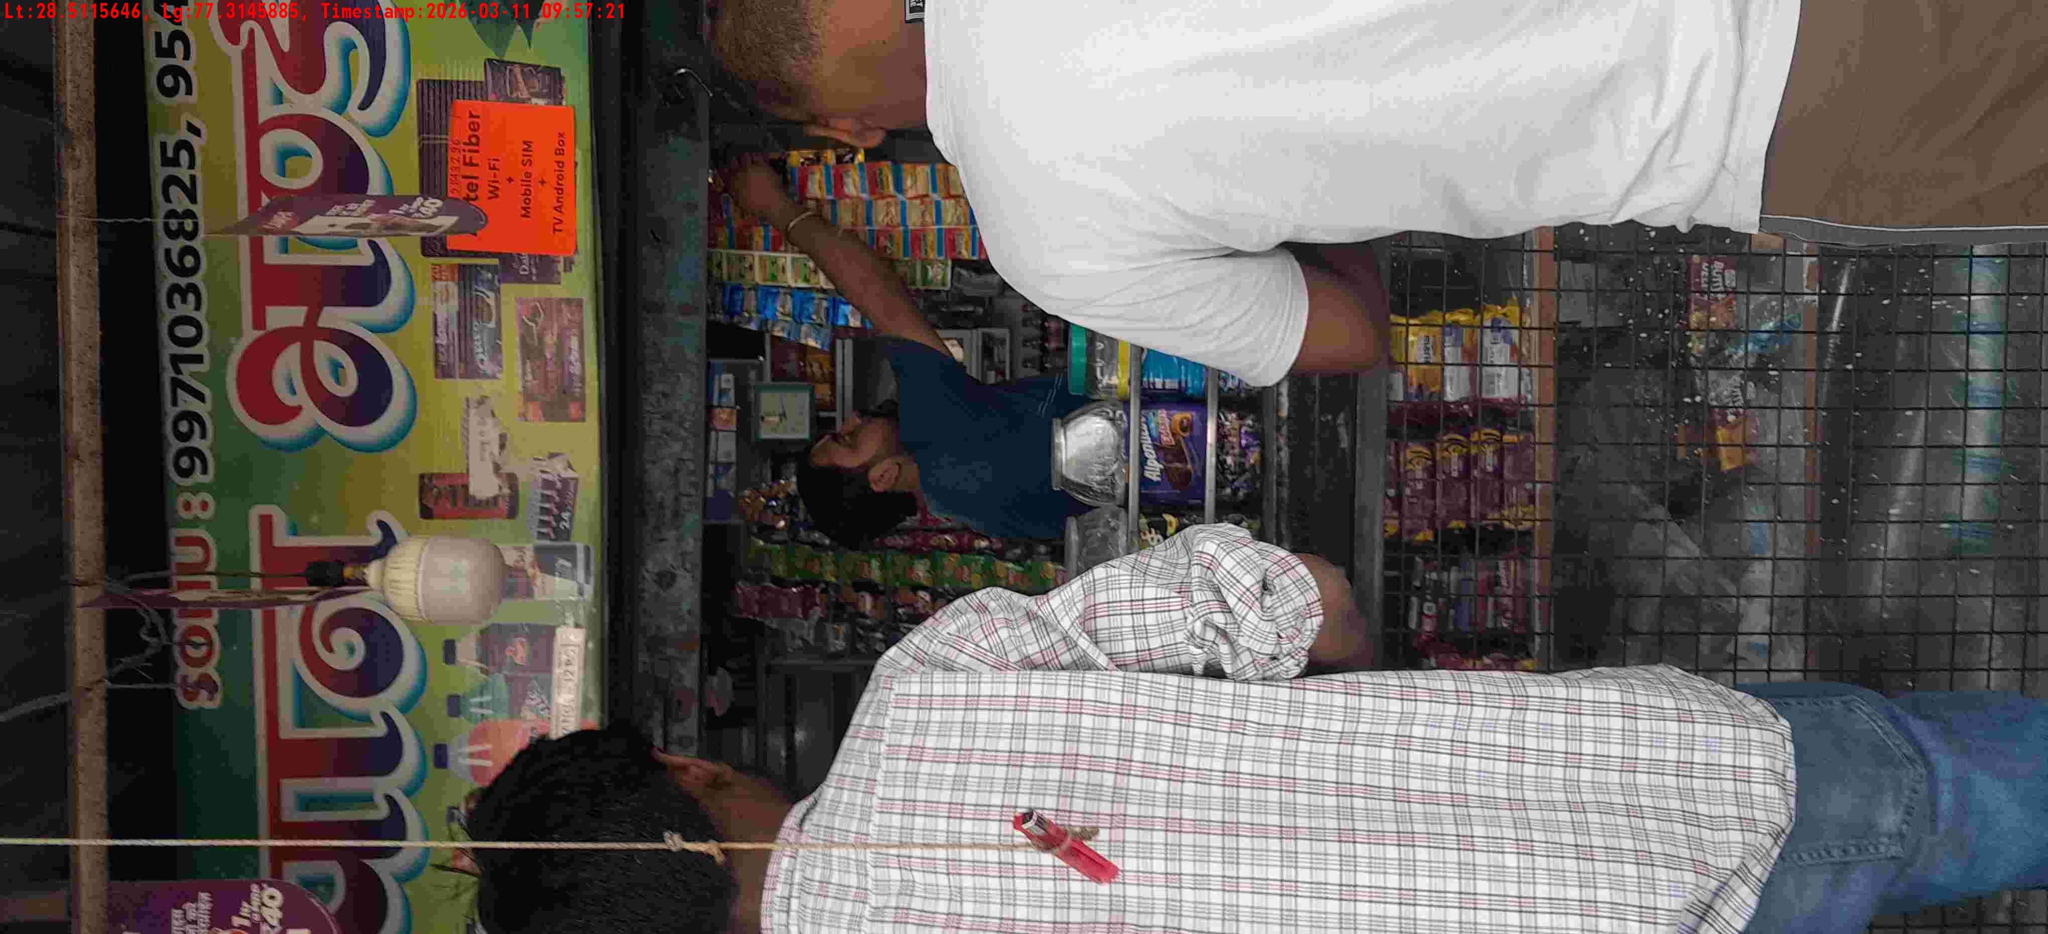
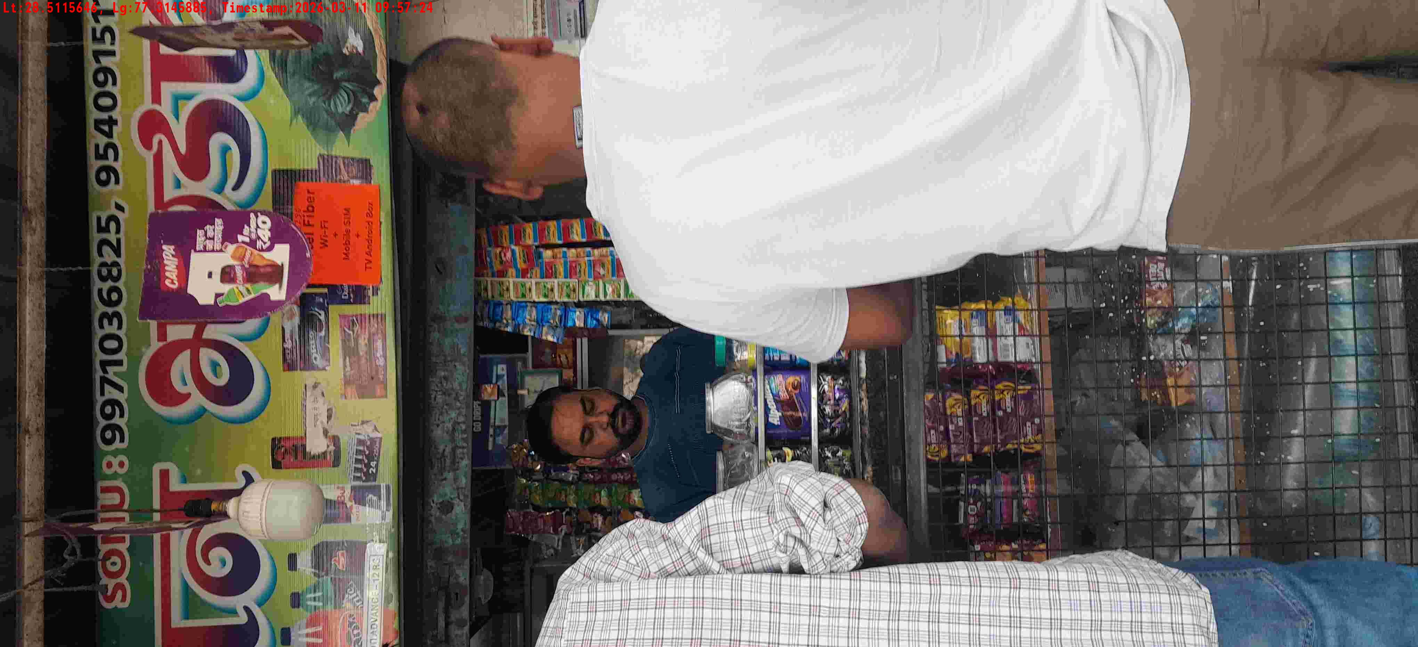
WD Code | DS Id | DS Name | Route Name | Shop Name | Date Time
DE5458 | 779 | Niche-DS4 | Wed-Sat | kalilash gen store | 11-03-2026 10:22:42 AM
Shop Inside Picture
Shop Front Picture

Slide 26
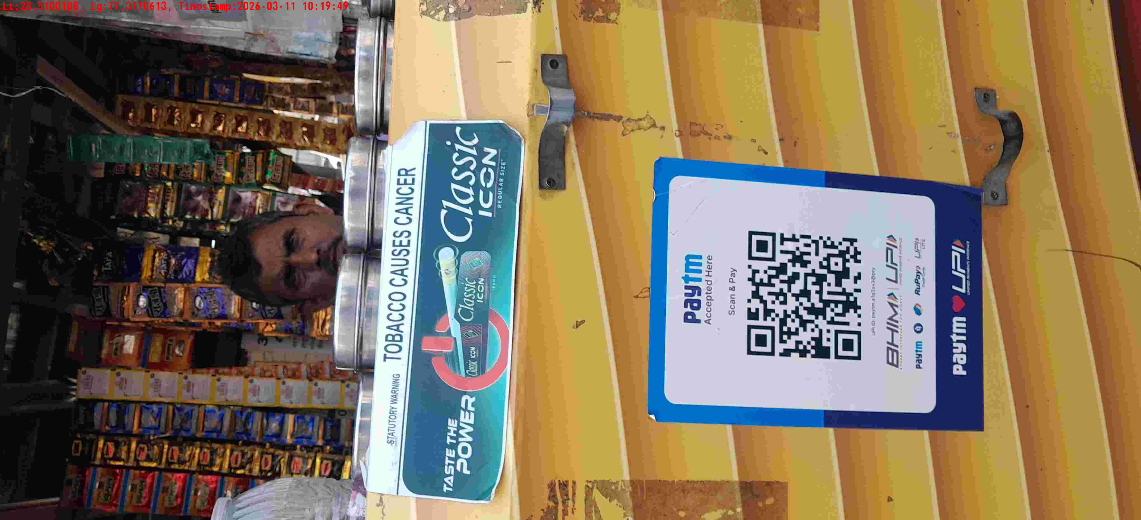
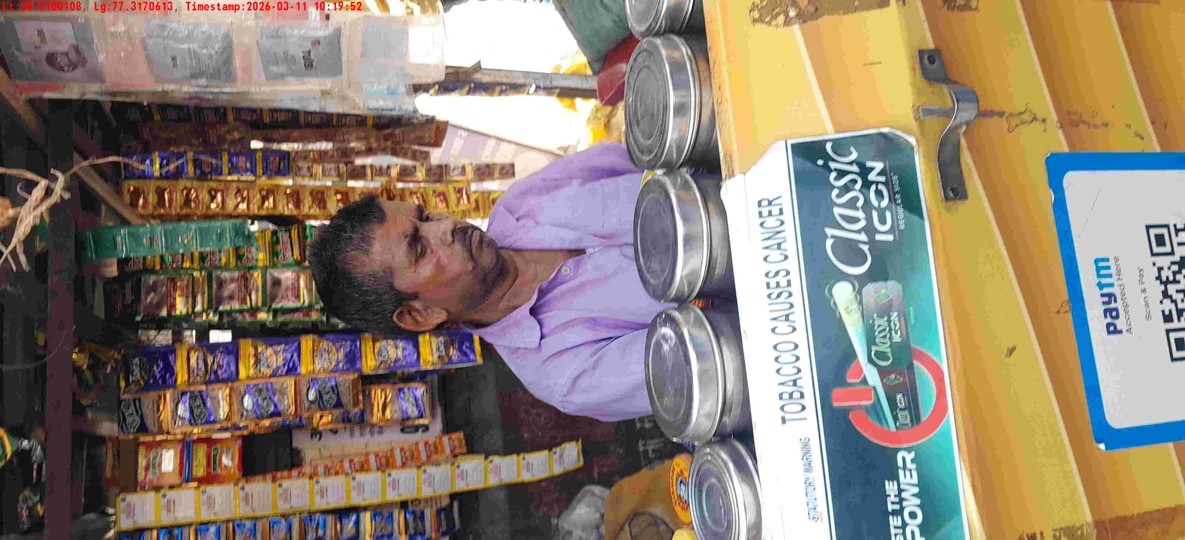
WD Code | DS Id | DS Name | Route Name | Shop Name | Date Time
DE5458 | 779 | Niche-DS4 | Wed-Sat | Sanjay store | 11-03-2026 10:19:46 AM
Shop Inside Picture
Shop Front Picture

Slide 27
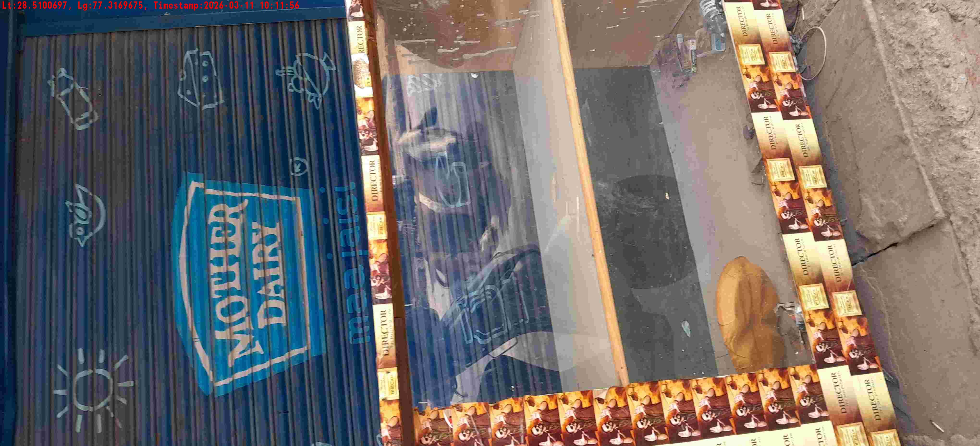
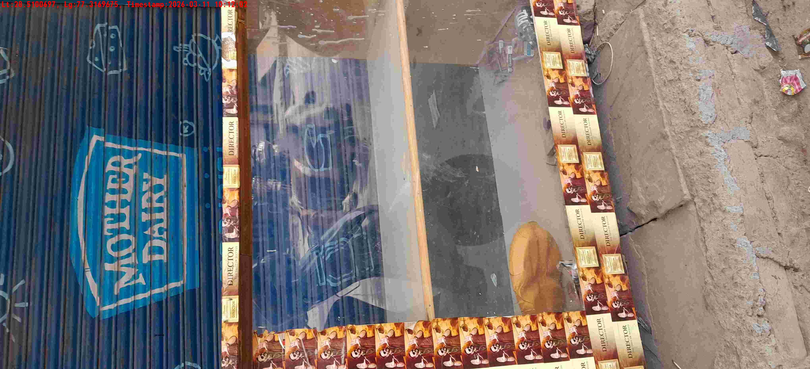
WD Code | DS Id | DS Name | Route Name | Shop Name | Date Time
DE5458 | 779 | Niche-DS4 | Wed-Sat | Tiwari Pan | 11-03-2026 10:11:51 AM
Shop Inside Picture
Shop Front Picture

Slide 28
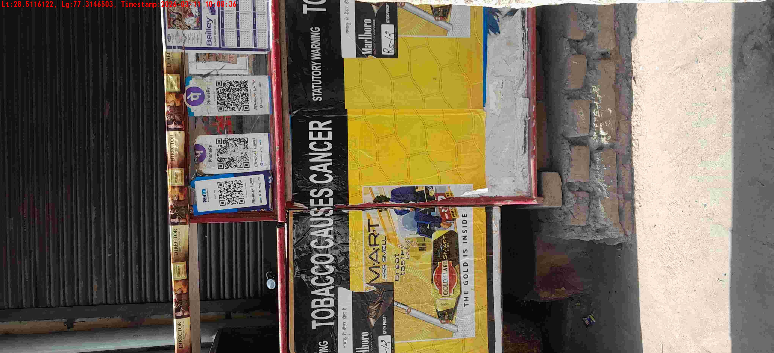
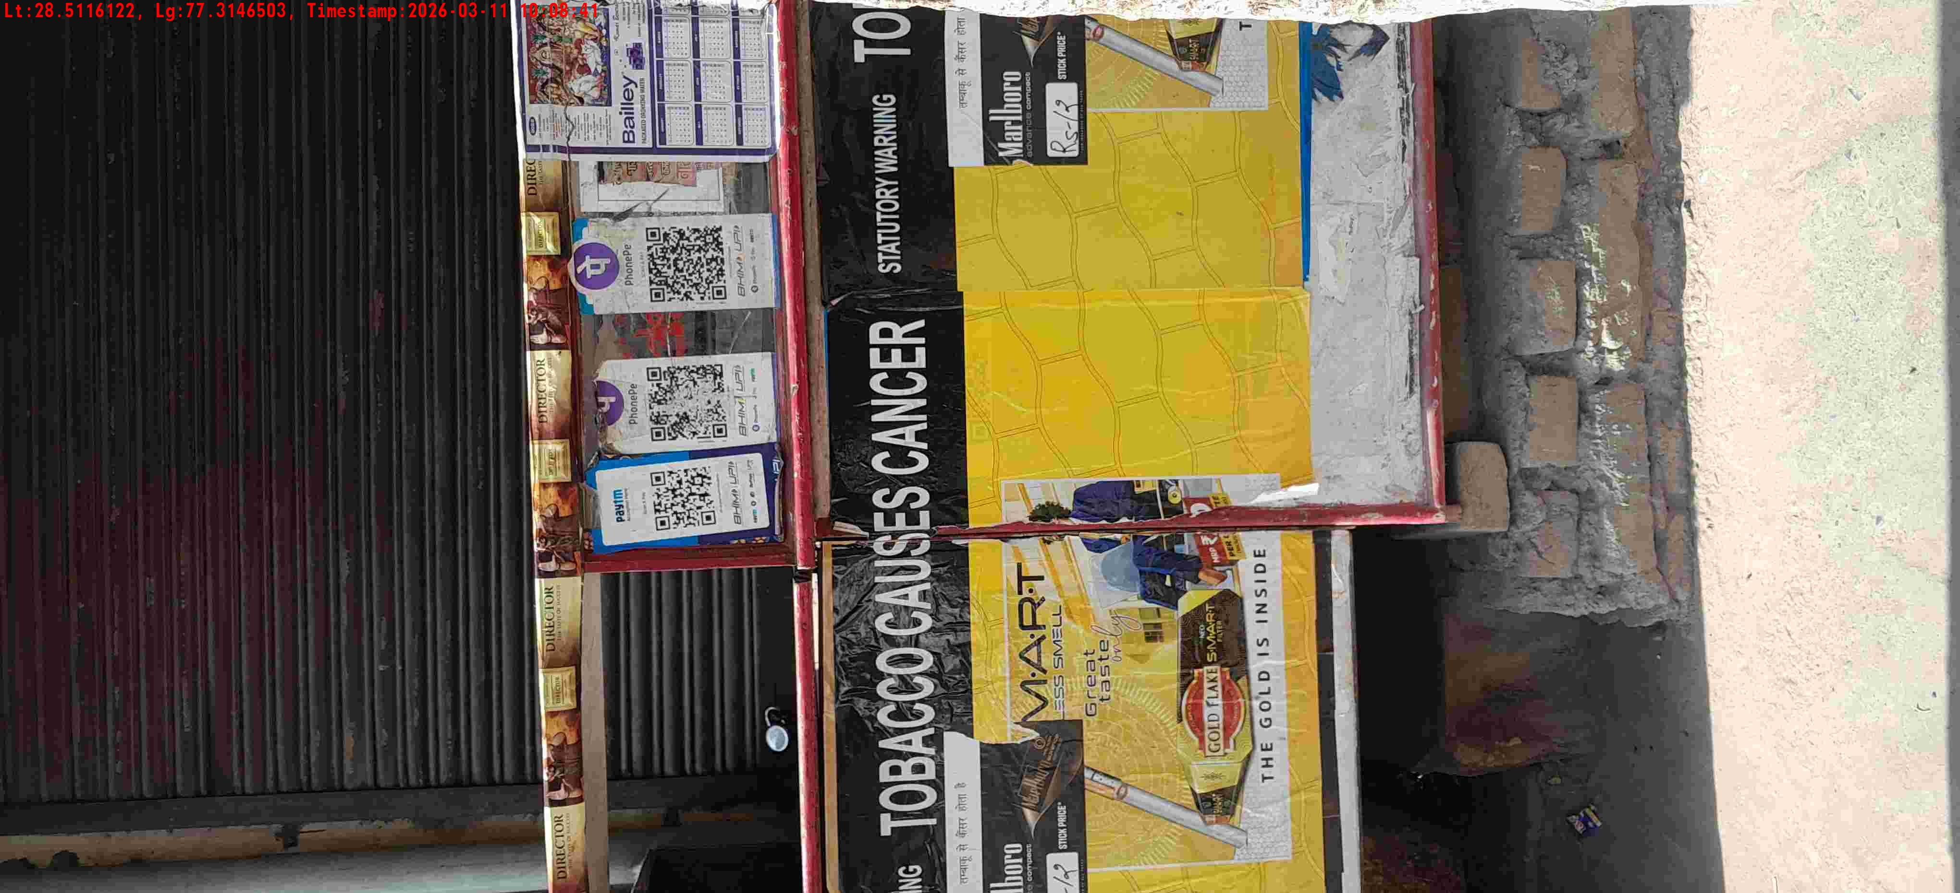
WD Code | DS Id | DS Name | Route Name | Shop Name | Date Time
DE5458 | 779 | Niche-DS4 | Wed-Sat | Vijay pan | 11-03-2026 10:08:31 AM
Shop Inside Picture
Shop Front Picture

Slide 29
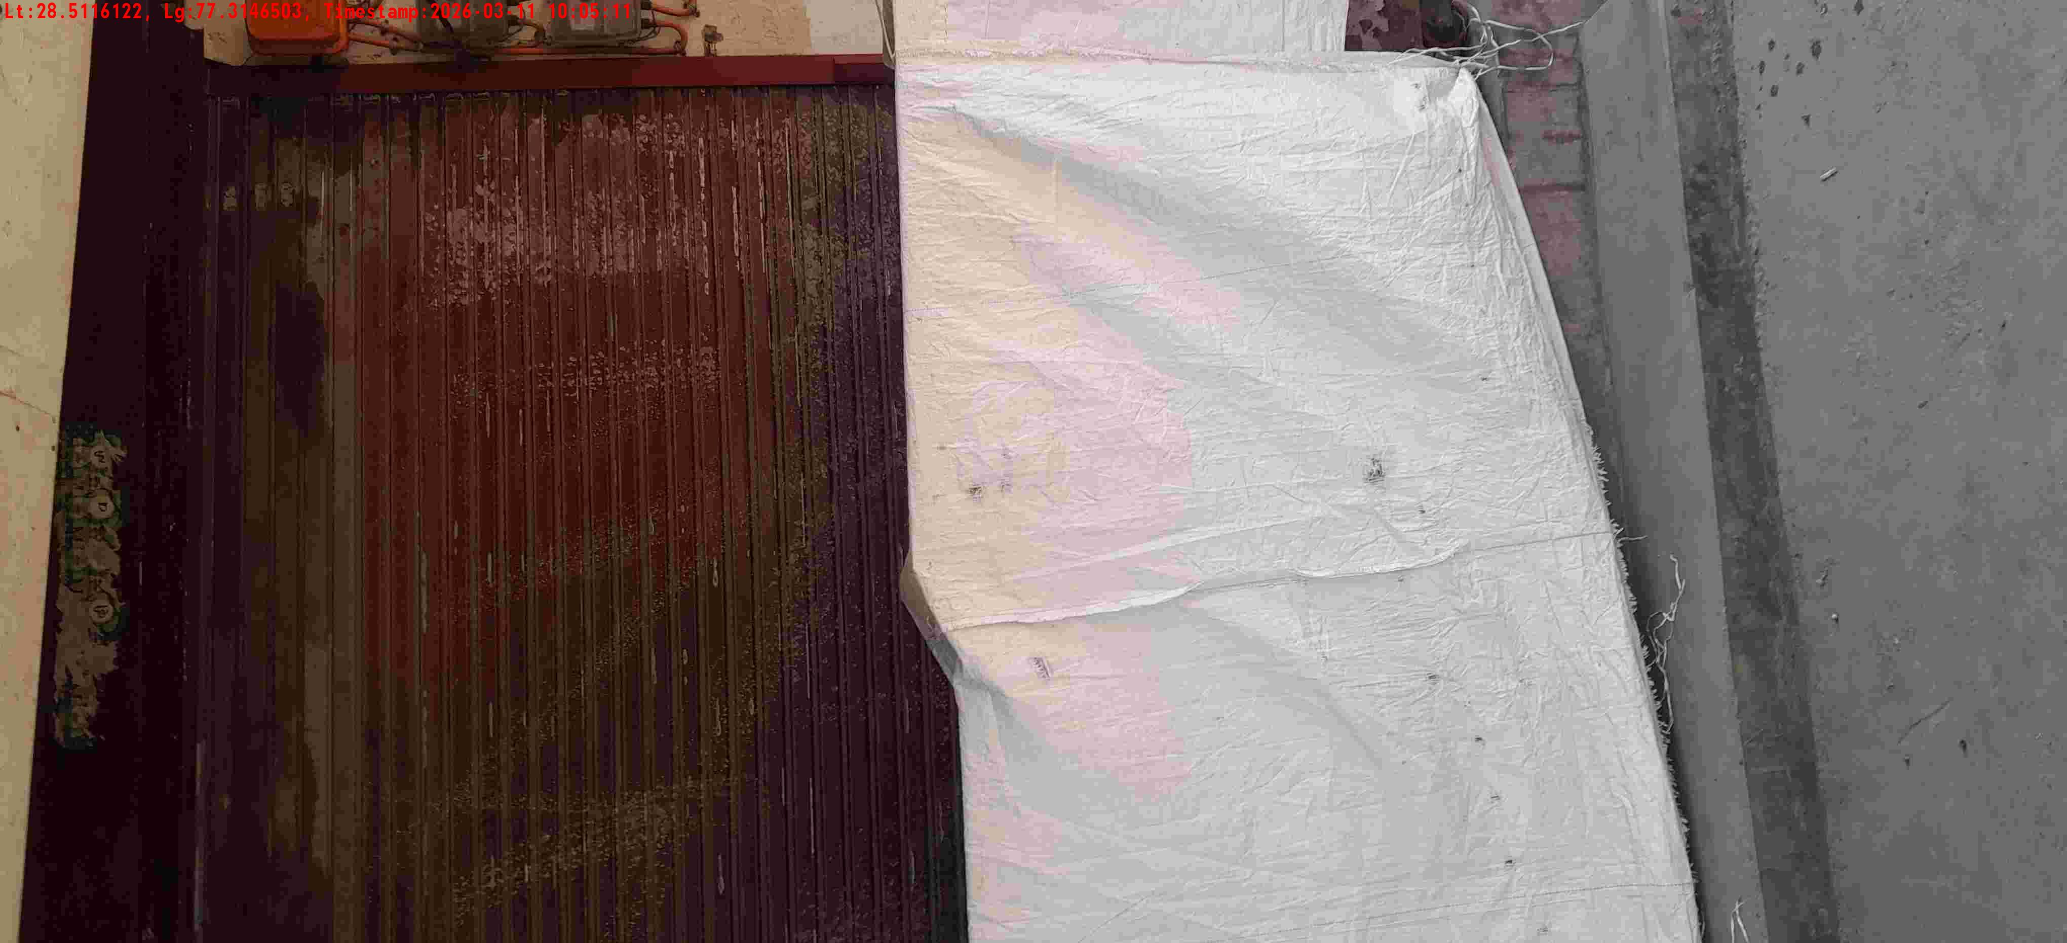
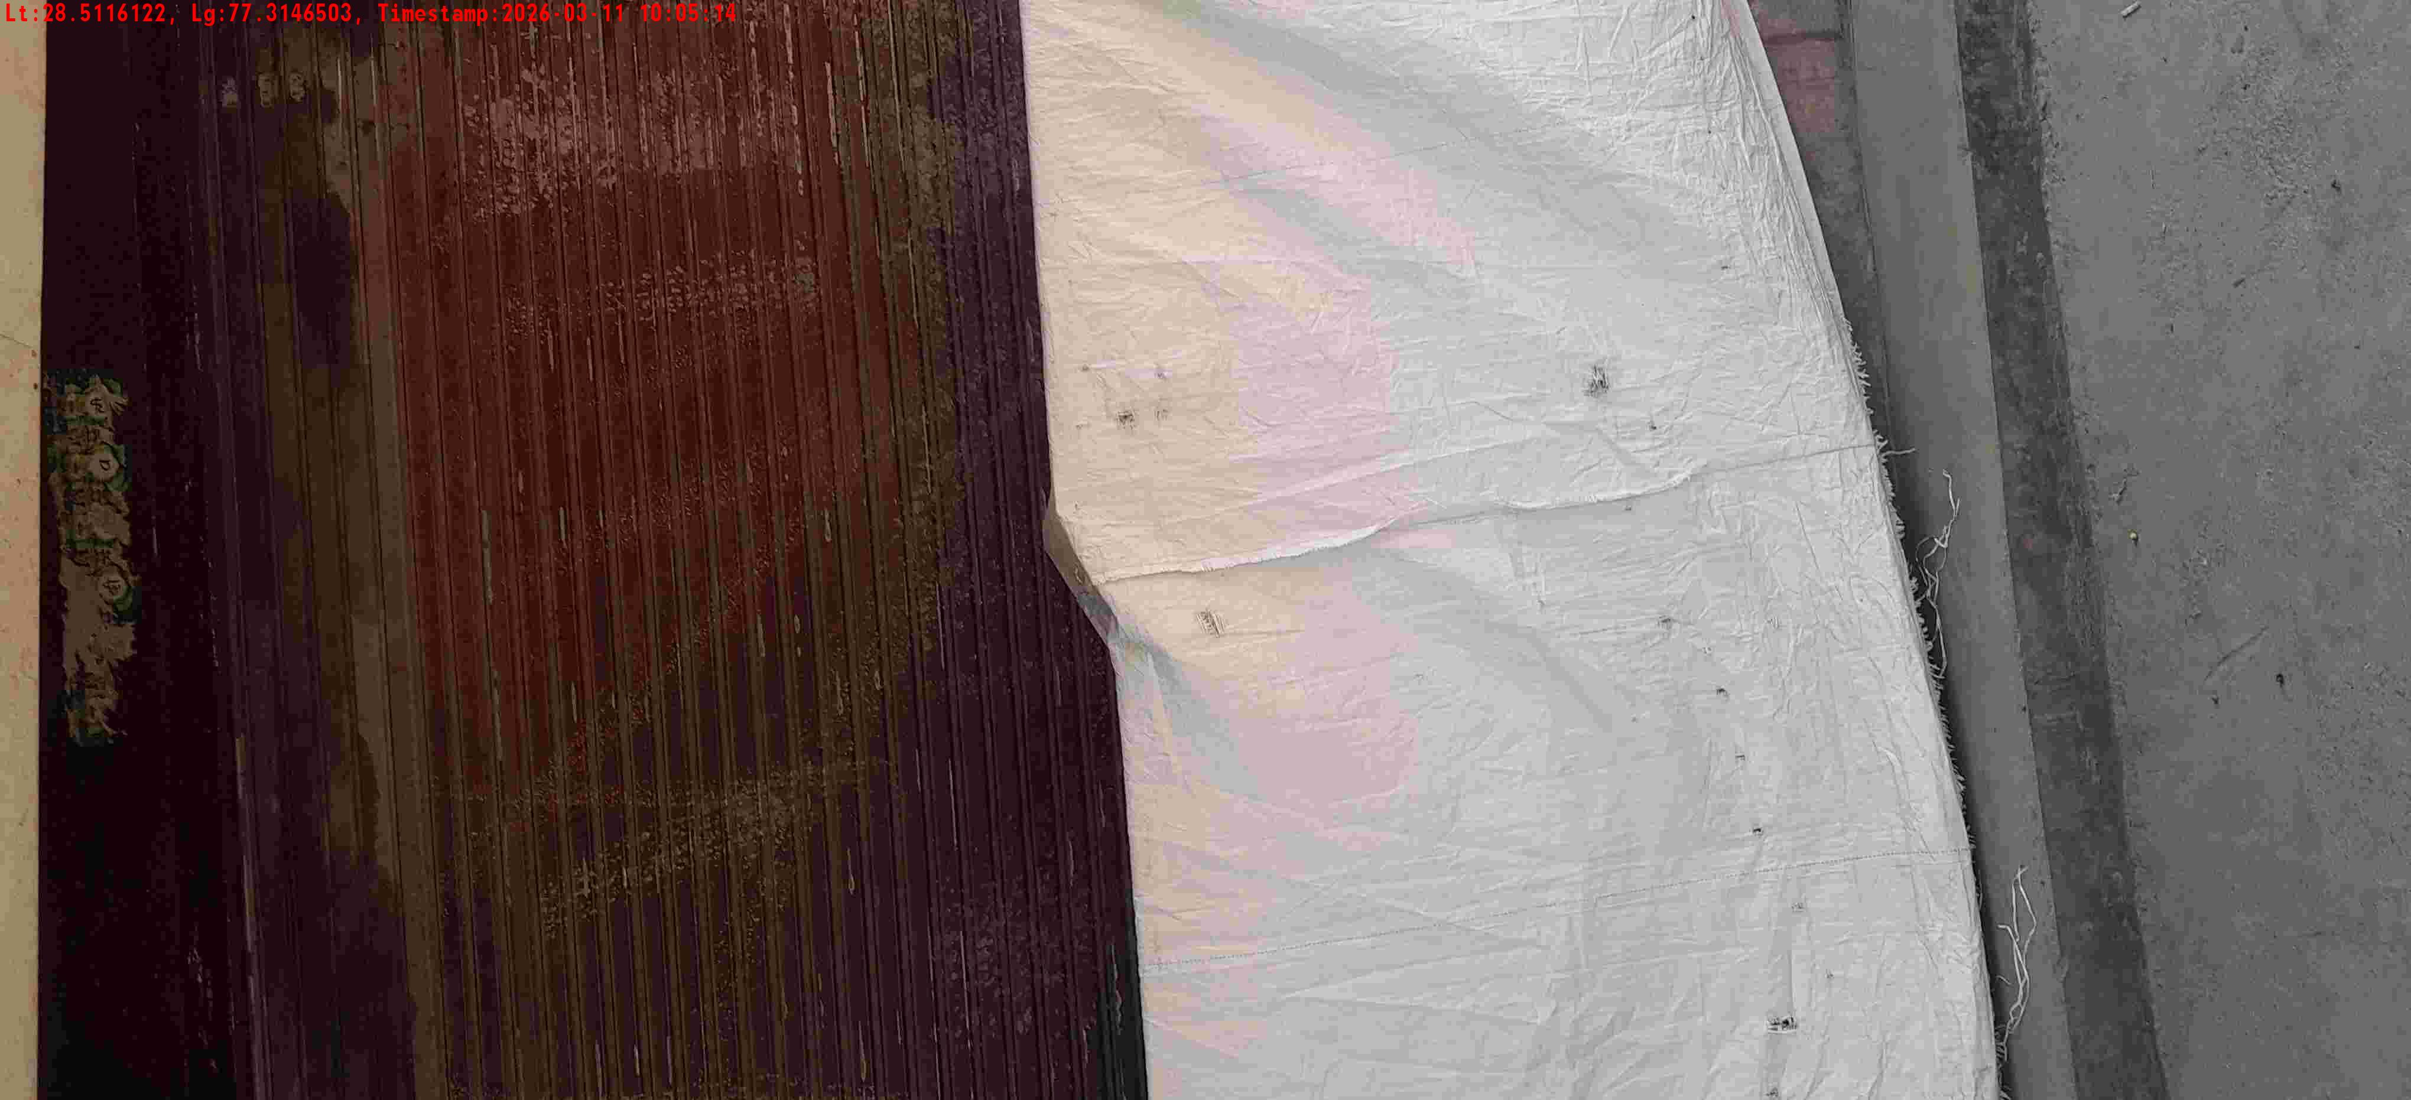
WD Code | DS Id | DS Name | Route Name | Shop Name | Date Time
DE5458 | 779 | Niche-DS4 | Wed-Sat | Vip Pan | 11-03-2026 10:05:08 AM
Shop Inside Picture
Shop Front Picture

Slide 30
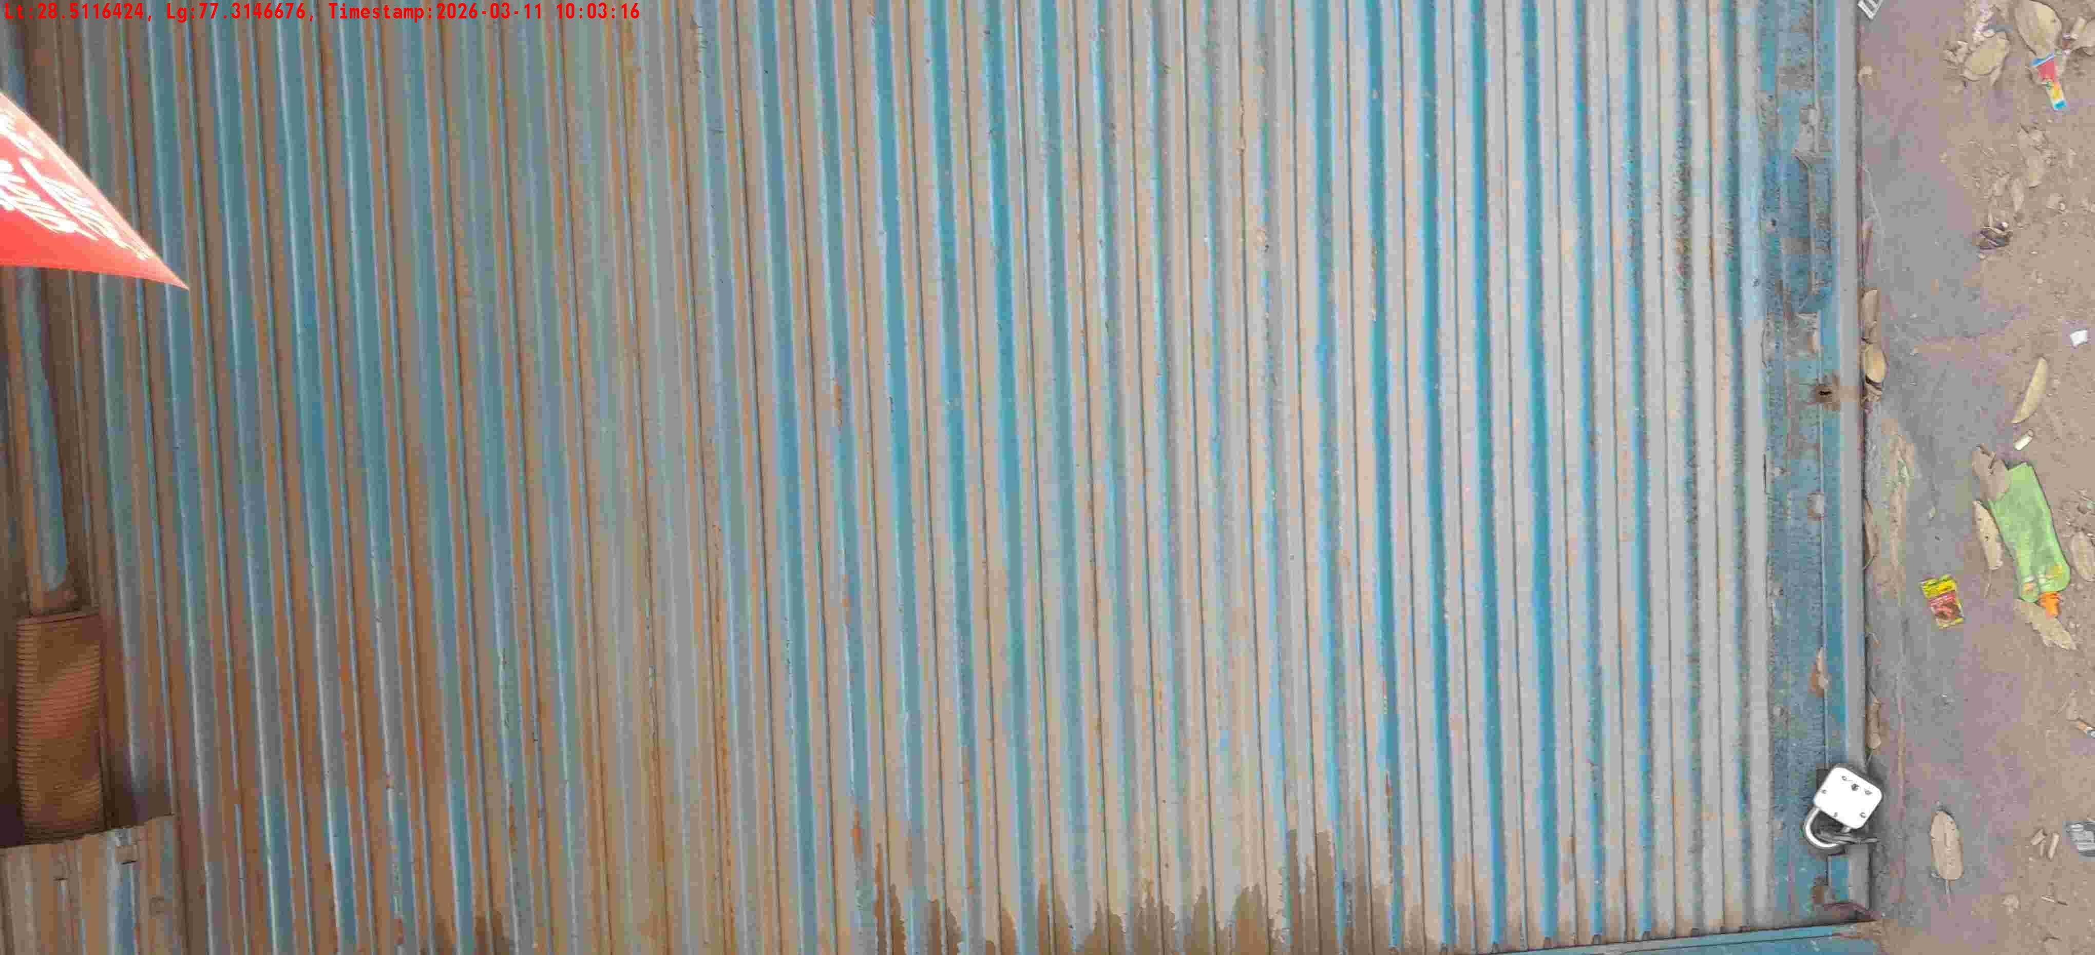
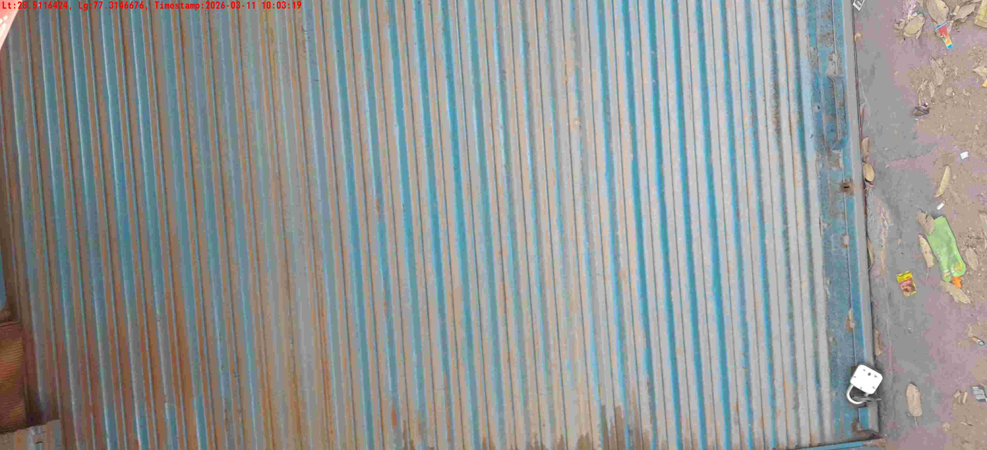
WD Code | DS Id | DS Name | Route Name | Shop Name | Date Time
DE5458 | 779 | Niche-DS4 | Wed-Sat | Yadav general store | 11-03-2026 10:03:13 AM
Shop Inside Picture
Shop Front Picture

