Slide 1
Transaction Ppt

Slide 2
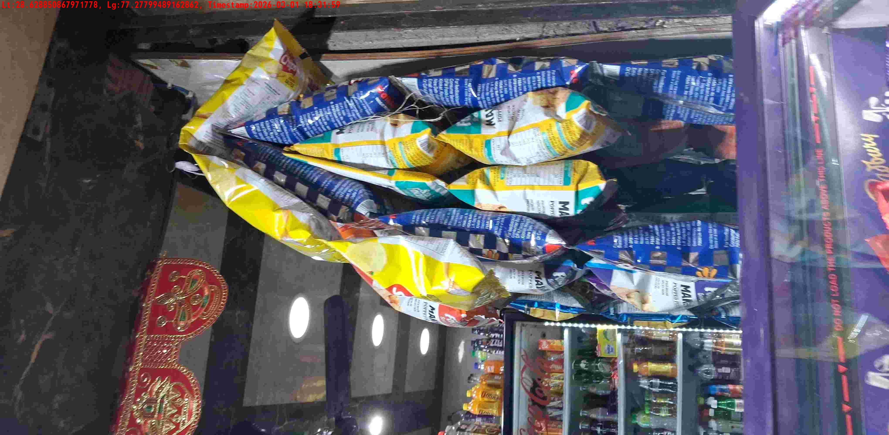
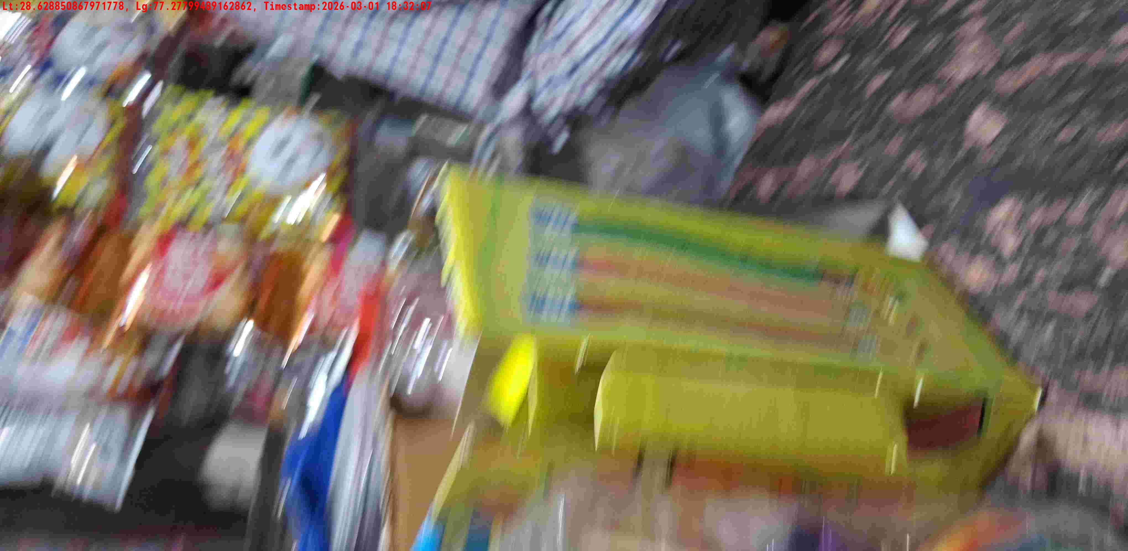
WD Code | DS Id | DS Name | Route Name | Shop Name | Date Time
DE5142 | 328 | YOGESH | Chajjupur | A-One Store | 01-03-2026 06:31:57 PM
Shop Inside Picture
Shop Front Picture

Slide 3
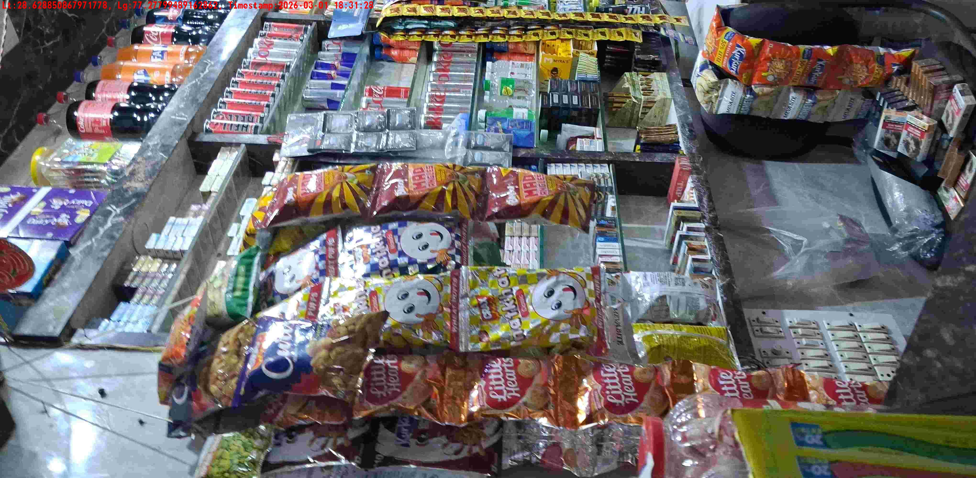
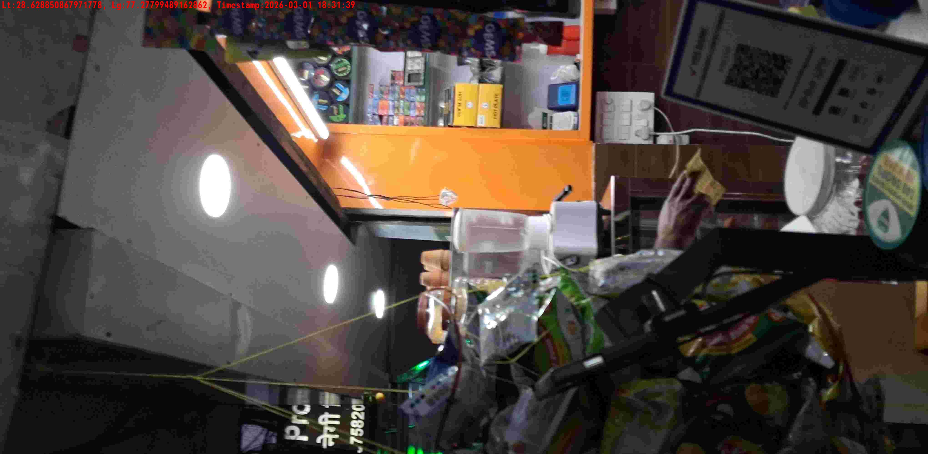
WD Code | DS Id | DS Name | Route Name | Shop Name | Date Time
DE5142 | 328 | YOGESH | Chajjupur | TYAGI STORE. | 01-03-2026 06:31:25 PM
Shop Inside Picture
Shop Front Picture

Slide 4
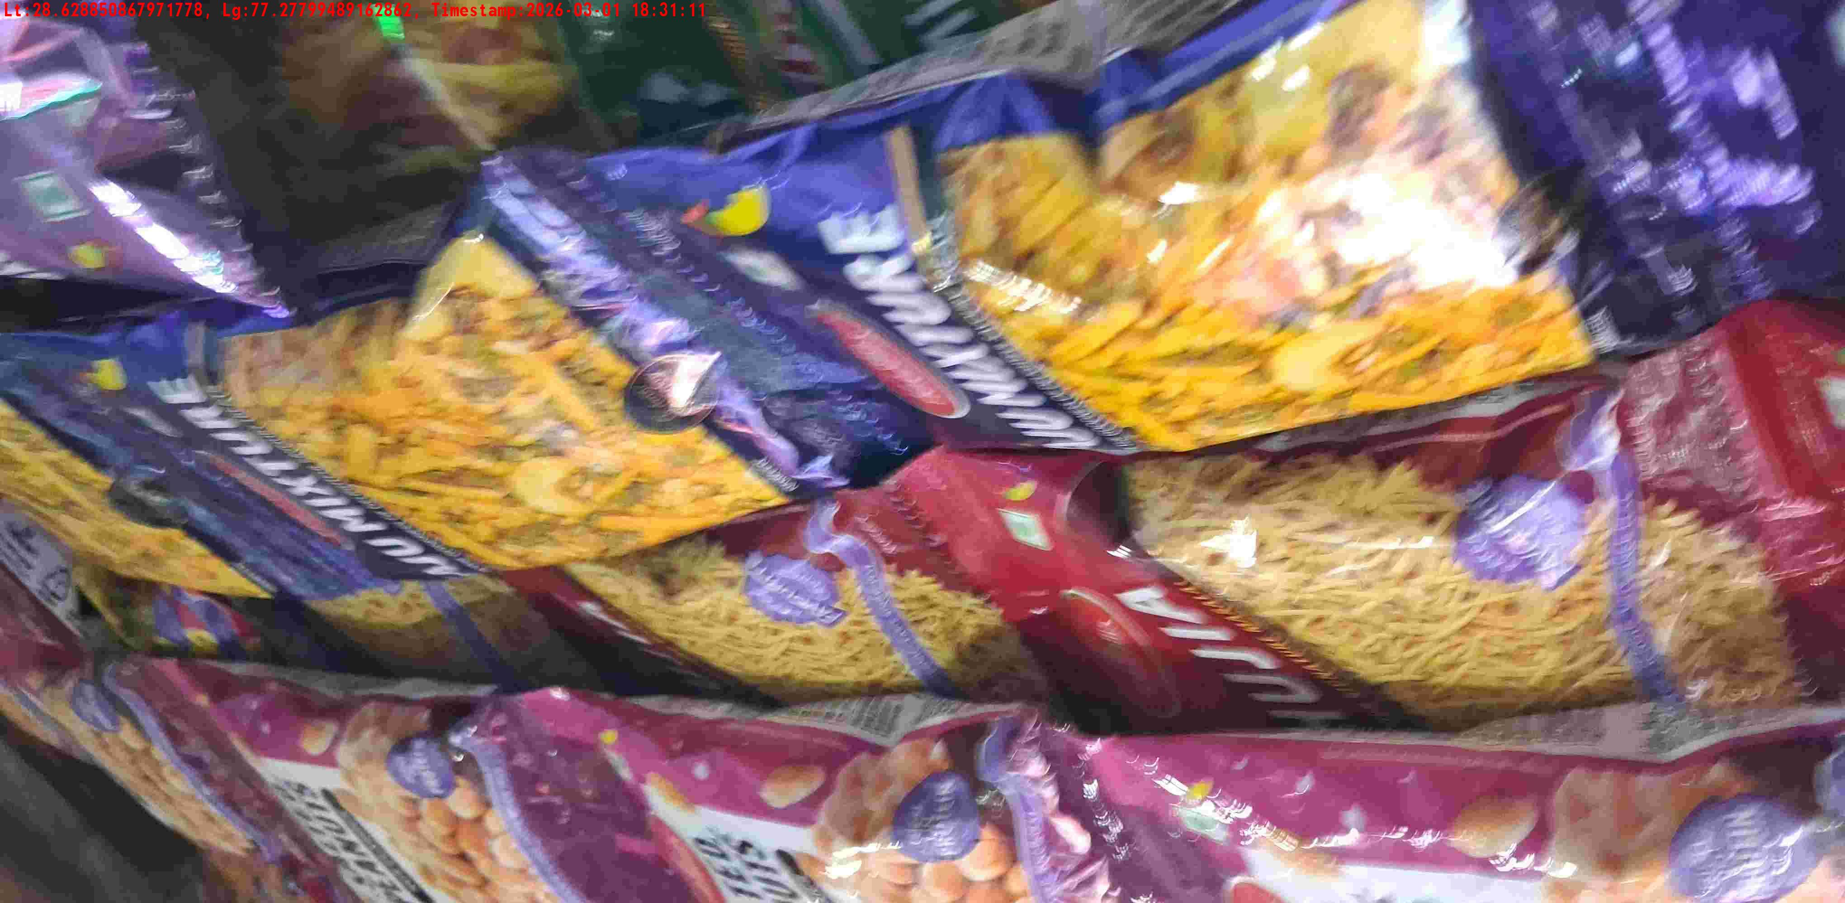
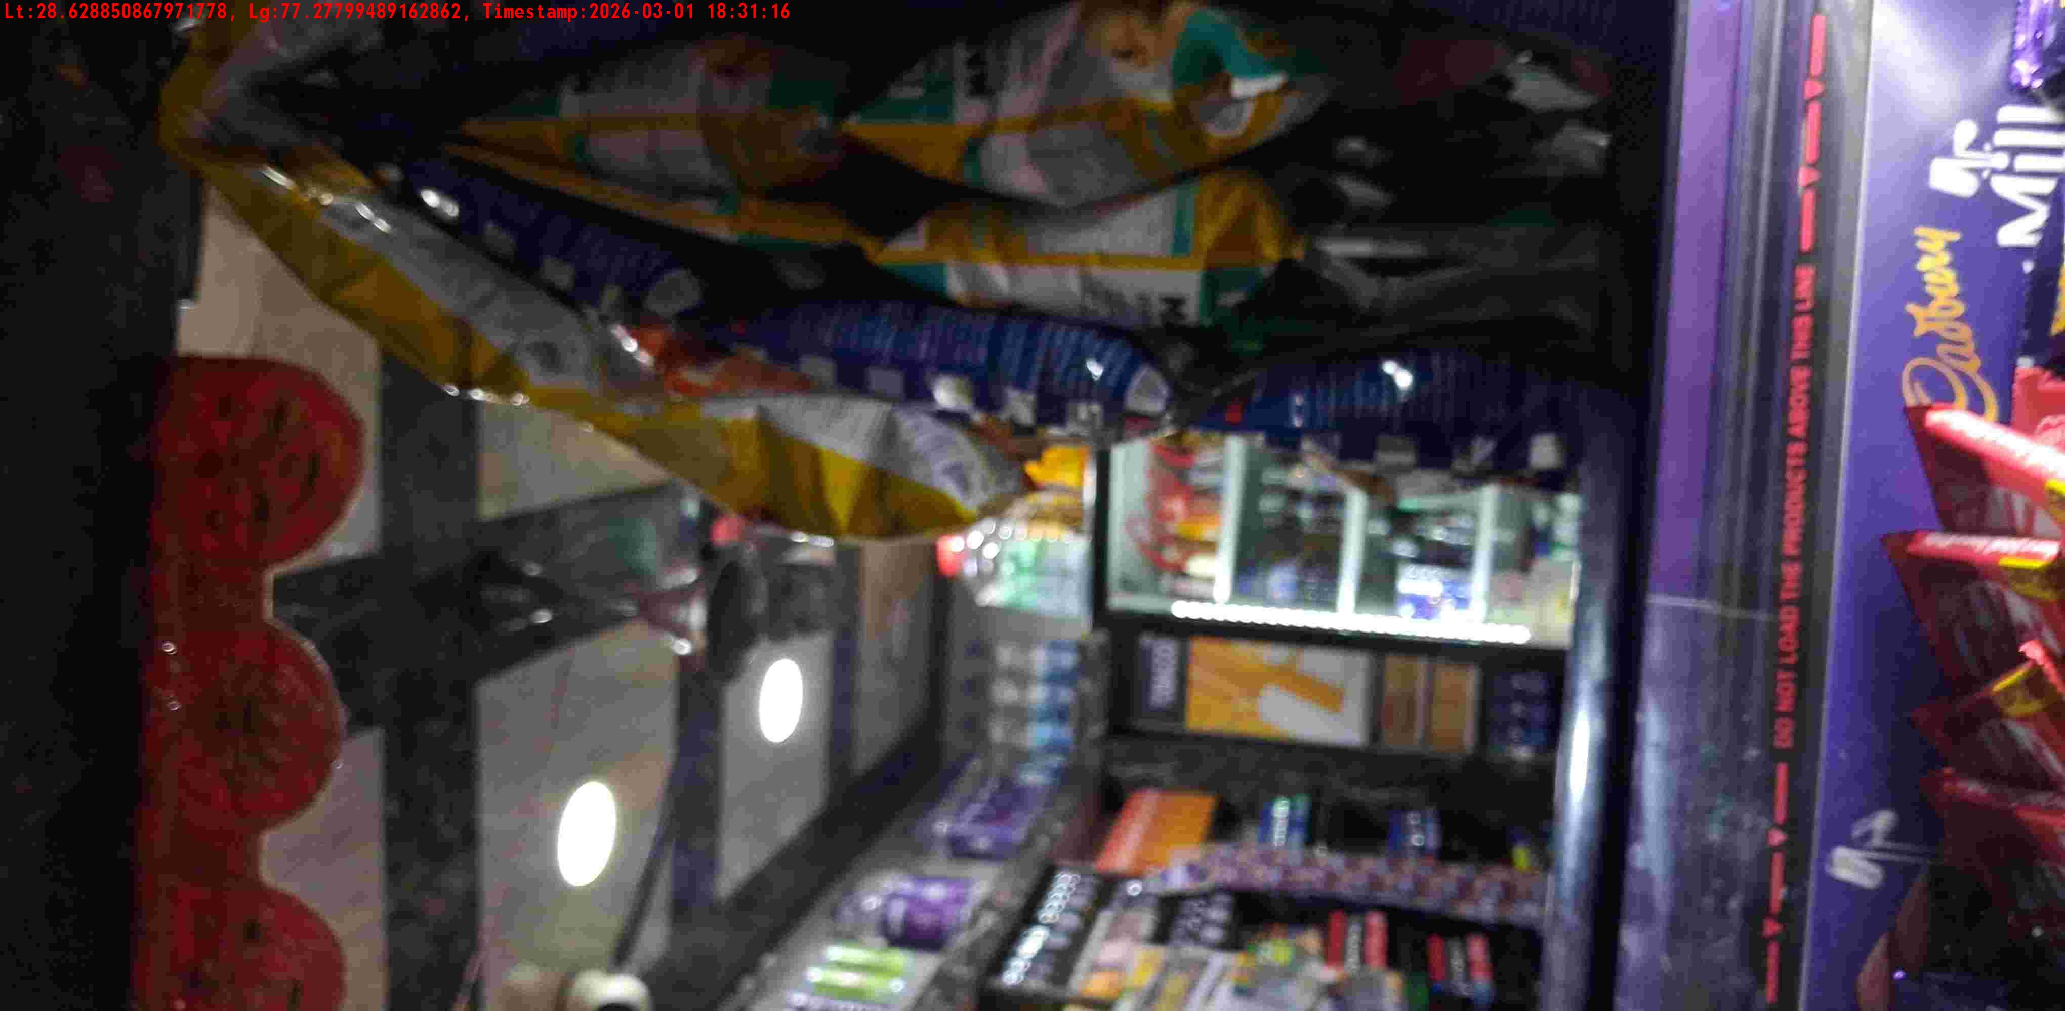
WD Code | DS Id | DS Name | Route Name | Shop Name | Date Time
DE5142 | 328 | YOGESH | Chajjupur | VAIBHAV STORE CHAJJU PUR | 01-03-2026 06:31:08 PM
Shop Inside Picture
Shop Front Picture

Slide 5
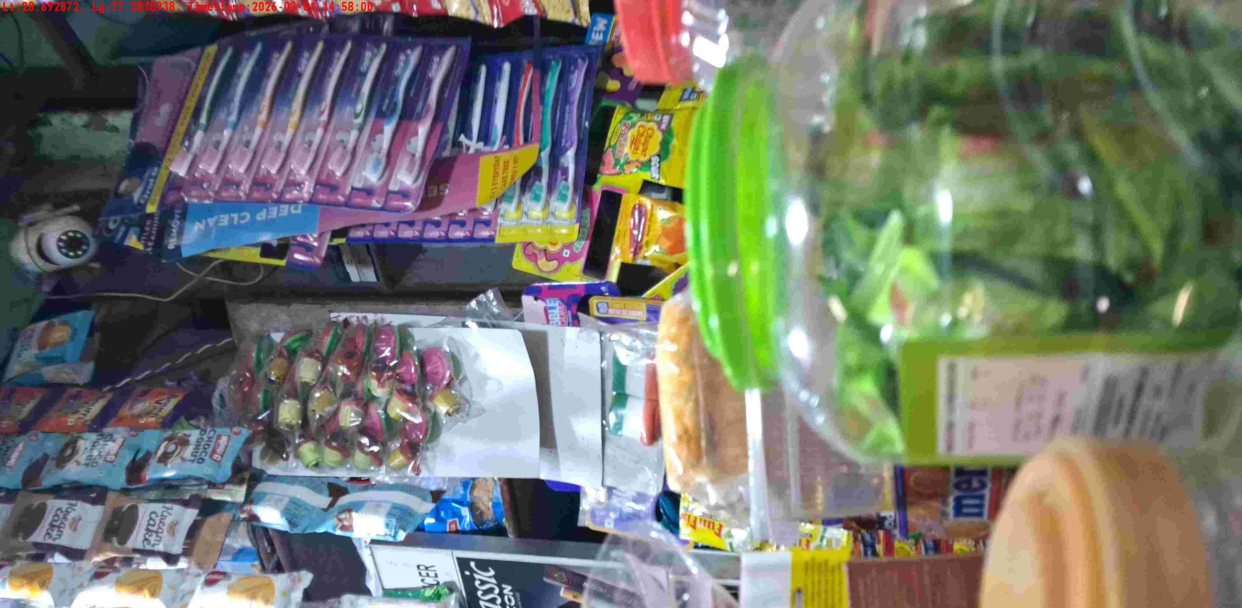
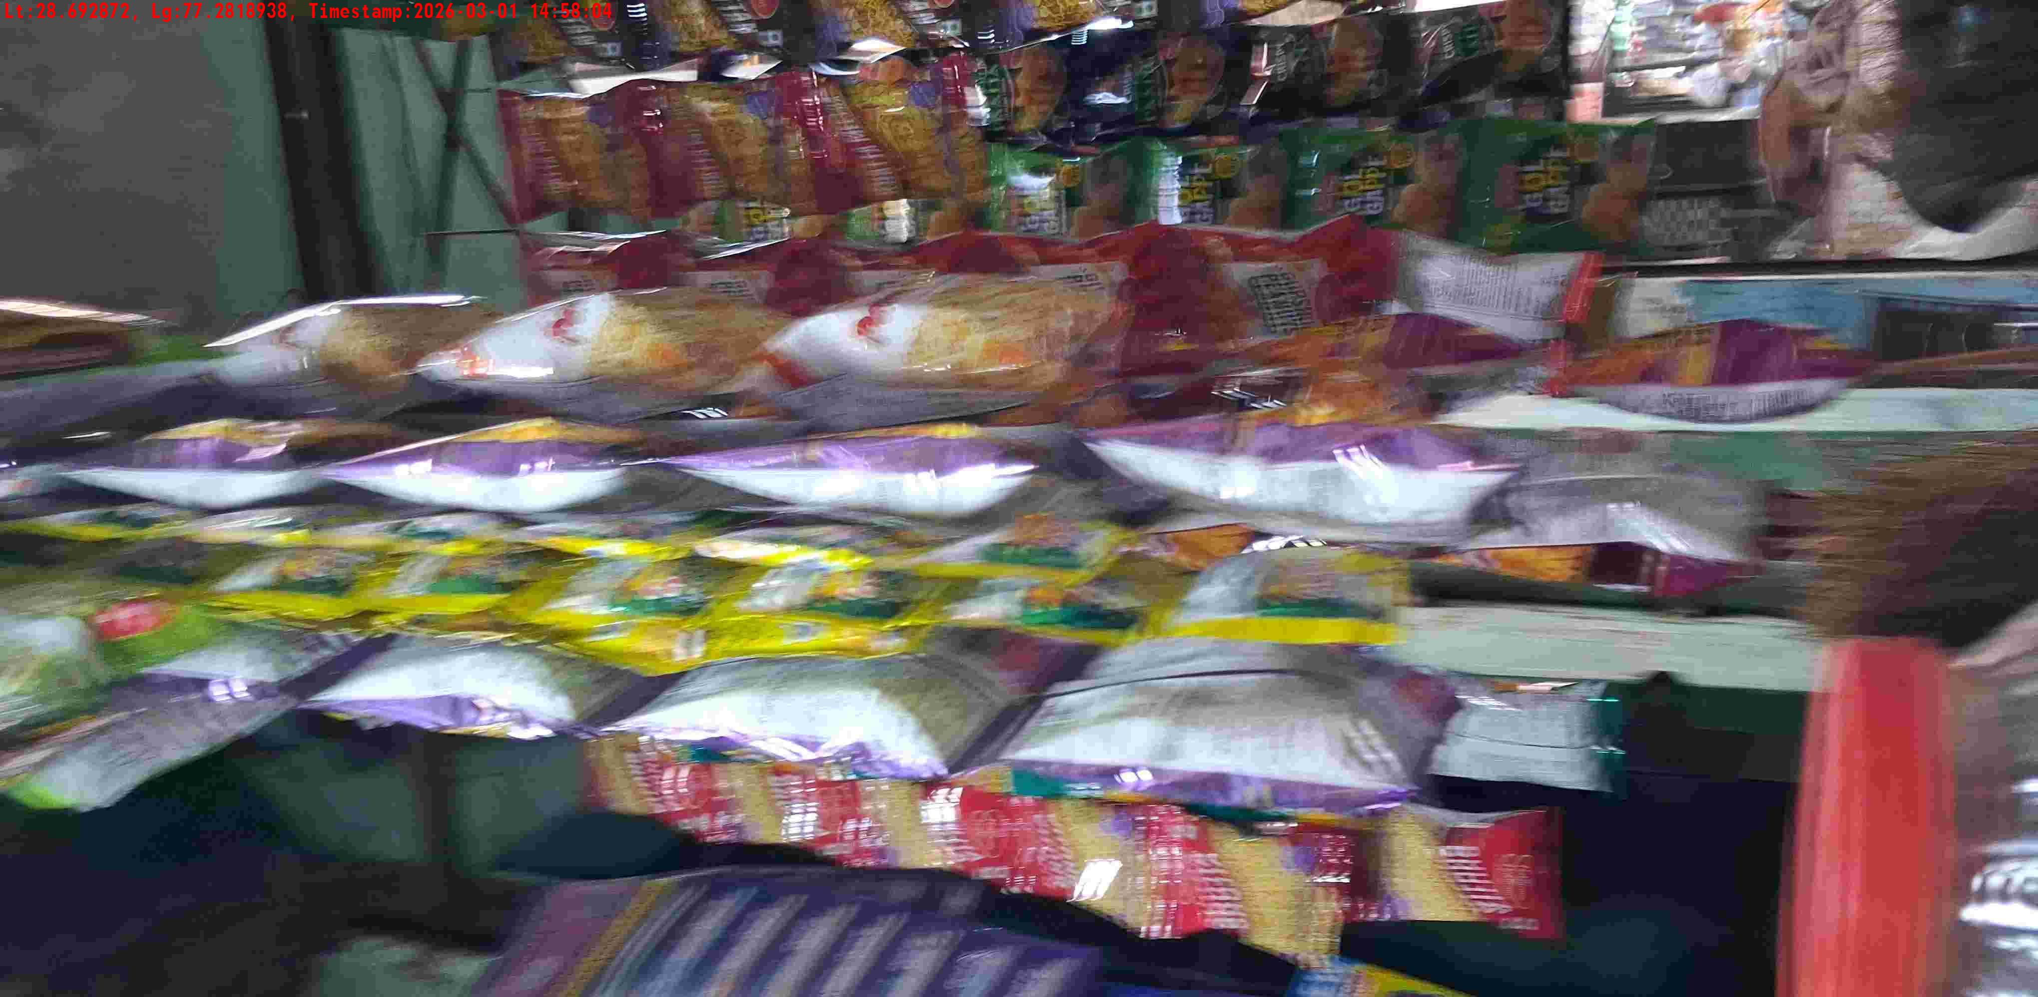
WD Code | DS Id | DS Name | Route Name | Shop Name | Date Time
DE5142 | 328 | YOGESH | Naveen Shahdra | MA JAGDAMBA STORE | 01-03-2026 02:57:57 PM
Shop Inside Picture
Shop Front Picture

Slide 6
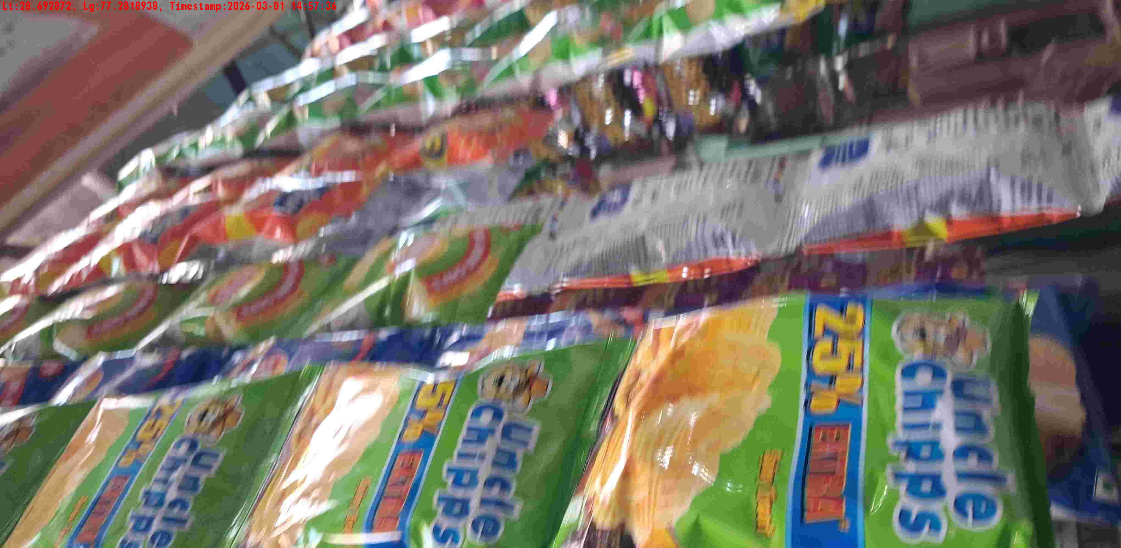
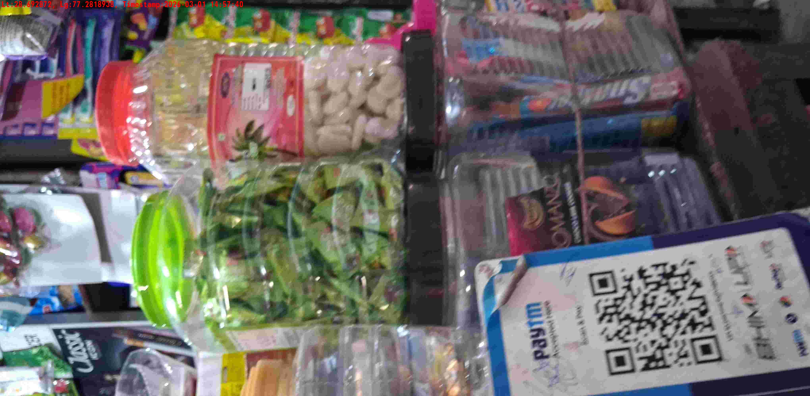
WD Code | DS Id | DS Name | Route Name | Shop Name | Date Time
DE5142 | 328 | YOGESH | Naveen Shahdra | MA JAGDAMBA STORE | 01-03-2026 02:57:33 PM
Shop Inside Picture
Shop Front Picture

Slide 7
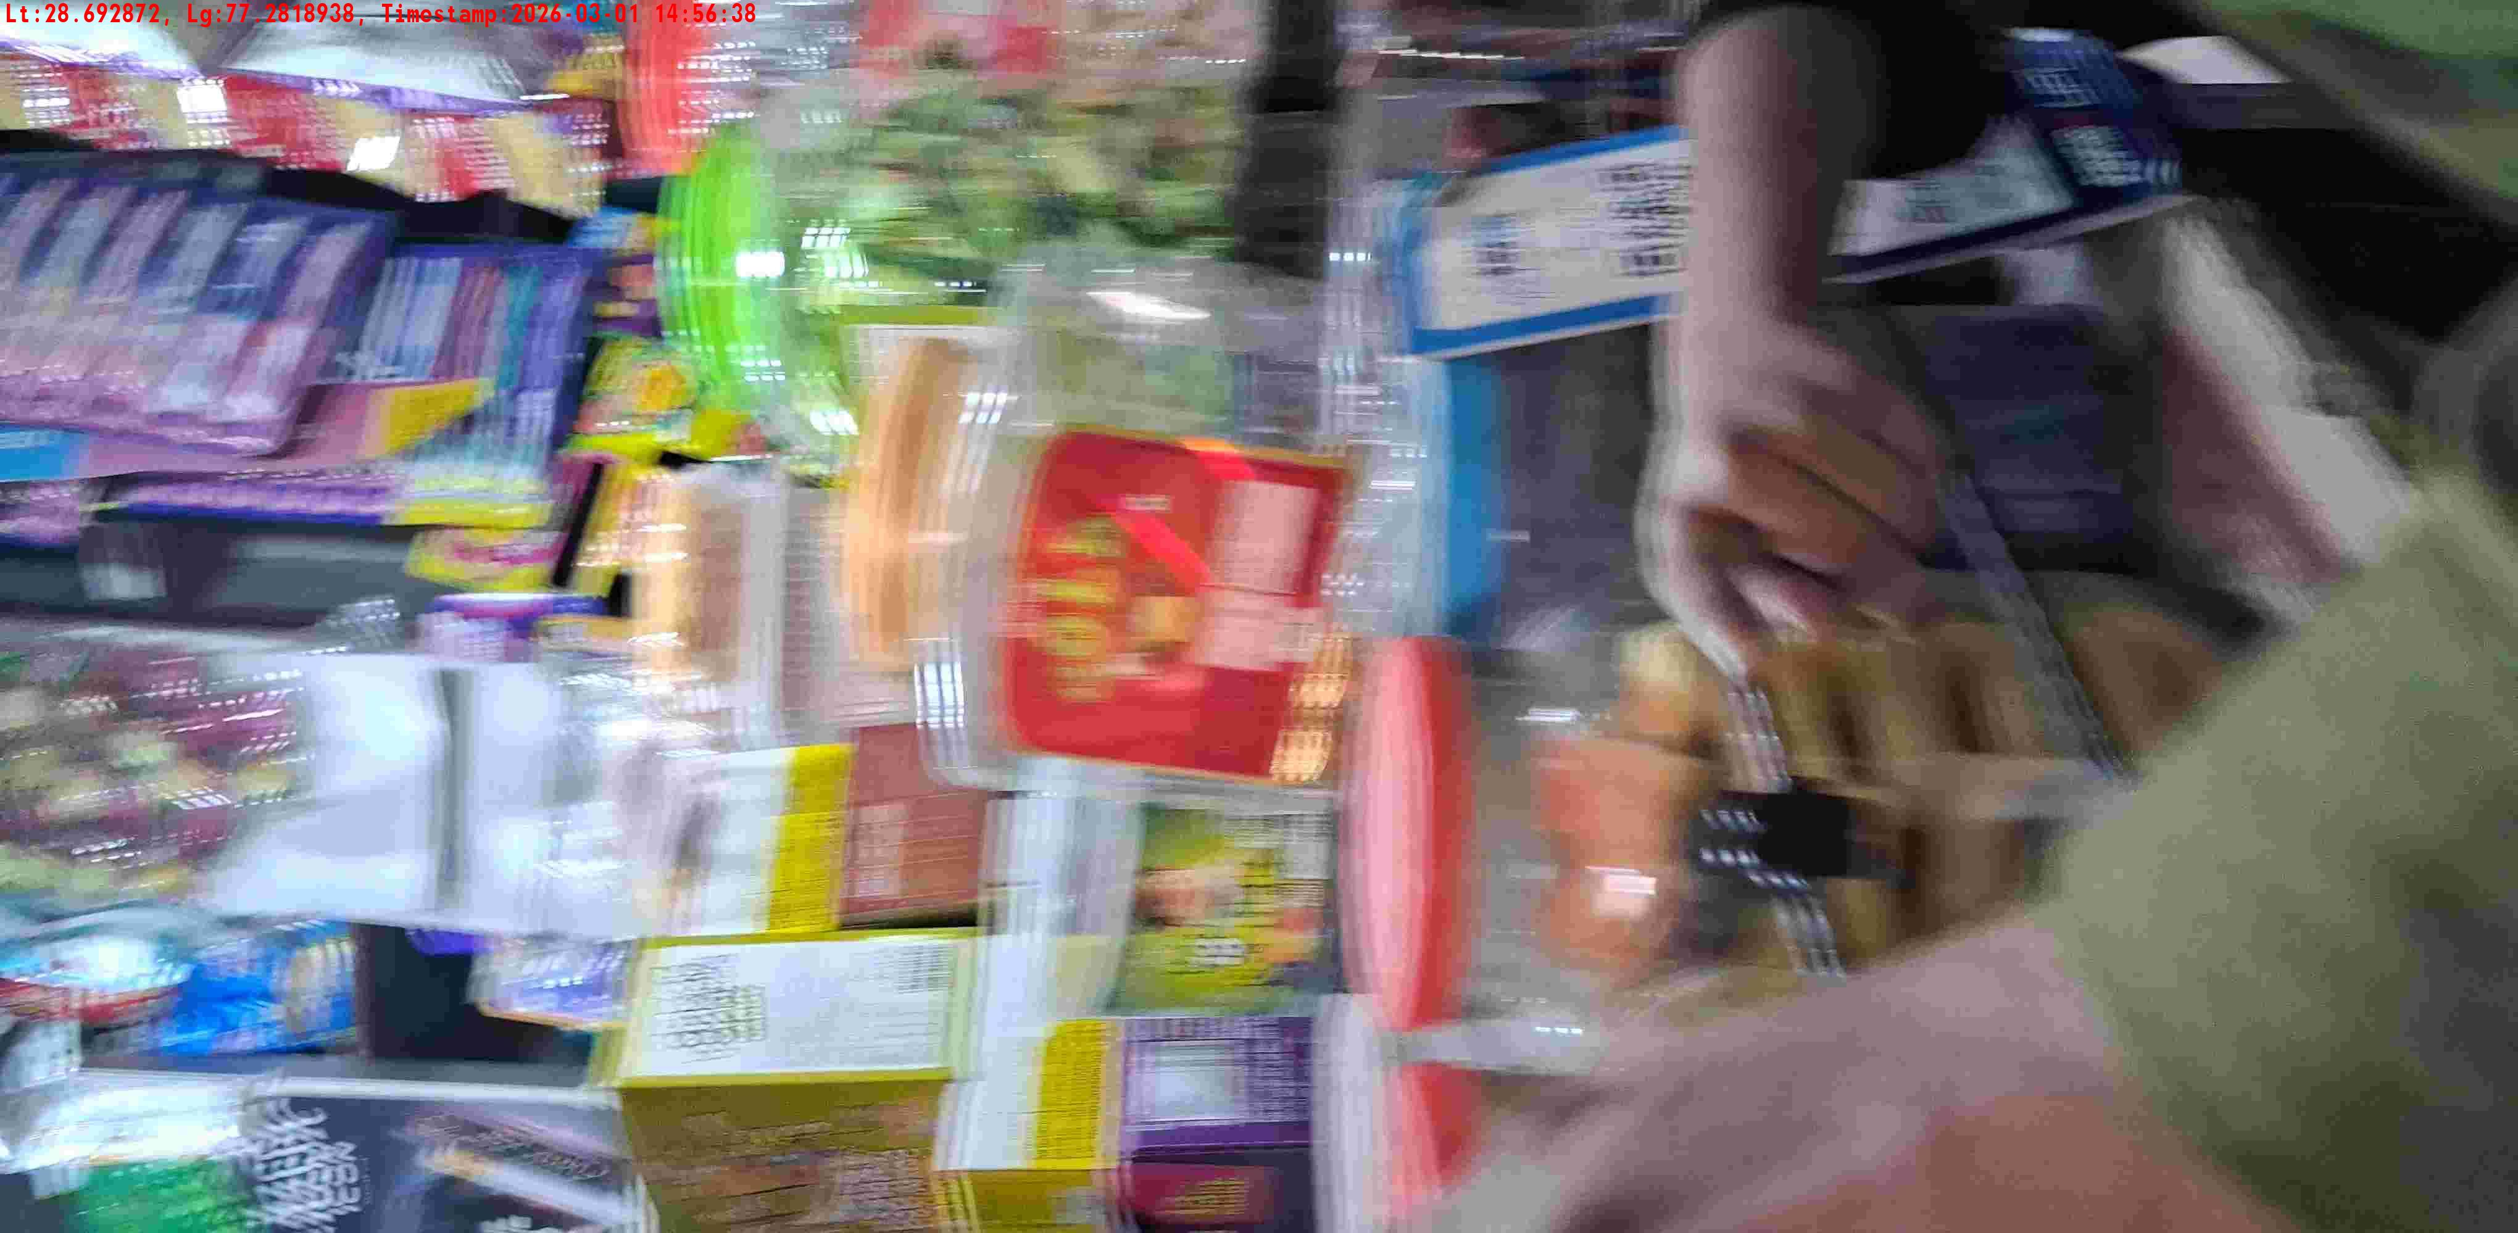
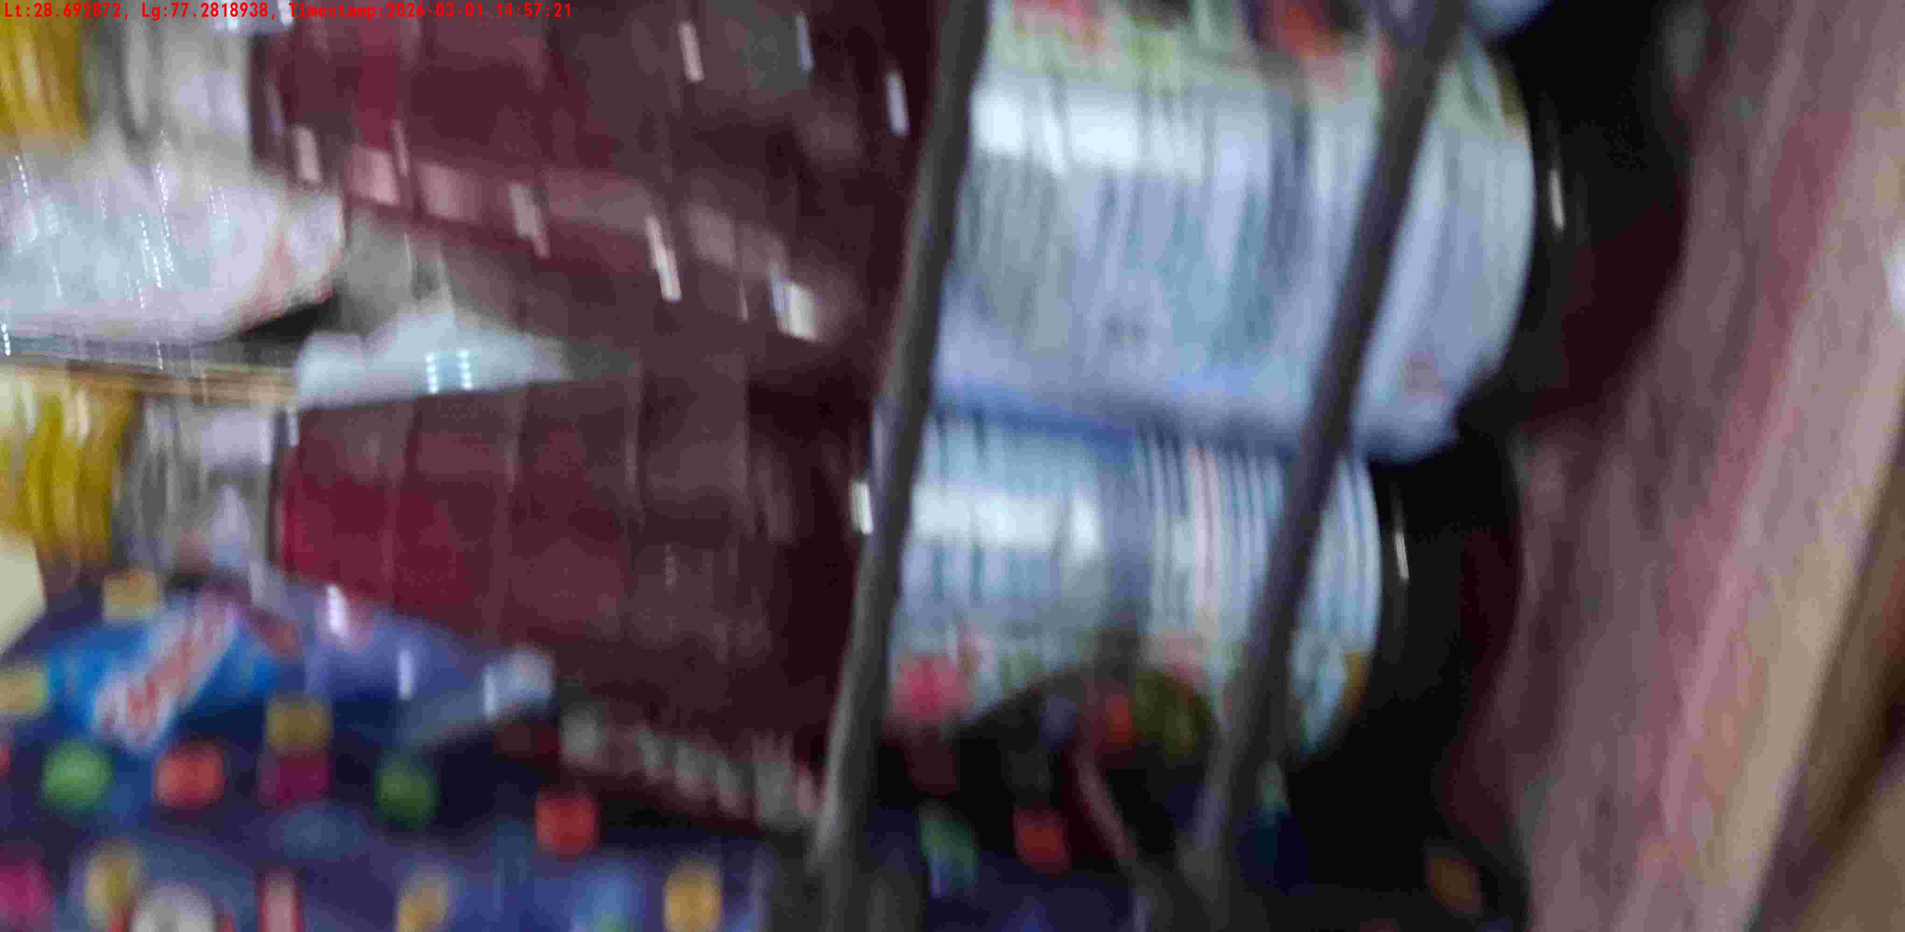
WD Code | DS Id | DS Name | Route Name | Shop Name | Date Time
DE5142 | 328 | YOGESH | Babarpur | MUKUT PAN | 01-03-2026 02:56:36 PM
Shop Inside Picture
Shop Front Picture

Slide 8
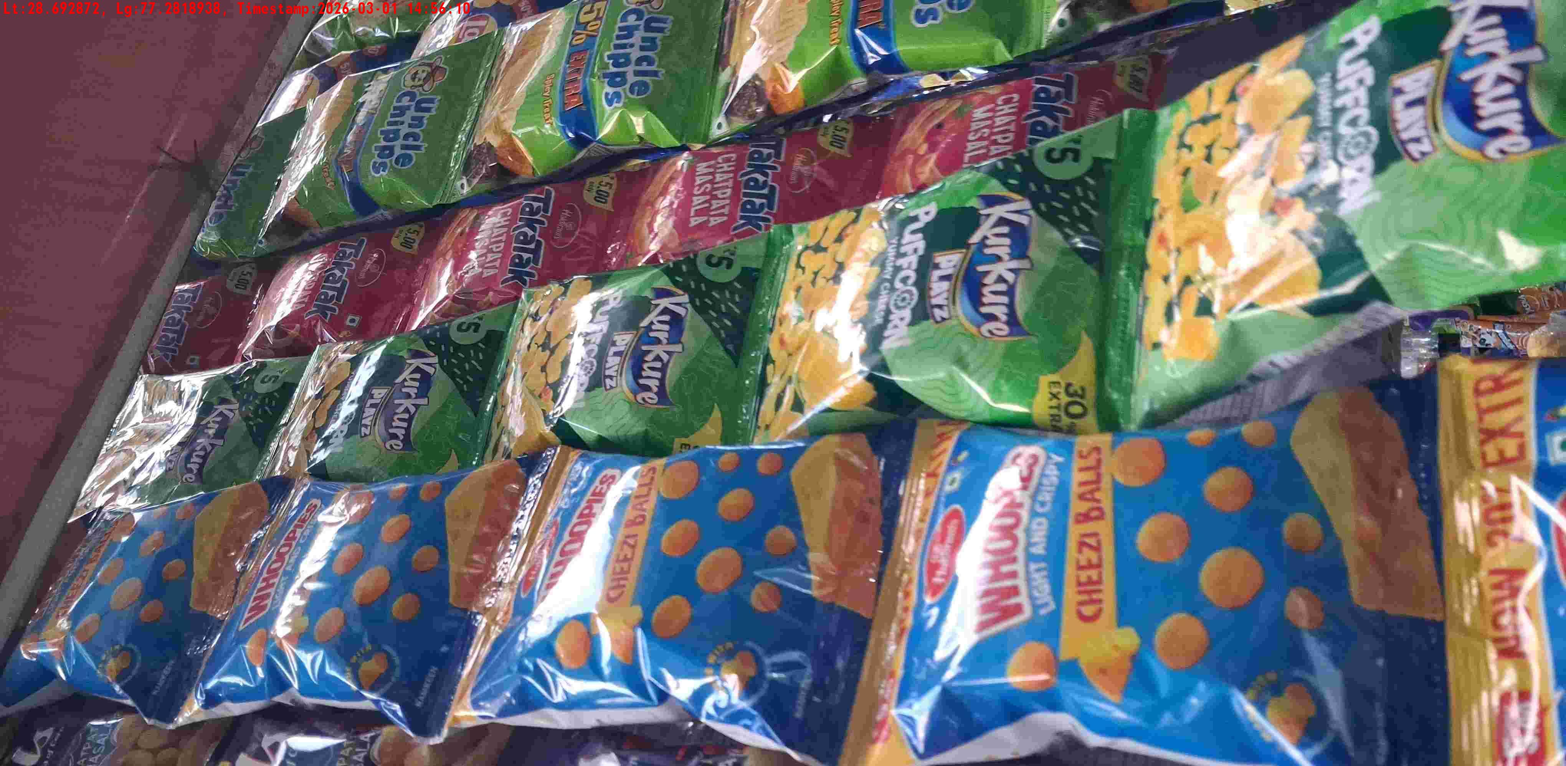
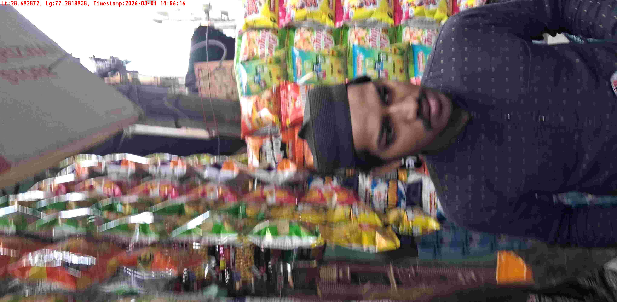
WD Code | DS Id | DS Name | Route Name | Shop Name | Date Time
DE5142 | 328 | YOGESH | Babarpur | BADAL PAN | 01-03-2026 02:56:08 PM
Shop Inside Picture
Shop Front Picture

Slide 9
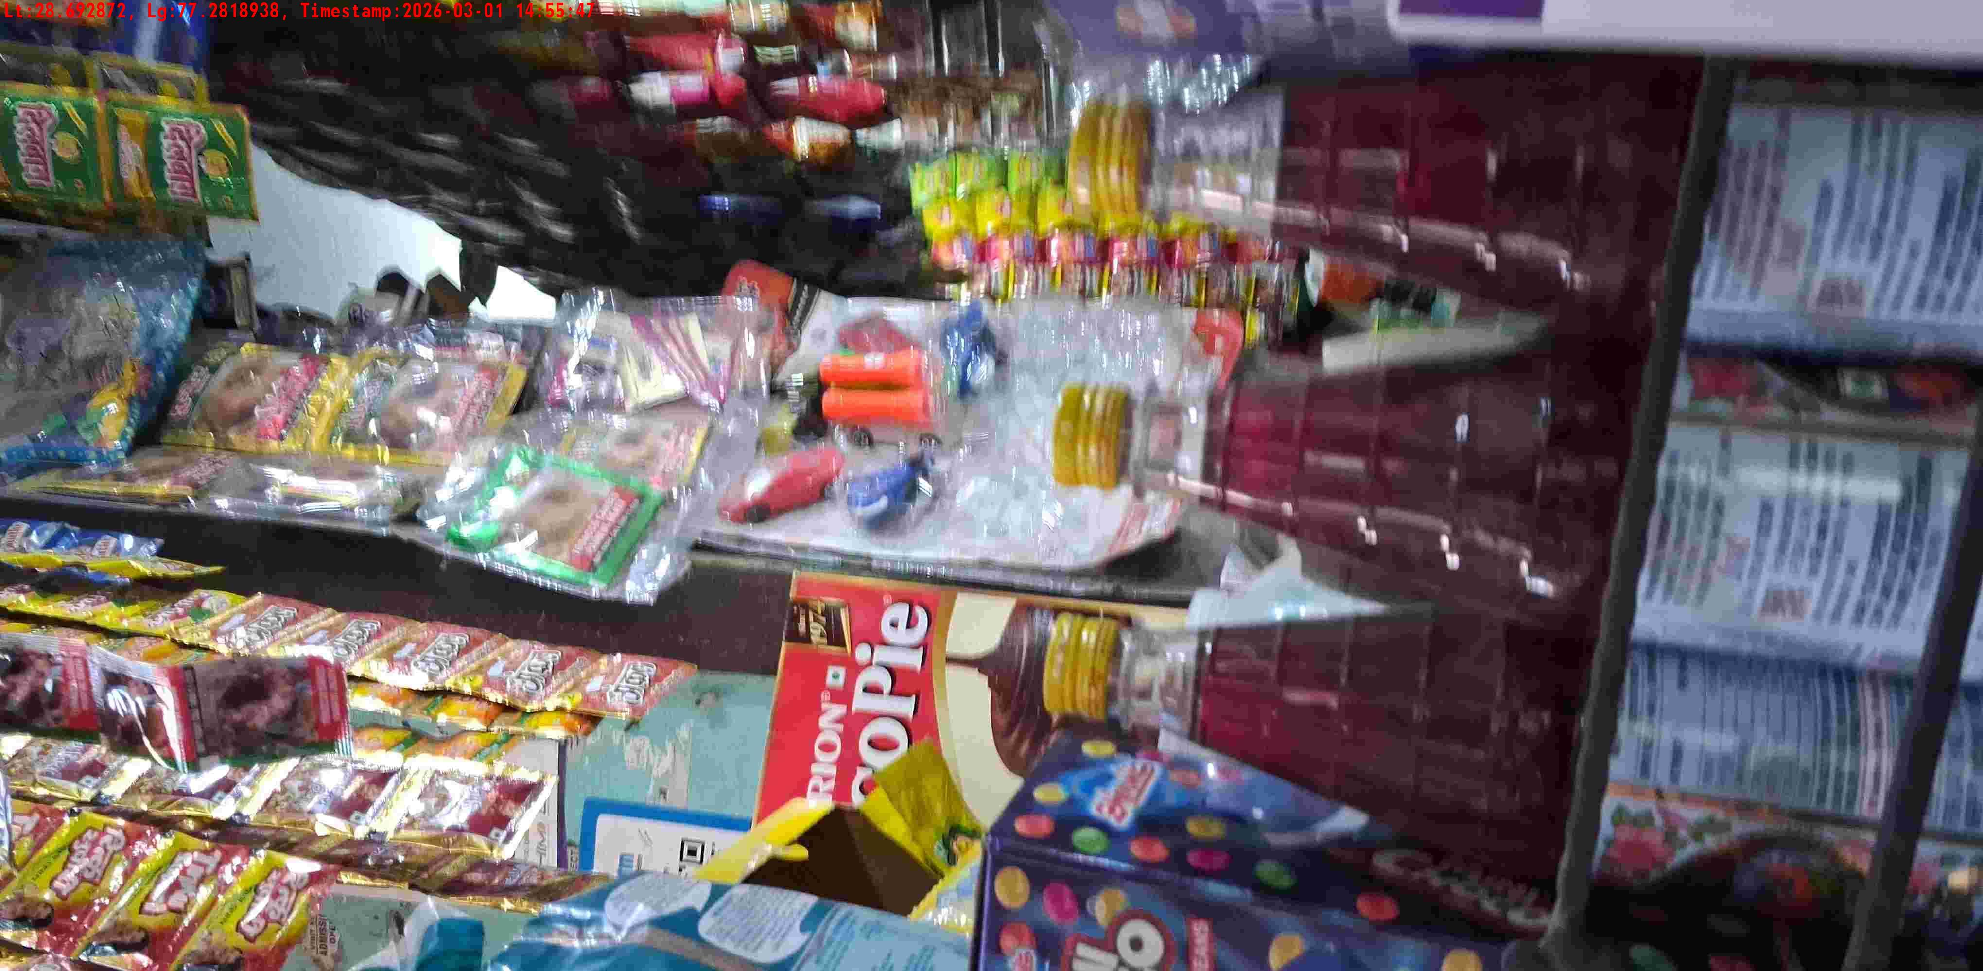
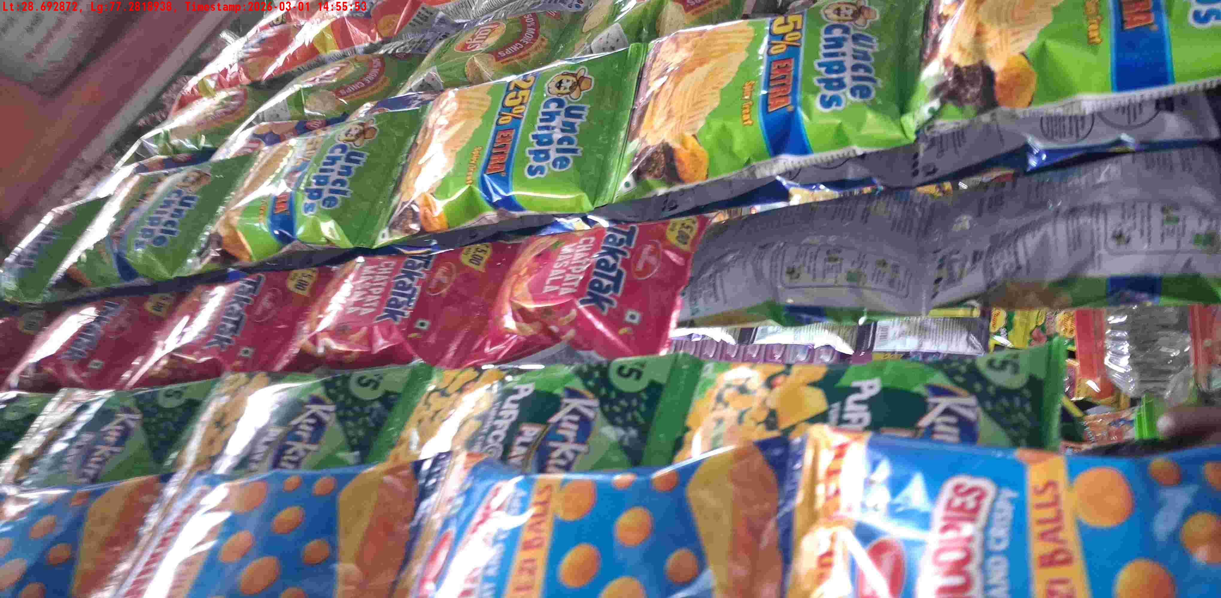
WD Code | DS Id | DS Name | Route Name | Shop Name | Date Time
DE5142 | 328 | YOGESH | Babarpur | MULLA JI STORE | 01-03-2026 02:55:45 PM
Shop Inside Picture
Shop Front Picture

Slide 10
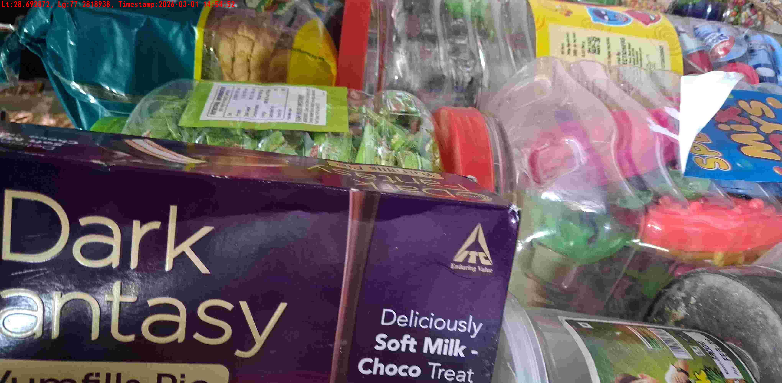
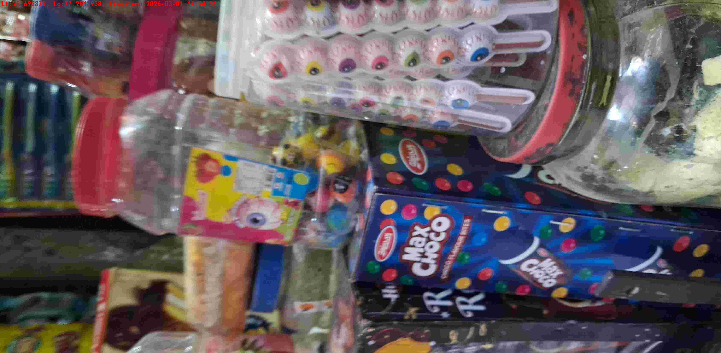
WD Code | DS Id | DS Name | Route Name | Shop Name | Date Time
DE5142 | 328 | YOGESH | Babarpur | ARORA GENERAL STORE | 01-03-2026 02:54:50 PM
Shop Inside Picture
Shop Front Picture

Slide 11
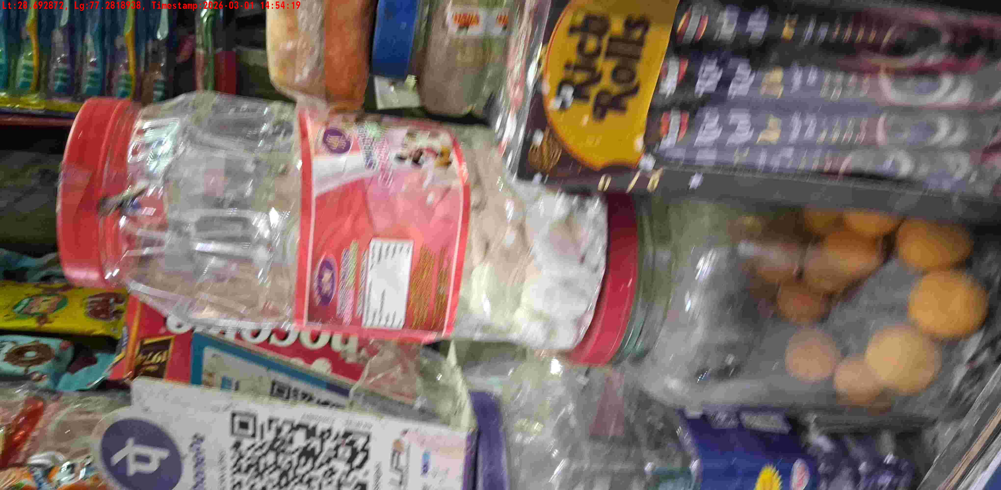
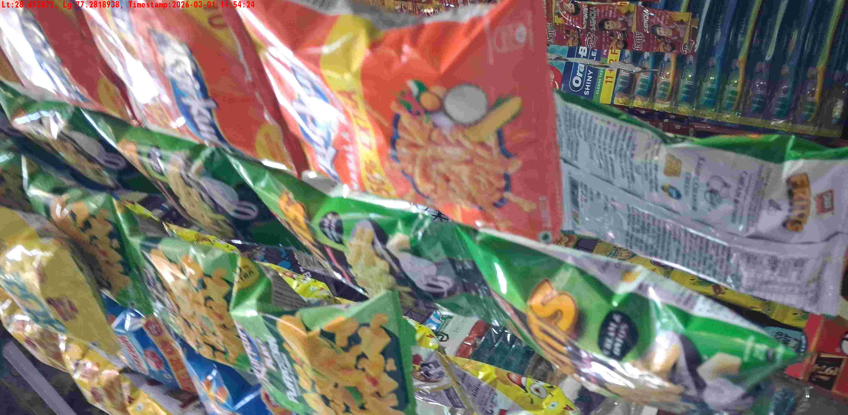
WD Code | DS Id | DS Name | Route Name | Shop Name | Date Time
DE5142 | 328 | YOGESH | Babarpur | ARORA GENERAL STORE | 01-03-2026 02:54:17 PM
Shop Inside Picture
Shop Front Picture

Slide 12
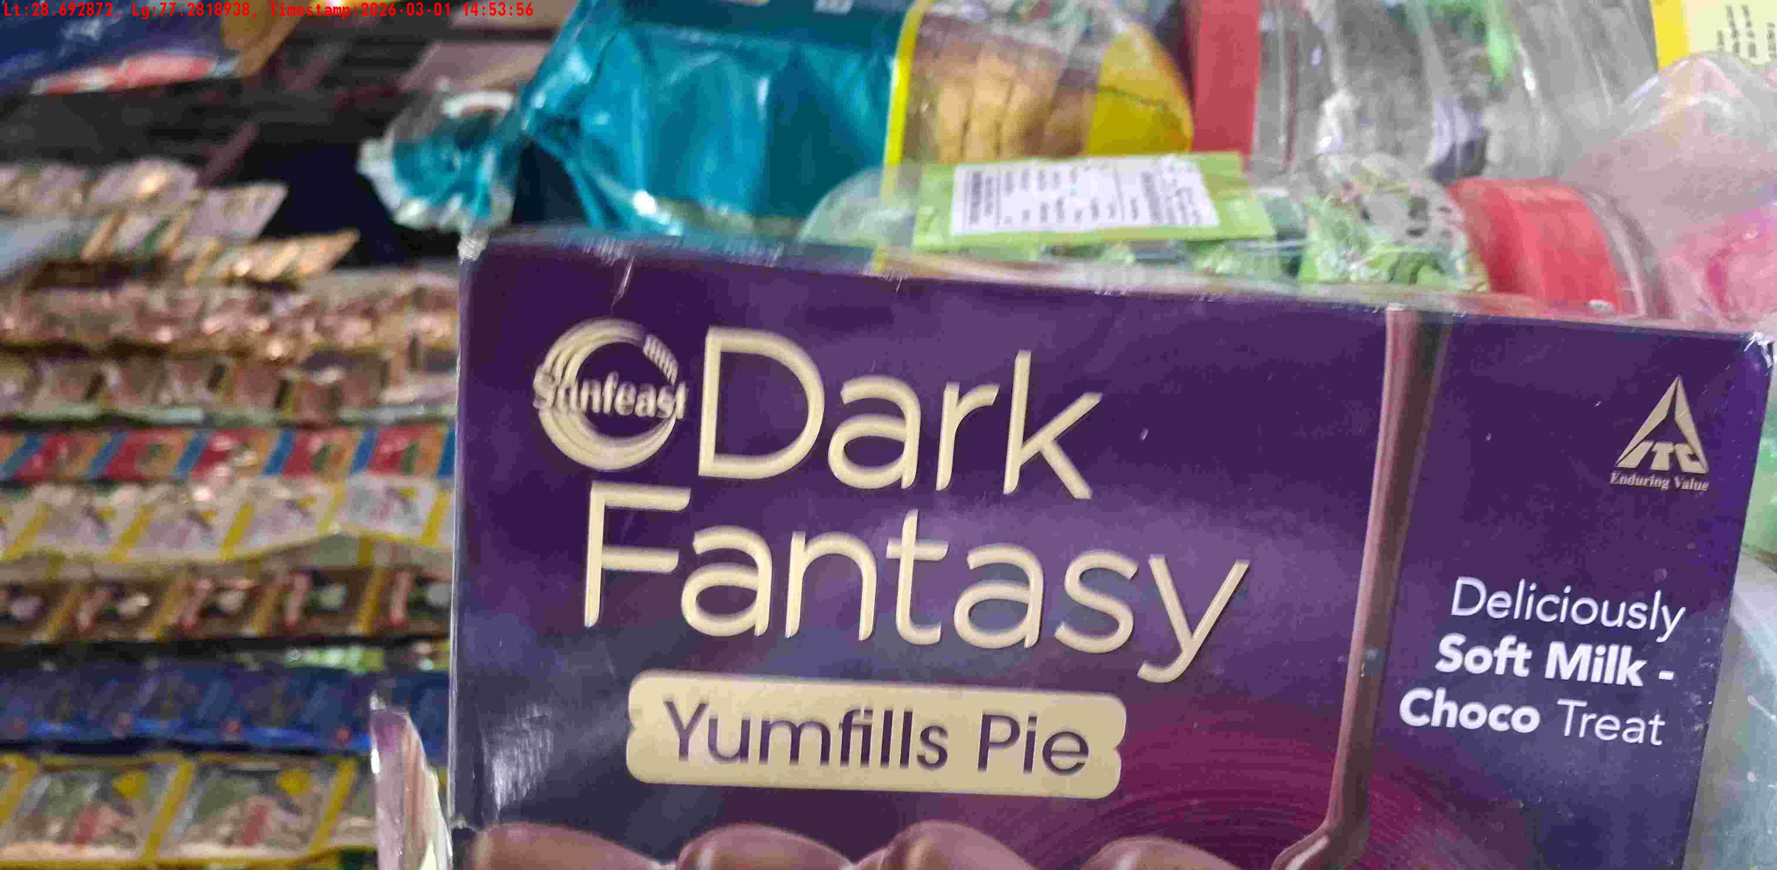
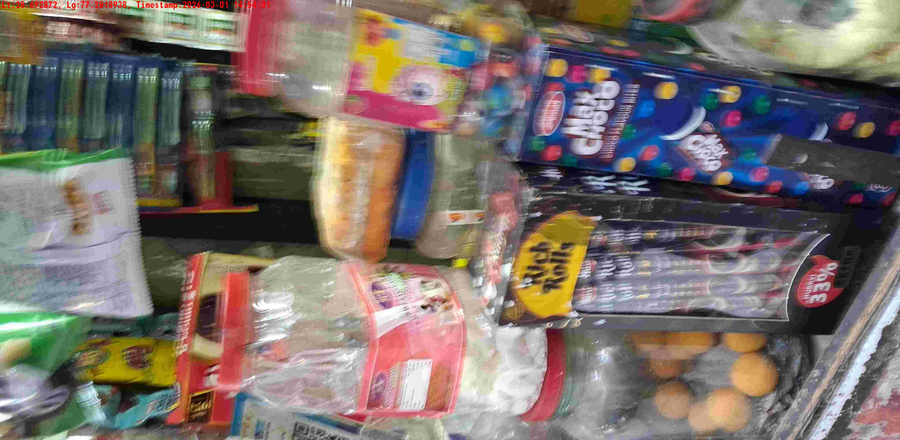
WD Code | DS Id | DS Name | Route Name | Shop Name | Date Time
DE5142 | 328 | YOGESH | Babarpur | V K GEN STORE | 01-03-2026 02:53:54 PM
Shop Inside Picture
Shop Front Picture

Slide 13
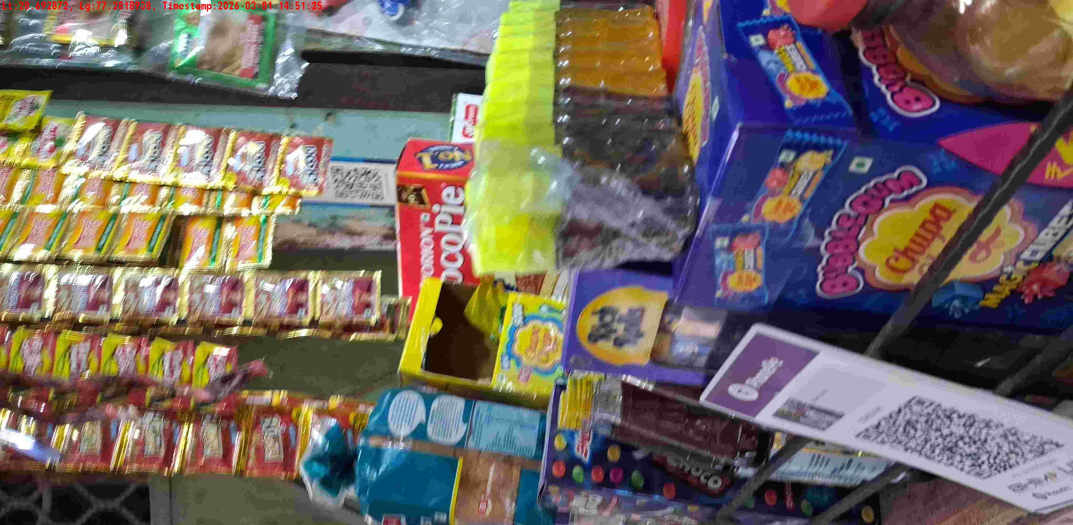
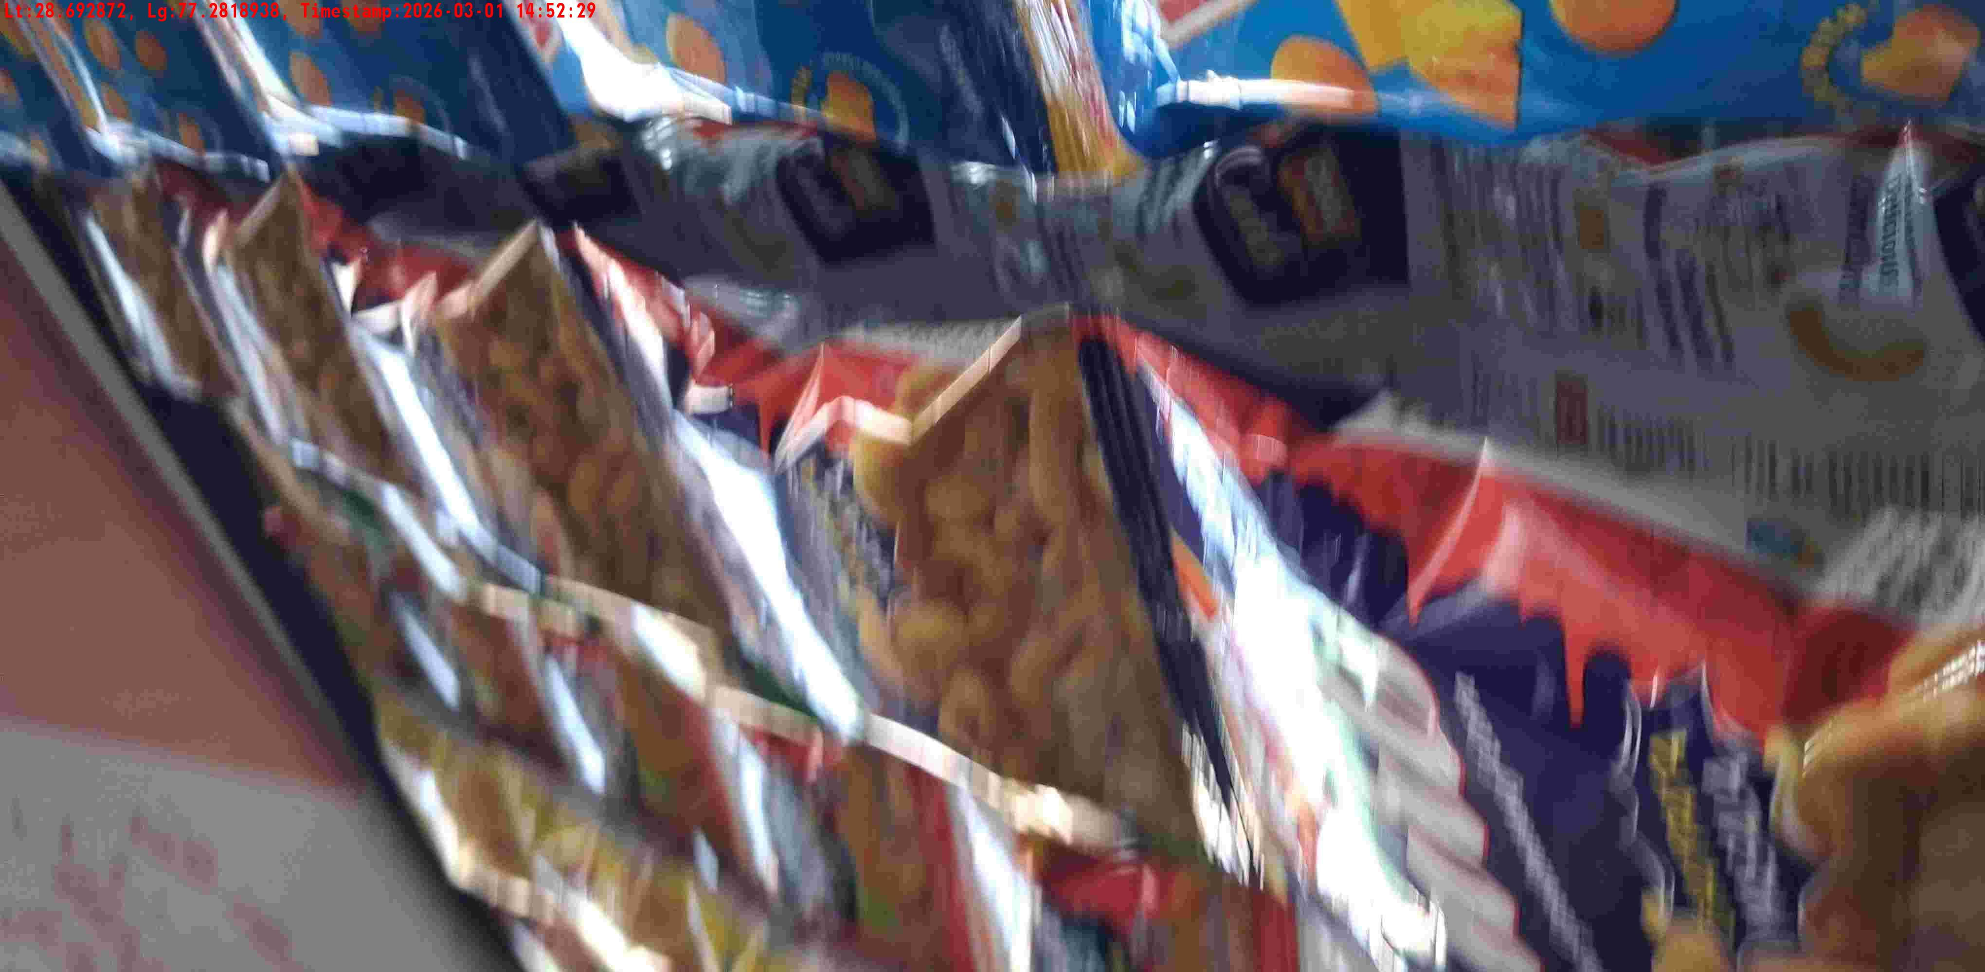
WD Code | DS Id | DS Name | Route Name | Shop Name | Date Time
DE5142 | 328 | YOGESH | Babarpur | VIVAN GEN STORE | 01-03-2026 02:51:23 PM
Shop Inside Picture
Shop Front Picture

Slide 14
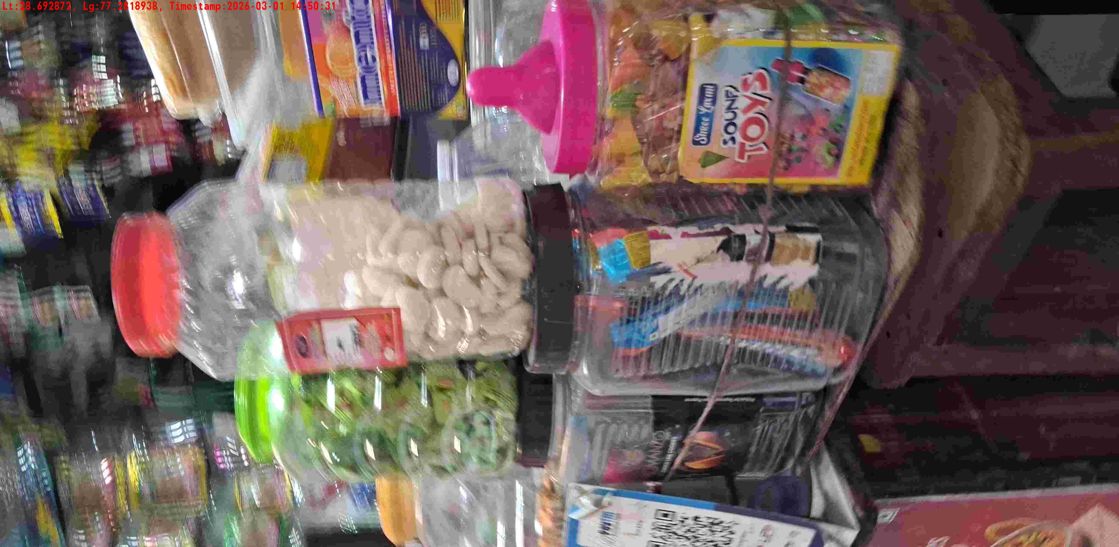
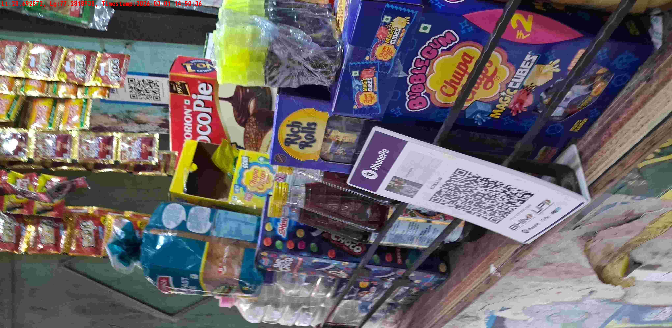
WD Code | DS Id | DS Name | Route Name | Shop Name | Date Time
DE5142 | 328 | YOGESH | Babarpur | VIVAN GEN STORE | 01-03-2026 02:50:29 PM
Shop Inside Picture
Shop Front Picture

Slide 15
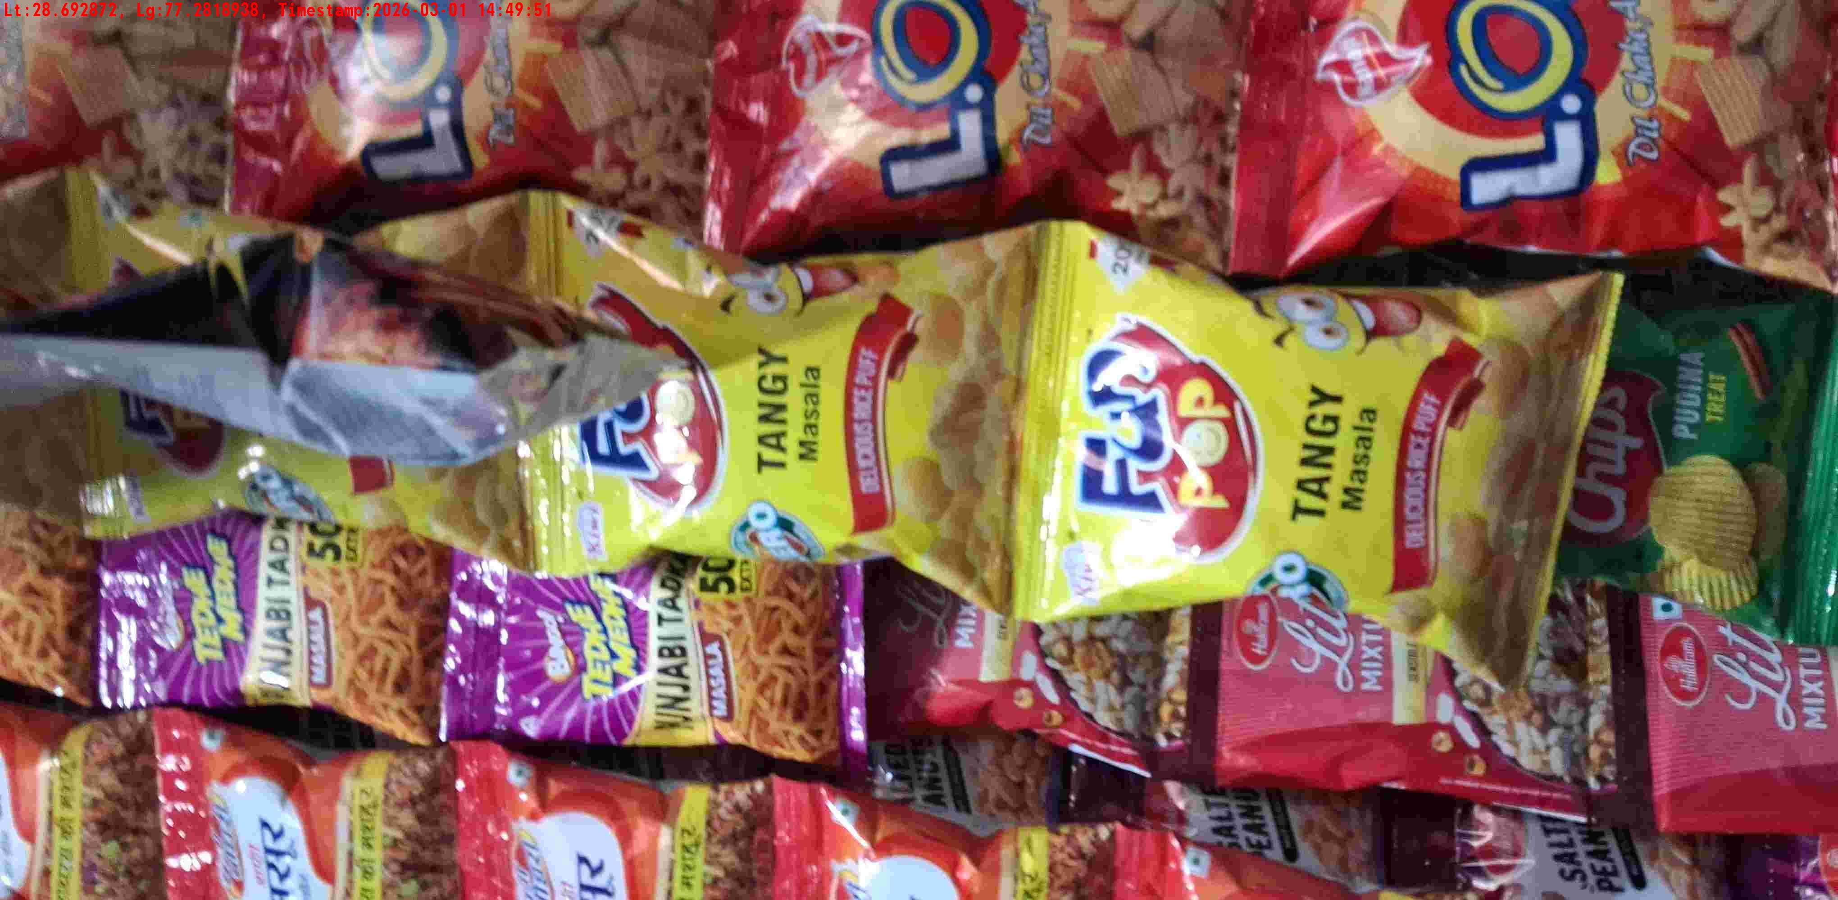
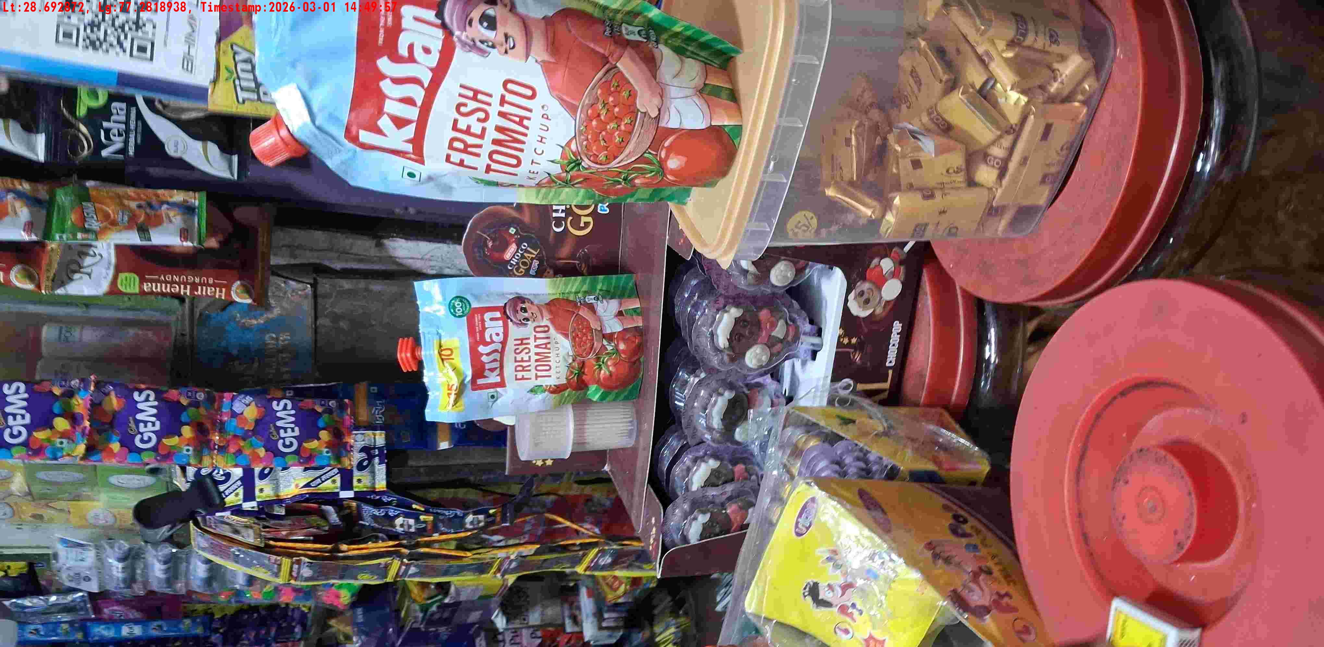
WD Code | DS Id | DS Name | Route Name | Shop Name | Date Time
DE5142 | 328 | YOGESH | West Jyoti Nagar | SANDEEP GEN STORE | 01-03-2026 02:49:44 PM
Shop Inside Picture
Shop Front Picture

Slide 16
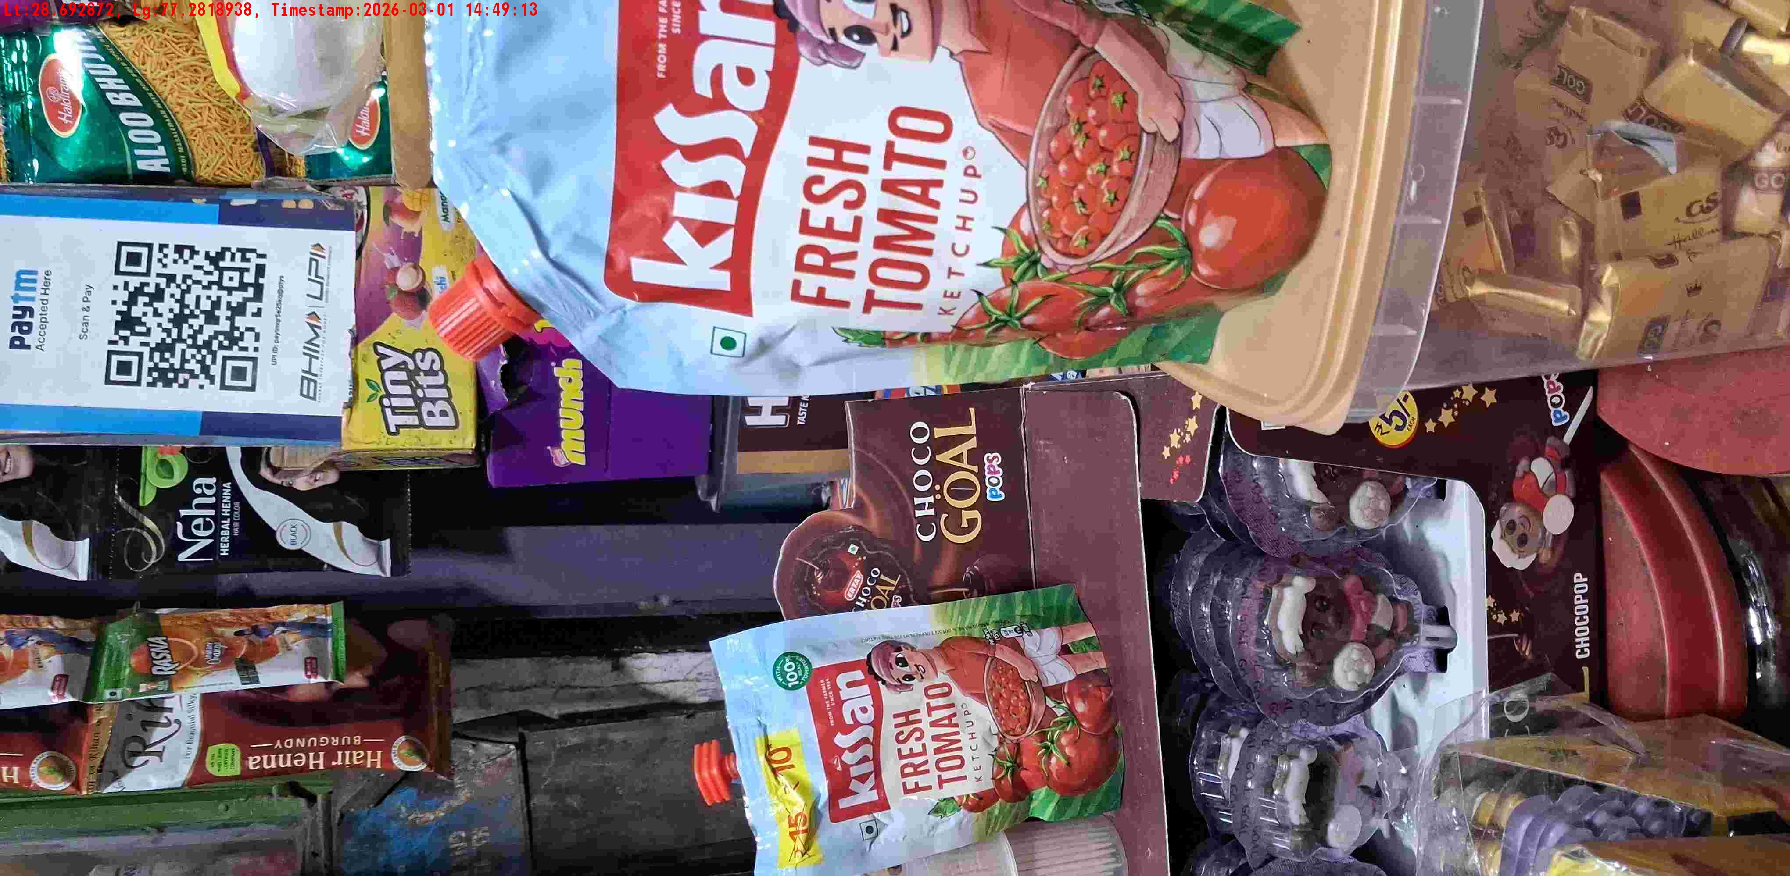
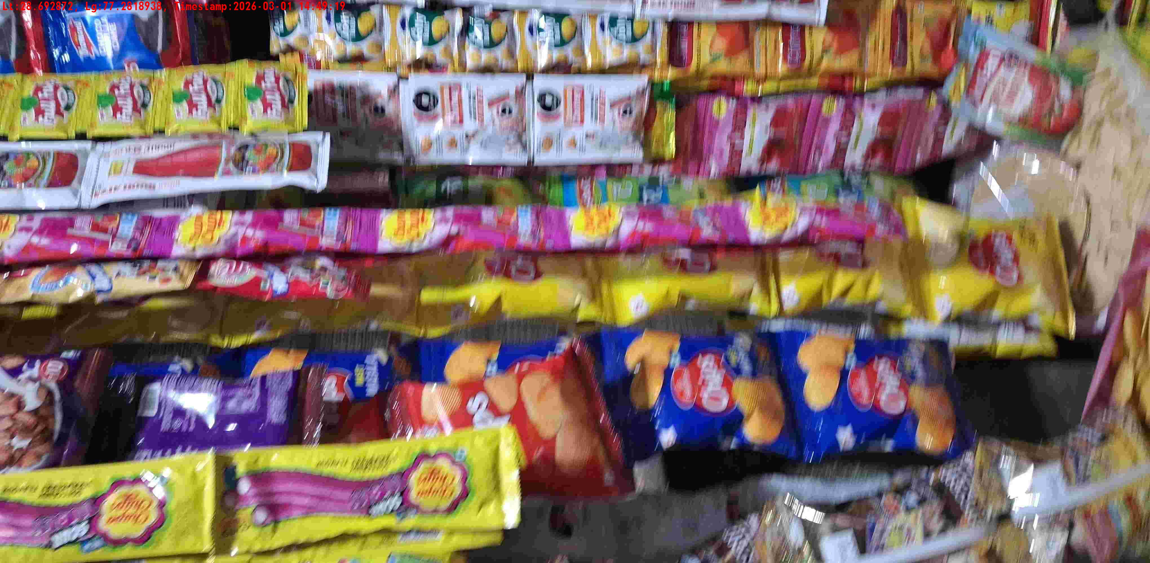
WD Code | DS Id | DS Name | Route Name | Shop Name | Date Time
DE5142 | 328 | YOGESH | West Jyoti Nagar | SANDEEP GEN STORE | 01-03-2026 02:49:10 PM
Shop Inside Picture
Shop Front Picture

Slide 17
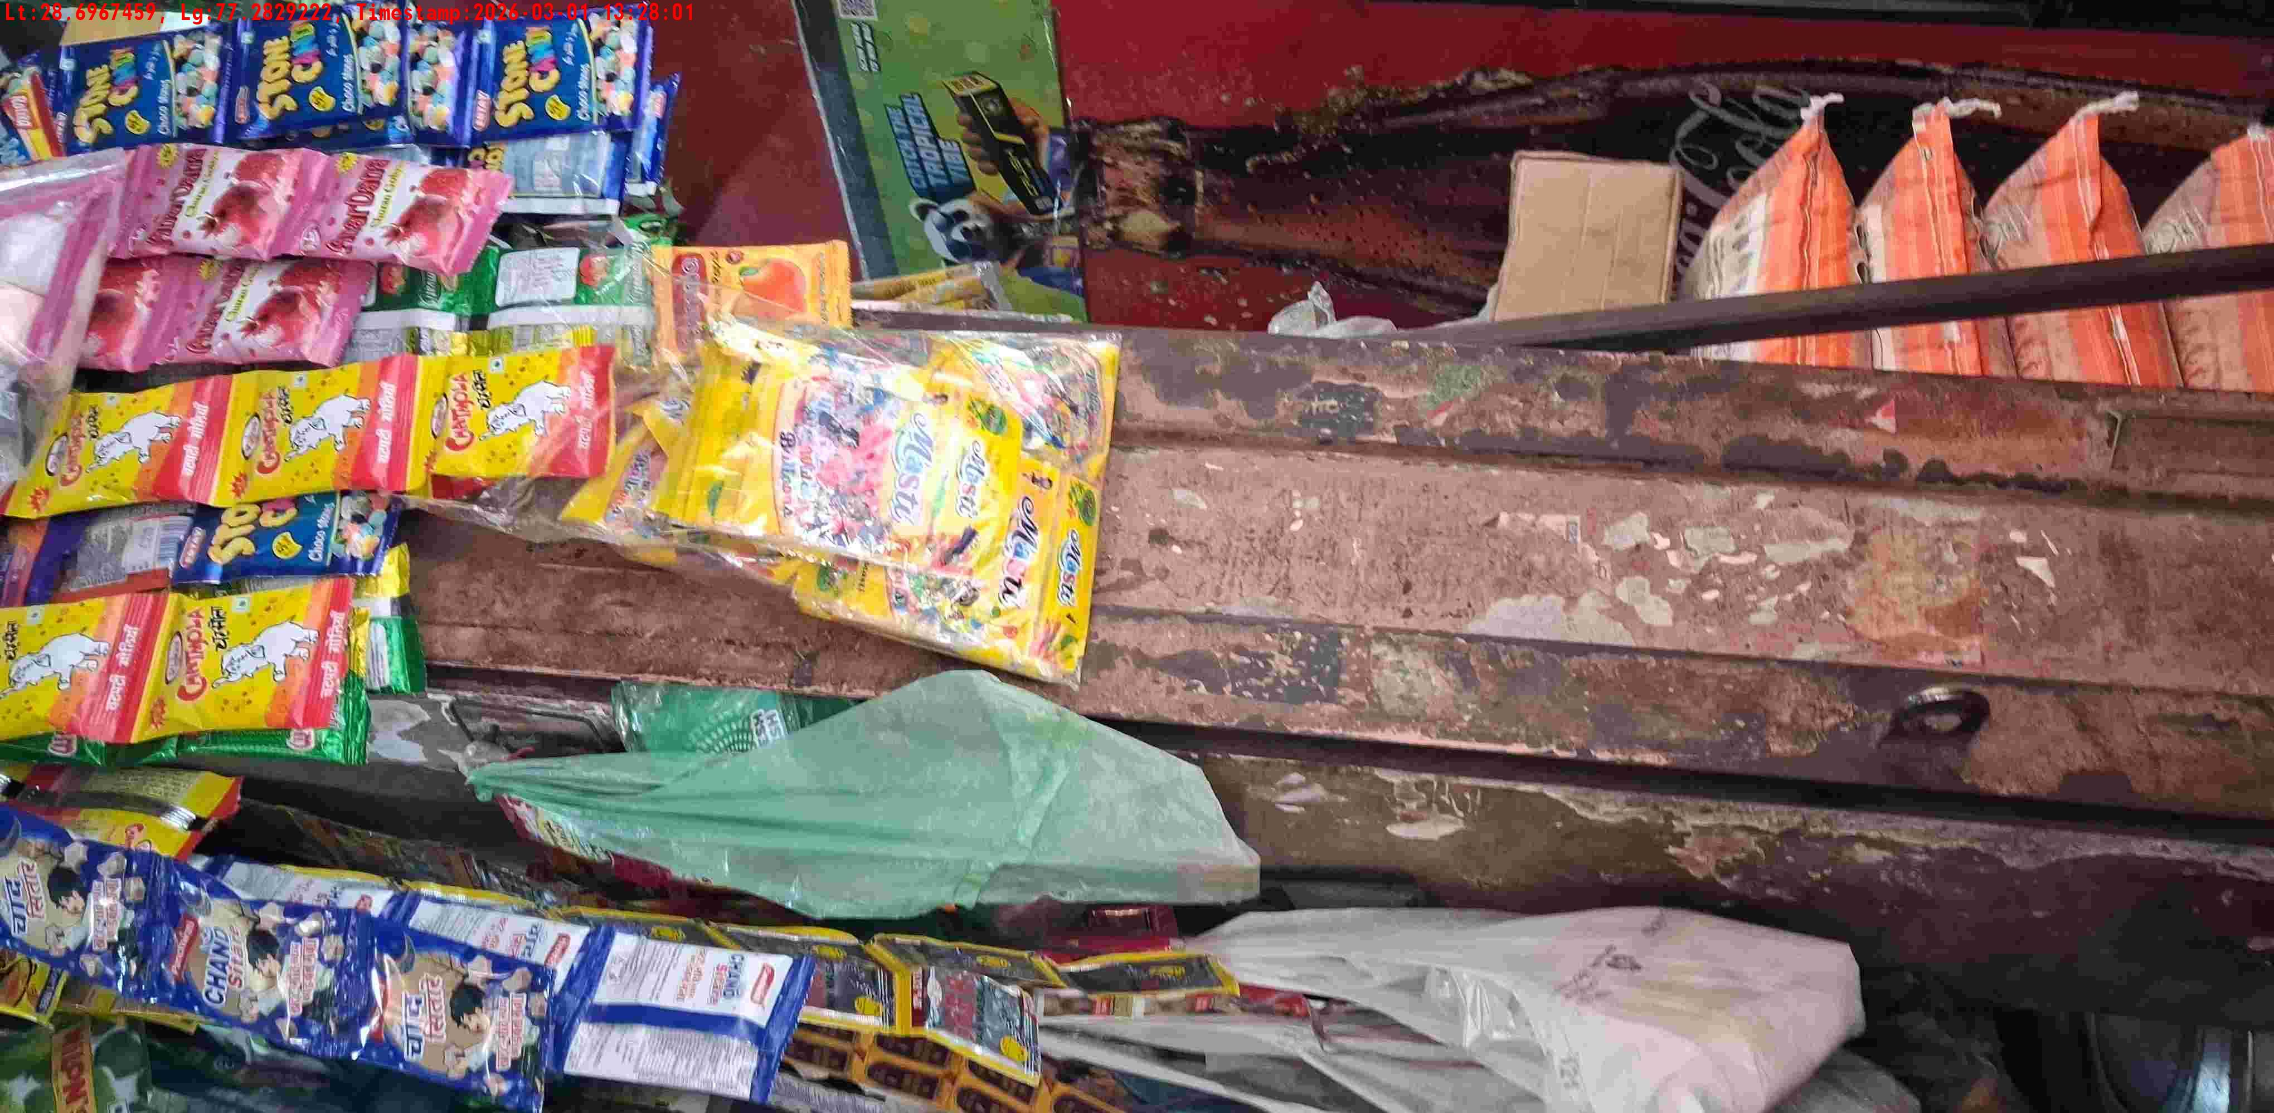
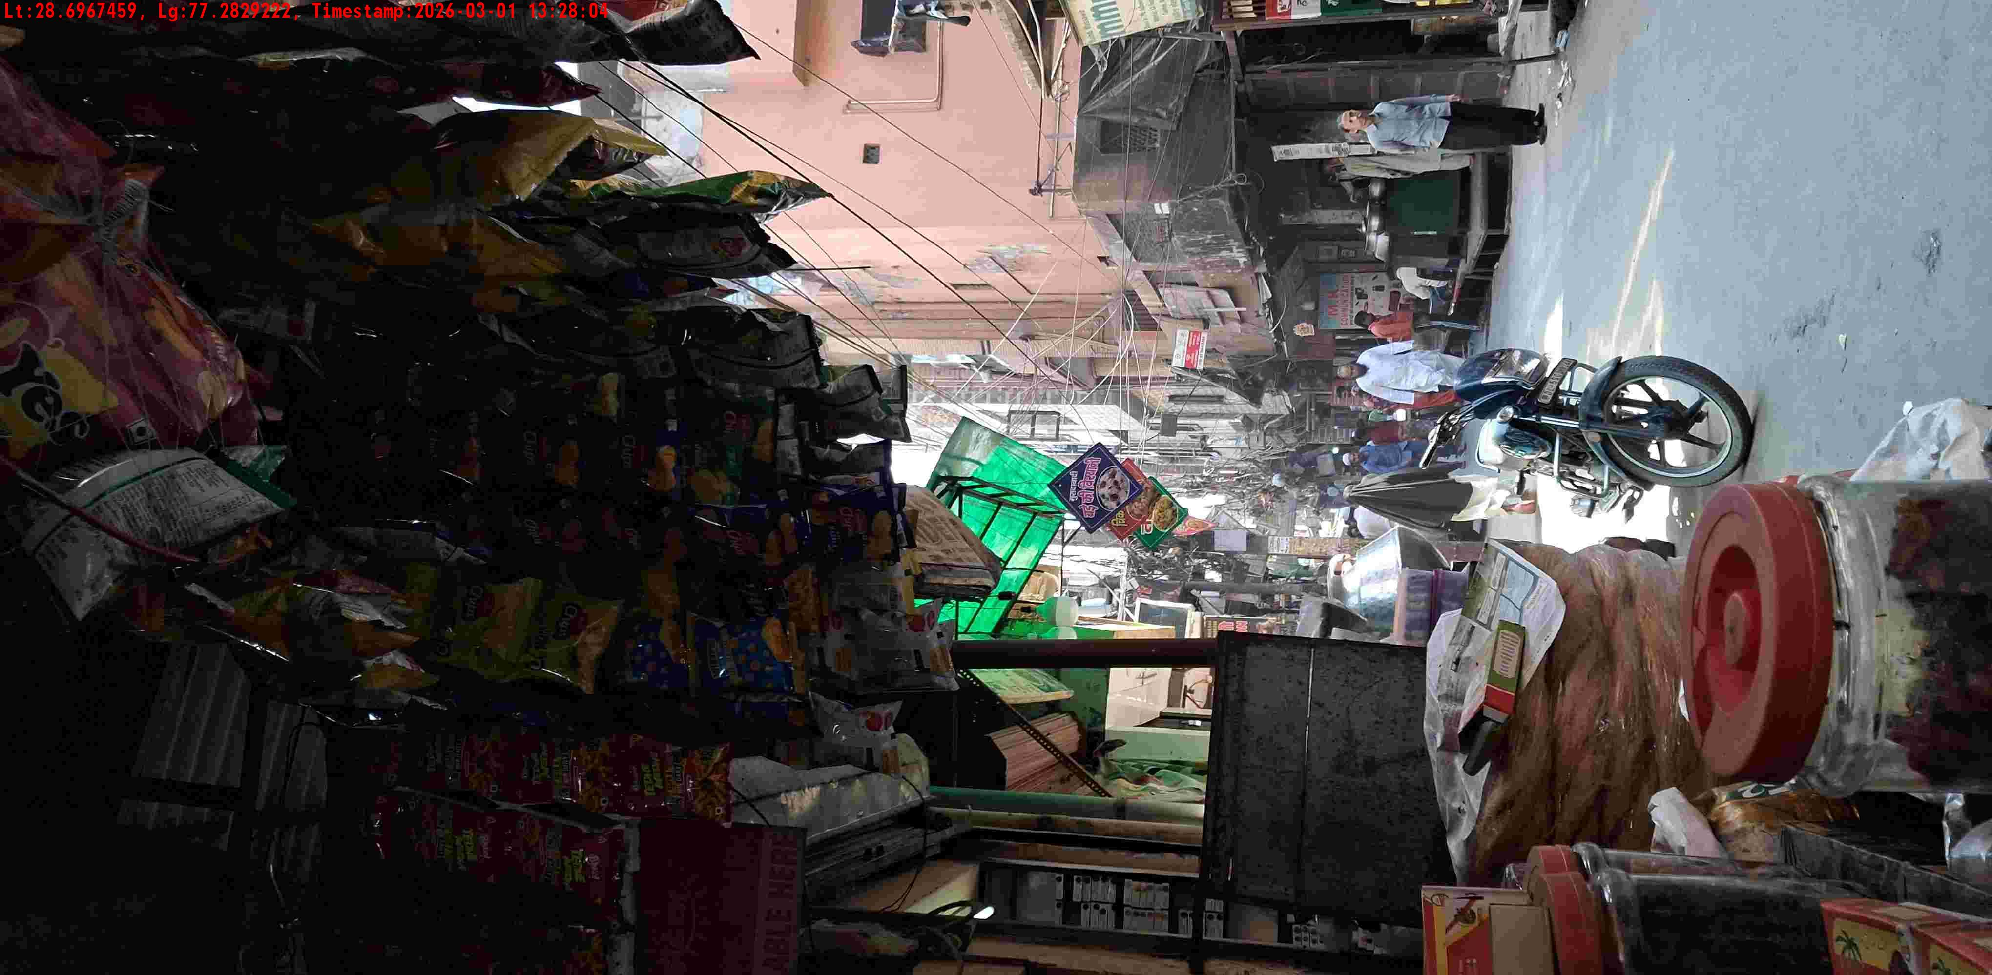
WD Code | DS Id | DS Name | Route Name | Shop Name | Date Time
DE5142 | 328 | YOGESH | West Jyoti Nagar | GOYAL STORE JYOTI COLONY | 01-03-2026 01:27:59 PM
Shop Inside Picture
Shop Front Picture

Slide 18
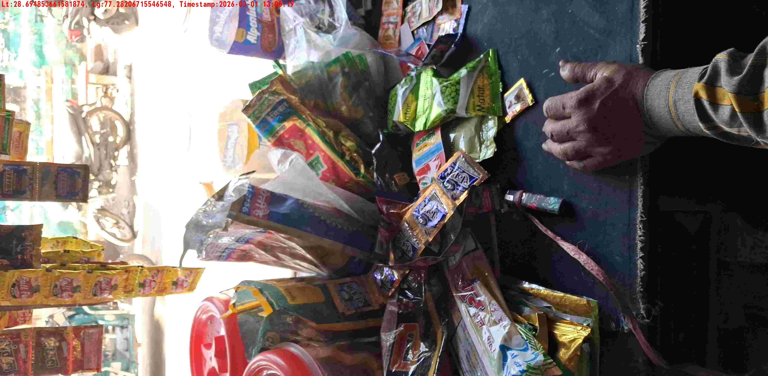
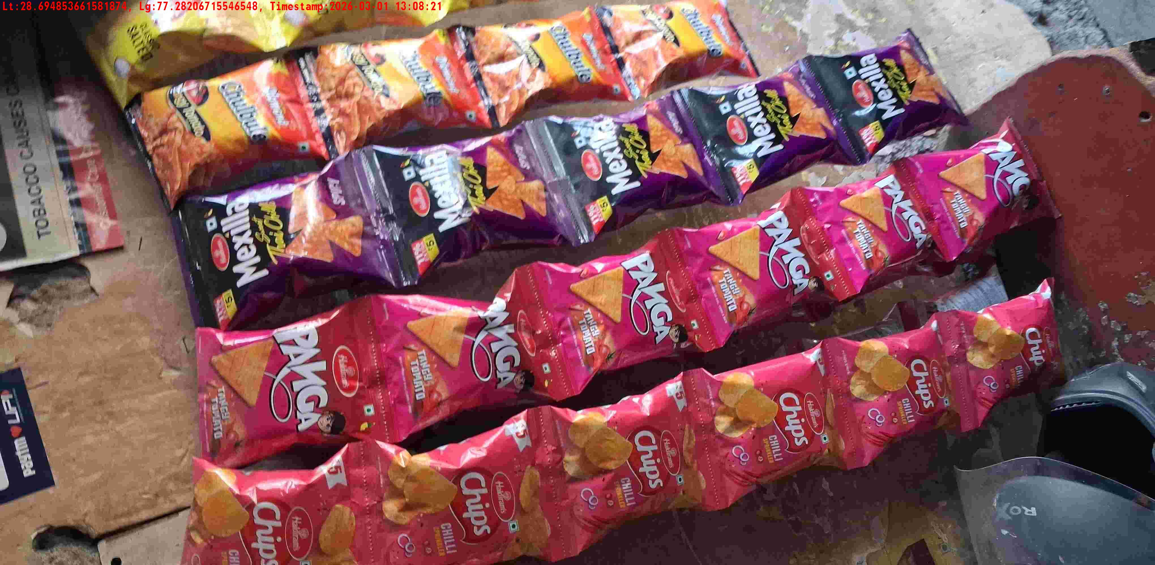
WD Code | DS Id | DS Name | Route Name | Shop Name | Date Time
DE5142 | 328 | YOGESH | Mandoli Road | JINDAL STORE | 01-03-2026 01:08:16 PM
Shop Inside Picture
Shop Front Picture

Slide 19
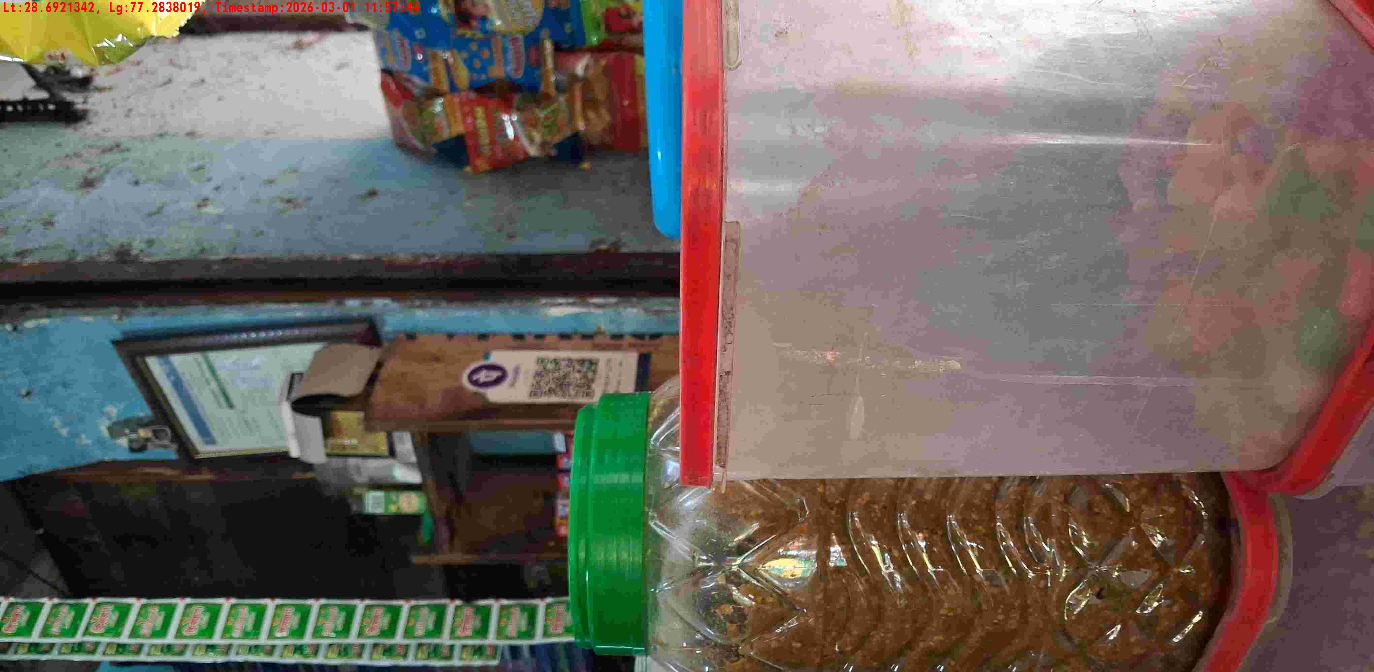
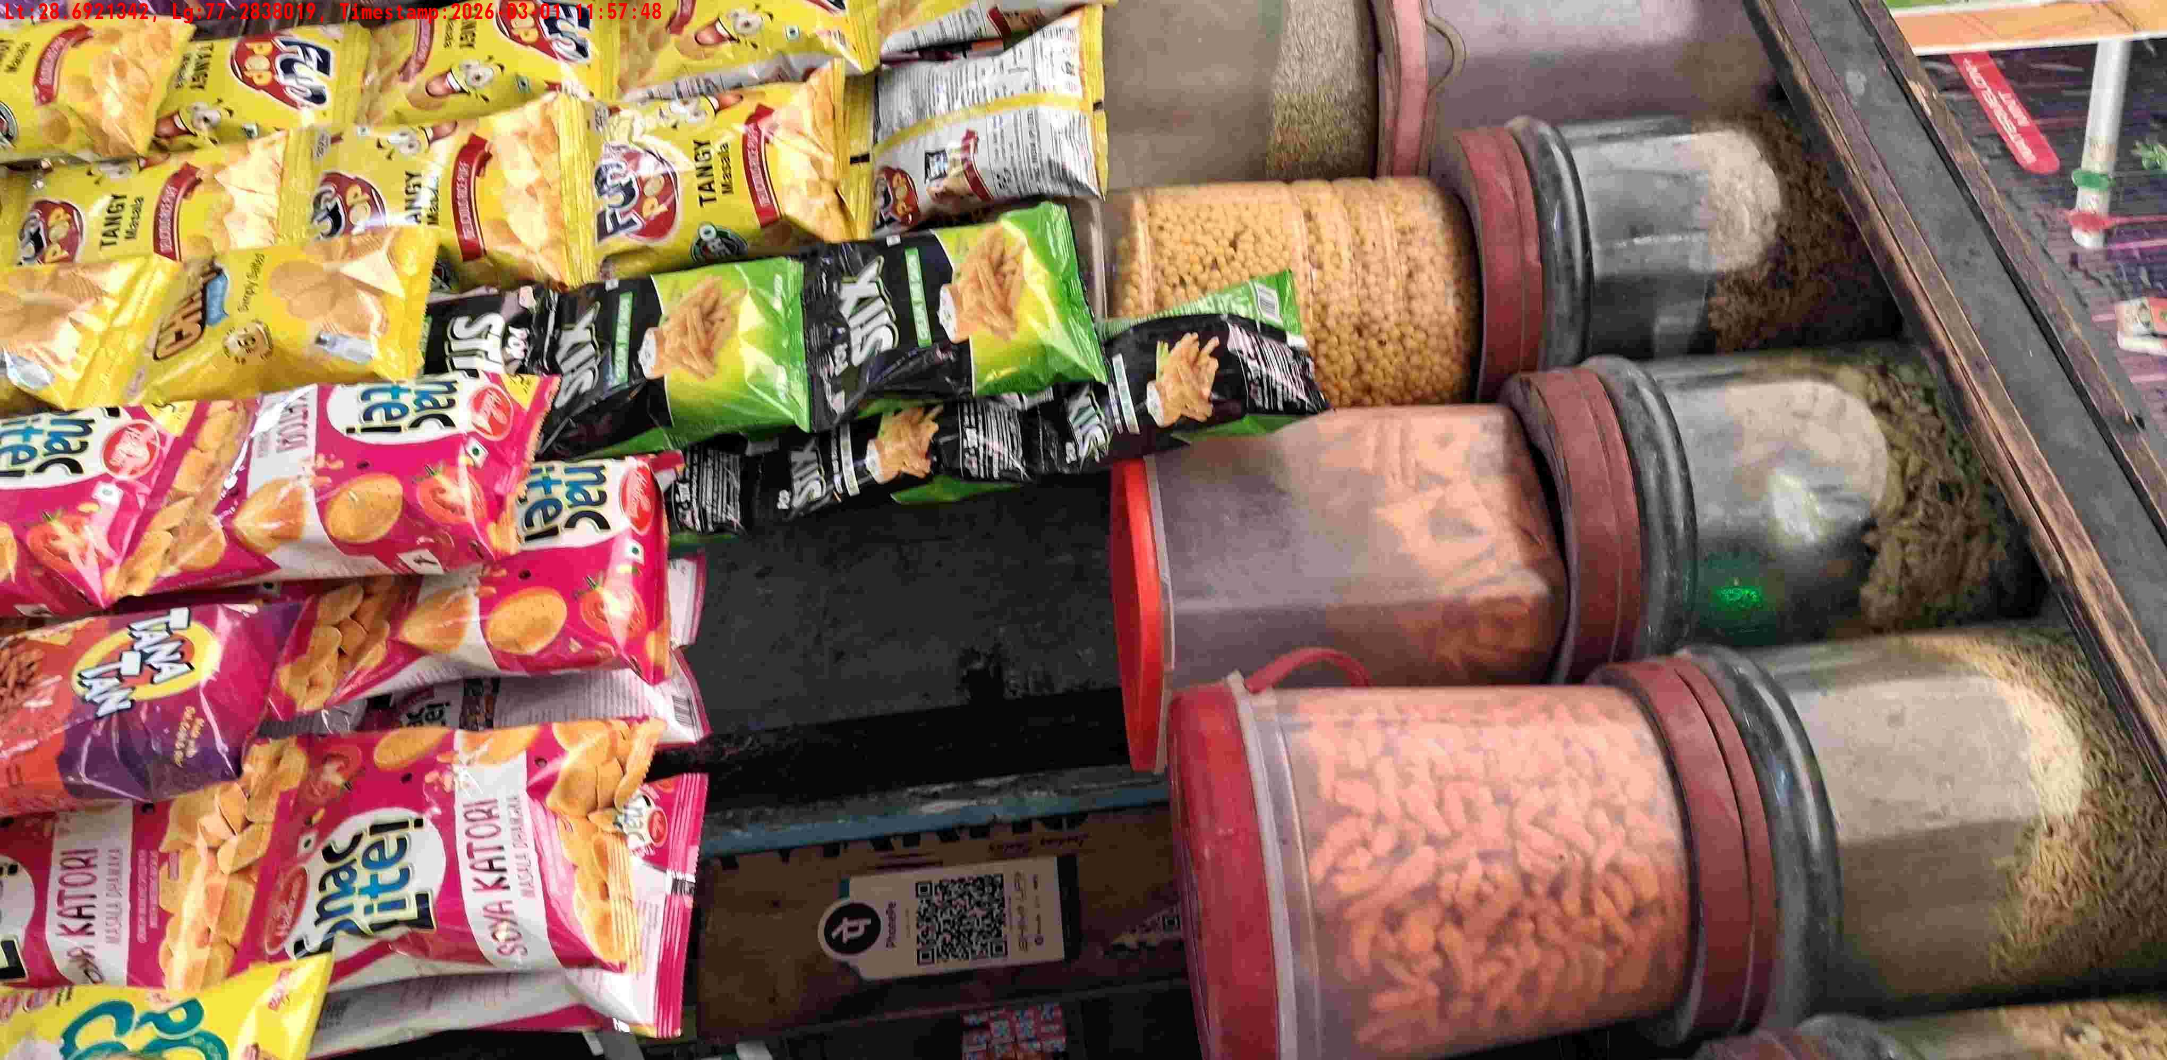
WD Code | DS Id | DS Name | Route Name | Shop Name | Date Time
DE5142 | 328 | YOGESH | West Jyoti Nagar | GOYAL STORE JYOTI COLONY | 01-03-2026 11:57:42 AM
Shop Inside Picture
Shop Front Picture

Slide 20
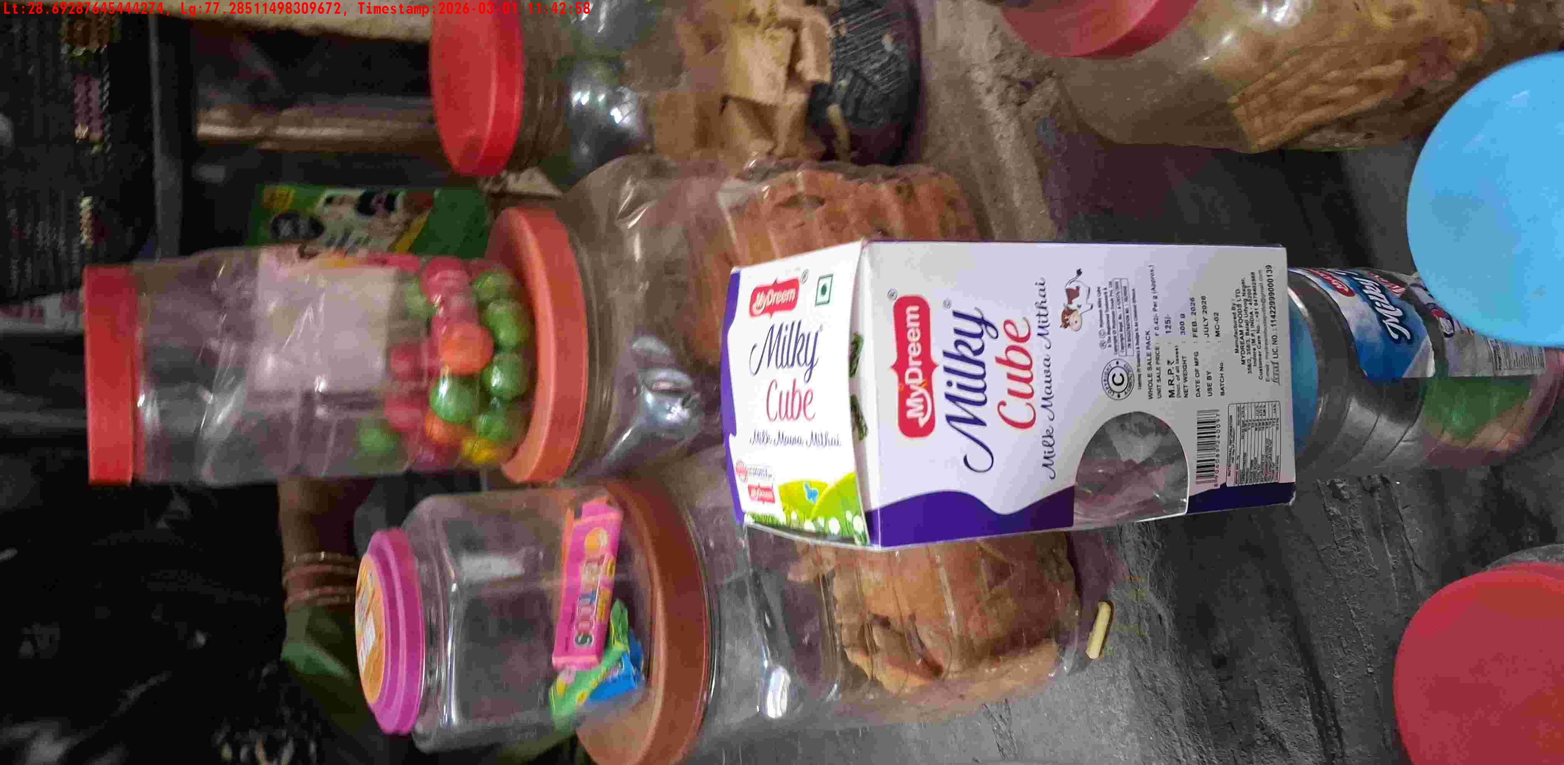
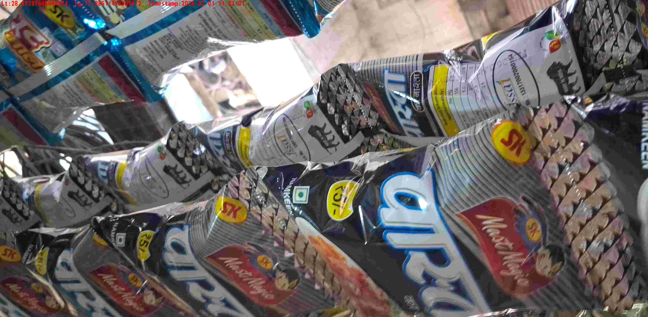
WD Code | DS Id | DS Name | Route Name | Shop Name | Date Time
DE5142 | 328 | YOGESH | West Jyoti Nagar | GORELAL PAN | 01-03-2026 11:42:55 AM
Shop Inside Picture
Shop Front Picture

Slide 21
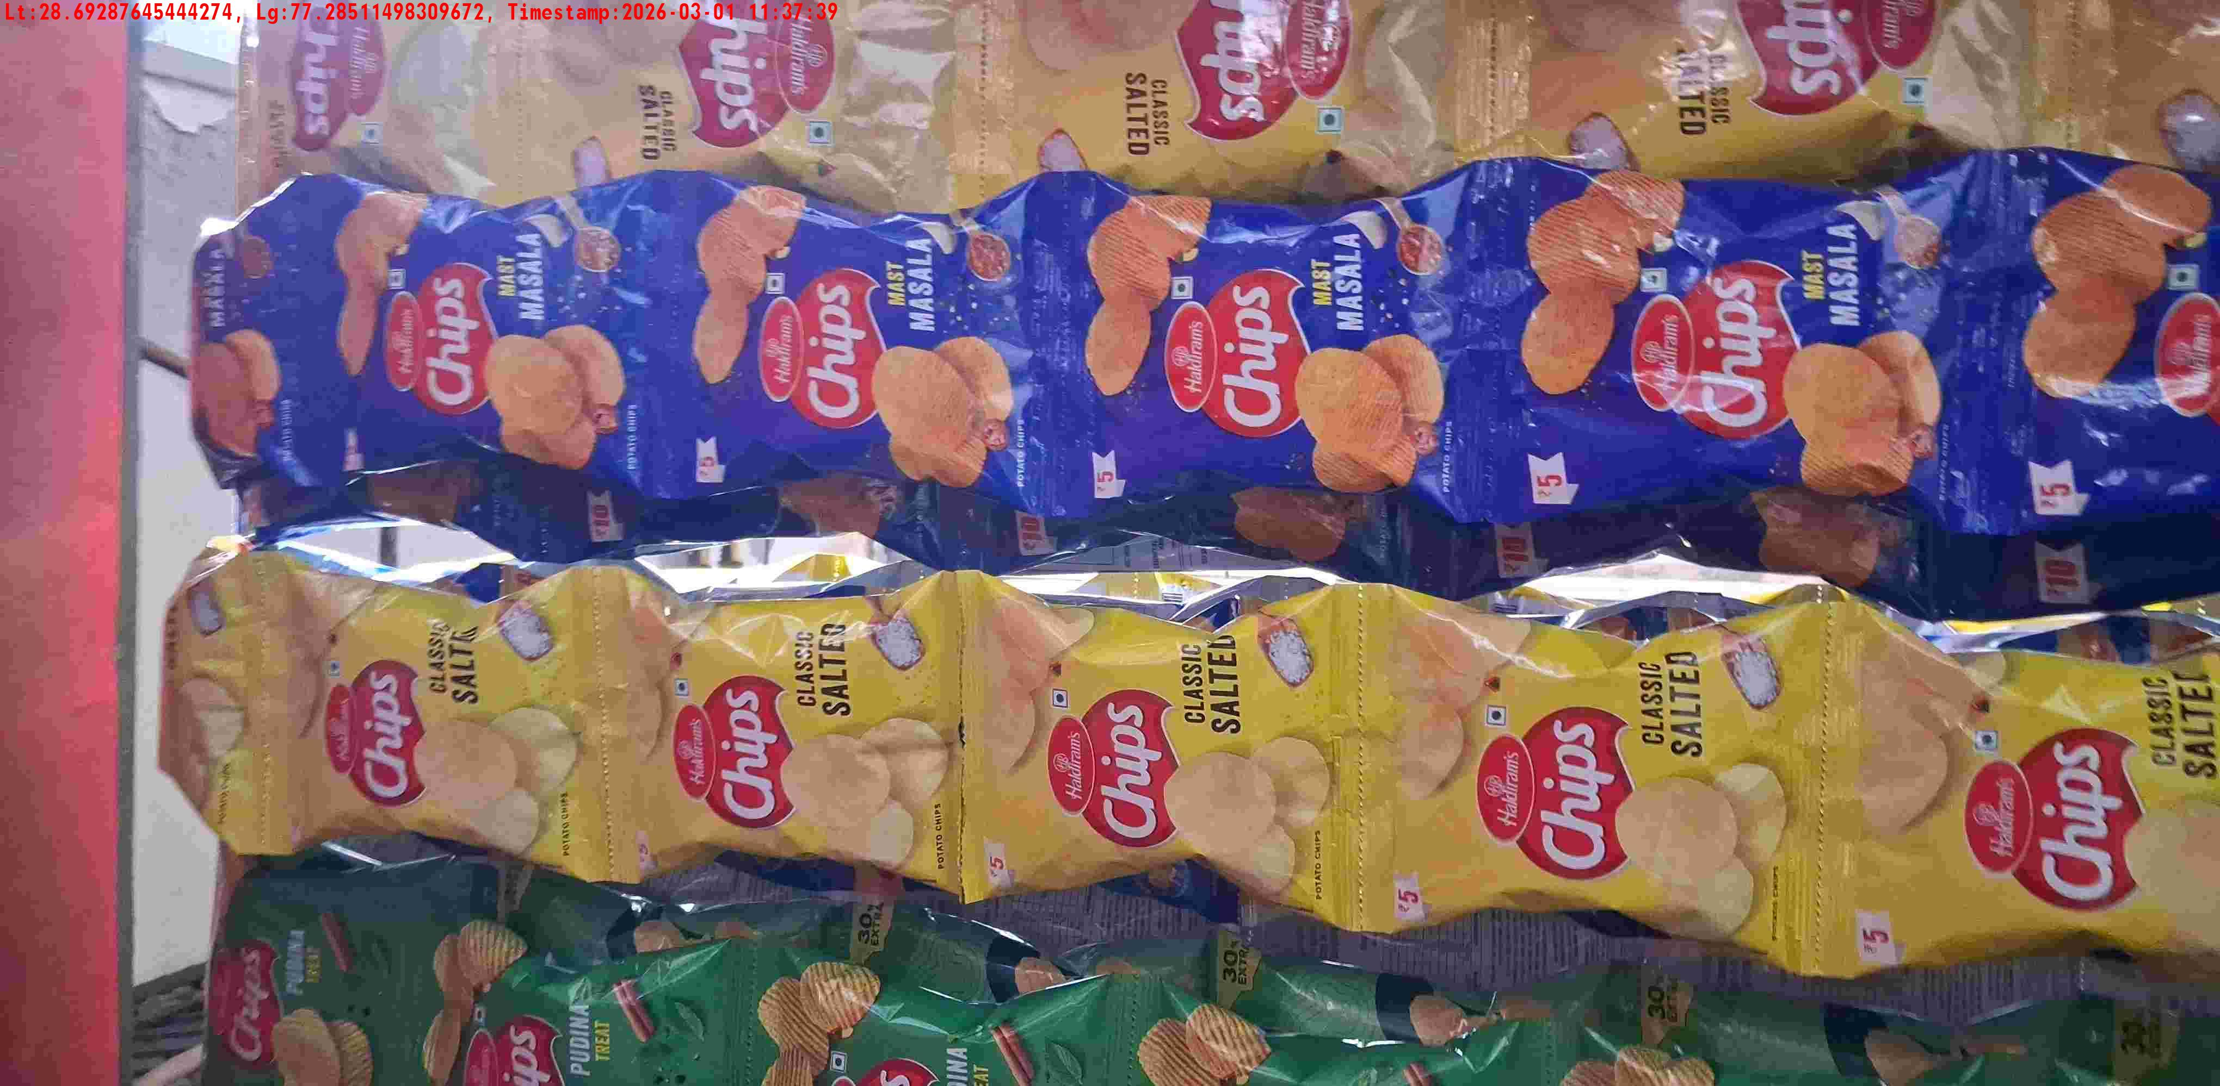
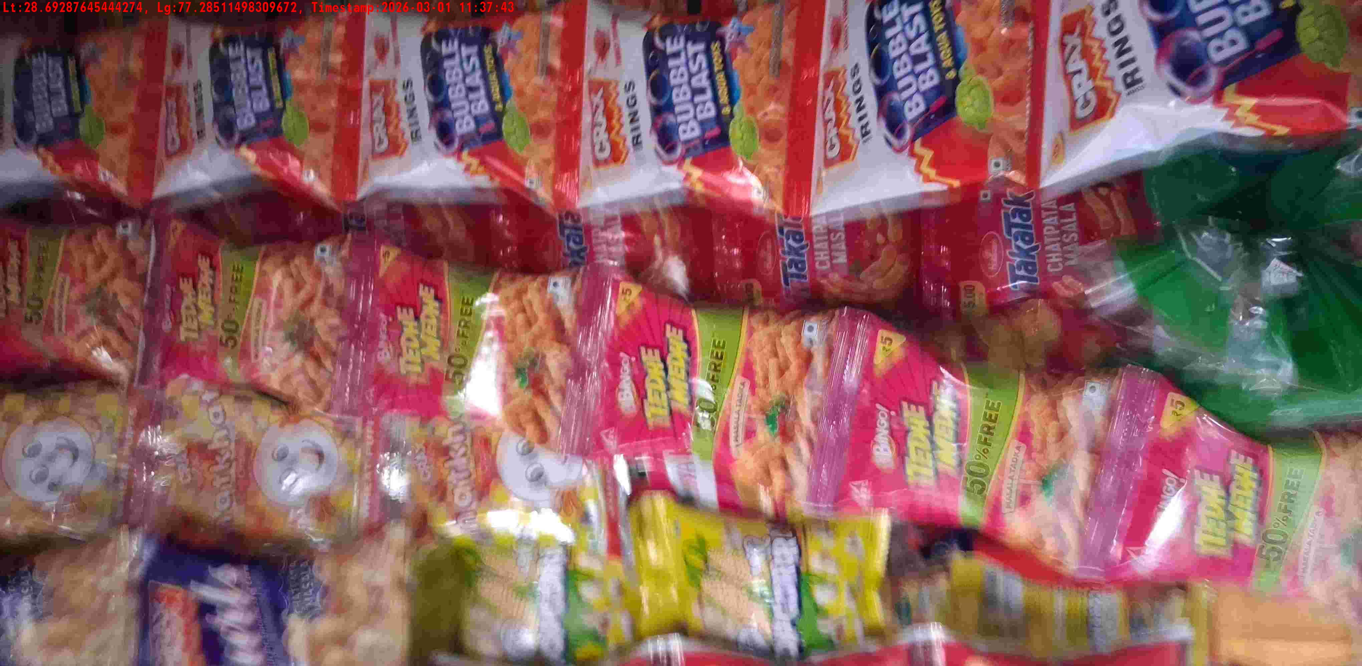
WD Code | DS Id | DS Name | Route Name | Shop Name | Date Time
DE5142 | 328 | YOGESH | West Jyoti Nagar | GOPAL GEN STORE | 01-03-2026 11:37:37 AM
Shop Inside Picture
Shop Front Picture

Slide 22
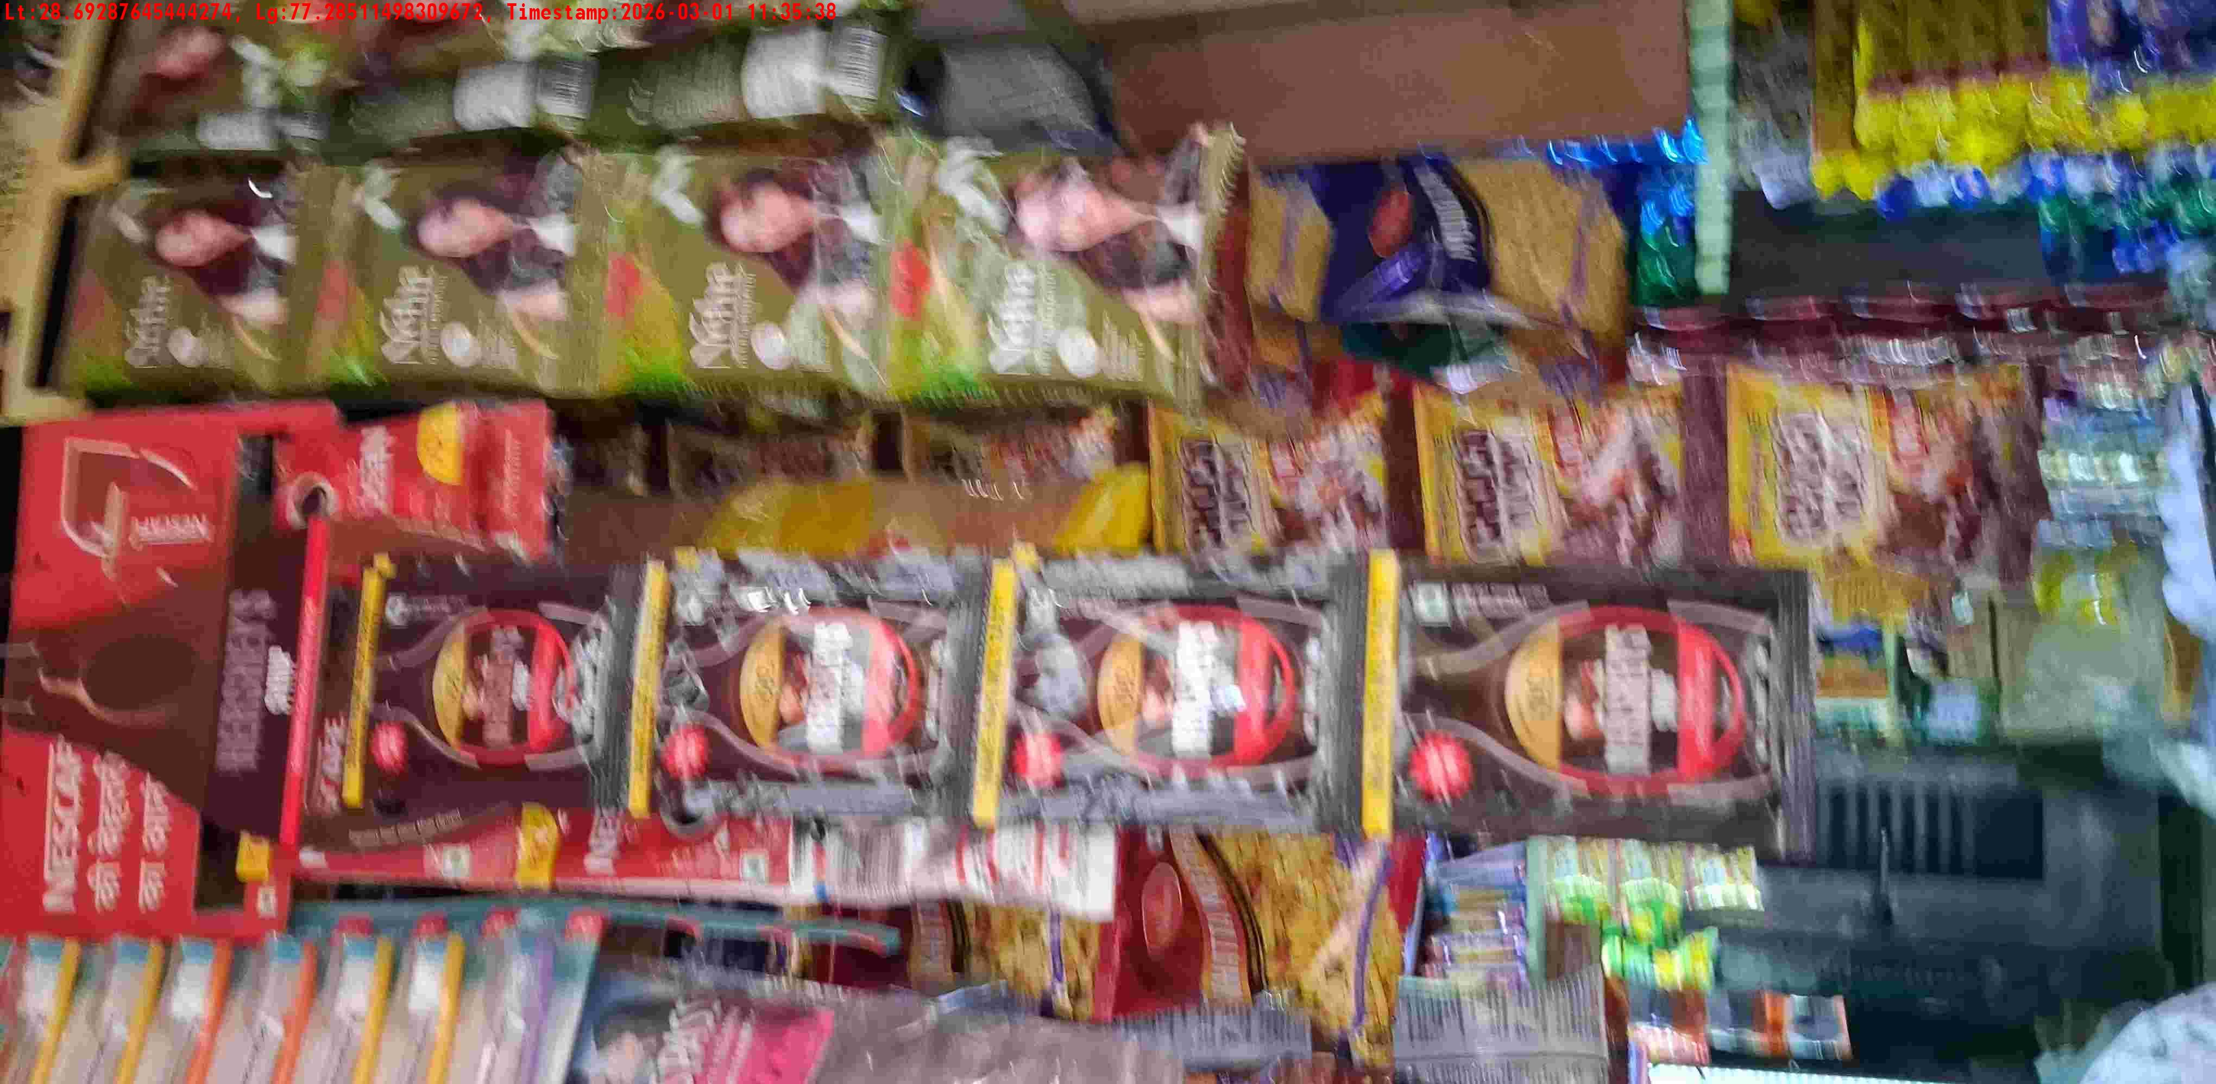
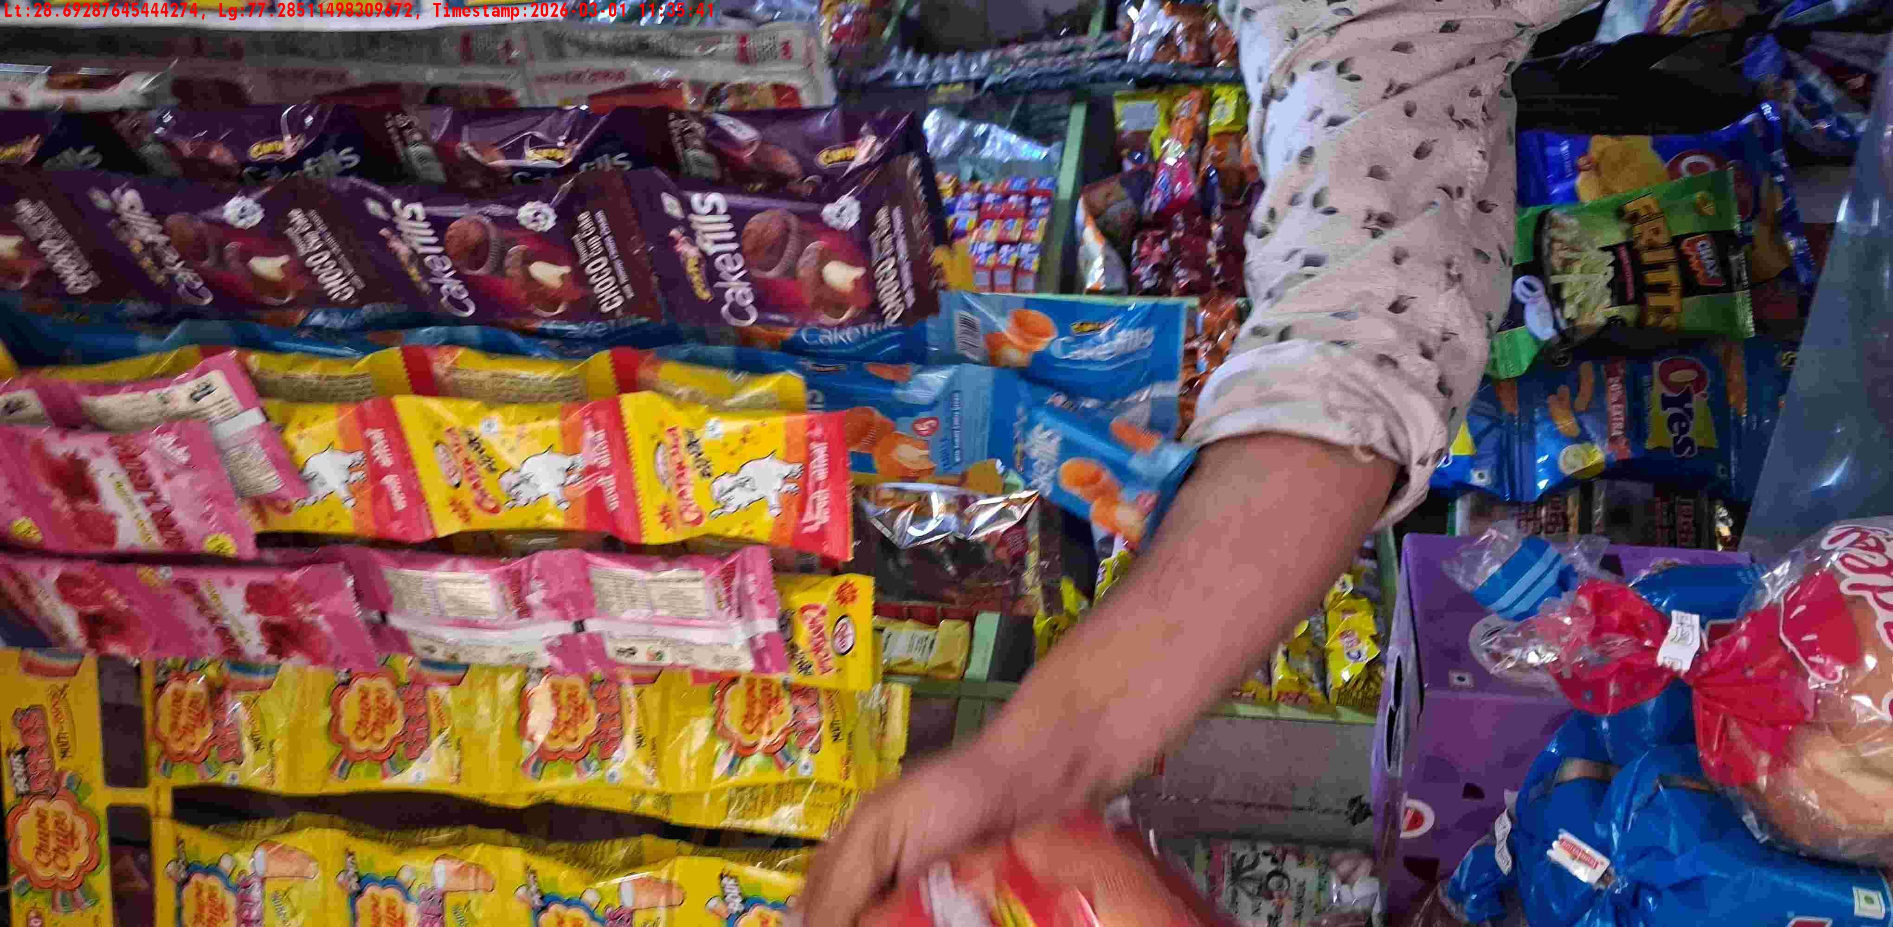
WD Code | DS Id | DS Name | Route Name | Shop Name | Date Time
DE5142 | 328 | YOGESH | West Jyoti Nagar | CHOUHAN GEN STORE | 01-03-2026 11:35:36 AM
Shop Inside Picture
Shop Front Picture

Slide 23
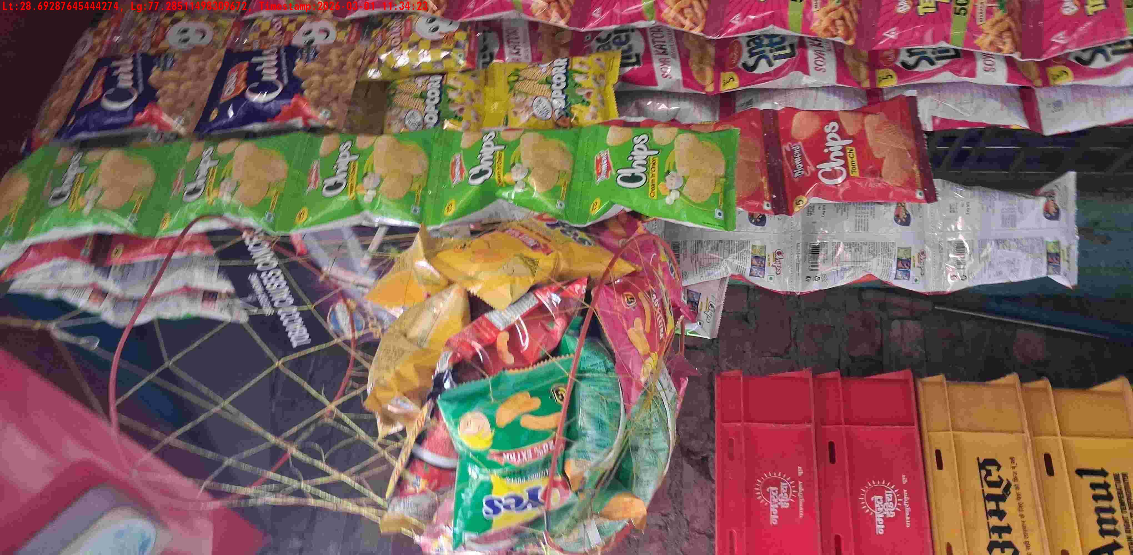
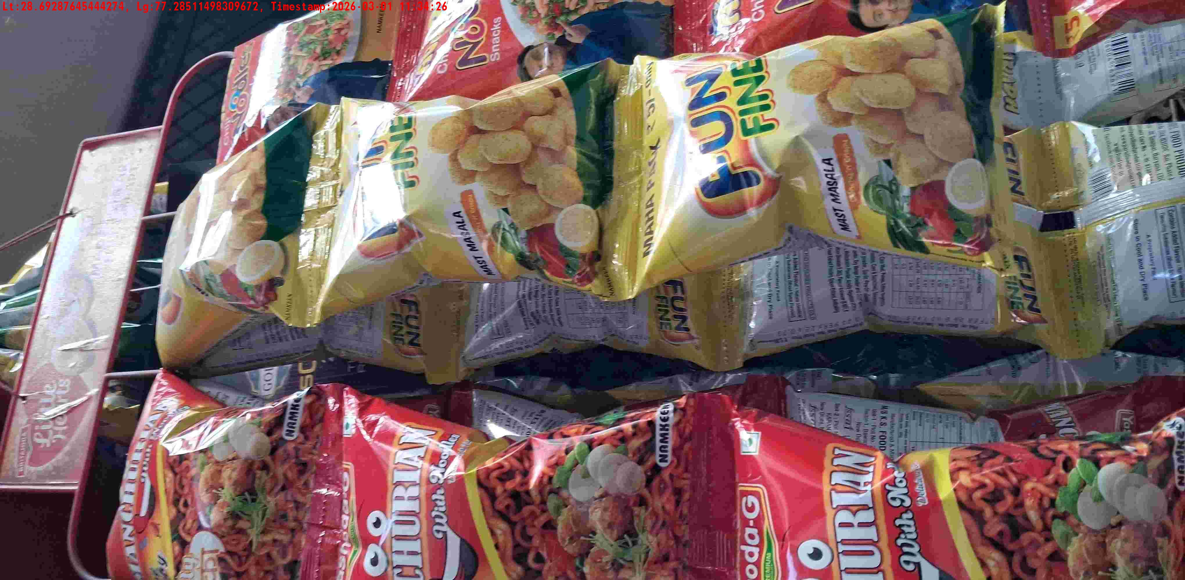
WD Code | DS Id | DS Name | Route Name | Shop Name | Date Time
DE5142 | 328 | YOGESH | West Jyoti Nagar | AJMAL GENERAL STORE | 01-03-2026 11:34:21 AM
Shop Inside Picture
Shop Front Picture

Slide 24

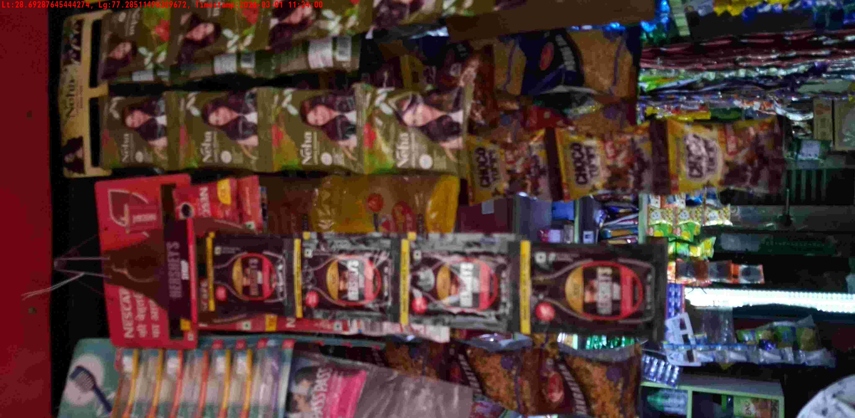
WD Code | DS Id | DS Name | Route Name | Shop Name | Date Time
DE5142 | 328 | YOGESH | West Jyoti Nagar | AHUJA GEN STORE | 01-03-2026 11:33:56 AM
Shop Inside Picture
Shop Front Picture

Slide 25
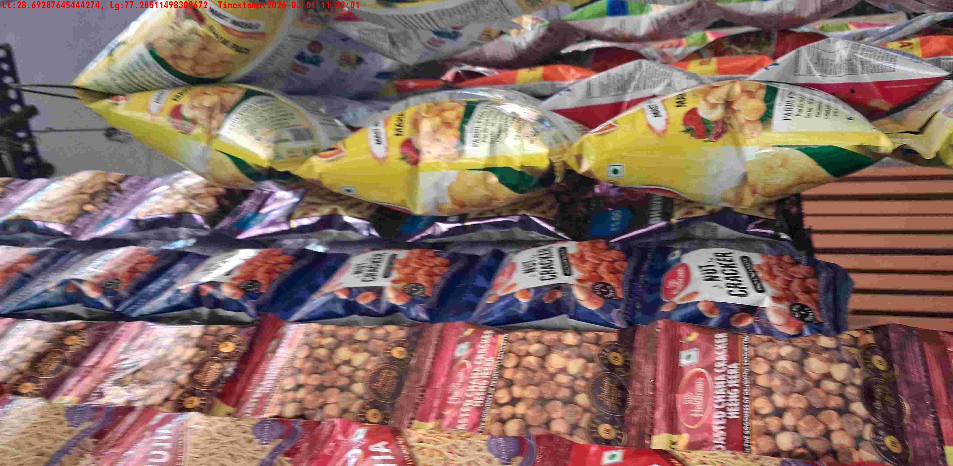
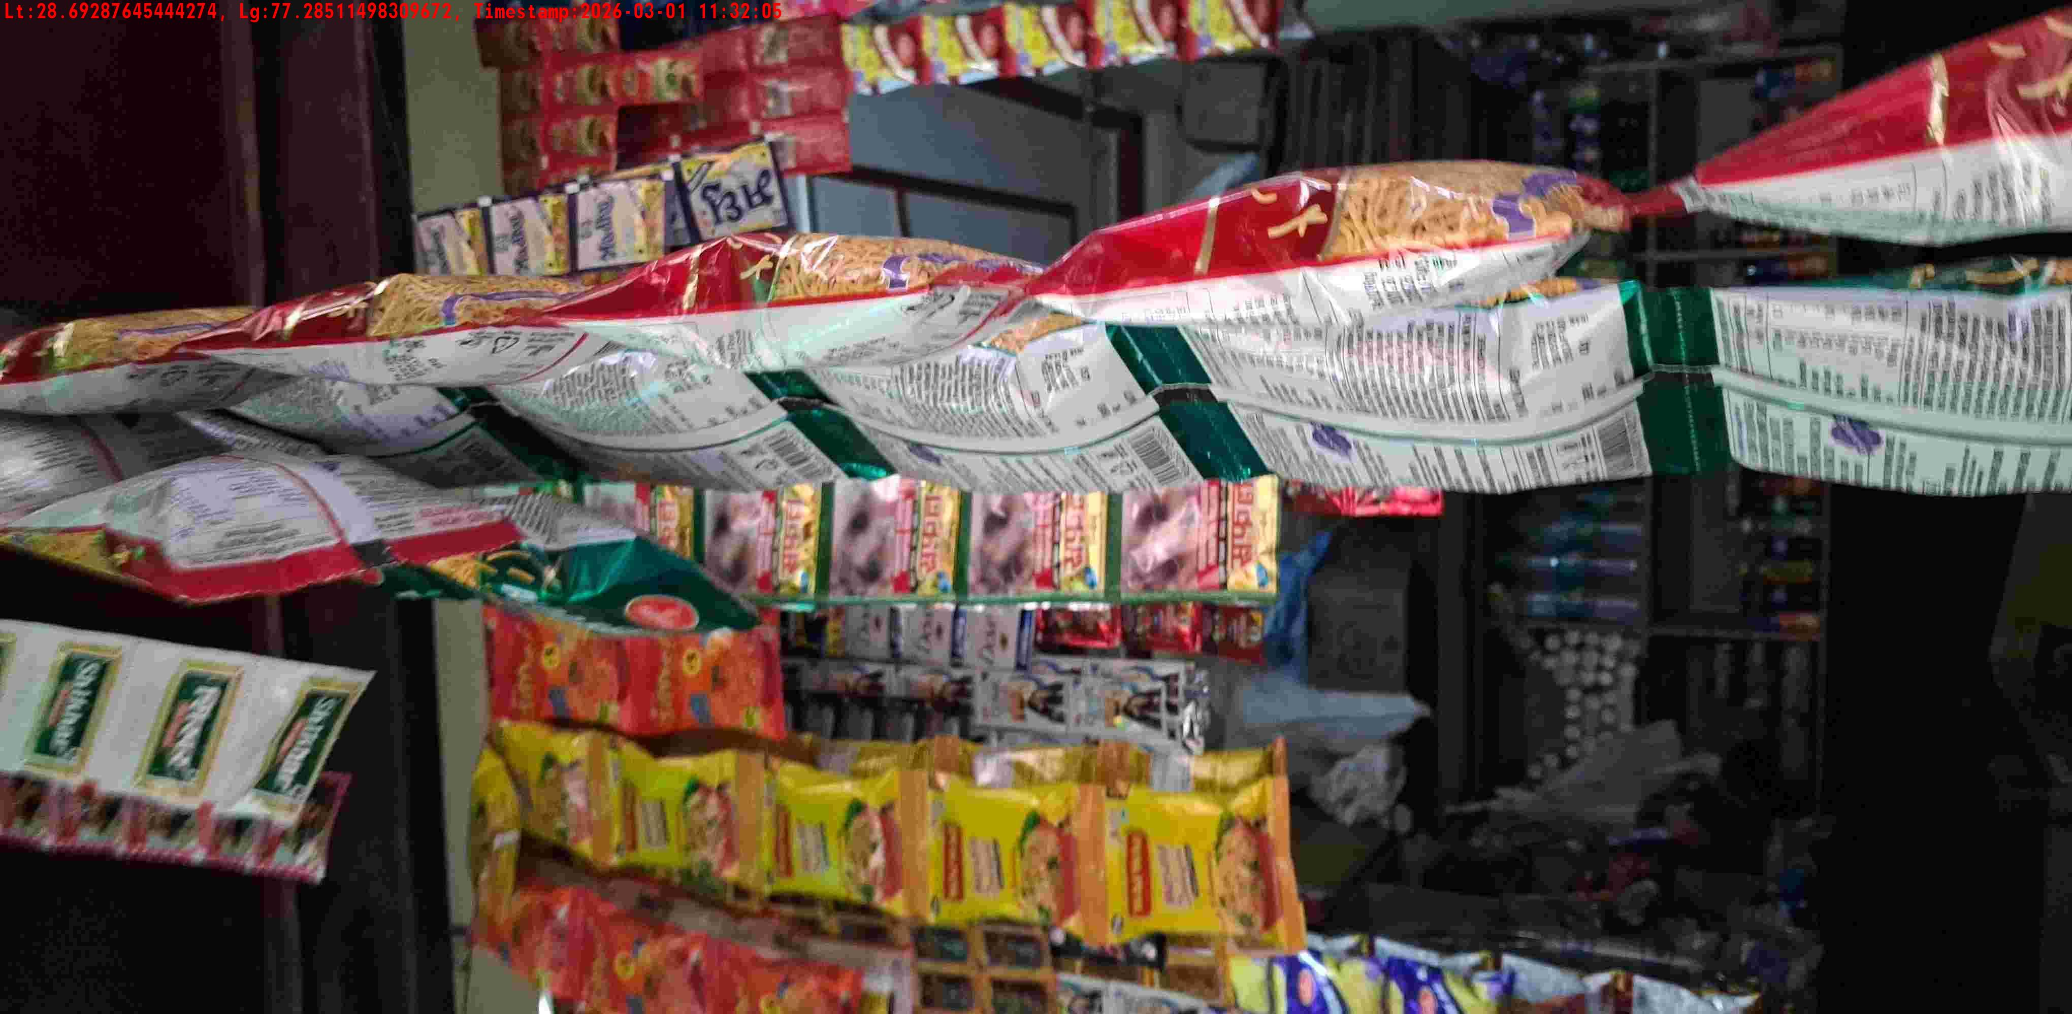
WD Code | DS Id | DS Name | Route Name | Shop Name | Date Time
DE5142 | 328 | YOGESH | West Jyoti Nagar | SHREE G | 01-03-2026 11:31:59 AM
Shop Inside Picture
Shop Front Picture

Slide 26
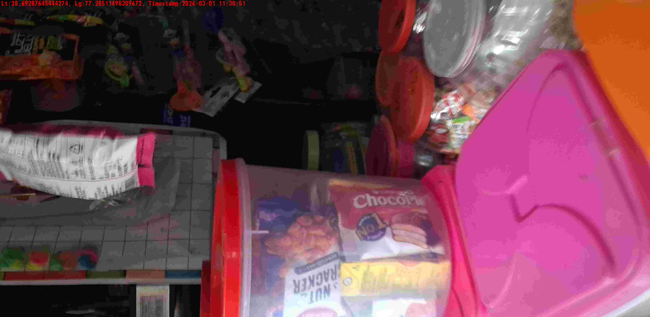
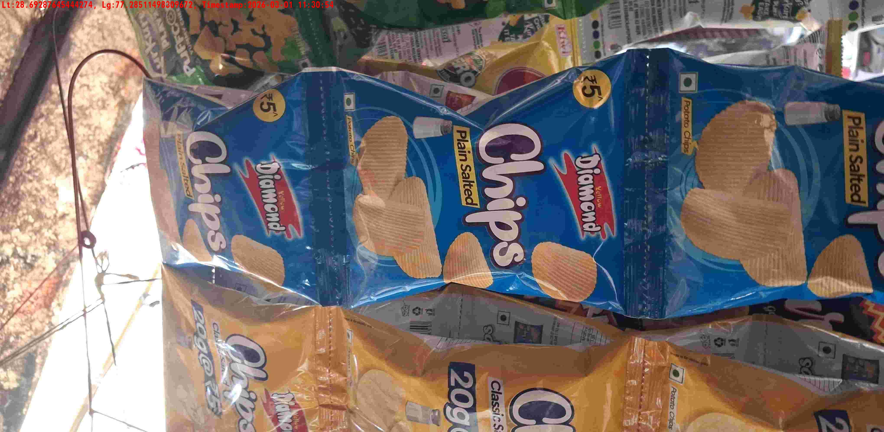
WD Code | DS Id | DS Name | Route Name | Shop Name | Date Time
DE5142 | 328 | YOGESH | West Jyoti Nagar | SHRI SHYAM STORE | 01-03-2026 11:30:49 AM
Shop Inside Picture
Shop Front Picture

Slide 27
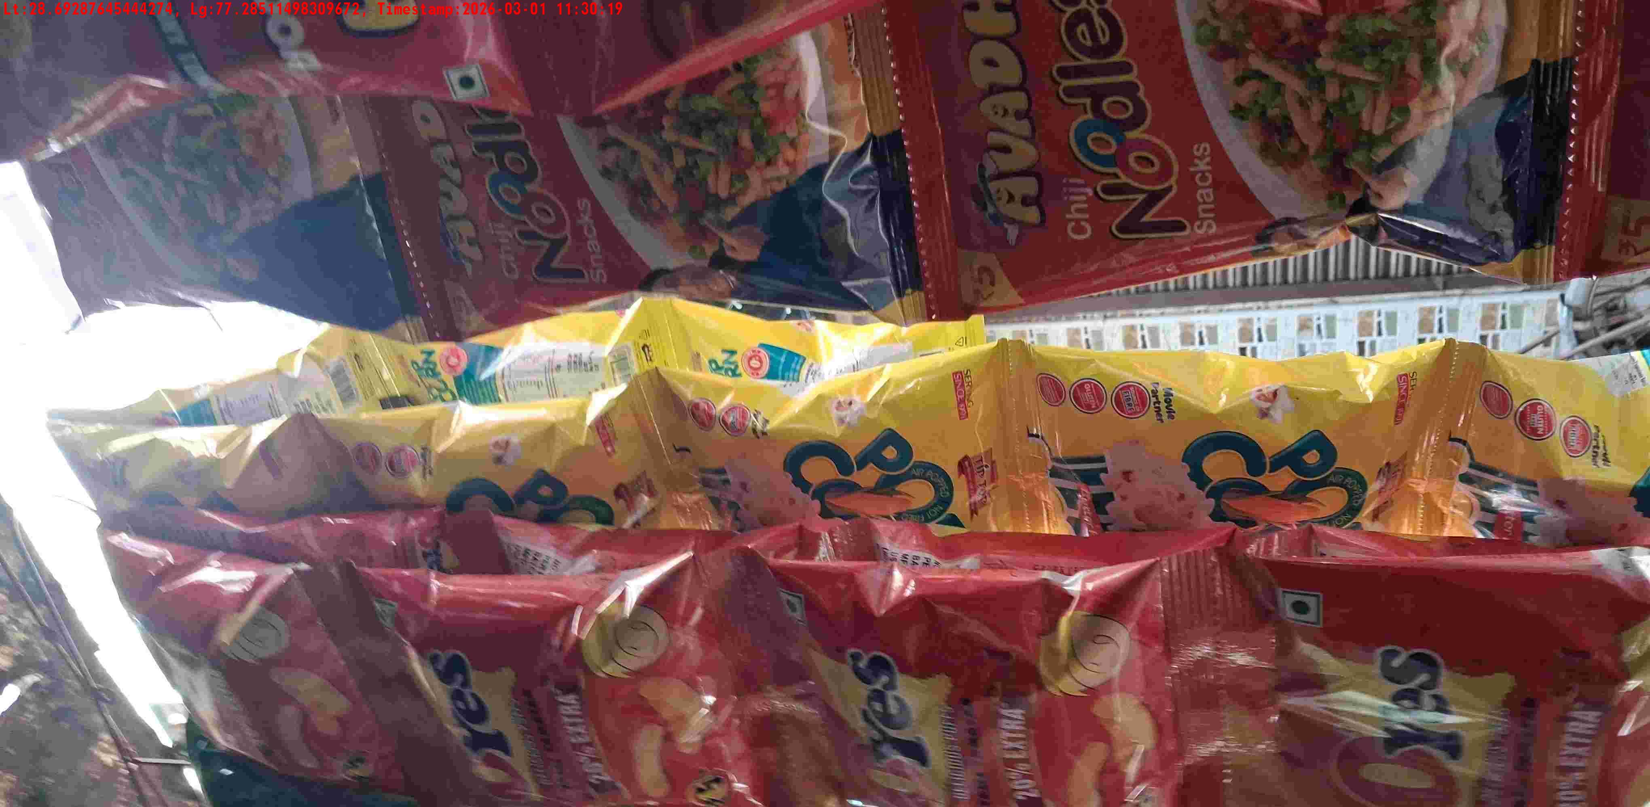

WD Code | DS Id | DS Name | Route Name | Shop Name | Date Time
DE5142 | 328 | YOGESH | West Jyoti Nagar | SURAJ GEN STORE | 01-03-2026 11:30:17 AM
Shop Inside Picture
Shop Front Picture

Slide 28


WD Code | DS Id | DS Name | Route Name | Shop Name | Date Time
DE5142 | 328 | YOGESH | West Jyoti Nagar | TYAGI GEN STORE | 01-03-2026 10:34:54 AM
Shop Inside Picture
Shop Front Picture

