Slide 1
Transaction Ppt

Slide 2
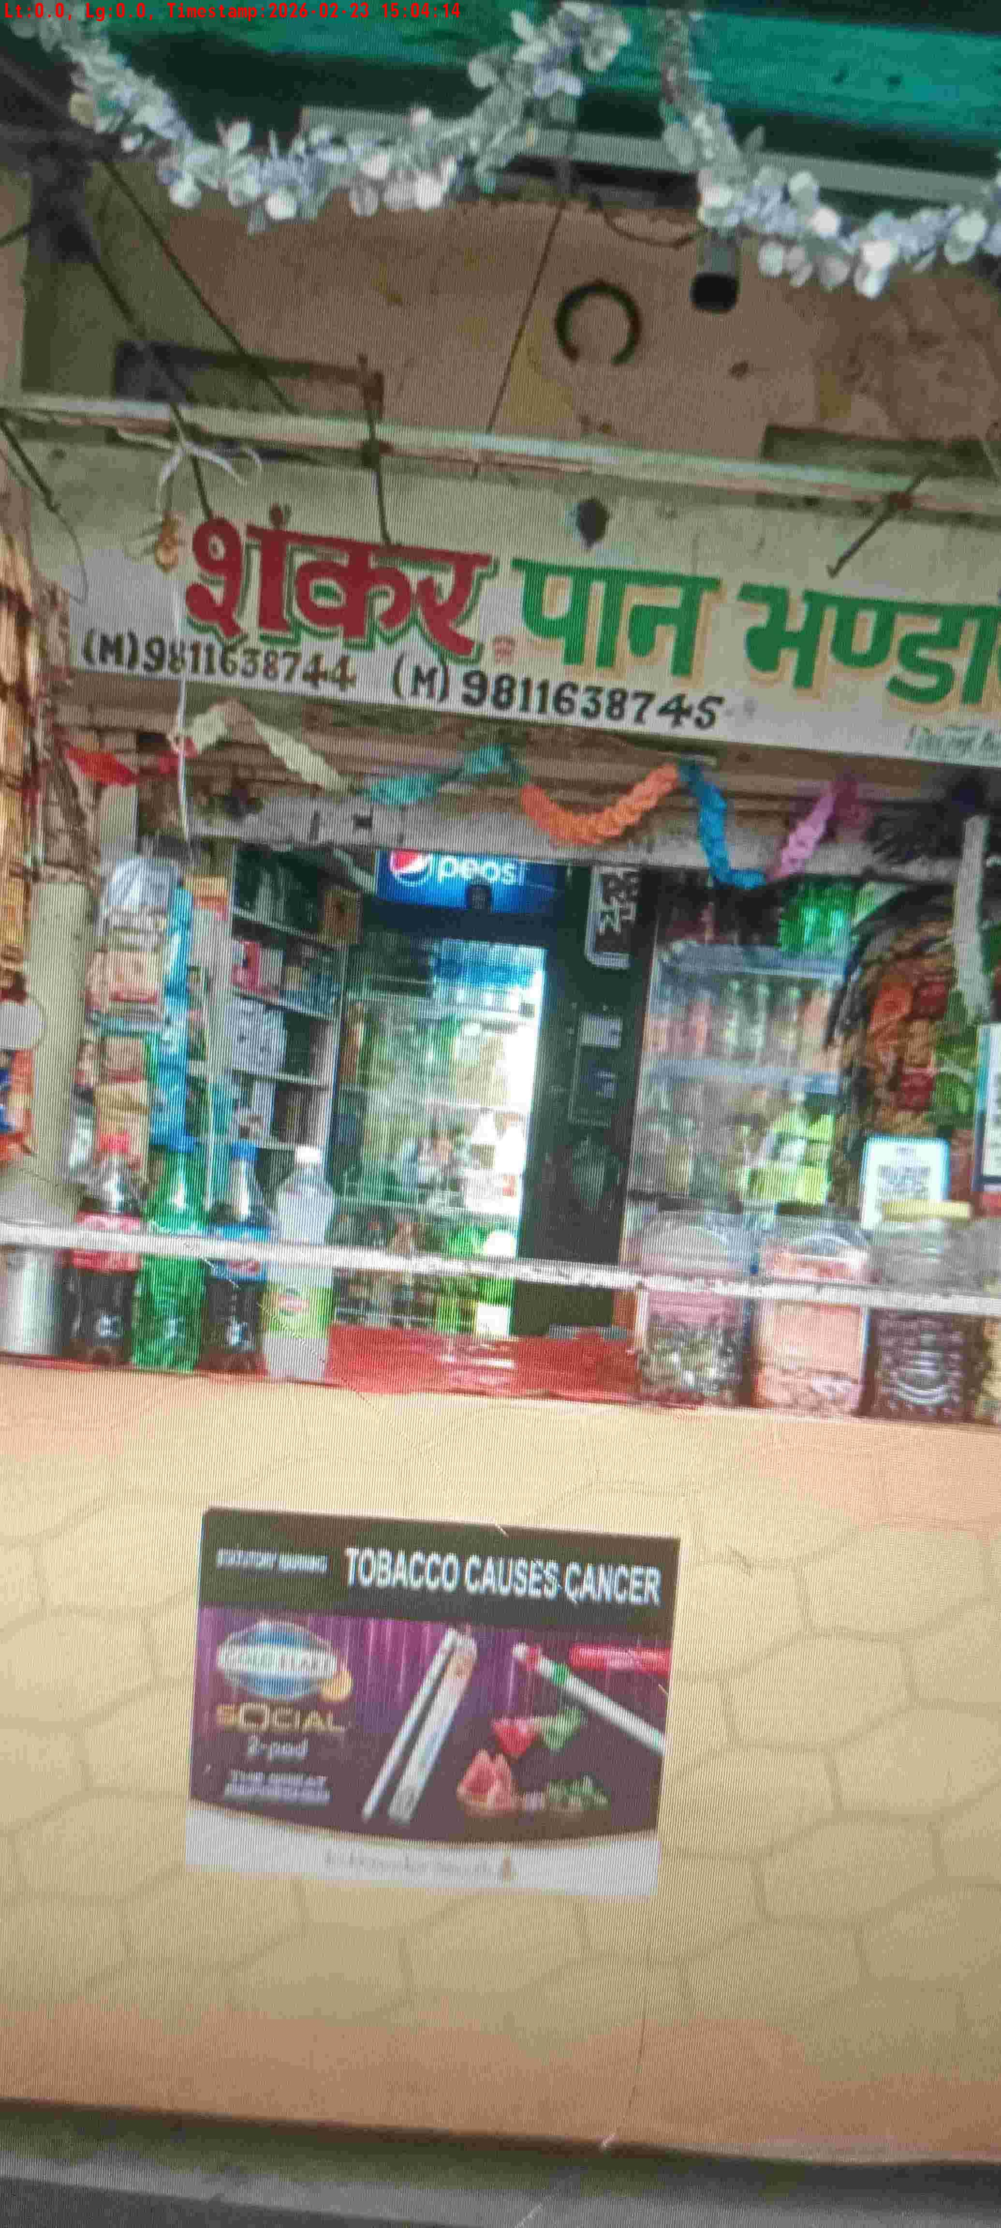
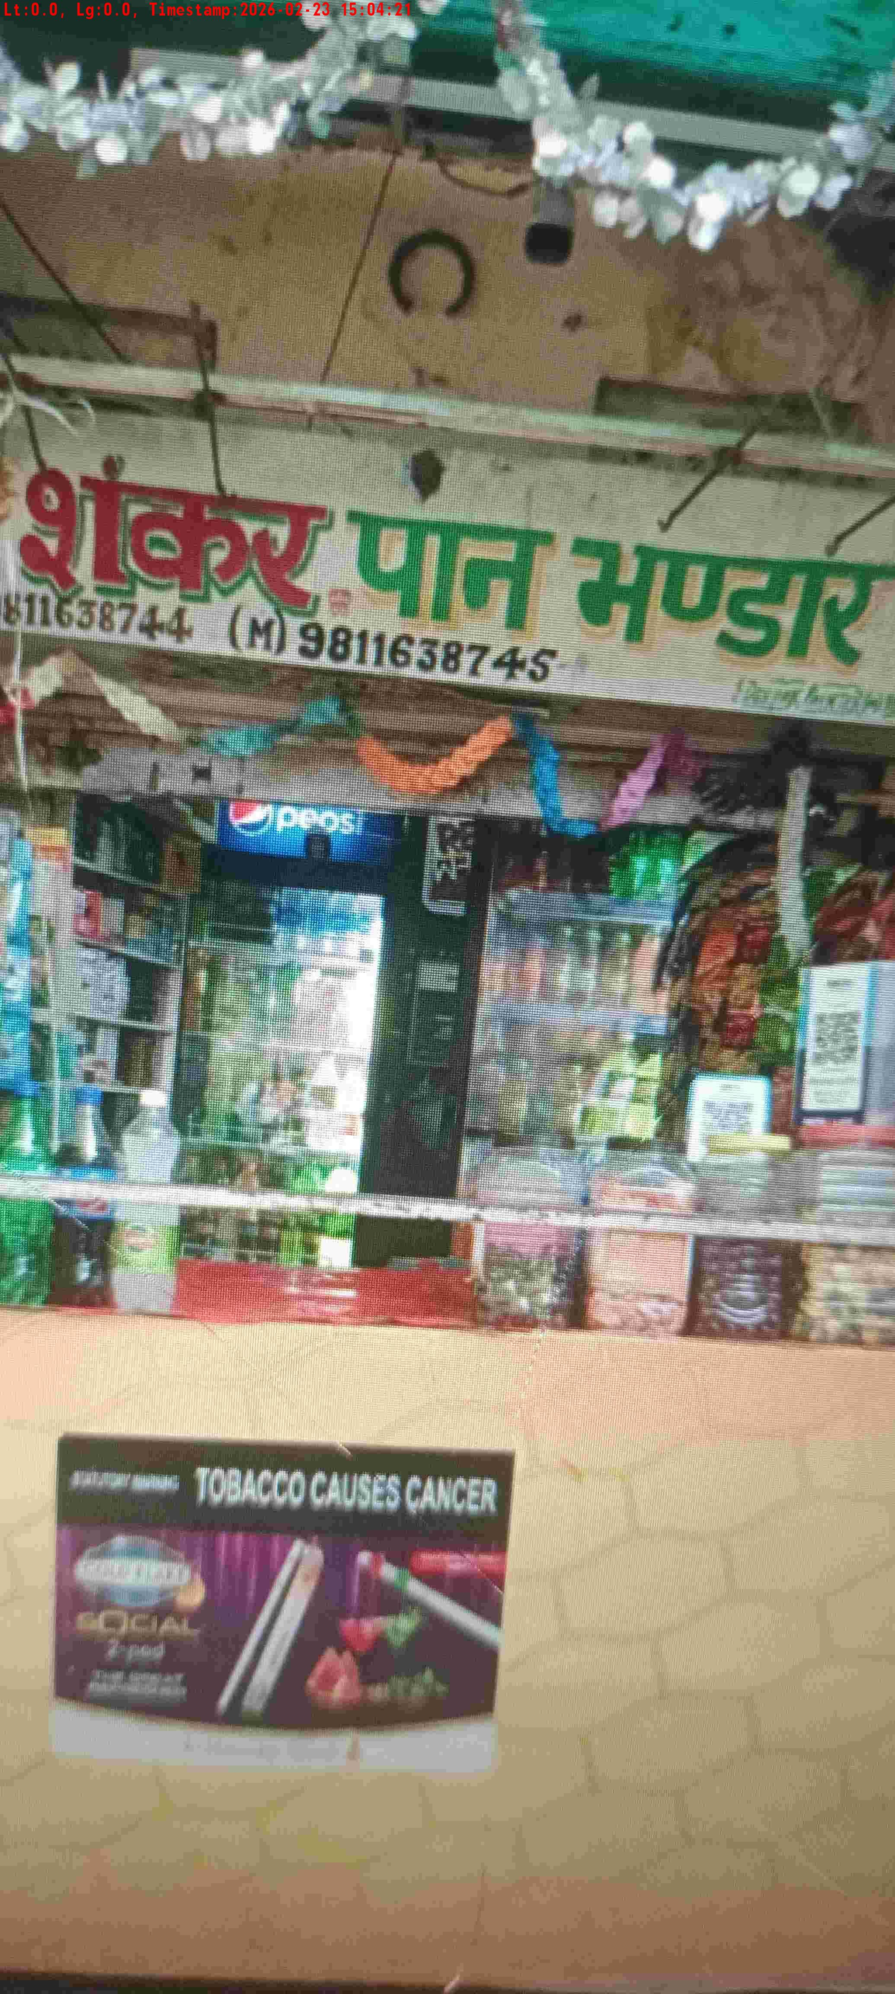
WD Code | DS Id | DS Name | Route Name | Shop Name | Date Time
DE5162 | 827 | Niche-DS48 | Mon-Thu | GROVER STORE | 23-02-2026 03:04:12 PM
Shop Inside Picture
Shop Front Picture

Slide 3
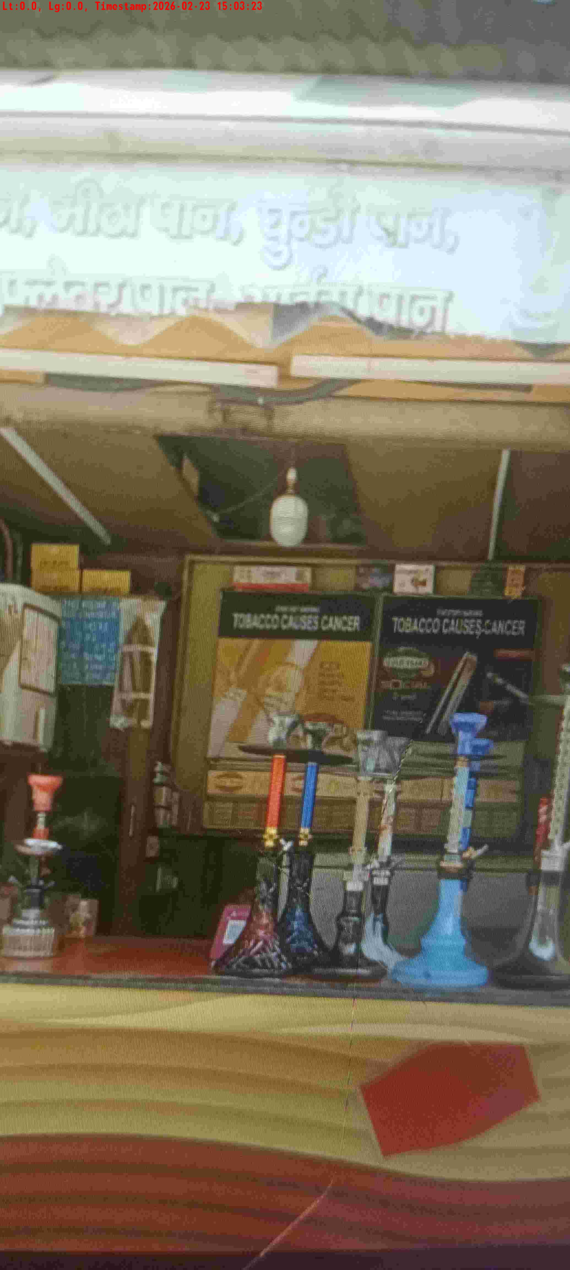
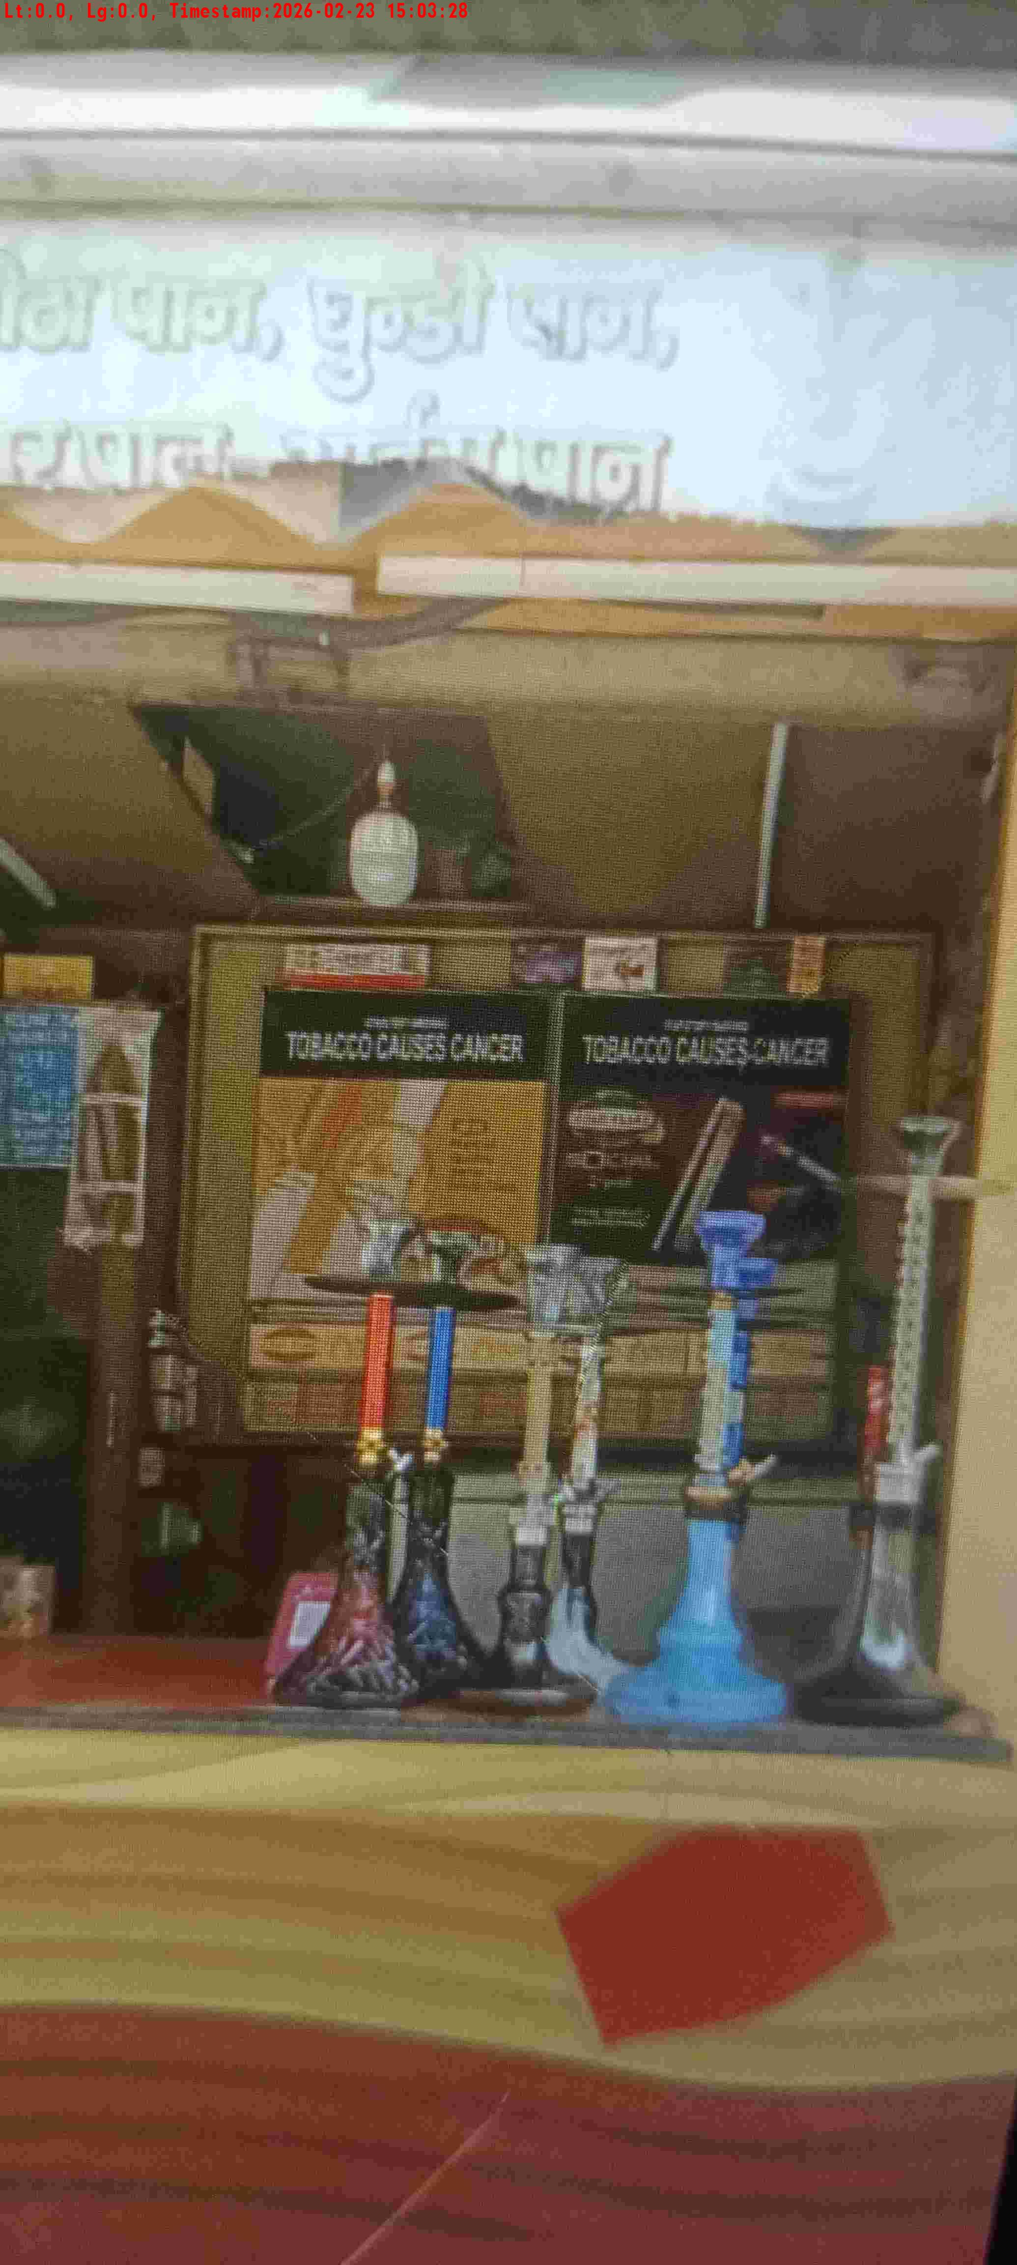
WD Code | DS Id | DS Name | Route Name | Shop Name | Date Time
DE5162 | 827 | Niche-DS48 | Mon-Thu | Mahak Pan 3 | 23-02-2026 03:03:21 PM
Shop Inside Picture
Shop Front Picture

Slide 4
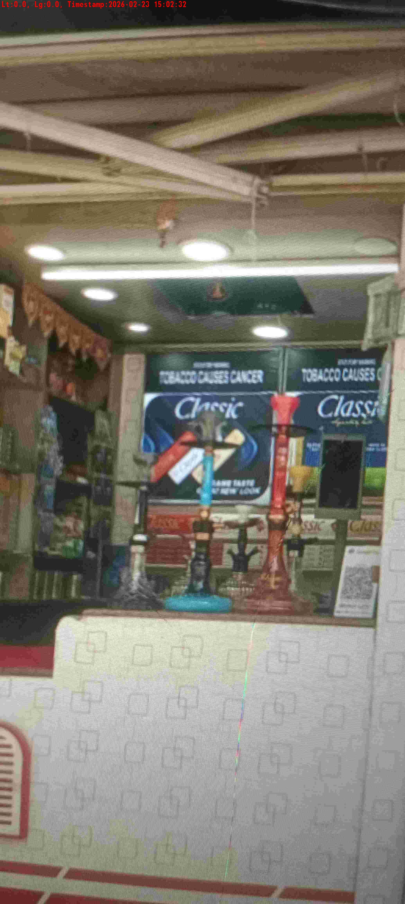
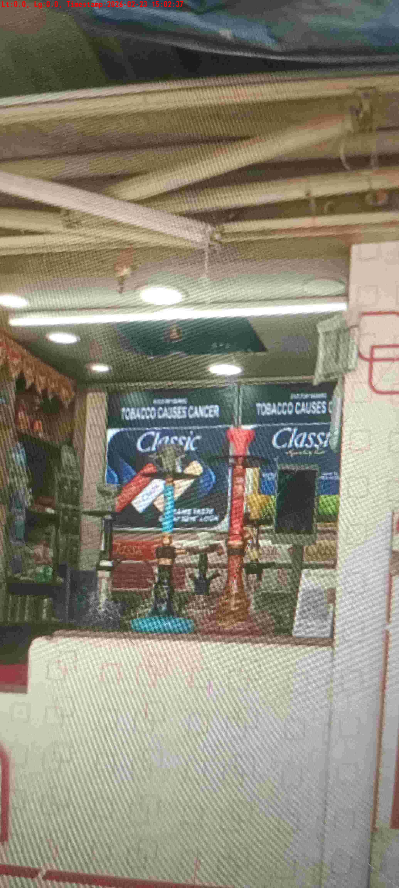
WD Code | DS Id | DS Name | Route Name | Shop Name | Date Time
DE5162 | 827 | Niche-DS48 | Mon-Thu | Mahak Pan 2 | 23-02-2026 03:02:29 PM
Shop Inside Picture
Shop Front Picture

Slide 5
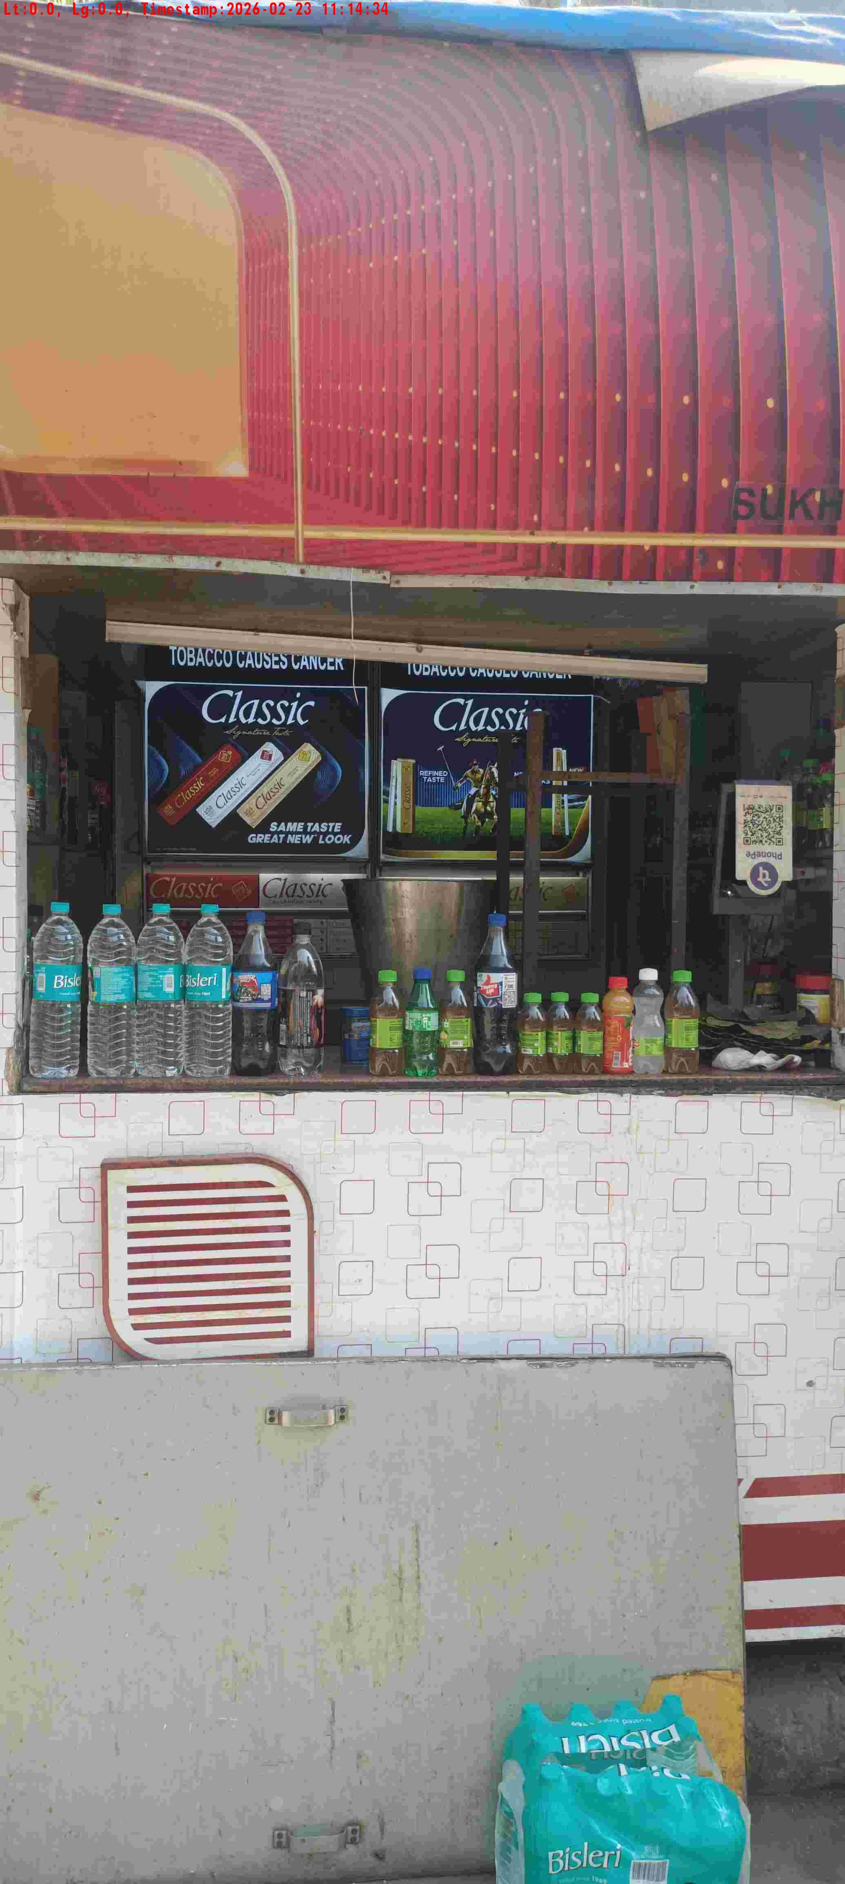
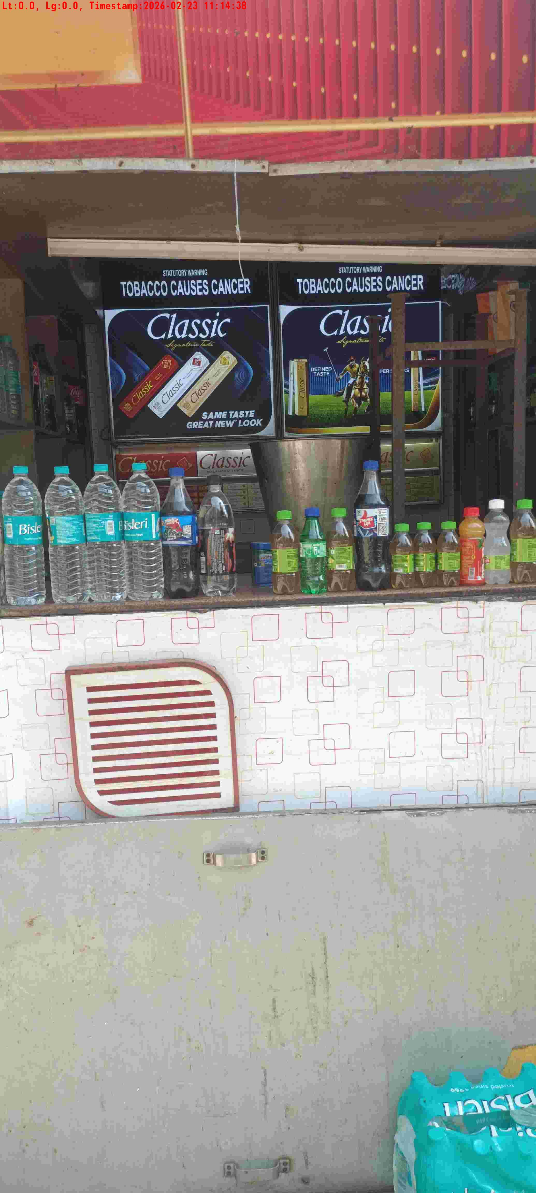
WD Code | DS Id | DS Name | Route Name | Shop Name | Date Time
DE5162 | 827 | Niche-DS48 | Mon-Thu | Shukla Pan1 | 23-02-2026 11:14:32 AM
Shop Inside Picture
Shop Front Picture

Slide 6
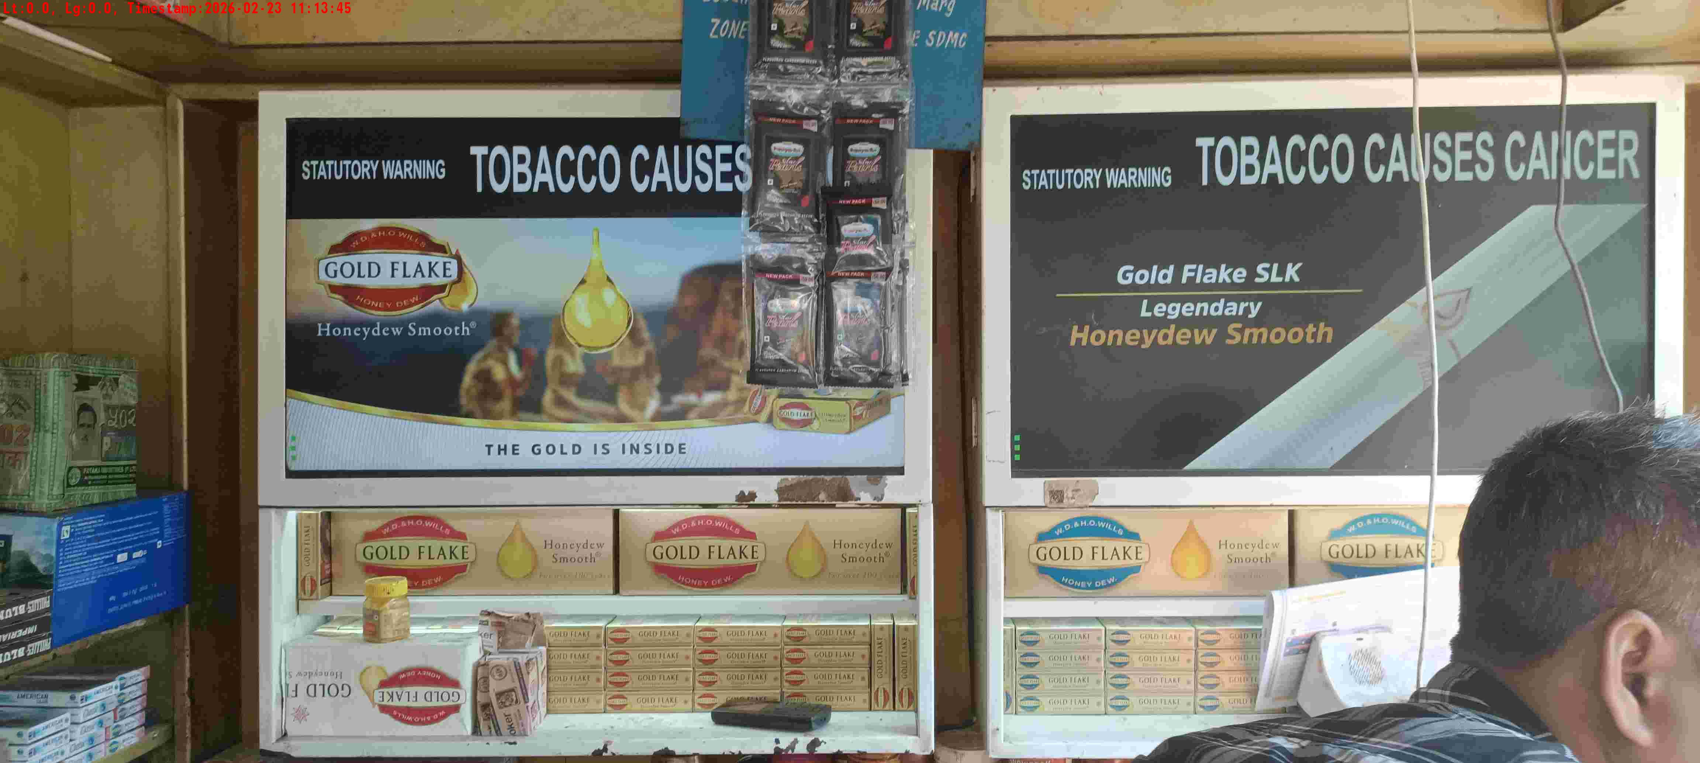
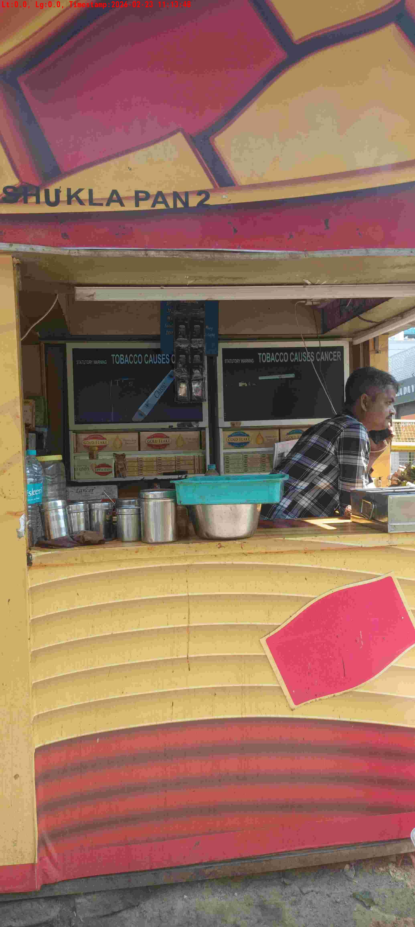
WD Code | DS Id | DS Name | Route Name | Shop Name | Date Time
DE5162 | 827 | Niche-DS48 | Mon-Thu | Shuklapan2 | 23-02-2026 11:13:43 AM
Shop Inside Picture
Shop Front Picture

Slide 7
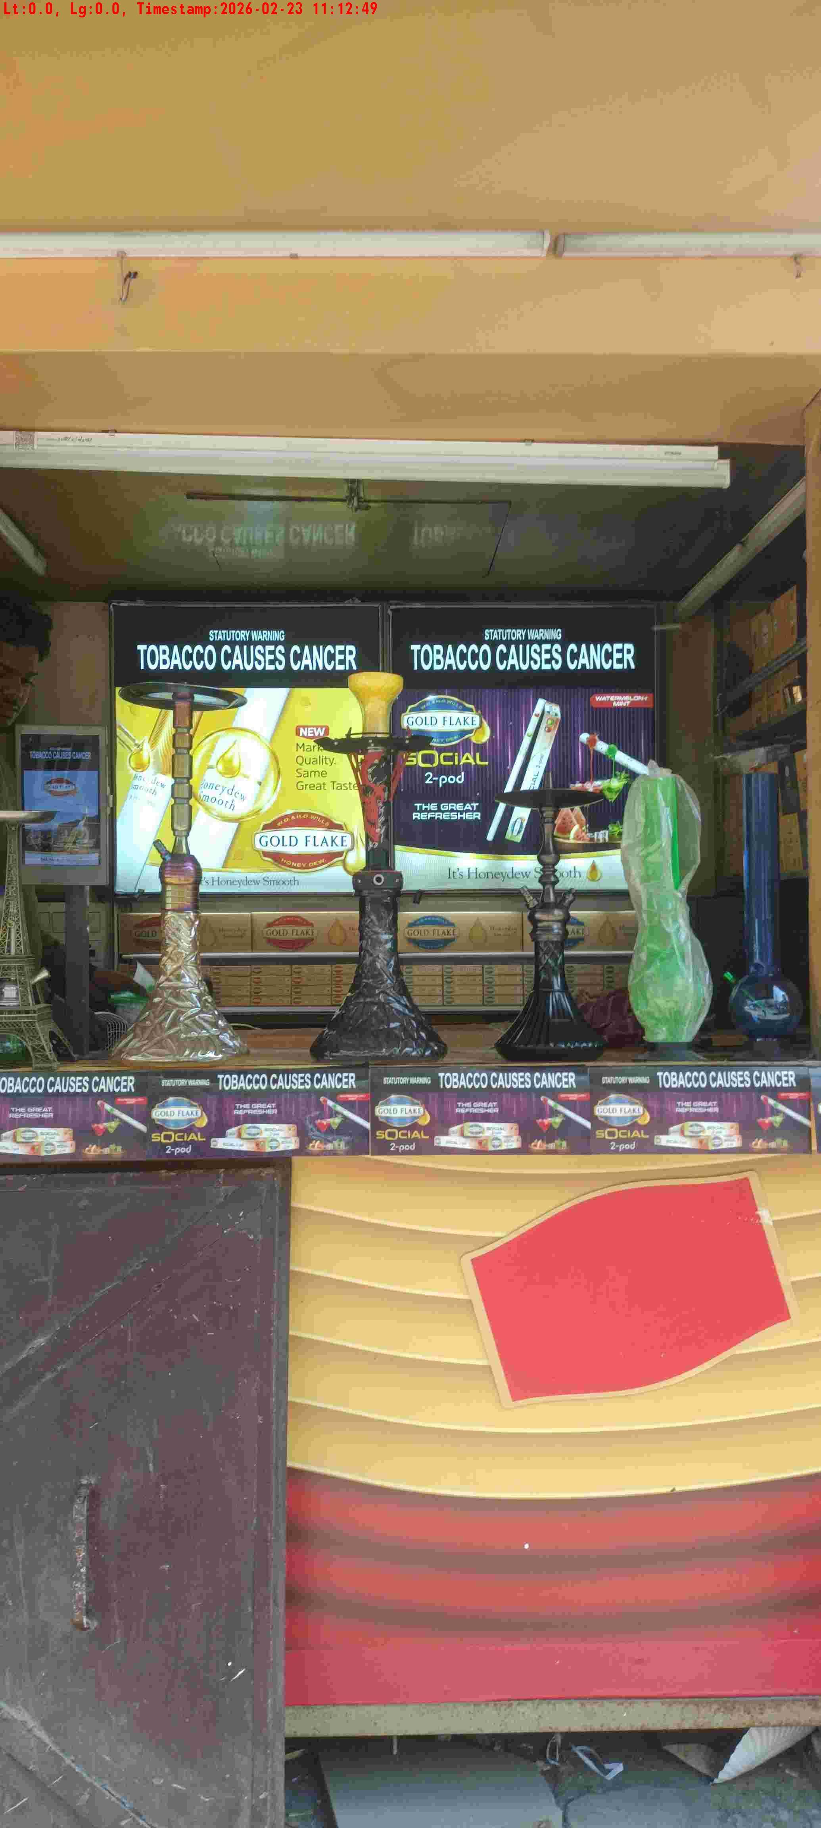
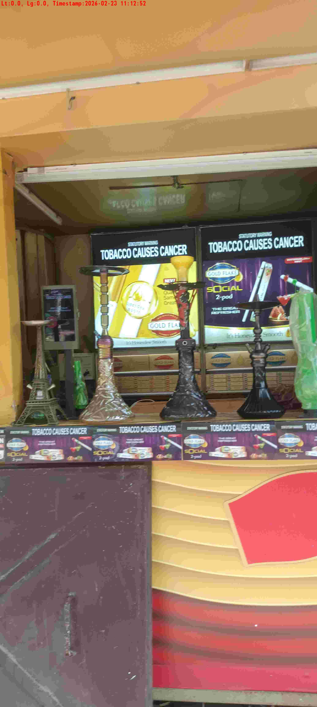
WD Code | DS Id | DS Name | Route Name | Shop Name | Date Time
DE5162 | 827 | Niche-DS48 | Mon-Thu | Classic Pan 3 | 23-02-2026 11:12:47 AM
Shop Inside Picture
Shop Front Picture

Slide 8
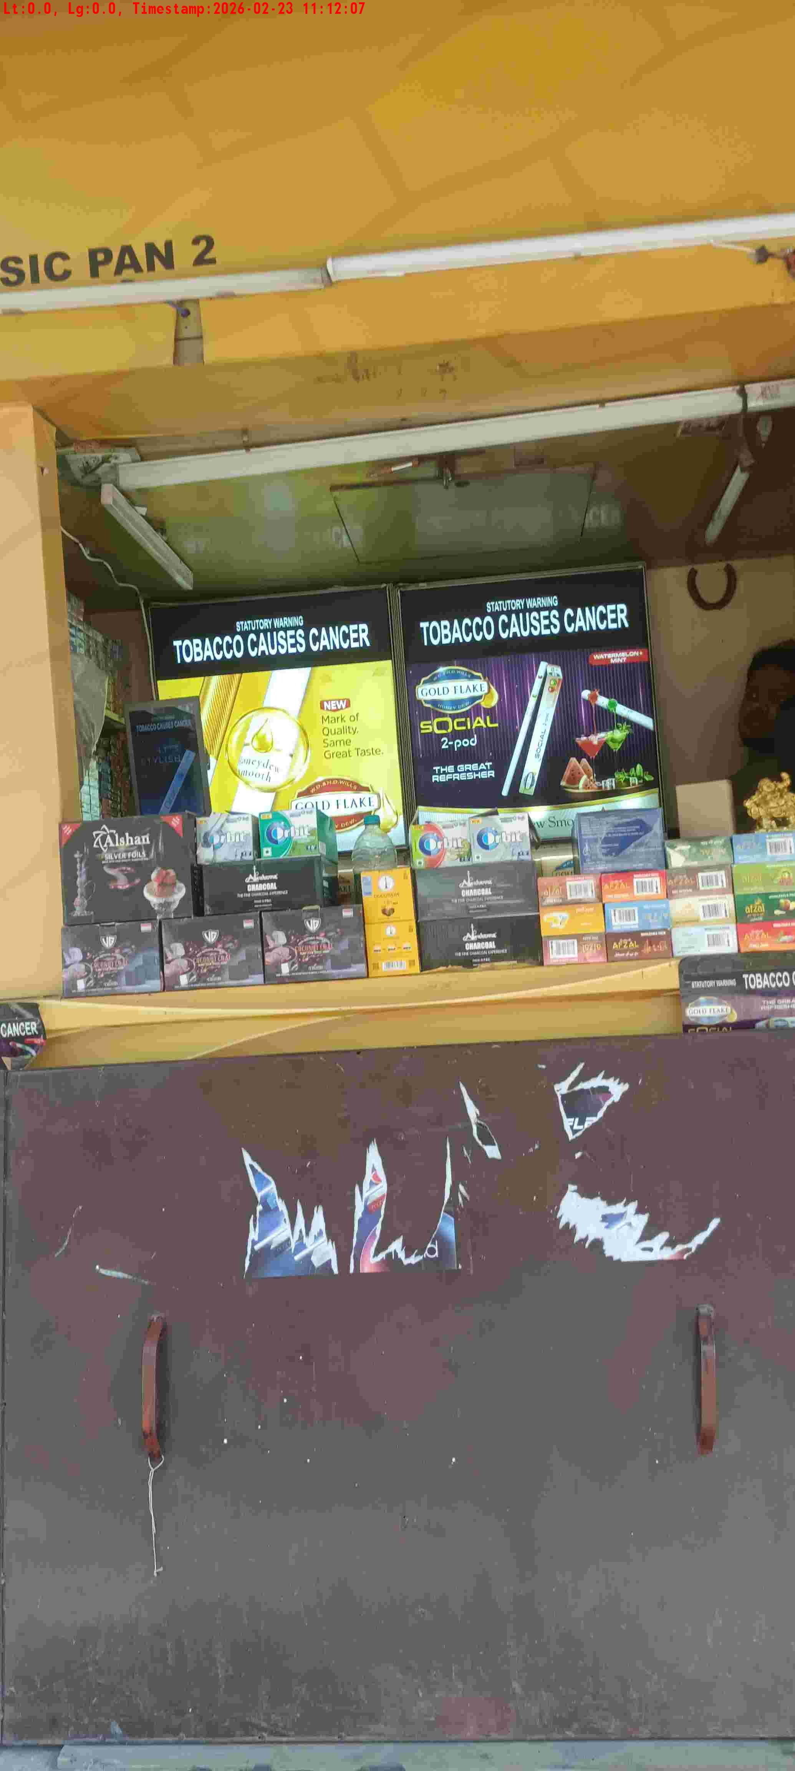
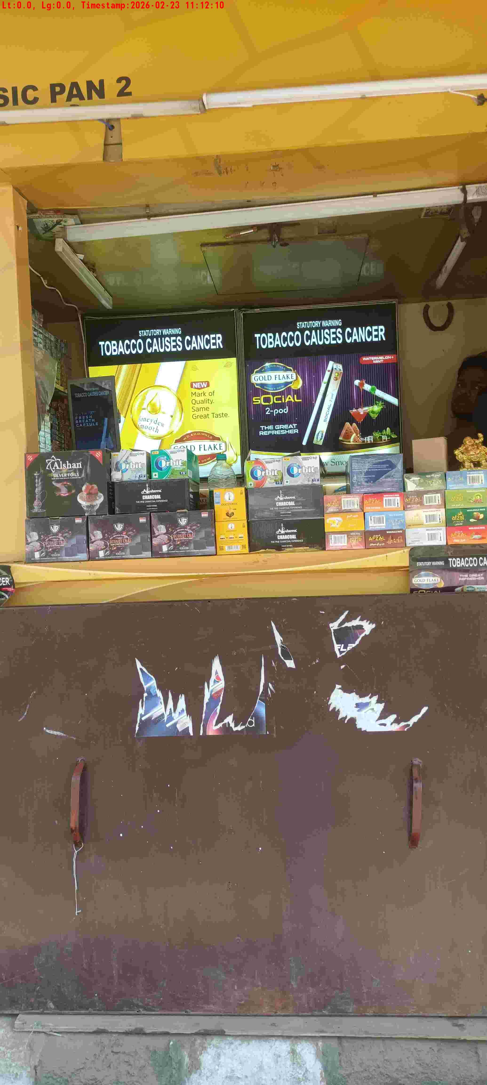
WD Code | DS Id | DS Name | Route Name | Shop Name | Date Time
DE5162 | 827 | Niche-DS48 | Mon-Thu | Classic Pan 2 | 23-02-2026 11:12:04 AM
Shop Inside Picture
Shop Front Picture

Slide 9
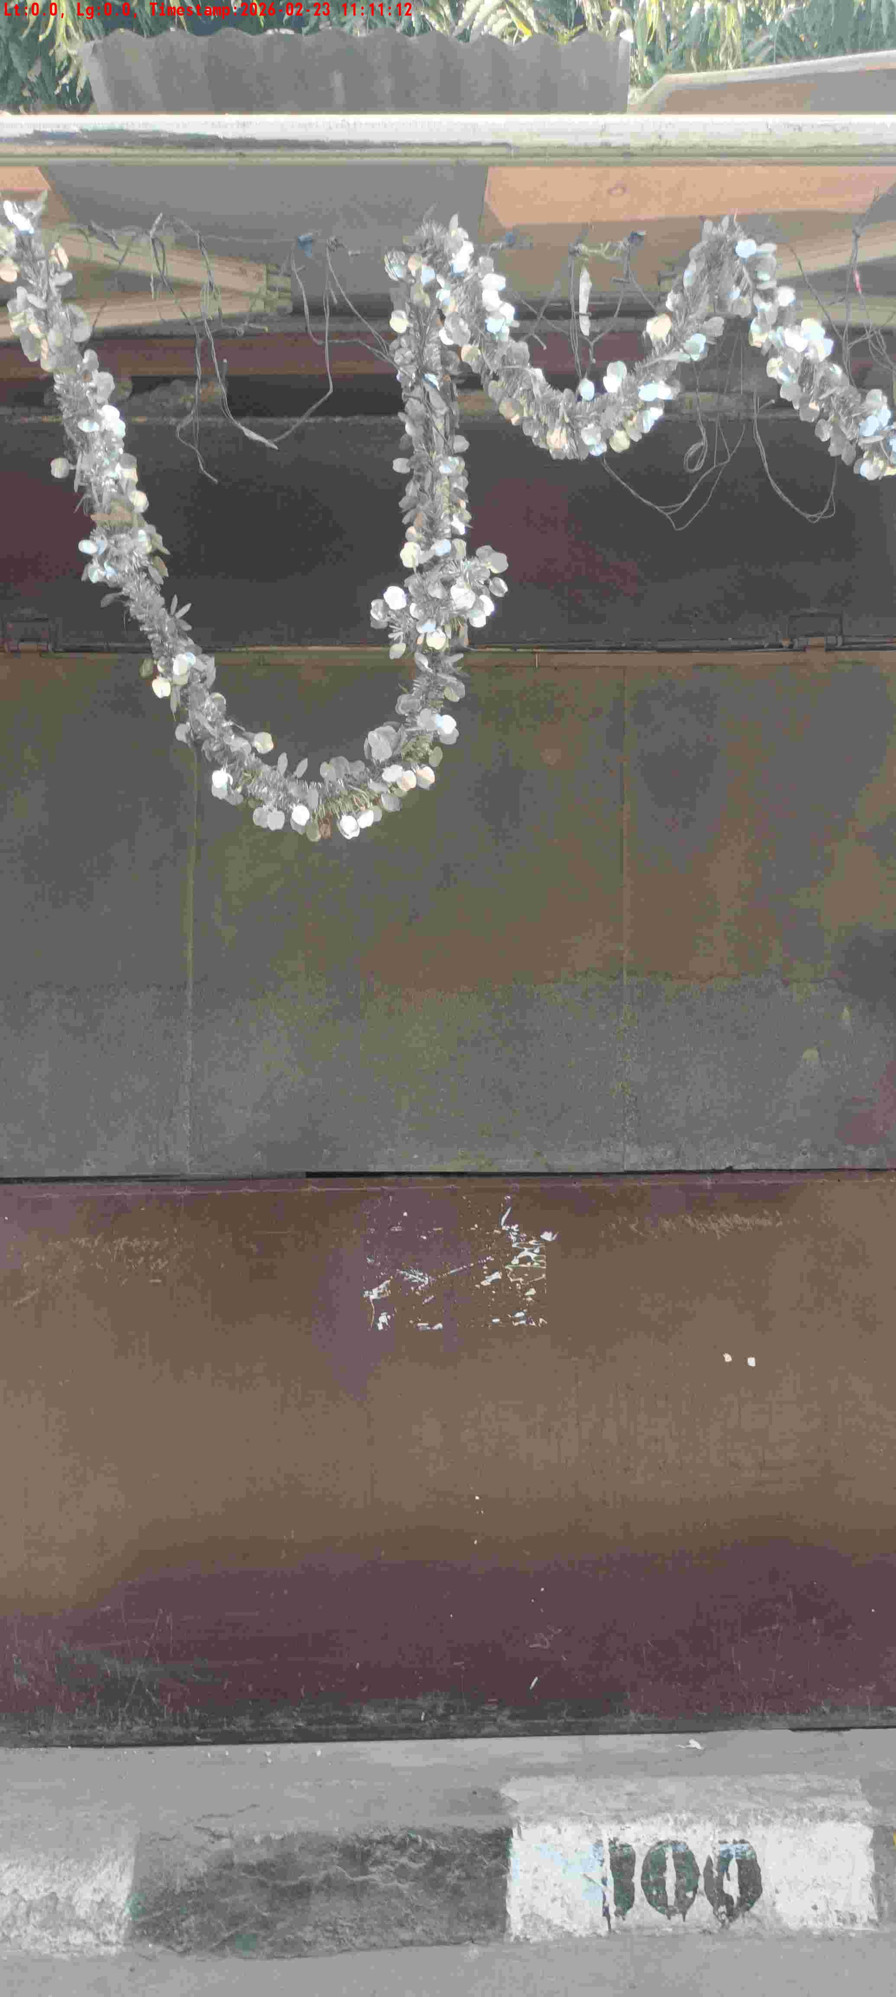
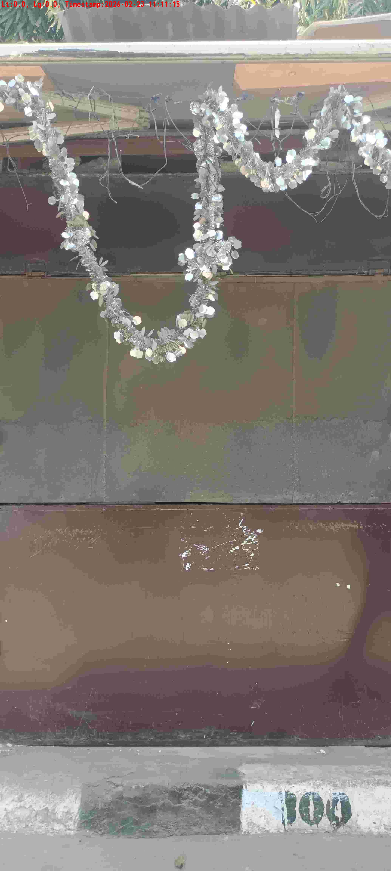
WD Code | DS Id | DS Name | Route Name | Shop Name | Date Time
DE5162 | 827 | Niche-DS48 | Mon-Thu | Harish Pan | 23-02-2026 11:11:10 AM
Shop Inside Picture
Shop Front Picture

Slide 10
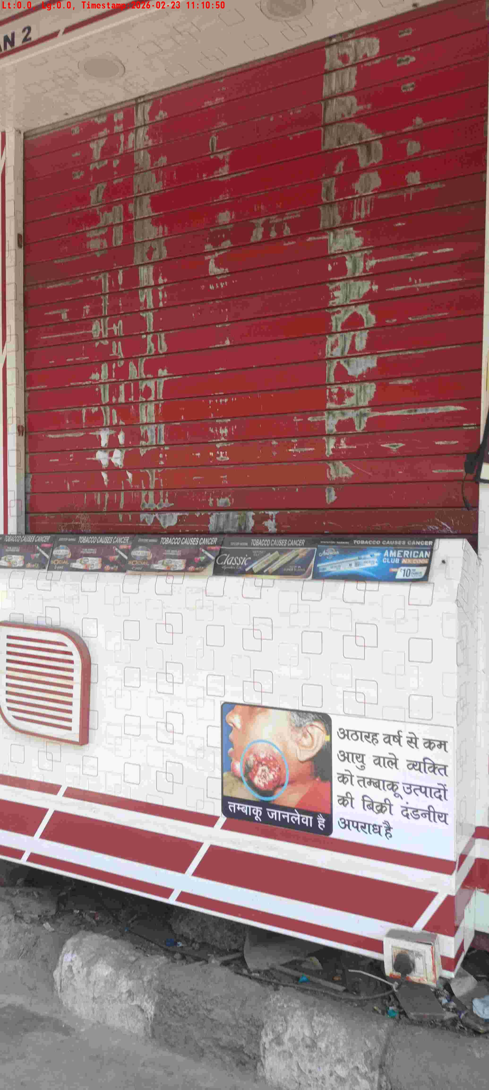
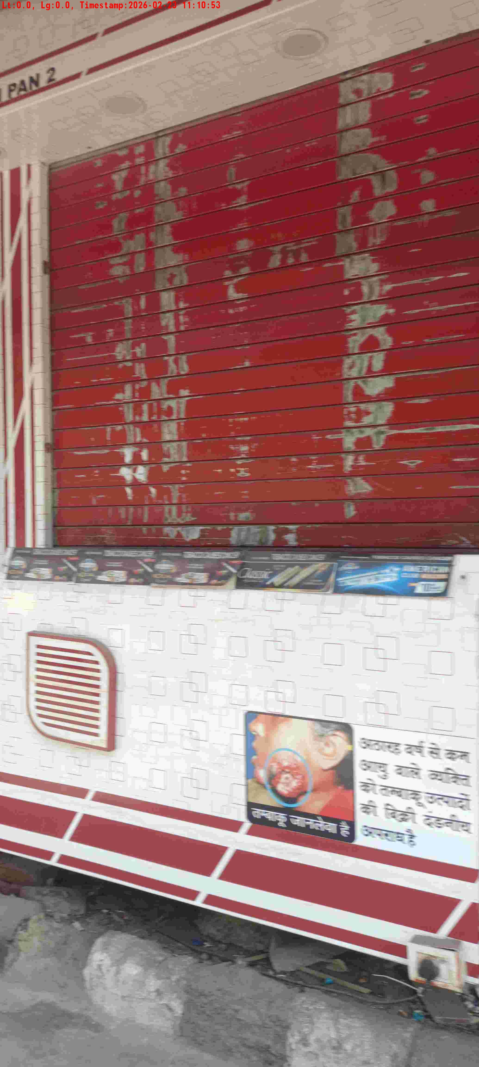
WD Code | DS Id | DS Name | Route Name | Shop Name | Date Time
DE5162 | 827 | Niche-DS48 | Mon-Thu | Vikash Pan 2 | 23-02-2026 11:10:48 AM
Shop Inside Picture
Shop Front Picture

Slide 11
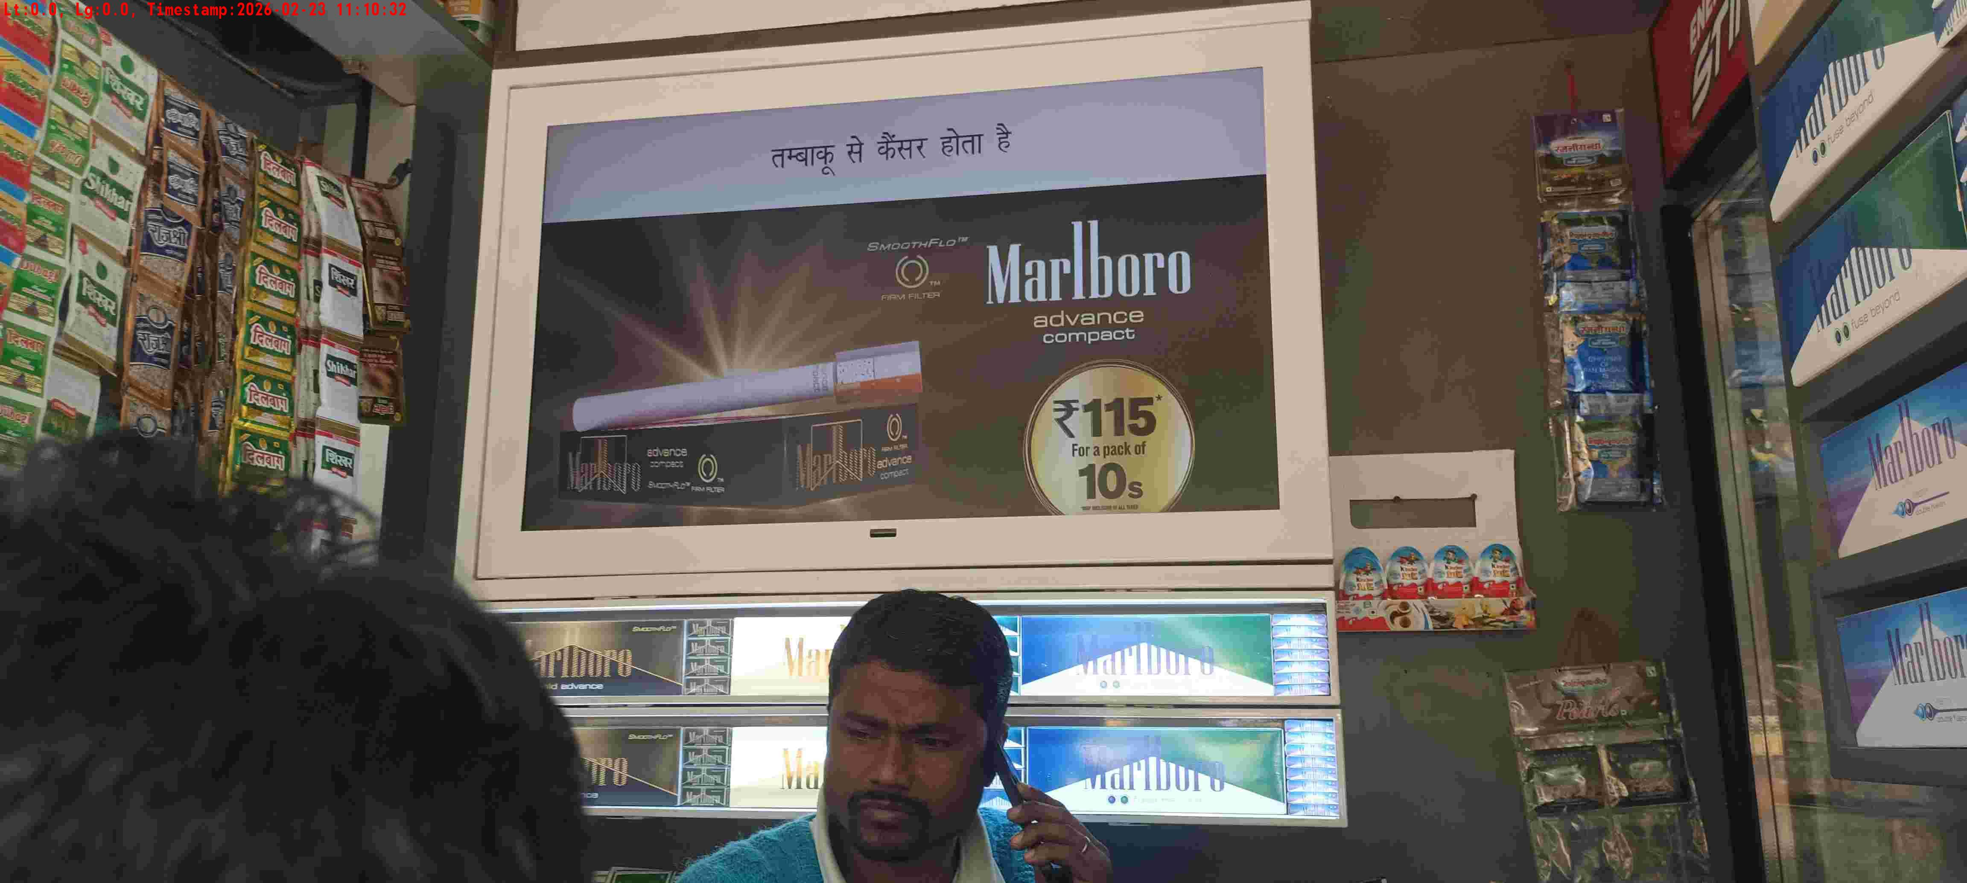
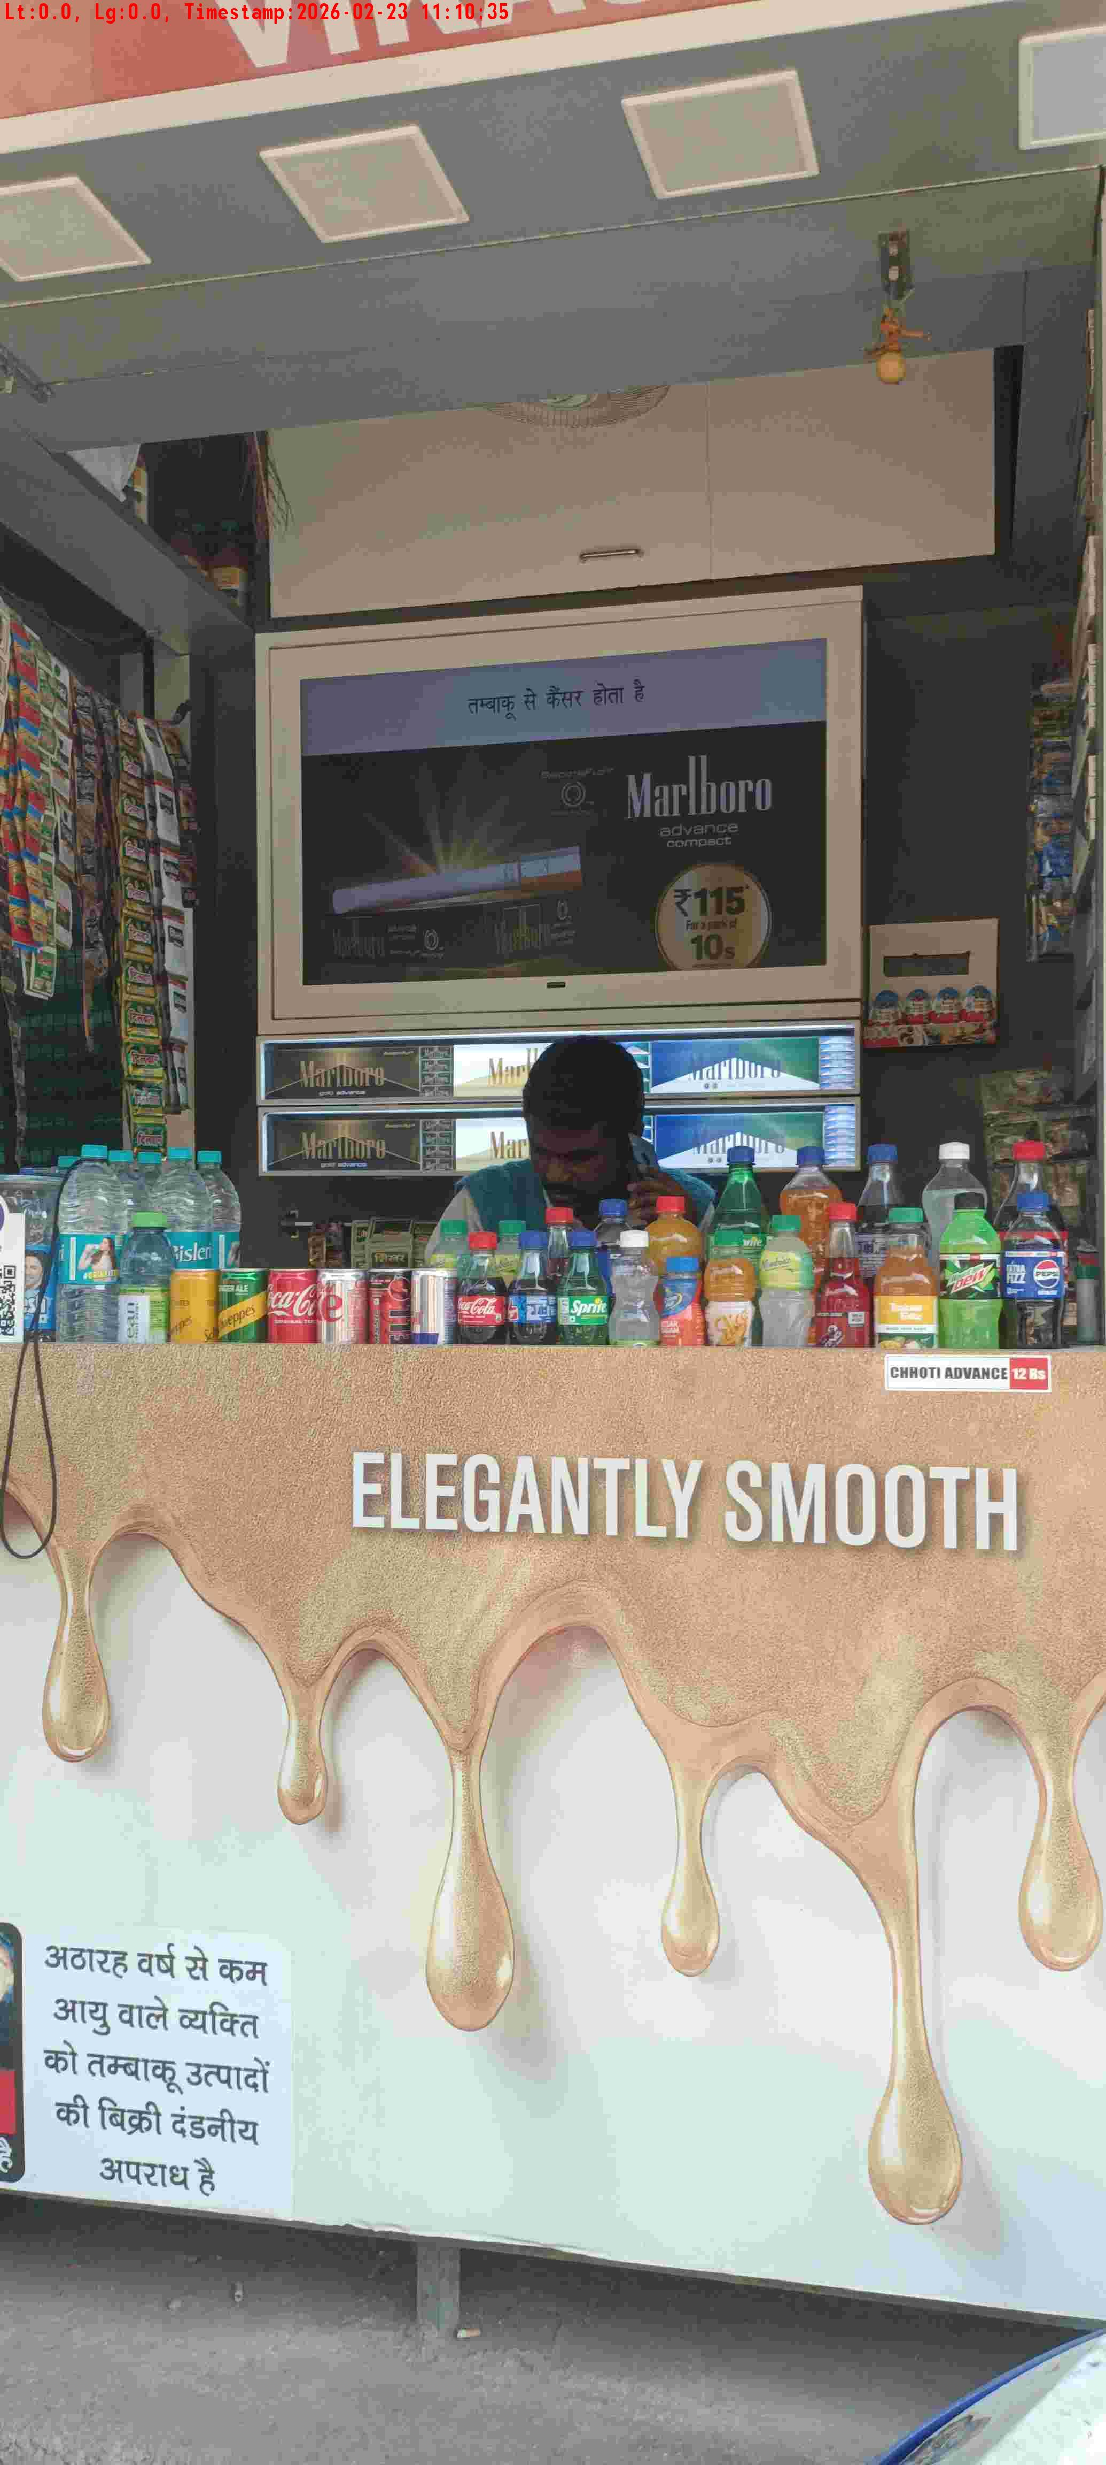
WD Code | DS Id | DS Name | Route Name | Shop Name | Date Time
DE5162 | 827 | Niche-DS48 | Mon-Thu | Vikash Pan1 | 23-02-2026 11:10:29 AM
Shop Inside Picture
Shop Front Picture

Slide 12
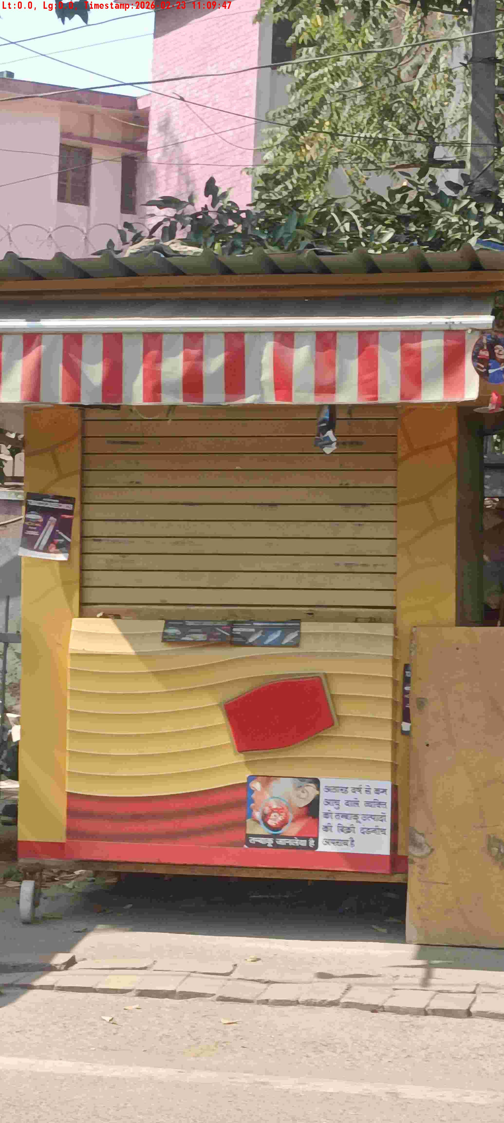
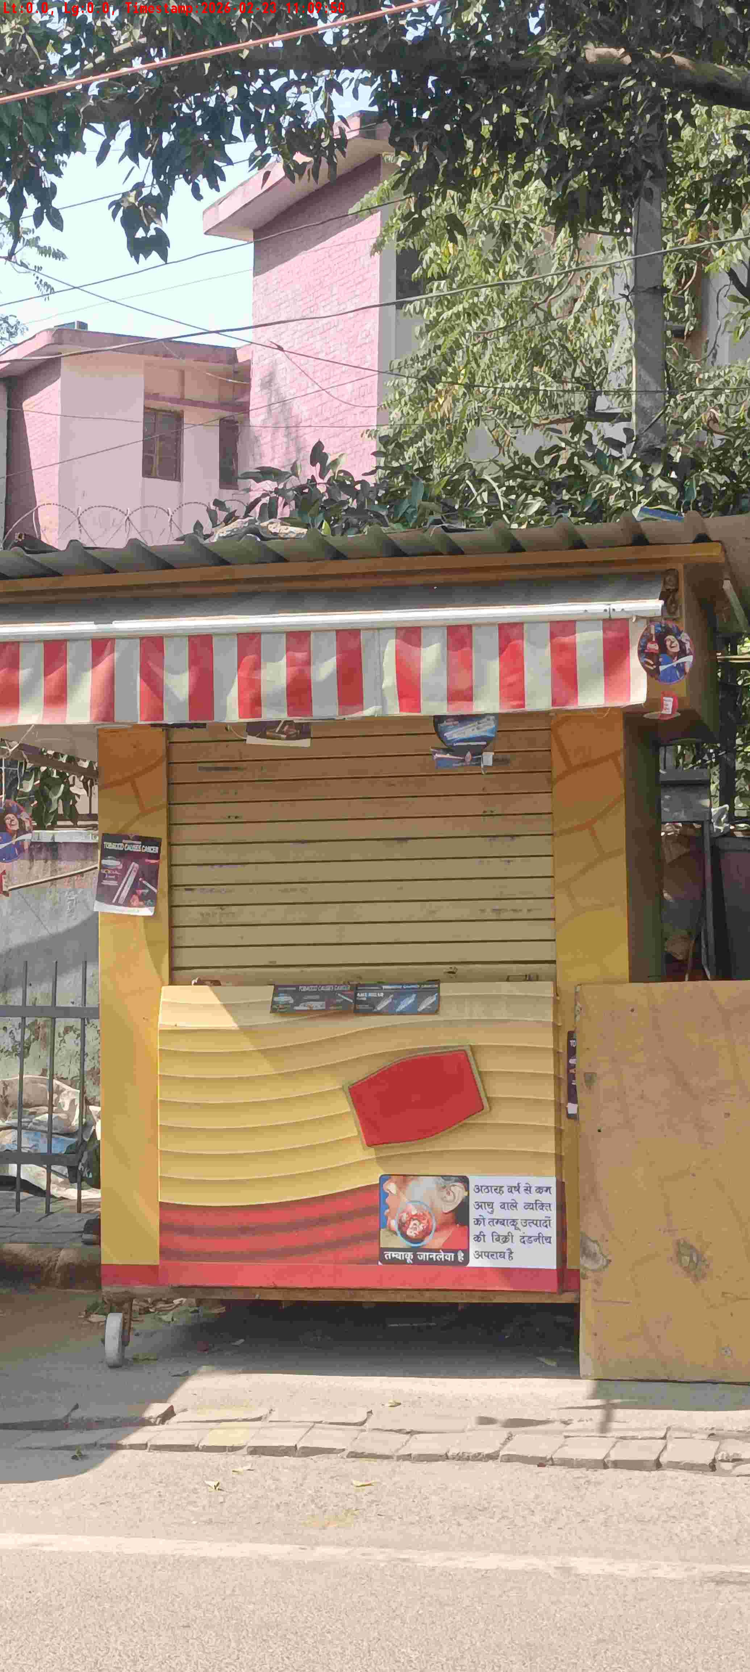
WD Code | DS Id | DS Name | Route Name | Shop Name | Date Time
DE5162 | 827 | Niche-DS48 | Mon-Thu | Asha Bhora Pan | 23-02-2026 11:09:44 AM
Shop Inside Picture
Shop Front Picture

Slide 13
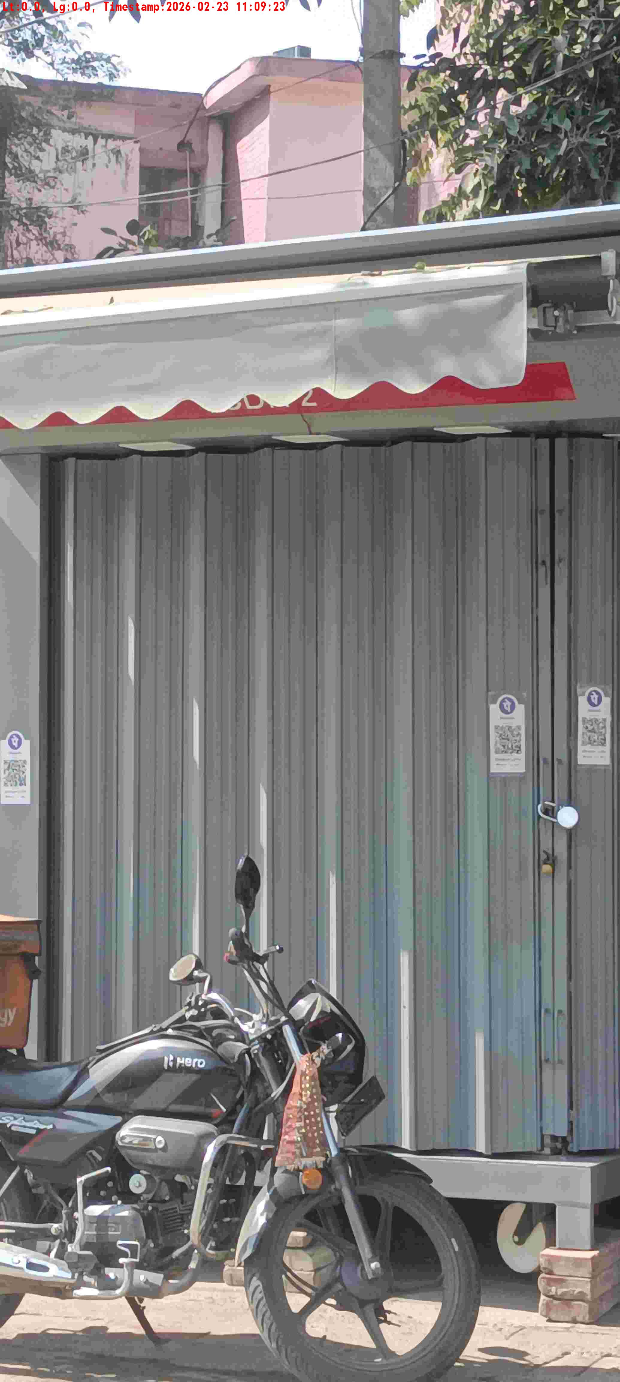
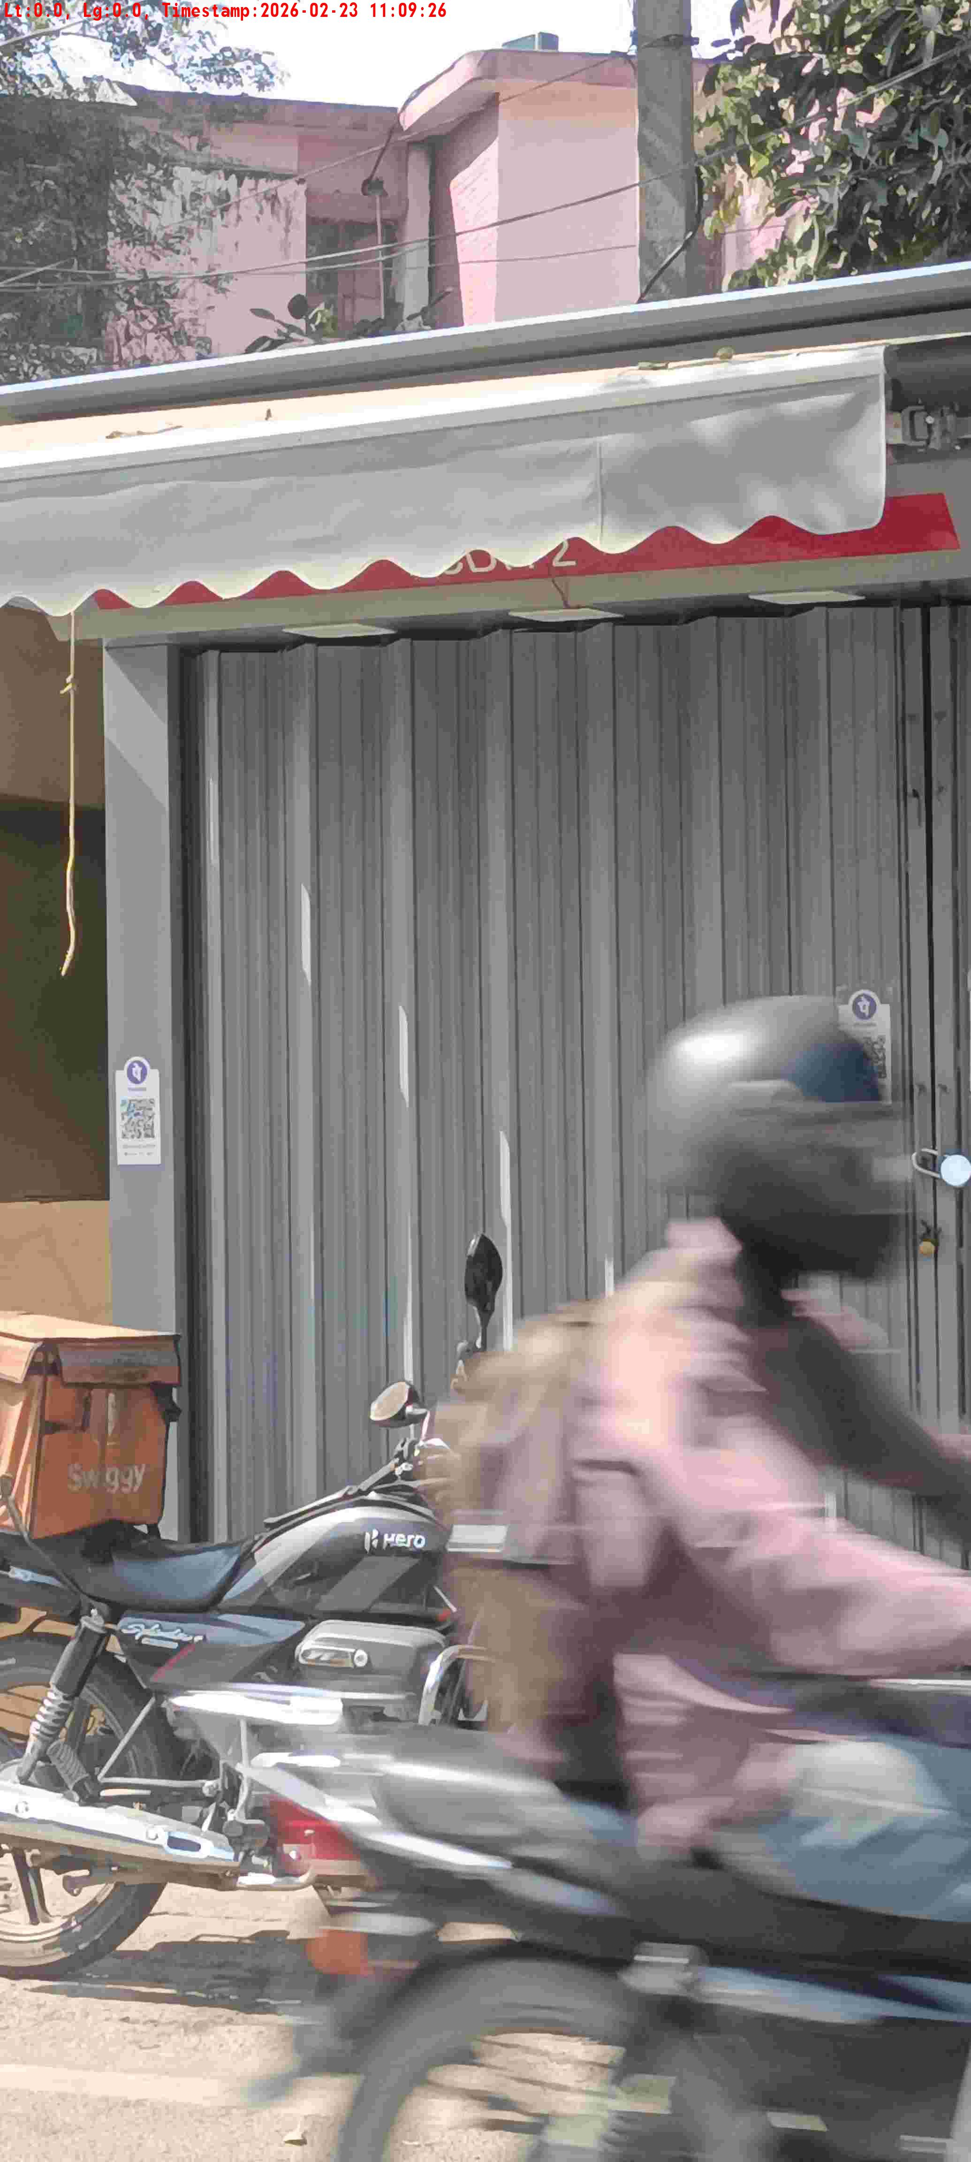
WD Code | DS Id | DS Name | Route Name | Shop Name | Date Time
DE5162 | 827 | Niche-DS48 | Mon-Thu | Asha Bhora Pan | 23-02-2026 11:09:20 AM
Shop Inside Picture
Shop Front Picture

Slide 14
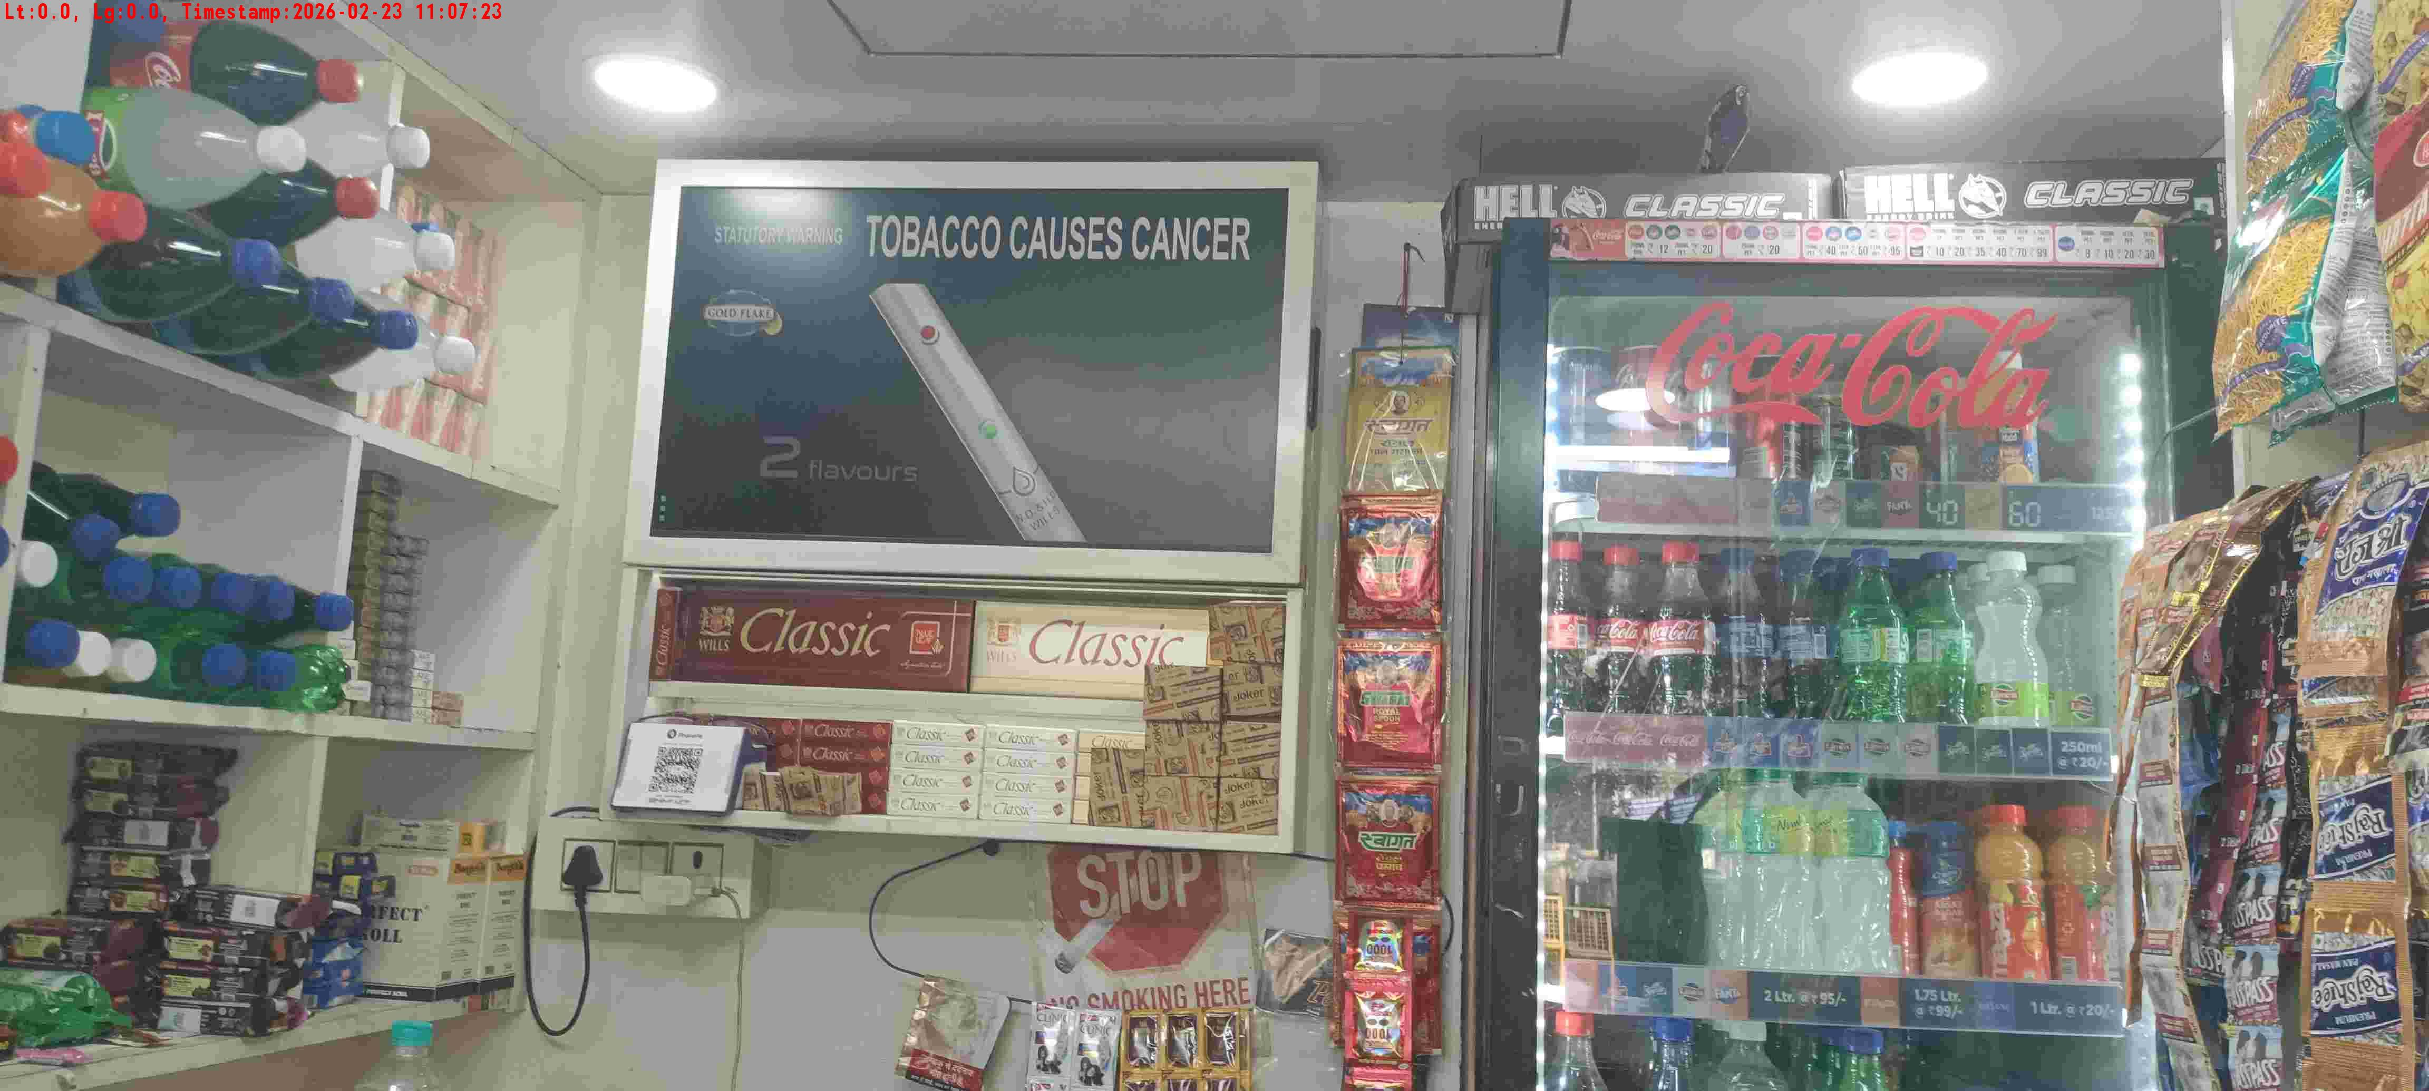
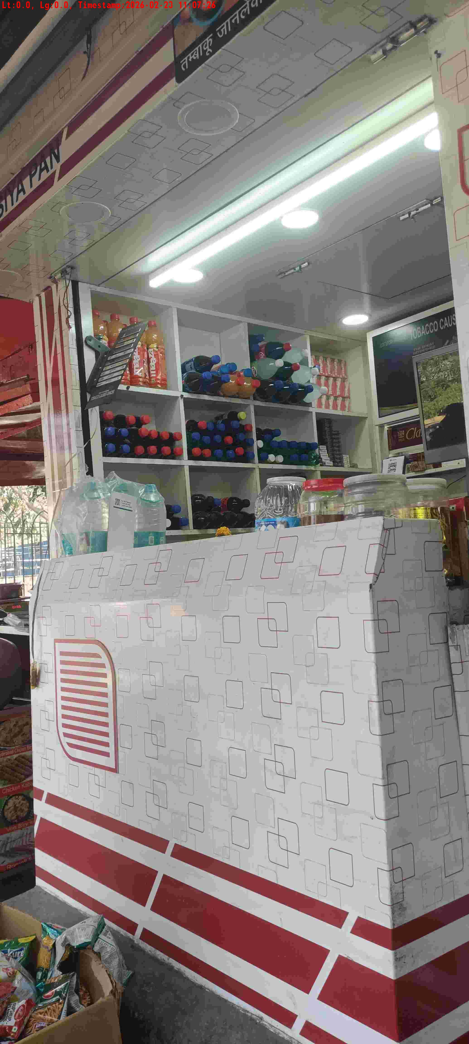
WD Code | DS Id | DS Name | Route Name | Shop Name | Date Time
DE5162 | 827 | Niche-DS48 | Mon-Thu | Up Chaurasia Pan | 23-02-2026 11:07:20 AM
Shop Inside Picture
Shop Front Picture

Slide 15
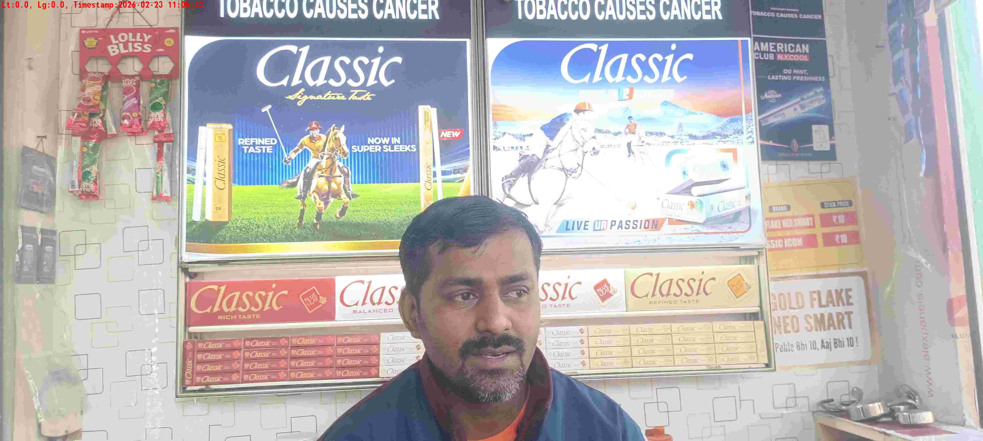
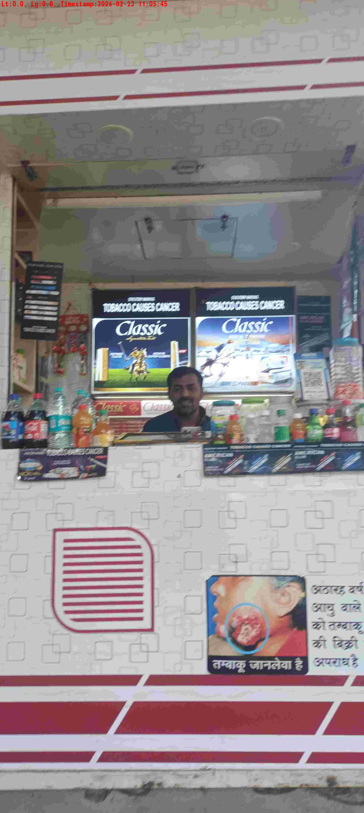
WD Code | DS Id | DS Name | Route Name | Shop Name | Date Time
DE5162 | 827 | Niche-DS48 | Mon-Thu | Vijay Pan 3 | 23-02-2026 11:05:39 AM
Shop Inside Picture
Shop Front Picture

Slide 16
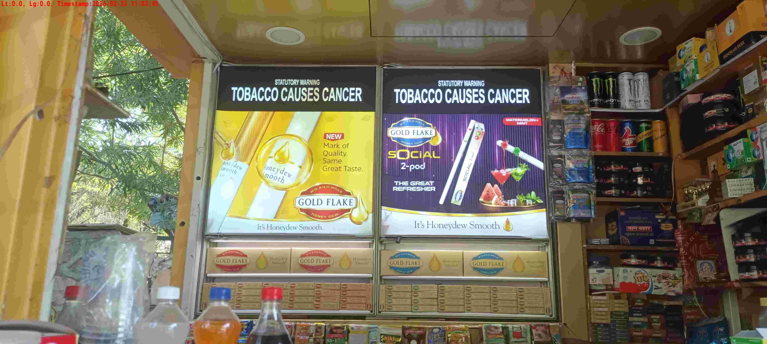
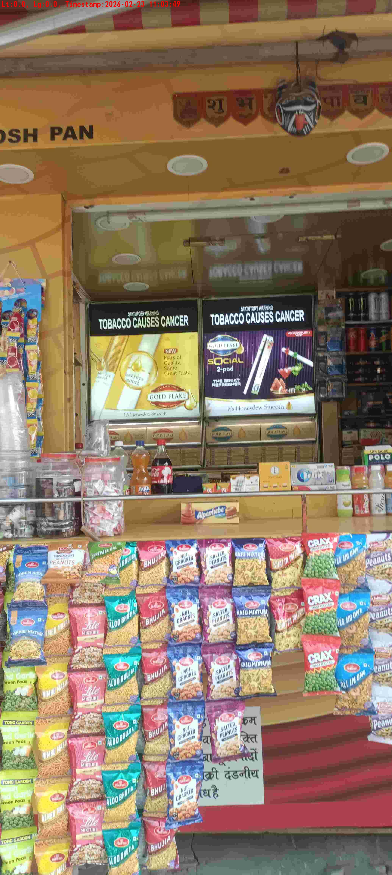
WD Code | DS Id | DS Name | Route Name | Shop Name | Date Time
DE5162 | 827 | Niche-DS48 | Mon-Thu | Santosh Pan | 23-02-2026 11:03:43 AM
Shop Inside Picture
Shop Front Picture

Slide 17
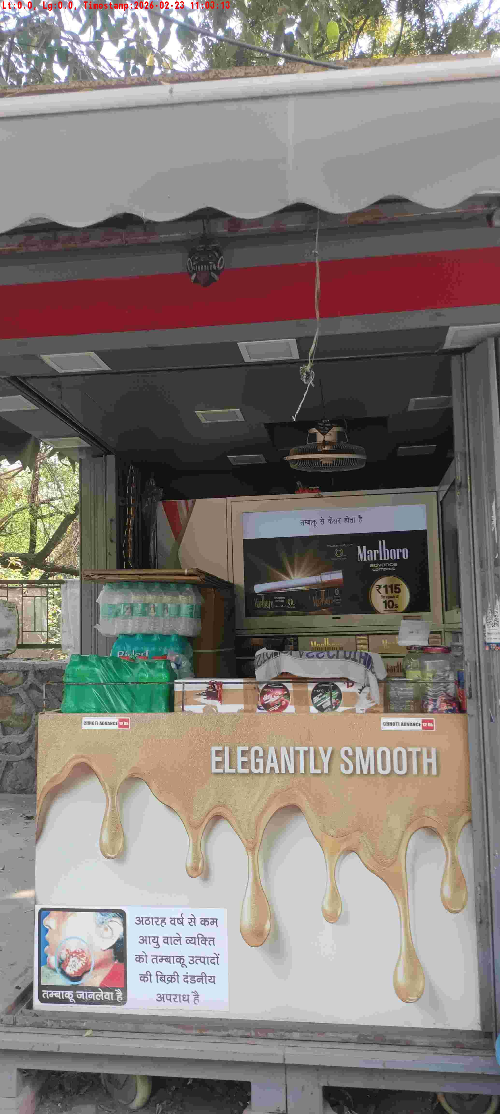
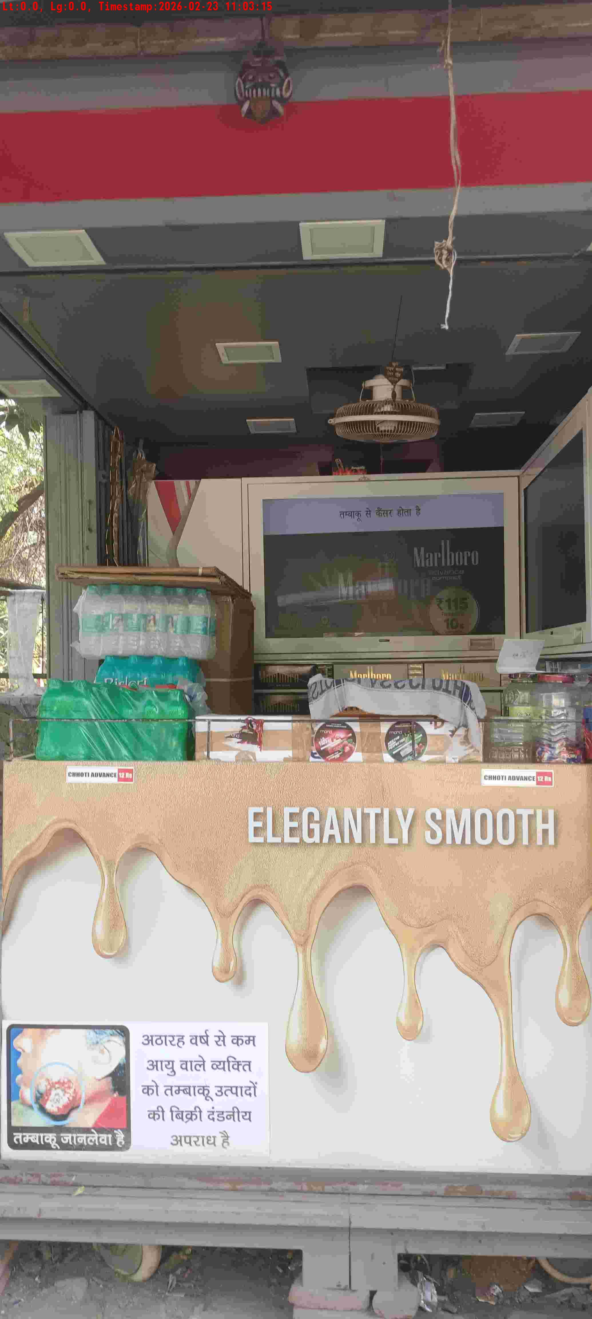
WD Code | DS Id | DS Name | Route Name | Shop Name | Date Time
DE5162 | 827 | Niche-DS48 | Mon-Thu | U Pan | 23-02-2026 11:03:11 AM
Shop Inside Picture
Shop Front Picture

Slide 18
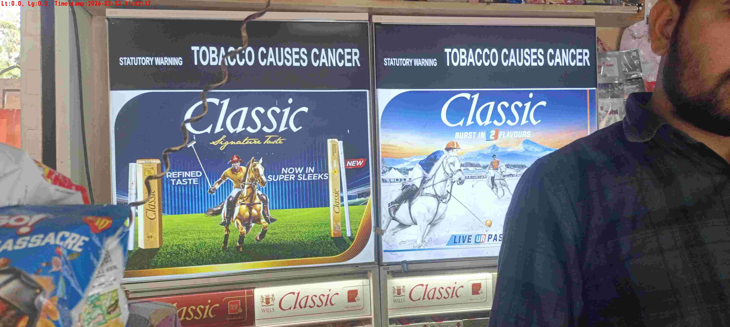
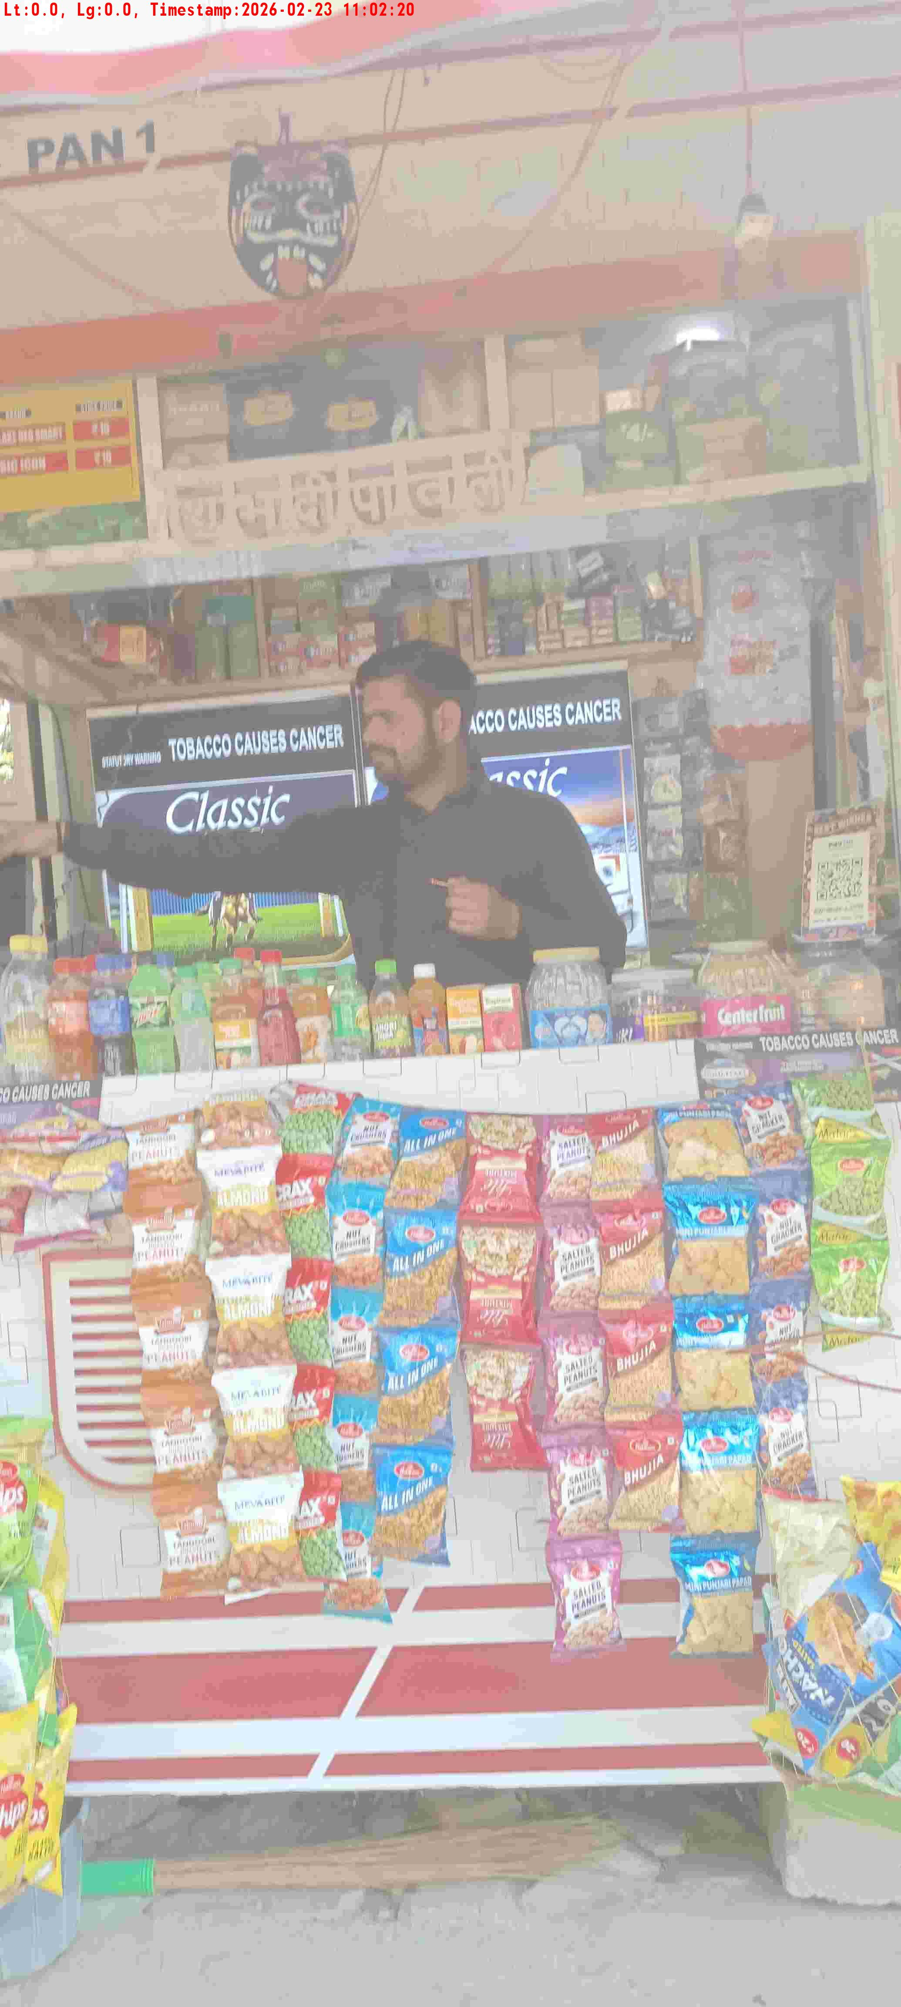
WD Code | DS Id | DS Name | Route Name | Shop Name | Date Time
DE5162 | 827 | Niche-DS48 | Mon-Thu | Classic Pan1 | 23-02-2026 11:02:15 AM
Shop Inside Picture
Shop Front Picture

Slide 19
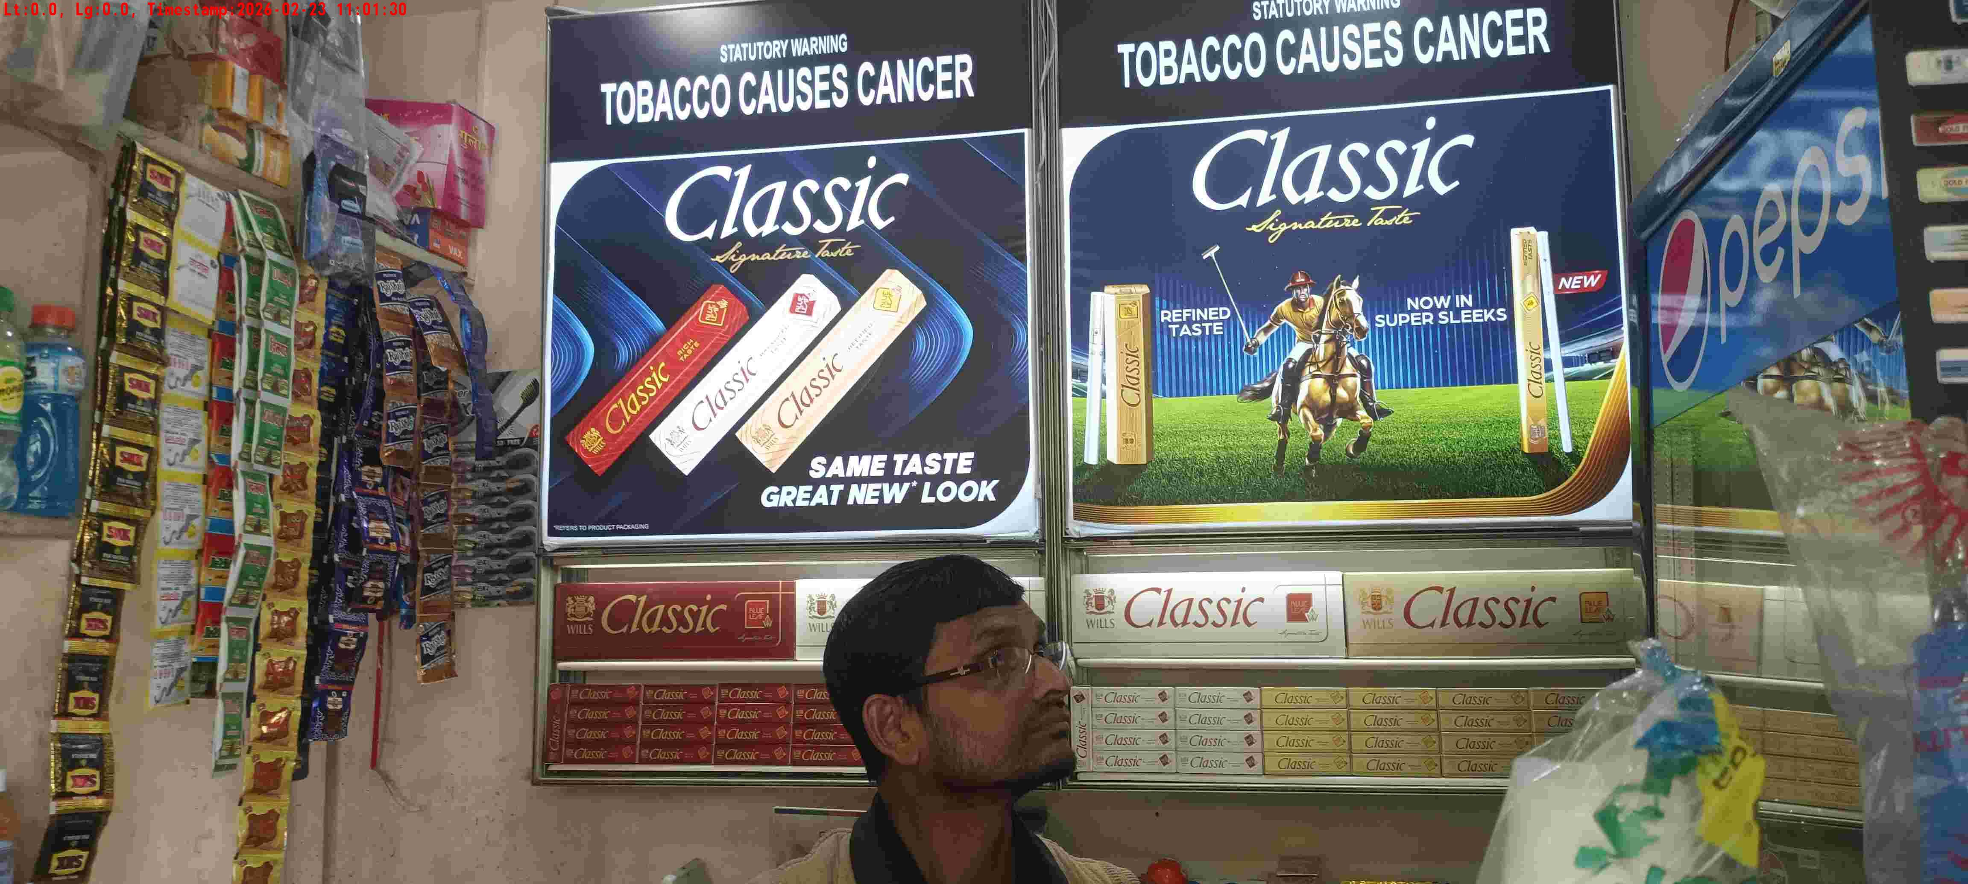
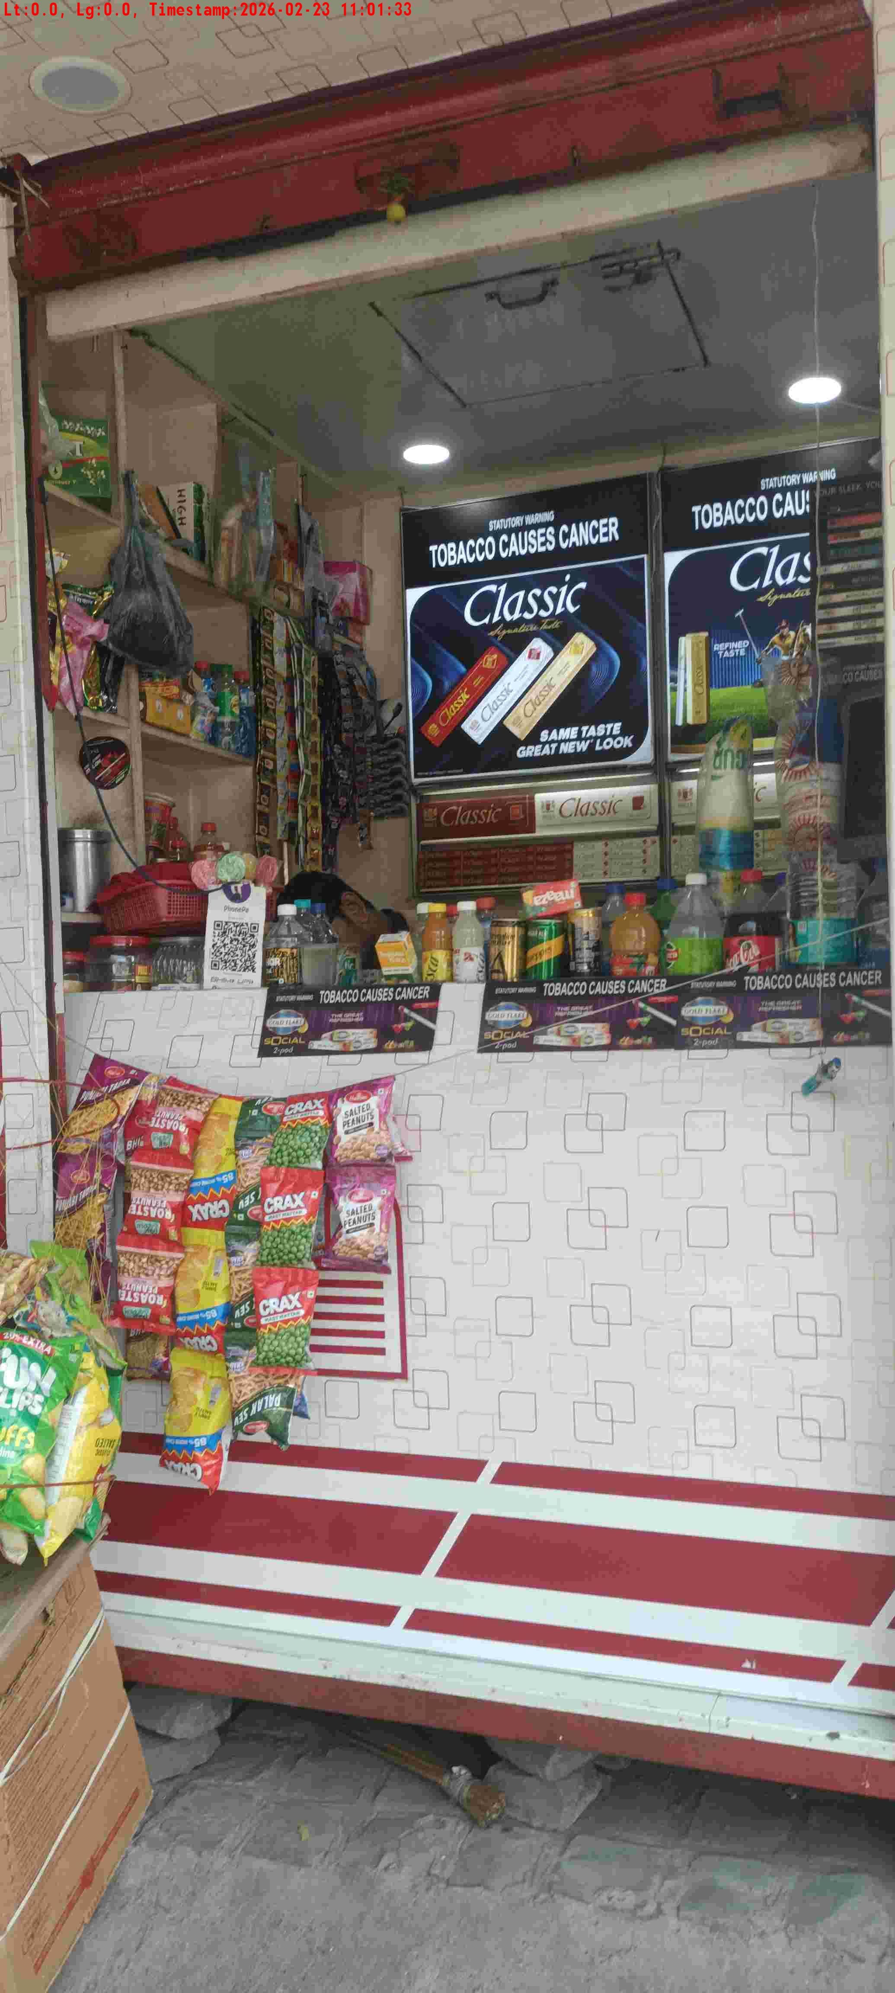
WD Code | DS Id | DS Name | Route Name | Shop Name | Date Time
DE5162 | 827 | Niche-DS48 | Mon-Thu | Lal Chand Pan | 23-02-2026 11:01:28 AM
Shop Inside Picture
Shop Front Picture

Slide 20
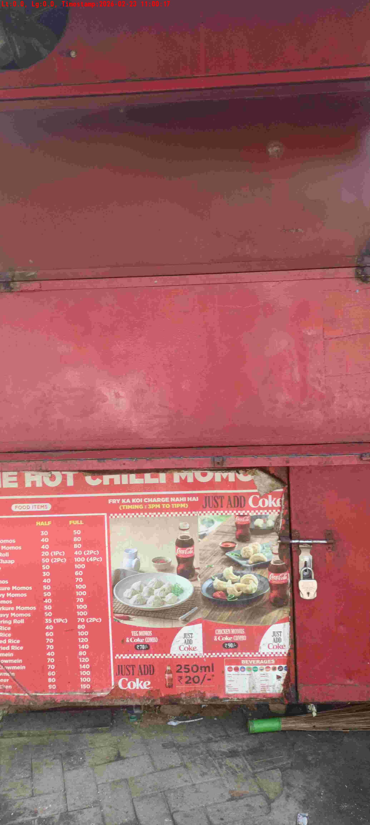
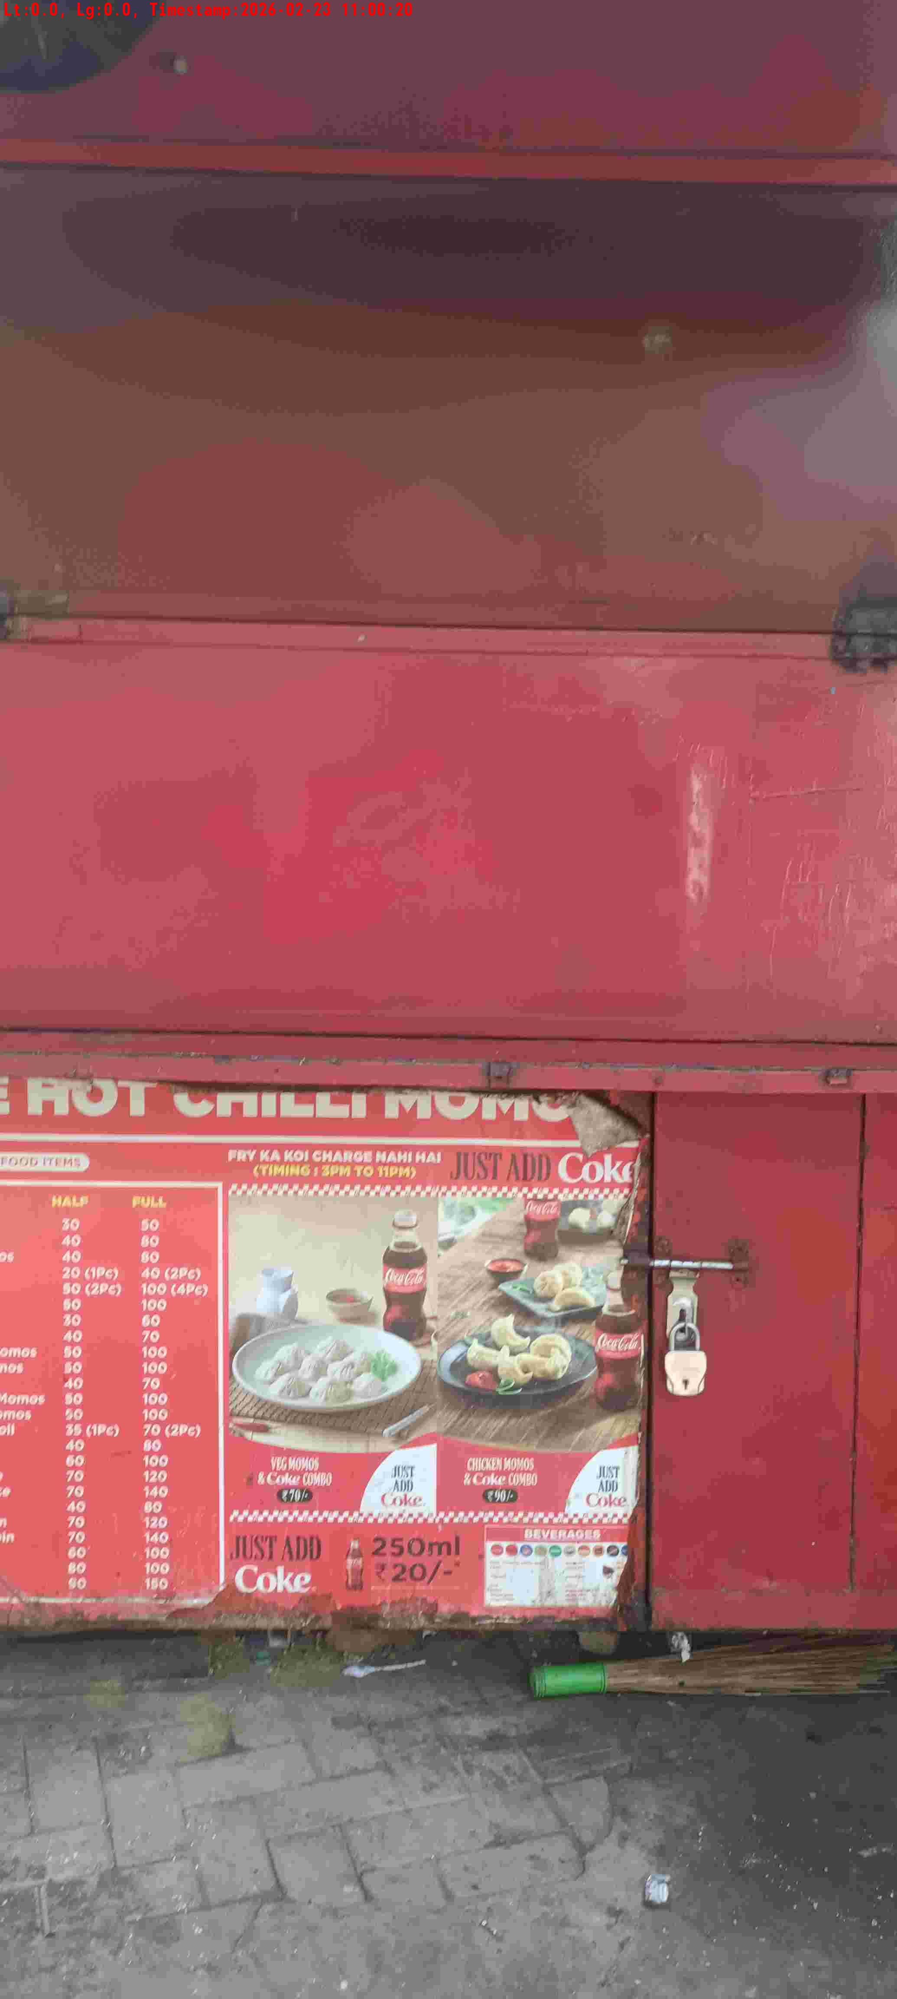
WD Code | DS Id | DS Name | Route Name | Shop Name | Date Time
DE5162 | 827 | Niche-DS48 | Mon-Thu | Vijender Pan Pan | 23-02-2026 11:00:15 AM
Shop Inside Picture
Shop Front Picture

Slide 21
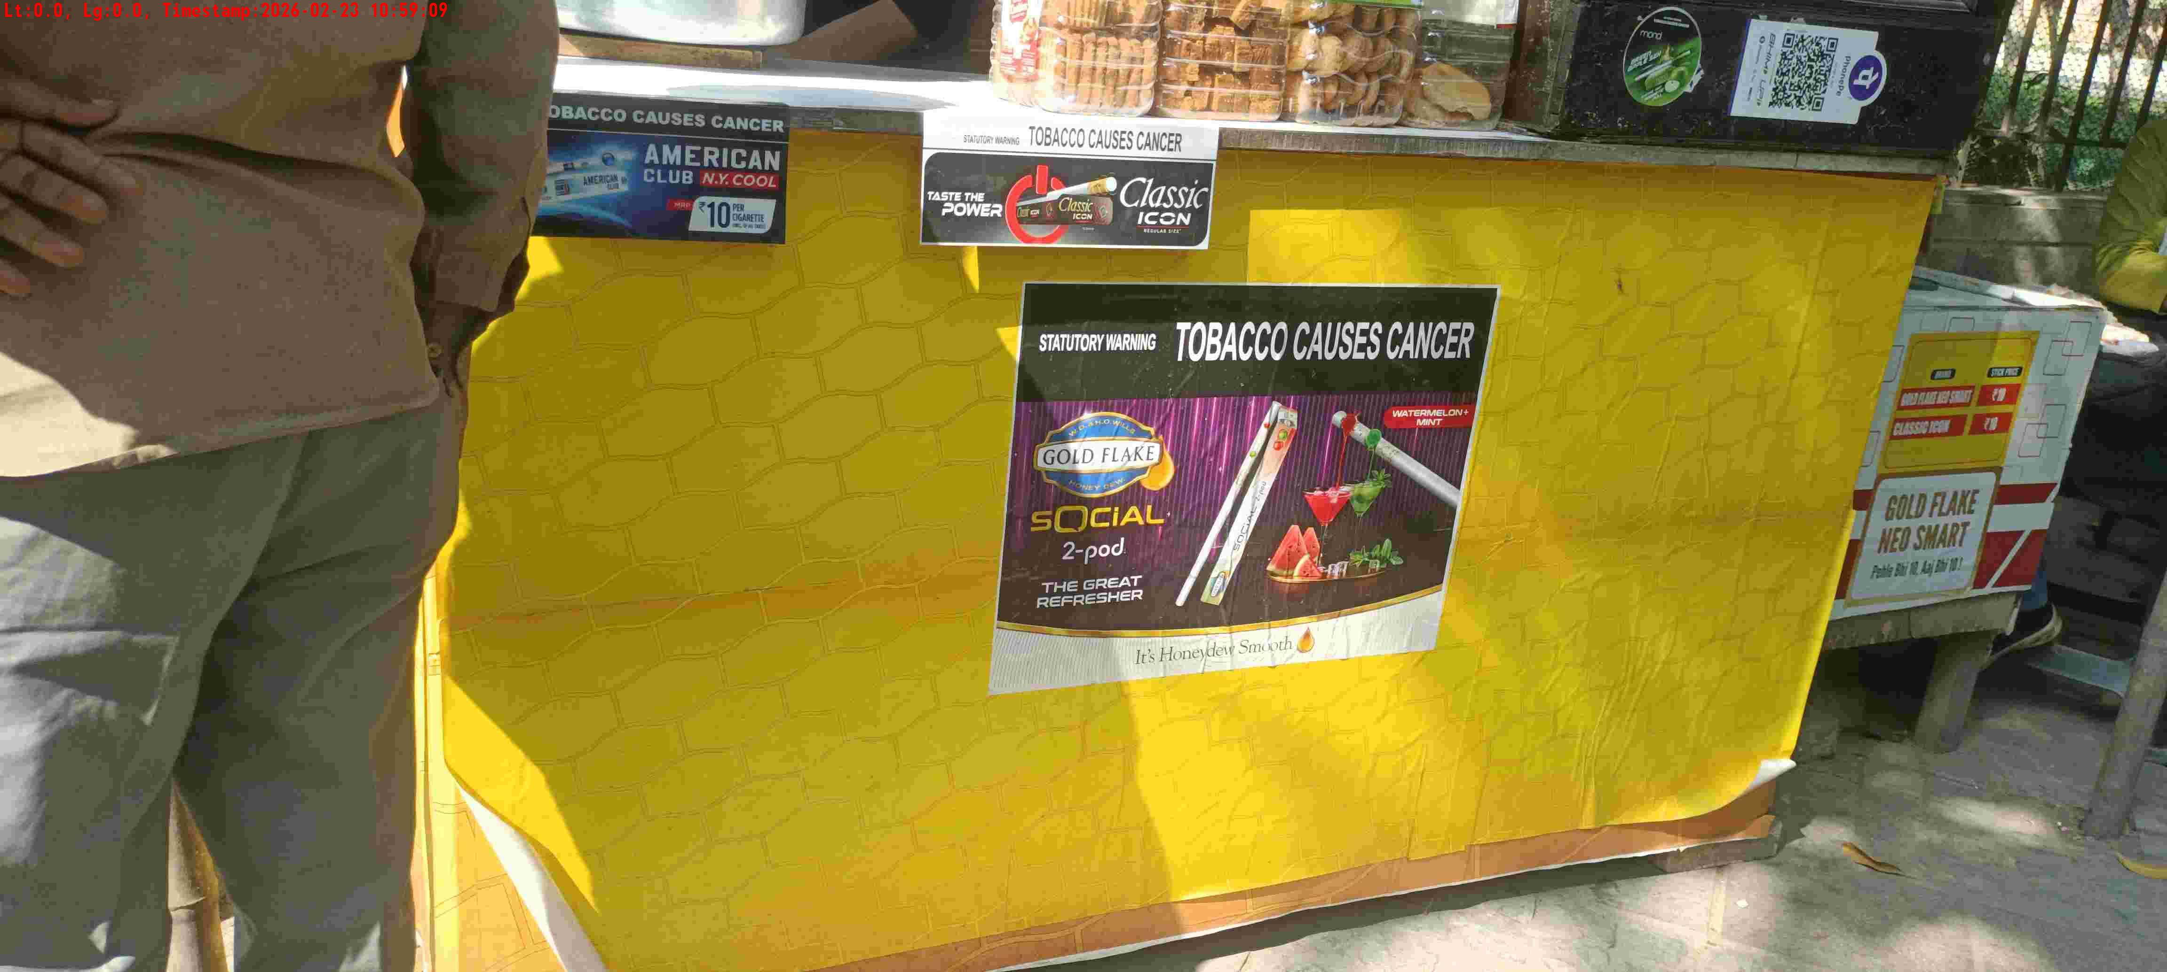
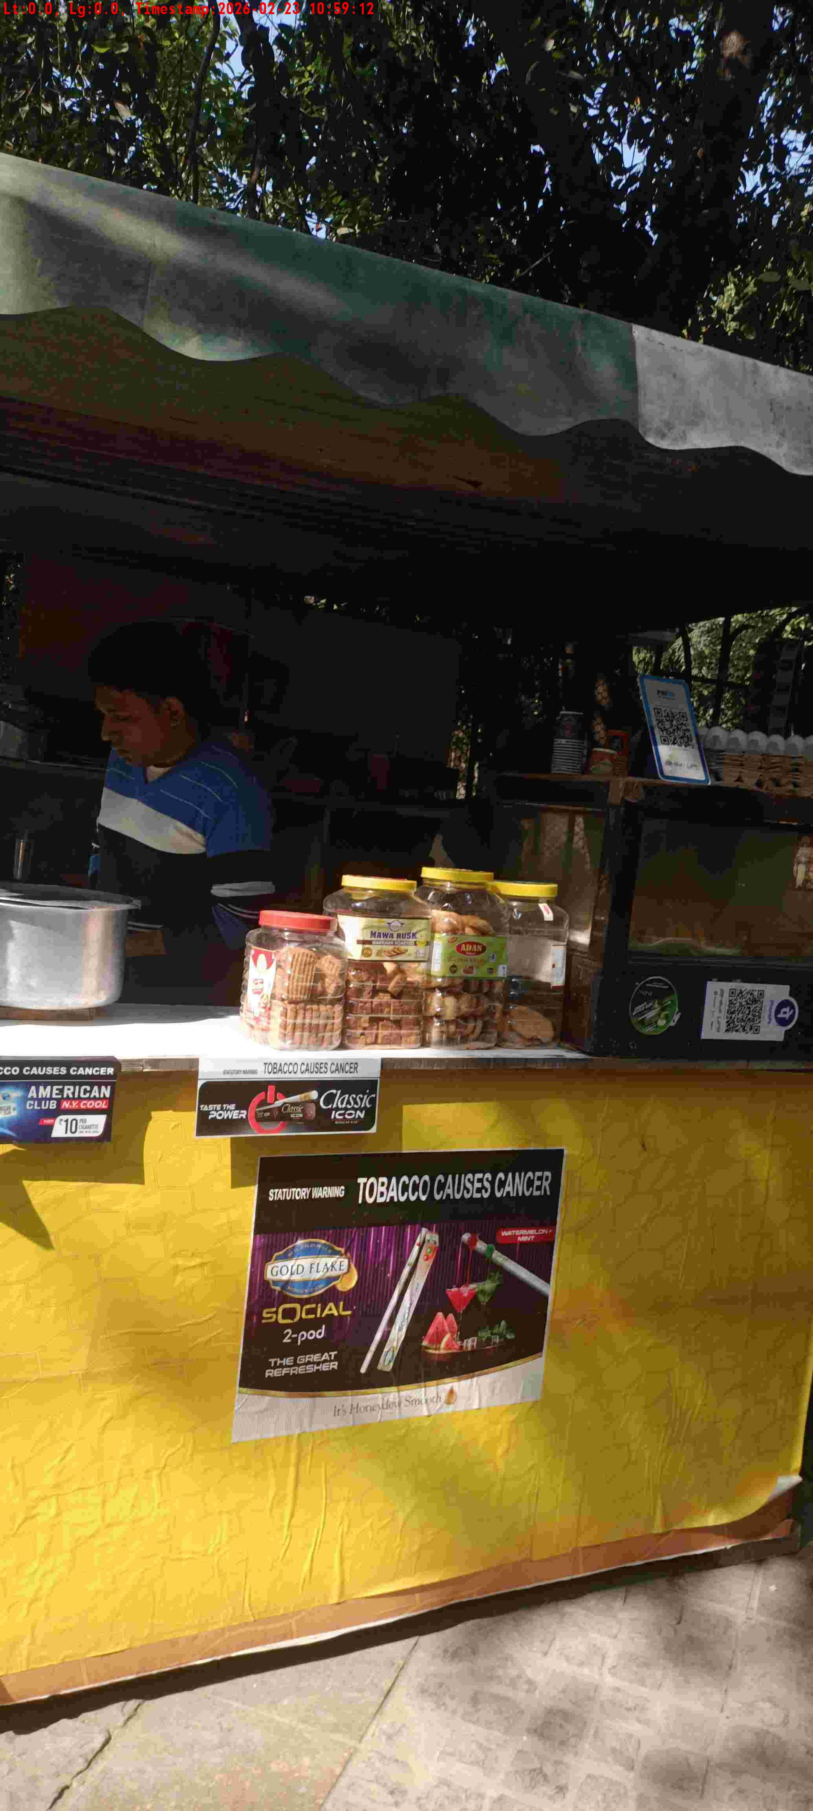
WD Code | DS Id | DS Name | Route Name | Shop Name | Date Time
DE5162 | 827 | Niche-DS48 | Mon-Thu | KRISHNA TEA | 23-02-2026 10:59:06 AM
Shop Inside Picture
Shop Front Picture

Slide 22
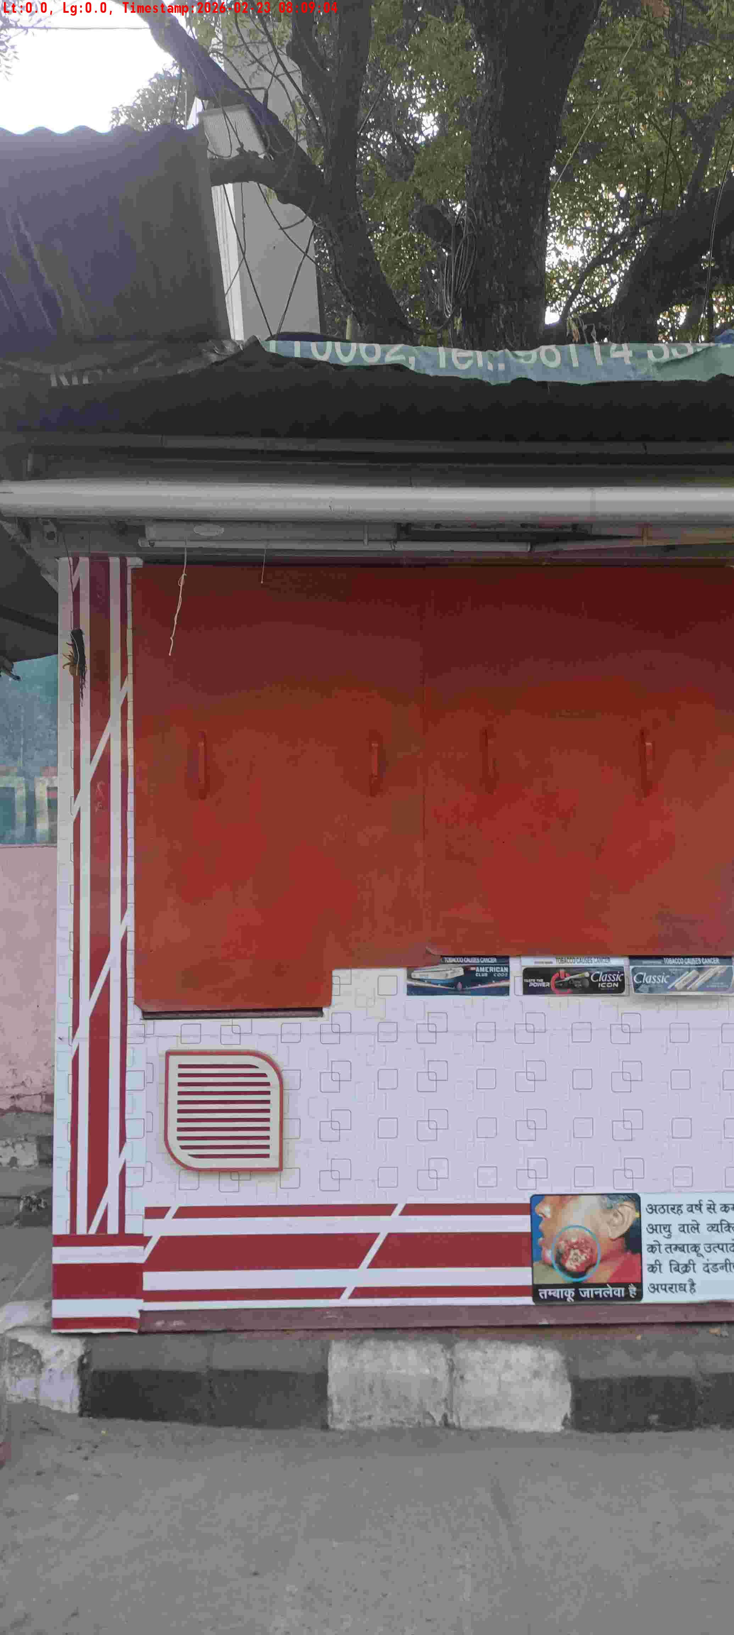
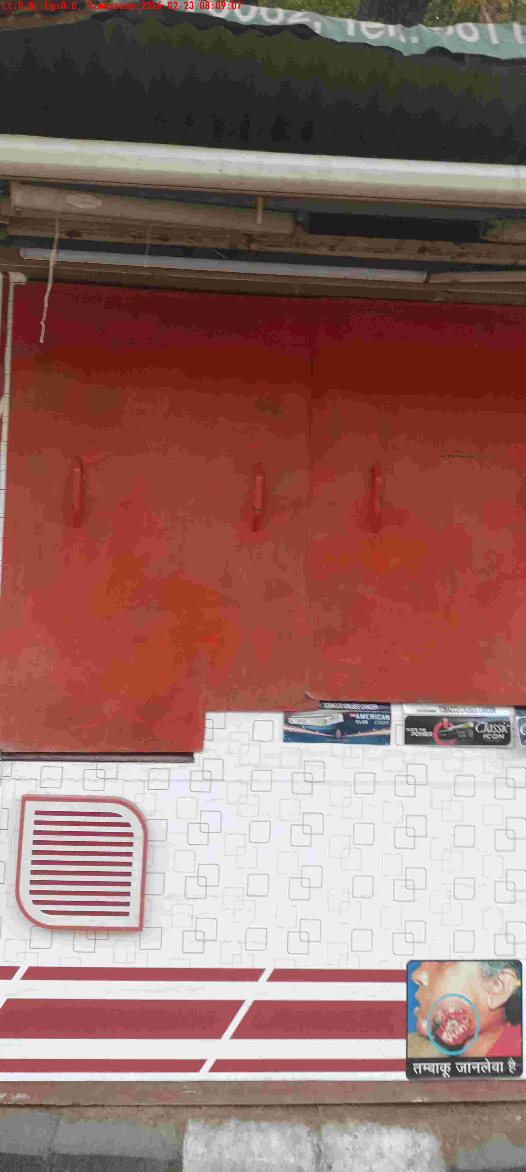
WD Code | DS Id | DS Name | Route Name | Shop Name | Date Time
DE5162 | 827 | Niche-DS48 | Mon-Thu | Mahak Pan1 | 23-02-2026 08:09:01 AM
Shop Inside Picture
Shop Front Picture

Slide 23
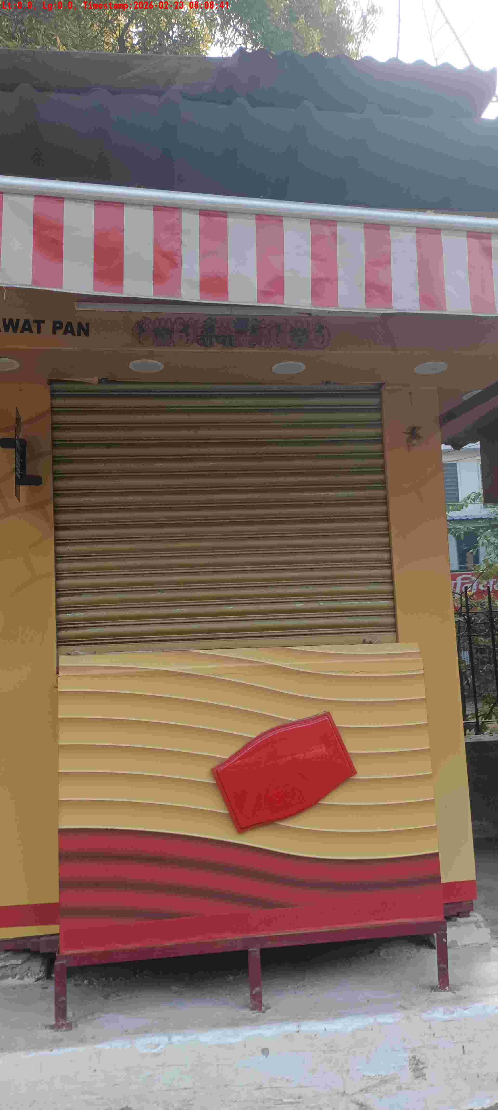
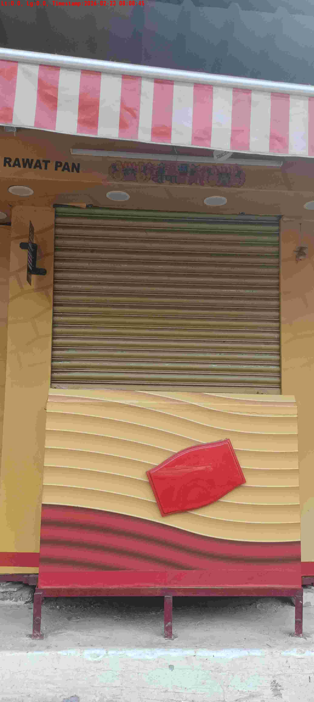
WD Code | DS Id | DS Name | Route Name | Shop Name | Date Time
DE5162 | 827 | Niche-DS48 | Mon-Thu | Rawat Pan | 23-02-2026 08:08:39 AM
Shop Inside Picture
Shop Front Picture

Slide 24
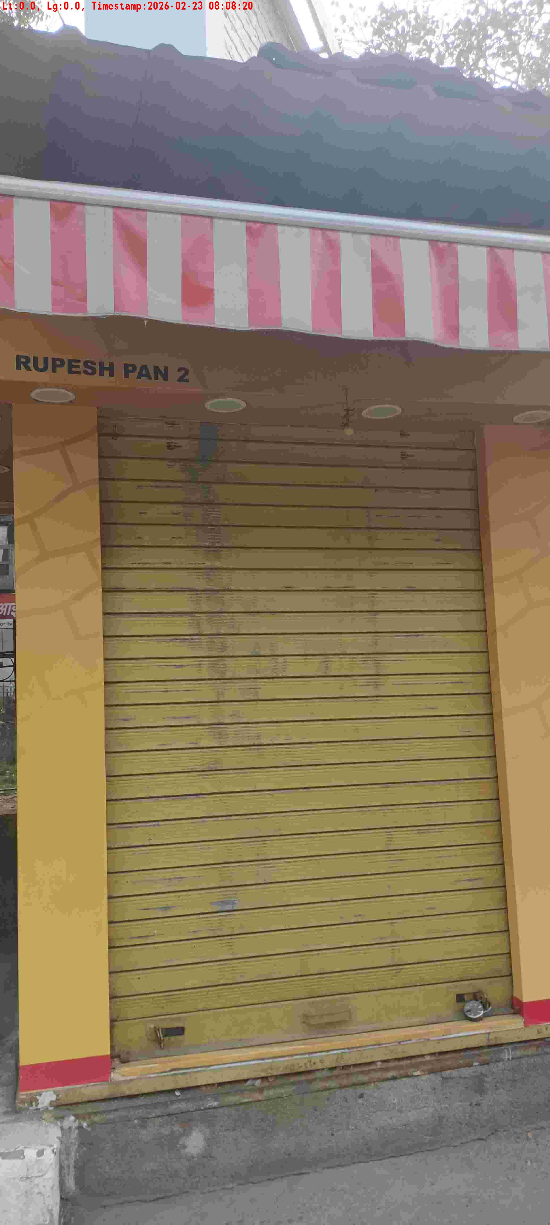
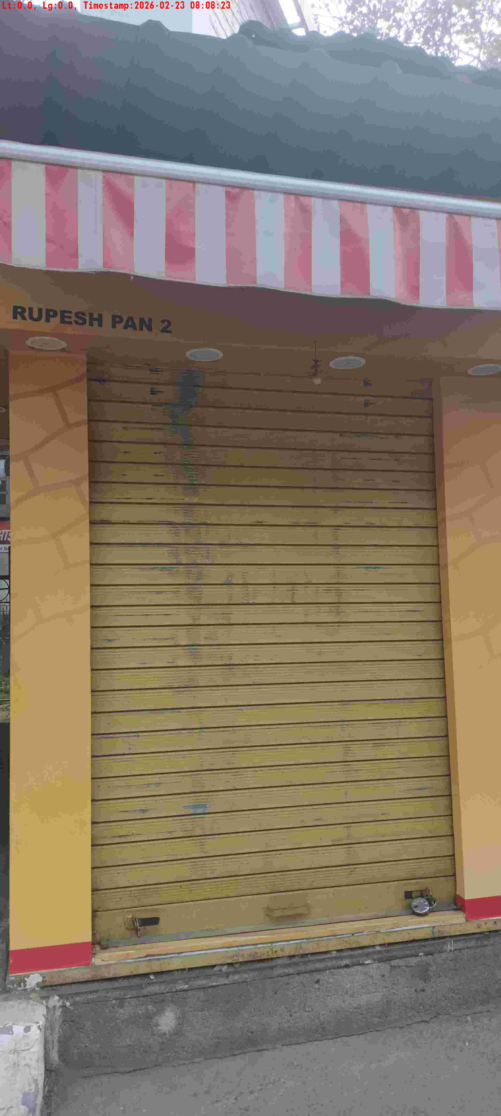
WD Code | DS Id | DS Name | Route Name | Shop Name | Date Time
DE5162 | 827 | Niche-DS48 | Mon-Thu | Rupesh Pan 2 | 23-02-2026 08:08:18 AM
Shop Inside Picture
Shop Front Picture

Slide 25
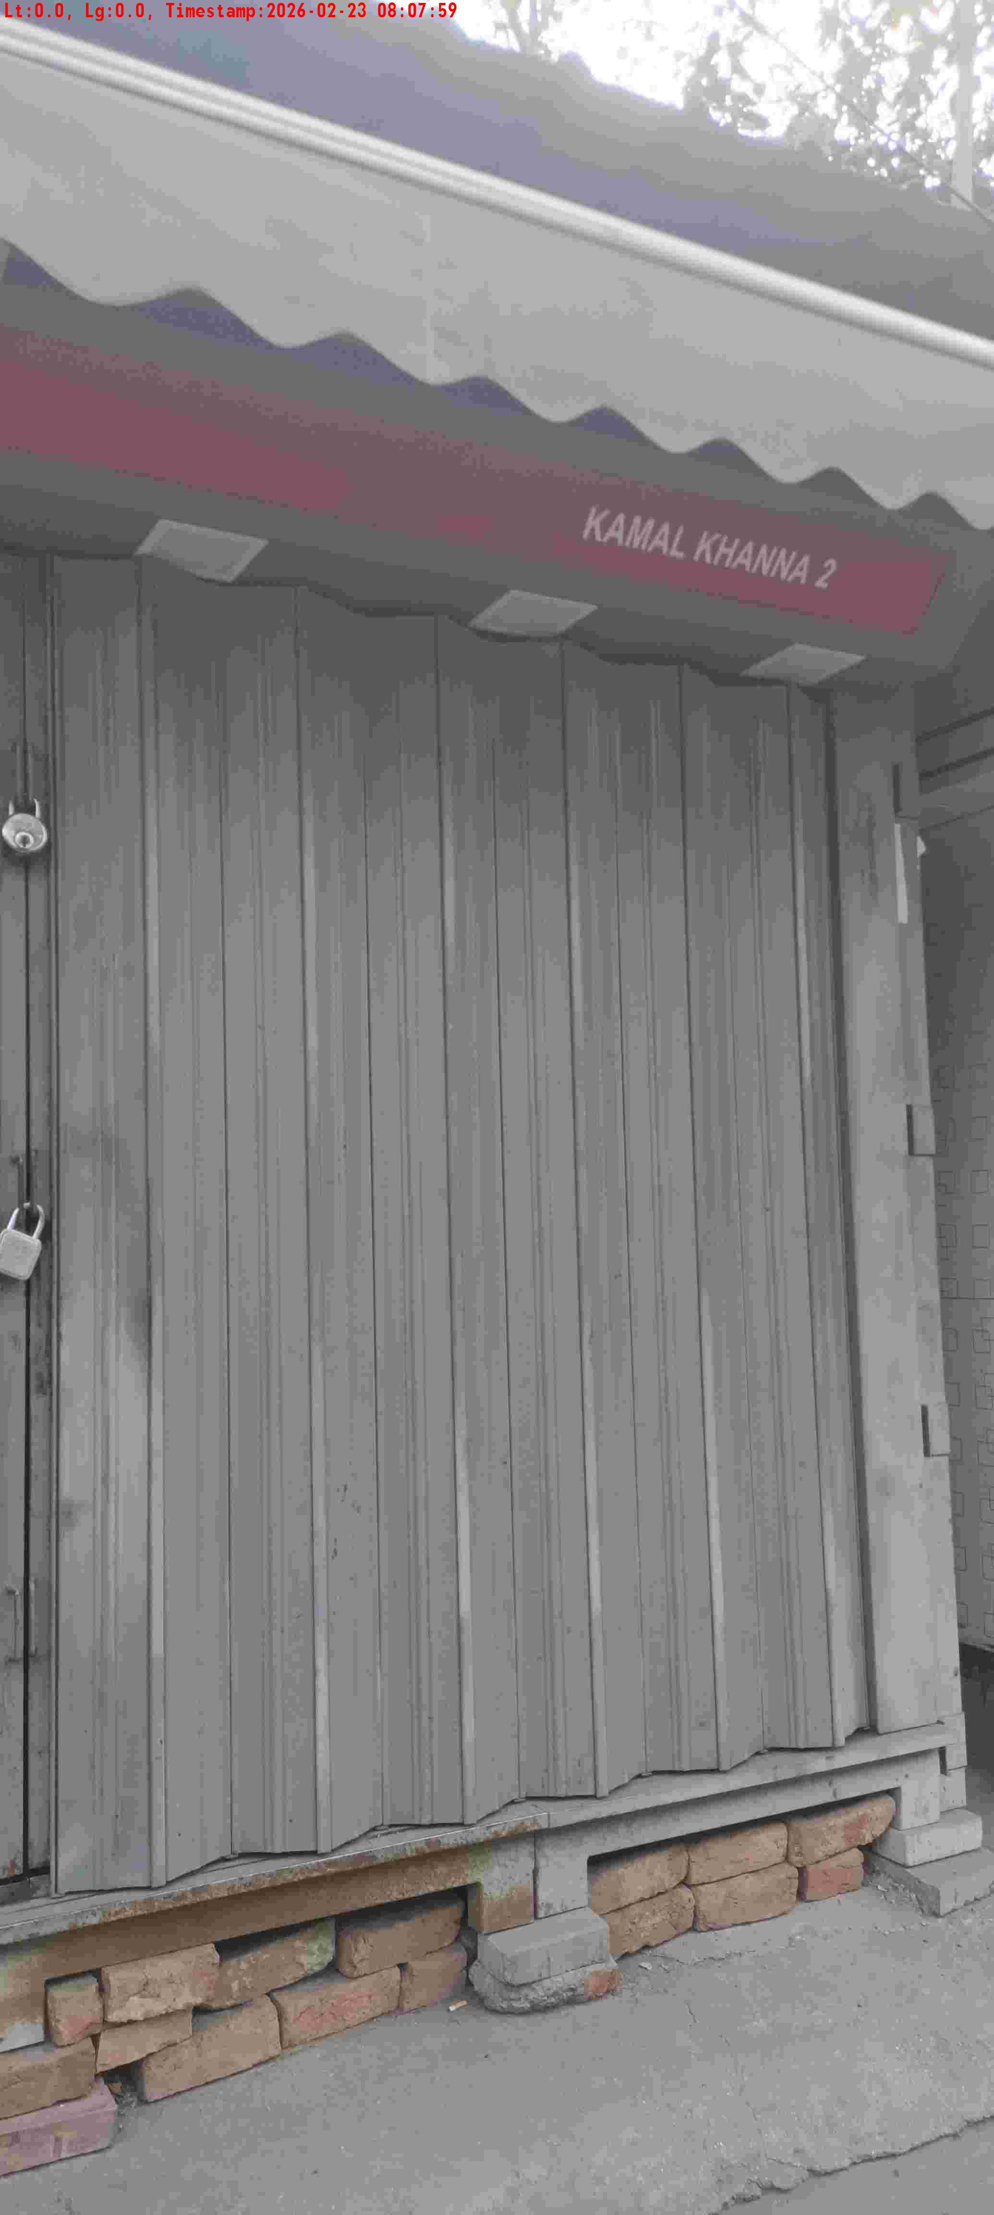
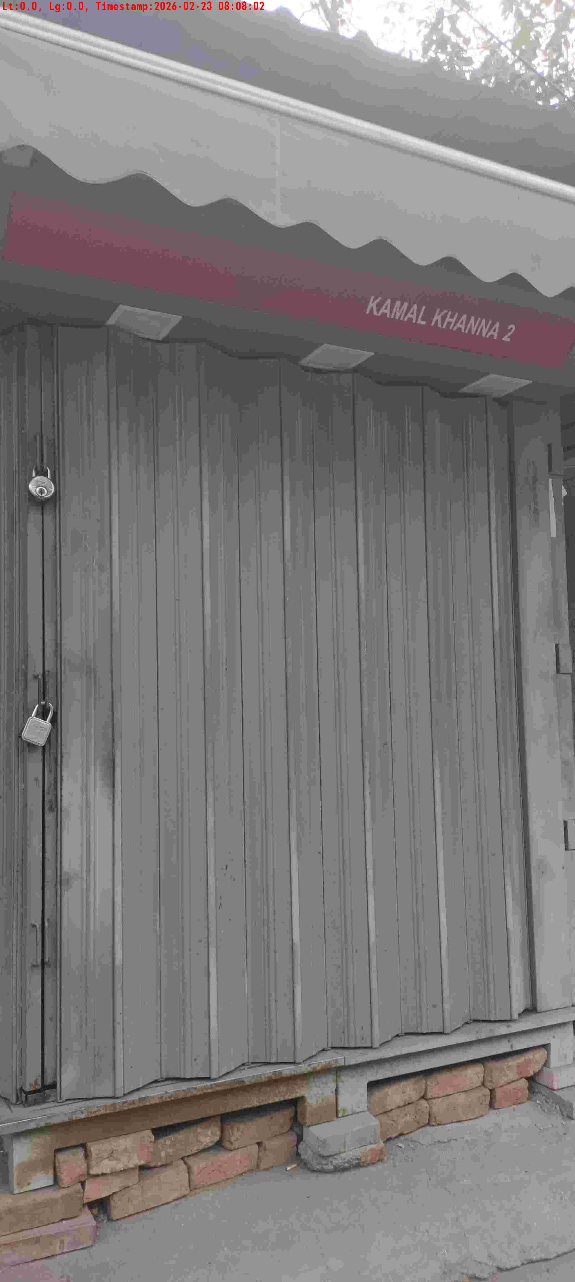
WD Code | DS Id | DS Name | Route Name | Shop Name | Date Time
DE5162 | 827 | Niche-DS48 | Mon-Thu | Kamal Khana Pan 2 | 23-02-2026 08:07:57 AM
Shop Inside Picture
Shop Front Picture

Slide 26
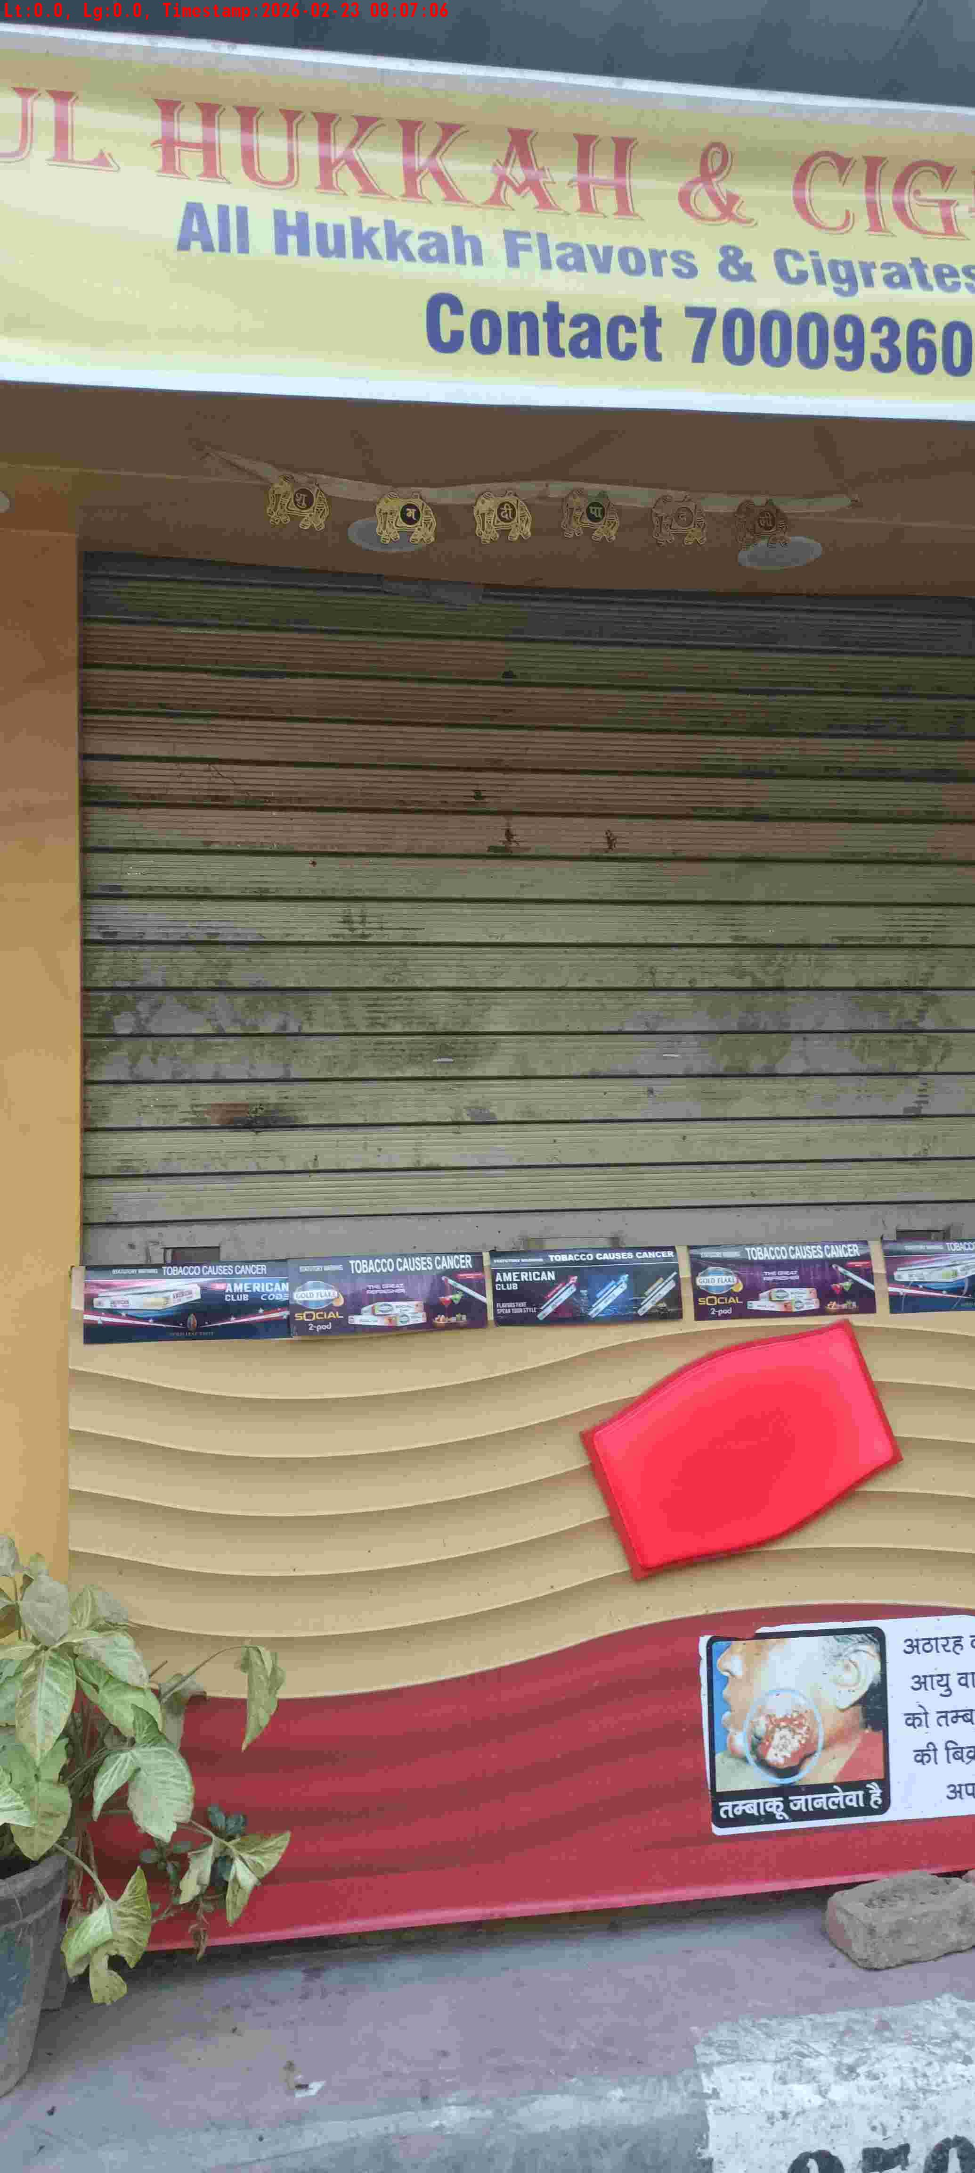
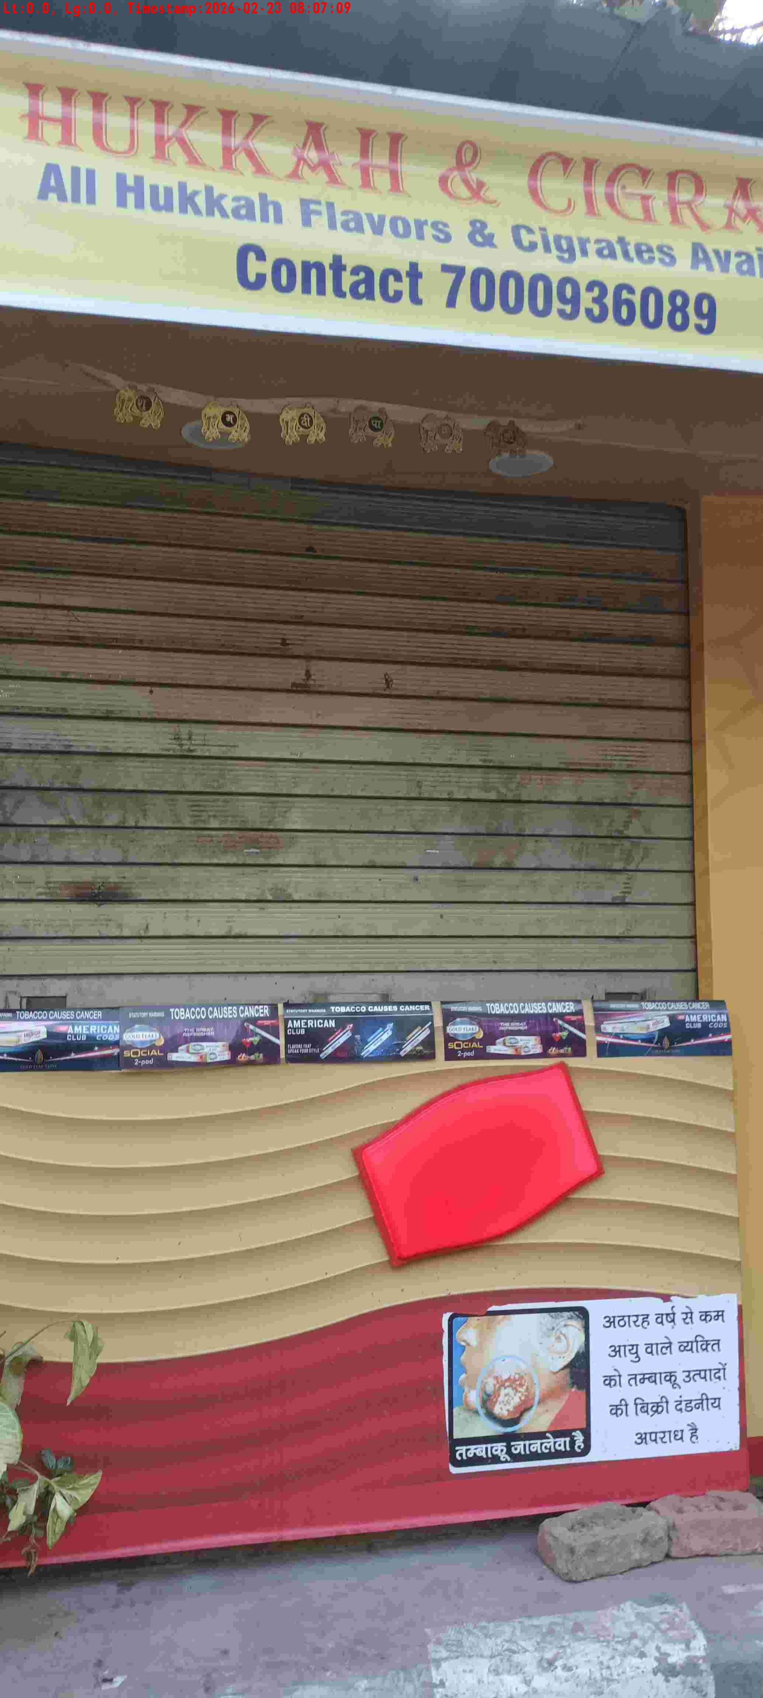
WD Code | DS Id | DS Name | Route Name | Shop Name | Date Time
DE5162 | 827 | Niche-DS48 | Mon-Thu | Neetu Pan 4 | 23-02-2026 08:07:04 AM
Shop Inside Picture
Shop Front Picture

Slide 27


WD Code | DS Id | DS Name | Route Name | Shop Name | Date Time
DE5162 | 827 | Niche-DS48 | Mon-Thu | Neetu Pan 3 | 23-02-2026 08:06:39 AM
Shop Inside Picture
Shop Front Picture

Slide 28


WD Code | DS Id | DS Name | Route Name | Shop Name | Date Time
DE5162 | 827 | Niche-DS48 | Mon-Thu | Neetu Pan 2 | 23-02-2026 08:06:19 AM
Shop Inside Picture
Shop Front Picture

Slide 29


WD Code | DS Id | DS Name | Route Name | Shop Name | Date Time
DE5162 | 827 | Niche-DS48 | Mon-Thu | Neetu Pan 1 | 23-02-2026 08:06:00 AM
Shop Inside Picture
Shop Front Picture

Slide 30


WD Code | DS Id | DS Name | Route Name | Shop Name | Date Time
DE5162 | 827 | Niche-DS48 | Mon-Thu | Vinod Pan | 23-02-2026 08:05:02 AM
Shop Inside Picture
Shop Front Picture

Slide 31


WD Code | DS Id | DS Name | Route Name | Shop Name | Date Time
DE5162 | 827 | Niche-DS48 | Mon-Thu | Ved Prakesh Pan | 23-02-2026 07:59:43 AM
Shop Inside Picture
Shop Front Picture

