Slide 1
Transaction Ppt

Slide 2
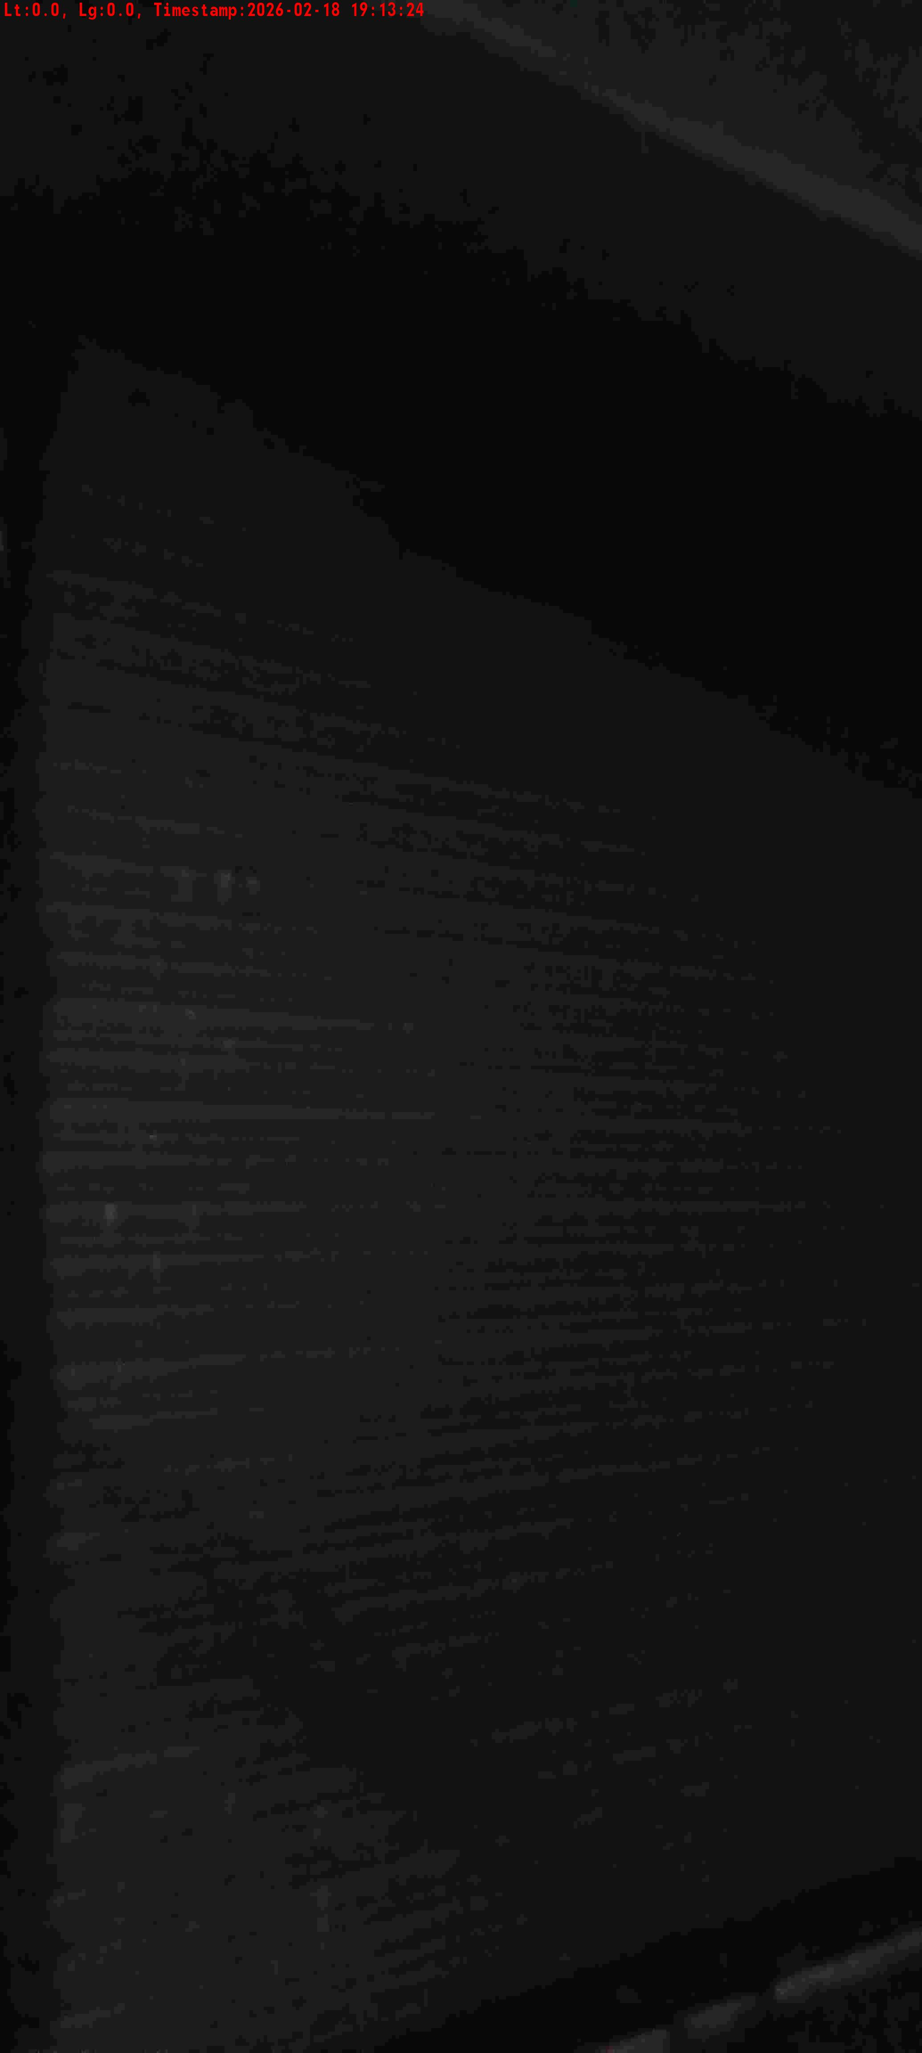
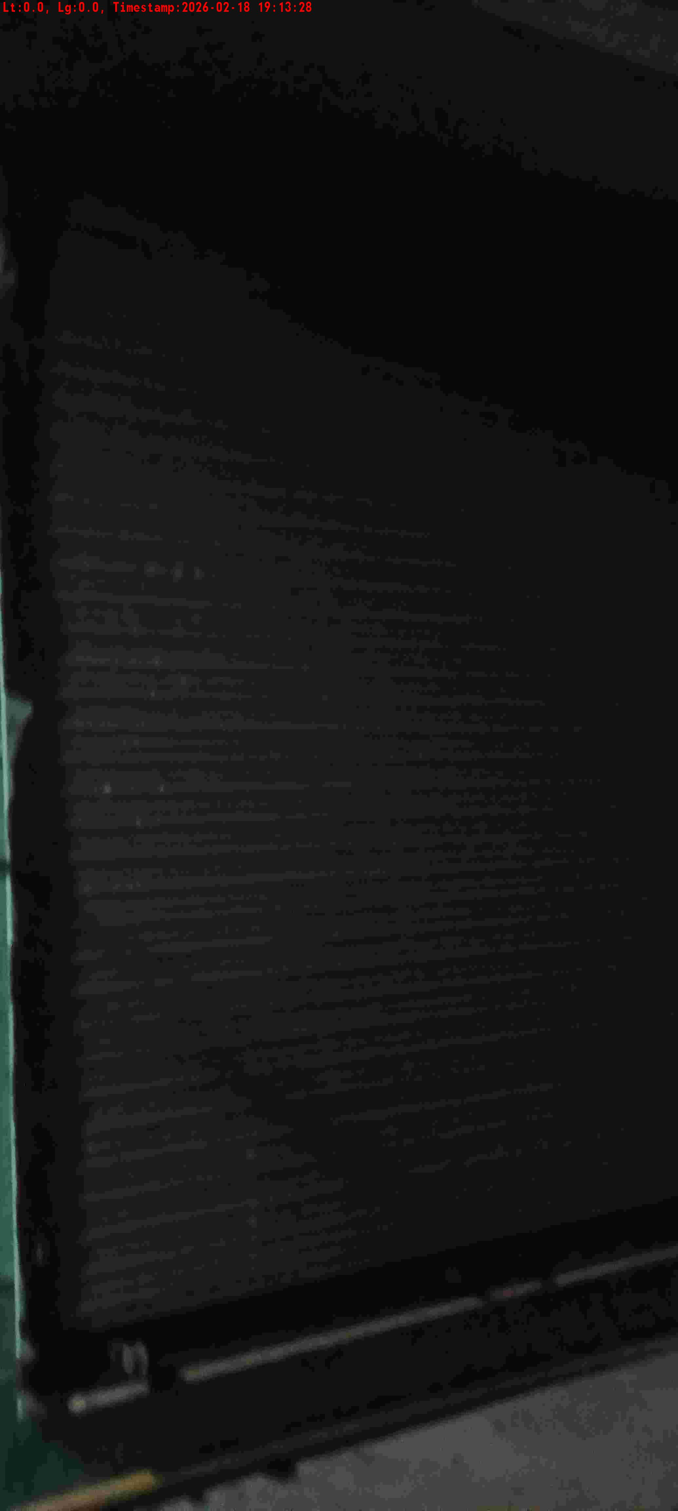
WD Code | DS Id | DS Name | Route Name | Shop Name | Date Time
DE5162 | 827 | Niche-DS48 | Wed-Sat | Himgiri Store | 18-02-2026 07:13:22 PM
Shop Inside Picture
Shop Front Picture

Slide 3
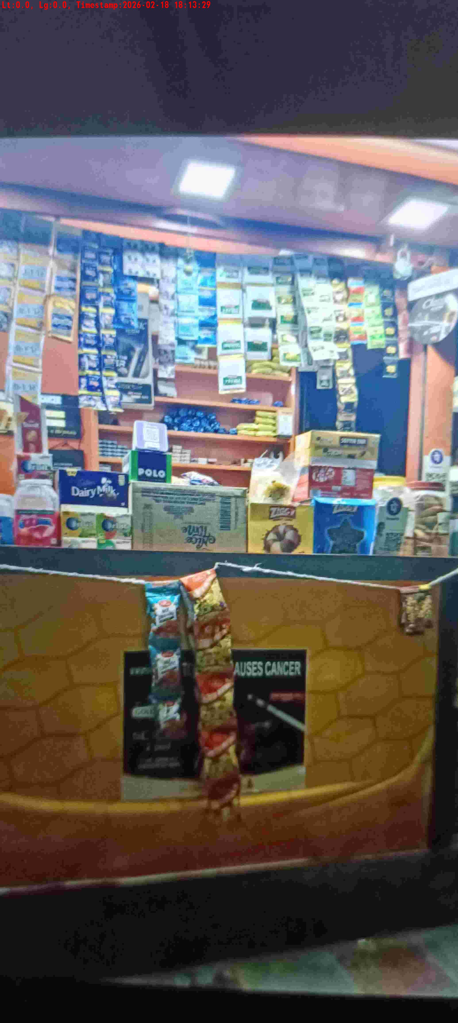
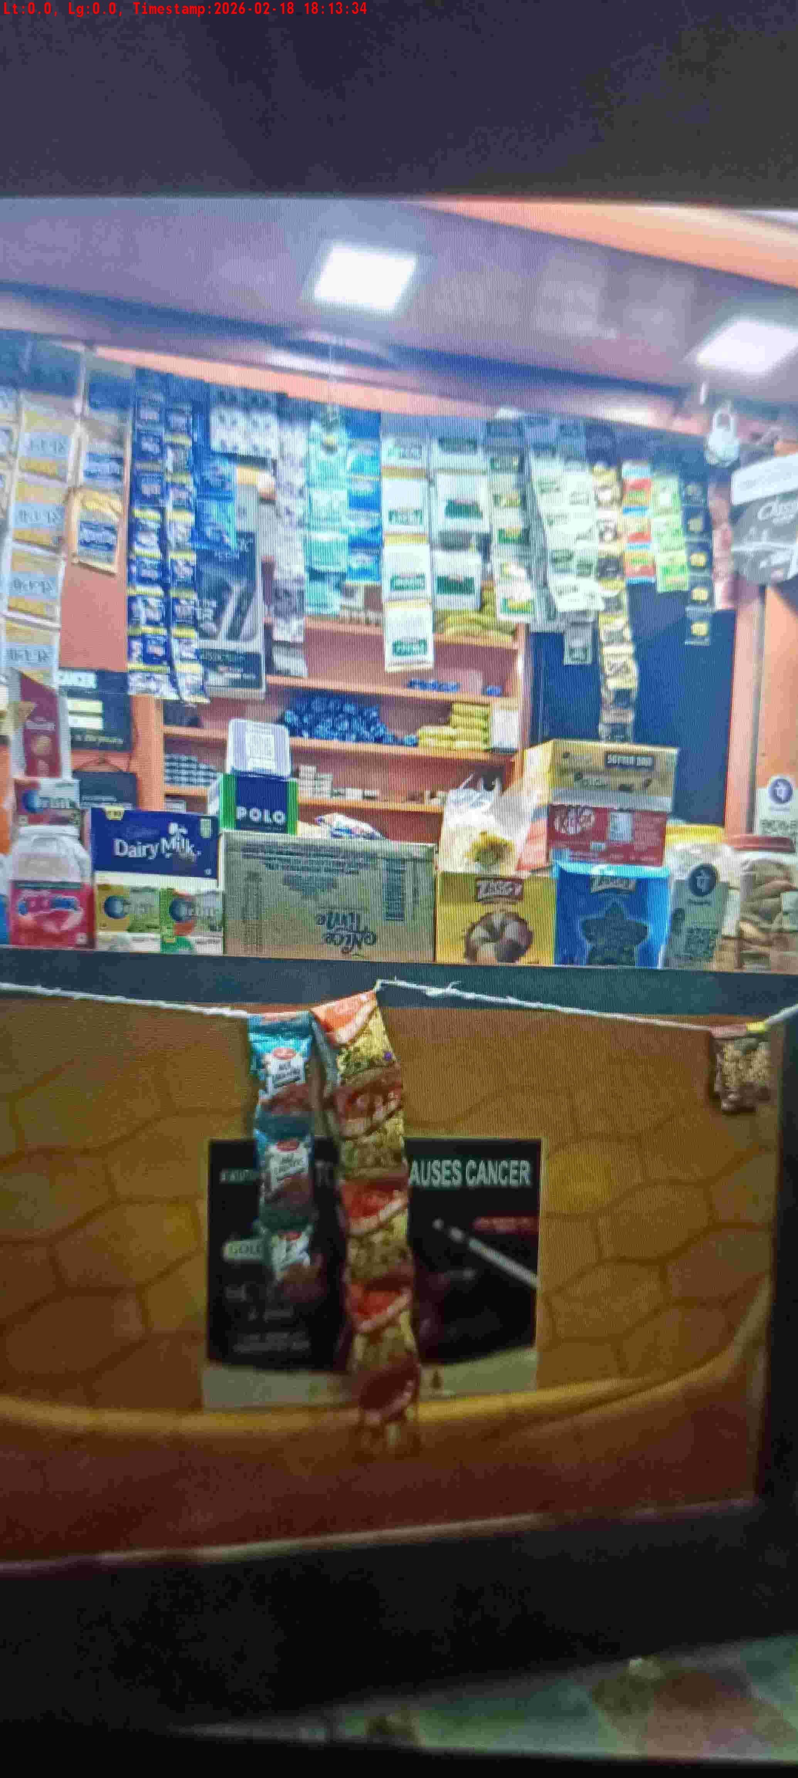
WD Code | DS Id | DS Name | Route Name | Shop Name | Date Time
DE5162 | 827 | Niche-DS48 | Wed-Sat | Vikash Tea | 18-02-2026 06:13:26 PM
Shop Inside Picture
Shop Front Picture

Slide 4
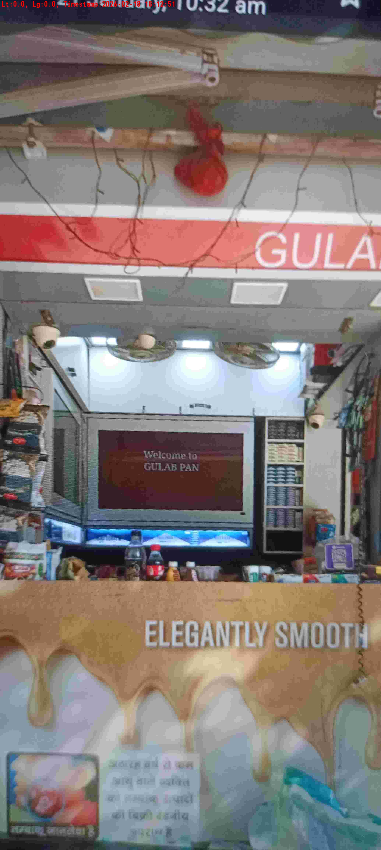
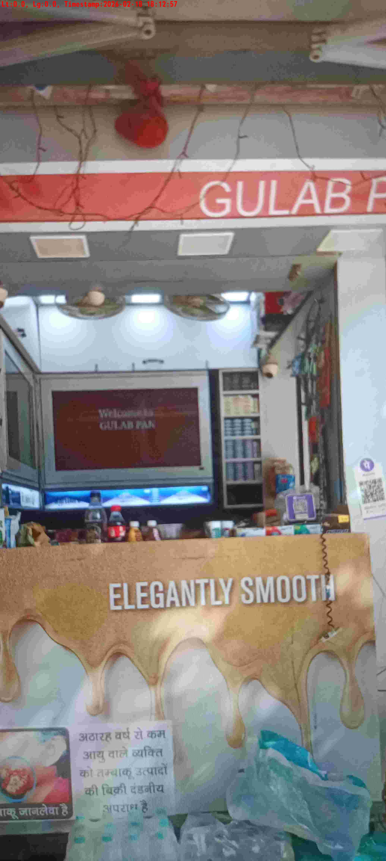
WD Code | DS Id | DS Name | Route Name | Shop Name | Date Time
DE5162 | 827 | Niche-DS48 | Wed-Sat | Gulab Pan | 18-02-2026 06:12:49 PM
Shop Inside Picture
Shop Front Picture

Slide 5
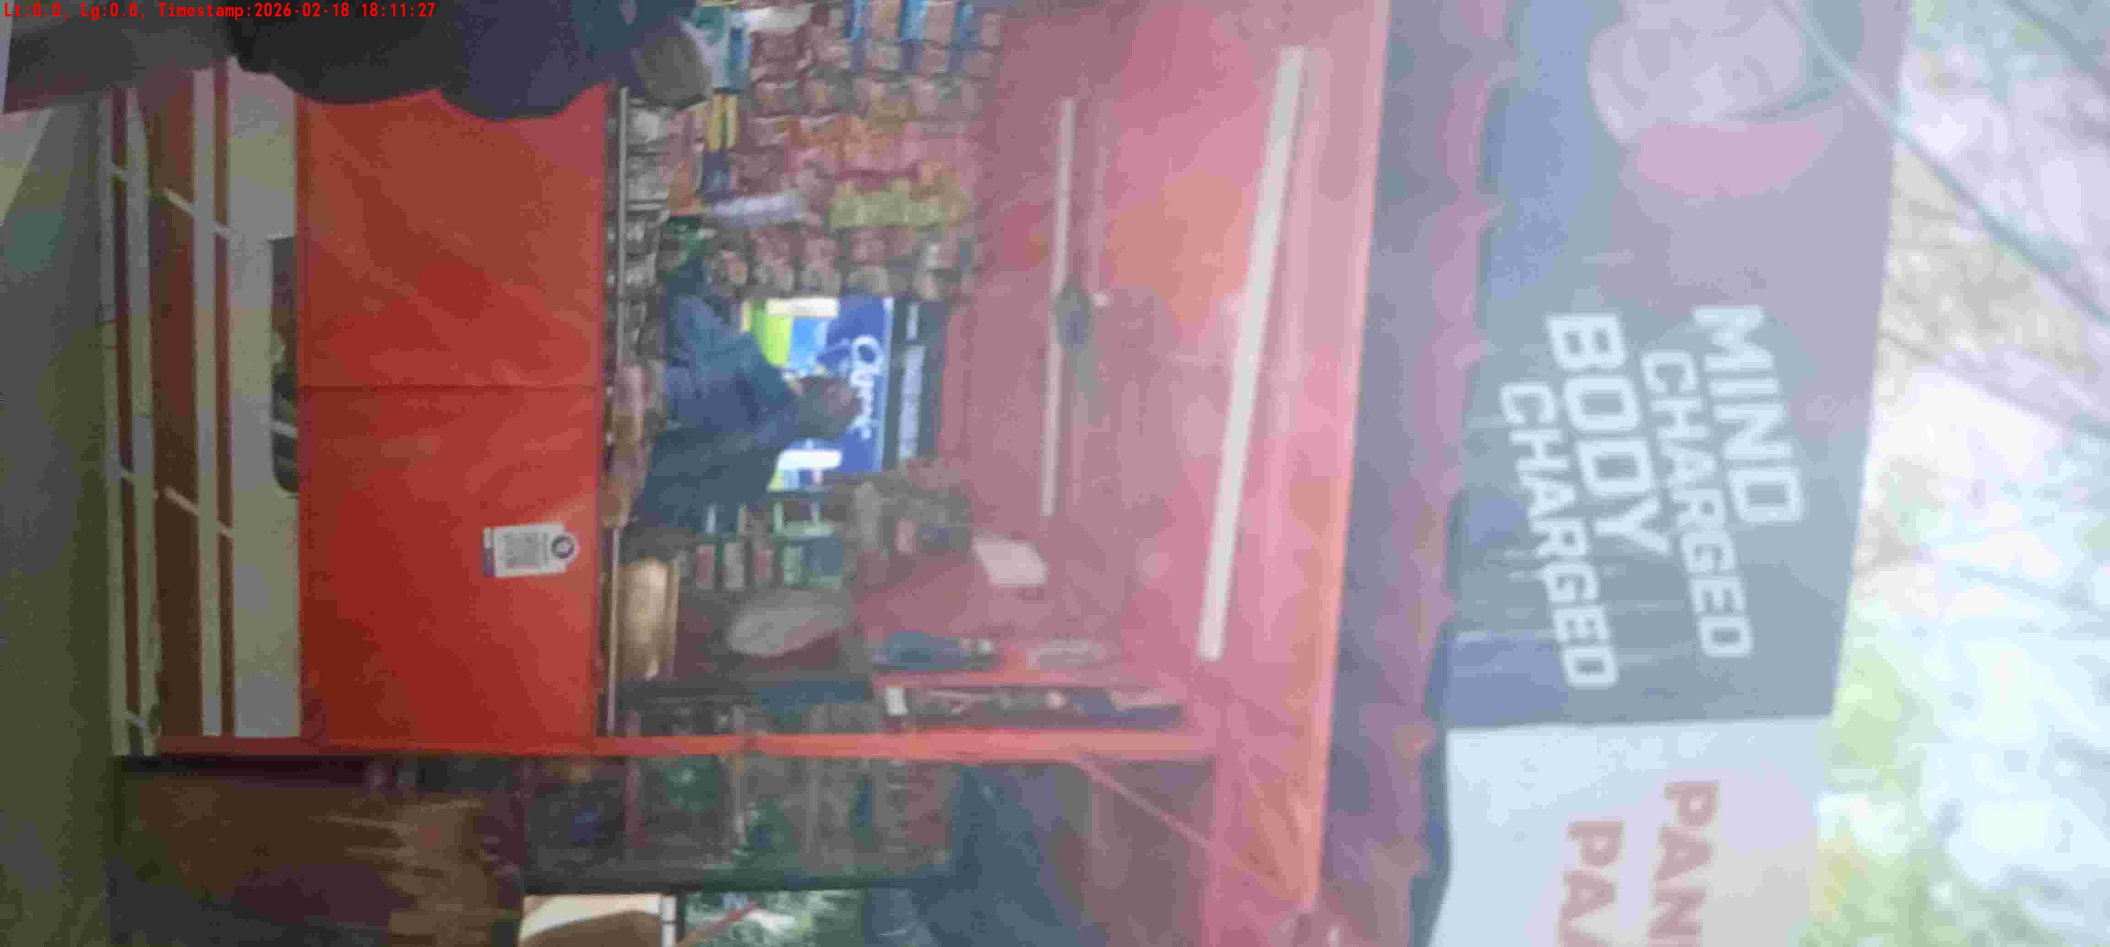
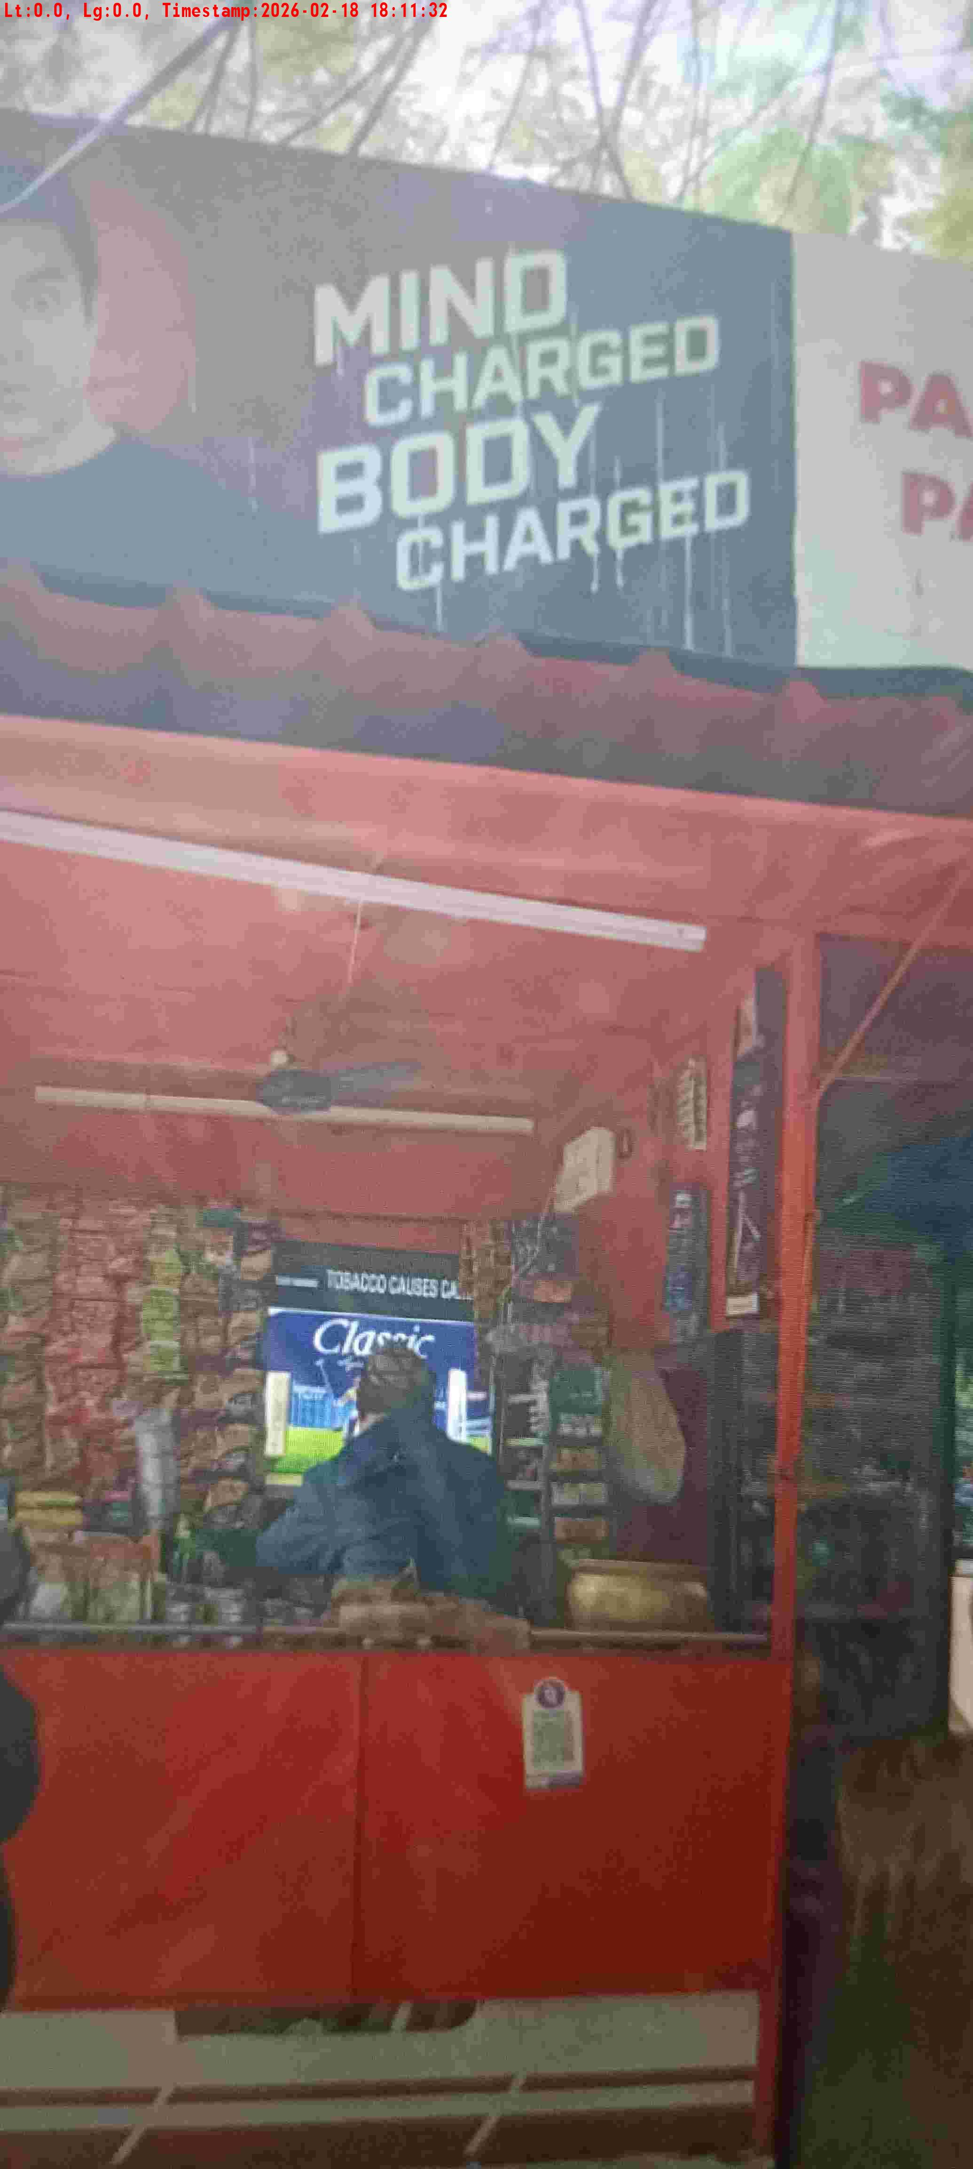
WD Code | DS Id | DS Name | Route Name | Shop Name | Date Time
DE5162 | 827 | Niche-DS48 | Wed-Sat | Pandit Pan | 18-02-2026 06:11:24 PM
Shop Inside Picture
Shop Front Picture

Slide 6
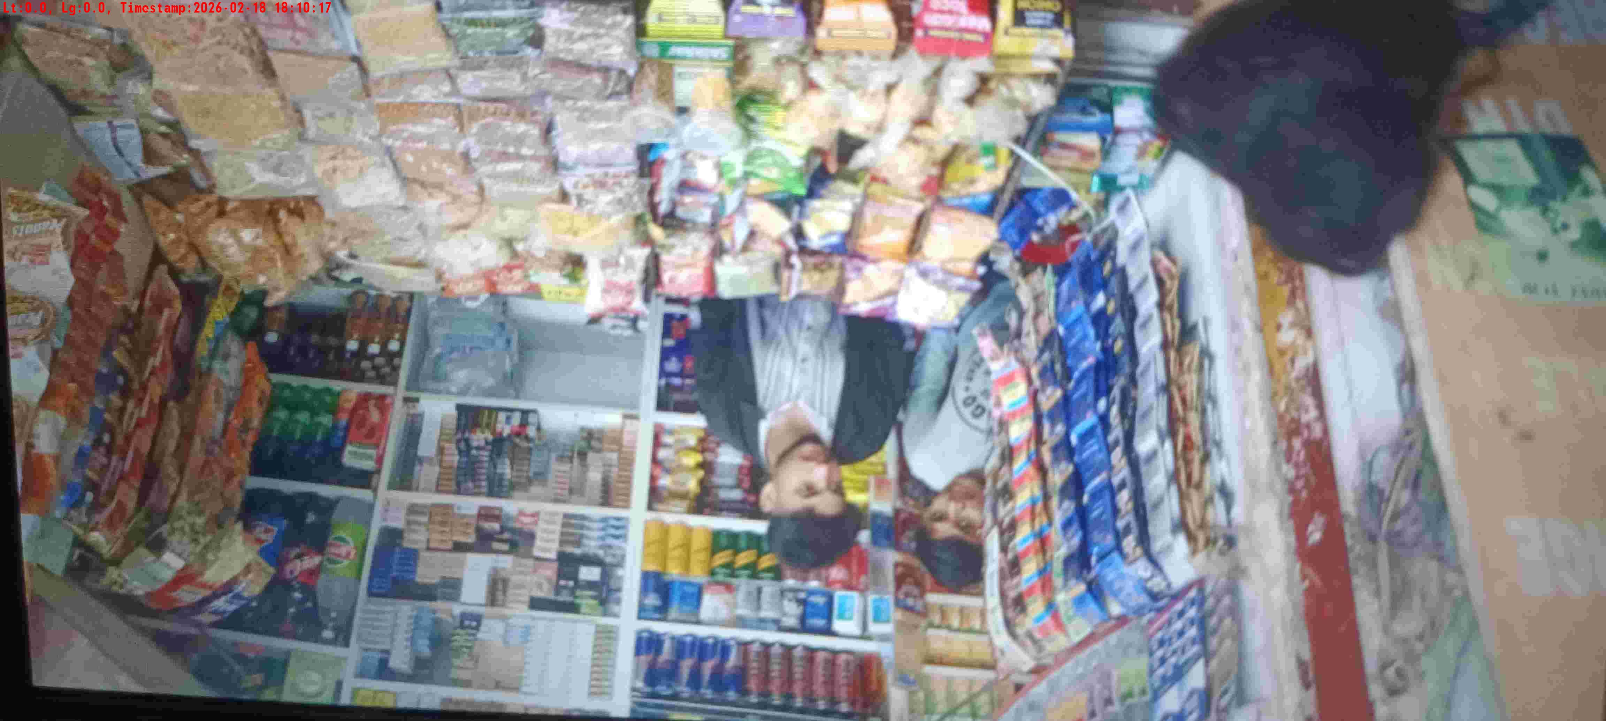
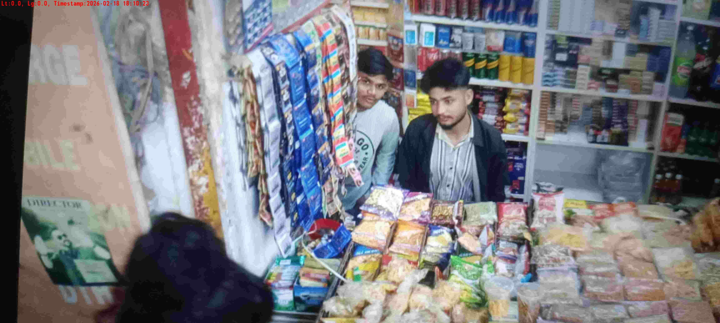
WD Code | DS Id | DS Name | Route Name | Shop Name | Date Time
DE5162 | 827 | Niche-DS48 | Wed-Sat | Jain Tele | 18-02-2026 06:10:14 PM
Shop Inside Picture
Shop Front Picture

Slide 7
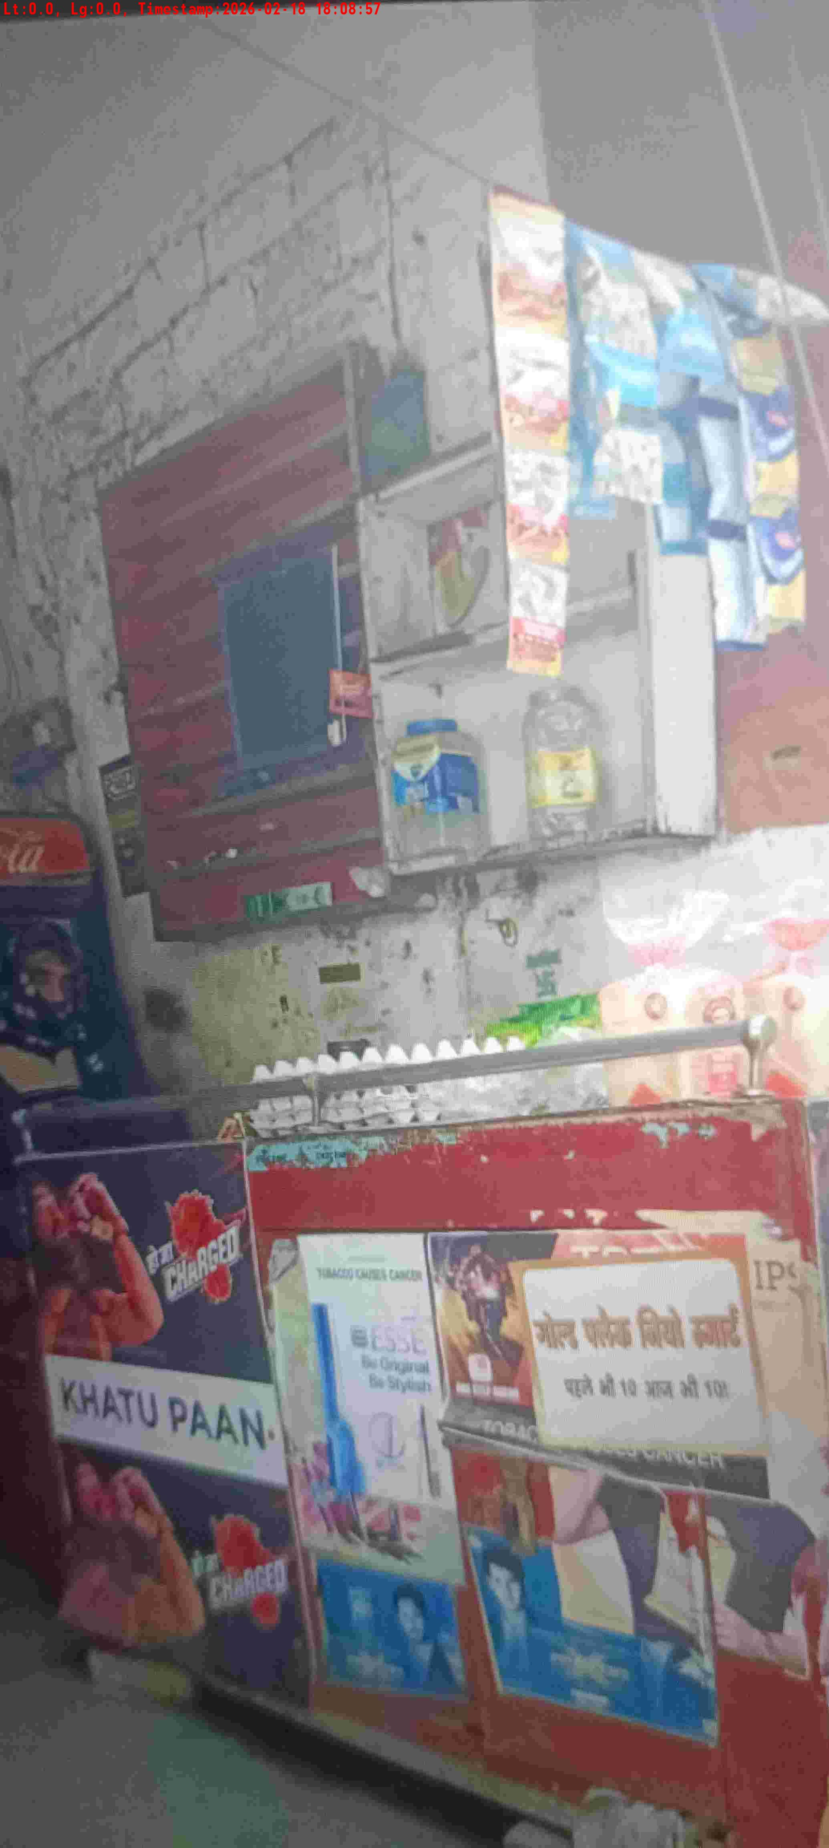
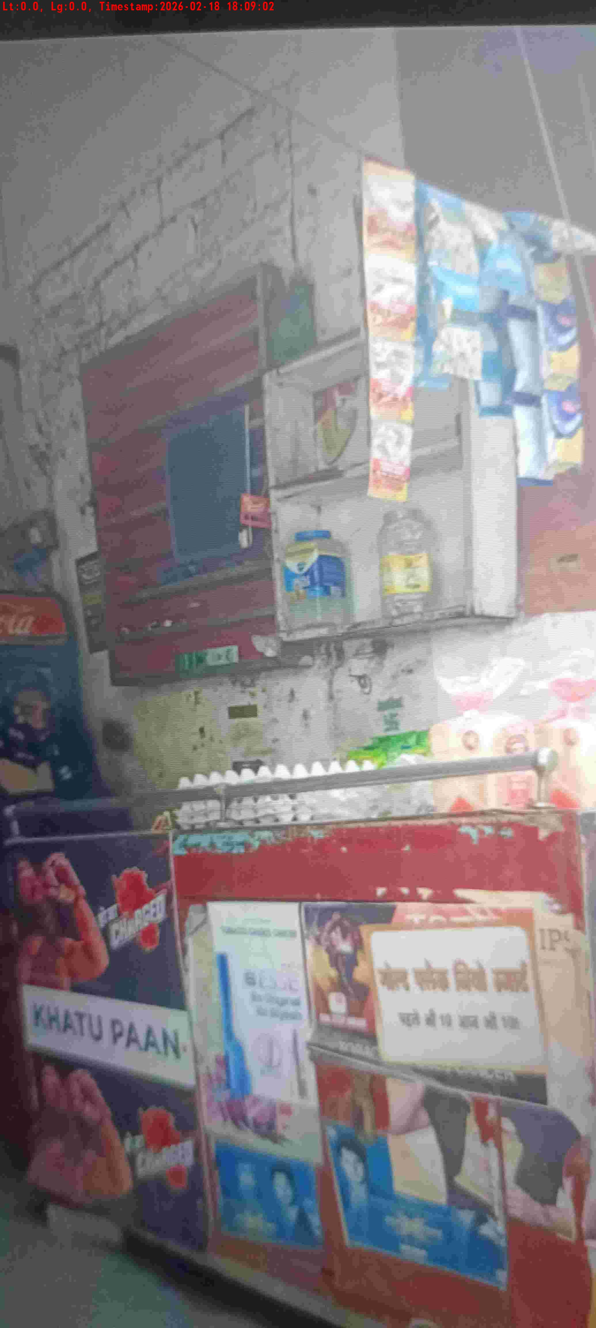
WD Code | DS Id | DS Name | Route Name | Shop Name | Date Time
DE5162 | 827 | Niche-DS48 | Wed-Sat | Durga store | 18-02-2026 06:08:54 PM
Shop Inside Picture
Shop Front Picture

Slide 8
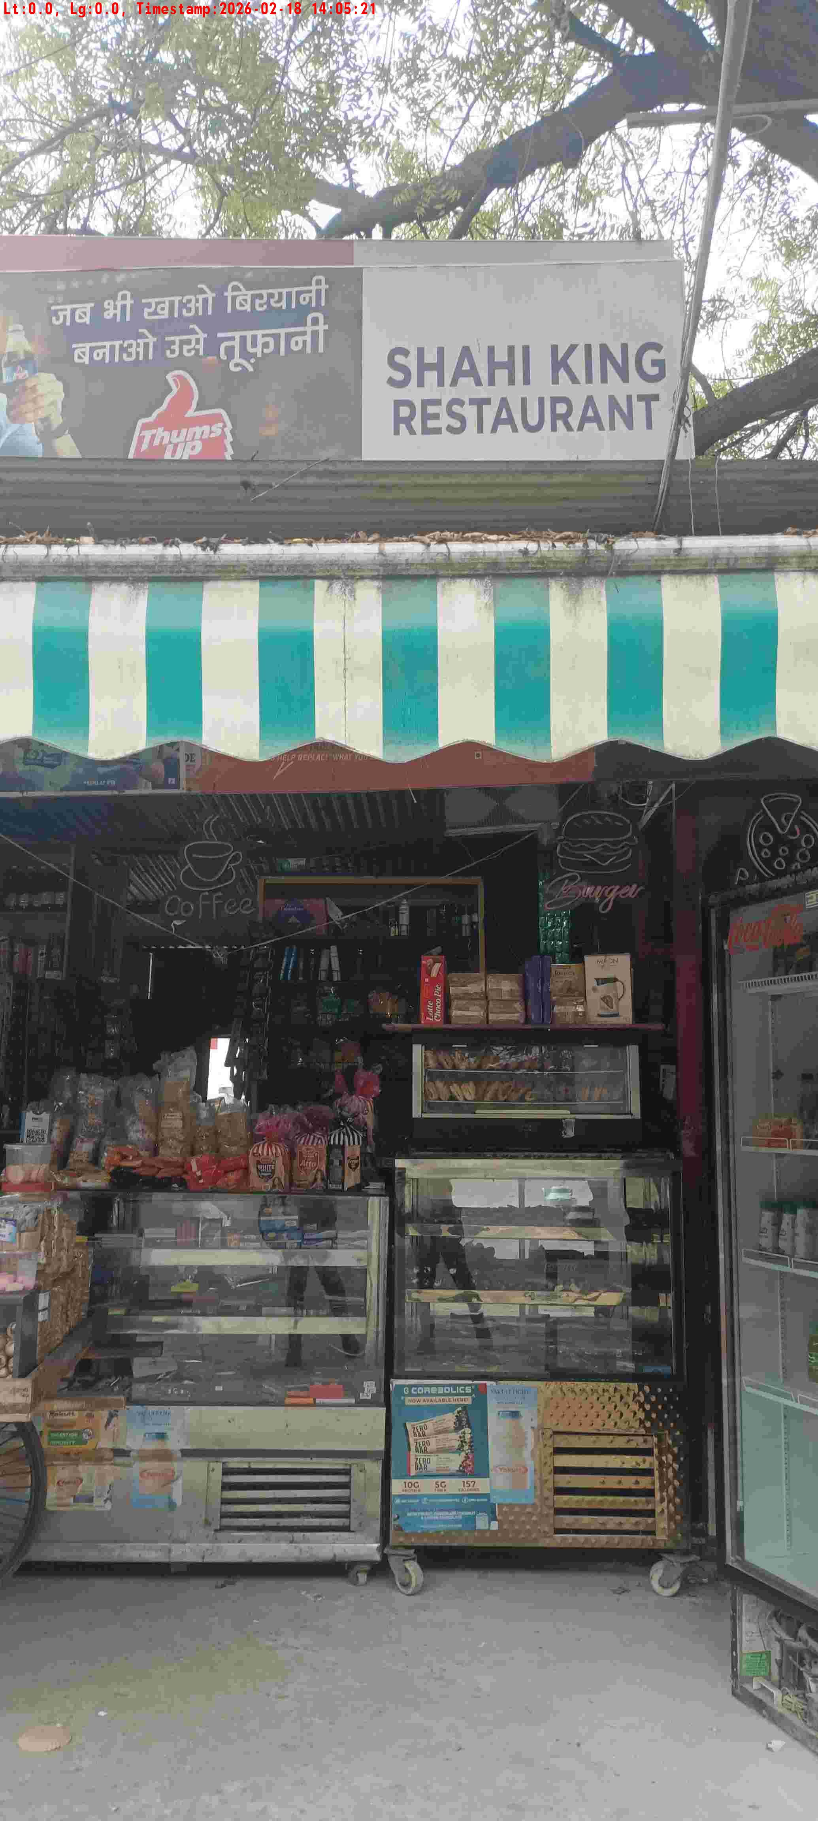
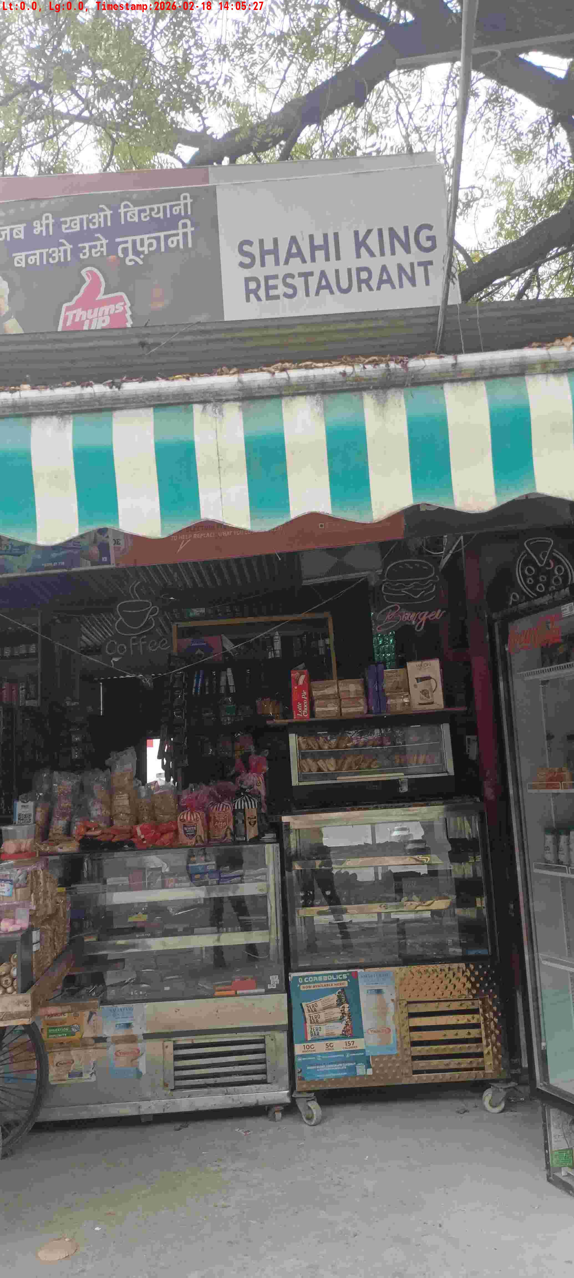
WD Code | DS Id | DS Name | Route Name | Shop Name | Date Time
DE5162 | 827 | Niche-DS48 | Wed-Sat | Maszid Pan | 18-02-2026 02:05:16 PM
Shop Inside Picture
Shop Front Picture

Slide 9
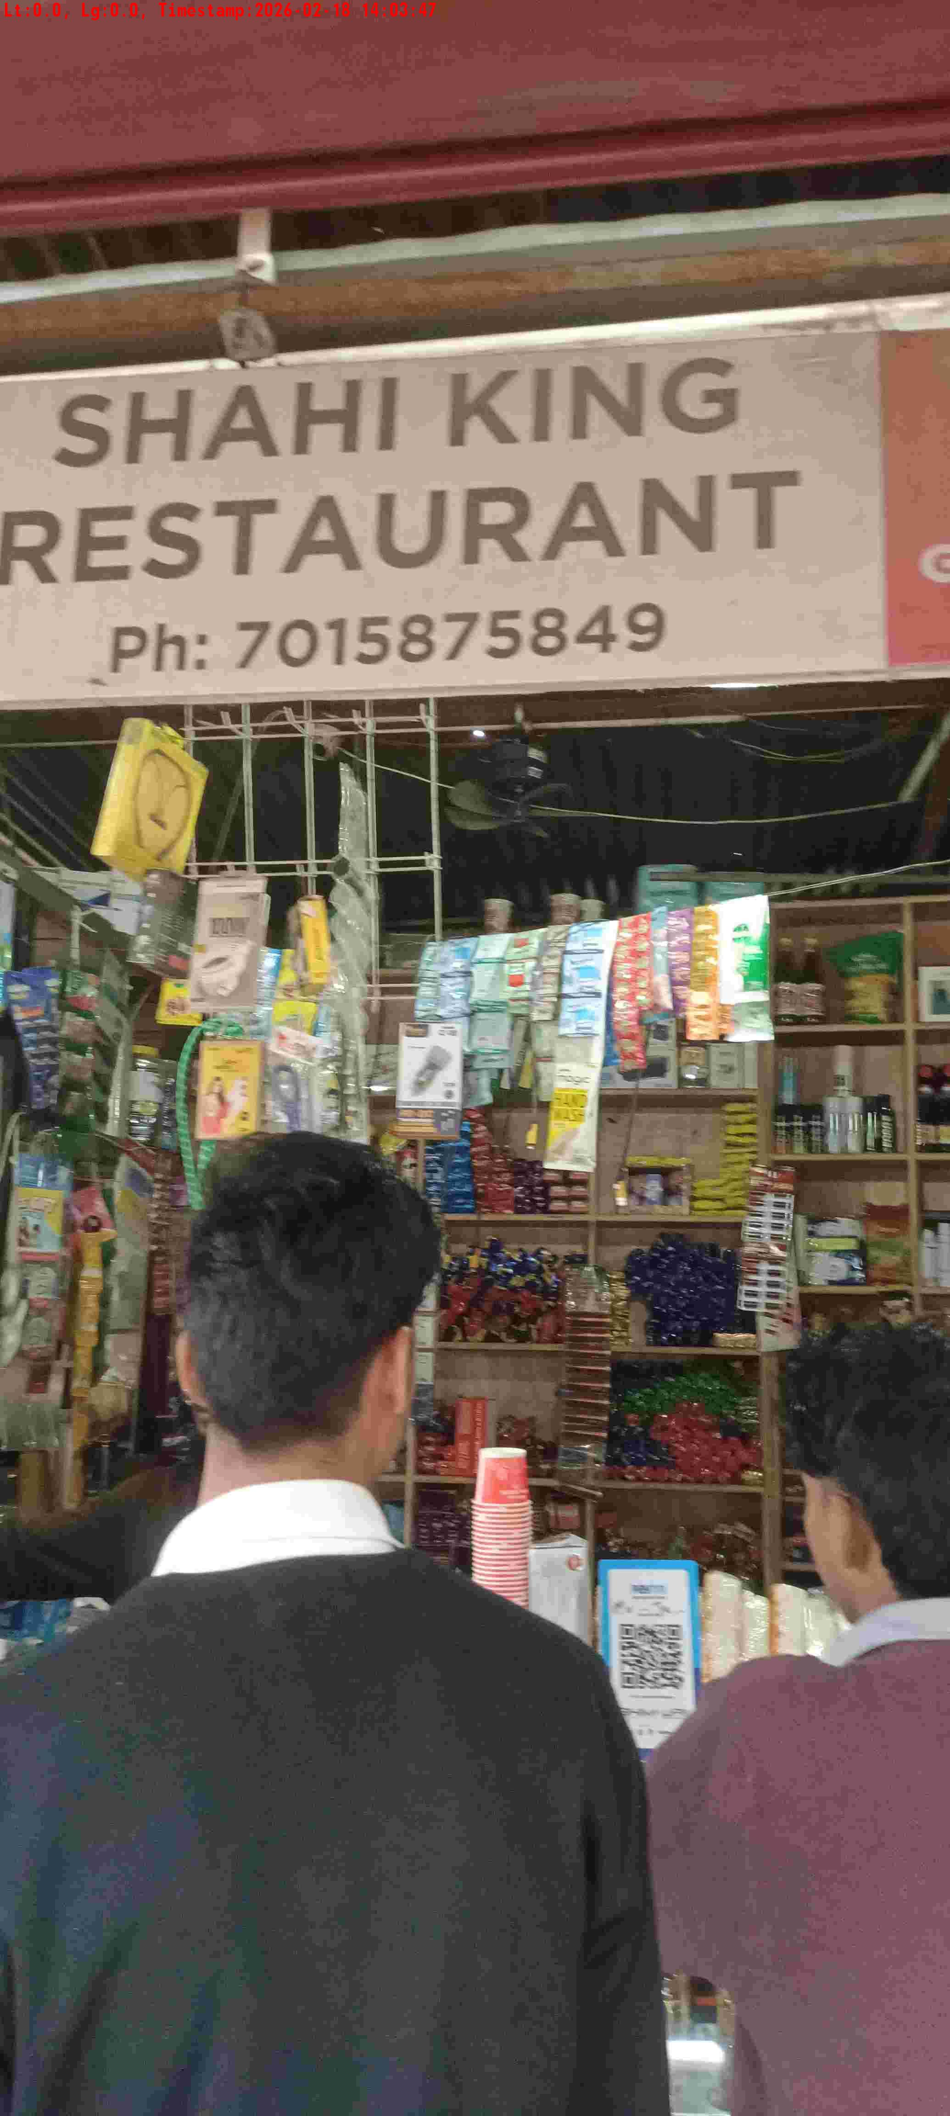
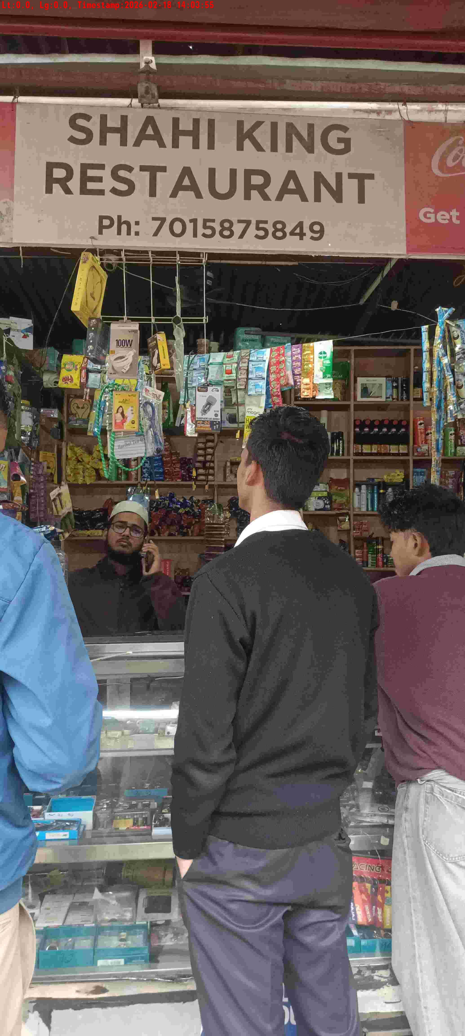
WD Code | DS Id | DS Name | Route Name | Shop Name | Date Time
DE5162 | 827 | Niche-DS48 | Wed-Sat | Masjid Pan 2 | 18-02-2026 02:03:42 PM
Shop Inside Picture
Shop Front Picture

Slide 10
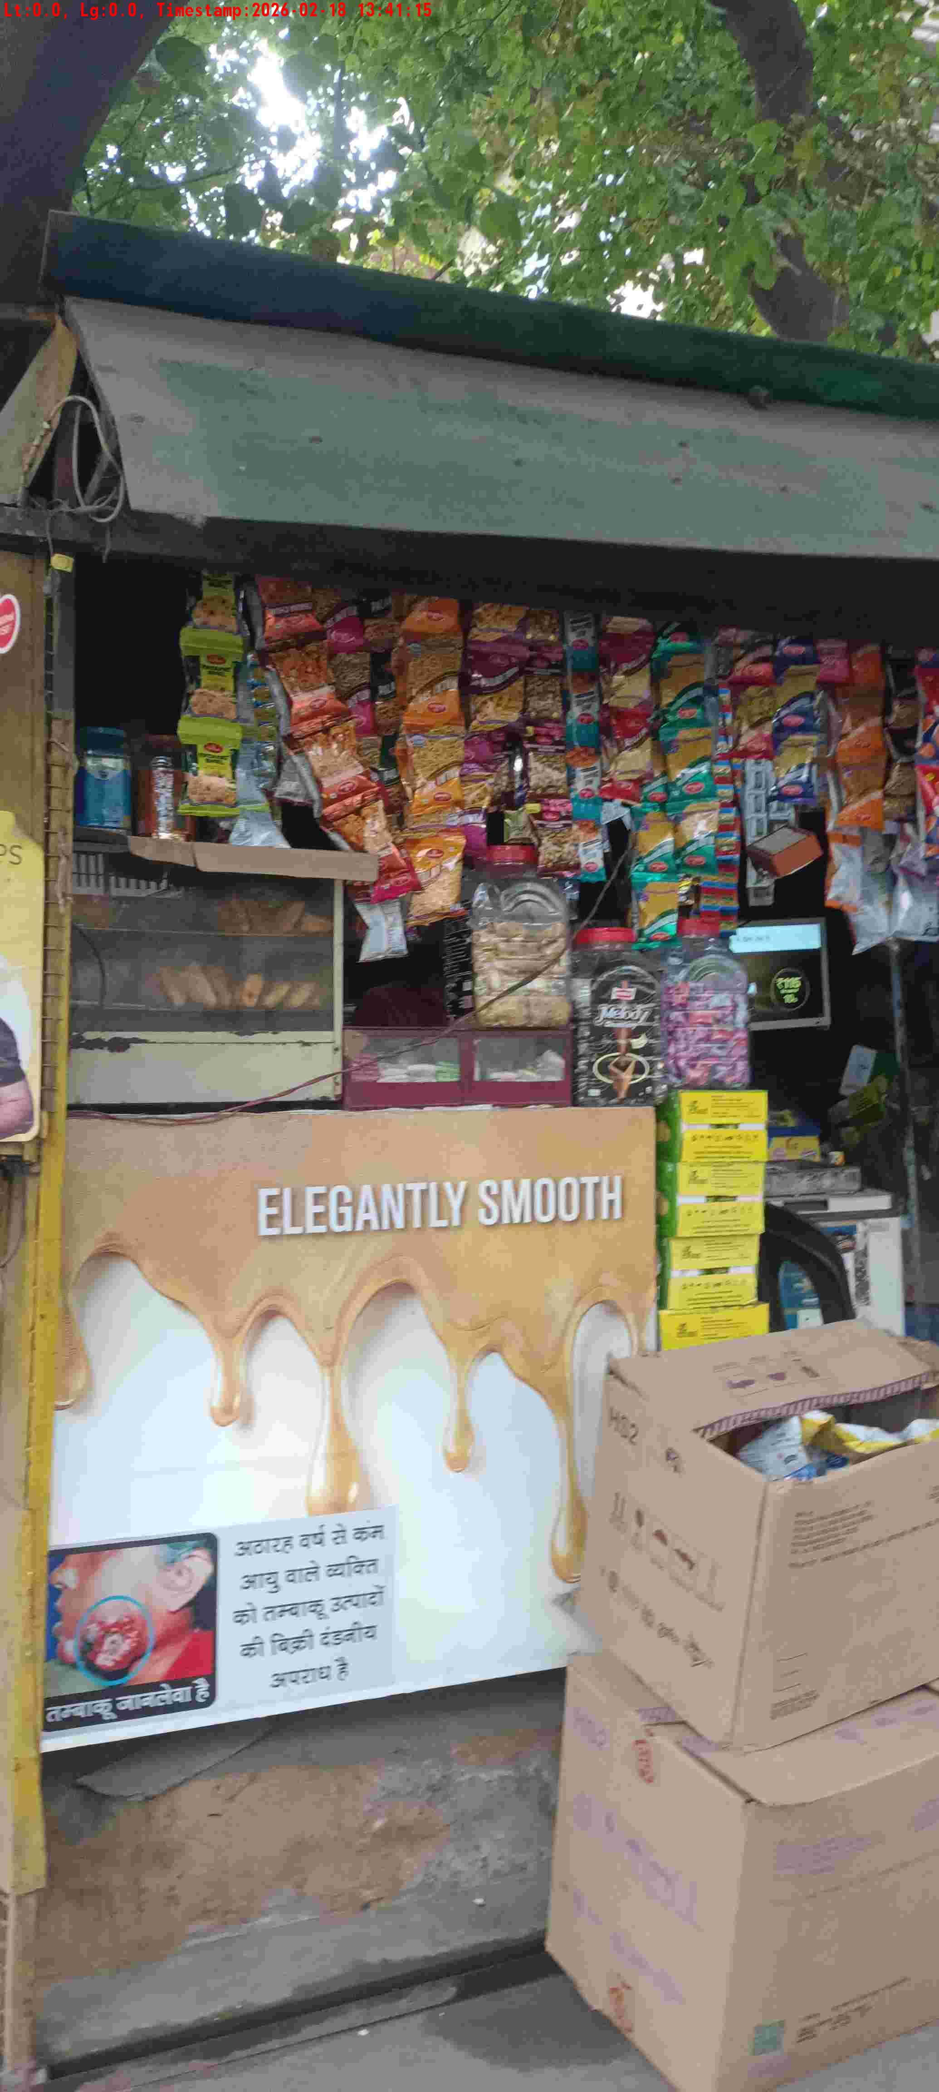
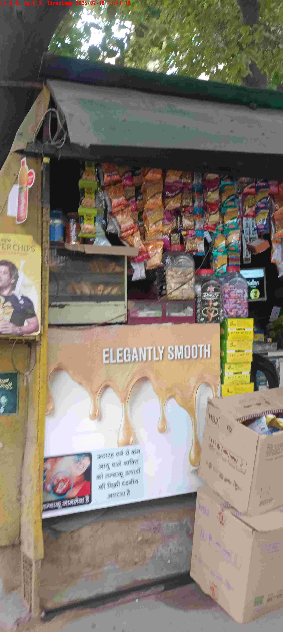
WD Code | DS Id | DS Name | Route Name | Shop Name | Date Time
DE5162 | 827 | Niche-DS48 | Wed-Sat | Tarun Pan | 18-02-2026 01:41:10 PM
Shop Inside Picture
Shop Front Picture

Slide 11
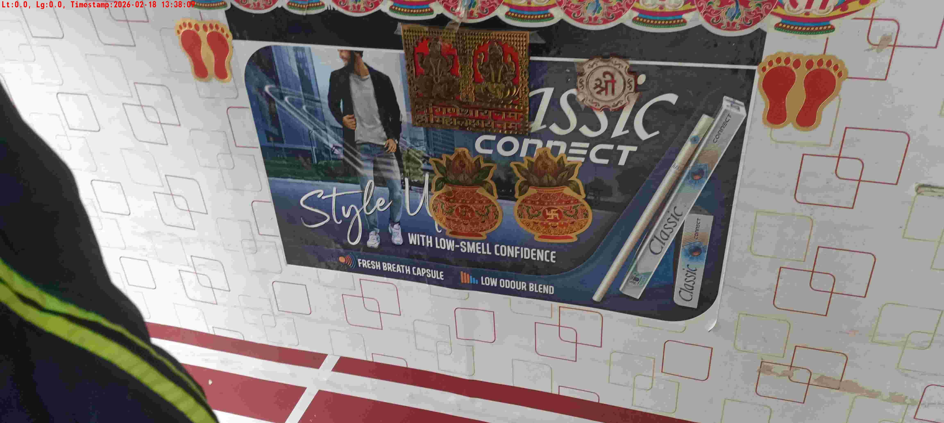
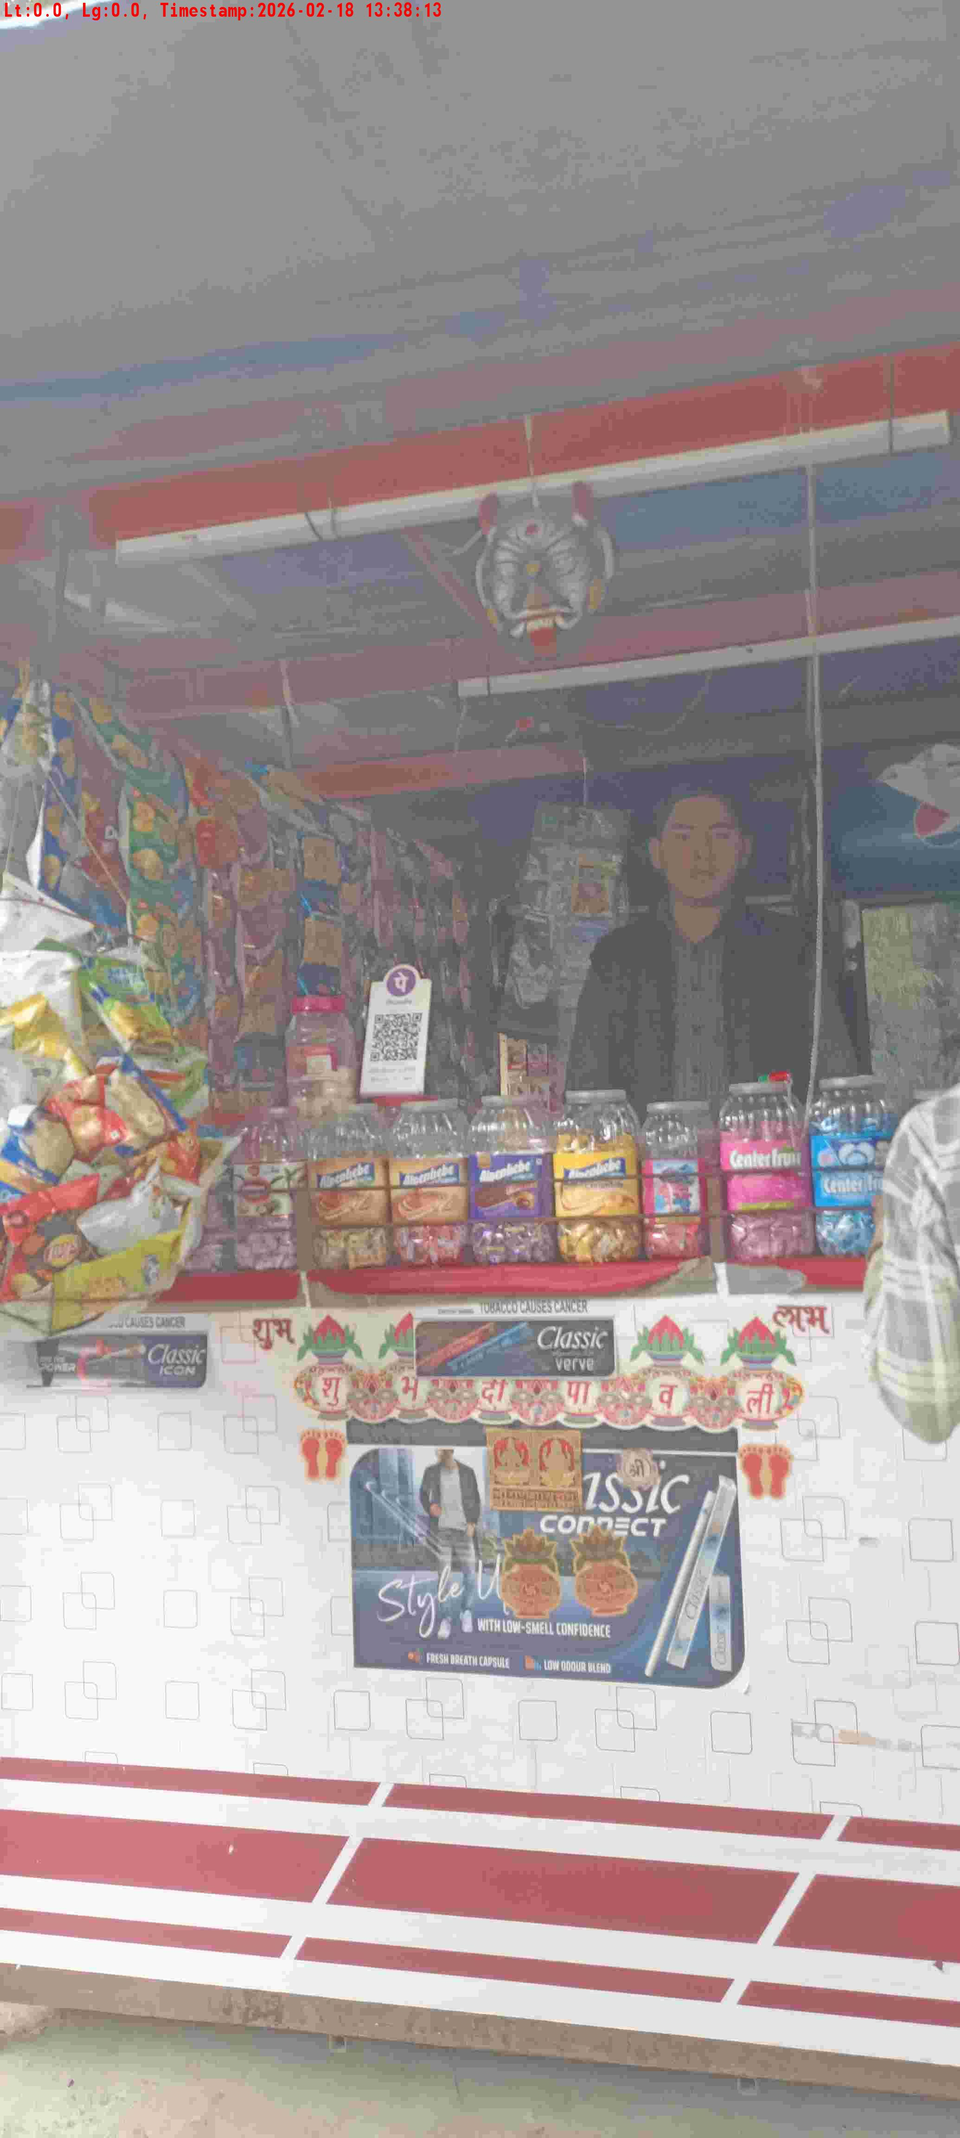
WD Code | DS Id | DS Name | Route Name | Shop Name | Date Time
DE5162 | 827 | Niche-DS48 | Wed-Sat | 11973 NEERAJ TEA STALL ( Dan Bhadur Pan ) | 18-02-2026 01:38:04 PM
Shop Inside Picture
Shop Front Picture

Slide 12
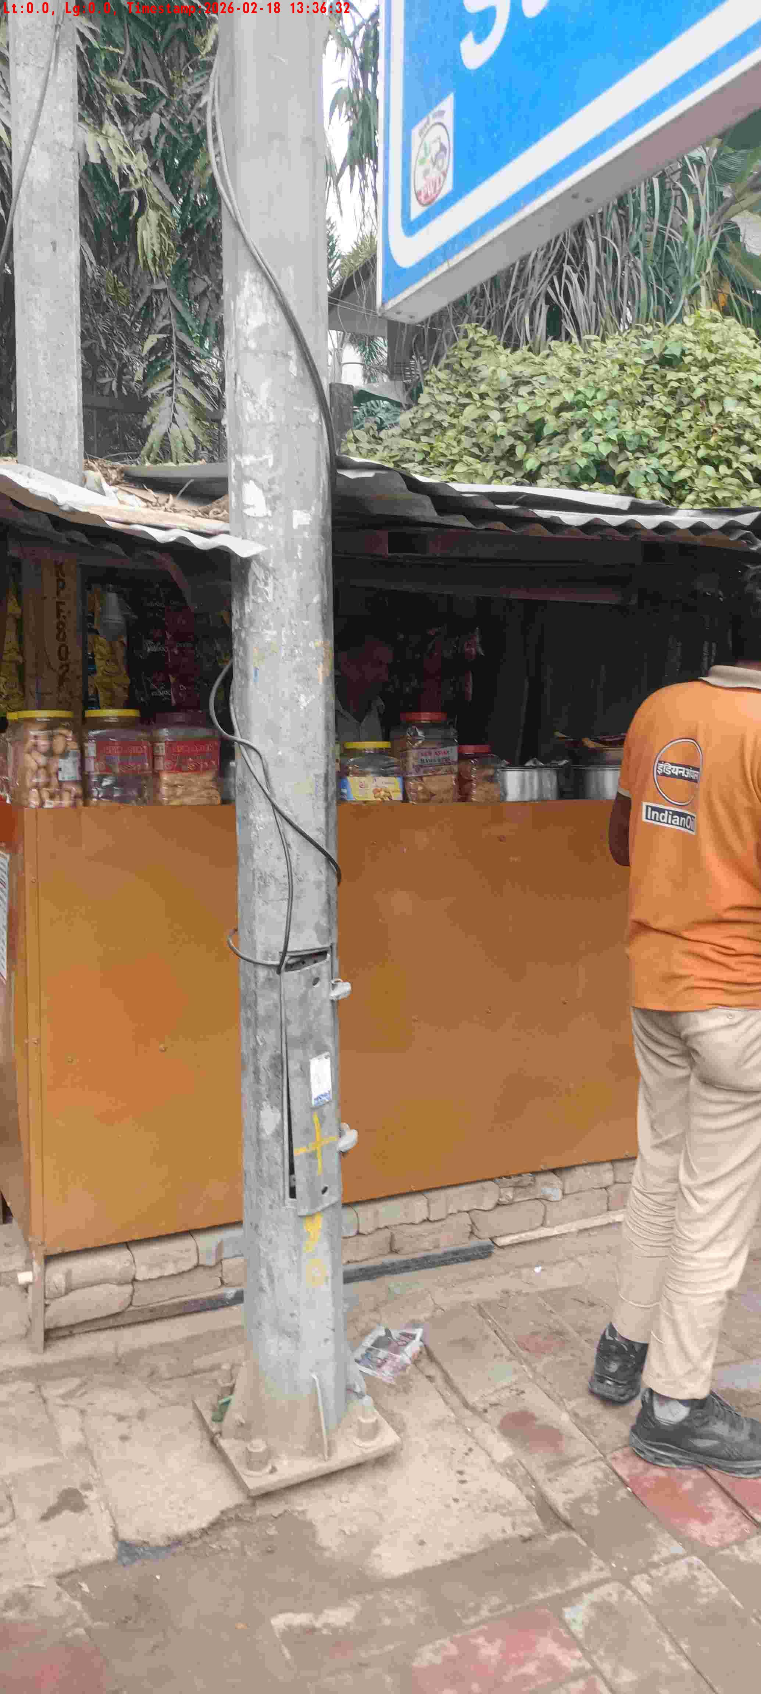
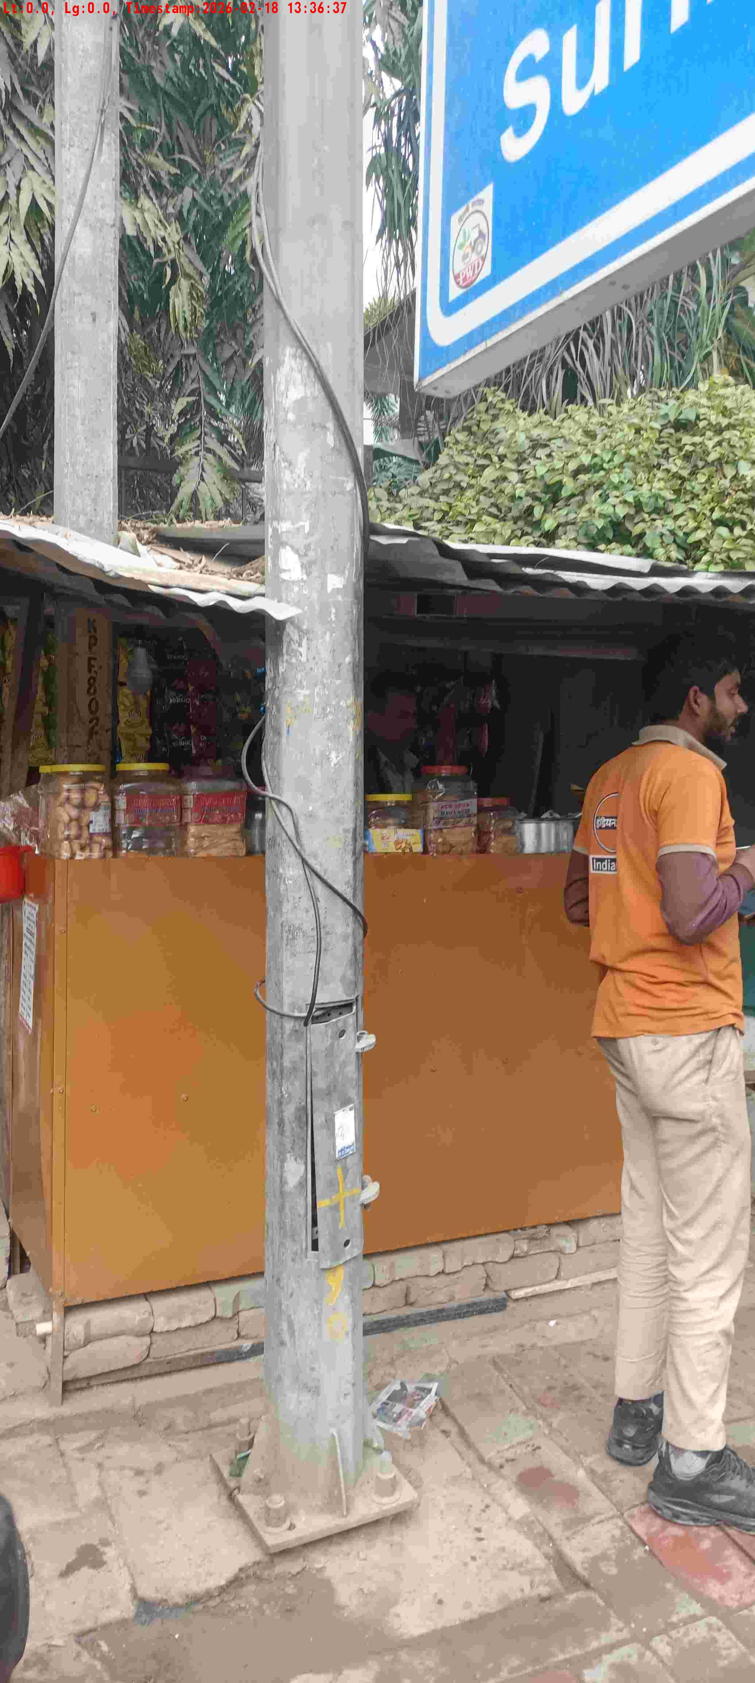
WD Code | DS Id | DS Name | Route Name | Shop Name | Date Time
DE5162 | 827 | Niche-DS48 | Wed-Sat | Sagar Store | 18-02-2026 01:36:27 PM
Shop Inside Picture
Shop Front Picture

Slide 13
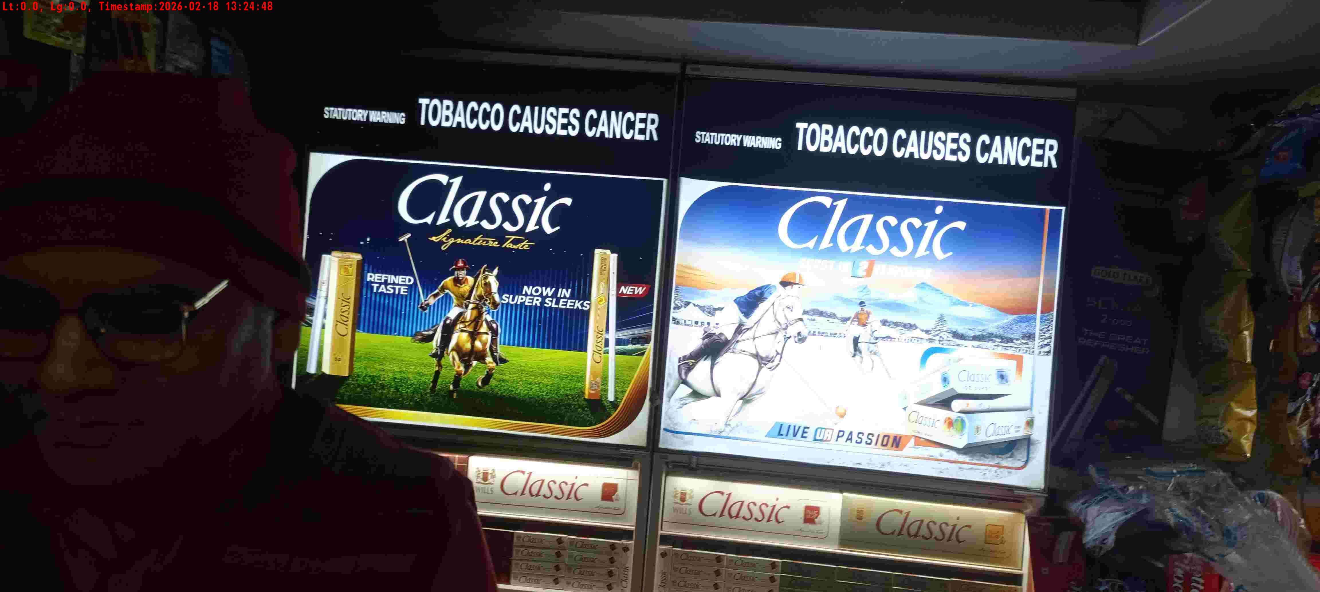
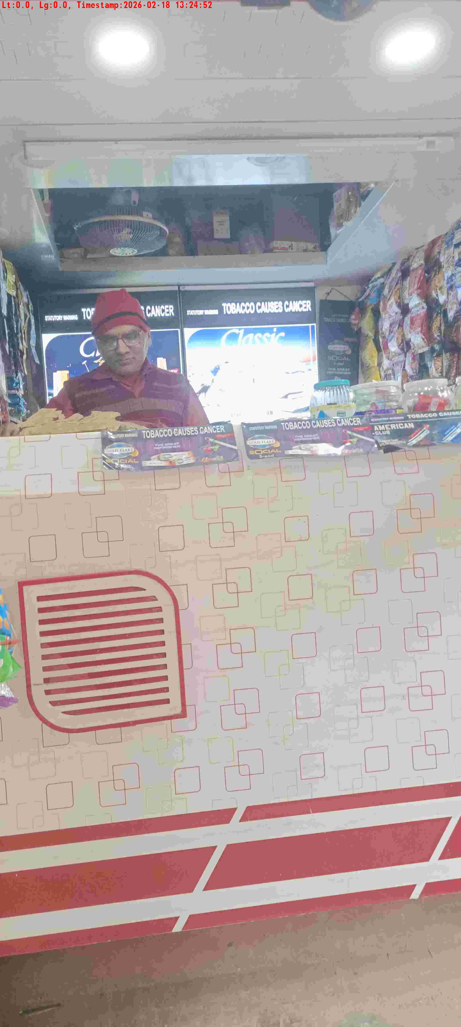
WD Code | DS Id | DS Name | Route Name | Shop Name | Date Time
DE5162 | 827 | Niche-DS48 | Wed-Sat | Rajbhadur Pan | 18-02-2026 01:24:42 PM
Shop Inside Picture
Shop Front Picture

Slide 14
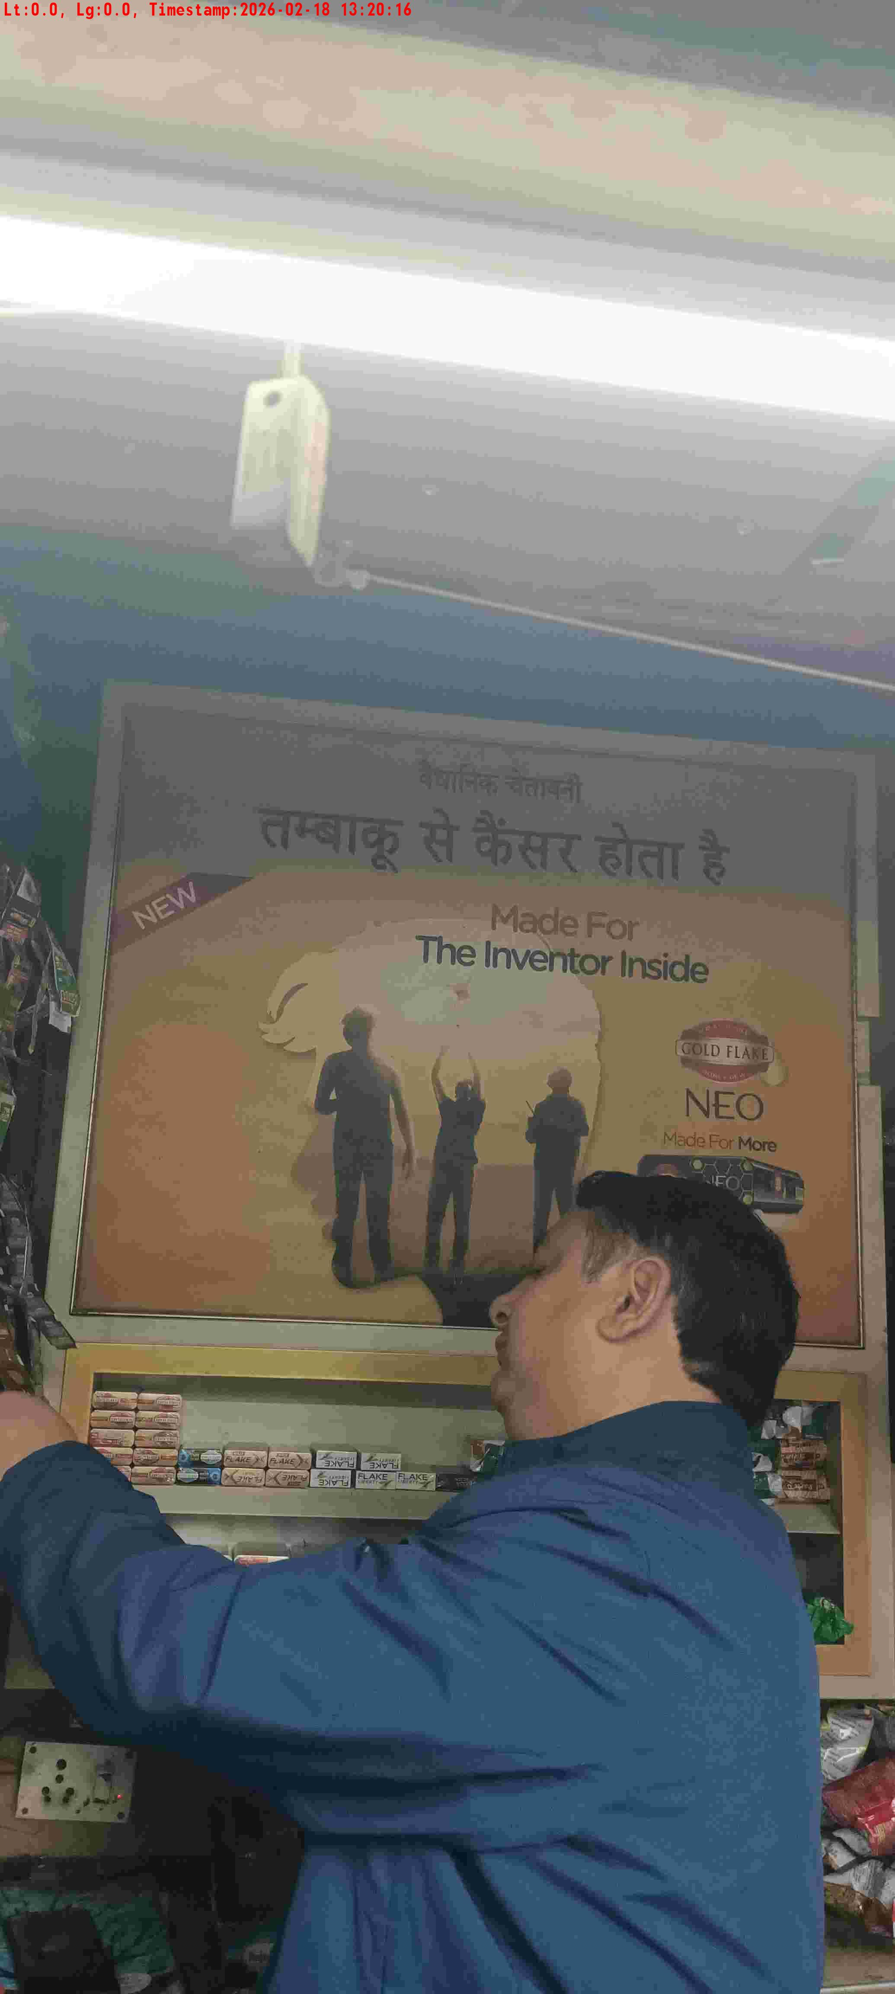
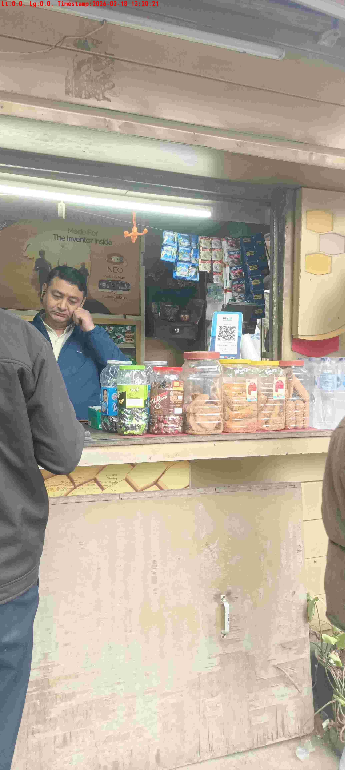
WD Code | DS Id | DS Name | Route Name | Shop Name | Date Time
DE5162 | 827 | Niche-DS48 | Wed-Sat | Hello Point | 18-02-2026 01:20:12 PM
Shop Inside Picture
Shop Front Picture

Slide 15
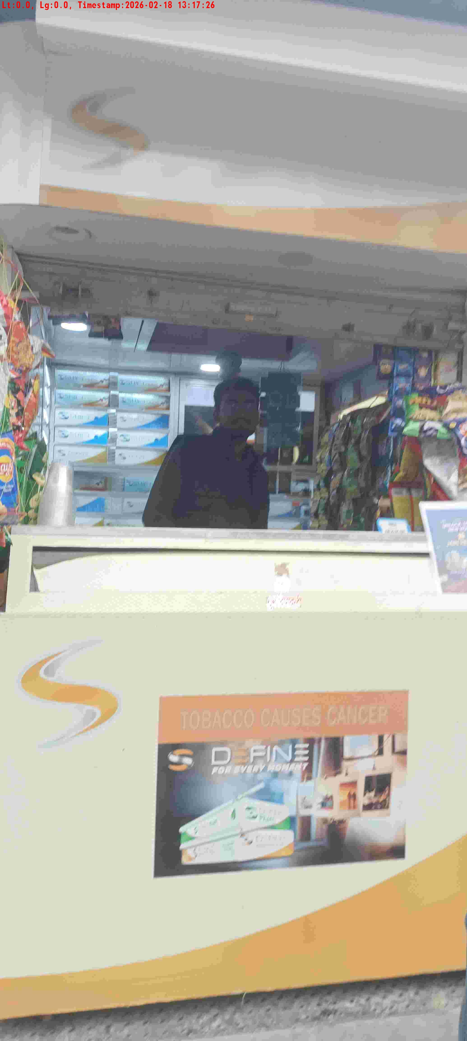
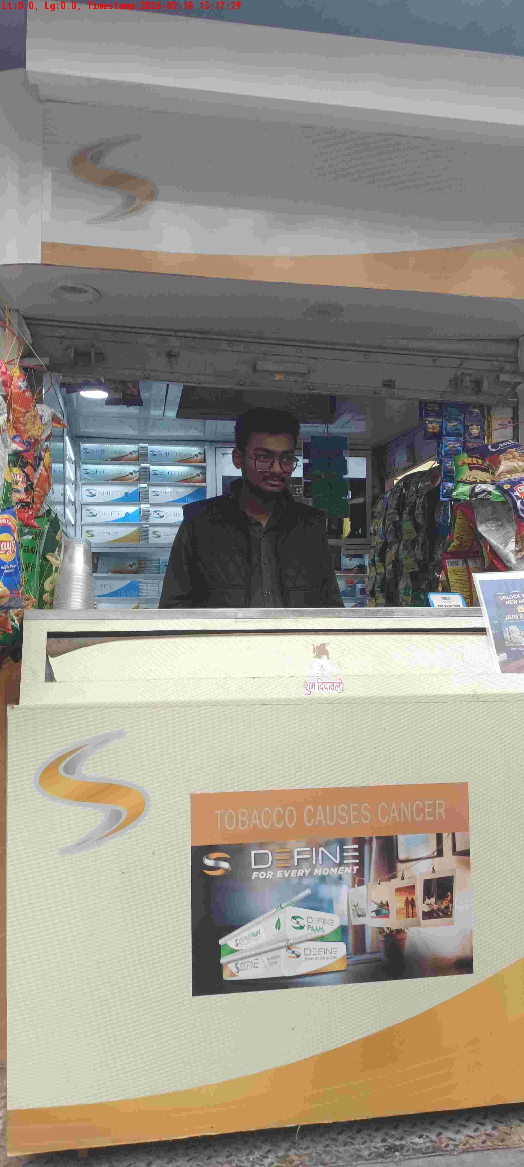
WD Code | DS Id | DS Name | Route Name | Shop Name | Date Time
DE5162 | 827 | Niche-DS48 | Wed-Sat | Jain Tele | 18-02-2026 01:17:22 PM
Shop Inside Picture
Shop Front Picture

Slide 16
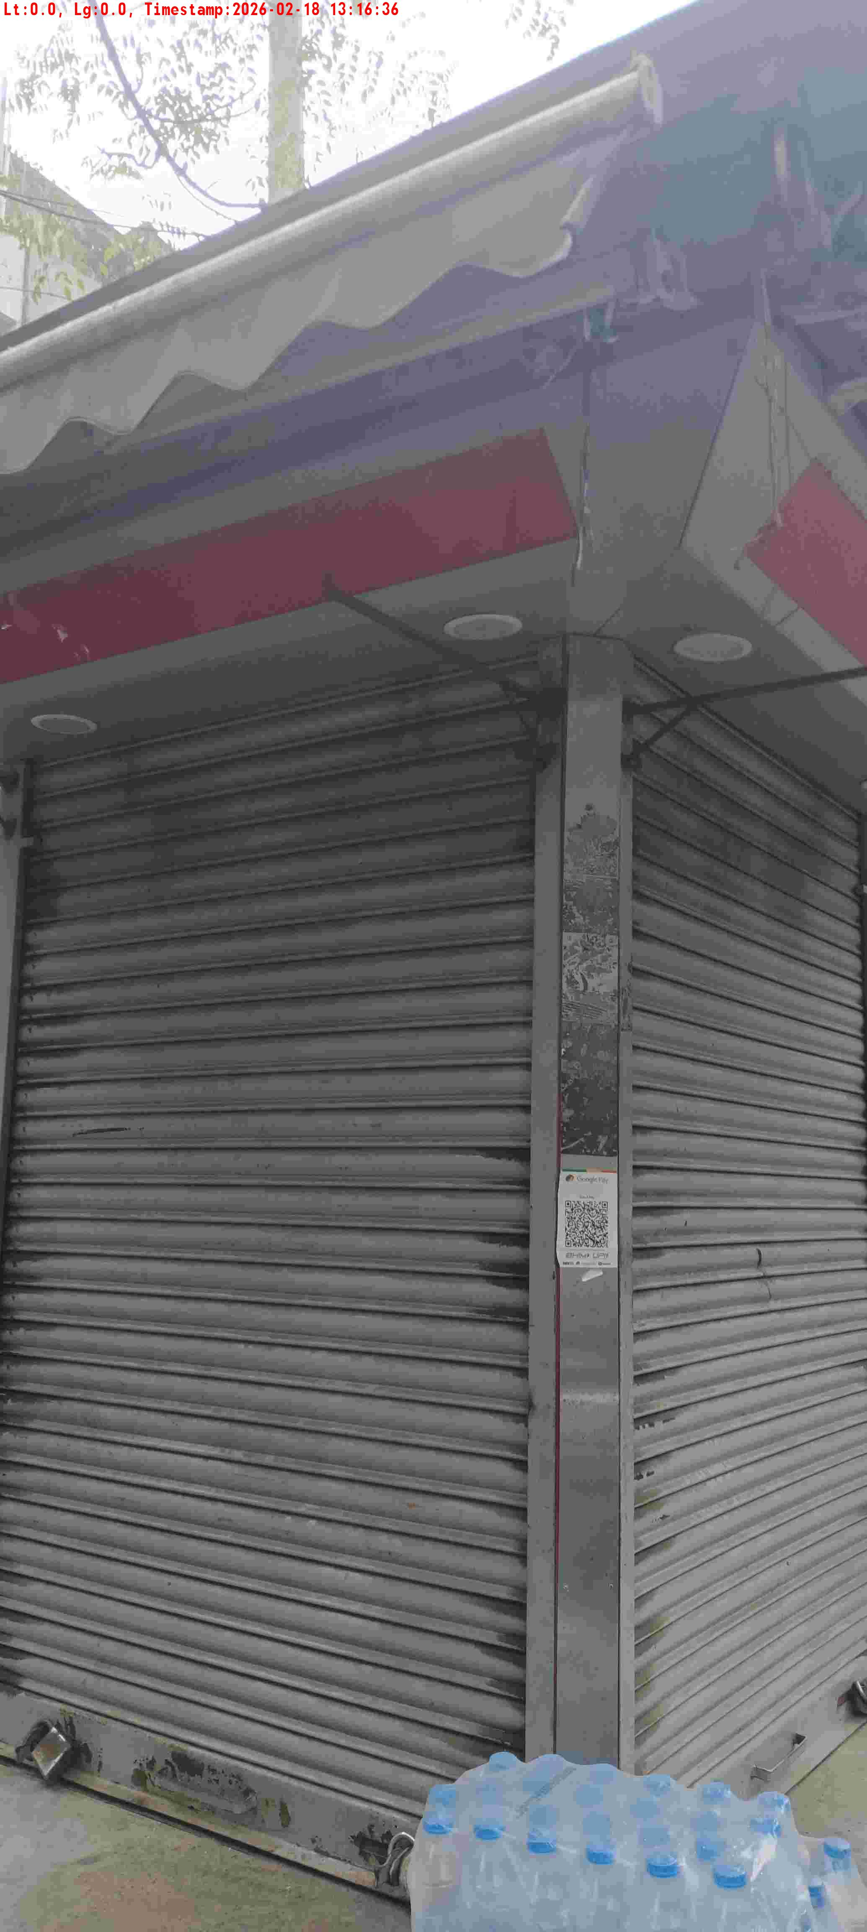
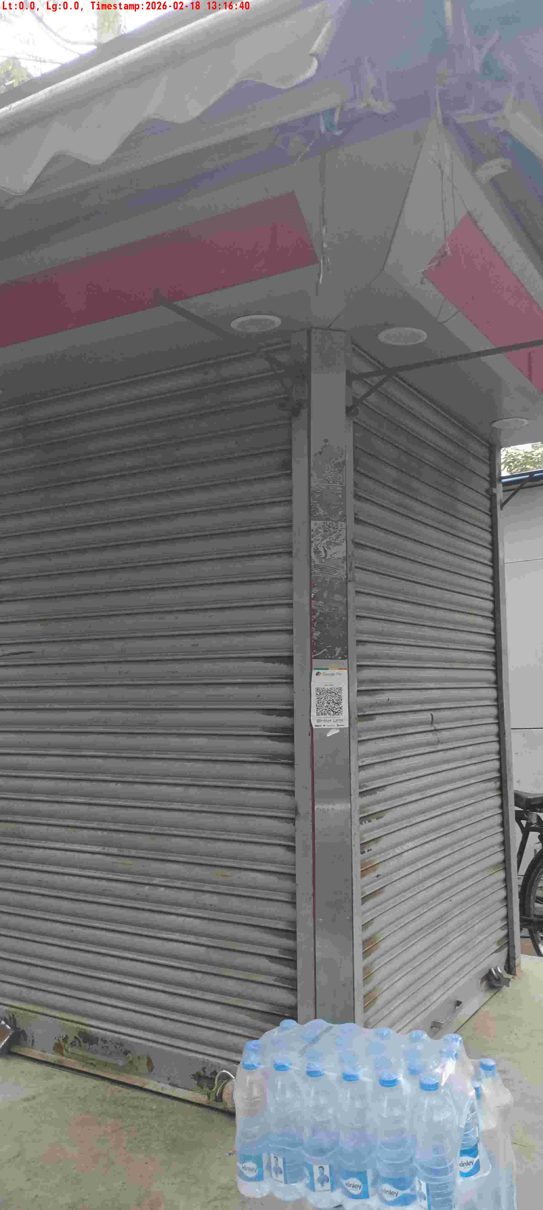
WD Code | DS Id | DS Name | Route Name | Shop Name | Date Time
DE5162 | 827 | Niche-DS48 | Wed-Sat | Pandit Pan | 18-02-2026 01:16:32 PM
Shop Inside Picture
Shop Front Picture

Slide 17
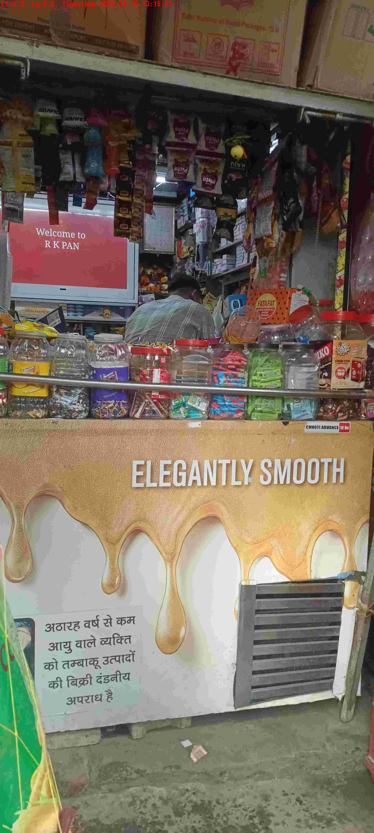
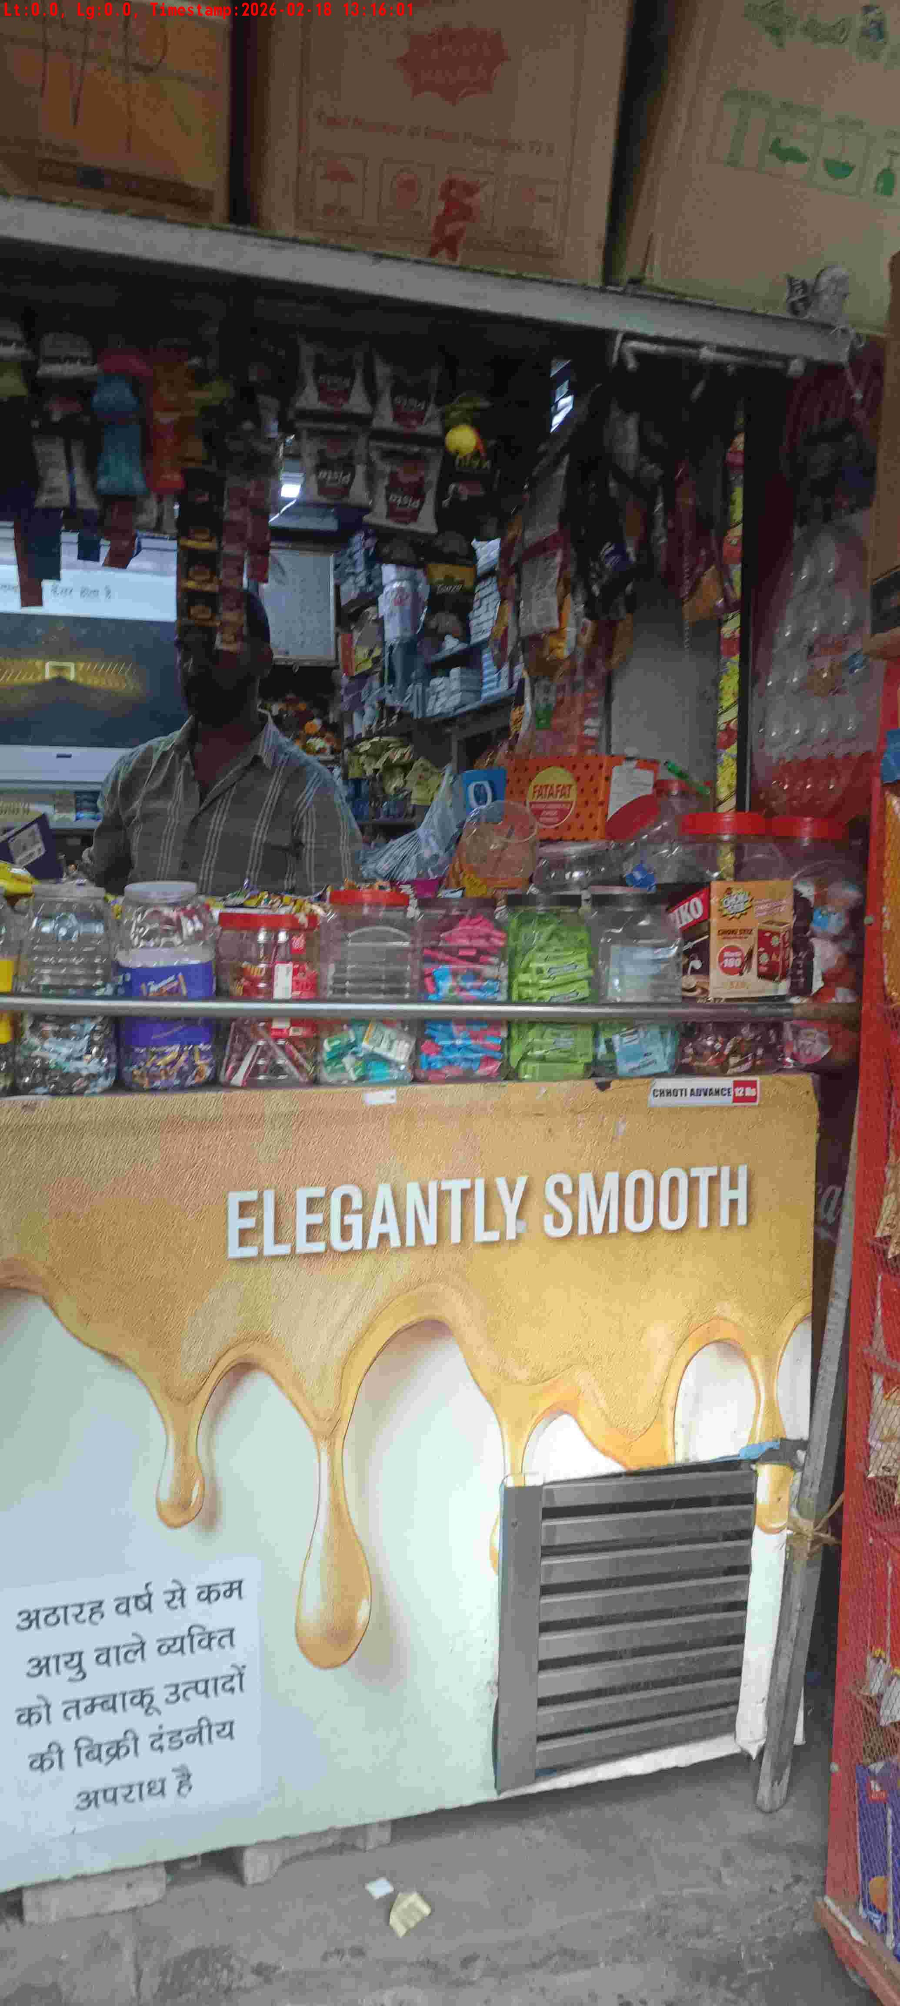
WD Code | DS Id | DS Name | Route Name | Shop Name | Date Time
DE5162 | 827 | Niche-DS48 | Wed-Sat | Rk Confectionary | 18-02-2026 01:15:50 PM
Shop Inside Picture
Shop Front Picture

Slide 18
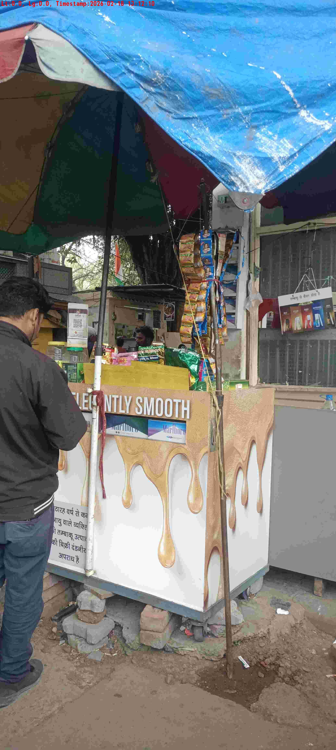
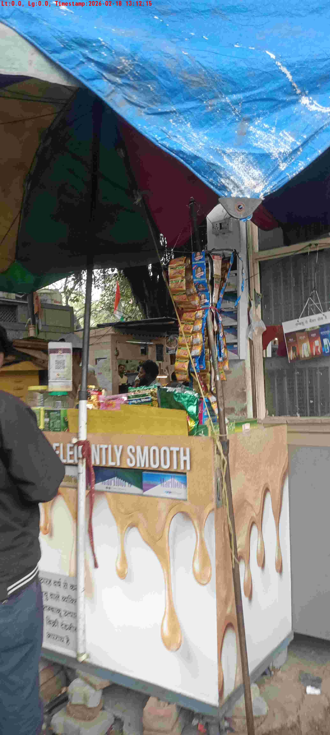
WD Code | DS Id | DS Name | Route Name | Shop Name | Date Time
DE5162 | 827 | Niche-DS48 | Wed-Sat | Mini Prince Pan | 18-02-2026 01:12:05 PM
Shop Inside Picture
Shop Front Picture

Slide 19
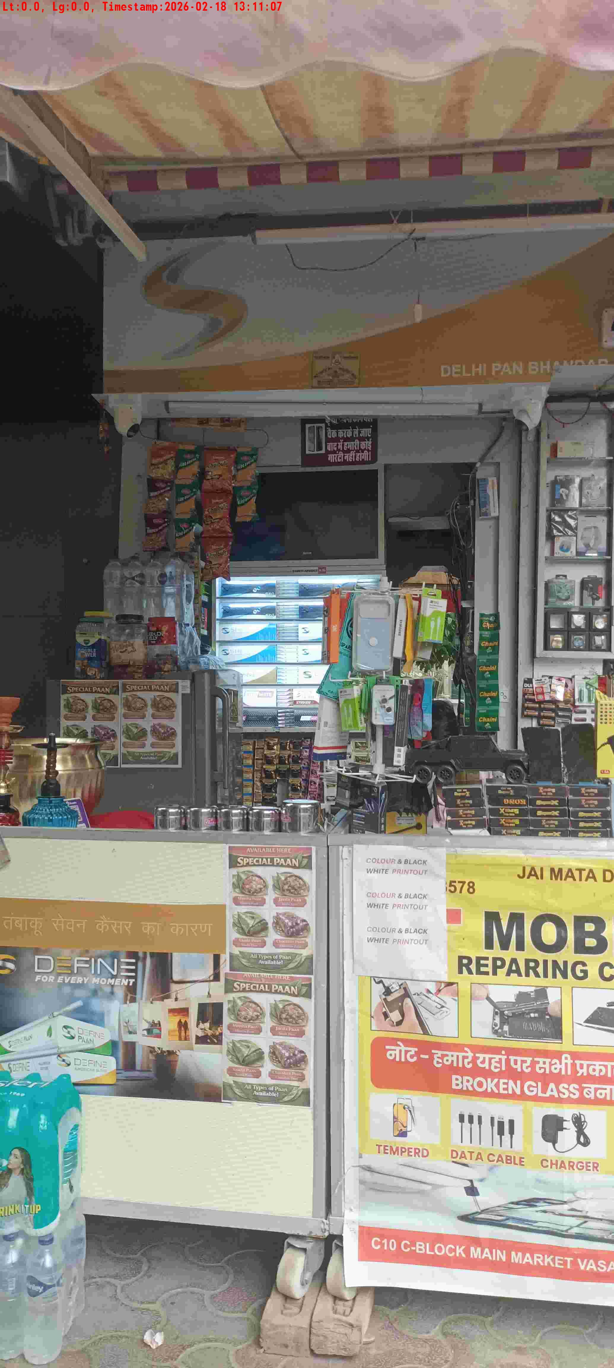
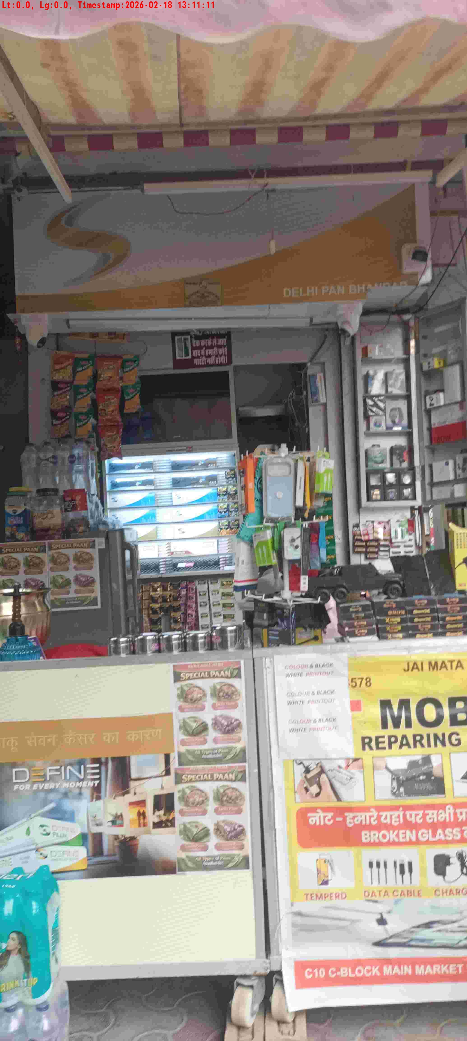
WD Code | DS Id | DS Name | Route Name | Shop Name | Date Time
DE5162 | 827 | Niche-DS48 | Wed-Sat | Delhi Pan | 18-02-2026 01:11:02 PM
Shop Inside Picture
Shop Front Picture

Slide 20
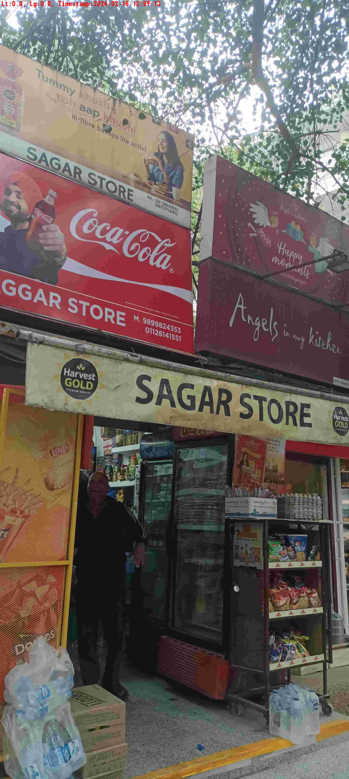
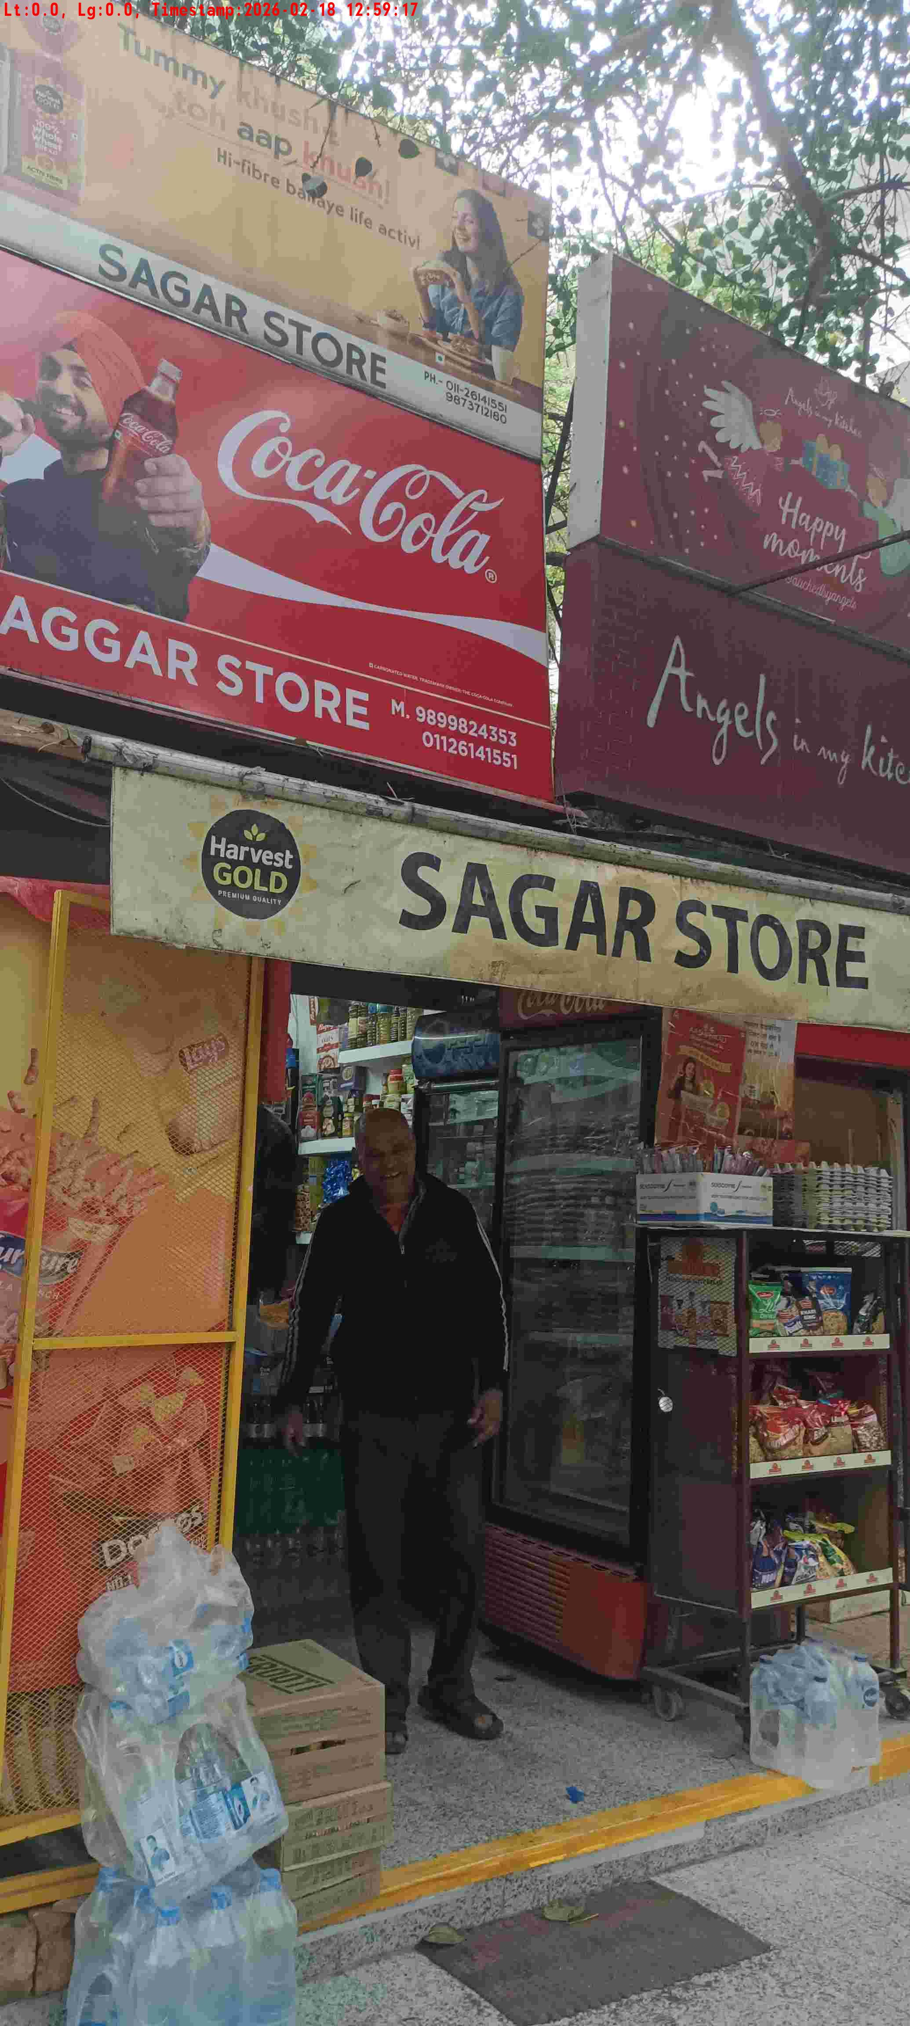
WD Code | DS Id | DS Name | Route Name | Shop Name | Date Time
DE5162 | 827 | Niche-DS48 | Wed-Sat | Sagar Store | 18-02-2026 12:58:53 PM
Shop Inside Picture
Shop Front Picture

Slide 21
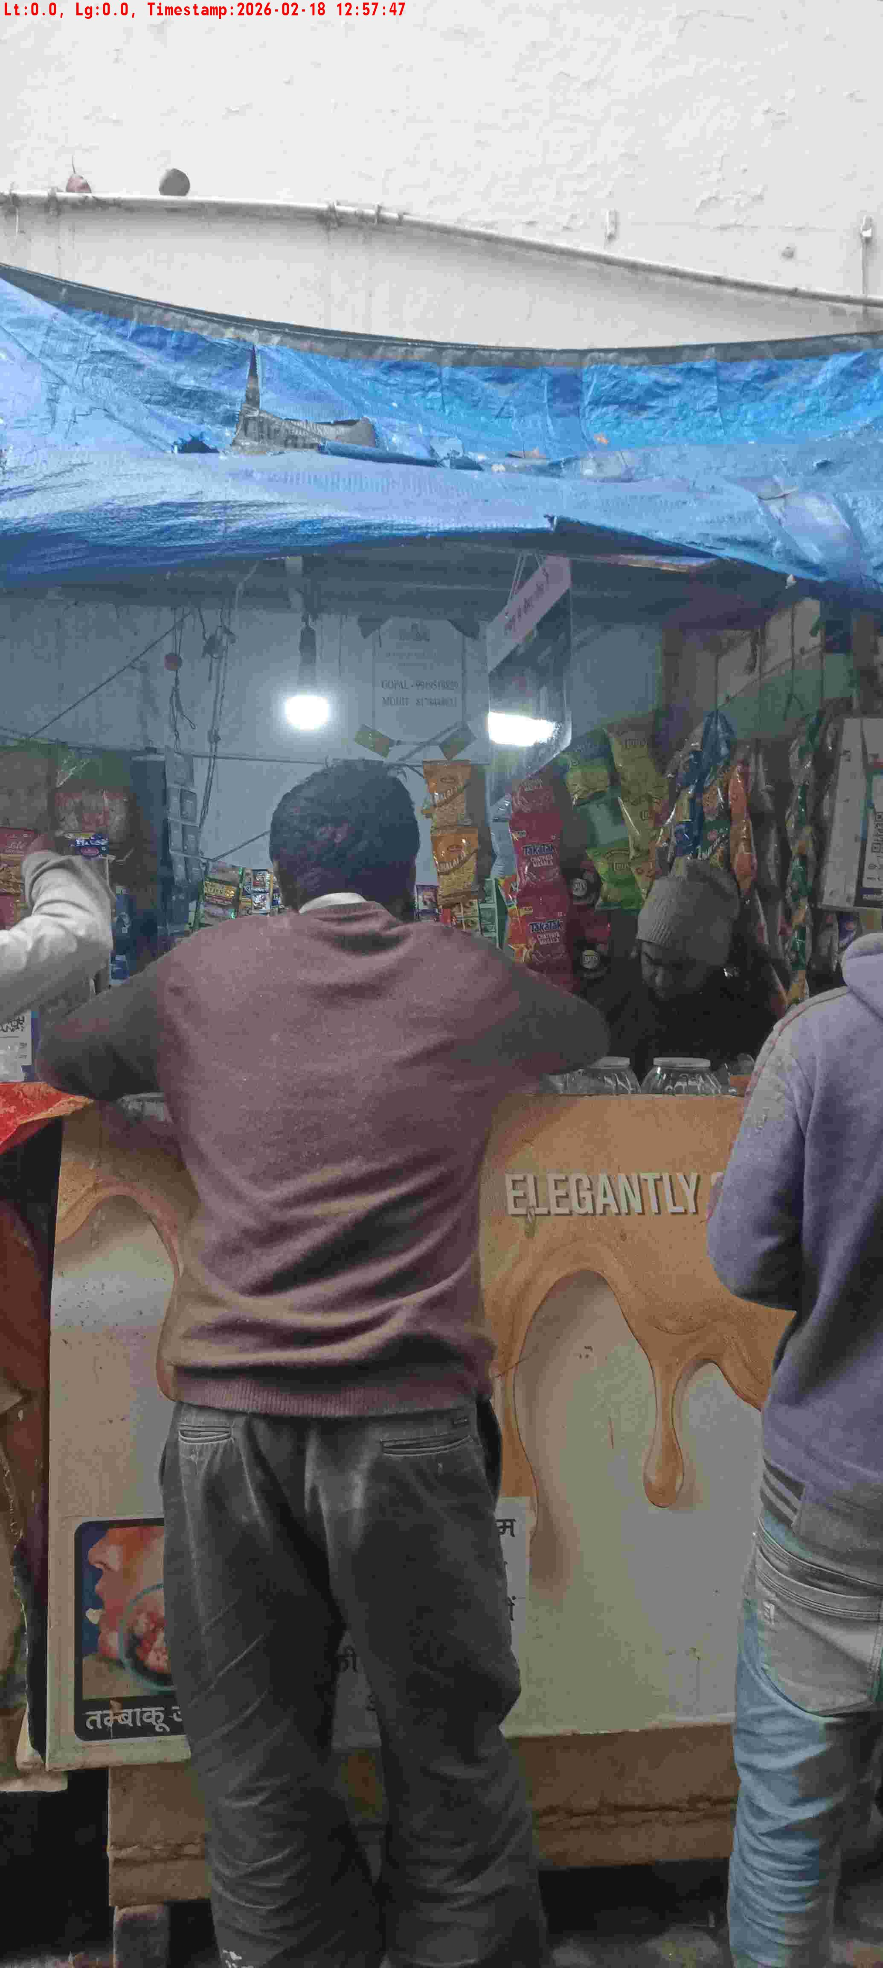
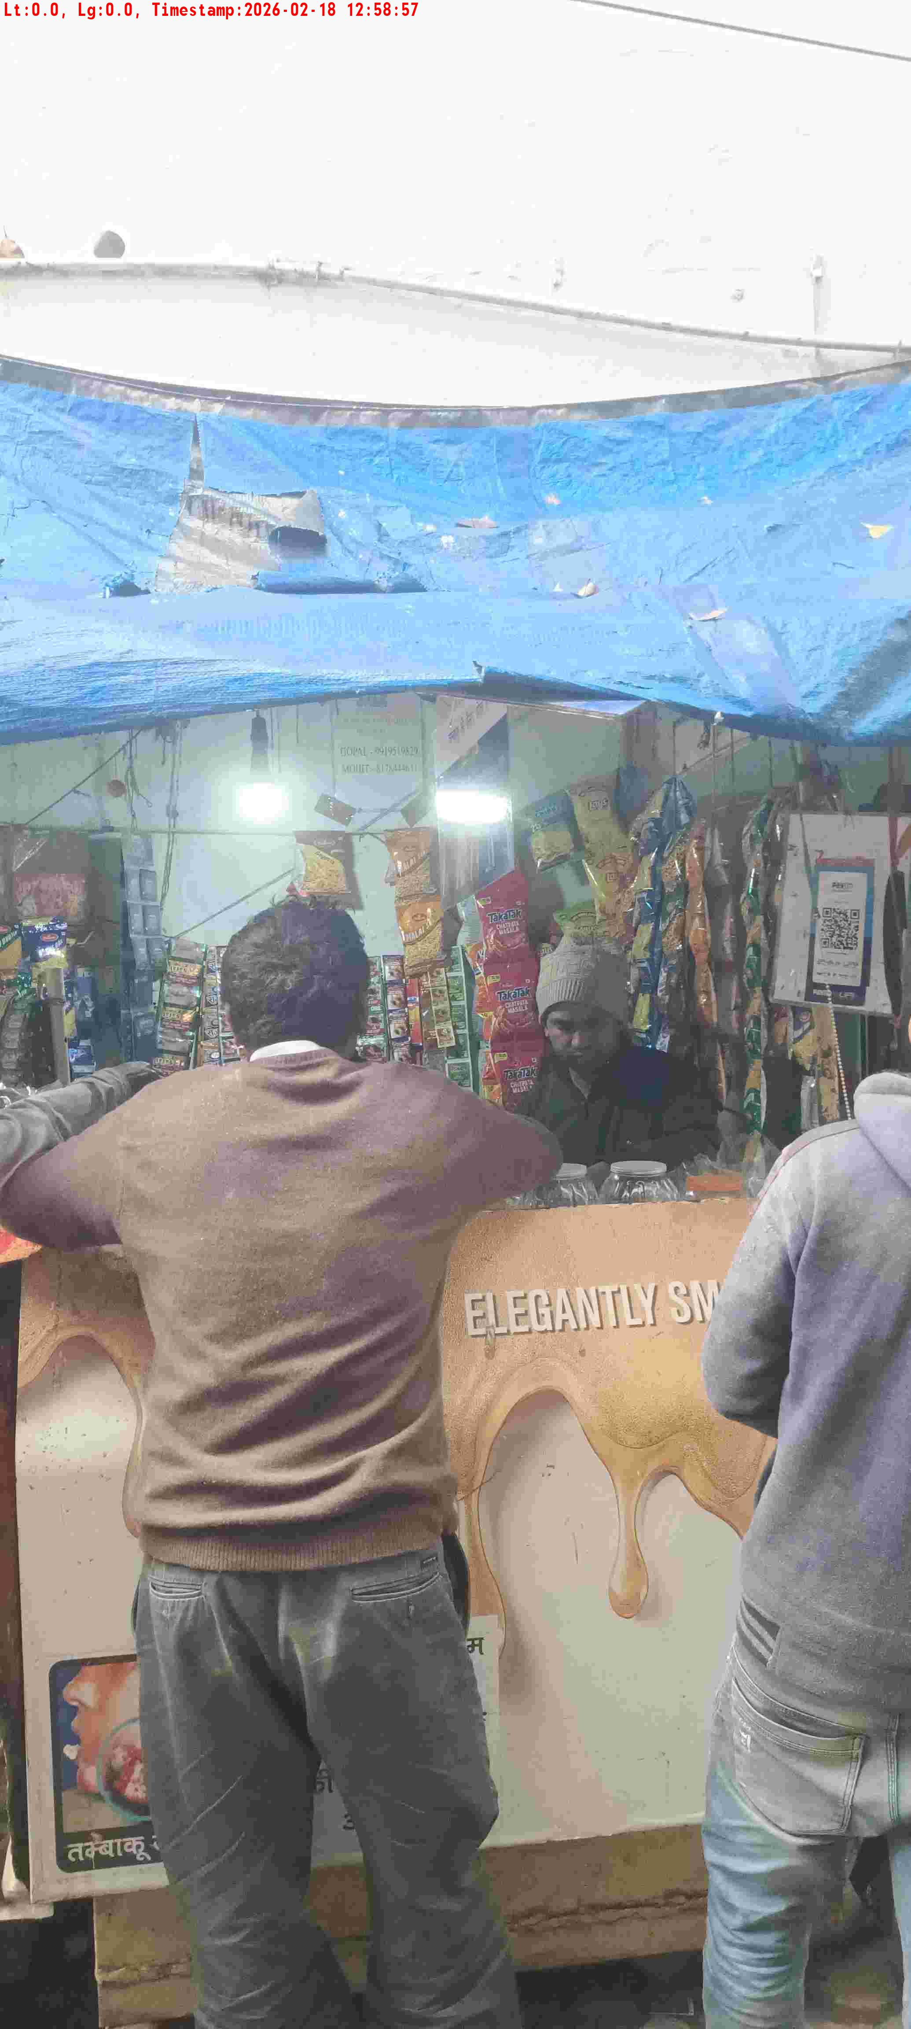
WD Code | DS Id | DS Name | Route Name | Shop Name | Date Time
DE5162 | 827 | Niche-DS48 | Wed-Sat | Ram Brij Pan | 18-02-2026 12:57:25 PM
Shop Inside Picture
Shop Front Picture

Slide 22
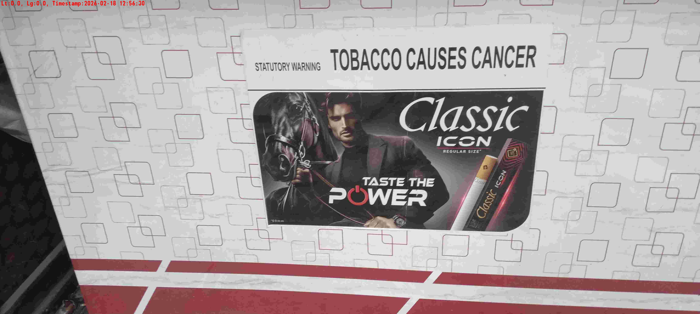
WD Code | DS Id | DS Name | Route Name | Shop Name | Date Time
DE5162 | 827 | Niche-DS48 | Wed-Sat | Vijay Pan | 18-02-2026 12:56:27 PM
Shop Inside Picture

Slide 23

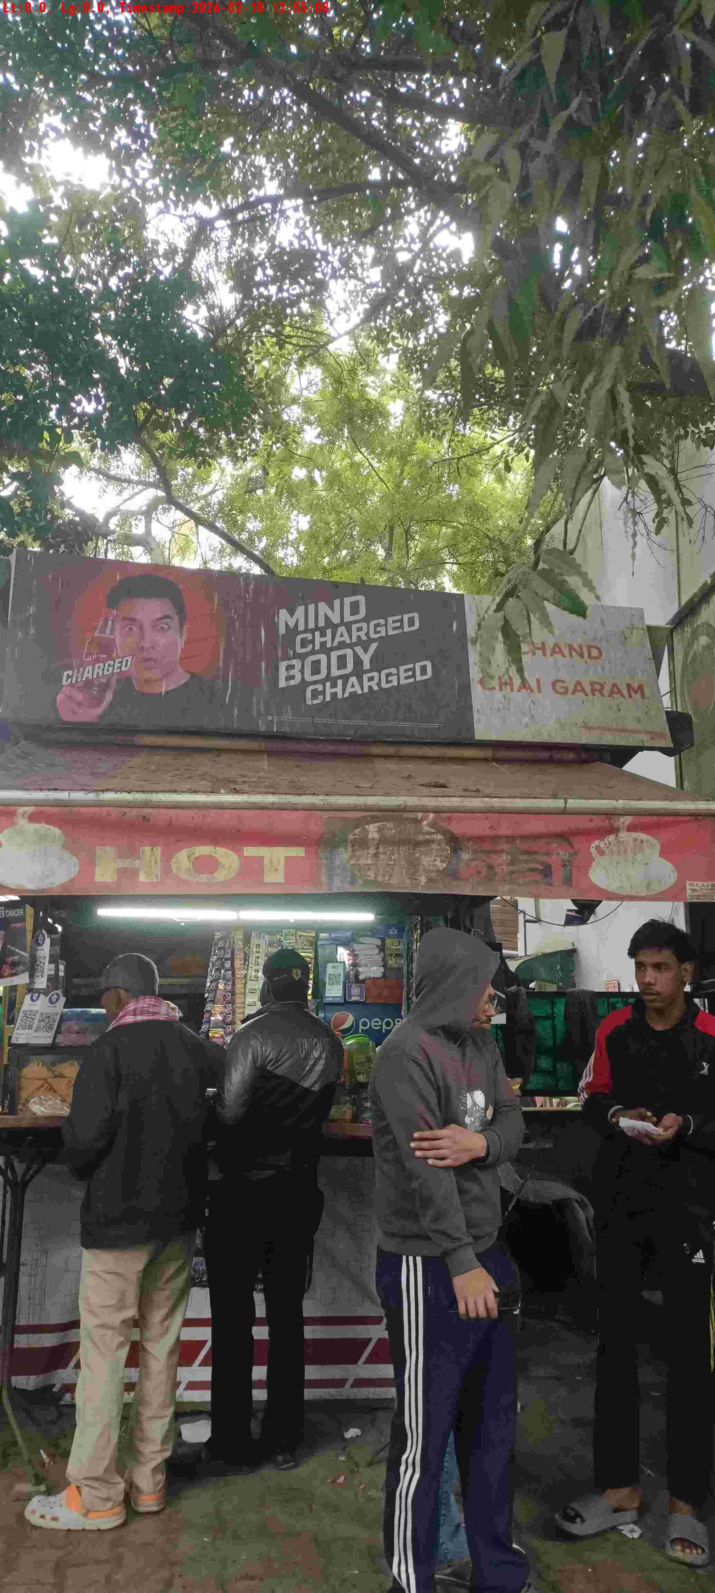
WD Code | DS Id | DS Name | Route Name | Shop Name | Date Time
DE5162 | 827 | Niche-DS48 | Wed-Sat | Tuna Pan( Rak)(M D Chand Pan) | 18-02-2026 12:55:00 PM
Shop Inside Picture
Shop Front Picture

Slide 24
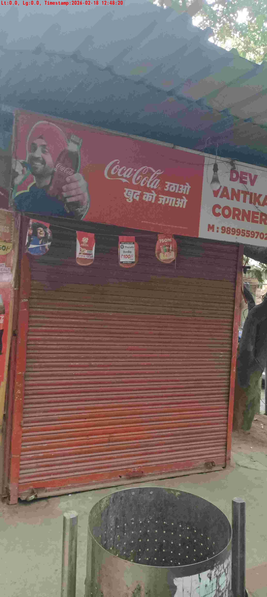
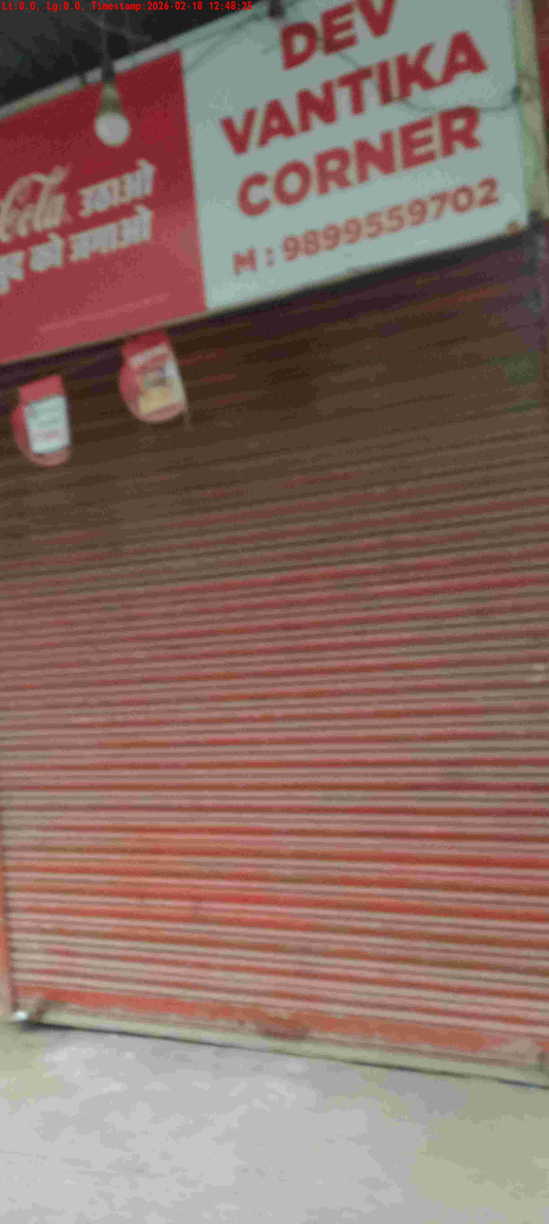
WD Code | DS Id | DS Name | Route Name | Shop Name | Date Time
DE5162 | 827 | Niche-DS48 | Wed-Sat | Dev Vantika | 18-02-2026 12:48:17 PM
Shop Inside Picture
Shop Front Picture

Slide 25
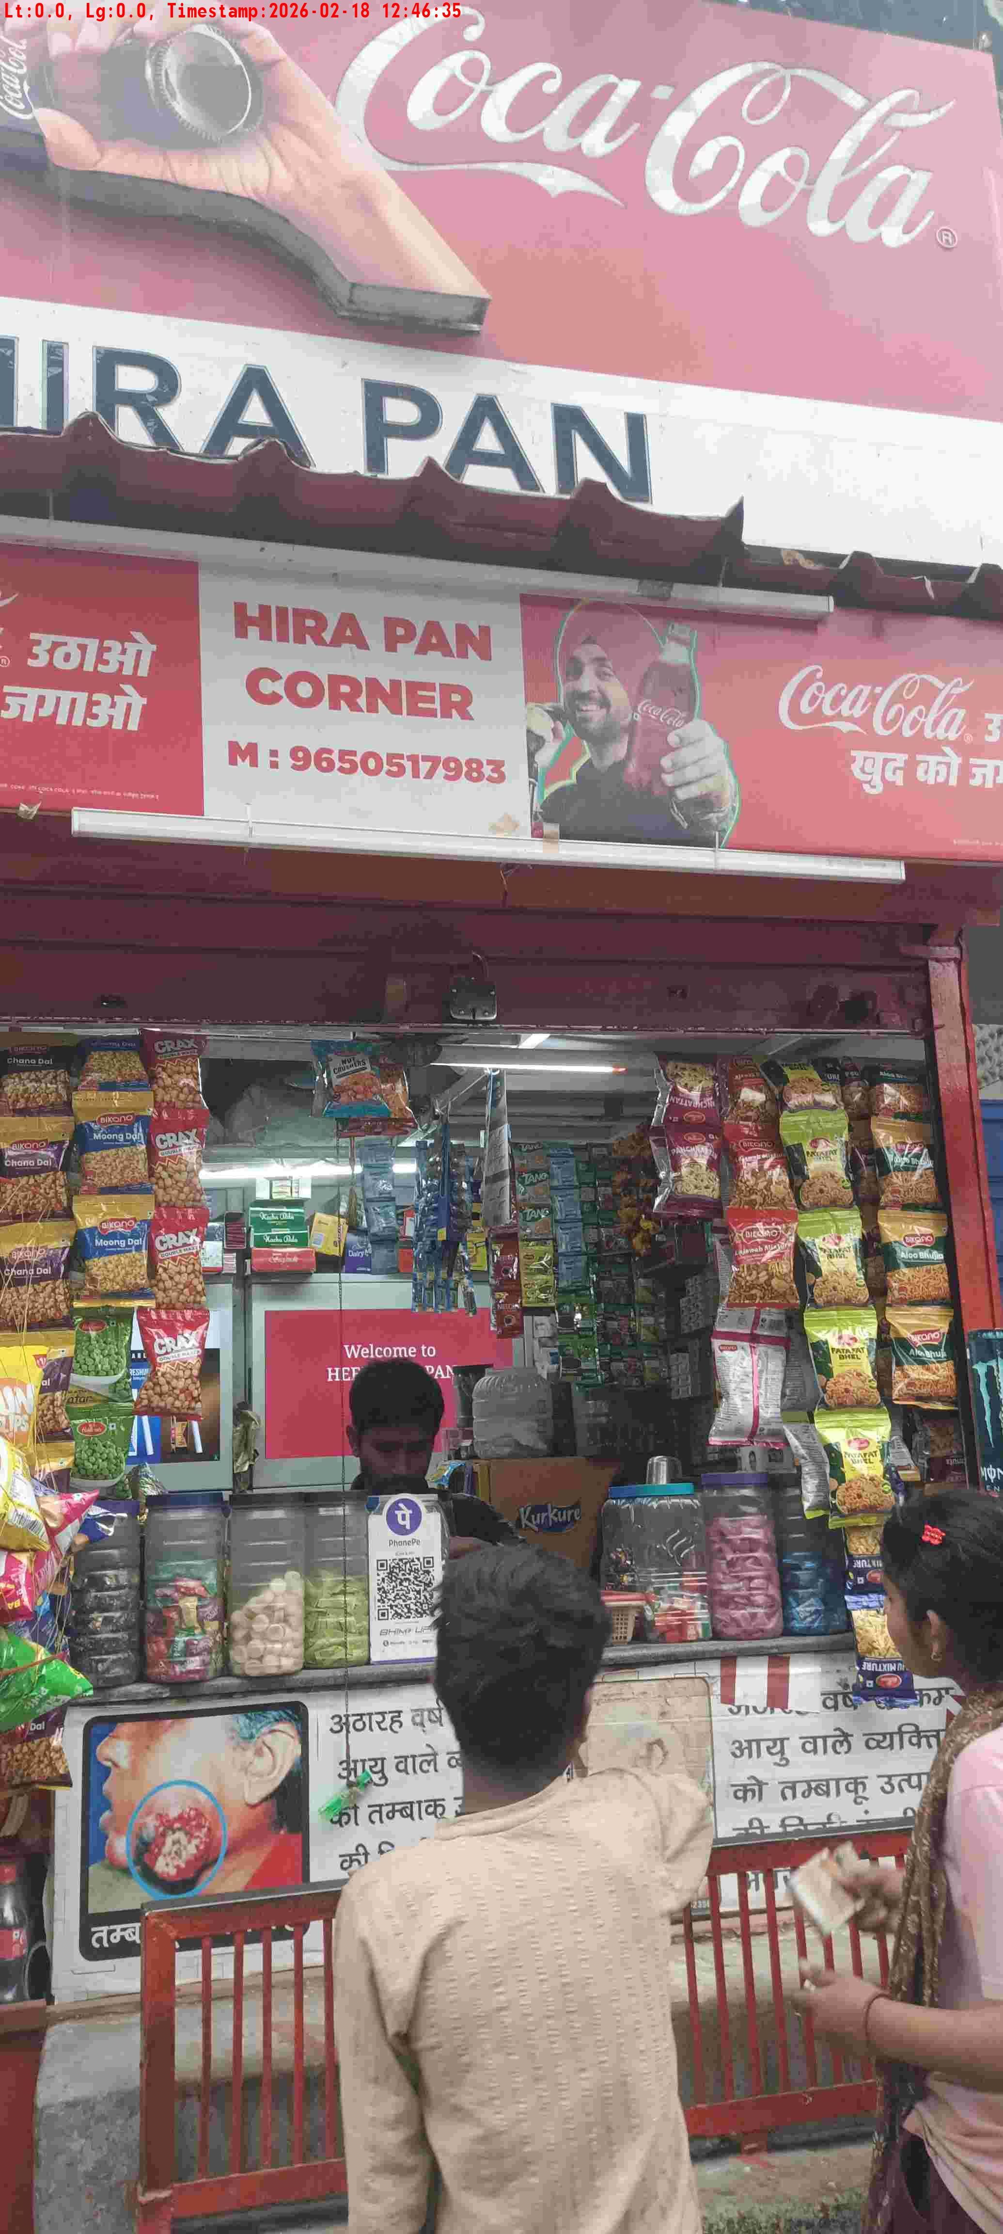
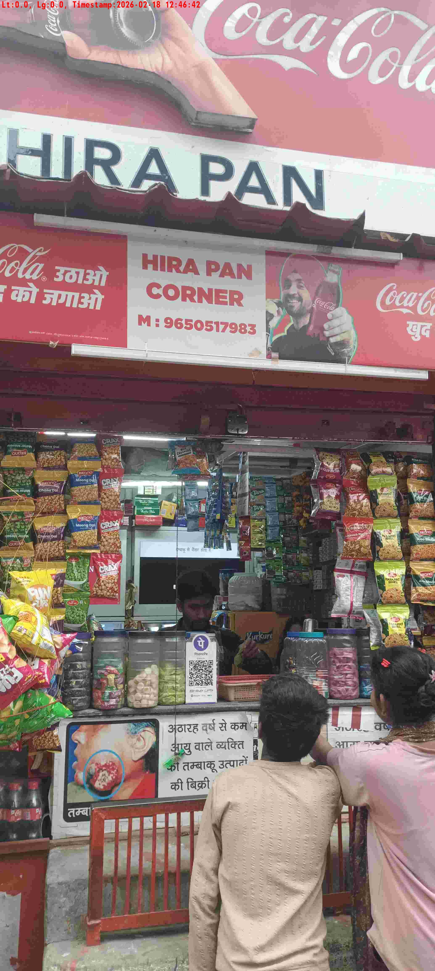
WD Code | DS Id | DS Name | Route Name | Shop Name | Date Time
DE5162 | 827 | Niche-DS48 | Wed-Sat | Heera Lal | 18-02-2026 12:46:32 PM
Shop Inside Picture
Shop Front Picture

Slide 26
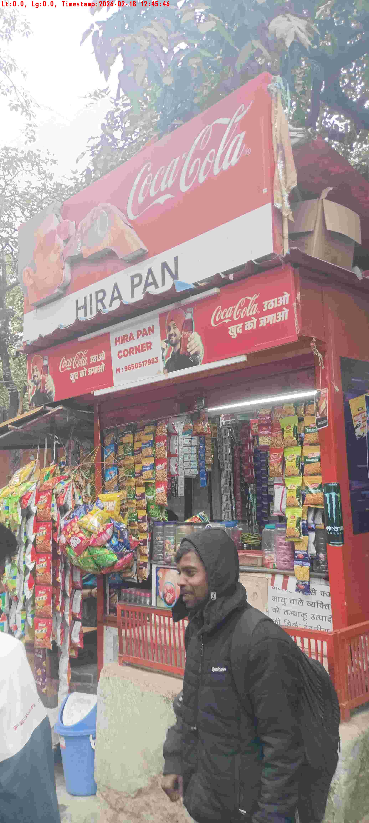
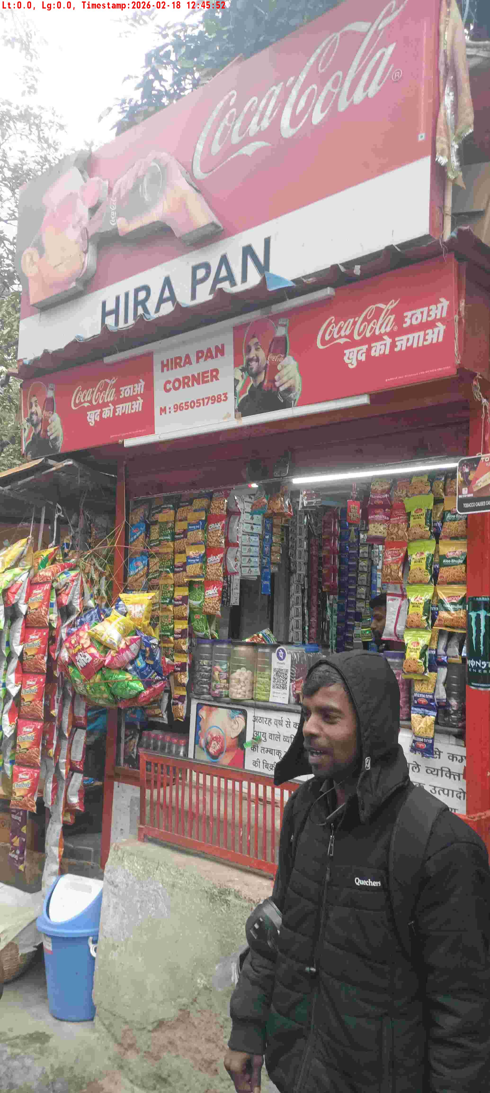
WD Code | DS Id | DS Name | Route Name | Shop Name | Date Time
DE5162 | 827 | Niche-DS48 | Wed-Sat | Hera Lal Pan | 18-02-2026 12:45:42 PM
Shop Inside Picture
Shop Front Picture

Slide 27
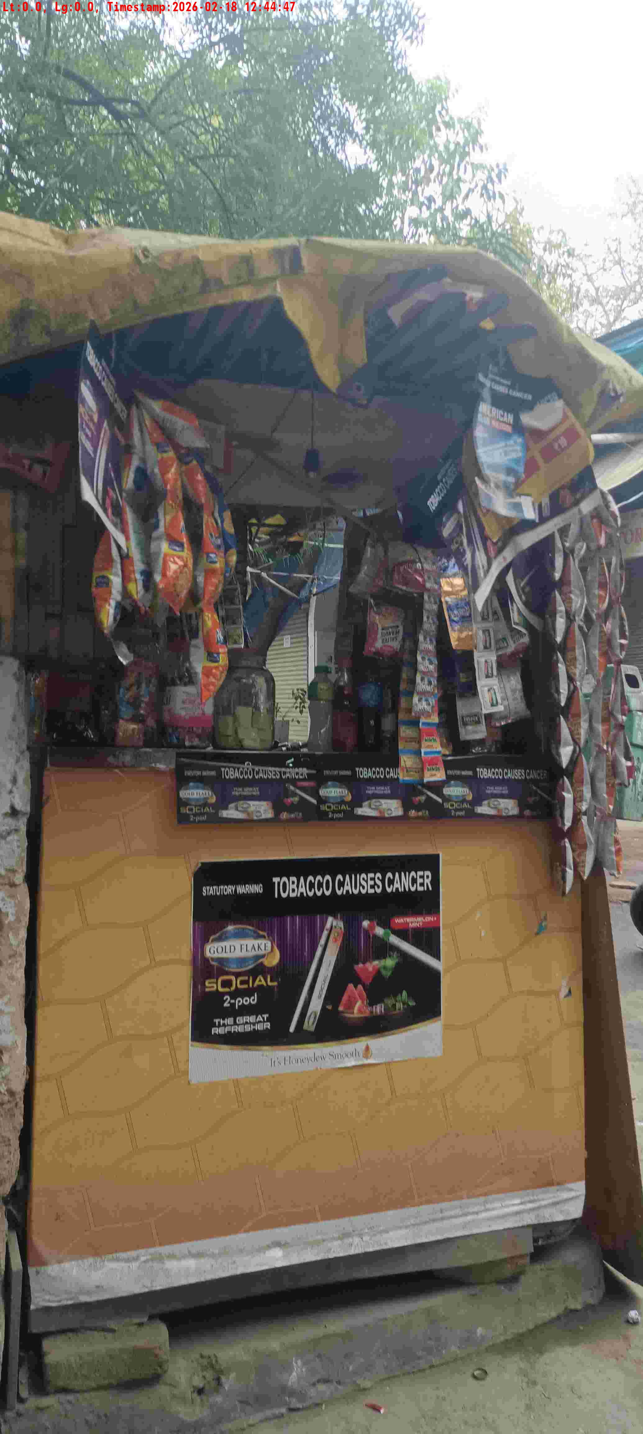
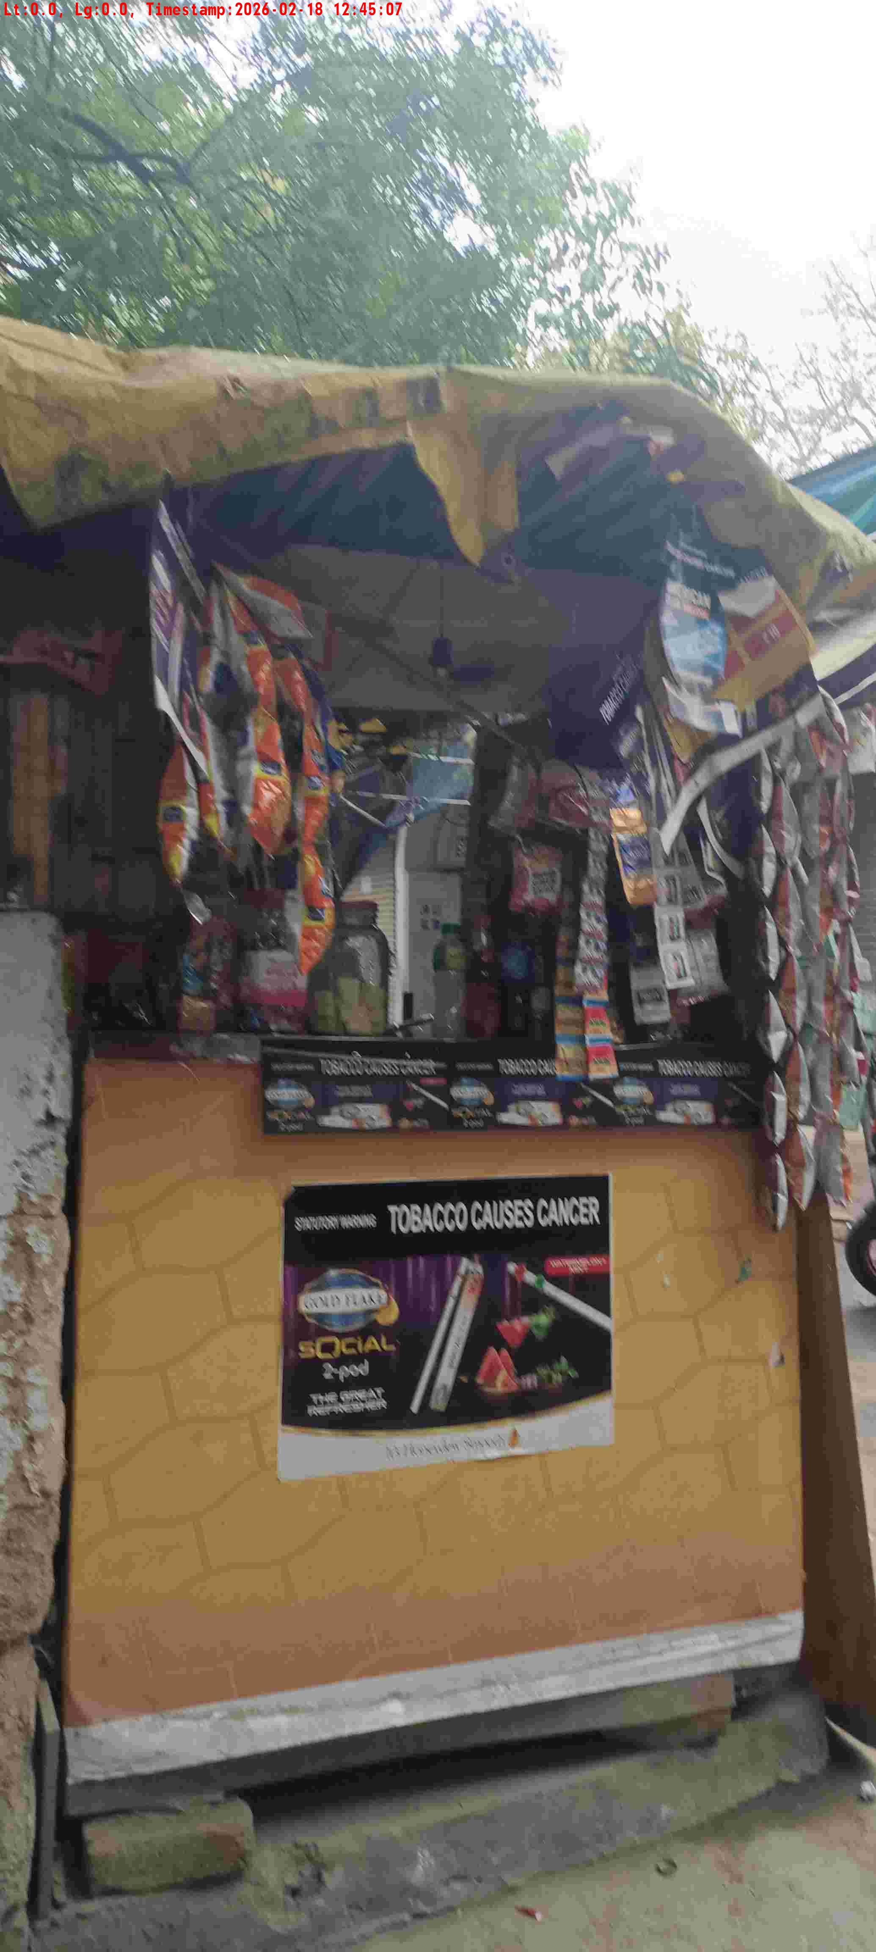
WD Code | DS Id | DS Name | Route Name | Shop Name | Date Time
DE5162 | 827 | Niche-DS48 | Wed-Sat | Yadav Pan | 18-02-2026 12:44:42 PM
Shop Inside Picture
Shop Front Picture

Slide 28


WD Code | DS Id | DS Name | Route Name | Shop Name | Date Time
DE5162 | 827 | Niche-DS48 | Wed-Sat | Sarvan Pan | 18-02-2026 12:44:07 PM
Shop Inside Picture
Shop Front Picture

Slide 29


WD Code | DS Id | DS Name | Route Name | Shop Name | Date Time
DE5162 | 827 | Niche-DS48 | Wed-Sat | Shyam Pan | 18-02-2026 12:05:25 PM
Shop Inside Picture
Shop Front Picture

Slide 30


WD Code | DS Id | DS Name | Route Name | Shop Name | Date Time
DE5162 | 827 | Niche-DS48 | Wed-Sat | GROVER STORE | 18-02-2026 10:18:24 AM
Shop Inside Picture
Shop Front Picture

