Slide 1
Transaction Ppt

Slide 2


WD Code | DS Id | DS Name | Route Name | Shop Name | Date Time
DE5296 | 884 | HR-Mohit | Tue-Fri | Lost Lemon | 17-02-2026 05:06:40 PM
Shop Inside Picture
Shop Front Picture

Slide 3


WD Code | DS Id | DS Name | Route Name | Shop Name | Date Time
DE5296 | 884 | HR-Mohit | Tue-Fri | SO YOU | 17-02-2026 04:55:14 PM
Shop Inside Picture
Shop Front Picture

Slide 4


WD Code | DS Id | DS Name | Route Name | Shop Name | Date Time
DE5296 | 884 | HR-Mohit | Tue-Fri | The Hook | 17-02-2026 04:54:45 PM
Shop Inside Picture
Shop Front Picture

Slide 5


WD Code | DS Id | DS Name | Route Name | Shop Name | Date Time
DE5296 | 884 | HR-Mohit | Tue-Fri | Walking Stret | 17-02-2026 04:04:40 PM
Shop Inside Picture
Shop Front Picture

Slide 6
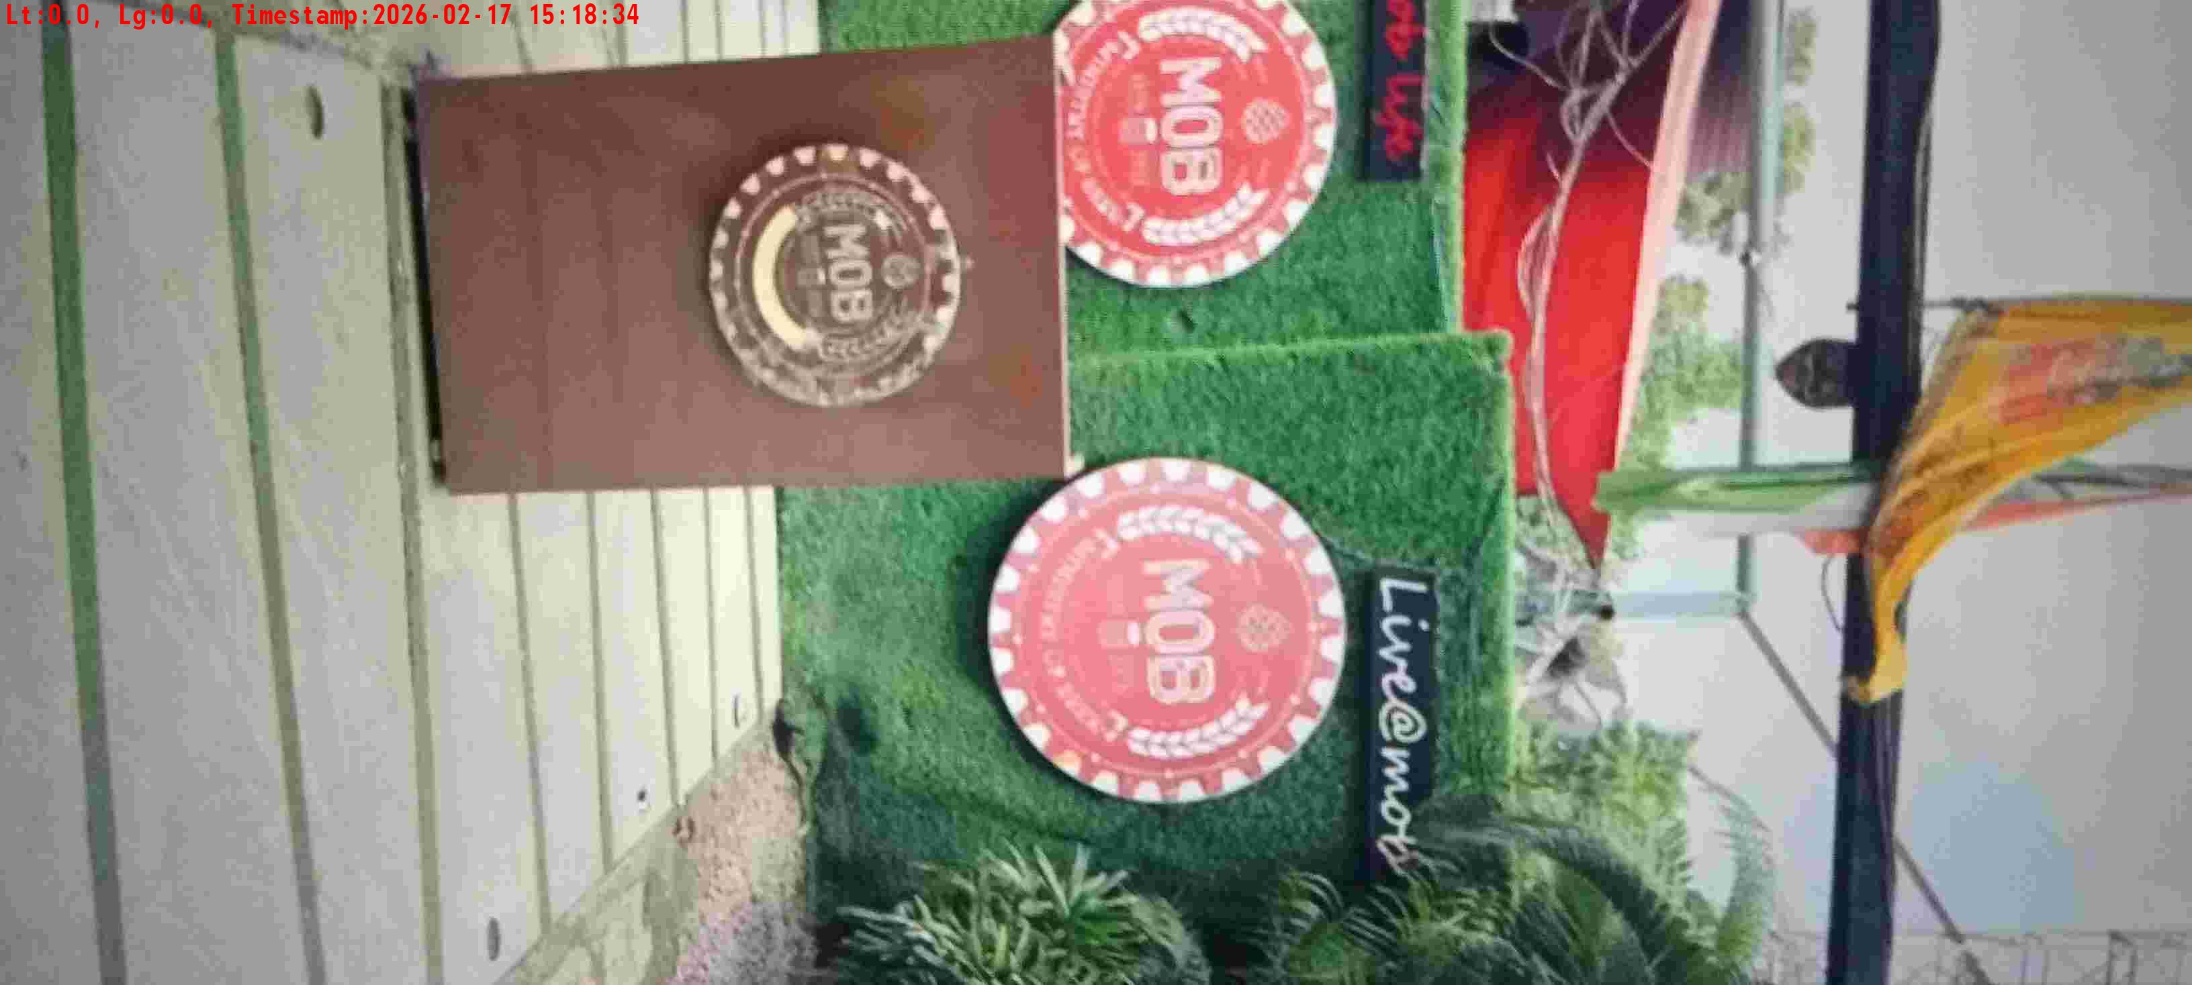
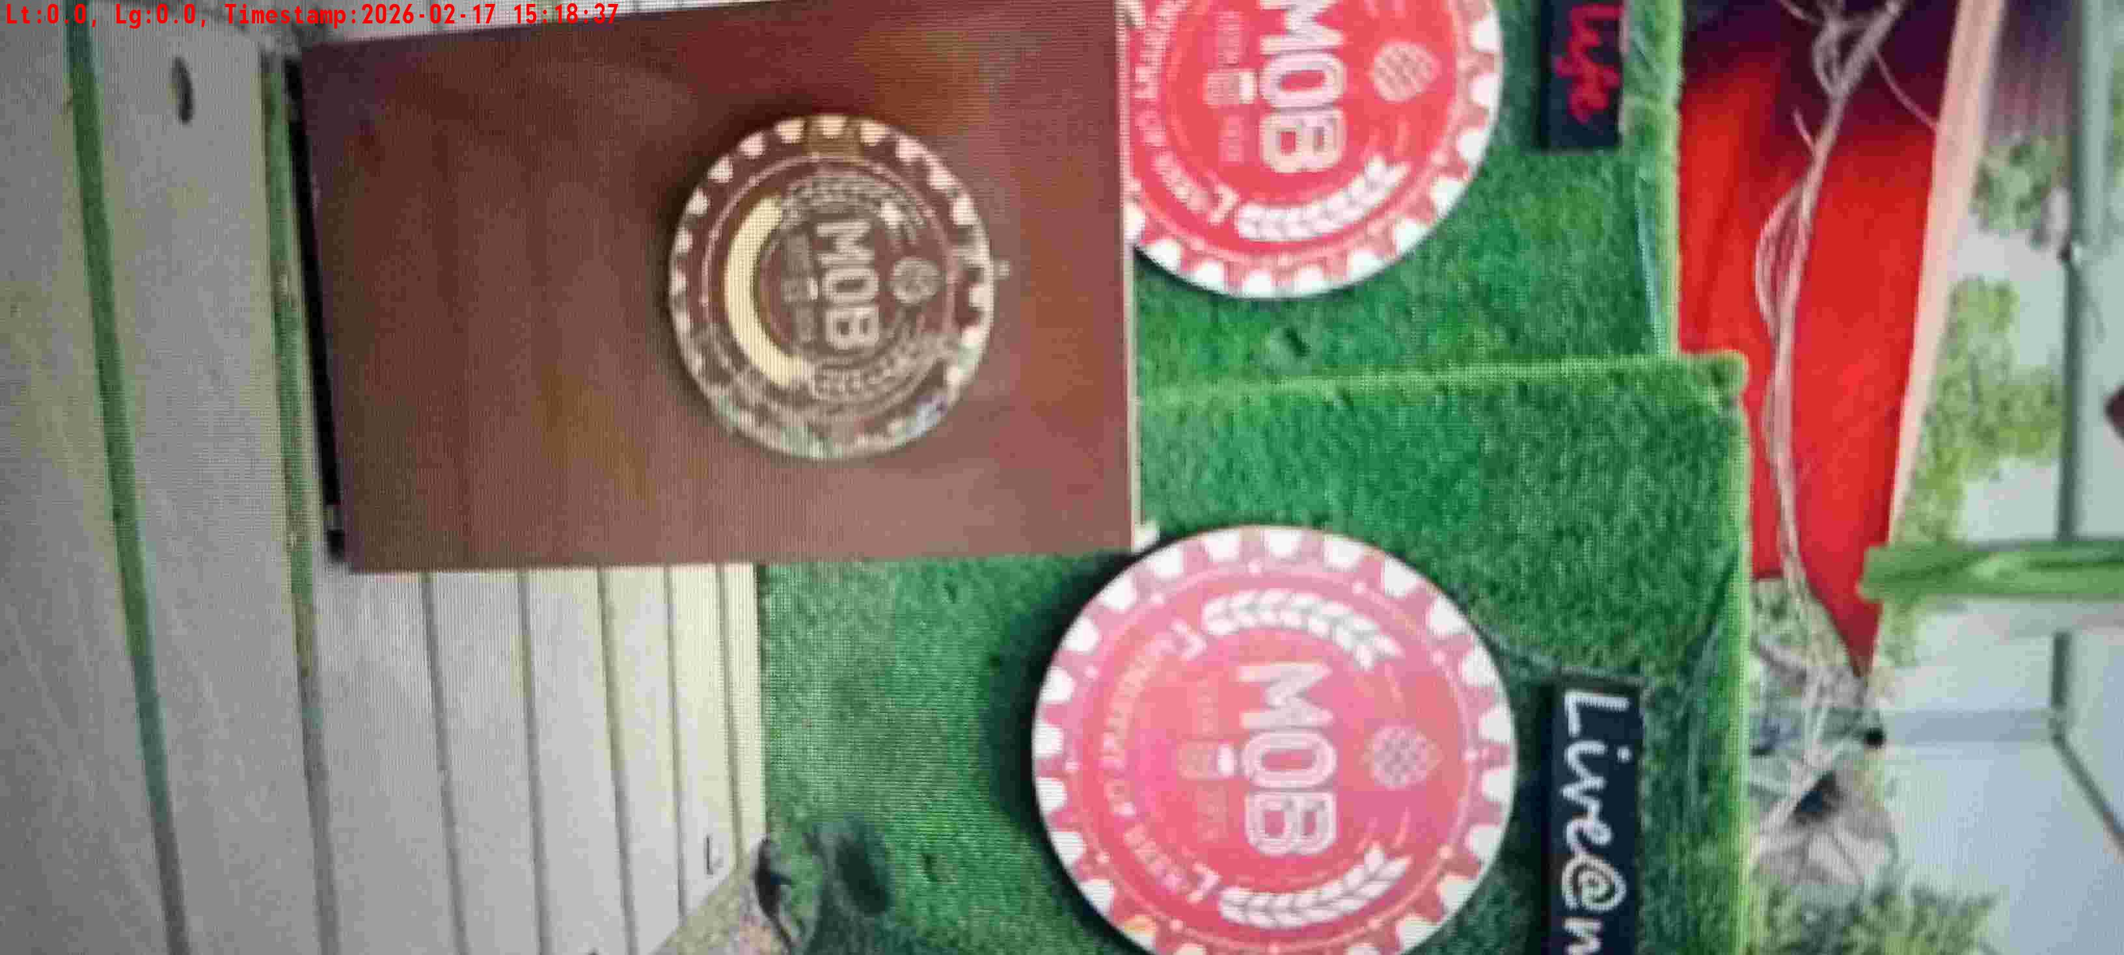
WD Code | DS Id | DS Name | Route Name | Shop Name | Date Time
DE5296 | 884 | HR-Mohit | Tue-Fri | MOB | 17-02-2026 03:18:31 PM
Shop Inside Picture
Shop Front Picture

Slide 7
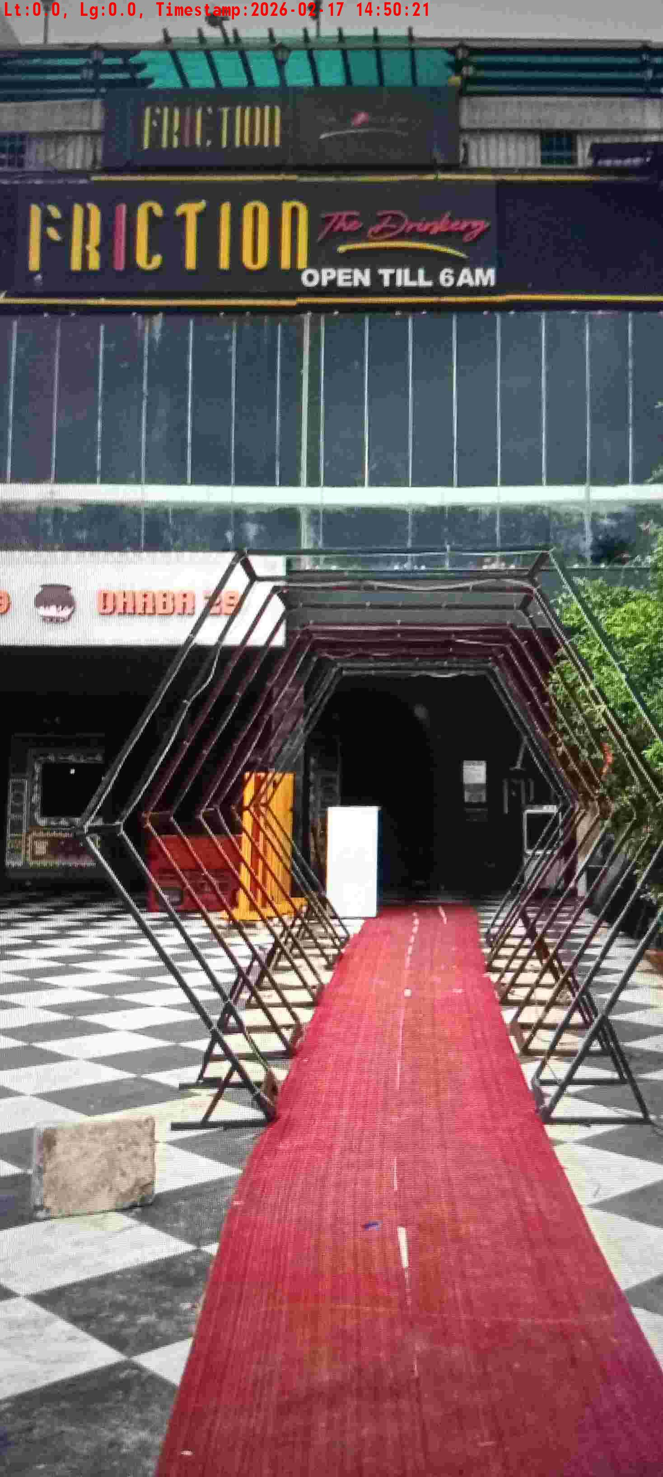
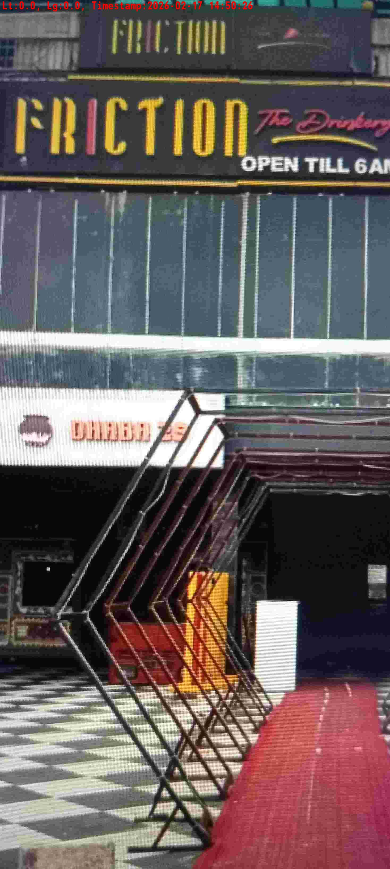
WD Code | DS Id | DS Name | Route Name | Shop Name | Date Time
DE5296 | 884 | HR-Mohit | Tue-Fri | MOB | 17-02-2026 02:50:18 PM
Shop Inside Picture
Shop Front Picture

Slide 8
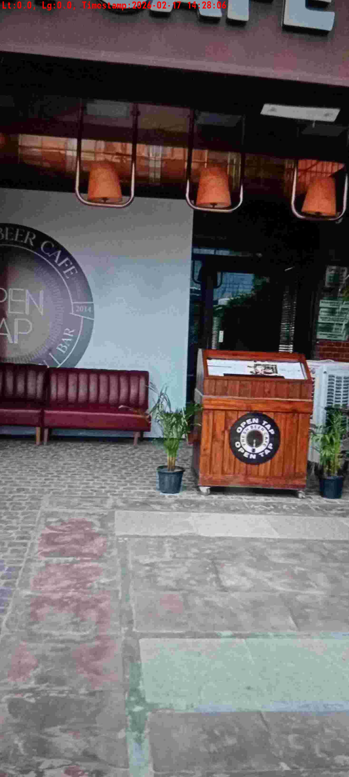
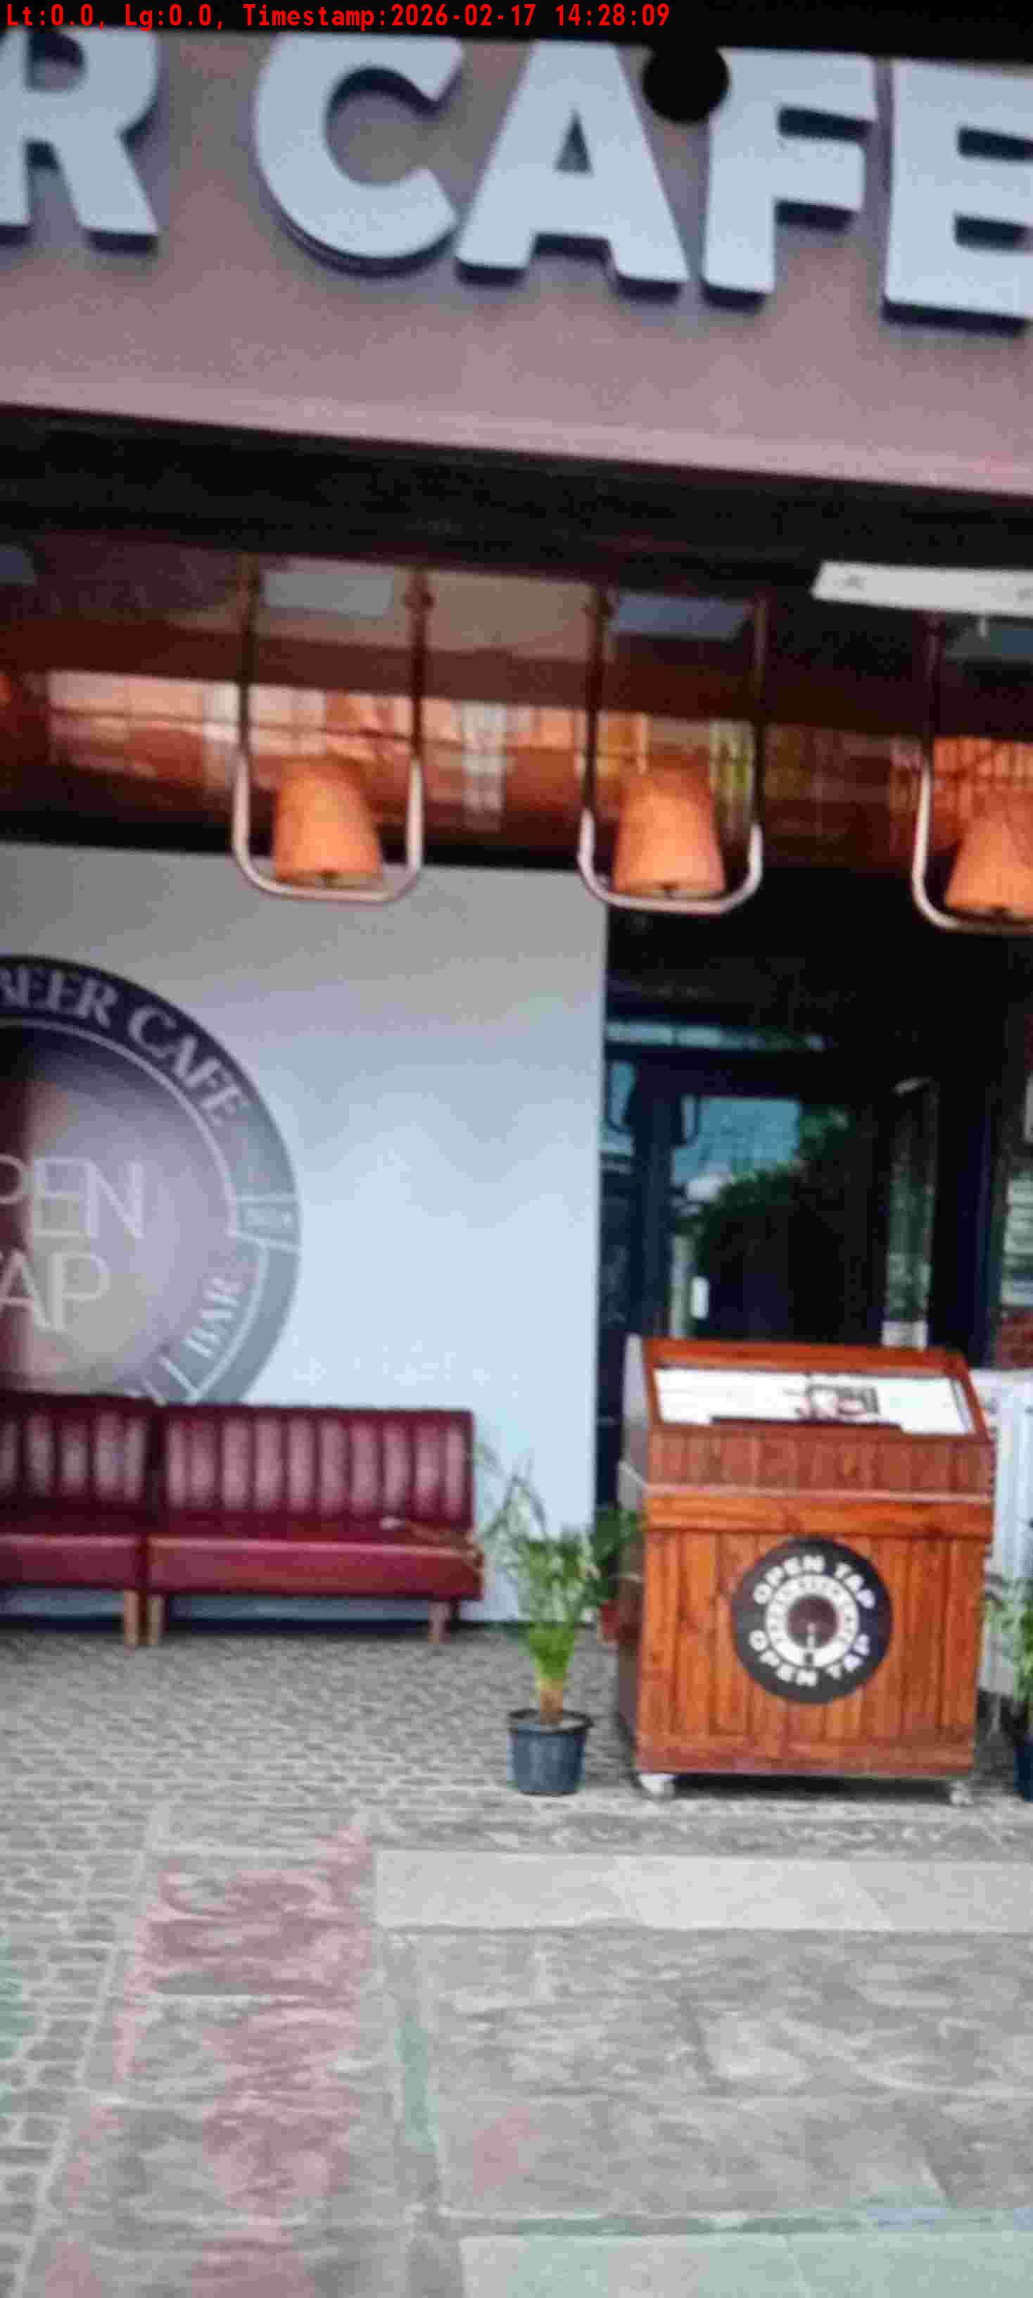
WD Code | DS Id | DS Name | Route Name | Shop Name | Date Time
DE5296 | 884 | HR-Mohit | Tue-Fri | Open Tap Sec 29 Gurgaon | 17-02-2026 02:28:03 PM
Shop Inside Picture
Shop Front Picture

Slide 9
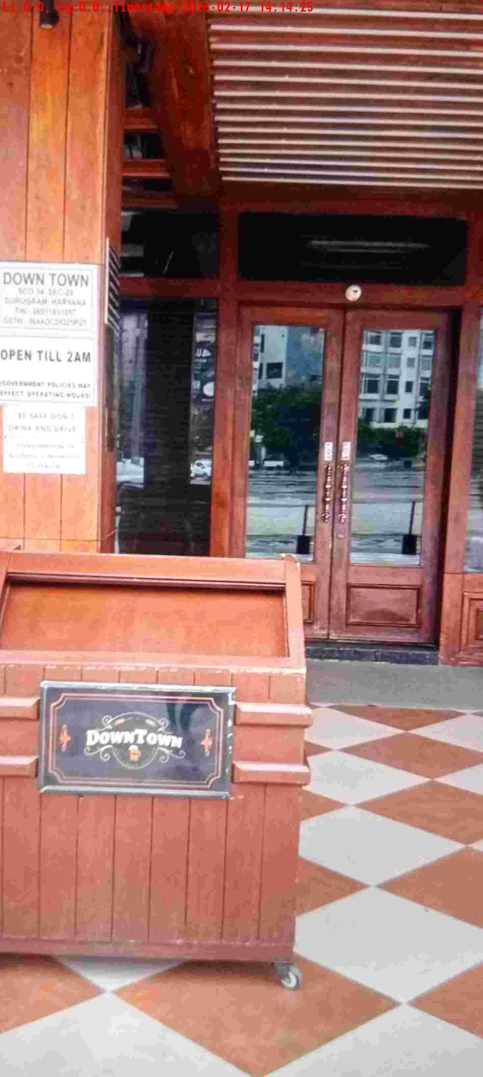
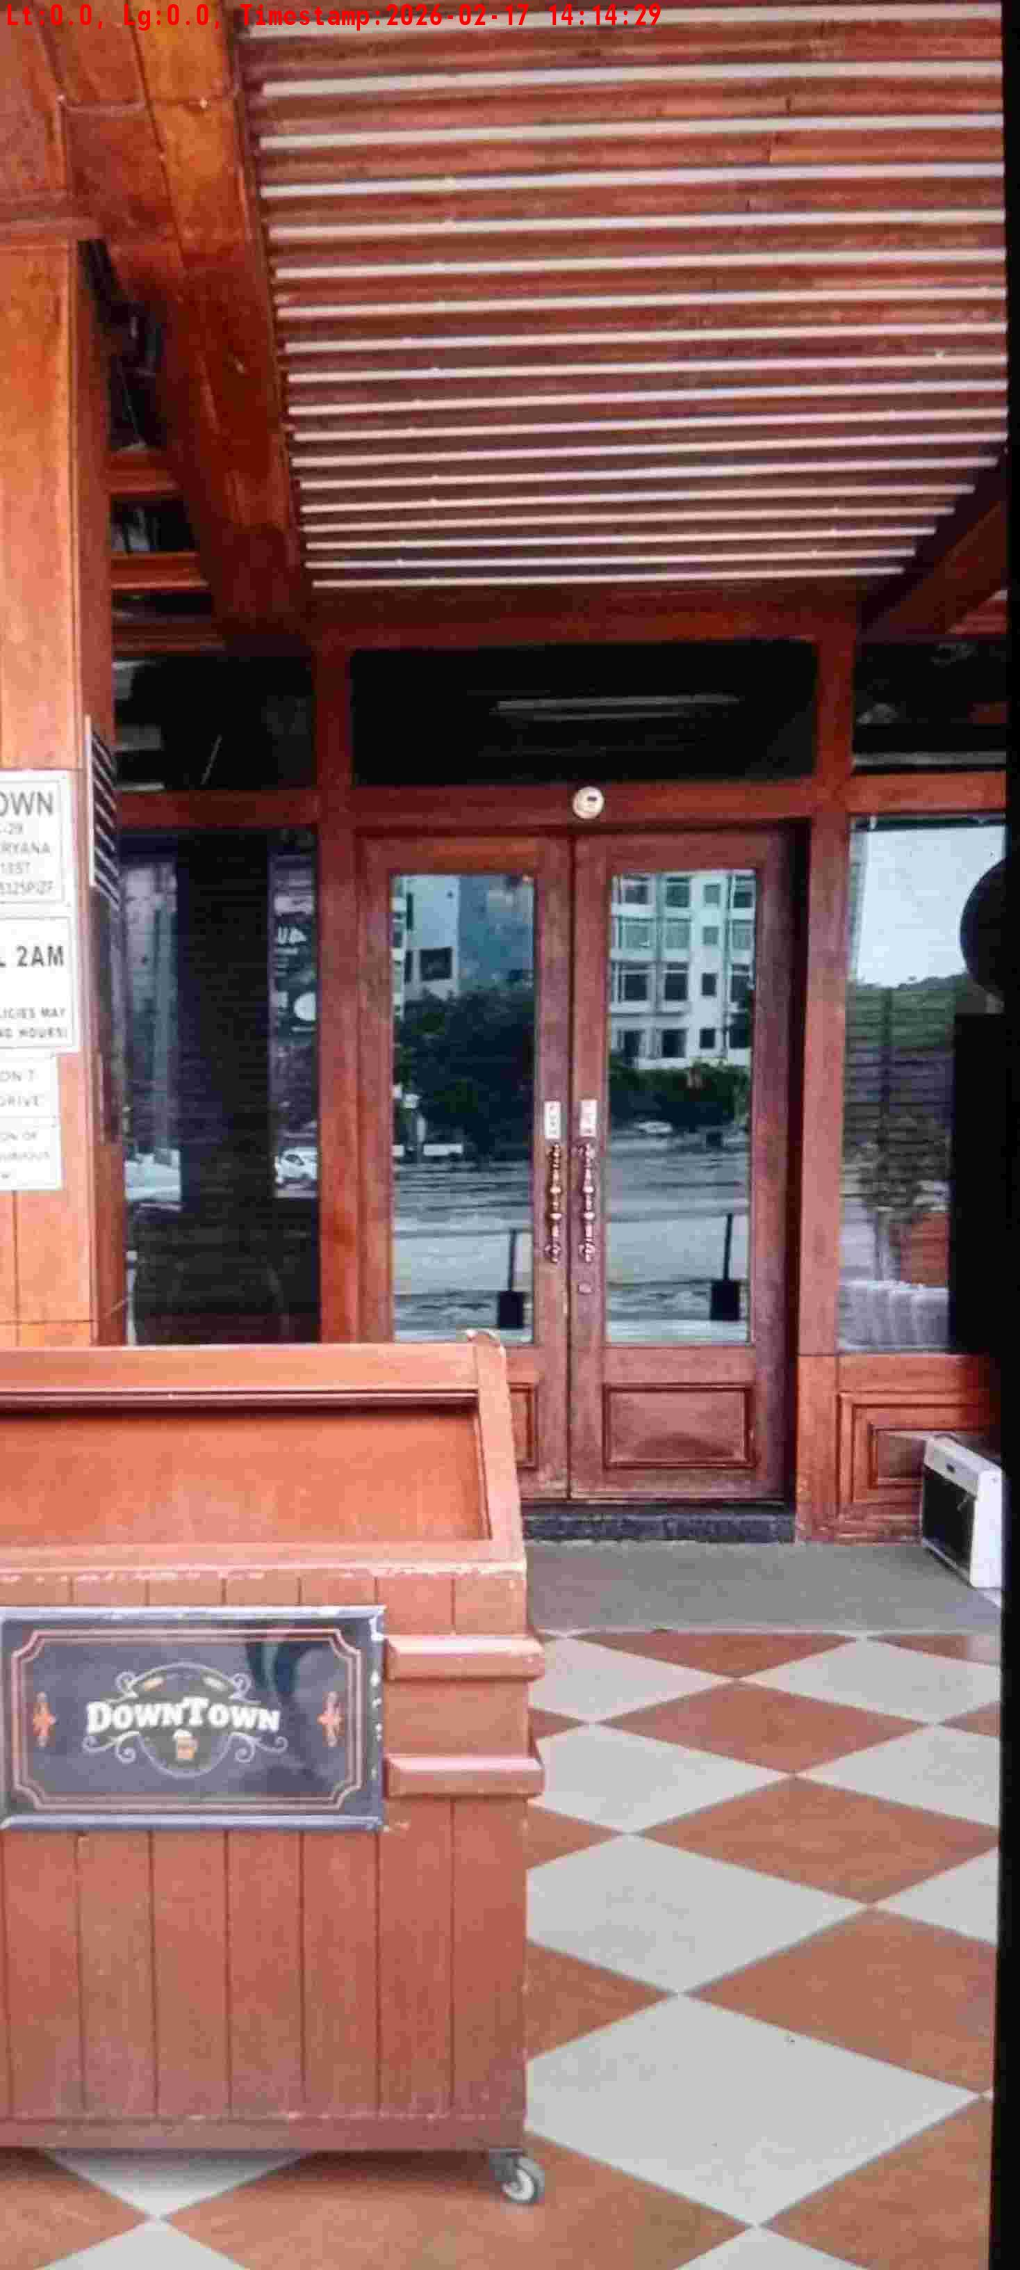
WD Code | DS Id | DS Name | Route Name | Shop Name | Date Time
DE5296 | 884 | HR-Mohit | Tue-Fri | Down Town Sec 29 Gurgaon | 17-02-2026 02:14:23 PM
Shop Inside Picture
Shop Front Picture

Slide 10
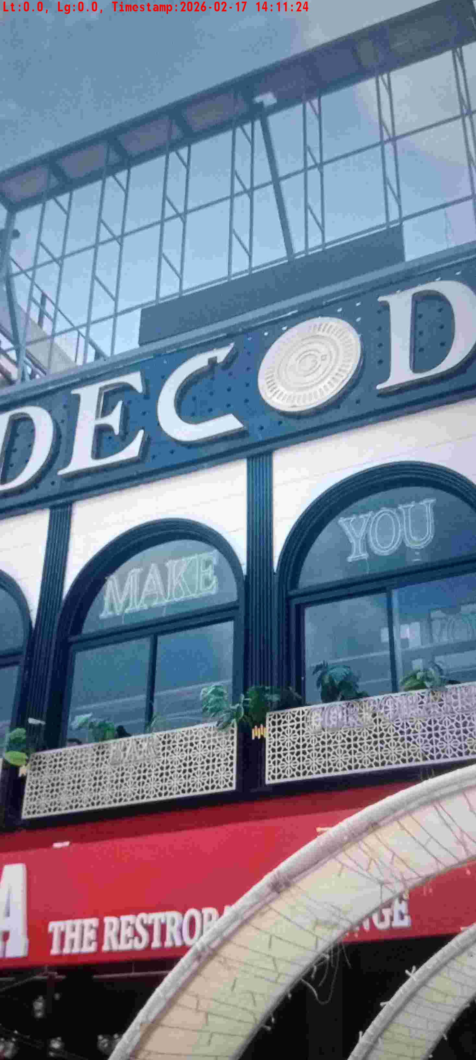
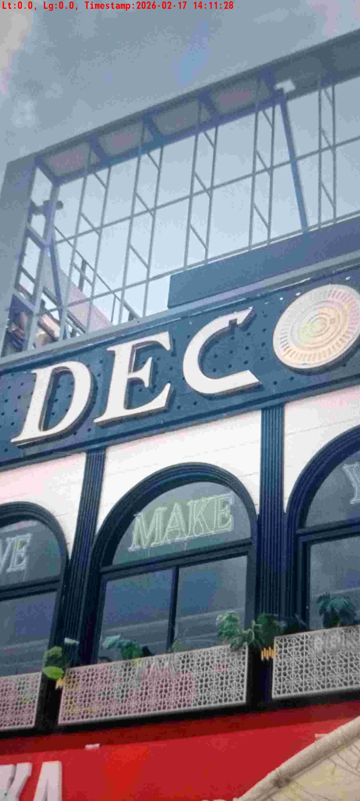
WD Code | DS Id | DS Name | Route Name | Shop Name | Date Time
DE5296 | 884 | HR-Mohit | Tue-Fri | Decode | 17-02-2026 02:11:21 PM
Shop Inside Picture
Shop Front Picture

Slide 11
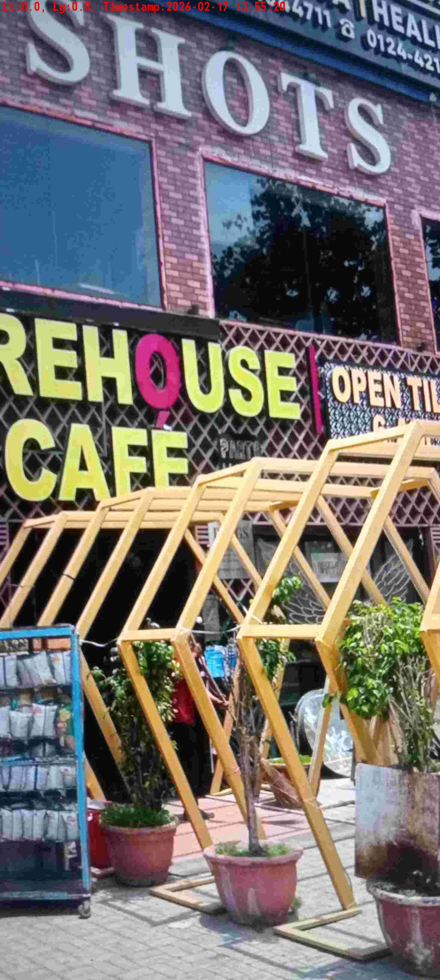
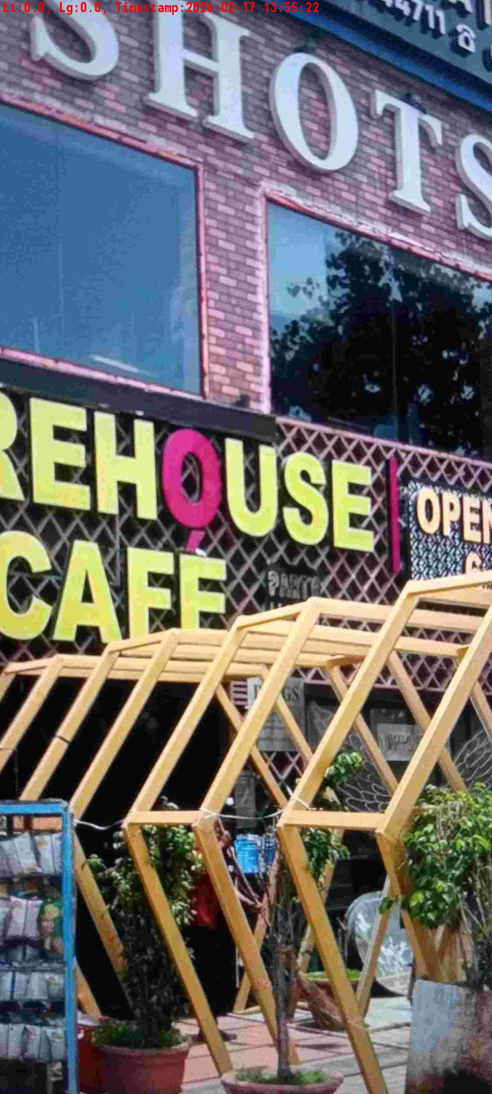
WD Code | DS Id | DS Name | Route Name | Shop Name | Date Time
DE5296 | 884 | HR-Mohit | Tue-Fri | Ware House | 17-02-2026 01:55:17 PM
Shop Inside Picture
Shop Front Picture

Slide 12
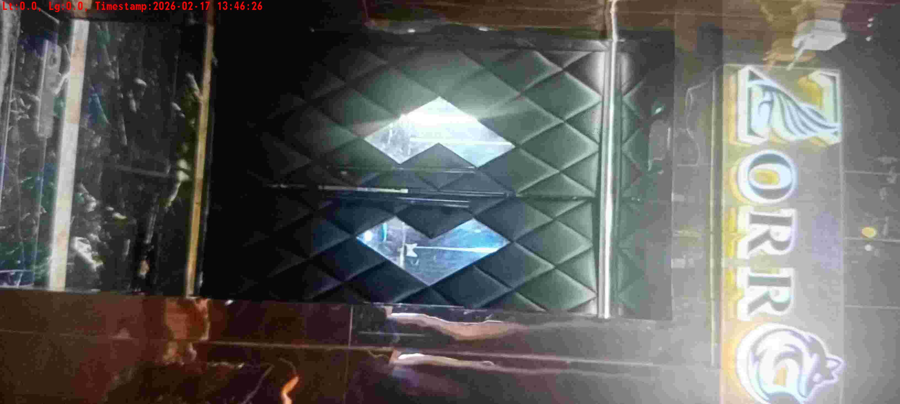
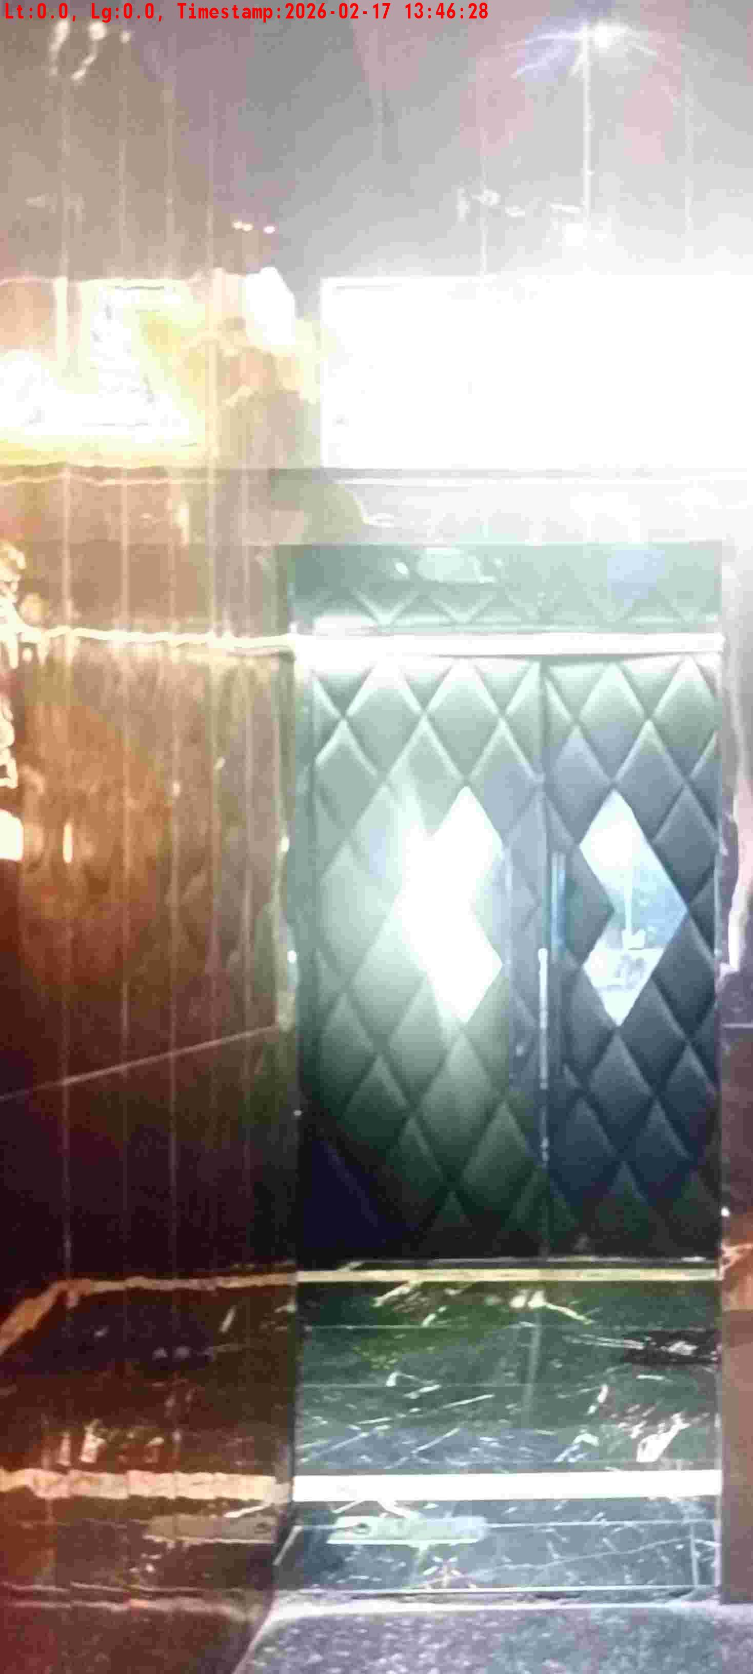
WD Code | DS Id | DS Name | Route Name | Shop Name | Date Time
DE5296 | 884 | HR-Mohit | Tue-Fri | Zorrow | 17-02-2026 01:46:23 PM
Shop Inside Picture
Shop Front Picture

Slide 13
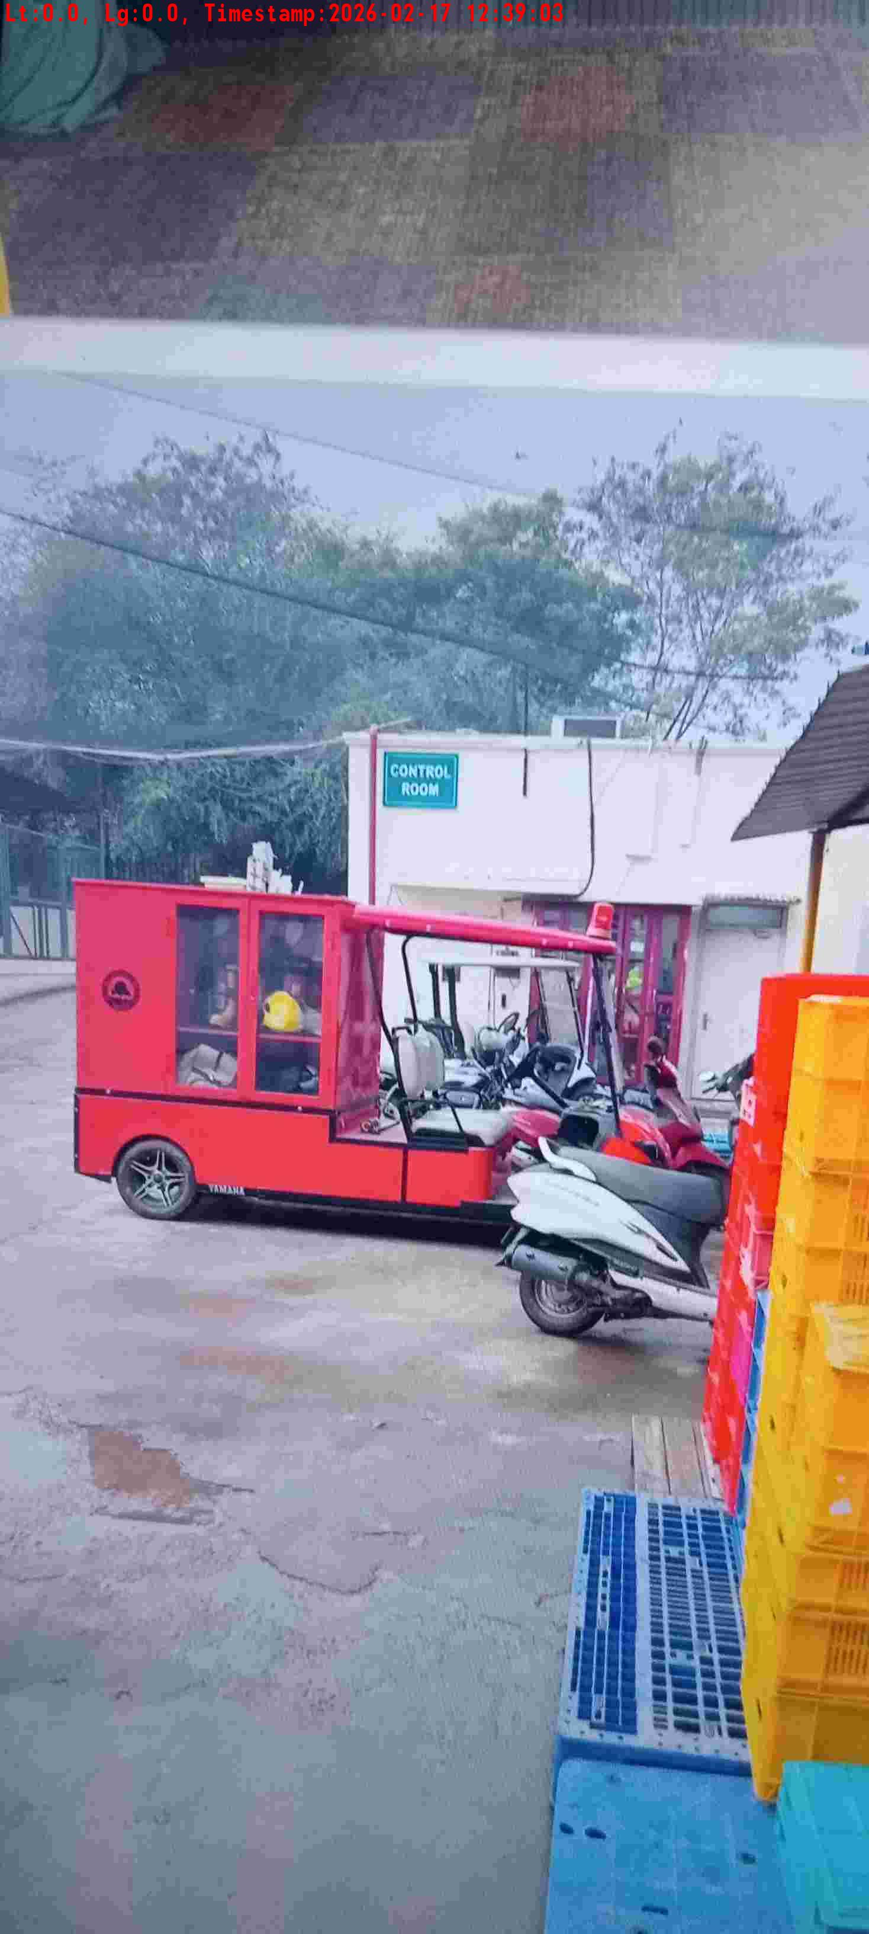
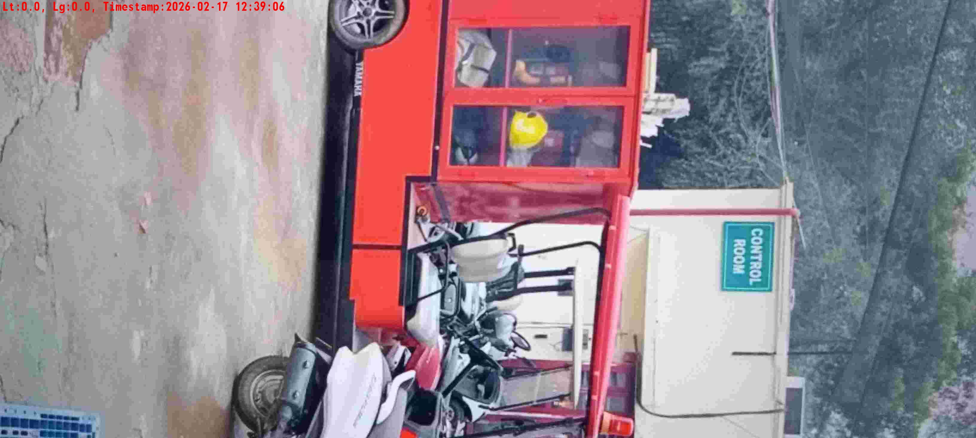
WD Code | DS Id | DS Name | Route Name | Shop Name | Date Time
DE5296 | 884 | HR-Mohit | Tue-Fri | DLF Golf Club | 17-02-2026 12:39:01 PM
Shop Inside Picture
Shop Front Picture

Slide 14
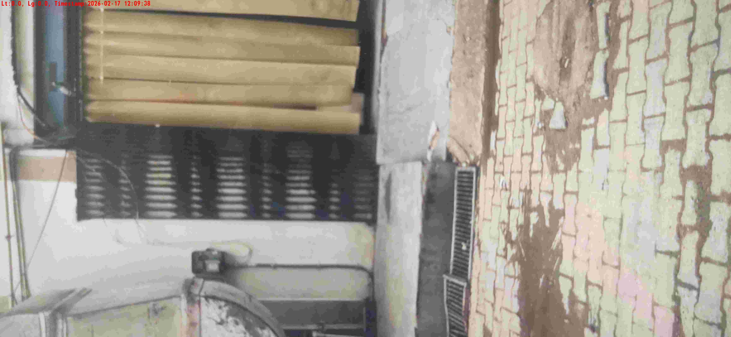
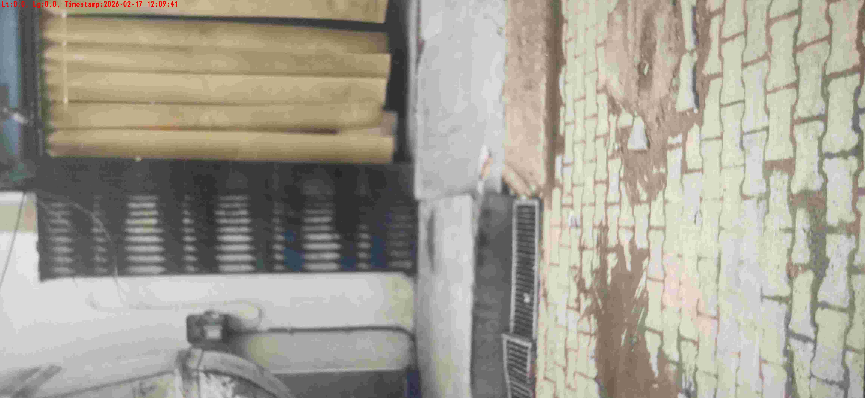
WD Code | DS Id | DS Name | Route Name | Shop Name | Date Time
DE5296 | 884 | HR-Mohit | Tue-Fri | LEMON TREE PREMIER Sec 29 | 17-02-2026 12:09:34 PM
Shop Inside Picture
Shop Front Picture

Slide 15
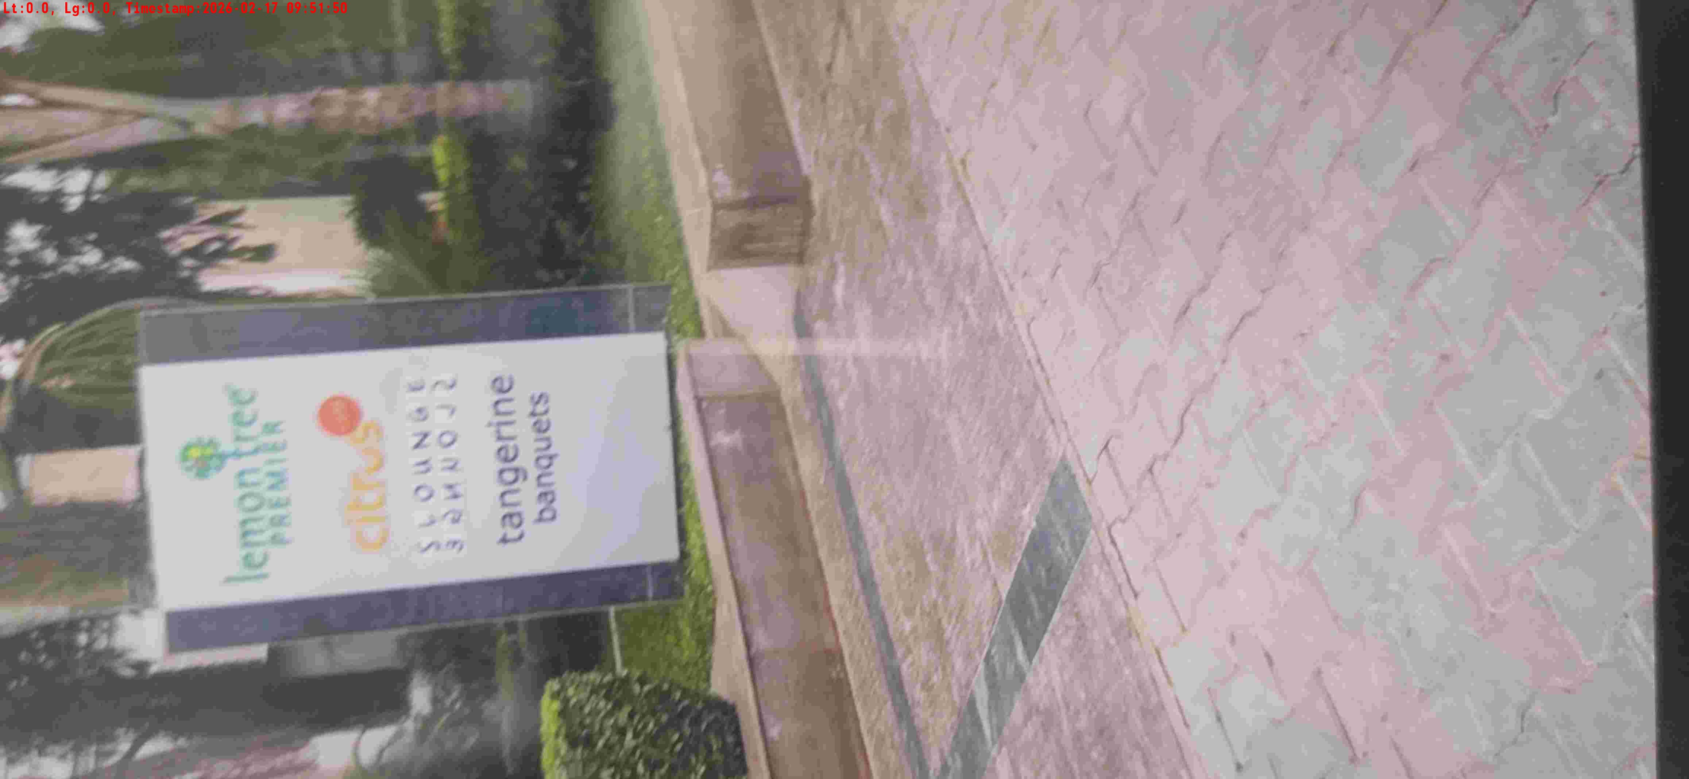

WD Code | DS Id | DS Name | Route Name | Shop Name | Date Time
DE5296 | 884 | HR-Mohit | Tue-Fri | Hotel Citrus | 17-02-2026 09:51:46 AM
Shop Inside Picture
Shop Front Picture

