Slide 1
Transaction Ppt

Slide 2
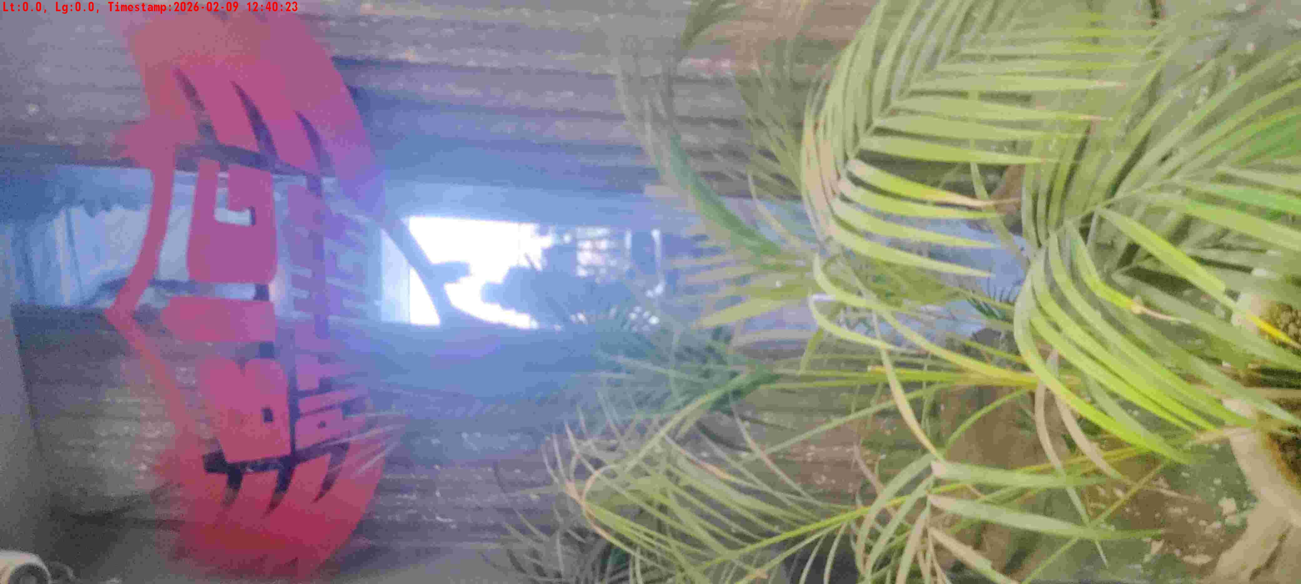
WD Code | DS Id | DS Name | Route Name | Shop Name | Date Time
DE5296 | 884 | HR-Mohit | Mon-Thu | Big Pitcher | 09-02-2026 12:40:21 PM
Shop Inside Picture

Slide 3
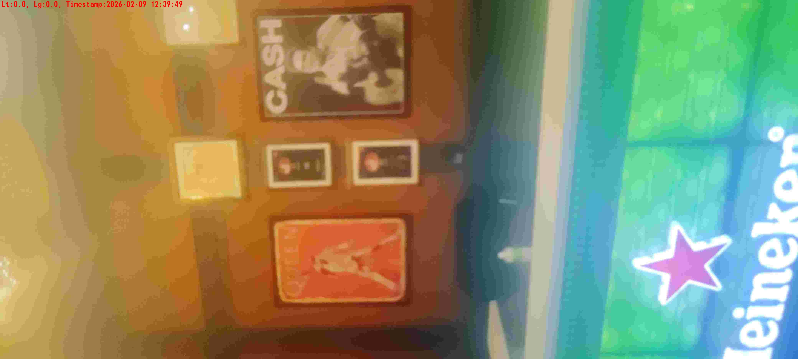

WD Code | DS Id | DS Name | Route Name | Shop Name | Date Time
DE5296 | 884 | HR-Mohit | Mon-Thu | Studio XO Bar | 09-02-2026 12:19:26 PM
Shop Inside Picture
Shop Front Picture

Slide 4
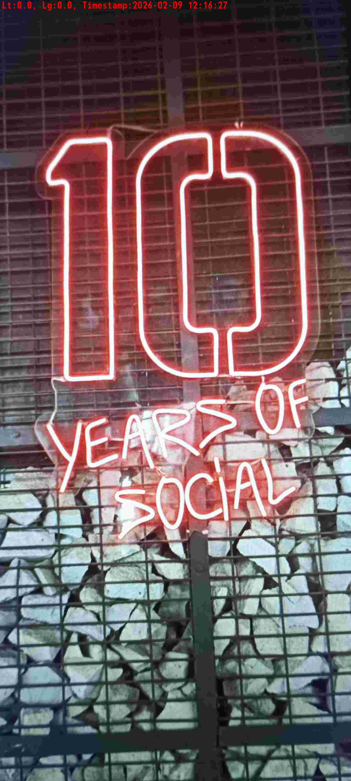
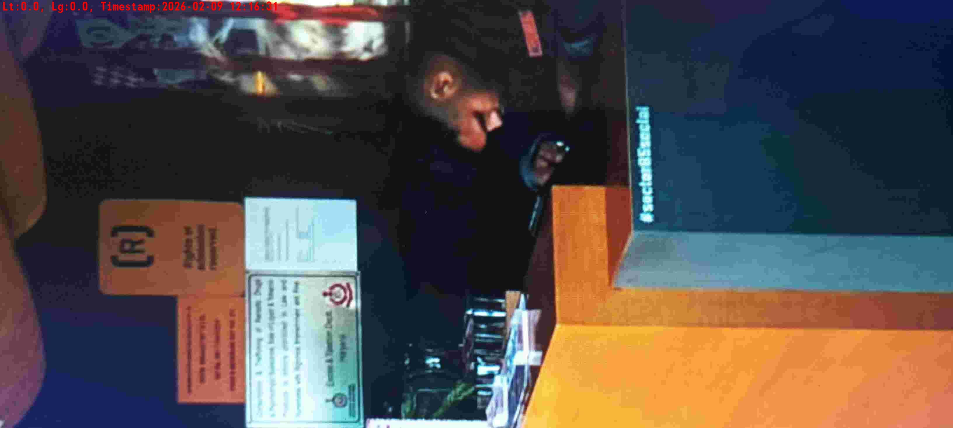
WD Code | DS Id | DS Name | Route Name | Shop Name | Date Time
DE5296 | 885 | HR-Satyasheel | Mon-Thu | Social Manesar | 09-02-2026 12:16:22 PM
Shop Inside Picture
Shop Front Picture

Slide 5
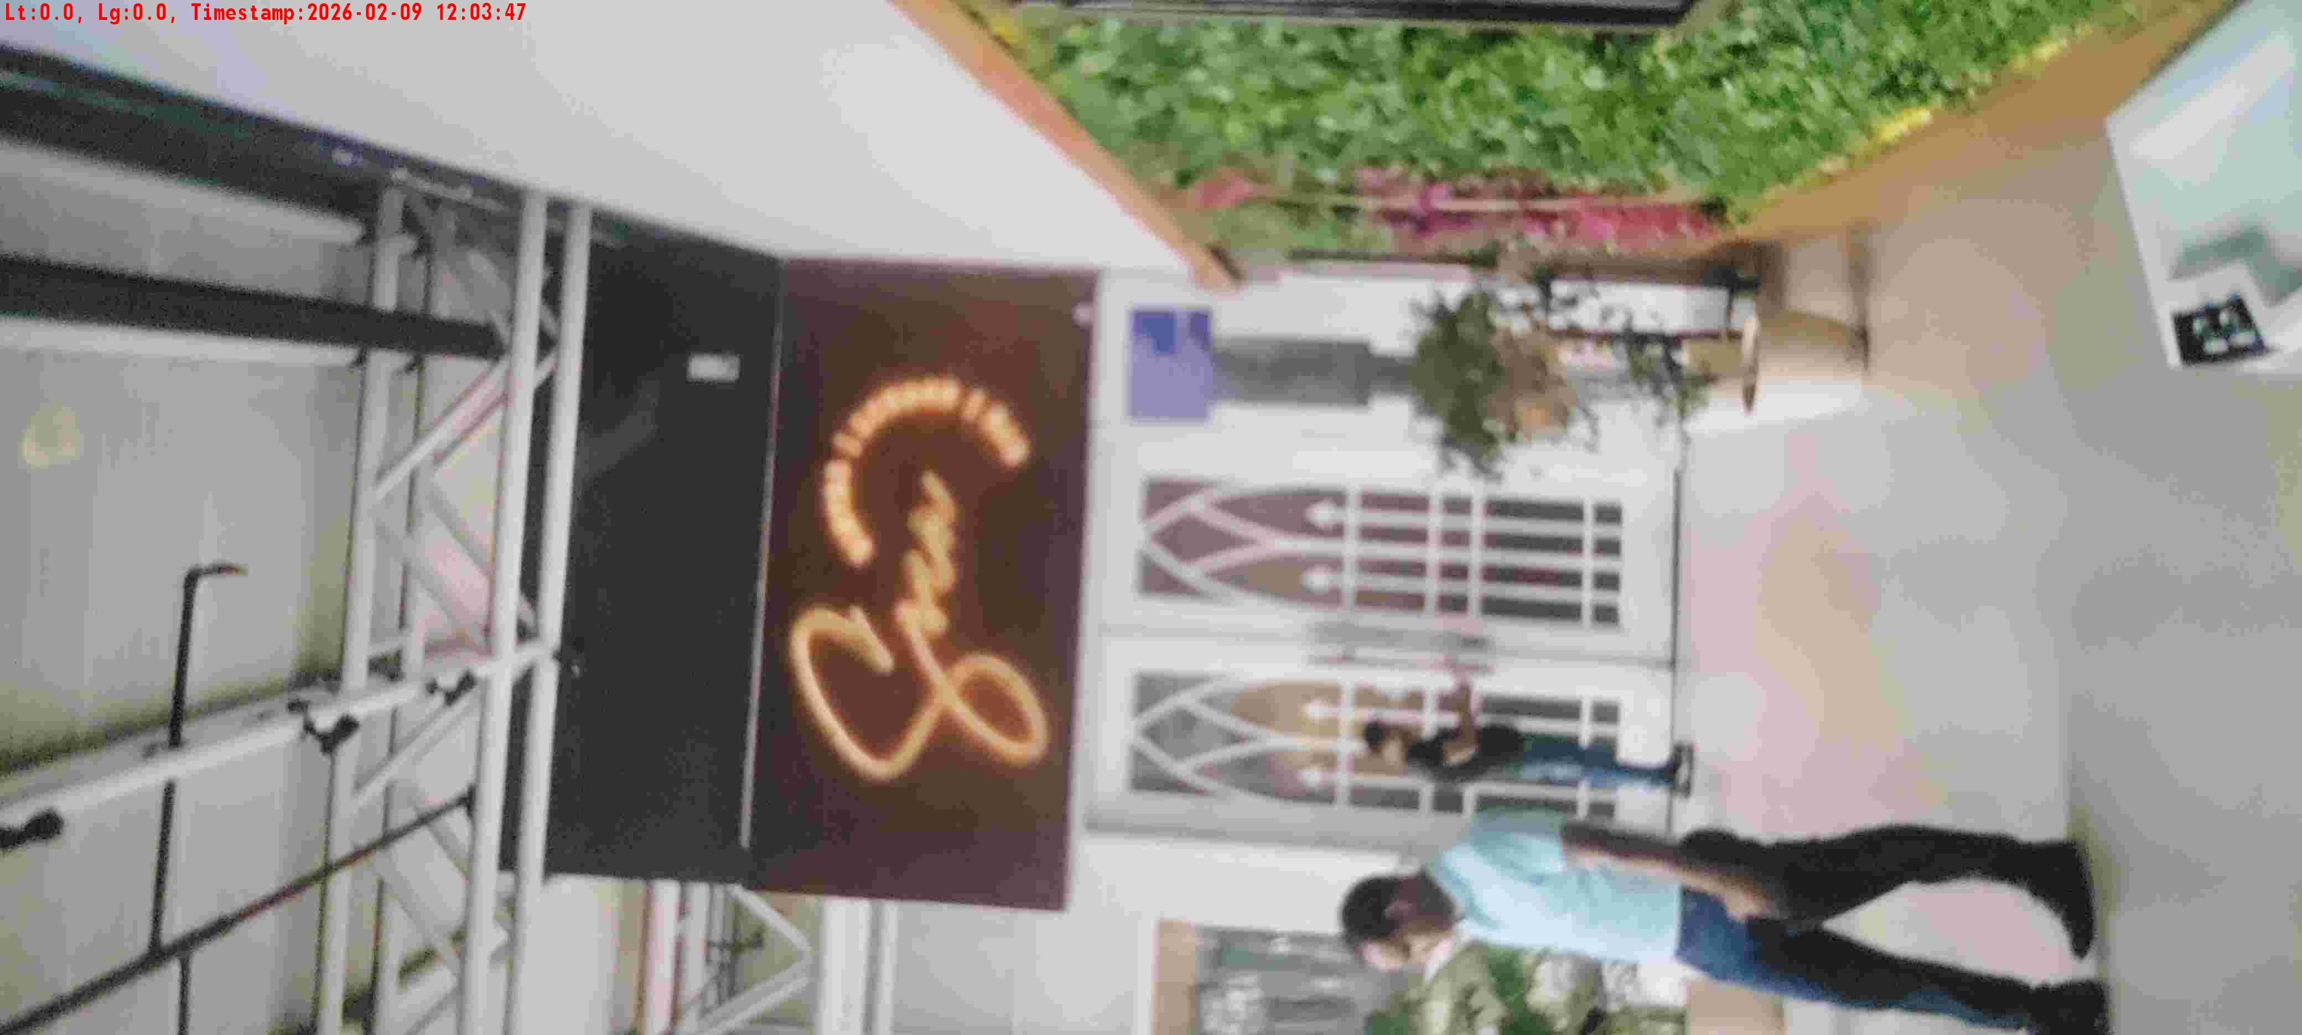
WD Code | DS Id | DS Name | Route Name | Shop Name | Date Time
DE5296 | 884 | HR-Mohit | Mon-Thu | SOCA | 09-02-2026 12:03:45 PM
Shop Inside Picture

Slide 6
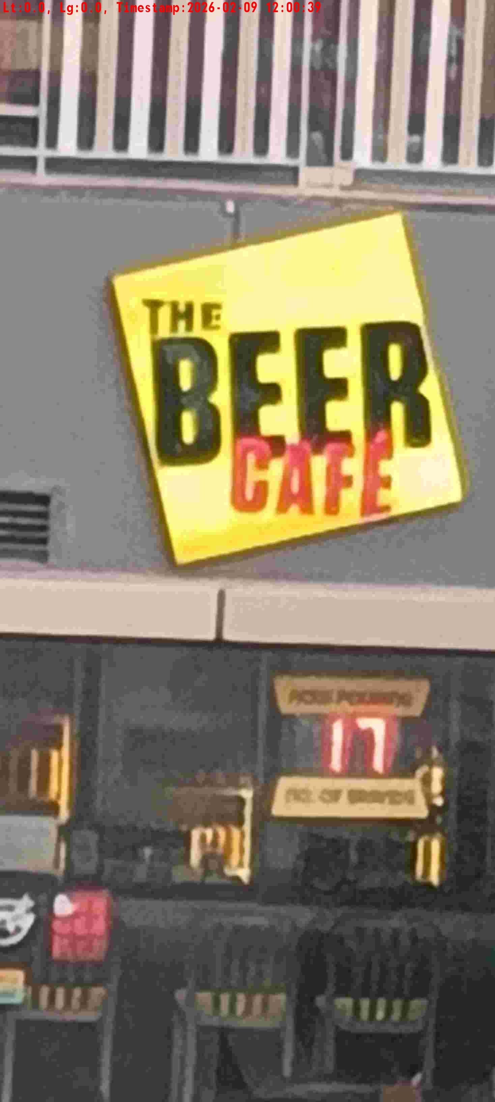
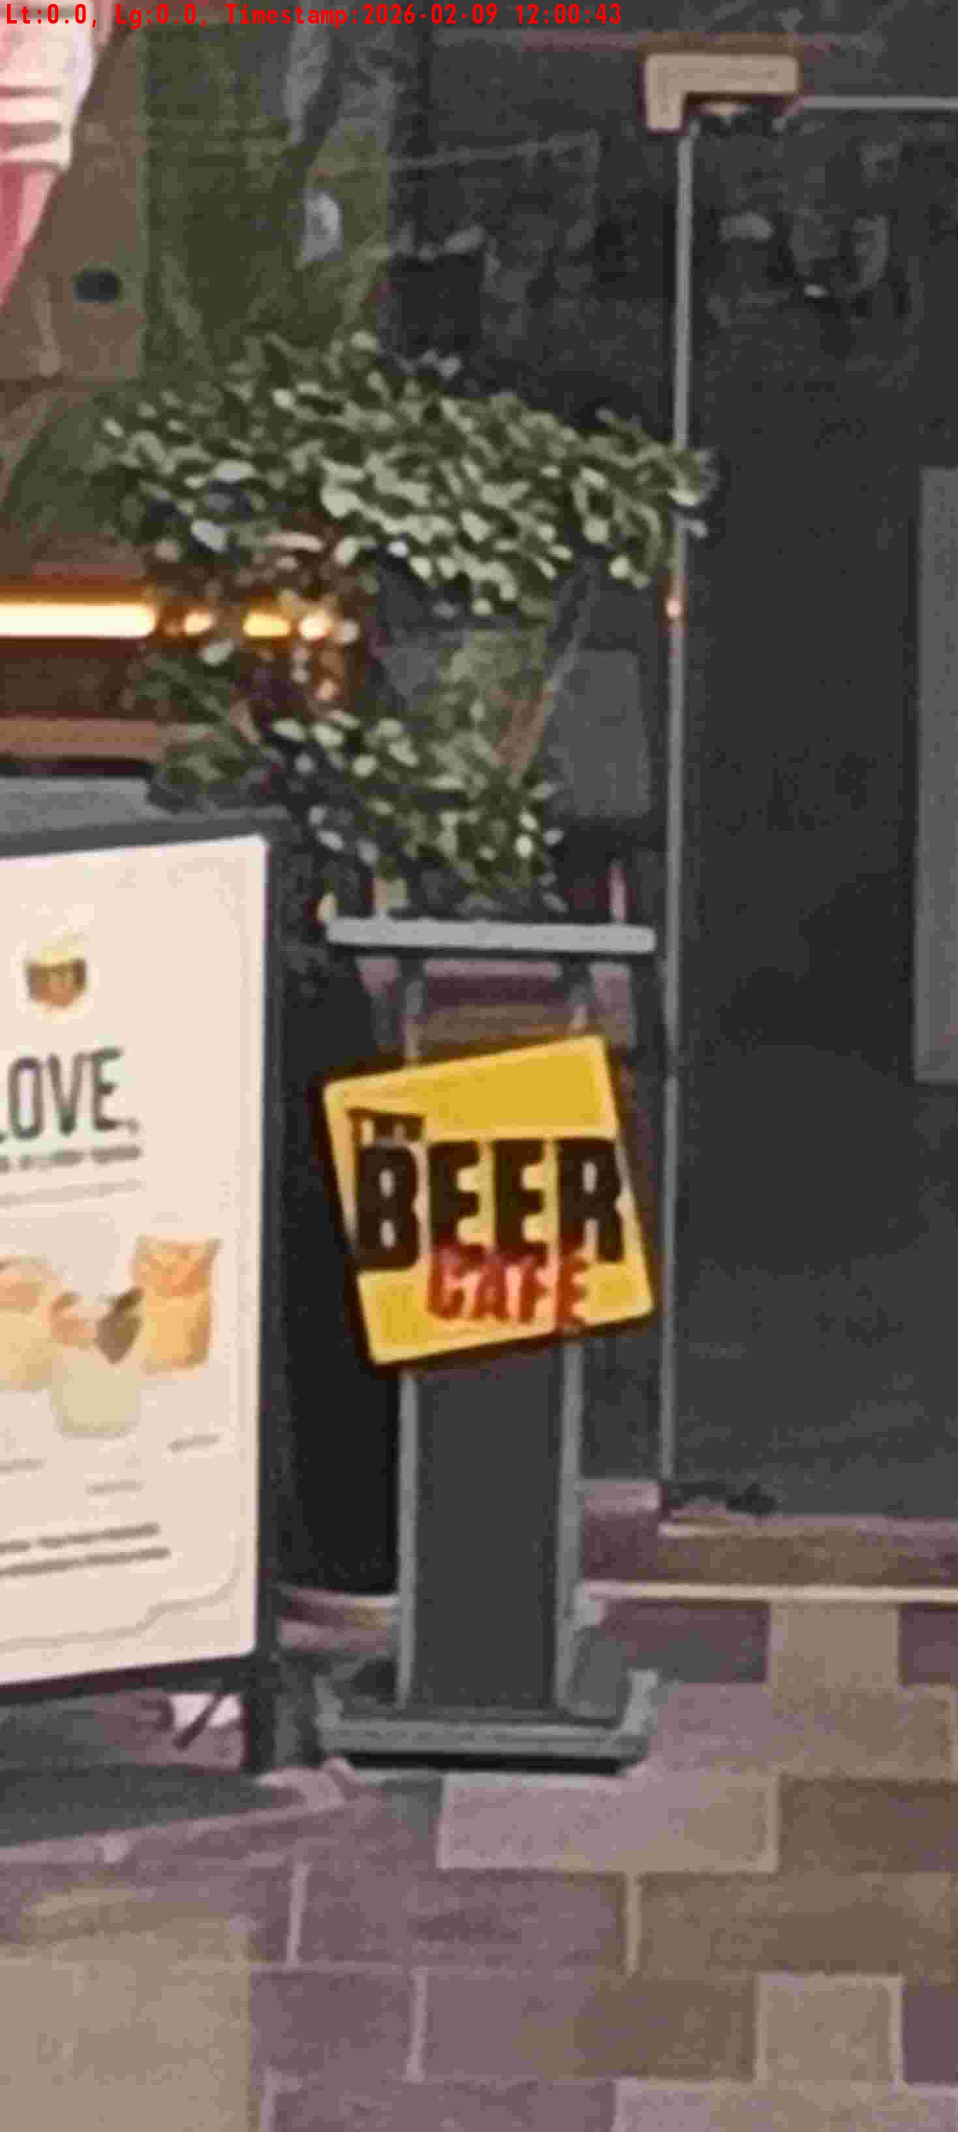
WD Code | DS Id | DS Name | Route Name | Shop Name | Date Time
DE5296 | 885 | HR-Satyasheel | Mon-Thu | Beer Cafe Manesar | 09-02-2026 12:00:36 PM
Shop Inside Picture
Shop Front Picture

Slide 7
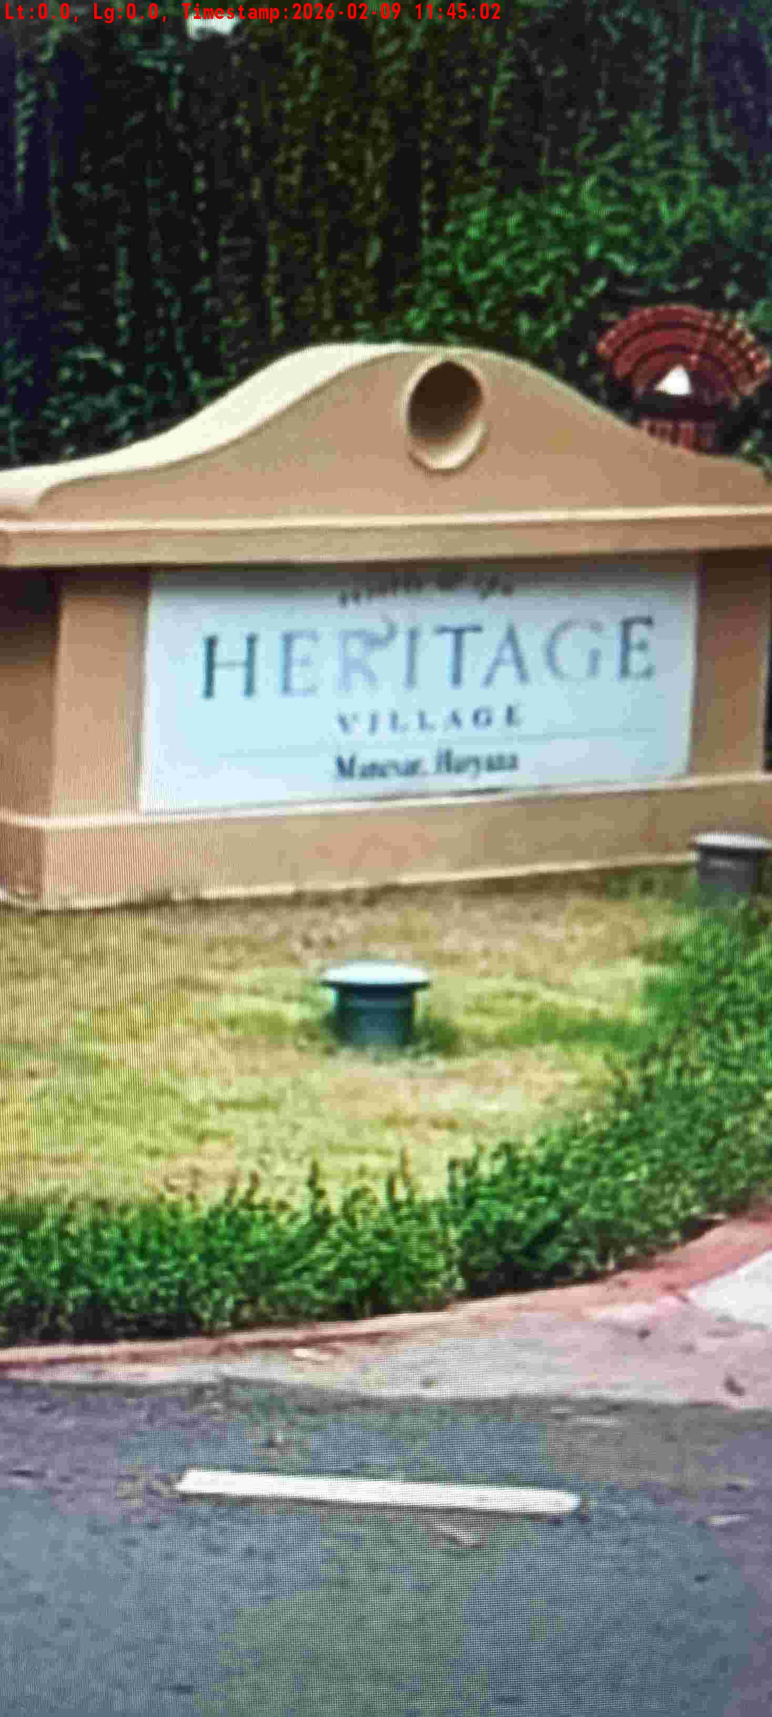
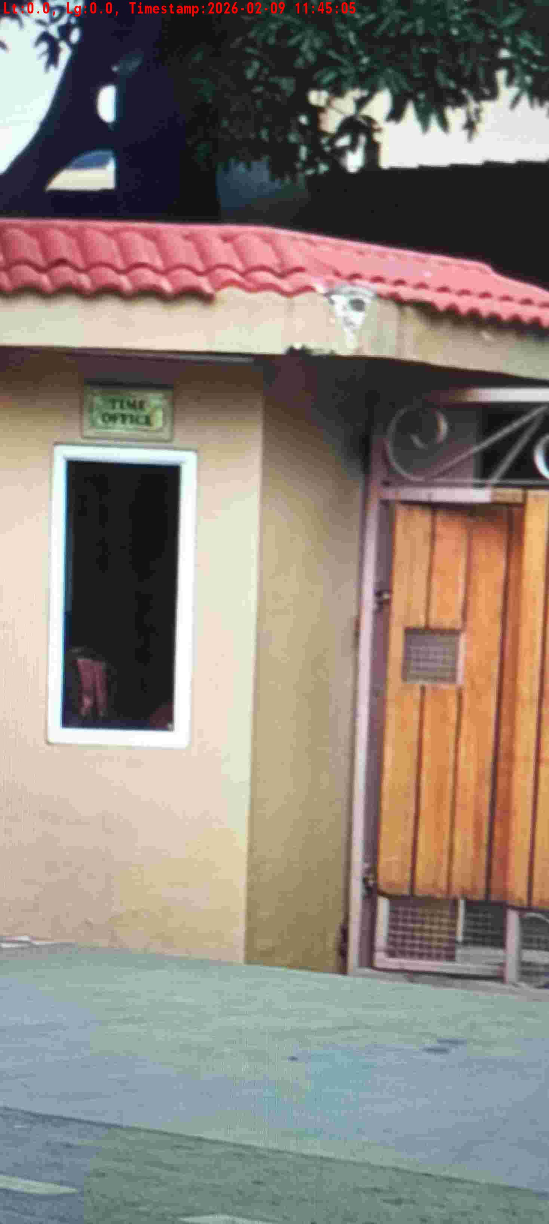
WD Code | DS Id | DS Name | Route Name | Shop Name | Date Time
DE5296 | 885 | HR-Satyasheel | Mon-Thu | Hotel Heritage | 09-02-2026 11:44:59 AM
Shop Inside Picture
Shop Front Picture

Slide 8


WD Code | DS Id | DS Name | Route Name | Shop Name | Date Time
DE5296 | 884 | HR-Mohit | Mon-Thu | Hotel WESTIN IFCO CHOWK | 09-02-2026 11:33:54 AM
Shop Inside Picture
Shop Front Picture

Slide 9
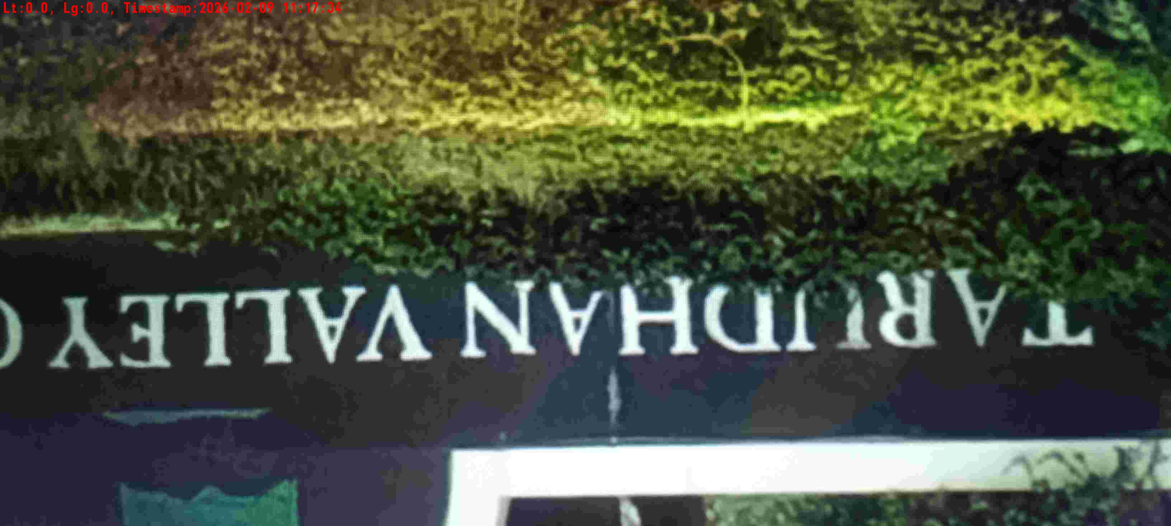

WD Code | DS Id | DS Name | Route Name | Shop Name | Date Time
DE5296 | 885 | HR-Satyasheel | Mon-Thu | Hotel Tarudhan | 09-02-2026 11:17:31 AM
Shop Inside Picture
Shop Front Picture

Slide 10
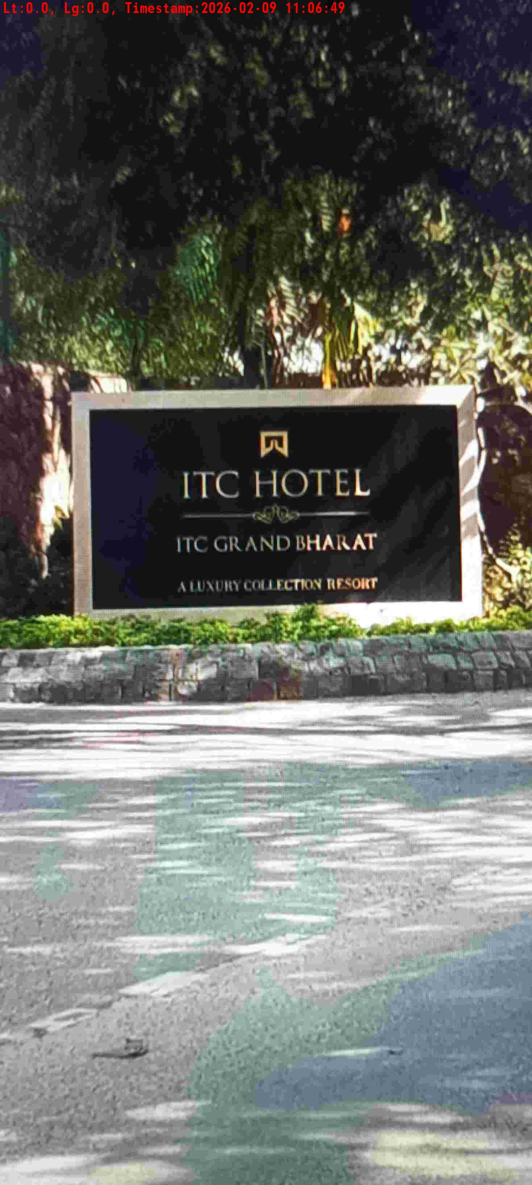
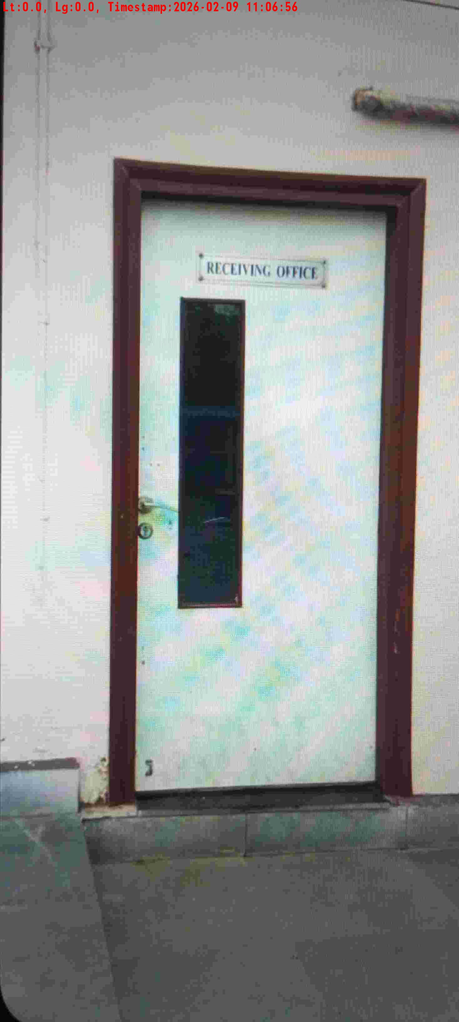
WD Code | DS Id | DS Name | Route Name | Shop Name | Date Time
DE5296 | 885 | HR-Satyasheel | Mon-Thu | Hotel ITC Grand | 09-02-2026 11:06:45 AM
Shop Inside Picture
Shop Front Picture

Slide 11
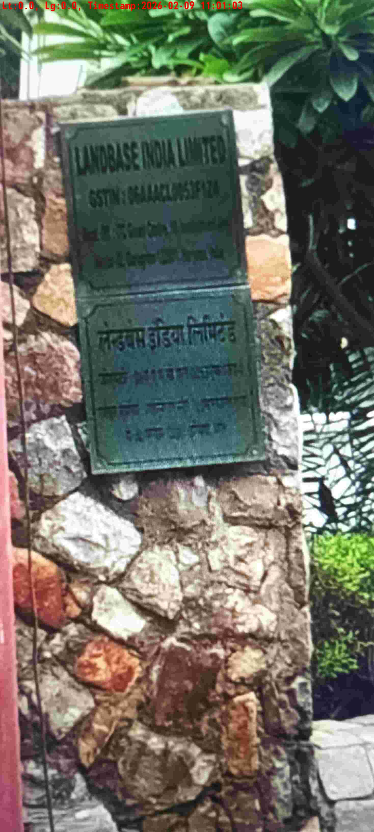
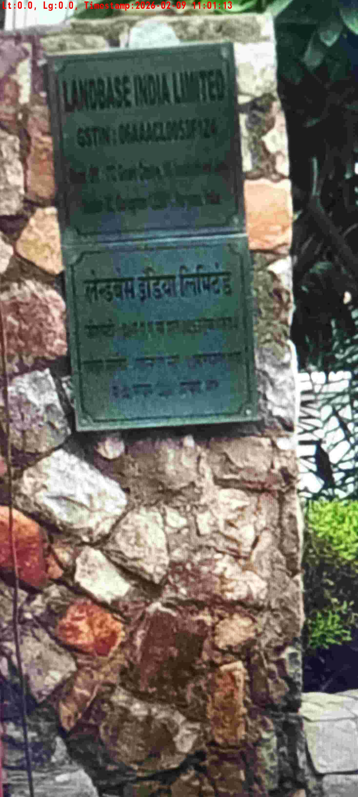
WD Code | DS Id | DS Name | Route Name | Shop Name | Date Time
DE5296 | 885 | HR-Satyasheel | Mon-Thu | Land Base | 09-02-2026 11:00:55 AM
Shop Inside Picture
Shop Front Picture

Slide 12
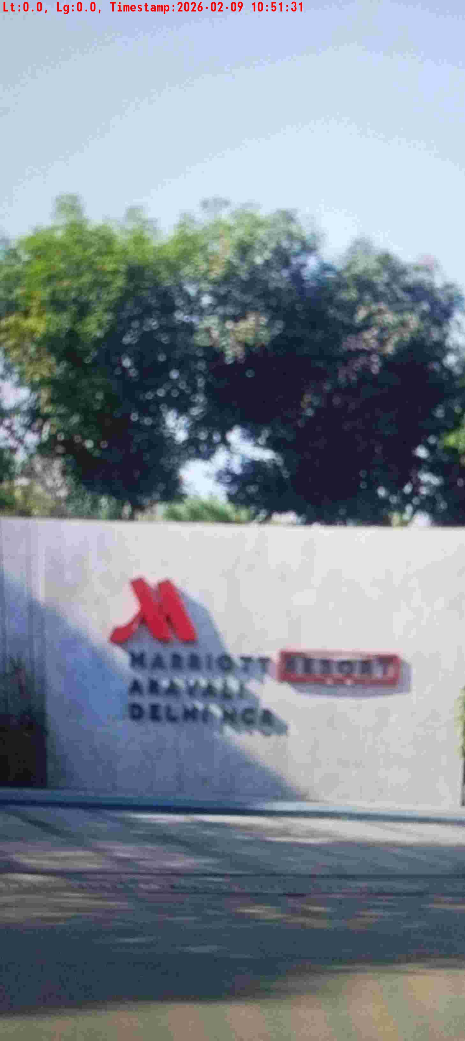
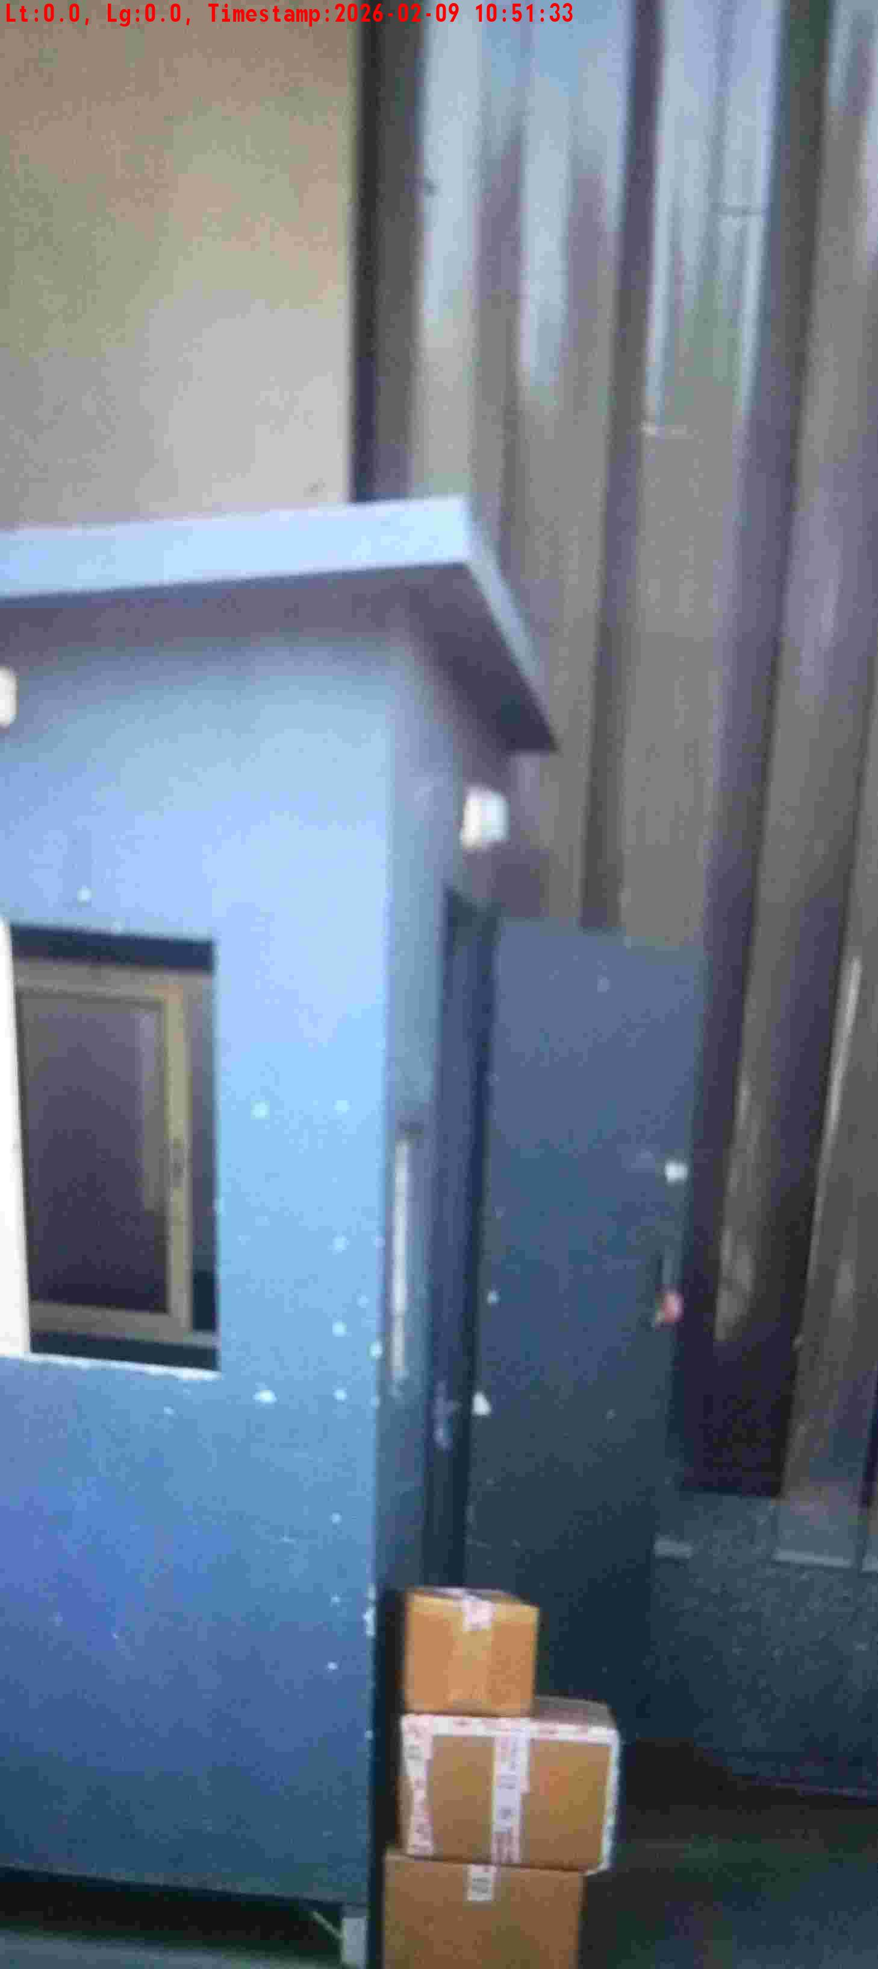
WD Code | DS Id | DS Name | Route Name | Shop Name | Date Time
DE5296 | 883 | HR-Candidate B | Mon-Thu | Hotel Marriot Sushant Lok | 09-02-2026 10:51:29 AM
Shop Inside Picture
Shop Front Picture

Slide 13
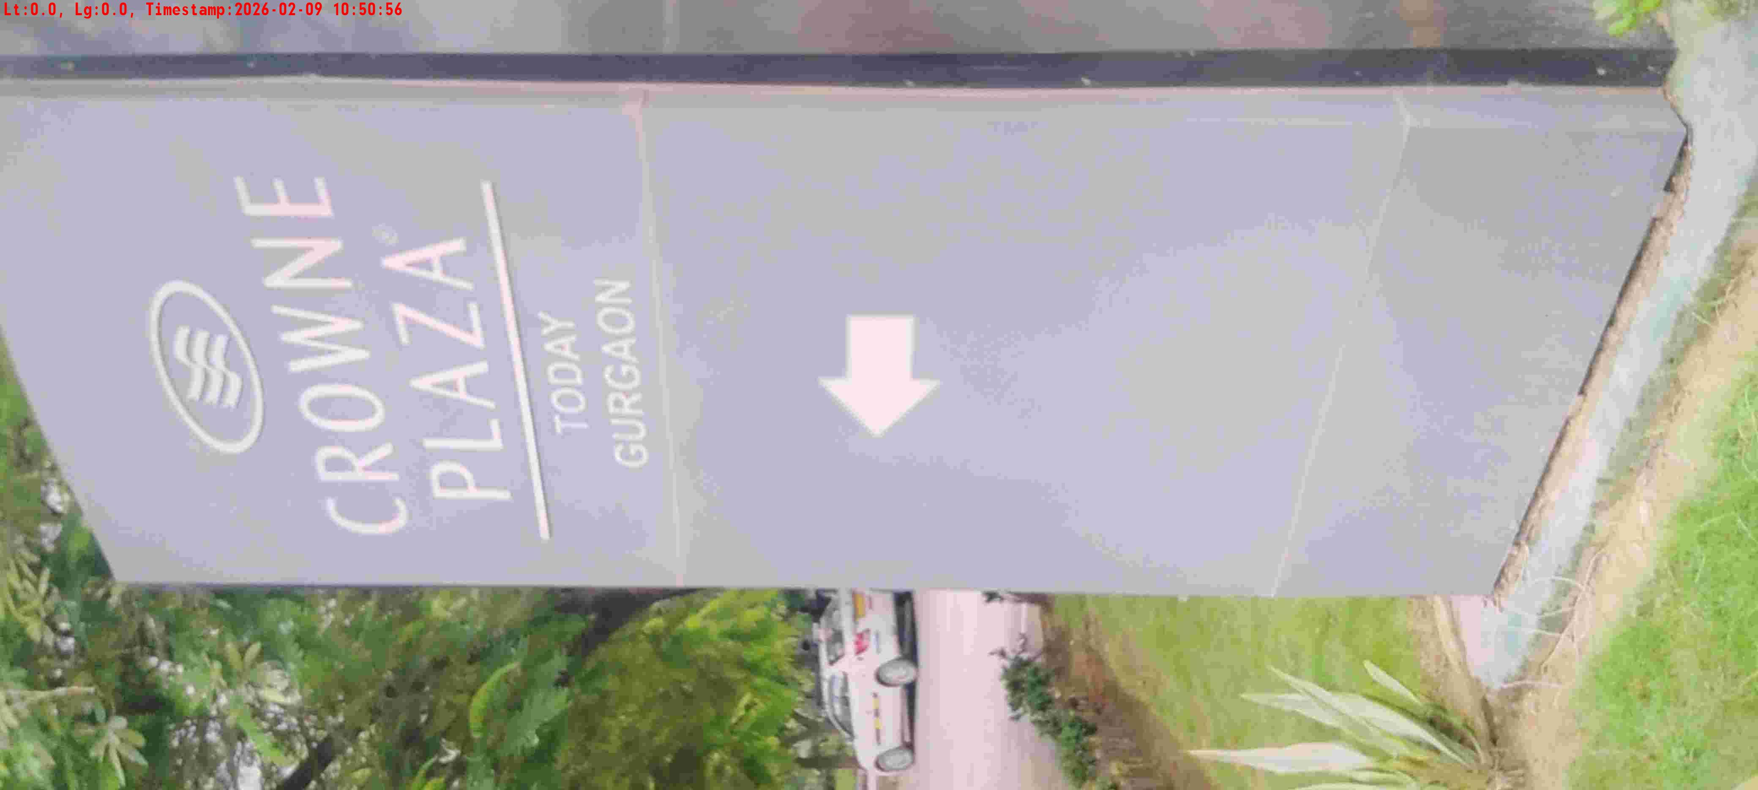
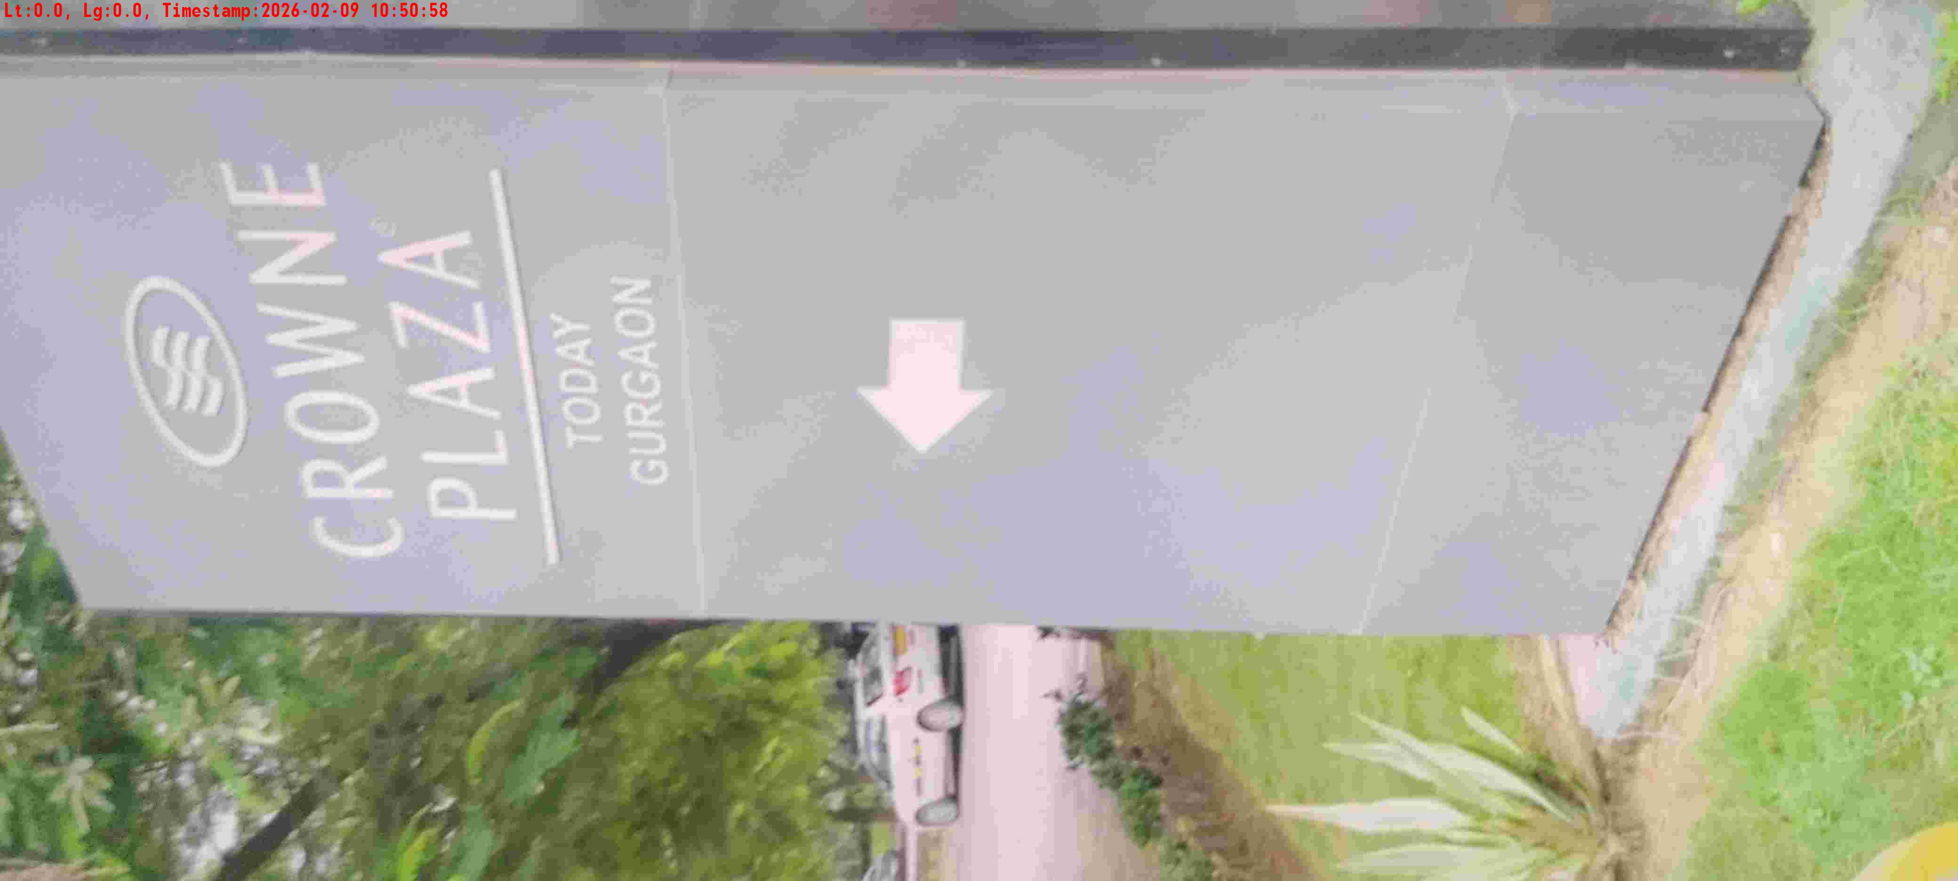
WD Code | DS Id | DS Name | Route Name | Shop Name | Date Time
DE5296 | 884 | HR-Mohit | Mon-Thu | Hotel Crown Plaza Sec29 | 09-02-2026 10:50:54 AM
Shop Inside Picture
Shop Front Picture

Slide 14
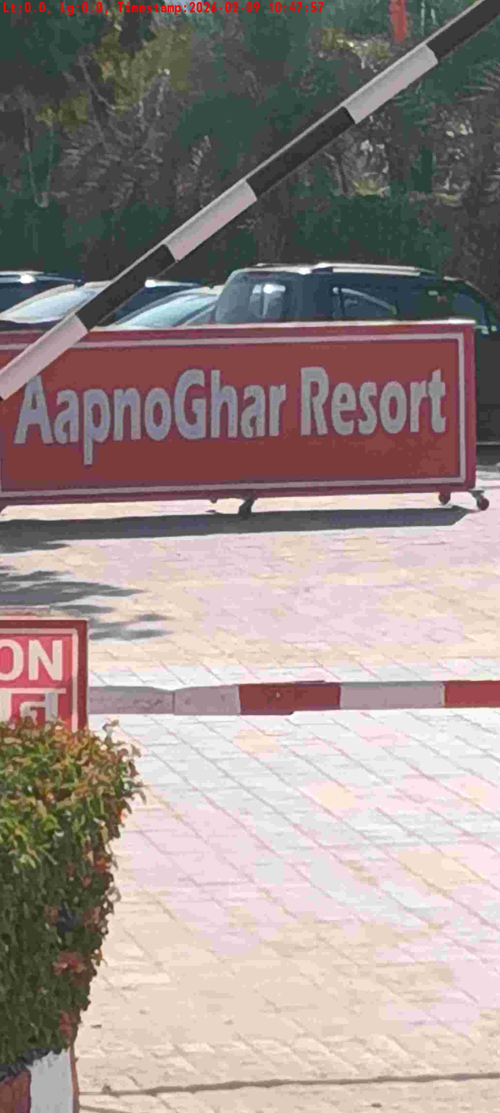
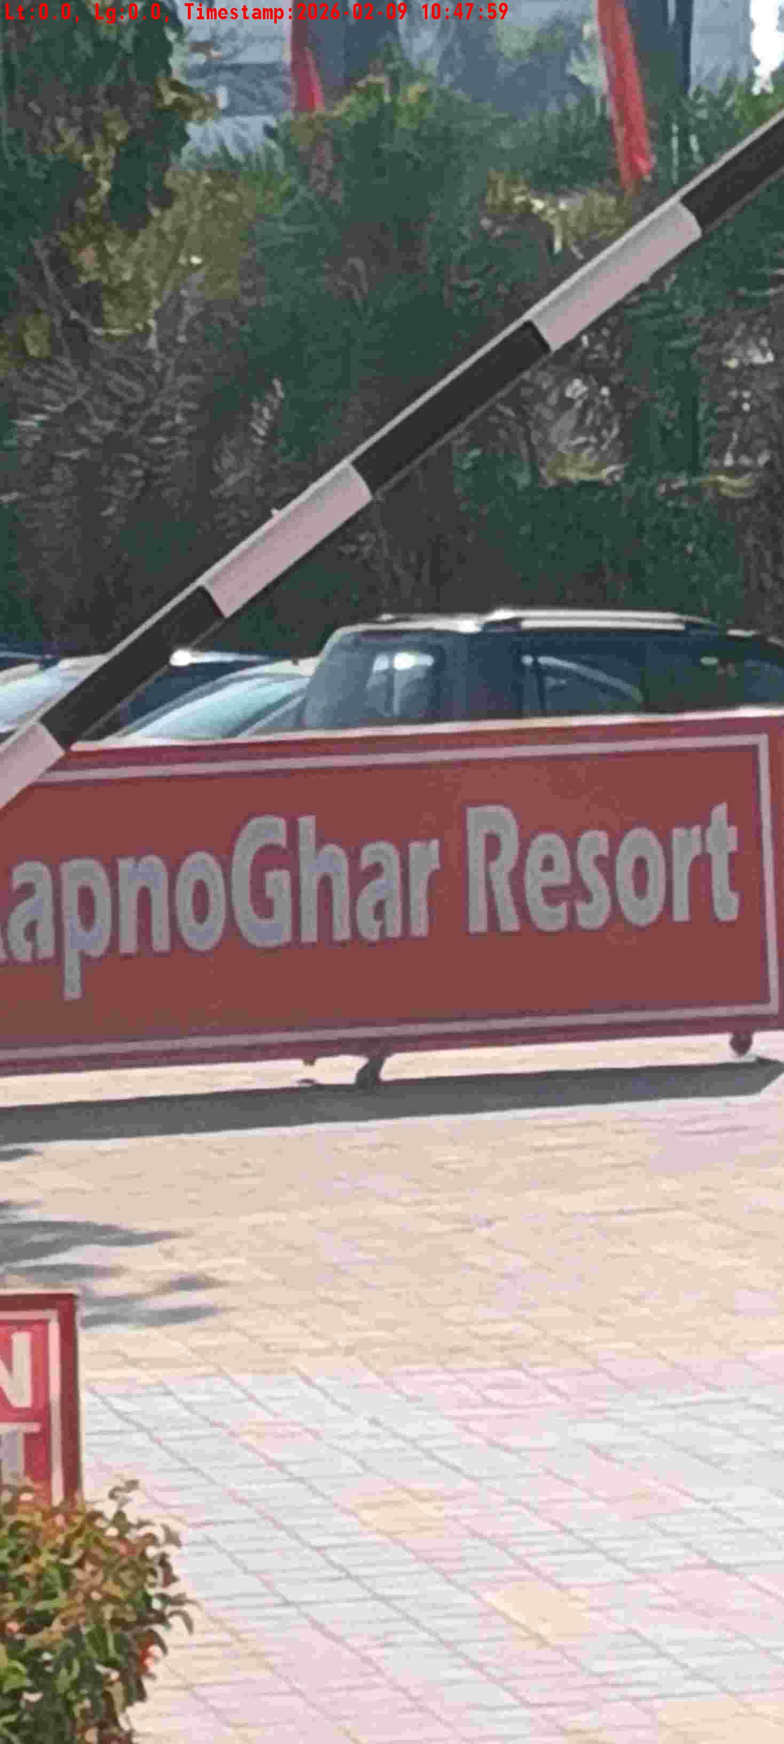
WD Code | DS Id | DS Name | Route Name | Shop Name | Date Time
DE5296 | 885 | HR-Satyasheel | Mon-Thu | Apno Ghar | 09-02-2026 10:47:54 AM
Shop Inside Picture
Shop Front Picture

Slide 15
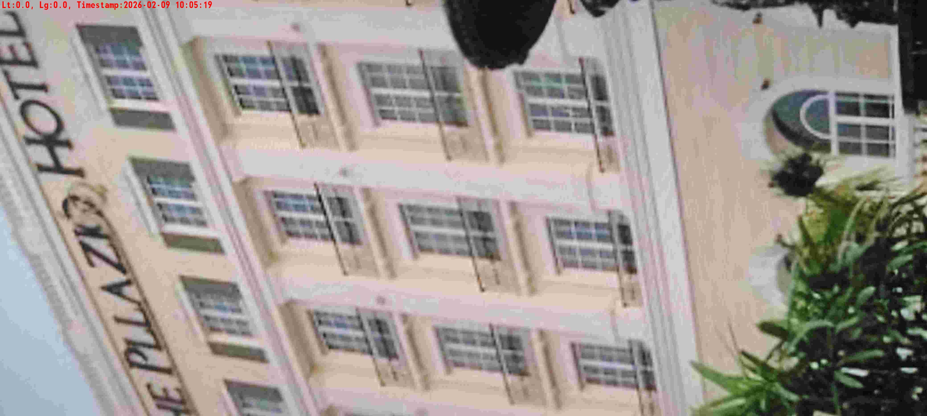
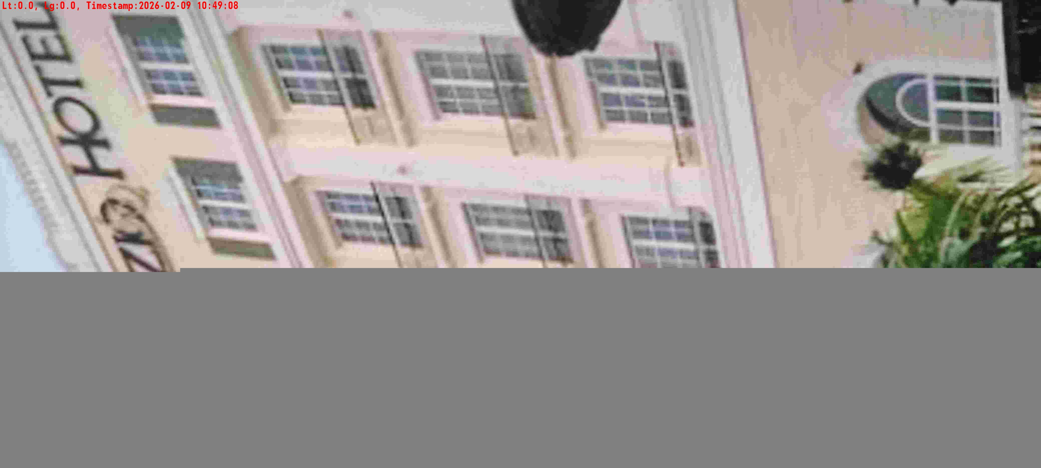
WD Code | DS Id | DS Name | Route Name | Shop Name | Date Time
DE5296 | 884 | HR-Mohit | Mon-Thu | Pllazio Hotel | 09-02-2026 10:05:16 AM
Shop Inside Picture
Shop Front Picture

Slide 16
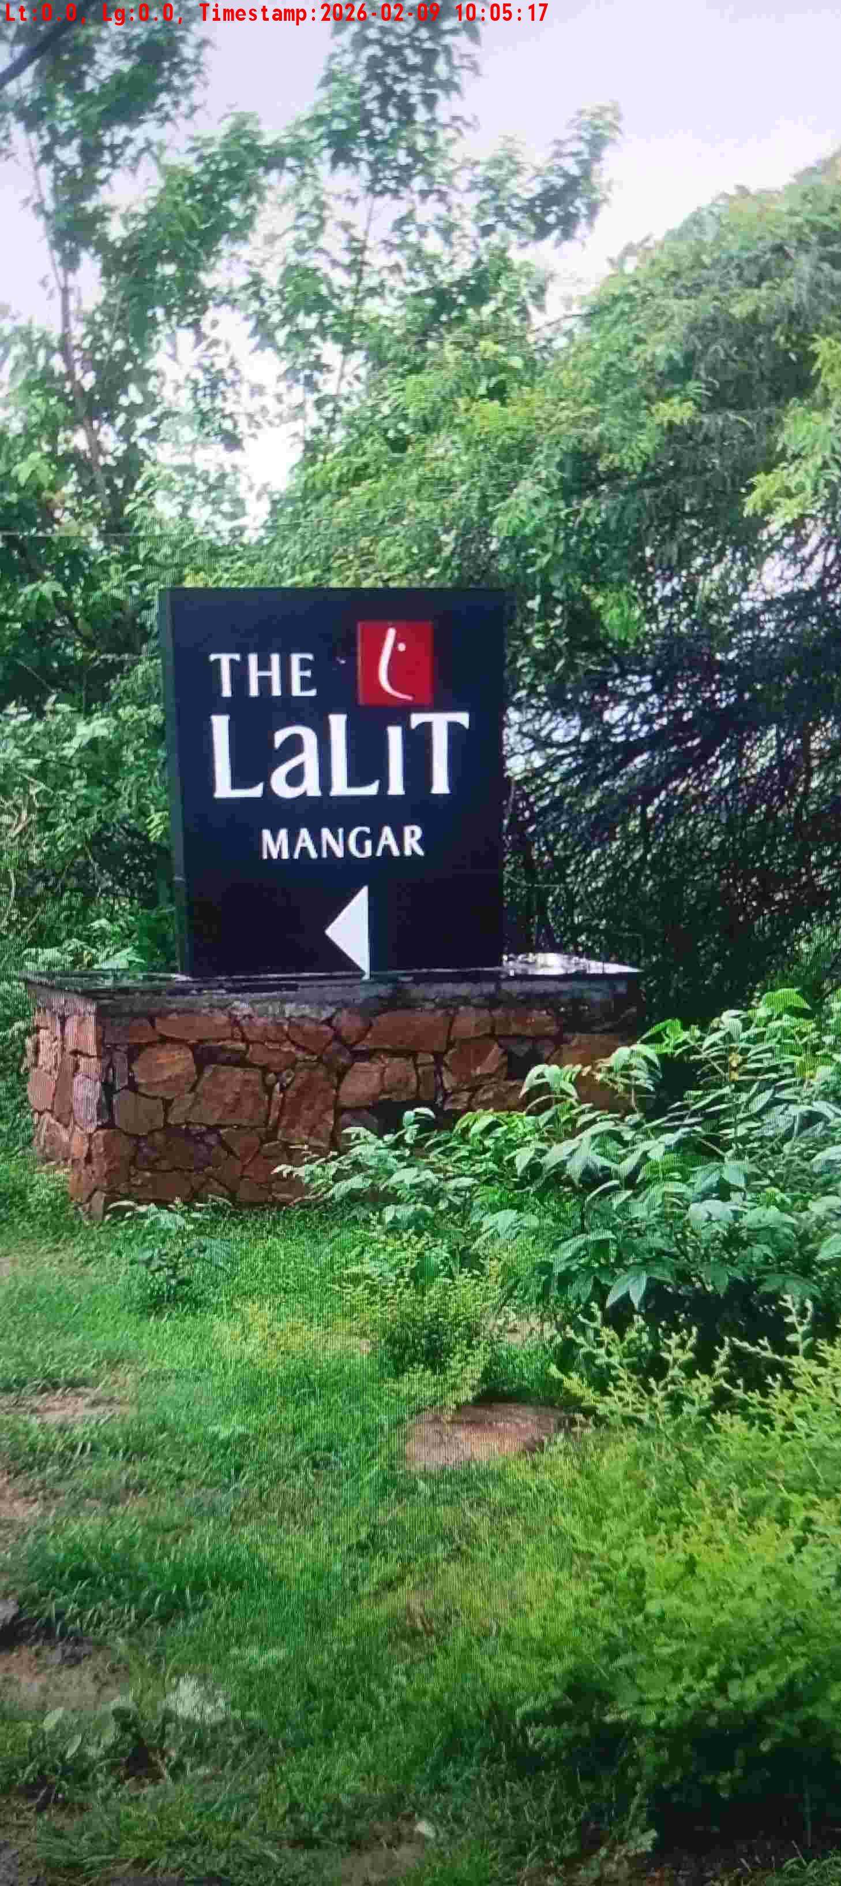
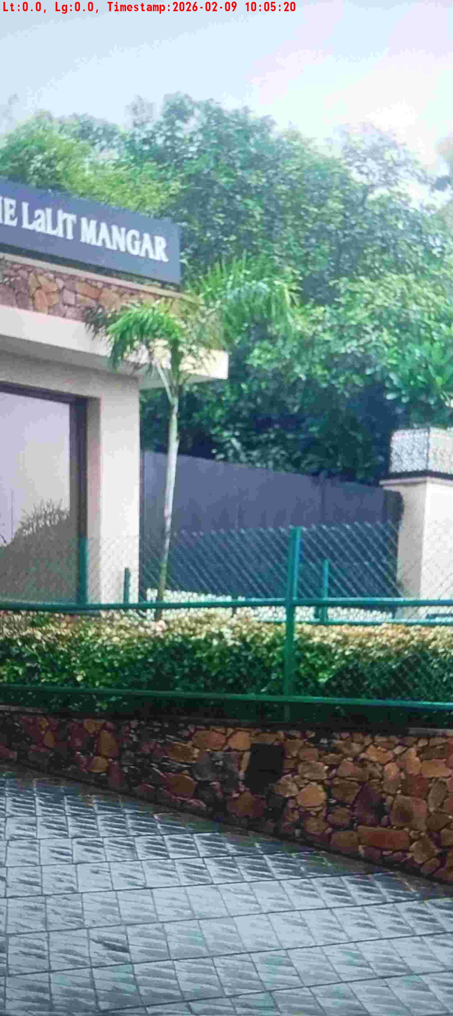
WD Code | DS Id | DS Name | Route Name | Shop Name | Date Time
DE5296 | 883 | HR-Candidate B | Mon-Thu | Hotel Lalit Faridabad | 09-02-2026 10:05:14 AM
Shop Inside Picture
Shop Front Picture

Slide 17

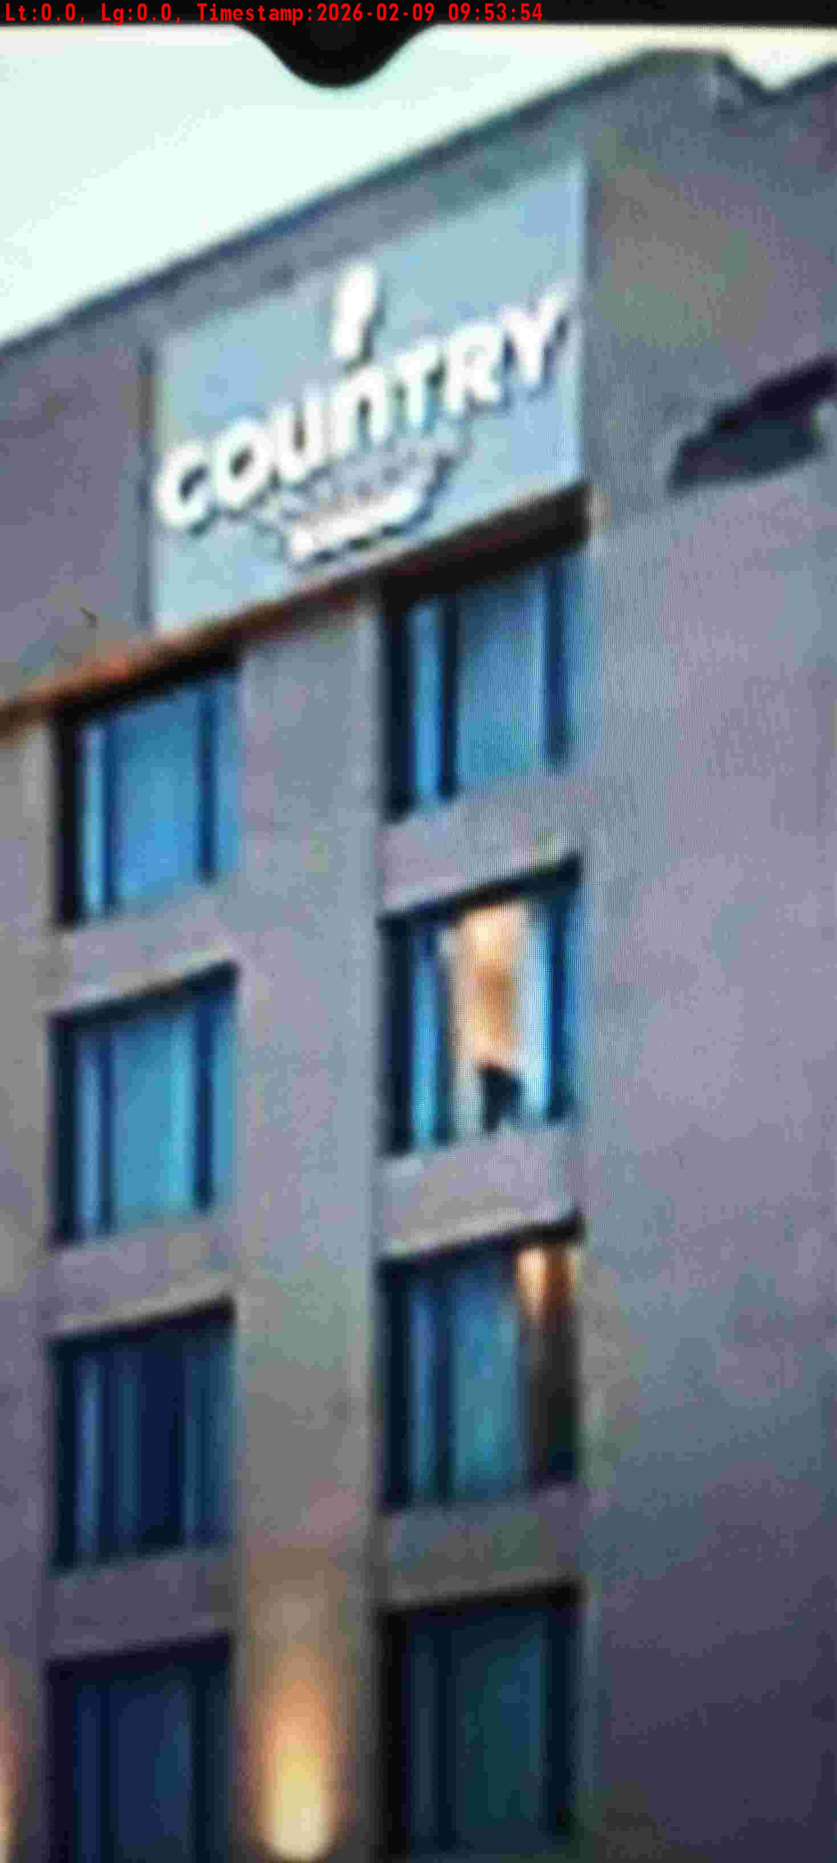
WD Code | DS Id | DS Name | Route Name | Shop Name | Date Time
DE5296 | 885 | HR-Satyasheel | Mon-Thu | Hotel Country Inn Daruheda | 09-02-2026 09:53:50 AM
Shop Inside Picture
Shop Front Picture

Slide 18


WD Code | DS Id | DS Name | Route Name | Shop Name | Date Time
DE5296 | 884 | HR-Mohit | Wed-Sat | Bottle and Barrek | 07-02-2026 07:41:30 PM
Shop Inside Picture
Shop Front Picture

Slide 19

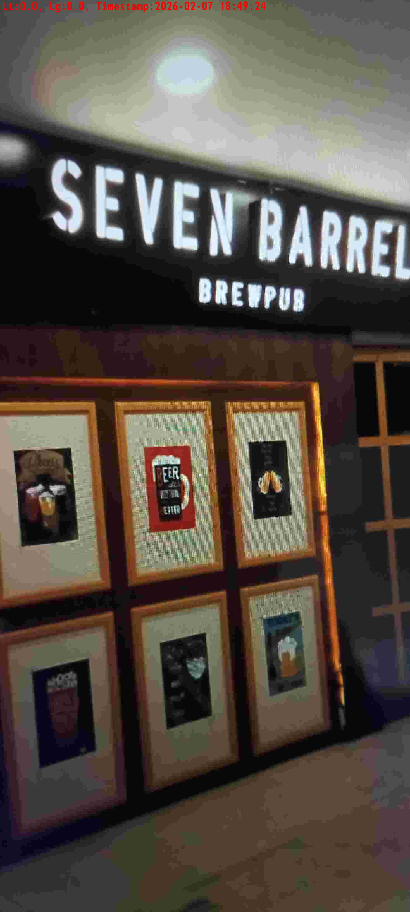
WD Code | DS Id | DS Name | Route Name | Shop Name | Date Time
DE5296 | 885 | HR-Satyasheel | Wed-Sat | Seven Barrel | 07-02-2026 06:49:19 PM
Shop Inside Picture
Shop Front Picture

Slide 20
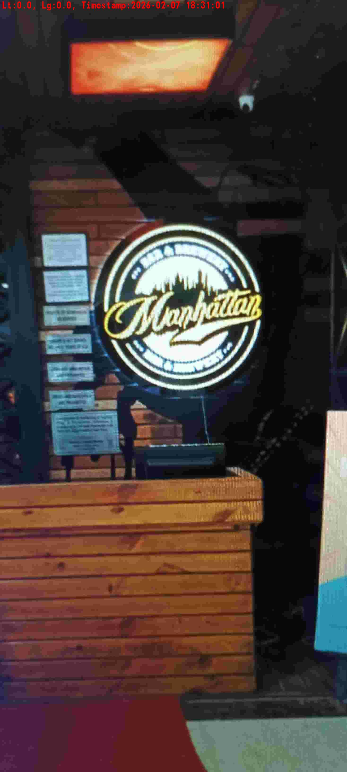
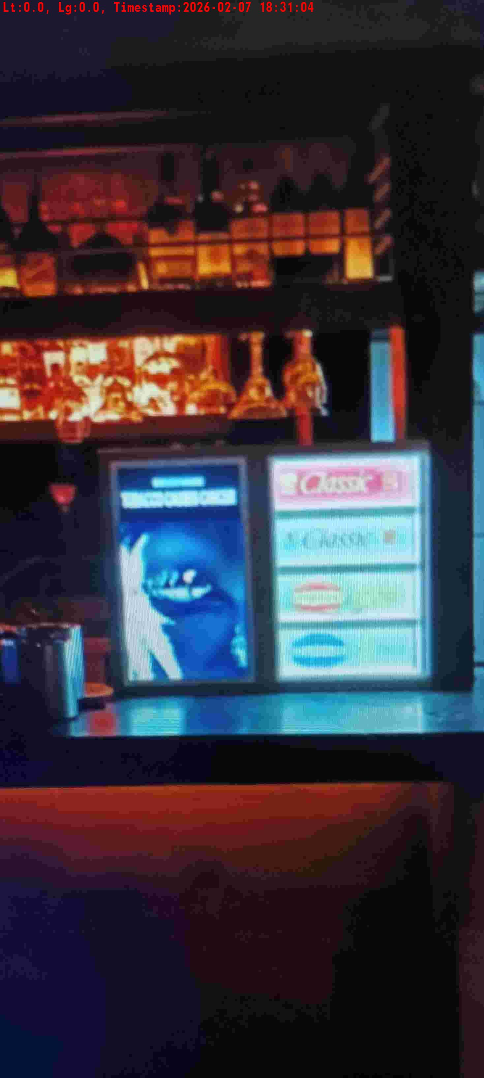
WD Code | DS Id | DS Name | Route Name | Shop Name | Date Time
DE5296 | 885 | HR-Satyasheel | Wed-Sat | Manhattan | 07-02-2026 06:30:58 PM
Shop Inside Picture
Shop Front Picture

Slide 21
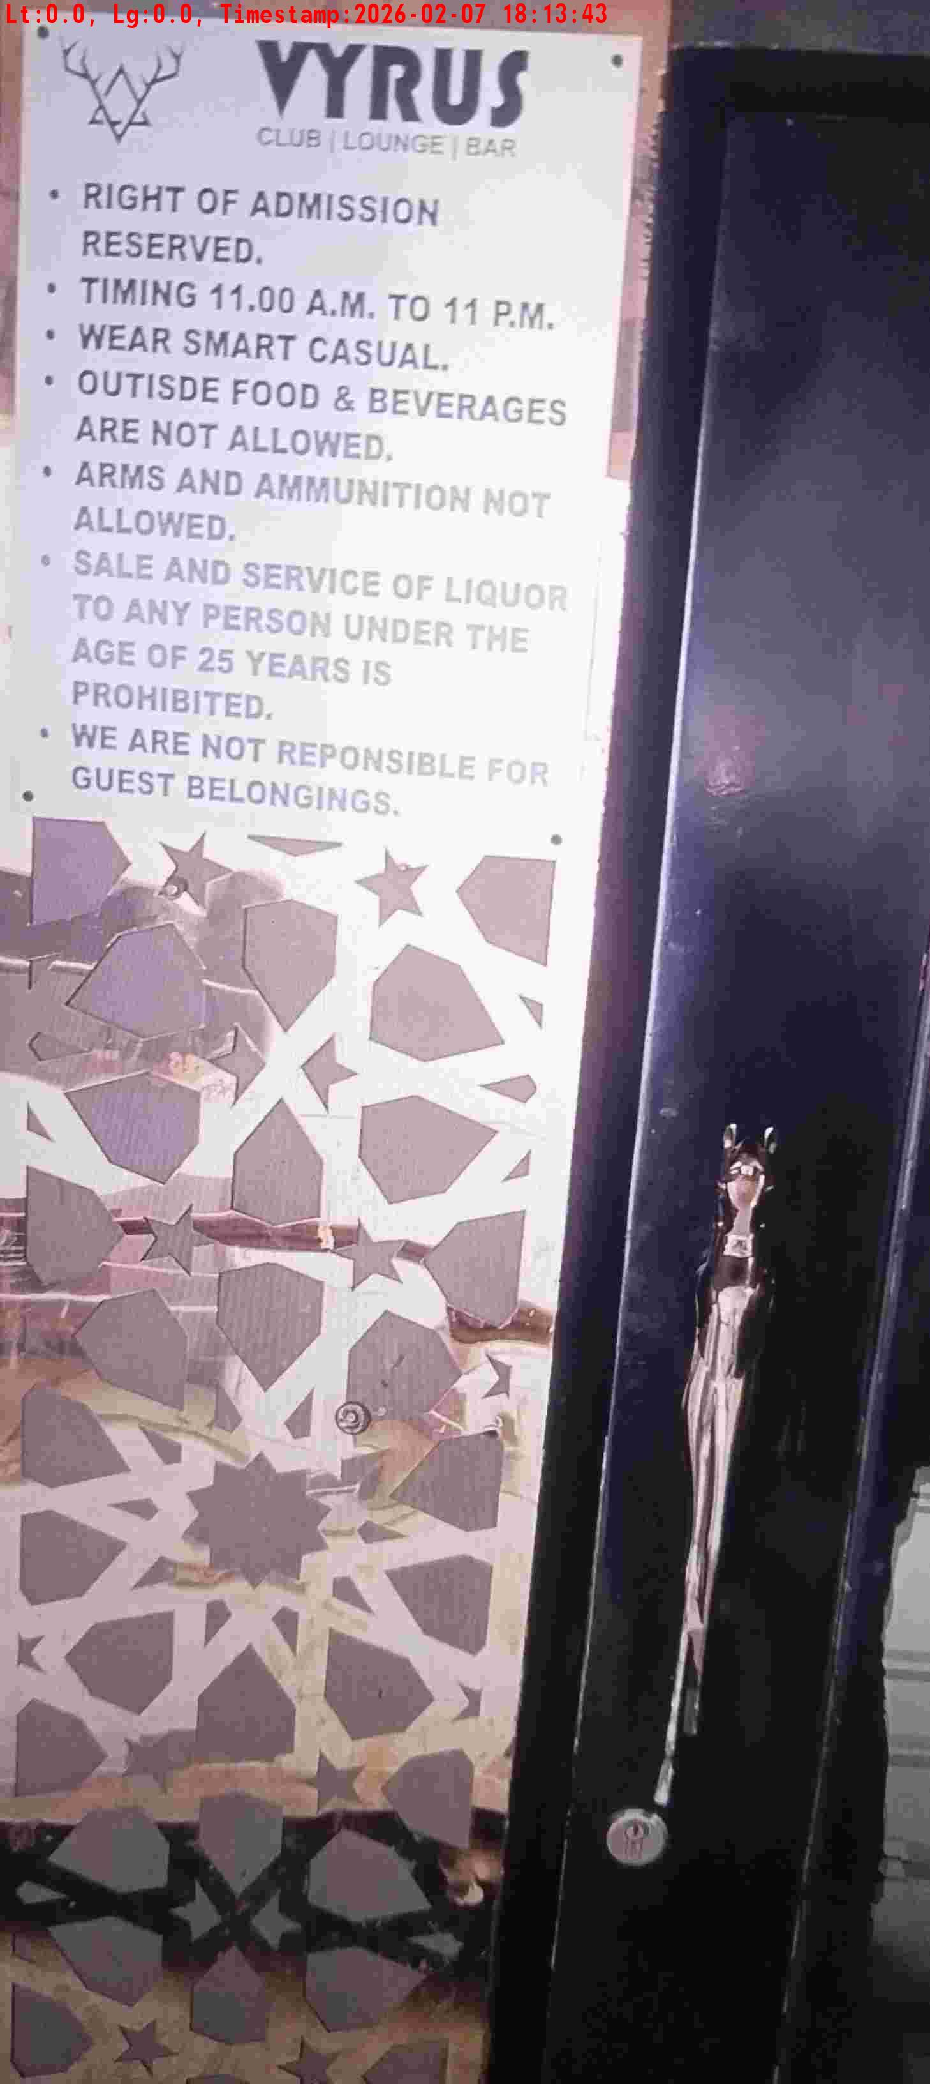
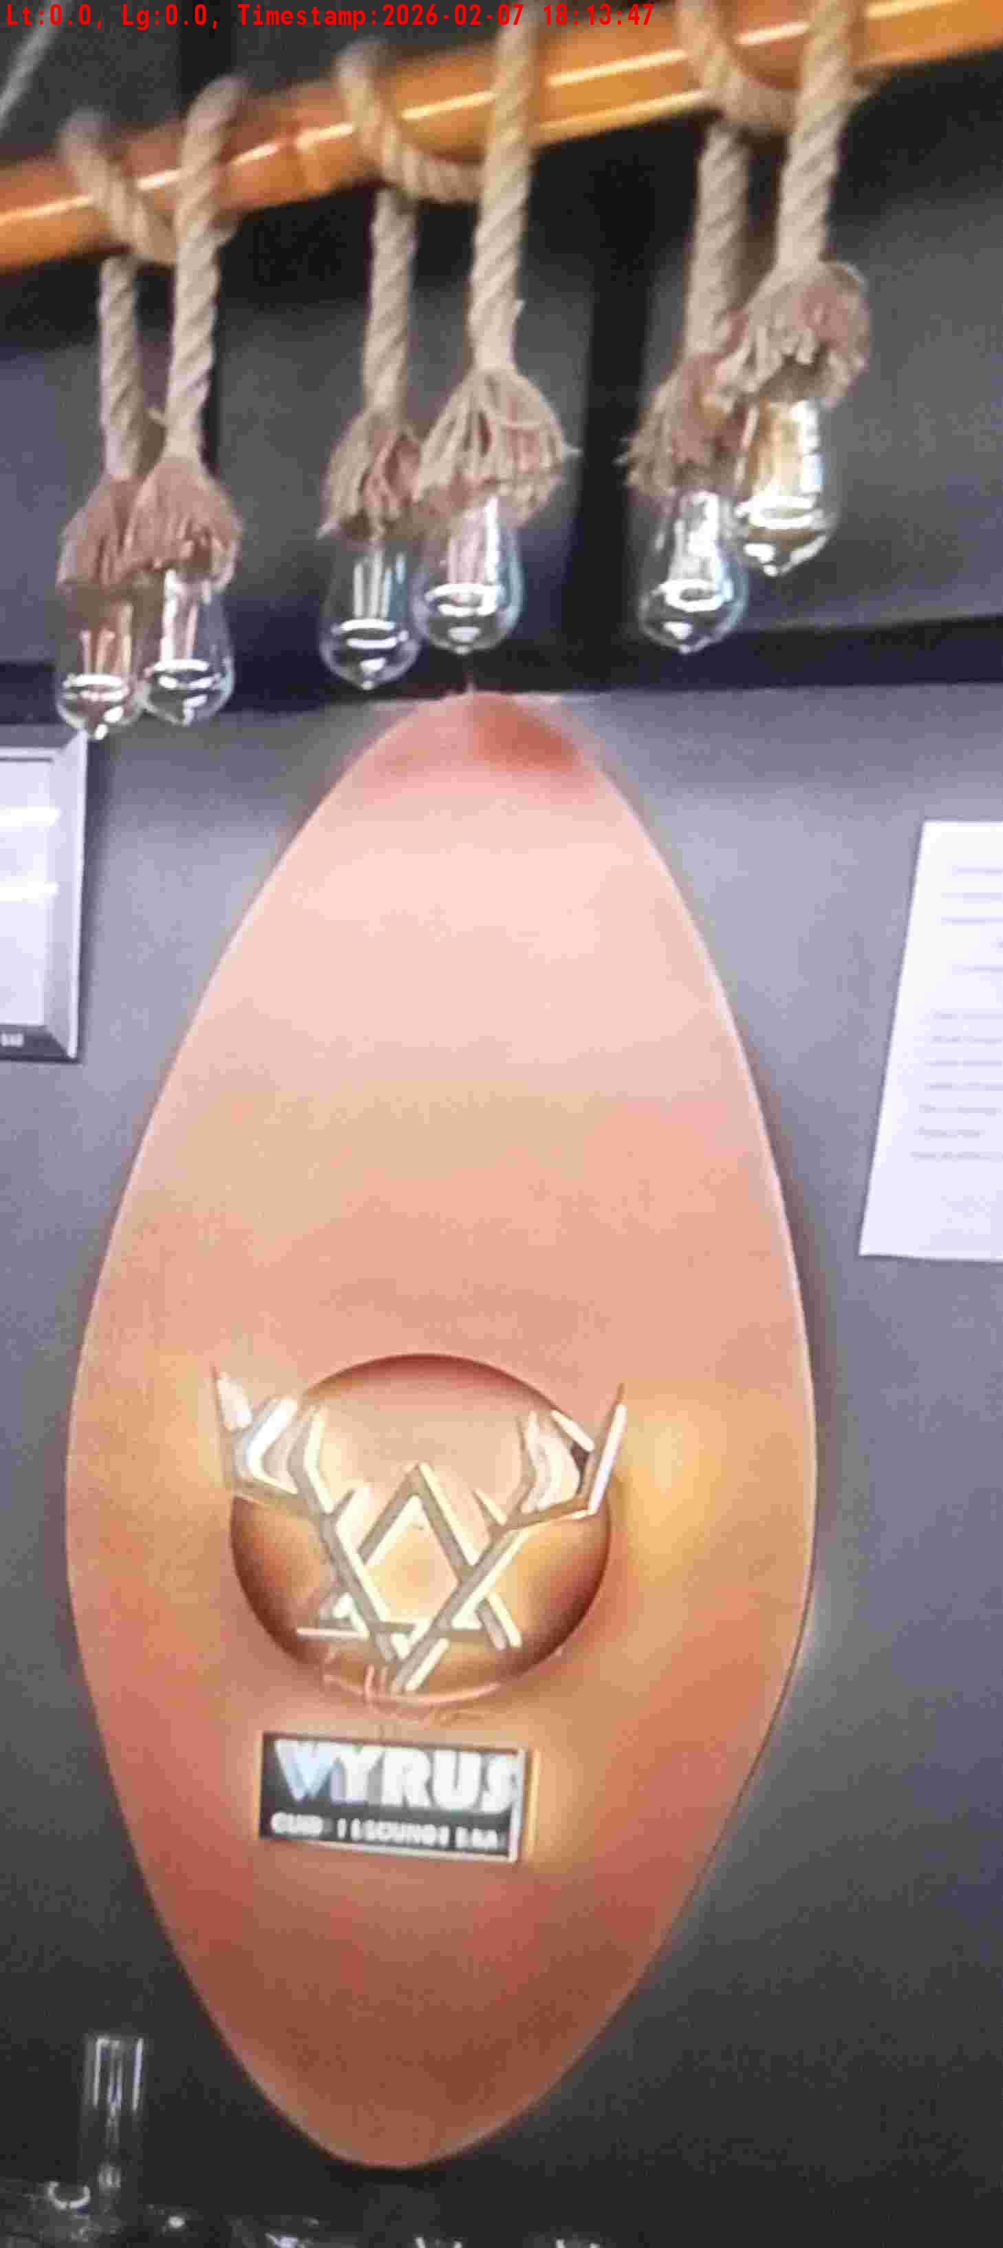
WD Code | DS Id | DS Name | Route Name | Shop Name | Date Time
DE5296 | 883 | HR-Candidate B | Wed-Sat | Vyrus | 07-02-2026 06:13:41 PM
Shop Inside Picture
Shop Front Picture

Slide 22
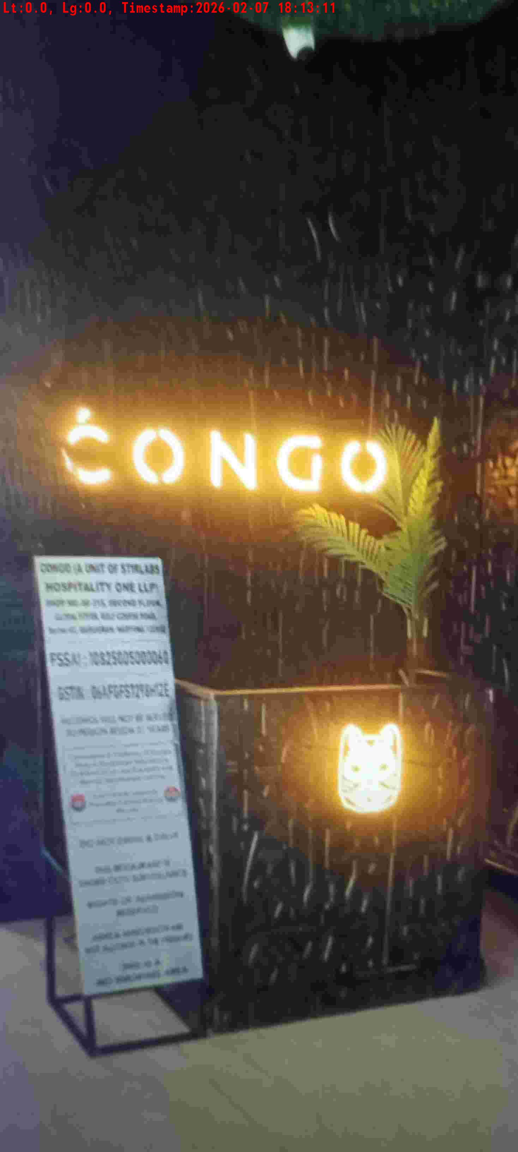
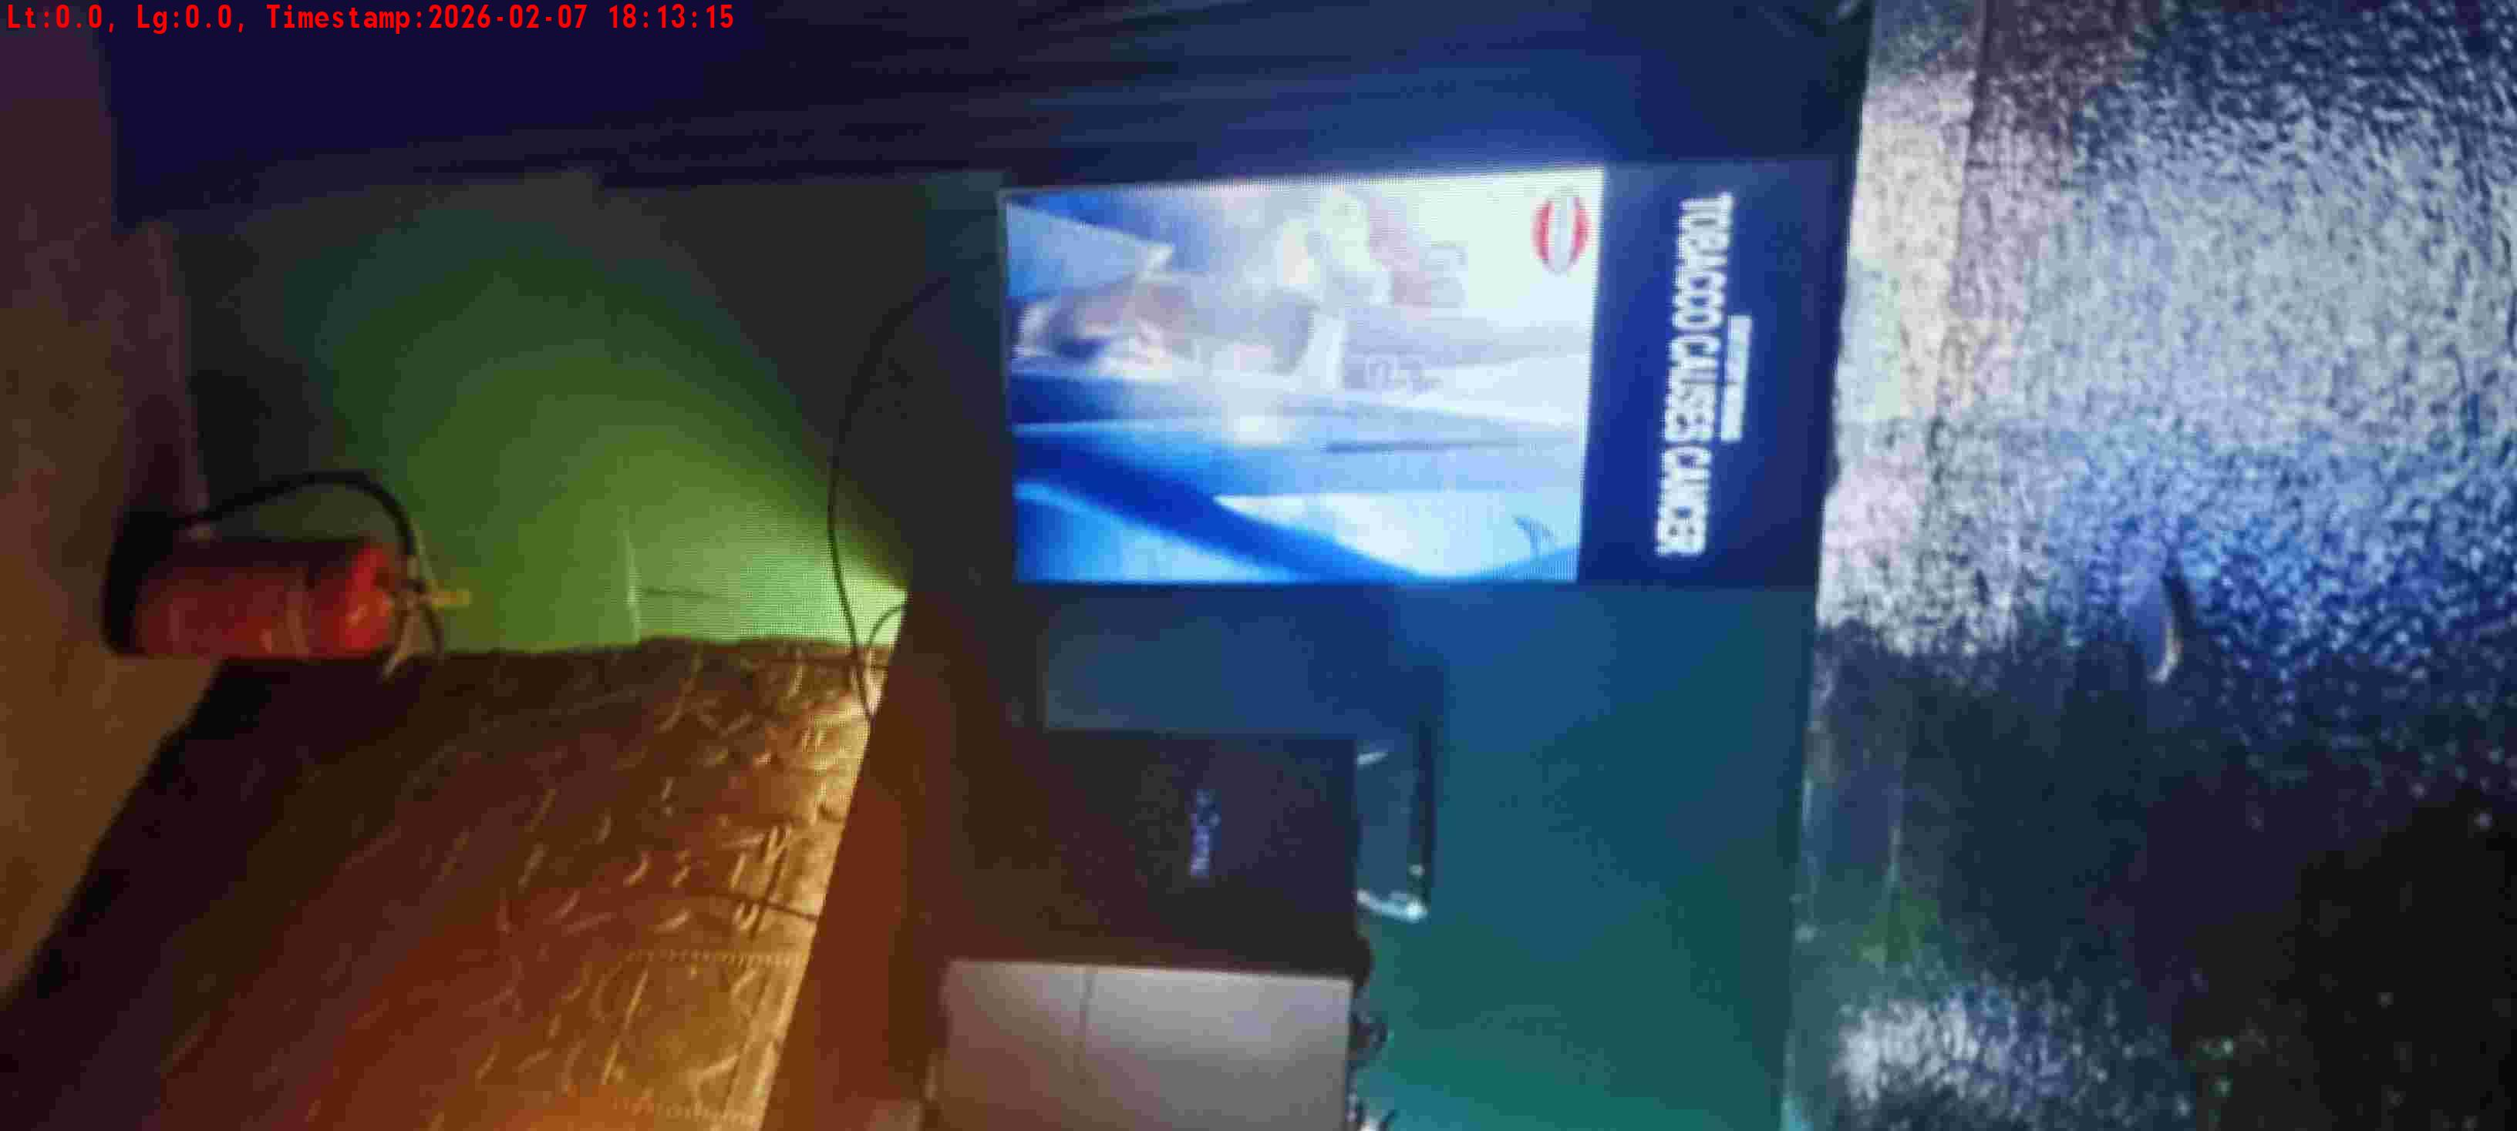
WD Code | DS Id | DS Name | Route Name | Shop Name | Date Time
DE5296 | 885 | HR-Satyasheel | Wed-Sat | Congo | 07-02-2026 06:13:09 PM
Shop Inside Picture
Shop Front Picture

Slide 23


WD Code | DS Id | DS Name | Route Name | Shop Name | Date Time
DE5296 | 884 | HR-Mohit | Wed-Sat | Soul Mykons | 07-02-2026 06:12:07 PM
Shop Inside Picture
Shop Front Picture

Slide 24
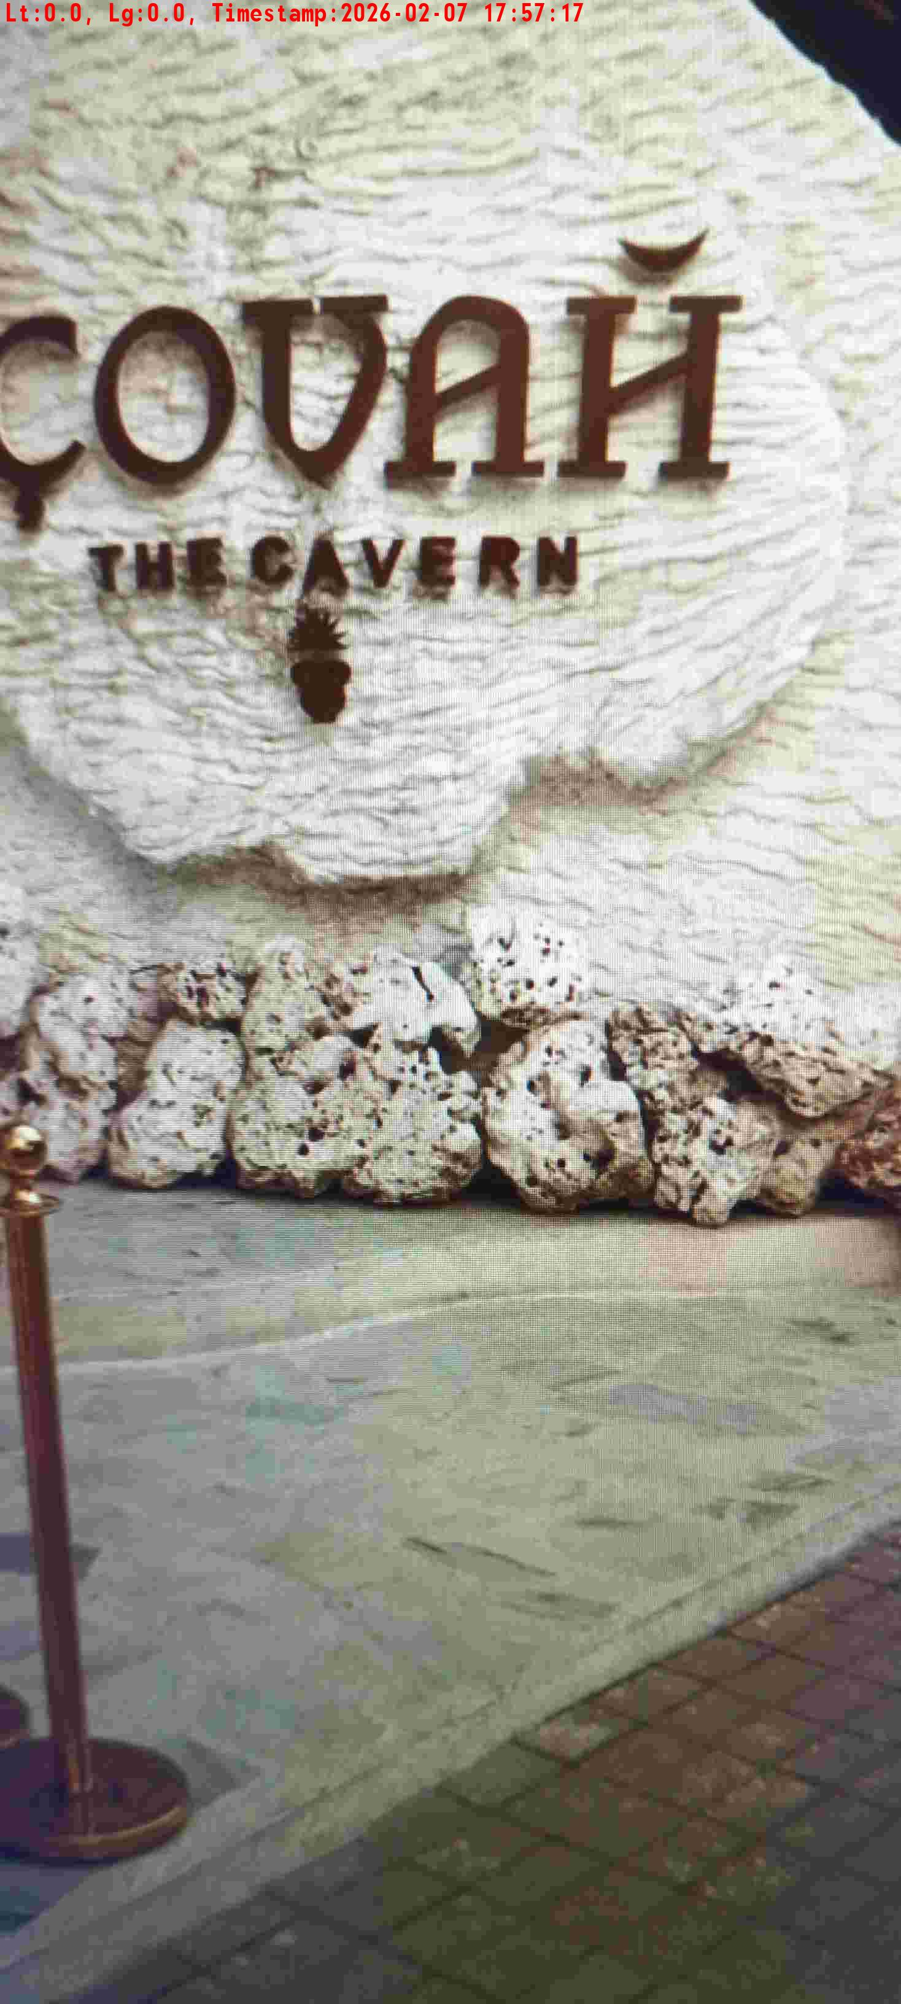
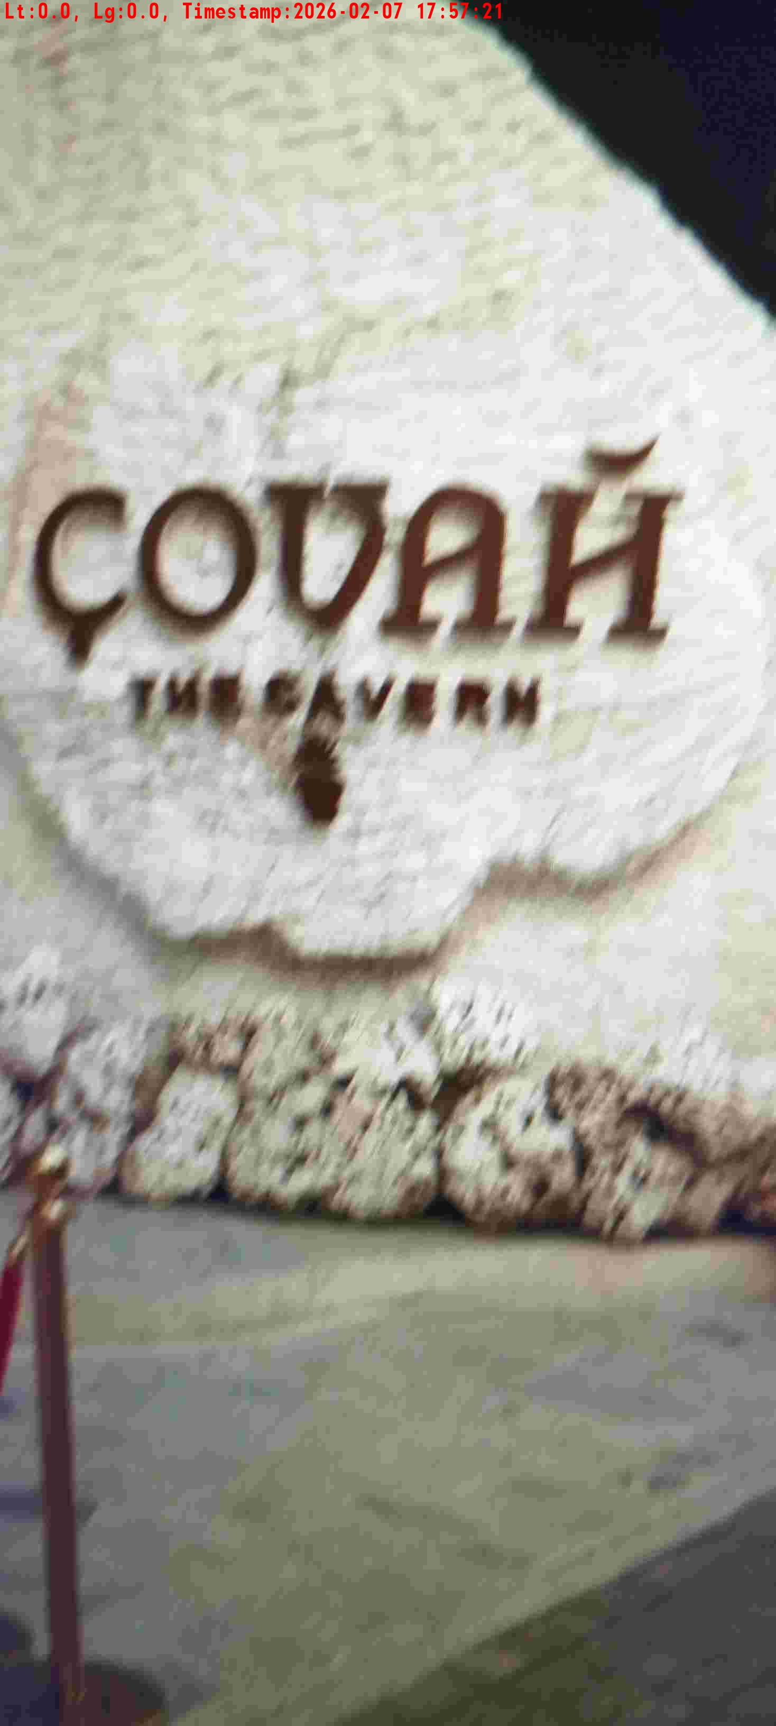
WD Code | DS Id | DS Name | Route Name | Shop Name | Date Time
DE5296 | 885 | HR-Satyasheel | Wed-Sat | Covah | 07-02-2026 05:57:14 PM
Shop Inside Picture
Shop Front Picture

Slide 25
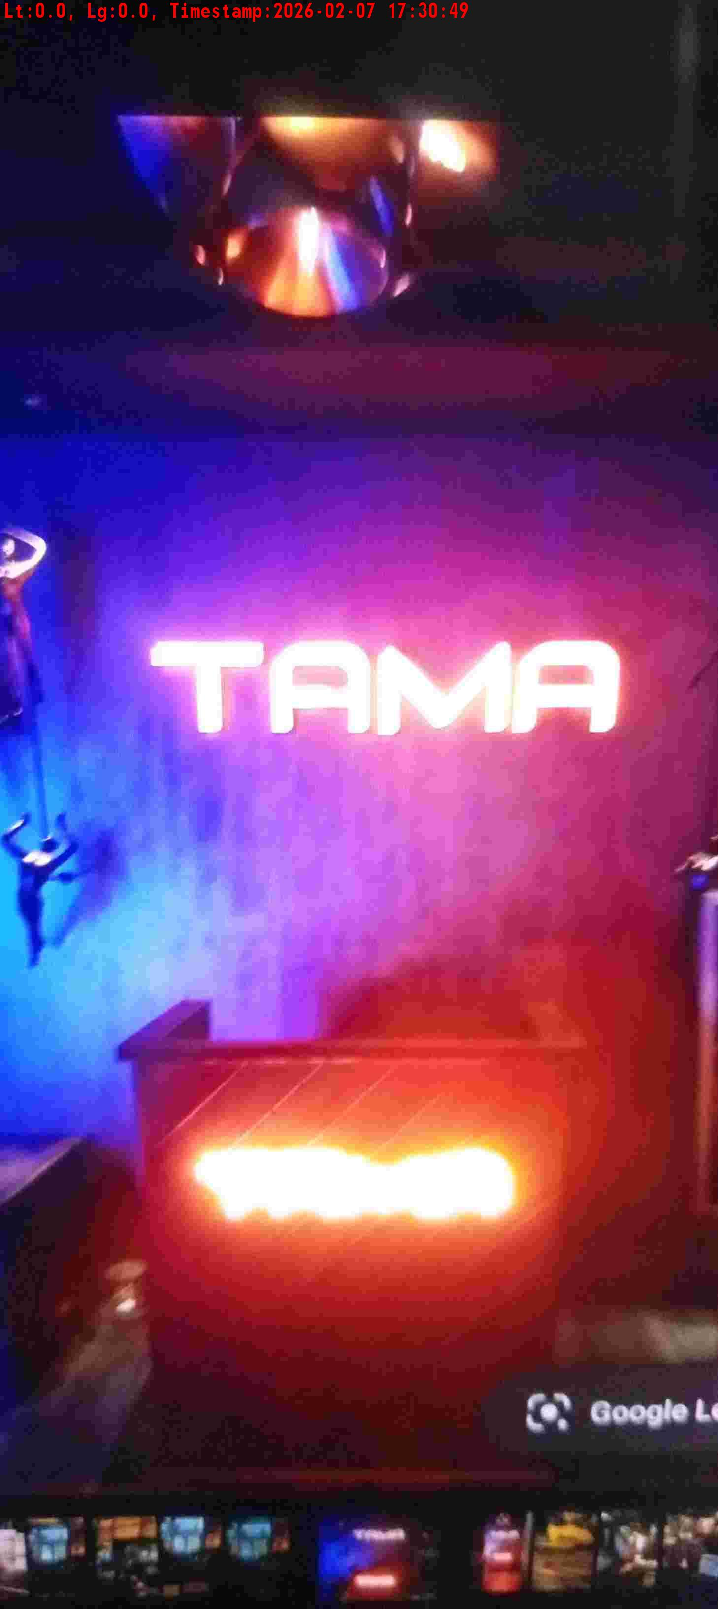
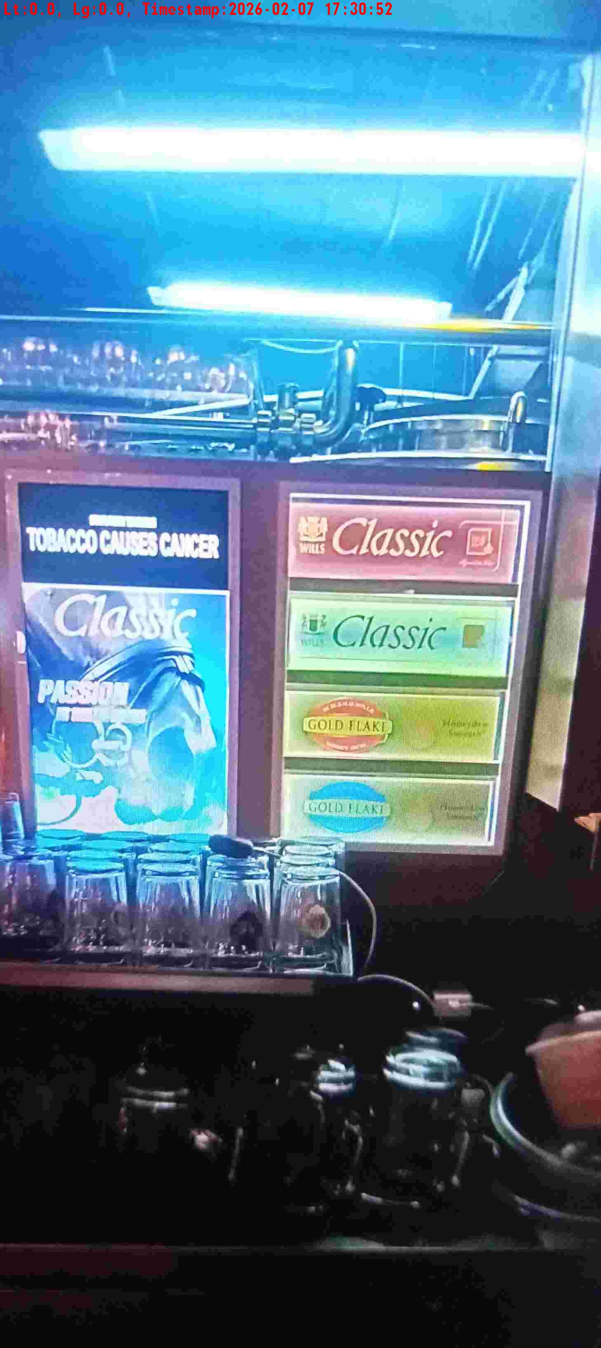
WD Code | DS Id | DS Name | Route Name | Shop Name | Date Time
DE5296 | 883 | HR-Candidate B | Wed-Sat | Tama | 07-02-2026 05:30:47 PM
Shop Inside Picture
Shop Front Picture

Slide 26
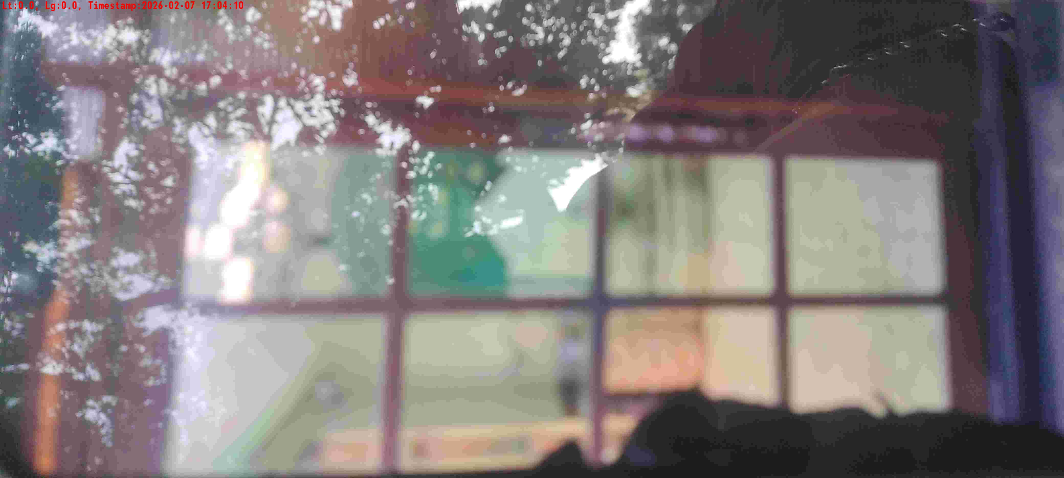
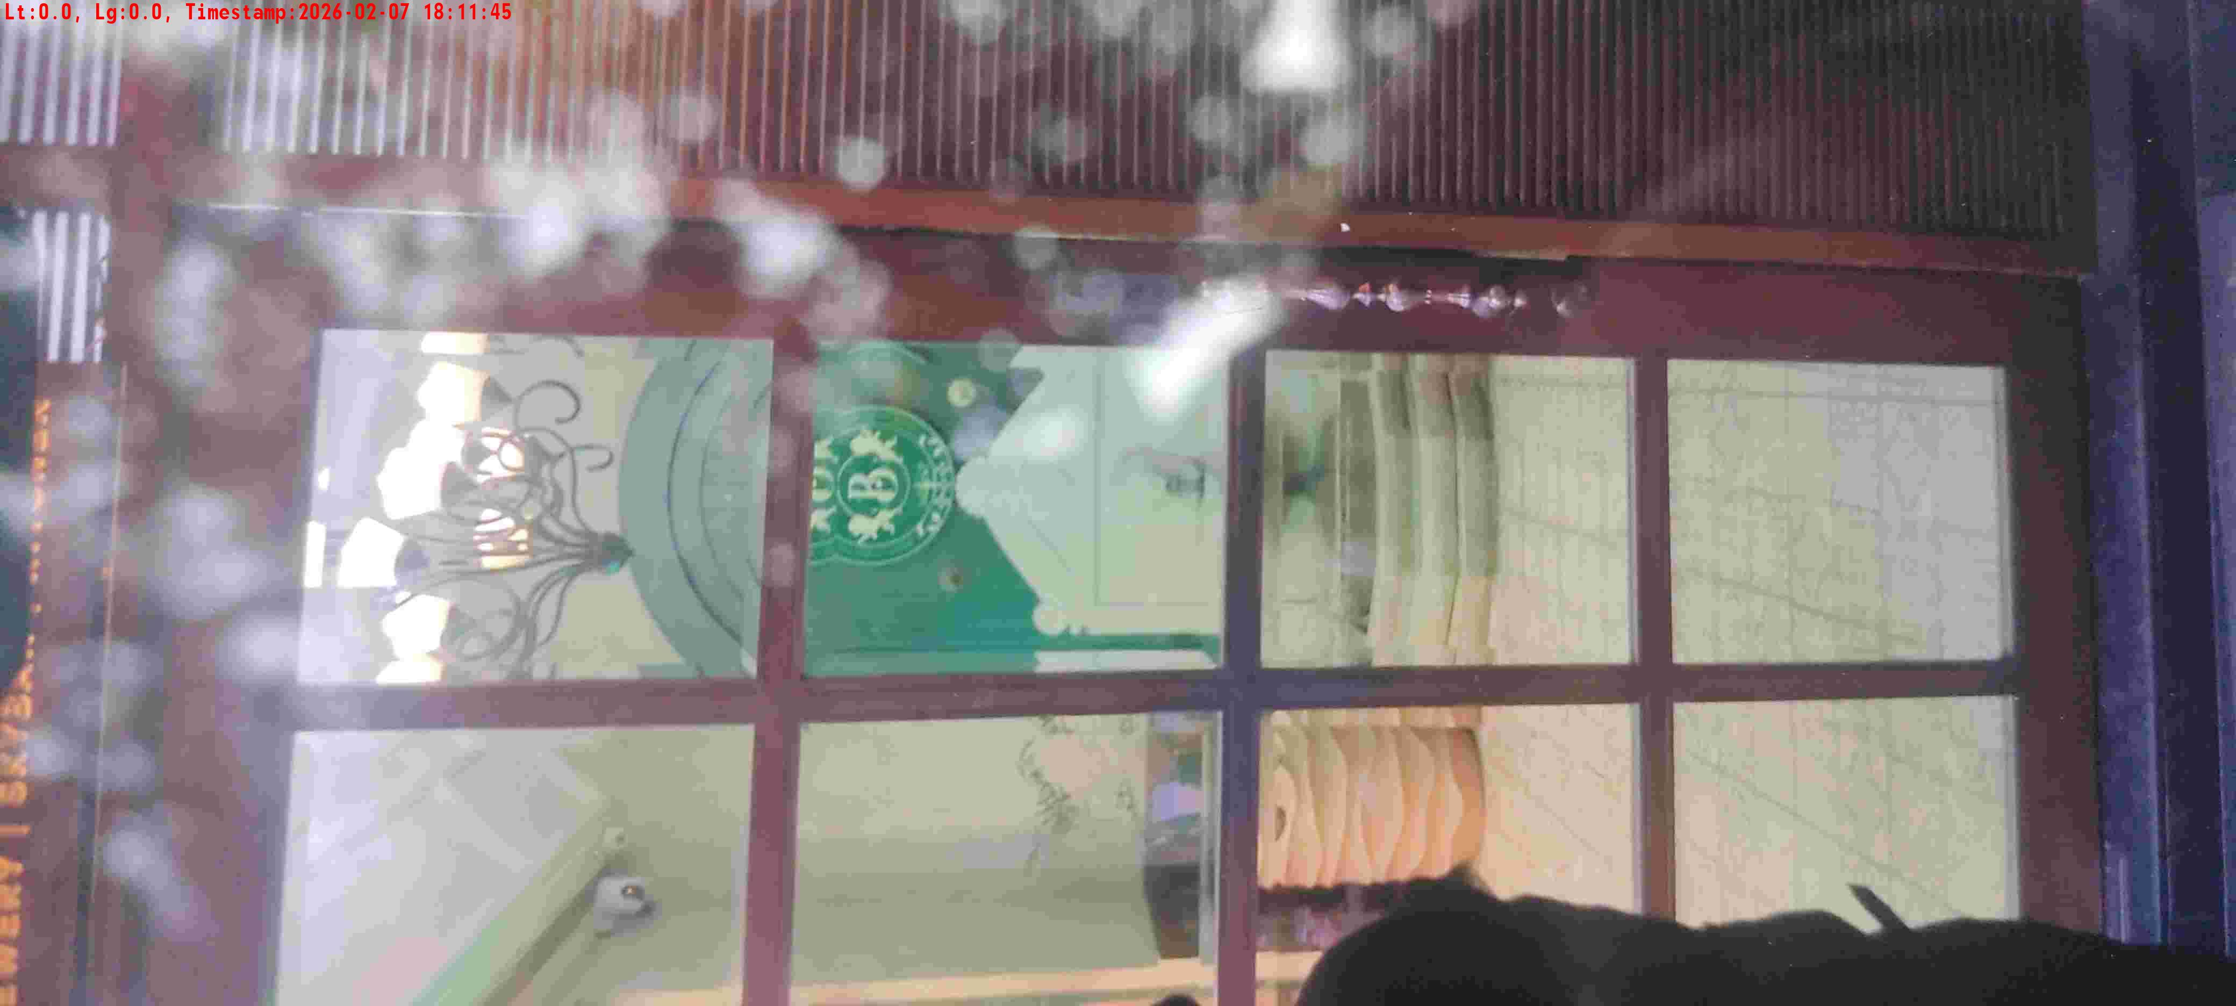
WD Code | DS Id | DS Name | Route Name | Shop Name | Date Time
DE5296 | 884 | HR-Mohit | Wed-Sat | Brew O Cart | 07-02-2026 05:04:07 PM
Shop Inside Picture
Shop Front Picture

Slide 27
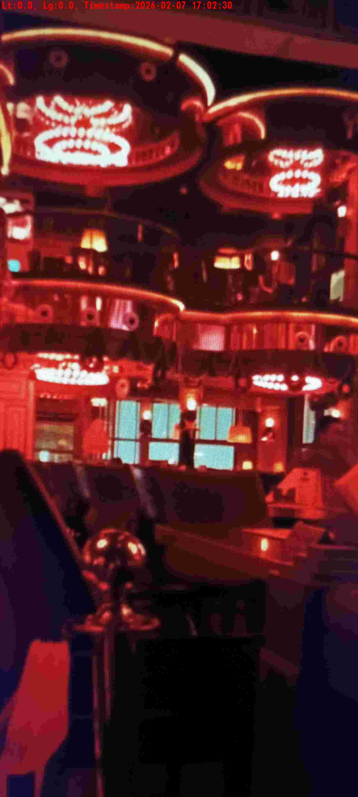
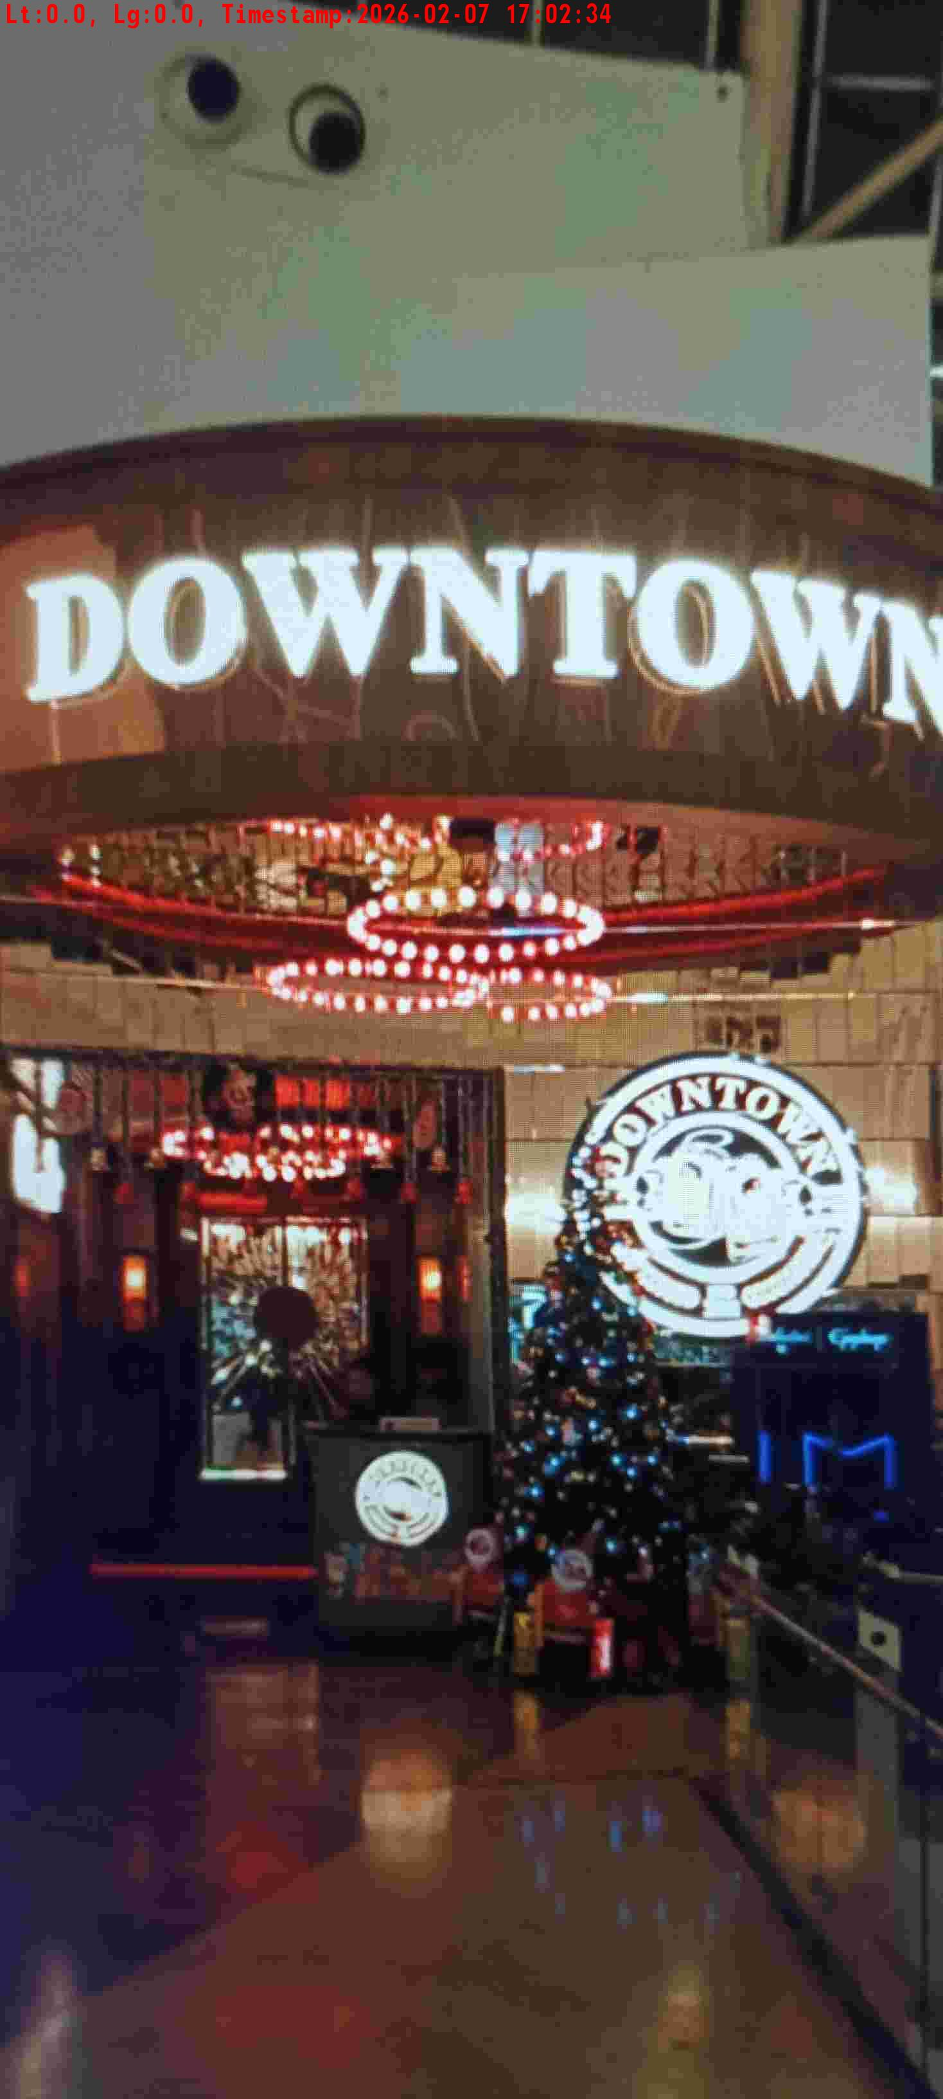
WD Code | DS Id | DS Name | Route Name | Shop Name | Date Time
DE5296 | 885 | HR-Satyasheel | Wed-Sat | DOWNTOWN SOUTH POINT | 07-02-2026 05:02:27 PM
Shop Inside Picture
Shop Front Picture

Slide 28
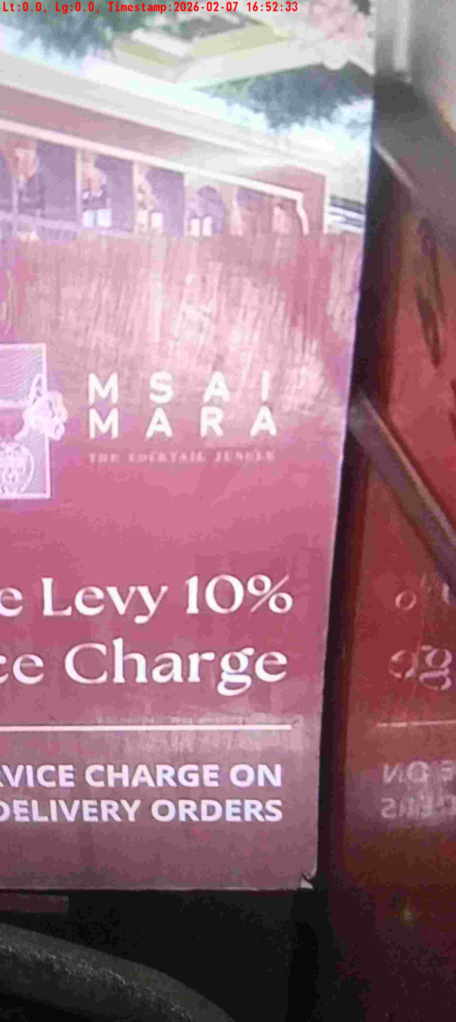
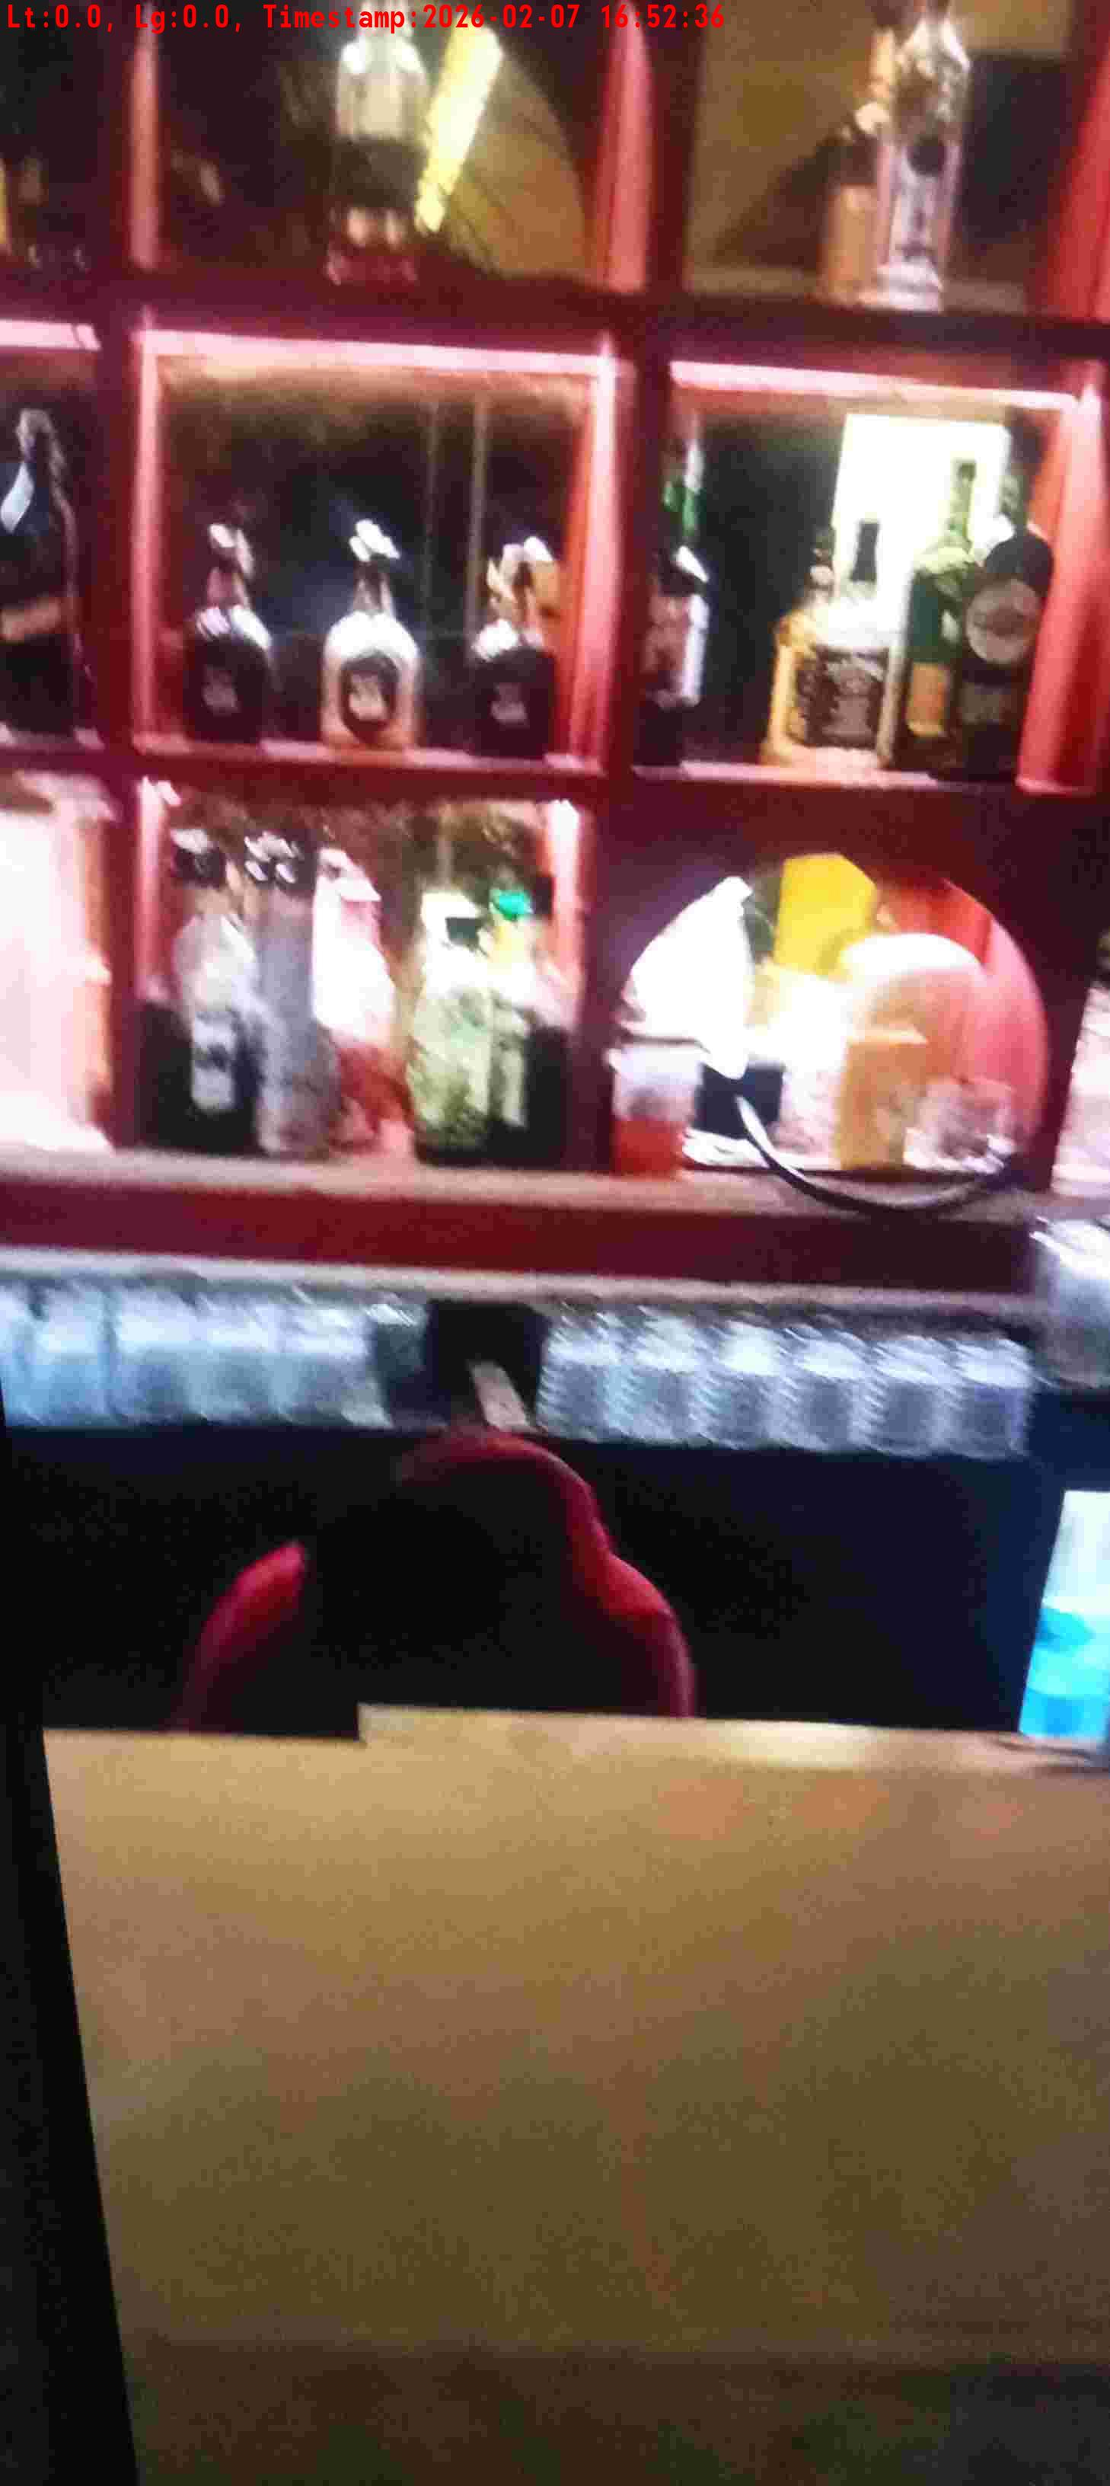
WD Code | DS Id | DS Name | Route Name | Shop Name | Date Time
DE5296 | 883 | HR-Candidate B | Wed-Sat | Msai Mara | 07-02-2026 04:52:31 PM
Shop Inside Picture
Shop Front Picture

Slide 29
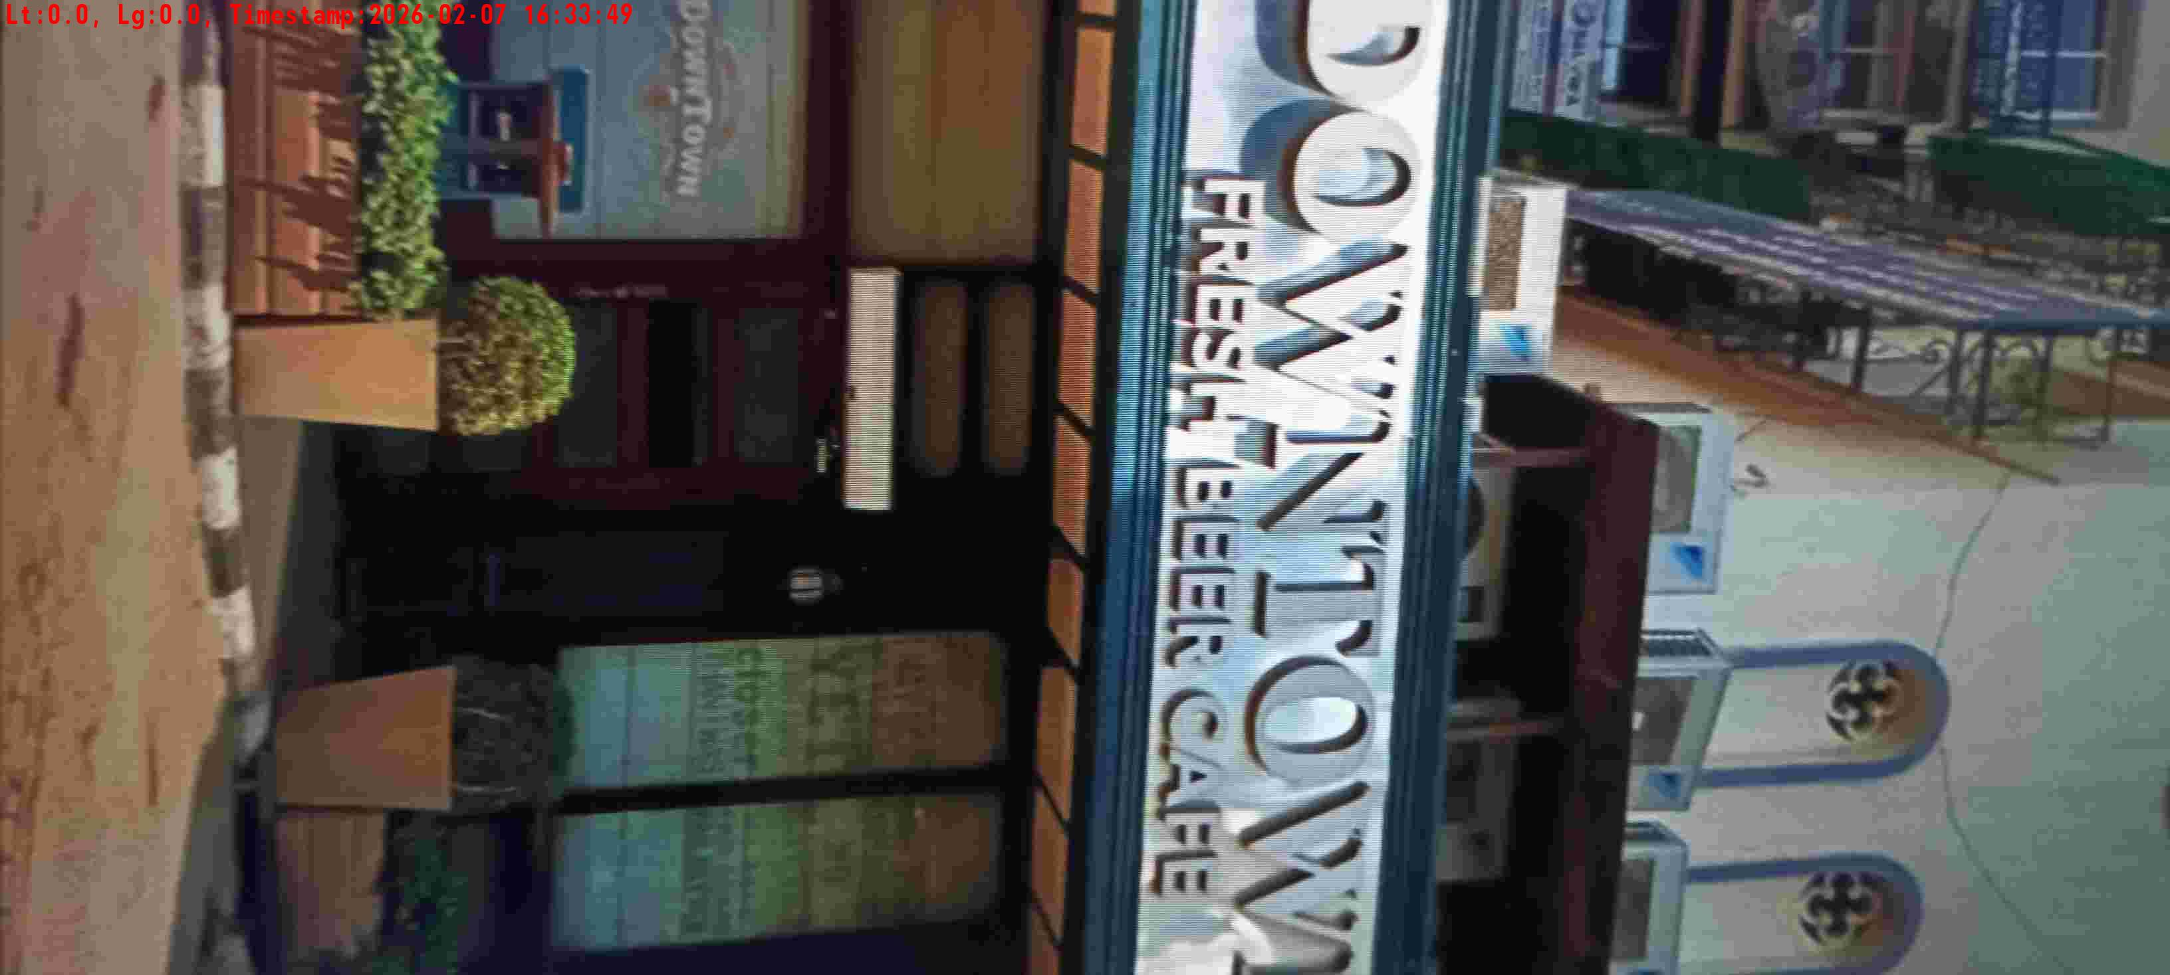
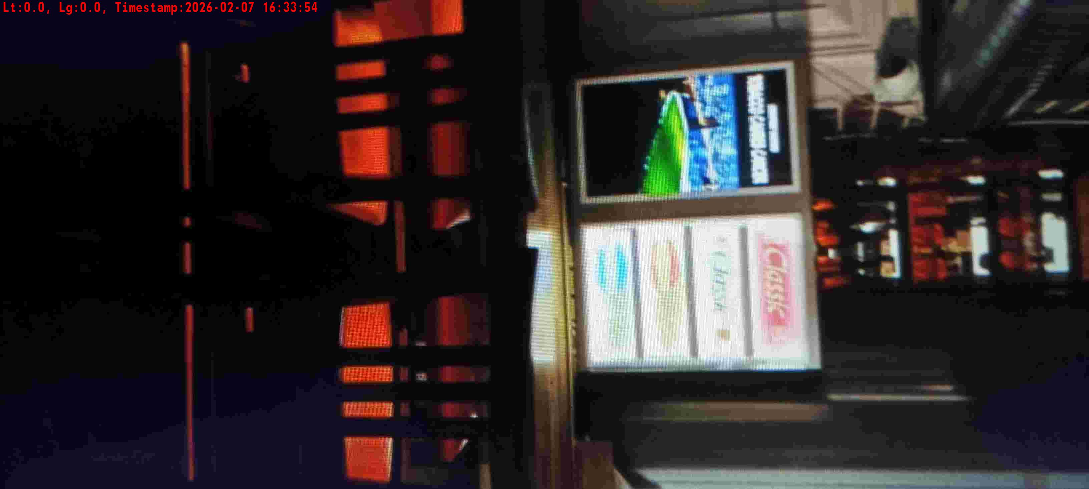
WD Code | DS Id | DS Name | Route Name | Shop Name | Date Time
DE5296 | 885 | HR-Satyasheel | Wed-Sat | Down Town Galleria Gurgaon | 07-02-2026 04:33:45 PM
Shop Inside Picture
Shop Front Picture

Slide 30
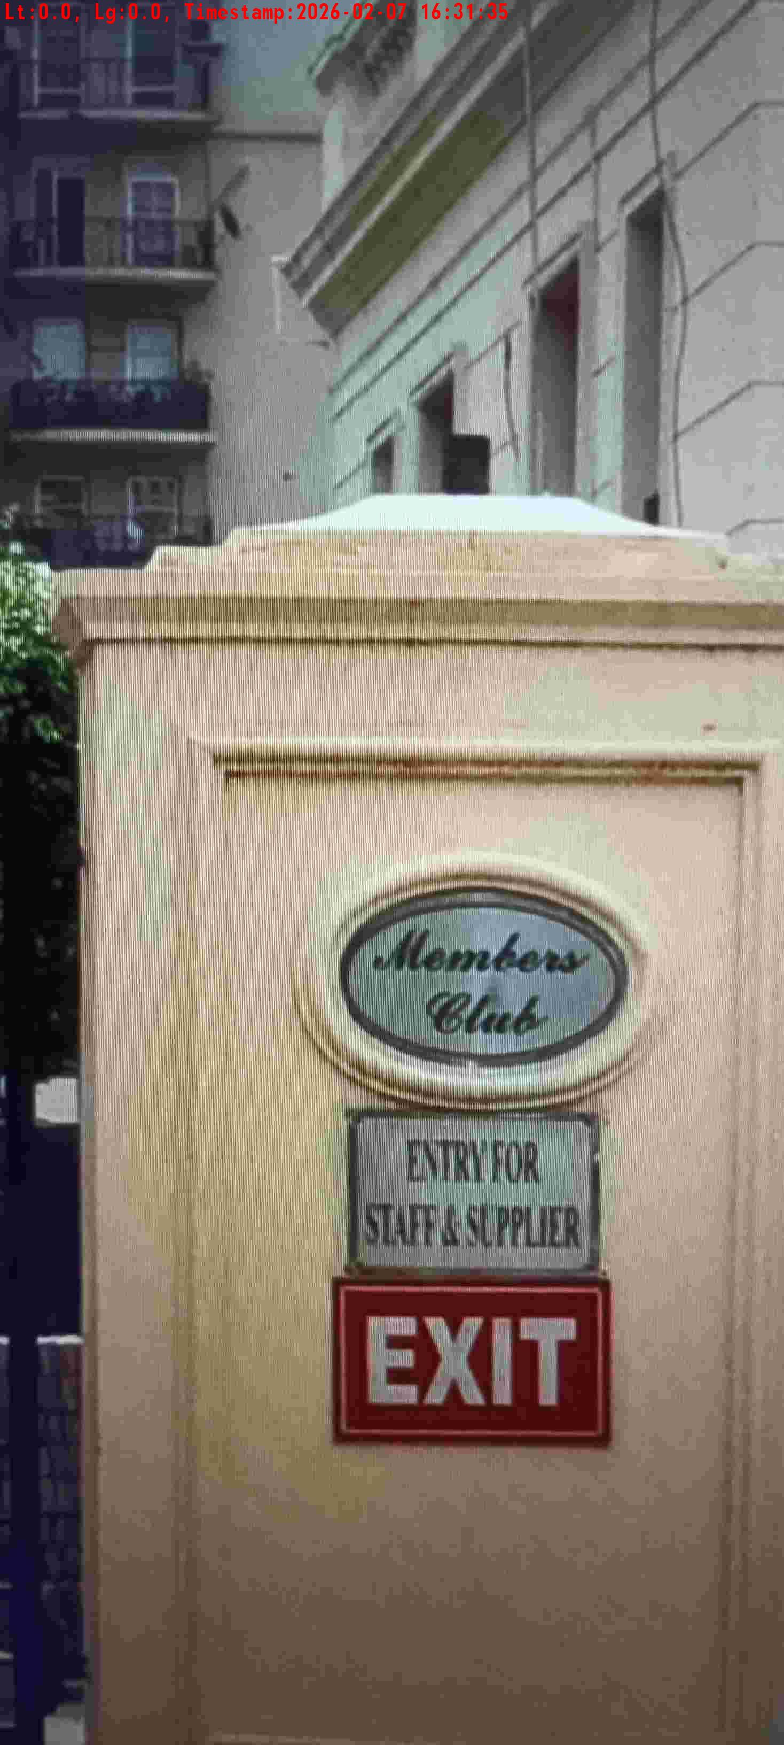
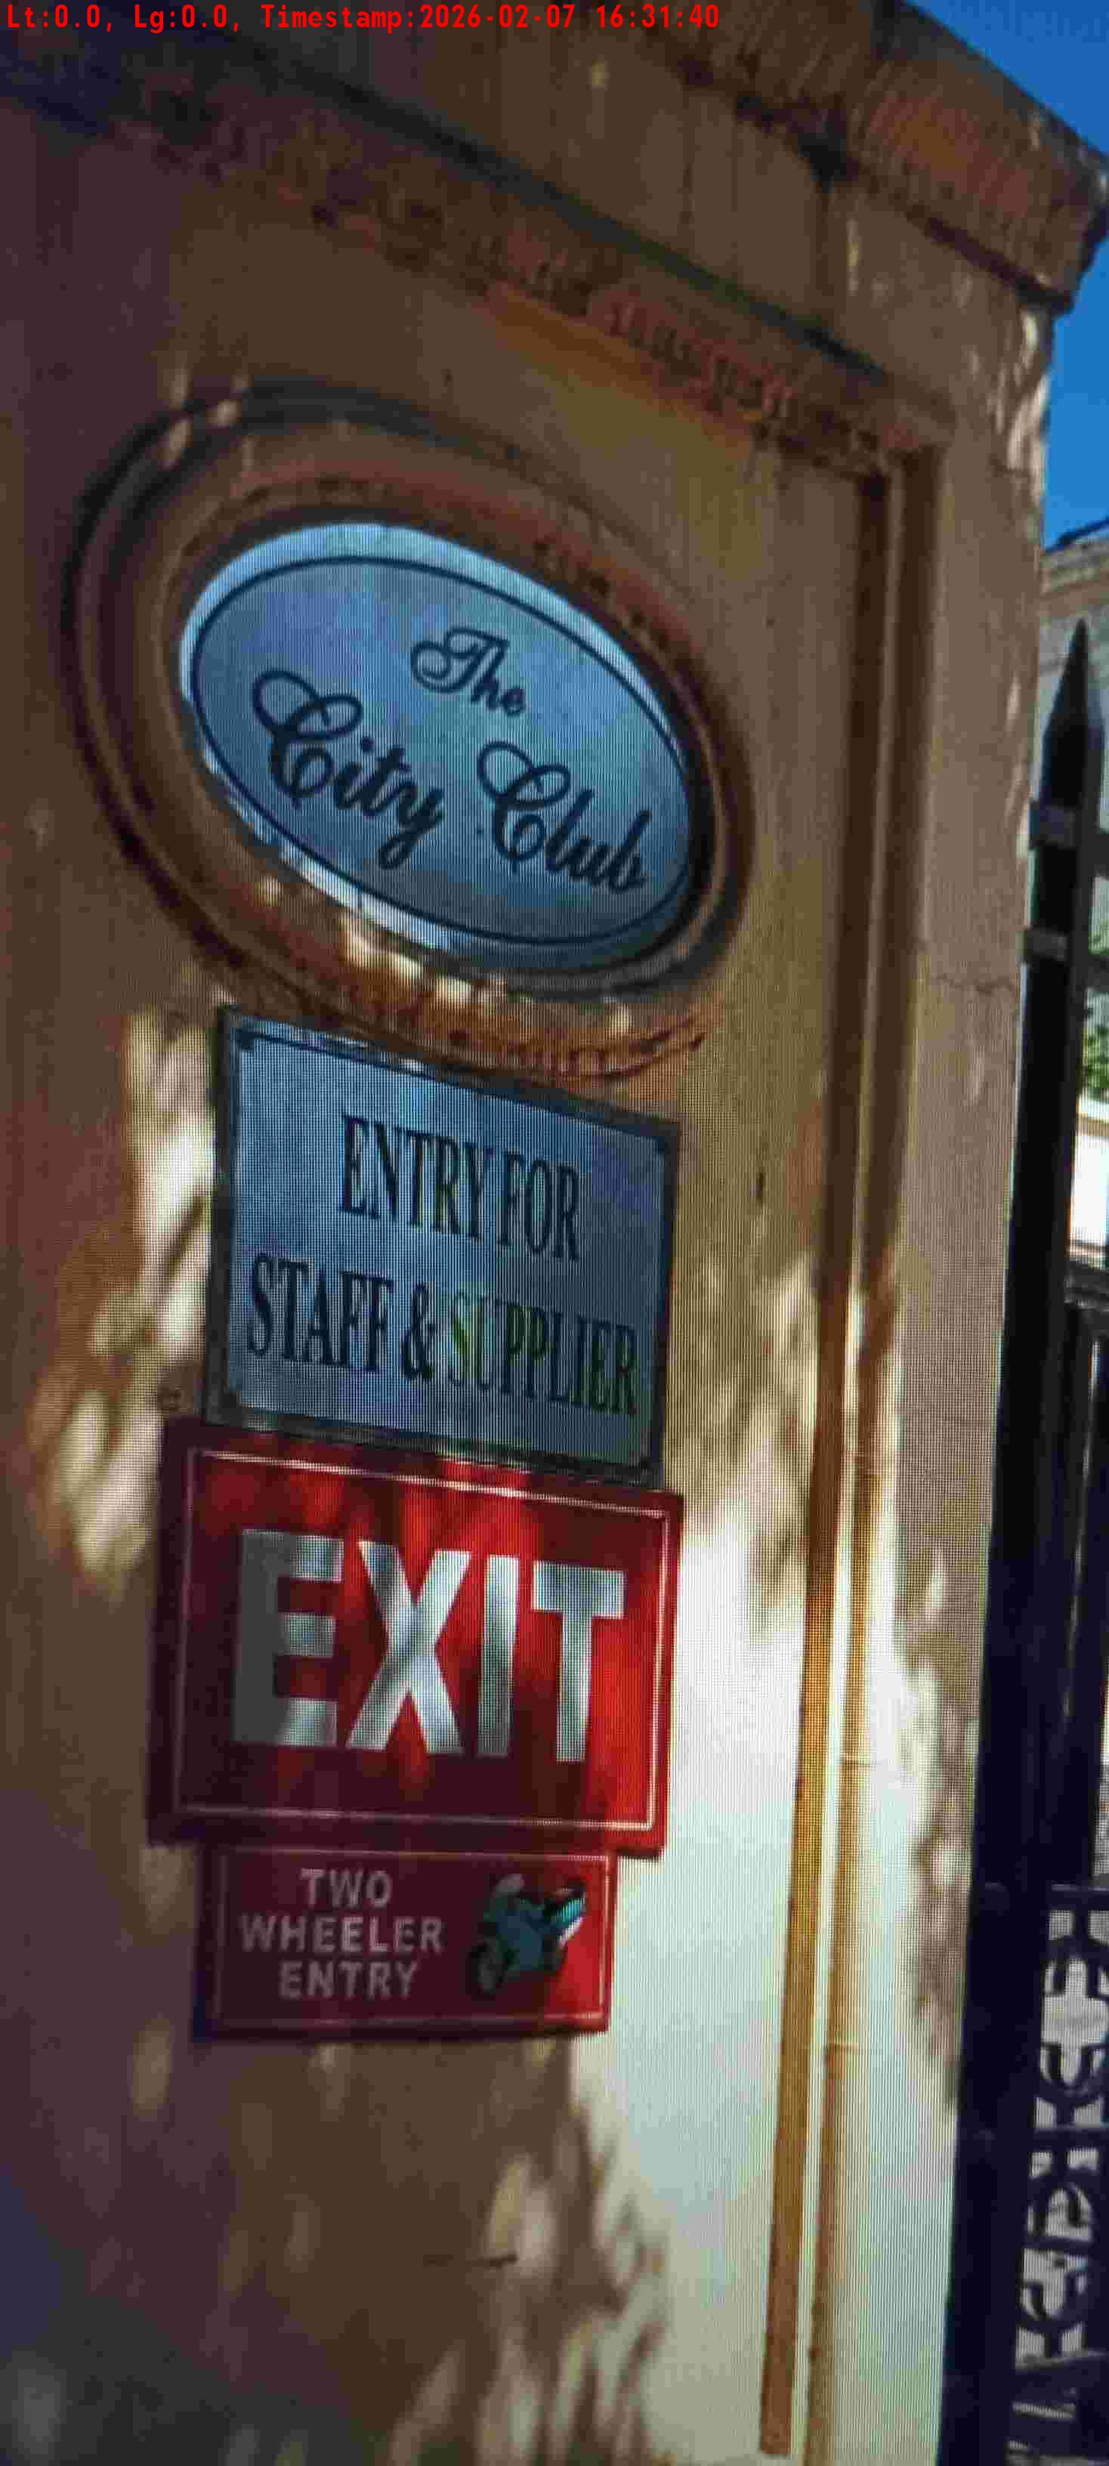
WD Code | DS Id | DS Name | Route Name | Shop Name | Date Time
DE5296 | 885 | HR-Satyasheel | Wed-Sat | The City Club Phase 4 | 07-02-2026 04:31:32 PM
Shop Inside Picture
Shop Front Picture

Slide 31
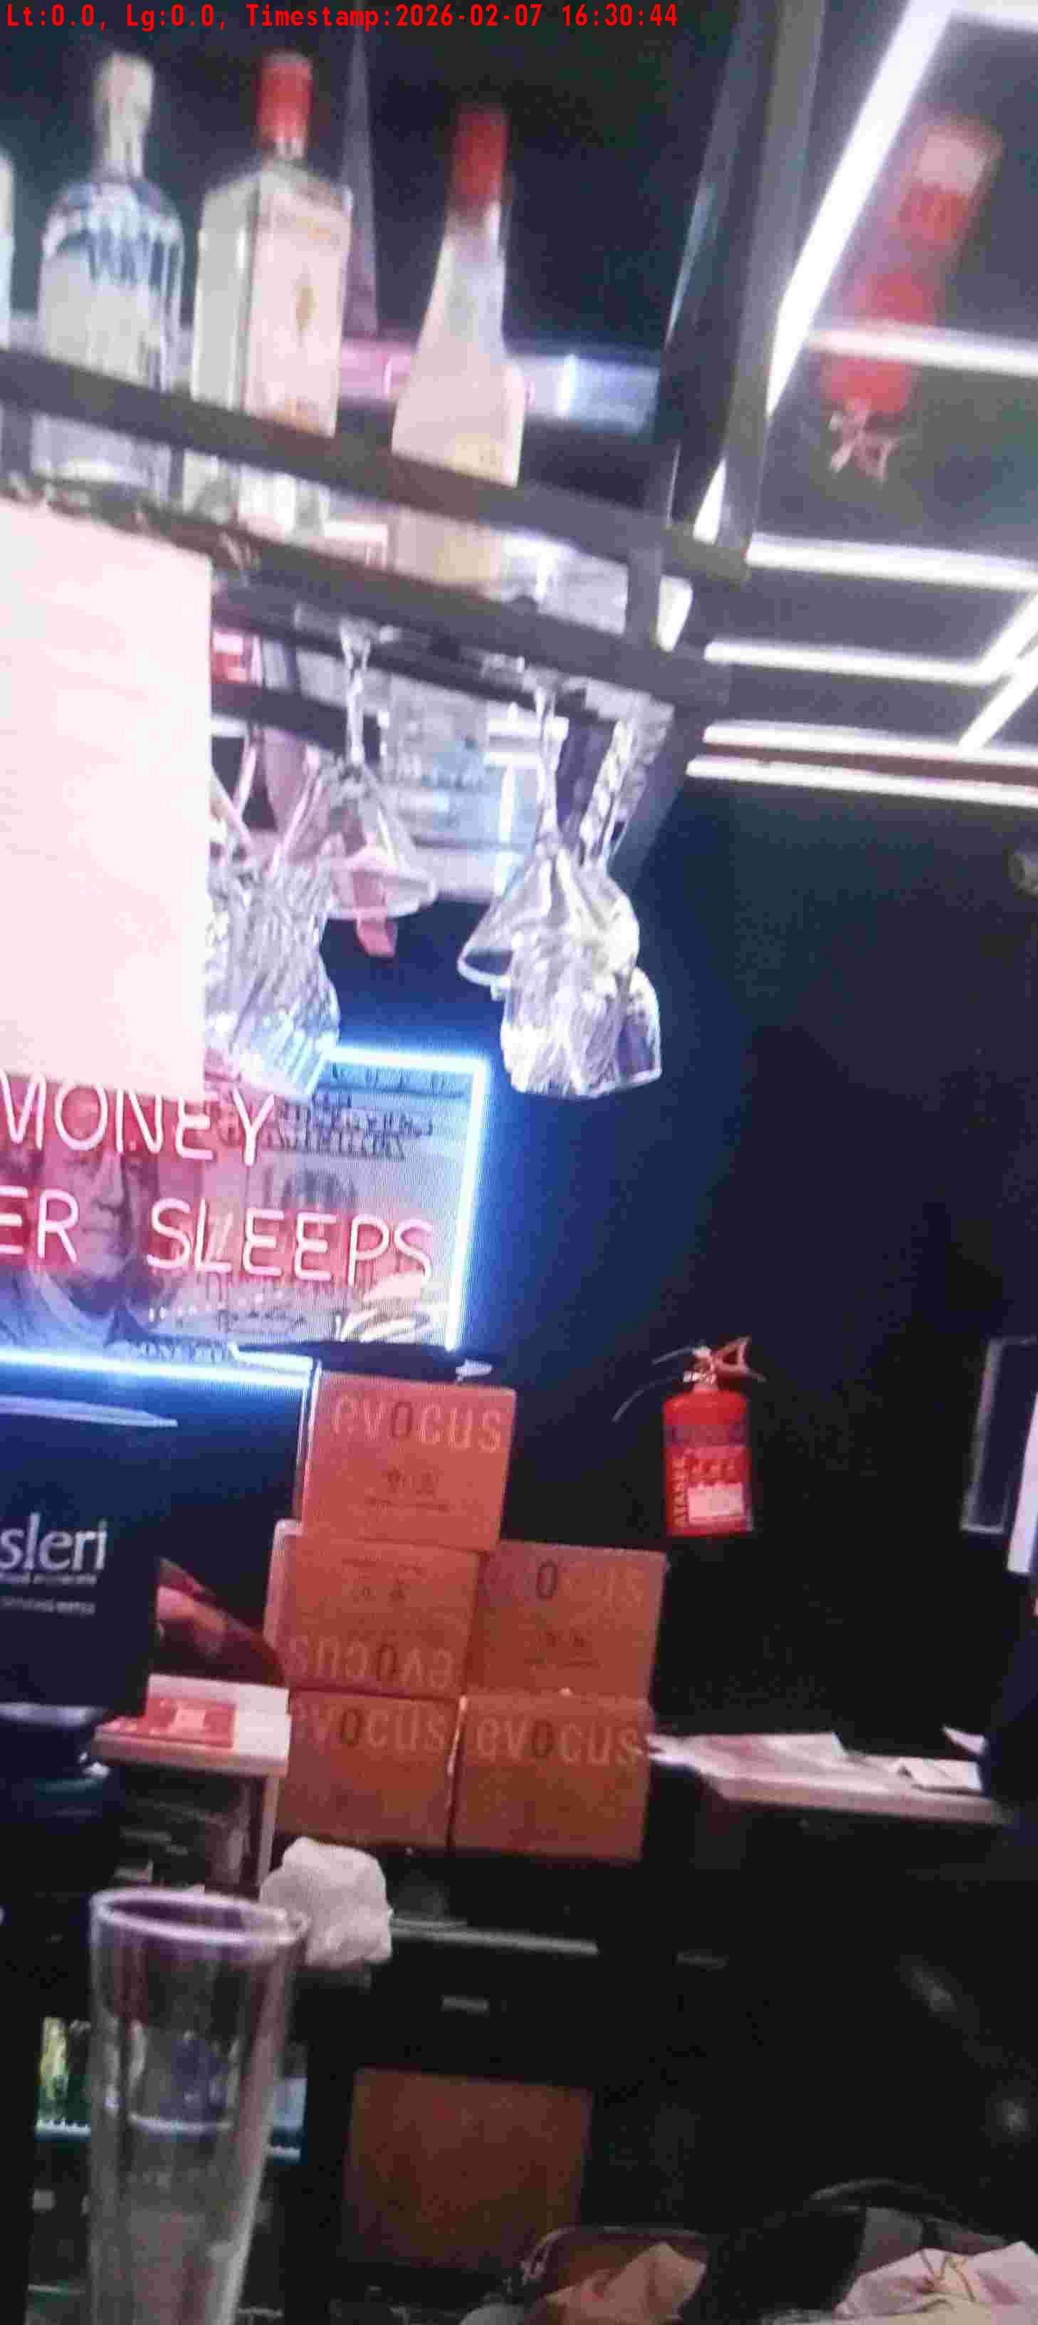
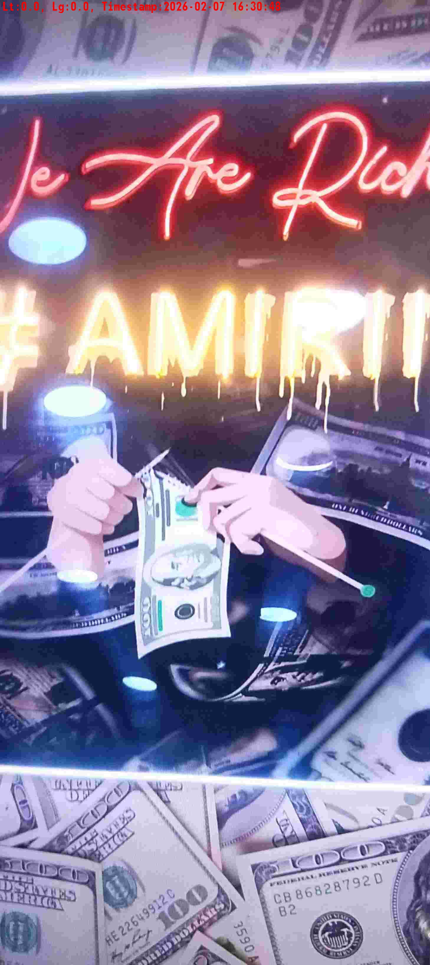
WD Code | DS Id | DS Name | Route Name | Shop Name | Date Time
DE5296 | 883 | HR-Candidate B | Wed-Sat | Cork | 07-02-2026 04:30:42 PM
Shop Inside Picture
Shop Front Picture

Slide 32


WD Code | DS Id | DS Name | Route Name | Shop Name | Date Time
DE5296 | 884 | HR-Mohit | Wed-Sat | Michigan Tap Sohna | 07-02-2026 04:12:40 PM
Shop Inside Picture
Shop Front Picture

Slide 33
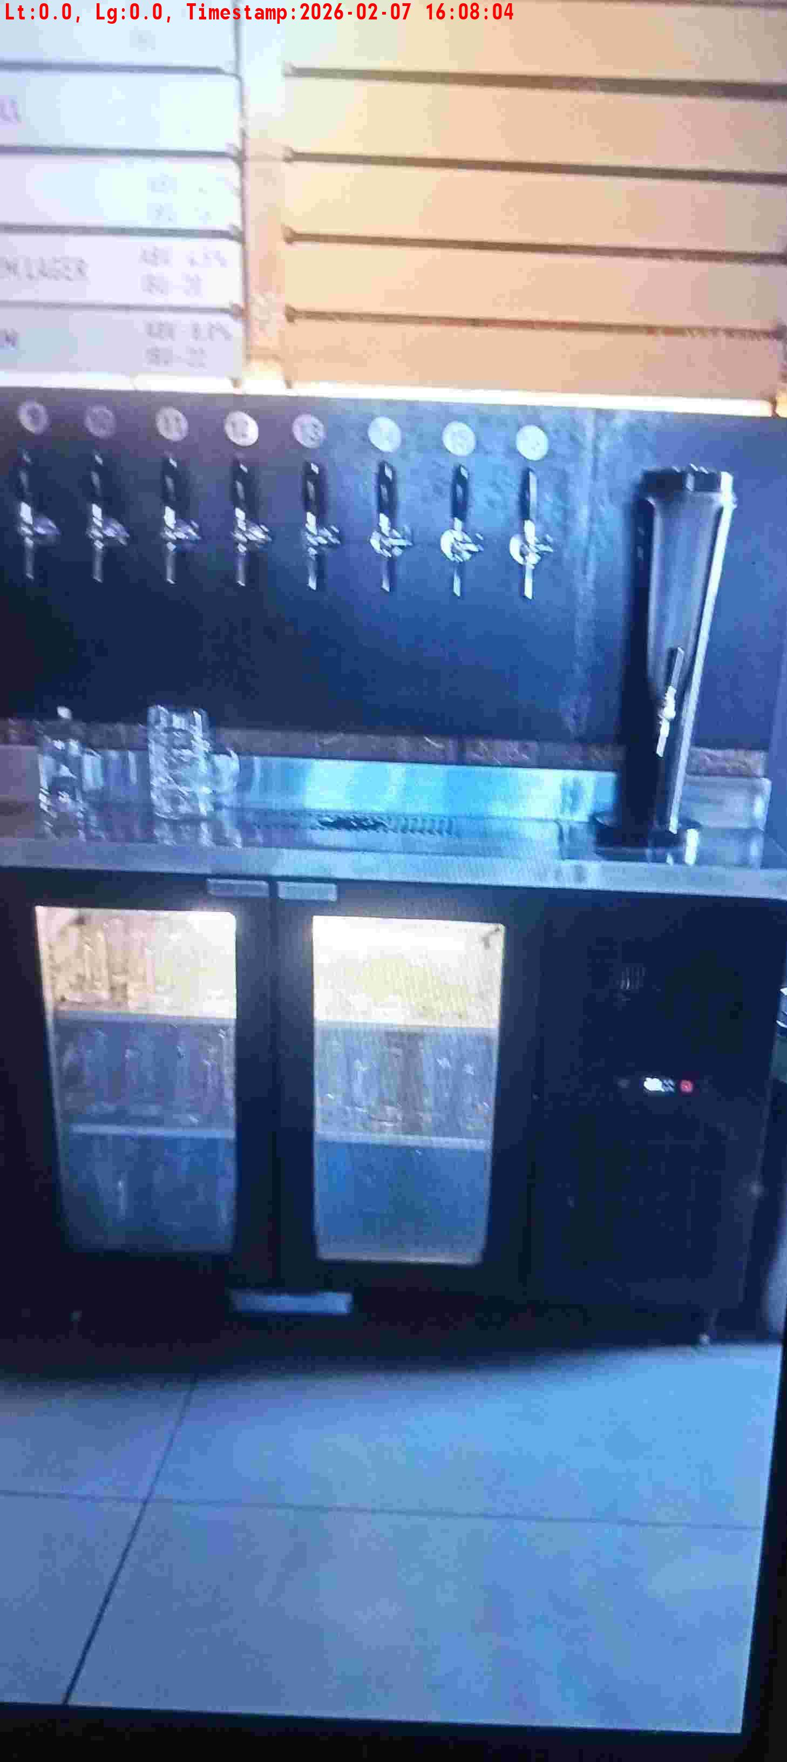
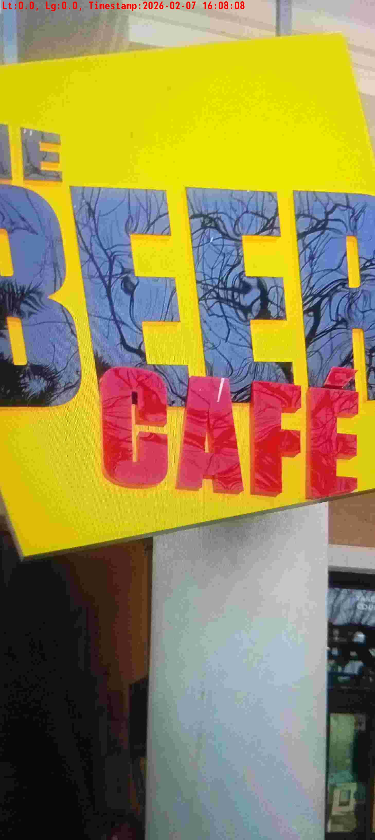
WD Code | DS Id | DS Name | Route Name | Shop Name | Date Time
DE5296 | 883 | HR-Candidate B | Wed-Sat | Beer Cafe Faridabad | 07-02-2026 04:08:02 PM
Shop Inside Picture
Shop Front Picture

Slide 34


WD Code | DS Id | DS Name | Route Name | Shop Name | Date Time
DE5296 | 885 | HR-Satyasheel | Wed-Sat | Delhi Club House | 07-02-2026 03:56:47 PM
Shop Inside Picture
Shop Front Picture

Slide 35


WD Code | DS Id | DS Name | Route Name | Shop Name | Date Time
DE5296 | 885 | HR-Satyasheel | Wed-Sat | Quram Club | 07-02-2026 03:55:35 PM
Shop Inside Picture
Shop Front Picture

Slide 36


WD Code | DS Id | DS Name | Route Name | Shop Name | Date Time
DE5296 | 883 | HR-Candidate B | Wed-Sat | Doranz | 07-02-2026 03:42:50 PM
Shop Inside Picture
Shop Front Picture

Slide 37


WD Code | DS Id | DS Name | Route Name | Shop Name | Date Time
DE5296 | 885 | HR-Satyasheel | Wed-Sat | The City Club Phase 5 | 07-02-2026 03:37:09 PM
Shop Inside Picture
Shop Front Picture

Slide 38


WD Code | DS Id | DS Name | Route Name | Shop Name | Date Time
DE5296 | 885 | HR-Satyasheel | Wed-Sat | Open Tap GCR Road | 07-02-2026 03:34:19 PM
Shop Inside Picture
Shop Front Picture

Slide 39


WD Code | DS Id | DS Name | Route Name | Shop Name | Date Time
DE5296 | 885 | HR-Satyasheel | Wed-Sat | Striker Sky Bar | 07-02-2026 03:30:49 PM
Shop Inside Picture
Shop Front Picture

Slide 40


WD Code | DS Id | DS Name | Route Name | Shop Name | Date Time
DE5296 | 883 | HR-Candidate B | Wed-Sat | Club Patio | 07-02-2026 03:20:29 PM
Shop Inside Picture
Shop Front Picture

Slide 41


WD Code | DS Id | DS Name | Route Name | Shop Name | Date Time
DE5296 | 884 | HR-Mohit | Wed-Sat | Zuvaah | 07-02-2026 03:19:26 PM
Shop Inside Picture
Shop Front Picture

Slide 42


WD Code | DS Id | DS Name | Route Name | Shop Name | Date Time
DE5296 | 885 | HR-Satyasheel | Wed-Sat | Double Tree by Hilton Hotel GCR Road | 07-02-2026 03:09:29 PM
Shop Inside Picture
Shop Front Picture

Slide 43


WD Code | DS Id | DS Name | Route Name | Shop Name | Date Time
DE5296 | 885 | HR-Satyasheel | Wed-Sat | Illuzn | 07-02-2026 03:08:09 PM
Shop Inside Picture
Shop Front Picture

Slide 44


WD Code | DS Id | DS Name | Route Name | Shop Name | Date Time
DE5296 | 883 | HR-Candidate B | Wed-Sat | Aggrefe | 07-02-2026 02:47:19 PM
Shop Inside Picture
Shop Front Picture

Slide 45


WD Code | DS Id | DS Name | Route Name | Shop Name | Date Time
DE5296 | 883 | HR-Candidate B | Wed-Sat | Chapter 12 | 07-02-2026 02:38:07 PM
Shop Inside Picture
Shop Front Picture

Slide 46


WD Code | DS Id | DS Name | Route Name | Shop Name | Date Time
DE5296 | 885 | HR-Satyasheel | Wed-Sat | DOWN TOWN SUNCITY | 07-02-2026 02:10:17 PM
Shop Inside Picture
Shop Front Picture

Slide 47


WD Code | DS Id | DS Name | Route Name | Shop Name | Date Time
DE5296 | 884 | HR-Mohit | Wed-Sat | Kozeba | 07-02-2026 01:59:26 PM
Shop Inside Picture
Shop Front Picture

Slide 48


WD Code | DS Id | DS Name | Route Name | Shop Name | Date Time
DE5296 | 884 | HR-Mohit | Wed-Sat | One8 Sohna Road | 07-02-2026 01:47:12 PM
Shop Inside Picture
Shop Front Picture

Slide 49


WD Code | DS Id | DS Name | Route Name | Shop Name | Date Time
DE5296 | 885 | HR-Satyasheel | Wed-Sat | THE GR8 TASTE OF INDIA | 07-02-2026 01:45:43 PM
Shop Inside Picture
Shop Front Picture

Slide 50


WD Code | DS Id | DS Name | Route Name | Shop Name | Date Time
DE5296 | 885 | HR-Satyasheel | Wed-Sat | THE BIKERS CAFE | 07-02-2026 01:41:01 PM
Shop Inside Picture
Shop Front Picture

Slide 51


WD Code | DS Id | DS Name | Route Name | Shop Name | Date Time
DE5296 | 884 | HR-Mohit | Wed-Sat | Social Sohna Road | 07-02-2026 01:19:17 PM
Shop Inside Picture
Shop Front Picture

Slide 52

WD Code | DS Id | DS Name | Route Name | Shop Name | Date Time
DE5296 | 884 | HR-Mohit | Wed-Sat | Smoke House Delhi | 07-02-2026 01:14:07 PM
Shop Inside Picture
Shop Front Picture

Slide 53


WD Code | DS Id | DS Name | Route Name | Shop Name | Date Time
DE5296 | 883 | HR-Candidate B | Wed-Sat | Social Faridabad | 07-02-2026 01:08:38 PM
Shop Inside Picture
Shop Front Picture

Slide 54


WD Code | DS Id | DS Name | Route Name | Shop Name | Date Time
DE5296 | 884 | HR-Mohit | Wed-Sat | Soul Barcalona | 07-02-2026 01:08:14 PM
Shop Inside Picture
Shop Front Picture

Slide 55


WD Code | DS Id | DS Name | Route Name | Shop Name | Date Time
DE5296 | 884 | HR-Mohit | Wed-Sat | Refflex | 07-02-2026 01:03:34 PM
Shop Inside Picture
Shop Front Picture

Slide 56


WD Code | DS Id | DS Name | Route Name | Shop Name | Date Time
DE5296 | 885 | HR-Satyasheel | Wed-Sat | Camelias Club | 07-02-2026 12:51:27 PM
Shop Inside Picture
Shop Front Picture

Slide 57


WD Code | DS Id | DS Name | Route Name | Shop Name | Date Time
DE5296 | 884 | HR-Mohit | Wed-Sat | Tuckinn | 07-02-2026 12:50:39 PM
Shop Inside Picture
Shop Front Picture

Slide 58


WD Code | DS Id | DS Name | Route Name | Shop Name | Date Time
DE5296 | 884 | HR-Mohit | Wed-Sat | Open Tap Sohna Road | 07-02-2026 12:48:58 PM
Shop Inside Picture
Shop Front Picture

Slide 59


WD Code | DS Id | DS Name | Route Name | Shop Name | Date Time
DE5296 | 884 | HR-Mohit | Wed-Sat | Radission Hotel Sohna Road | 07-02-2026 12:43:51 PM
Shop Inside Picture
Shop Front Picture

Slide 60


WD Code | DS Id | DS Name | Route Name | Shop Name | Date Time
DE5296 | 885 | HR-Satyasheel | Wed-Sat | Mangolias Club | 07-02-2026 12:29:49 PM
Shop Inside Picture
Shop Front Picture

Slide 61


WD Code | DS Id | DS Name | Route Name | Shop Name | Date Time
DE5296 | 884 | HR-Mohit | Wed-Sat | Vapour | 07-02-2026 12:21:21 PM
Shop Inside Picture
Shop Front Picture

Slide 62


WD Code | DS Id | DS Name | Route Name | Shop Name | Date Time
DE5296 | 884 | HR-Mohit | Wed-Sat | Beer Caf sec 70 | 07-02-2026 11:58:01 AM
Shop Inside Picture
Shop Front Picture

Slide 63


WD Code | DS Id | DS Name | Route Name | Shop Name | Date Time
DE5296 | 884 | HR-Mohit | Wed-Sat | Smaaash | 07-02-2026 11:28:48 AM
Shop Inside Picture
Shop Front Picture

Slide 64


WD Code | DS Id | DS Name | Route Name | Shop Name | Date Time
DE5296 | 885 | HR-Satyasheel | Wed-Sat | SORBO | 07-02-2026 11:20:07 AM
Shop Inside Picture
Shop Front Picture

Slide 65


WD Code | DS Id | DS Name | Route Name | Shop Name | Date Time
DE5296 | 885 | HR-Satyasheel | Wed-Sat | The City Club Phase 3 | 07-02-2026 10:54:14 AM
Shop Inside Picture
Shop Front Picture

Slide 66


WD Code | DS Id | DS Name | Route Name | Shop Name | Date Time
DE5296 | 884 | HR-Mohit | Wed-Sat | Hotel GATEWAY RESORTS | 07-02-2026 10:53:51 AM
Shop Inside Picture
Shop Front Picture

Slide 67


WD Code | DS Id | DS Name | Route Name | Shop Name | Date Time
DE5296 | 884 | HR-Mohit | Wed-Sat | Hotel WESTIN Sohna Road | 07-02-2026 10:12:19 AM
Shop Inside Picture
Shop Front Picture

Slide 68


WD Code | DS Id | DS Name | Route Name | Shop Name | Date Time
DE5296 | 883 | HR-Candidate B | Wed-Sat | Cataliyst | 07-02-2026 10:08:47 AM
Shop Inside Picture
Shop Front Picture

Slide 69


WD Code | DS Id | DS Name | Route Name | Shop Name | Date Time
DE5296 | 884 | HR-Mohit | Tue-Fri | Zorrow | 06-02-2026 08:27:52 PM
Shop Inside Picture
Shop Front Picture

Slide 70


WD Code | DS Id | DS Name | Route Name | Shop Name | Date Time
DE5296 | 885 | HR-Satyasheel | Tue-Fri | Hotel IBIS GCR extension Road | 06-02-2026 08:10:07 PM
Shop Inside Picture
Shop Front Picture

Slide 71


WD Code | DS Id | DS Name | Route Name | Shop Name | Date Time
DE5296 | 885 | HR-Satyasheel | Tue-Fri | Beer Cafe Ardee Mall | 06-02-2026 07:44:06 PM
Shop Inside Picture
Shop Front Picture

Slide 72


WD Code | DS Id | DS Name | Route Name | Shop Name | Date Time
DE5296 | 883 | HR-Candidate B | Tue-Fri | Nasha | 06-02-2026 07:02:17 PM
Shop Inside Picture
Shop Front Picture

Slide 73


WD Code | DS Id | DS Name | Route Name | Shop Name | Date Time
DE5296 | 884 | HR-Mohit | Tue-Fri | Elite | 06-02-2026 07:02:06 PM
Shop Inside Picture
Shop Front Picture

Slide 74


WD Code | DS Id | DS Name | Route Name | Shop Name | Date Time
DE5296 | 883 | HR-Candidate B | Tue-Fri | Club 18 | 06-02-2026 06:24:33 PM
Shop Inside Picture
Shop Front Picture

Slide 75


WD Code | DS Id | DS Name | Route Name | Shop Name | Date Time
DE5296 | 883 | HR-Candidate B | Tue-Fri | Club Ignite | 06-02-2026 06:01:56 PM
Shop Inside Picture
Shop Front Picture

Slide 76


WD Code | DS Id | DS Name | Route Name | Shop Name | Date Time
DE5296 | 883 | HR-Candidate B | Tue-Fri | Last Chance | 06-02-2026 05:47:53 PM
Shop Inside Picture
Shop Front Picture

Slide 77


WD Code | DS Id | DS Name | Route Name | Shop Name | Date Time
DE5296 | 884 | HR-Mohit | Tue-Fri | SO YOU | 06-02-2026 05:46:51 PM
Shop Inside Picture
Shop Front Picture

Slide 78
WD Code | DS Id | DS Name | Route Name | Shop Name | Date Time
DE5296 | 884 | HR-Mohit | Tue-Fri | Walking Stret | 06-02-2026 05:46:31 PM

Slide 79
WD Code | DS Id | DS Name | Route Name | Shop Name | Date Time
DE5296 | 884 | HR-Mohit | Tue-Fri | Human Club | 06-02-2026 05:46:06 PM

Slide 80


WD Code | DS Id | DS Name | Route Name | Shop Name | Date Time
DE5296 | 883 | HR-Candidate B | Tue-Fri | Odessy | 06-02-2026 05:32:46 PM
Shop Inside Picture
Shop Front Picture

Slide 81


WD Code | DS Id | DS Name | Route Name | Shop Name | Date Time
DE5296 | 885 | HR-Satyasheel | Tue-Fri | Hotel Hayyat GCR Extension road | 06-02-2026 05:27:04 PM
Shop Inside Picture
Shop Front Picture

Slide 82


WD Code | DS Id | DS Name | Route Name | Shop Name | Date Time
DE5296 | 884 | HR-Mohit | Tue-Fri | Ware House | 06-02-2026 05:26:26 PM
Shop Inside Picture
Shop Front Picture

Slide 83


WD Code | DS Id | DS Name | Route Name | Shop Name | Date Time
DE5296 | 885 | HR-Satyasheel | Tue-Fri | Romeo Lane GCR Extension Road | 06-02-2026 05:18:50 PM
Shop Inside Picture
Shop Front Picture

Slide 84


WD Code | DS Id | DS Name | Route Name | Shop Name | Date Time
DE5296 | 885 | HR-Satyasheel | Tue-Fri | Avaatar | 06-02-2026 05:16:56 PM
Shop Inside Picture
Shop Front Picture

Slide 85


WD Code | DS Id | DS Name | Route Name | Shop Name | Date Time
DE5296 | 885 | HR-Satyasheel | Tue-Fri | BELLAGIO | 06-02-2026 05:15:45 PM
Shop Inside Picture
Shop Front Picture

Slide 86


WD Code | DS Id | DS Name | Route Name | Shop Name | Date Time
DE5296 | 884 | HR-Mohit | Tue-Fri | Factory | 06-02-2026 05:03:18 PM
Shop Inside Picture
Shop Front Picture

Slide 87


WD Code | DS Id | DS Name | Route Name | Shop Name | Date Time
DE5296 | 884 | HR-Mohit | Tue-Fri | Lost Lemon | 06-02-2026 04:37:42 PM
Shop Inside Picture
Shop Front Picture

Slide 88


WD Code | DS Id | DS Name | Route Name | Shop Name | Date Time
DE5296 | 883 | HR-Candidate B | Tue-Fri | Club IPSA | 06-02-2026 04:34:36 PM
Shop Inside Picture
Shop Front Picture

Slide 89


WD Code | DS Id | DS Name | Route Name | Shop Name | Date Time
DE5296 | 885 | HR-Satyasheel | Tue-Fri | Beer Cafe GCR Extension Road | 06-02-2026 04:34:07 PM
Shop Inside Picture
Shop Front Picture

Slide 90


WD Code | DS Id | DS Name | Route Name | Shop Name | Date Time
DE5296 | 885 | HR-Satyasheel | Tue-Fri | Striker Prevee | 06-02-2026 04:32:51 PM
Shop Inside Picture
Shop Front Picture

Slide 91


WD Code | DS Id | DS Name | Route Name | Shop Name | Date Time
DE5296 | 883 | HR-Candidate B | Tue-Fri | Club Prision | 06-02-2026 04:22:42 PM
Shop Inside Picture
Shop Front Picture

Slide 92


WD Code | DS Id | DS Name | Route Name | Shop Name | Date Time
DE5296 | 884 | HR-Mohit | Tue-Fri | Friction | 06-02-2026 03:17:28 PM
Shop Inside Picture
Shop Front Picture

Slide 93


WD Code | DS Id | DS Name | Route Name | Shop Name | Date Time
DE5296 | 883 | HR-Candidate B | Tue-Fri | Quenz Bar | 06-02-2026 03:09:45 PM
Shop Inside Picture
Shop Front Picture

Slide 94


WD Code | DS Id | DS Name | Route Name | Shop Name | Date Time
DE5296 | 884 | HR-Mohit | Tue-Fri | Down Town Sec 29 Gurgaon | 06-02-2026 02:49:23 PM
Shop Inside Picture
Shop Front Picture

Slide 95


WD Code | DS Id | DS Name | Route Name | Shop Name | Date Time
DE5296 | 885 | HR-Satyasheel | Tue-Fri | Roe Sia | 06-02-2026 02:44:08 PM
Shop Inside Picture
Shop Front Picture

Slide 96


WD Code | DS Id | DS Name | Route Name | Shop Name | Date Time
DE5296 | 883 | HR-Candidate B | Tue-Fri | Empire Club | 06-02-2026 02:39:53 PM
Shop Inside Picture
Shop Front Picture

Slide 97

WD Code | DS Id | DS Name | Route Name | Shop Name | Date Time
DE5296 | 884 | HR-Mohit | Tue-Fri | Open Tap Sec 29 Gurgaon | 06-02-2026 02:29:53 PM
Shop Inside Picture

Slide 98


WD Code | DS Id | DS Name | Route Name | Shop Name | Date Time
DE5296 | 885 | HR-Satyasheel | Tue-Fri | Club Hermis | 06-02-2026 02:29:15 PM
Shop Inside Picture
Shop Front Picture

Slide 99


WD Code | DS Id | DS Name | Route Name | Shop Name | Date Time
DE5296 | 883 | HR-Candidate B | Tue-Fri | Mojos | 06-02-2026 02:21:53 PM
Shop Inside Picture
Shop Front Picture

Slide 100


WD Code | DS Id | DS Name | Route Name | Shop Name | Date Time
DE5296 | 883 | HR-Candidate B | Tue-Fri | Big Shot | 06-02-2026 02:12:58 PM
Shop Inside Picture
Shop Front Picture

Slide 101


WD Code | DS Id | DS Name | Route Name | Shop Name | Date Time
DE5296 | 884 | HR-Mohit | Tue-Fri | DLF Golf Club | 06-02-2026 01:26:15 PM
Shop Inside Picture
Shop Front Picture

Slide 102


WD Code | DS Id | DS Name | Route Name | Shop Name | Date Time
DE5296 | 883 | HR-Candidate B | Tue-Fri | Waka Waka | 06-02-2026 01:15:04 PM
Shop Inside Picture
Shop Front Picture

Slide 103


WD Code | DS Id | DS Name | Route Name | Shop Name | Date Time
DE5296 | 885 | HR-Satyasheel | Tue-Fri | Hotel Ramada Huda City Centre | 06-02-2026 01:01:02 PM
Shop Inside Picture
Shop Front Picture

Slide 104


WD Code | DS Id | DS Name | Route Name | Shop Name | Date Time
DE5296 | 883 | HR-Candidate B | Tue-Fri | Hotel Bristol | 06-02-2026 12:59:15 PM
Shop Inside Picture
Shop Front Picture

Slide 105


WD Code | DS Id | DS Name | Route Name | Shop Name | Date Time
DE5296 | 884 | HR-Mohit | Tue-Fri | The Hook | 06-02-2026 12:55:57 PM
Shop Inside Picture
Shop Front Picture

Slide 106


WD Code | DS Id | DS Name | Route Name | Shop Name | Date Time
DE5296 | 885 | HR-Satyasheel | Tue-Fri | Taj City Centre | 06-02-2026 12:44:58 PM
Shop Inside Picture
Shop Front Picture

Slide 107


WD Code | DS Id | DS Name | Route Name | Shop Name | Date Time
DE5296 | 884 | HR-Mohit | Tue-Fri | Decode | 06-02-2026 12:24:47 PM
Shop Inside Picture
Shop Front Picture

Slide 108


WD Code | DS Id | DS Name | Route Name | Shop Name | Date Time
DE5296 | 884 | HR-Mohit | Tue-Fri | MOB | 06-02-2026 11:46:40 AM
Shop Inside Picture
Shop Front Picture

Slide 109


WD Code | DS Id | DS Name | Route Name | Shop Name | Date Time
DE5296 | 883 | HR-Candidate B | Tue-Fri | Hotel Fortune MG Road | 06-02-2026 10:51:57 AM
Shop Inside Picture
Shop Front Picture

Slide 110


WD Code | DS Id | DS Name | Route Name | Shop Name | Date Time
DE5296 | 884 | HR-Mohit | Tue-Fri | LEMON TREE PREMIER Sec 29 | 06-02-2026 10:43:03 AM
Shop Inside Picture
Shop Front Picture

Slide 111


WD Code | DS Id | DS Name | Route Name | Shop Name | Date Time
DE5296 | 885 | HR-Satyasheel | Tue-Fri | Club Cheveron | 06-02-2026 10:37:42 AM
Shop Inside Picture
Shop Front Picture

Slide 112


WD Code | DS Id | DS Name | Route Name | Shop Name | Date Time
DE5296 | 885 | HR-Satyasheel | Tue-Fri | Bella Cafe | 06-02-2026 10:21:03 AM
Shop Inside Picture
Shop Front Picture

Slide 113


WD Code | DS Id | DS Name | Route Name | Shop Name | Date Time
DE5296 | 884 | HR-Mohit | Tue-Fri | Hotel Citrus | 06-02-2026 10:17:34 AM
Shop Inside Picture
Shop Front Picture

Slide 114


WD Code | DS Id | DS Name | Route Name | Shop Name | Date Time
DE5296 | 883 | HR-Candidate B | Tue-Fri | Hotel Le Meridian Sector 49 | 06-02-2026 10:14:56 AM
Shop Inside Picture
Shop Front Picture

Slide 115


WD Code | DS Id | DS Name | Route Name | Shop Name | Date Time
DE5296 | 884 | HR-Mohit | Mon-Thu | Beer Cafe Cyber Hub | 05-02-2026 07:50:25 PM
Shop Inside Picture
Shop Front Picture

Slide 116


WD Code | DS Id | DS Name | Route Name | Shop Name | Date Time
DE5296 | 884 | HR-Mohit | Mon-Thu | Rassta | 05-02-2026 07:33:14 PM
Shop Inside Picture
Shop Front Picture

Slide 117


WD Code | DS Id | DS Name | Route Name | Shop Name | Date Time
DE5296 | 883 | HR-Candidate B | Mon-Thu | Hotel Godavari | 05-02-2026 06:55:07 PM
Shop Inside Picture
Shop Front Picture

Slide 118


WD Code | DS Id | DS Name | Route Name | Shop Name | Date Time
DE5296 | 883 | HR-Candidate B | Mon-Thu | Wolves Cave | 05-02-2026 06:41:29 PM
Shop Inside Picture
Shop Front Picture

Slide 119


WD Code | DS Id | DS Name | Route Name | Shop Name | Date Time
DE5296 | 884 | HR-Mohit | Mon-Thu | Quaff | 05-02-2026 06:23:17 PM
Shop Inside Picture
Shop Front Picture

Slide 120


WD Code | DS Id | DS Name | Route Name | Shop Name | Date Time
DE5296 | 883 | HR-Candidate B | Mon-Thu | Folks | 05-02-2026 06:07:59 PM
Shop Inside Picture
Shop Front Picture

Slide 121


WD Code | DS Id | DS Name | Route Name | Shop Name | Date Time
DE5296 | 885 | HR-Satyasheel | Mon-Thu | Beer Cafe Udyog Vihar | 05-02-2026 06:05:37 PM
Shop Inside Picture
Shop Front Picture

Slide 122


WD Code | DS Id | DS Name | Route Name | Shop Name | Date Time
DE5296 | 885 | HR-Satyasheel | Mon-Thu | Hotel Leela Udyog Vihar | 05-02-2026 05:33:19 PM
Shop Inside Picture
Shop Front Picture

Slide 123


WD Code | DS Id | DS Name | Route Name | Shop Name | Date Time
DE5296 | 884 | HR-Mohit | Mon-Thu | Sutra | 05-02-2026 05:14:21 PM
Shop Inside Picture
Shop Front Picture

Slide 124


WD Code | DS Id | DS Name | Route Name | Shop Name | Date Time
DE5296 | 885 | HR-Satyasheel | Mon-Thu | Radission Hotel NH8 Gurgaon | 05-02-2026 04:32:27 PM
Shop Inside Picture
Shop Front Picture

Slide 125


WD Code | DS Id | DS Name | Route Name | Shop Name | Date Time
DE5296 | 883 | HR-Candidate B | Mon-Thu | Radission Hotel Faridabad | 05-02-2026 04:25:56 PM
Shop Inside Picture
Shop Front Picture

Slide 126


WD Code | DS Id | DS Name | Route Name | Shop Name | Date Time
DE5296 | 884 | HR-Mohit | Mon-Thu | Soi 7 | 05-02-2026 04:22:55 PM
Shop Inside Picture
Shop Front Picture

Slide 127


WD Code | DS Id | DS Name | Route Name | Shop Name | Date Time
DE5296 | 884 | HR-Mohit | Mon-Thu | Diablo Cyber Hub | 05-02-2026 03:53:45 PM
Shop Inside Picture
Shop Front Picture

Slide 128


WD Code | DS Id | DS Name | Route Name | Shop Name | Date Time
DE5296 | 885 | HR-Satyasheel | Mon-Thu | UNPLUGED BY COURTYARD | 05-02-2026 03:41:44 PM
Shop Inside Picture
Shop Front Picture

Slide 129


WD Code | DS Id | DS Name | Route Name | Shop Name | Date Time
DE5296 | 883 | HR-Candidate B | Mon-Thu | HOTEL RAJMANDIR Faridabad | 05-02-2026 03:36:41 PM
Shop Inside Picture
Shop Front Picture

Slide 130


WD Code | DS Id | DS Name | Route Name | Shop Name | Date Time
DE5296 | 884 | HR-Mohit | Mon-Thu | DOWN TOWN LUKA | 05-02-2026 03:22:24 PM
Shop Inside Picture
Shop Front Picture

Slide 131


WD Code | DS Id | DS Name | Route Name | Shop Name | Date Time
DE5296 | 885 | HR-Satyasheel | Mon-Thu | Hotel Oberoi Udyog Vihar | 05-02-2026 03:20:52 PM
Shop Inside Picture
Shop Front Picture

Slide 132


WD Code | DS Id | DS Name | Route Name | Shop Name | Date Time
DE5296 | 885 | HR-Satyasheel | Mon-Thu | Hotel Trident | 05-02-2026 03:19:08 PM
Shop Inside Picture
Shop Front Picture

Slide 133


WD Code | DS Id | DS Name | Route Name | Shop Name | Date Time
DE5296 | 884 | HR-Mohit | Mon-Thu | Social Cyber Hub | 05-02-2026 02:47:07 PM
Shop Inside Picture
Shop Front Picture

Slide 134


WD Code | DS Id | DS Name | Route Name | Shop Name | Date Time
DE5296 | 883 | HR-Candidate B | Mon-Thu | Hotel Park Plaza Faridabad | 05-02-2026 02:29:36 PM
Shop Inside Picture
Shop Front Picture

Slide 135


WD Code | DS Id | DS Name | Route Name | Shop Name | Date Time
DE5296 | 884 | HR-Mohit | Mon-Thu | 145 Sky Bar | 05-02-2026 02:25:37 PM
Shop Inside Picture
Shop Front Picture

Slide 136


WD Code | DS Id | DS Name | Route Name | Shop Name | Date Time
DE5296 | 885 | HR-Satyasheel | Mon-Thu | Hotel Hyaat Manesar | 05-02-2026 02:24:24 PM
Shop Inside Picture
Shop Front Picture

Slide 137


WD Code | DS Id | DS Name | Route Name | Shop Name | Date Time
DE5296 | 885 | HR-Satyasheel | Mon-Thu | Beer Cafe Manesar | 05-02-2026 01:57:27 PM
Shop Inside Picture
Shop Front Picture

Slide 138

WD Code | DS Id | DS Name | Route Name | Shop Name | Date Time
DE5296 | 884 | HR-Mohit | Mon-Thu | DUTY FREE Sec 29 Gurgaon | 05-02-2026 01:55:20 PM
Shop Inside Picture

Slide 139


WD Code | DS Id | DS Name | Route Name | Shop Name | Date Time
DE5296 | 884 | HR-Mohit | Mon-Thu | SOCA | 05-02-2026 01:55:00 PM
Shop Inside Picture
Shop Front Picture

Slide 140


WD Code | DS Id | DS Name | Route Name | Shop Name | Date Time
DE5296 | 885 | HR-Satyasheel | Mon-Thu | Social Manesar | 05-02-2026 01:51:31 PM
Shop Inside Picture
Shop Front Picture

Slide 141


WD Code | DS Id | DS Name | Route Name | Shop Name | Date Time
DE5296 | 883 | HR-Candidate B | Mon-Thu | Hotel EXPRESS SAROVAR PORTICO | 05-02-2026 01:43:35 PM
Shop Inside Picture
Shop Front Picture

Slide 142


WD Code | DS Id | DS Name | Route Name | Shop Name | Date Time
DE5296 | 884 | HR-Mohit | Mon-Thu | Hotel Clarens | 05-02-2026 01:42:42 PM
Shop Inside Picture
Shop Front Picture

Slide 143


WD Code | DS Id | DS Name | Route Name | Shop Name | Date Time
DE5296 | 885 | HR-Satyasheel | Mon-Thu | Hotel Heritage | 05-02-2026 01:42:11 PM
Shop Inside Picture
Shop Front Picture

Slide 144


WD Code | DS Id | DS Name | Route Name | Shop Name | Date Time
DE5296 | 883 | HR-Candidate B | Mon-Thu | Hotel Taj Faridabad | 05-02-2026 01:24:55 PM
Shop Inside Picture
Shop Front Picture

Slide 145


WD Code | DS Id | DS Name | Route Name | Shop Name | Date Time
DE5296 | 884 | HR-Mohit | Mon-Thu | Studio XO Bar | 05-02-2026 01:21:02 PM
Shop Inside Picture
Shop Front Picture

Slide 146


WD Code | DS Id | DS Name | Route Name | Shop Name | Date Time
DE5296 | 885 | HR-Satyasheel | Mon-Thu | Hotel Tarudhan | 05-02-2026 01:20:53 PM
Shop Inside Picture
Shop Front Picture

Slide 147


WD Code | DS Id | DS Name | Route Name | Shop Name | Date Time
DE5296 | 883 | HR-Candidate B | Mon-Thu | Hotel Lake Faridabad | 05-02-2026 01:13:28 PM
Shop Inside Picture
Shop Front Picture

Slide 148


WD Code | DS Id | DS Name | Route Name | Shop Name | Date Time
DE5296 | 884 | HR-Mohit | Mon-Thu | La Bumba | 05-02-2026 12:36:19 PM
Shop Inside Picture
Shop Front Picture

Slide 149
WD Code | DS Id | DS Name | Route Name | Shop Name | Date Time
DE5296 | 885 | HR-Satyasheel | Mon-Thu | Hotel ITC Grand | 05-02-2026 12:29:57 PM

Slide 150
WD Code | DS Id | DS Name | Route Name | Shop Name | Date Time
DE5296 | 885 | HR-Satyasheel | Mon-Thu | Land Base | 05-02-2026 12:28:36 PM

Slide 151
WD Code | DS Id | DS Name | Route Name | Shop Name | Date Time
DE5296 | 885 | HR-Satyasheel | Mon-Thu | Apno Ghar | 05-02-2026 12:10:07 PM

Slide 152
WD Code | DS Id | DS Name | Route Name | Shop Name | Date Time
DE5296 | 884 | HR-Mohit | Mon-Thu | Big Pitcher | 05-02-2026 12:03:40 PM

Slide 153
WD Code | DS Id | DS Name | Route Name | Shop Name | Date Time
DE5296 | 884 | HR-Mohit | Mon-Thu | Hotel WESTIN IFCO CHOWK | 05-02-2026 11:24:20 AM

Slide 154
WD Code | DS Id | DS Name | Route Name | Shop Name | Date Time
DE5296 | 885 | HR-Satyasheel | Mon-Thu | Hotel Hilton | 05-02-2026 11:06:36 AM

Slide 155
WD Code | DS Id | DS Name | Route Name | Shop Name | Date Time
DE5296 | 883 | HR-Candidate B | Mon-Thu | Hotel Marriot Sushant Lok | 05-02-2026 11:00:39 AM

Slide 156
WD Code | DS Id | DS Name | Route Name | Shop Name | Date Time
DE5296 | 885 | HR-Satyasheel | Mon-Thu | Imperfecto Patio | 05-02-2026 10:56:41 AM

Slide 157
WD Code | DS Id | DS Name | Route Name | Shop Name | Date Time
DE5296 | 884 | HR-Mohit | Mon-Thu | Hotel Crown Plaza Sec29 | 05-02-2026 10:52:15 AM

Slide 158
WD Code | DS Id | DS Name | Route Name | Shop Name | Date Time
DE5296 | 884 | HR-Mohit | Mon-Thu | Pllazio Hotel | 05-02-2026 10:18:37 AM

Slide 159
WD Code | DS Id | DS Name | Route Name | Shop Name | Date Time
DE5296 | 885 | HR-Satyasheel | Mon-Thu | Hotel Marriot Sushant Lok | 05-02-2026 10:15:35 AM

Slide 160
WD Code | DS Id | DS Name | Route Name | Shop Name | Date Time
DE5296 | 883 | HR-Candidate B | Mon-Thu | Hotel Lalit Faridabad | 05-02-2026 10:12:15 AM

Slide 161
WD Code | DS Id | DS Name | Route Name | Shop Name | Date Time
DE5296 | 884 | HR-Mohit | Wed-Sat | Bottle and Barrek | 04-02-2026 07:03:46 PM

Slide 162
WD Code | DS Id | DS Name | Route Name | Shop Name | Date Time
DE5296 | 885 | HR-Satyasheel | Wed-Sat | Seven Barrel | 04-02-2026 06:40:33 PM

Slide 163
WD Code | DS Id | DS Name | Route Name | Shop Name | Date Time
DE5296 | 885 | HR-Satyasheel | Wed-Sat | Congo | 04-02-2026 06:26:22 PM

Slide 164
WD Code | DS Id | DS Name | Route Name | Shop Name | Date Time
DE5296 | 885 | HR-Satyasheel | Wed-Sat | Manhattan | 04-02-2026 06:15:35 PM

Slide 165
WD Code | DS Id | DS Name | Route Name | Shop Name | Date Time
DE5296 | 883 | HR-Candidate B | Wed-Sat | Vyrus | 04-02-2026 05:57:04 PM

Slide 166
WD Code | DS Id | DS Name | Route Name | Shop Name | Date Time
DE5296 | 883 | HR-Candidate B | Wed-Sat | Tama | 04-02-2026 05:44:03 PM

Slide 167
WD Code | DS Id | DS Name | Route Name | Shop Name | Date Time
DE5296 | 885 | HR-Satyasheel | Wed-Sat | Covah | 04-02-2026 05:34:49 PM

Slide 168
WD Code | DS Id | DS Name | Route Name | Shop Name | Date Time
DE5296 | 884 | HR-Mohit | Wed-Sat | Brew O Cart | 04-02-2026 05:34:37 PM

Slide 169


WD Code | DS Id | DS Name | Route Name | Shop Name | Date Time
DE5296 | 885 | HR-Satyasheel | Wed-Sat | The City Club Phase 4 | 04-02-2026 04:58:40 PM
Shop Inside Picture
Shop Front Picture

Slide 170


WD Code | DS Id | DS Name | Route Name | Shop Name | Date Time
DE5296 | 885 | HR-Satyasheel | Wed-Sat | Down Town Galleria Gurgaon | 04-02-2026 04:57:25 PM
Shop Inside Picture
Shop Front Picture

Slide 171

WD Code | DS Id | DS Name | Route Name | Shop Name | Date Time
DE5296 | 884 | HR-Mohit | Wed-Sat | Michigan Tap Sohna | 04-02-2026 04:31:08 PM
Shop Inside Picture

Slide 172


WD Code | DS Id | DS Name | Route Name | Shop Name | Date Time
DE5296 | 885 | HR-Satyasheel | Wed-Sat | Open Tap GCR Road | 04-02-2026 04:29:39 PM
Shop Inside Picture
Shop Front Picture

Slide 173


WD Code | DS Id | DS Name | Route Name | Shop Name | Date Time
DE5296 | 885 | HR-Satyasheel | Wed-Sat | The City Club Phase 5 | 04-02-2026 04:18:58 PM
Shop Inside Picture
Shop Front Picture

Slide 174


WD Code | DS Id | DS Name | Route Name | Shop Name | Date Time
DE5296 | 884 | HR-Mohit | Wed-Sat | Vapour | 04-02-2026 03:53:31 PM
Shop Inside Picture
Shop Front Picture

Slide 175


WD Code | DS Id | DS Name | Route Name | Shop Name | Date Time
DE5296 | 885 | HR-Satyasheel | Wed-Sat | Delhi Club House | 04-02-2026 03:52:49 PM
Shop Inside Picture
Shop Front Picture

Slide 176


WD Code | DS Id | DS Name | Route Name | Shop Name | Date Time
DE5296 | 885 | HR-Satyasheel | Wed-Sat | Quram Club | 04-02-2026 03:50:52 PM
Shop Inside Picture
Shop Front Picture

Slide 177


WD Code | DS Id | DS Name | Route Name | Shop Name | Date Time
DE5296 | 884 | HR-Mohit | Wed-Sat | Tuckinn | 04-02-2026 03:38:26 PM
Shop Inside Picture
Shop Front Picture

Slide 178


WD Code | DS Id | DS Name | Route Name | Shop Name | Date Time
DE5296 | 883 | HR-Candidate B | Wed-Sat | Cork | 04-02-2026 03:38:10 PM
Shop Inside Picture
Shop Front Picture

Slide 179


WD Code | DS Id | DS Name | Route Name | Shop Name | Date Time
DE5296 | 884 | HR-Mohit | Wed-Sat | Open Tap Sohna Road | 04-02-2026 03:20:31 PM
Shop Inside Picture
Shop Front Picture

Slide 180


WD Code | DS Id | DS Name | Route Name | Shop Name | Date Time
DE5296 | 885 | HR-Satyasheel | Wed-Sat | DOWNTOWN SOUTH POINT | 04-02-2026 02:50:45 PM
Shop Inside Picture
Shop Front Picture

Slide 181


WD Code | DS Id | DS Name | Route Name | Shop Name | Date Time
DE5296 | 885 | HR-Satyasheel | Wed-Sat | Striker Sky Bar | 04-02-2026 02:49:10 PM
Shop Inside Picture
Shop Front Picture

Slide 182


WD Code | DS Id | DS Name | Route Name | Shop Name | Date Time
DE5296 | 884 | HR-Mohit | Wed-Sat | Refflex | 04-02-2026 02:47:02 PM
Shop Inside Picture
Shop Front Picture

Slide 183


WD Code | DS Id | DS Name | Route Name | Shop Name | Date Time
DE5296 | 883 | HR-Candidate B | Wed-Sat | Beer Cafe Faridabad | 04-02-2026 02:41:18 PM
Shop Inside Picture
Shop Front Picture

Slide 184


WD Code | DS Id | DS Name | Route Name | Shop Name | Date Time
DE5296 | 884 | HR-Mohit | Wed-Sat | Soul Barcalona | 04-02-2026 02:31:18 PM
Shop Inside Picture
Shop Front Picture

Slide 185


WD Code | DS Id | DS Name | Route Name | Shop Name | Date Time
DE5296 | 883 | HR-Candidate B | Wed-Sat | Doranz | 04-02-2026 02:27:33 PM
Shop Inside Picture
Shop Front Picture

Slide 186


WD Code | DS Id | DS Name | Route Name | Shop Name | Date Time
DE5296 | 883 | HR-Candidate B | Wed-Sat | Club Patio | 04-02-2026 02:19:26 PM
Shop Inside Picture
Shop Front Picture

Slide 187
WD Code | DS Id | DS Name | Route Name | Shop Name | Date Time
DE5296 | 883 | HR-Candidate B | Wed-Sat | Club Patio | 04-02-2026 02:19:26 PM
Shop Inside Picture
Shop Front Picture

Slide 188
WD Code | DS Id | DS Name | Route Name | Shop Name | Date Time
DE5296 | 883 | HR-Candidate B | Wed-Sat | Club Patio | 04-02-2026 02:19:26 PM
Shop Inside Picture
Shop Front Picture

Slide 189
WD Code | DS Id | DS Name | Route Name | Shop Name | Date Time
DE5296 | 883 | HR-Candidate B | Wed-Sat | Club Patio | 04-02-2026 02:19:26 PM
Shop Inside Picture
Shop Front Picture

Slide 190


WD Code | DS Id | DS Name | Route Name | Shop Name | Date Time
DE5296 | 884 | HR-Mohit | Wed-Sat | One8 Sohna Road | 04-02-2026 02:16:54 PM
Shop Inside Picture
Shop Front Picture

Slide 191


WD Code | DS Id | DS Name | Route Name | Shop Name | Date Time
DE5296 | 884 | HR-Mohit | Wed-Sat | Kozeba | 04-02-2026 02:10:51 PM
Shop Inside Picture
Shop Front Picture

Slide 192


WD Code | DS Id | DS Name | Route Name | Shop Name | Date Time
DE5296 | 883 | HR-Candidate B | Wed-Sat | Aggrefe | 04-02-2026 02:06:51 PM
Shop Inside Picture
Shop Front Picture

Slide 193


WD Code | DS Id | DS Name | Route Name | Shop Name | Date Time
DE5296 | 884 | HR-Mohit | Wed-Sat | Smoke House Delhi | 04-02-2026 02:03:44 PM
Shop Inside Picture
Shop Front Picture

Slide 194


WD Code | DS Id | DS Name | Route Name | Shop Name | Date Time
DE5296 | 883 | HR-Candidate B | Wed-Sat | Chapter 12 | 04-02-2026 02:01:41 PM
Shop Inside Picture
Shop Front Picture

Slide 195


WD Code | DS Id | DS Name | Route Name | Shop Name | Date Time
DE5296 | 885 | HR-Satyasheel | Wed-Sat | Illuzn | 04-02-2026 02:00:47 PM
Shop Inside Picture
Shop Front Picture

Slide 196
WD Code | DS Id | DS Name | Route Name | Shop Name | Date Time
DE5296 | 885 | HR-Satyasheel | Wed-Sat | Double Tree by Hilton Hotel GCR Road | 04-02-2026 01:56:01 PM

Slide 197


WD Code | DS Id | DS Name | Route Name | Shop Name | Date Time
DE5296 | 884 | HR-Mohit | Wed-Sat | Social Sohna Road | 04-02-2026 01:52:52 PM
Shop Inside Picture
Shop Front Picture

Slide 198
WD Code | DS Id | DS Name | Route Name | Shop Name | Date Time
DE5296 | 885 | HR-Satyasheel | Wed-Sat | DOWN TOWN SUNCITY | 04-02-2026 01:34:03 PM

Slide 199


WD Code | DS Id | DS Name | Route Name | Shop Name | Date Time
DE5296 | 884 | HR-Mohit | Wed-Sat | Zuvaah | 04-02-2026 01:28:02 PM
Shop Inside Picture
Shop Front Picture

Slide 200


WD Code | DS Id | DS Name | Route Name | Shop Name | Date Time
DE5296 | 883 | HR-Candidate B | Wed-Sat | Msai Mara | 04-02-2026 01:25:41 PM
Shop Inside Picture
Shop Front Picture

Slide 201


WD Code | DS Id | DS Name | Route Name | Shop Name | Date Time
DE5296 | 883 | HR-Candidate B | Wed-Sat | Social Faridabad | 04-02-2026 01:03:28 PM
Shop Inside Picture
Shop Front Picture

Slide 202


WD Code | DS Id | DS Name | Route Name | Shop Name | Date Time
DE5296 | 885 | HR-Satyasheel | Wed-Sat | THE GR8 TASTE OF INDIA | 04-02-2026 01:03:09 PM
Shop Inside Picture
Shop Front Picture

Slide 203


WD Code | DS Id | DS Name | Route Name | Shop Name | Date Time
DE5296 | 884 | HR-Mohit | Wed-Sat | Smaaash | 04-02-2026 01:02:21 PM
Shop Inside Picture
Shop Front Picture

Slide 204


WD Code | DS Id | DS Name | Route Name | Shop Name | Date Time
DE5296 | 885 | HR-Satyasheel | Wed-Sat | THE BIKERS CAFE | 04-02-2026 12:49:55 PM
Shop Inside Picture
Shop Front Picture

Slide 205


WD Code | DS Id | DS Name | Route Name | Shop Name | Date Time
DE5296 | 884 | HR-Mohit | Wed-Sat | Radission Hotel Sohna Road | 04-02-2026 12:30:59 PM
Shop Inside Picture
Shop Front Picture

Slide 206


WD Code | DS Id | DS Name | Route Name | Shop Name | Date Time
DE5296 | 885 | HR-Satyasheel | Wed-Sat | Camelias Club | 04-02-2026 12:19:43 PM
Shop Inside Picture
Shop Front Picture

Slide 207


WD Code | DS Id | DS Name | Route Name | Shop Name | Date Time
DE5296 | 885 | HR-Satyasheel | Wed-Sat | Mangolias Club | 04-02-2026 11:48:38 AM
Shop Inside Picture
Shop Front Picture

Slide 208


WD Code | DS Id | DS Name | Route Name | Shop Name | Date Time
DE5296 | 884 | HR-Mohit | Wed-Sat | Beer Caf sec 70 | 04-02-2026 11:28:46 AM
Shop Inside Picture
Shop Front Picture

Slide 209


WD Code | DS Id | DS Name | Route Name | Shop Name | Date Time
DE5296 | 885 | HR-Satyasheel | Wed-Sat | SORBO | 04-02-2026 11:11:07 AM
Shop Inside Picture
Shop Front Picture

Slide 210

WD Code | DS Id | DS Name | Route Name | Shop Name | Date Time
DE5296 | 884 | HR-Mohit | Wed-Sat | Hotel GATEWAY RESORTS | 04-02-2026 10:52:44 AM
Shop Inside Picture
Shop Front Picture

Slide 211


WD Code | DS Id | DS Name | Route Name | Shop Name | Date Time
DE5296 | 885 | HR-Satyasheel | Wed-Sat | The City Club Phase 3 | 04-02-2026 10:27:46 AM
Shop Inside Picture
Shop Front Picture

Slide 212

WD Code | DS Id | DS Name | Route Name | Shop Name | Date Time
DE5296 | 884 | HR-Mohit | Wed-Sat | Hotel WESTIN Sohna Road | 04-02-2026 10:11:50 AM
Shop Inside Picture
Shop Front Picture

Slide 213


WD Code | DS Id | DS Name | Route Name | Shop Name | Date Time
DE5296 | 883 | HR-Candidate B | Wed-Sat | Cataliyst | 04-02-2026 10:04:25 AM
Shop Inside Picture
Shop Front Picture

Slide 214


WD Code | DS Id | DS Name | Route Name | Shop Name | Date Time
DE5296 | 884 | HR-Mohit | Tue-Fri | Zorrow | 03-02-2026 08:59:10 PM
Shop Inside Picture
Shop Front Picture

Slide 215


WD Code | DS Id | DS Name | Route Name | Shop Name | Date Time
DE5296 | 885 | HR-Satyasheel | Tue-Fri | Beer Cafe Ardee Mall | 03-02-2026 07:22:48 PM
Shop Inside Picture
Shop Front Picture

Slide 216


WD Code | DS Id | DS Name | Route Name | Shop Name | Date Time
DE5296 | 883 | HR-Candidate B | Tue-Fri | Club 18 | 03-02-2026 07:03:21 PM
Shop Inside Picture
Shop Front Picture

Slide 217


WD Code | DS Id | DS Name | Route Name | Shop Name | Date Time
DE5296 | 883 | HR-Candidate B | Tue-Fri | Last Chance | 03-02-2026 06:32:07 PM
Shop Inside Picture
Shop Front Picture

Slide 218


WD Code | DS Id | DS Name | Route Name | Shop Name | Date Time
DE5296 | 883 | HR-Candidate B | Tue-Fri | Club Prision | 03-02-2026 06:14:03 PM
Shop Inside Picture
Shop Front Picture

Slide 219


WD Code | DS Id | DS Name | Route Name | Shop Name | Date Time
DE5296 | 884 | HR-Mohit | Tue-Fri | Elite | 03-02-2026 06:01:41 PM
Shop Inside Picture
Shop Front Picture

Slide 220


WD Code | DS Id | DS Name | Route Name | Shop Name | Date Time
DE5296 | 885 | HR-Satyasheel | Tue-Fri | Hotel IBIS GCR extension Road | 03-02-2026 05:59:37 PM
Shop Inside Picture
Shop Front Picture

Slide 221


WD Code | DS Id | DS Name | Route Name | Shop Name | Date Time
DE5296 | 883 | HR-Candidate B | Tue-Fri | Club Ignite | 03-02-2026 05:58:47 PM
Shop Inside Picture
Shop Front Picture

Slide 222


WD Code | DS Id | DS Name | Route Name | Shop Name | Date Time
DE5296 | 885 | HR-Satyasheel | Tue-Fri | Hotel Hayyat GCR Extension road | 03-02-2026 05:36:09 PM
Shop Inside Picture
Shop Front Picture

Slide 223


WD Code | DS Id | DS Name | Route Name | Shop Name | Date Time
DE5296 | 883 | HR-Candidate B | Tue-Fri | Odessy | 03-02-2026 04:51:08 PM
Shop Inside Picture
Shop Front Picture

Slide 224


WD Code | DS Id | DS Name | Route Name | Shop Name | Date Time
DE5296 | 883 | HR-Candidate B | Tue-Fri | Club IPSA | 03-02-2026 04:45:18 PM
Shop Inside Picture
Shop Front Picture

Slide 225


WD Code | DS Id | DS Name | Route Name | Shop Name | Date Time
DE5296 | 885 | HR-Satyasheel | Tue-Fri | Romeo Lane GCR Extension Road | 03-02-2026 04:43:32 PM
Shop Inside Picture
Shop Front Picture

Slide 226


WD Code | DS Id | DS Name | Route Name | Shop Name | Date Time
DE5296 | 885 | HR-Satyasheel | Tue-Fri | Avaatar | 03-02-2026 04:41:34 PM
Shop Inside Picture
Shop Front Picture

Slide 227


WD Code | DS Id | DS Name | Route Name | Shop Name | Date Time
DE5296 | 884 | HR-Mohit | Tue-Fri | Walking Stret | 03-02-2026 04:37:15 PM
Shop Inside Picture
Shop Front Picture

Slide 228


WD Code | DS Id | DS Name | Route Name | Shop Name | Date Time
DE5296 | 885 | HR-Satyasheel | Tue-Fri | BELLAGIO | 03-02-2026 04:20:19 PM
Shop Inside Picture
Shop Front Picture

Slide 229


WD Code | DS Id | DS Name | Route Name | Shop Name | Date Time
DE5296 | 883 | HR-Candidate B | Tue-Fri | Empire Club | 03-02-2026 04:13:06 PM
Shop Inside Picture
Shop Front Picture

Slide 230


WD Code | DS Id | DS Name | Route Name | Shop Name | Date Time
DE5296 | 883 | HR-Candidate B | Tue-Fri | Quenz Bar | 03-02-2026 04:03:39 PM
Shop Inside Picture
Shop Front Picture

Slide 231


WD Code | DS Id | DS Name | Route Name | Shop Name | Date Time
DE5296 | 884 | HR-Mohit | Tue-Fri | SO YOU | 03-02-2026 03:56:41 PM
Shop Inside Picture
Shop Front Picture

Slide 232


WD Code | DS Id | DS Name | Route Name | Shop Name | Date Time
DE5296 | 883 | HR-Candidate B | Tue-Fri | Mojos | 03-02-2026 03:38:12 PM
Shop Inside Picture
Shop Front Picture

Slide 233


WD Code | DS Id | DS Name | Route Name | Shop Name | Date Time
DE5296 | 885 | HR-Satyasheel | Tue-Fri | Beer Cafe GCR Extension Road | 03-02-2026 03:35:55 PM
Shop Inside Picture
Shop Front Picture

Slide 234


WD Code | DS Id | DS Name | Route Name | Shop Name | Date Time
DE5296 | 883 | HR-Candidate B | Tue-Fri | Big Shot | 03-02-2026 03:27:15 PM
Shop Inside Picture
Shop Front Picture

Slide 235
WD Code | DS Id | DS Name | Route Name | Shop Name | Date Time
DE5296 | 885 | HR-Satyasheel | Tue-Fri | Striker Prevee | 03-02-2026 03:26:31 PM

Slide 236


WD Code | DS Id | DS Name | Route Name | Shop Name | Date Time
DE5296 | 884 | HR-Mohit | Tue-Fri | Human Club | 03-02-2026 03:21:27 PM
Shop Inside Picture
Shop Front Picture

Slide 237


WD Code | DS Id | DS Name | Route Name | Shop Name | Date Time
DE5296 | 884 | HR-Mohit | Tue-Fri | Ware House | 03-02-2026 03:20:32 PM
Shop Inside Picture
Shop Front Picture

Slide 238


WD Code | DS Id | DS Name | Route Name | Shop Name | Date Time
DE5296 | 884 | HR-Mohit | Tue-Fri | Down Town Sec 29 Gurgaon | 03-02-2026 03:06:59 PM
Shop Inside Picture
Shop Front Picture

Slide 239


WD Code | DS Id | DS Name | Route Name | Shop Name | Date Time
DE5296 | 884 | HR-Mohit | Tue-Fri | Open Tap Sec 29 Gurgaon | 03-02-2026 03:03:08 PM
Shop Inside Picture
Shop Front Picture

Slide 240


WD Code | DS Id | DS Name | Route Name | Shop Name | Date Time
DE5296 | 885 | HR-Satyasheel | Tue-Fri | Roe Sia | 03-02-2026 02:44:14 PM
Shop Inside Picture
Shop Front Picture

Slide 241


WD Code | DS Id | DS Name | Route Name | Shop Name | Date Time
DE5296 | 884 | HR-Mohit | Tue-Fri | Factory | 03-02-2026 02:29:11 PM
Shop Inside Picture
Shop Front Picture

Slide 242


WD Code | DS Id | DS Name | Route Name | Shop Name | Date Time
DE5296 | 884 | HR-Mohit | Tue-Fri | Friction | 03-02-2026 02:02:27 PM
Shop Inside Picture
Shop Front Picture

Slide 243


WD Code | DS Id | DS Name | Route Name | Shop Name | Date Time
DE5296 | 883 | HR-Candidate B | Tue-Fri | Waka Waka | 03-02-2026 02:00:59 PM
Shop Inside Picture
Shop Front Picture

Slide 244


WD Code | DS Id | DS Name | Route Name | Shop Name | Date Time
DE5296 | 885 | HR-Satyasheel | Tue-Fri | Club Hermis | 03-02-2026 01:57:52 PM
Shop Inside Picture
Shop Front Picture

Slide 245


WD Code | DS Id | DS Name | Route Name | Shop Name | Date Time
DE5296 | 884 | HR-Mohit | Tue-Fri | Decode | 03-02-2026 01:55:45 PM
Shop Inside Picture
Shop Front Picture

Slide 246


WD Code | DS Id | DS Name | Route Name | Shop Name | Date Time
DE5296 | 883 | HR-Candidate B | Tue-Fri | Hotel Bristol | 03-02-2026 01:42:22 PM
Shop Inside Picture
Shop Front Picture

Slide 247


WD Code | DS Id | DS Name | Route Name | Shop Name | Date Time
DE5296 | 884 | HR-Mohit | Tue-Fri | MOB | 03-02-2026 01:32:20 PM
Shop Inside Picture
Shop Front Picture

Slide 248

WD Code | DS Id | DS Name | Route Name | Shop Name | Date Time
DE5296 | 884 | HR-Mohit | Tue-Fri | Lost Lemon | 03-02-2026 01:01:43 PM
Shop Inside Picture

Slide 249


WD Code | DS Id | DS Name | Route Name | Shop Name | Date Time
DE5296 | 885 | HR-Satyasheel | Tue-Fri | Club Cheveron | 03-02-2026 12:57:38 PM
Shop Inside Picture
Shop Front Picture

Slide 250


WD Code | DS Id | DS Name | Route Name | Shop Name | Date Time
DE5296 | 885 | HR-Satyasheel | Tue-Fri | Bella Cafe | 03-02-2026 12:52:37 PM
Shop Inside Picture
Shop Front Picture

Slide 251


WD Code | DS Id | DS Name | Route Name | Shop Name | Date Time
DE5296 | 884 | HR-Mohit | Tue-Fri | The Hook | 03-02-2026 12:24:19 PM
Shop Inside Picture
Shop Front Picture

Slide 252


WD Code | DS Id | DS Name | Route Name | Shop Name | Date Time
DE5296 | 884 | HR-Mohit | Tue-Fri | DLF Golf Club | 03-02-2026 11:29:33 AM
Shop Inside Picture
Shop Front Picture

Slide 253


WD Code | DS Id | DS Name | Route Name | Shop Name | Date Time
DE5296 | 885 | HR-Satyasheel | Tue-Fri | Hotel Ramada Huda City Centre | 03-02-2026 11:01:39 AM
Shop Inside Picture
Shop Front Picture

Slide 254


WD Code | DS Id | DS Name | Route Name | Shop Name | Date Time
DE5296 | 884 | HR-Mohit | Tue-Fri | LEMON TREE PREMIER Sec 29 | 03-02-2026 10:52:34 AM
Shop Inside Picture
Shop Front Picture

Slide 255


WD Code | DS Id | DS Name | Route Name | Shop Name | Date Time
DE5296 | 883 | HR-Candidate B | Tue-Fri | Hotel Fortune MG Road | 03-02-2026 10:33:27 AM
Shop Inside Picture
Shop Front Picture

Slide 256


WD Code | DS Id | DS Name | Route Name | Shop Name | Date Time
DE5296 | 885 | HR-Satyasheel | Tue-Fri | Taj City Centre | 03-02-2026 10:27:09 AM
Shop Inside Picture
Shop Front Picture

Slide 257


WD Code | DS Id | DS Name | Route Name | Shop Name | Date Time
DE5296 | 884 | HR-Mohit | Tue-Fri | Hotel Citrus | 03-02-2026 10:12:19 AM
Shop Inside Picture
Shop Front Picture

Slide 258


WD Code | DS Id | DS Name | Route Name | Shop Name | Date Time
DE5296 | 883 | HR-Candidate B | Tue-Fri | Hotel Le Meridian Sector 49 | 03-02-2026 10:02:27 AM
Shop Inside Picture
Shop Front Picture

Slide 259


WD Code | DS Id | DS Name | Route Name | Shop Name | Date Time
DE5296 | 883 | HR-Candidate B | Mon-Thu | Hotel Godavari | 02-02-2026 07:13:39 PM
Shop Inside Picture
Shop Front Picture

Slide 260


WD Code | DS Id | DS Name | Route Name | Shop Name | Date Time
DE5296 | 883 | HR-Candidate B | Mon-Thu | Wolves Cave | 02-02-2026 06:45:13 PM
Shop Inside Picture
Shop Front Picture

Slide 261


WD Code | DS Id | DS Name | Route Name | Shop Name | Date Time
DE5296 | 884 | HR-Mohit | Mon-Thu | DUTY FREE Sec 29 Gurgaon | 02-02-2026 06:43:44 PM
Shop Inside Picture
Shop Front Picture

Slide 262


WD Code | DS Id | DS Name | Route Name | Shop Name | Date Time
DE5296 | 885 | HR-Satyasheel | Mon-Thu | Beer Cafe Udyog Vihar | 02-02-2026 06:39:03 PM
Shop Inside Picture
Shop Front Picture

Slide 263


WD Code | DS Id | DS Name | Route Name | Shop Name | Date Time
DE5296 | 884 | HR-Mohit | Mon-Thu | SOCA | 02-02-2026 06:01:55 PM
Shop Inside Picture
Shop Front Picture

Slide 264


WD Code | DS Id | DS Name | Route Name | Shop Name | Date Time
DE5296 | 883 | HR-Candidate B | Mon-Thu | Folks | 02-02-2026 05:52:52 PM
Shop Inside Picture
Shop Front Picture

Slide 265


WD Code | DS Id | DS Name | Route Name | Shop Name | Date Time
DE5296 | 885 | HR-Satyasheel | Mon-Thu | Hotel Leela Udyog Vihar | 02-02-2026 05:28:51 PM
Shop Inside Picture
Shop Front Picture

Slide 266


WD Code | DS Id | DS Name | Route Name | Shop Name | Date Time
DE5296 | 883 | HR-Candidate B | Mon-Thu | Radission Hotel Faridabad | 02-02-2026 05:15:02 PM
Shop Inside Picture
Shop Front Picture

Slide 267


WD Code | DS Id | DS Name | Route Name | Shop Name | Date Time
DE5296 | 885 | HR-Satyasheel | Mon-Thu | Radission Hotel NH8 Gurgaon | 02-02-2026 05:08:23 PM
Shop Inside Picture
Shop Front Picture

Slide 268
WD Code | DS Id | DS Name | Route Name | Shop Name | Date Time
DE5296 | 885 | HR-Satyasheel | Mon-Thu | UNPLUGED BY COURTYARD | 02-02-2026 05:01:49 PM

Slide 269


WD Code | DS Id | DS Name | Route Name | Shop Name | Date Time
DE5296 | 884 | HR-Mohit | Mon-Thu | Hotel Clarens | 02-02-2026 04:38:46 PM
Shop Inside Picture
Shop Front Picture

Slide 270


WD Code | DS Id | DS Name | Route Name | Shop Name | Date Time
DE5296 | 884 | HR-Mohit | Mon-Thu | Studio XO Bar | 02-02-2026 04:21:47 PM
Shop Inside Picture
Shop Front Picture

Slide 271


WD Code | DS Id | DS Name | Route Name | Shop Name | Date Time
DE5296 | 883 | HR-Candidate B | Mon-Thu | HOTEL RAJMANDIR Faridabad | 02-02-2026 04:17:33 PM
Shop Inside Picture
Shop Front Picture

Slide 272
WD Code | DS Id | DS Name | Route Name | Shop Name | Date Time
DE5296 | 885 | HR-Satyasheel | Mon-Thu | Hotel Oberoi Udyog Vihar | 02-02-2026 04:09:22 PM

Slide 273


WD Code | DS Id | DS Name | Route Name | Shop Name | Date Time
DE5296 | 885 | HR-Satyasheel | Mon-Thu | Hotel Trident | 02-02-2026 04:02:14 PM
Shop Inside Picture
Shop Front Picture

Slide 274


WD Code | DS Id | DS Name | Route Name | Shop Name | Date Time
DE5296 | 884 | HR-Mohit | Mon-Thu | La Bumba | 02-02-2026 03:53:06 PM
Shop Inside Picture
Shop Front Picture

Slide 275


WD Code | DS Id | DS Name | Route Name | Shop Name | Date Time
DE5296 | 884 | HR-Mohit | Mon-Thu | Beer Cafe Cyber Hub | 02-02-2026 03:24:28 PM
Shop Inside Picture
Shop Front Picture

Slide 276


WD Code | DS Id | DS Name | Route Name | Shop Name | Date Time
DE5296 | 883 | HR-Candidate B | Mon-Thu | Hotel Park Plaza Faridabad | 02-02-2026 03:15:43 PM
Shop Inside Picture
Shop Front Picture

Slide 277


WD Code | DS Id | DS Name | Route Name | Shop Name | Date Time
DE5296 | 885 | HR-Satyasheel | Mon-Thu | Hotel Hyaat Manesar | 02-02-2026 03:03:22 PM
Shop Inside Picture
Shop Front Picture

Slide 278


WD Code | DS Id | DS Name | Route Name | Shop Name | Date Time
DE5296 | 885 | HR-Satyasheel | Mon-Thu | Beer Cafe Manesar | 02-02-2026 02:51:31 PM
Shop Inside Picture
Shop Front Picture

Slide 279


WD Code | DS Id | DS Name | Route Name | Shop Name | Date Time
DE5296 | 885 | HR-Satyasheel | Mon-Thu | Social Manesar | 02-02-2026 02:48:54 PM
Shop Inside Picture
Shop Front Picture

Slide 280


WD Code | DS Id | DS Name | Route Name | Shop Name | Date Time
DE5296 | 883 | HR-Candidate B | Mon-Thu | Hotel EXPRESS SAROVAR PORTICO | 02-02-2026 02:38:37 PM
Shop Inside Picture
Shop Front Picture

Slide 281


WD Code | DS Id | DS Name | Route Name | Shop Name | Date Time
DE5296 | 885 | HR-Satyasheel | Mon-Thu | Hotel Heritage | 02-02-2026 02:35:59 PM
Shop Inside Picture
Shop Front Picture

Slide 282


WD Code | DS Id | DS Name | Route Name | Shop Name | Date Time
DE5296 | 883 | HR-Candidate B | Mon-Thu | Hotel Taj Faridabad | 02-02-2026 02:25:13 PM
Shop Inside Picture
Shop Front Picture

Slide 283


WD Code | DS Id | DS Name | Route Name | Shop Name | Date Time
DE5296 | 884 | HR-Mohit | Mon-Thu | Rassta | 02-02-2026 02:10:06 PM
Shop Inside Picture
Shop Front Picture

Slide 284


WD Code | DS Id | DS Name | Route Name | Shop Name | Date Time
DE5296 | 885 | HR-Satyasheel | Mon-Thu | Hotel Tarudhan | 02-02-2026 02:05:58 PM
Shop Inside Picture
Shop Front Picture

Slide 285


WD Code | DS Id | DS Name | Route Name | Shop Name | Date Time
DE5296 | 885 | HR-Satyasheel | Mon-Thu | Hotel ITC Grand | 02-02-2026 01:48:28 PM
Shop Inside Picture
Shop Front Picture

Slide 286


WD Code | DS Id | DS Name | Route Name | Shop Name | Date Time
DE5296 | 883 | HR-Candidate B | Mon-Thu | Hotel Lake Faridabad | 02-02-2026 01:46:37 PM
Shop Inside Picture
Shop Front Picture

Slide 287


WD Code | DS Id | DS Name | Route Name | Shop Name | Date Time
DE5296 | 885 | HR-Satyasheel | Mon-Thu | Land Base | 02-02-2026 01:38:14 PM
Shop Inside Picture
Shop Front Picture

Slide 288


WD Code | DS Id | DS Name | Route Name | Shop Name | Date Time
DE5296 | 884 | HR-Mohit | Mon-Thu | DOWN TOWN LUKA | 02-02-2026 01:22:41 PM
Shop Inside Picture
Shop Front Picture

Slide 289


WD Code | DS Id | DS Name | Route Name | Shop Name | Date Time
DE5296 | 885 | HR-Satyasheel | Mon-Thu | Apno Ghar | 02-02-2026 01:14:11 PM
Shop Inside Picture
Shop Front Picture

Slide 290


WD Code | DS Id | DS Name | Route Name | Shop Name | Date Time
DE5296 | 884 | HR-Mohit | Mon-Thu | Soi 7 | 02-02-2026 12:49:08 PM
Shop Inside Picture
Shop Front Picture

Slide 291


WD Code | DS Id | DS Name | Route Name | Shop Name | Date Time
DE5296 | 884 | HR-Mohit | Mon-Thu | Diablo Cyber Hub | 02-02-2026 12:38:35 PM
Shop Inside Picture
Shop Front Picture

Slide 292


WD Code | DS Id | DS Name | Route Name | Shop Name | Date Time
DE5296 | 884 | HR-Mohit | Mon-Thu | Sutra | 02-02-2026 12:36:42 PM
Shop Inside Picture
Shop Front Picture

Slide 293


WD Code | DS Id | DS Name | Route Name | Shop Name | Date Time
DE5296 | 884 | HR-Mohit | Mon-Thu | Quaff | 02-02-2026 12:35:01 PM
Shop Inside Picture
Shop Front Picture

Slide 294


WD Code | DS Id | DS Name | Route Name | Shop Name | Date Time
DE5296 | 884 | HR-Mohit | Mon-Thu | Social Cyber Hub | 02-02-2026 12:34:10 PM
Shop Inside Picture
Shop Front Picture

Slide 295


WD Code | DS Id | DS Name | Route Name | Shop Name | Date Time
DE5296 | 884 | HR-Mohit | Mon-Thu | 145 Sky Bar | 02-02-2026 12:31:54 PM
Shop Inside Picture
Shop Front Picture

Slide 296


WD Code | DS Id | DS Name | Route Name | Shop Name | Date Time
DE5296 | 884 | HR-Mohit | Mon-Thu | Big Pitcher | 02-02-2026 12:01:31 PM
Shop Inside Picture
Shop Front Picture

Slide 297


WD Code | DS Id | DS Name | Route Name | Shop Name | Date Time
DE5296 | 885 | HR-Satyasheel | Mon-Thu | Imperfecto Patio | 02-02-2026 11:46:29 AM
Shop Inside Picture
Shop Front Picture

Slide 298


WD Code | DS Id | DS Name | Route Name | Shop Name | Date Time
DE5296 | 885 | HR-Satyasheel | Mon-Thu | Hotel Hilton | 02-02-2026 11:23:36 AM
Shop Inside Picture
Shop Front Picture

Slide 299


WD Code | DS Id | DS Name | Route Name | Shop Name | Date Time
DE5296 | 883 | HR-Candidate B | Mon-Thu | Hotel Taj Faridabad | 02-02-2026 11:03:03 AM
Shop Inside Picture
Shop Front Picture

Slide 300


WD Code | DS Id | DS Name | Route Name | Shop Name | Date Time
DE5296 | 884 | HR-Mohit | Mon-Thu | Hotel WESTIN IFCO CHOWK | 02-02-2026 10:54:59 AM
Shop Inside Picture
Shop Front Picture

Slide 301


WD Code | DS Id | DS Name | Route Name | Shop Name | Date Time
DE5296 | 885 | HR-Satyasheel | Mon-Thu | Hotel Marriot Sushant Lok | 02-02-2026 10:30:14 AM
Shop Inside Picture
Shop Front Picture

Slide 302


WD Code | DS Id | DS Name | Route Name | Shop Name | Date Time
DE5296 | 884 | HR-Mohit | Mon-Thu | Hotel Crown Plaza Sec29 | 02-02-2026 10:23:40 AM
Shop Inside Picture
Shop Front Picture

Slide 303


WD Code | DS Id | DS Name | Route Name | Shop Name | Date Time
DE5296 | 883 | HR-Candidate B | Mon-Thu | Hotel Lalit Faridabad | 02-02-2026 10:12:00 AM
Shop Inside Picture
Shop Front Picture

Slide 304


WD Code | DS Id | DS Name | Route Name | Shop Name | Date Time
DE5296 | 884 | HR-Mohit | Mon-Thu | Pllazio Hotel | 02-02-2026 09:59:47 AM
Shop Inside Picture
Shop Front Picture

