Slide 1
Cook Meet Report

Slide 2
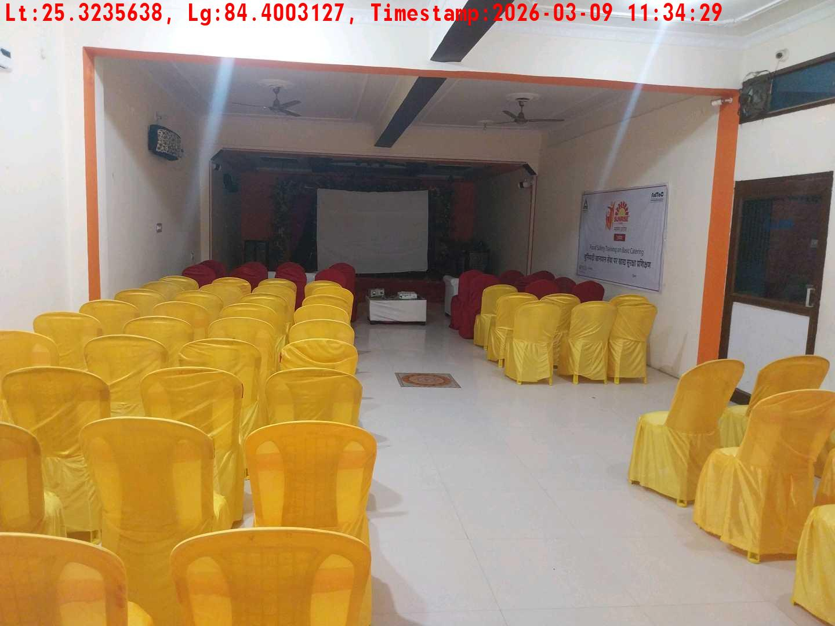
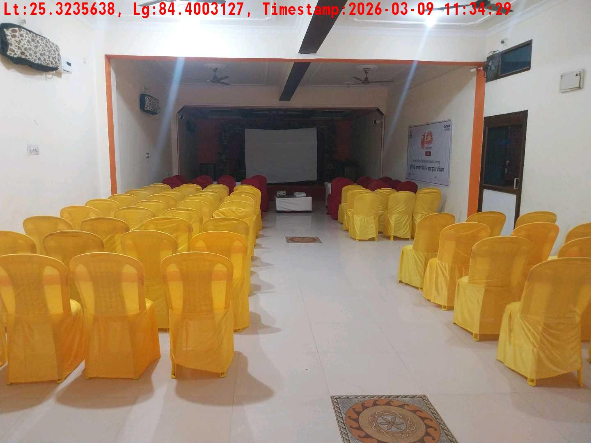
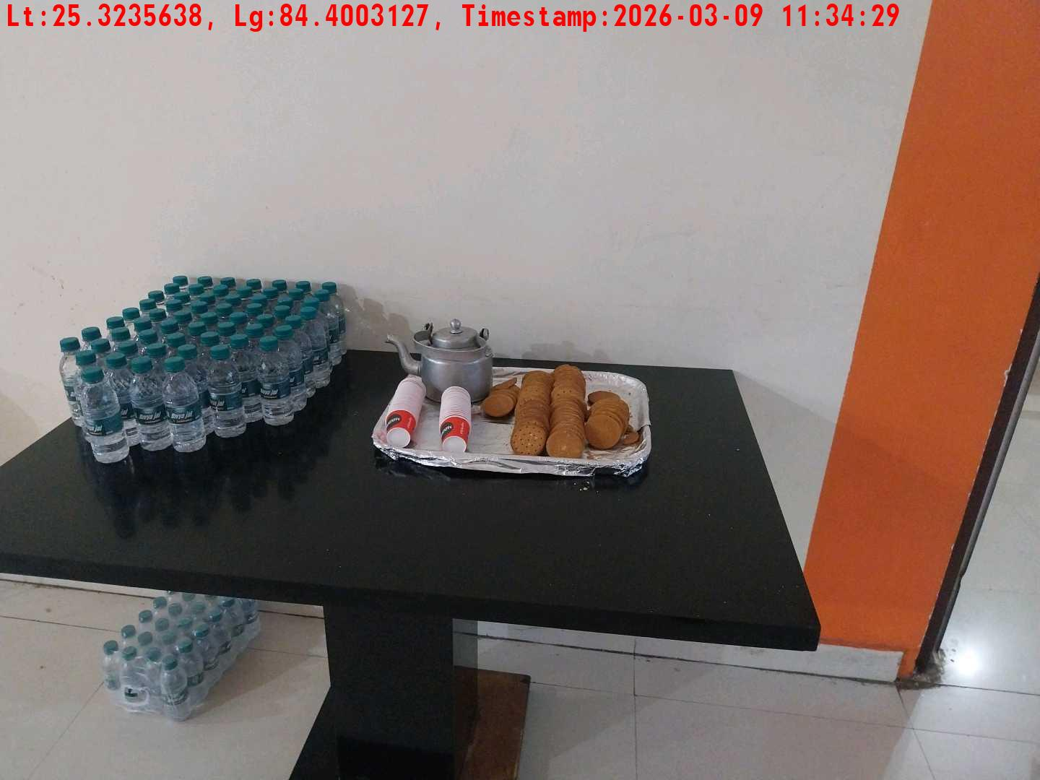
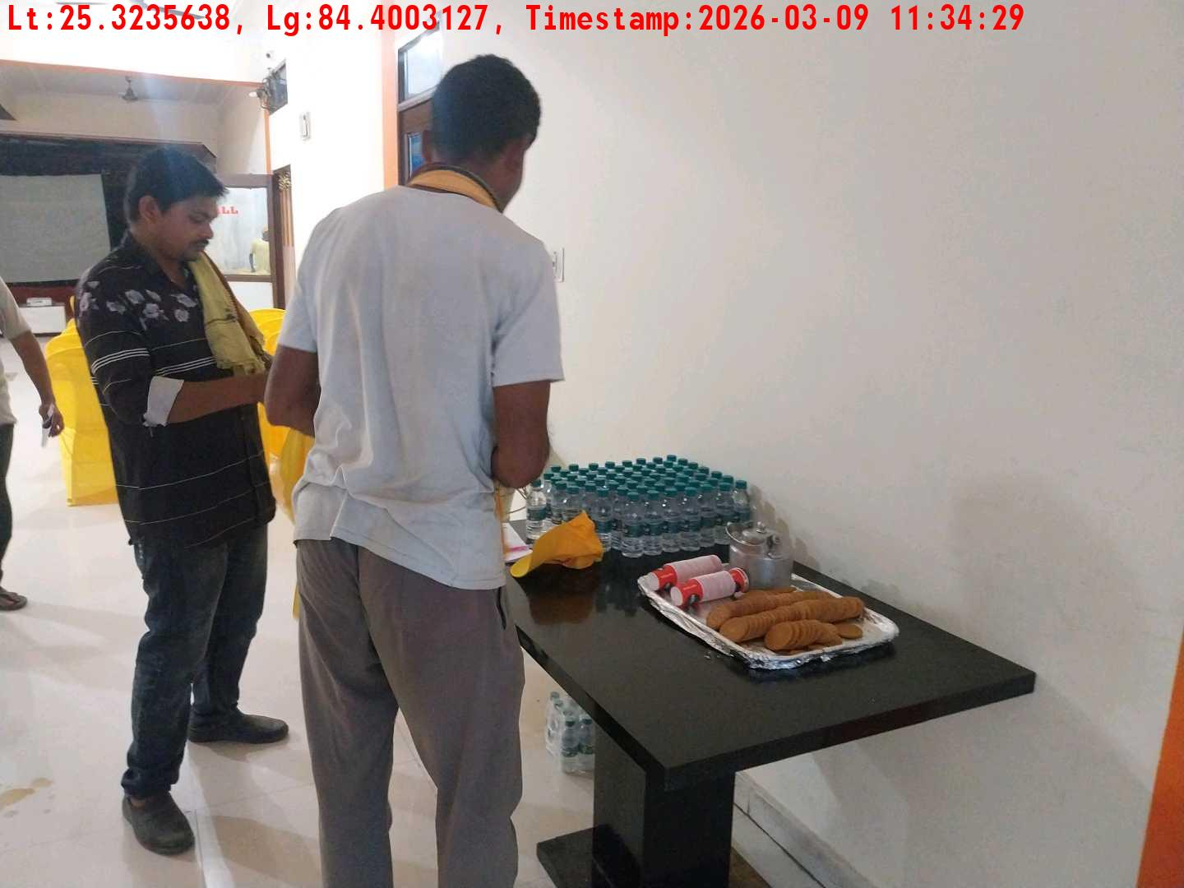
Date | Team | City | Agency | Promoter | Location
09-03-2026 | Bihar-2 | Bihar | Mindshaft | Dipak Singh | Dehri
Long shot picture covering banner
Long shot picture covering table
Tea & coffee arrangement picture
Tea & coffee with crowd

Slide 3
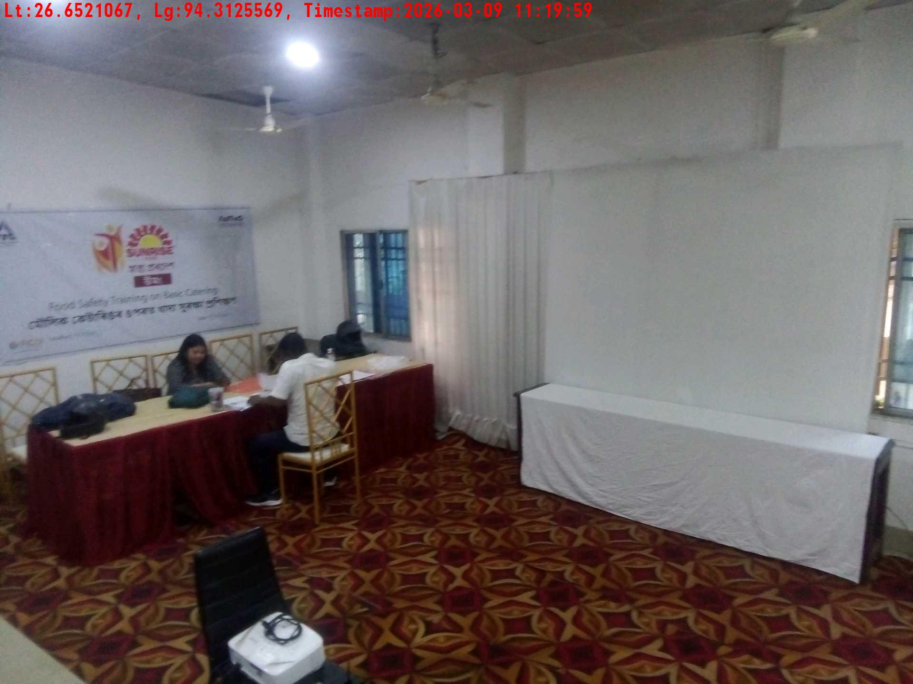
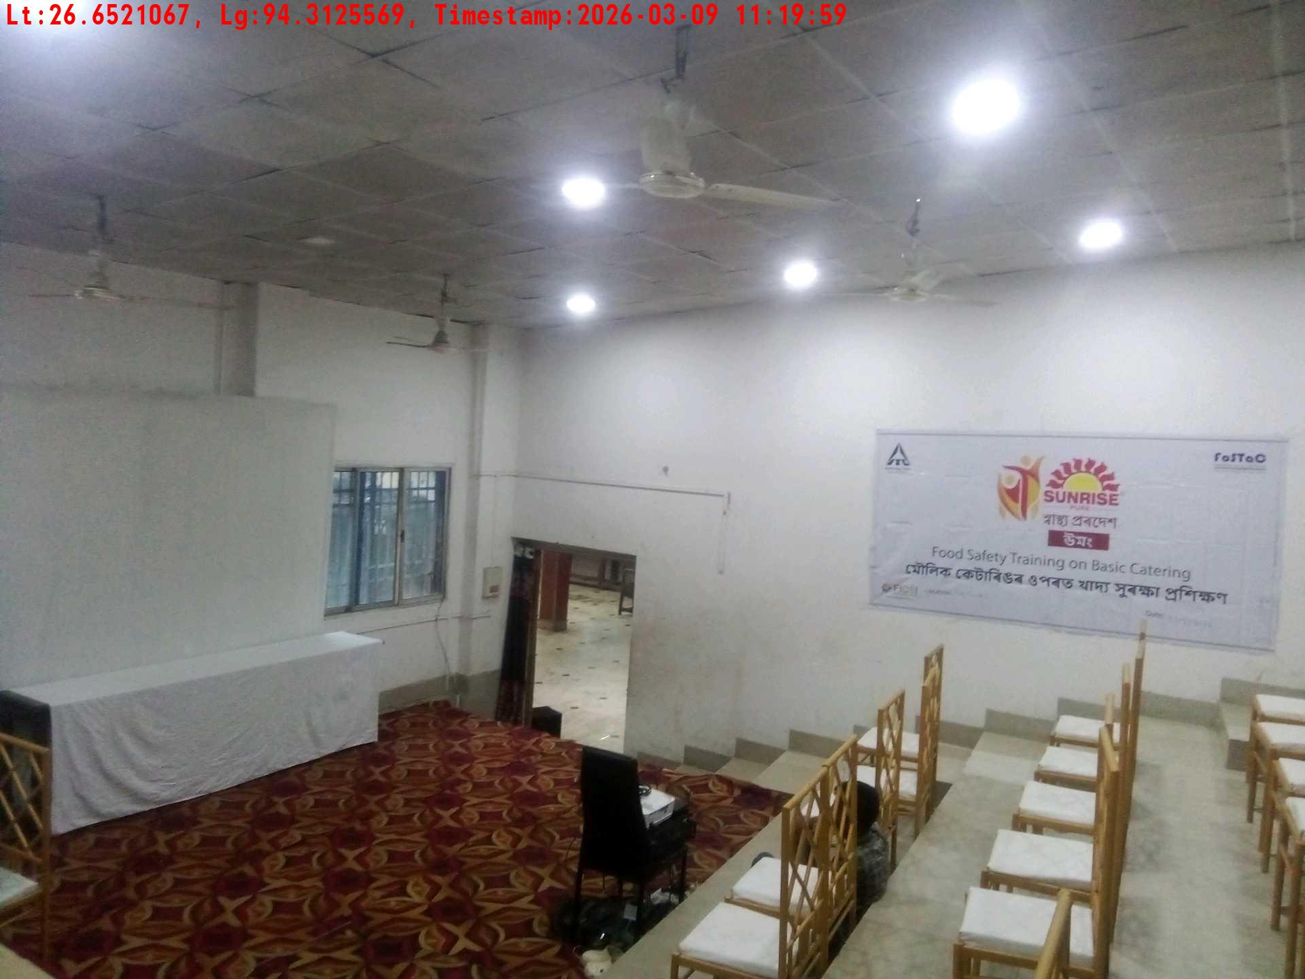
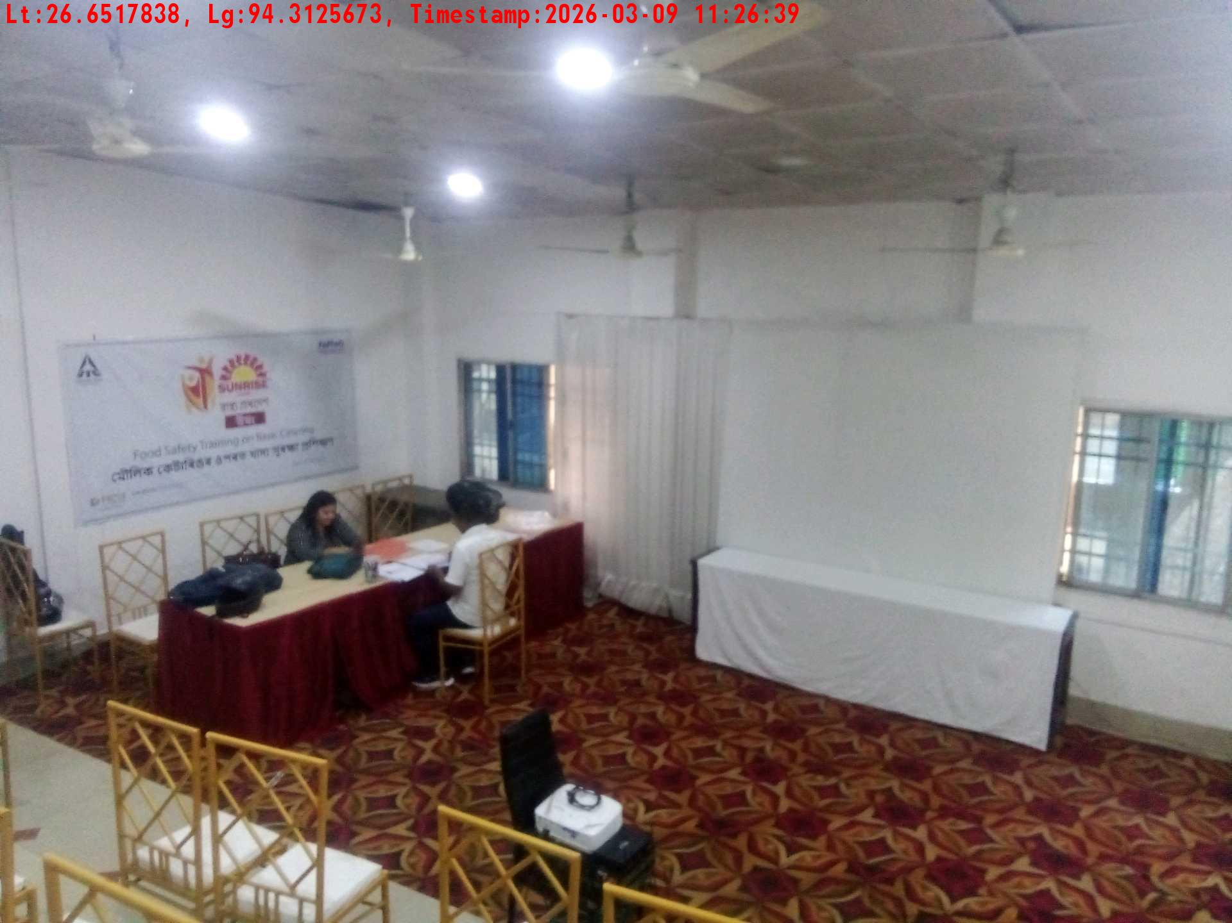
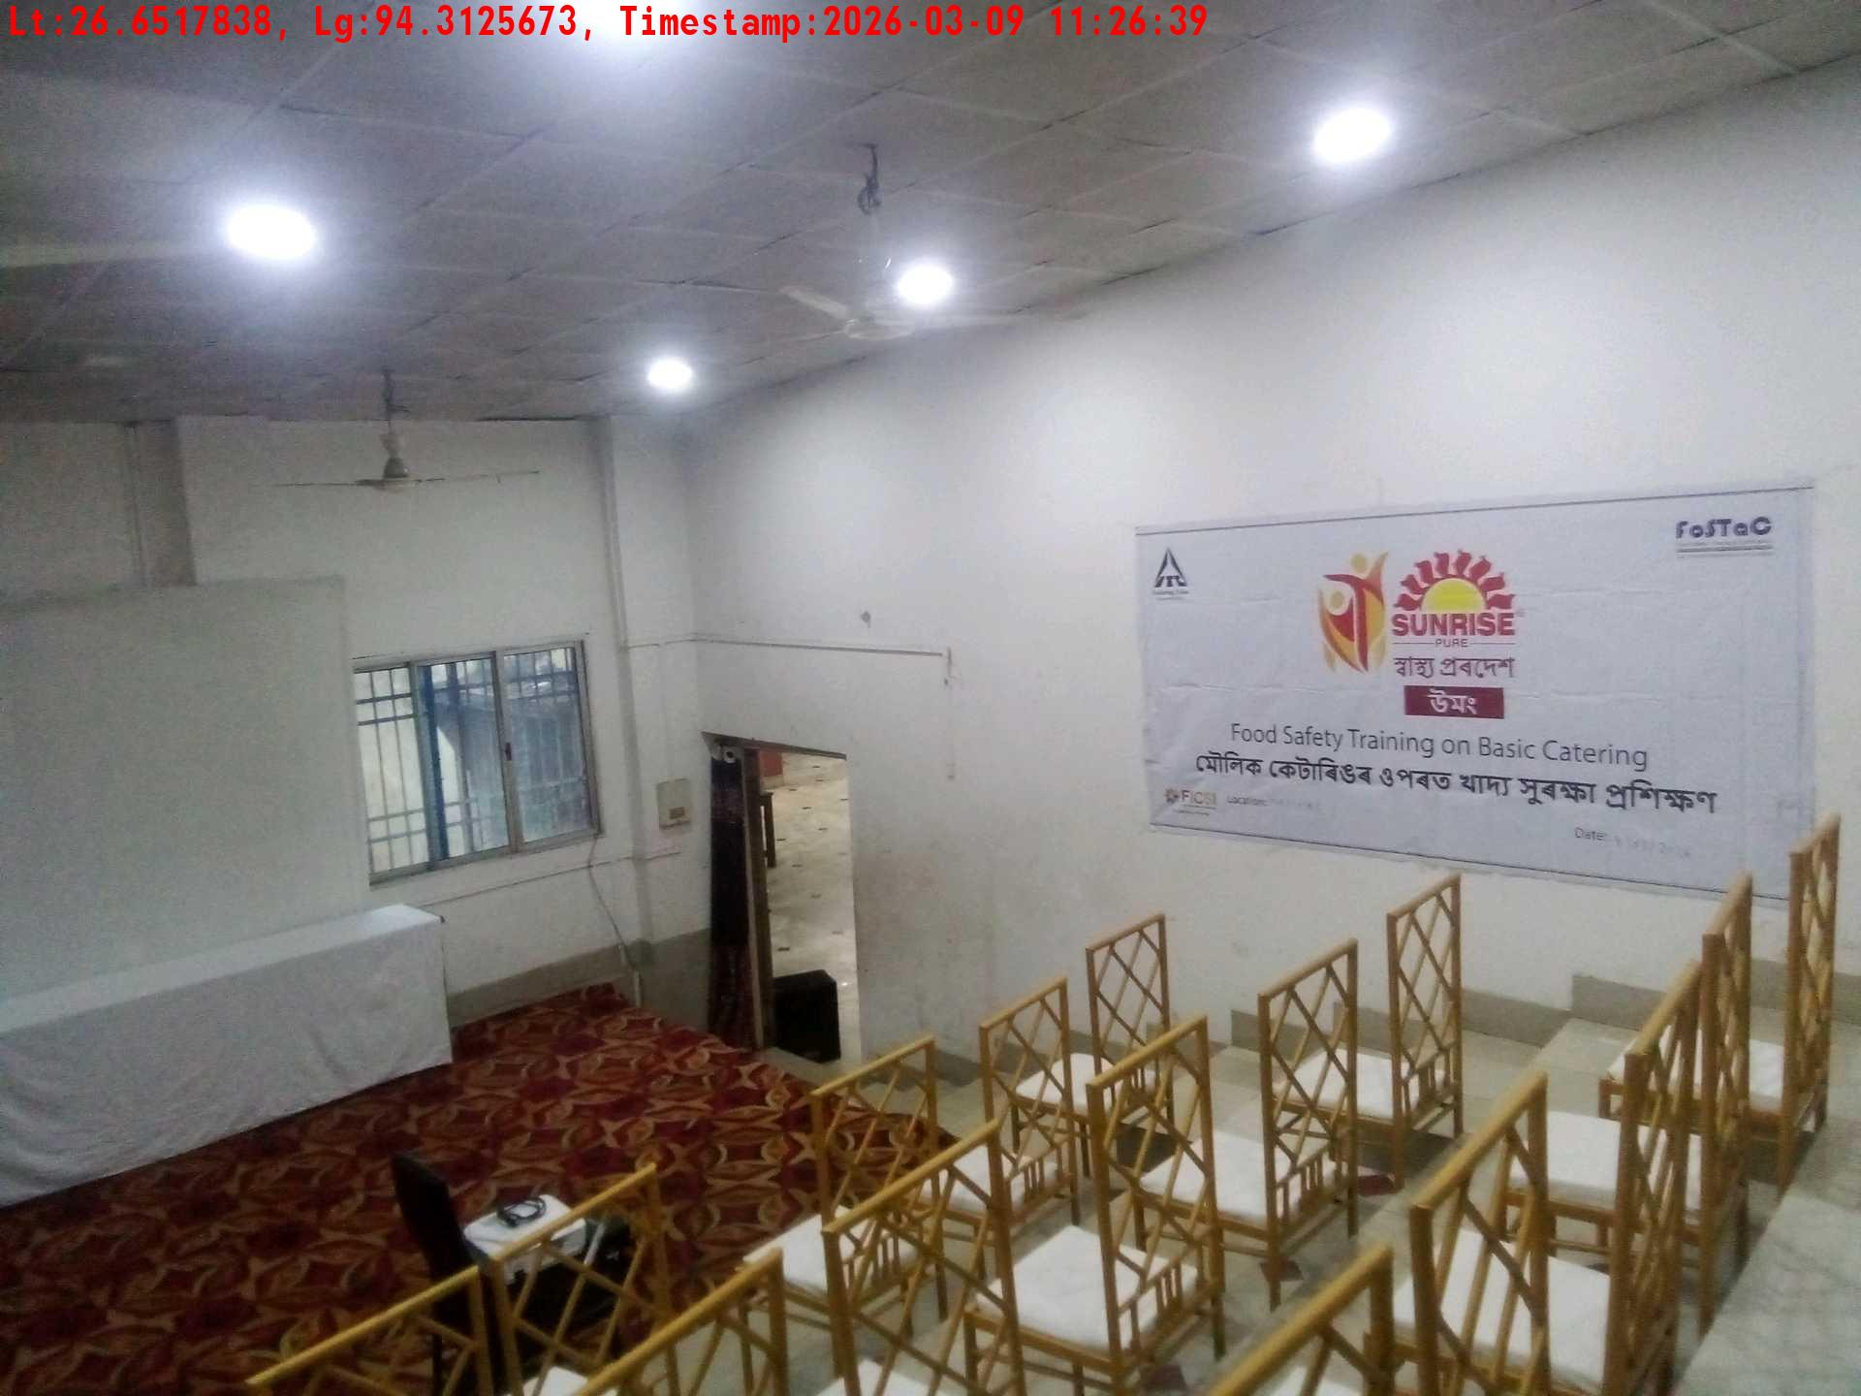
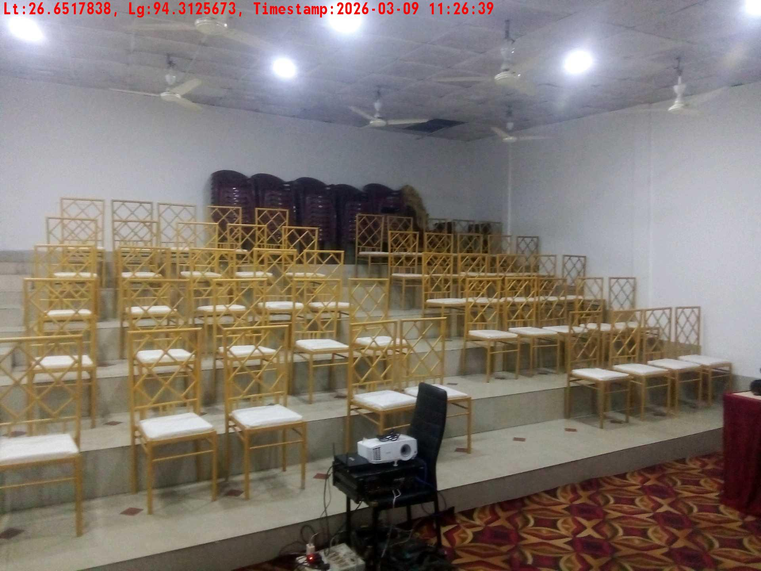
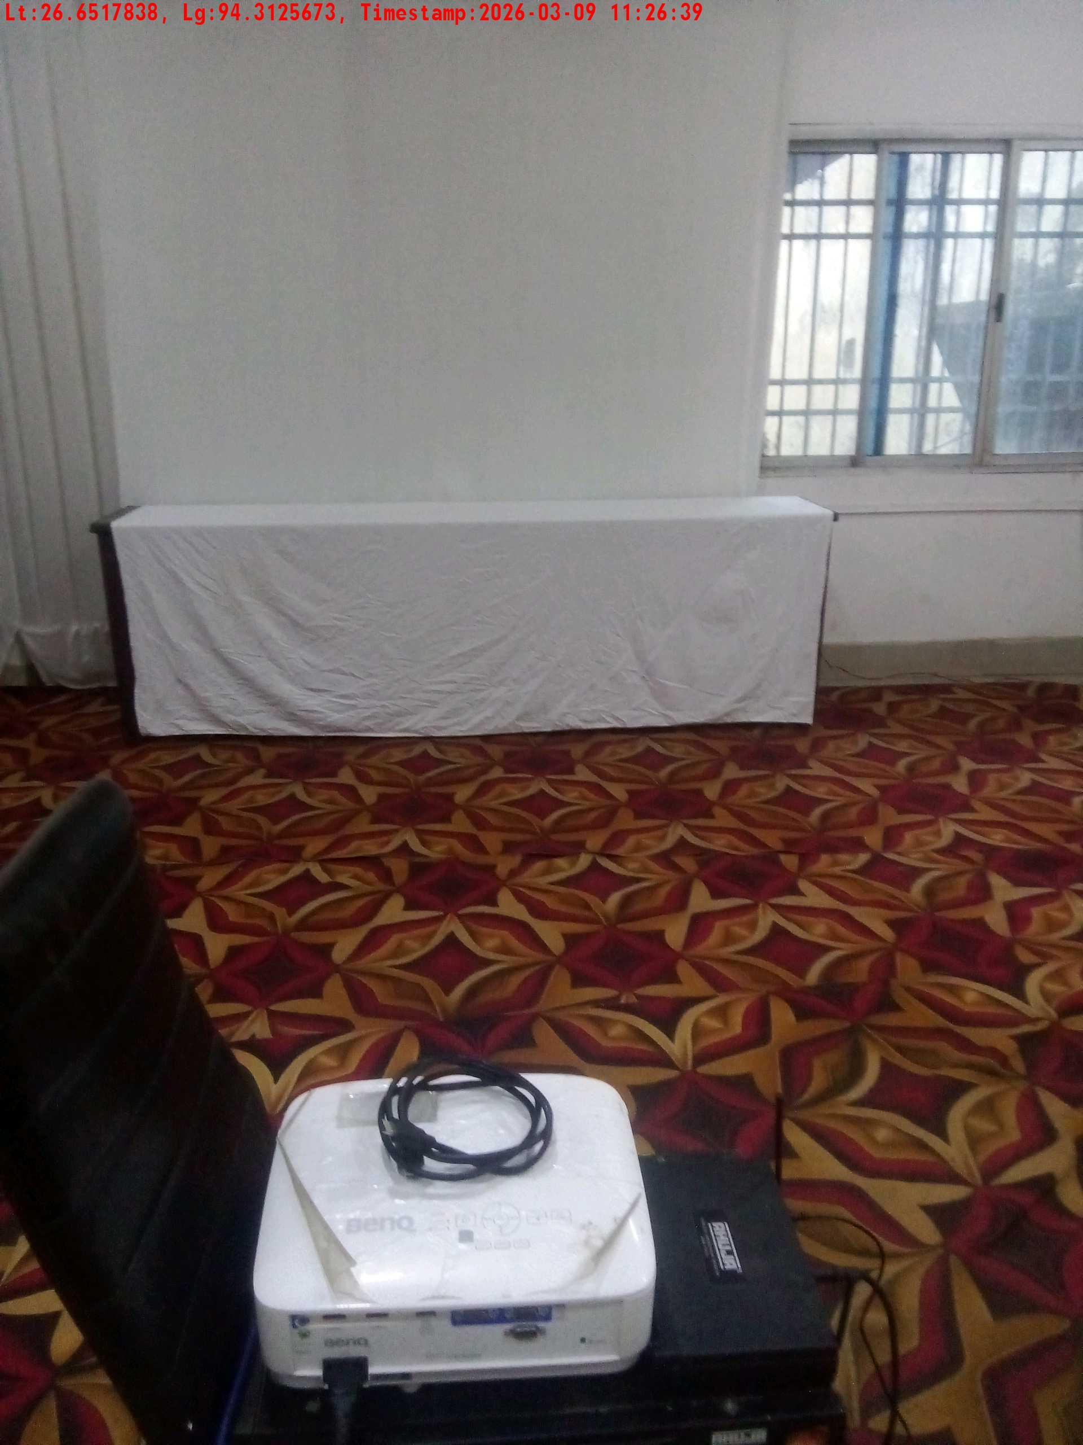
Date | Team | City | Agency | Promoter | Location
09-03-2026 | Assam | Assam | Mindshaft | Manish ray | guwahati
Trainer with presentation picture
Crowd visibility picture
Long shot picture covering banner
Long shot picture covering table
Tea & coffee arrangement picture
Tea & coffee with crowd

Slide 4
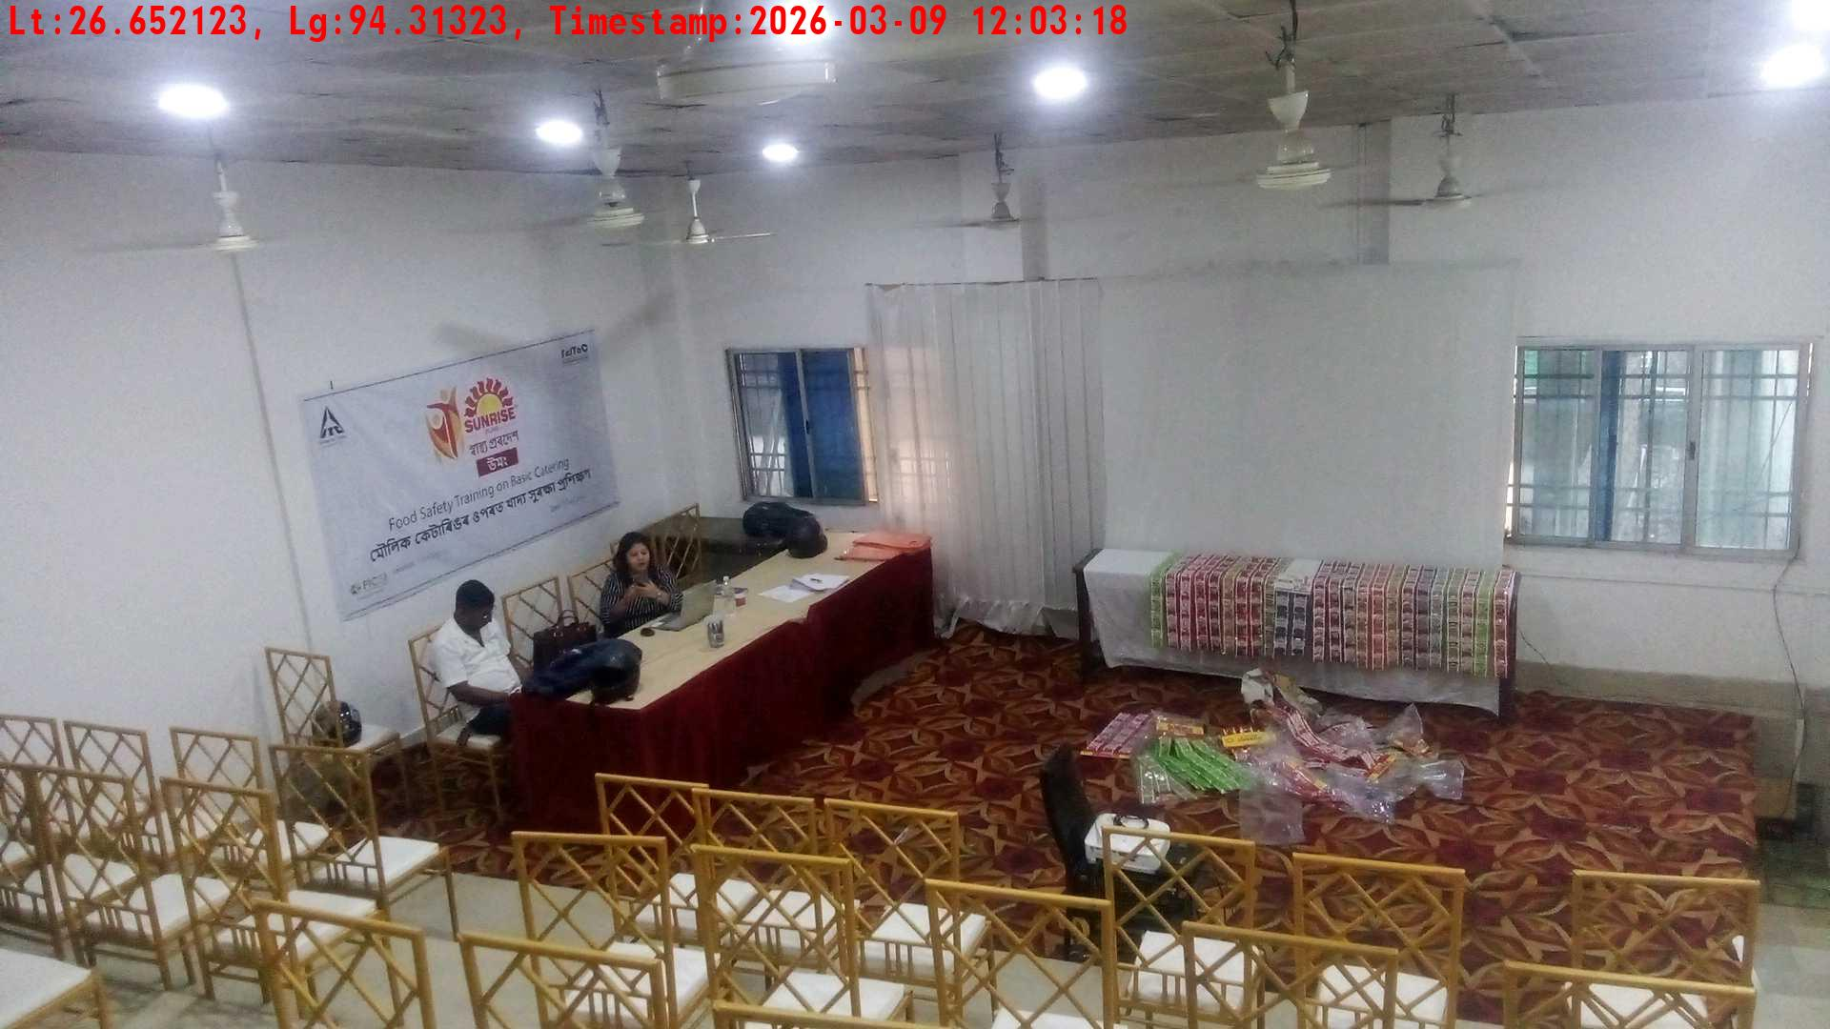
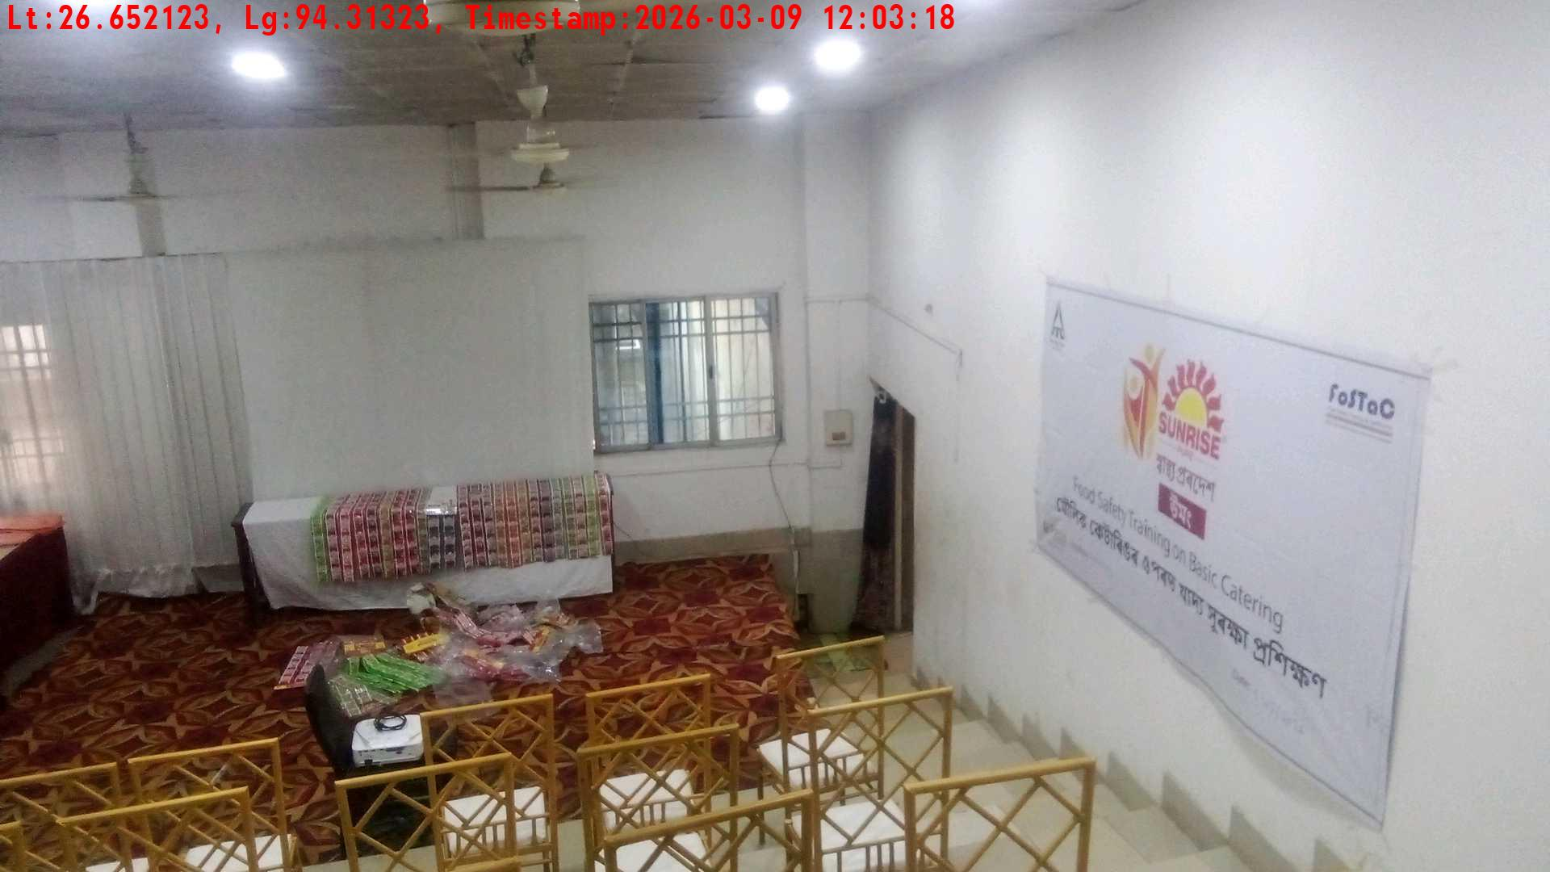
Date | Team | City | Agency | Promoter | Location
09-03-2026 | Assam | Assam | Mindshaft | Manish ray | guwahati
Trainer with presentation picture
Crowd visibility picture

Slide 5
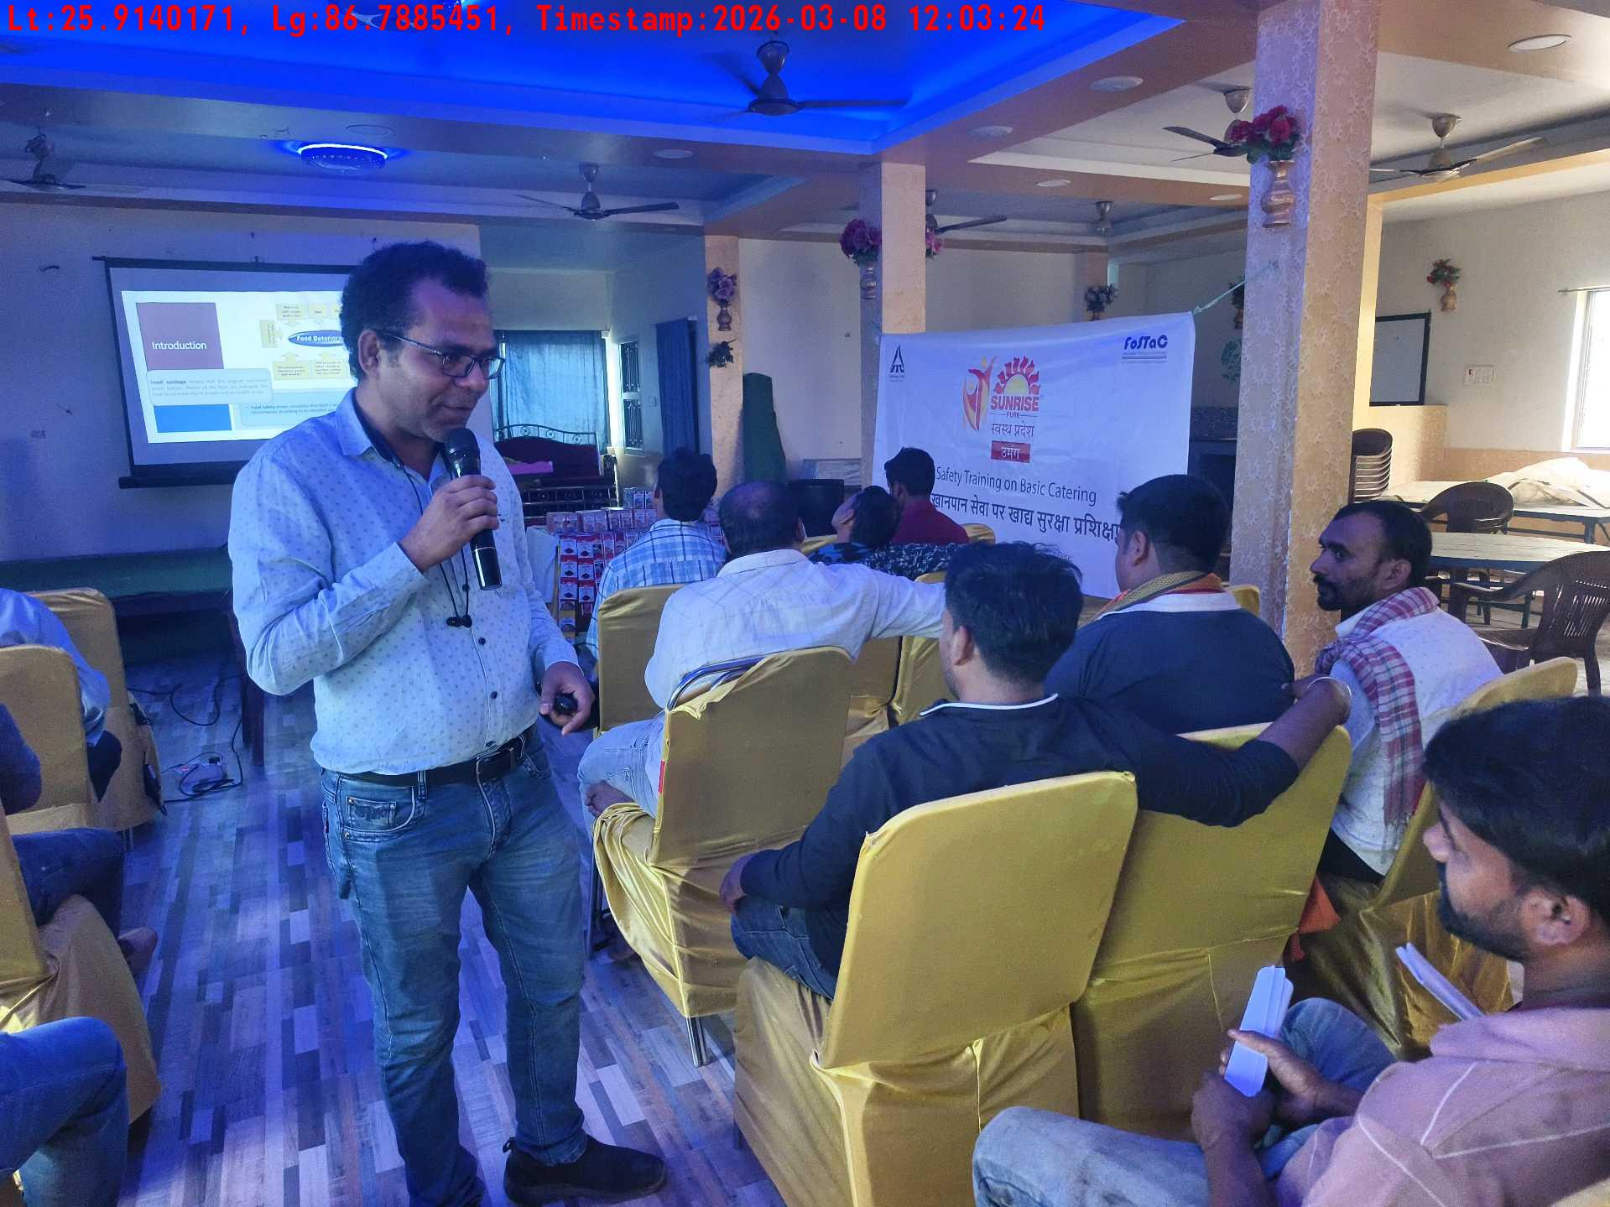
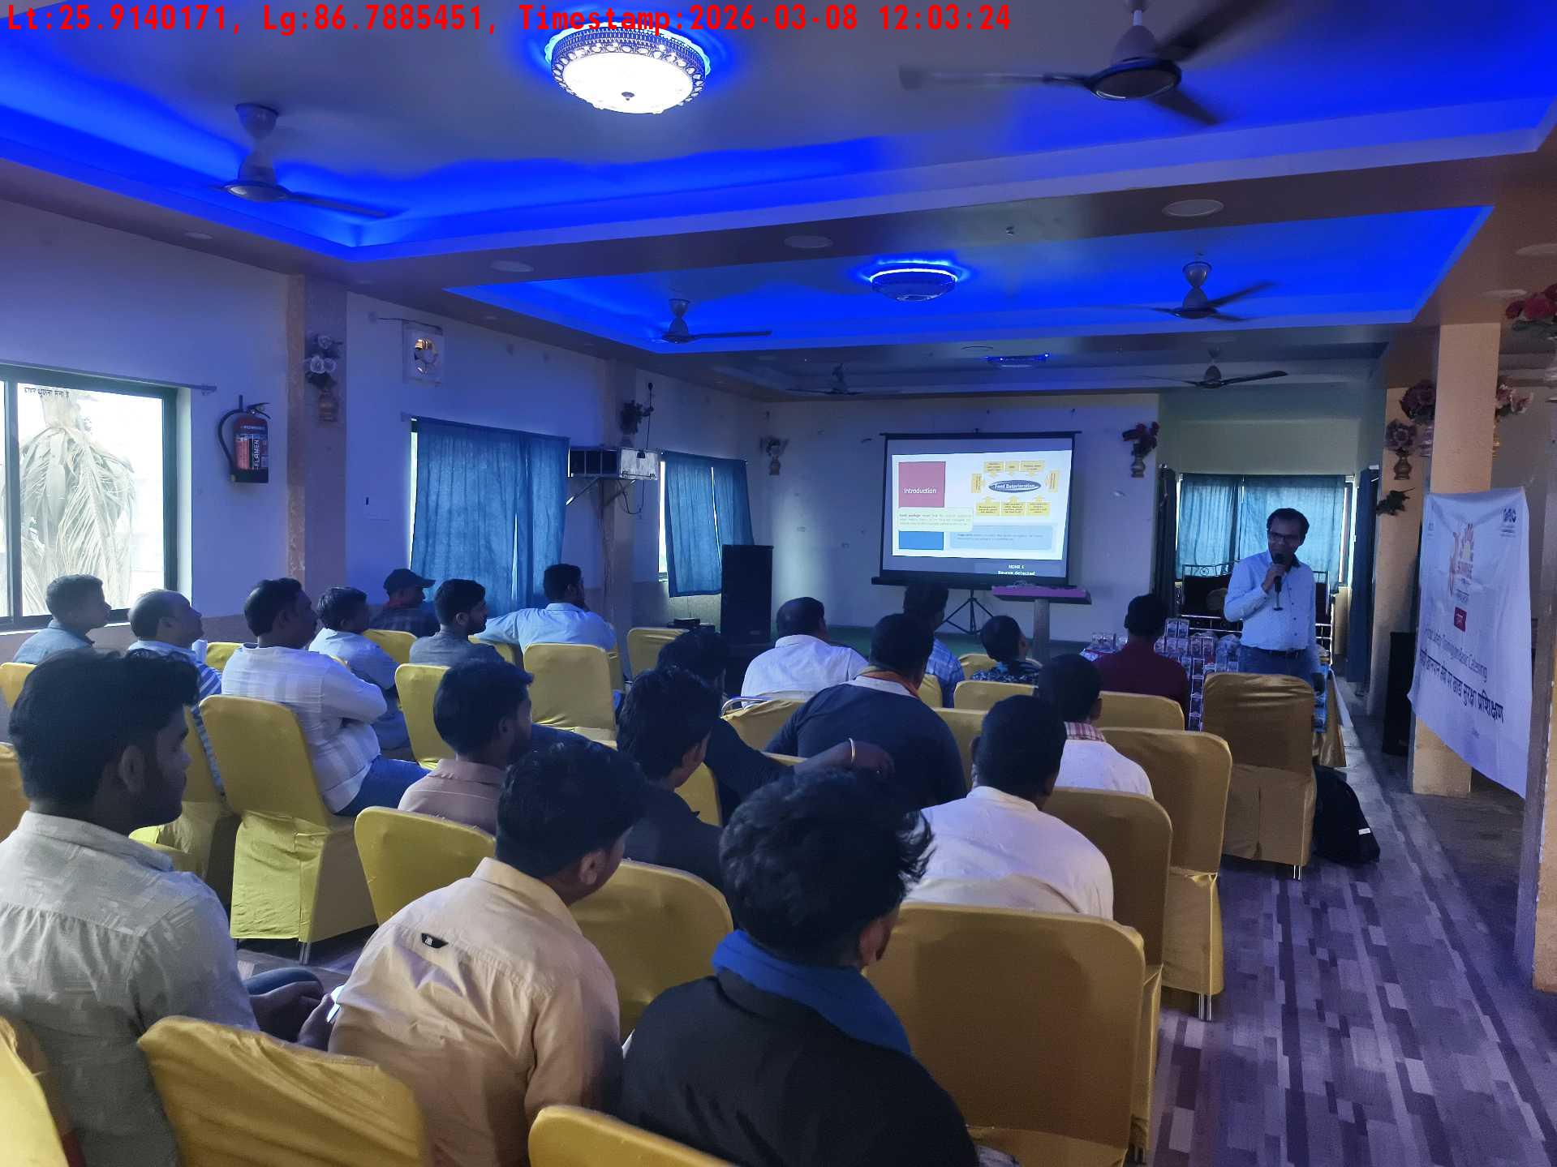
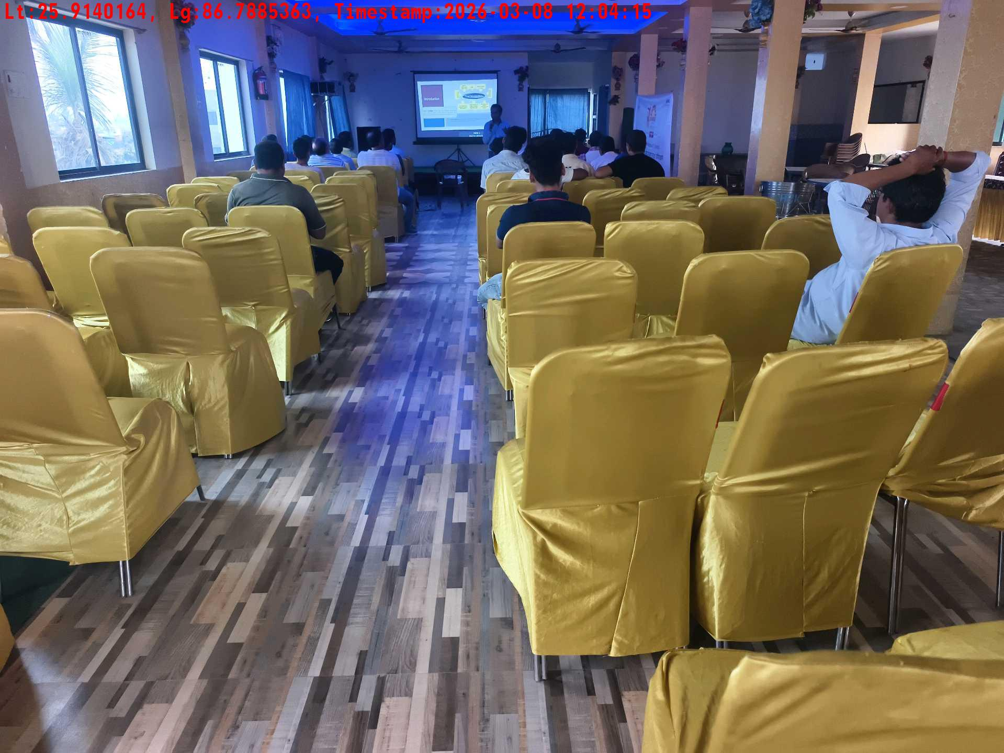
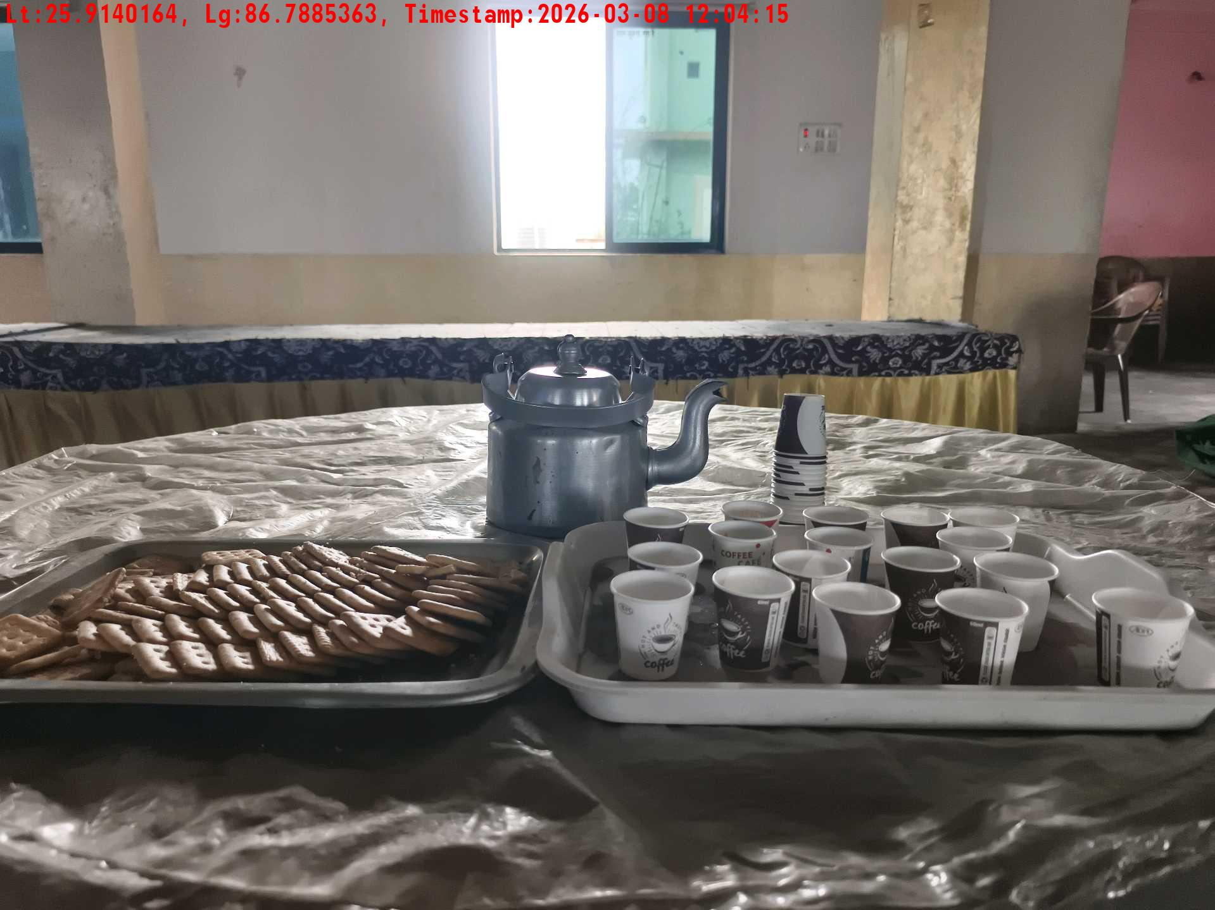
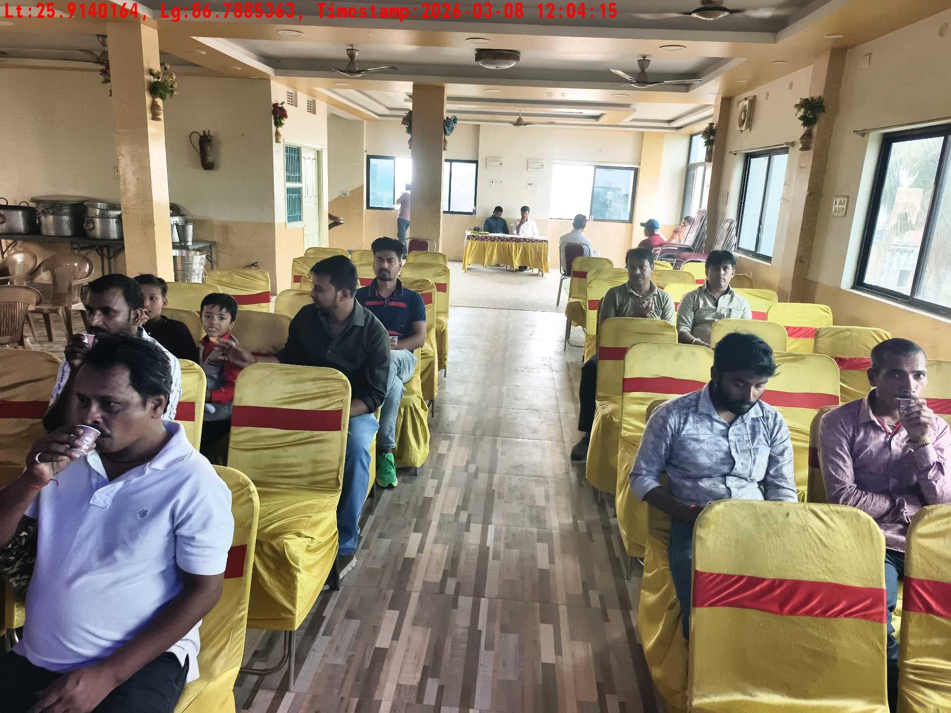
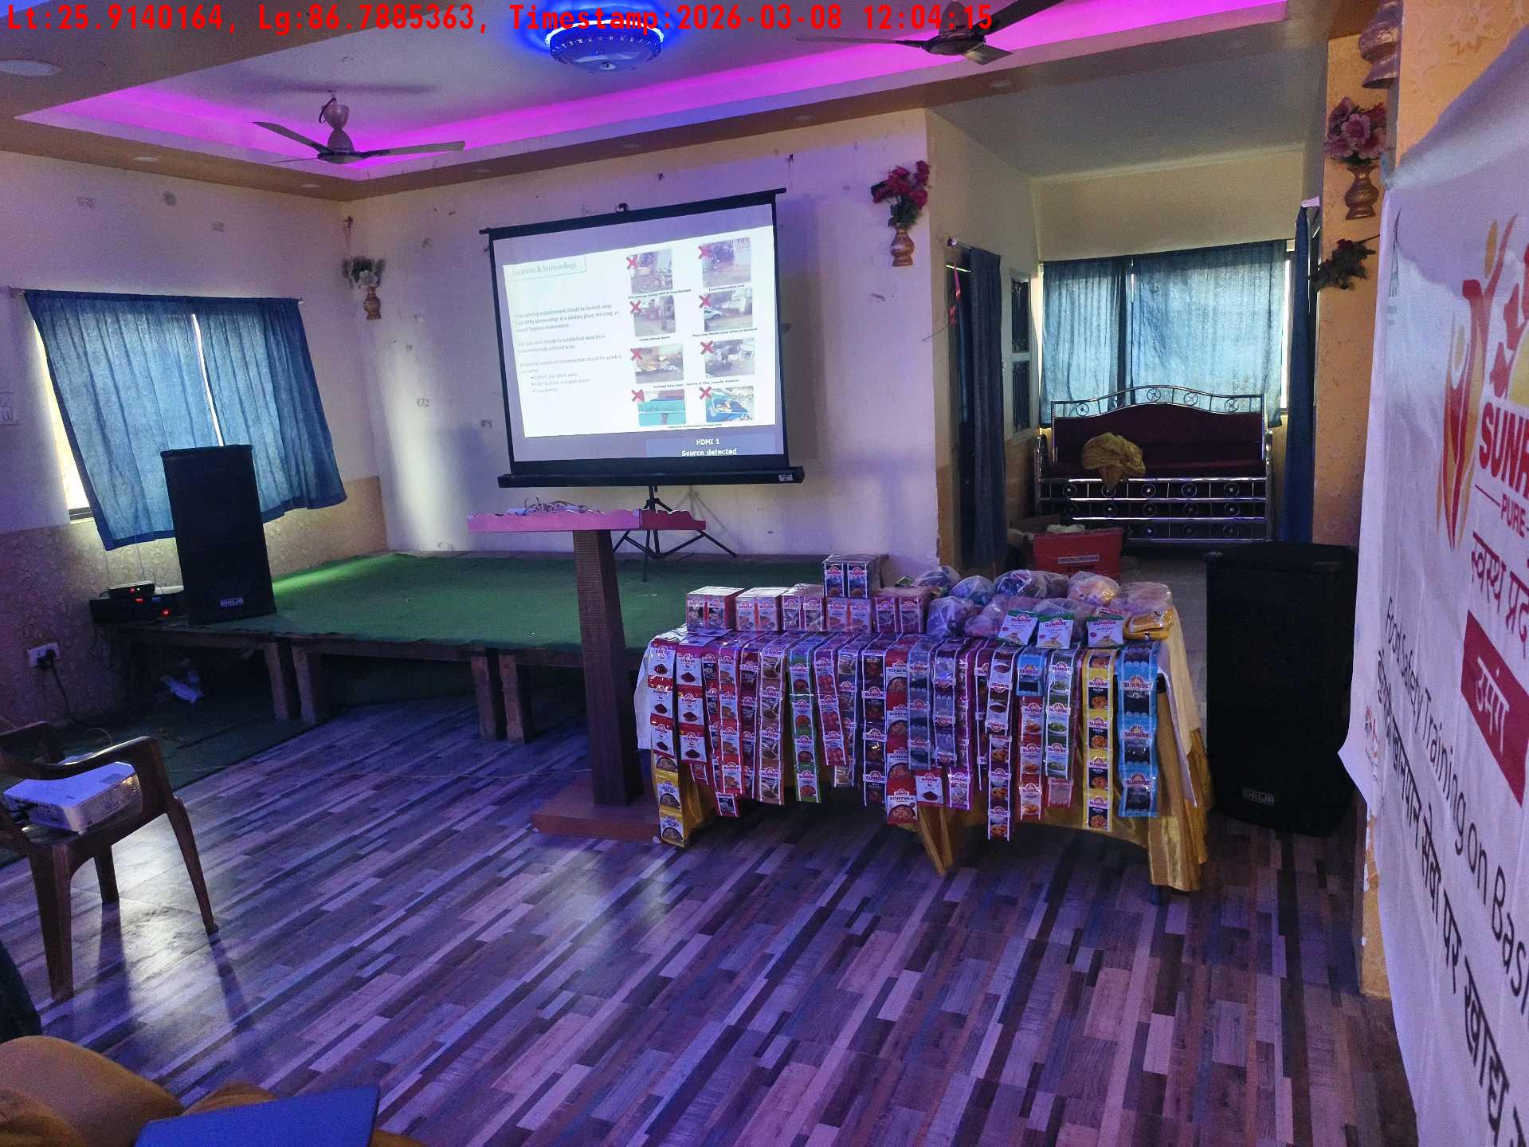
Date | Team | City | Agency | Promoter | Location
08-03-2026 | Bihar-1 | Bihar | Mindshaft | twinkle | Katihar
Trainer with presentation picture
Crowd visibility picture
Long shot picture covering table
Tea & coffee arrangement picture
Tea & coffee with crowd
Long shot picture covering banner

Slide 6
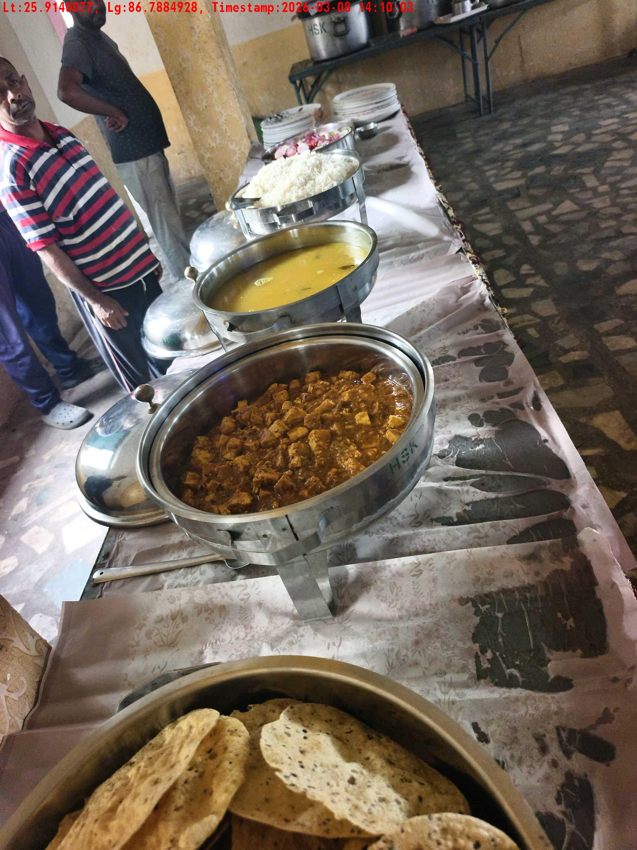
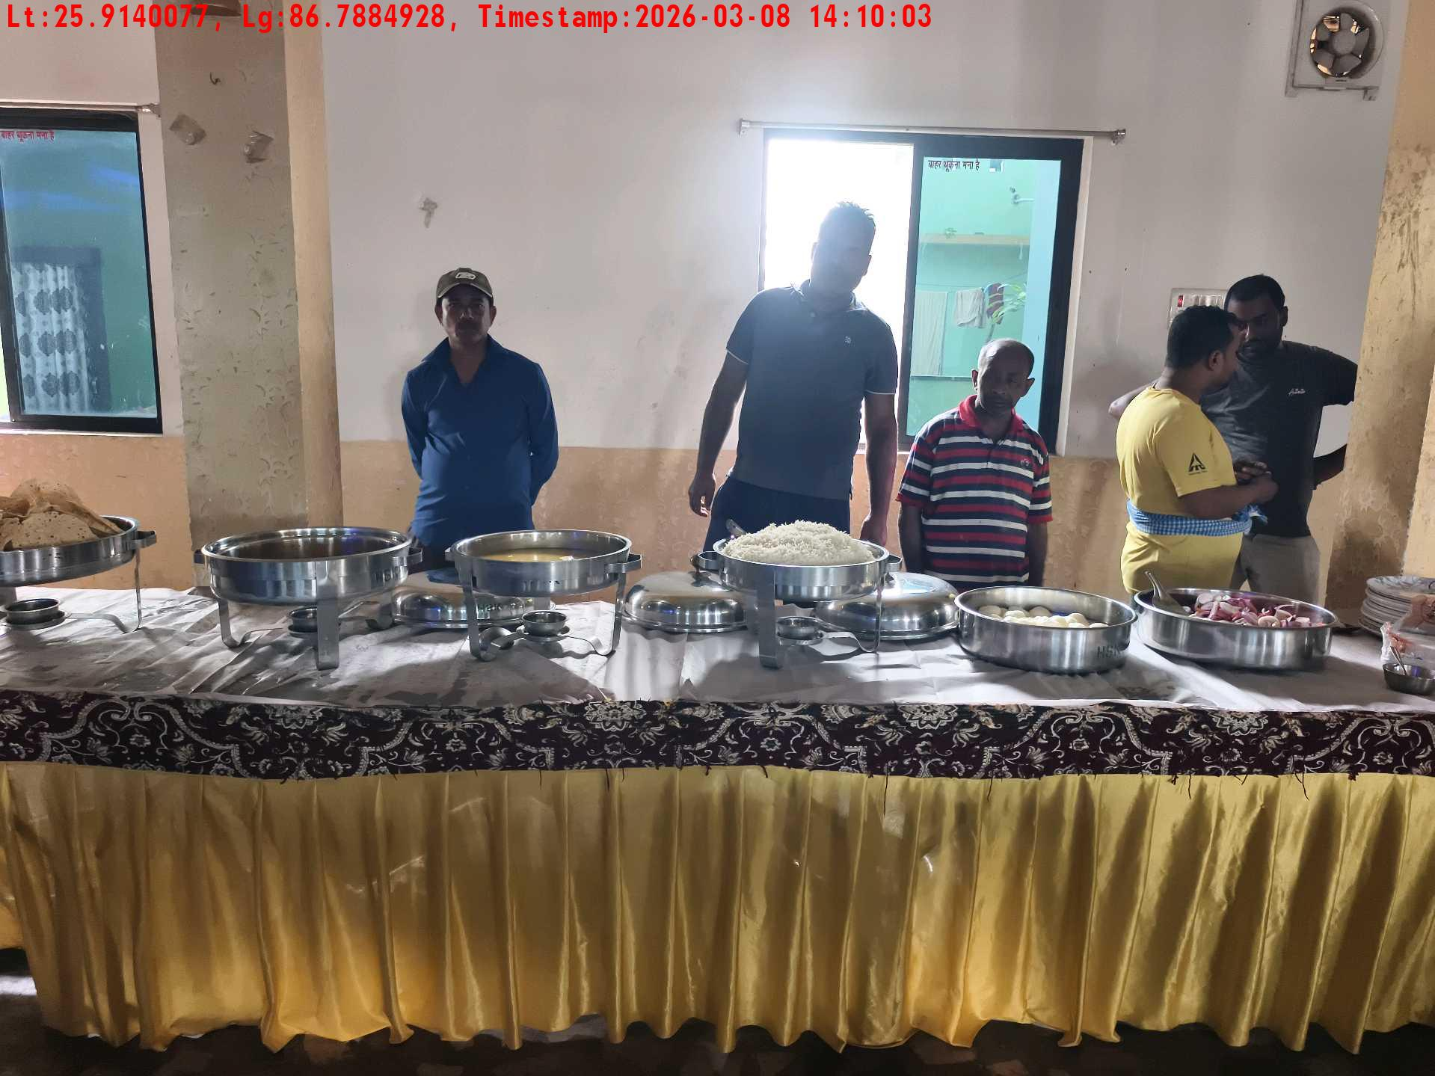
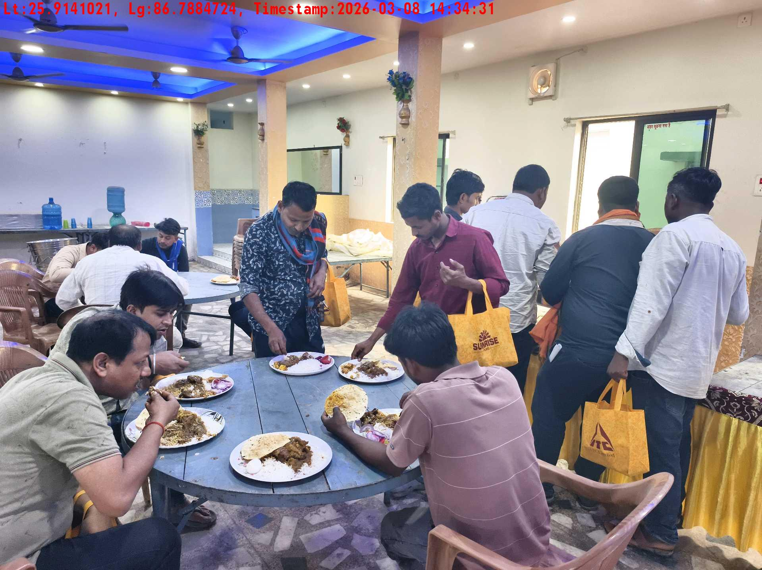
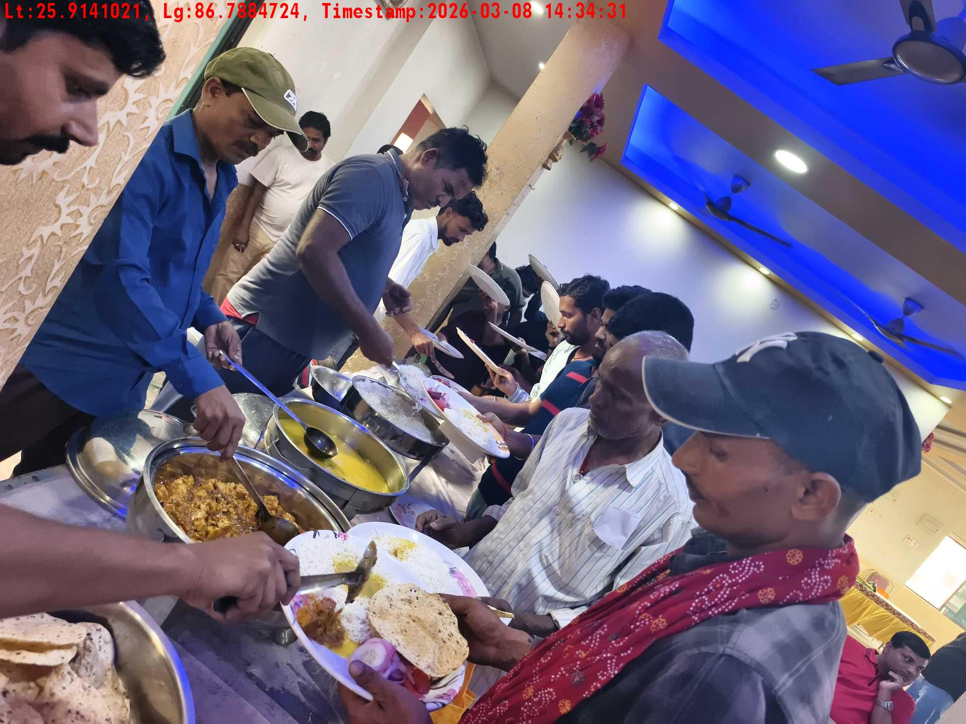
Date | Team | City | Agency | Promoter | Location
08-03-2026 | Bihar-1 | Bihar | Mindshaft | twinkle | Katihar
Lunch setup picture-1
Lunch setup picture-2
Lunch eating pictures-2
Lunch eating pictures-1

Slide 7
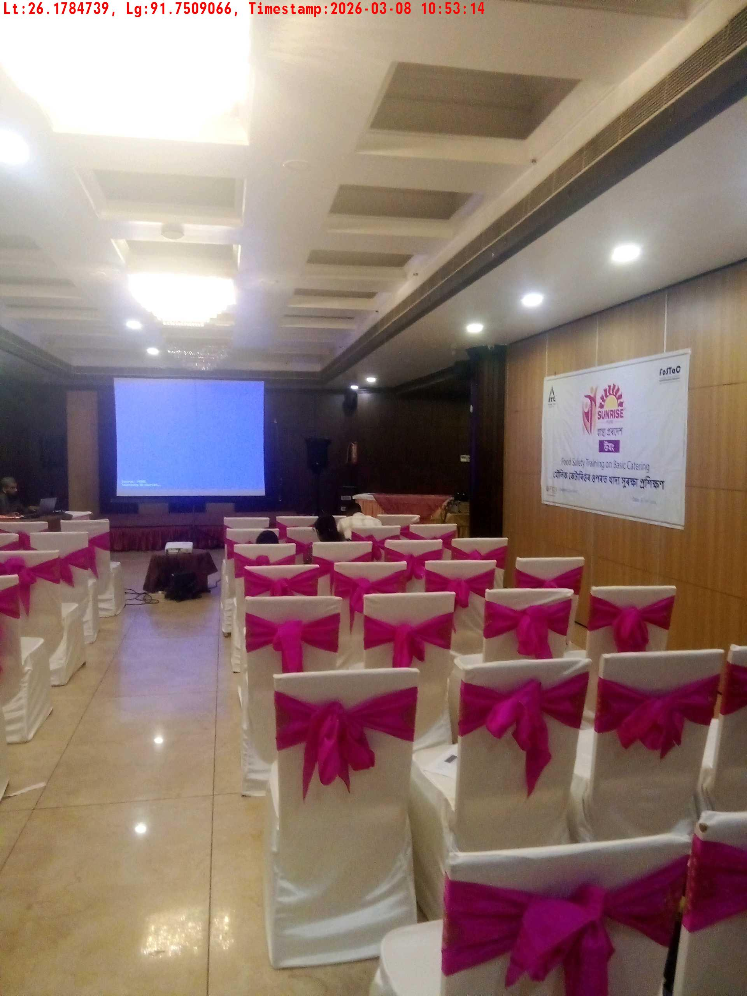
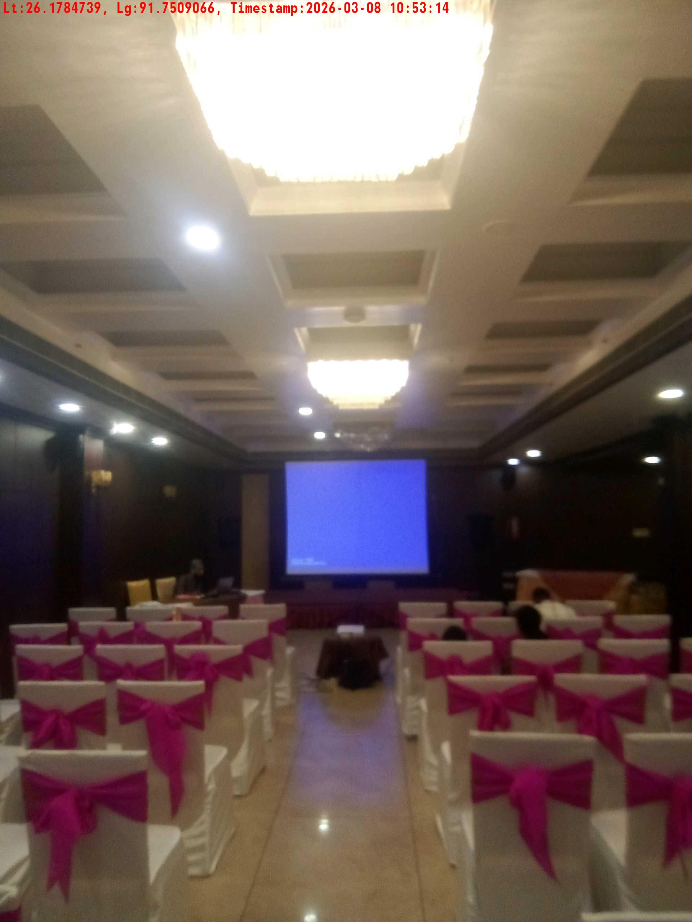
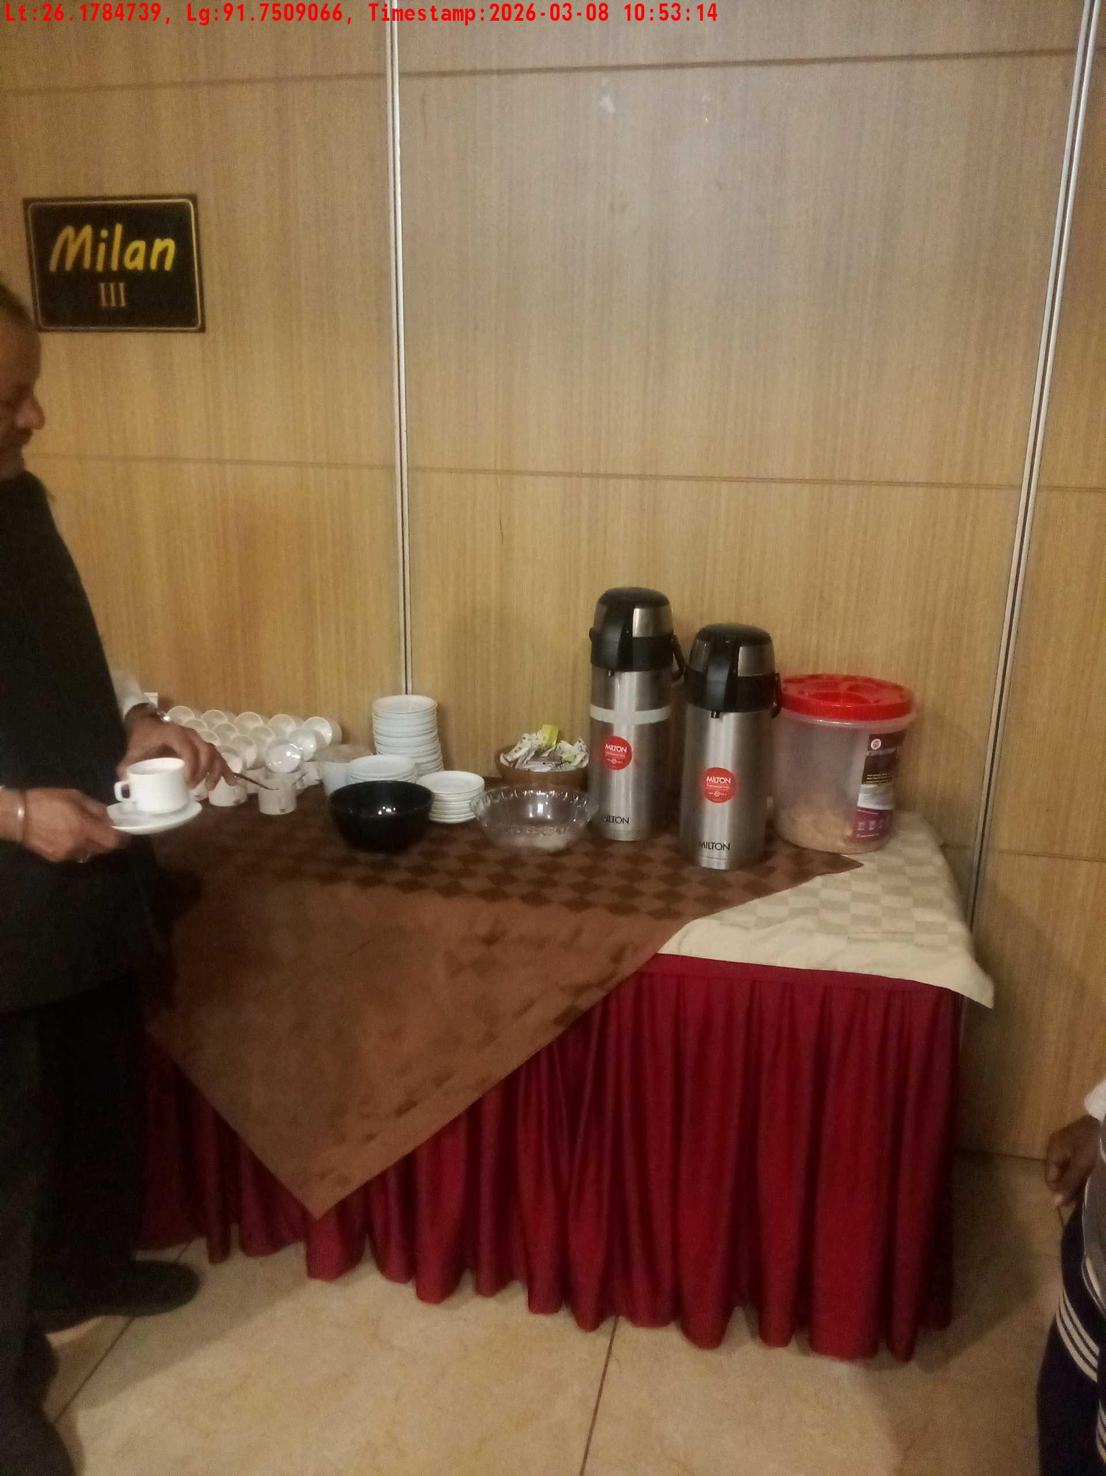
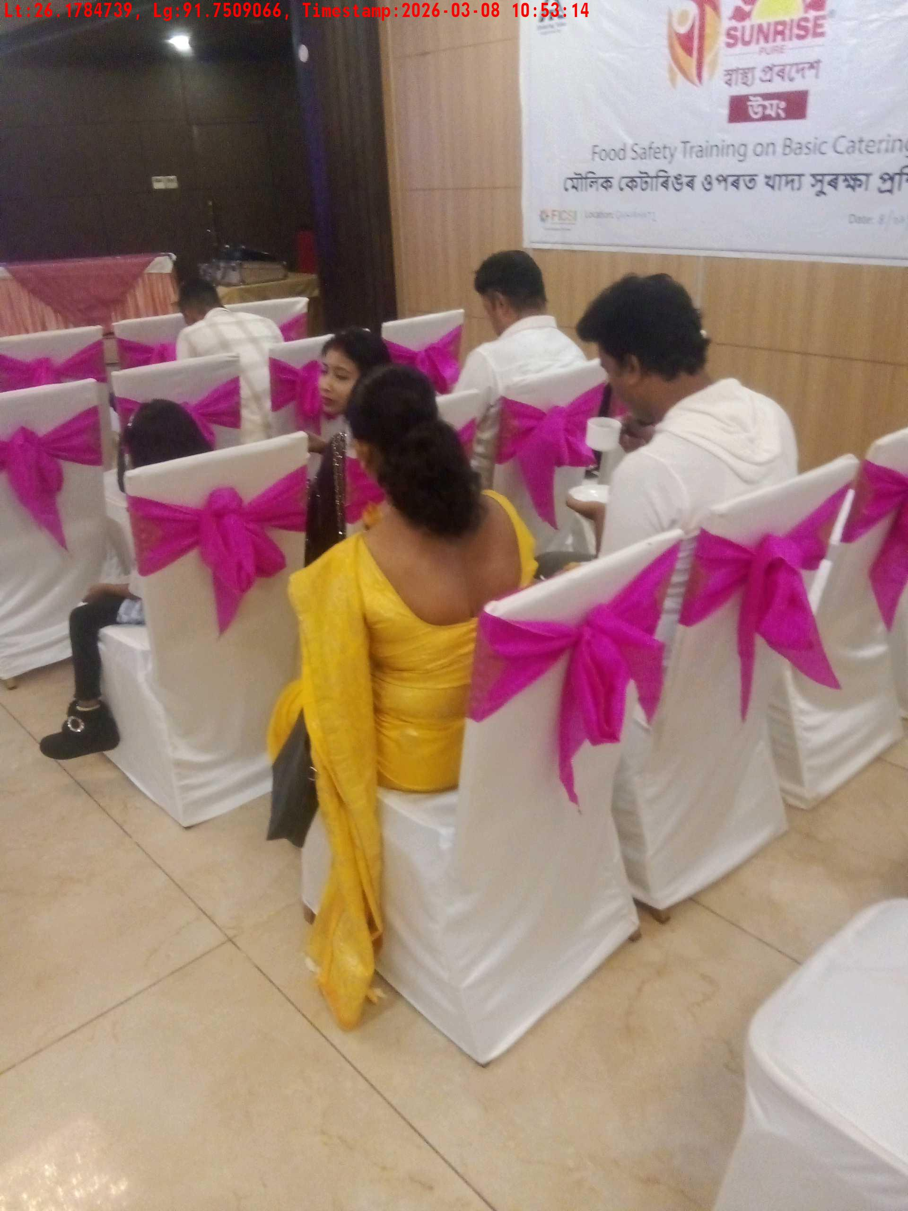
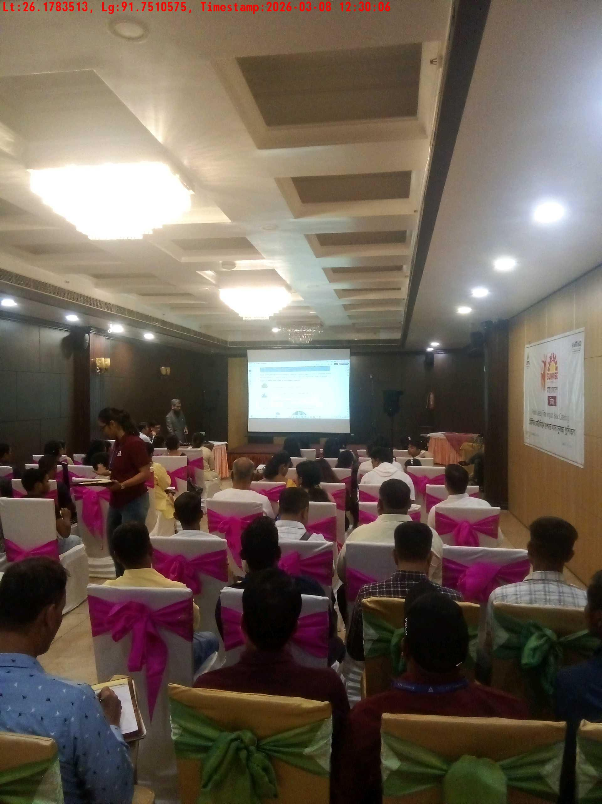
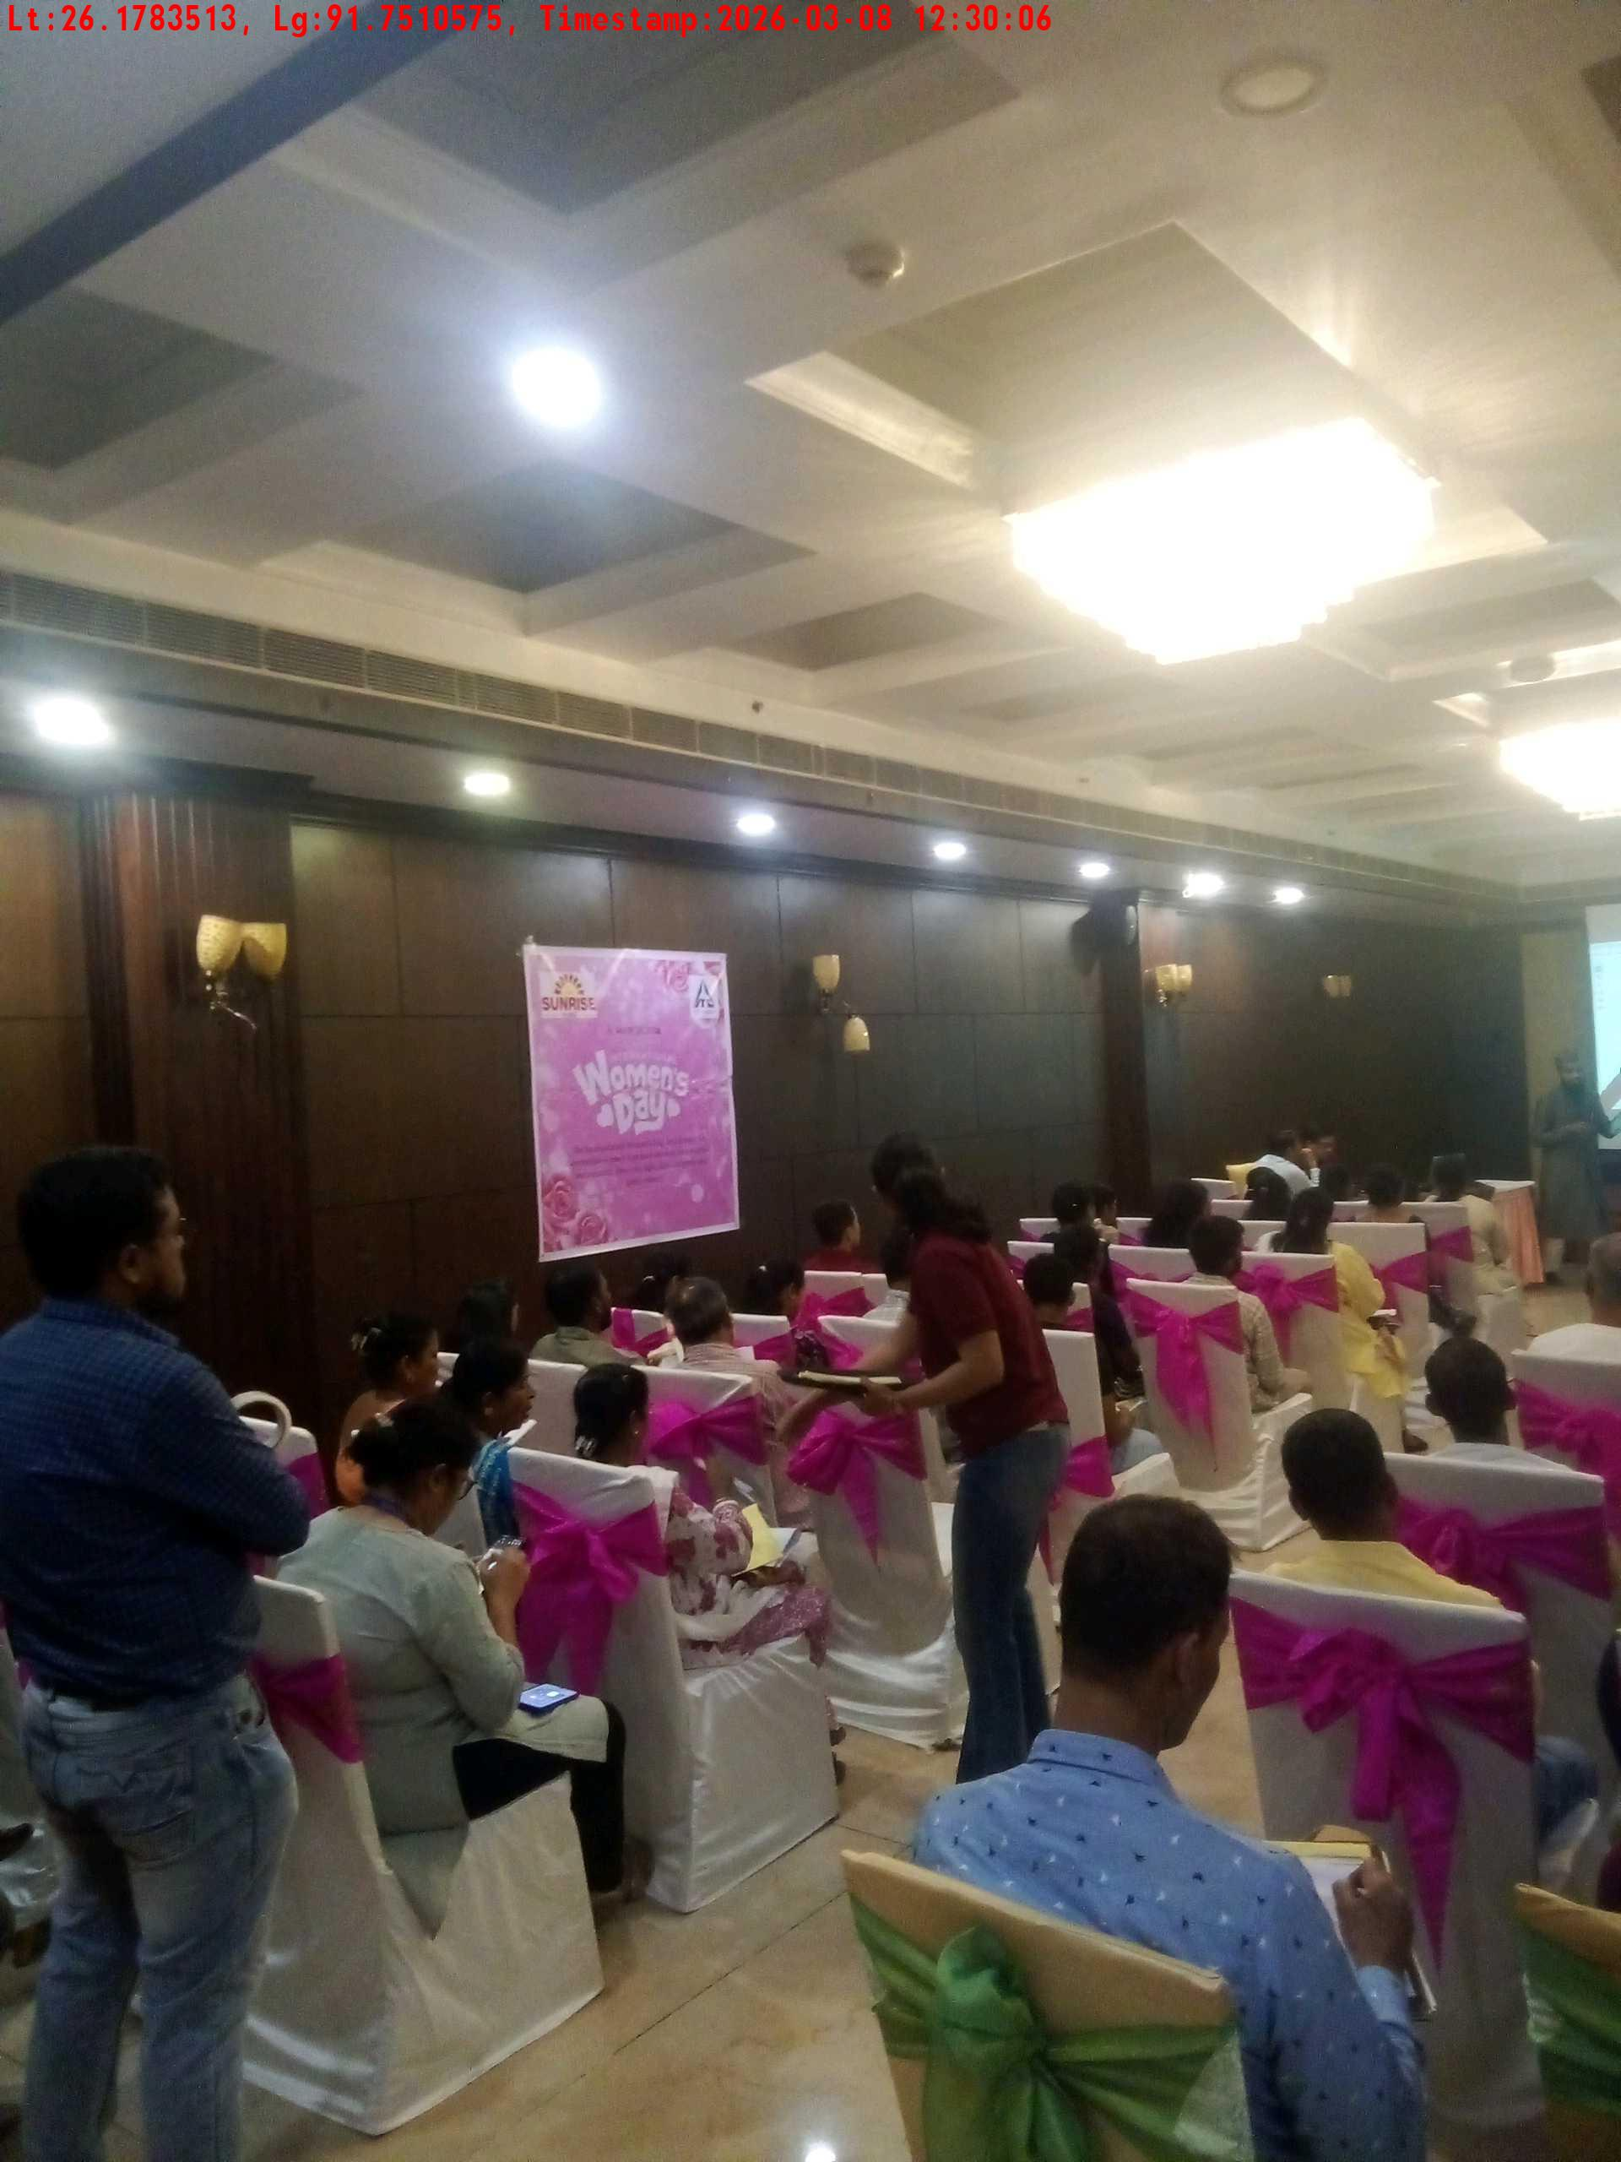
Date | Team | City | Agency | Promoter | Location
08-03-2026 | Assam | Assam | Mindshaft | Manish ray | guwahati
Long shot picture covering banner
Long shot picture covering table
Tea & coffee arrangement picture
Tea & coffee with crowd
Trainer with presentation picture
Crowd visibility picture

Slide 8
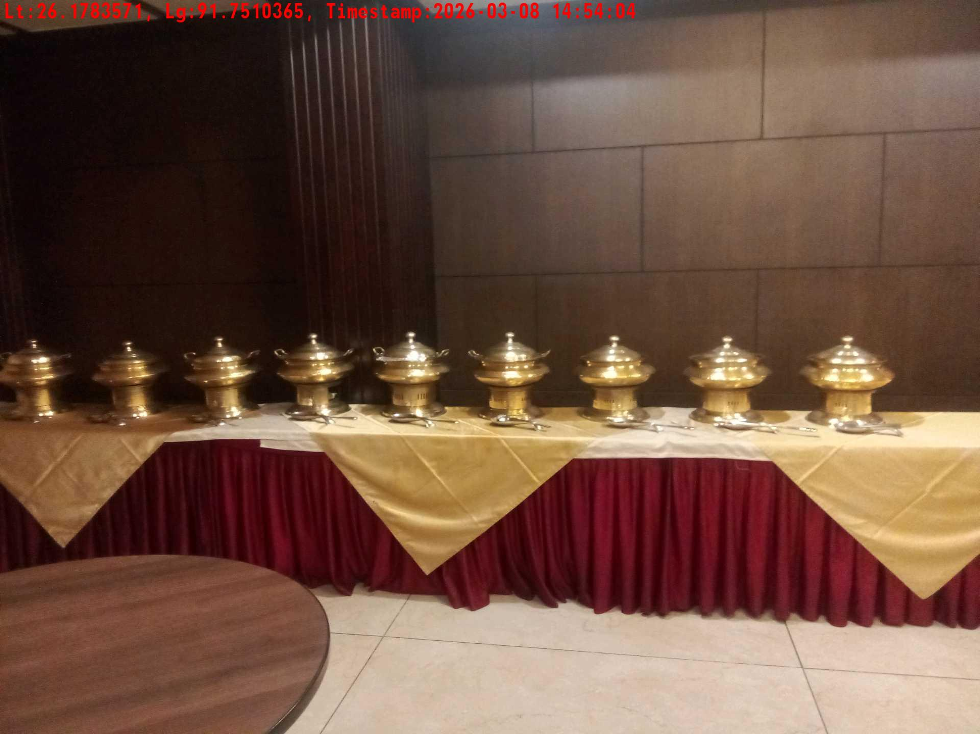
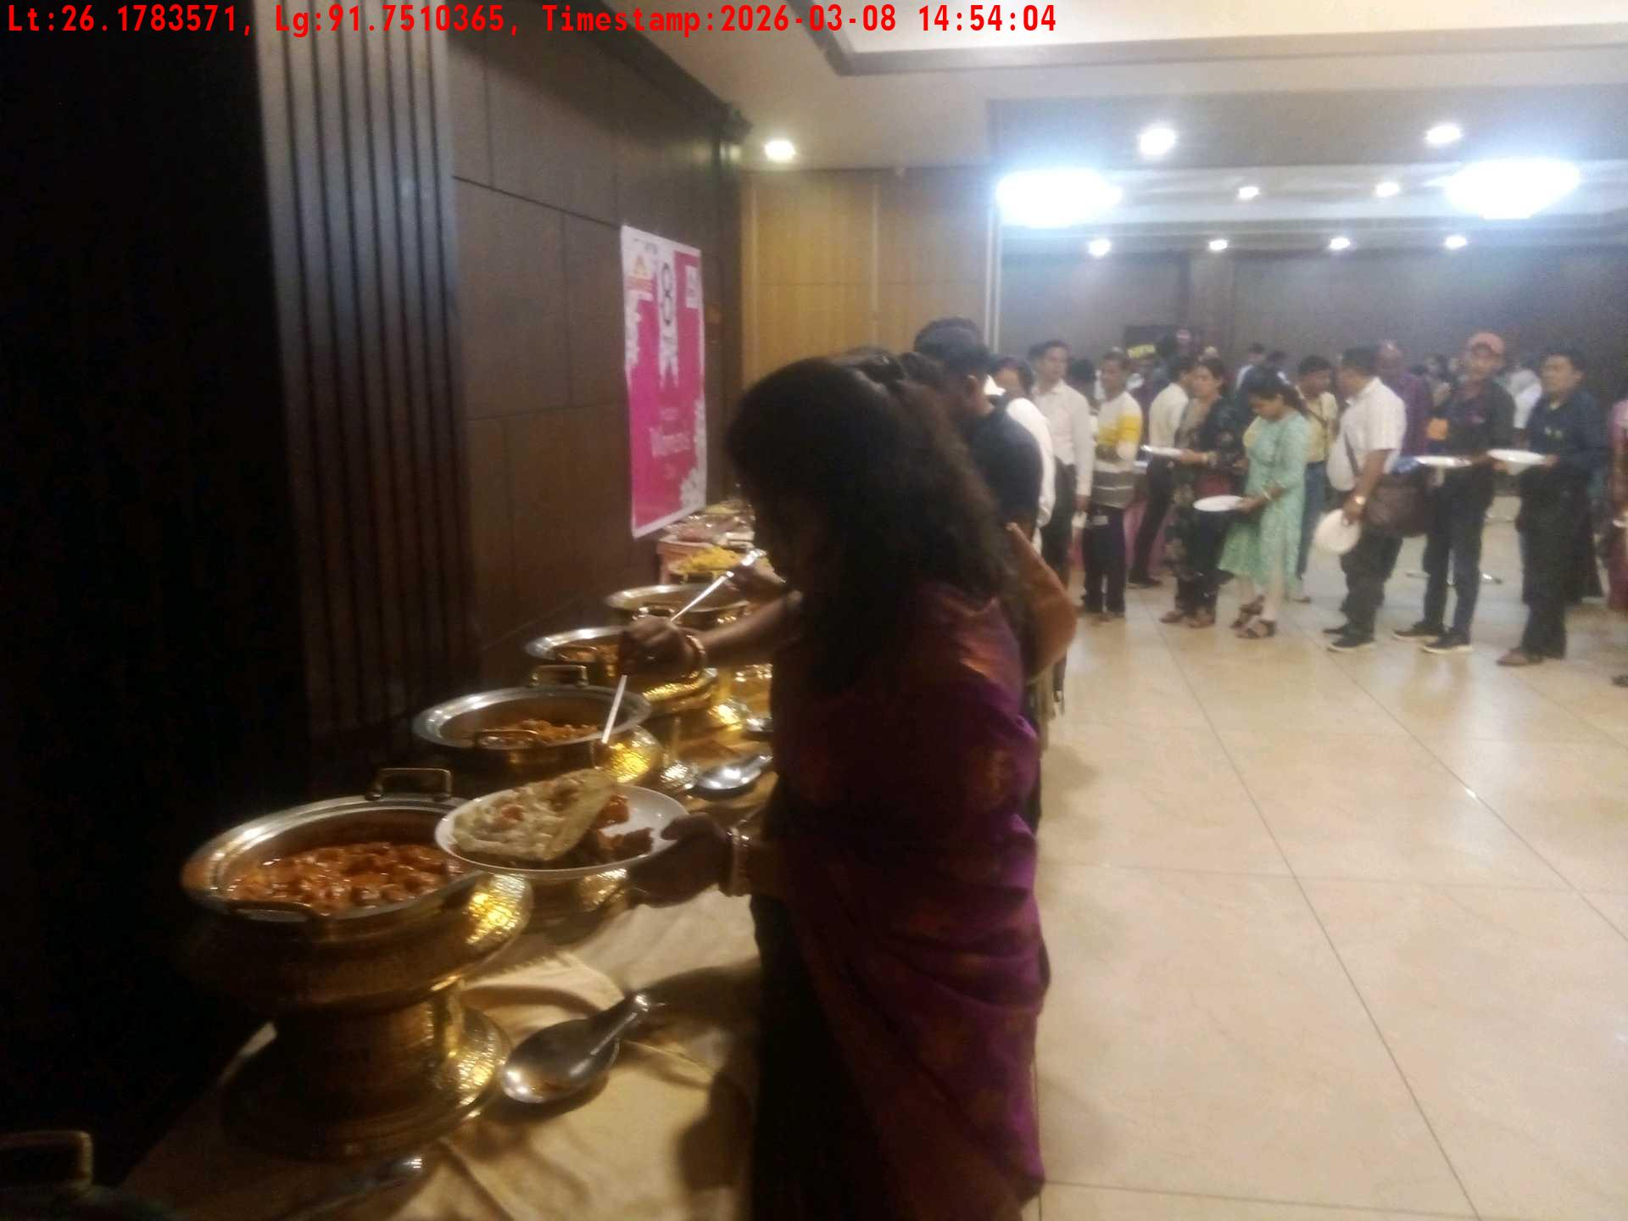
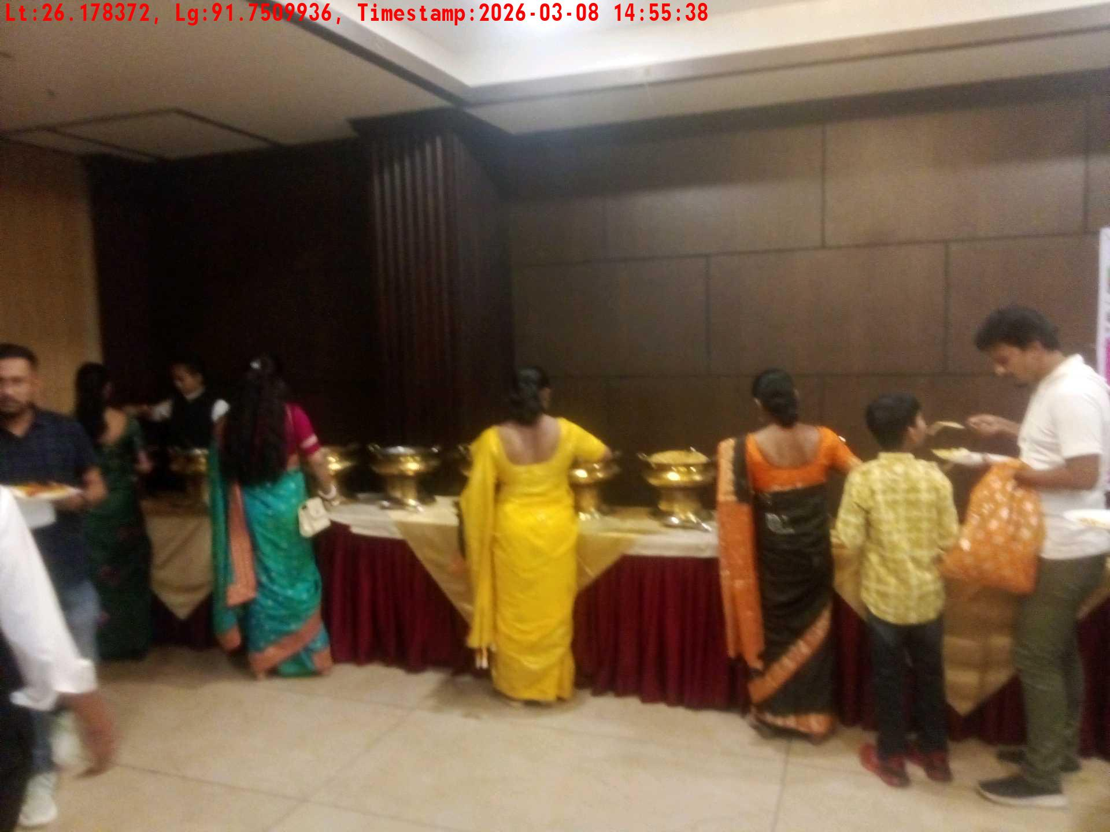
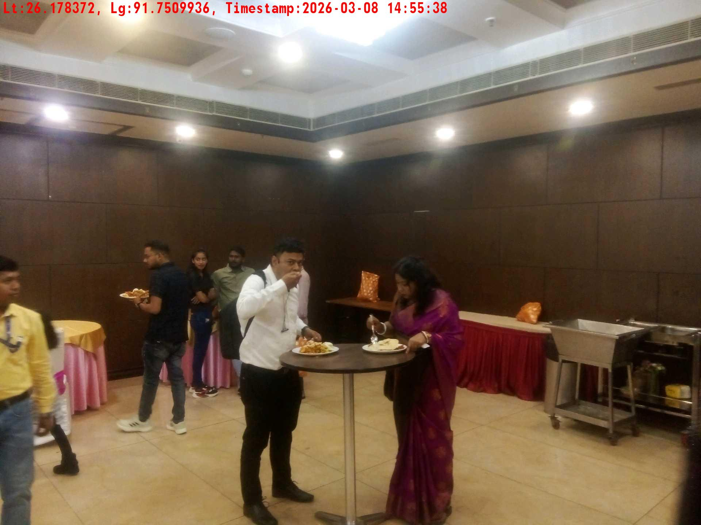
Date | Team | City | Agency | Promoter | Location
08-03-2026 | Assam | Assam | Mindshaft | Manish ray | guwahati
Lunch setup picture-1
Lunch setup picture-2
Lunch eating pictures-1
Lunch eating pictures-2

Slide 9
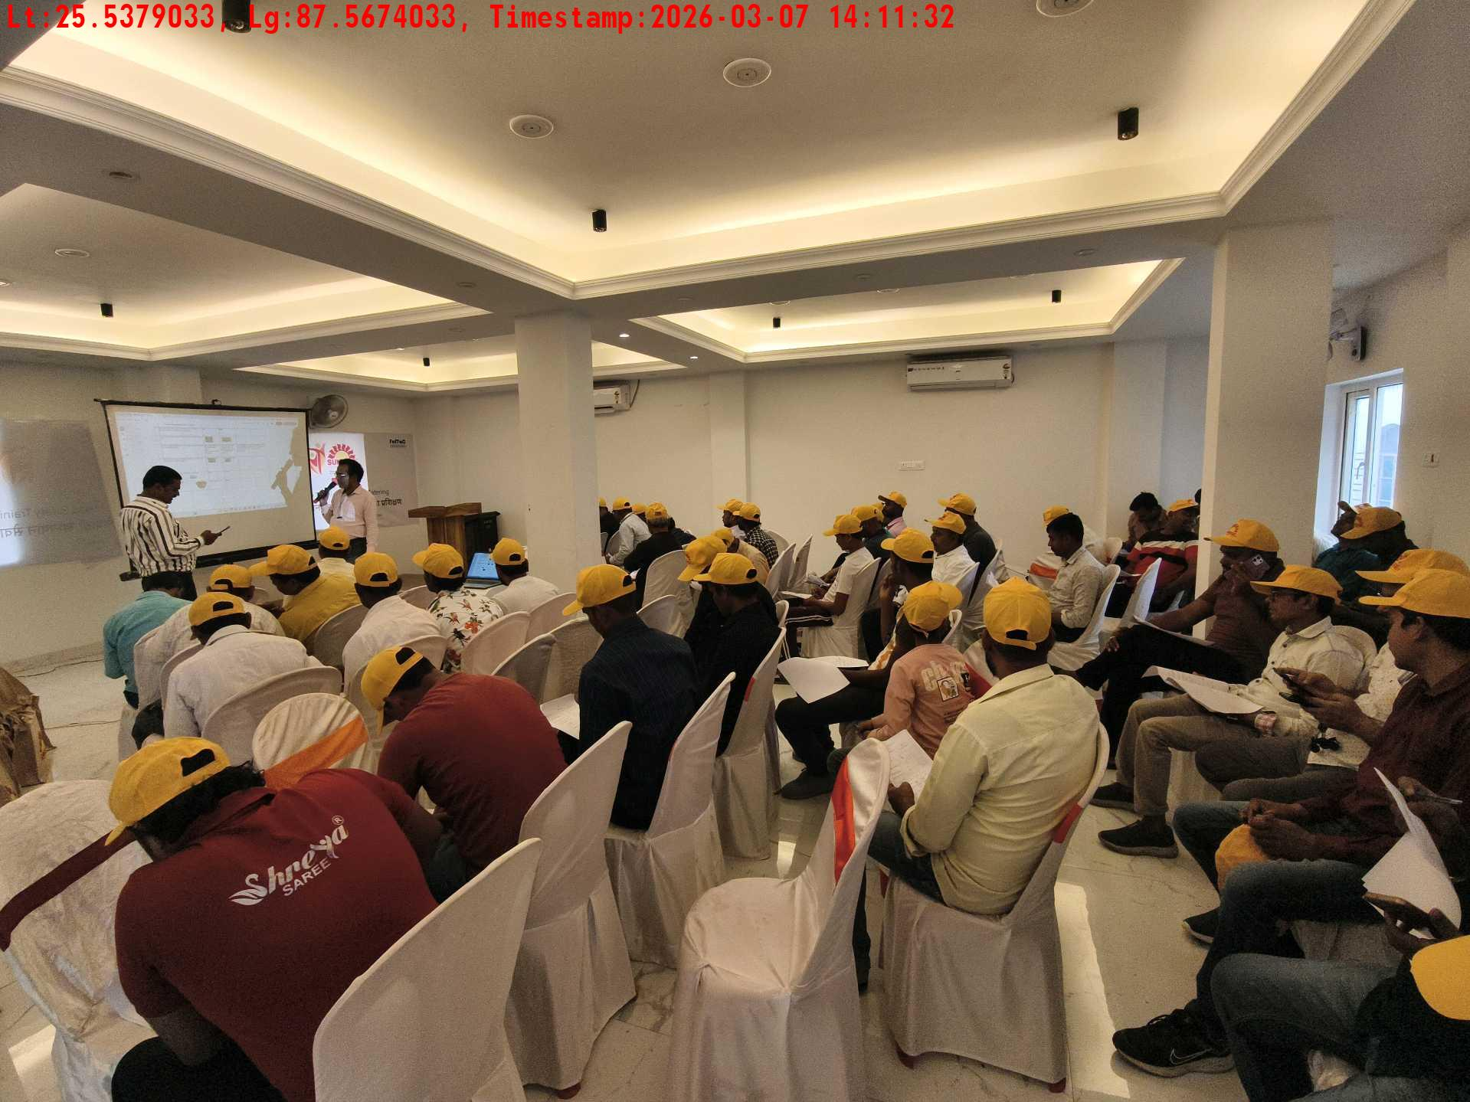
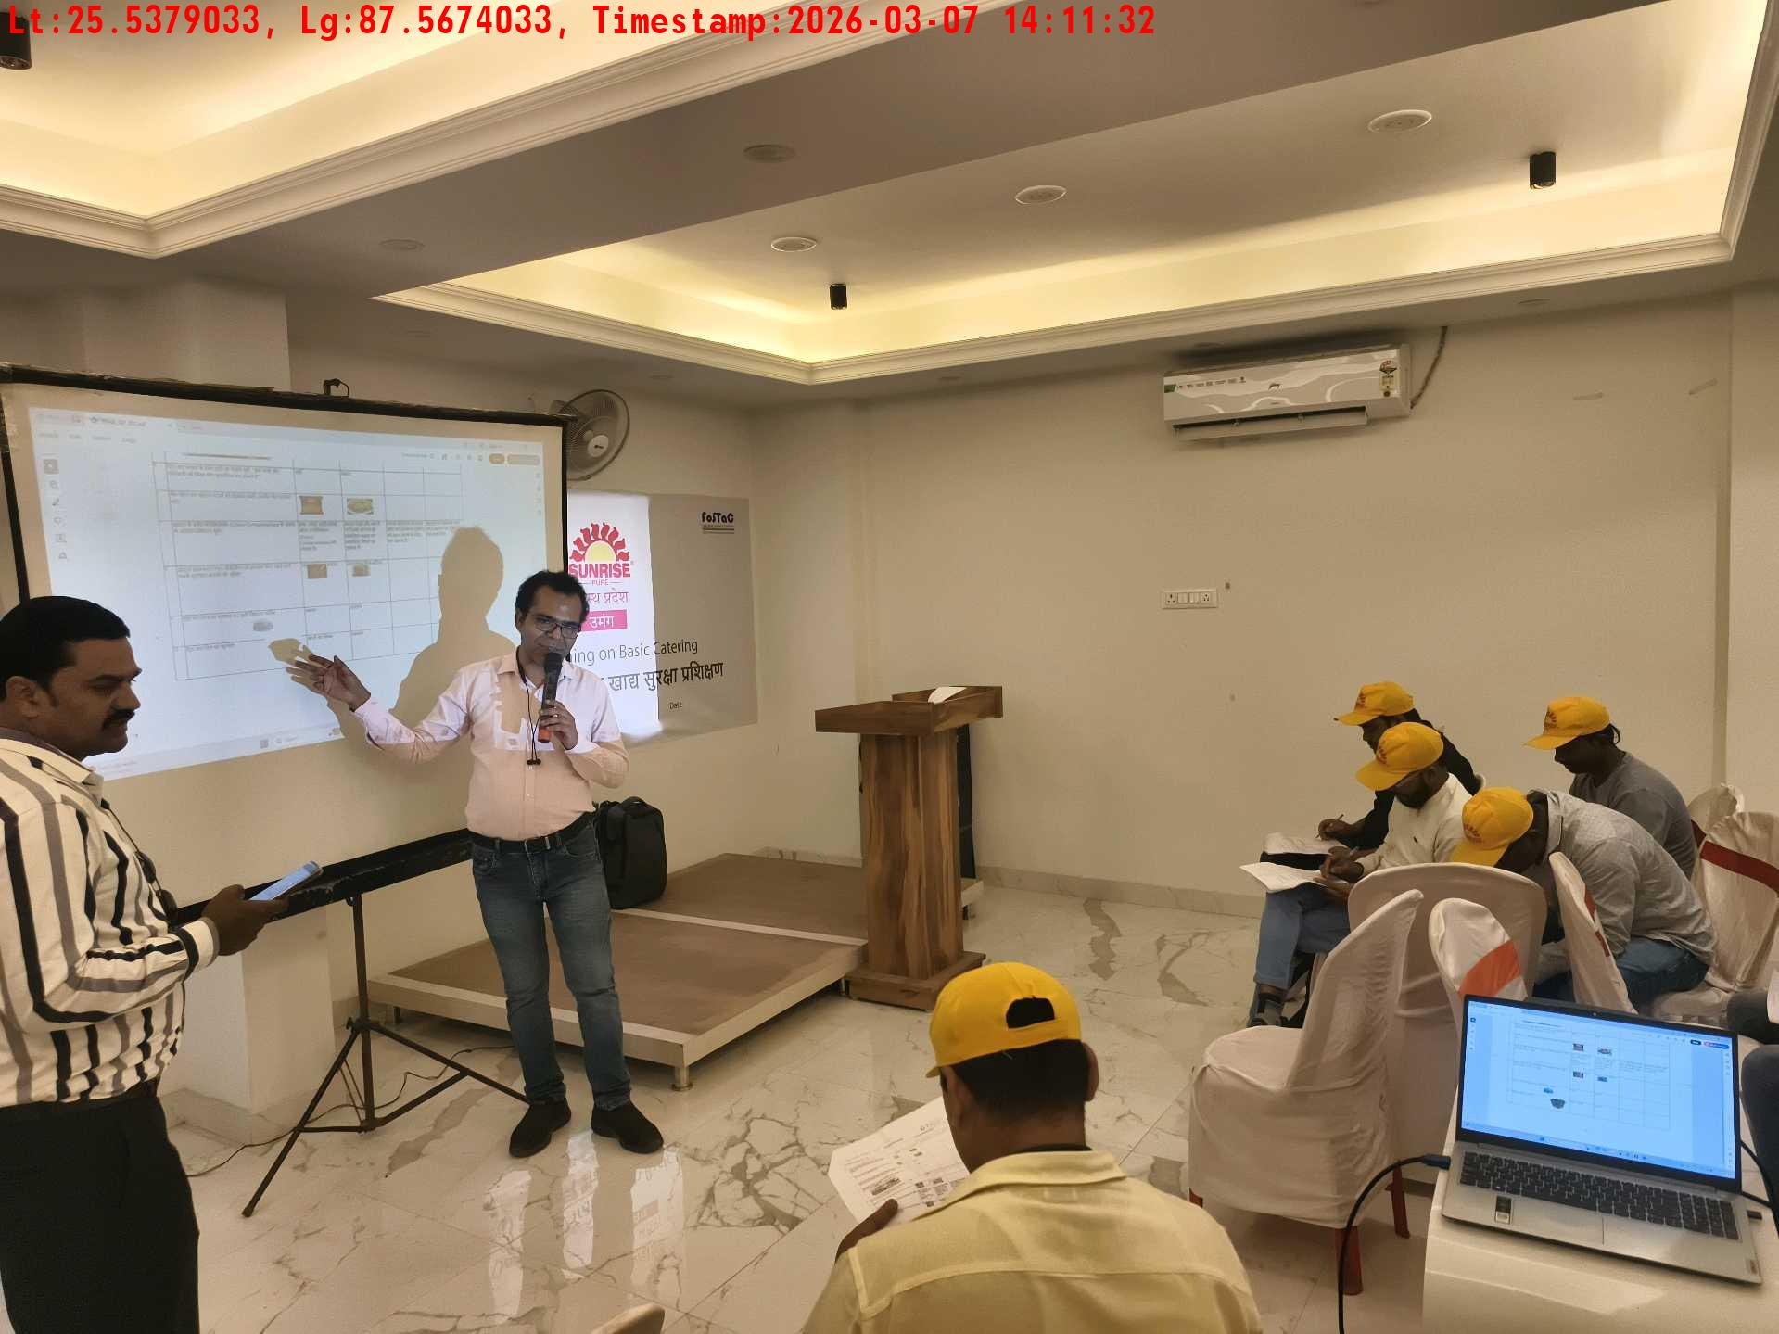
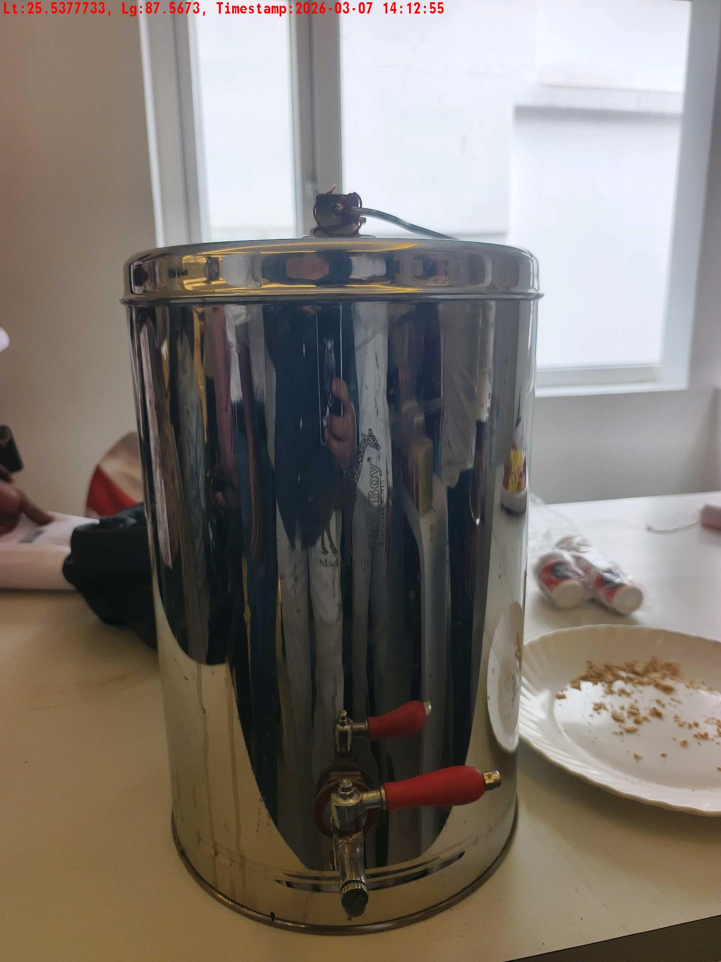
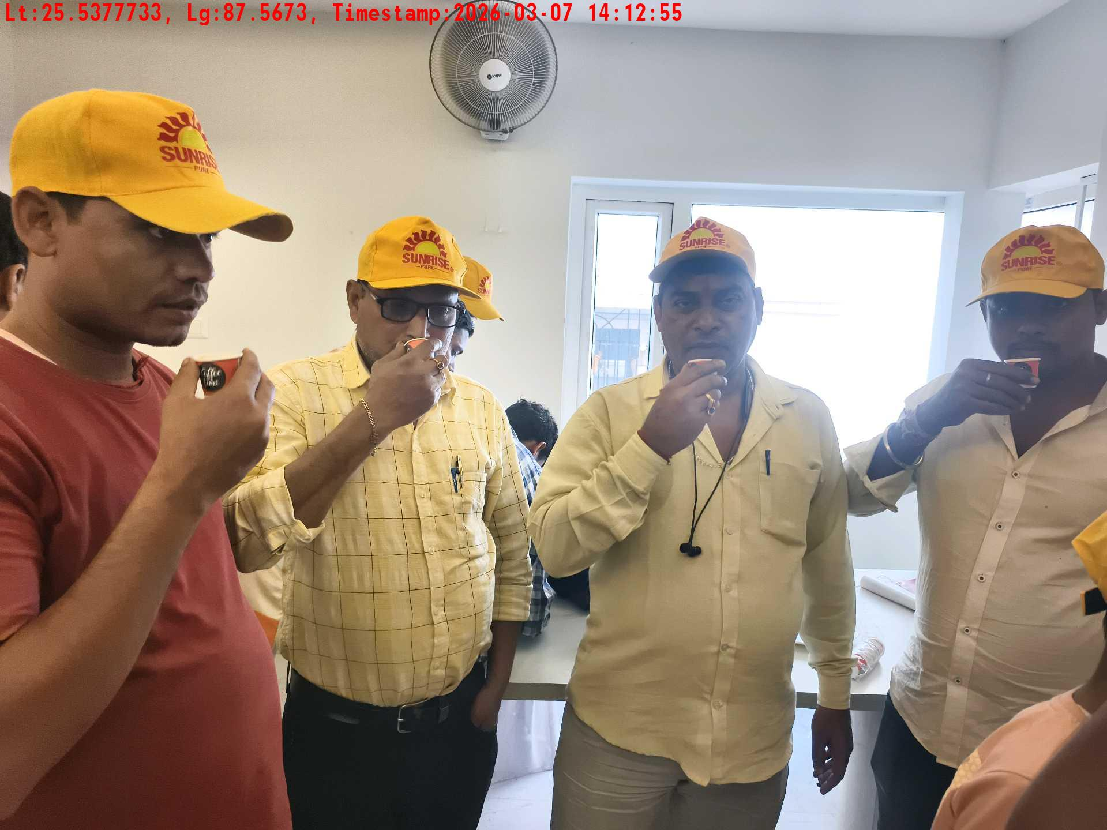
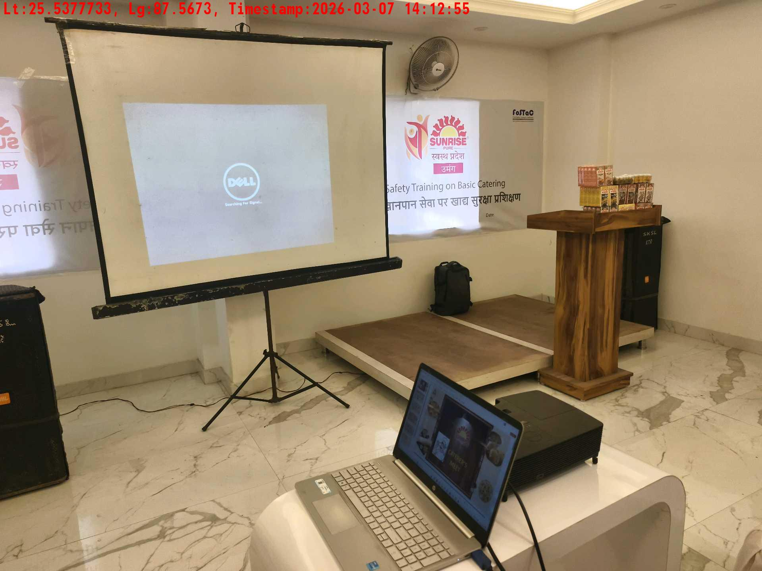
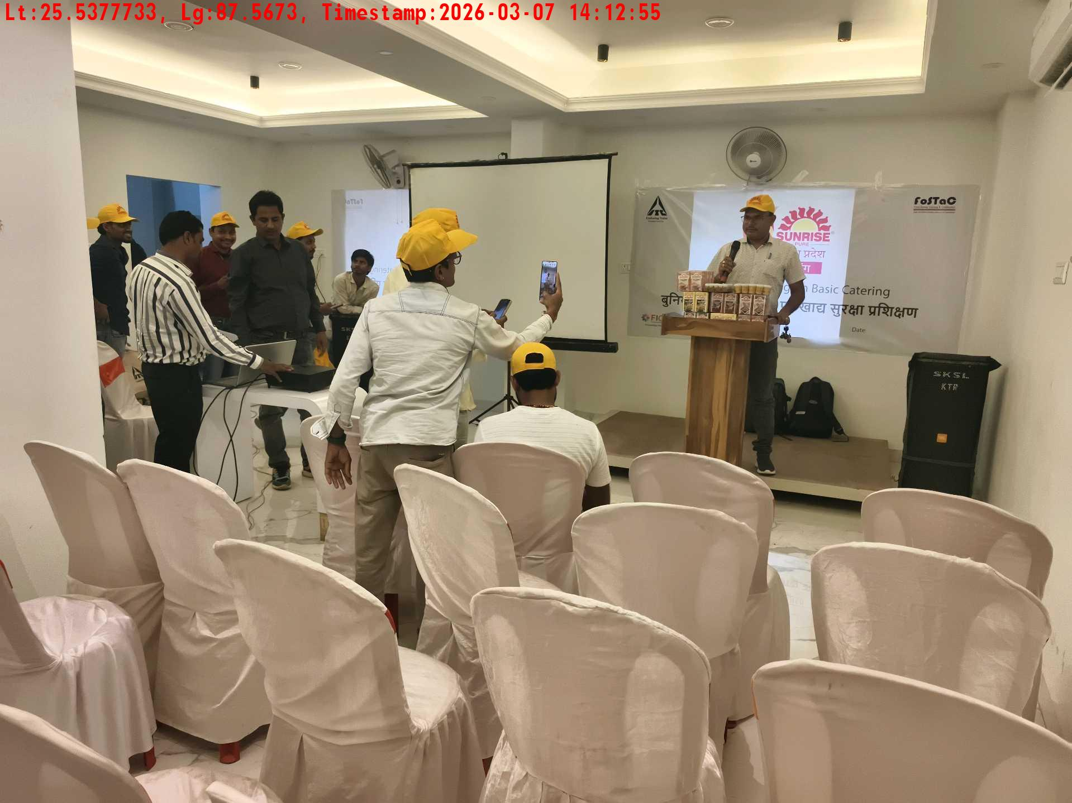
Date | Team | City | Agency | Promoter | Location
07-03-2026 | Bihar-1 | Bihar | Mindshaft | twinkle | Katihar
Crowd visibility picture
Trainer with presentation picture
Tea & coffee arrangement picture
Tea & coffee with crowd
Long shot picture covering banner
Long shot picture covering table

Slide 10
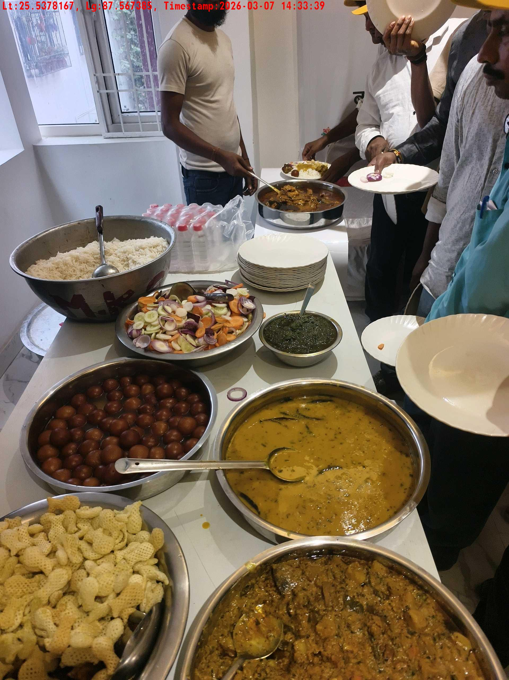
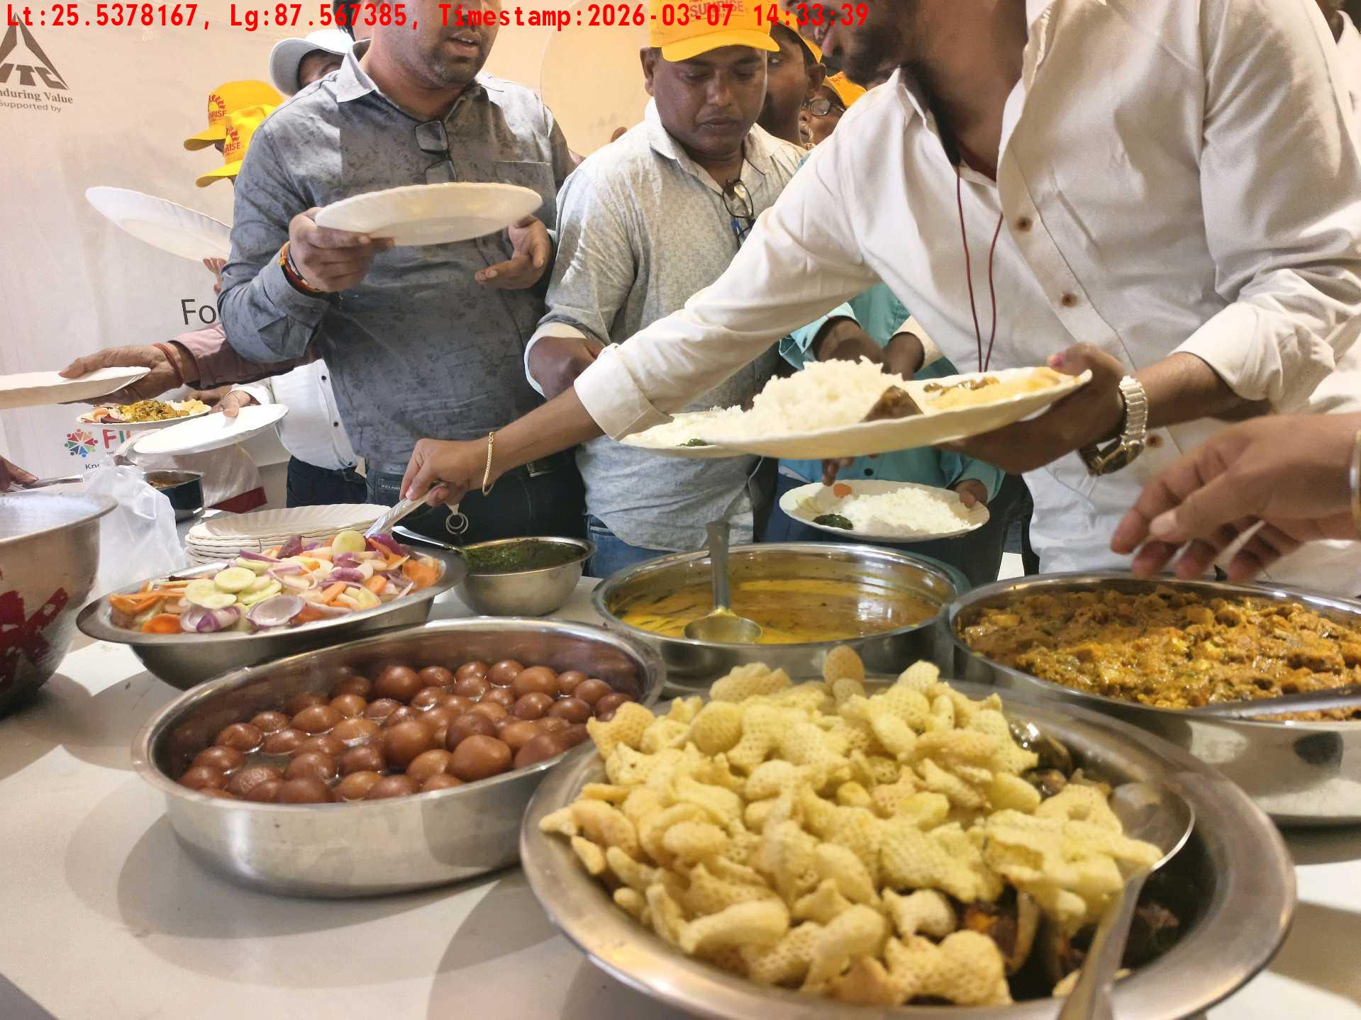
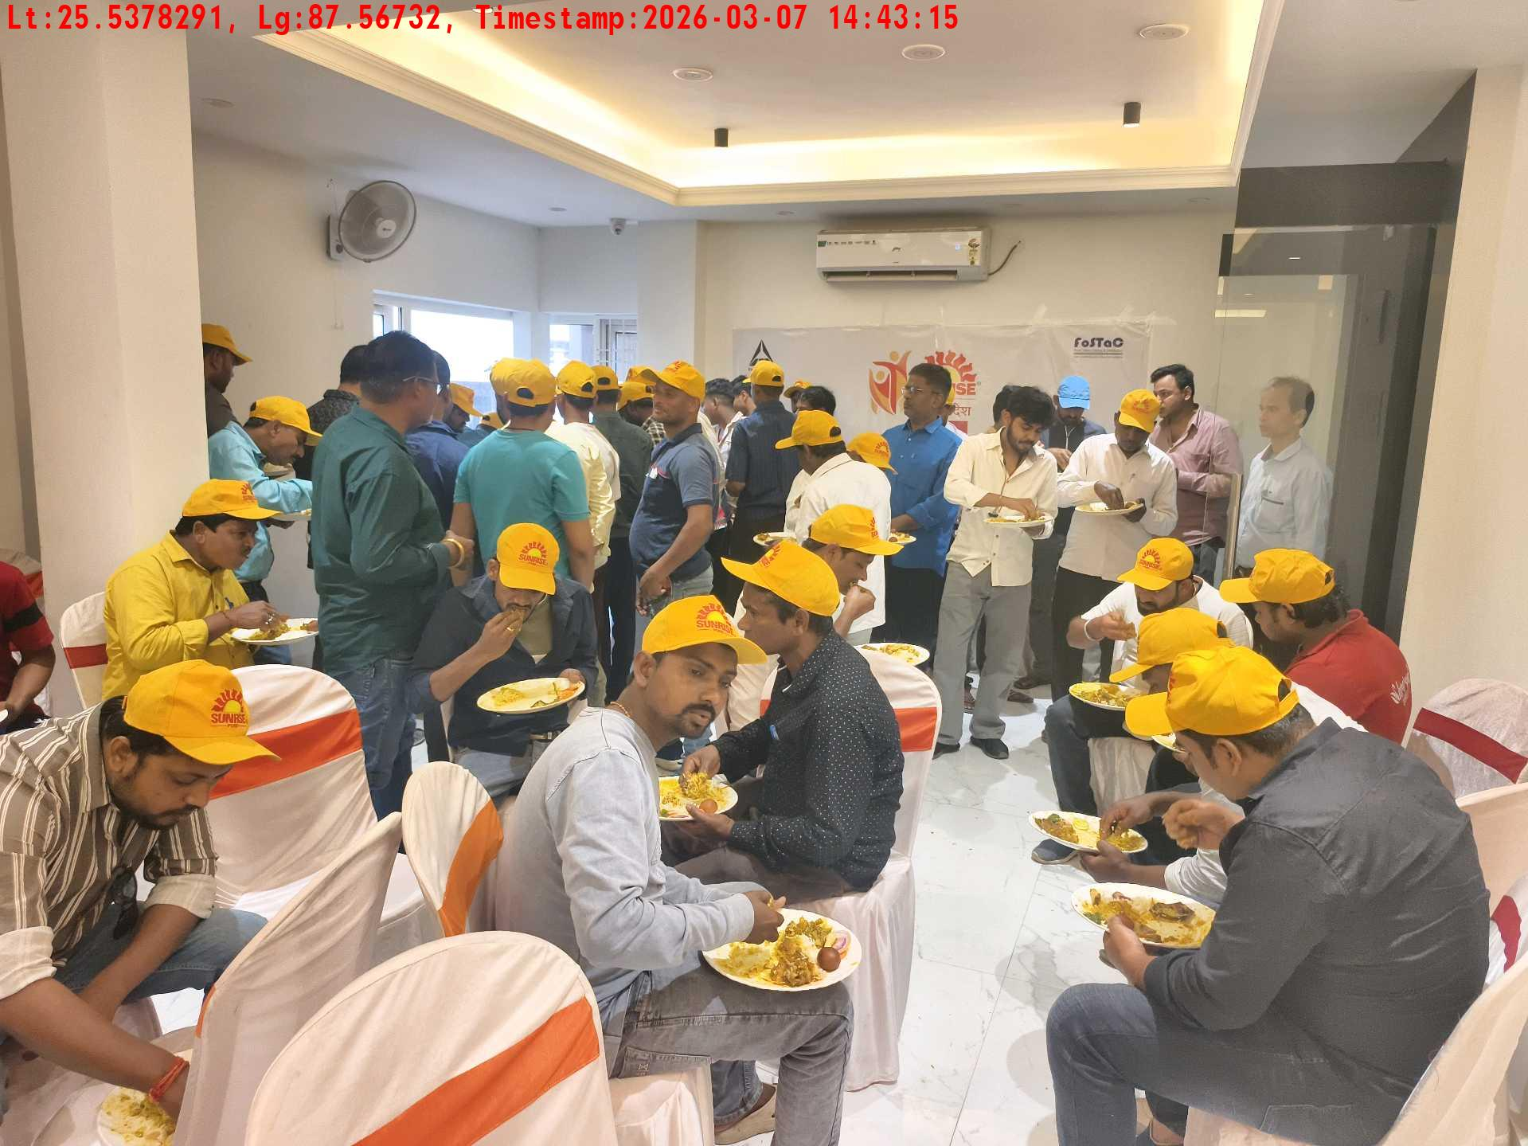
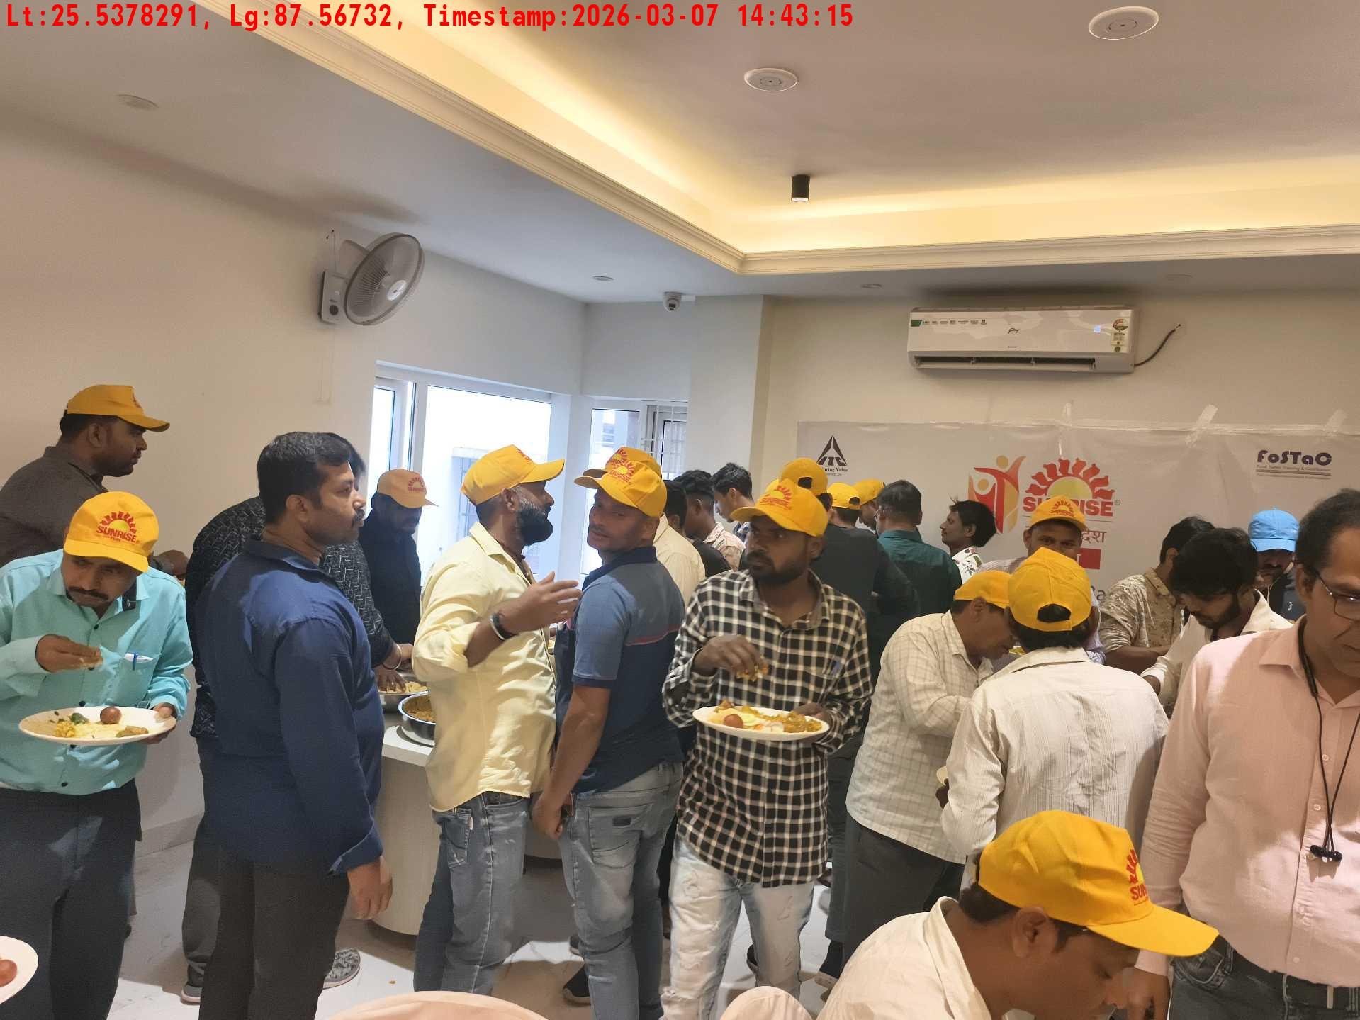
Date | Team | City | Agency | Promoter | Location
07-03-2026 | Bihar-1 | Bihar | Mindshaft | twinkle | Katihar
Lunch setup picture-1
Lunch setup picture-2
Lunch eating pictures-1
Lunch eating pictures-2

Slide 11
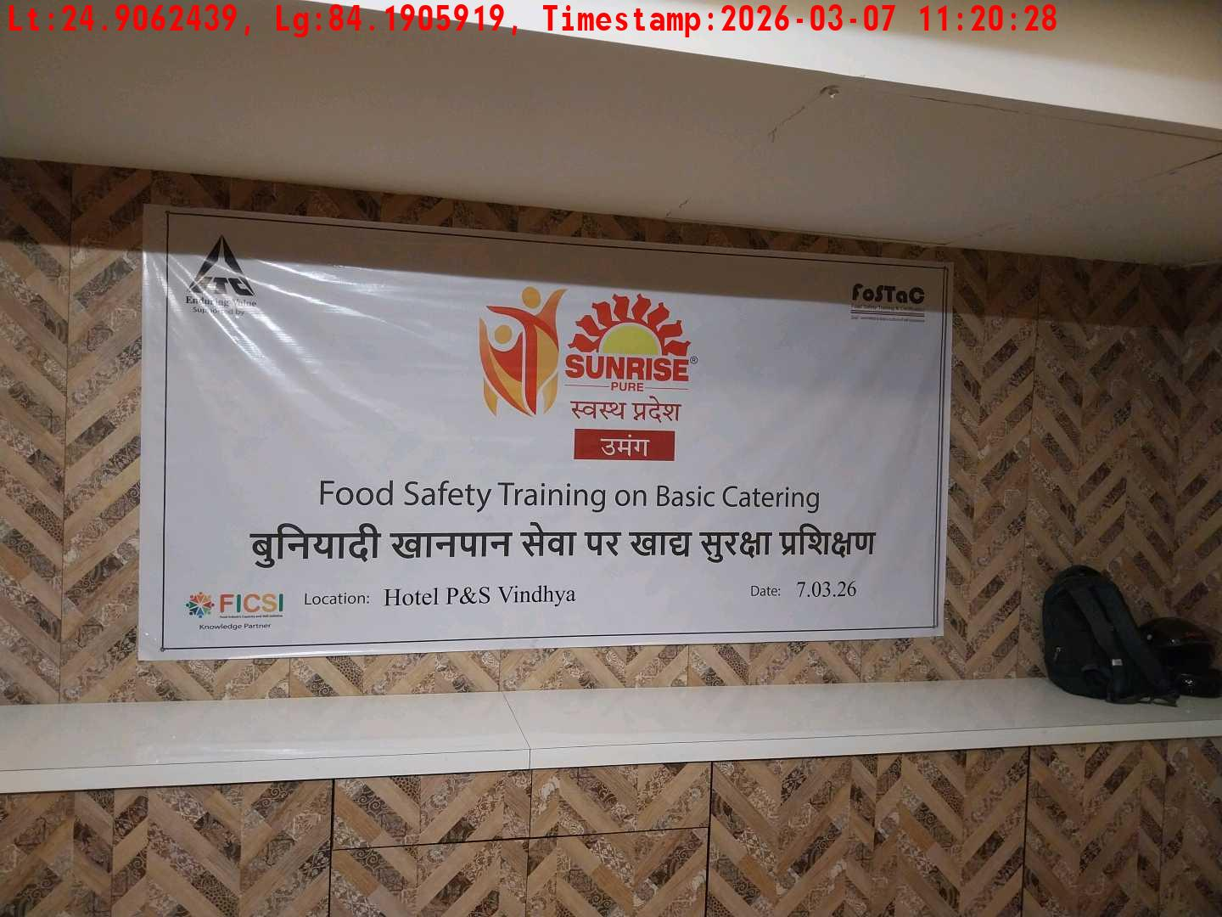
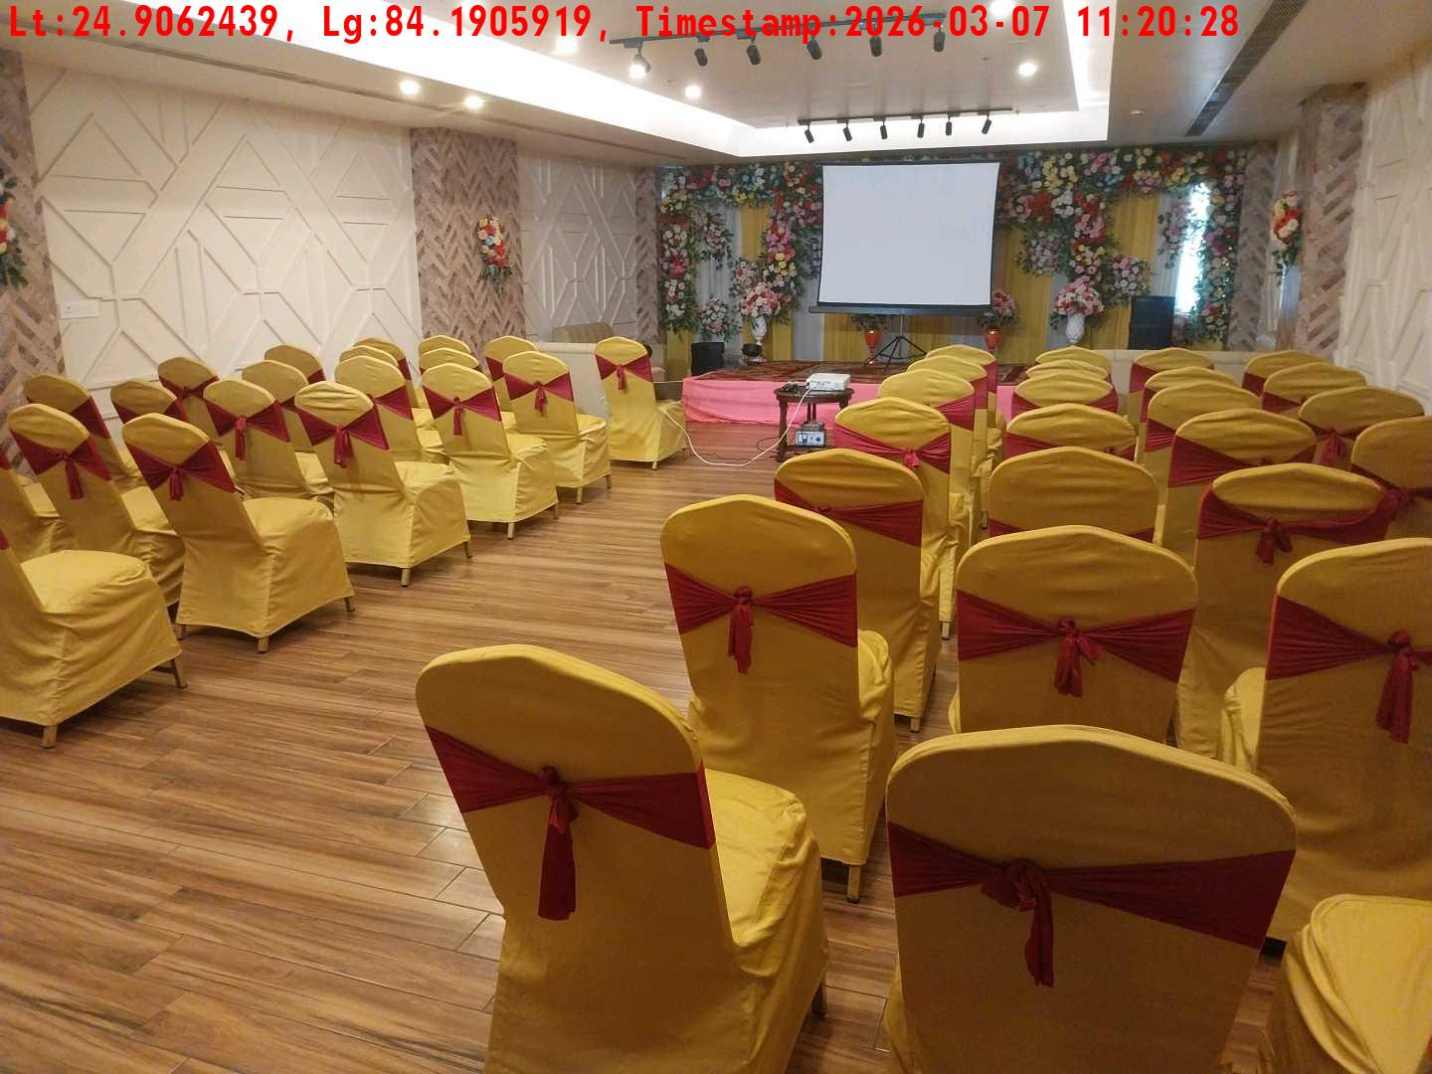
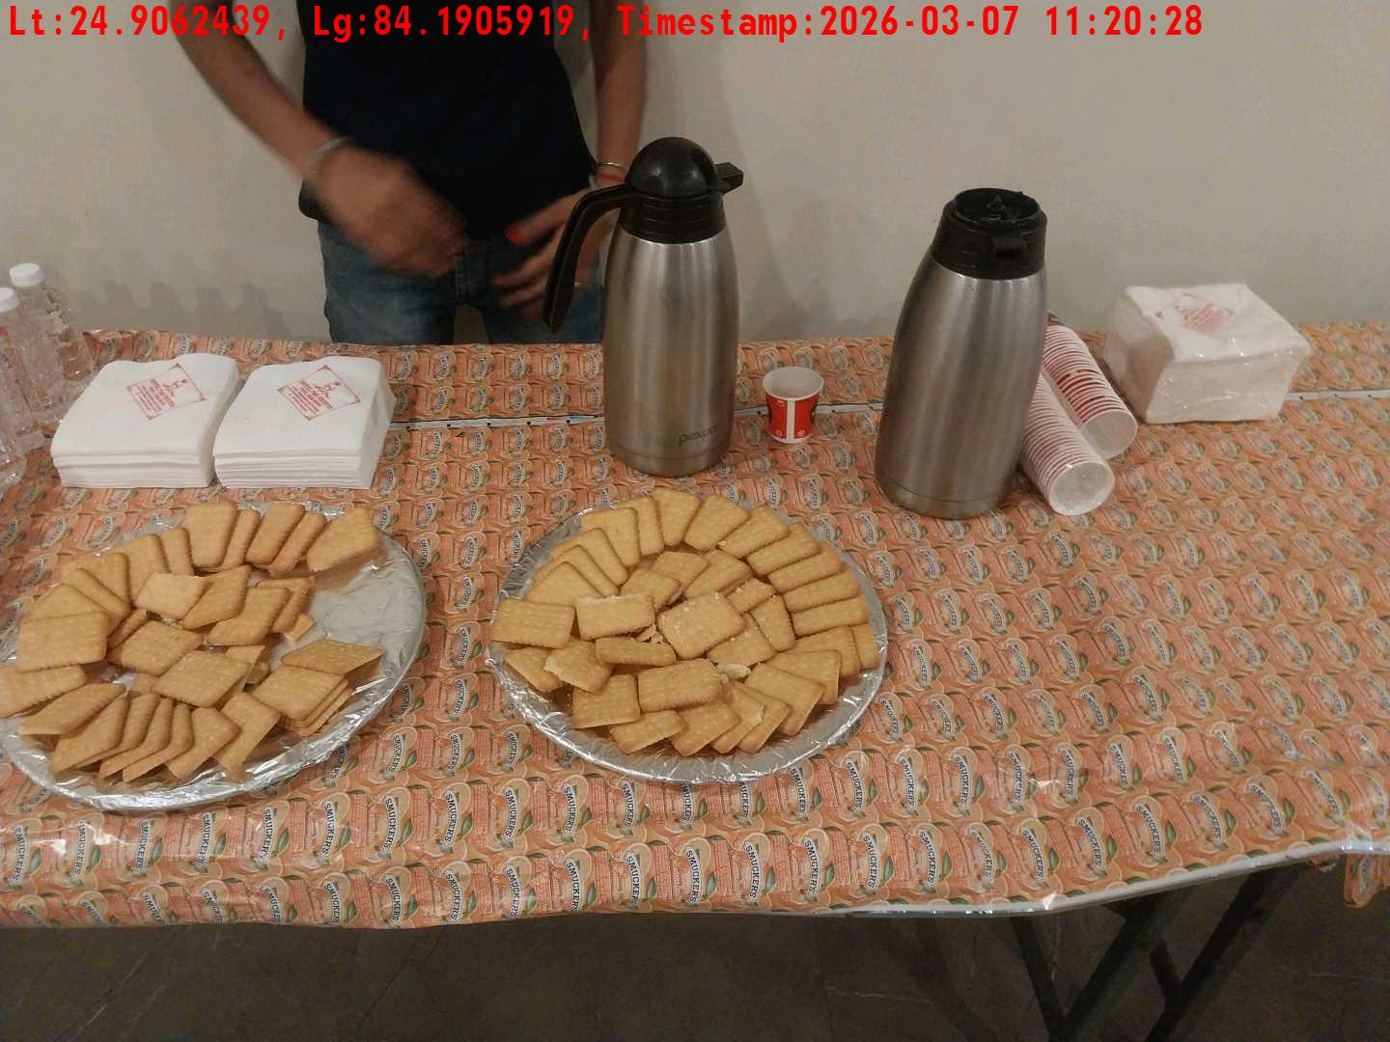
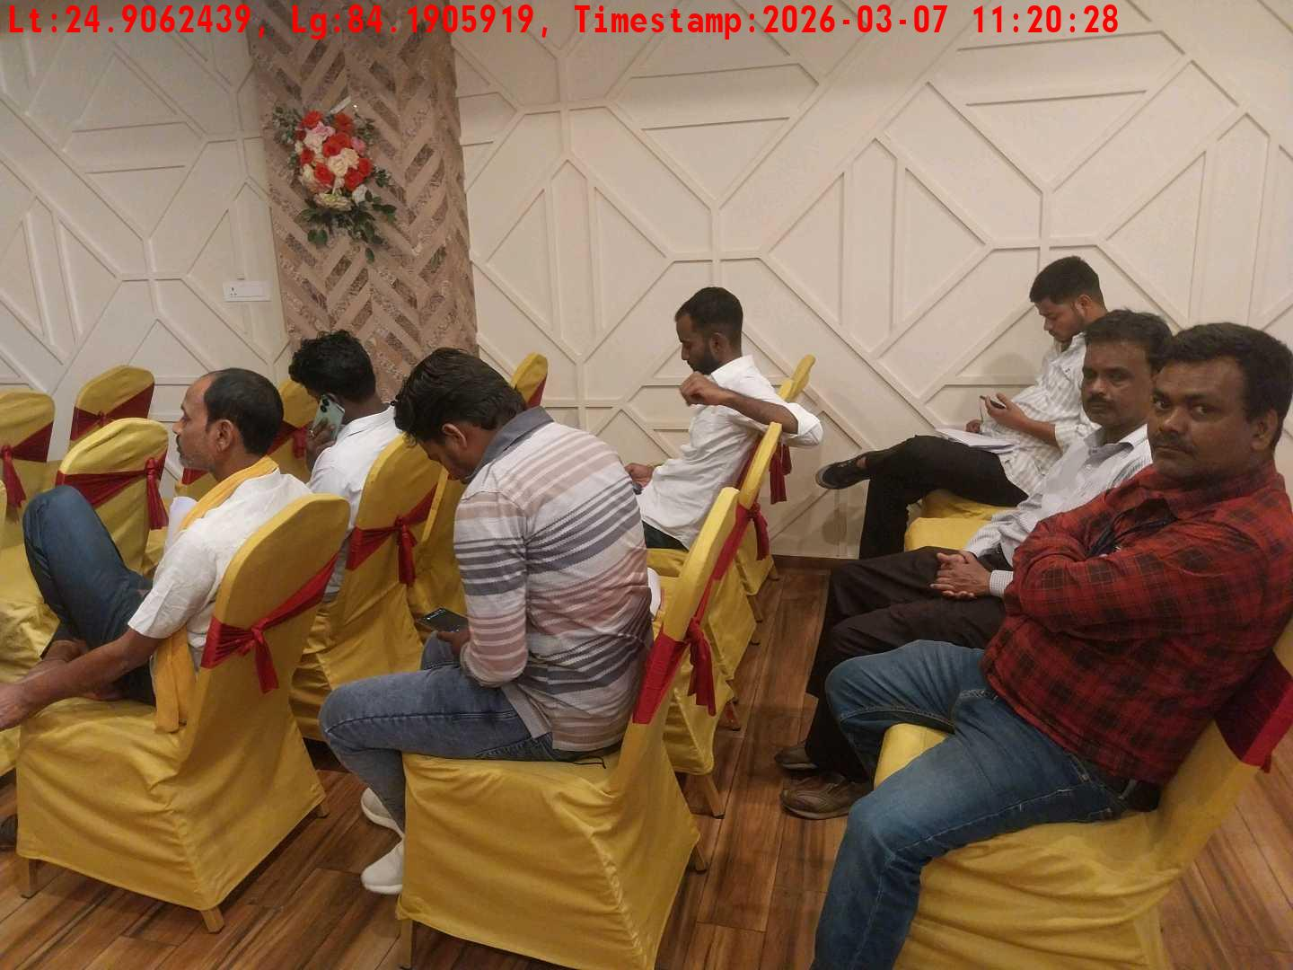
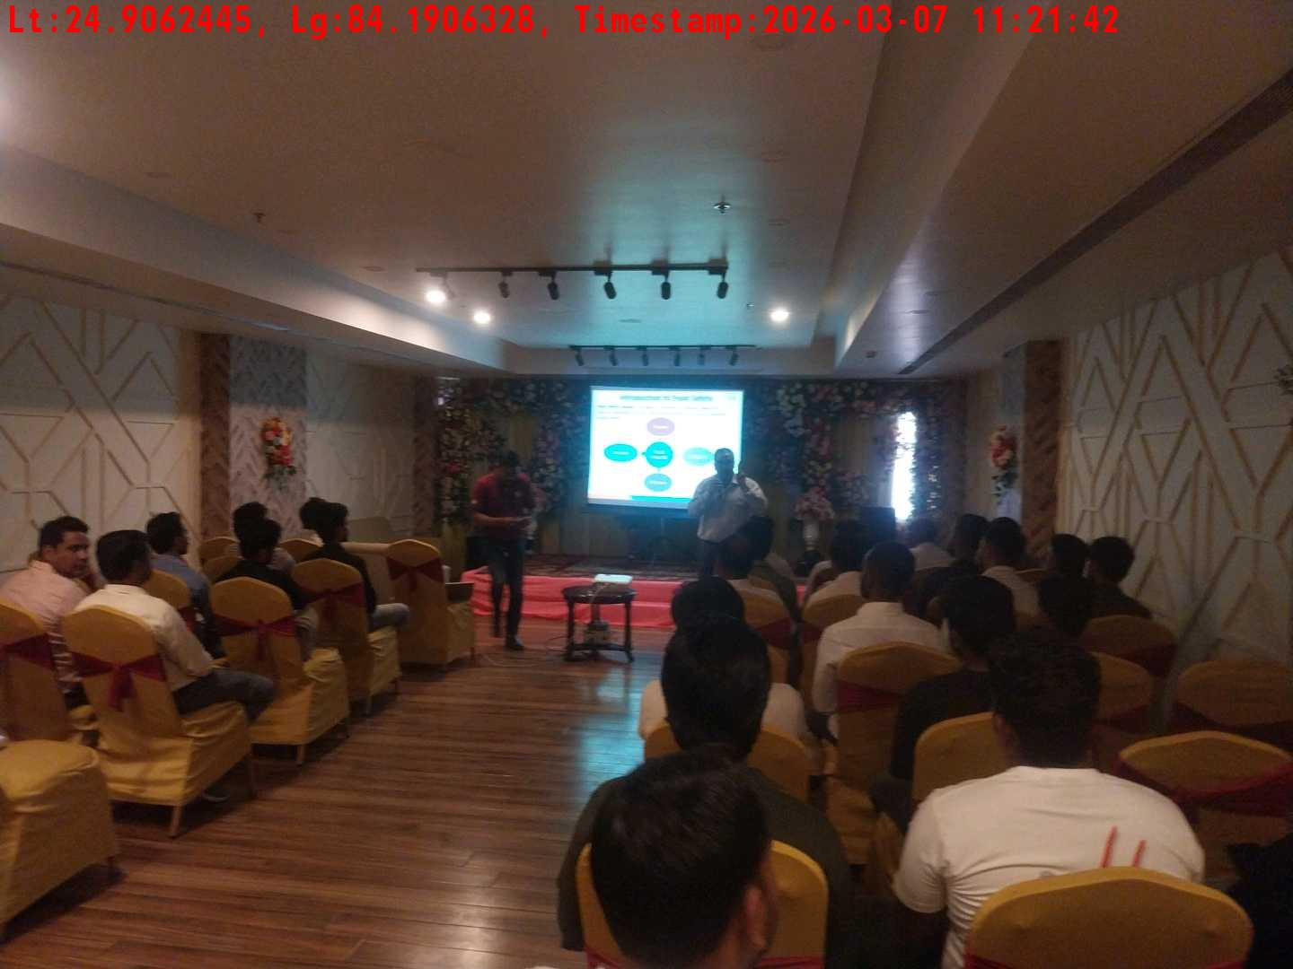
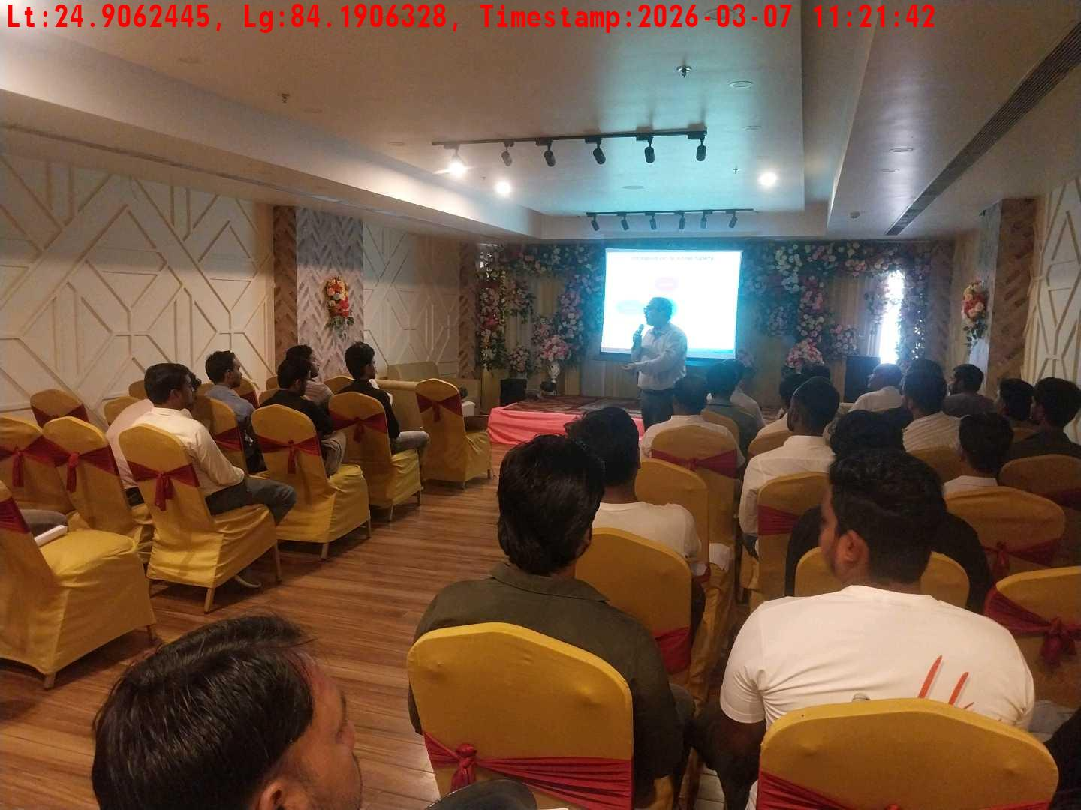
Date | Team | City | Agency | Promoter | Location
07-03-2026 | Bihar-2 | Bihar | Mindshaft | Dipak Singh | Dehri
Long shot picture covering banner
Long shot picture covering table
Tea & coffee arrangement picture
Tea & coffee with crowd
Trainer with presentation picture
Crowd visibility picture

Slide 12
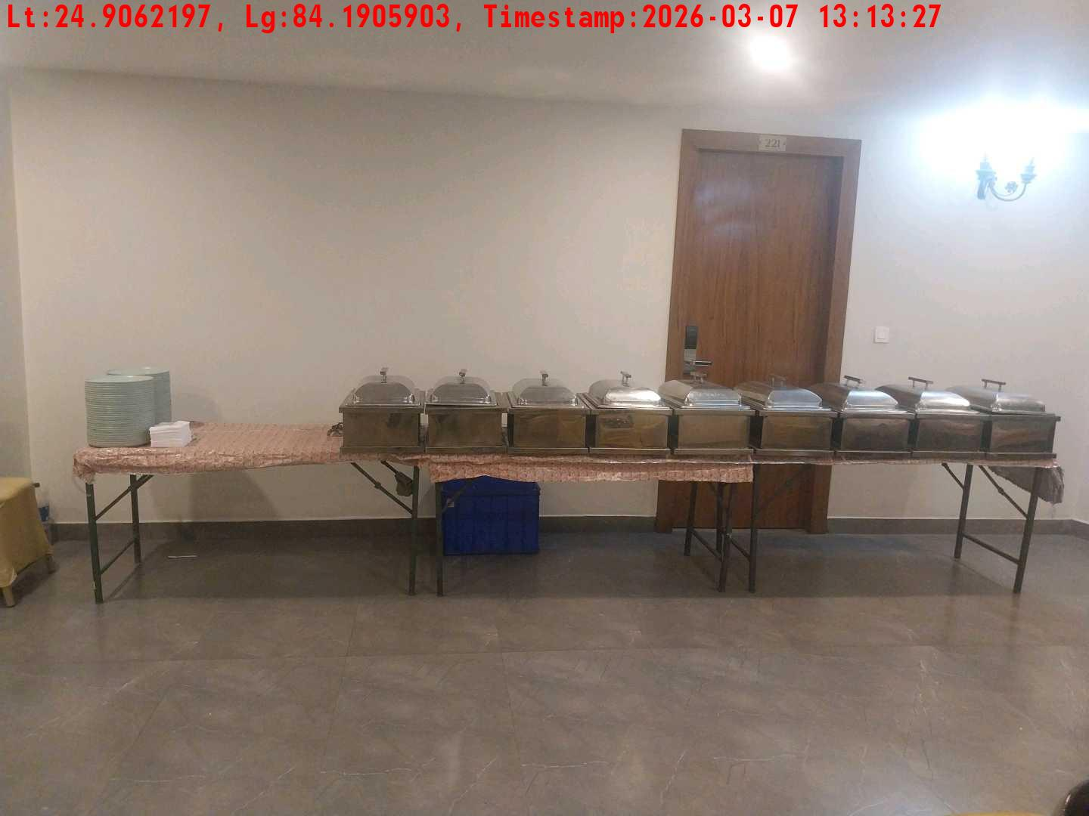
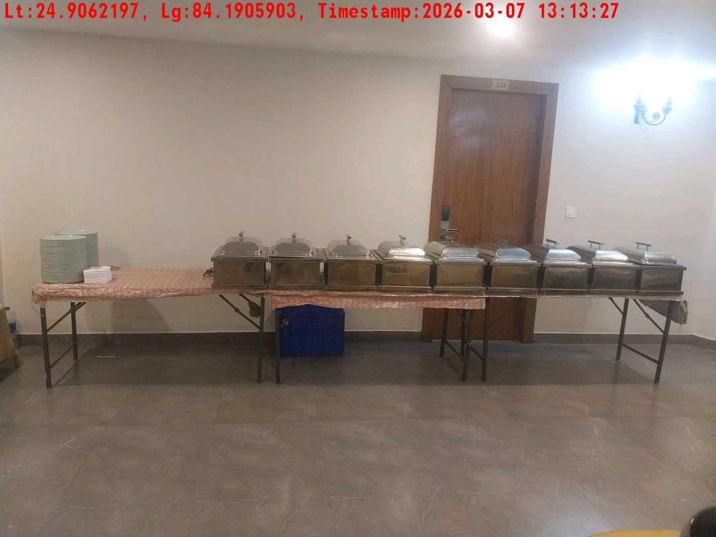


Date | Team | City | Agency | Promoter | Location
07-03-2026 | Bihar-2 | Bihar | Mindshaft | Dipak Singh | Dehri
Lunch setup picture-1
Lunch setup picture-2
Lunch setup picture-1
Lunch setup picture-2

Slide 13






Date | Team | City | Agency | Promoter | Location
06-03-2026 | Test Cook | Adilabad | Mindshaft | tesst
Long shot picture covering banner
Long shot picture covering table
Tea & coffee arrangement picture
Tea & coffee with crowd
Trainer with presentation picture
Crowd visibility picture

Slide 14






Date | Team | City | Agency | Promoter | Location
06-03-2026 | Test Cook | Adilabad | Mindshaft | tesst
Lunch setup picture-1
Lunch setup picture-2
Lunch eating pictures-1
Lunch eating pictures-2
Lunch eating pictures-1
Lunch eating pictures-2

Slide 15






Date | Team | City | Agency | Promoter | Location
05-03-2026 | Test Cook | Adilabad | Mindshaft | tesst
Long shot picture covering banner
Long shot picture covering table
Tea & coffee arrangement picture
Tea & coffee with crowd
Trainer with presentation picture
Crowd visibility picture

Slide 16






Date | Team | City | Agency | Promoter | Location
05-03-2026 | Test Cook | Adilabad | Mindshaft | tesst
Lunch setup picture-1
Lunch setup picture-2
Lunch eating pictures-1
Lunch eating pictures-2
Long shot picture covering banner
Long shot picture covering table

Slide 17






Date | Team | City | Agency | Promoter | Location
05-03-2026 | Test Cook | Adilabad | Mindshaft | tesst
Tea & coffee arrangement picture
Tea & coffee with crowd
Trainer with presentation picture
Crowd visibility picture
Lunch setup picture-1
Lunch setup picture-2

Slide 18






Date | Team | City | Agency | Promoter | Location
05-03-2026 | Test Cook | Adilabad | Mindshaft | tesst
Lunch eating pictures-1
Lunch eating pictures-2
Long shot picture covering banner
Long shot picture covering table
Tea & coffee arrangement picture
Tea & coffee with crowd

Slide 19






Date | Team | City | Agency | Promoter | Location
05-03-2026 | Test Cook | Adilabad | Mindshaft | tesst
Trainer with presentation picture
Crowd visibility picture
Lunch setup picture-1
Lunch setup picture-2
Lunch eating pictures-1
Lunch eating pictures-2

Slide 20
Date | Team | City | Agency | Promoter | Location
05-03-2026 | Test Cook | Adilabad | Mindshaft | tesst
Lunch eating pictures-2

Slide 21






Date | Team | City | Agency | Promoter | Location
04-03-2026 | Test Cook | Adilabad | Mindshaft | tesst
Long shot picture covering banner
Long shot picture covering table
Tea & coffee arrangement picture
Tea & coffee with crowd
Trainer with presentation picture
Crowd visibility picture

Slide 22




Date | Team | City | Agency | Promoter | Location
04-03-2026 | Test Cook | Adilabad | Mindshaft | tesst
Lunch setup picture-1
Lunch setup picture-2
Lunch eating pictures-1
Lunch eating pictures-2

