Slide 1
Cook Meet Report

Slide 2
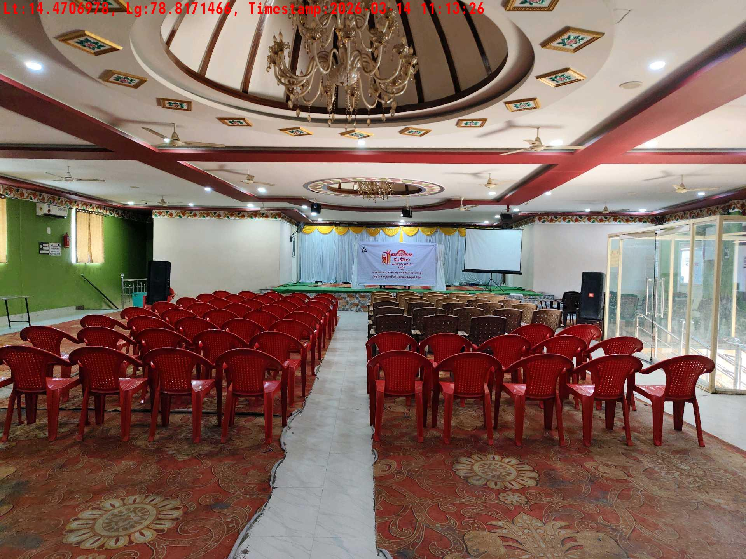
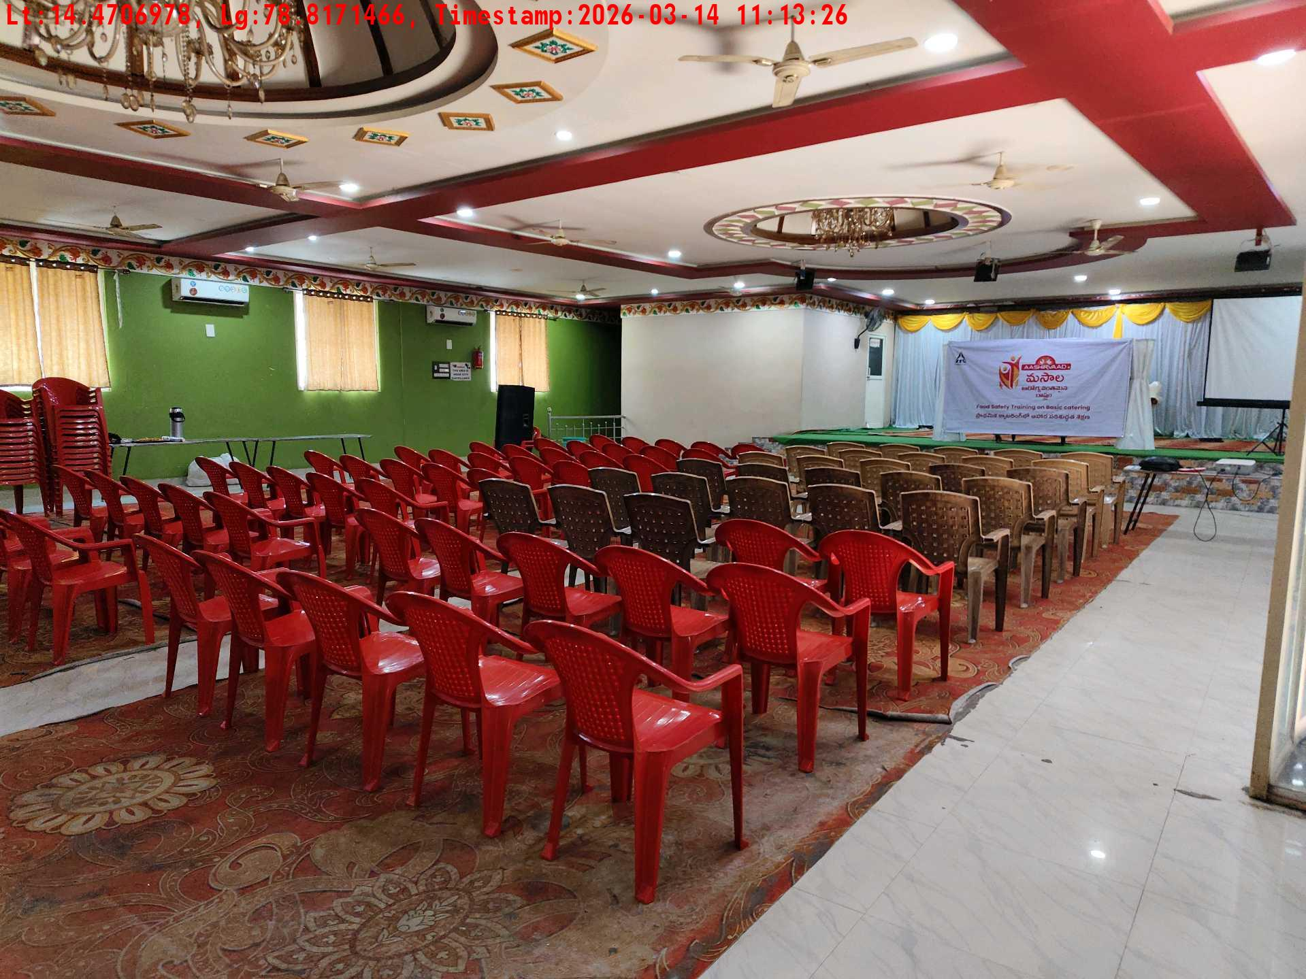
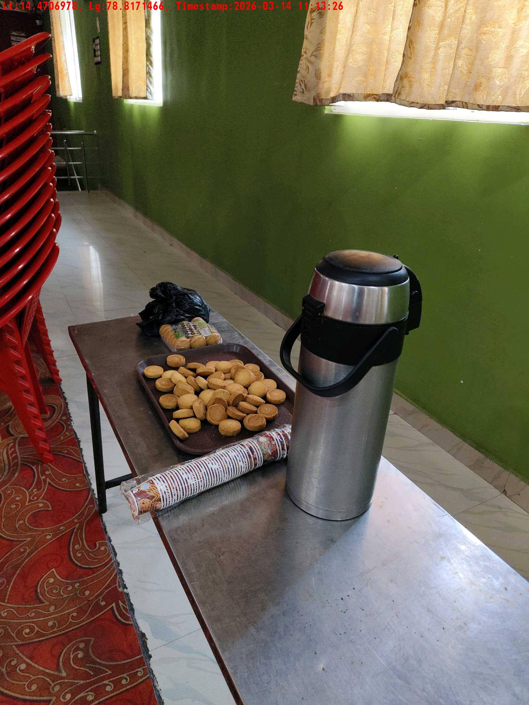
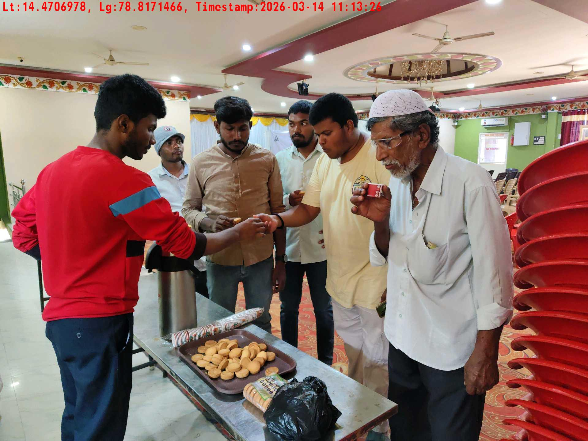
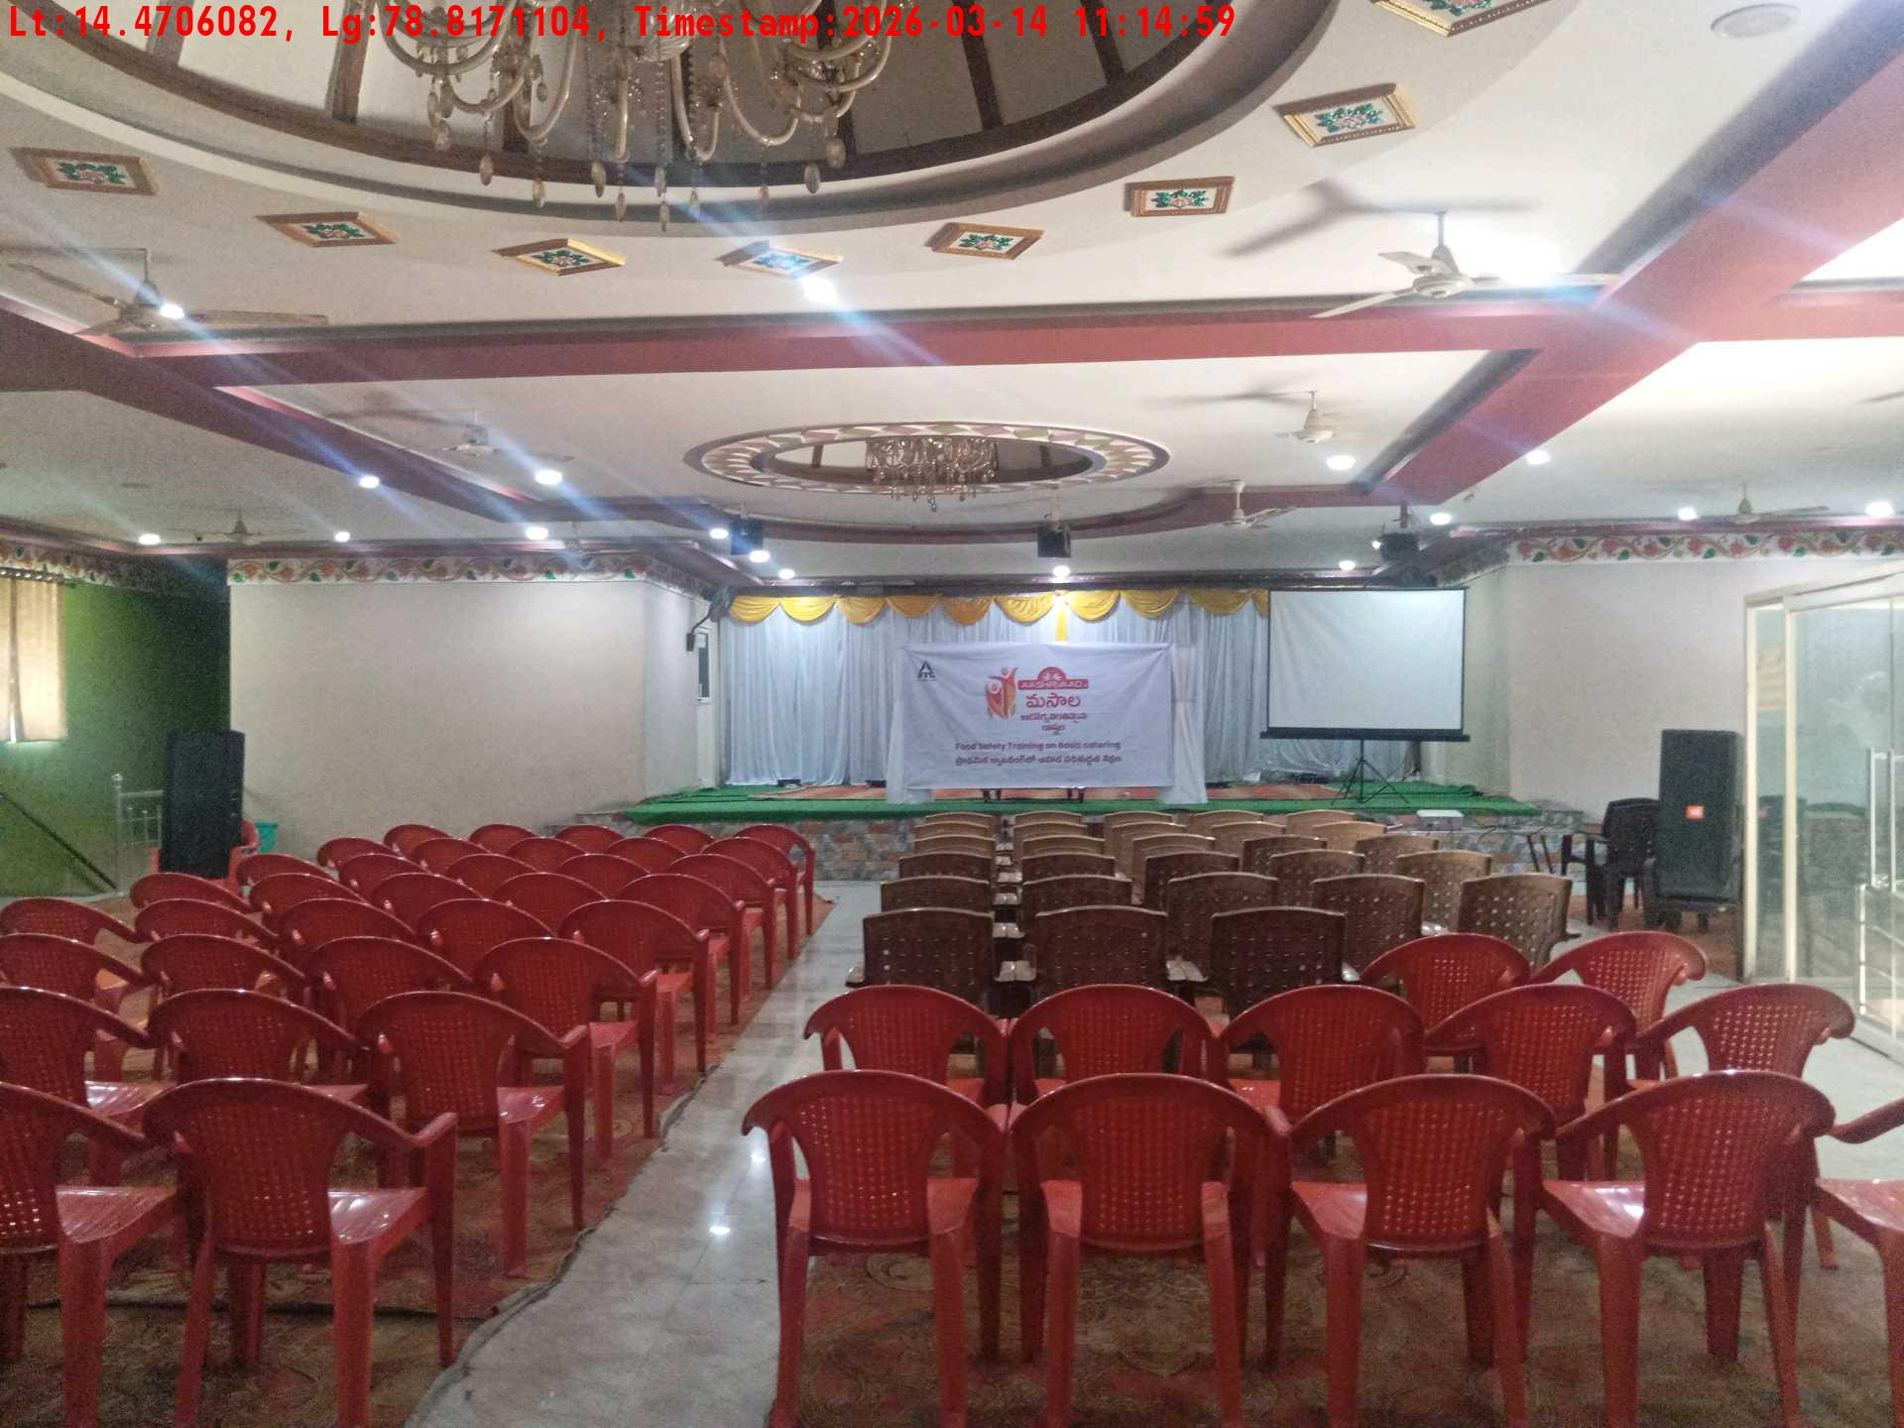
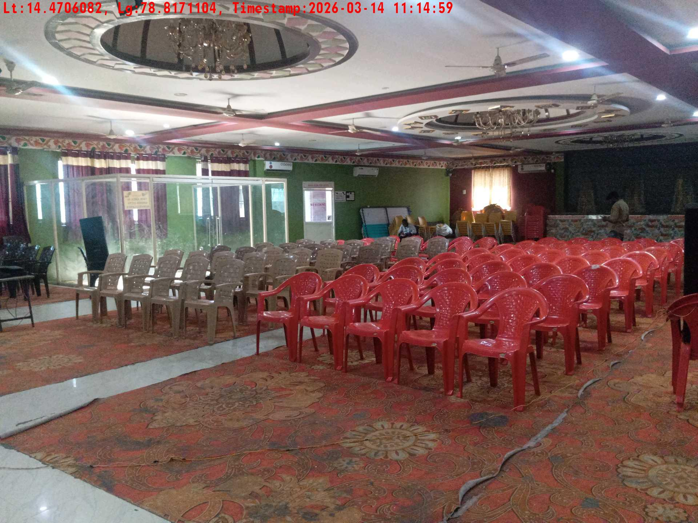
Date | Team | City | Agency Name | Promoter Name | Location Name
14-03-2026 | APTG-1 | AP/TG | Insight India | K Hiteesh Kumar | Thirupathi
Long shot picture covering banner
Long shot picture covering table
Tea & coffee arrangement picture
Tea & coffee with crowd
Long shot picture covering banner
Long shot picture covering table

Slide 3
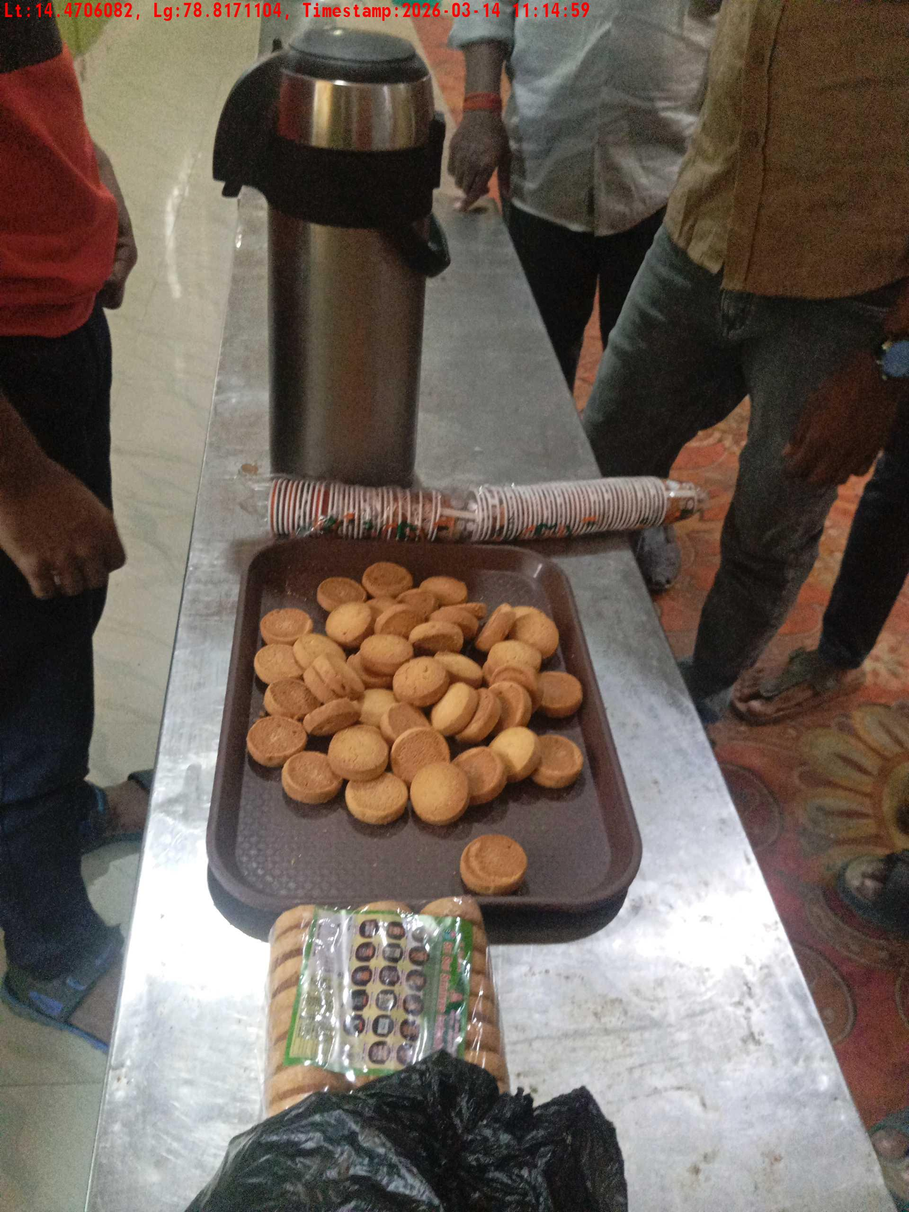
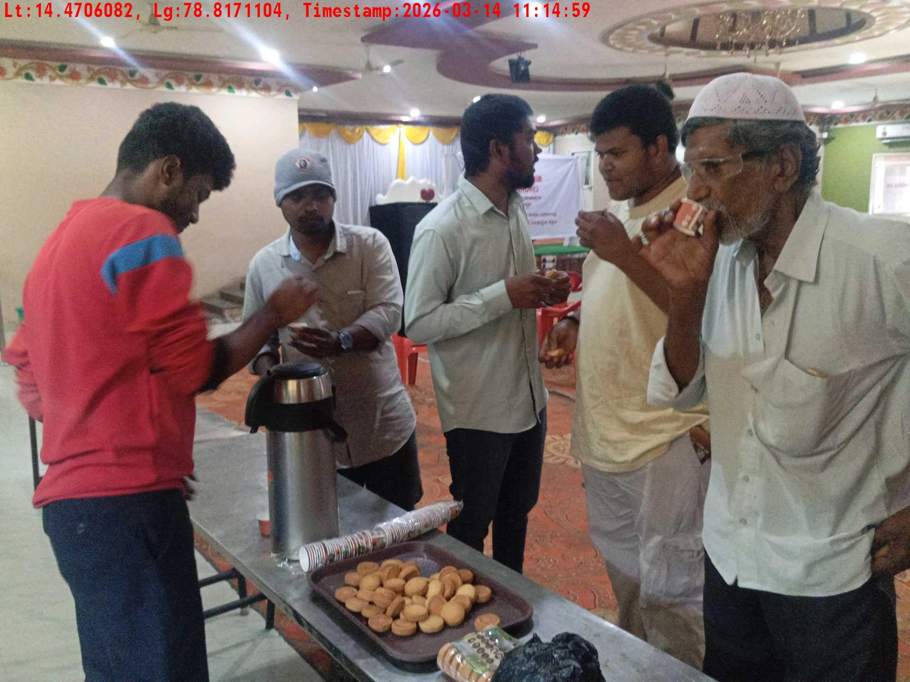
Date | Team | City | Agency Name | Promoter Name | Location Name
14-03-2026 | APTG-1 | AP/TG | Insight India | K Hiteesh Kumar | Thirupathi
Tea & coffee arrangement picture
Tea & coffee with crowd

Slide 4
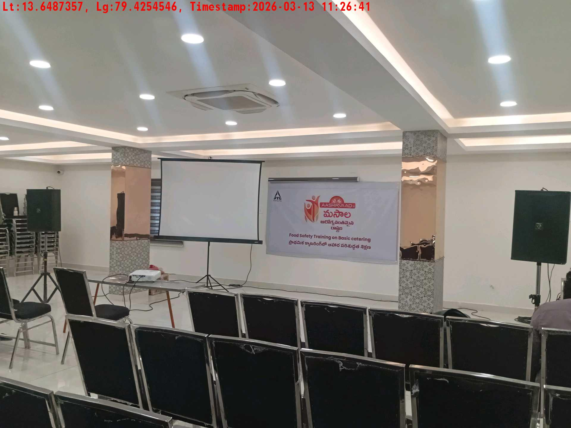
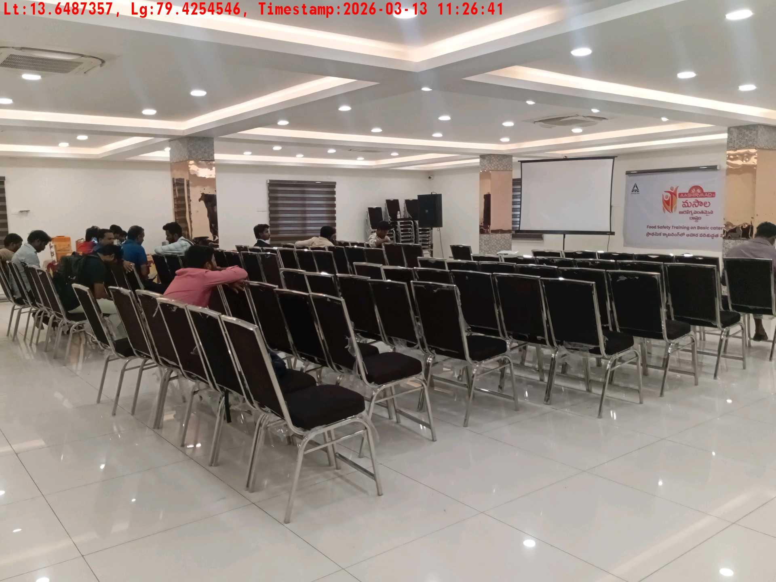
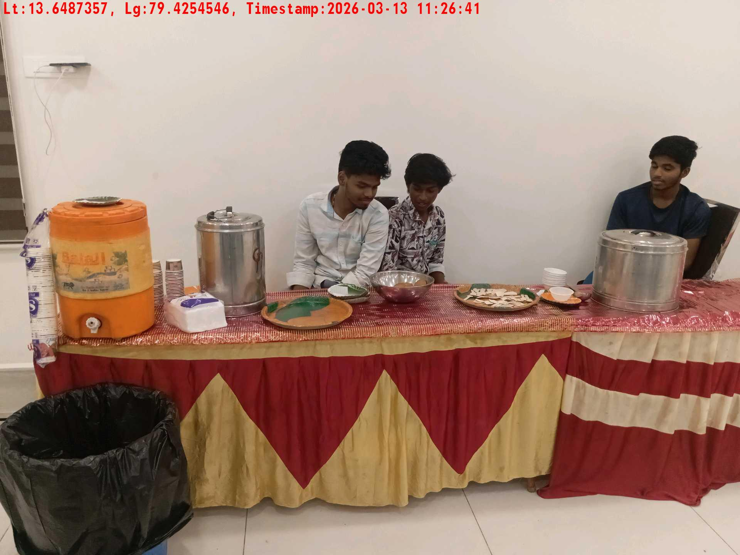
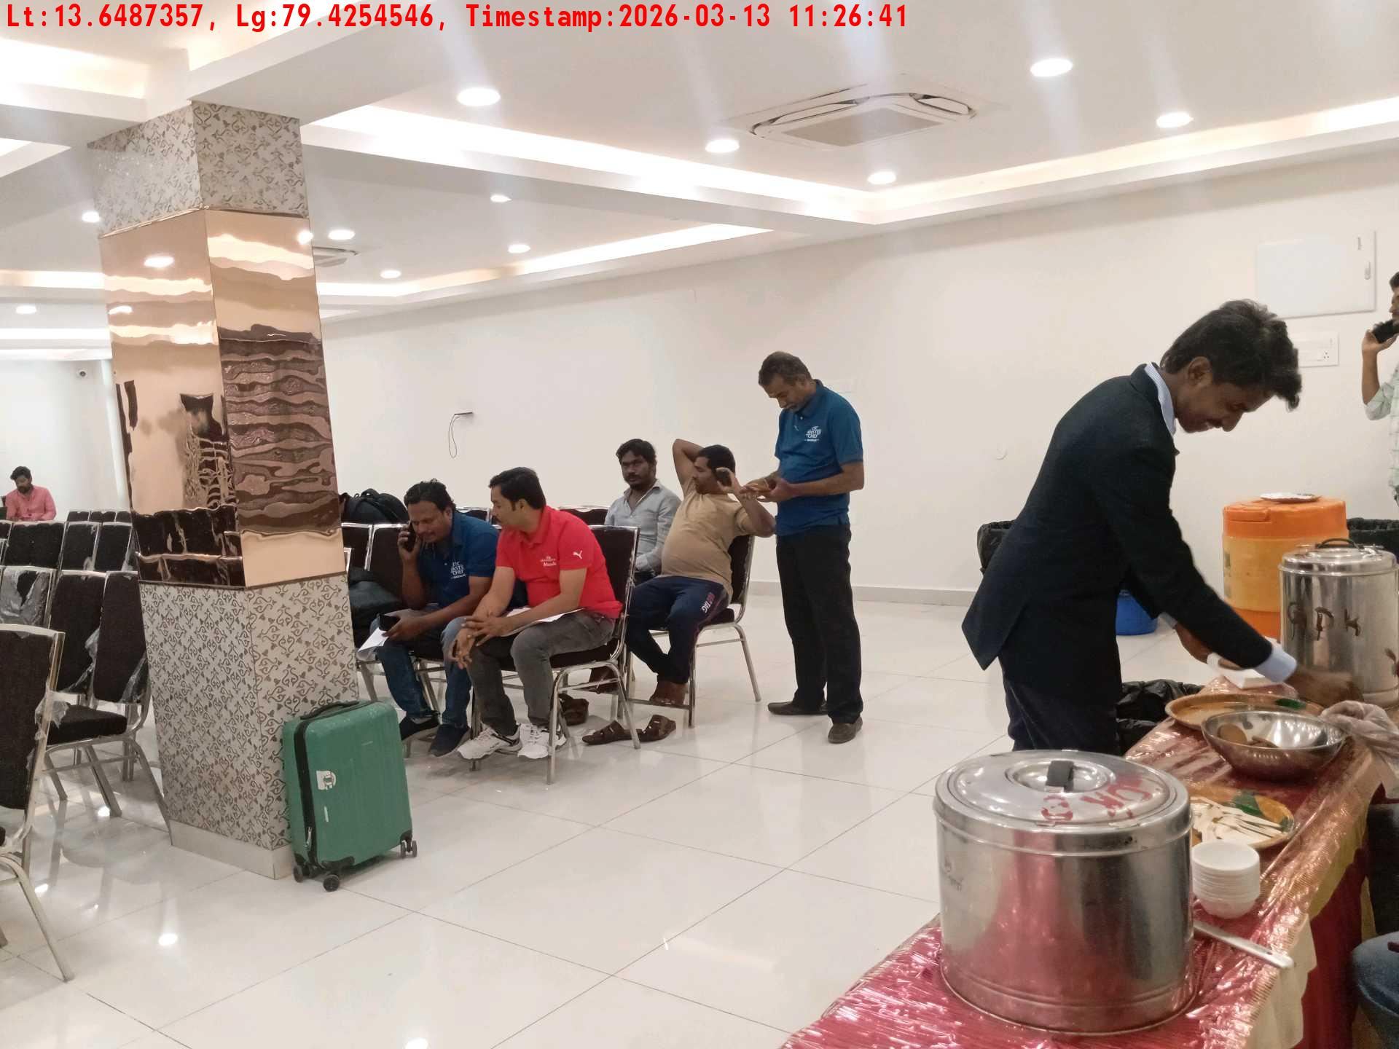
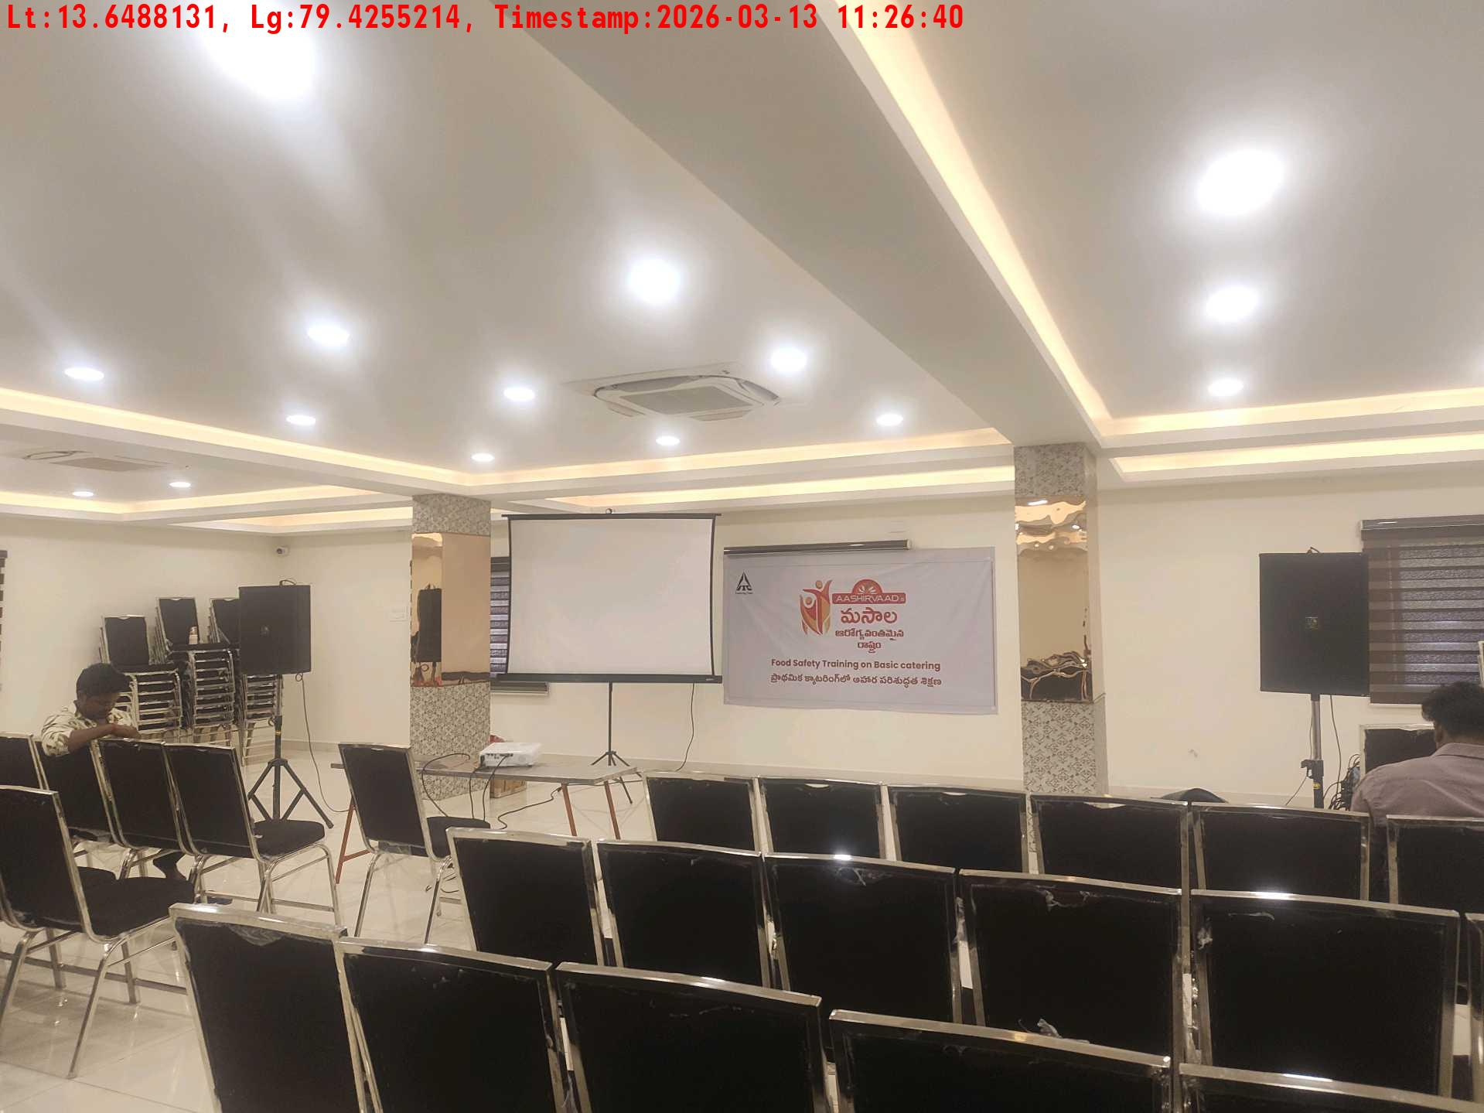
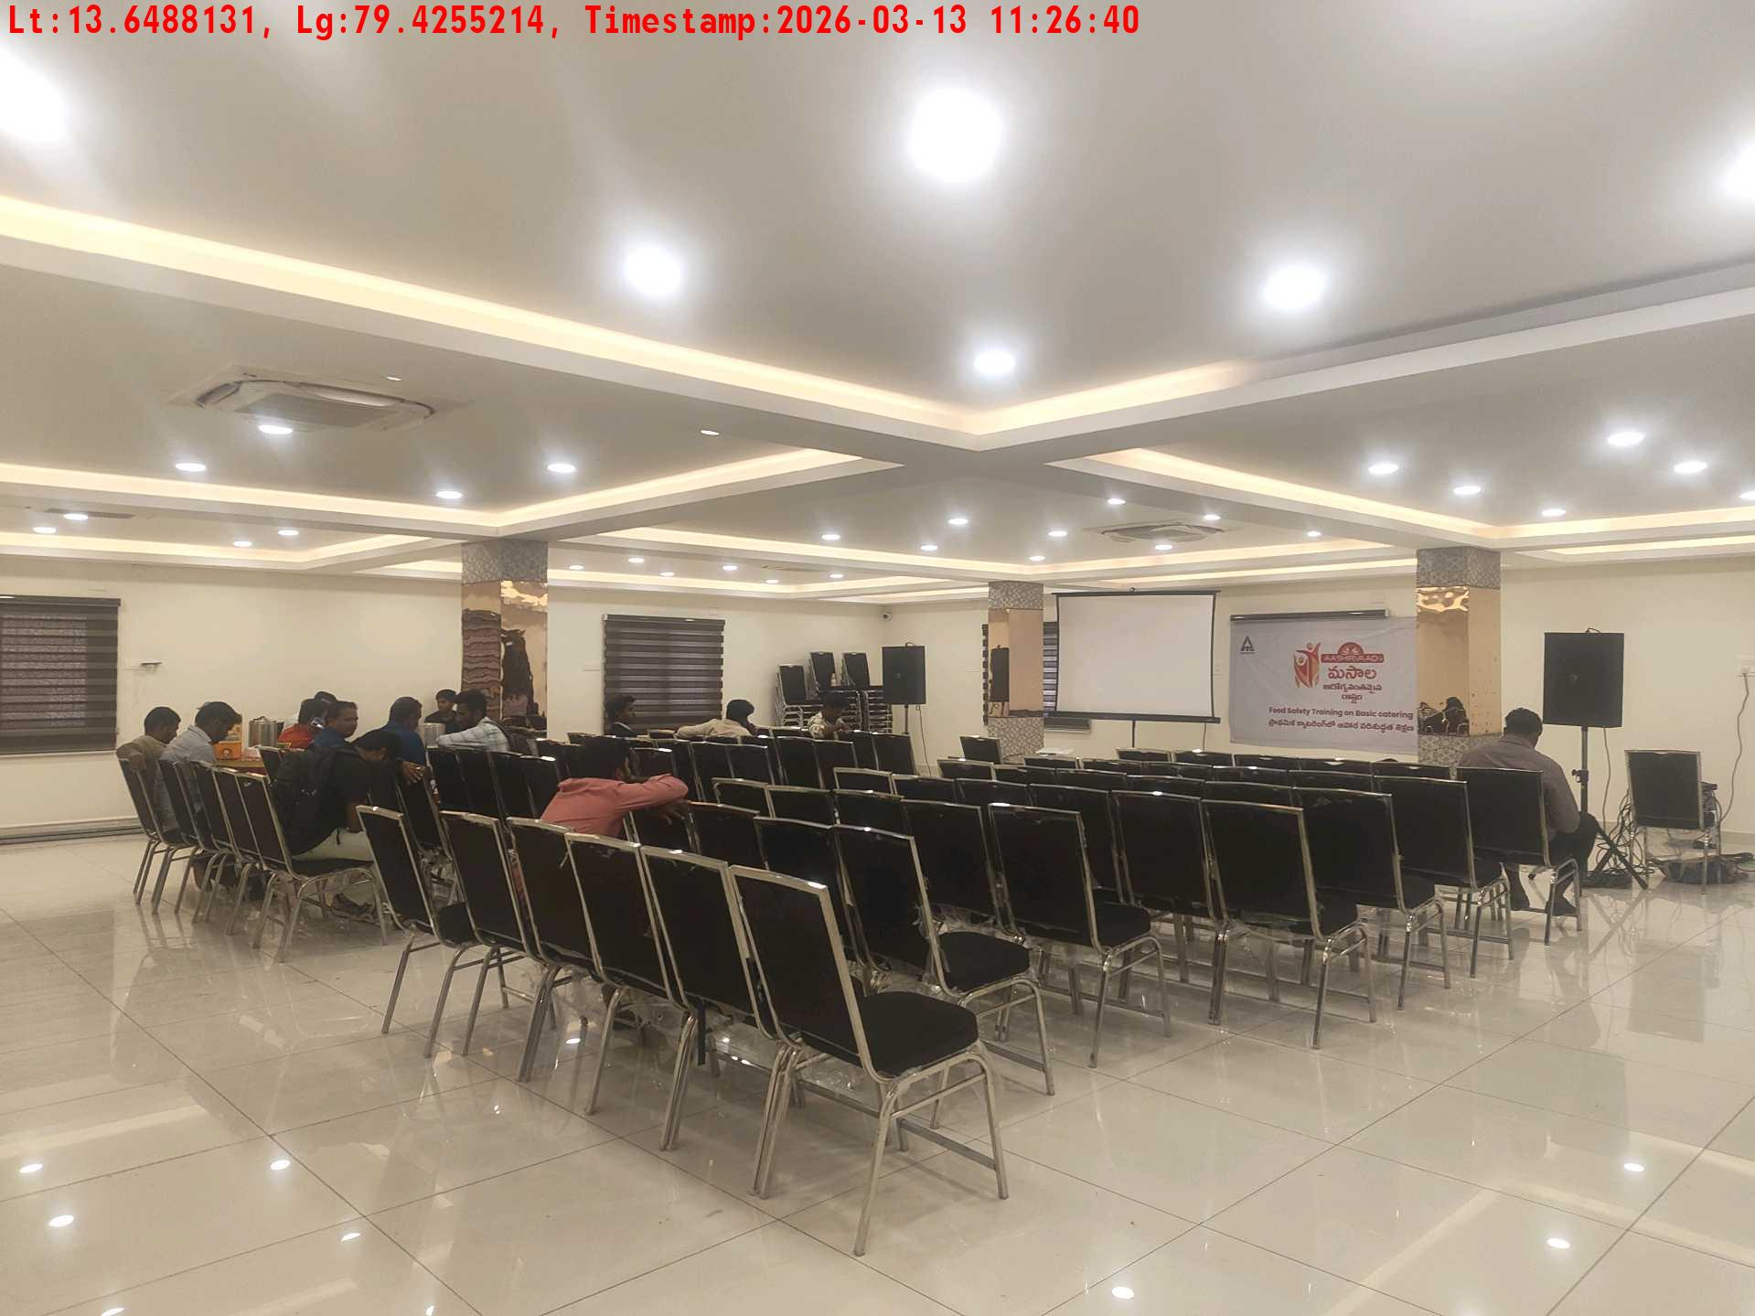
Date | Team | City | Agency Name | Promoter Name | Location Name
13-03-2026 | APTG-1 | AP/TG | Insight India | K Hiteesh Kumar | Thirupathi
Long shot picture covering banner
Long shot picture covering table
Tea & coffee arrangement picture
Tea & coffee with crowd
Long shot picture covering banner
Long shot picture covering table

Slide 5
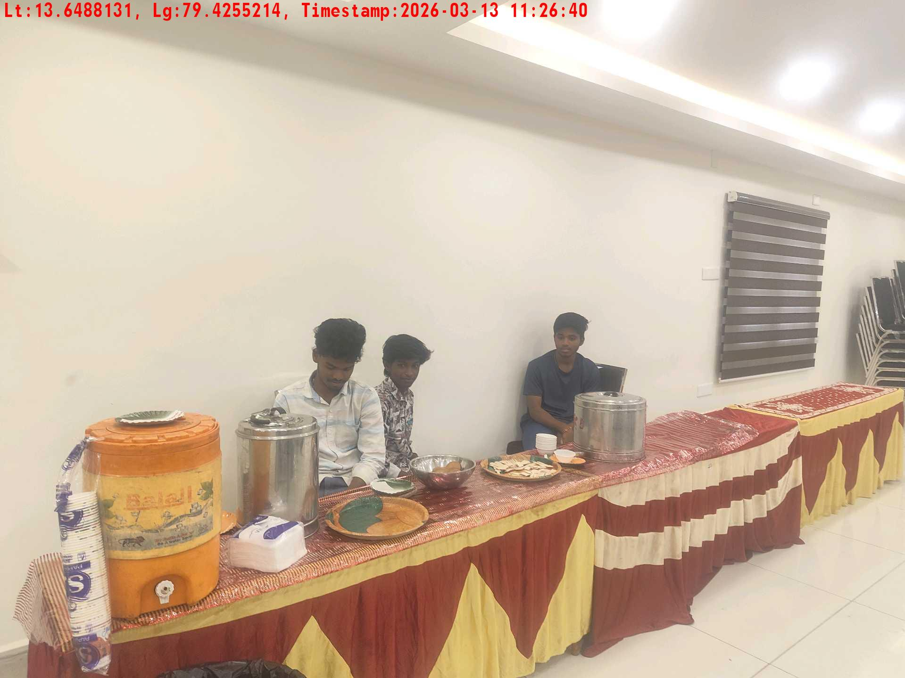
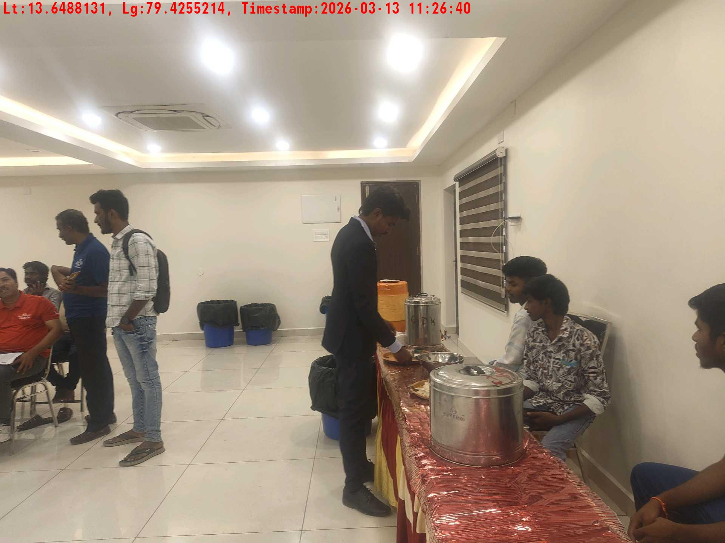
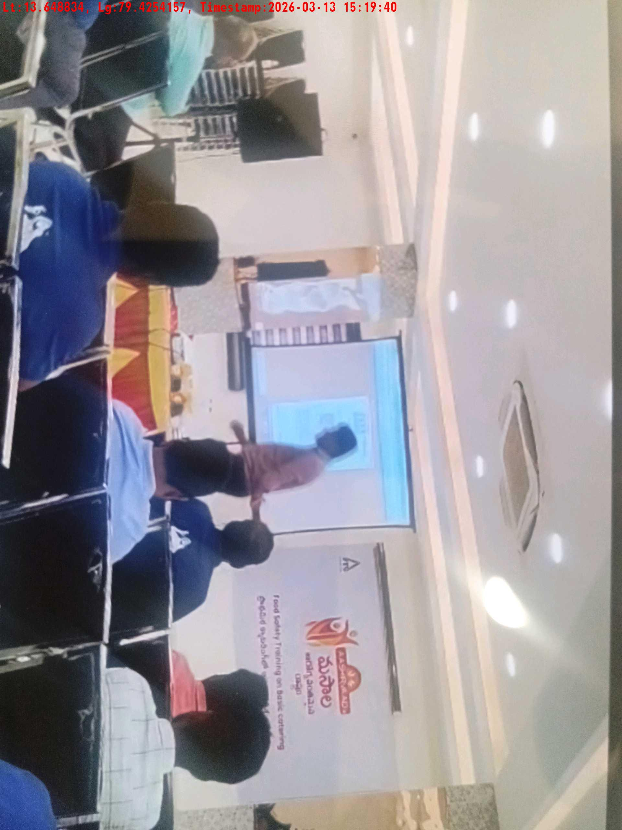
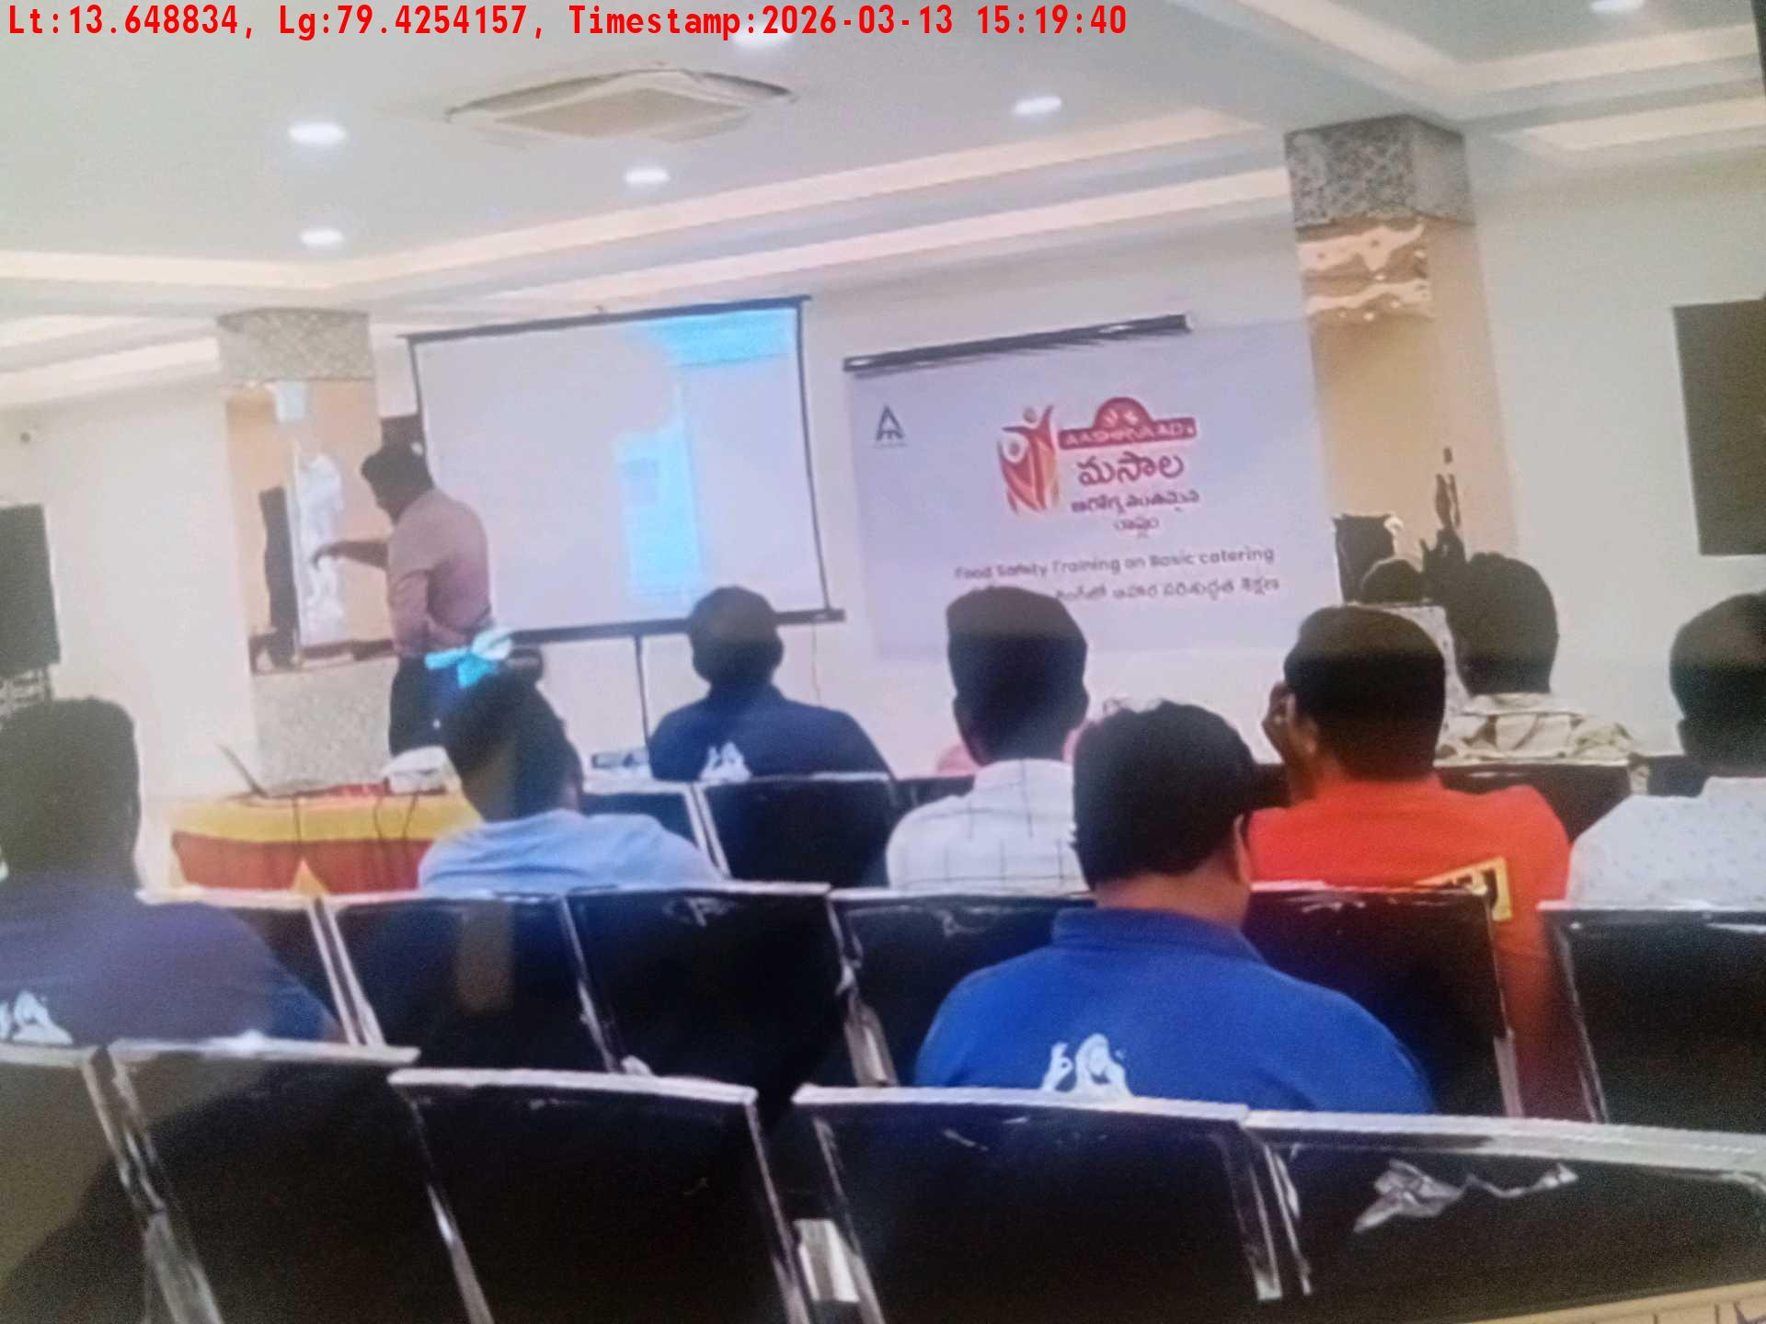
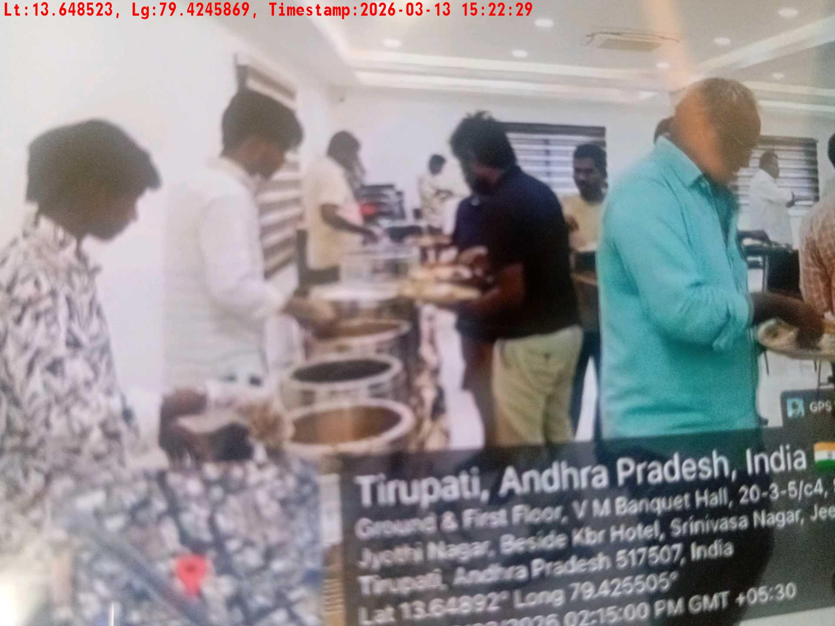
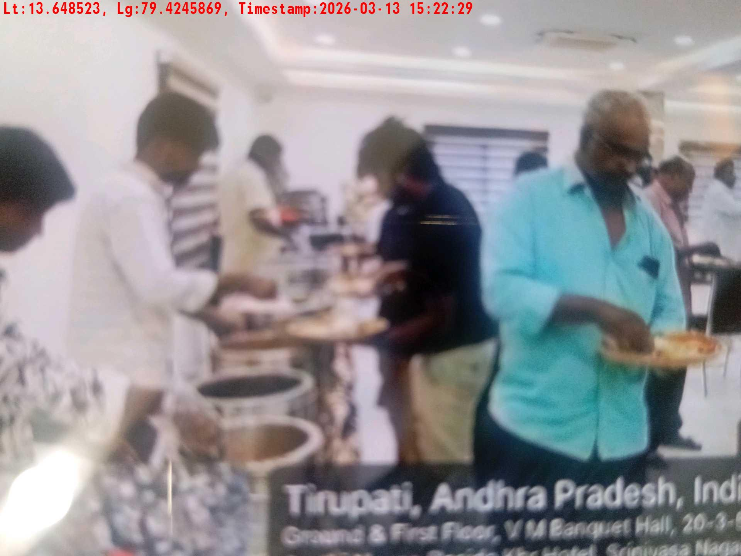
Date | Team | City | Agency Name | Promoter Name | Location Name
13-03-2026 | APTG-1 | AP/TG | Insight India | K Hiteesh Kumar | Thirupathi
Tea & coffee arrangement picture
Tea & coffee with crowd
Trainer with presentation picture
Crowd visibility picture
Lunch setup picture-1
Lunch setup picture-2

Slide 6
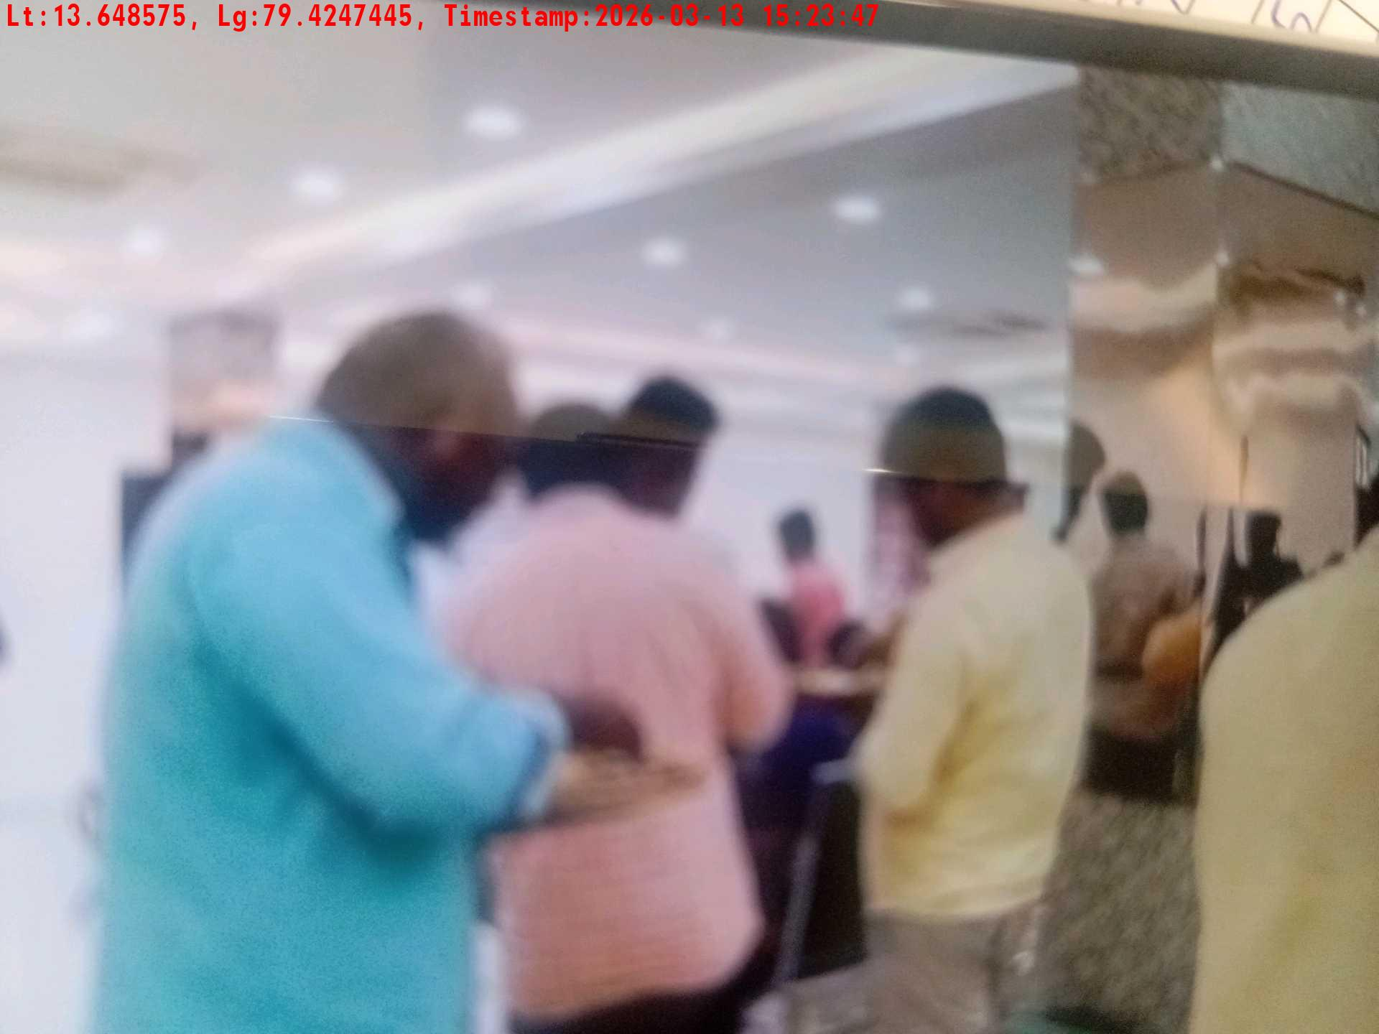
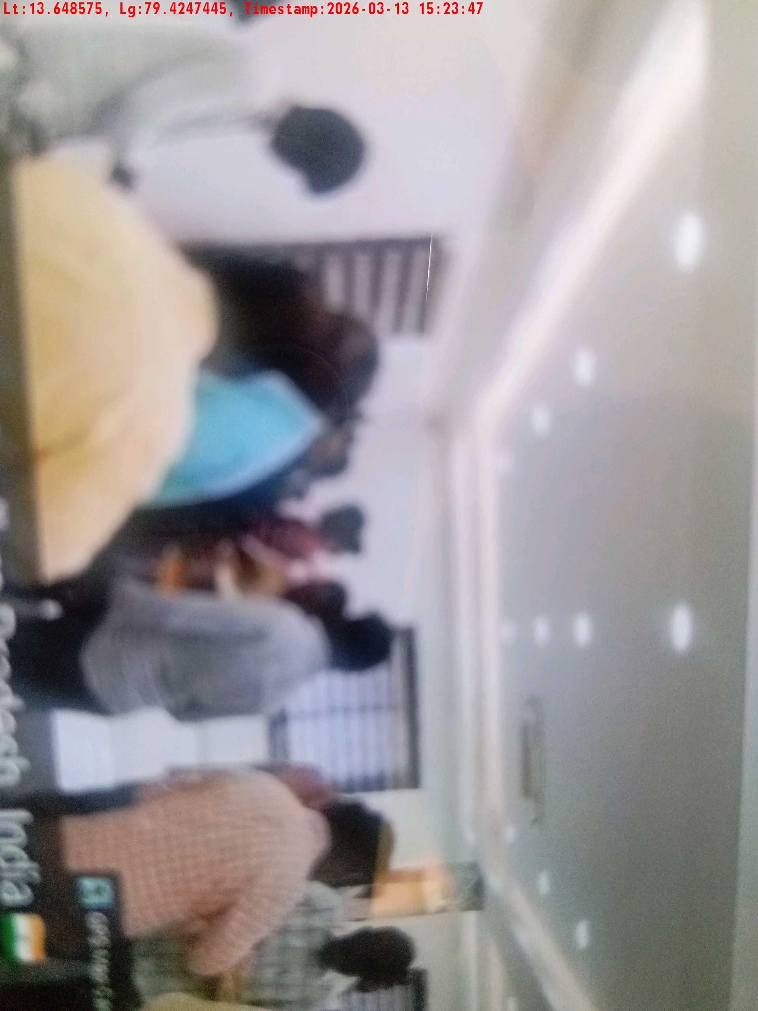
Date | Team | City | Agency Name | Promoter Name | Location Name
13-03-2026 | APTG-1 | AP/TG | Insight India | K Hiteesh Kumar | Thirupathi
Lunch eating pictures-1
Lunch eating pictures-2

