Slide 1
Cook Meet Report

Slide 2
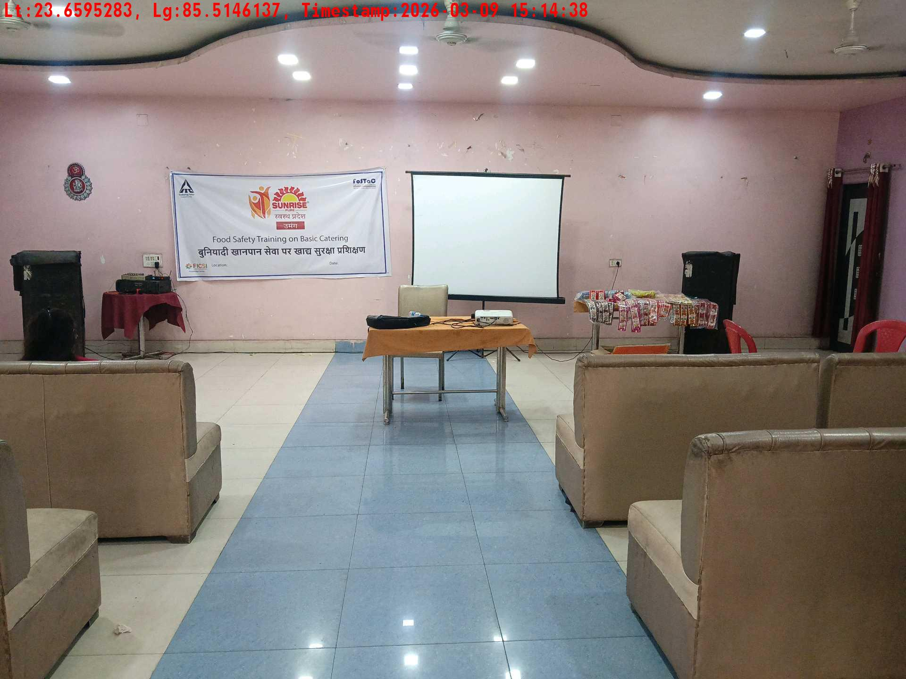
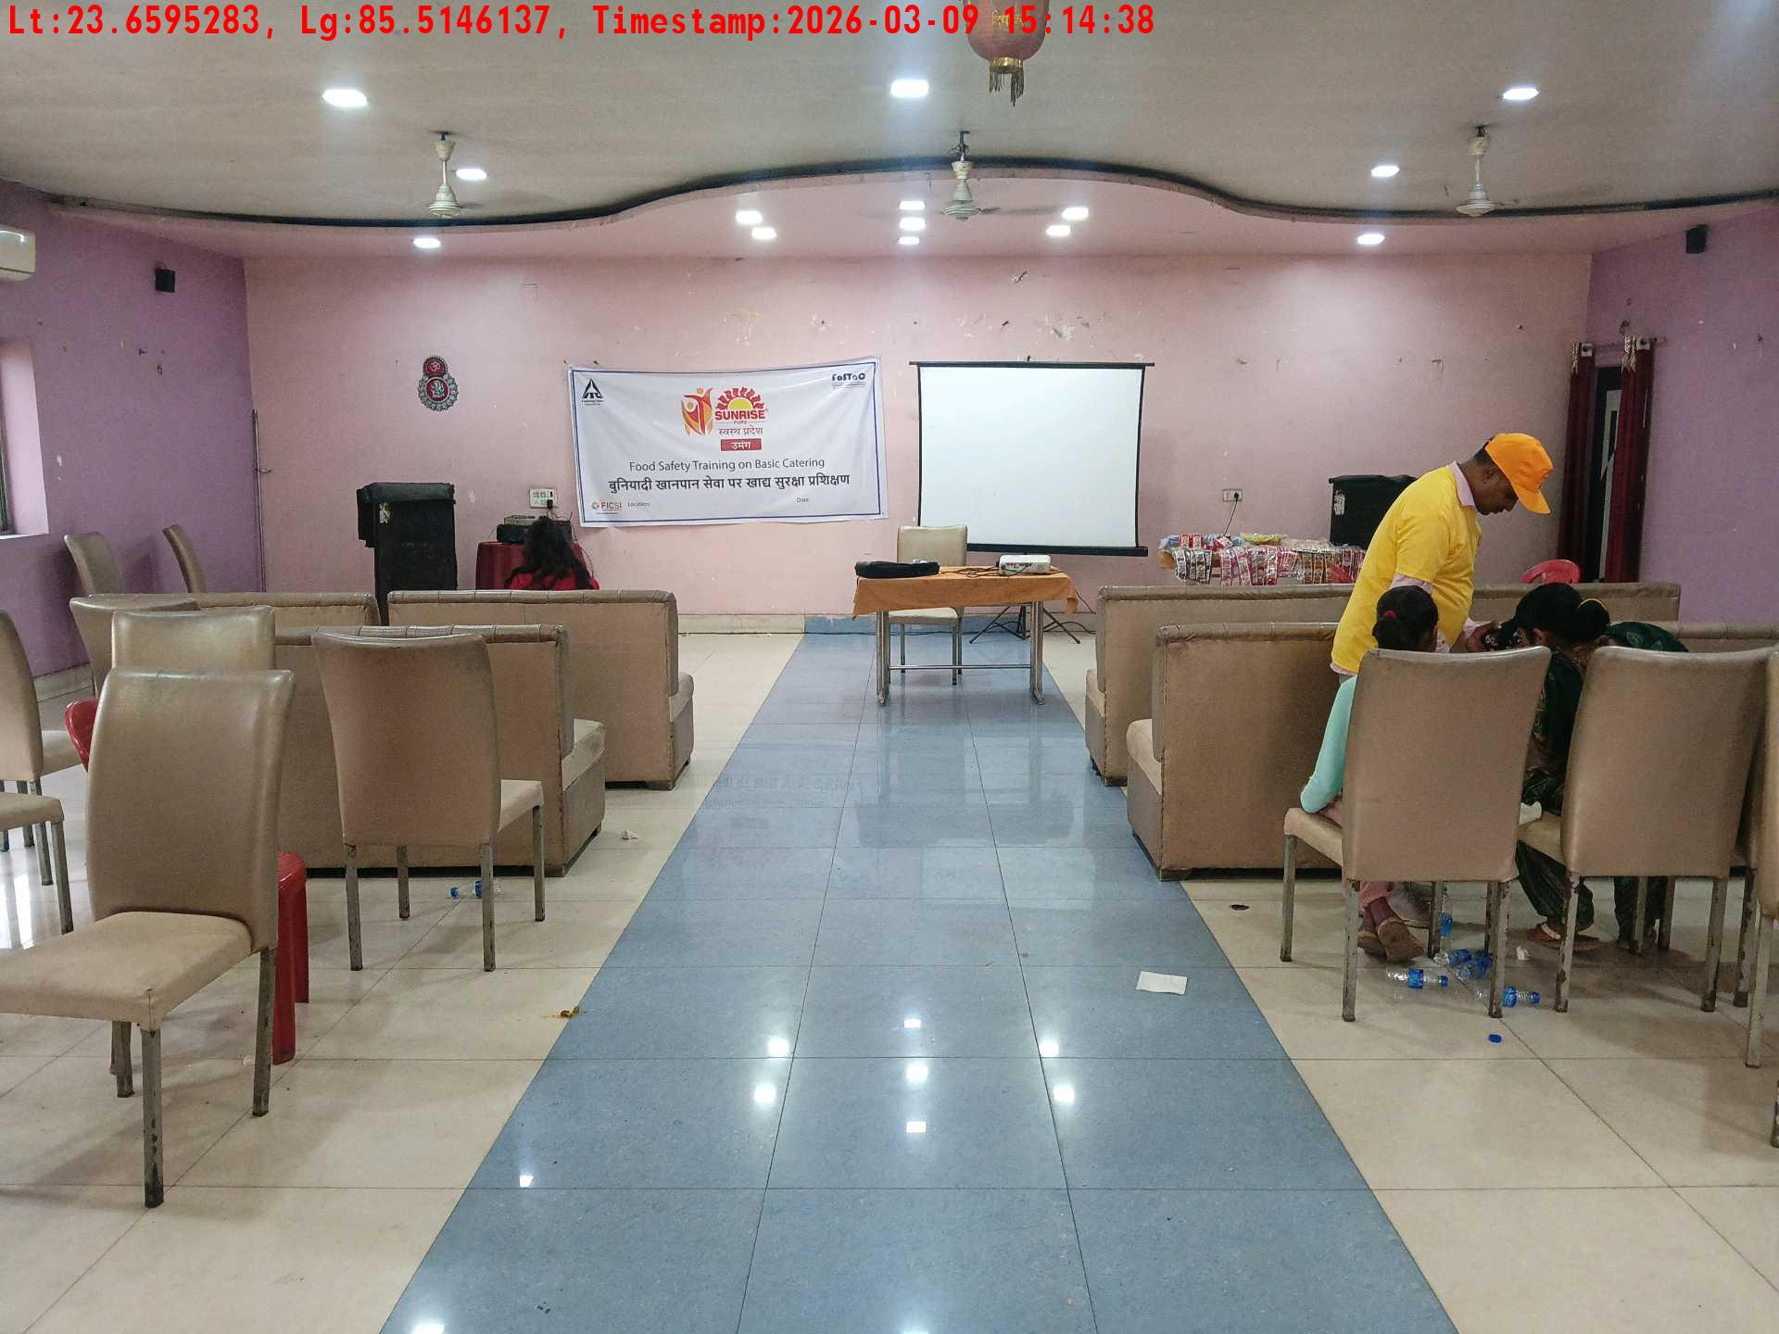
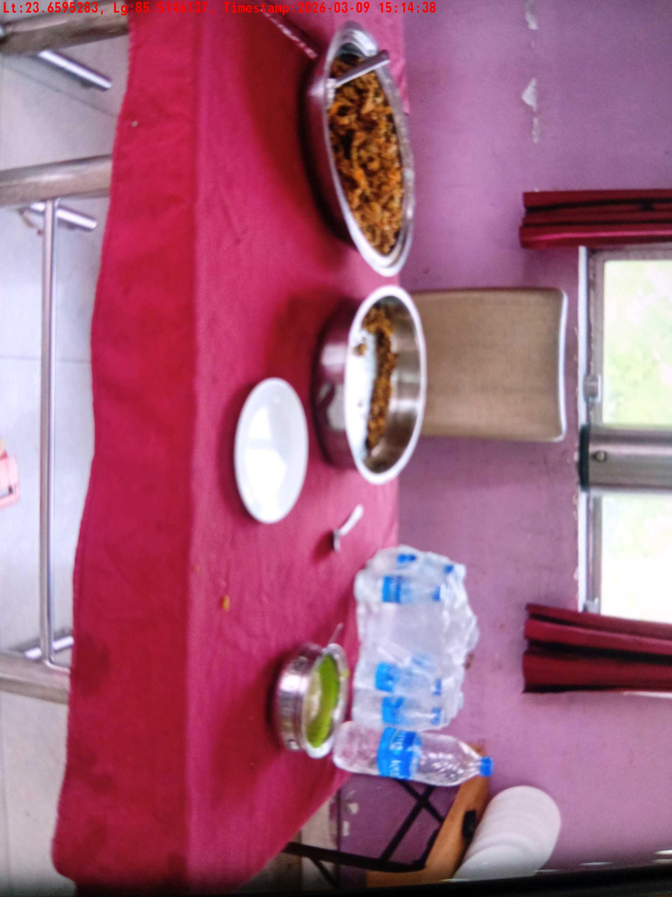
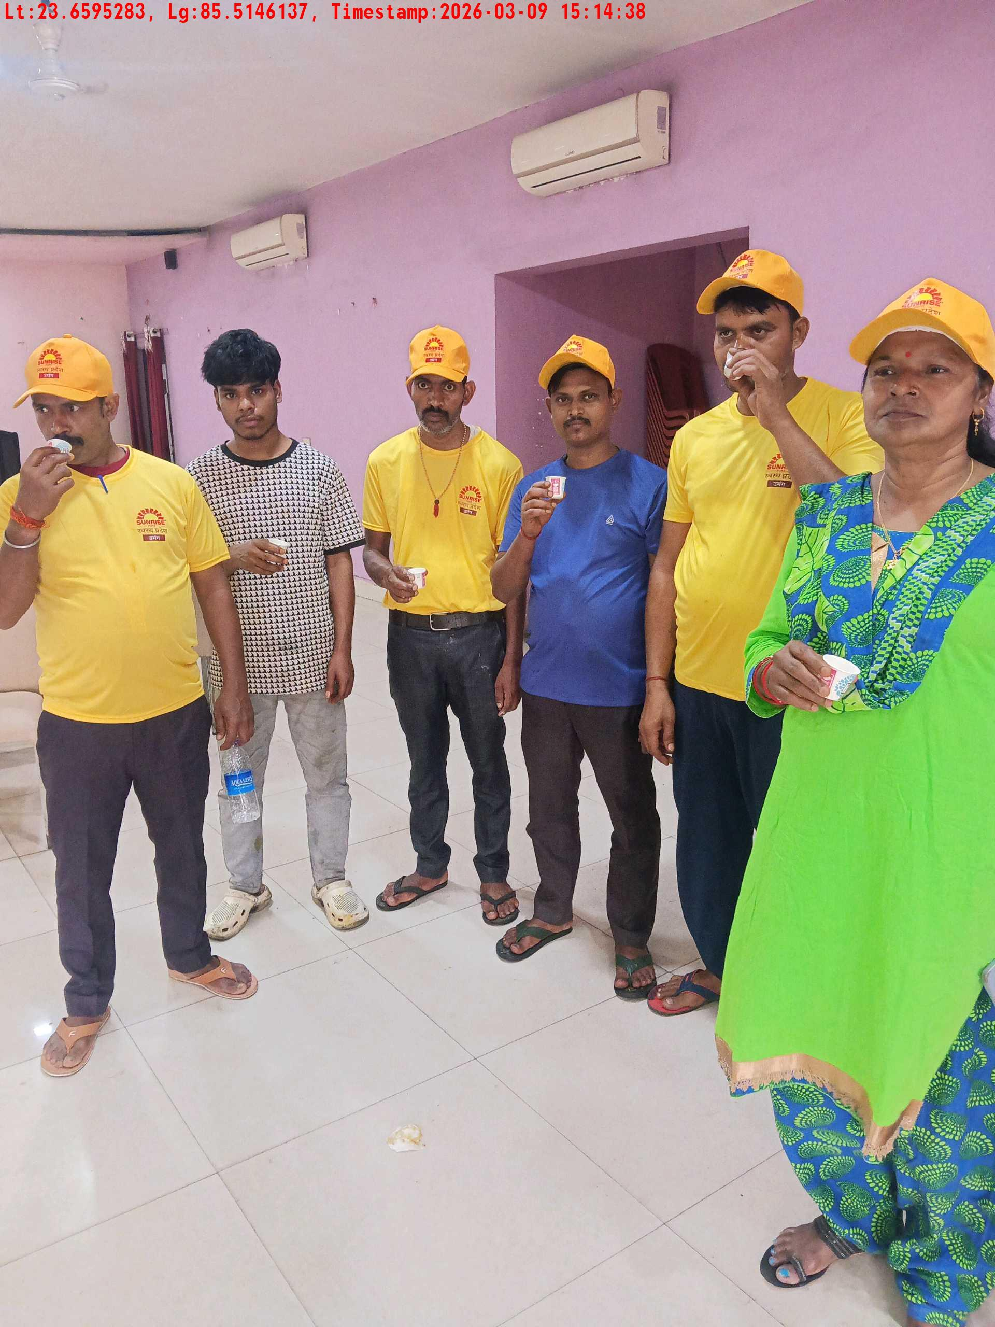
Date | Team | City | Agency Name | Promoter Name | Location Name
09-03-2026 | Jharkhand-1 | Jharkhand | Mindshaft | test | Jharkhand
Long shot picture covering banner
Long shot picture covering table
Tea & coffee arrangement picture
Tea & coffee with crowd

Slide 3
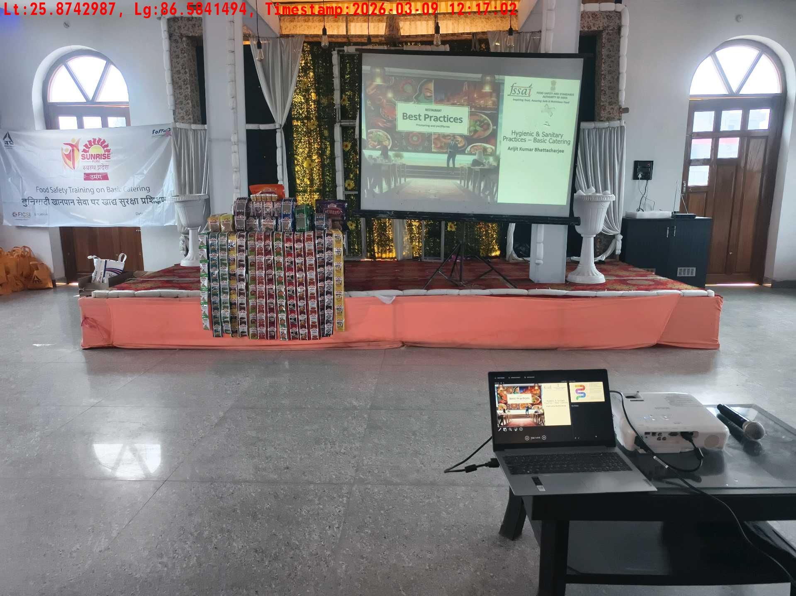
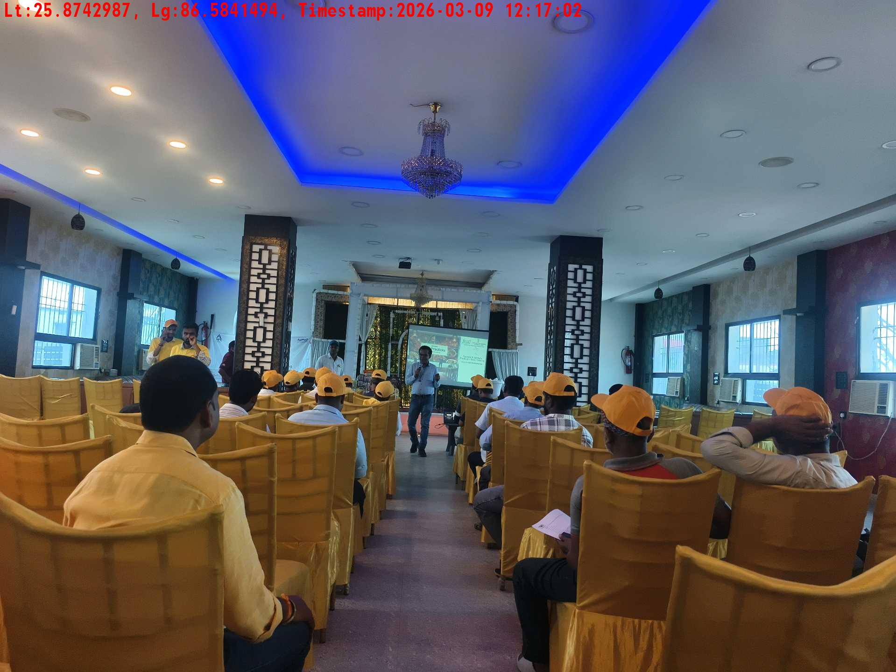
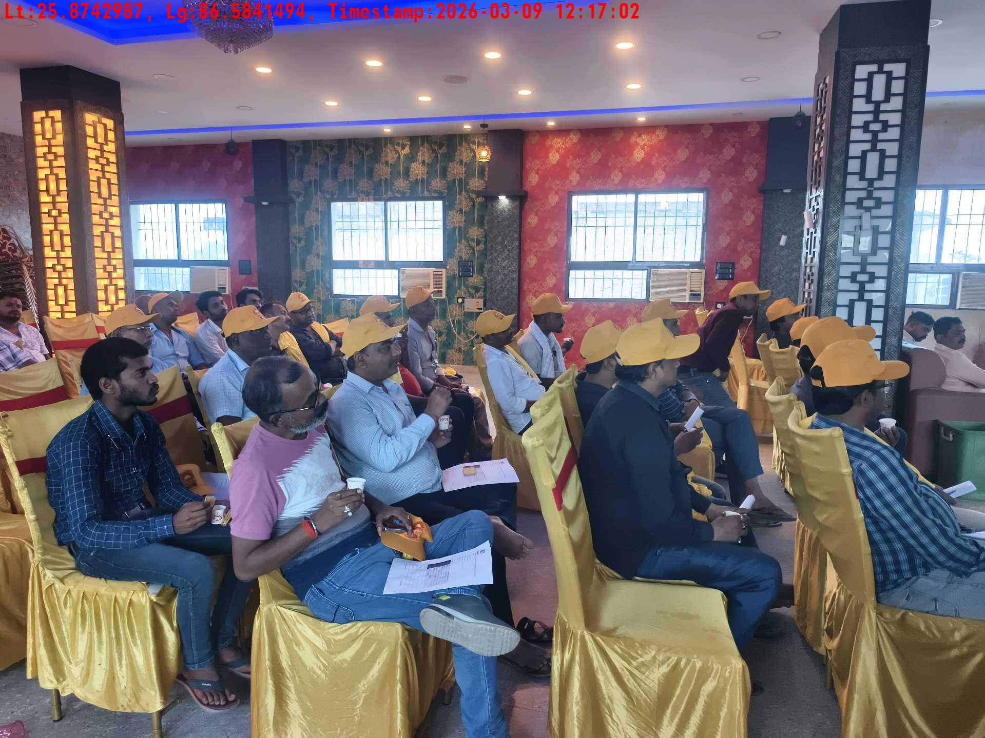
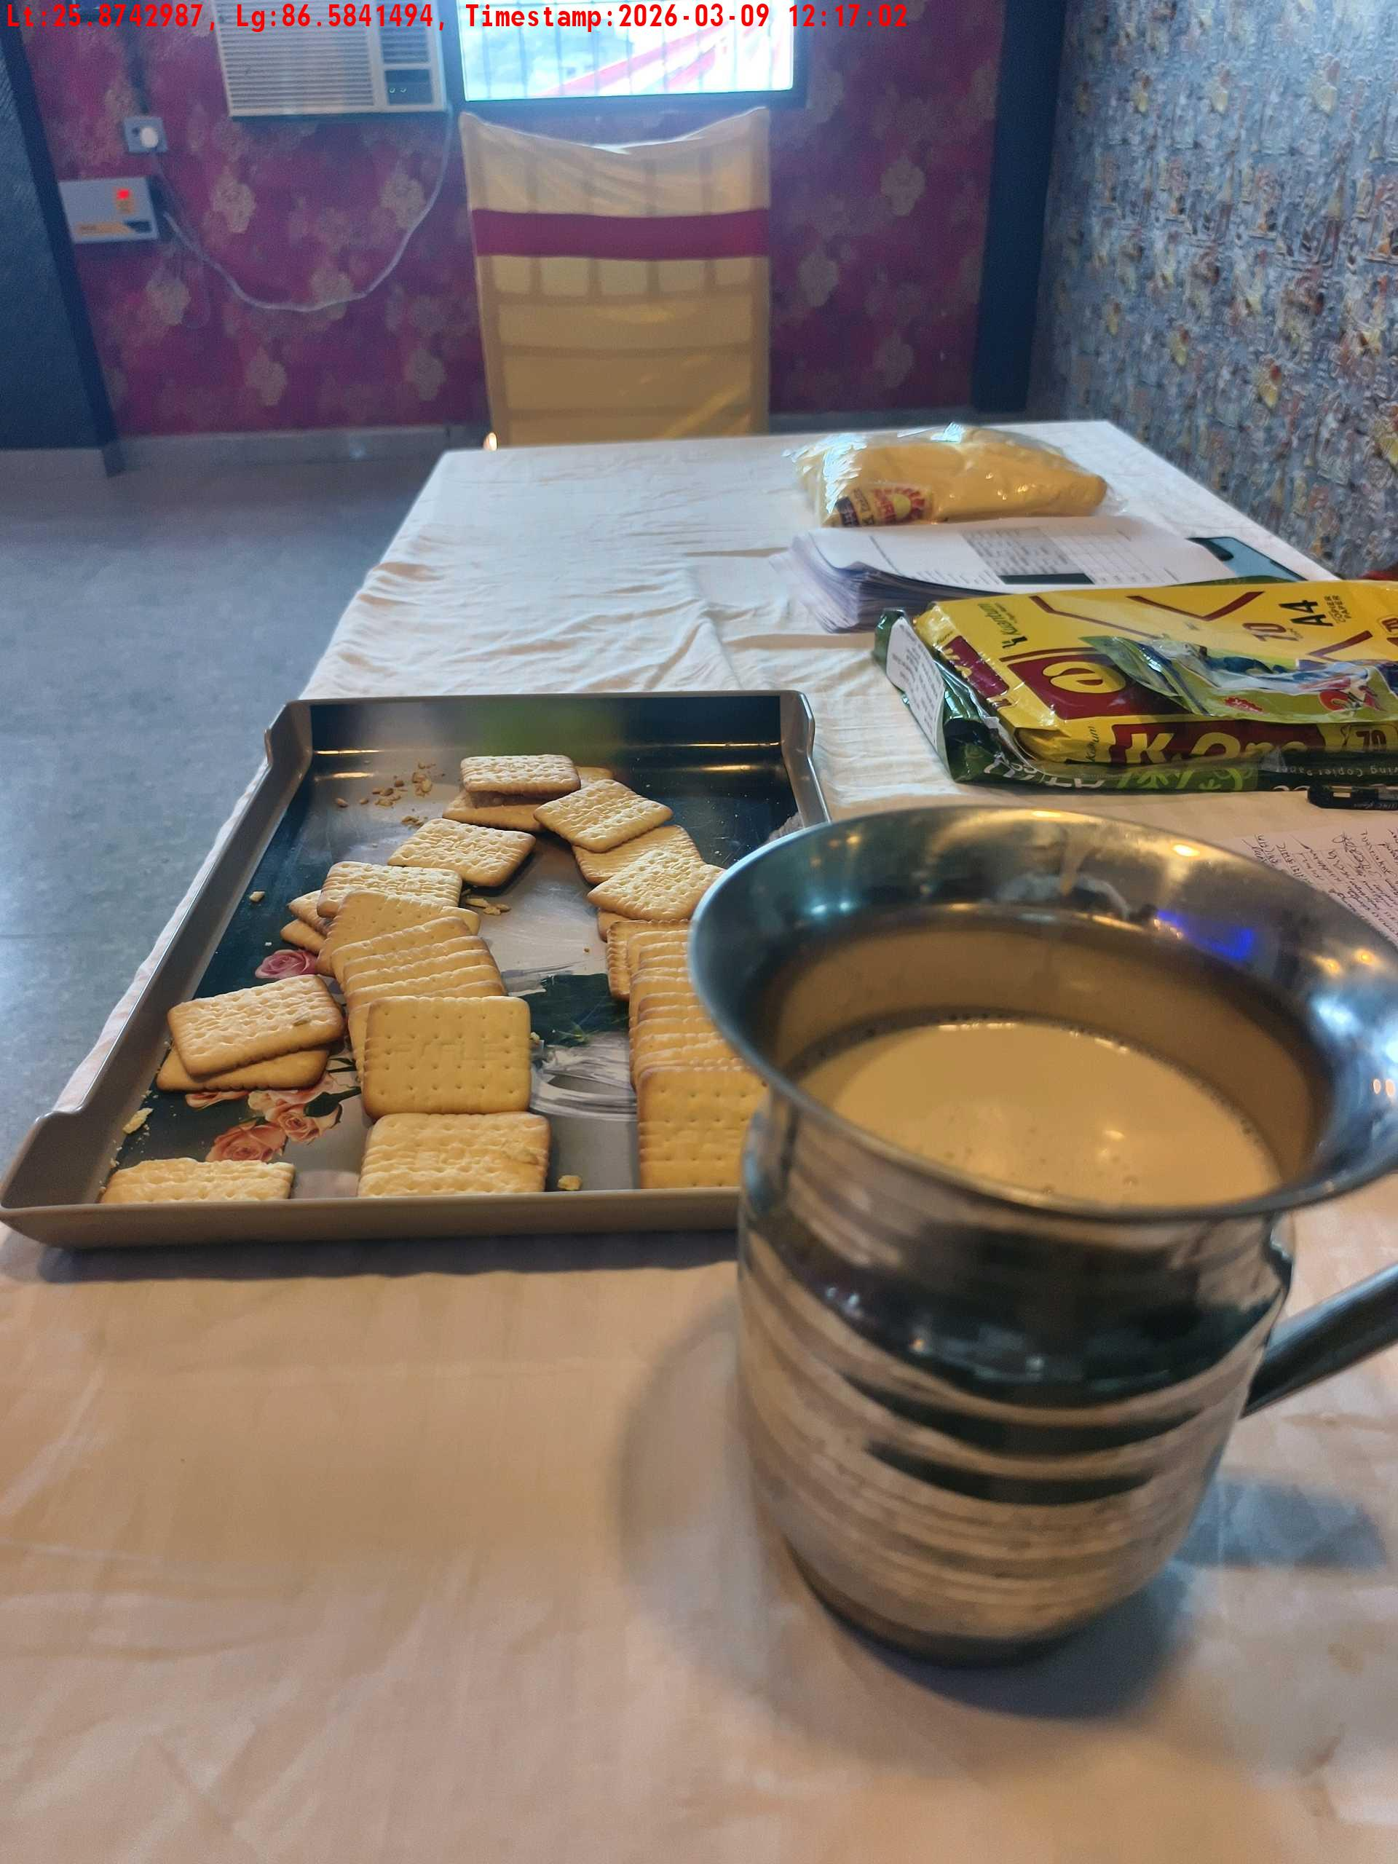
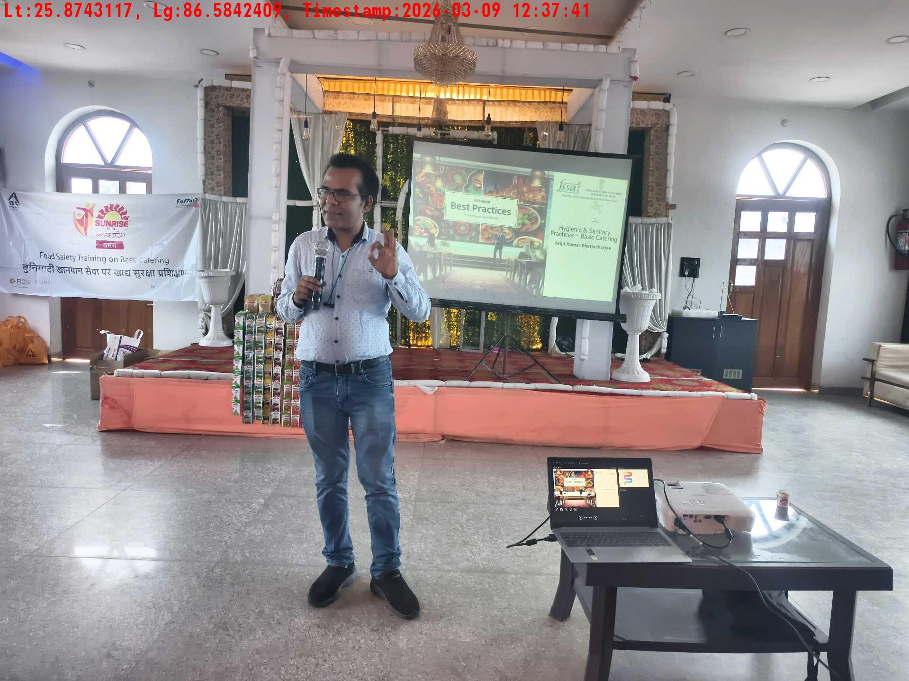
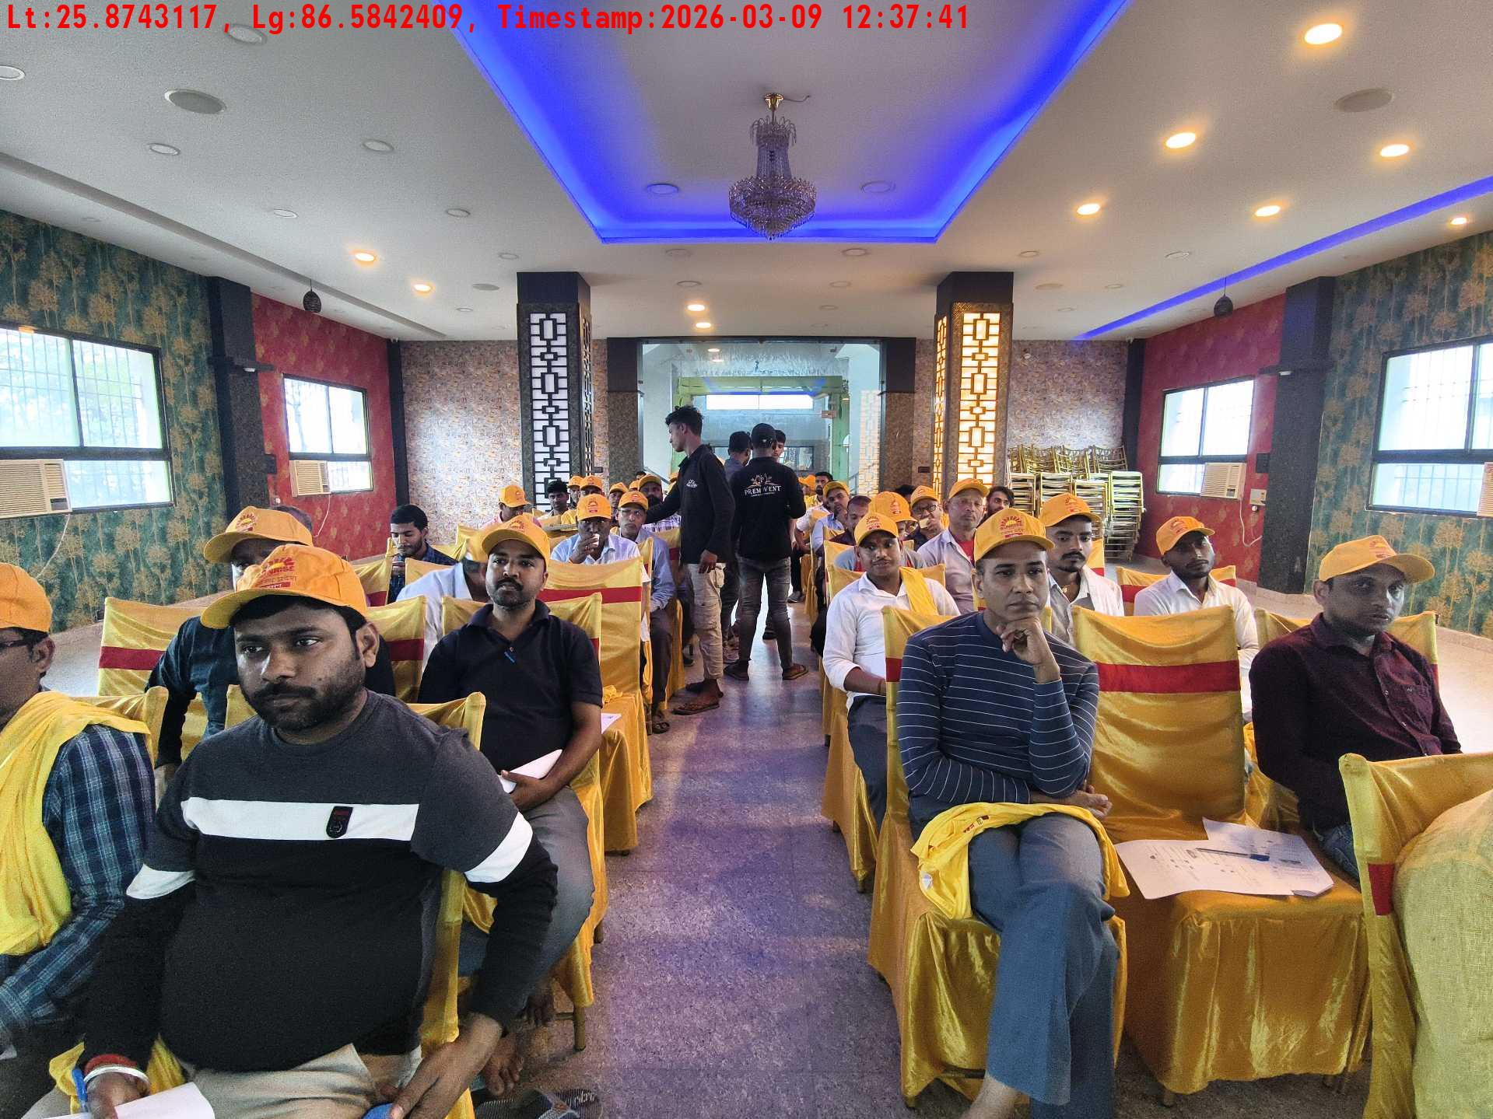
Date | Team | City | Agency Name | Promoter Name | Location Name
09-03-2026 | Bihar-1 | Bihar | Mindshaft | twinkle | Katihar
Long shot picture covering banner
Long shot picture covering table
Tea & coffee with crowd
Tea & coffee arrangement picture
Trainer with presentation picture
Crowd visibility picture

Slide 4
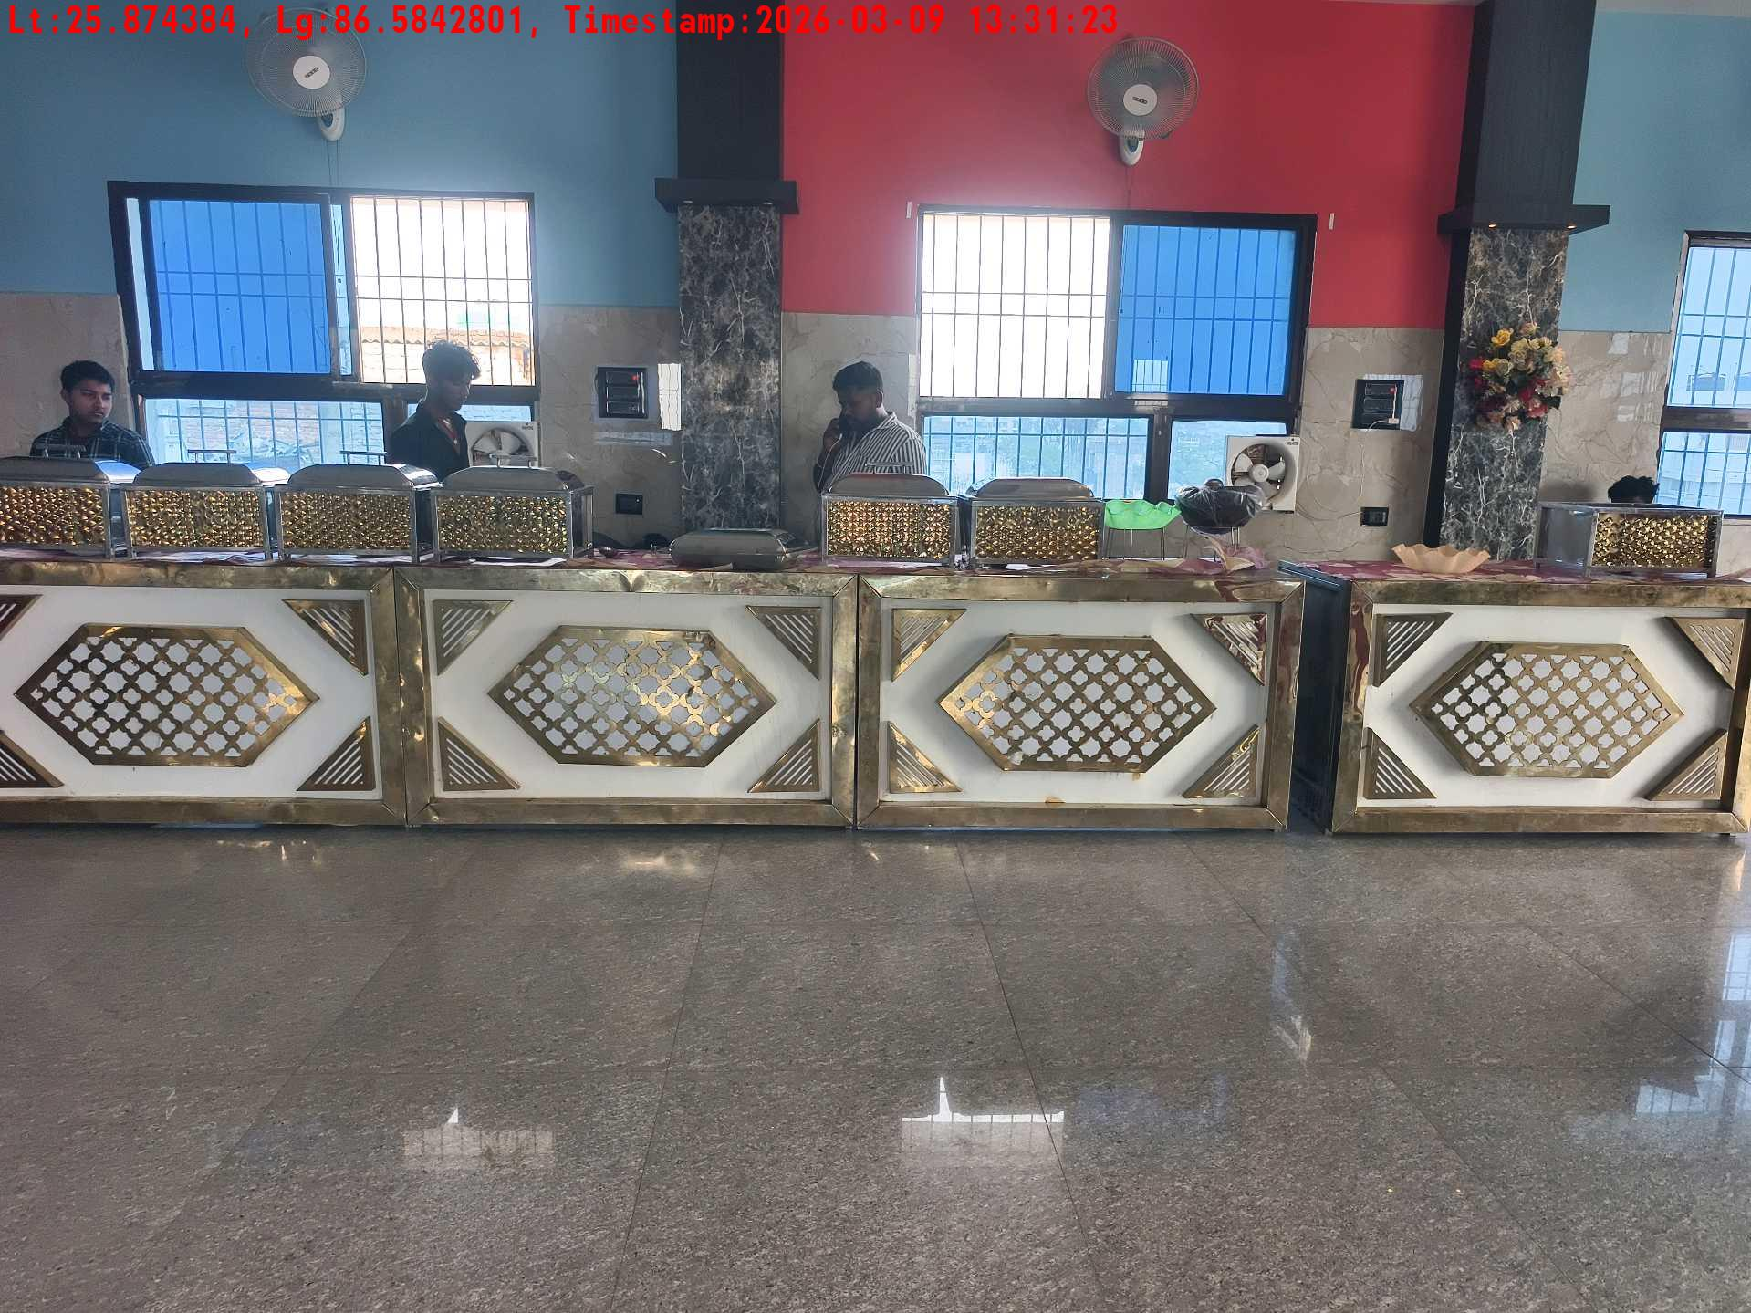
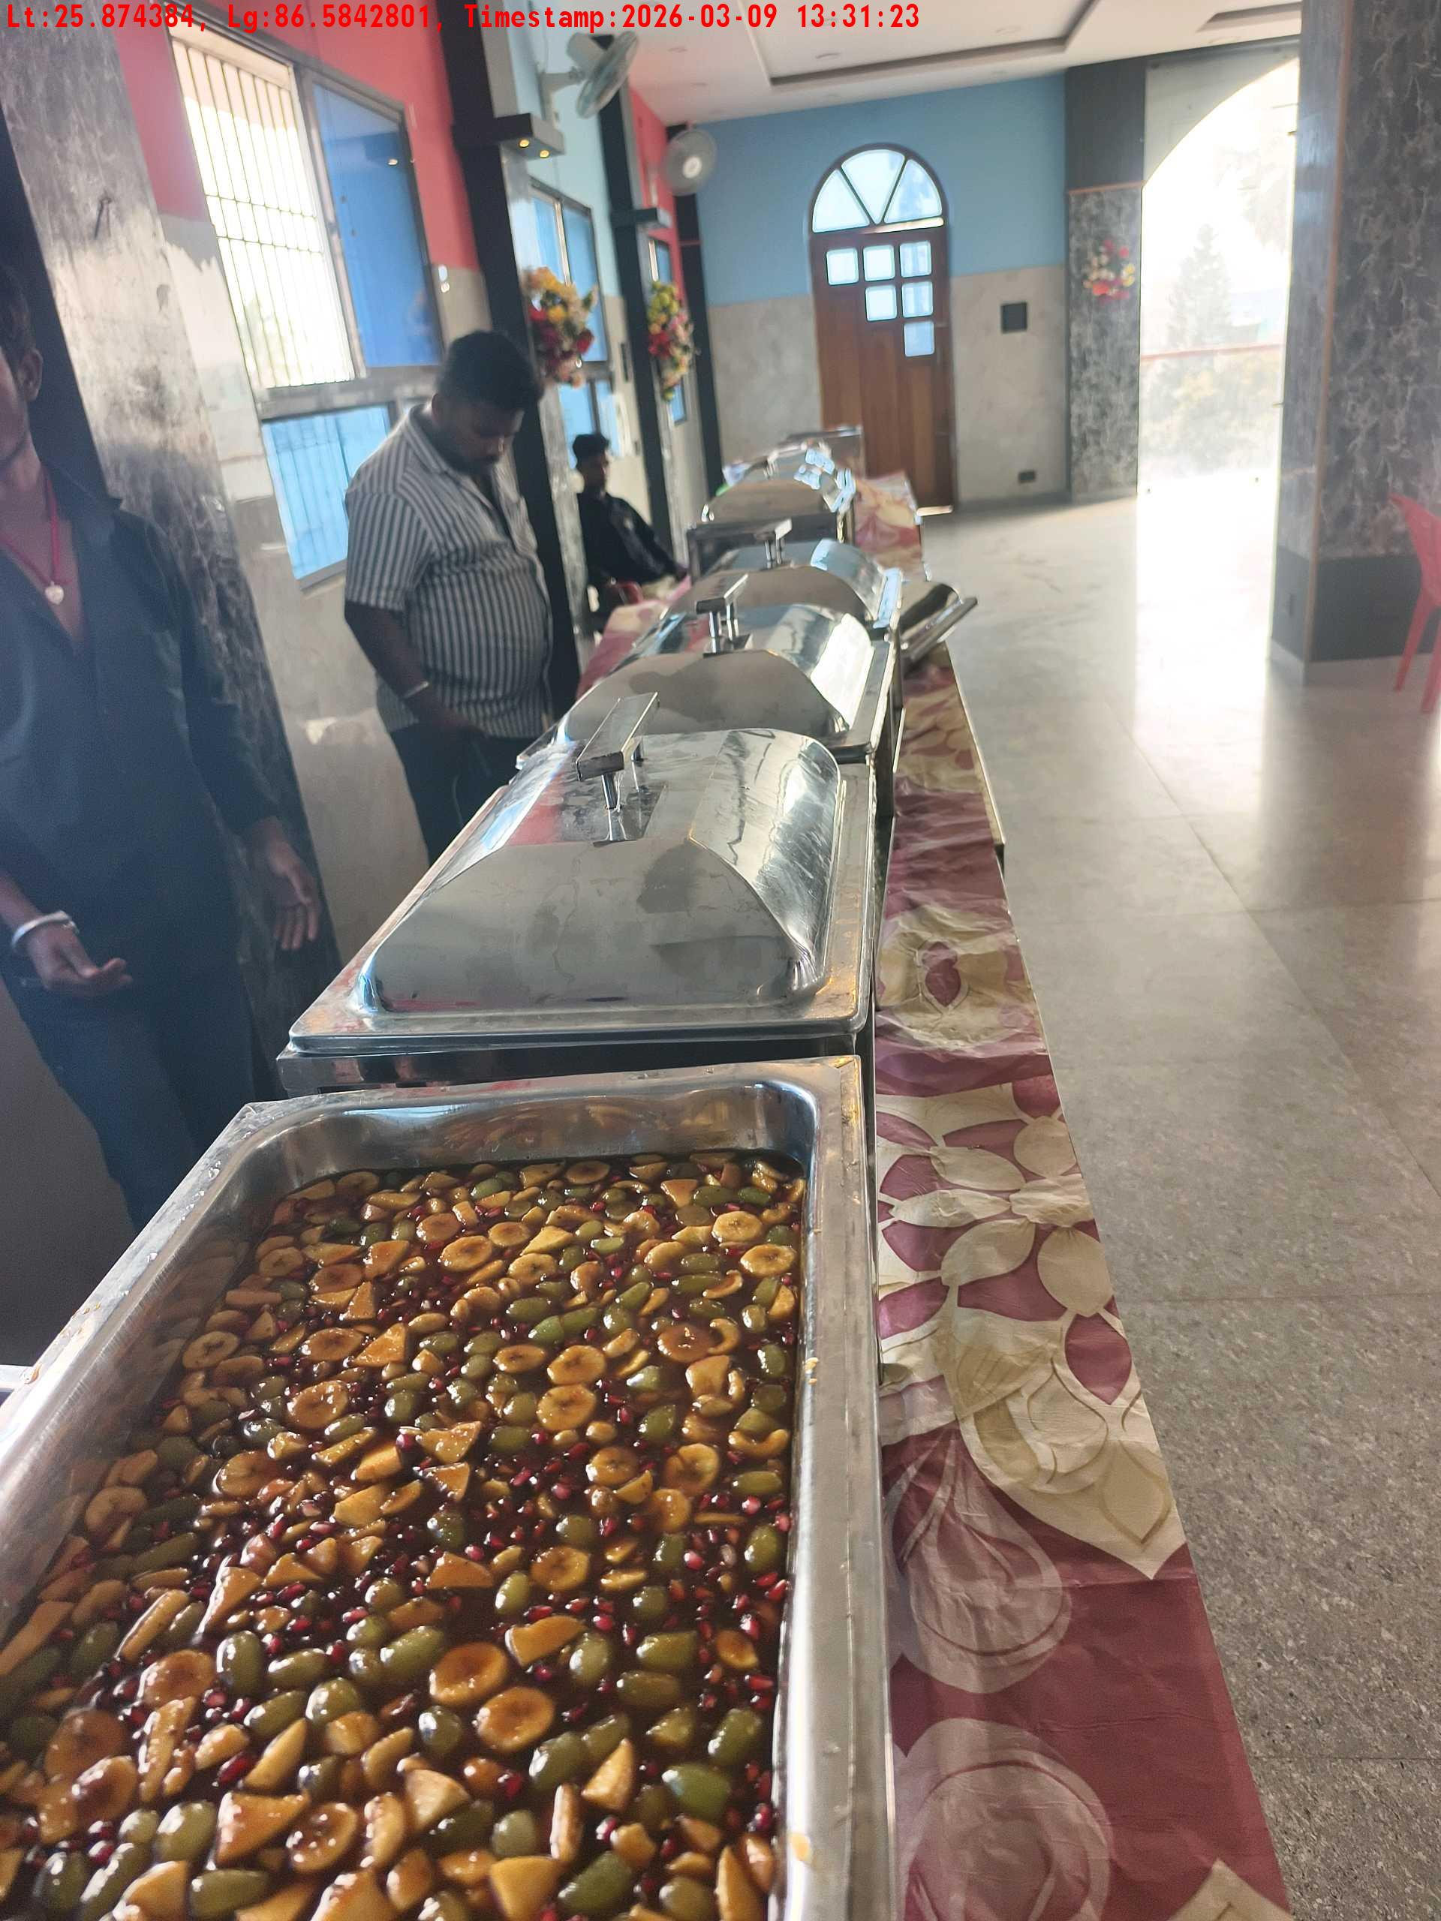
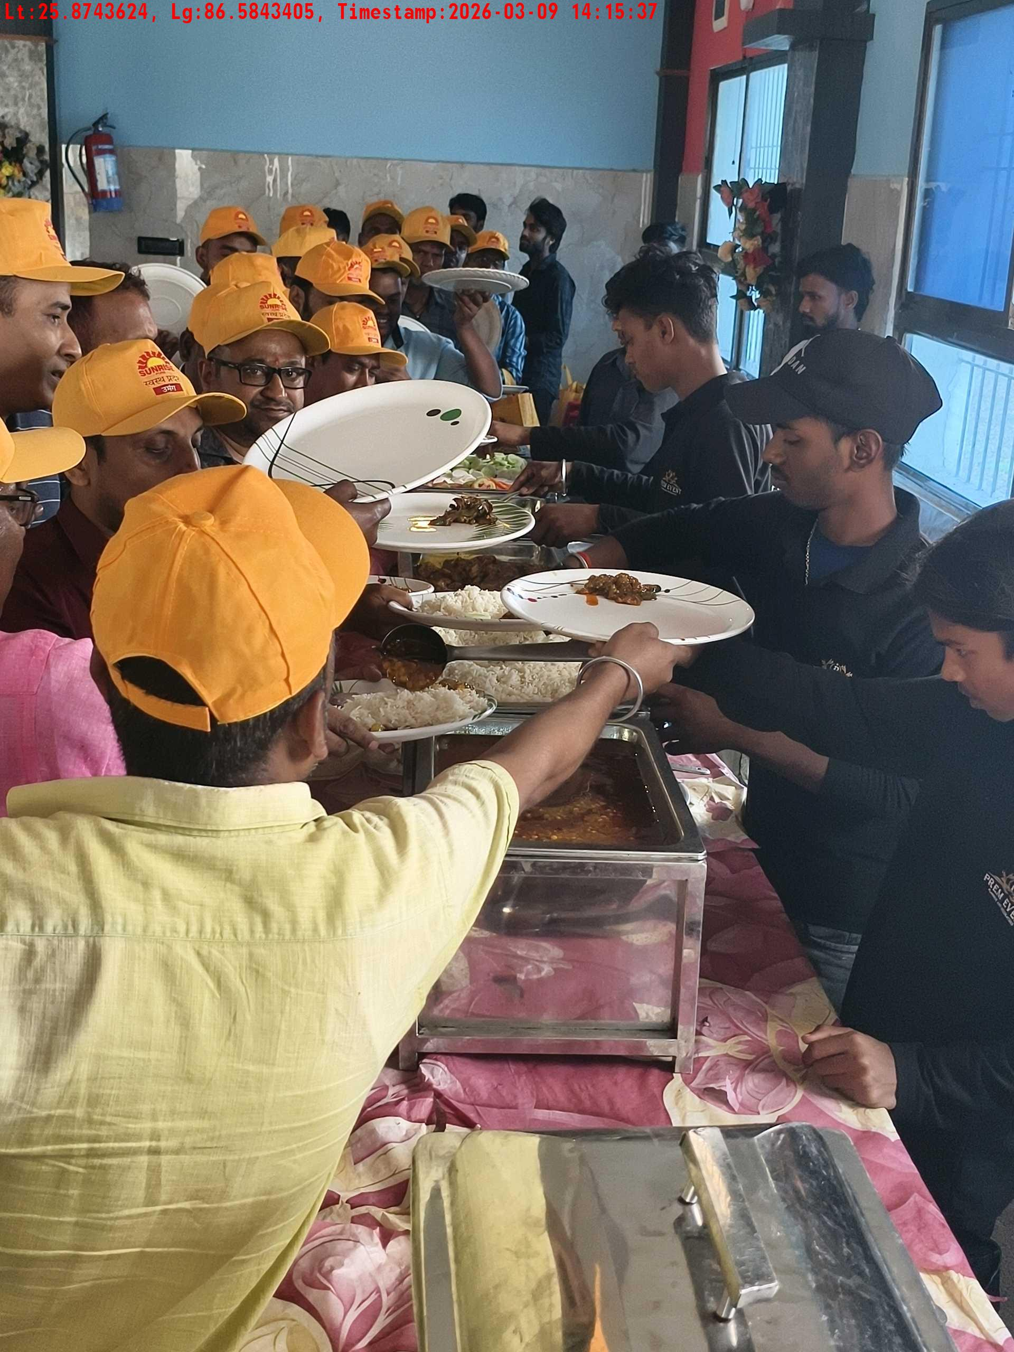
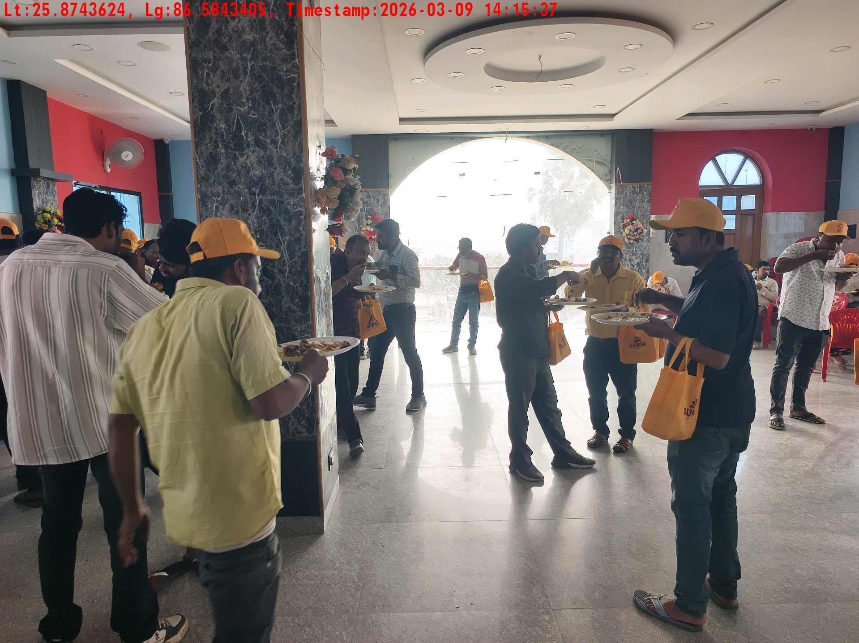
Date | Team | City | Agency Name | Promoter Name | Location Name
09-03-2026 | Bihar-1 | Bihar | Mindshaft | twinkle | Katihar
Lunch setup picture-1
Lunch setup picture-2
Lunch eating pictures-1
Lunch eating pictures-2

Slide 5
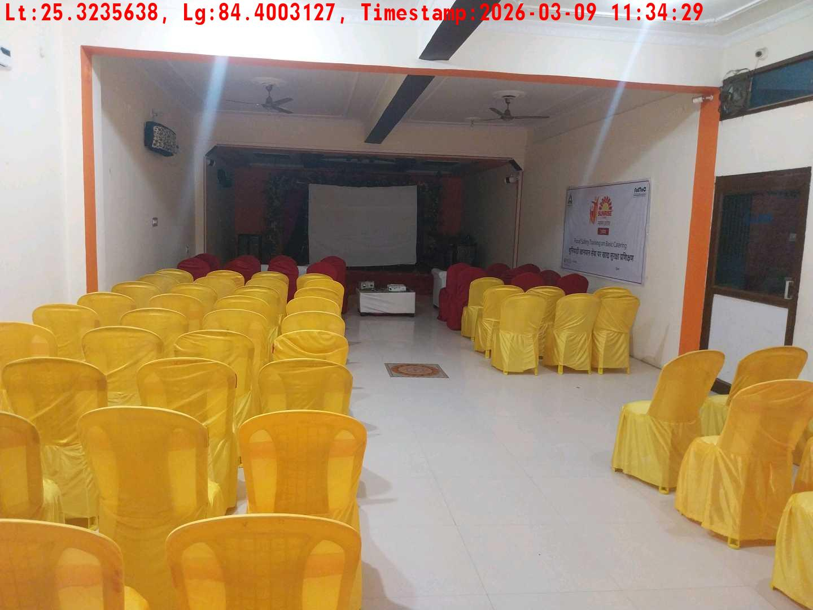
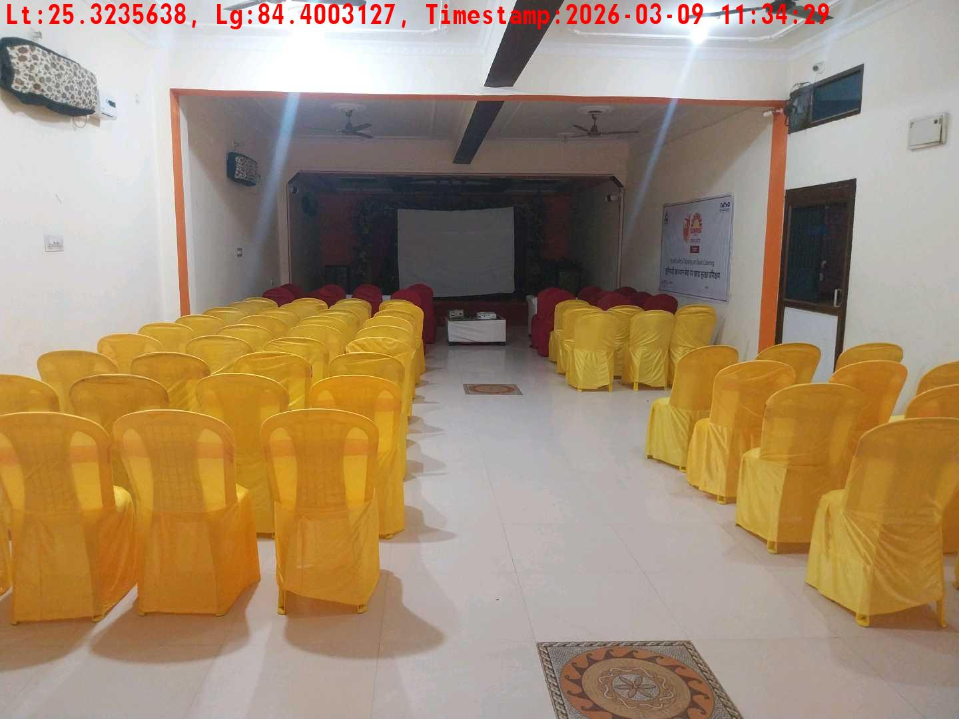
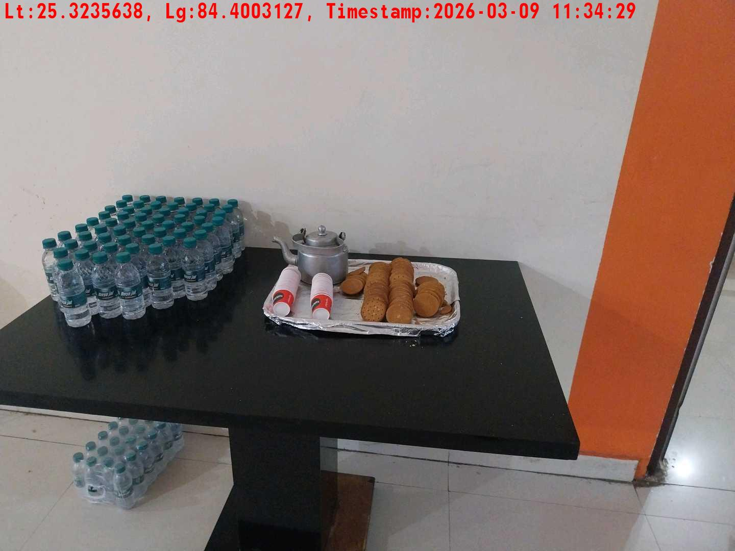
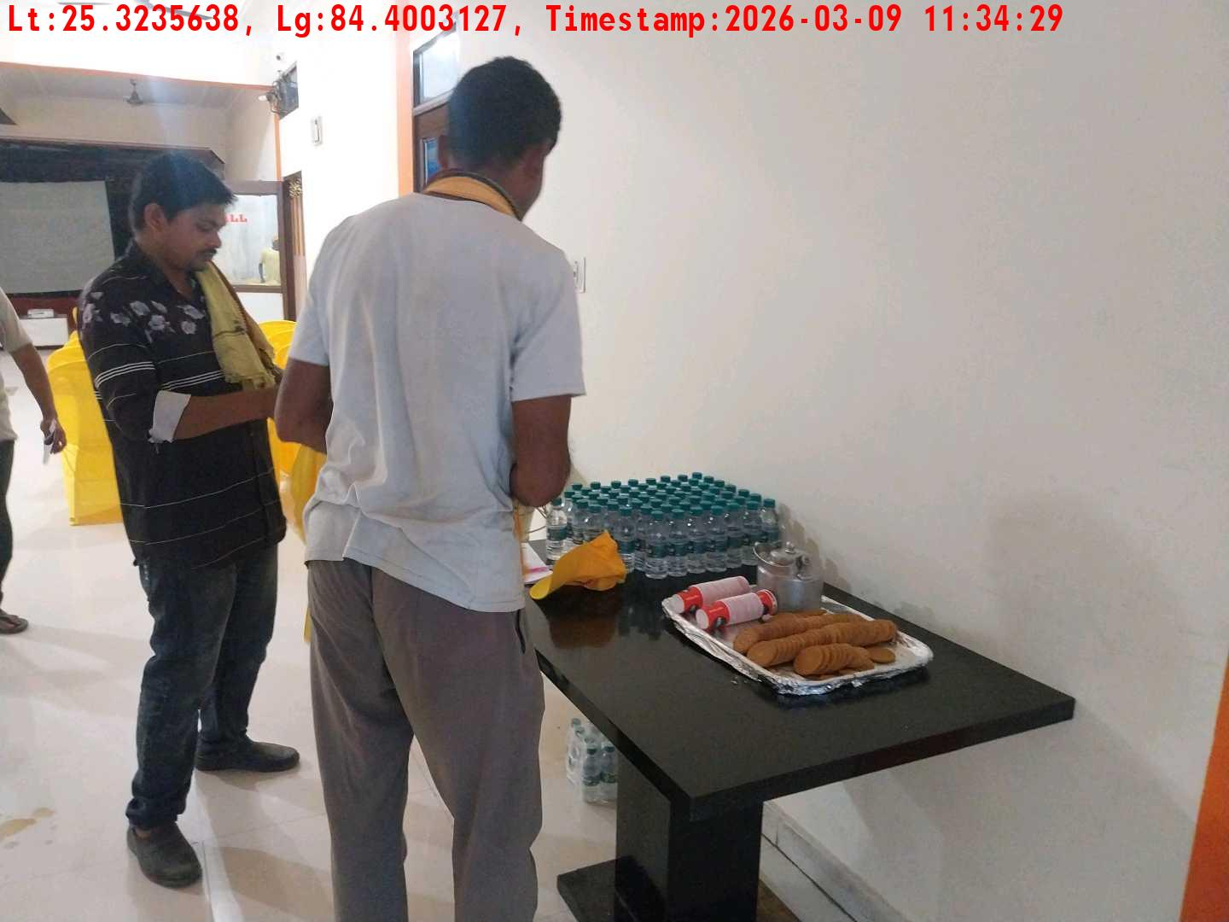
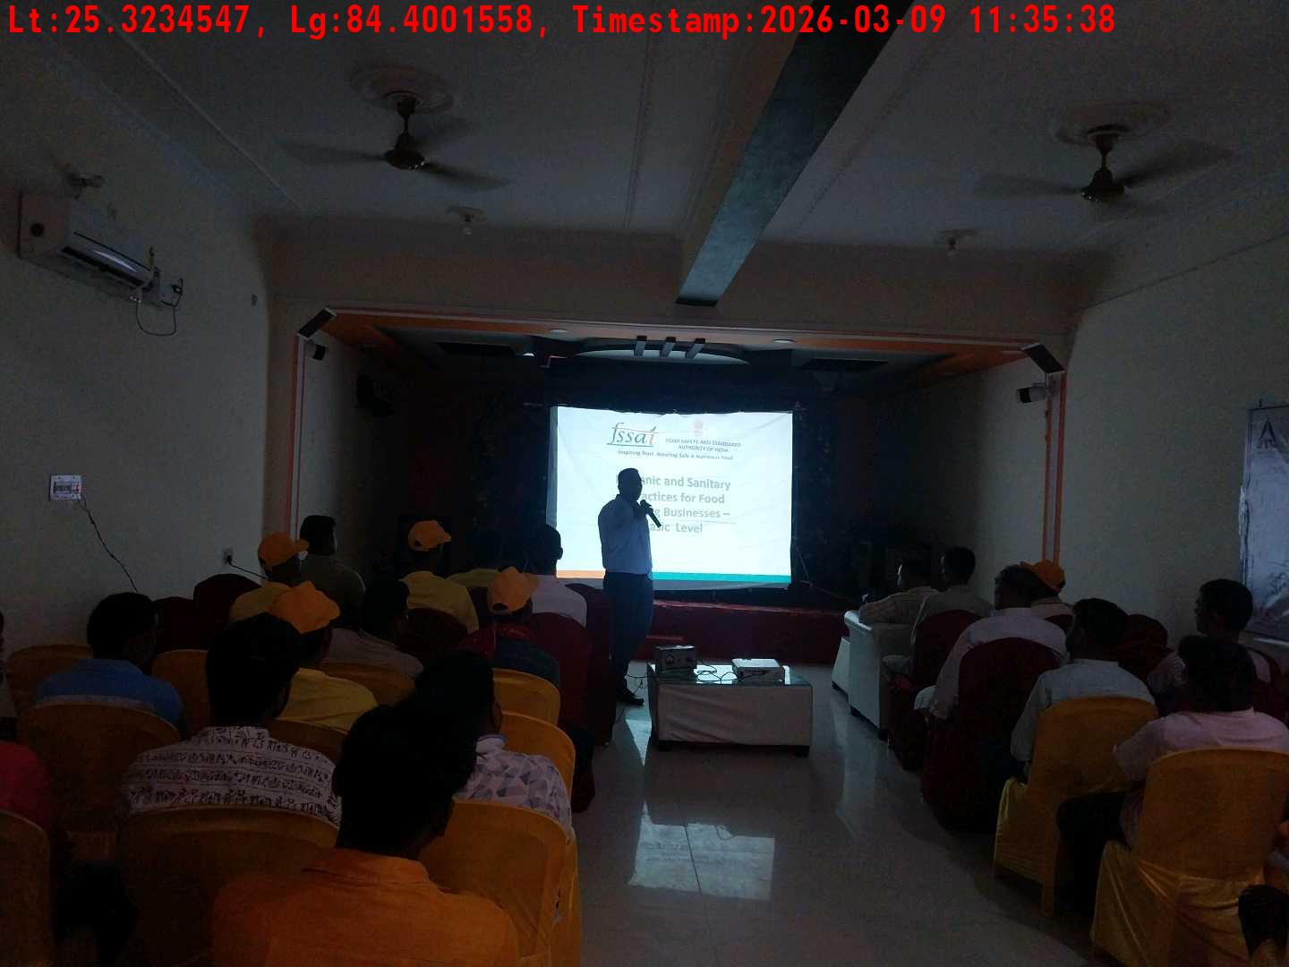
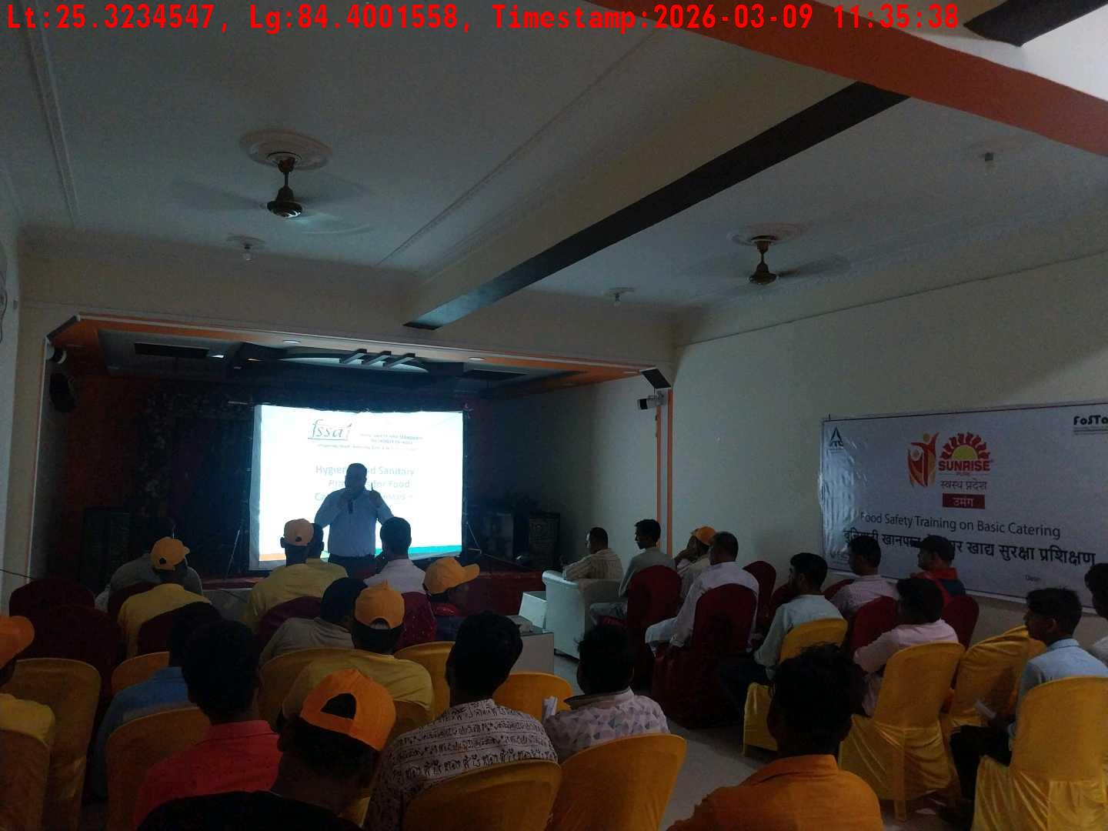
Date | Team | City | Agency Name | Promoter Name | Location Name
09-03-2026 | Bihar-2 | Bihar | Mindshaft | Dipak Singh | Dehri
Long shot picture covering banner
Long shot picture covering table
Tea & coffee arrangement picture
Tea & coffee with crowd
Trainer with presentation picture
Crowd visibility picture

Slide 6
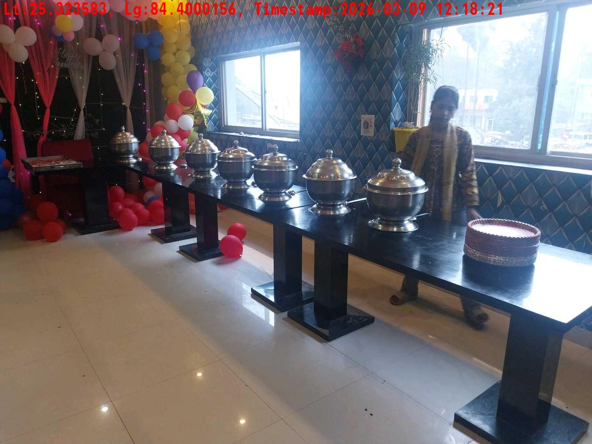
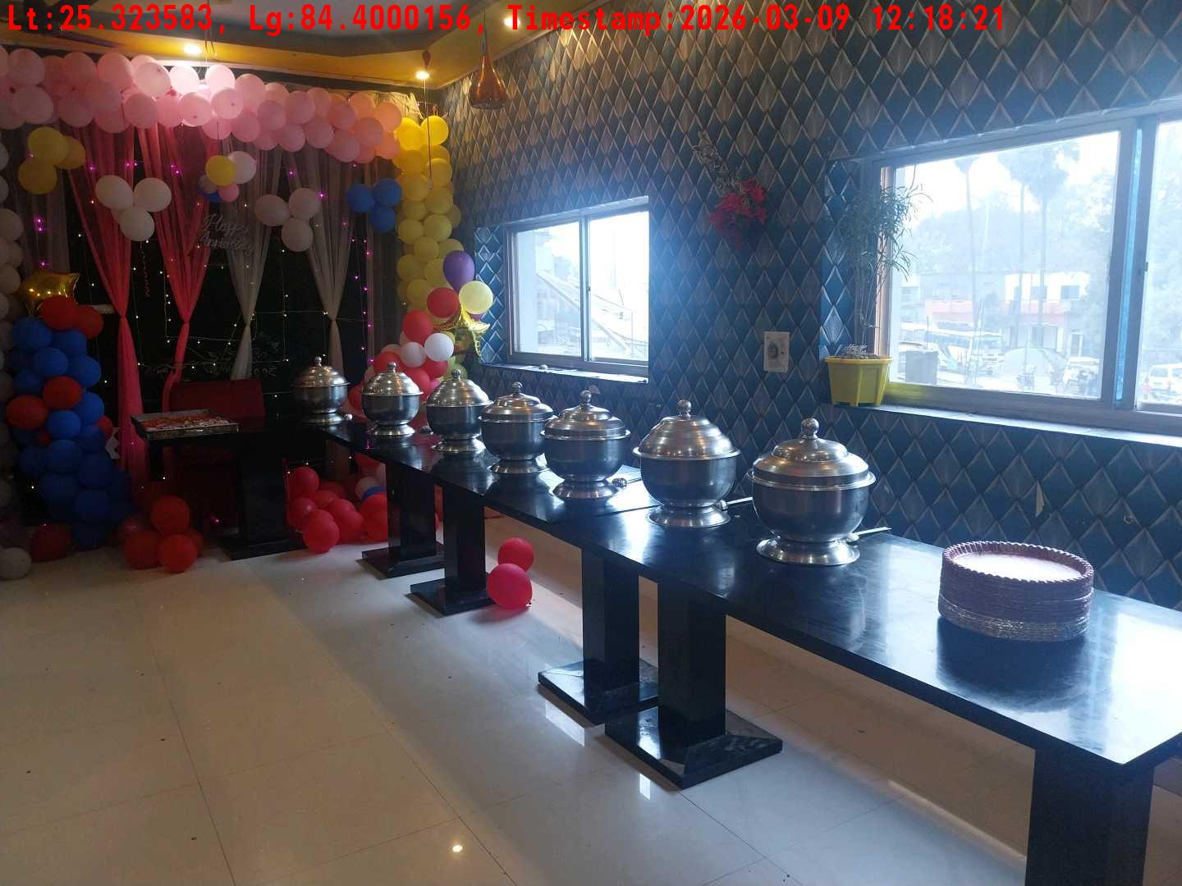
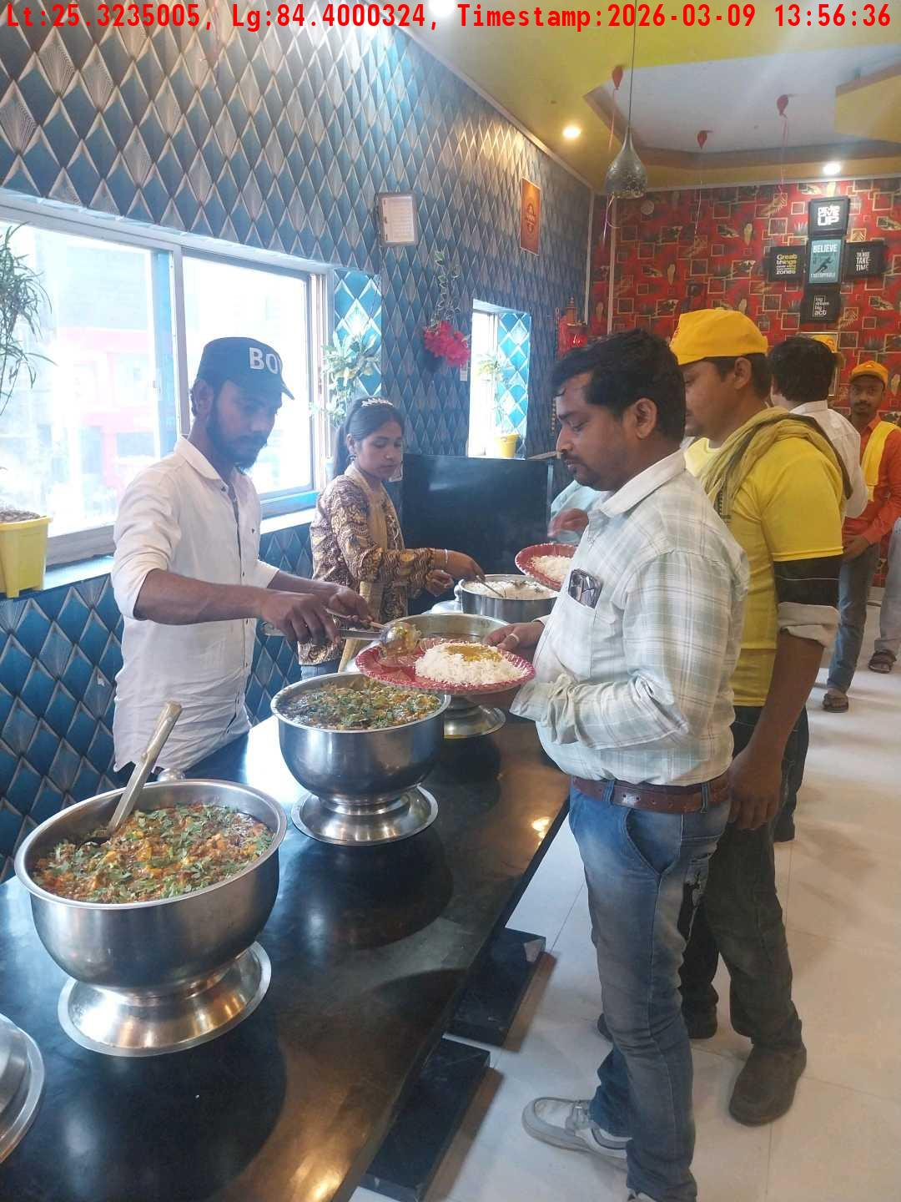
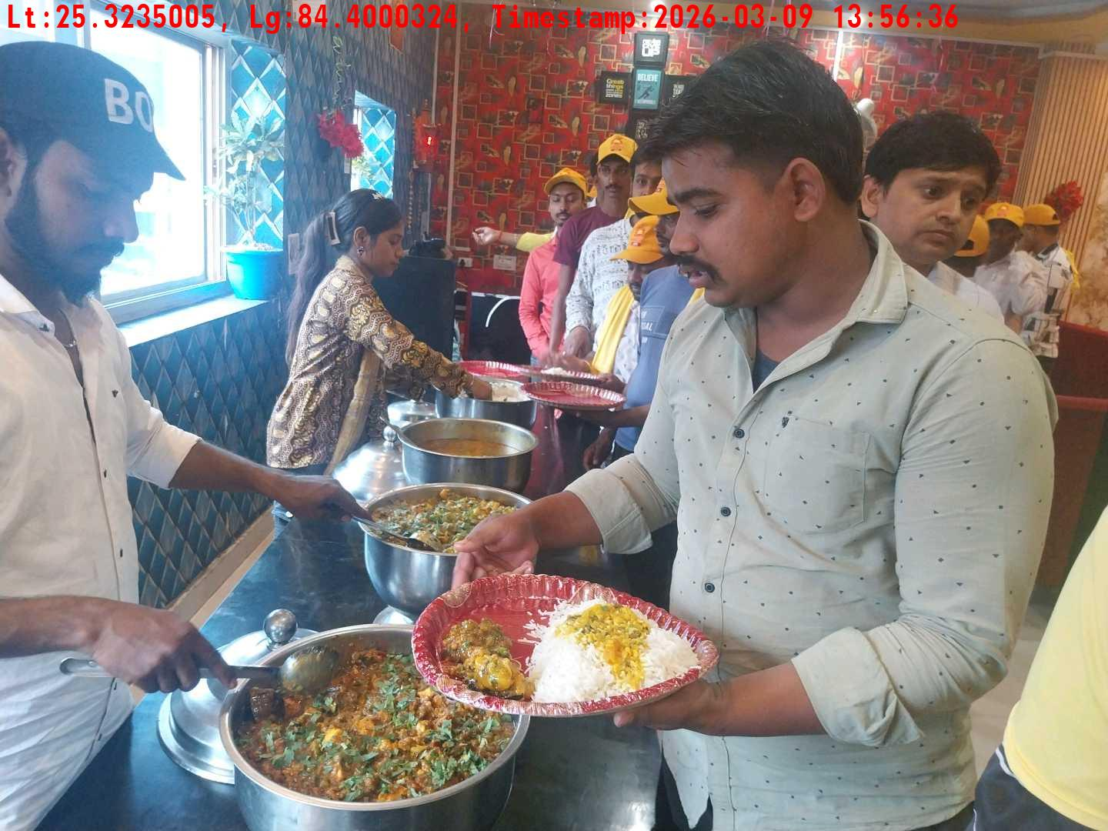
Date | Team | City | Agency Name | Promoter Name | Location Name
09-03-2026 | Bihar-2 | Bihar | Mindshaft | Dipak Singh | Dehri
Lunch setup picture-1
Lunch setup picture-2
Lunch eating pictures-1
Lunch eating pictures-2

Slide 7
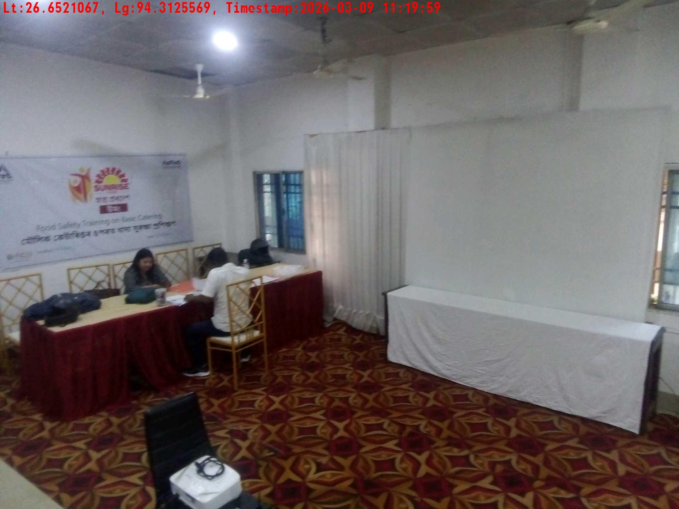
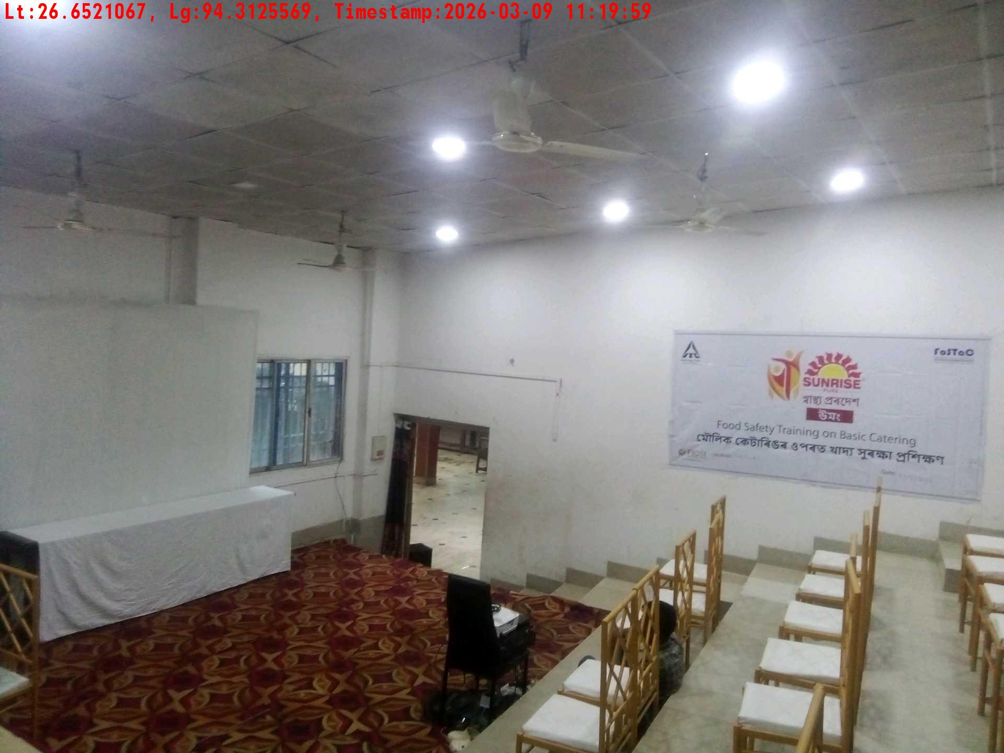
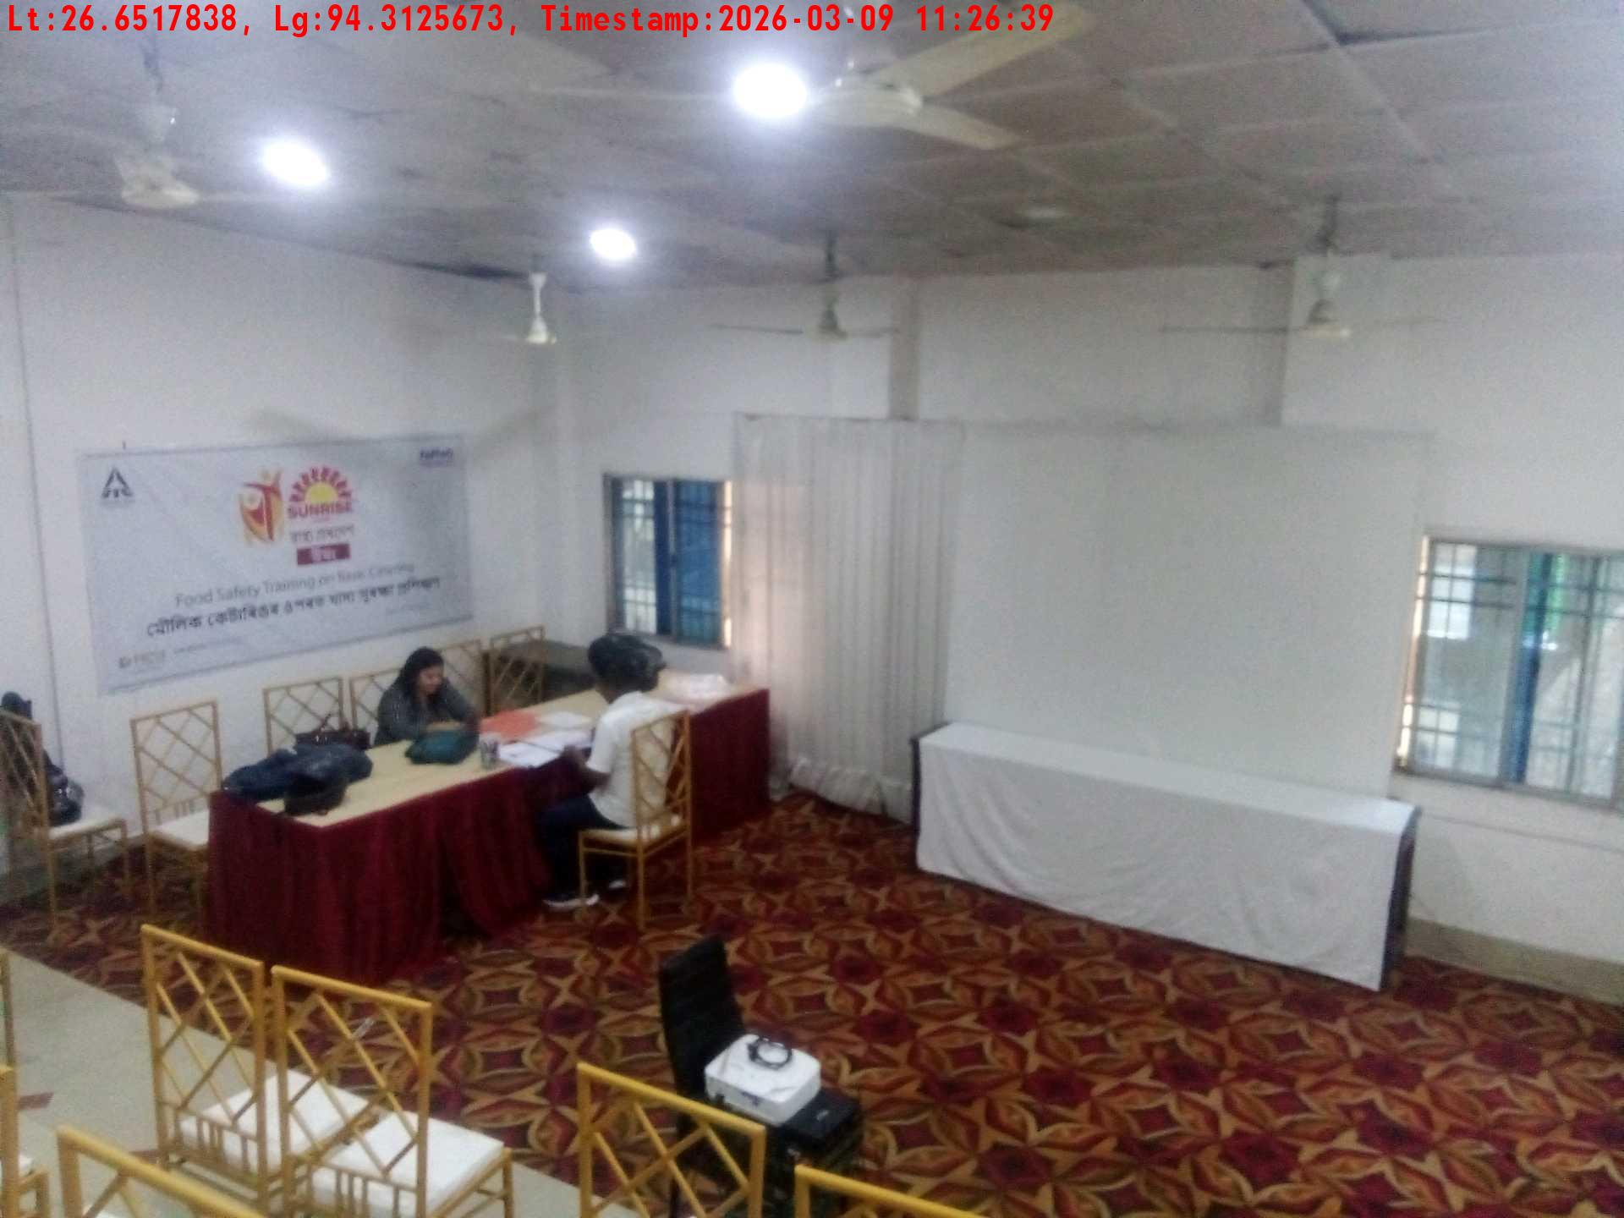
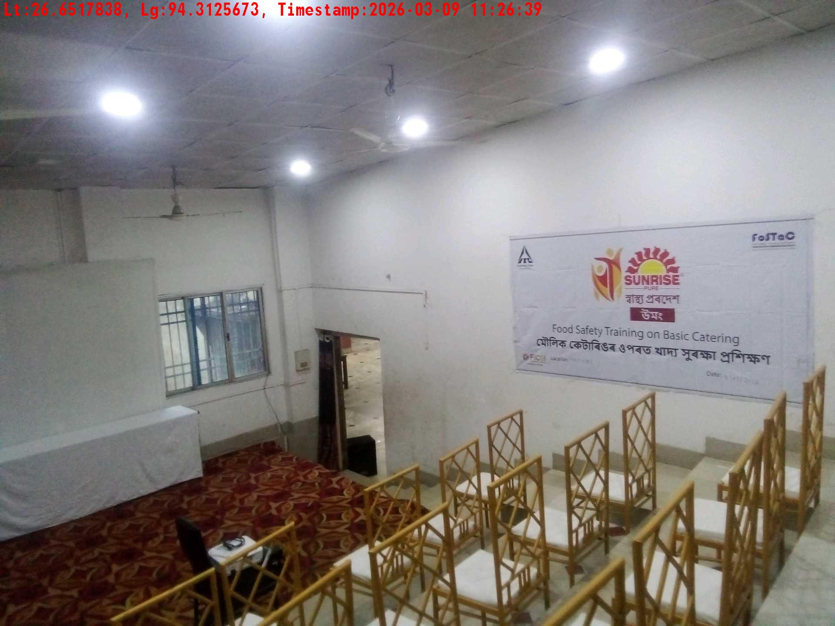
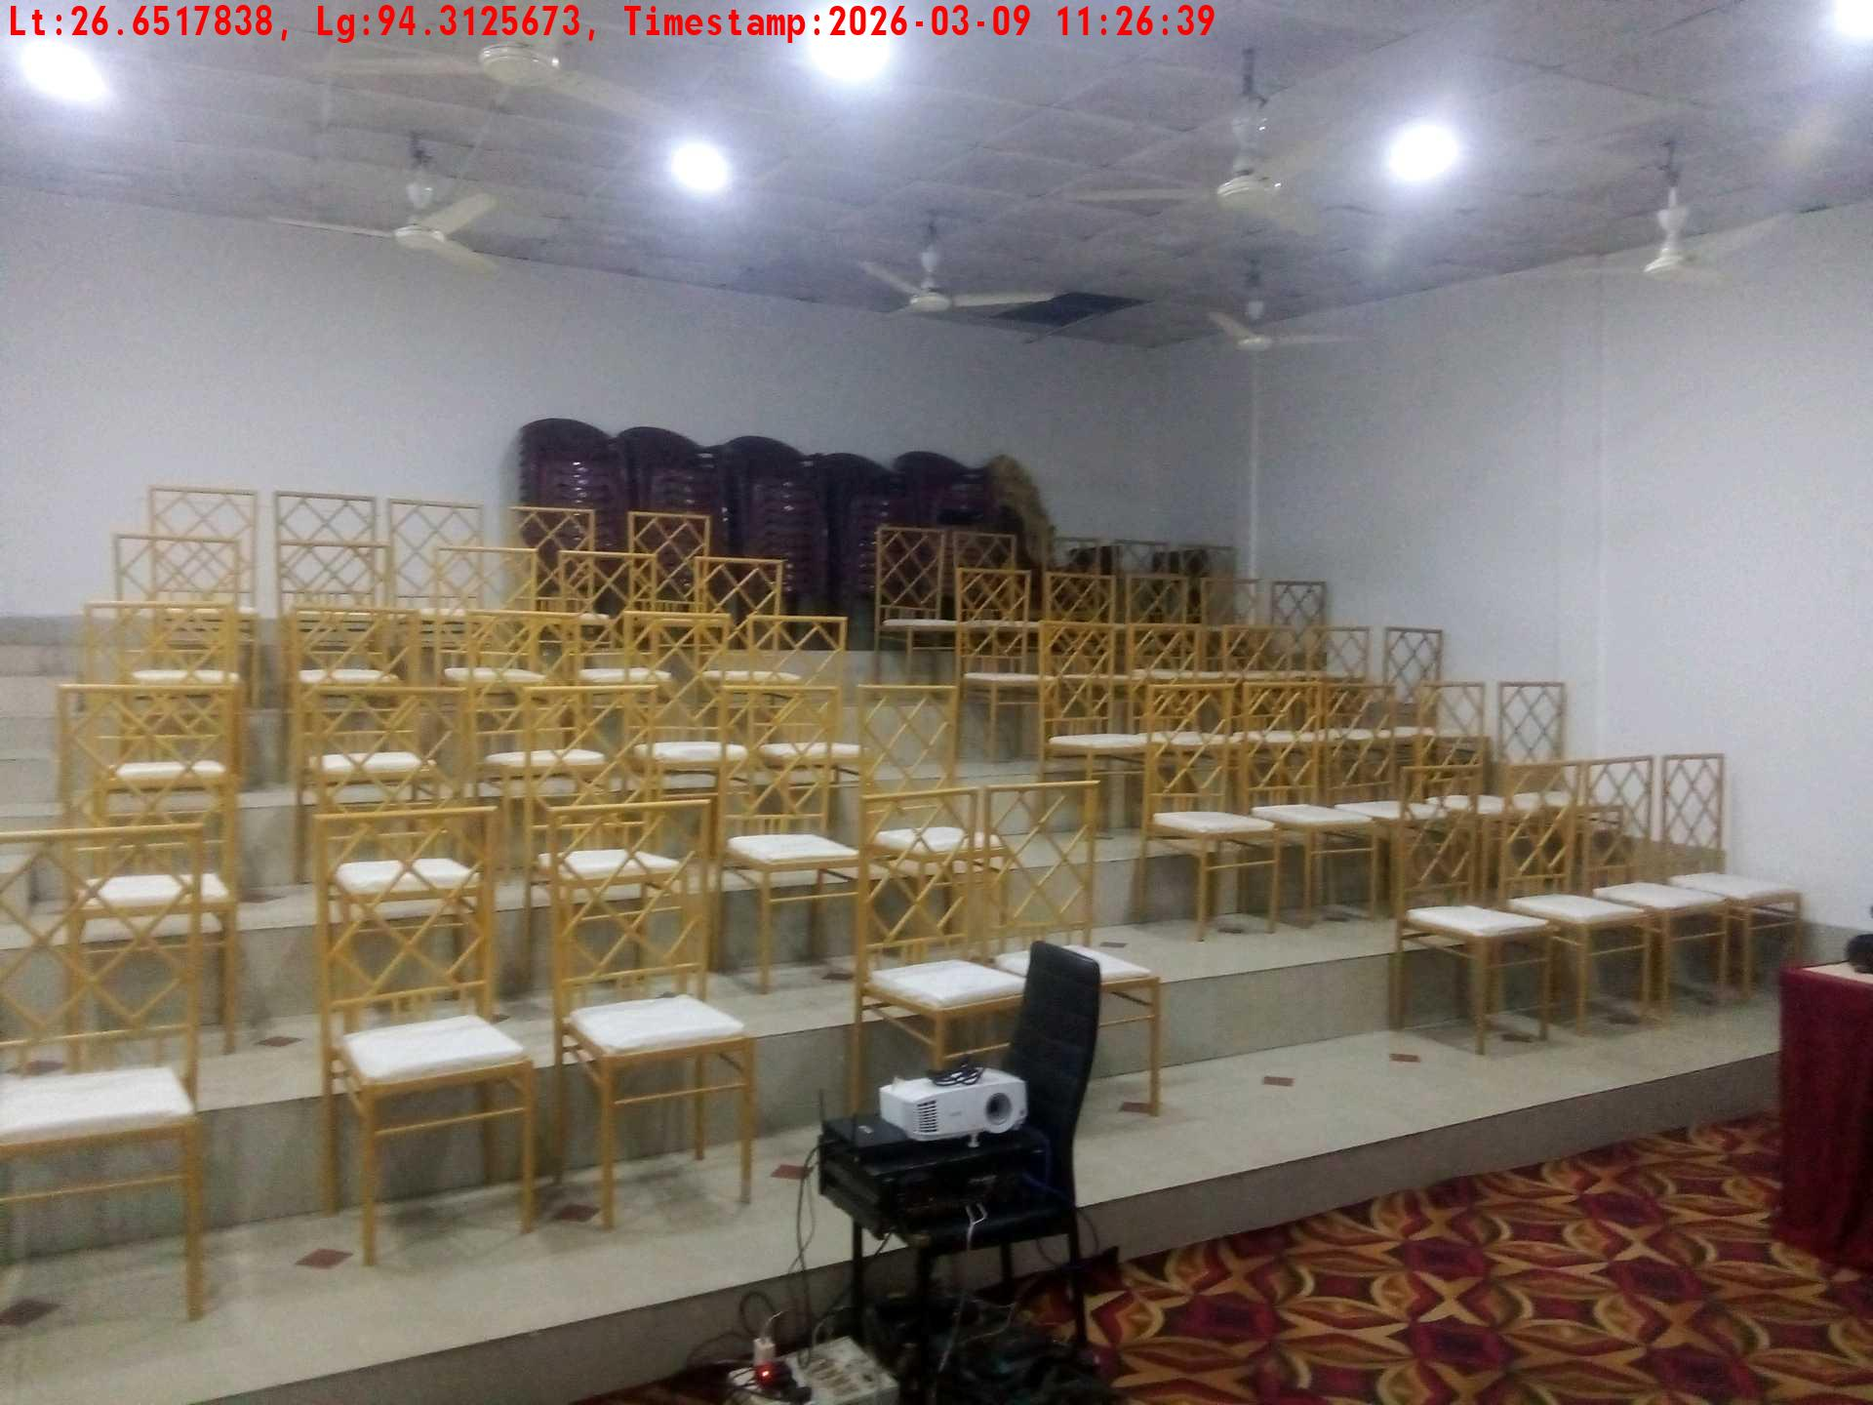
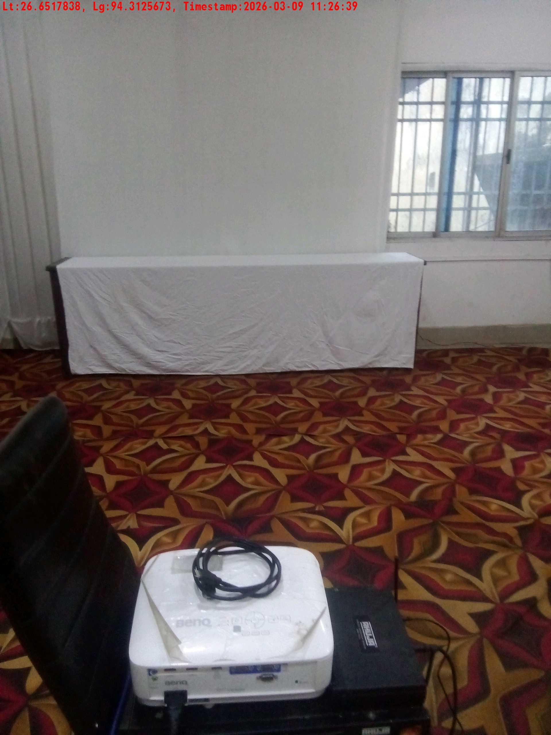
Date | Team | City | Agency Name | Promoter Name | Location Name
09-03-2026 | Assam | Assam | Mindshaft | Manish ray | guwahati
Trainer with presentation picture
Crowd visibility picture
Long shot picture covering banner
Long shot picture covering table
Tea & coffee arrangement picture
Tea & coffee with crowd

Slide 8
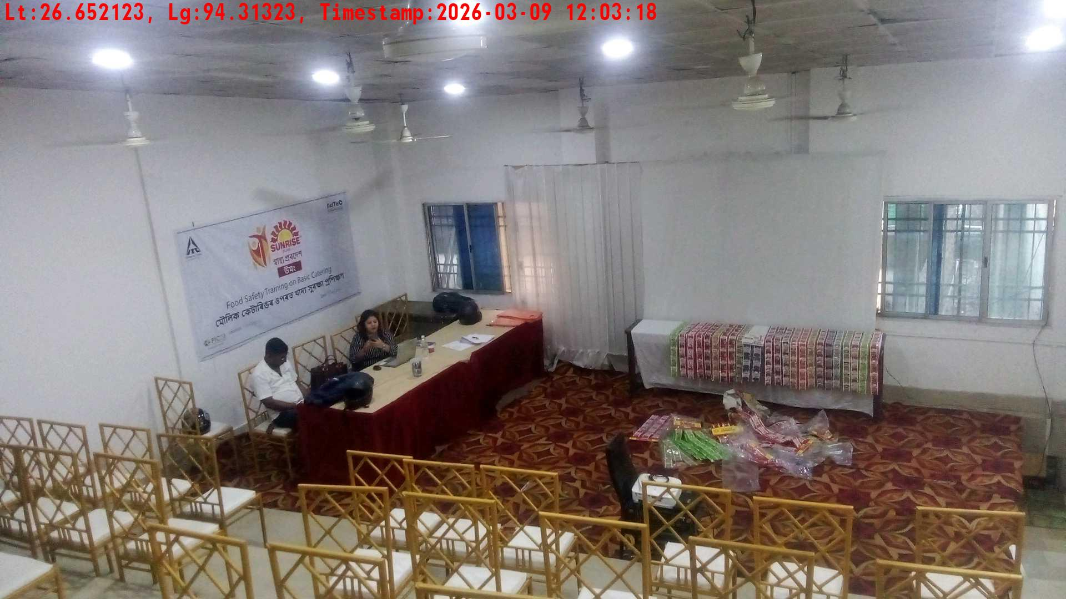
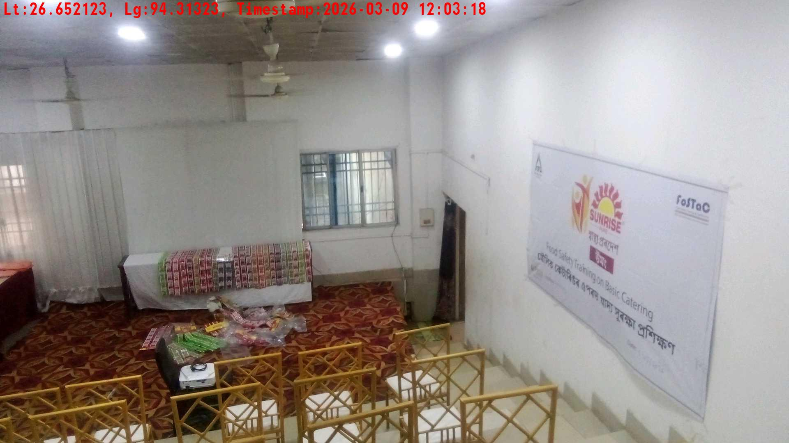
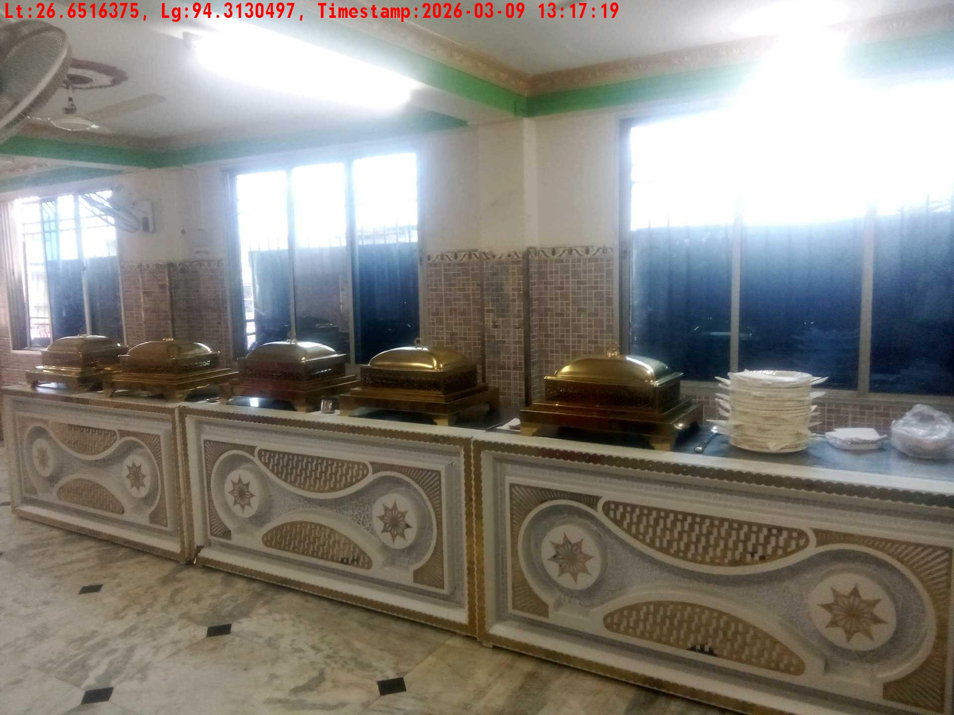
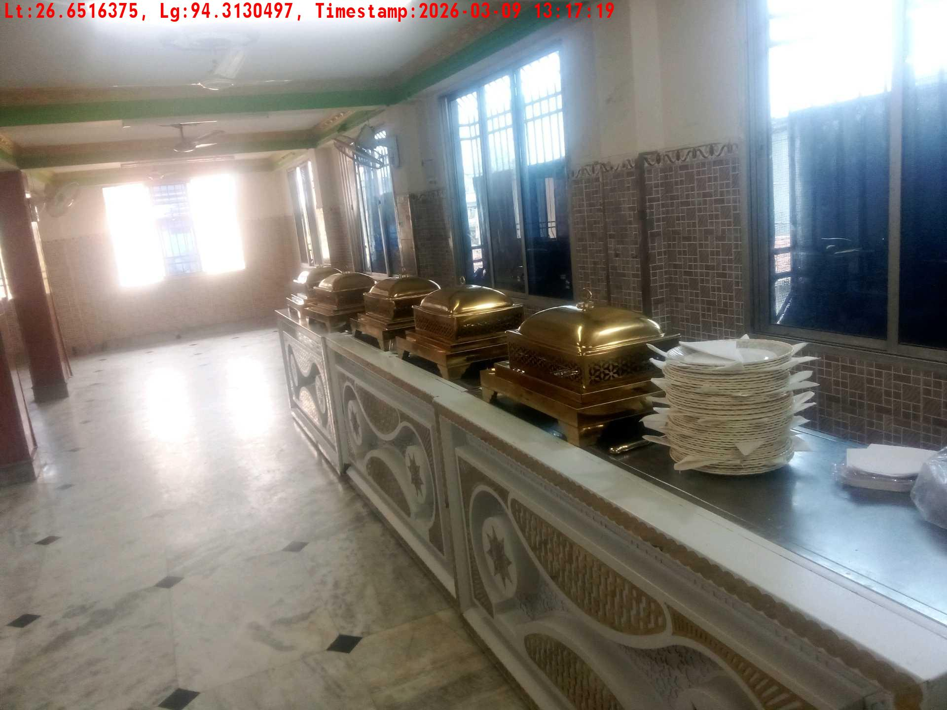
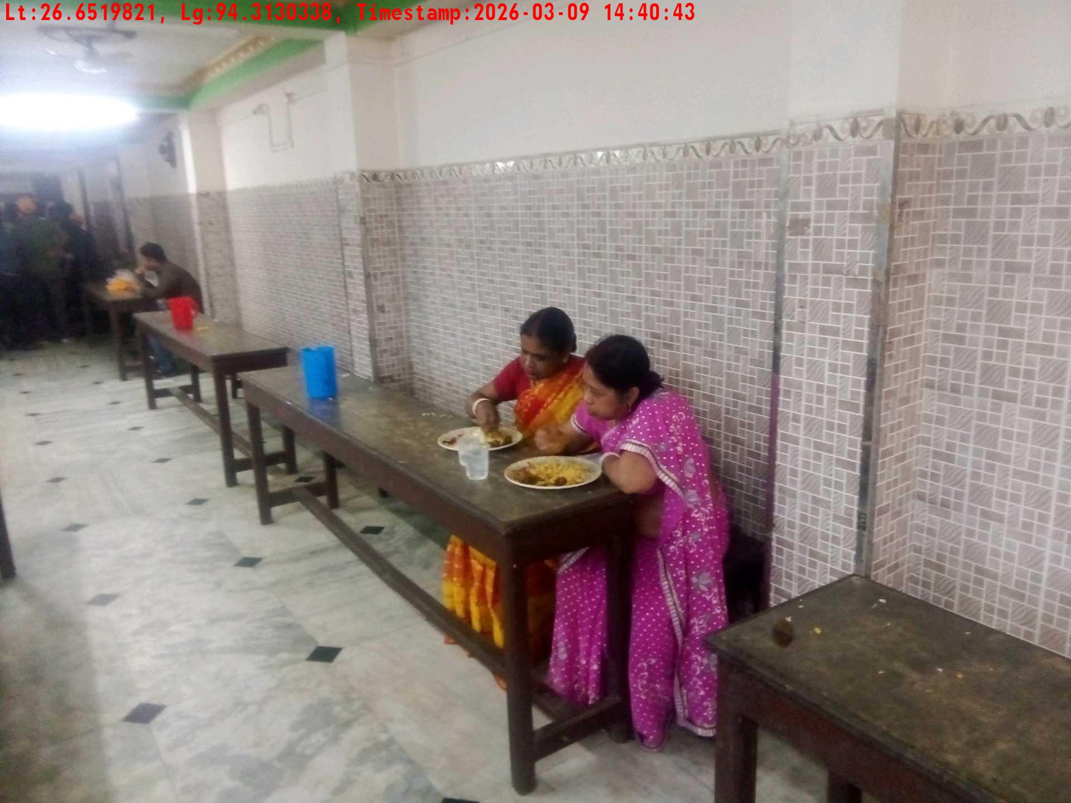
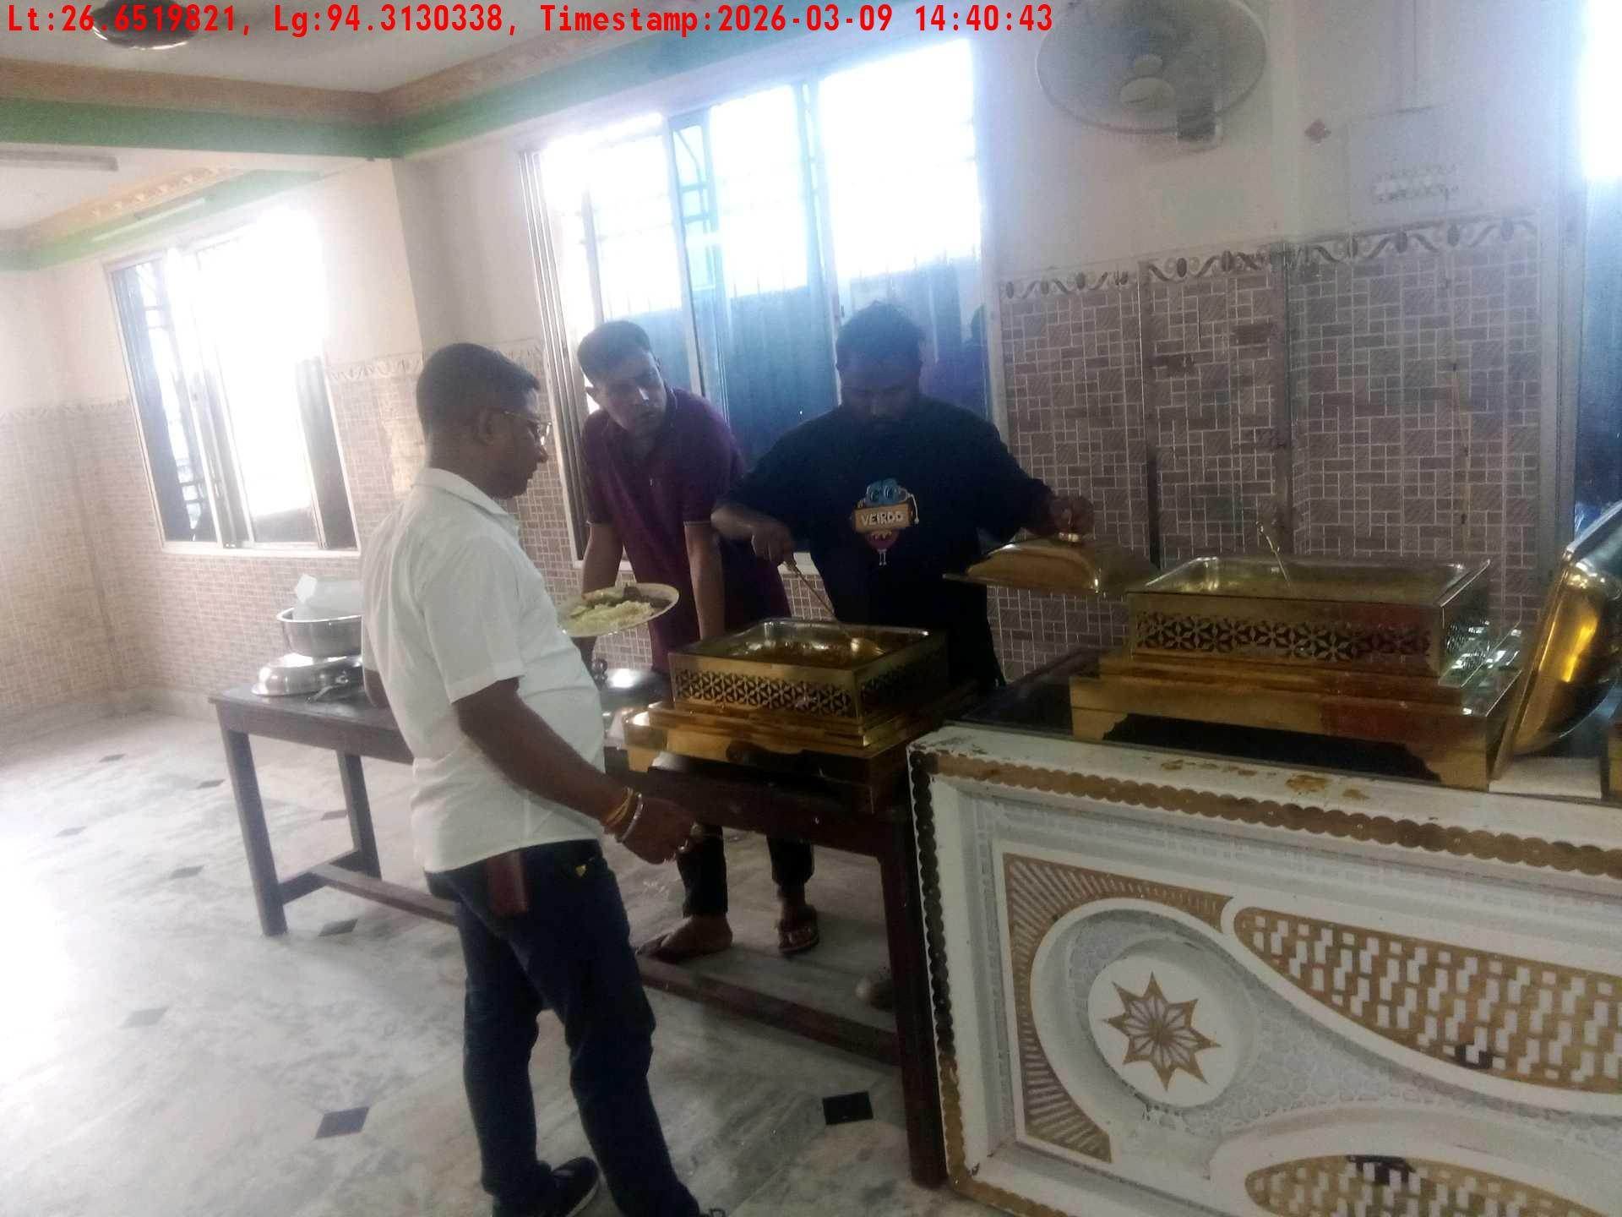
Date | Team | City | Agency Name | Promoter Name | Location Name
09-03-2026 | Assam | Assam | Mindshaft | Manish ray | guwahati
Trainer with presentation picture
Crowd visibility picture
Lunch setup picture-1
Lunch setup picture-2
Lunch eating pictures-1
Lunch eating pictures-2

Slide 9
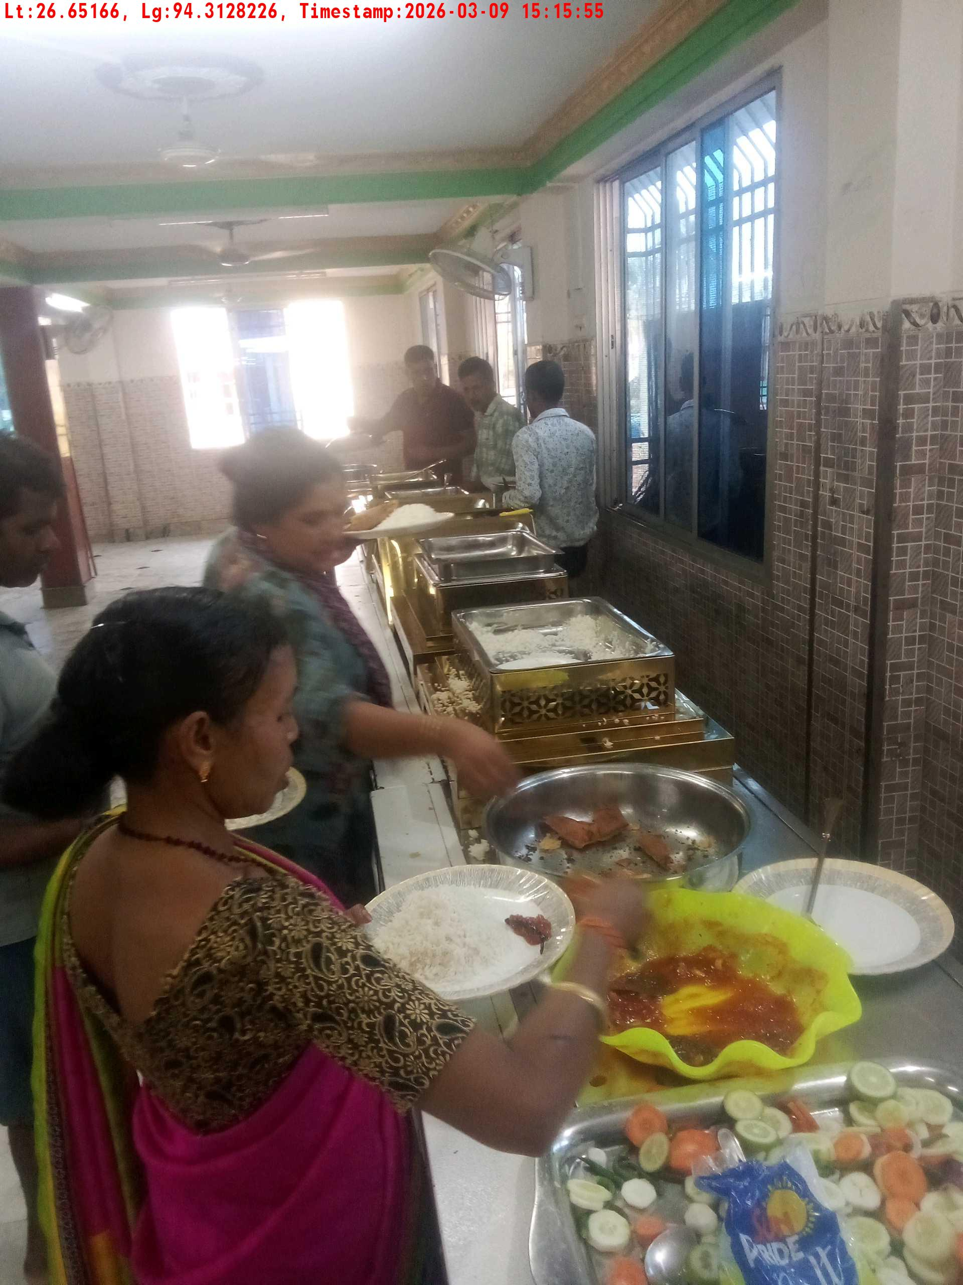
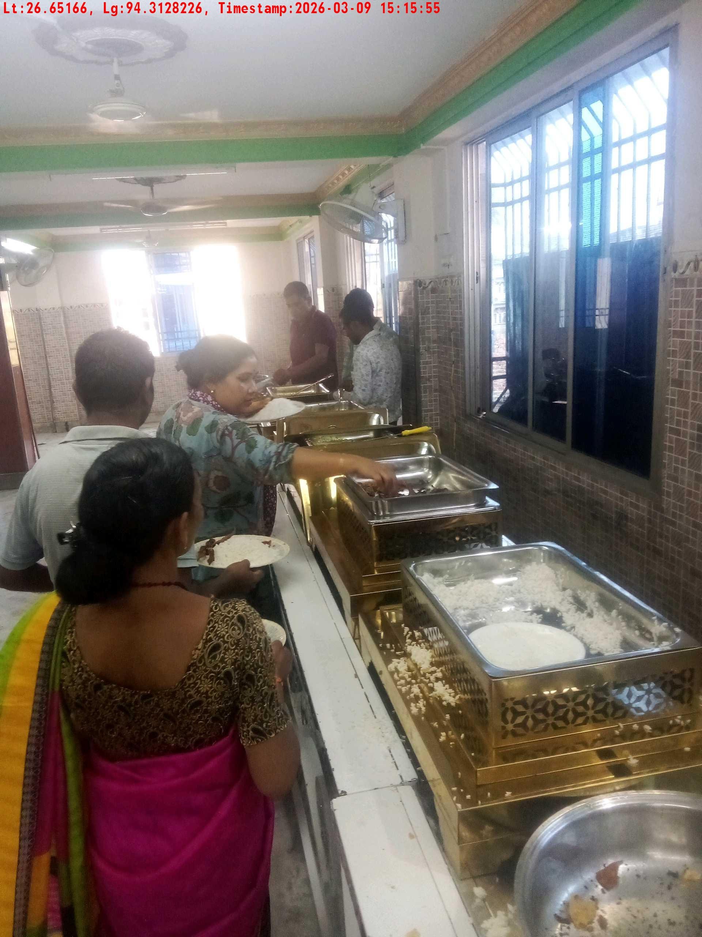
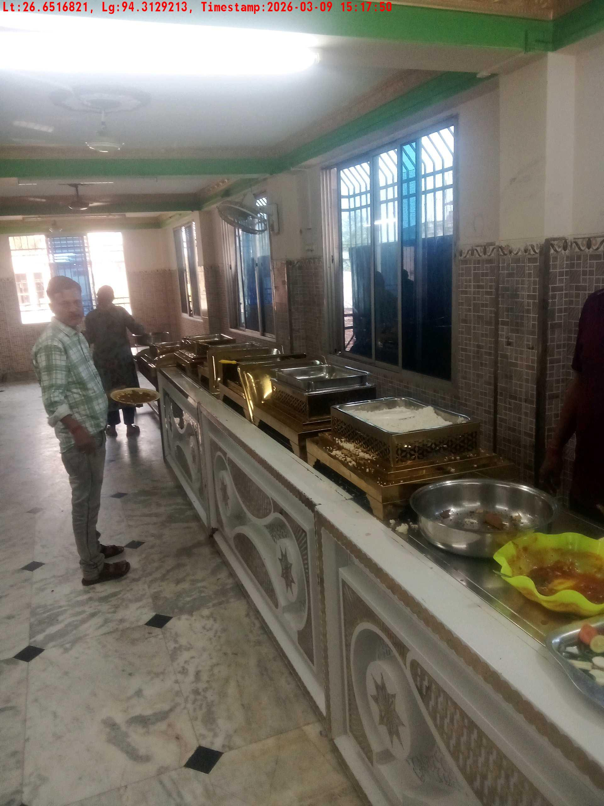
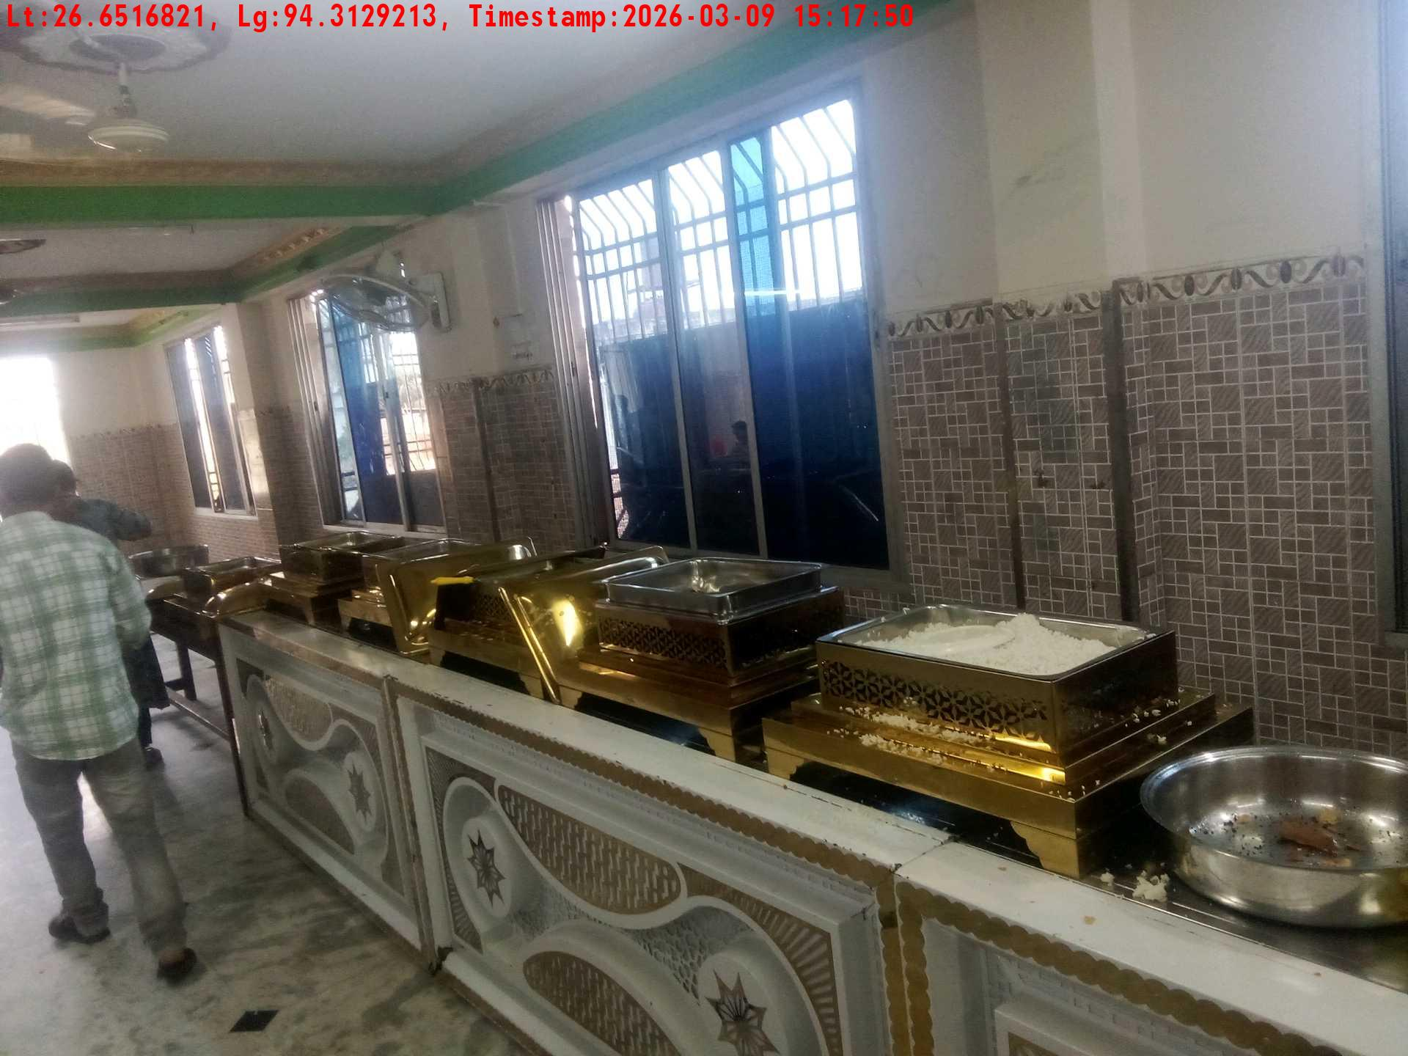
Date | Team | City | Agency Name | Promoter Name | Location Name
09-03-2026 | Assam | Assam | Mindshaft | Manish ray | guwahati
Lunch eating pictures-1
Lunch eating pictures-2
Lunch setup picture-1
Lunch setup picture-2

Slide 10
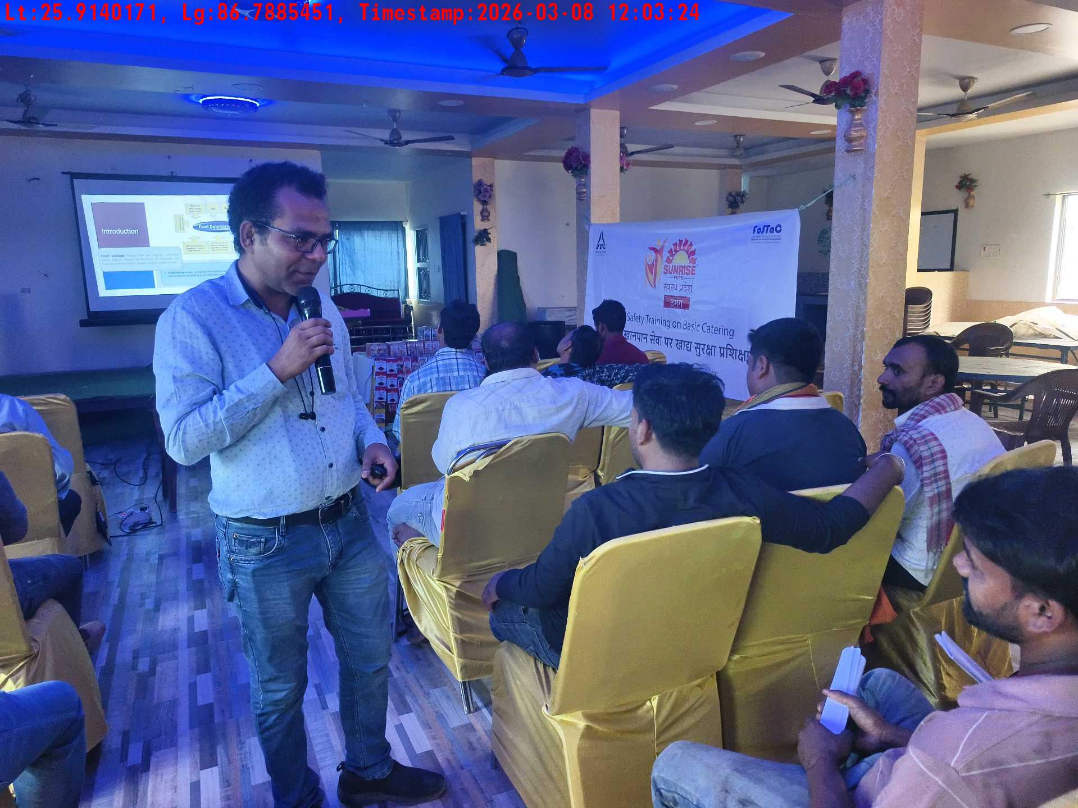
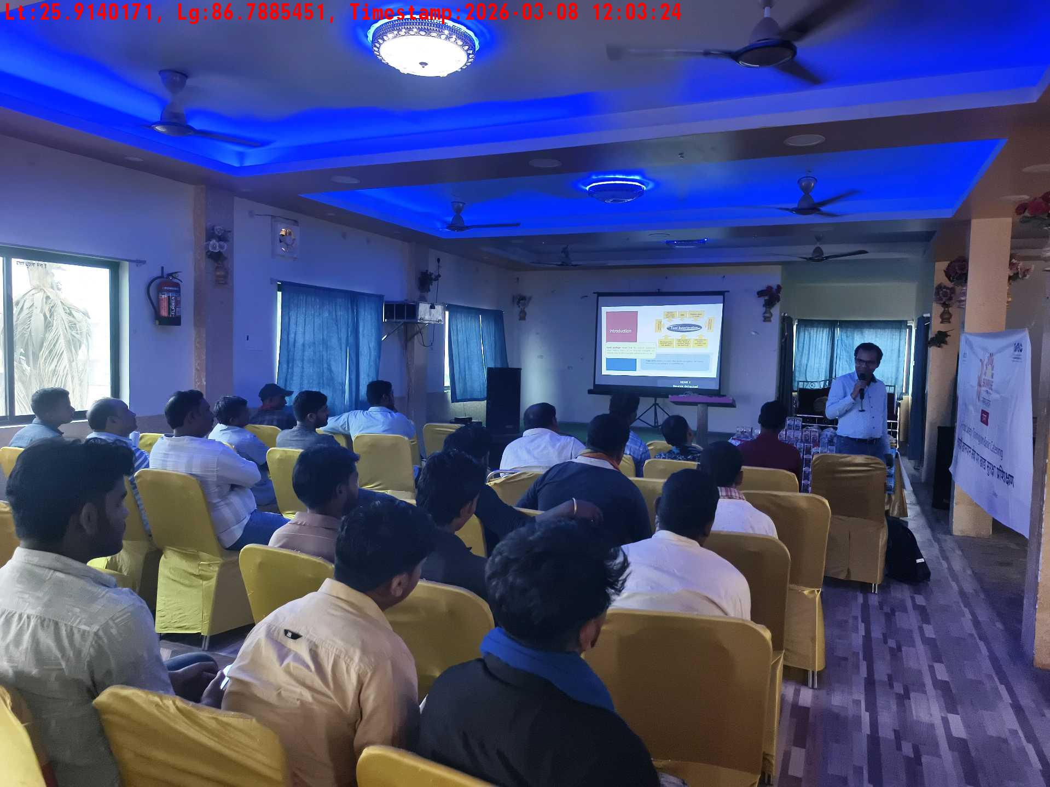
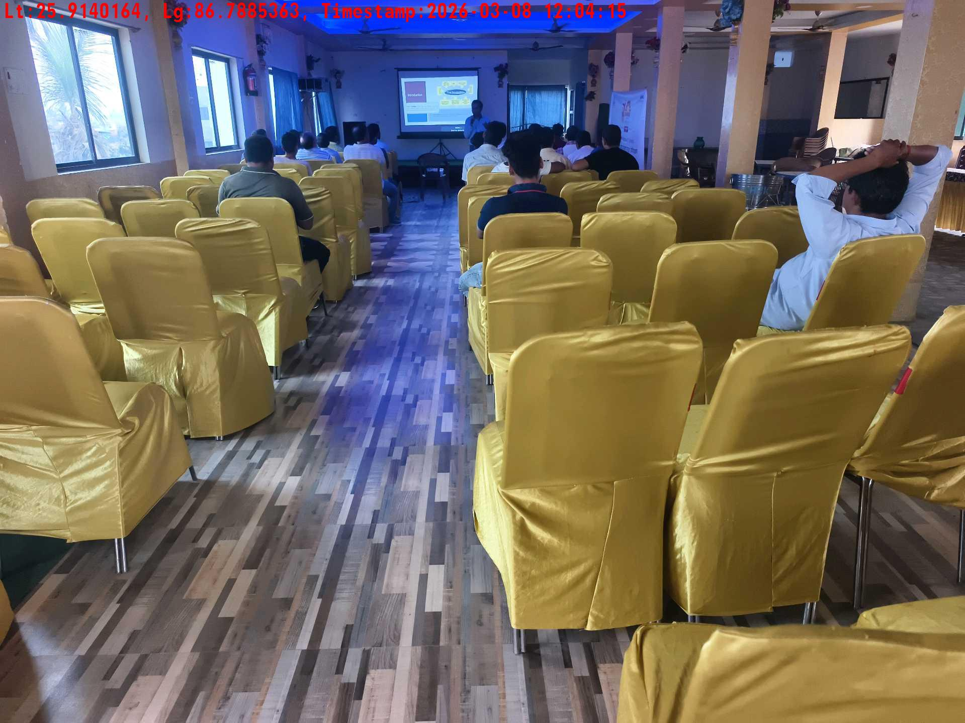
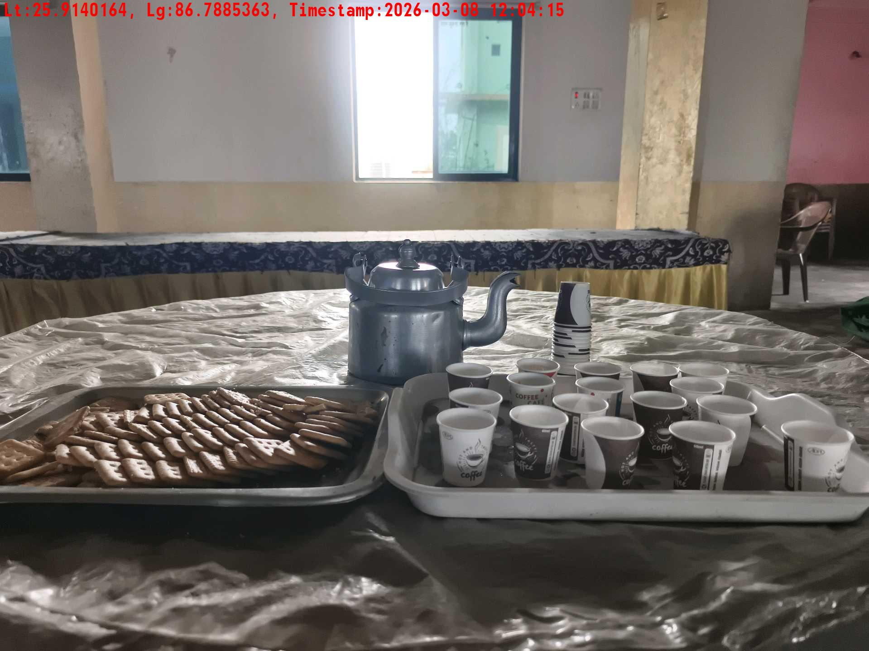
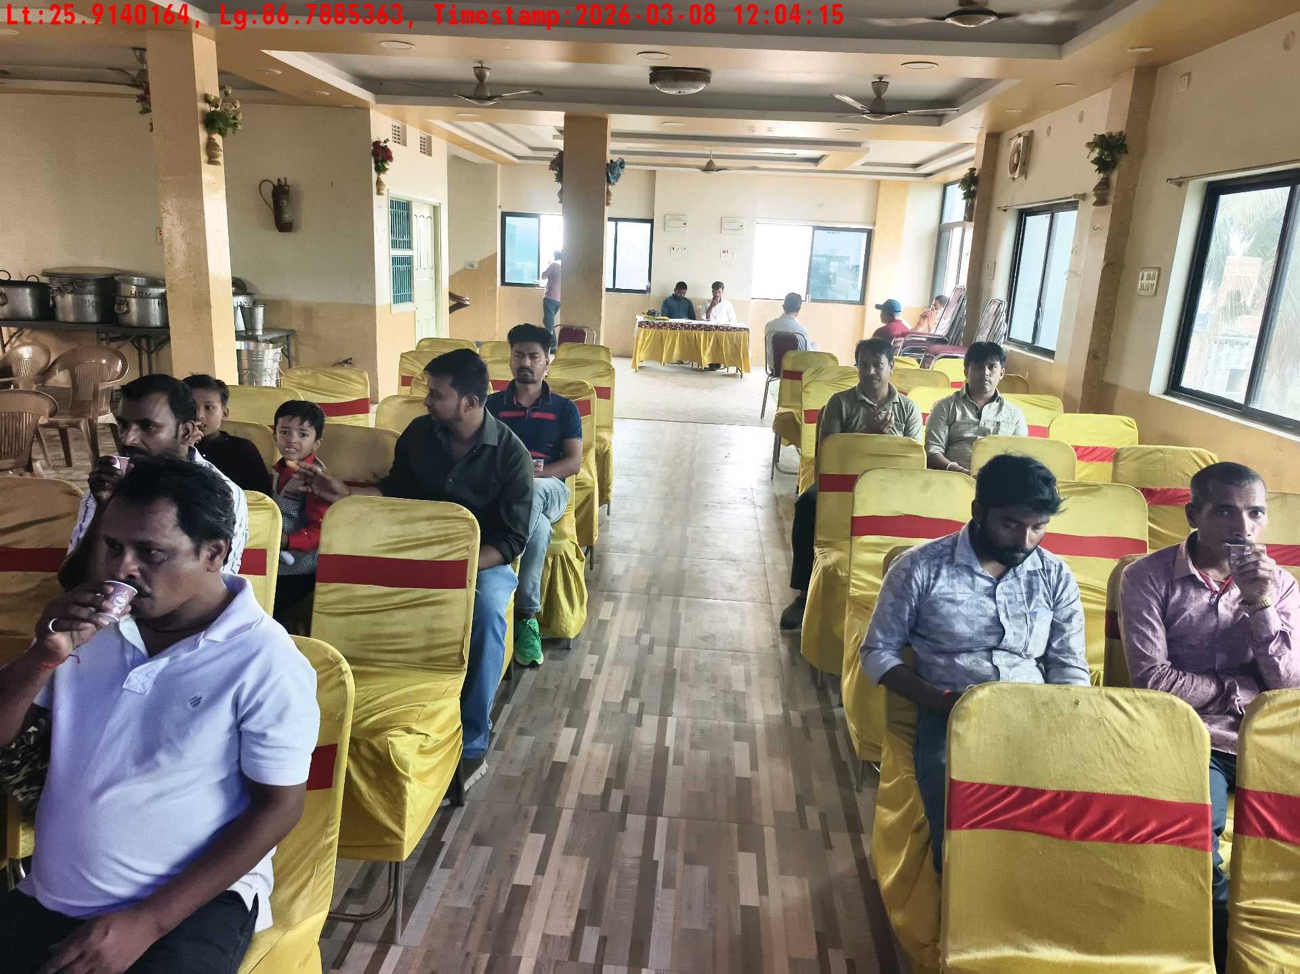
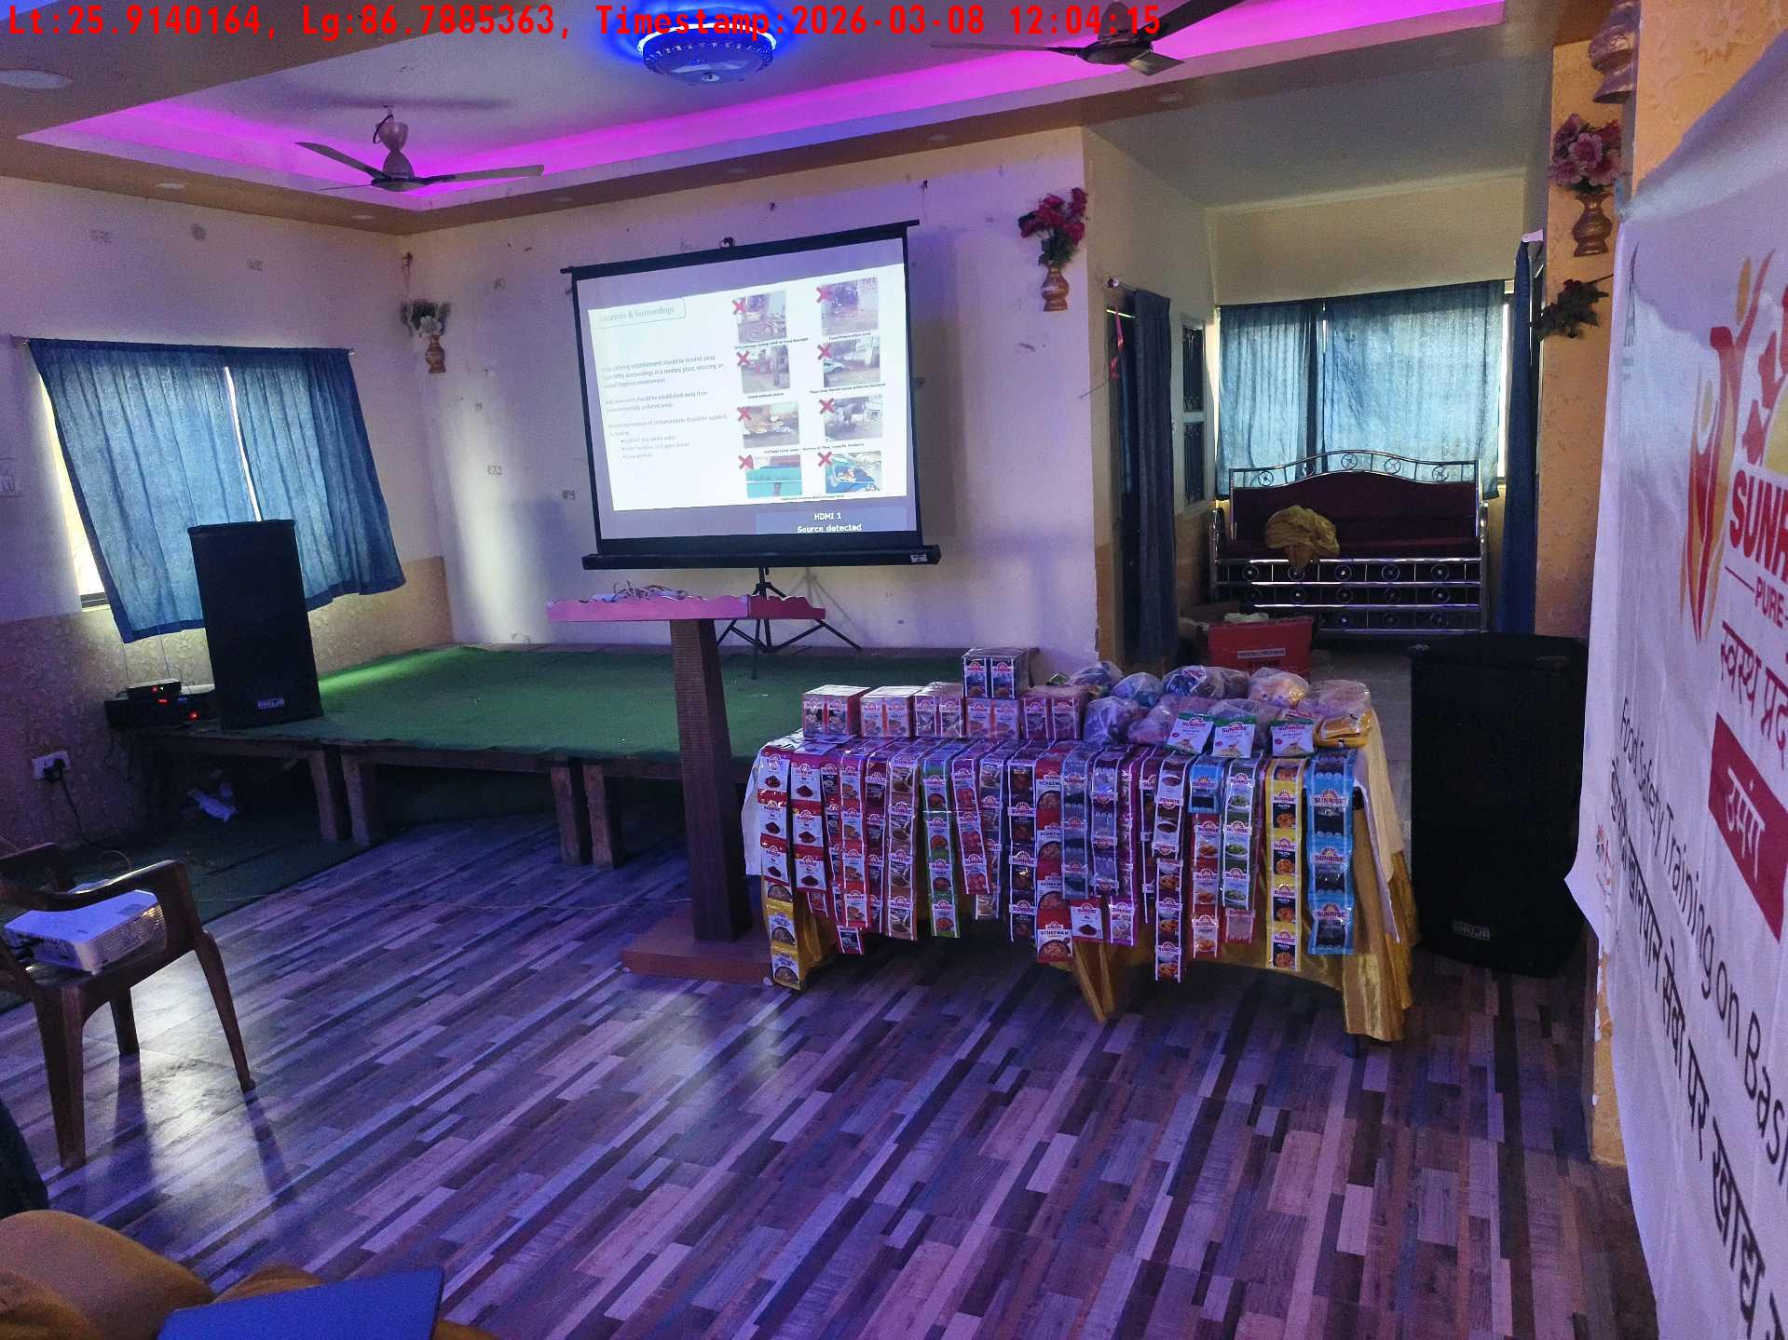
Date | Team | City | Agency Name | Promoter Name | Location Name
08-03-2026 | Bihar-1 | Bihar | Mindshaft | twinkle | Katihar
Trainer with presentation picture
Crowd visibility picture
Long shot picture covering table
Tea & coffee arrangement picture
Tea & coffee with crowd
Long shot picture covering banner

Slide 11
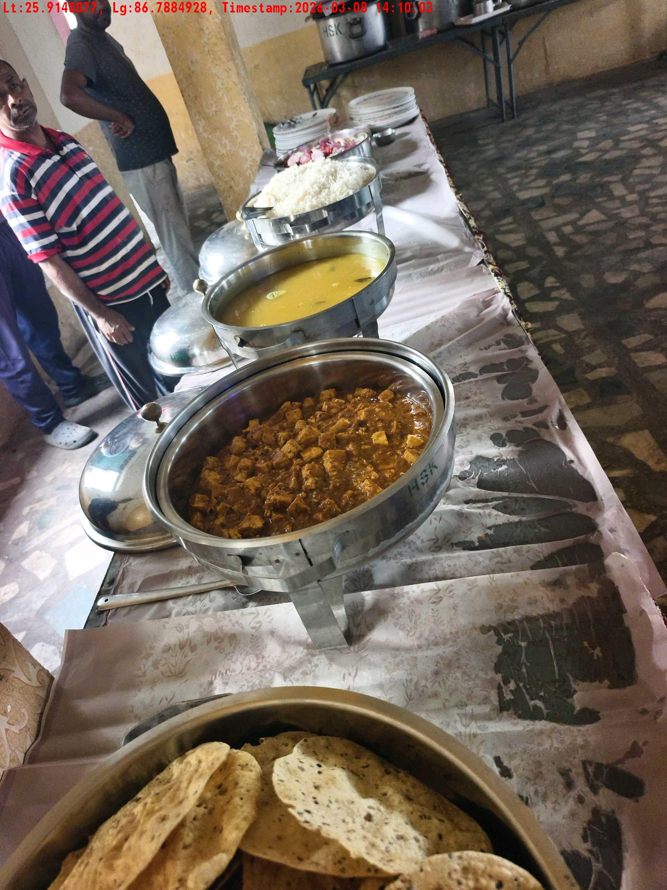
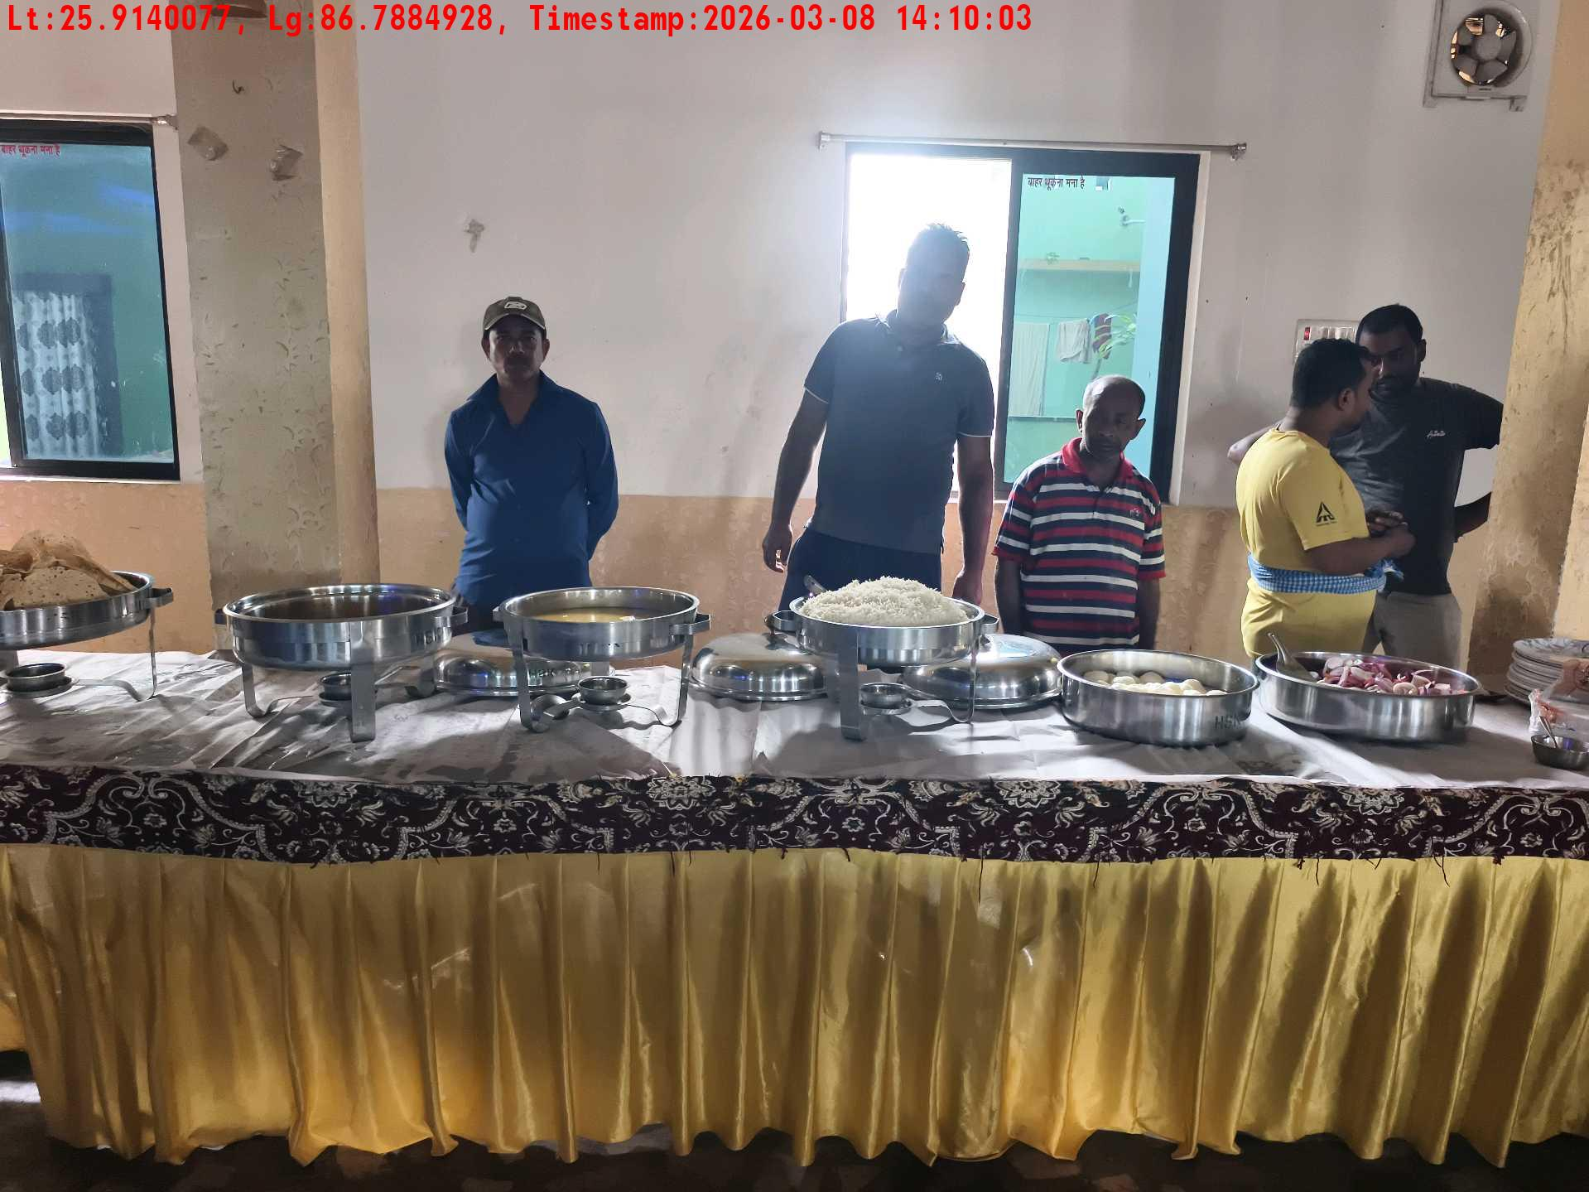
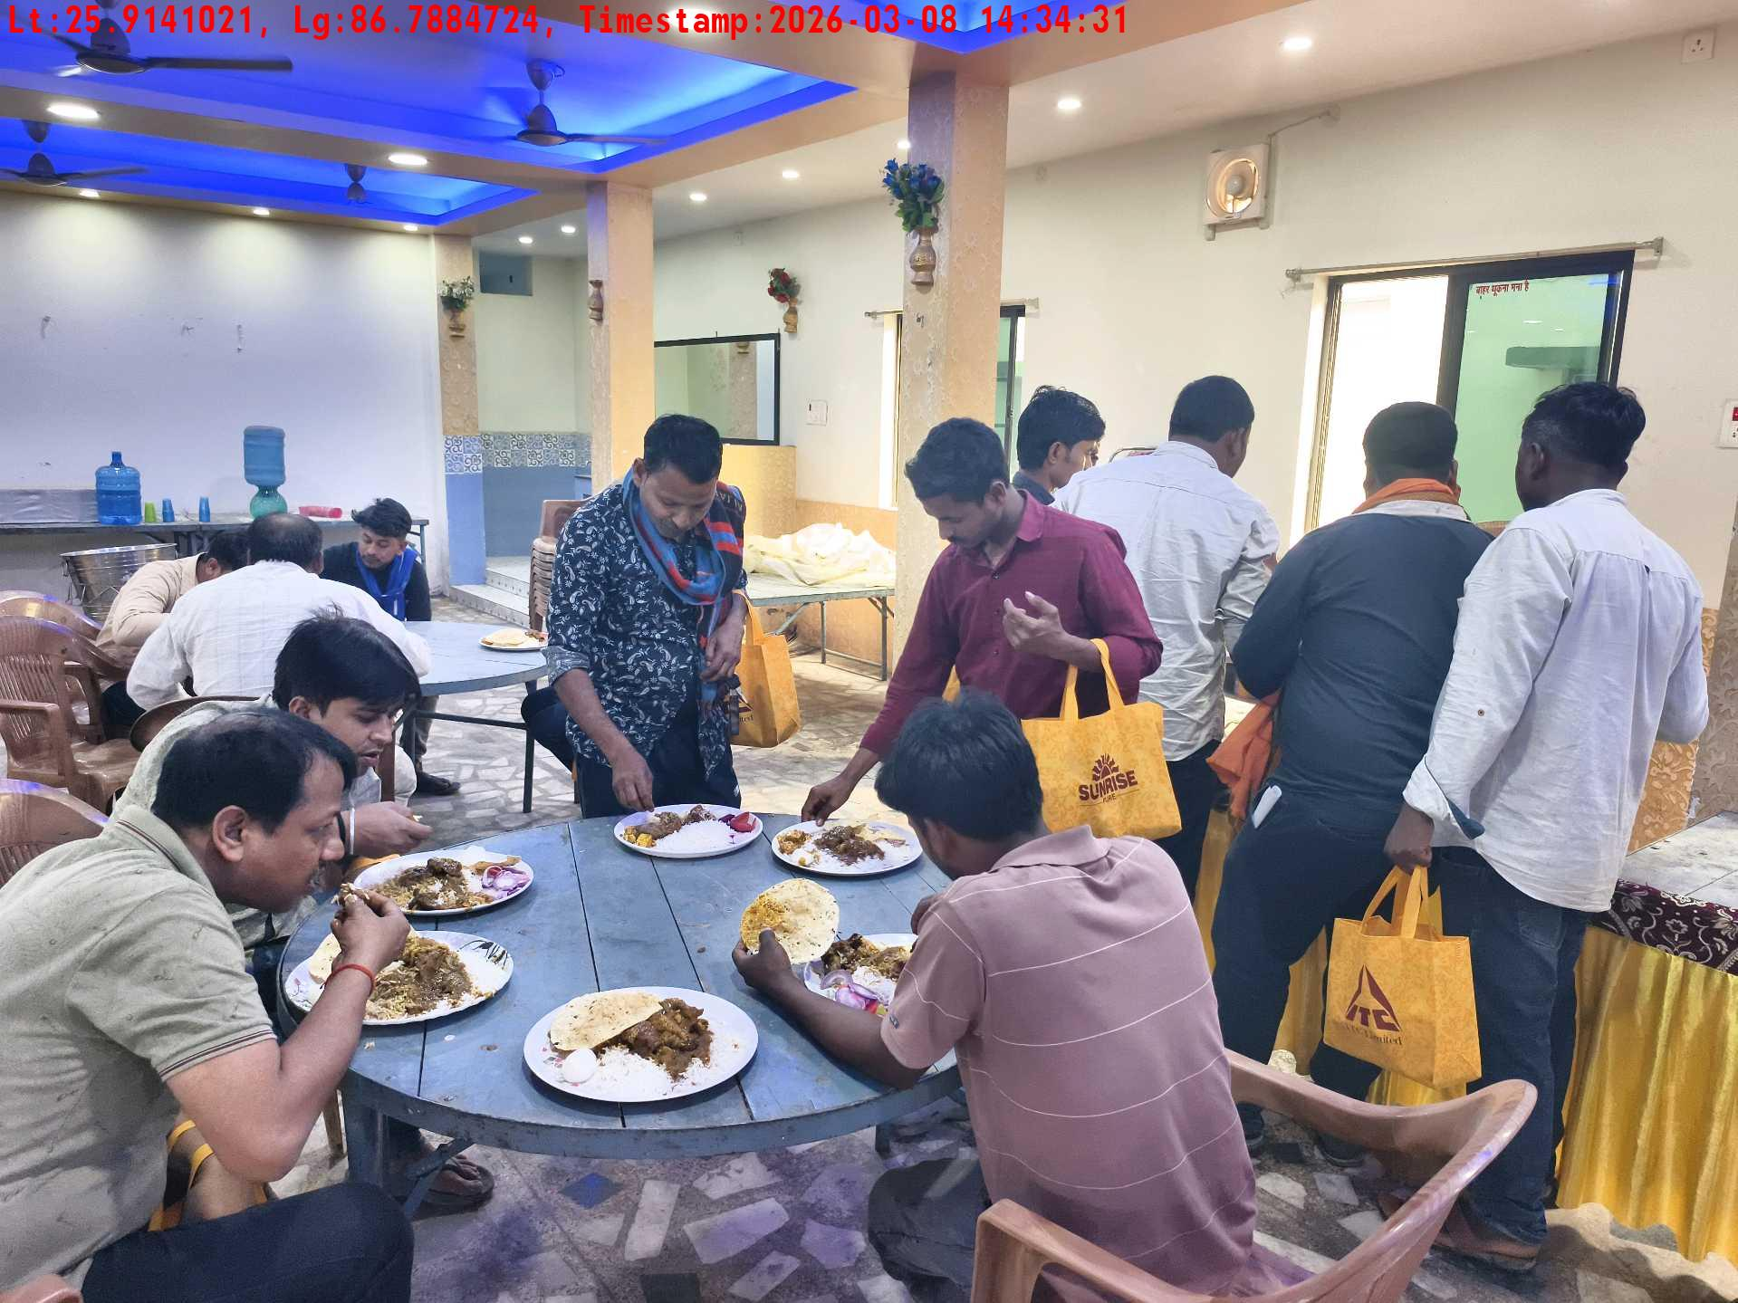
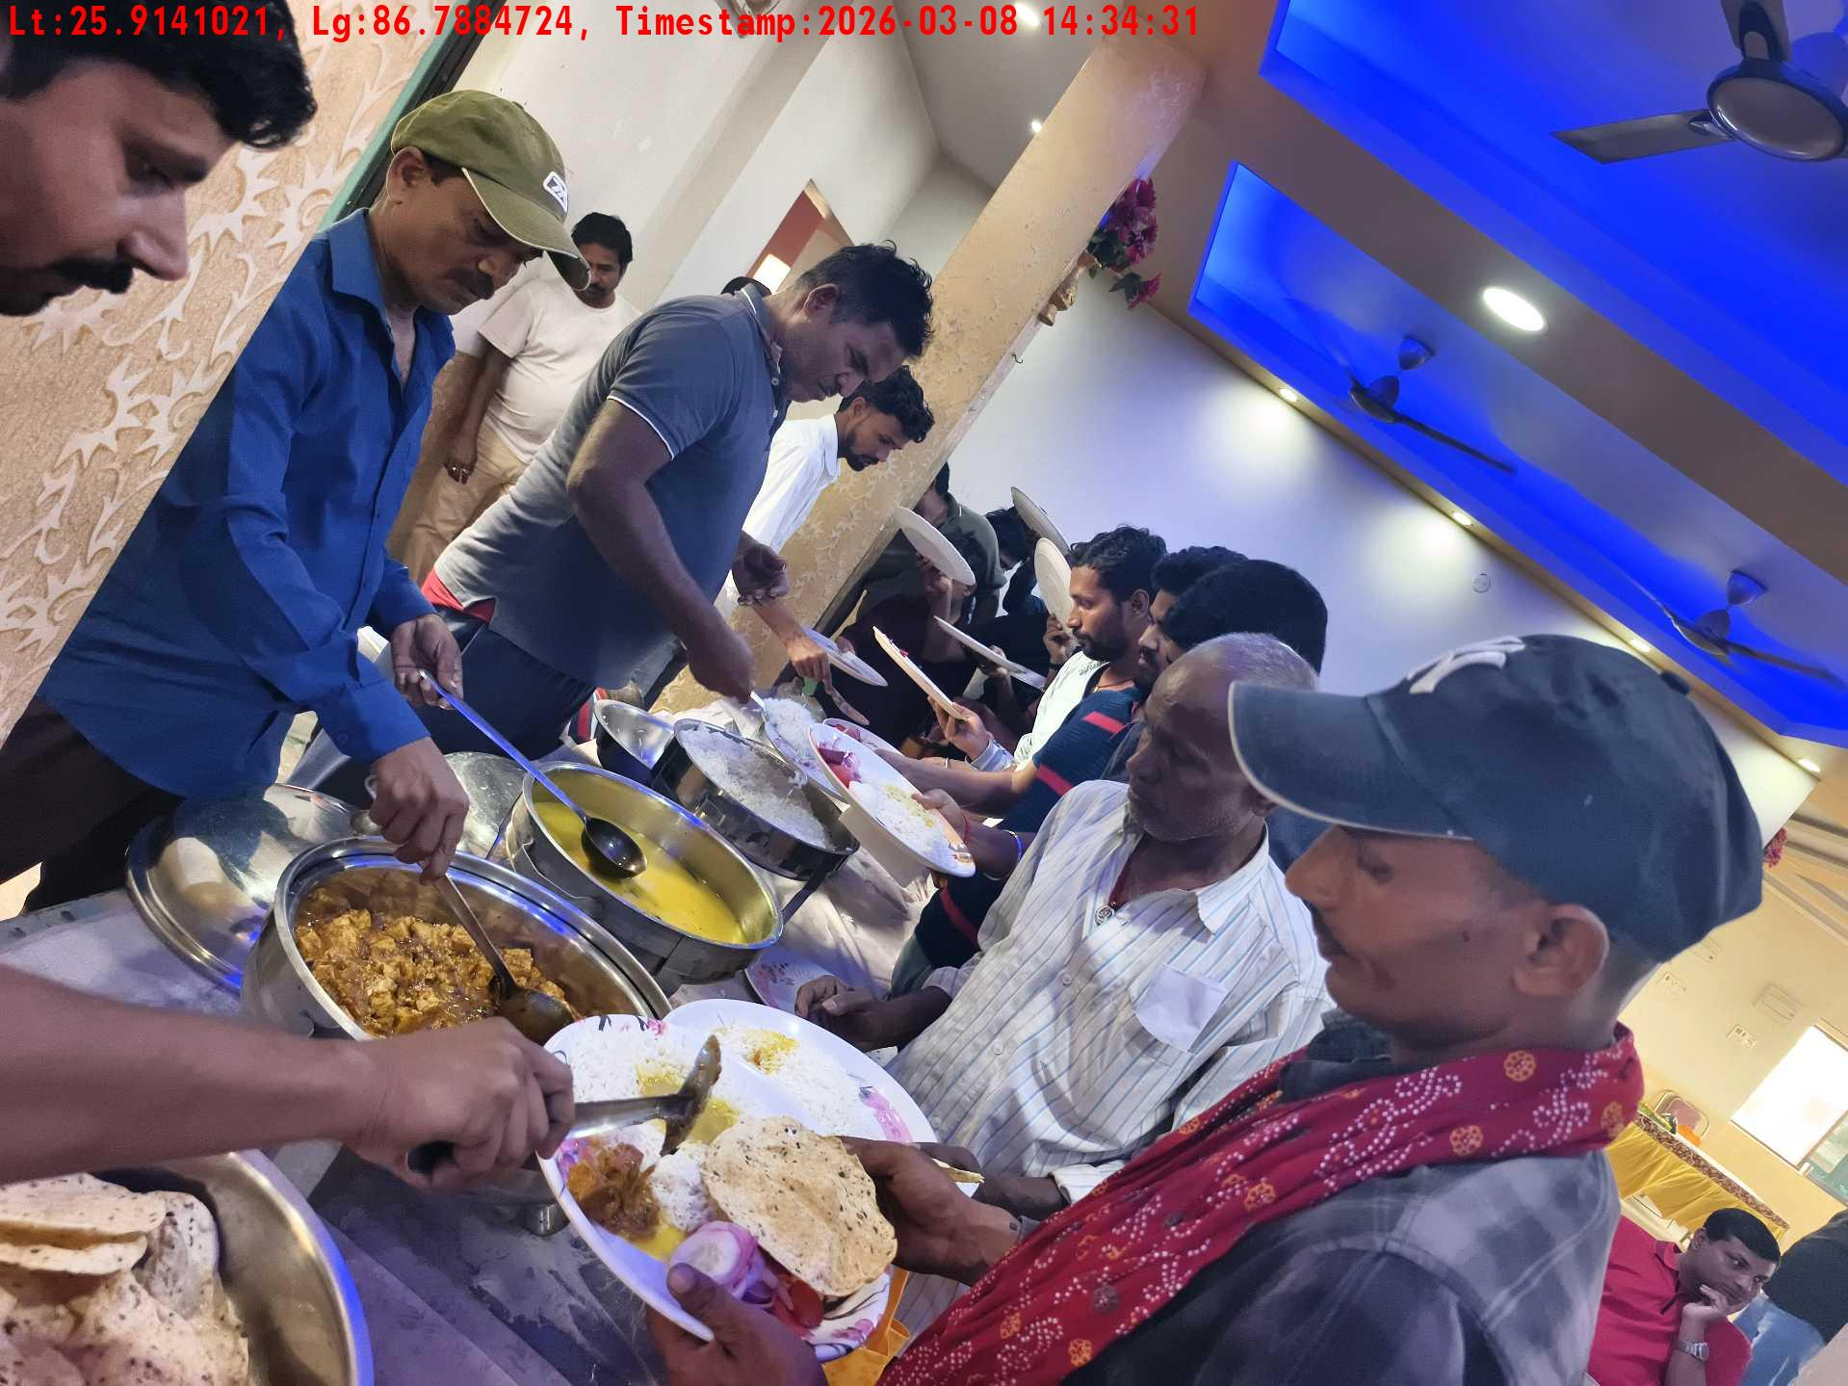
Date | Team | City | Agency Name | Promoter Name | Location Name
08-03-2026 | Bihar-1 | Bihar | Mindshaft | twinkle | Katihar
Lunch setup picture-1
Lunch setup picture-2
Lunch eating pictures-2
Lunch eating pictures-1

Slide 12






Date | Team | City | Agency Name | Promoter Name | Location Name
08-03-2026 | Assam | Assam | Mindshaft | Manish ray | guwahati
Long shot picture covering banner
Long shot picture covering table
Tea & coffee arrangement picture
Tea & coffee with crowd
Trainer with presentation picture
Crowd visibility picture

Slide 13




Date | Team | City | Agency Name | Promoter Name | Location Name
08-03-2026 | Assam | Assam | Mindshaft | Manish ray | guwahati
Lunch setup picture-1
Lunch setup picture-2
Lunch eating pictures-1
Lunch eating pictures-2

Slide 14






Date | Team | City | Agency Name | Promoter Name | Location Name
07-03-2026 | Bihar-1 | Bihar | Mindshaft | twinkle | Katihar
Crowd visibility picture
Trainer with presentation picture
Tea & coffee arrangement picture
Tea & coffee with crowd
Long shot picture covering banner
Long shot picture covering table

Slide 15




Date | Team | City | Agency Name | Promoter Name | Location Name
07-03-2026 | Bihar-1 | Bihar | Mindshaft | twinkle | Katihar
Lunch setup picture-1
Lunch setup picture-2
Lunch eating pictures-1
Lunch eating pictures-2

Slide 16






Date | Team | City | Agency Name | Promoter Name | Location Name
07-03-2026 | Bihar-2 | Bihar | Mindshaft | Dipak Singh | Dehri
Long shot picture covering banner
Long shot picture covering table
Tea & coffee arrangement picture
Tea & coffee with crowd
Trainer with presentation picture
Crowd visibility picture

Slide 17




Date | Team | City | Agency Name | Promoter Name | Location Name
07-03-2026 | Bihar-2 | Bihar | Mindshaft | Dipak Singh | Dehri
Lunch setup picture-1
Lunch setup picture-2
Lunch setup picture-1
Lunch setup picture-2

Slide 18






Date | Team | City | Agency Name | Promoter Name | Location Name
06-03-2026 | Test Cook | Adilabad | Mindshaft | tesst
Long shot picture covering banner
Long shot picture covering table
Tea & coffee arrangement picture
Tea & coffee with crowd
Trainer with presentation picture
Crowd visibility picture

Slide 19






Date | Team | City | Agency Name | Promoter Name | Location Name
06-03-2026 | Test Cook | Adilabad | Mindshaft | tesst
Lunch setup picture-1
Lunch setup picture-2
Lunch eating pictures-1
Lunch eating pictures-2
Lunch eating pictures-1
Lunch eating pictures-2

Slide 20






Date | Team | City | Agency Name | Promoter Name | Location Name
05-03-2026 | Test Cook | Adilabad | Mindshaft | tesst
Long shot picture covering banner
Long shot picture covering table
Tea & coffee arrangement picture
Tea & coffee with crowd
Trainer with presentation picture
Crowd visibility picture

Slide 21






Date | Team | City | Agency Name | Promoter Name | Location Name
05-03-2026 | Test Cook | Adilabad | Mindshaft | tesst
Lunch setup picture-1
Lunch setup picture-2
Lunch eating pictures-1
Lunch eating pictures-2
Long shot picture covering banner
Long shot picture covering table

Slide 22






Date | Team | City | Agency Name | Promoter Name | Location Name
05-03-2026 | Test Cook | Adilabad | Mindshaft | tesst
Tea & coffee arrangement picture
Tea & coffee with crowd
Trainer with presentation picture
Crowd visibility picture
Lunch setup picture-1
Lunch setup picture-2

Slide 23






Date | Team | City | Agency Name | Promoter Name | Location Name
05-03-2026 | Test Cook | Adilabad | Mindshaft | tesst
Lunch eating pictures-1
Lunch eating pictures-2
Long shot picture covering banner
Long shot picture covering table
Tea & coffee arrangement picture
Tea & coffee with crowd

Slide 24






Date | Team | City | Agency Name | Promoter Name | Location Name
05-03-2026 | Test Cook | Adilabad | Mindshaft | tesst
Trainer with presentation picture
Crowd visibility picture
Lunch setup picture-1
Lunch setup picture-2
Lunch eating pictures-1
Lunch eating pictures-2

Slide 25
Date | Team | City | Agency Name | Promoter Name | Location Name
05-03-2026 | Test Cook | Adilabad | Mindshaft | tesst
Lunch eating pictures-2

Slide 26






Date | Team | City | Agency Name | Promoter Name | Location Name
04-03-2026 | Test Cook | Adilabad | Mindshaft | tesst
Long shot picture covering banner
Long shot picture covering table
Tea & coffee arrangement picture
Tea & coffee with crowd
Trainer with presentation picture
Crowd visibility picture

Slide 27




Date | Team | City | Agency Name | Promoter Name | Location Name
04-03-2026 | Test Cook | Adilabad | Mindshaft | tesst
Lunch setup picture-1
Lunch setup picture-2
Lunch eating pictures-1
Lunch eating pictures-2

